Slide 1
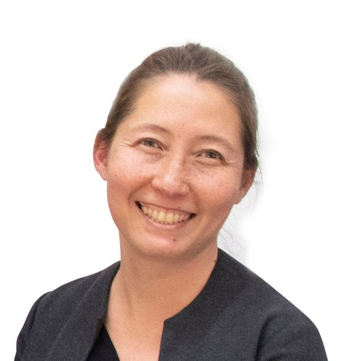
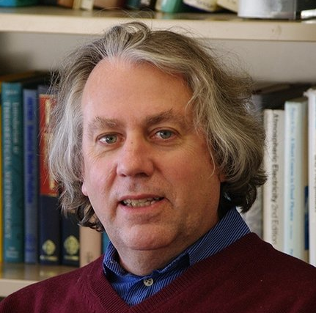
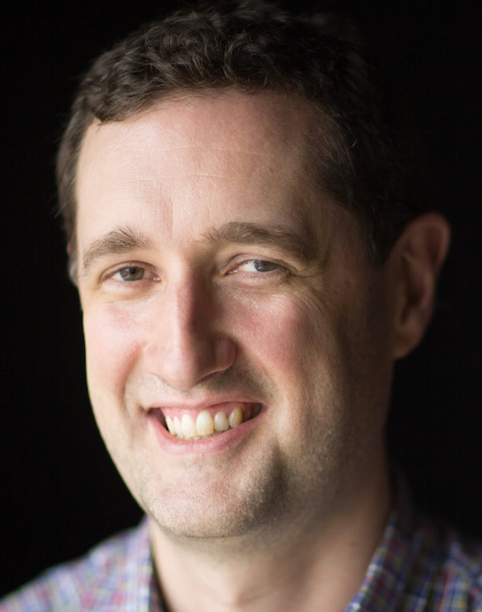
Preparing for a new world of climate and weather extremes
Prof. Miho Mazereeuw
MIT Urban Risk Lab
Prof. Kerry Emanuel
EAPS, MIT
Prof. Paul O’Gorman
EAPS, MIT

Slide 2
Extreme weather and climate events already have major societal and economic impacts that are expected to intensify with climate change
Billion dollar disasters
National Climate Assessment
Notes:
The figure shows (a) the total number of water-related billion-dollar disaster events (tropical cyclones, flooding, and droughts combined) each year in the United States and (b) the associated costs (in 2017 dollars, adjusted for inflation). Source: adapted from NOAA NCEI 2018.19
number of such events was largest in 2023
severe convection is largest number (but not largest cost)
meiler shows future TC related damages increase due to both climate change and economic growth (more from the latter, but cc contributes more uncertainty)

Slide 3
The rarest events have outsized impacts, and their risks are challenging to model accurately which poses a challenge for adaptation
NOAA/NASA
NASA Earth Observatory
Scott Olson/Getty Images
Elayna Yussen/Reuters
Hurricane Harvey, 2017 ($144 Billion)
Western North America Heatwave, 2021 (>1000 deaths)
Notes:
Mention Harvey roughly tied with 2005 Katrina in cost

Slide 4
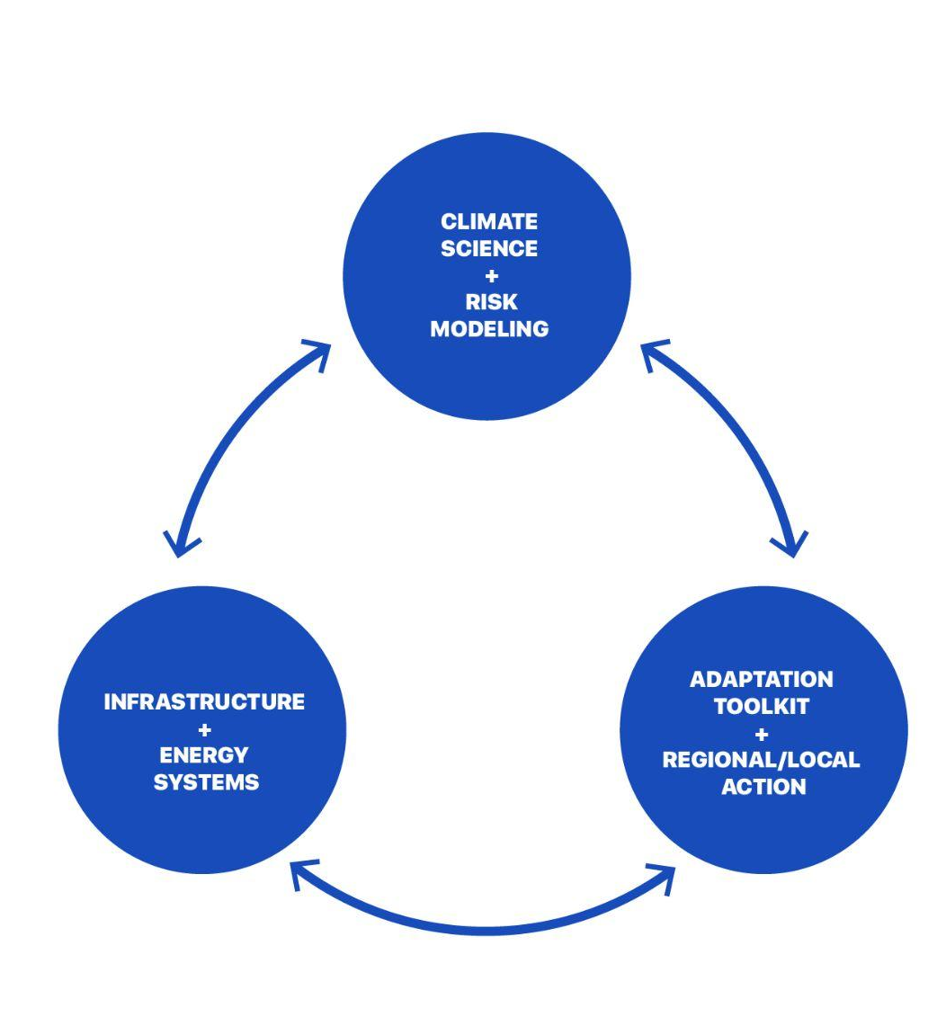
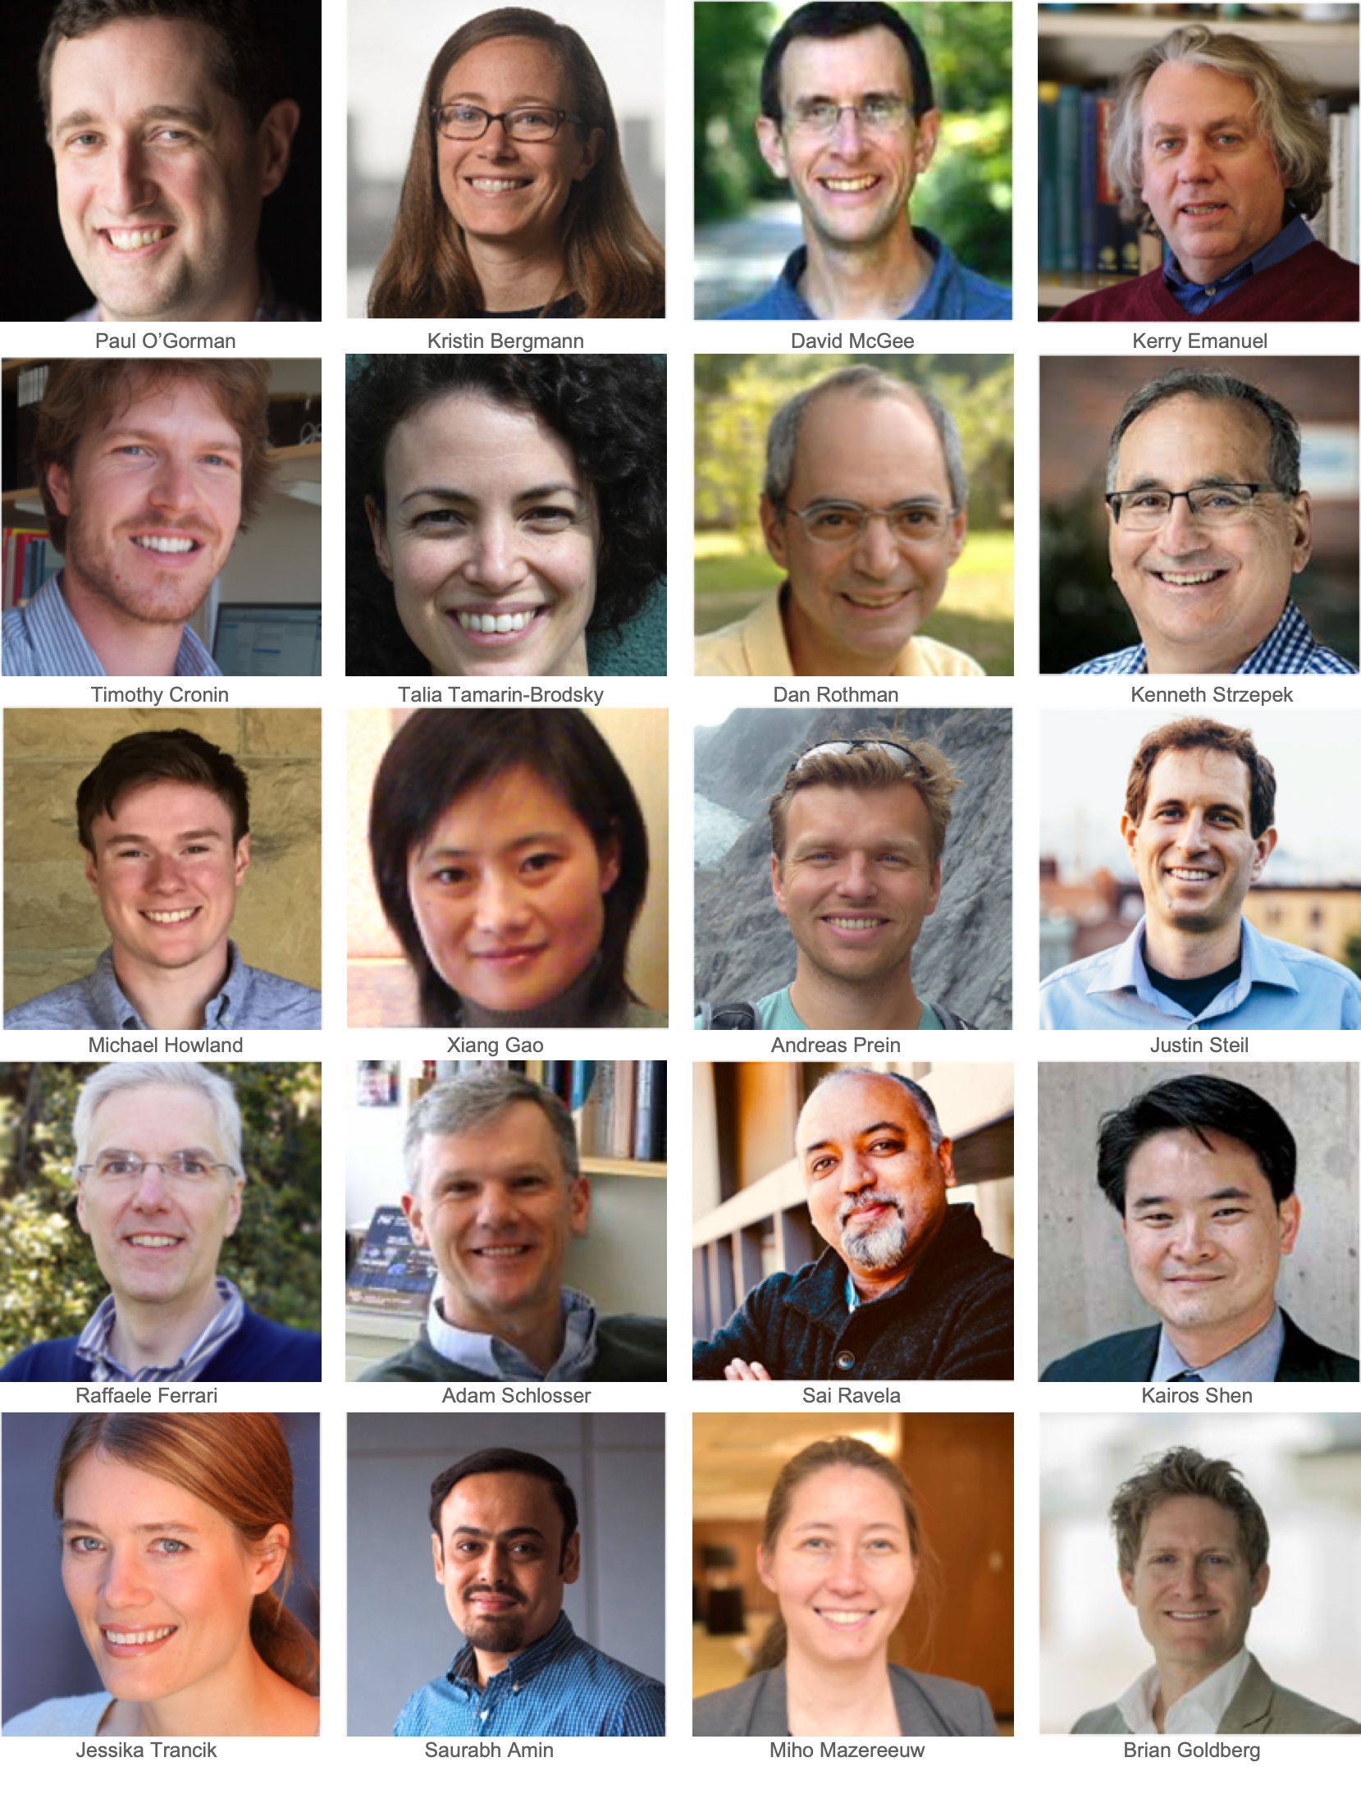
MIT Climate Grand Challenge:
Preparing for a new world of climate and weather extremes

Slide 5
Challenge: We don’t adequately understand the changing risk of extremes at the regional scale and for the most impactful events
Increases in extreme rainfall over the past century vary widely by region (National Climate Assessment Report)
Notes:
The map shows percent increases in the amount of precipitation falling in very heavy events (defined as the heaviest 1% of all daily events) from 1958 to 2012 for each region of the continental United States
mention delta C 13 graph from Perrin as ratio of the two stable isotopes of carbon—13C and 12C - what causes the excitations and how it relates to feedback processes in the carbon cycle
petm is 56ma

Slide 6
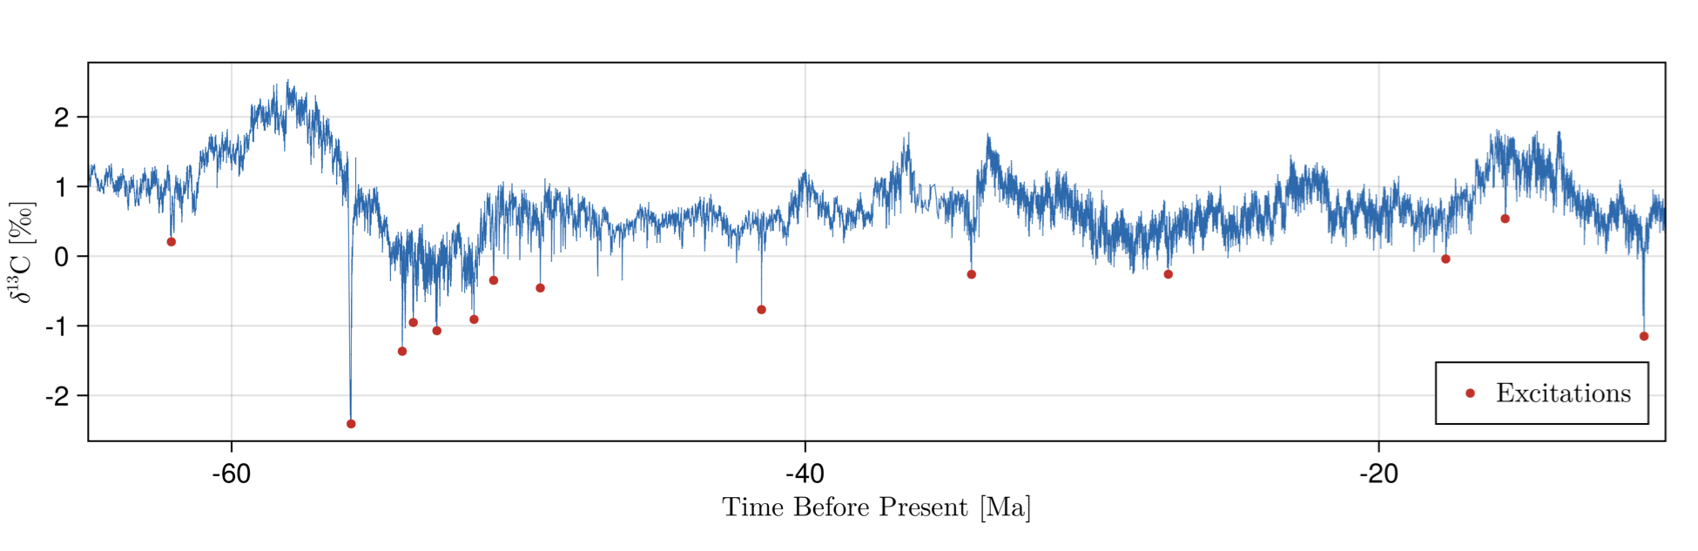
Objective: Reduce key scientific uncertainties related to extreme weather and climate
Abrupt excursions of the carbon cycle in past climate record
Graph: Postdoc Perrin Davidson
NASA Earth Observatory
Improve understanding of changing heavy precipitation (PIs O’Gorman and Cronin),
temperature extremes (PI Tamarin-Brodsky),
convective storms (PI Emanuel)
Improve understanding of the risk of extreme climate change: Use past climate to assess potential for tipping points due to critical rates of change in CO2
PIs Rothman and McGee
Notes:
The map shows percent increases in the amount of precipitation falling in very heavy events (defined as the heaviest 1% of all daily events) from 1958 to 2012 for each region of the continental United States
mention delta C 13 graph from Perrin as ratio of the two stable isotopes of carbon—13C and 12C - what causes the excitations and how it relates to feedback processes in the carbon cycle
petm is 56ma - did not cause marine mass extinction
question is how to compare the carbon cycle perturbation that we are causing since 1850 to what caused e.g. mass marine extinctions in the past (overall amount, timescale matter)
“The modern critical size for the marine carbon cycle is roughly similar to the mass of carbon that human activities will likely have added to the oceans by the year 2100.”

Slide 7
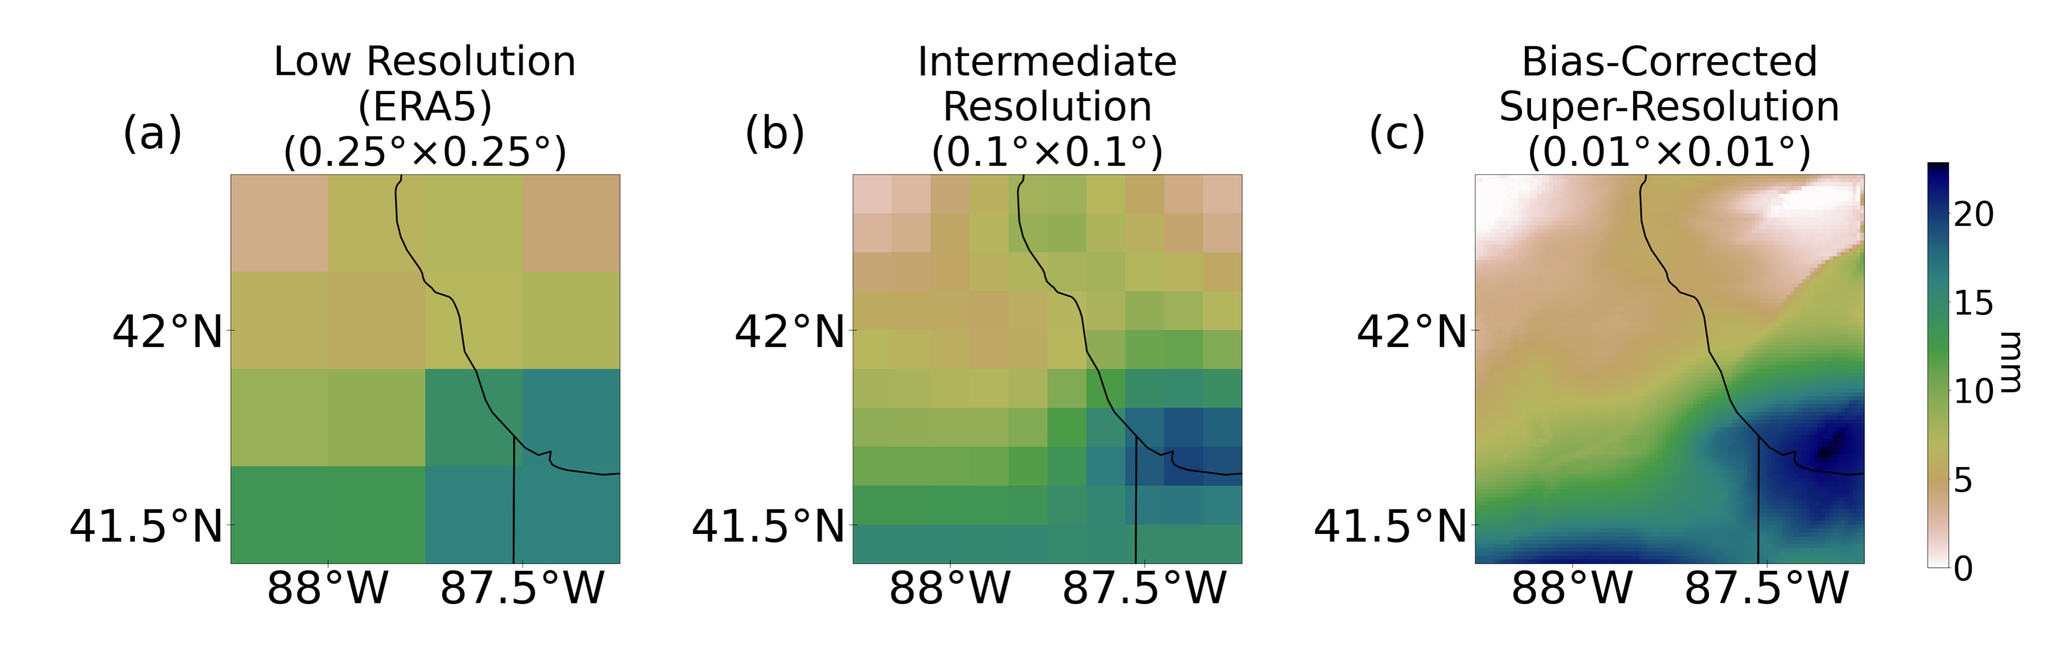
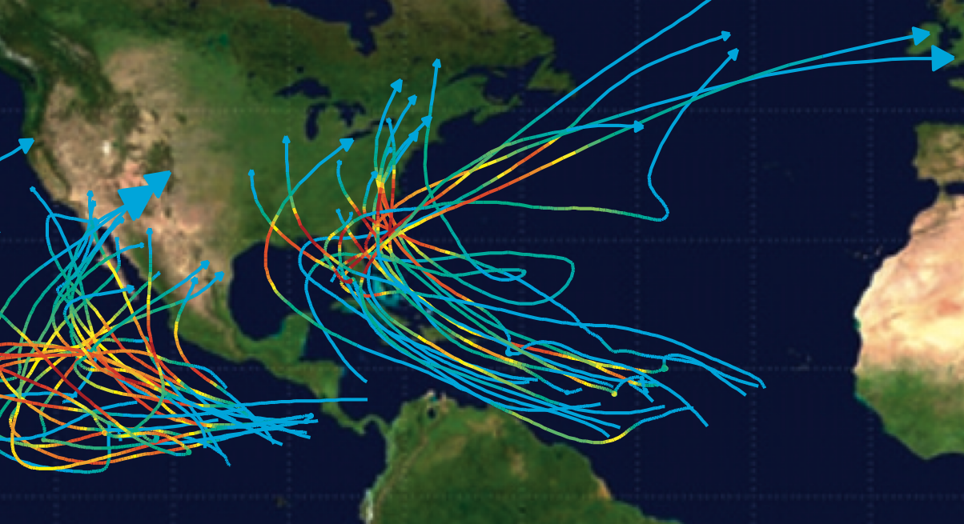

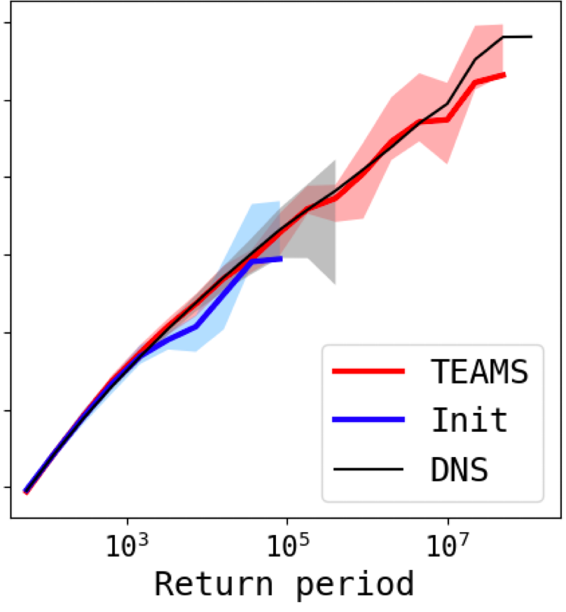

Objective: Develop new tools to assess risk of current and changing extremes in specific locations
Saha and Ravela
Improved downscaling of precipitation and flood modeling
Mendelsohn, Emanuel, Chonabayashi & Bakkensen
PIs Ravela and Strzepeck
Statistical-dynamical modeling of changing risk of tropical and extratropical cyclones
PIs Emanuel, Ravela, Schlosser
Rare-event sampling algorithms to access longer return periods
Climate-model emulators that include
tails of distributions
PI O’Gorman
Rare event sampling
Initial ensemble
Direct sampling
Graph: Postdoc Justin Finkel
Research in collaboration with Raffaele Ferrari
and Themis Tsapsis

Slide 8
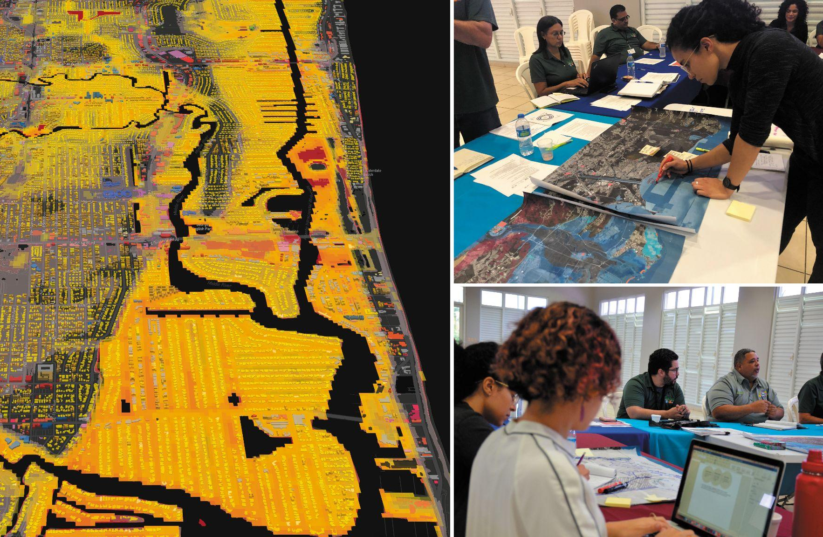
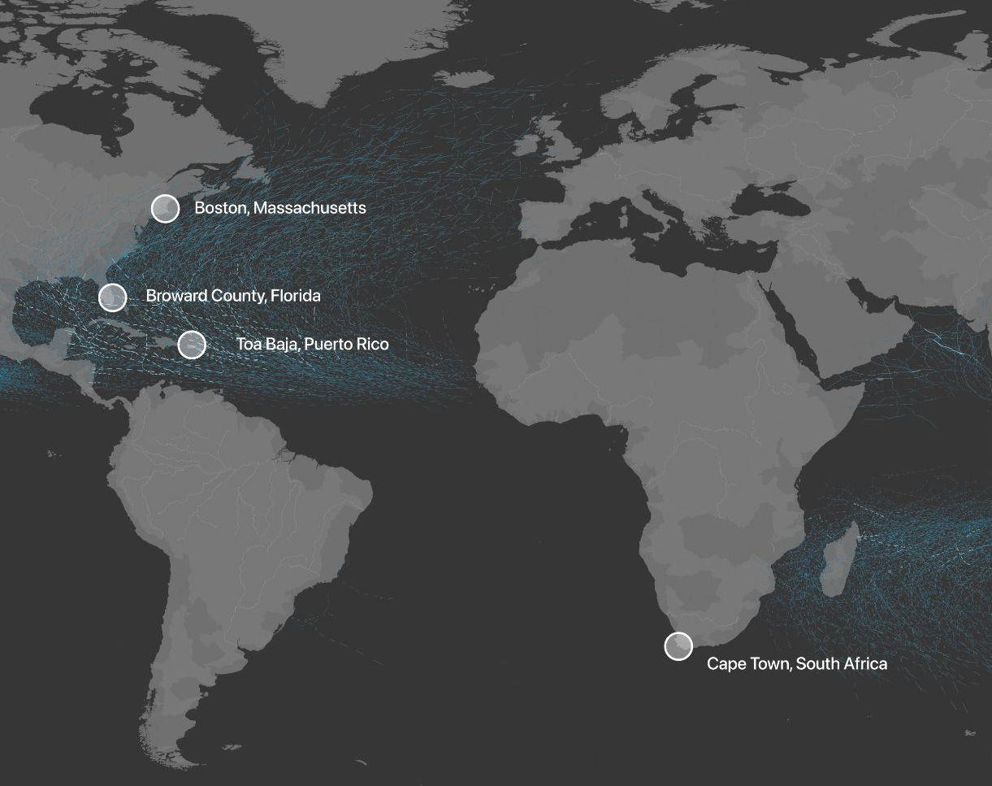
Challenge: Progress in adaptation to changing extremes is slow and generally for the best resourced communities
Objective: Work with communities and government to pilot an adaptation toolkit for cities to adapt to the risks of extreme events, using best available climate science and modeling
Notes:
Cities are formed by DIVERSE communities, operating through a range of power dynamics and embedded histories. Adaptation strategies are costly, with complex legislative overlays, especially in federal, state, and local resources, regulations and plans. Currently, only those who have time and resources can navigate these procedures. The Urban Risk Lab develops tools and designs strategies to align otherwise top-down processes to engage with and foster bottom-up collaboration. Our third step - Working with emergency officers, city planners, real estate developers and residents we will create more flexible and equitable ways to prepare for extreme weather events. It is our role to listen and learn, while sharing new data and developing new tools that allow for co-creation of solutions.

Slide 9
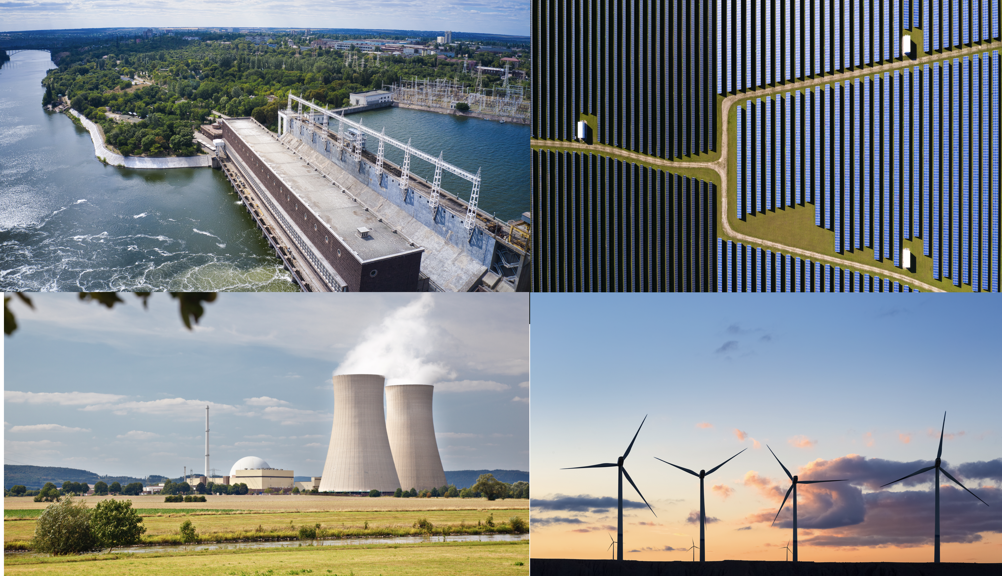
Challenge: Our energy system is rapidly changing and vulnerable to extreme weather events
Notes:
graph is for Iowa
But the risks to power systems infrastructure from extreme weather also depend on the characteristics of that infrastructure.
Need to anticipate a new set of vulnerabilities such as periods of lower resource availability, extreme winds, and how spikes in electricity demand may evolve as further energy services are electrified.
Overall an energy system incorporating more renewable energy and other clean energy sources can be much more robust than the one we have today, but to achieve this potential will require new understanding of infrastructural vulnerabilities.

Slide 10
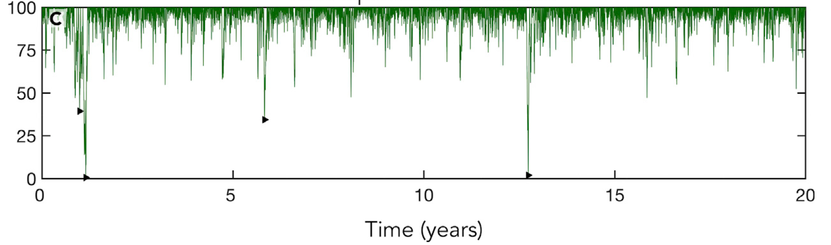
Objective: Address vulnerabilities such as periods of lower resource availability due to extreme weather as the energy system evolves
Storage state of charge (%) for wind and solar energy system
Figure: Ziegler & Trancik, Joule, 2019
Objective involves PIs Trancik, Amin, Howland
Notes:
graph is for Iowa
But the risks to power systems infrastructure from extreme weather also depend on the characteristics of that infrastructure.
Need to anticipate a new set of vulnerabilities such as periods of lower resource availability, extreme winds, and how spikes in electricity demand may evolve as further energy services are electrified.
Overall an energy system incorporating more renewable energy and other clean energy sources can be much more robust than the one we have today, but to achieve this potential will require new understanding of infrastructural vulnerabilities.

Slide 11
Research highlight 1: Downscaling of extreme rainfall (and wind) using
machine learning informed by physics of orographic rainfall
Work lead by Postdoc Anamitra Saha and PI Ravela
Saha and Ravela, Downscaling extreme rainfall using physical-statistical generative adversarial learning, submitted
Notes:
mention constraint of not much training data for rare events

Slide 12
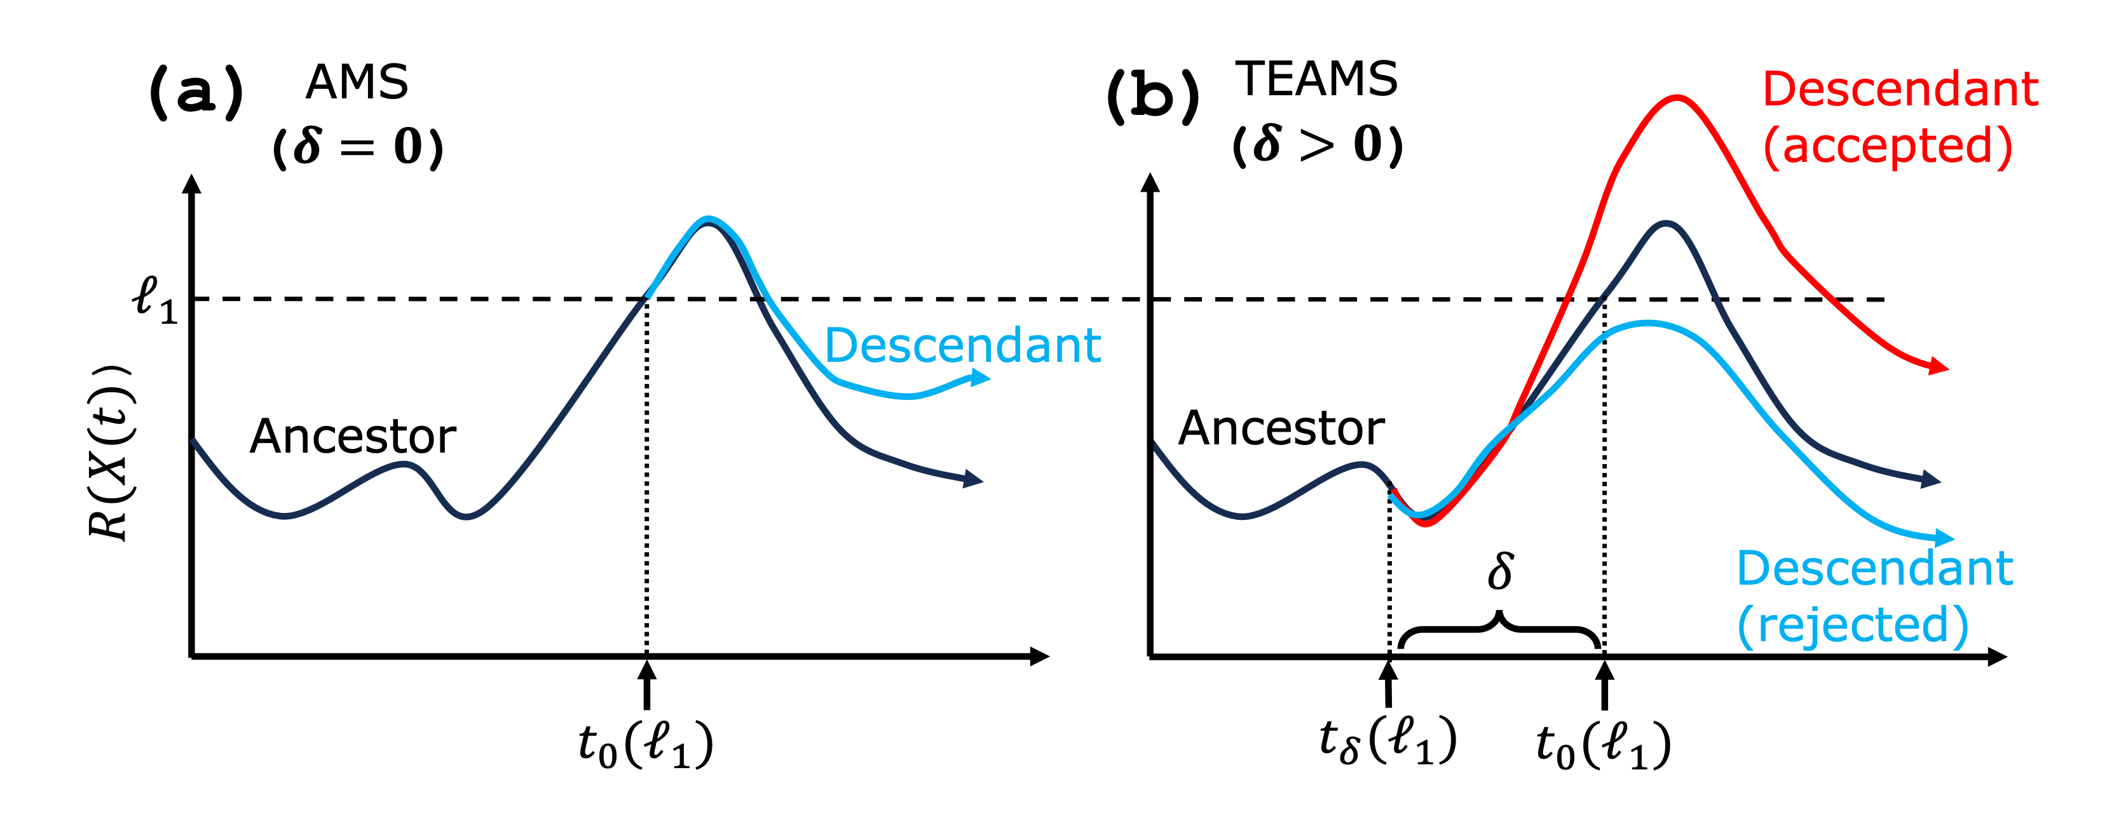
Research highlight 2: A rare-even sampling algorithm that is suitable for extreme weather events
Restart simulations and perturb with the aim of reaching more extreme events
Keep track of probabilities so that can
estimate risk of more extreme events
Target variable
Rare event sampling
Initial ensemble
Direct sampling
Work lead by Postdoc Justin Finkel and PI O’Gorman
Finkel and O’Gorman, Bringing statistics to storylines: rare event sampling for sudden, transient extreme events, JAMES (Submitted)

Slide 13
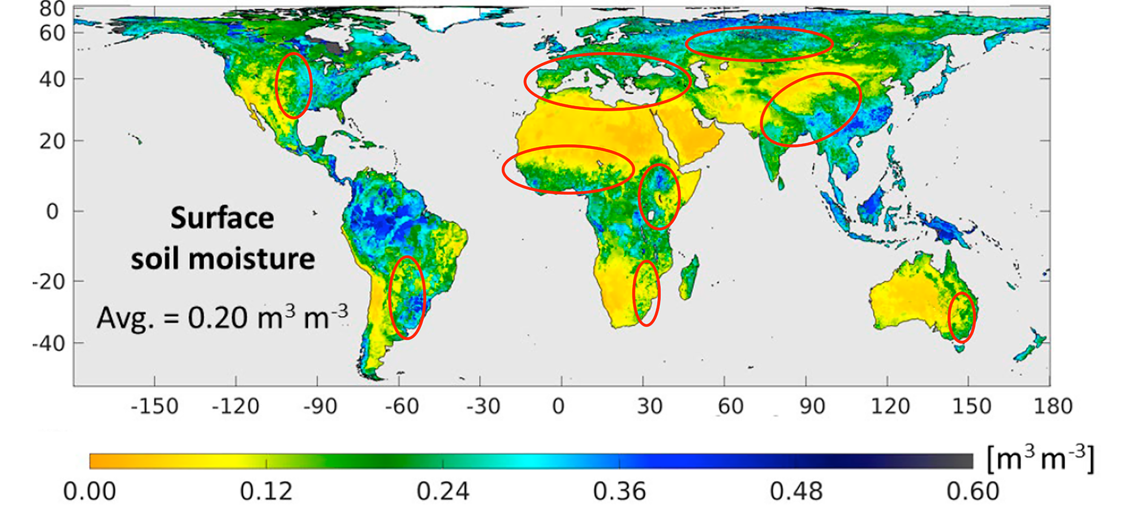
Research highlight 3: Understanding the causes of high convective available energy (an important ingredient for severe convection)
Work lead by PI Emanuel
Emanuel, K., 2023: On the physics of high CAPE. Journal of the Atmospheric Sciences, 80, 2669–2683

Slide 14
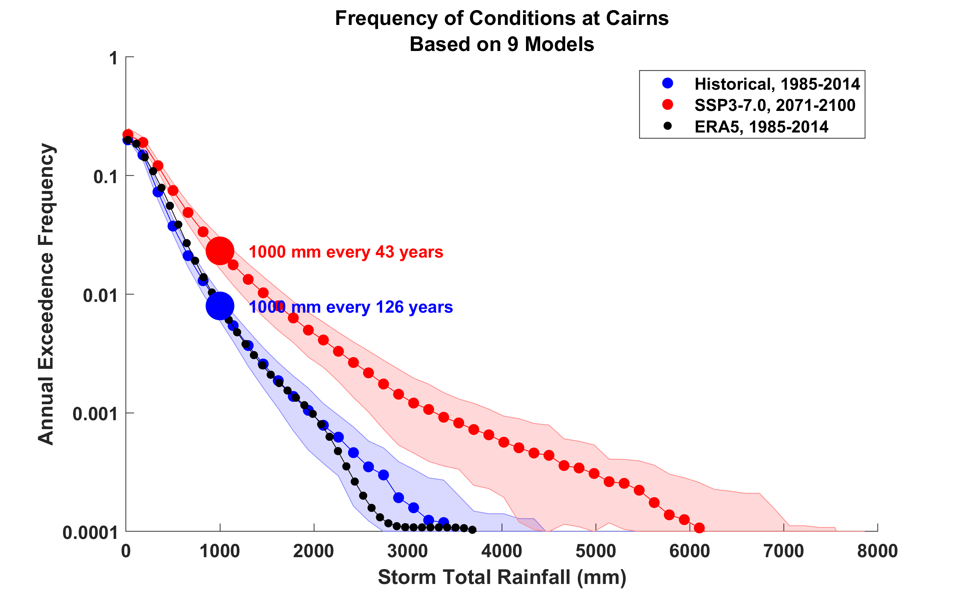
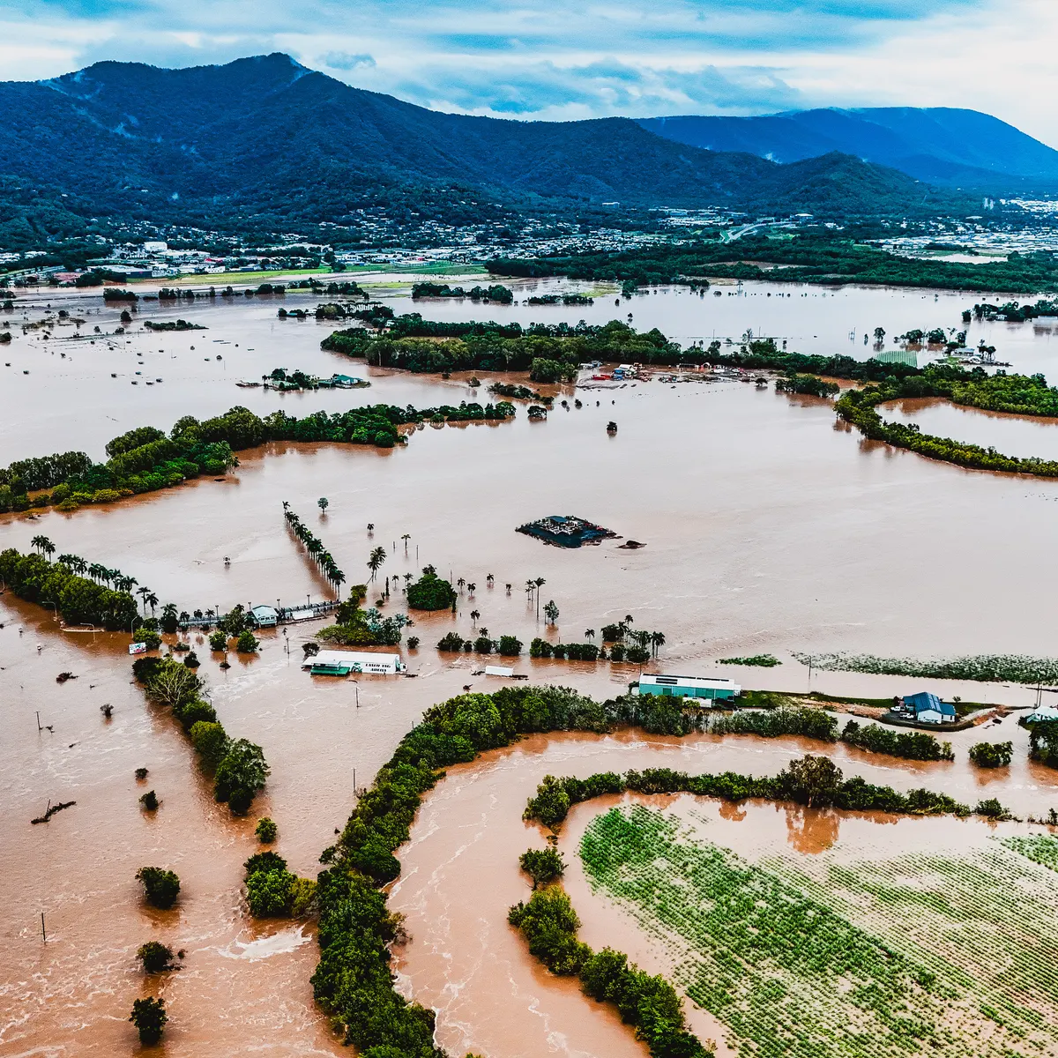
Research highlight 4: Current and future tropical cyclone risk assessment
Cyclone Jasper of December, 2023, was the wettest cyclone in Australia’s history, flooding large parts of Queensland
The risk of rainfall of Jasper’s magnitude has increased by about 50% since the year 2000 and will double again by the end of the century
Work lead by PI Emanuel
Emanuel, K., 2024: Cyclone Jasper’s rains in the context of climate change. PNAS, in press

Slide 15
Research in climate science and risk modeling is informed by and feeds into research related to energy and adaptation for cities
Learn more: climate-extremes.mit.edu

