Slide 1

Causes and Effects of Global Warming
Kerry Emanuel
Program in Atmospheres, Oceans, and Climate
Department of Earth, Atmospheric and Planetary Sciences
MIT

Slide 2
Program
History of earth’s climate
A little climate science
Forcings and feedbacks
Possible effects of climate change

Slide 3
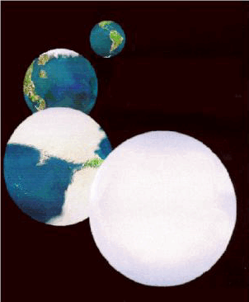
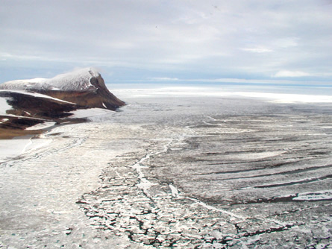

The Snowball Earth (~500 mya)

Slide 4
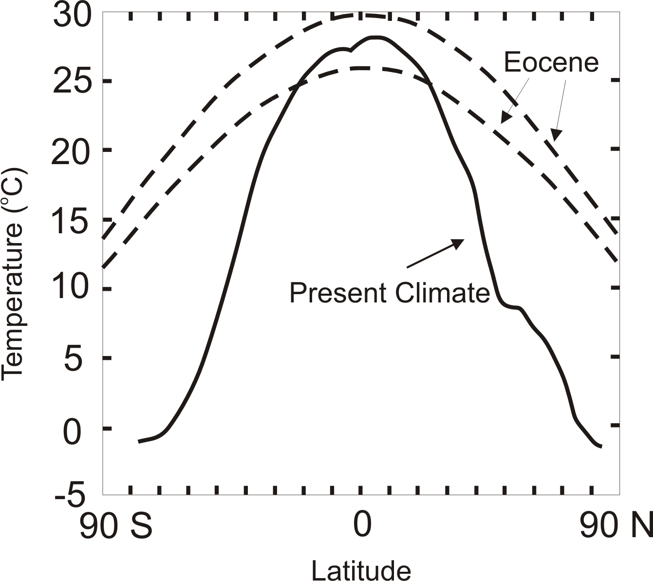
Climate of The Eocene (~50 mya)
Notes:
4

Slide 5
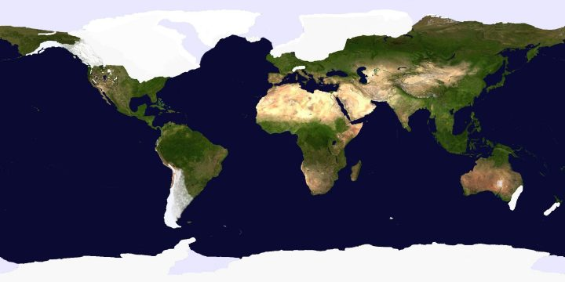
Ice Cover, Last Glacial Maximum (~18,000 years ago)
Notes:
5

Slide 6

Paleo reconstructions of temperature change over the last 2000 years
Instrumental Record
Year
Notes:
6

Slide 7
Some Characteristics of Climate Science
Described by some as the most difficult scientific problem ever faced
Draws on all the major scientific disciplines:
  Chemistry, geology, atmospheric science, oceanography, solar physics, orbital mechanics, biology
  Climate prediction also requires understanding of economics, politics, human psychology
Very much a frontier science

Slide 8
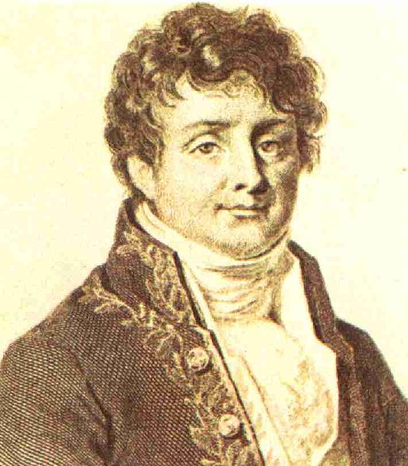


The Greenhouse Effect
Jean Baptiste Joseph Fourier
(1768-1830)
John Tyndall (1820-1893)

Slide 9
Tyndall’s Discovery:
Oxygen (O₂) and Nitrogen (N₂), which together comprise about 97% of the atmosphere, are transparent to solar and infrared radiation
If that’s all there were, it would be easy to calculate our global mean surface temperature, and it would be about 0 F.

Slide 10
But certain trace gases interact strongly with radiation:
H₂0 (water vapor)
CO₂ (carbon dioxide)
CH₄ (methane)
Clouds also interact strongly with radiation. Together, they yield:

Slide 11
Essence of the Greenhouse Effect:
The Earth’s surface receives radiation both directly from the sun and from the atmosphere and clouds within it. It must therefore get warm enough to emit enough radiation to balance both sunlight and back radiation from the atmosphere.

Slide 12
Climate Forcing
Varying Sunlight
Varying composition of atmosphere

Slide 13

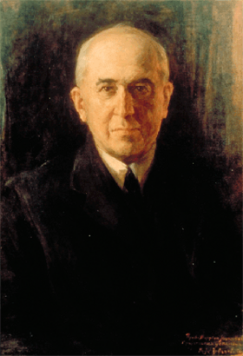
Climate Forcing by Orbital Variations
Milutin Milanković, 1879-1958

Slide 14
Climate Feedbacks

Slide 15
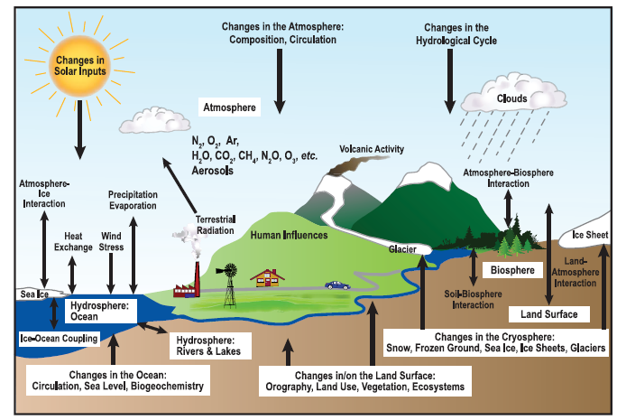
Climate Elements and Feedbacks

Slide 16
If the Only Feedback Were Temperature, Doubling Carbon Dioxide would Increase Surface Temperature by about 1.1 ºC.

Slide 17
Causes of Recent Climate Change

Slide 18
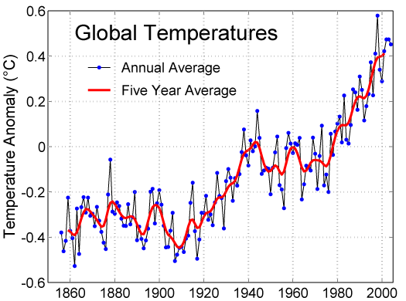

Slide 19
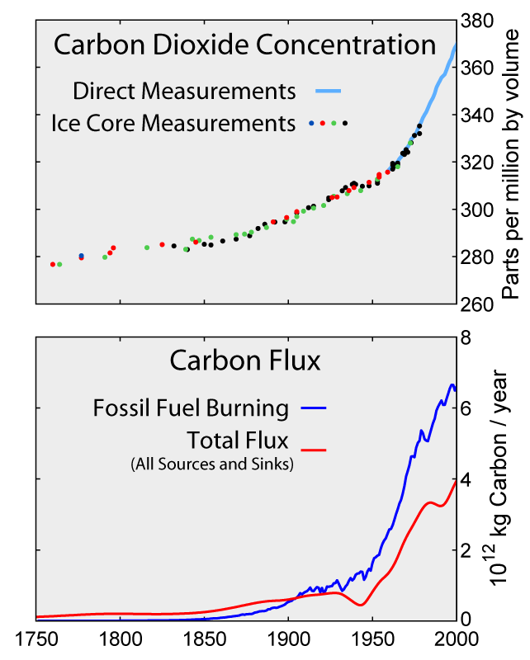

Slide 20
Variation in carbon dioxide and methane over the past 20,000 years, based on ice core and other records

Slide 21
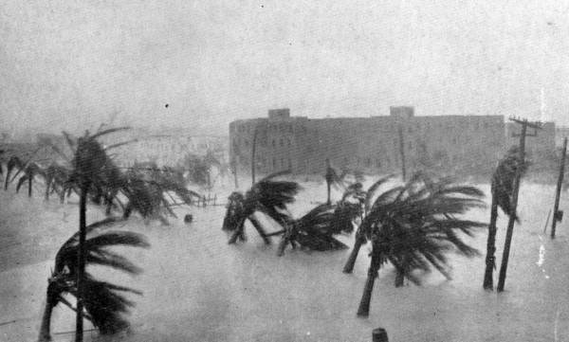
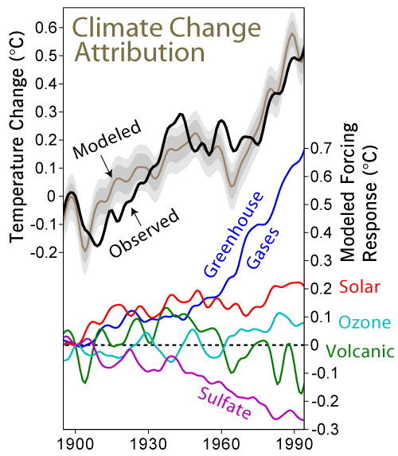

Slide 22
Distribution of temperature change, 1901-2005

Slide 23
Projected Warming:

Slide 24
Does Any of this Matter?

Slide 25
Possible Benefits of Warming:
Fewer deaths from exposure
More vigorous plant growth
Increase of arable land at high latitudes
Increased mining potential in current permafrost regions
Arctic waterways become navigable
Reduced heating costs

Slide 26
Warming Risks
Rising sea level
Concentration of rainfall into fewer but more intense events...more drought, floods
Increased incidence of some diseases
Increased production of allergens
Increased mortality from heat waves
Increased consumption of electricity
Possible increase in violent storms
Ocean acidification, increased species extinctions

Slide 27
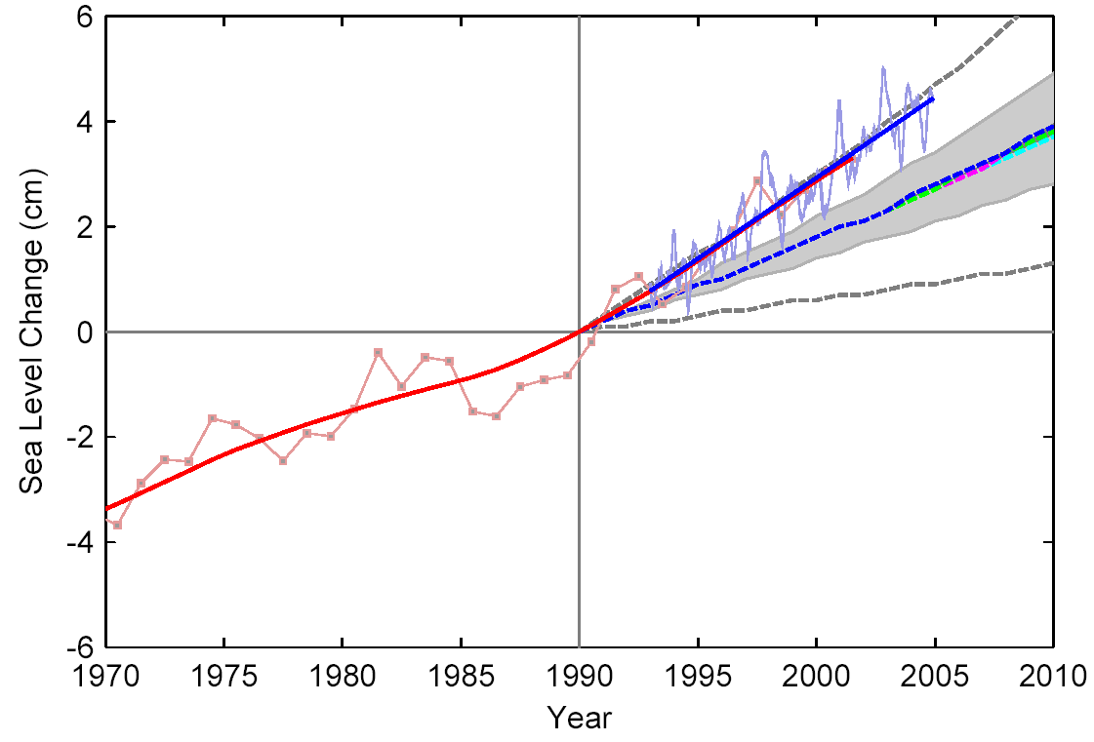
Sea Level Rise
Satellite Altimeter
IPCC
IPCC 2007:
for 1961–2003:
Models 1.2 mm/year
Data 1.8 mm/year
Tide Gauges

Slide 28
Past Sea Level vs. Temperature
(Source: WBGU after David Archer 2006)
Notes:
This graph shows how temperature and sea level were closely related in Earth’s history. During the last Ice Age, temperatures were about 6 ºC colder than now, while sea level was 120 meters lower. During the Pliocene, when it was last significantly warmer than now (by about 2 ºC), sea level was 20-30 meters higher. During the Eocene there was almost no ice on the planet, and sea level was about 70 meters higher.
The history of climate thus sends a strong warning: past climate changes by just a few degrees in global temperature have come with very large sea level changes, by tens of meters. In the long run, this is likely to happen again. The sea level rise by the year 2100 (likely below one meter) is only the small beginning of a much larger rise that will unfold over coming centuries and perhaps millennia, caused by our carbon emissions in this century.

Slide 29
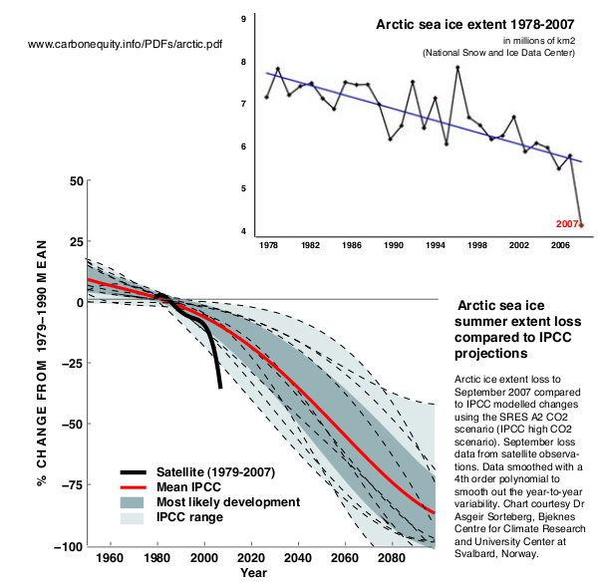
Arctic Minimum Sea Ice Extent

Slide 30
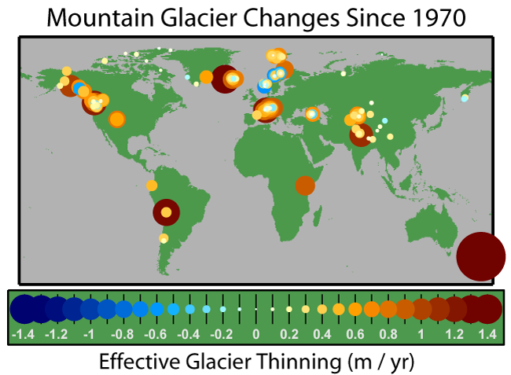

Slide 31
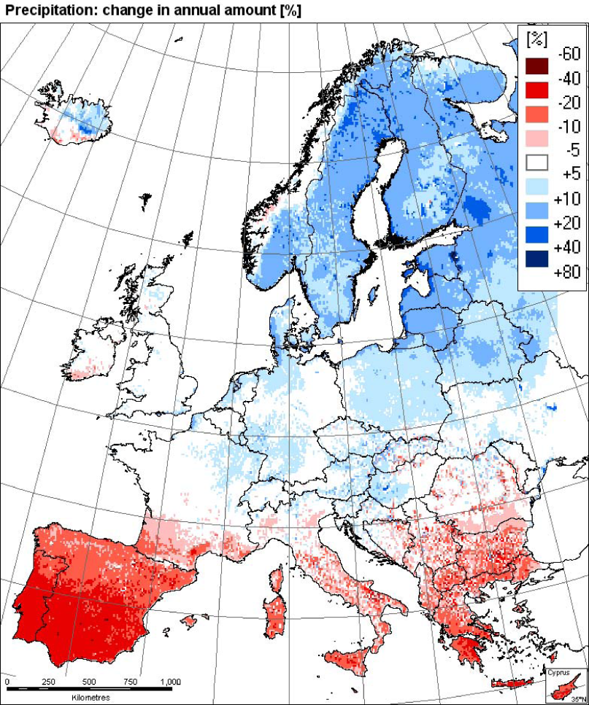
Changes in Precipitation
Observations: trend 1961-2006
Model simulation
Southern Europe
Is drying out
EEA
2008

Slide 32
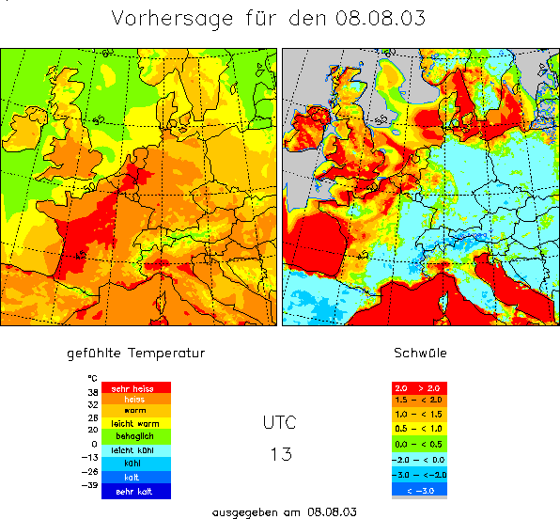
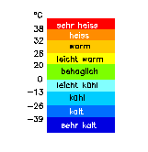
Heat Waves
Mortality and heat stress (8. August 2003, 13 UTC)
Summer 2003,
greatest natural disaster
in Europe
ca. 35.000 fatalities
2,000
†
2,000
†
Heat Stress
7,000
†
extreme
15,000
†
high
moderate
slight
4,000
†
leicht
mäßig
hoch
1,500
†
Mortality data: Earth Policy Institute
Heat Stress: Deutscher Wetterdienst
4,000
†
extrem
Kältestress
© 2007 Geo Risks Research, Munich Re

Slide 33
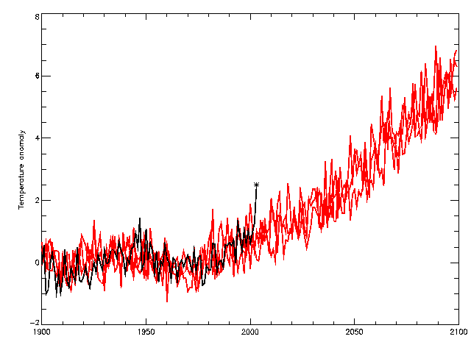
Heat Waves
2060s
observations
HadCM3 Medium-High (SRES A2)
2040s
2003
Temperature anomaly (wrt 1961-90) °C

Slide 34
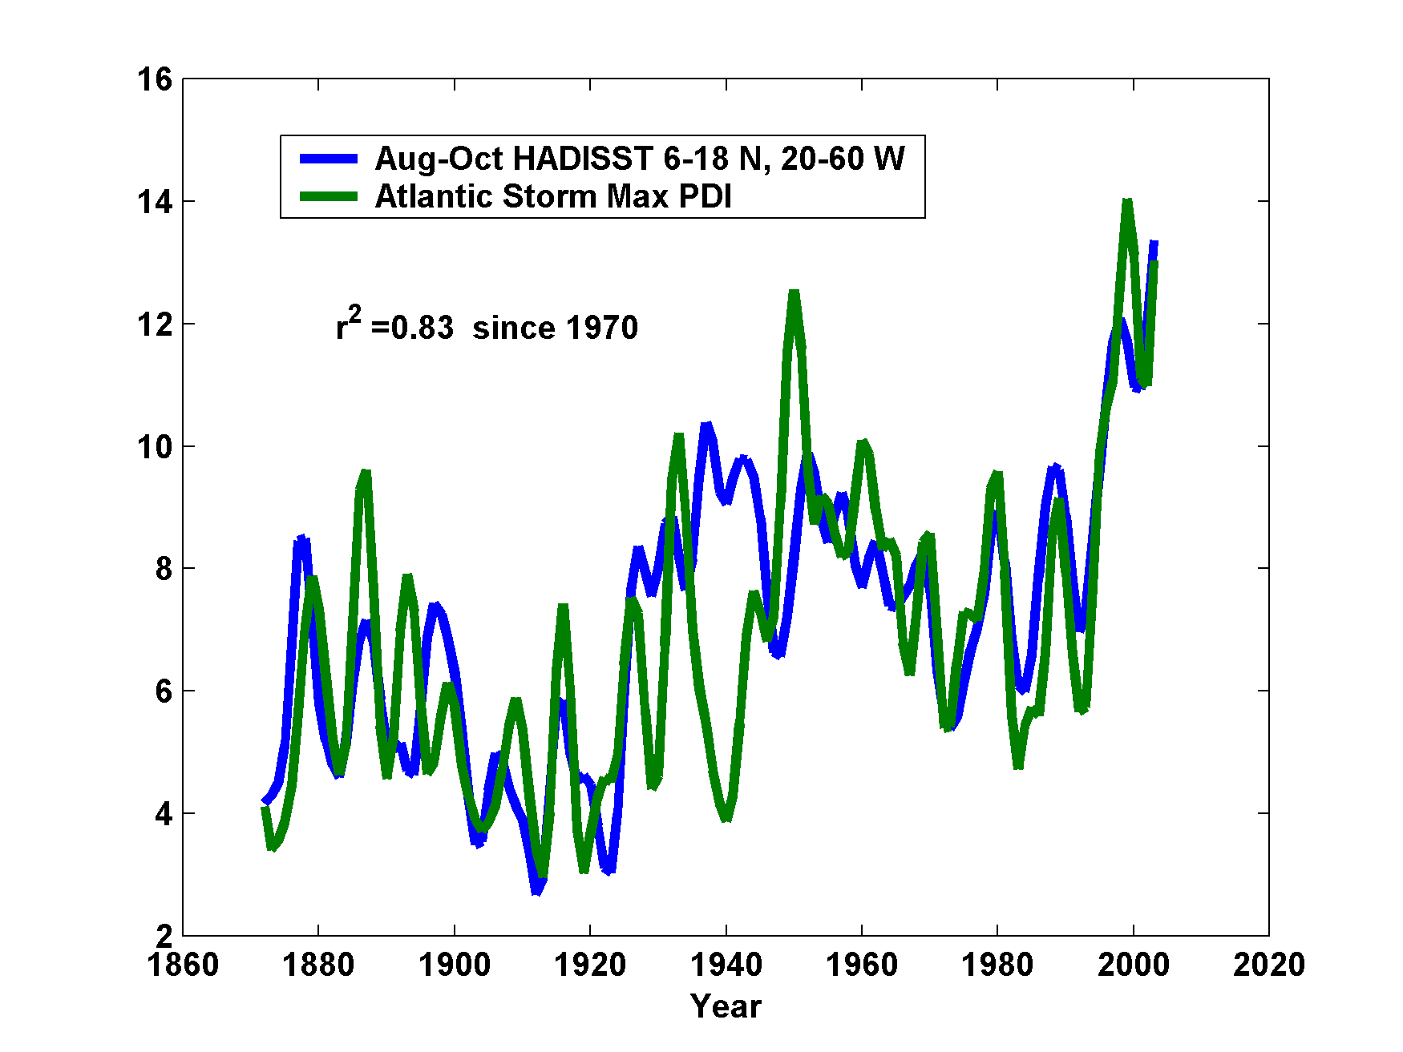
Hurricane Power is Changing in Concert with Tropical Ocean Temperature

Slide 35
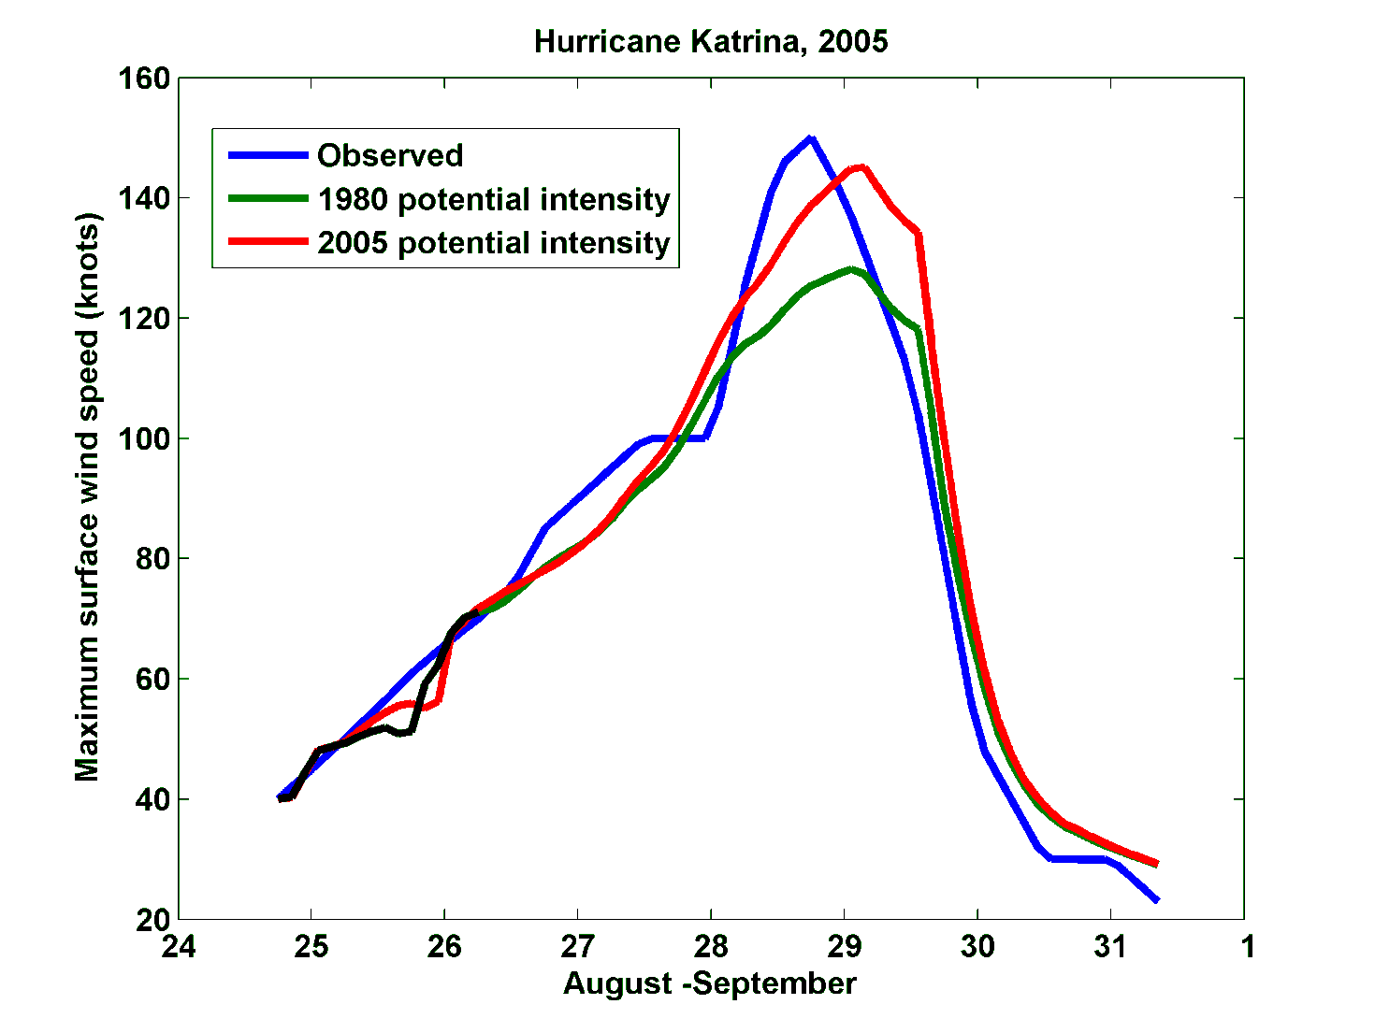
Effect of Increased Potential Intensity on Hurricane Katrina

Slide 36
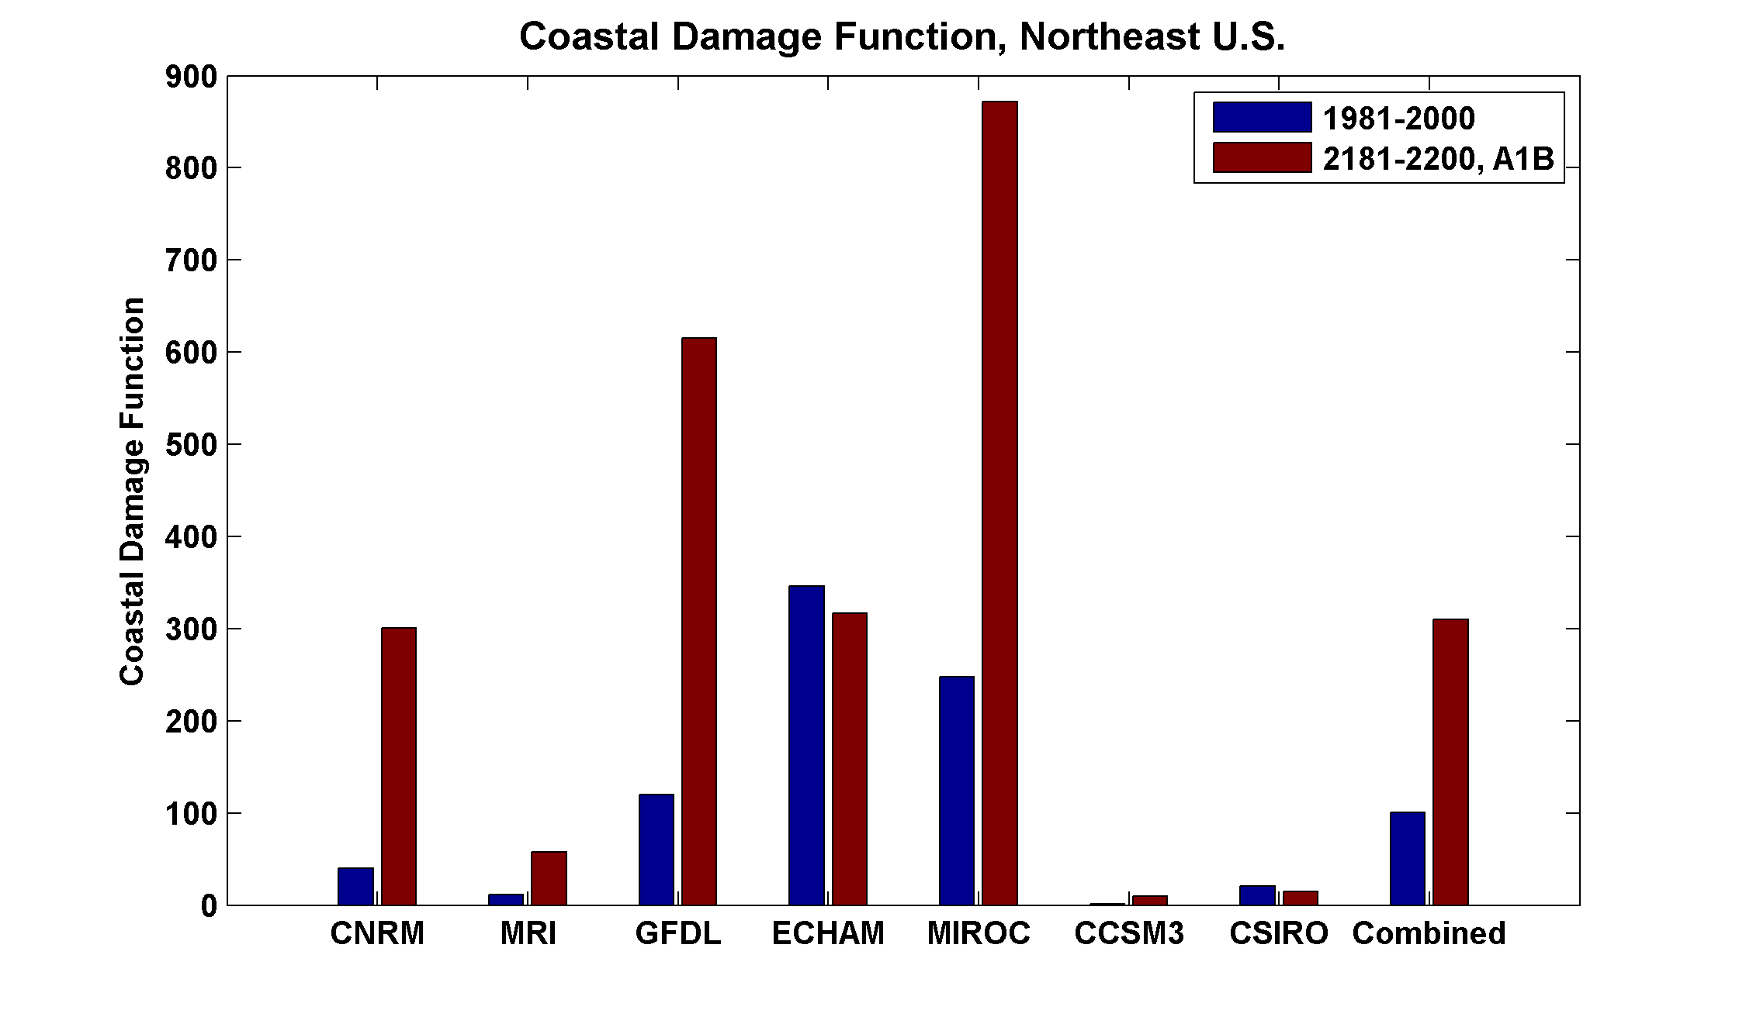

Slide 37

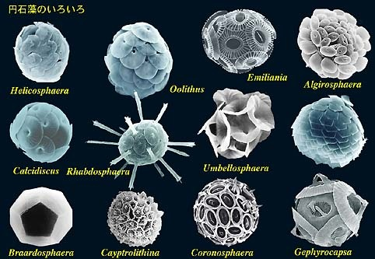
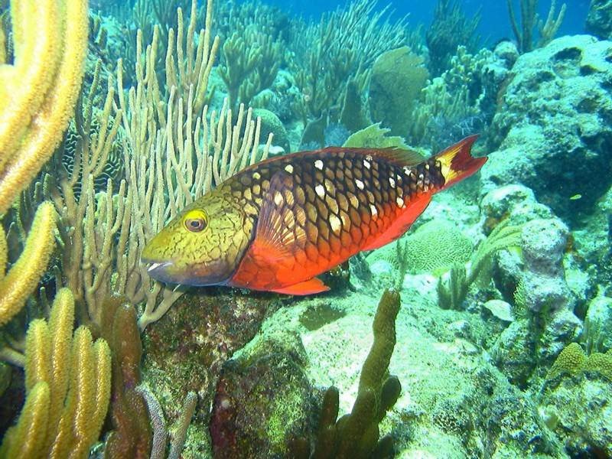
The Oceans are Turning Sour
Acidification through CO₂ threatens marine life
Plankton
Coral Reefs
Notes:
Abbildung 4.3-1
Aragonitsättigung und
gegenwärtige Riffstandorte
von Warmwasserkorallen
(blaue Punkte). (a)
vorindustrielle Werte
(ca. 1870, atmosphärische
CO2-Konzentration
280 ppm), (b) Gegenwart
(ca. 2005, 375 ppm CO2), (c)
Zukunft (ca. 2065, 517 ppm
CO2). Der Grad der
Aragonitsättigung (Ù)
bezeichnet das relative
Verhältnis zwischen dem
Produkt der Konzentrationen
von Kalzium- und
Karbonationen und dem
Löslichkeitsprodukt für
Aragonit. Standorte mit
einer Aragonitsättigung
unterhalb von 3,5 sind nur
noch bedingt für riffbildende
Warmwasserkorallen
geeignet (marginal),
unterhalb von 3 sind sie
ungeeignet.
Quelle: Steffen et al., 2004

Slide 38
Summary
Earth’s climate has changed radically and often abruptly through time
Primary culprits:
  Changing insolation, through solar evolution and orbital variations
  Changing concentrations of trace greenhouse gases
  Changing concentration of aerosols: Volcanic eruptions
Evidence for human-induced climate change now very compelling

Slide 39
Many climate processes remain poorly understood. Past abrupt climate change remains enigmatic and future abrupt state transitions cannot be ruled out
The culture of climate science is overly reliant on large, complex models. The field is in need of a fresh approach and an influx of original thinkers

Slide 40
Rate of increase of CO₂ if all remained in atmosphere
Observed annual rate of increase of CO₂

Slide 41
Estimates of Global Mean Surface Temperature from the Instrumental Record
Notes:
41

Slide 42
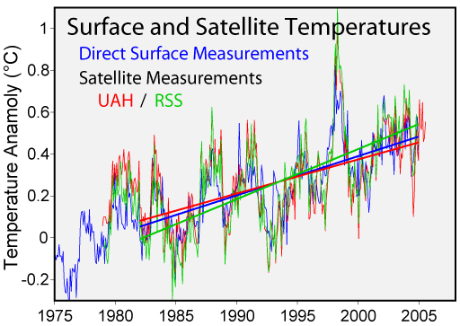

Slide 43
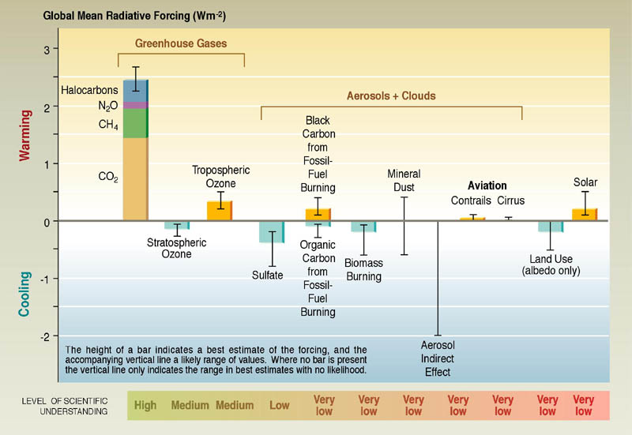
Contributions to net radiative forcing change, 1750-2004:

Slide 44
Global Climate Models:
How Good Are They, and What Do They Tell Us about The Future?

Slide 45
Global Climate Modeling
General philosophy:
  Simulate large-scale motions of atmosphere, oceans, ice
  Solve approximations to full radiative transfer equations
  Parameterize processes too small to resolve
  Some models also try to simulate biogeochemical processes
  First GCMs developed in 1960s
Notes:
45

Slide 46
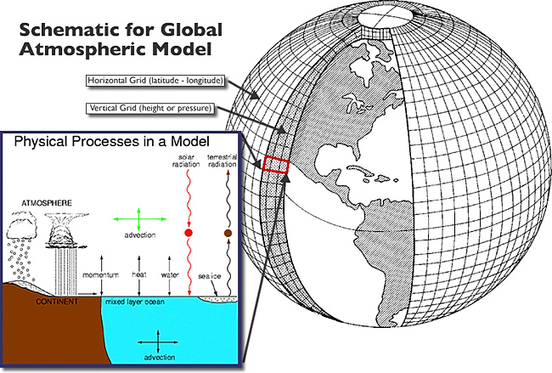
Equations solved by discretizing to finite volumes

Slide 47
Unresolved physical processes must be handled parametrically
Convection
Thin and/or broken clouds
Cloud microphysics
Aerosols and chemistry (e.g. photochemical processes, ozone
Turbulence, including surface fluxes
Sea ice
Land ice
Land surface processes

Slide 48
Climate Elements and Feedbacks

Slide 49
Global mean temperature (black) and simulations using many different global models (colors) including all forcings
Same as above, but models run with only natural forcings

Slide 50
Ensemble of climate models, Scenario A1b

Slide 51
Dealing with Climate Change
Winners and losers
Difficult but necessary cost-benefit analysis
Still large uncertainty in climate projections
Small but difficult-to-quantify risk of major climate shifts (e.g. collapse of Greenland ice sheet)

Slide 52
Atmospheric lifetime of CO₂ is centuries long
52
Hansen, 2007
Notes:
52

Slide 53
Strategies
Reduce emissions
  gasification of coal—potential CO₂ capture
  alternative sources– nuclear, wind, etc.
  unlikely to effect major reductions
  Fcous on non-CO₂ greenhouse gases
Carbon sequestration
Other geoengineering
  technically feasible, $20-30 billion/year
  Side effects, e.g. reduced precipitation
Adaptation

