Slide 1
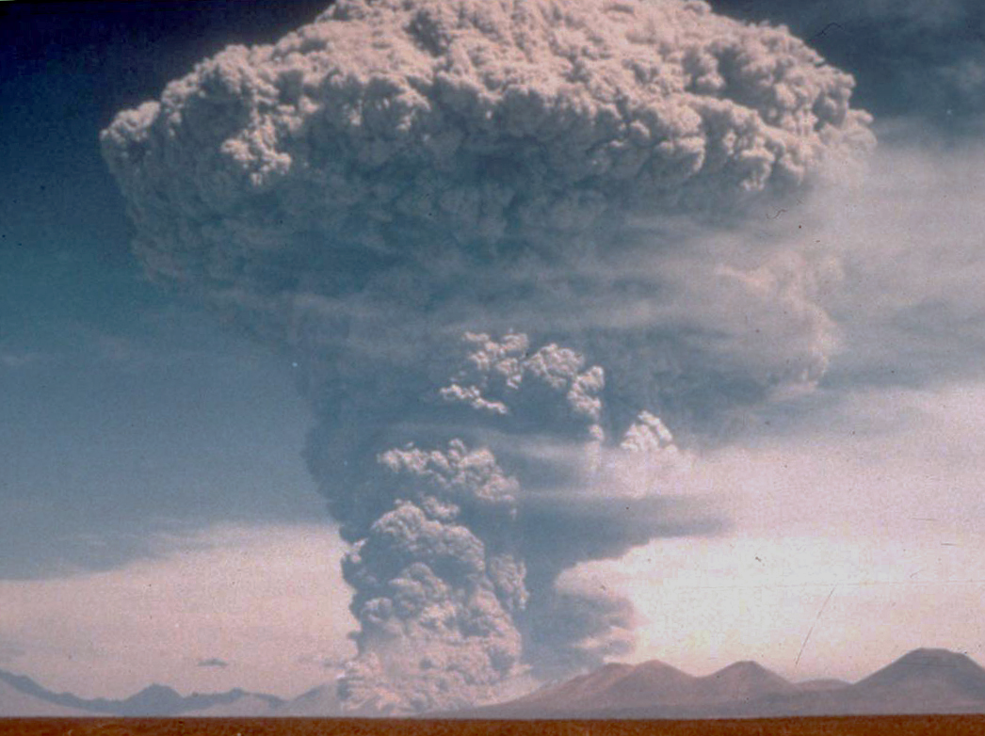
Volcanoes and Tropical Cyclones
Kerry Emanuel
Lorenz Center

Slide 2
Do Large Volcanic Eruptions Affect Tropical Cyclone Activity?
Why should we care?
  Interesting scientific challenge
  May illuminate how large-scale processes control TC activity
  Potential utility to, e.g., re-insurance firms

Slide 3
Physical Effects of Large Volcanic Eruptions Relevant to TCs
Only eruptions large enough to loft significant masses of aerosols and gases into the stratosphere really matter in this problem
Direct effects:
  Cooling of sea surface owing to absorption of shortwave radiation
  Heating of lower stratosphere by shortwave and longwave absorption
  Possible reduction of middle-level saturation deficit by cooling of tropical troposphere
Indirect effects:
  Changes in tropical circulation leading to changes in wind shear and TC movement

Slide 4
Approach
Following Yan et al., Climate Dynamics, 2018, use the global Community Earth System Model-Last Millennium Ensemble (CESM-LME) forced by volcanic aerosols only (no variability of greenhouse gases, solar (including orbital) or land-use changes. We examine only a single ensemble member here.
Again following Yan et al., we calculate large-scale predictors of tropical cyclone activity, including potential intensity and its components, a genesis potential index, wind shear, and mid-level saturation deficit.
Using CESM-LME output, downscale 520,00 tropical cyclones over the period 850-2000
Composite both large-scale predictors and downscaled TC metrics around the times of major eruptions, defined here as those that loft more than 15 Tg of material into the stratosphere

Slide 5
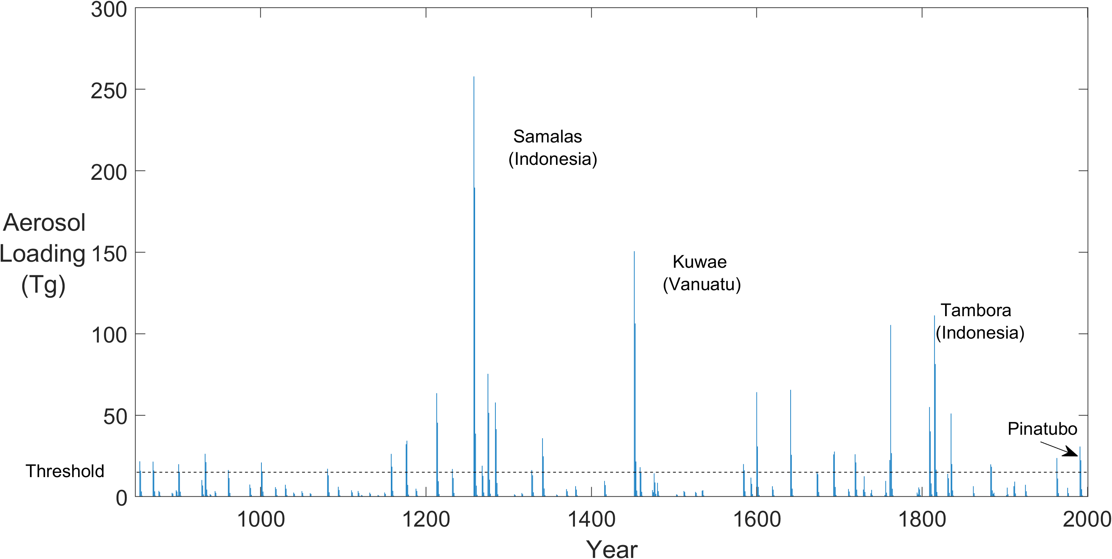
Eruption Aerosol Loading (from ice cores)
Gao, C., A. Robock, and C. Ammann, 2008: Volcanic forcing of climate over the past 1500 years: An improved ice core-based index for climate models. Journal of Geophysical Research: Atmospheres, 113, https://doi.org/10.1029/2008JD010239.

Slide 6
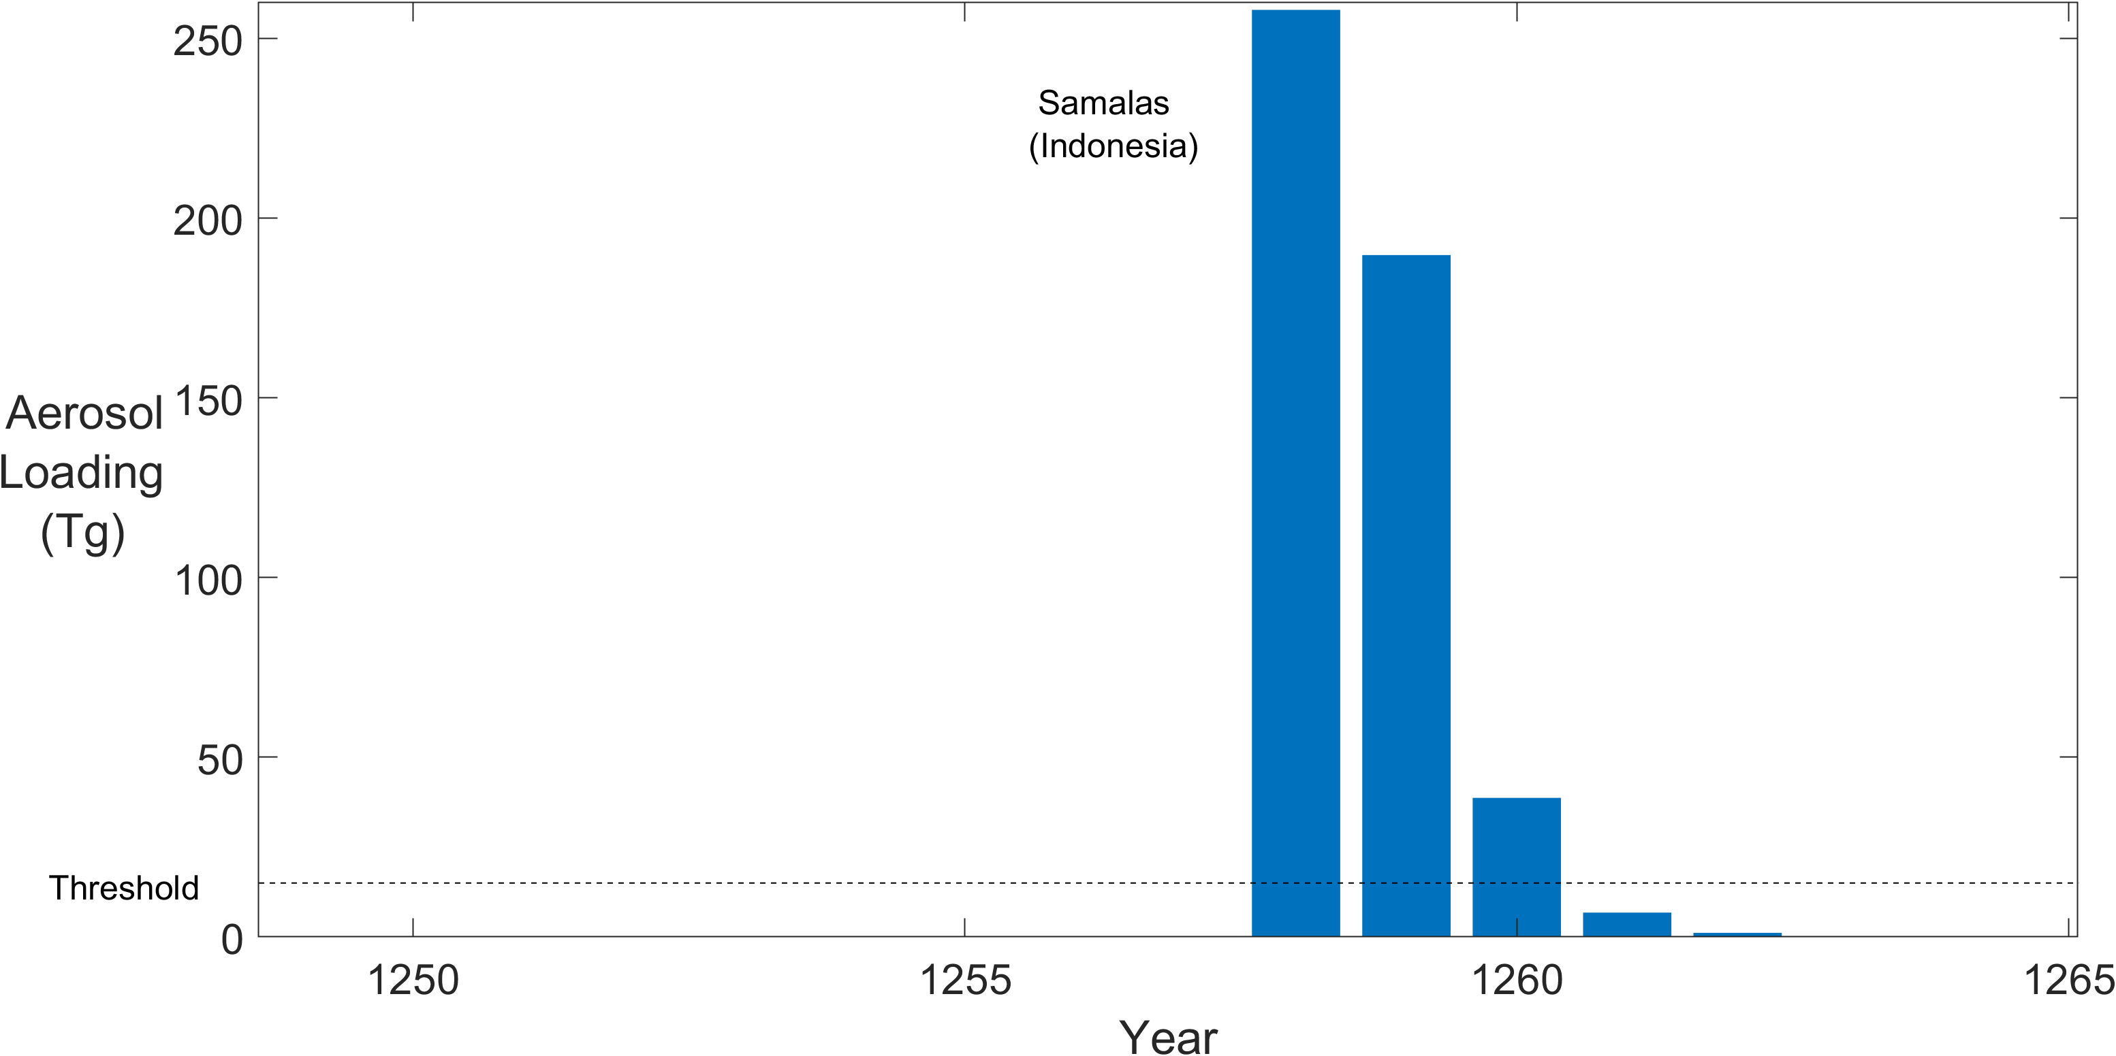
We composite around the first year of these sequences
Gao, C., A. Robock, and C. Ammann, 2008: Volcanic forcing of climate over the past 1500 years: An improved ice core-based index for climate models. Journal of Geophysical Research: Atmospheres, 113, https://doi.org/10.1029/2008JD010239.

Slide 7
Large-Scale Tropical Cyclone Predictors

Slide 8
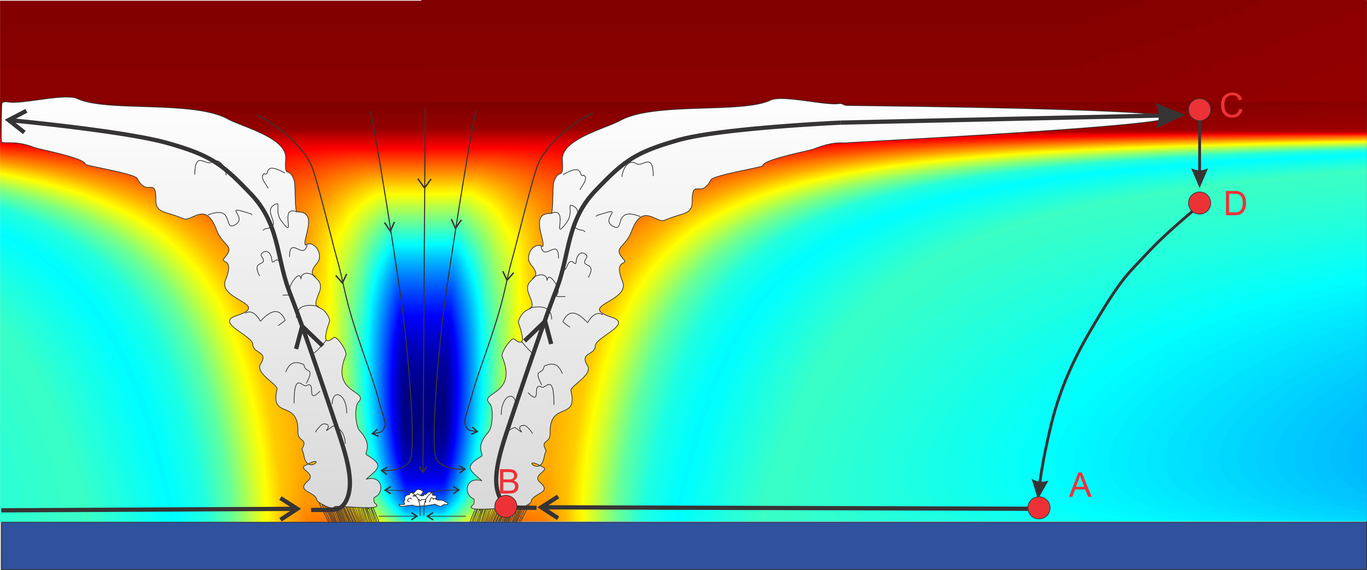
Thermodynamic Disequilibrium Between the Surface and Atmosphere is Caused by the Greenhouse Effect
Thermal cycle of a mature hurricane
Isothermal compression
Adiabatic expansion
Adiabatic compression
Isothermal expansion
A nearly perfect Carnot Engine in nature
Note sensitivity to temperature at C

Slide 9
Potential Intensity
Rate of air flow through the Carnot Cycle tells us how fast wind energy is generated
Wind energy is dissipated mostly by friction between air flow and the surface
Equating dissipation with generation gives us a wind speed called the potential intensity
Potential intensity turn out to be a good upper bound on the intensity of real hurricanes

Slide 10
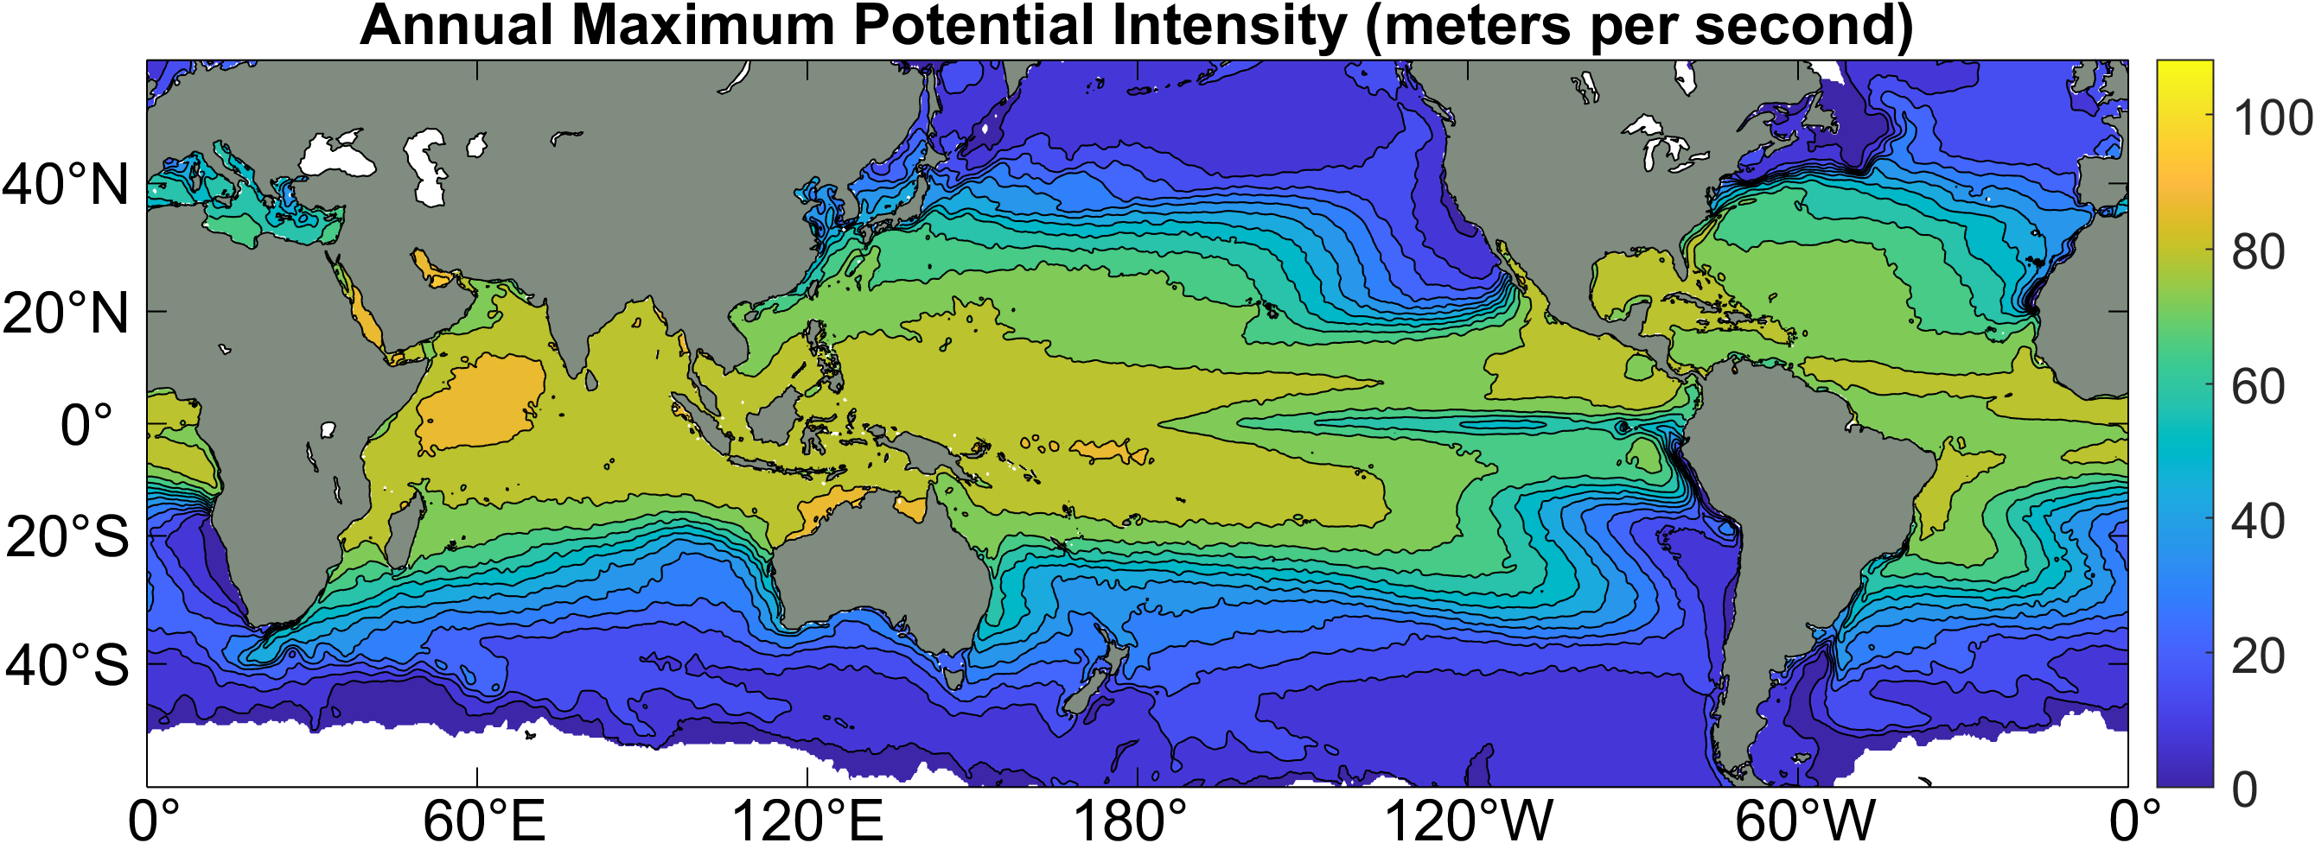
Annual Maximum Potential Intensity (meters per second)

Slide 11
A Genesis Potential Index:
GPI has correct dimensions
850 hPa absolute vorticity (h)
850 – 250 hPa shear (S)
Potential intensity (PI)
Non-dimensional subsaturation of the middle troposphere:

Slide 12
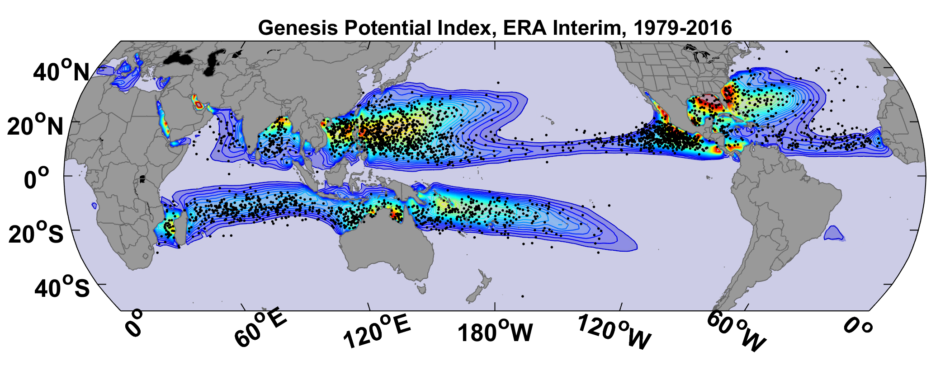
GPI from ERA-Interim Data, 1979-2016, with Observed Genesis Points

Slide 13
Seasonal Cycle
Genesis Potential Index from ERA5 reanalysis, 1979-2018 vs. Observed TCs, 1980-2018

Slide 14
Physics-based Tropical Cyclone Generator
Reliable, global records of coarse-scale climate are robust and widely available
Cull from these datasets the key statistics known to control tropical cyclone generation, movement, and intensity evolution
Bootstrap these key statistics to create unlimited synthetic time series of the hurricane-relevant environmental variables
Use these to drive specialized, very high resolution physical hurricane models (CHIPS)
Extensively validate the results against historical hurricane data
Exact same method can be applied to output of climate models

Slide 15

MIT Synthetic Hurricanes
Embed high-resolution, fast coupled ocean-atmosphere hurricane model in global climate model or climate reanalysis data
Coupled Hurricane Intensity prediction Model (CHIPS) has been used for 20 years to forecast real hurricanes in near-real time

Slide 16
Synthetic TC Generation
Step 1: Seed each ocean basin with a very large number of weak, randomly located cyclones
Step 2: Cyclones are assumed to move with the large scale atmospheric flow in which they are embedded, plus a correction for the earth’s rotation and sphericity (beta-drift)
Step 3: Run the CHIPS coupled intensity model for each cyclone, and note how many achieve at least tropical storm strength
Step 4: Using the small fraction of surviving events, determine storm statistics. Can easily generate 100,000 events
Details: Emanuel et al., Bull. Amer. Meteor. Soc, 2008
Notes:
16

Slide 17
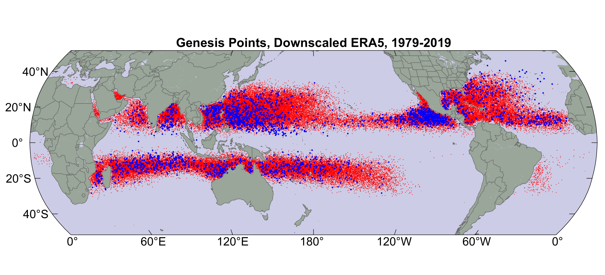
Origin points of successful seeds (red); observed genesis locations (blue)

Slide 18
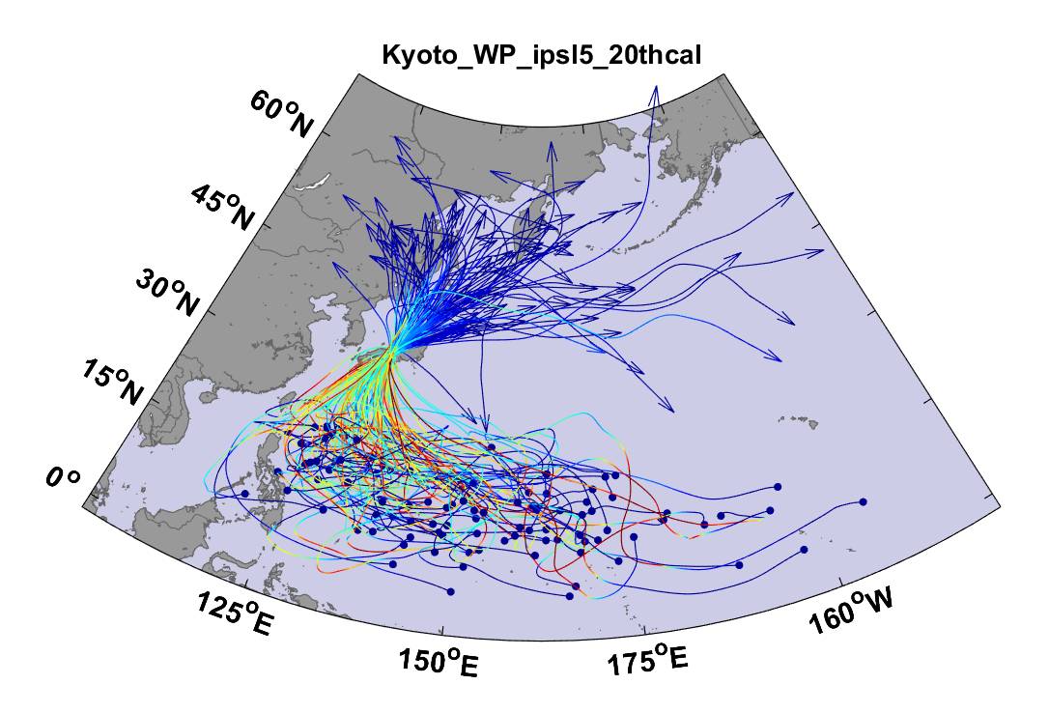
Example:
Top 100 out of 2000 TCs Affecting Kyoto, 1981-2000

Slide 19
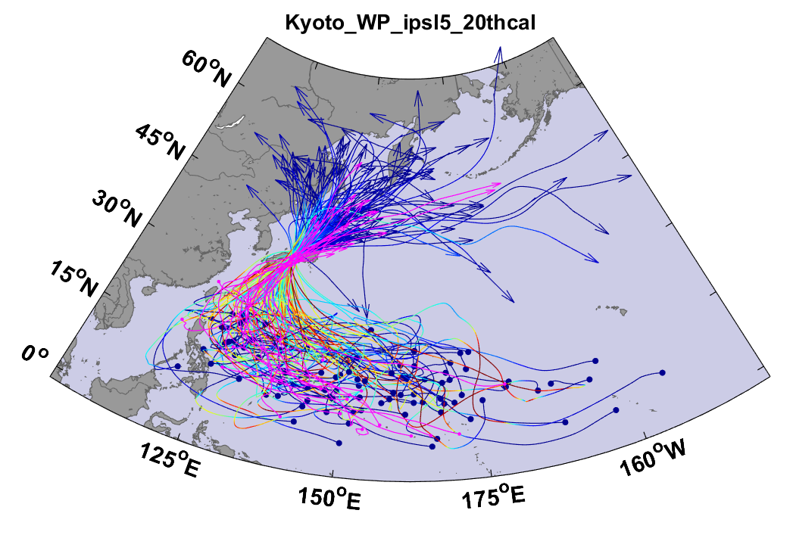
Same, but with top 20 historical tracks

Slide 20
Atlantic Annual Cycle

Slide 21
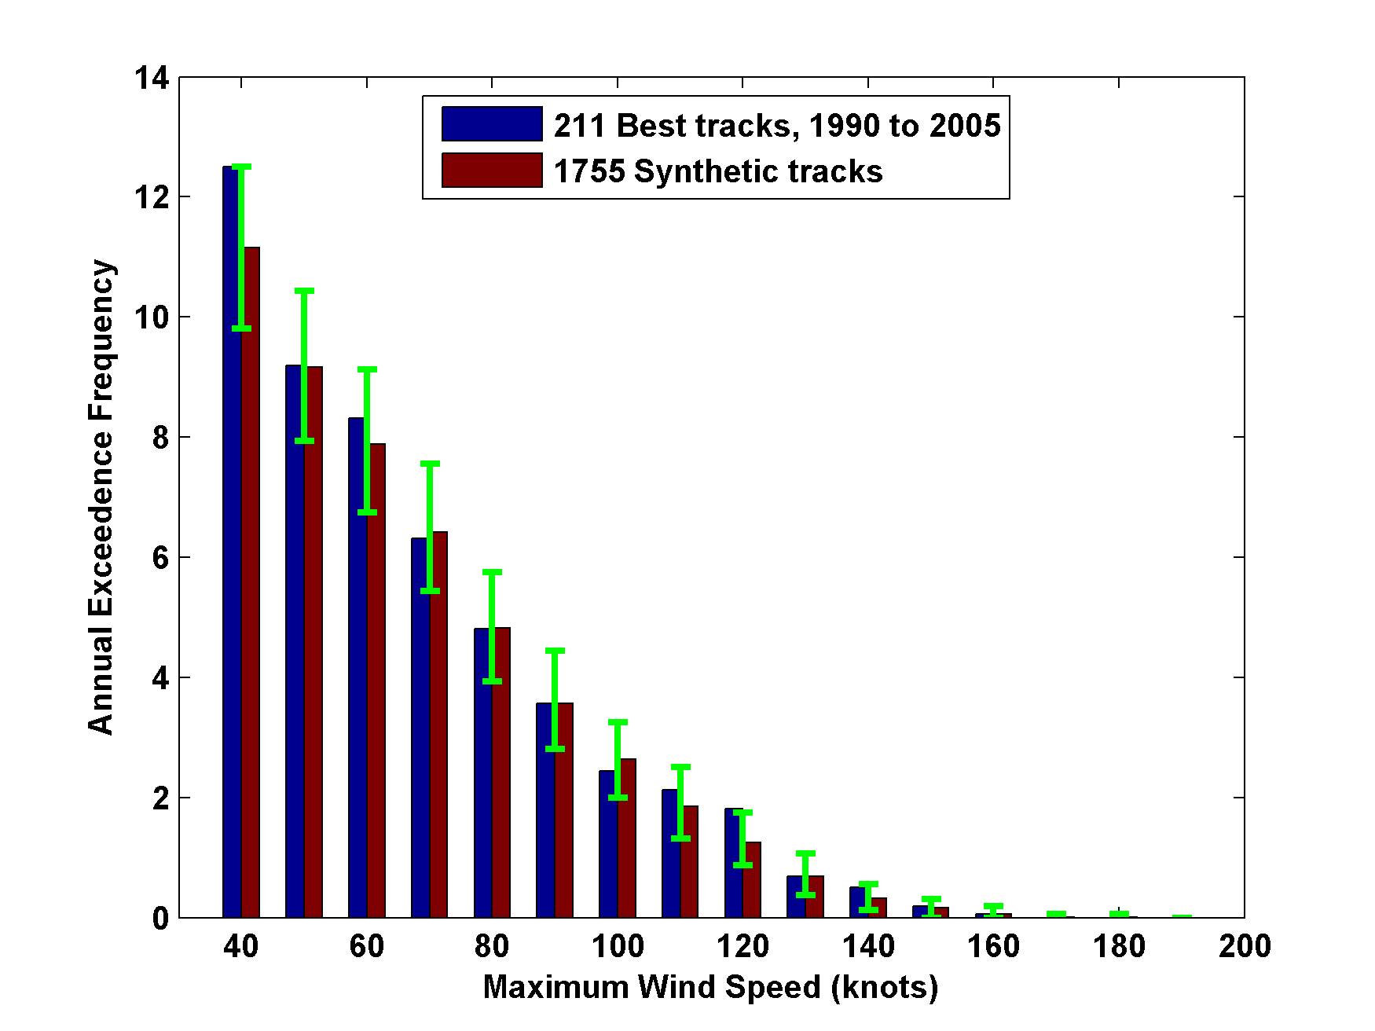
Cumulative Distribution of Storm Lifetime Peak Wind Speed, with Sample of 1755 Synthetic Tracks
Blue bars: Actual
Red bars: Predicted
90% confidence bounds

Slide 22
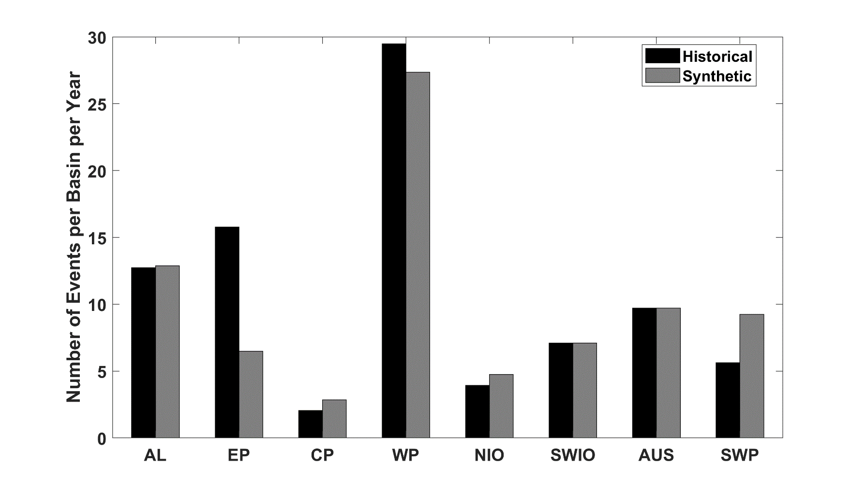
Average annual number of tropical cyclones over the period 1980-2020 in observations (IBTrACS; Knapp et al. 2010; black bars) and from random seeding of ERA-5 (gray bars)

Slide 23
With enhanced seeding of far eastern North Atlantic and near Mexican coast in the eastern Pacific
Average annual number of tropical cyclones over the period 1979-2023 in observations (IBTrACS; Knapp et al. 2010; blue bars) and from random seeding of ERA-5 (red bars), but with enhanced seeding frequency in the far eastern North Atlantic and far eastern North Pacific

Slide 24
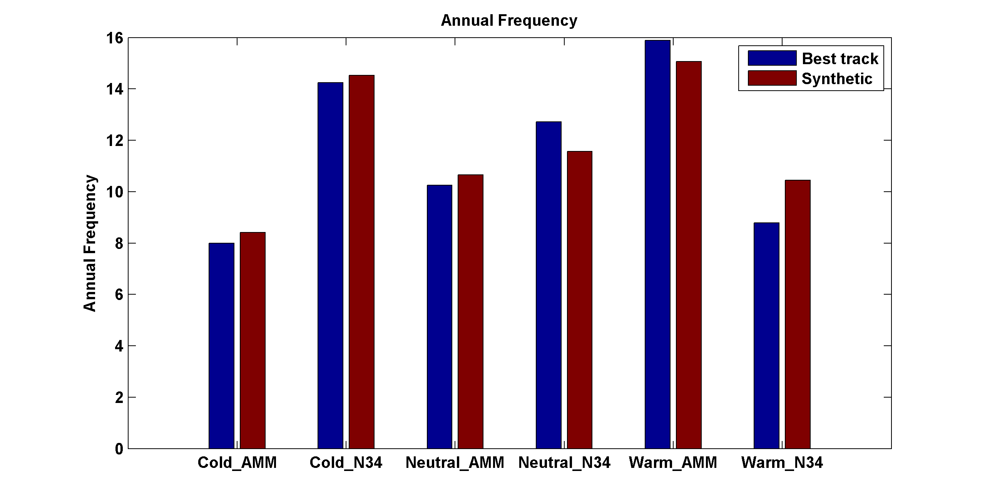
Captures effects of regional climate phenomena (e.g. ENSO, AMM)
Blue bars: Actual
Red bars: Predicted

Slide 25
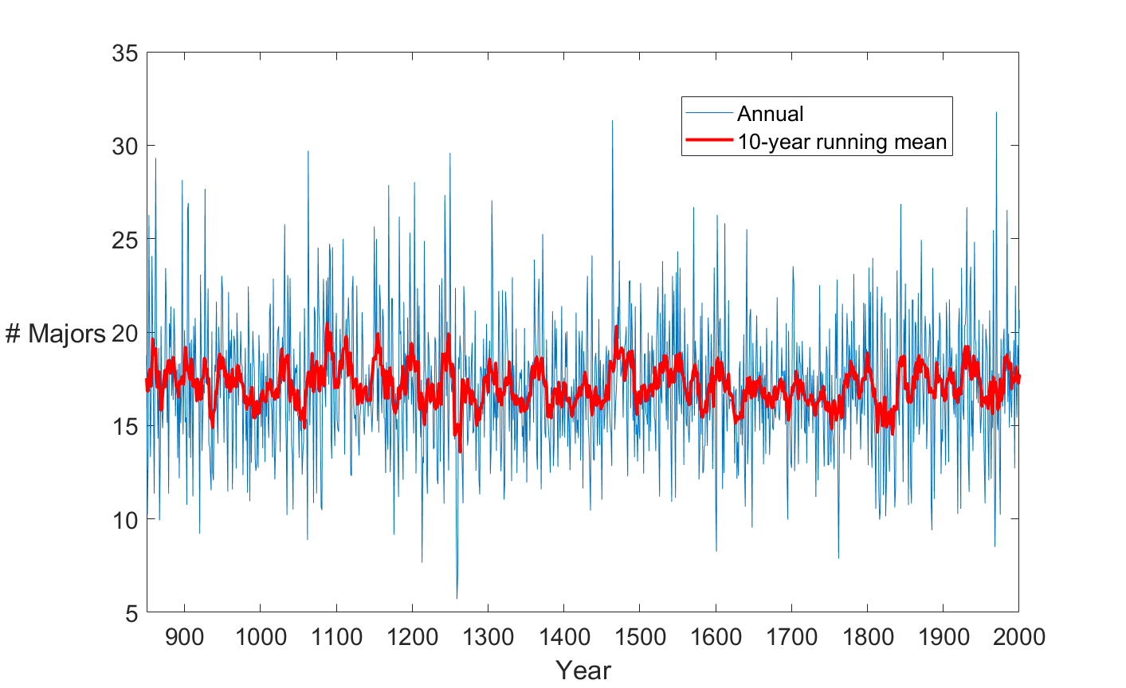
TCs Downscaled from CESM-LME, 850-2020, western North Pacific

Slide 26
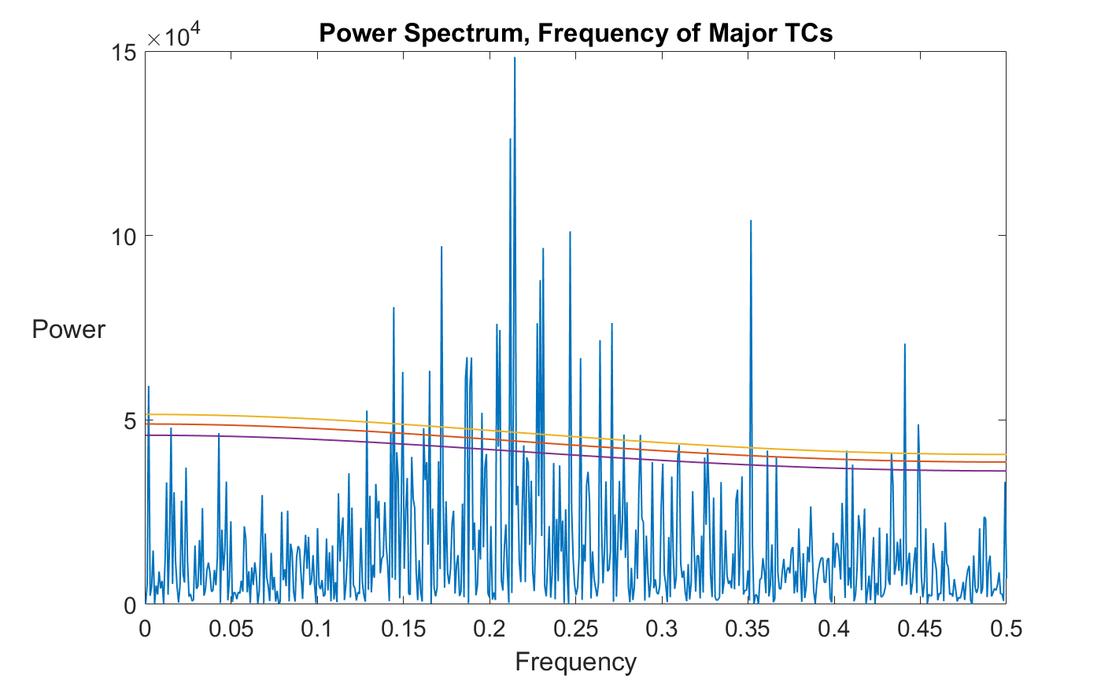
TCs Downscaled from CESM-LME, 850-2020, western North Pacific

Slide 27
Compositing Results

Slide 28
First, results of Yan et al. (2018)*
Used full CESM-LME ensemble
Considered only eruptions >= 7.5 Tg and with no other eruptions occurring within 6 years before or after eruption in question; only 17 eruptions meet these criteria
For each ensemble member and each eruption, took average over the 3 days after the eruption and subtracted average over 3 days before the eruption
Then averaged the results over all ensemble members and over all eruptions
*Yan, Q., Z. Zhang, and H. Wang, 2018: Divergent responses of tropical cyclone genesis factors to strong volcanic eruptions at different latitudes. Climate Dynamics, 50, 2121–2136, https://doi.org/10.1007/s00382-017-3739-1.

Slide 29
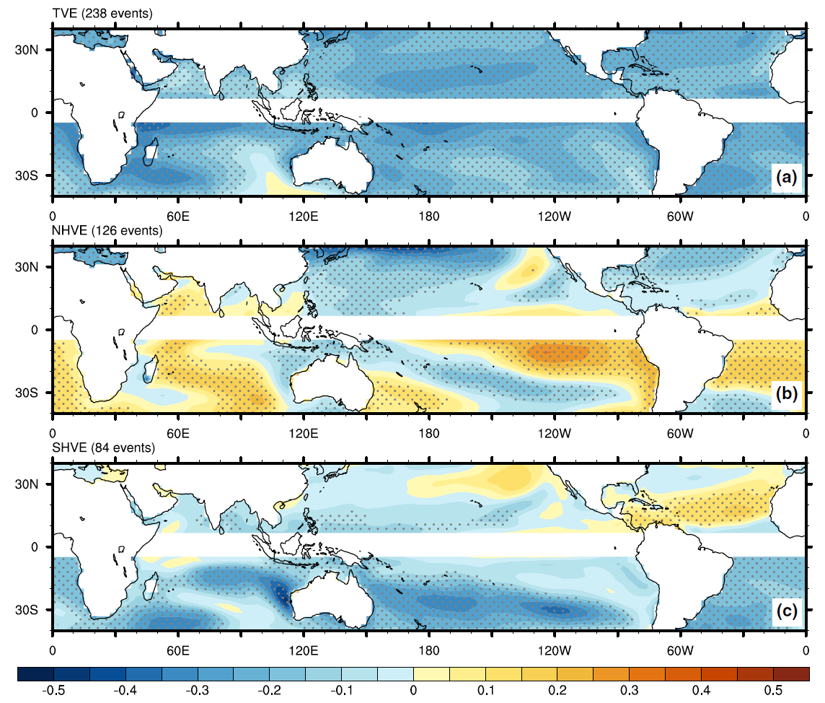
Sea Surface Temperature
All tropical eruptions
N. Hemisphere tropical eruptions
S. Hemisphere tropical eruptions
K
Yan, Q., Z. Zhang, and H. Wang, 2018: Divergent responses of tropical cyclone genesis factors to strong volcanic eruptions at different latitudes. Climate Dynamics, 50, 2121–2136, https://doi.org/10.1007/s00382-017-3739-1.

Slide 30
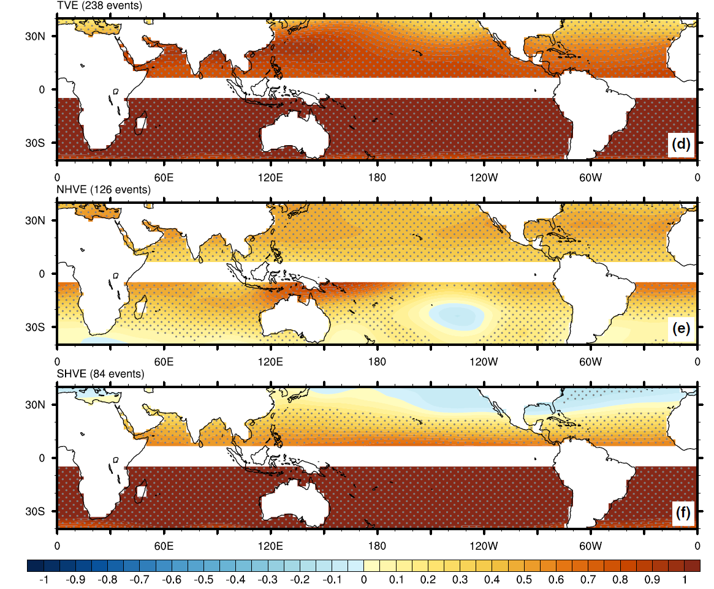
70 hPa Temperature
All tropical eruptions
N. Hemisphere tropical eruptions
S. Hemisphere tropical eruptions
K
Yan, Q., Z. Zhang, and H. Wang, 2018: Divergent responses of tropical cyclone genesis factors to strong volcanic eruptions at different latitudes. Climate Dynamics, 50, 2121–2136, https://doi.org/10.1007/s00382-017-3739-1.

Slide 31
Potential Intensity
All tropical eruptions
N. Hemisphere tropical eruptions
Enhanced PI
S. Hemisphere tropical eruptions
m s⁻¹
Yan, Q., Z. Zhang, and H. Wang, 2018: Divergent responses of tropical cyclone genesis factors to strong volcanic eruptions at different latitudes. Climate Dynamics, 50, 2121–2136, https://doi.org/10.1007/s00382-017-3739-1.

Slide 32
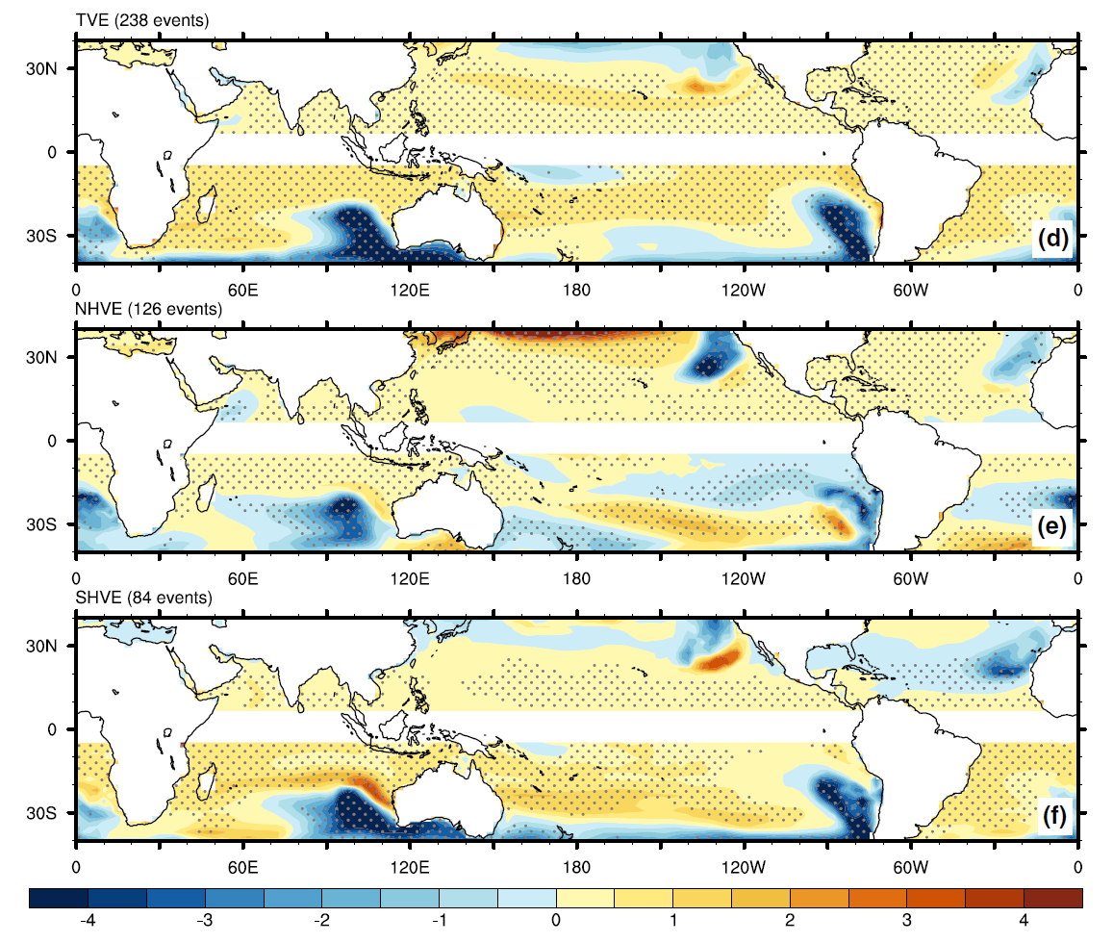
Outflow Temperature
All tropical eruptions
N. Hemisphere tropical eruptions
Cooling
S. Hemisphere tropical eruptions
K
Yan, Q., Z. Zhang, and H. Wang, 2018: Divergent responses of tropical cyclone genesis factors to strong volcanic eruptions at different latitudes. Climate Dynamics, 50, 2121–2136, https://doi.org/10.1007/s00382-017-3739-1.

Slide 33
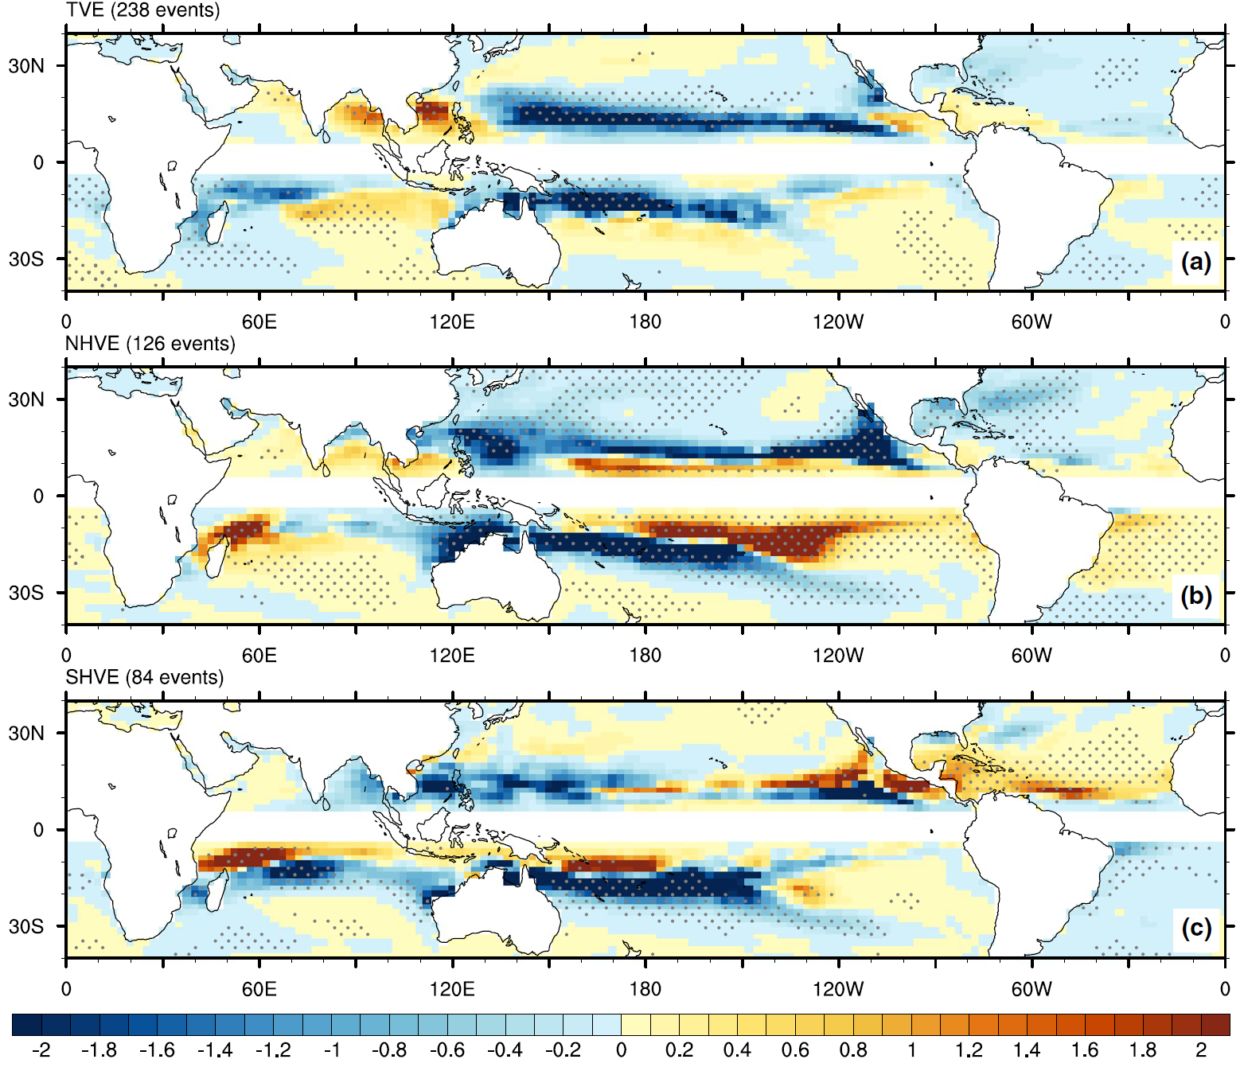
Genesis Potential Index
All tropical eruptions
N. Hemisphere tropical eruptions
Enhanced GPI
S. Hemisphere tropical eruptions
Yan, Q., Z. Zhang, and H. Wang, 2018: Divergent responses of tropical cyclone genesis factors to strong volcanic eruptions at different latitudes. Climate Dynamics, 50, 2121–2136, https://doi.org/10.1007/s00382-017-3739-1.

Slide 34
Vertical Wind Shear
All tropical eruptions
N. Hemisphere tropical eruptions
Reduced shear
S. Hemisphere tropical eruptions
m s⁻¹
Yan, Q., Z. Zhang, and H. Wang, 2018: Divergent responses of tropical cyclone genesis factors to strong volcanic eruptions at different latitudes. Climate Dynamics, 50, 2121–2136, https://doi.org/10.1007/s00382-017-3739-1.

Slide 35
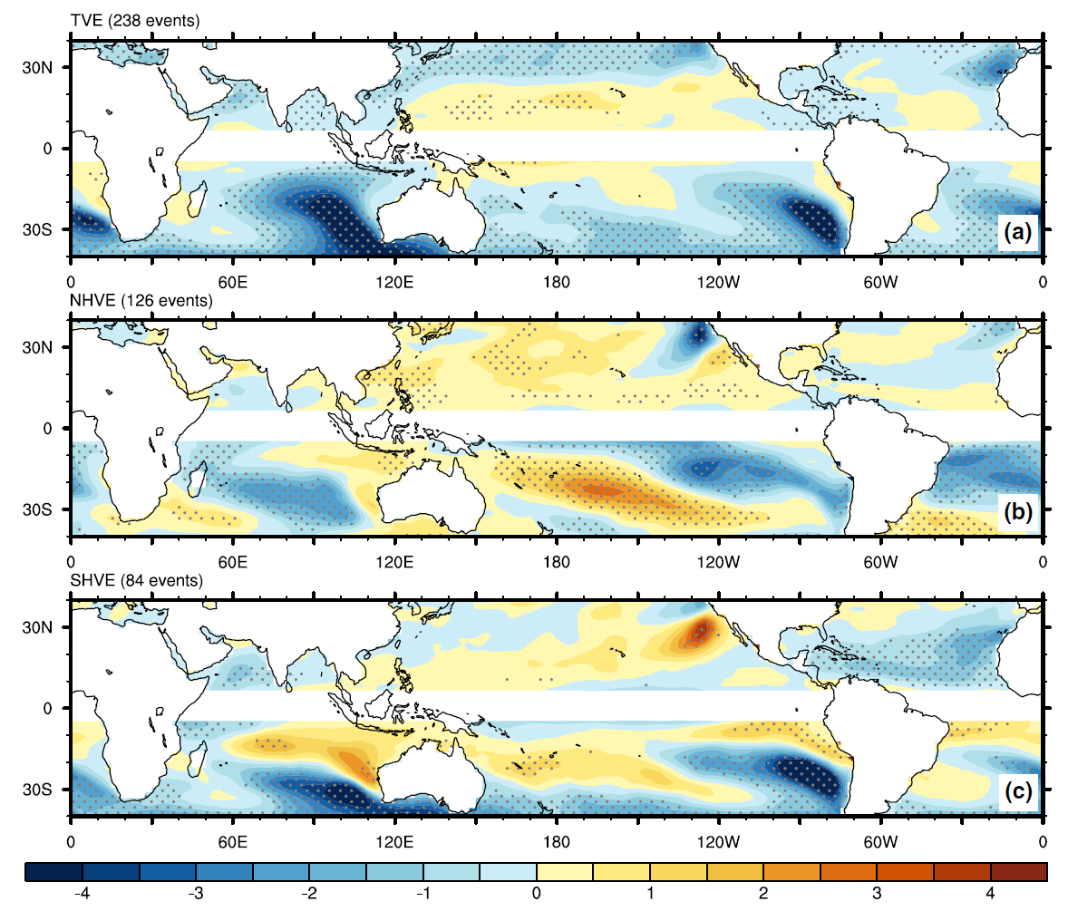
Moist entropy deficit (χ)
All tropical eruptions
N. Hemisphere tropical eruptions
Reduced entropy deficit
S. Hemisphere tropical eruptions
10⁻²
Yan, Q., Z. Zhang, and H. Wang, 2018: Divergent responses of tropical cyclone genesis factors to strong volcanic eruptions at different latitudes. Climate Dynamics, 50, 2121–2136, https://doi.org/10.1007/s00382-017-3739-1.

Slide 36
New Compositing Results
Considered all eruptions not preceded by a large eruption in the previous year.
Assumption: Natural variability uncorrelated with large eruptions.
Number of Eruptions >= 15 Tg over 1150 years:
Total tropics: 60
Northern hemisphere: 33
Southern hemisphere: 23
Note: There were 4 years with eruptions in both hemispheres that were each < 15 Tg but together exceeded 15 Tg
Note: Sequences of years with smaller eruptions can also be important but are neglected here.

Slide 37
Large-Scale Predictors

Slide 38
Genesis Potential Index

Slide 39
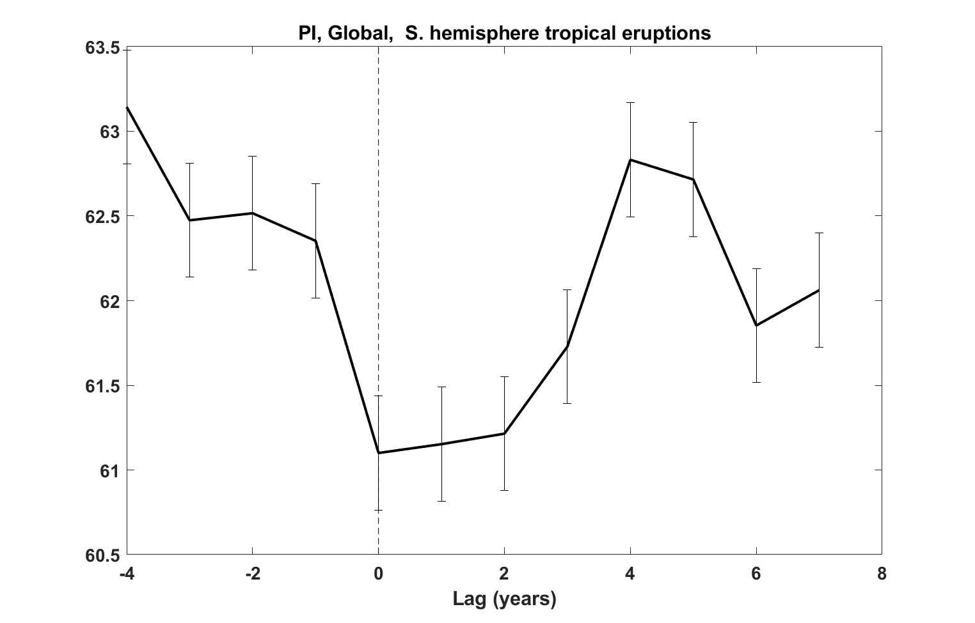
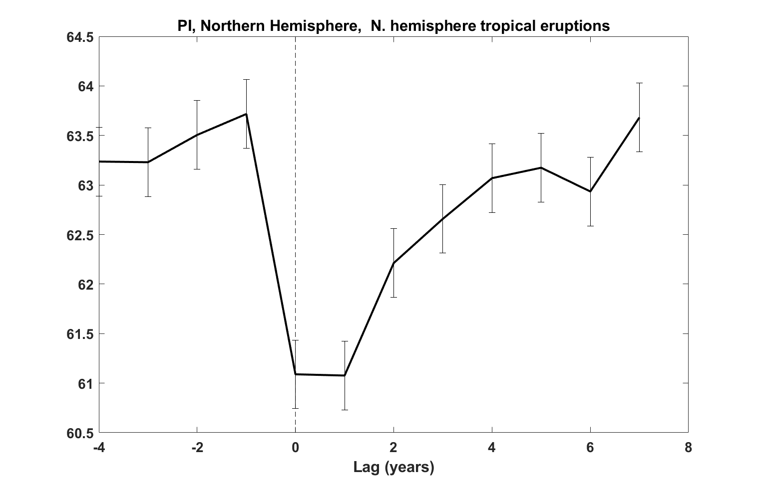
Potential Intensity

Slide 40
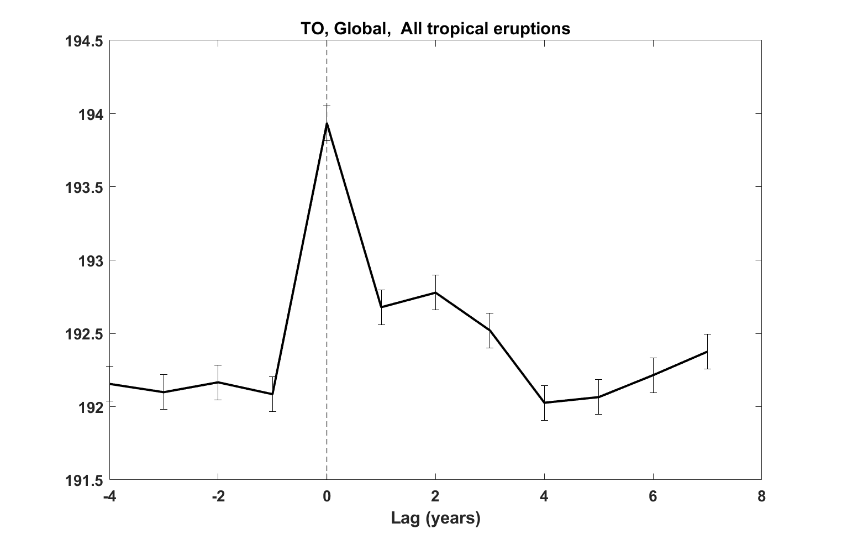
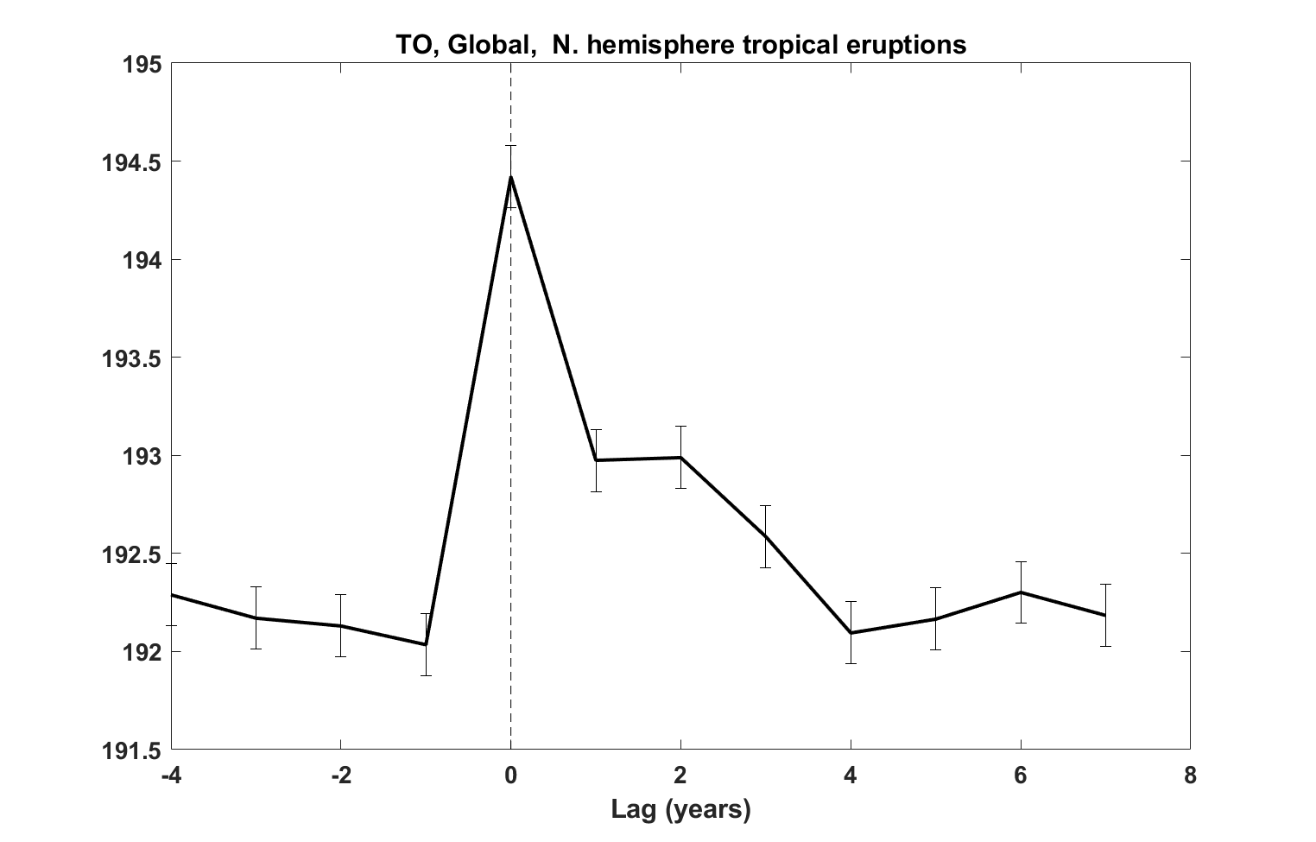
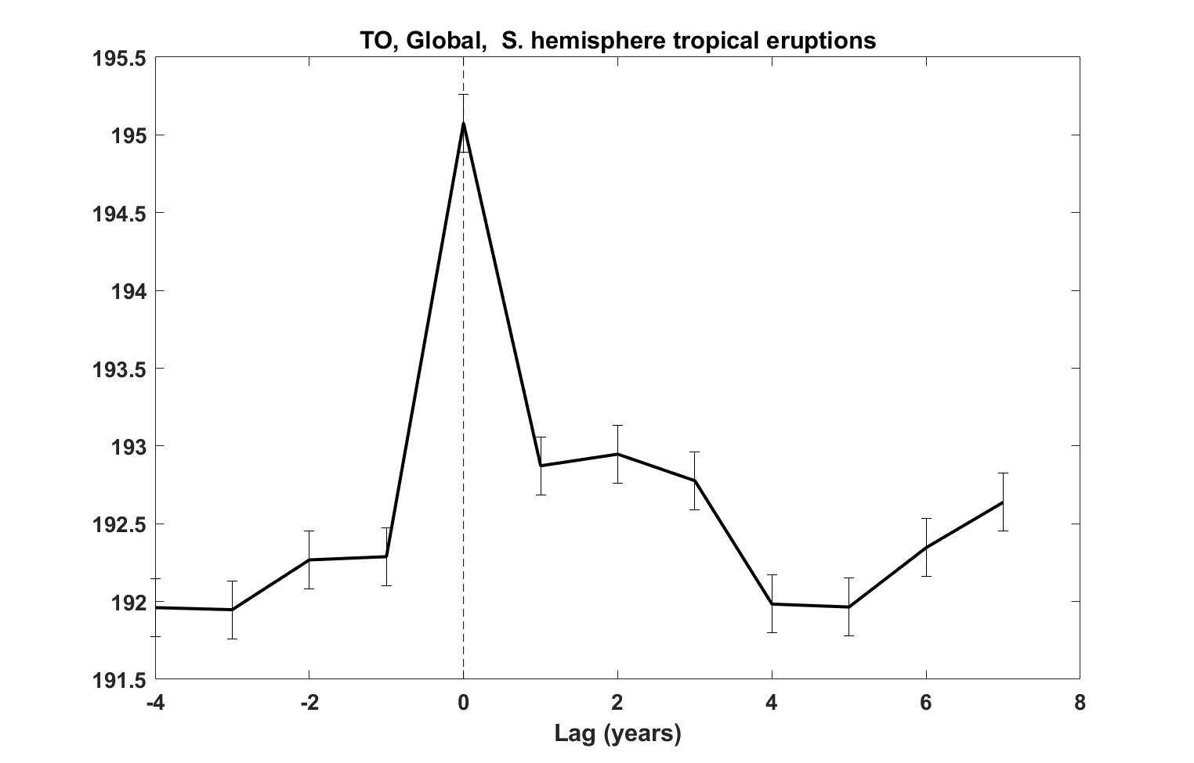
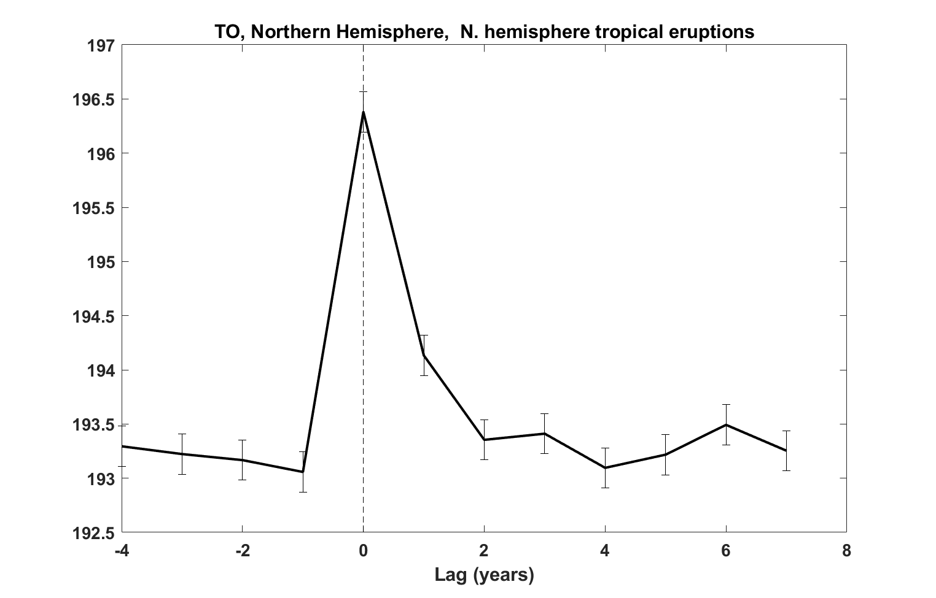
Outflow Temperature

Slide 41
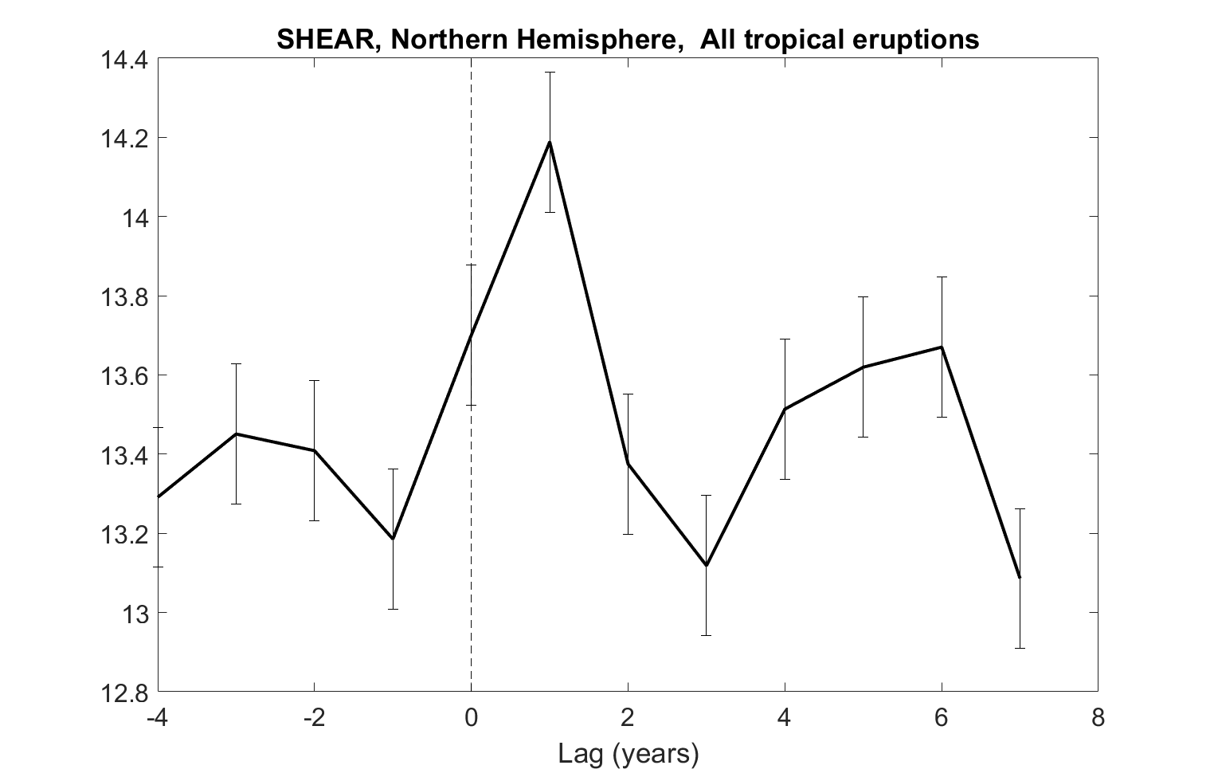
850-250 hPa shear

Slide 42
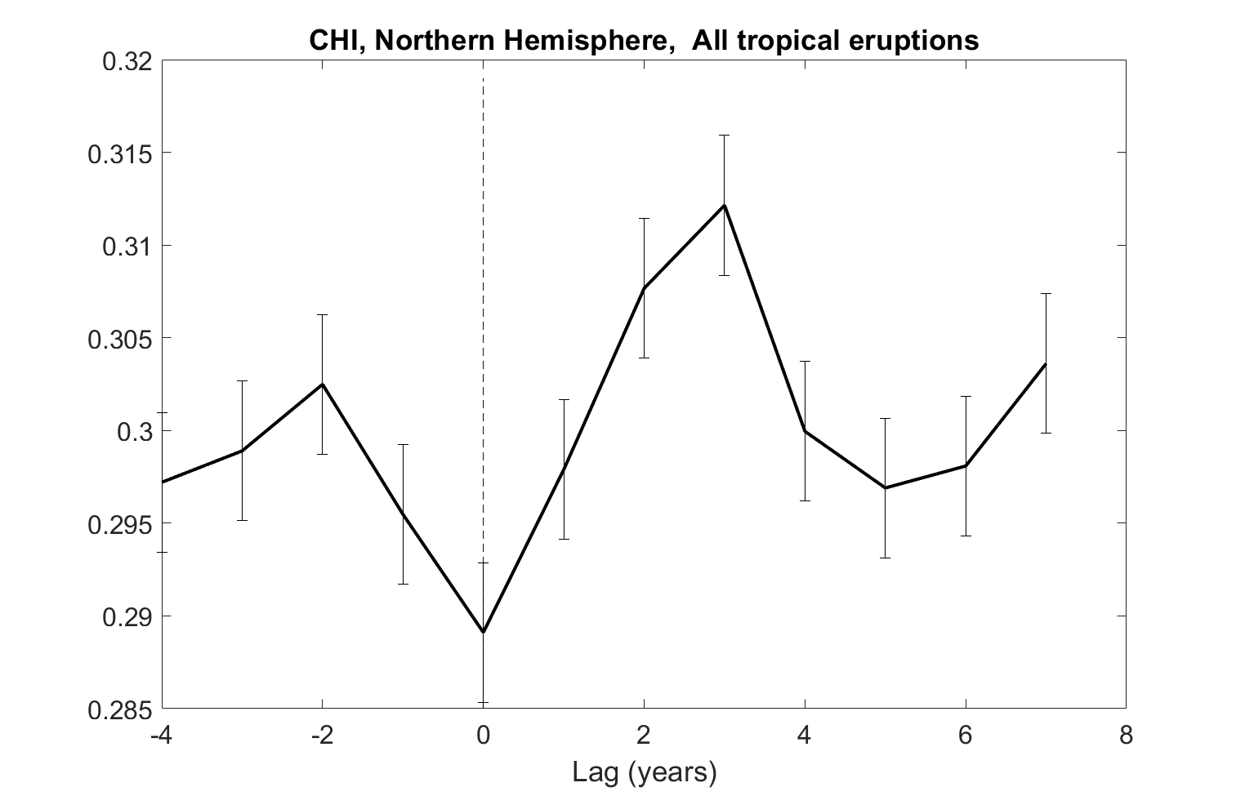
600 hPa Saturation Deficit

Slide 43
Synthetic TC Metrics

Slide 44
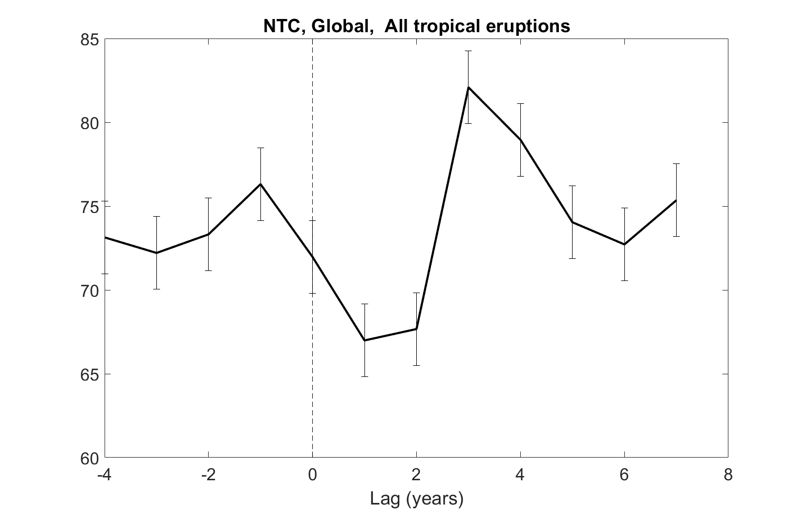
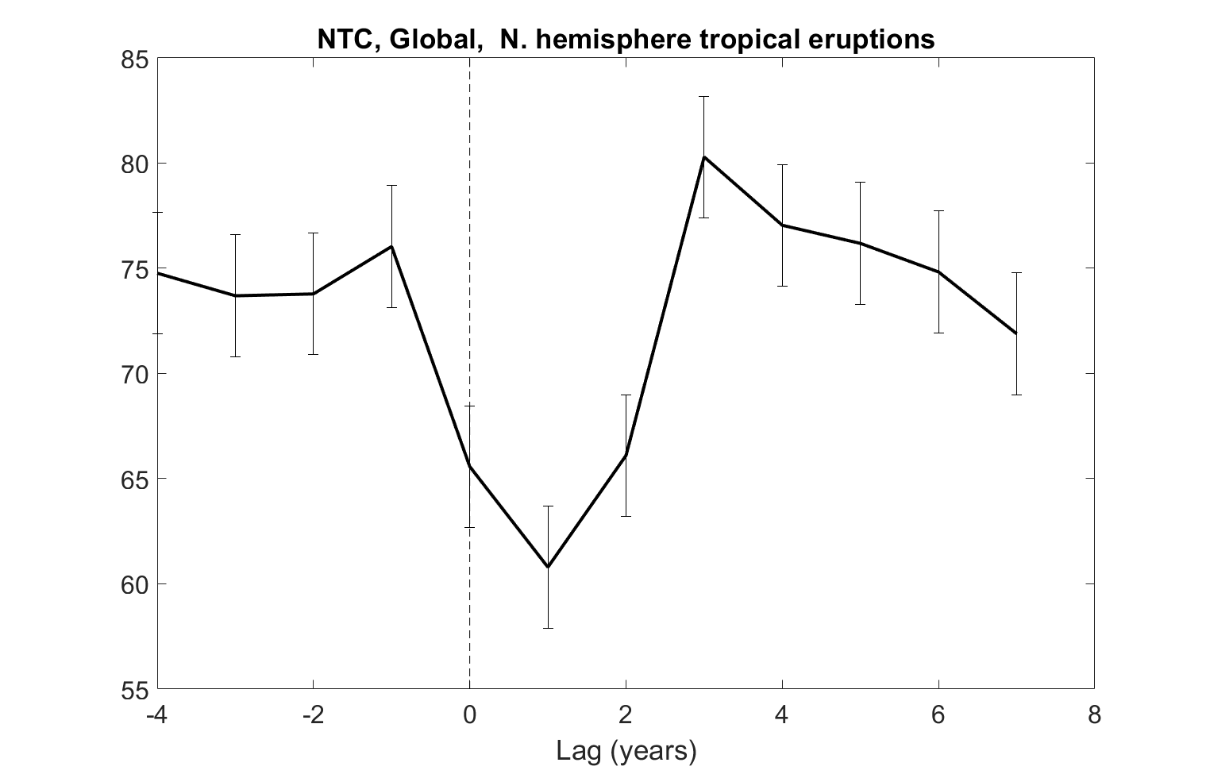
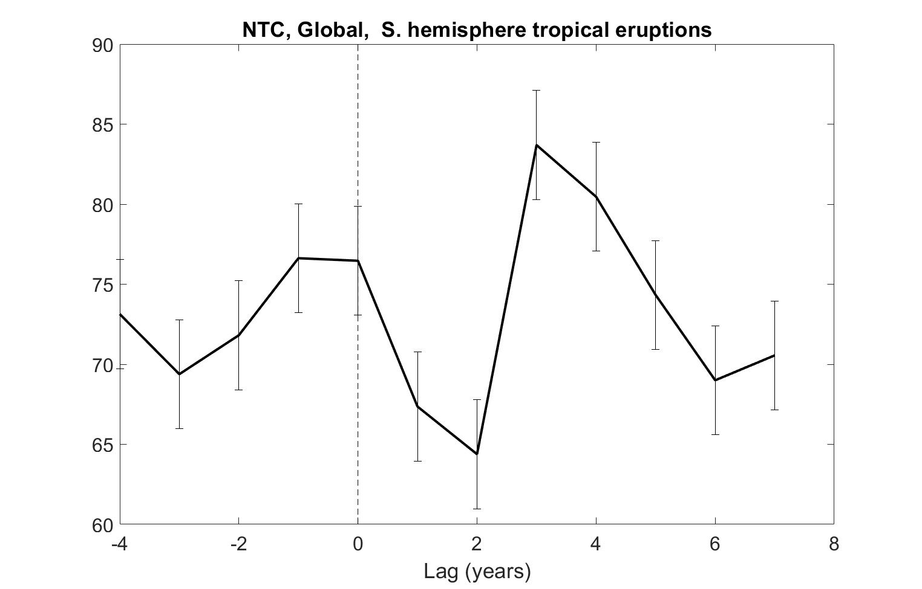
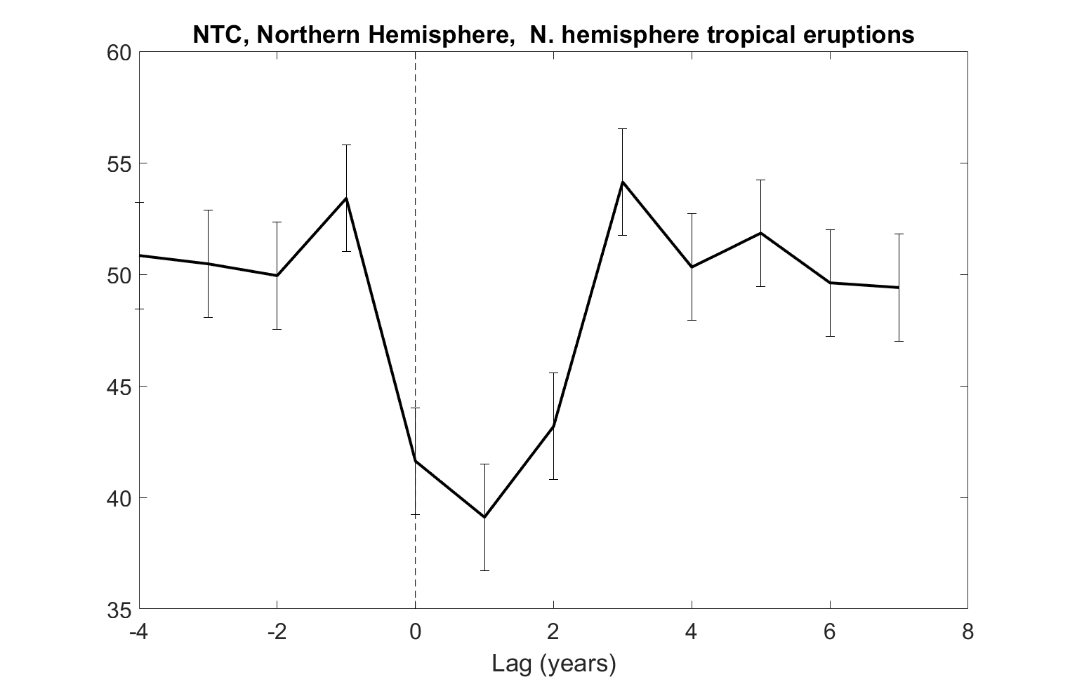
Annual Frequency

Slide 45
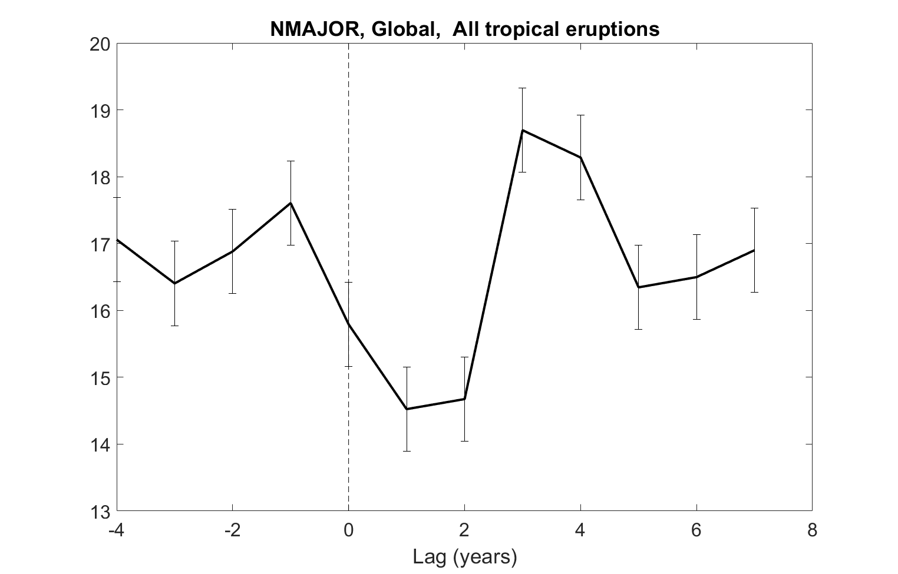
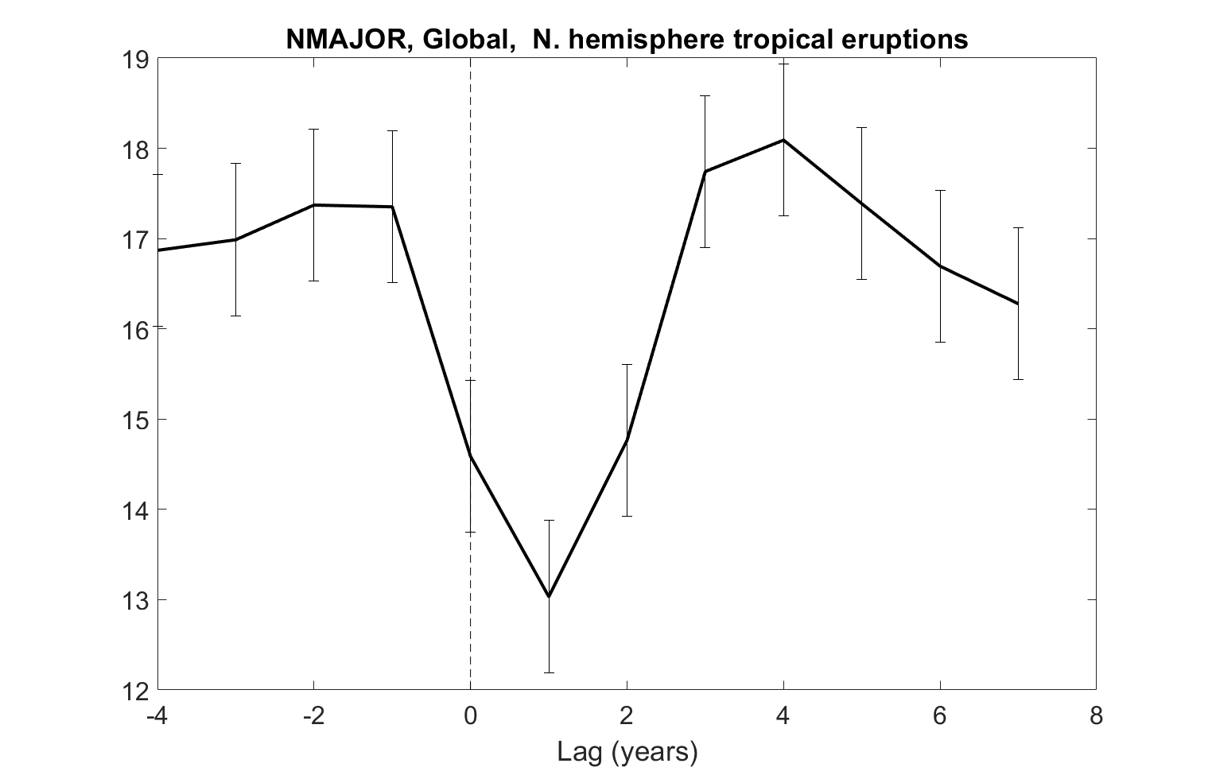
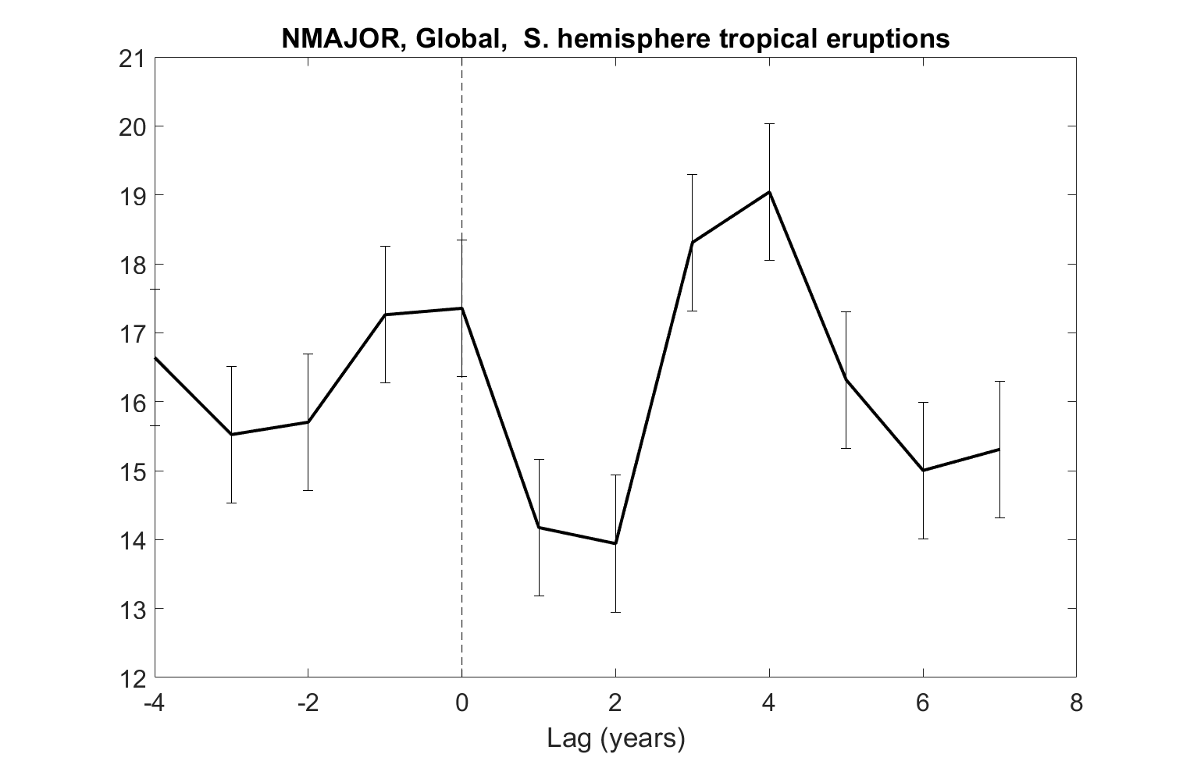
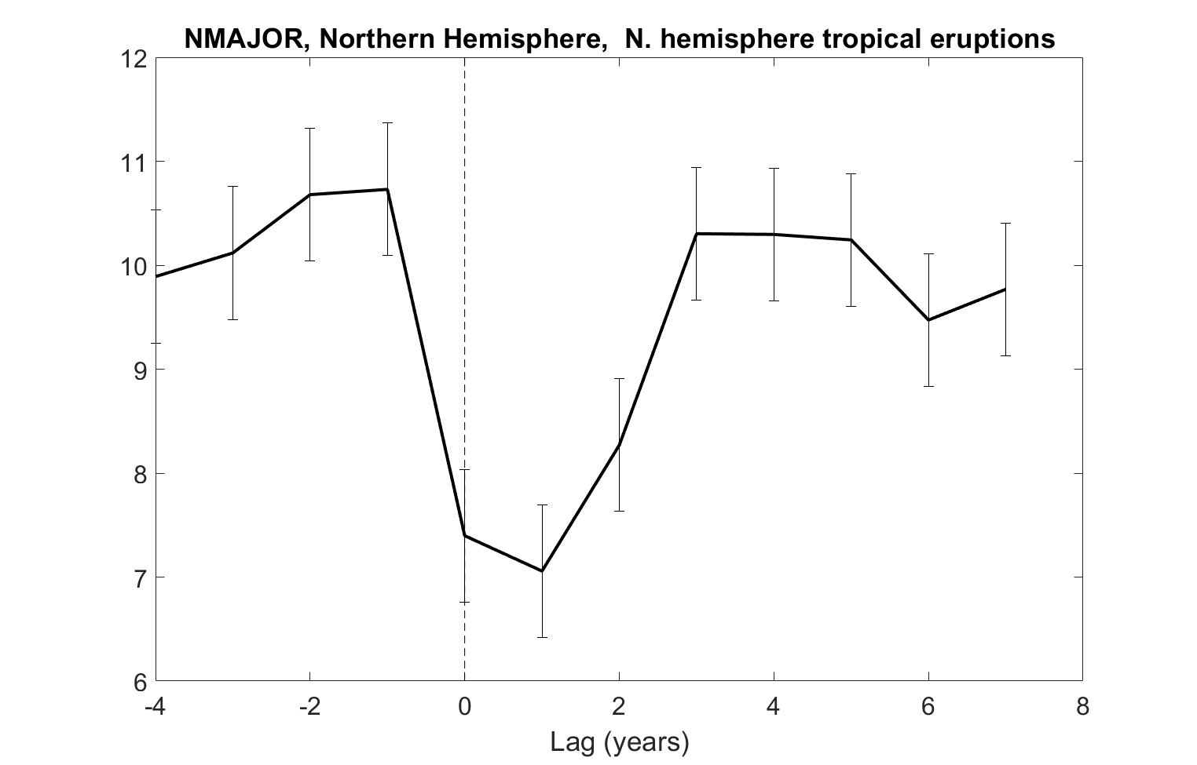
Frequency of Major Hurricanes

Slide 46
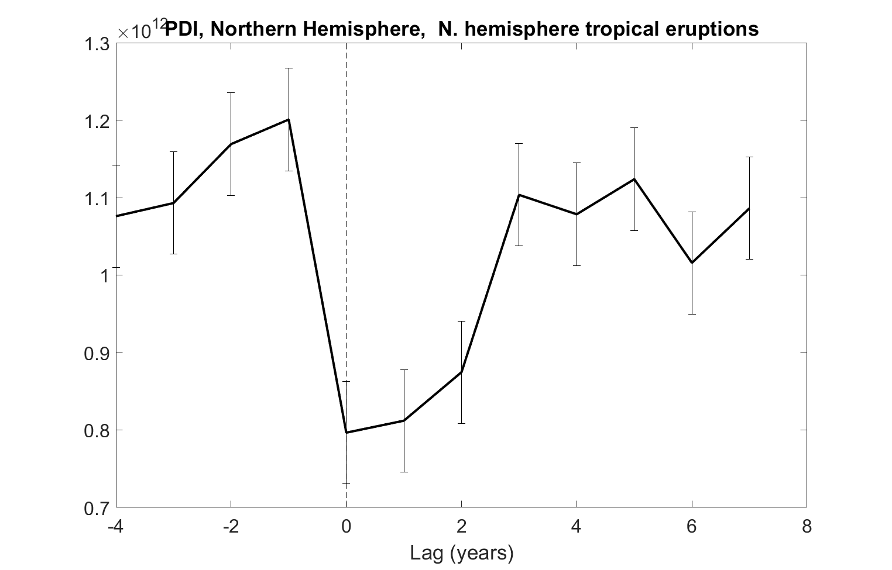
Power Dissipation Index

Slide 47
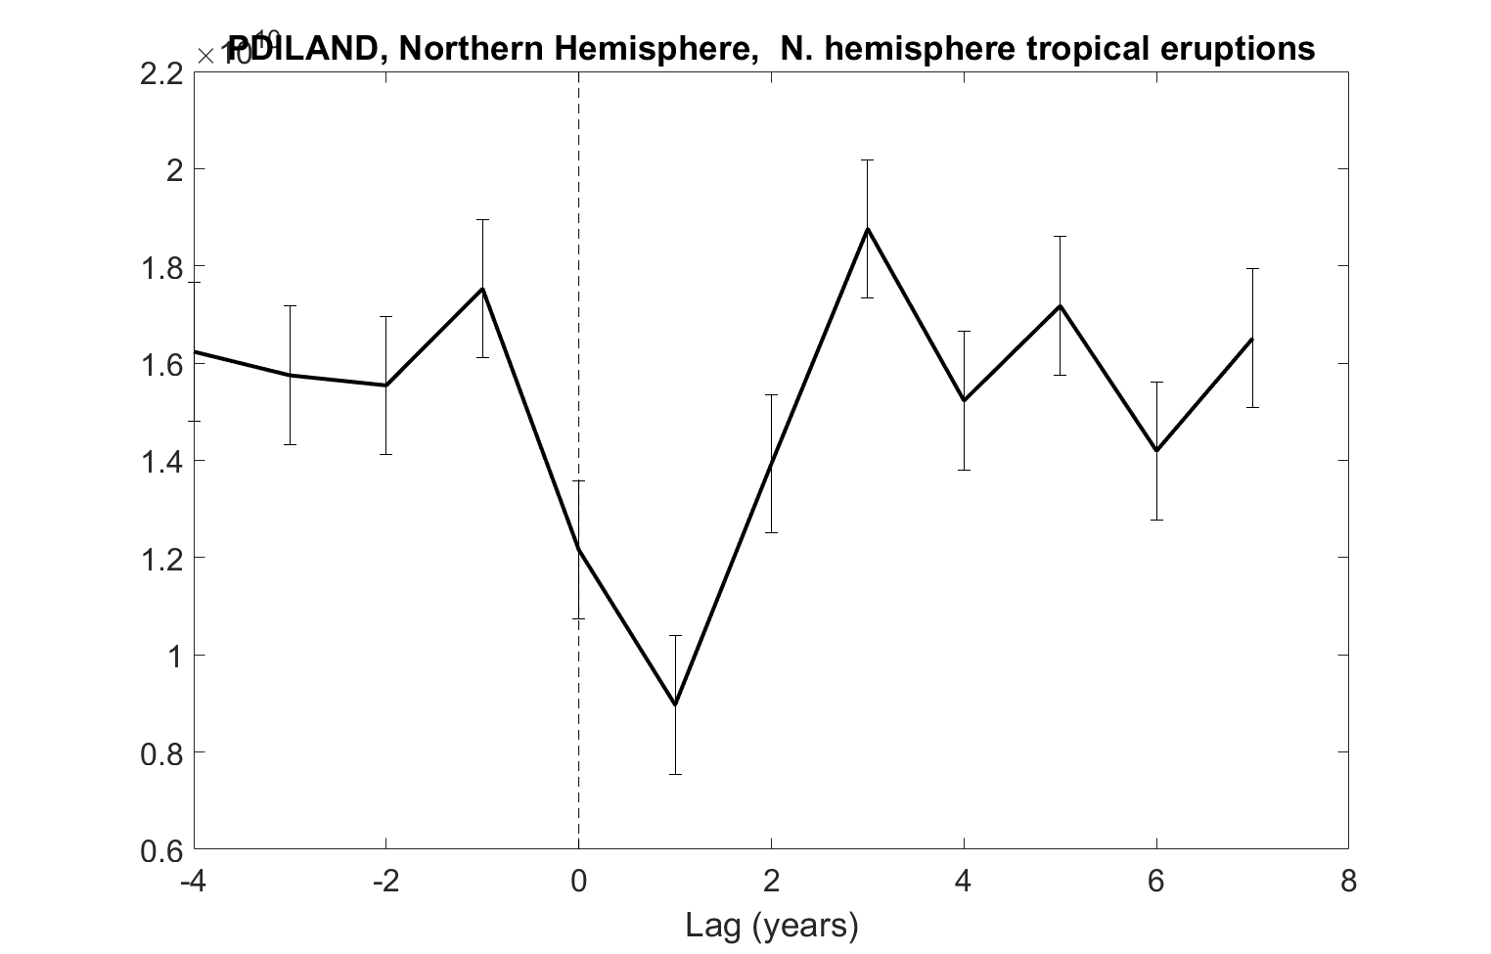
Power Dissipation at Landfall

Slide 48
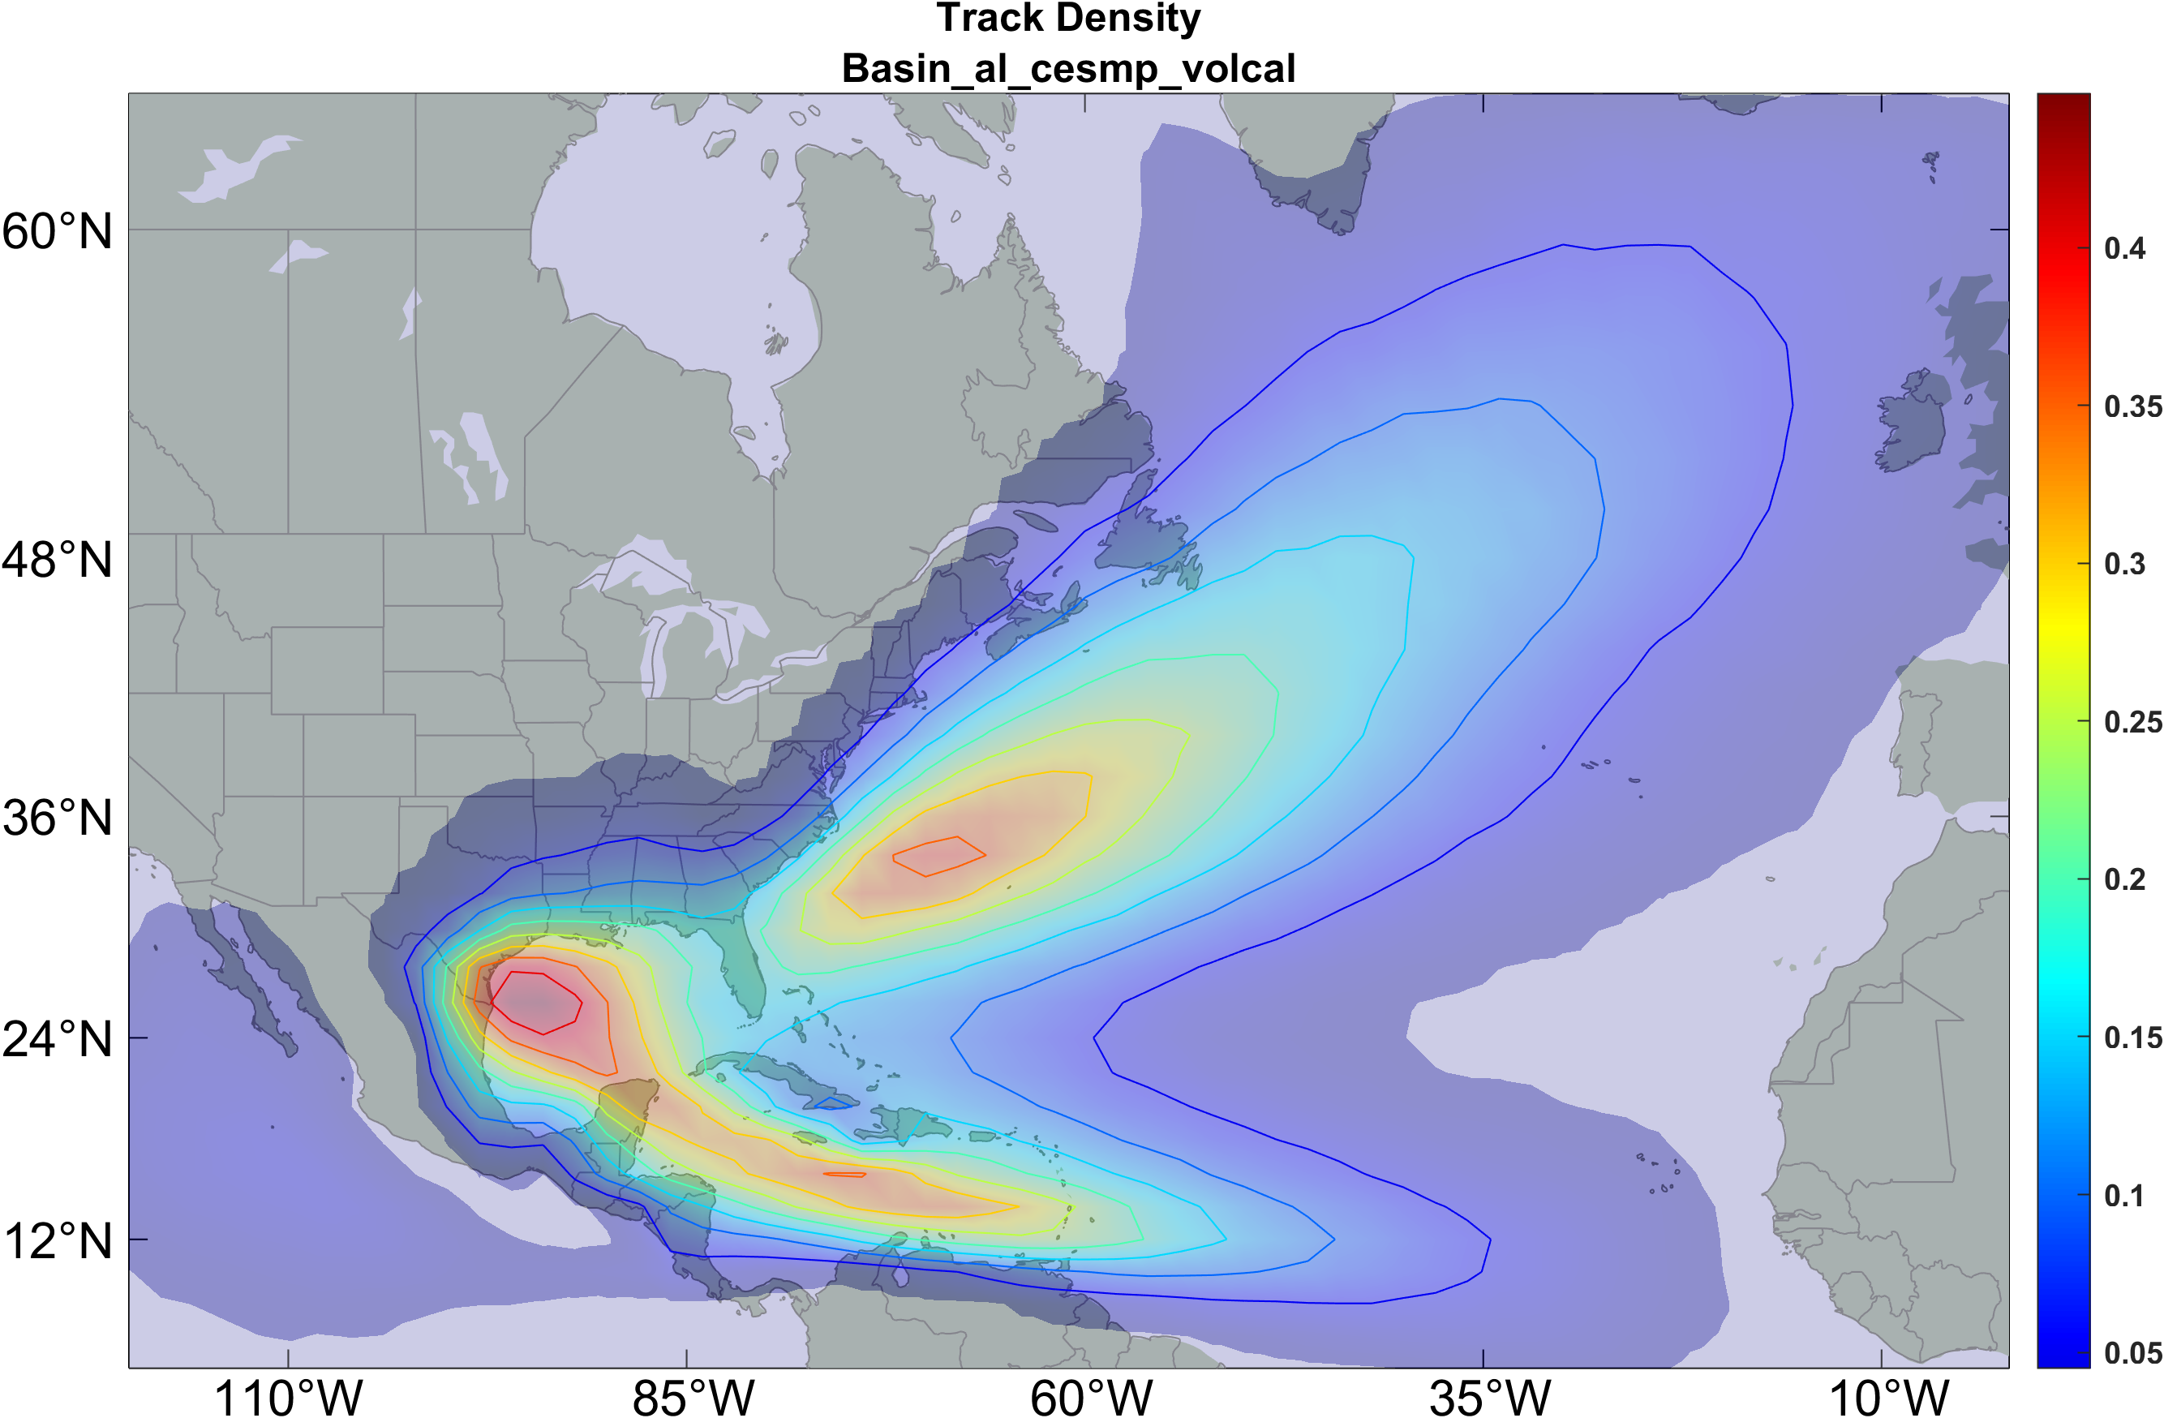
Track Density, All Years

Slide 49
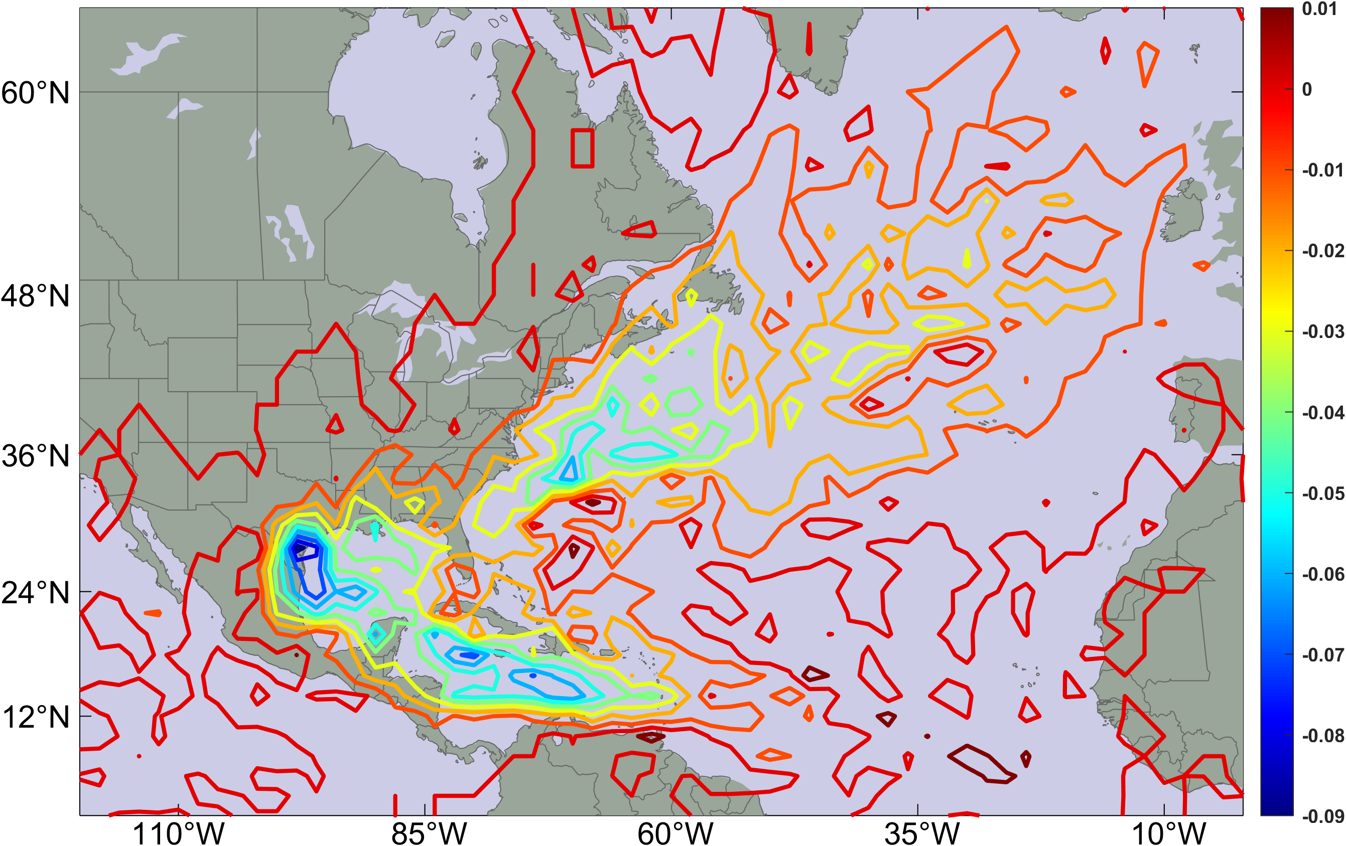
Composite Difference in Track Density, 1 year after eruptions, minus all events

Slide 50
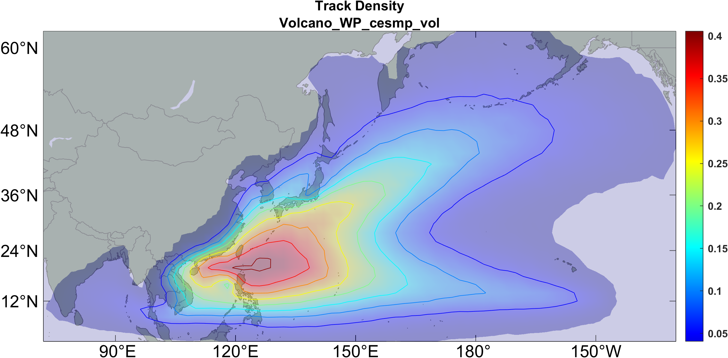
Track Density, All Years

Slide 51
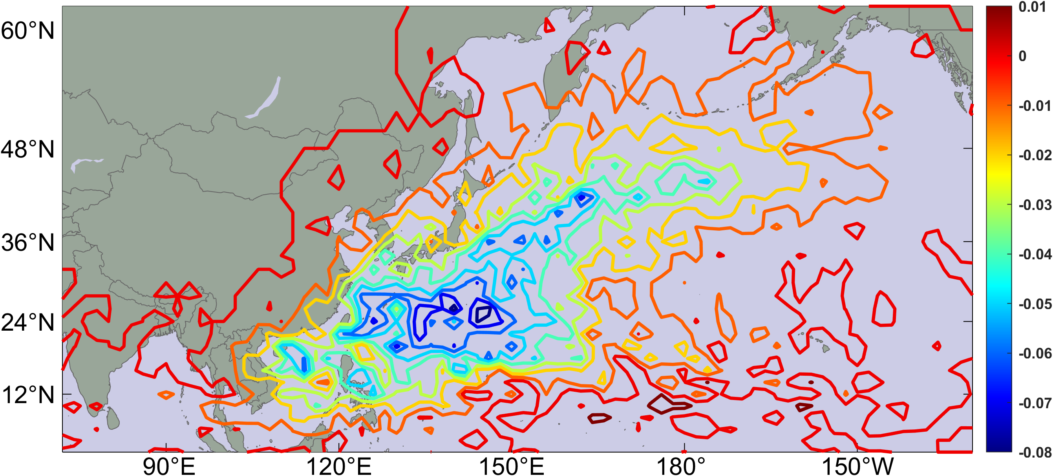
Composite Difference in Track Density, 1 year after eruptions, minus all events

Slide 52
Summary
Large volcanic eruptions inject aerosols into the lower stratosphere, heating it while cooling the surface and troposphere
Both these effects lower tropical cyclone potential intensity
Potential intensity reaches a minimum the year of or the year after eruptions, dropping about 4%. (Would be good to resolve this on a monthly time scale

Slide 53
Genesis potential index also reaches minimum the year of or the year after eruptions, dropping about 15%.
Decline of GPI driven by potential intensity (including increase in outflow temperature) and increasing shear, but opposed by declining mid-level saturation deficit
Effects most noticeable in northern hemisphere eruptions affecting northern hemisphere TCs and large-scale predictors

Slide 54
Consistent with decline in GPI, TC frequency declines after composite eruption, by about 25%
Power dissipation declines by more than 30%, implying that both intensity and frequency decrease
Changes in track density mostly reflect decline in frequency rather that shifts in track locations
Most, if not all, signals that are statistically significant in composite are not significant in individual events, limiting practical utility of the relationship between volcanoes and TCs

Slide 55
Up Next:
History of the Scientific Understanding of Hurricanes
Tropical Cyclone Physics, Part I
Tropical Cyclone Physics, Part II
Using Physics to Catalyze Climate Action, Part I
Using Physics to Catalyze Climate Action, Part II

