Slide 1

Using Physics to Catalyze Climate Action, Part I
Kerry Emanuel
Lorenz Center, PAOC

Slide 2
Program
The policy problem
The technical problem
A physically based hazard model
Catalyzing action through free markets

Slide 3
Program
The policy problem
The technical problem
A physically based hazard model
Catalyzing action through free markets

Slide 4
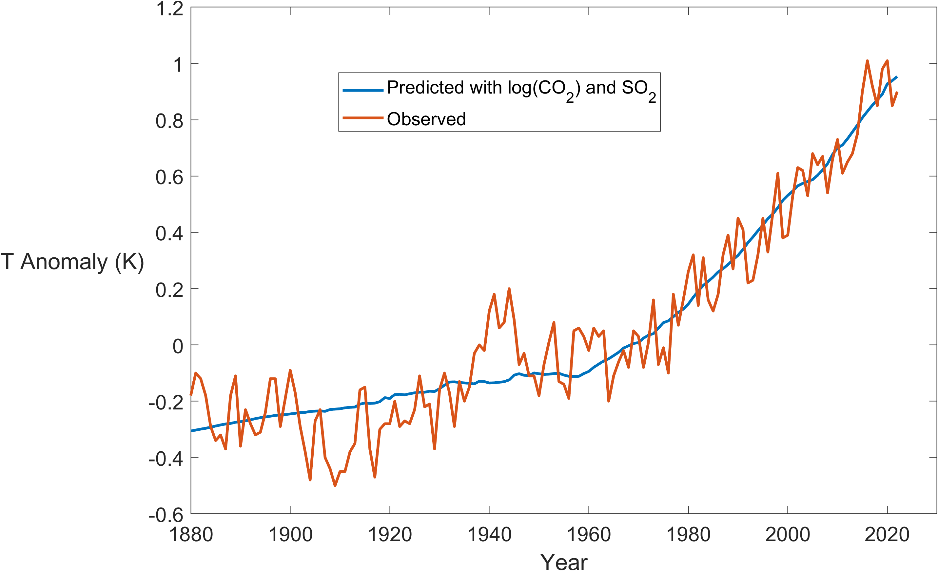
Global Mean Temperature Predicted by CO₂ and SO₂
r=0.95

Slide 5
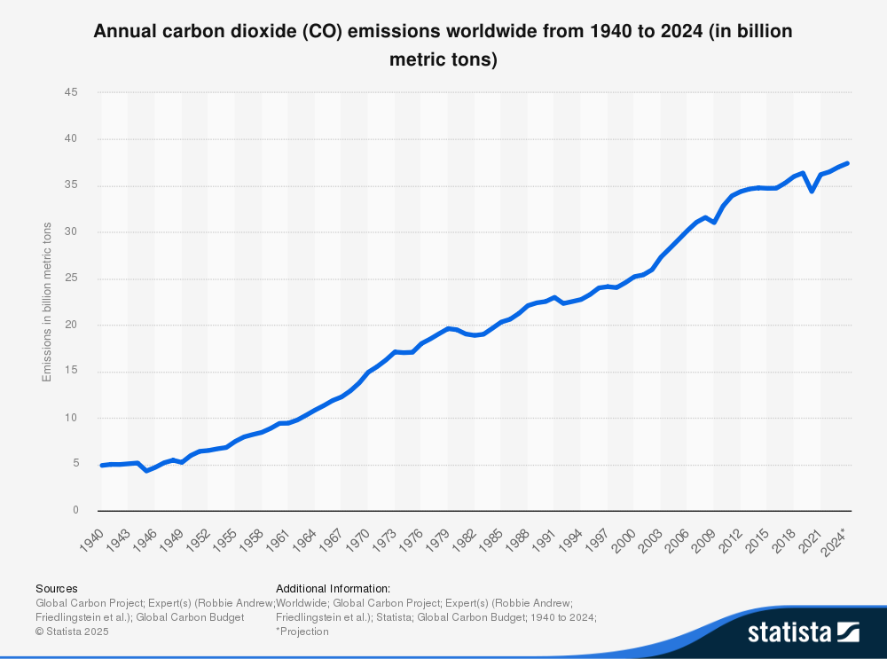
Despite wide publicity of climate risk and large subsidies for renewables, carbon emissions continue to climb

Slide 6
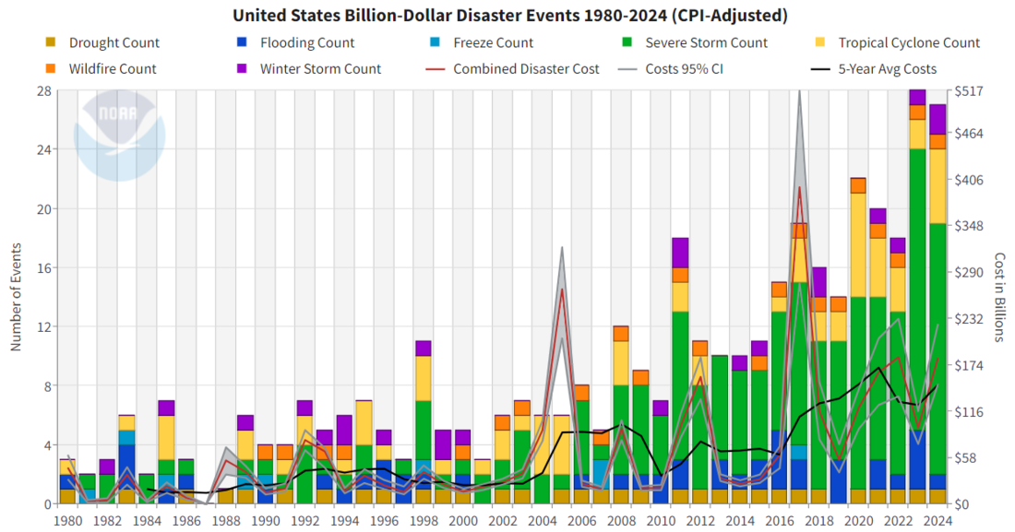
Damages from Natural Disasters are Increasing
Source: National Oceanic and Atmospheric Administration (NOAA)

Slide 7
Global Damage Normalized by Gross World Product
Storms, droughts, floods, wildfires
EM-DAT, 2024: The OFDA/CRED International Disaster Database
http://www.emdat.be/.

Slide 9
People are migrating from relatively safe places to dangerous ones. WHY?

Slide 10
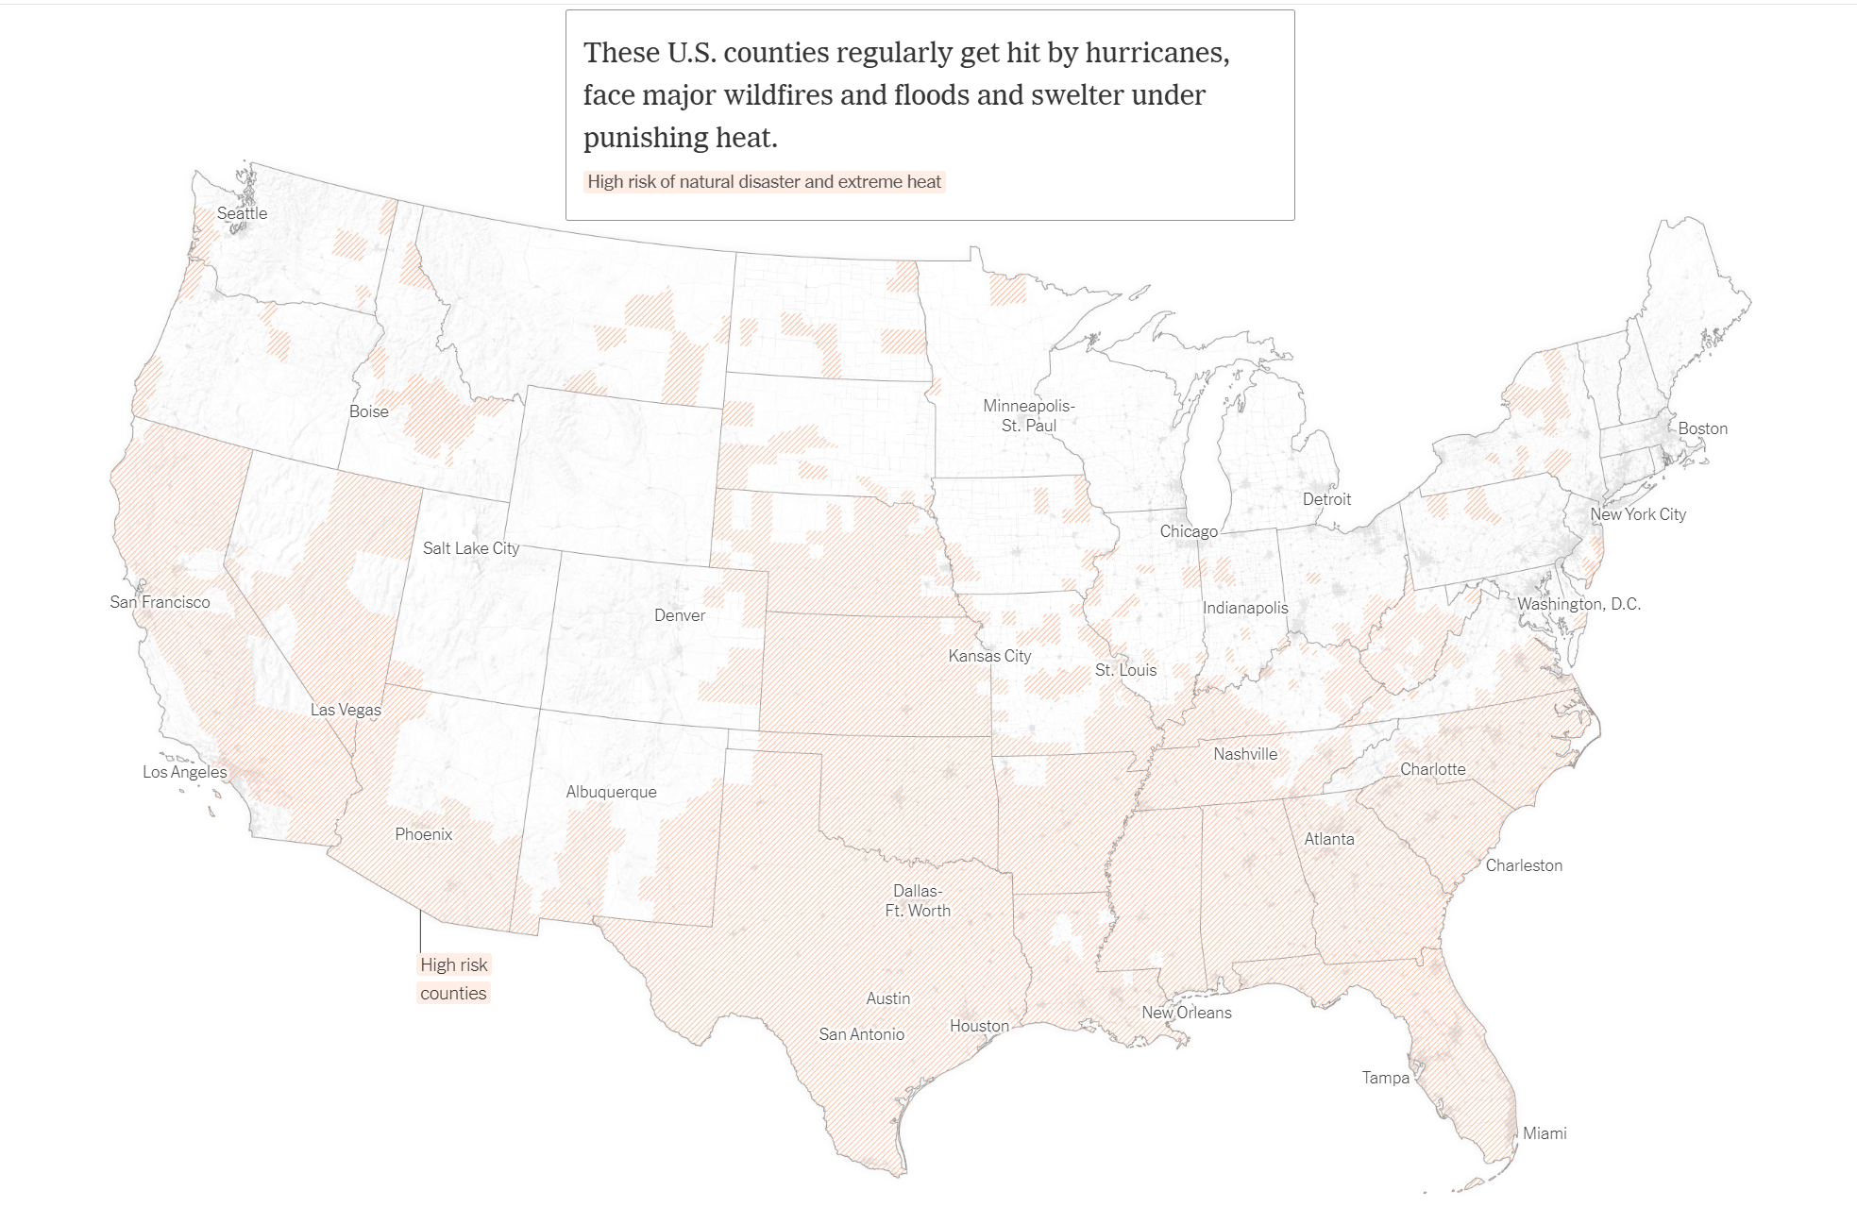
Source: New York Times

Slide 12
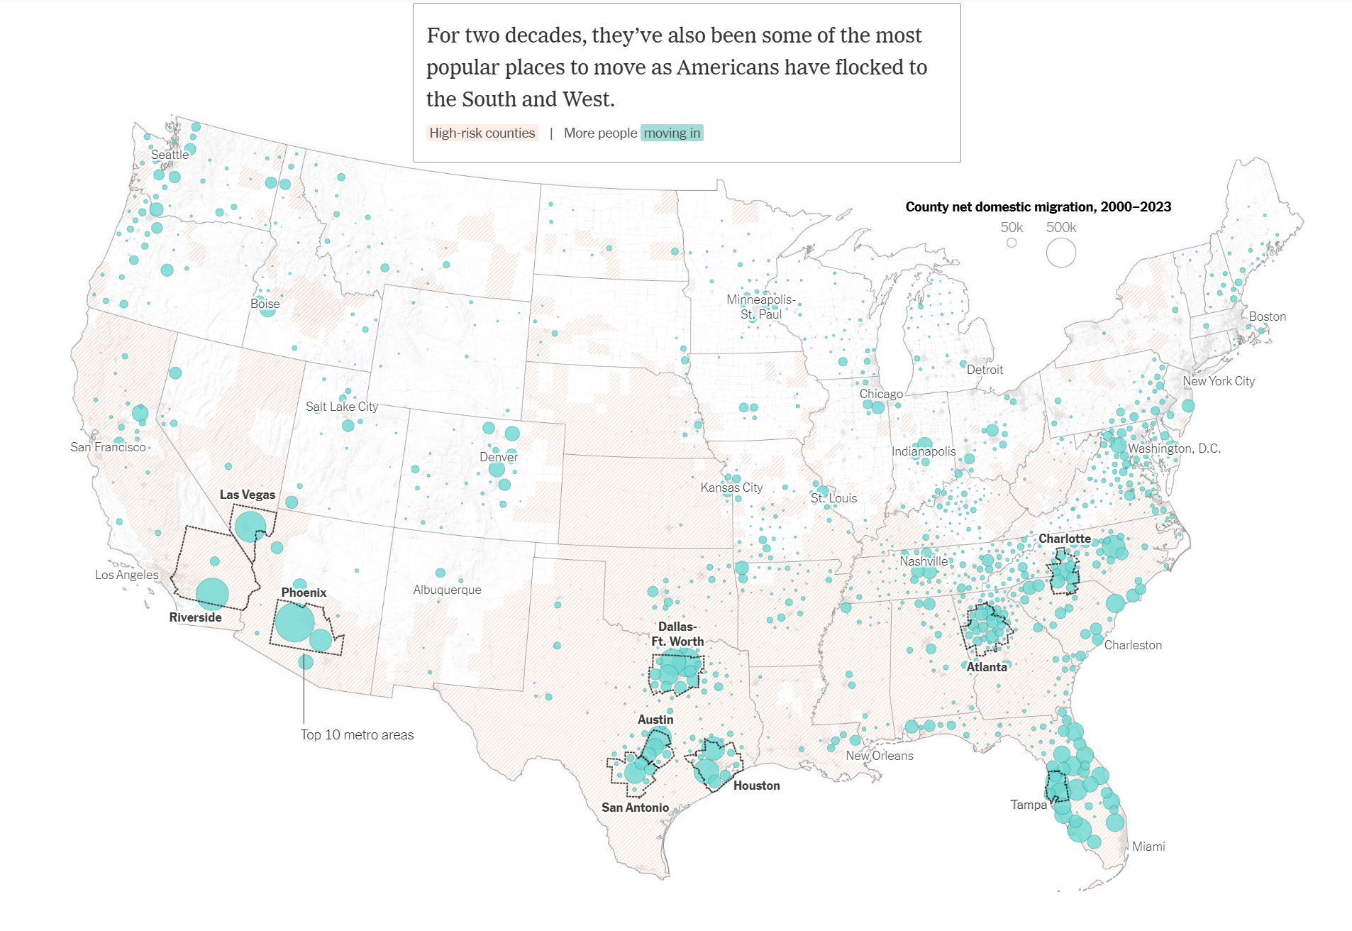
Source: New York Times

Slide 13
Here is why we move to more dangerous places:
All water damage is insured by the federal government through the National Flood Insurance Program (NFIP)
Political pressure forces rates to be artificially low in risky places and too high in safe places
Insurance is regulated by individual states through insurance commissioners
Regulation was put in place to ensure solvency but long ago became captive to special interests
State insurance commissioners routinely cap insurance premiums in risky areas, such as coastal regions

Slide 16
First Street Foundation

Slide 17
First Street Foundation

Slide 18
SFHA=special flood hazard area
Whose paying for this?
Kansas!
Courtesy First Street Foundation

Slide 19
Courtesy First Street Foundation

Slide 22
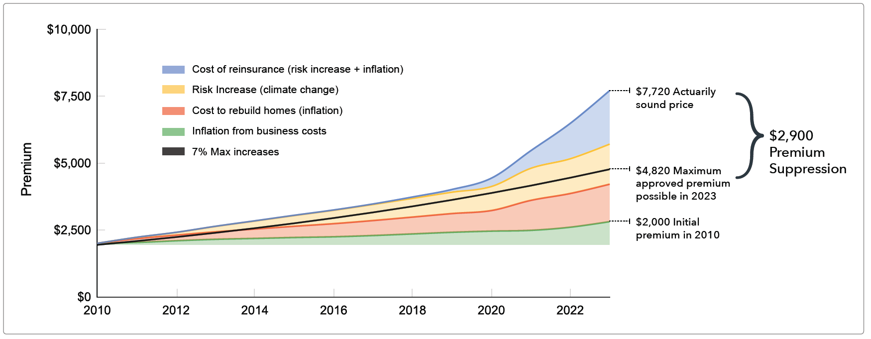
Under political pressure, state insurance commissioners (some of whom are elected) place caps on private insurance premiums, forcing the firms to lose money
Insurance premiums in California
The result: Massive exodus of insurance companies from California, including State Farm, Allstate, Farmers, American National, Chubb, and Tokio Marine

Slide 23
Private insurance has become large unprofitable
U.S. Homeowners insurance annual combined ratio

Slide 24
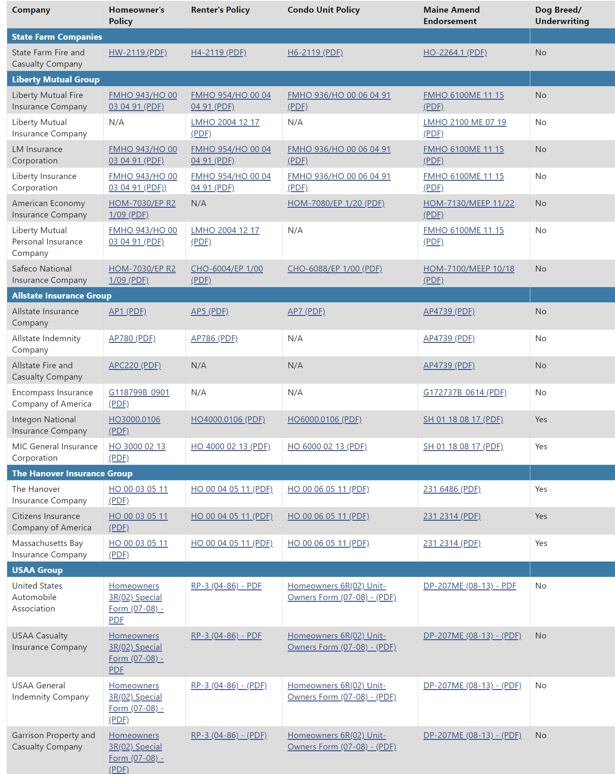

But private insurance is highly competitive; its premiums do not need to be regulated
Homeowner’s Insurance Companies Doing Business in Maine (2025)
Source: State of Maine Bureau of Insurance

Slide 25
What A Mess
National Flood Insurance has been captured by special interests in risky places, holding down premiums there, with premiums too high in less risky areas
State regulation of private insurance has capped premiums in risky places, causing insolvency in direct contradiction to its mandate
We are paying folks to move to and develop risk- prone regions
This is driving up damages, with climate change acting as a large threat multiplier

Slide 26
Consequences
We have inadvertently encouraged a massive migration from safer to riskier places by preventing insurance from communicating risk
Relatively poor people are paying the insurance bills of relatively wealthy people
Damages are soaring, amplified by climate change
We are insulating wealthier and more politically influential people from climate change and reducing their incentive to do something about it

Slide 27
Program
The policy problem
The technical problem
A physically based hazard model
Catalyzing action through free markets

Slide 28
Flawed Basis of Current Risk Modeling
Almost all current risk assessments are based on historical statistics
Historical records are flawed and too short (stay tuned) to assess key statistics, like average annual loss
Moreover, the past 50-150 years is a poor guide to the present owing to climate change that has already occurred
We need to bring physics to bear on weather hazard risk
CAT modeling industry has been slow to migrate to a physics-based approach
Weather researchers should consider getting more involved in physical modeling of weather risk

Slide 29
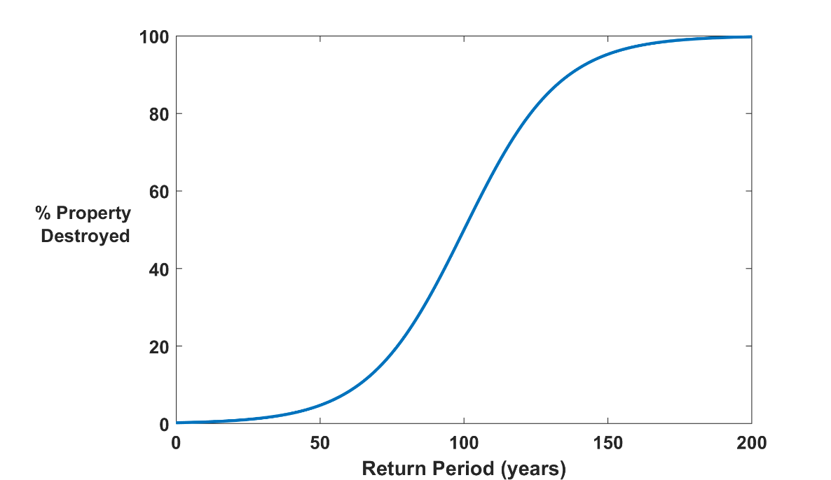

Why Climate Risk is Dominated by Extreme Events:
Societies are usually well adapted to frequent events (> 1/100 yr)
Societies are often poorly adapted to rare events (< 1/100 yr)
Large cost increases result when > 100-yr events become < 100-yr events
Largest slope

Slide 30
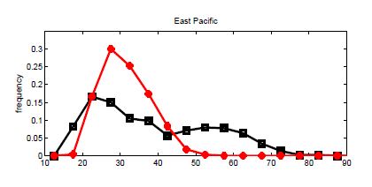
Modeling risk: Today’s global climate models are far too coarse to simulate destructive hurricanes
Histograms of Tropical Cyclone Intensity as Simulated by a Global Model with 50 km grid point spacing. (Courtesy Isaac Held, GFDL)
Category 3
Modeled
Observed
Global models do not simulate the storms that cause destruction
Wind Speed (meters per second)
Detailed, high-resolution modeling suggests grid spacing of no more than 3 km required
HighResMip: Grid spacings of 20-200 km (NICAM has short run at 14 km)
We need high resolution and O(1000 yr) simulations

Slide 31
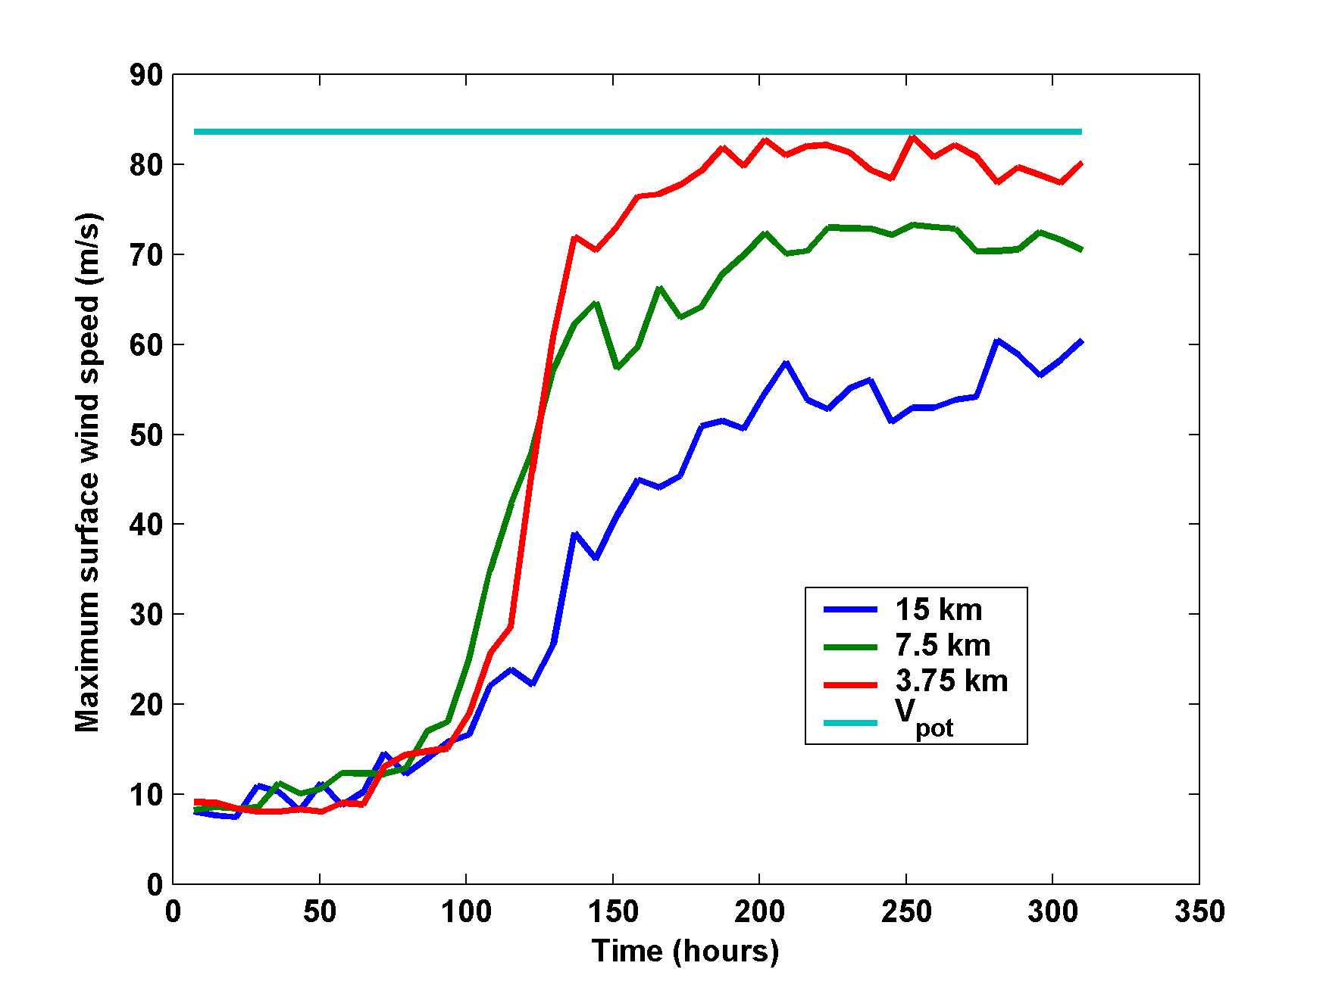
What it Takes to Simulate a Hurricane Accurately
Horizontal distance between computational nodes
Typical Climate Model Grid spacings: of 50-200 km

Slide 32
The TC Hurricane Hazard Model (TCHM)

Slide 33
Reanalysis and Global Model Input Data
The TCHM is driven by time-evolving global gridded data from reanalyses and climate models
NO historical hurricane data are used
This data consists of monthly mean quantities for each year in the data set. Each year is unique: For example, August of 1979 differs from August of 1980
The input data can be divided into thermodynamic and kinematic quantities, and are treated differently

Slide 34
Input Data
Thermodynamic
Potential Intensity (function of sea surface and tropospheric temperatures)
Thermodynamic resistance (required by intensity model; function of sea surface temperature and 600 hPa temperature and humidity)
Note: This is NOT a choice. It is what is demanded by the deterministic intensity model.

Slide 35
Input Data (continue)
Kinematic
First, daily winds at 850 and 250 hPa are used to calculate monthly mean winds and monthly mean covariances among the 4 wind components (two components at each of two levels)
These are then used to synthesize times series of wind at the two levels, representing them as Fourier series in time with random phase. For example, the zonal wind at 250 hPa is represented as
where t is a fast time scale and τ represents the month-to- month variability, and

Slide 36
Four Essential Components:
Genesis Module
Track Module
Intensity Module
Wind Field Module

Slide 37
Genesis
Place tropical cyclone “seeds” randomly in space and time
Seeds are warm core vortices with peak winds of 12 ms⁻¹
We save time by not seeding over land or where a genesis index falls below a threshold
We do not seed near the equator
Survival of seeds depends on intensity module

Slide 38
Track
TCs are assumed to move with a weighted average of the (synthesized) flow plus two corrections:
where the weights are given by
and the “beta drift”, V_{β}, is given by
with θ being the latitude.

Slide 39
Track (continued)
Finally, the “shear drift” term is given by

Slide 40
Intensity
Intensity is calculated along each track using the fully deterministic “Coupled Hurricane Intensity Prediction System” (CHIPS), used to forecast real tropical cyclones in real time.
Model is axisymmetric with parameterized shear effects and coupled to a one-dimensional ocean model that captures feedback effect of mixing of cold water to the surface.
Model is phrase in a coordinate system whose radial coordinate is proportional to the square root of the angular momentum:

Slide 41
Intensity (continued)
Intensity sensitive to surface drag and heat flux coefficients
These are a function of surface roughness over land and surface wind speed over water
If seed intensity does not exceed a prescribed threshold after 2 days, the seed is terminated
Genesis + intensity modules amount to a natural selection algorithm
Tracks are terminated when the circular wind speed falls below a prescribed threshold, or the maximum surface wind falls below another threshold, whichever comes first

Slide 42
Wind Field
Output of the TCHM consists of maximum surface wind speed, radius of maximum winds, center latitude and longitude, date and time, and several environmental parameters, every 2 hours
To this output we fit a surface wind profile based on theory but slightly modified empirically

Slide 43
Wind Field (continued)
To this circularly symmetric wind we add asymmetries based on background flow and shear.
This allows us to calculate the (time-evolving) wind at any point in space

Slide 44
Performance

Slide 45
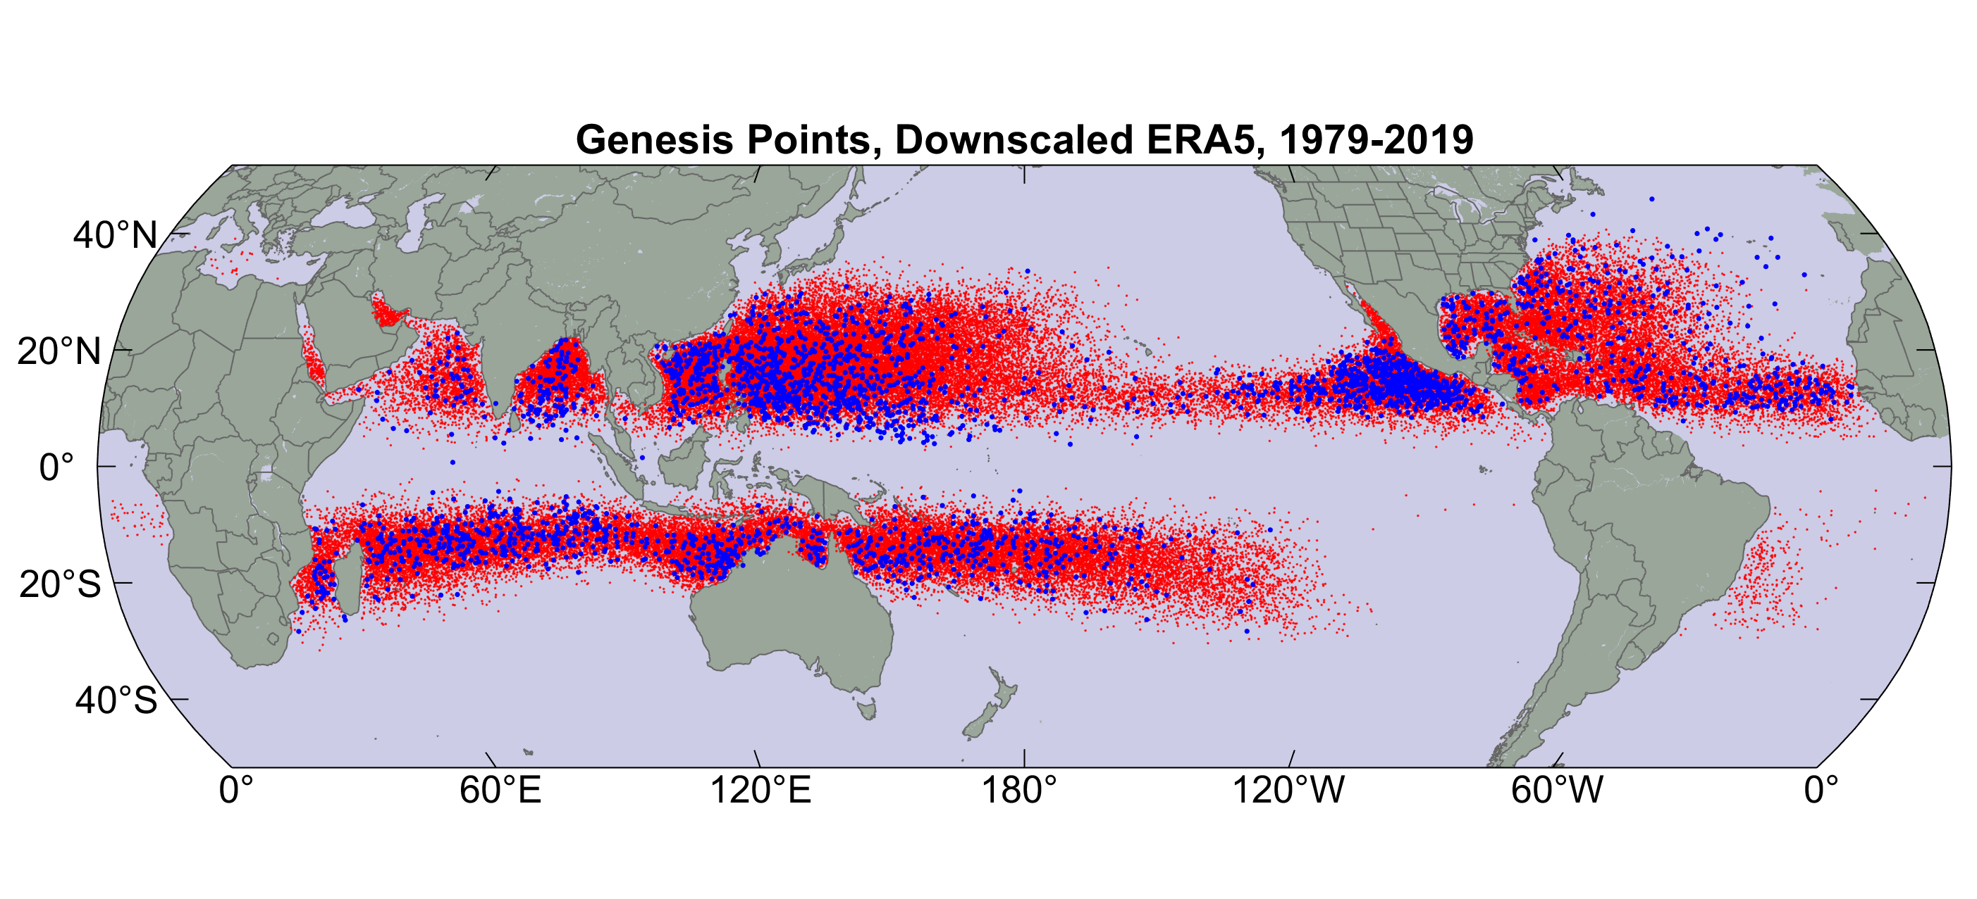
Genesis
Origin points of successful seeds (red); observed genesis locations (blue)

Slide 46
Bad!

Slide 47
With easterly wave seeding in far eastern North Pacific and North Atlantic

Slide 48
Tracks

Slide 49
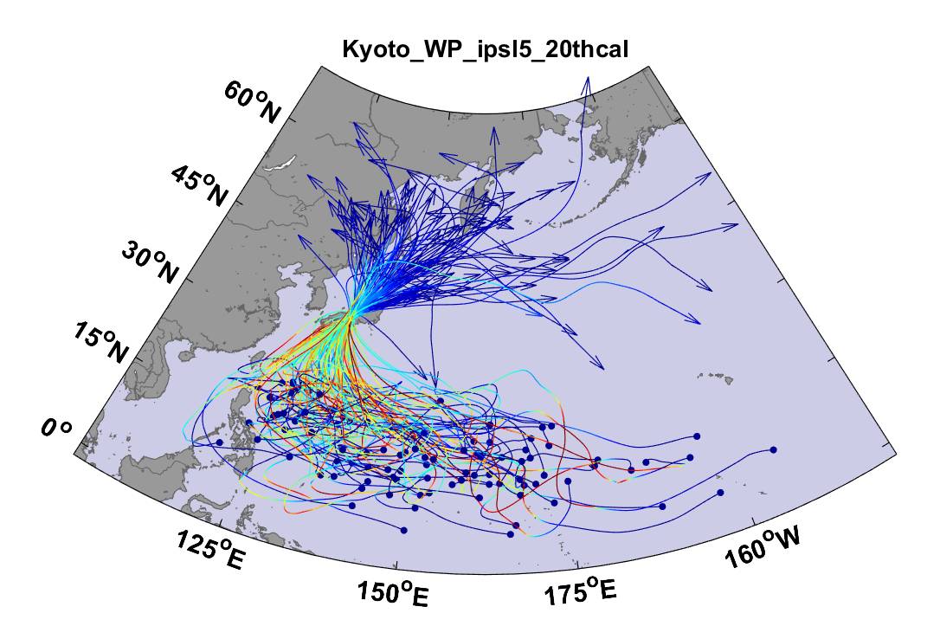
Example:
Top 100 out of 2000 TCs Affecting Kyoto, 1981-2000

Slide 50
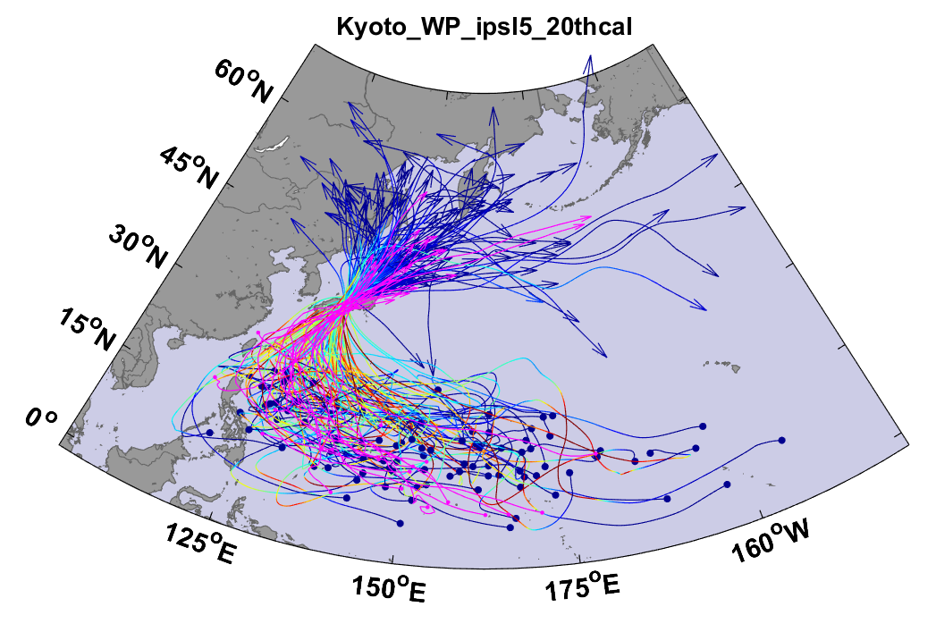
Same, but with top 20 historical tracks

Slide 51
Intensity

Slide 53
Secondary Eyewalls

Slide 56
Seasonal Cycle

Slide 57
North Atlantic
Western North Pacific

Slide 58
North Atlantic Time Series

Slide 59
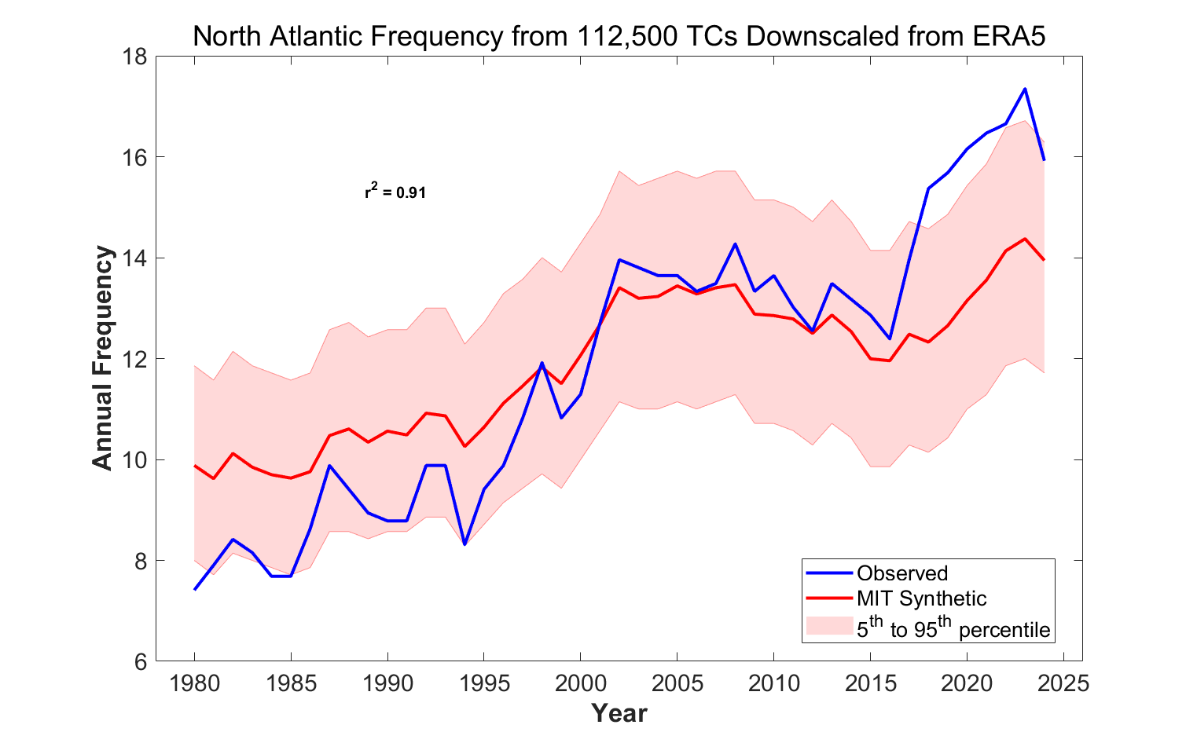

Slide 60
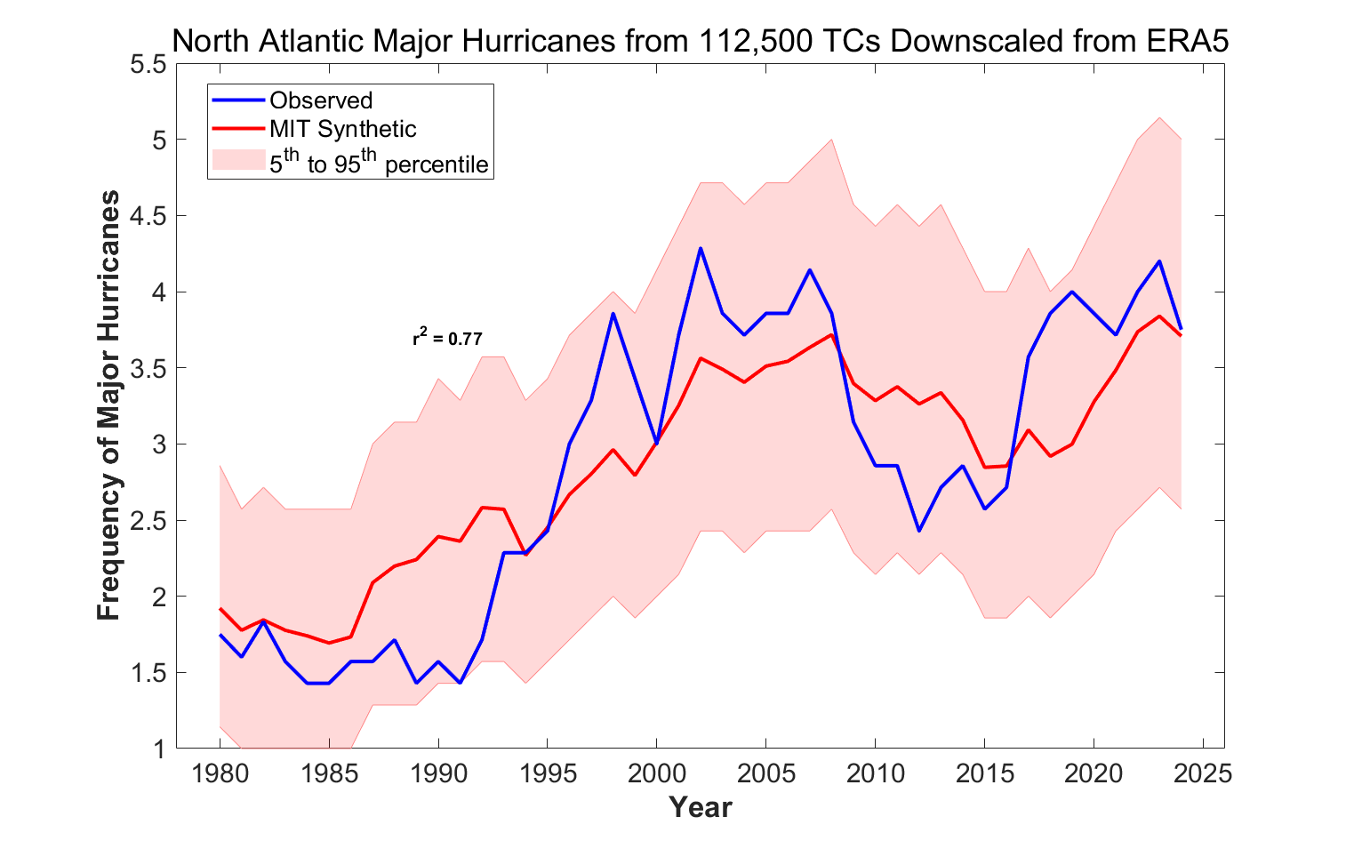

Slide 61
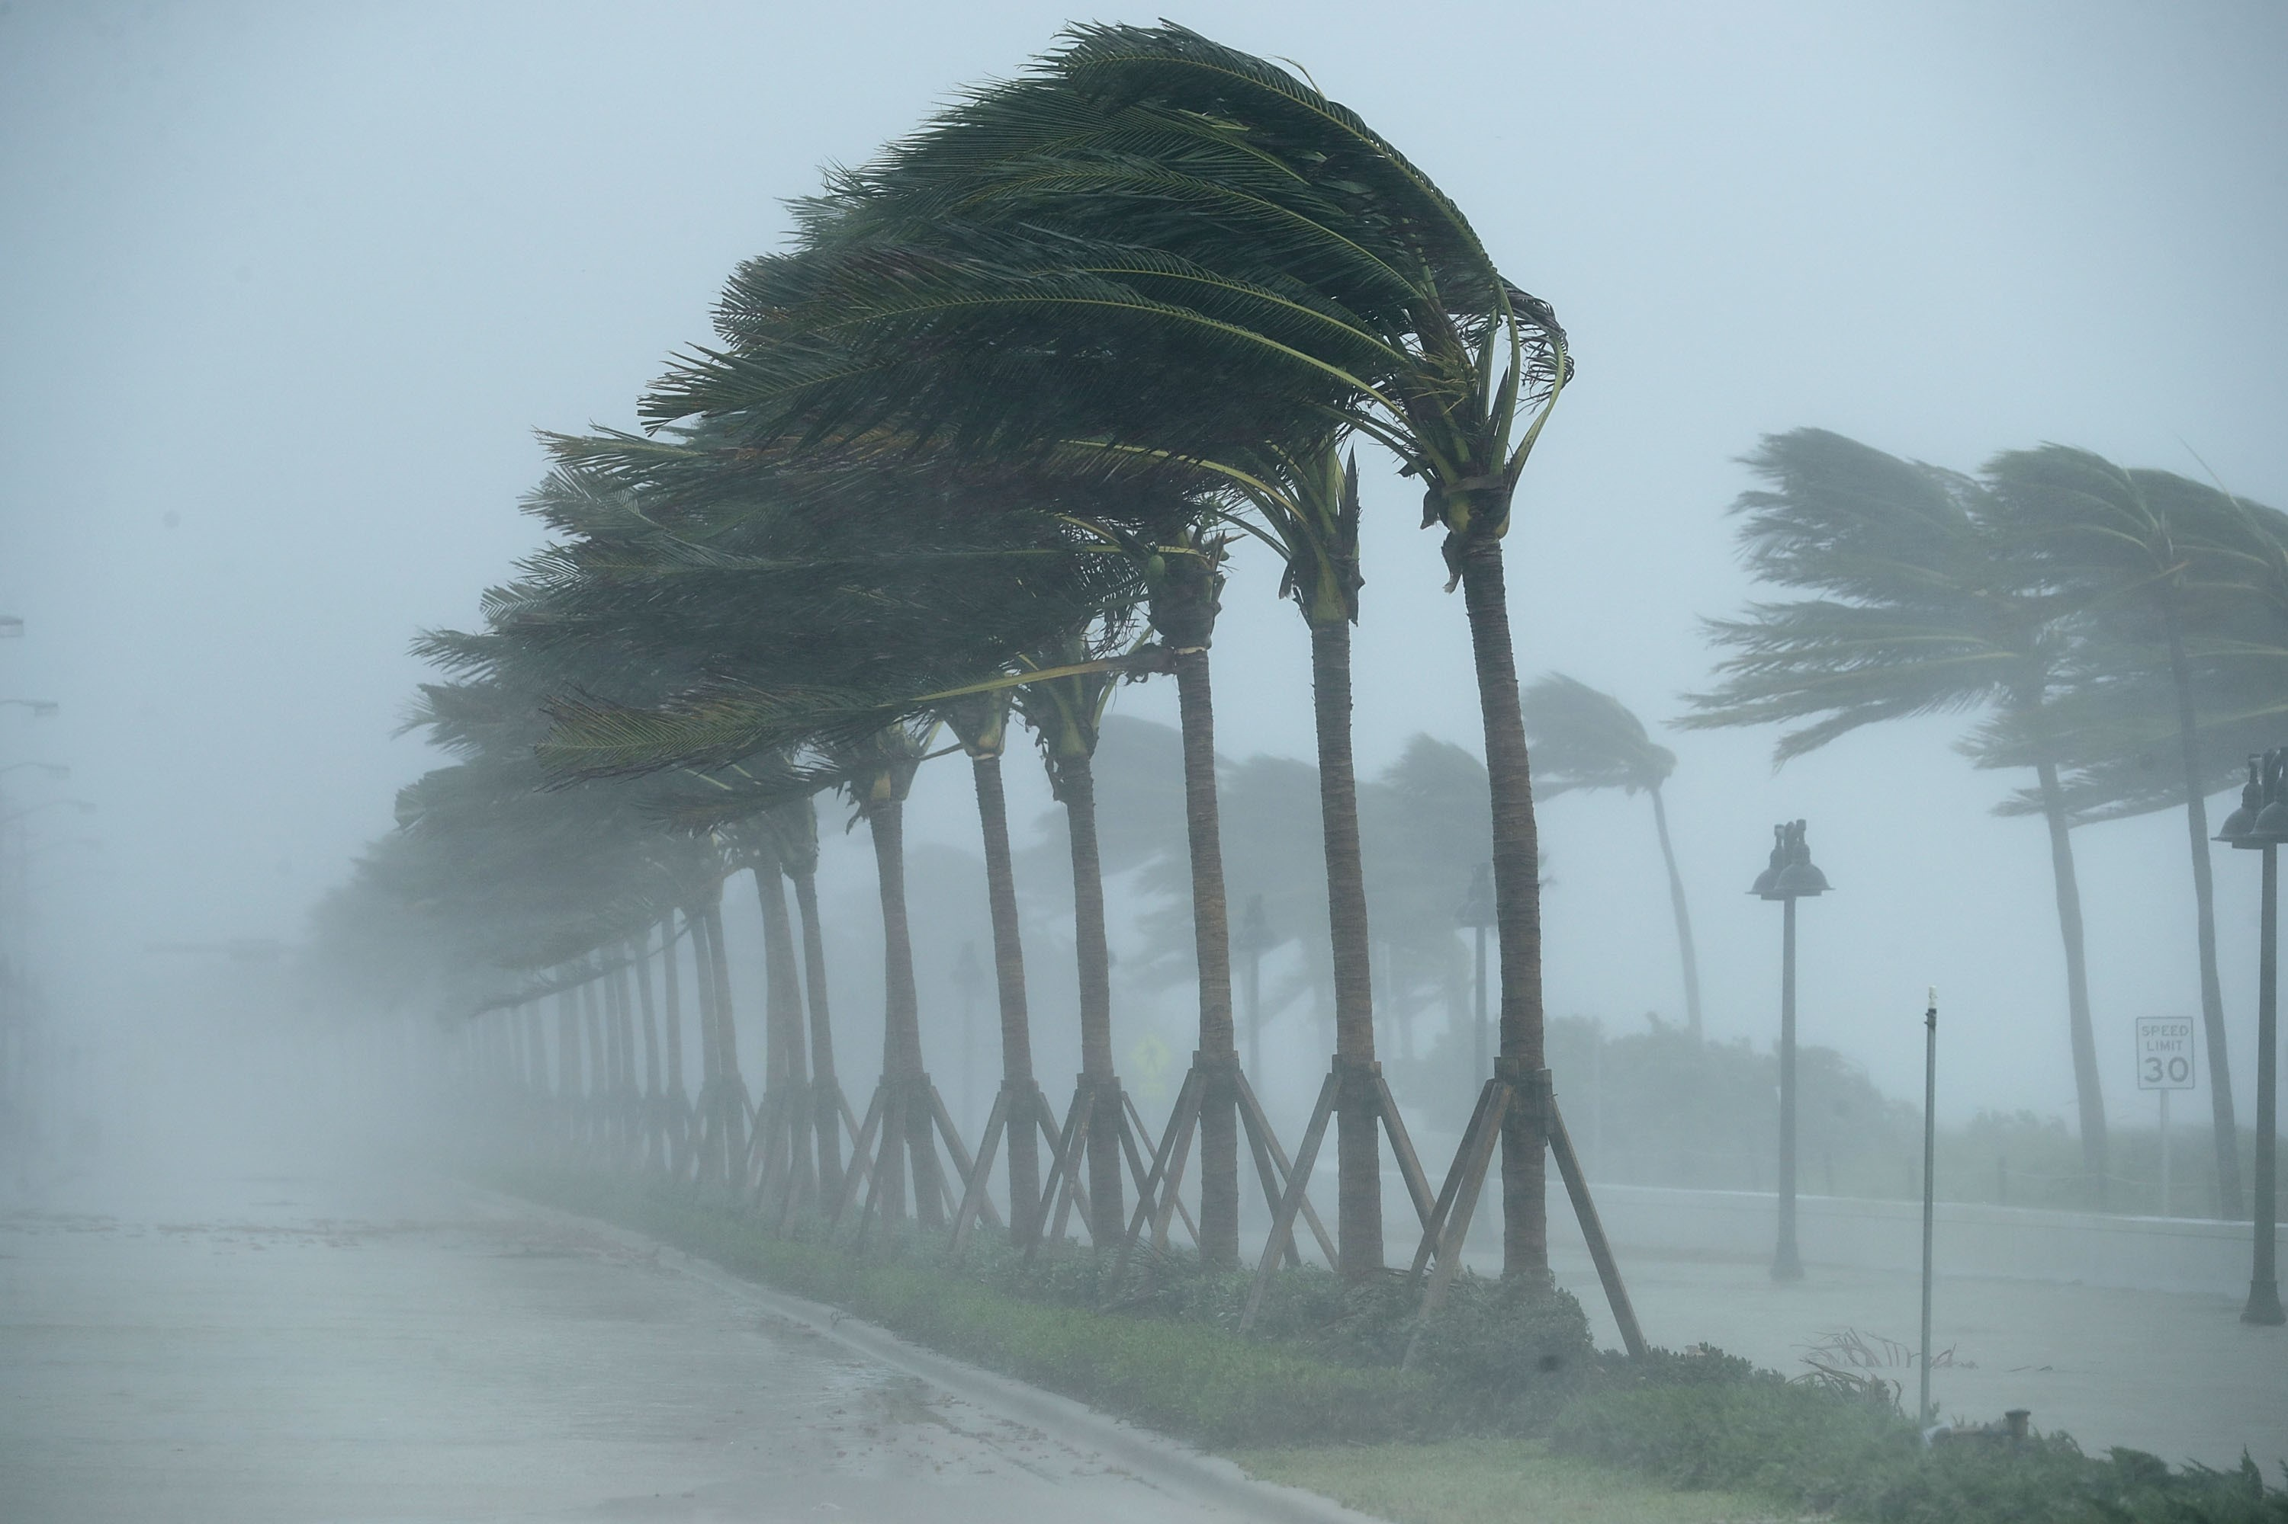
Next Up: Turning Hazard into Risk

