Slide 1
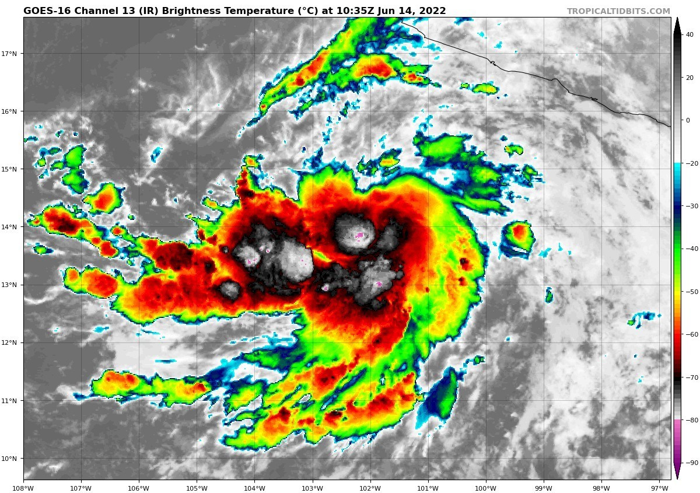
Tropical Cyclone Physics, Part II
Kerry Emanuel
Lorenz Center, PAOC

Slide 2
From last lecture: TCs as zero-SPV vortices
We can invert this to find gradient wind and other quantities subject to boundary conditions, provided hydrostatic and gradient wind balances prevail above the boundary layer

Slide 3
Invertibility can be conducted through thermal wind equation
Gradient wind:
Hydrostatic:
Eliminate φ:
Thermal wind:

Slide 4
Express the thermal wind equation in terms of the moist entropy rather than the specific volume:
Divide through by
Note that this can be integrated in pressure along M surfaces

Slide 5
We choose to integrate this down from a point along an M surface at radius r_{o} and absolute temperature T_{o} at which the azimuthal velocity, V, vanishes:
This is the invertibility relationship, and yields the shape of M surfaces as a function of T and ds*/dM², given the boundary condition that determines T_{o}. We can simplify this a bit by multiplying through by M and using its definition:
Note that the natural independent coordinates are T and M.
We need s* and T_{o} as functions of M…these are the boundary conditions

Slide 6
In a convectively neutral vortex,
Neglecting vertical advection
Rate equation for boundary layer entropy:
Rate equation for boundary layer angular momentum:

Slide 7
From gradient wind relation:
Assumption: Radius (r), entropy (s_{b}), and horizontal pressure gradient (V_{g}) do not vary with altitude within the boundary layer.
Putting it altogether:
Horizontal advection (in disguise)
Surface enthalpy flux: the main driver
No wind, no amplification
Dissipative heating
All the time dependence is in this lower boundary condition (like Eady model)
Still need expressions for k, T_{o}, and relations among

Slide 8
In steady state, this becomes
Compare this to what we derived (last lecture) from the differential Carnot cycle:
Taking T_{b} ~= T_{s}, these two expressions can both be true only if
Using this and angular momentum conservation in the boundary layer, we can solve for the surface azimuthal wind speed and the total surface wind speed given V_{g}. This also give us the radial component of surface wind.

Slide 9
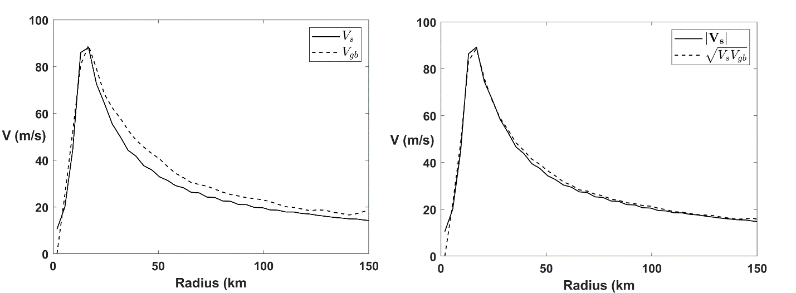
Test this relation in full-physics axisymmetric model (Rotunno and Emanuel, 1987)

Slide 10
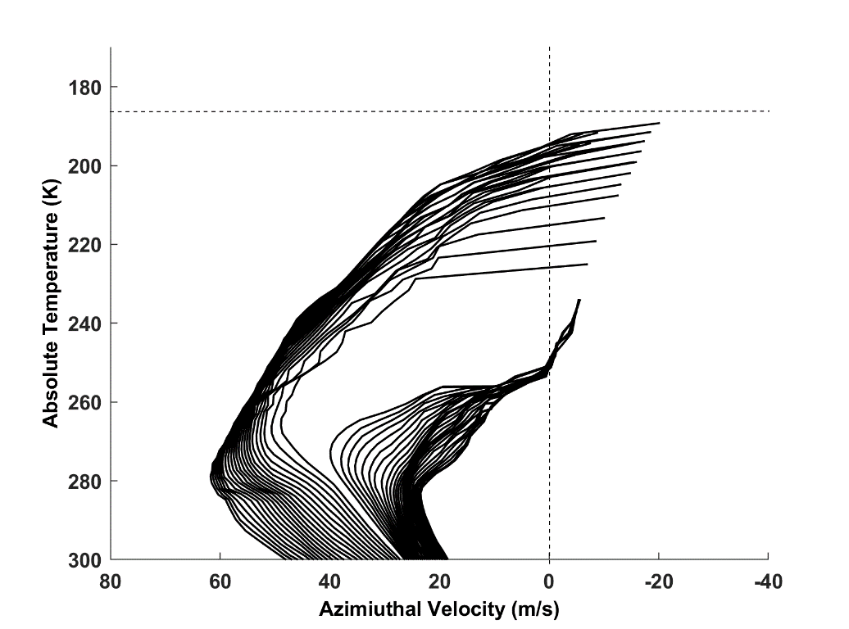
We are really now just left with the problem of the upper boundary condition, T_{o}(M). Not considered a solved problem.
Let’s look for clues in the distribution of T_{o}(M) in a numerical simulation:
Tropopause T
Upflow M surfaces: Note: T_{o}=T_{o}(M)
Downflow M surfaces
Contours of constant angular momentum plotted as a function of azimuthal velocity and absolute temperature from the quasi-steady state of a simulation using the nonhydrostatic, axisymmetric model of Rotunno and Emanuel (1987).

Slide 11
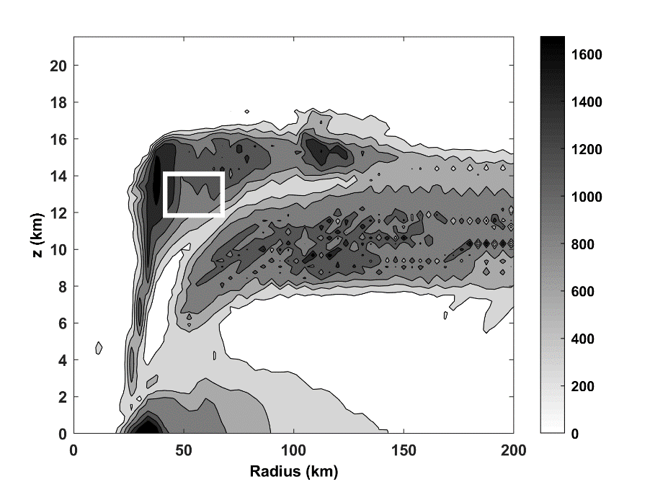
Hypothesis: 1) Stratification of TC outflow determined by turbulence; 2) turbulence holds Richardson Number constant at its critical value
Vertical diffusivity (m² s⁻¹) averaged over the last 24 hours of a numerical simulation of a tropical cyclone using the model of Rotunno and Emanuel (1987). The white box indicates an area in which sample of stratification and wind shear are collected.

Slide 12
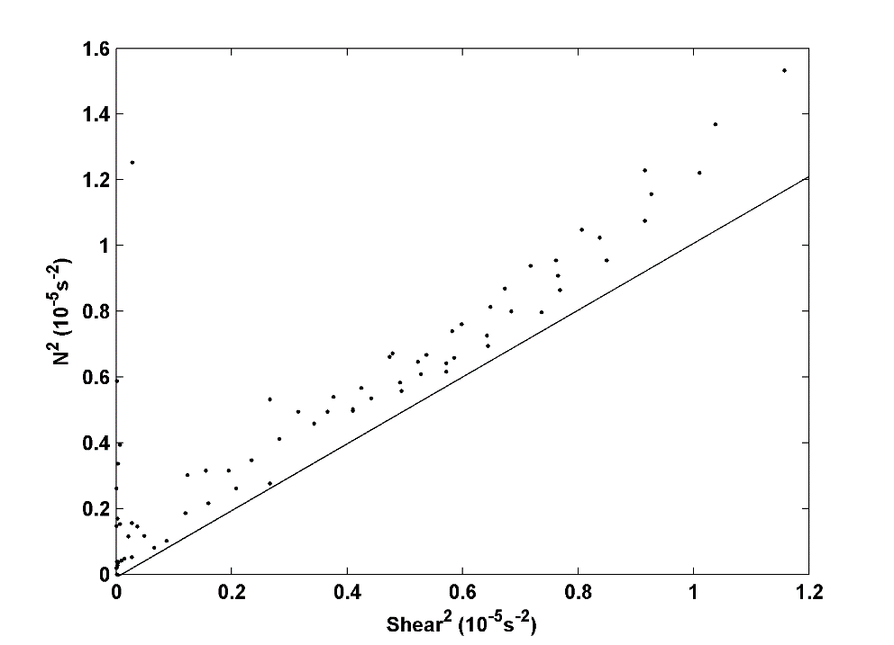
Square of the buoyancy frequency plotted against square of the vertical wind shear in samples collected from within the white box of previous figure. Solid line shows Richardson Number =1.

Slide 13
Assuming that Ri = 1 and that the innermost upflowing M surface attains the tropopause temperature closes the problem completely. I will spare you the math.
This solves for both the structure and intensity of the vortex. Here is an approximate solution for the maximum wind speed, ignoring dissipative heating and isothermal expansion effects on boundary layer entropy and making a few other approximations:
where
Environmental saturation entropy

Slide 14
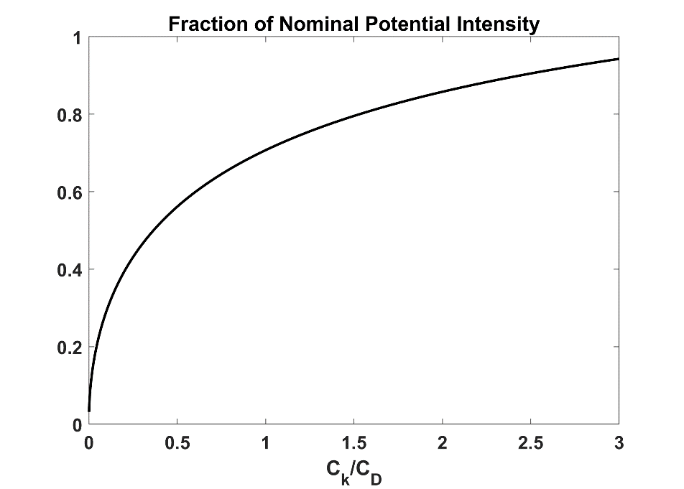
Ratio of the maximum wind speed to the quantity

Slide 15
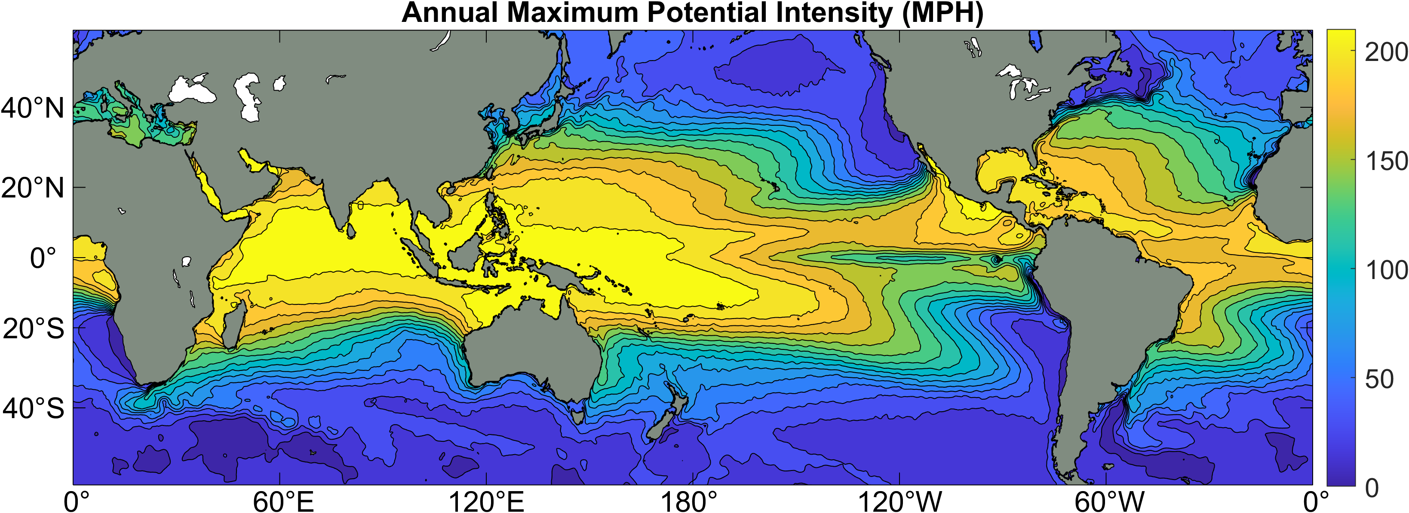
Annual Maximum Potential Intensity (miles per hour)

Slide 16
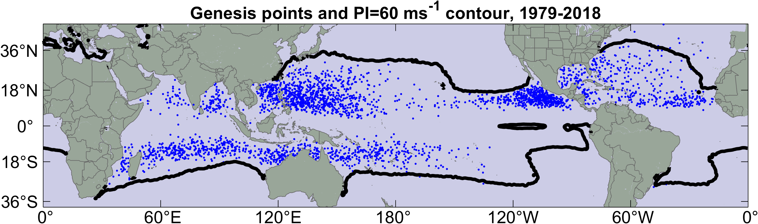
Hurricanes only form where potential intensity is large enough
Blue dots are locations of hurricane formation, 1979-2018
Black contour is contour of 130 MPH potential intensity

Slide 17
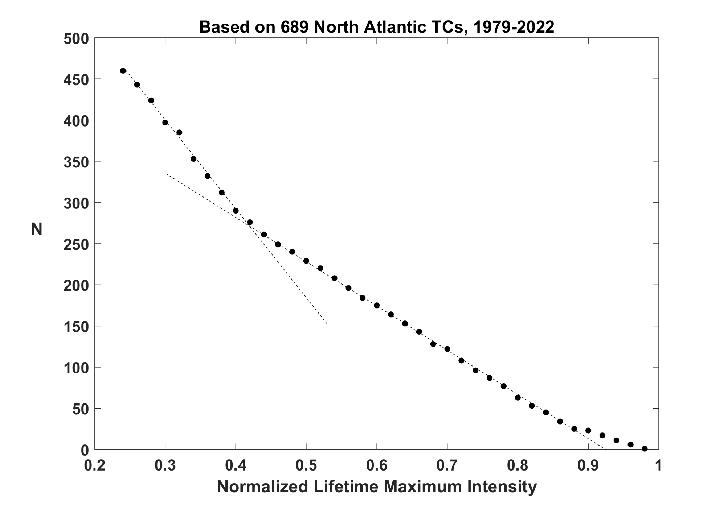
Limited by landfall
Limited by shear

Slide 18
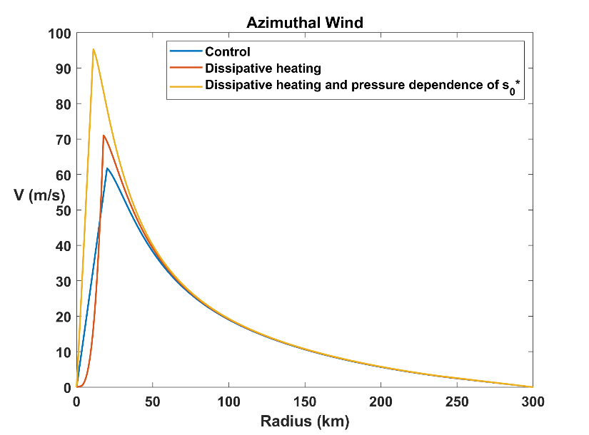
Numerical solution of full steady-state model, without approximations, available in MATLAB code steady_state_model.m at
https://zenodo.org/records/18635966
as part of a larger set of codes, including full-physics axisymmetric model. (Code can also be run in free Octave.)
Importance of isothermal expansion and dissipative heating:
Steady-state radial profiles of surface azimuthal wind for the standard experiment with neither dissipative heating nor pressure dependence of (blue), just dissipative heating (red), and both effects together (yellow)

Slide 19
Retain full time dependence of lower boundary layer entropy. Use same diagnostic relationship for To(M) as in steady state.
Classic quasi-balance problem: Inversion of zero-SPV vortex subject to (time-dependent) lower boundary condition and (diagnostic) upper boundary condition.
Vortex amplified by wind-dependent surface enthalpy fluxes, damped by friction and radial “advection” of entropy in boundary layer
Problem solved in absolute temperature – angular momentum space
Definition of angular momentum inverted to find quantities in physical space
MATLAB code for time-dependent model, time_dependent_model.m, available at previously mentioned zenodo site. (Can be run in free Octave, but much slower.)

Slide 20
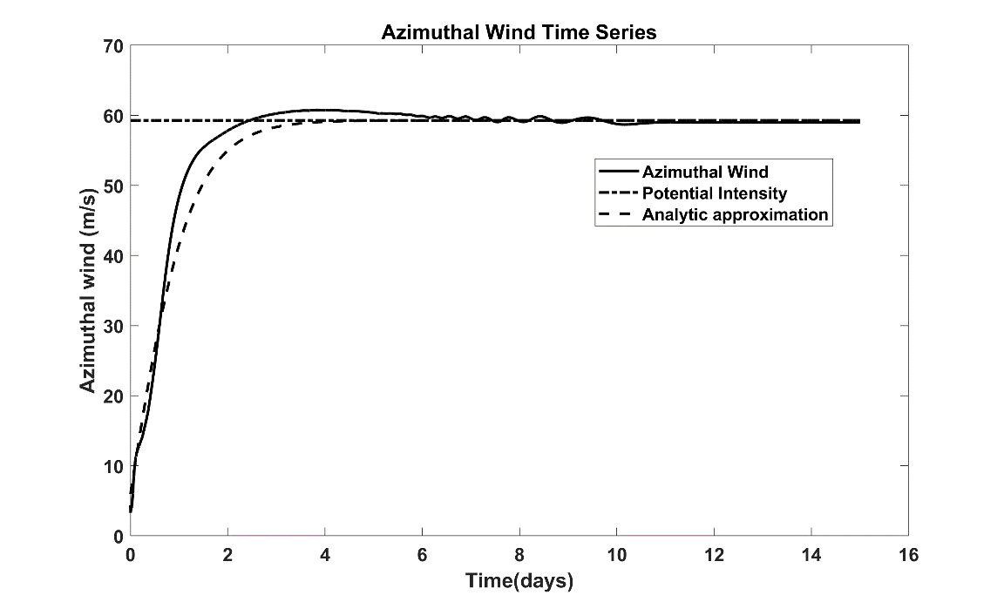
Example solution:
Evolution with time of the gradient wind in a simulation using the simple model. The solid black line shows the simulated gradient wind, and the dashed line shows an analytic approximation to it, using the same parameters as used in the full simulation. The flat, dash-dot line is the theoretical potential intensity.
Note: Assumptions in this model include that the inner core is saturated at all times. Model cannot capture pre-saturation spin-up.

Slide 21
Some lessons from time-dependent model
After maximum wind speed exceeds potential intensity divided by , inner core becomes frontogenetical
Sometime after this happens, coordinate transformation from M-space back to physical space fails…frontal discontinuity has formed at eyewall. Same as with semi- geostrophic frontogenesis.
Must assume turbulent diffusion of angular velocity into the core….eye formation
Intensification rate scales as V_{p}²

Slide 22
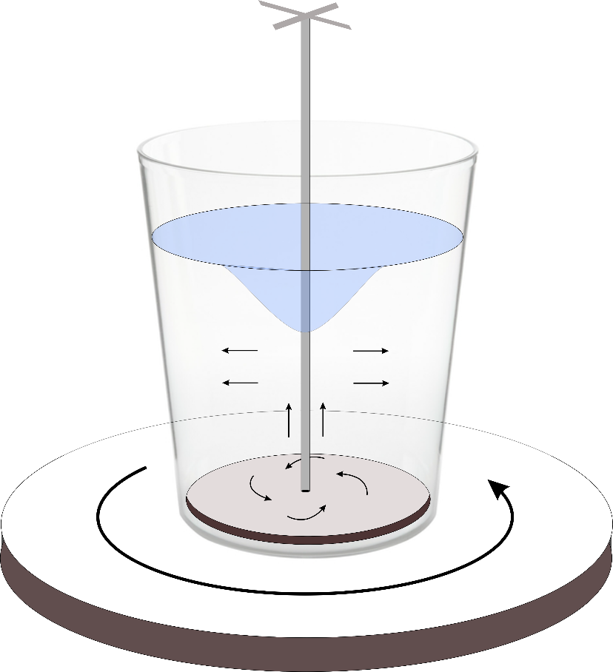
Eye Formation
Spindle with disk held stationary
Thought experiment and possible laboratory experiment: A glass bucket or beaker of water is placed on a rotating turntable. A disk on a spindle is lowered to the bottom of the vessel and is kept stationary while the vessel rotates around it. The black arrows show the resulting motion of the water, which could be made visible by suspending small particles in the water.

Slide 23
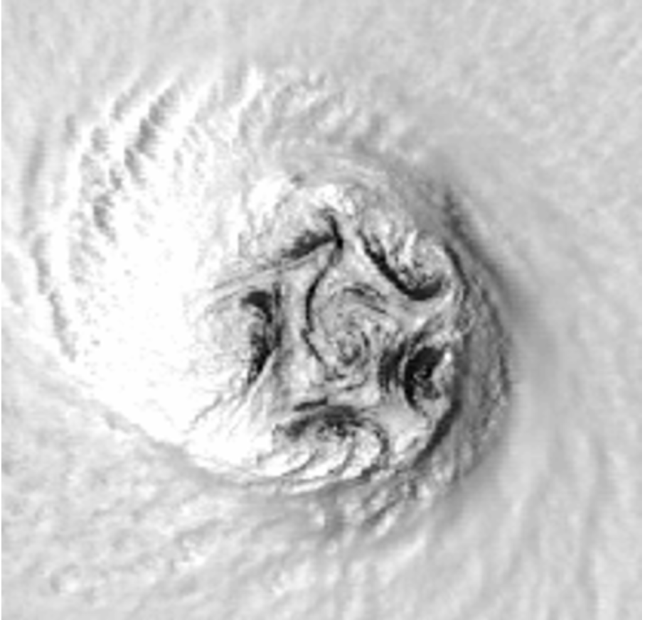

Slide 24
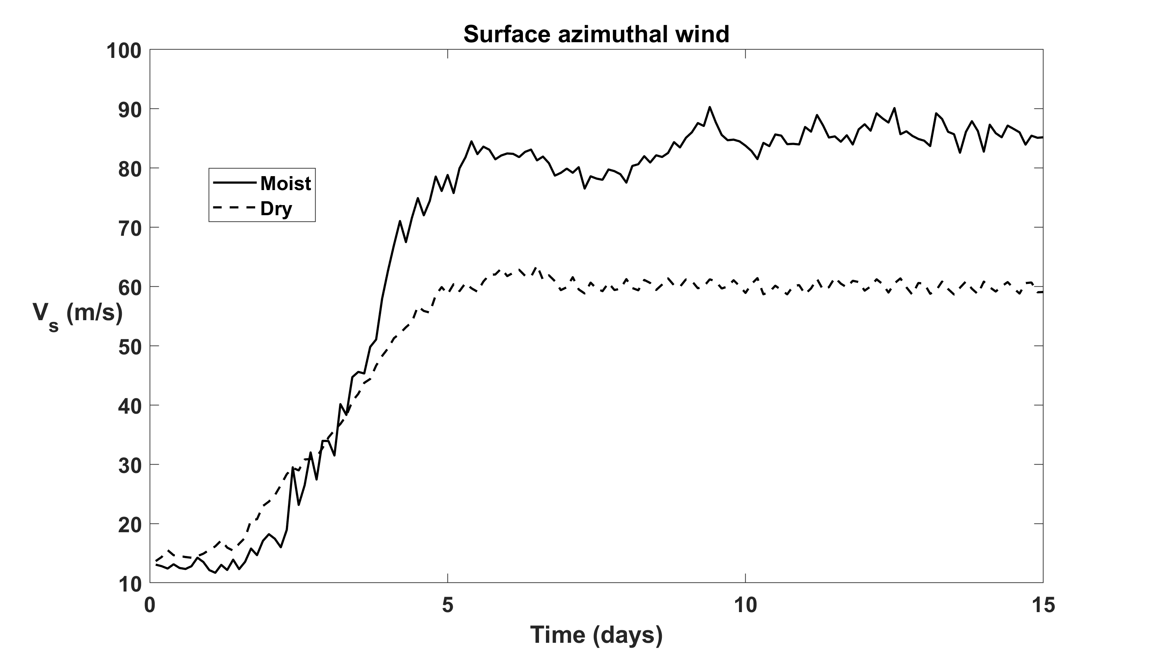
Dry vs. Moist TCs
Smaller inhibition to development, but much weaker for the same V_{p}

Slide 25
Why are dry TCs weaker?
Possibly because stable stratification in moist case suppresses turbulence outside the core and above the boundary layer, decreasing internal dissipation of kinetic energy
Vertical turbulent diffusivity
Dry
Moist

Slide 26
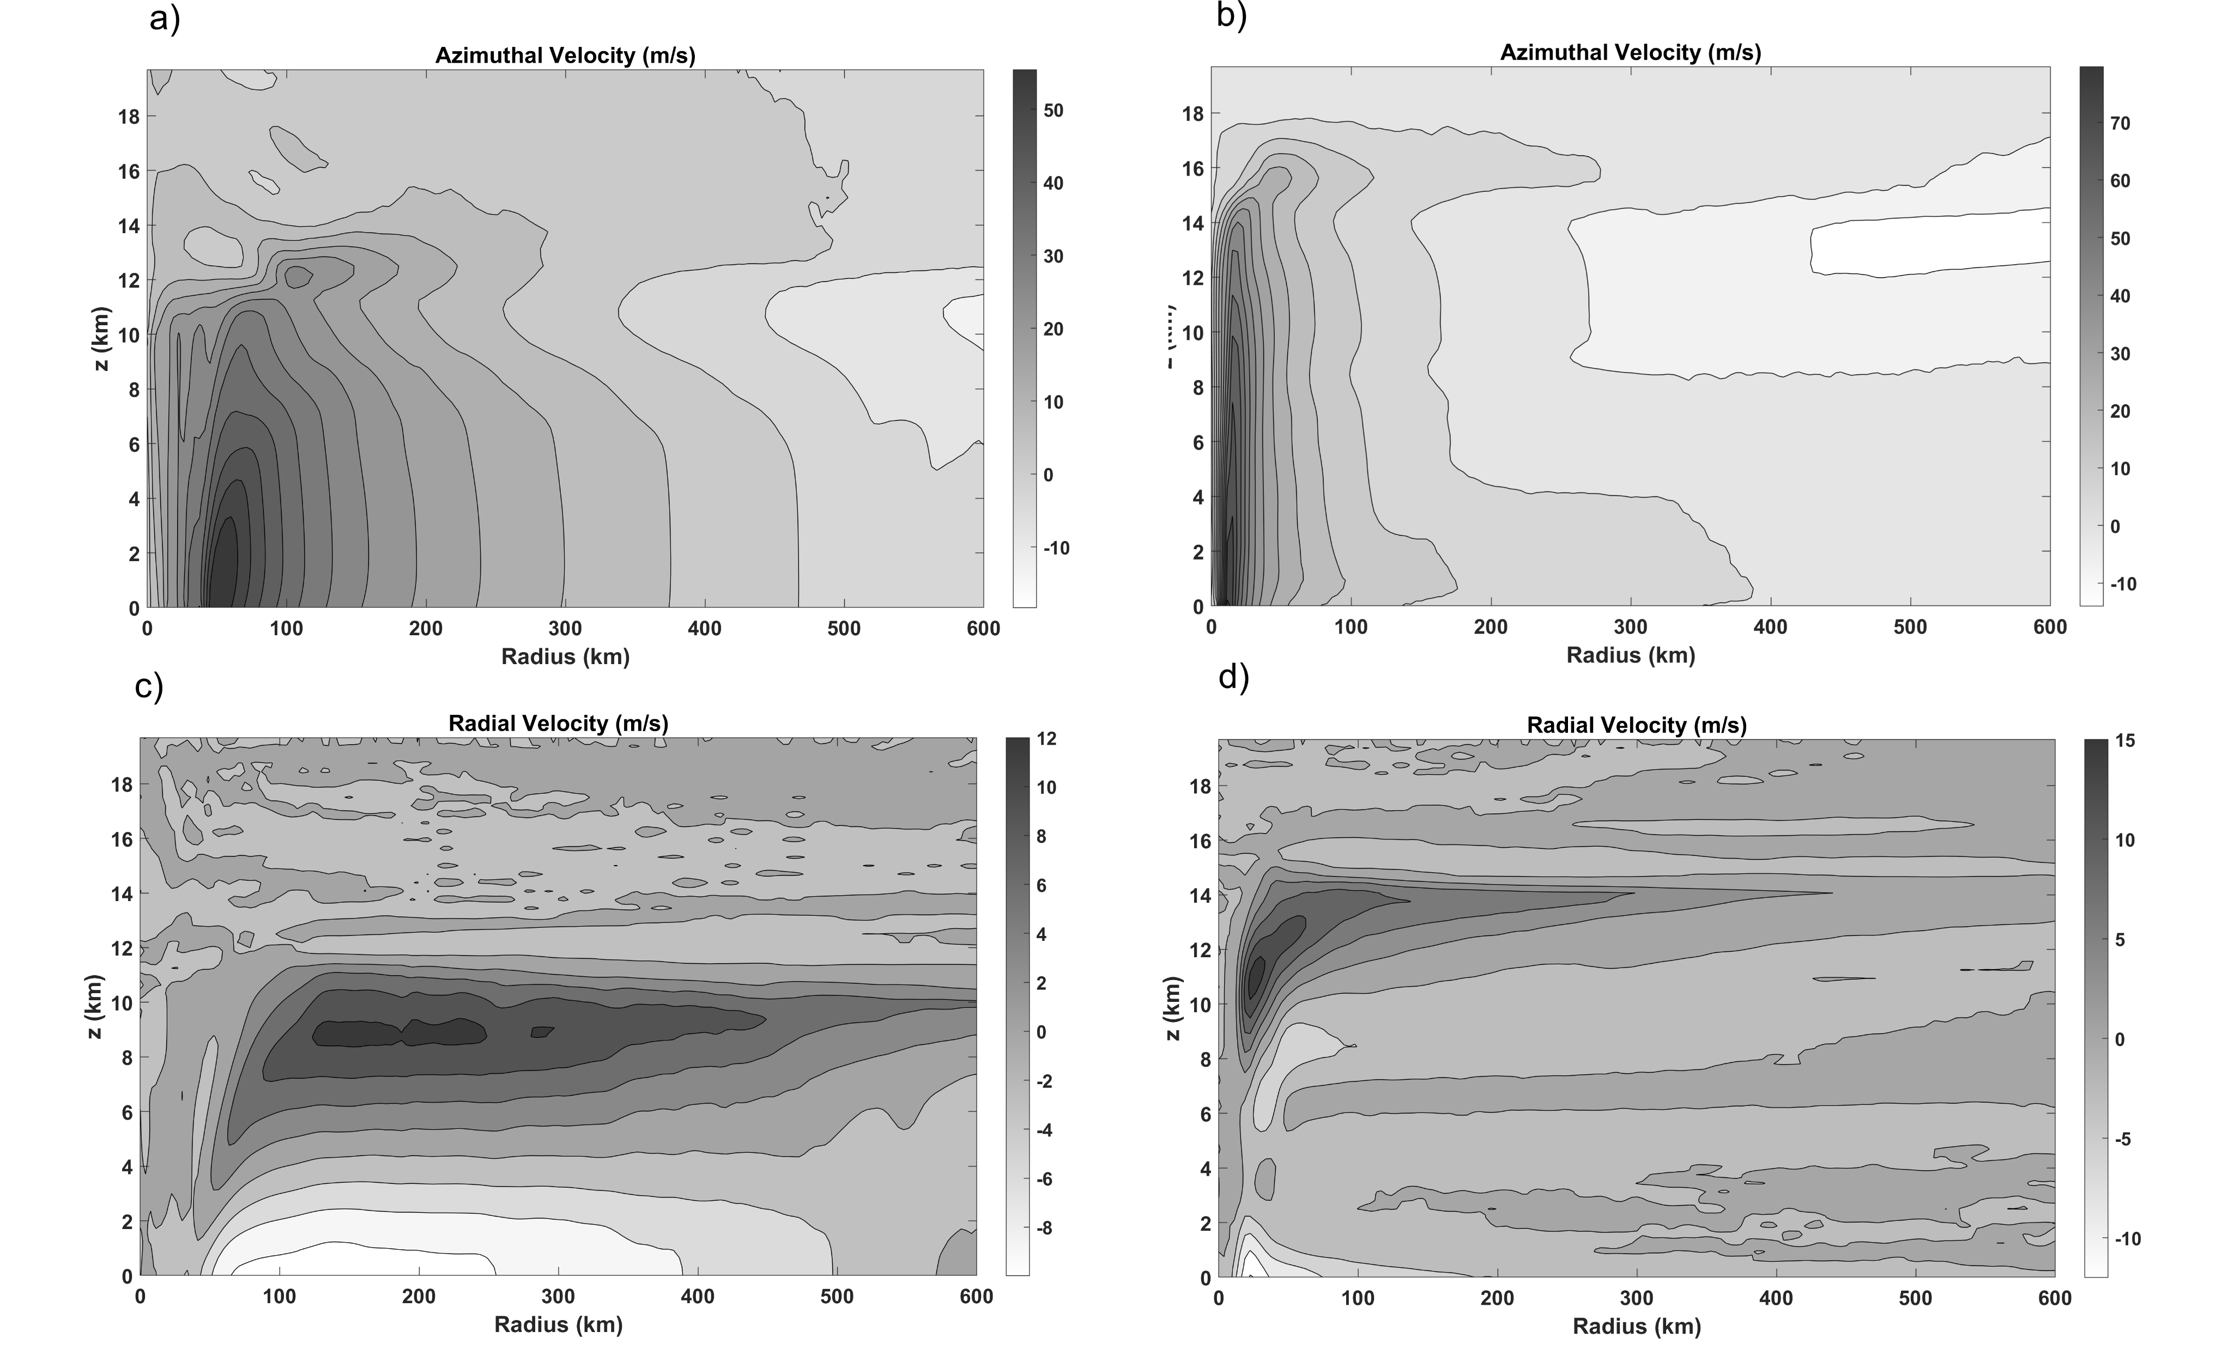
Simpler radial flow structure
Dry
Moist

Slide 27
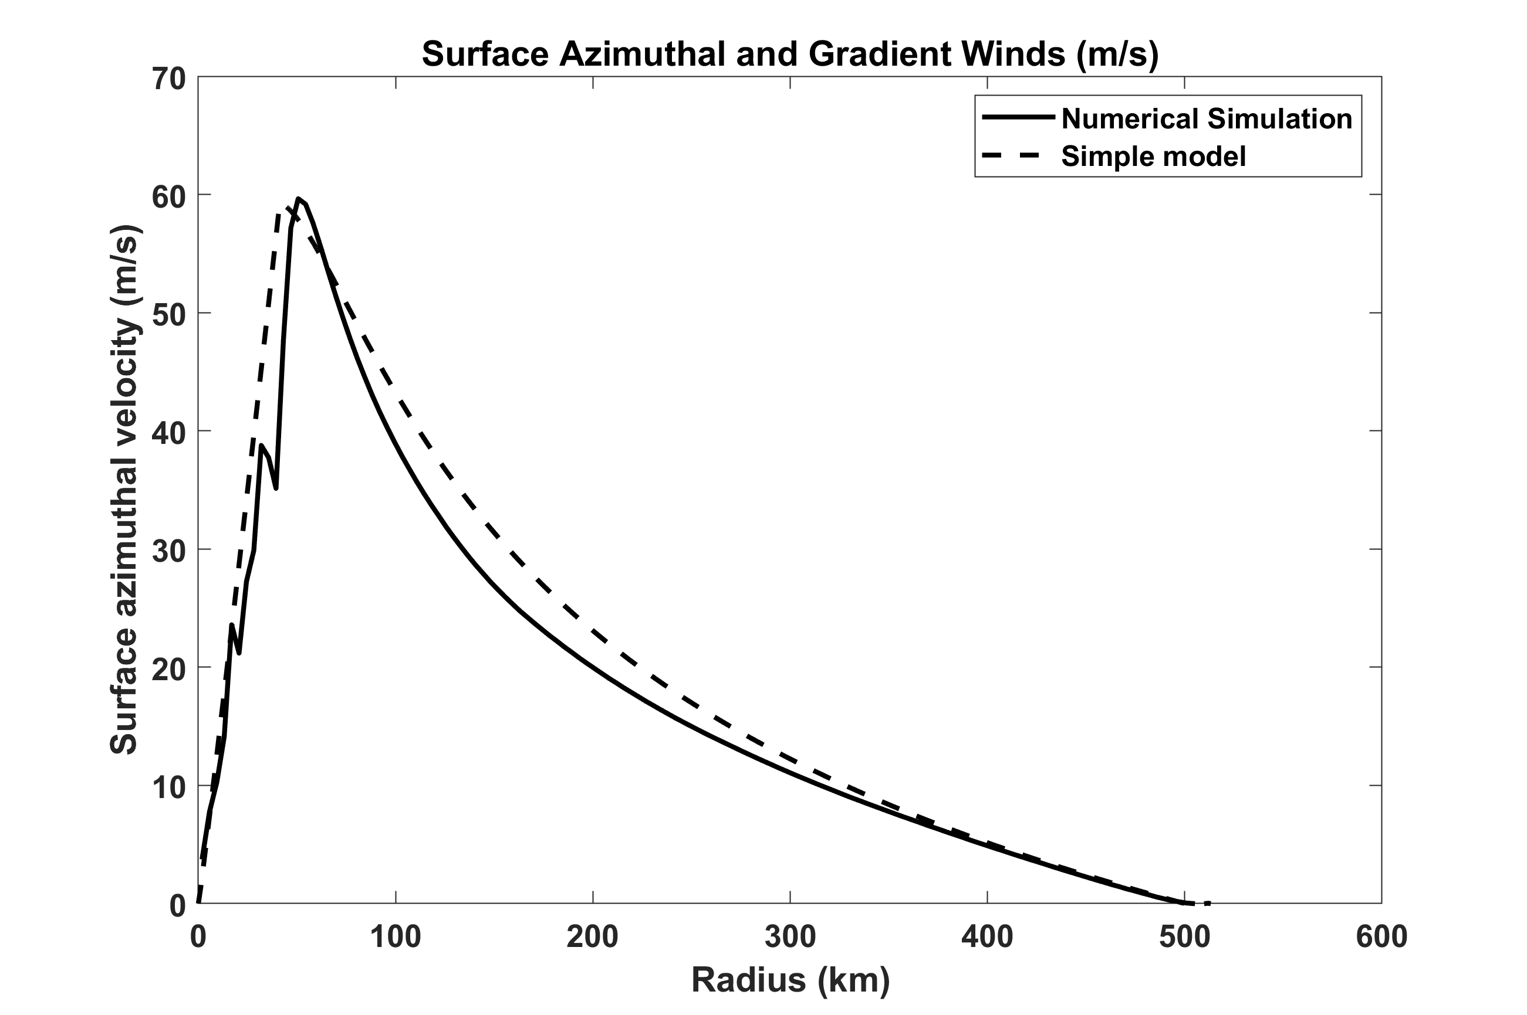
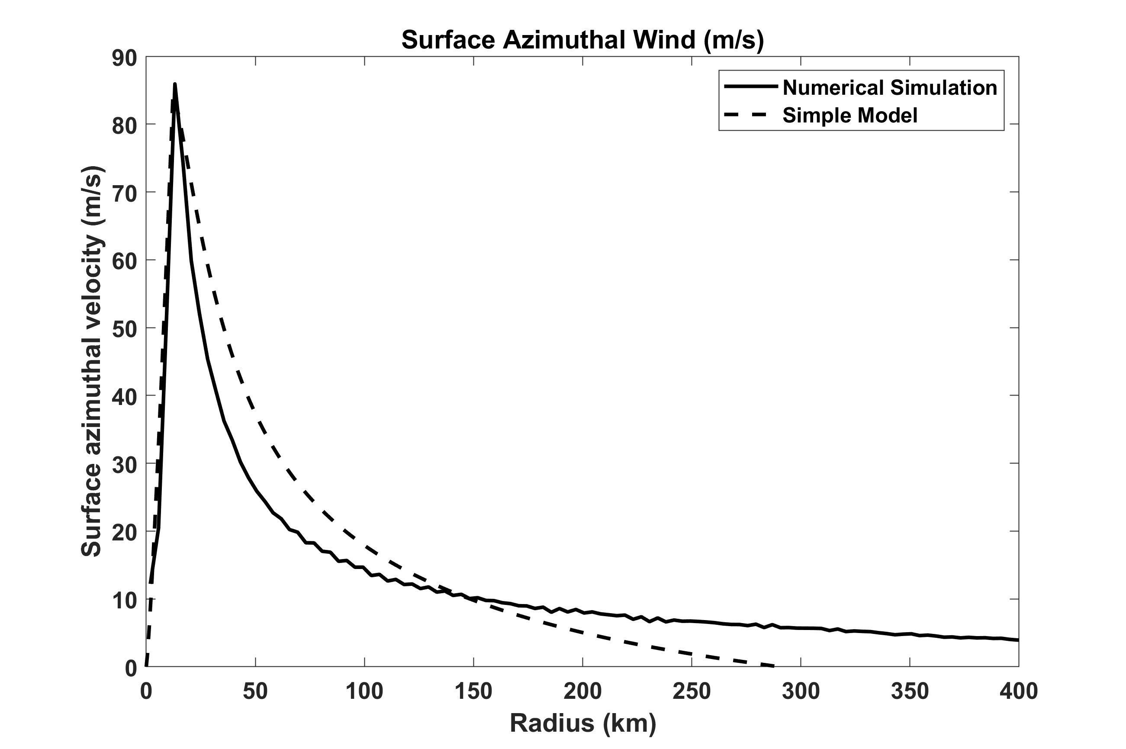
Dry simulation fits theoretical profile better than moist simulation does
Dry
Moist
Moist V profile has long outer tail. Why?

Slide 28
In clear air outside core, adiabatic warming by subsidence must balance Ekman suction
Radiative cooling rate
Radiative subsidence velocity:
Dry static energy gradient
From mass continuity, this implies an inward radial flow, u, in the boundary layer:
Boundary layer depth
Assuming w_{e} is constant, we can integrate this inward from an outer radius, r_{o}:
This must match boundary layer u from angular momentum conservation:

Slide 29
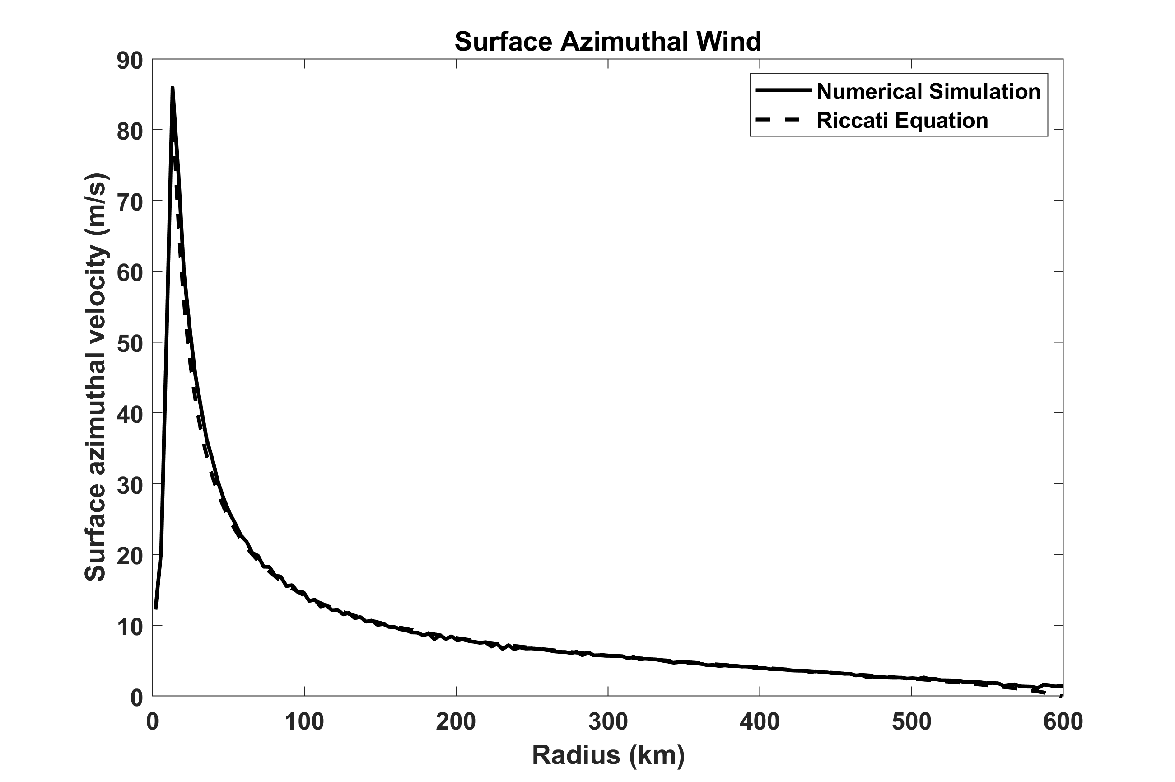
Results in 1-D Riccati Equation:
No known analytic solution, but Tim Cronin (GRL, 2023) has a nice analytic approximation to it. Can also be integrated numerically.
Radial profile of near-surface azimuthal velocity from the near steady-state of the fully moist simulation of the RE87 model (solid) compared to the solution of the Riccati equation above

Slide 30
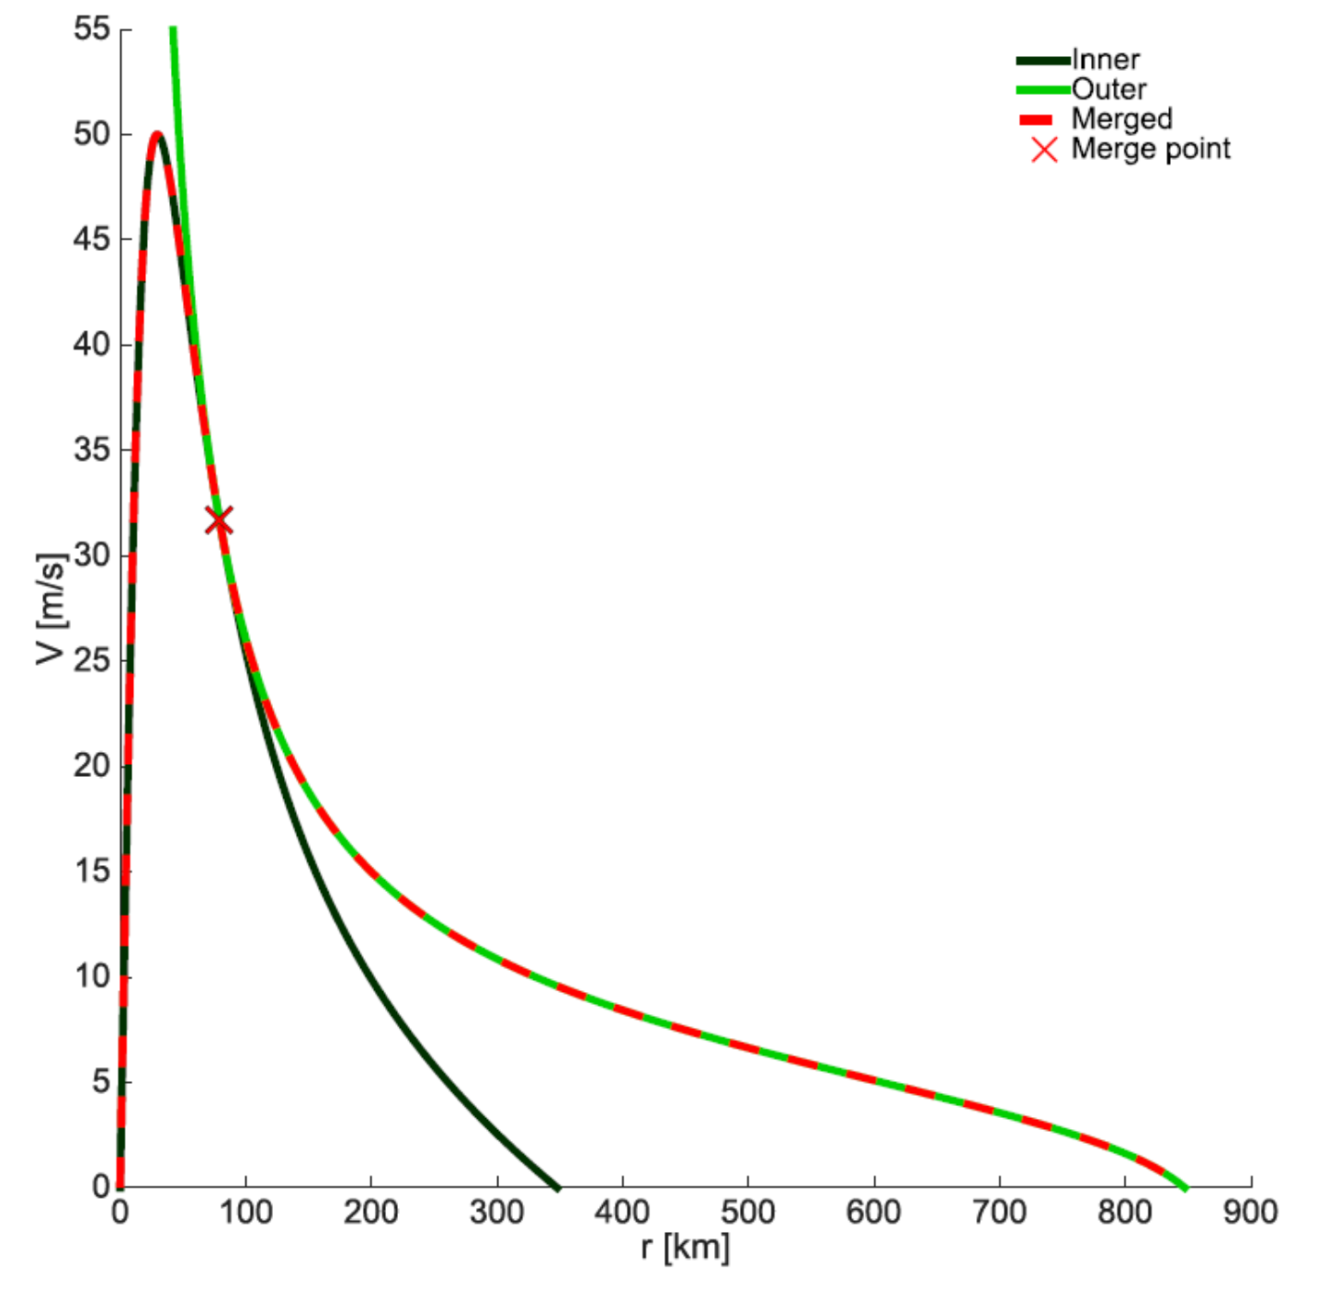
Inner core analytic solution can be matched to outer solution at point where V and it first derivative match
Chavas, D. R., N. Lin, and K. Emanuel, 2015: A model for the complete radial structure of the tropical cyclone wind field. Part I: comparison with observed structure. Journal of the Atmospheric Sciences, 72, 3647–3662, https://doi.org/10.1175/jas-d-15-0014.1.

Slide 31
Other important TC physics
TC motion
Interaction with sheared environment
Interaction with ocean
  Negative feedback on intensity
  Sea spray effects: Sea surface tends to emulsion
Effect of climate variability on TCs
Effect of TCs on climate

Slide 32
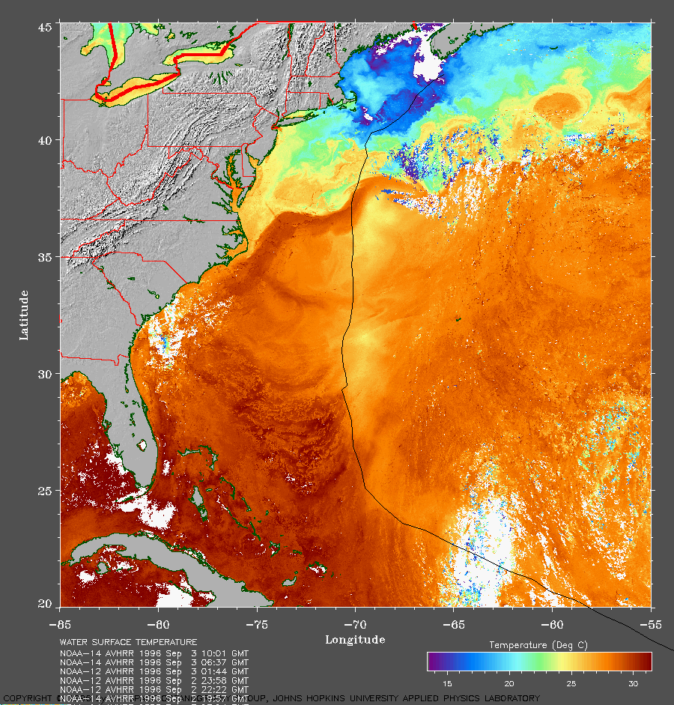
Strong Mixing of Upper Ocean

Slide 33
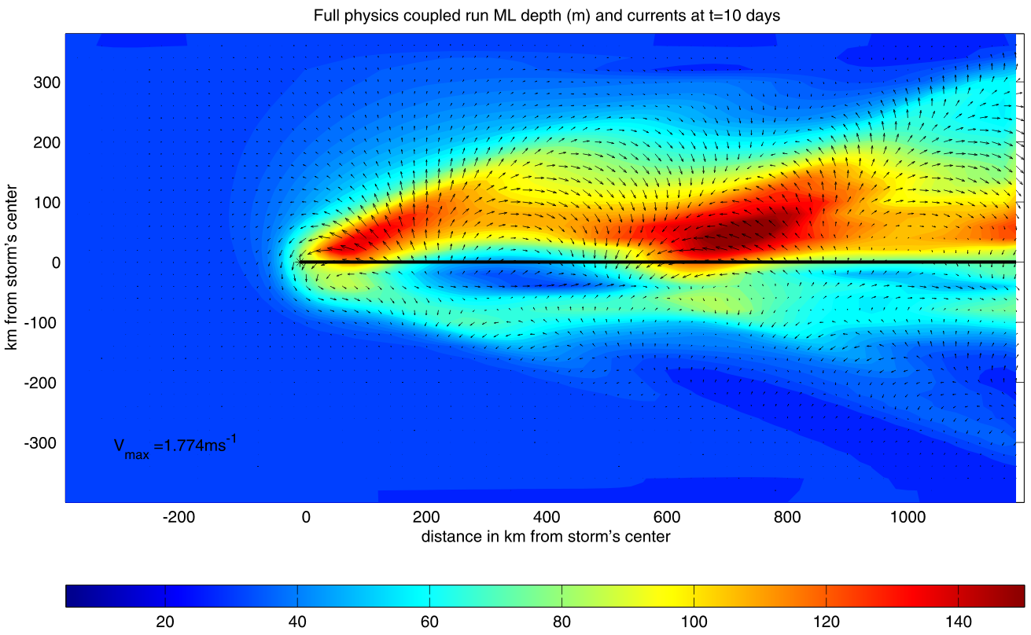
Mixed layer depth and currents

Slide 34
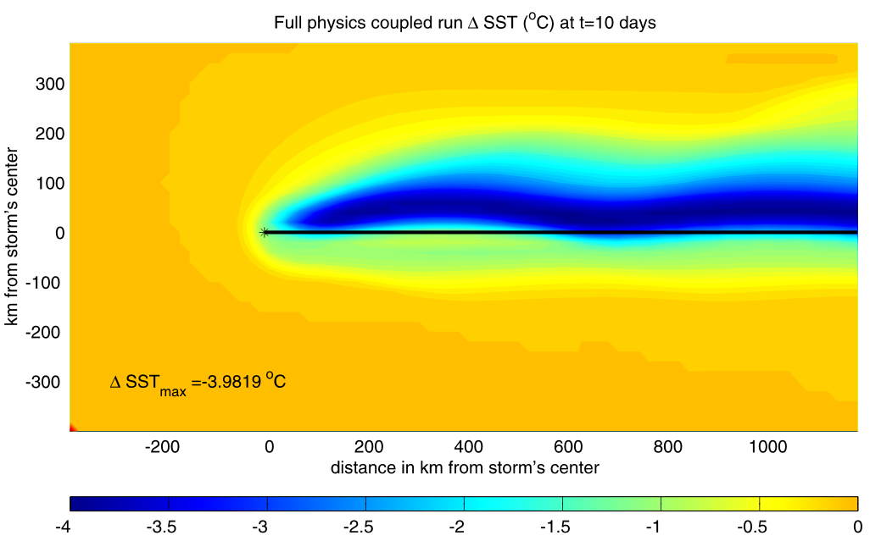
SST Change

Slide 35
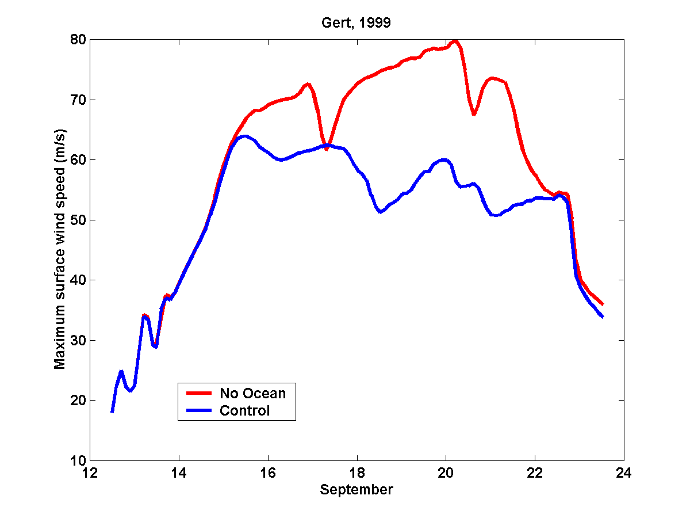
Comparing Fixed to Interactive SST:

Slide 36
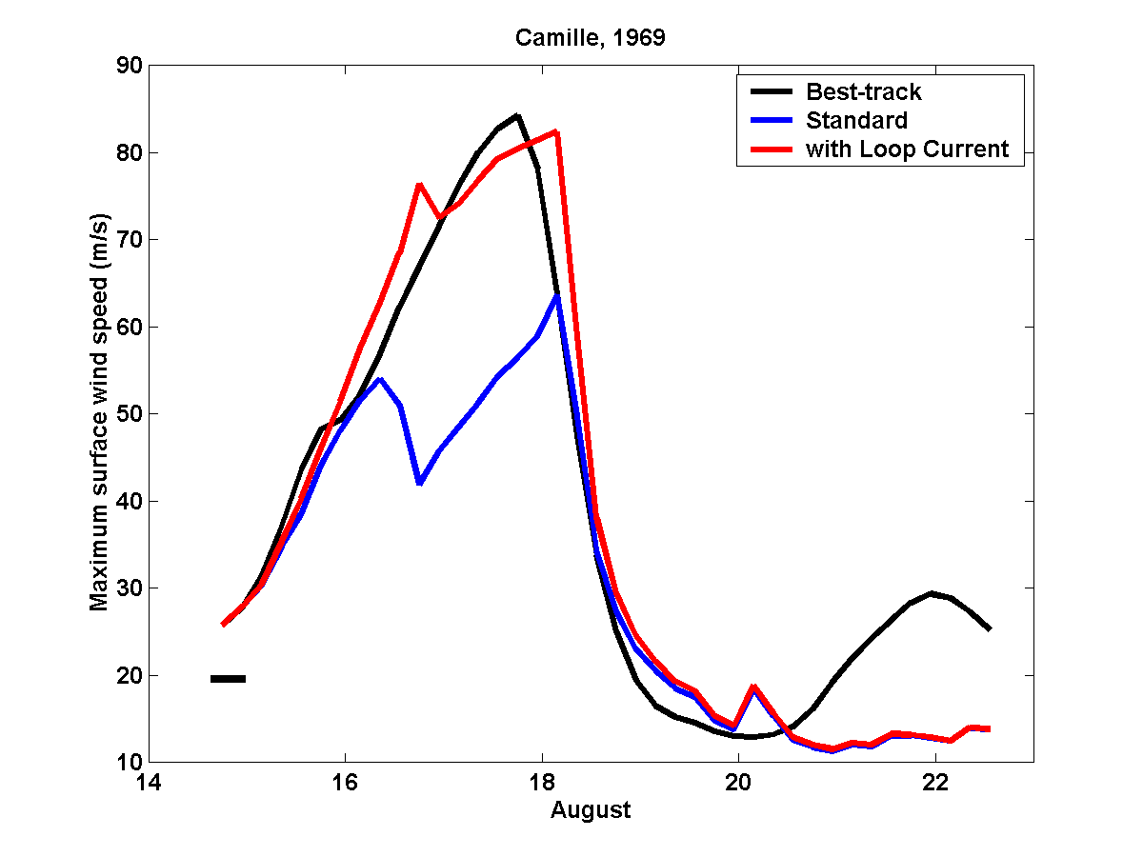
A good simulation of Camille can only be obtained by assuming that
it traveled right up the axis of the Loop Current:

Slide 37
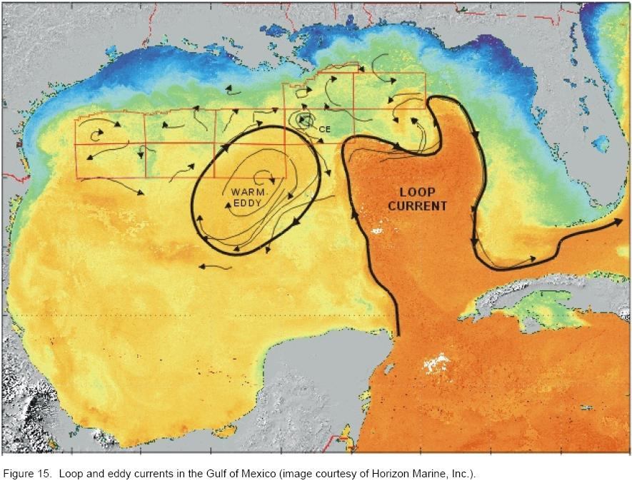

Slide 38
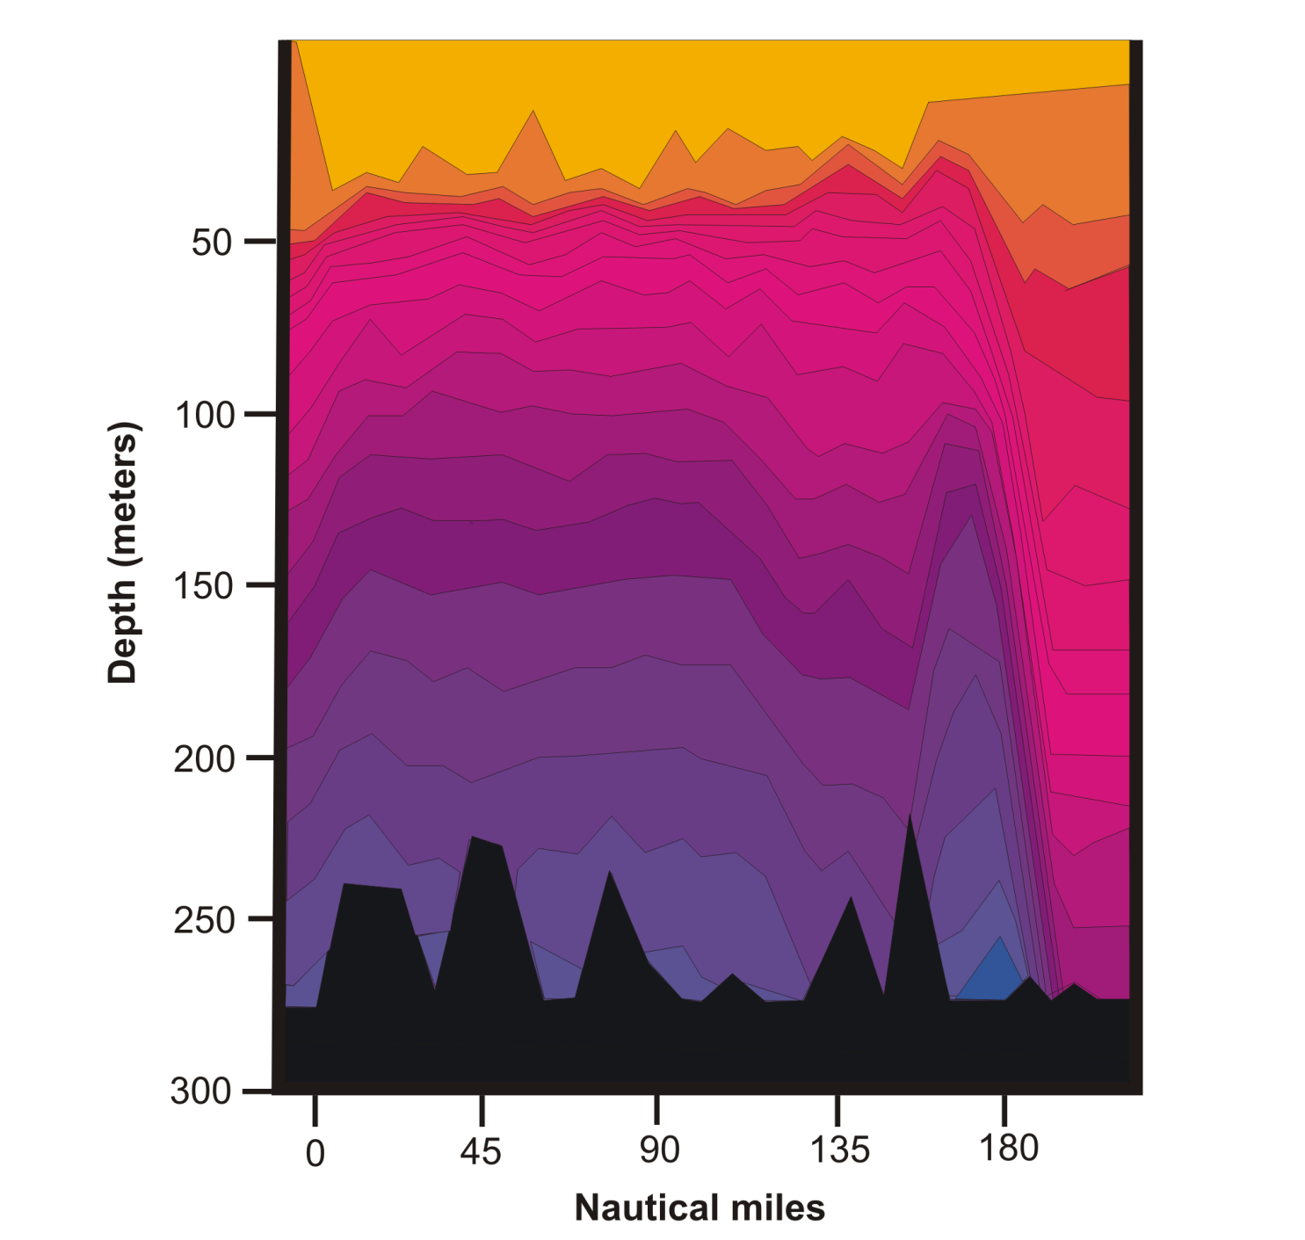
Loop Current

Slide 39
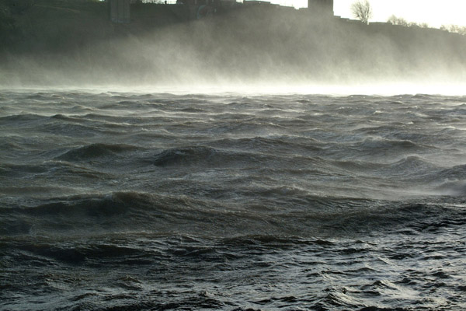
Sea Spray

Slide 40
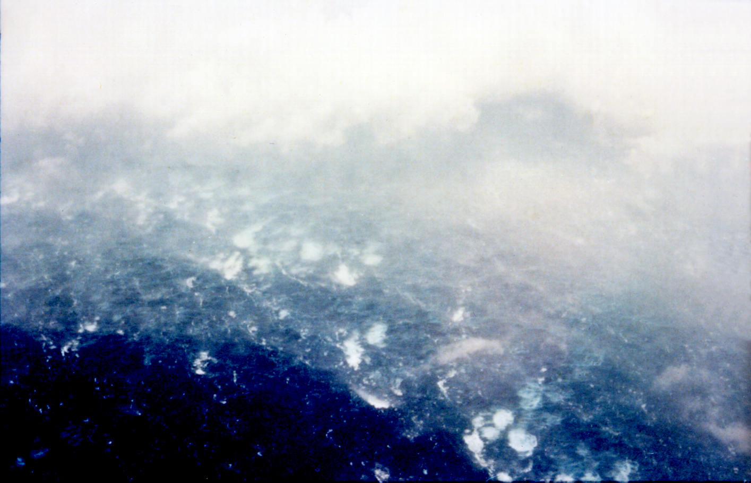

Slide 41
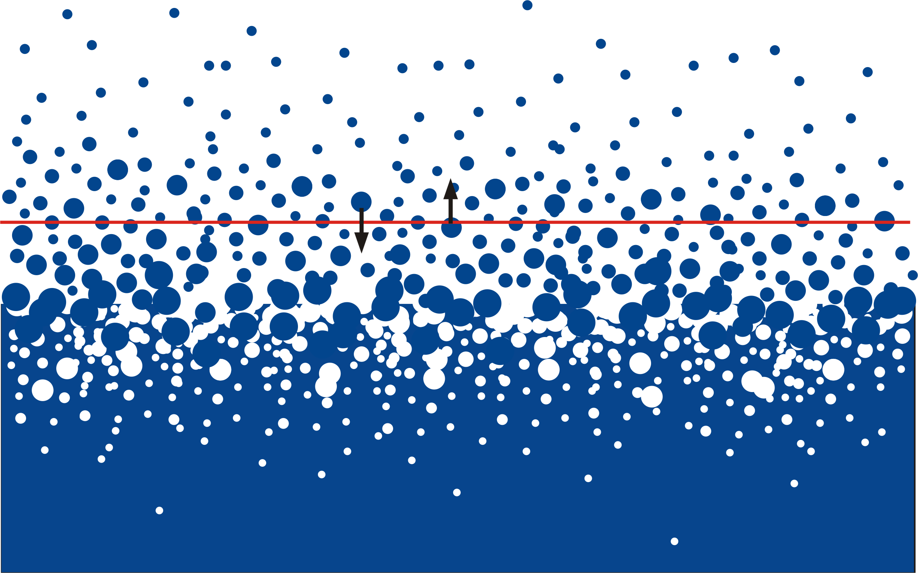

Slide 42
At altitude where volume of water ~= volume of air, most heat and momentum flux is carried by spray drops
Upward spray mass flux does not equal downward flux because some spray evaporates
Drop mass must accelerate toward the free stream wind speed regardless of whether it evaporates
But spray enthalpy flux is carried only by re-entrant drops
Re-entrant spray mass flux
Wet-bulb temperature
Spray enthalpy flux:
Heat capacity of liquid water
Spray momentum flux:
Total spray mass flux

Slide 43
If S_{me} ~= S_{m}, the ratio of enthalpy flux to momentum flux is independent of S_{m}

Slide 44

Princeton University Press.
Will be released on April 14; can be pre-ordered from publisher, Amazon, Walmart, Barnes and Noble, etc.

Slide 45
Up Next:
Using Physics to Catalyze Climate Action, Part I
Using Physics to Catalyze Climate Action, Part II

