Slide 1
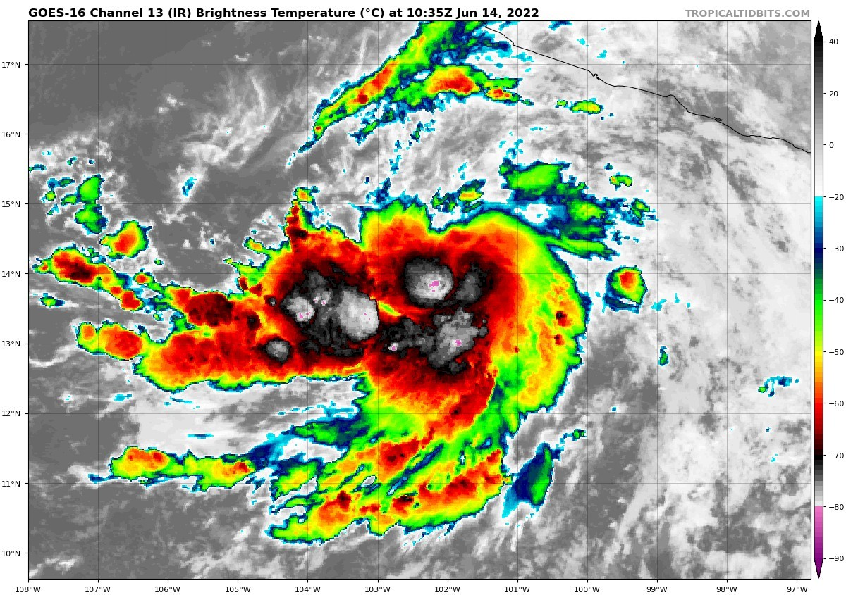
Physics of Tropical Cyclones
Kerry Emanuel
Lorenz Center, PAOC

Slide 2
Program
What distinguishes tropical cyclones from other forms of convection?
Dry versus moist dynamics
Inhibition of genesis in moist atmospheres
TC energetics

Slide 3
Conventional View of TC Energetics:
Me: What drives tropical cyclones?
Claude:
Warm, moist surface air rises rapidly, releasing latent heat as water vapor condenses
This latent heat warms the upper atmosphere, lowering surface pressure
Lower pressure draws in more warm, moist air from the surface
That air rises, releases more latent heat, further deepens the low — a positive feedback loop
The Coriolis effect organizes this inflow into a rotating spiral (cyclonic rotation)
Note: Claude goes on to cite sea-air heat transfer as necessary for further intensification

Slide 4
This is Fundamentally Wrong

Slide 5
Program
What distinguishes tropical cyclones from other forms of convection?

Slide 6
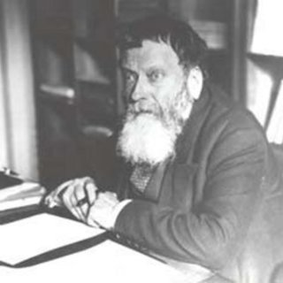
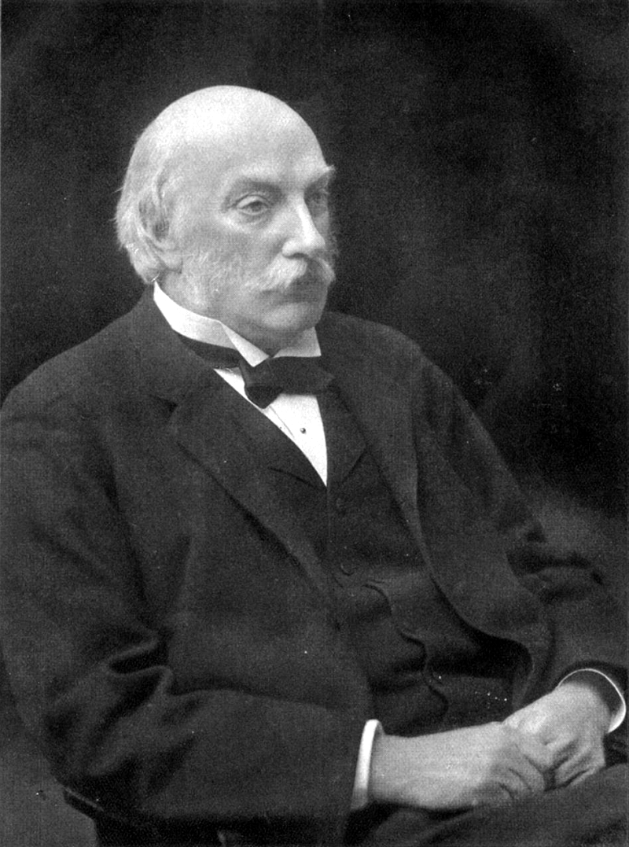
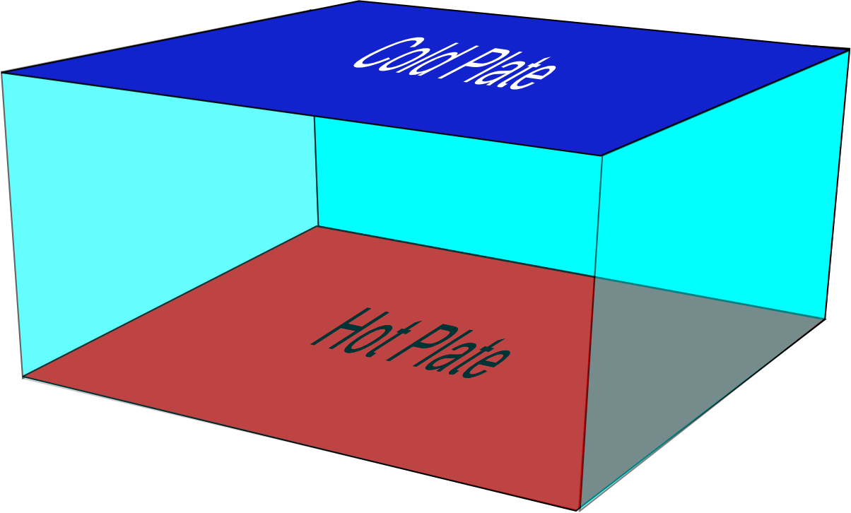
Start with a simple example: Convection in a box
Rayleigh–Bénard convection
Henri Bénard
Experiments, 1900
John Strutt, Lord Rayleigh
Theory, 1916
No phase changes

Slide 7
Classical, non-rotating parallel-plate convection governed by just two nondimensional parameters:
Distance between plates
Coefficient of thermal expansion
Temperature difference between plates
gravity
Rayleigh Number:
Kinematic viscosity
Thermal diffusivity
Prandtl Number:

Slide 8
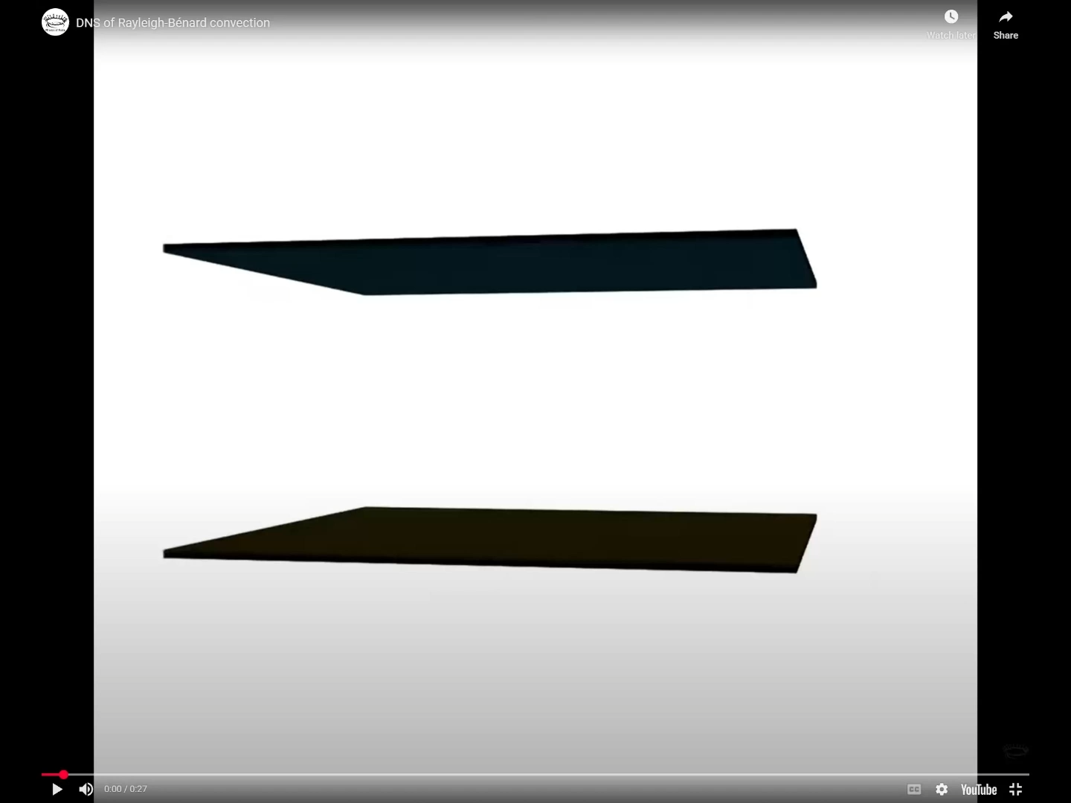
Direct Numerical Simulation of Rayleigh–Bénard convection
Notes:
This snapshot was taken from a movie based on data from a Rayleigh-Bénard convection simulation. The system is a fluid heated from below and cooled from above with periodic sidewalls and impermeable horizontal plates. The visible quantity is the temperature of the fluid, where red and blue indicate hot and cold fluid, respectively. Using the volume rendering with ray casting and an opacity profile dependent on the temperature, the mean temperature has been made transparent. This results in the temperature extrema being clearly visible and the possibility to see through the system, revealing the 3D structure. One can clearly distinguish the small scale thermal plumes and the large scale circulation, both characteristic coherent structures in this type of flow. Visualization and simulation by: Erwin P. van der Poel & Rodolfo Ostilla Mónico. Compute resources courtesy of SURFsara. https://wci.llnl.gov/simulation/compu...
Physics of Fluids Group University of Twente

Slide 9
Nondimensional measure of heat flux between the plates:
Heat flux
Nusselt Number:
Early conjecture: At very high Ra, heat flux would become independent of molecular diffusivities. This requires that
But this is not observed, instead:
Heat flux always limited by molecular diffusivity

Slide 10
In 1925, Ludwig Prandtl developed a mixing length theory to explain observed logarithmic wind profiles in fully turbulent flows without density stratification:
Friction velocity
Von Karman constant ~= 0.4
Surface roughness length
No dependence on molecular diffusivities
Key: Surface is ROUGH

Slide 11
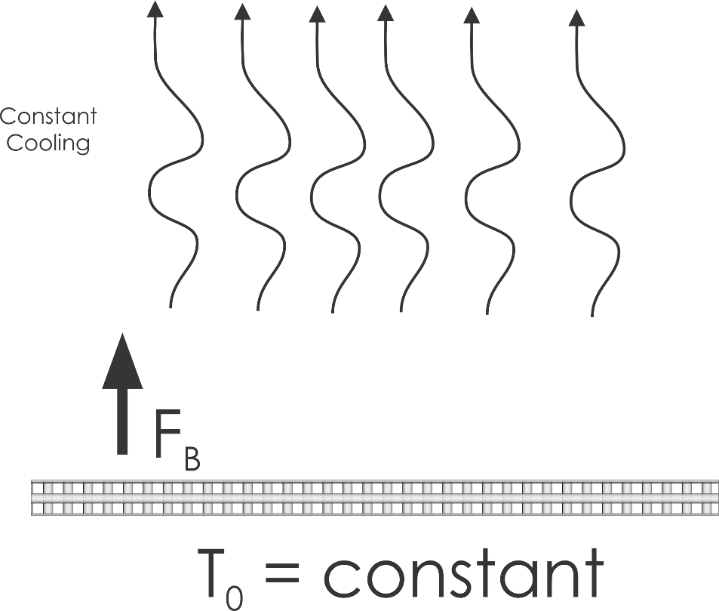
The Priestley Convection Problem
Rough surface
Semi-infinite, dry Boussinesq fluid subject to a constant rate of cooling, overlying a rigid plate held at fixed temperature
Priestley, C., 1954: Convection from a Large Horizontal Surface. Australian Journal of Physics, 7, 176–201, https://doi.org/10.1071/PH540176.

Slide 12
Heat flux though surface must equal integrated radiative cooling:
Surface buoyancy flux proportional to heat flux:
Dimensional analysis:
4. Almost all entropy production is by dissipation of turbulence kinetic energy

Slide 13
What happens when there are both heat and momentum sources/sinks in the flow?
In 1954, Monin and Obukhov, using dimensional reasoning, proposed that in turbulent flows heated from below, turbulent fluxes below a length scale L are primarily driven by shear. This length scale is now called the Monin-Obukhov length and is given by
where F_{B} is the surface buoyancy flux
In TCs, L is very large and fluxes from the surface are rate-limited by mechanical turbulence

Slide 14
In these conditions, fluxes obey aerodynamic exchange laws:
Drag coefficient
Velocity vector
Air density
Specific enthalpy of air saturated at SST
Exchange coefficient
Specific enthalpy of air
No dependence on molecular diffusivities, but exchange coefficients do depend on surface roughness
Under most experimental or real-world conditions, neither the velocities nor the fluxes are true externals of the system!

Slide 15
What happens if we use these instead of traditional boundary conditions in parallel plate convection?
Numerical simulations by Velez-Pardo and Cronin*: Numerical parallel-plate convection in a box and with constant Coriolis parameter
*Velez-Pardo, M., and T. W. Cronin, 2023: Large-scale circulations and dry tropical cyclones in direct numerical simulations of rotating Rayleigh–Bénard convection. Journal of the Atmospheric Sciences, 80, 2221–2237

Slide 16
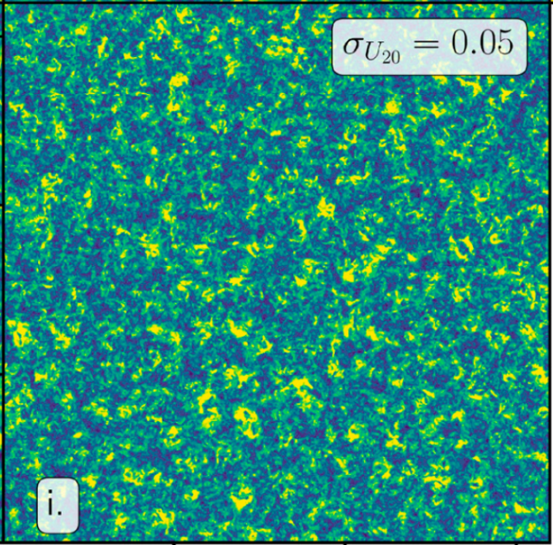
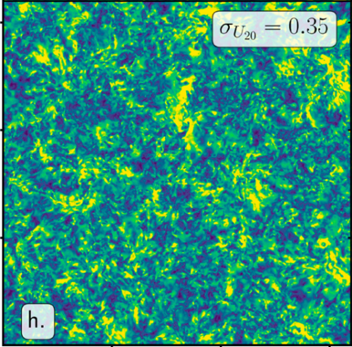

Simulated convection in a rotating box
Fluid temperature must equal plate temperature at bottom
Fluid temperature must equal plate temperature also at top
Fluid cooled at constant rate everywhere
Horizontal wind speed near the bottom of the box
Velez-Pardo, M., and T. W. Cronin, 2023: Large-scale circulations and dry tropical cyclones in direct numerical simulations of rotating Rayleigh–Bénard convection. Journal of the Atmospheric Sciences, 80, 2221–2237

Slide 17
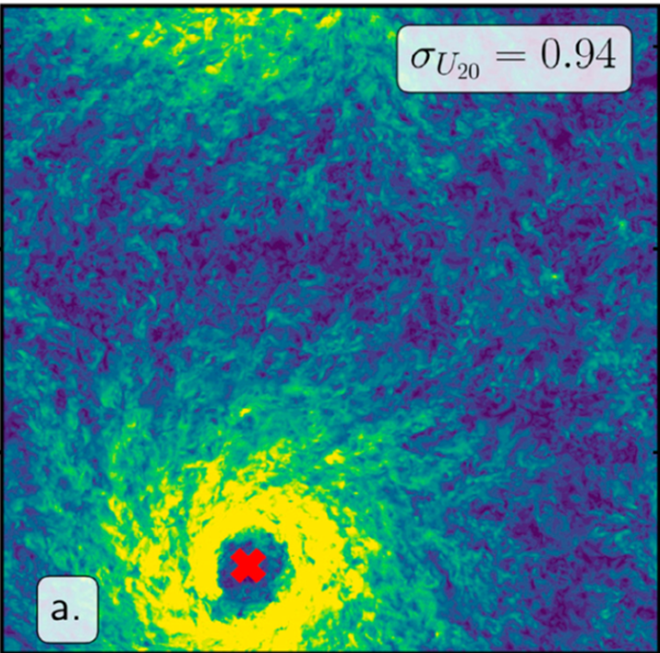
Now assume that the surface is rough and replace the lower boundary condition on temperature by the aerodynamic formulation:
Fluid cooled at constant rate everywhere
Hurricanes!
No phase changes
Velez-Pardo, M., and T. W. Cronin, 2023: Large-scale circulations and dry tropical cyclones in direct numerical simulations of rotating Rayleigh–Bénard convection. Journal of the Atmospheric Sciences, 80, 2221–2237

Slide 18
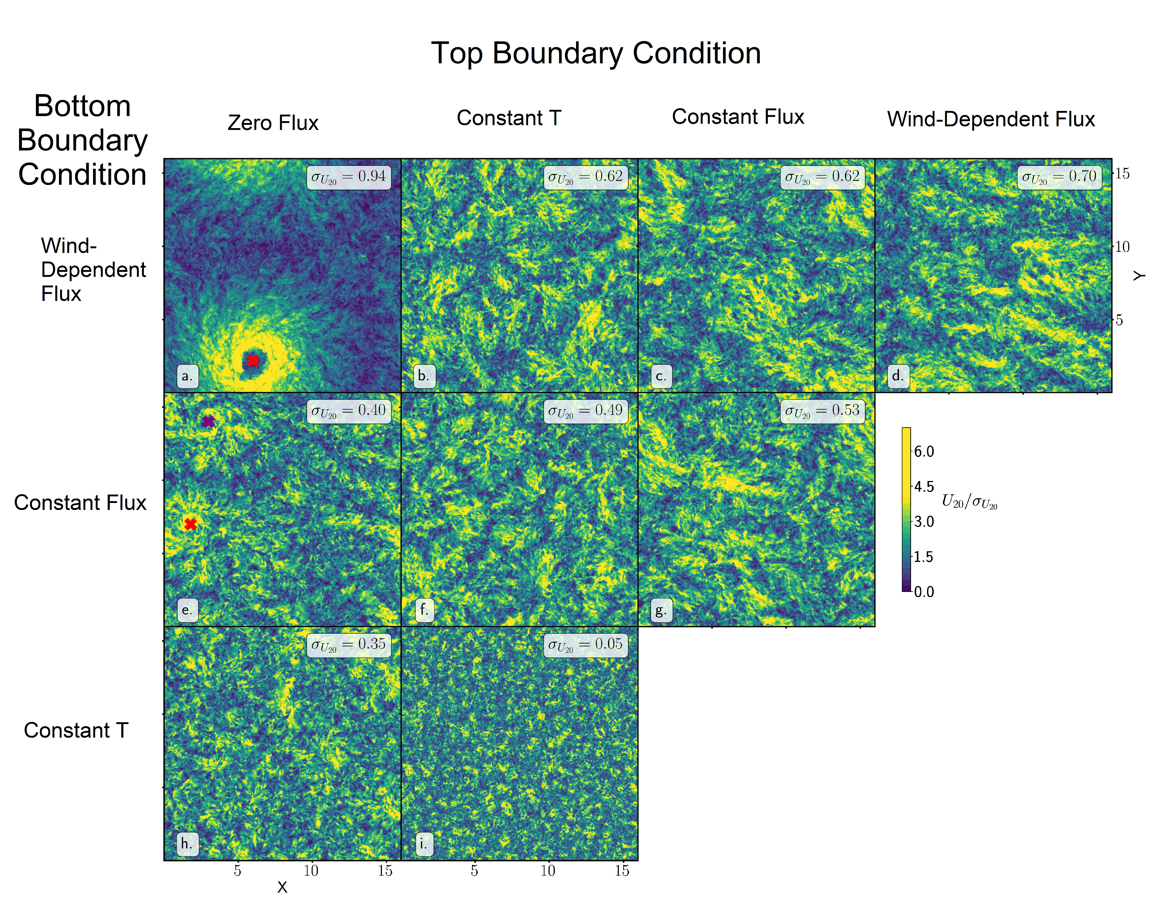
WISHE
Velez-Pardo, M., and T. W. Cronin, 2023: Large-scale circulations and dry tropical cyclones in direct numerical simulations of rotating Rayleigh-Bénard convection. Journal of the Atmospheric Sciences, https://doi.org/10.1175/JAS-D-23-0018.1.

Slide 19
Tropical cyclones are driven by wind-dependent lower boundary heat fluxes
They are not driven by latent heat release in clouds

Slide 20
What Difference DOES moisture make?
Strong inhibition to TC formation
But for equivalent overall driving, phase change of water makes TCs more intense
Note: Latent heating is not diabatic heating

Slide 21

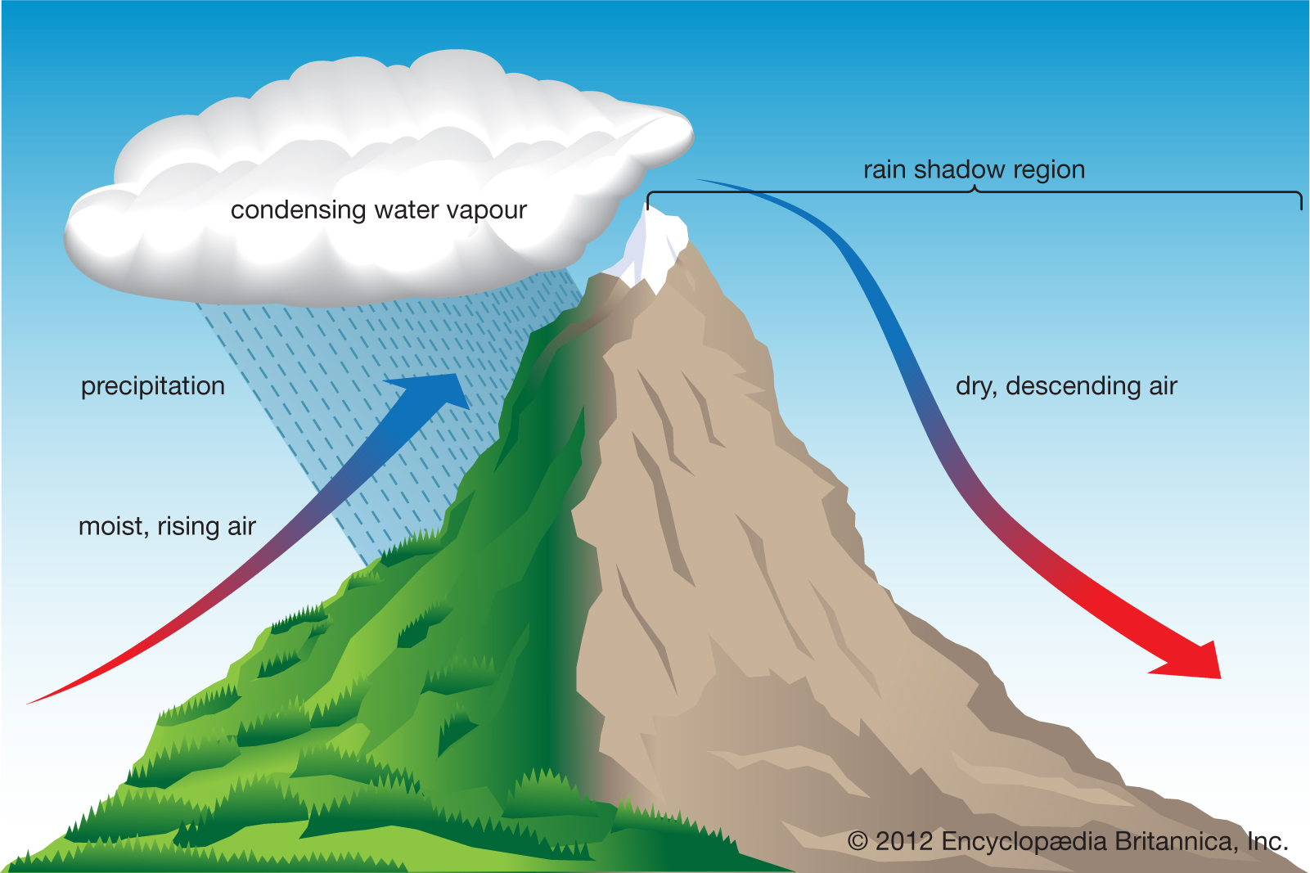
X
True Diabatic Heating
Conversion of latent to sensible heat
Heating always positively correlated with temperature
Will always create a circulation
“Heating” may be negatively correlated with temperature
Will often damp a circulation
Guaranteed to damp circulation when upstream Moist Available Potential Energy (MAPE) = 0

Slide 22
A Variant on the Priestley Convection Problem
Rough surface
Semi-infinite, dry Boussinesq fluid subject to a constant rate of cooling, overlying a rigid plate held at fixed temperature

Slide 23
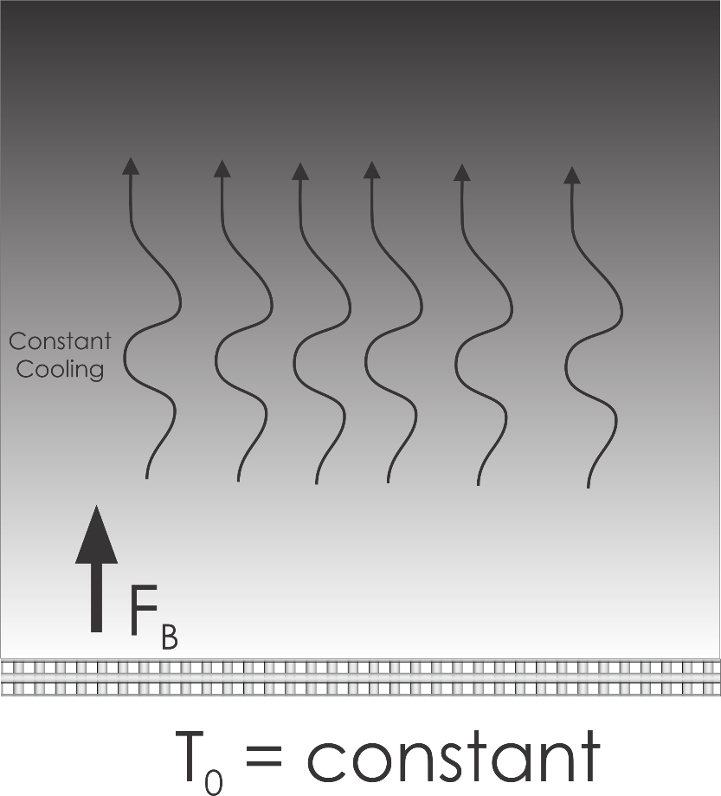
Variation: The Saturated Moist Priestley Convection Problem
As in dry problem but for a water-saturated atmosphere with constant total water concentration, but whose cloud water content (shading) increases with altitude

Slide 24
This problem is mathematically isomorphic to the classical Priestley problem after transforming vertical coordinate to
Temperature along a moist adiabat starting at T₀
Dry adiabatic lapse rate
Same exact solution as before, replacing z by μ
Moist rather than dry static energy becomes the relevant conserved variable
As before, almost all entropy production is by dissipation of turbulence kinetic energy

Slide 25
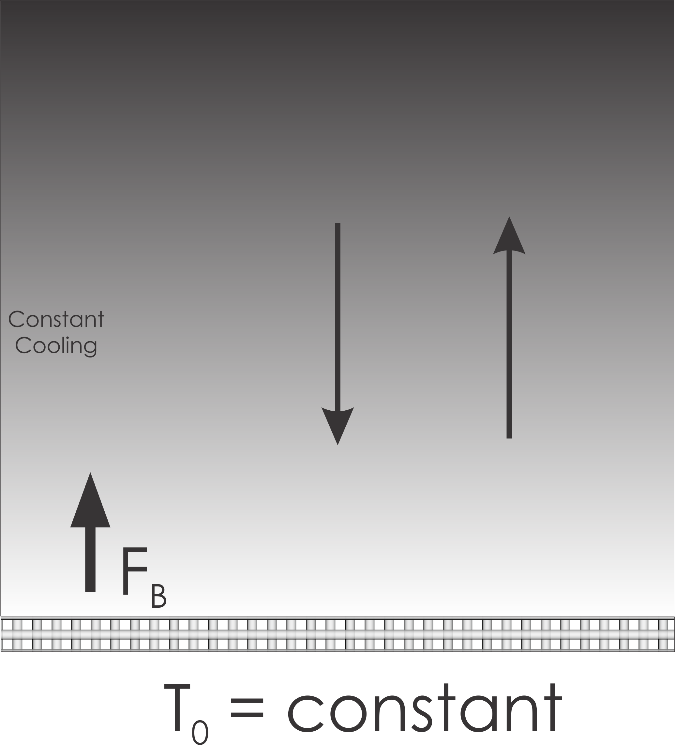
Latent cooling
Latent heating

Slide 26
Latent cooling
Latent heating
Would you say that the turbulence is driven by latent heating and cooling?

Slide 27
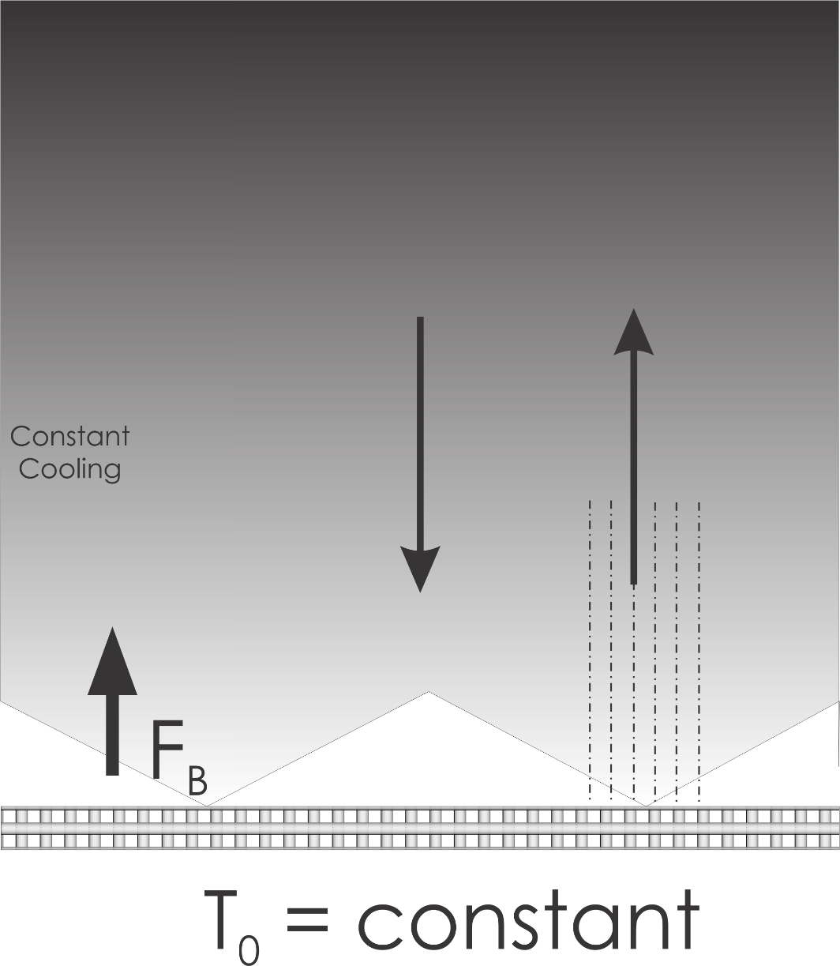
One more variant: permit just a little precipitation:
Unsaturated air
But with moist adiabatic lapse rate. Source of buoyancy in downward-moving unsaturated air

Slide 28

Moist Radiative-Convective Equilibrium (RCE)
No source of saturation moist static energy in upward moving air
Strong source of saturation moist static energy in downward moving air
Irreversible fallout of water leads to strong buoyant brake on TKE production
Almost all entropy production is by mixing of saturated with unsaturated air; little left over for TKE production
For same radiative forcing, moist convection is much weaker than dry convection

Slide 29
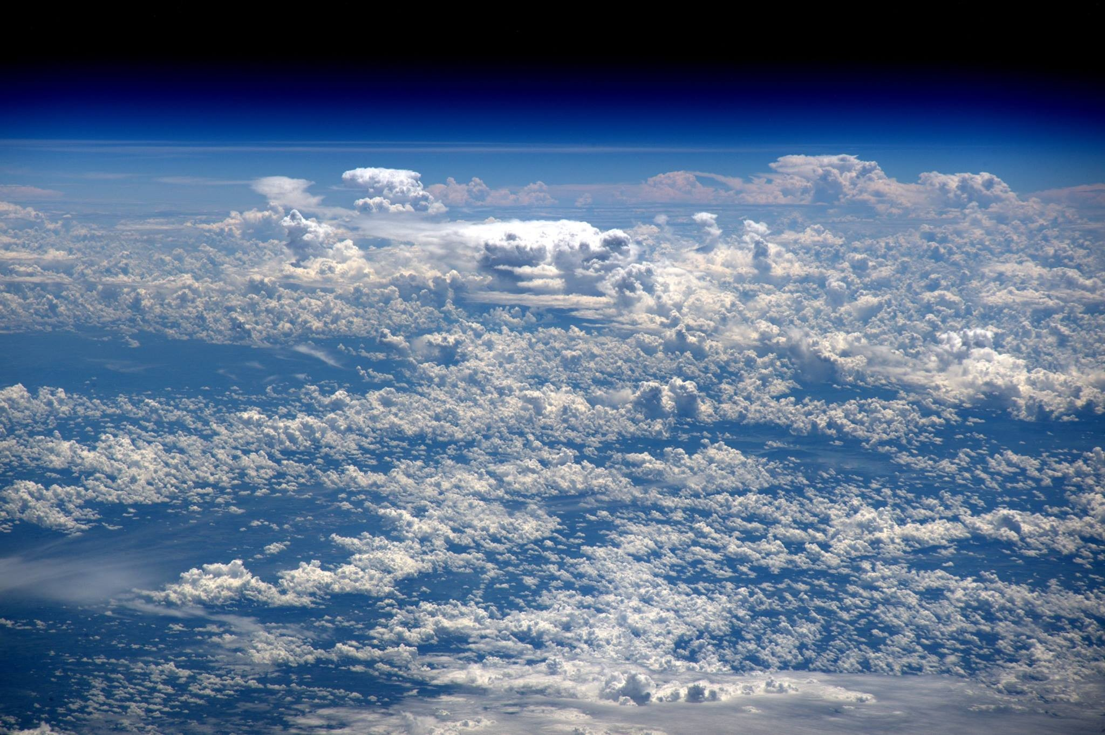
Real TCs Form in Mostly Non-rotating Near-RCE States

Slide 31
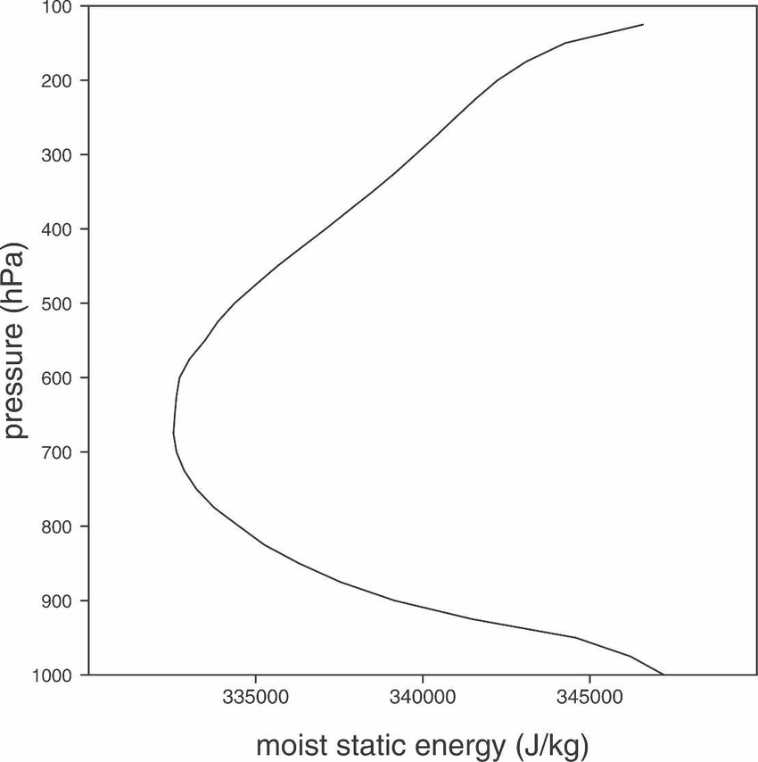
The Inhibition to Genesis

Slide 32
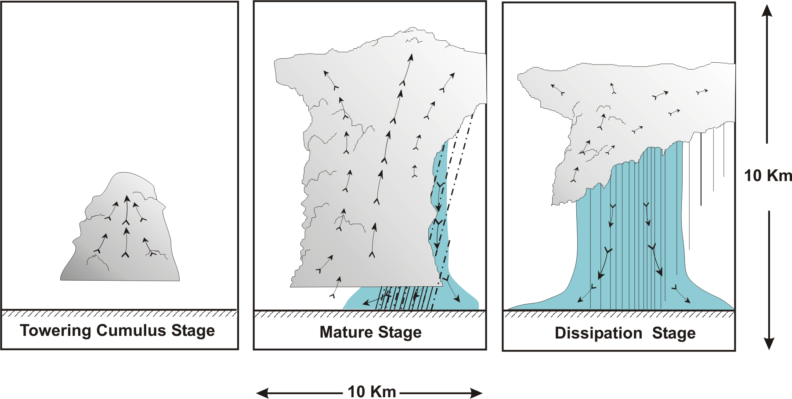
“Air-Mass” Showers:
After Byers and Braham, 1948

Slide 33
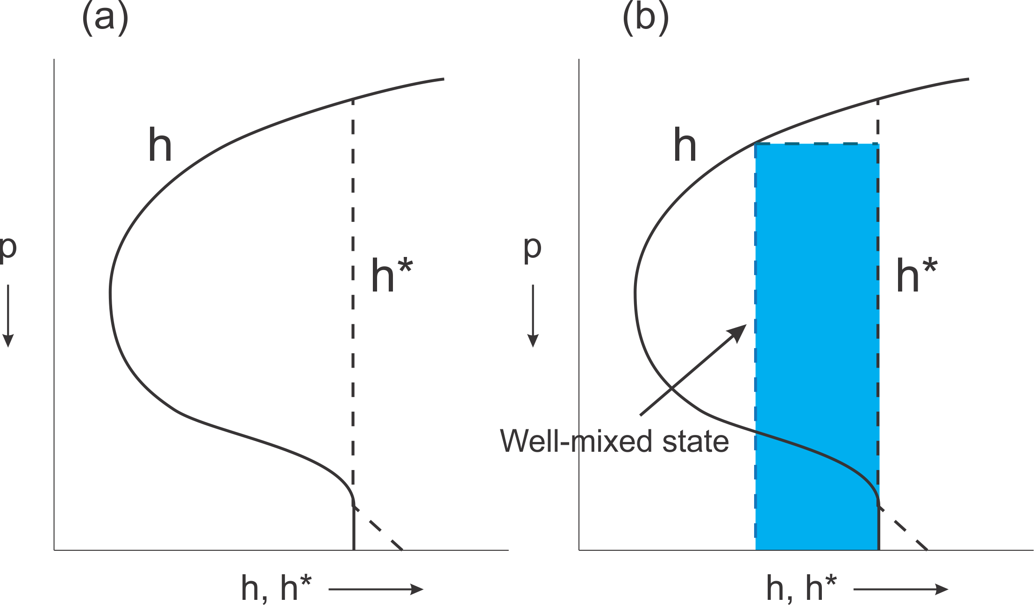
To overcome thermodynamic inhibition, mesoscale column must come close to saturation. How does that happen?
Saturation at SST
Energetically advantageous to go through cold-core phase first

Slide 34
Self-Aggregation of Moist Convection

Slide 35
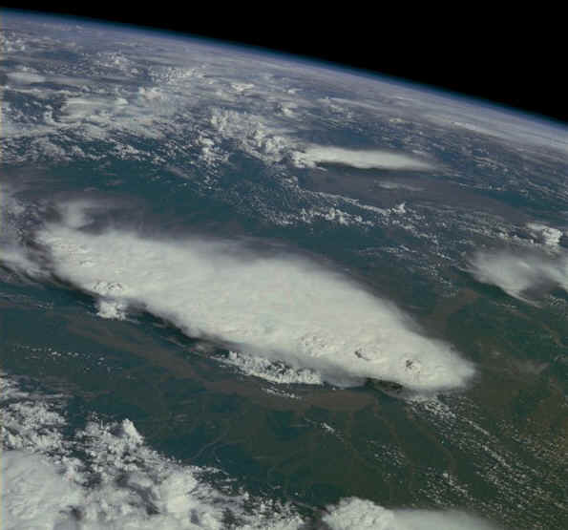
Monsoonal Thunderstorms, Bangladesh and India, July 1985

Slide 36

Compelling Results from Cloud-Permitting Models:
Tompkins and Craig, 1998: RCE in 3-D box: “This organization seems to result from interactions between radiation, convection and surface fluxes.”
Bretherton, Blossey and Khairoutdinov (2005): “The self-aggregation is analyzed as an instability of a horizontally homogeneous convecting atmosphere driven by convection–water vapor–radiation feedbacks that systematically dry the drier air columns and moisten the moister air columns.”
Self-aggregation can be suppressed by horizontally homogenizing the radiative cooling or surface fluxes.
Lower-tropospheric wind shear leads to slightly slower and less pronounced self-aggregation into bands aligned along the shear vector.

Slide 37
Aggregation on an f-plane
For a range of Coriolis parameter values, self-aggregation on an f-plane takes the form of tropical cyclones
Once a mesoscale column becomes saturated, the vortex is amplified by a feedback between vortex winds and surface enthalpy fluxes.
This is known as Wind-Induced Surface Heat Exchange (WISHE)

Slide 38
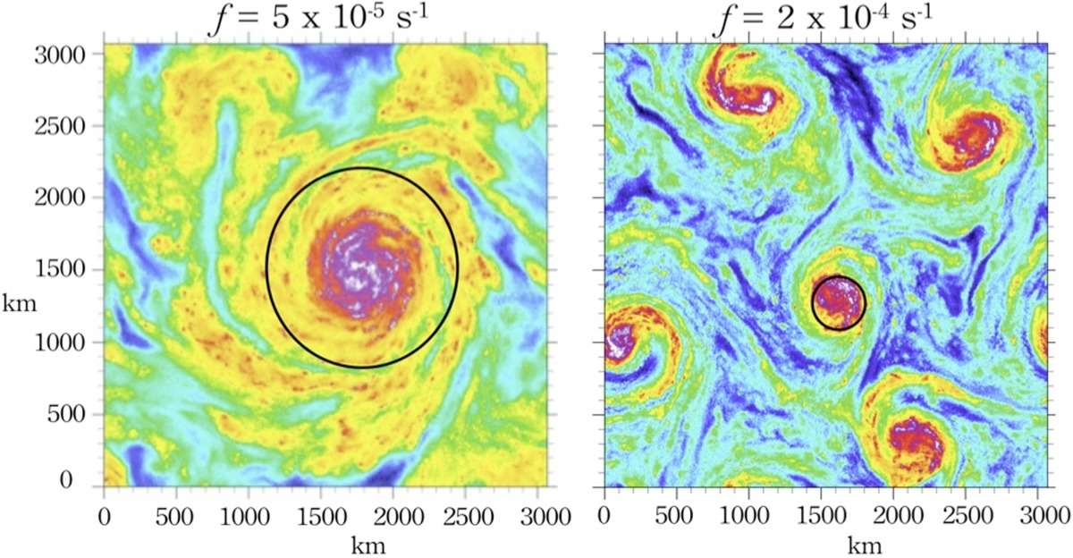
Rotating radiative‐convective equilibrium simulated by a cloud‐resolving model
Precipitable Water
J Adv Model Earth Syst, Volume: 5, Issue: 4, Pages: 816-825, First published: 12 November 2013, DOI: (10.1002/2013MS000253)
Notes:
Tropical cyclones for two different values of the Coriolis parameter in otherwise identical RCE simulations (precipitable water is shown; warm colors represent higher values). The black circles on the foreground have diameters computed from formula (1).
IF THIS IMAGE HAS BEEN PROVIDED BY OR IS OWNED BY A THIRD PARTY, AS INDICATED IN THE CAPTION LINE, THEN FURTHER PERMISSION MAY BE NEEDED BEFORE ANY FURTHER USE. PLEASE CONTACT WILEY'S PERMISSIONS DEPARTMENT ON PERMISSIONS@WILEY.COM OR USE THE RIGHTSLINK SERVICE BY CLICKING ON THE 'REQUEST PERMISSIONS' LINK ACCOMPANYING THIS ARTICLE. WILEY OR AUTHOR OWNED IMAGES MAY BE USED FOR NON-COMMERCIAL PURPOSES, SUBJECT TO PROPER CITATION OF THE ARTICLE, AUTHOR, AND PUBLISHER.

Slide 39
Steady-State Energetics

Slide 40
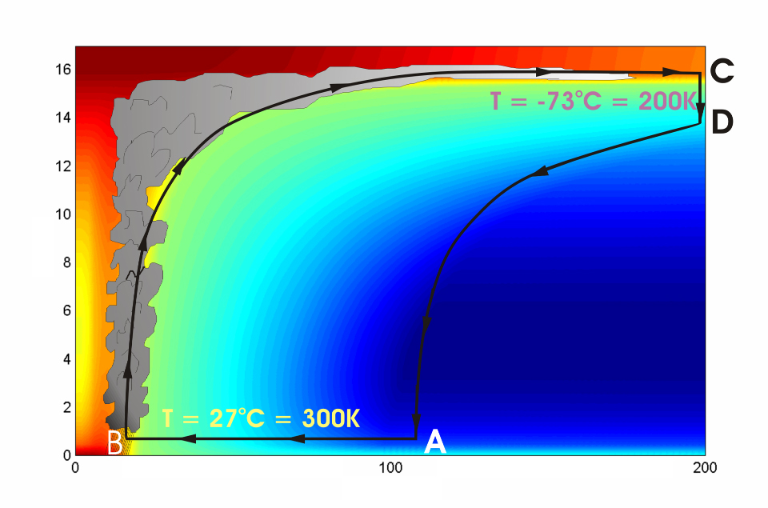




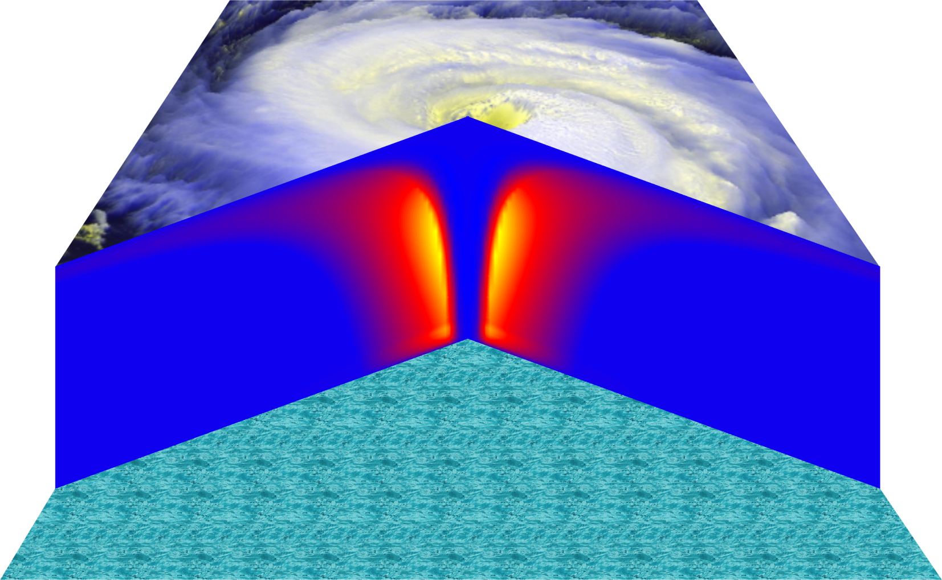
Cross-section through a Hurricane & Energy Production
eye
edge
Isothermal compression
Adiabatic expansion
Adiabatic compression
Height above ocean
Nearly isothermal expansion
Low entropy
Ocean surface
Radius (km)
Notes:
NOTE: We have animated the path of air for this slide and included labels to help our audience understand what you will be describing. Many of them will have never even heard of a Carnot heat engine and do not have a strong understanding of entropy. We would like to do whatever we can in to make this information accessible to our audience. Please let us know if you approve of these changes, and feel free to replace the labels as needed. The simpler you can keep your description of this, the better. You do an excellent job of describing the process in your book.
***
The energy cycle of a mature hurricane - the hurricane as a Carnot heat engine. This two-dimensional plot of the thermodynamic cycle shows a vertical cross section of the hurricane, whose storm center lies along the left edge. The colors depict the entropy distribution; cooler colors indicate lower entropy. Loosely, this means the total heat content of the air. Note that as air approaches the eyewall, its entropy increases rapidly, reflecting the large input of heat from the ocean.
Let’s follow a sample of air that begins at point A near the sea surface, a hundred kilometers or so from the storm center. The process mainly responsible for driving the storm is the evaporation of seawater, which transfers energy from sea to air. As a result of that transfer, air spirals inward close to the sea surface, between Points A and B. The storm center is an area of relatively low pressure, so the pressure on air decreases as it travels from A to B. But it is always in contact with the sea surface, which acts as an almost unlimited heat reservoir, so its temperature is approximately constant (acquiring entropy at a constant temperature). It is during this leg that enormous quantities of heat are added to the air from evaporation of seawater. Evaporation of water is a very efficient way to transfer heat from one body to another. That is why you feel cold when you are wet, especially if it is windy and/or dry: evaporation is taking heat from your body. Thus the addition of heat in leg A-B shows up mostly as an increase in humidity in the air. This form of heat is called latent heat. Evaporation of sea water into the inflowing air is by far the most important source of heat driving the hurricane, which makes leg A-B the firebox of the hurricane. When hurricanes reach land, they quickly die because they are cut off from their oceanic energy source. At point B, the air turns and flows upward through the towering cumulonimbus clouds that make up the hurricane’s eyewall. It is here that the latent heat is converted to sensible heat as water vapor condenses. But it is important to note that although there is enormous conversion between these two forms of heat, the total heat content (entropy, actually) remains approximately constant along this leg (note that the colors do not change along leg B-C). As the air flows upward, the pressure on it decreases very rapidly. What we have here is an example of adiabatic expansion. By the time the air reaches point C in the high troposphere or lower stratosphere, some 12 to 18 kilometers above the sea surface, the adiabatic expansion has lowered its temperature to a value close to that of the undisturbed upper tropical atmosphere, around -70°C or about 200 Kelvin. The air remains at approximately this temperature as it sinks down toward the tropopause (point D). Although the air is undergoing compression, it is losing heat by electromagnetic radiation to space. The depicted compression is very nearly isothermal. Finally, between D and A, the air returns to its starting point while undergoing an adiabatic compression. Voilà, the four legs of a Carnot cycle.
In a real hurricane, the energy cycle is open because hurricanes continuously exchange air with their environment.
Image is copyrighted 2005 by Oxford University Press.
Description from “Divine Wind: The History and Science of Hurricanes”, Kerry Emanuel, 2005, Oxford University Press, 296 p.

Slide 41
Carnot Theorem: Maximum efficiency results from a particular energy cycle:
Isothermal expansion
Adiabatic expansion
Isothermal compression
Adiabatic compression
Note: Last leg is not adiabatic in hurricanes: Air cools radiatively. But since the environmental temperature profile is moist adiabatic, the amount of radiative cooling is the same as if air were saturated and descending moist adiabatically.
Maximum rate of energy production:

Slide 42
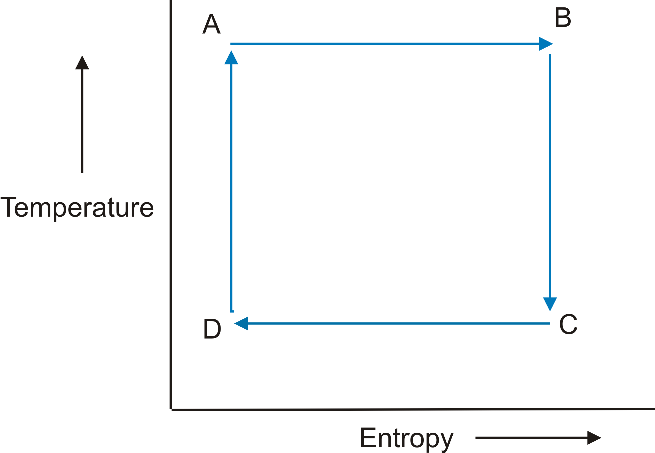

Slide 43
Total rate of enthalpy input to hurricane:
Dissipative heating
Surface enthalpy flux
In the steady state, energy production is used to balance frictional dissipation:

Slide 44
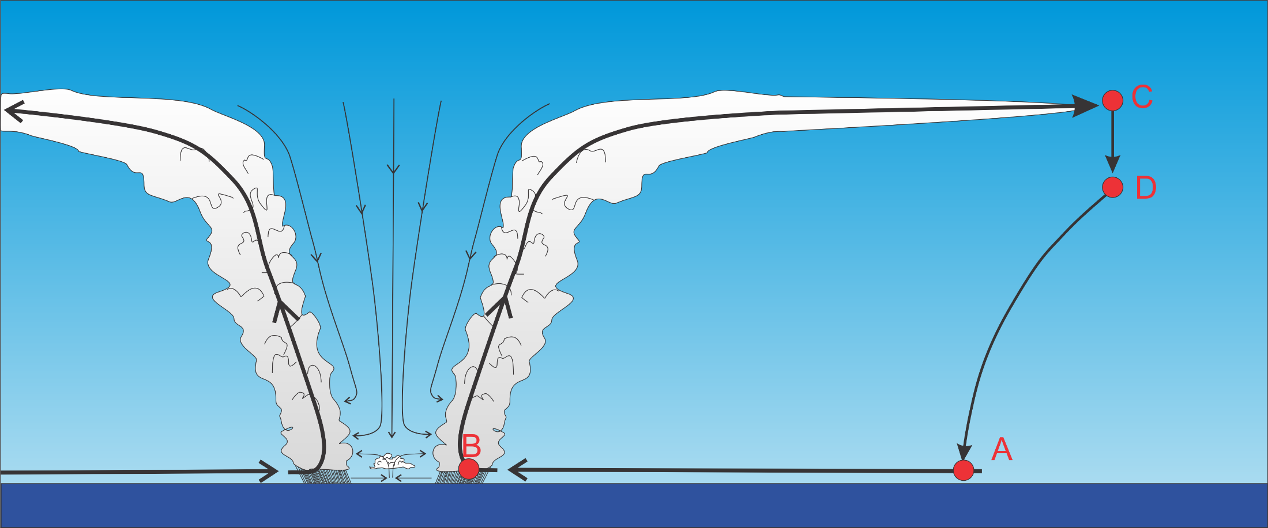
Differential Carnot Cycle

Slide 45
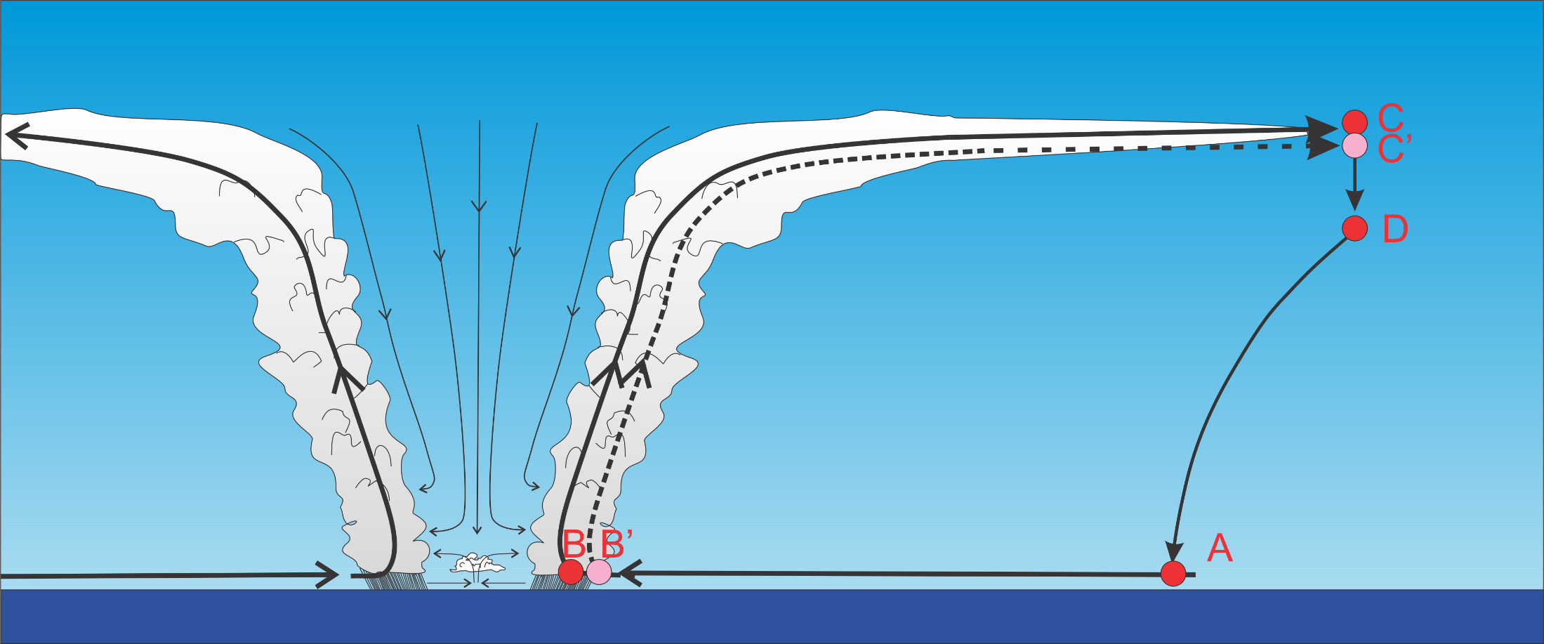

Slide 46
Internally determined
Note that this is valid between ANY two streamlines in the region of ascent

Slide 47
Potential Intensity
Depends only on ratio of exchange coefficients for enthalpy and momentum
Not a closed expression because the enthalpy, k, at the radius of maximum winds is unknown, as is the outflow temperature, T_{o}
Although traditionally evaluated at the radius of maximum winds, it is in fact valid anywhere in the core where the column is saturated

Slide 48
Internally determined
Moist neutrality:

Slide 49
Thermal Wind relation in rotating, moist-neutral atmosphere:
Integrate inward to find h*.
What about T₀?

Slide 50
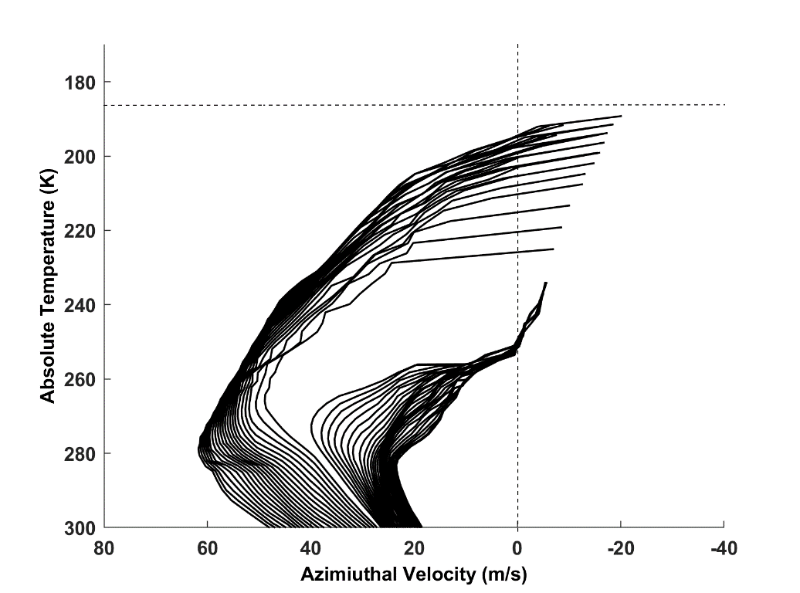
We are really now just left with the problem of the upper boundary condition, T_{o}(M). Not considered a solved problem.
Let’s look for clues in the distribution of T_{o}(M) in a numerical simulation:
Tropopause T
Upflow M surfaces: Note: T_{o}=T_{o}(M)
Downflow M surfaces
Contours of constant angular momentum plotted as a function of azimuthal velocity and absolute temperature from the quasi-steady state of a simulation using the nonhydrostatic, axisymmetric model of Rotunno and Emanuel (1987).

Slide 51
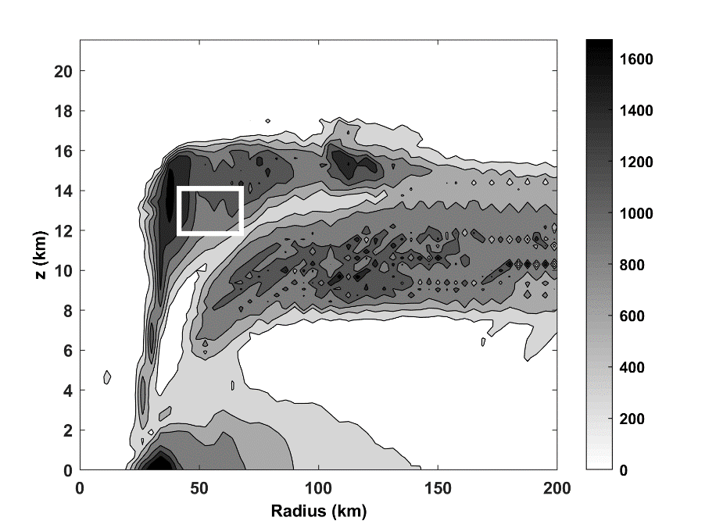
Hypothesis: 1) Stratification of TC outflow determined by turbulence; 2) turbulence holds Richardson Number constant at its critical value
Vertical diffusivity (m² s⁻¹) averaged over the last 24 hours of a numerical simulation of a tropical cyclone using the model of Rotunno and Emanuel (1987). The white box indicates an area in which sample of stratification and wind shear are collected.

Slide 52
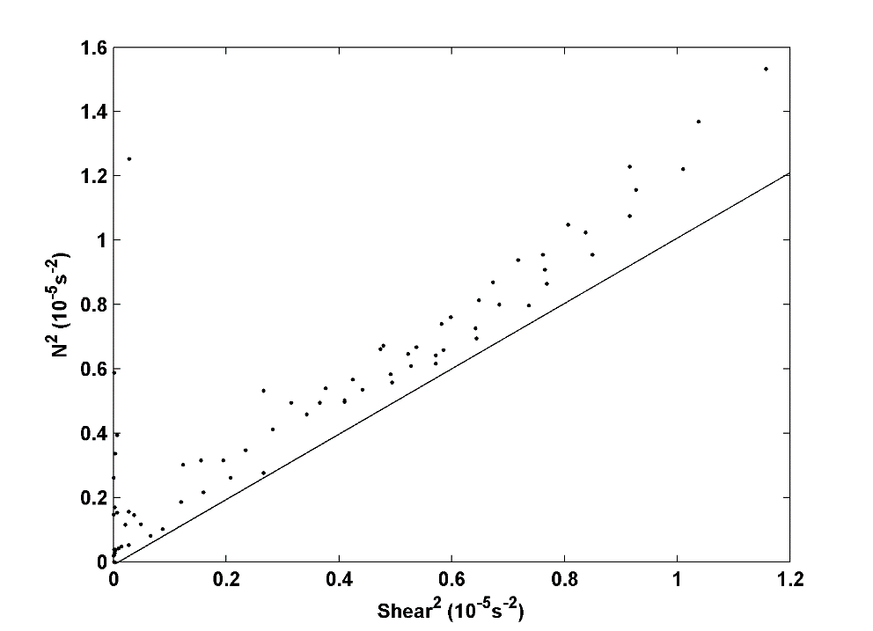
Square of the buoyancy frequency plotted against square of the vertical wind shear in samples collected from within the white box of previous figure. Solid line shows Richardson Number =1.

Slide 53
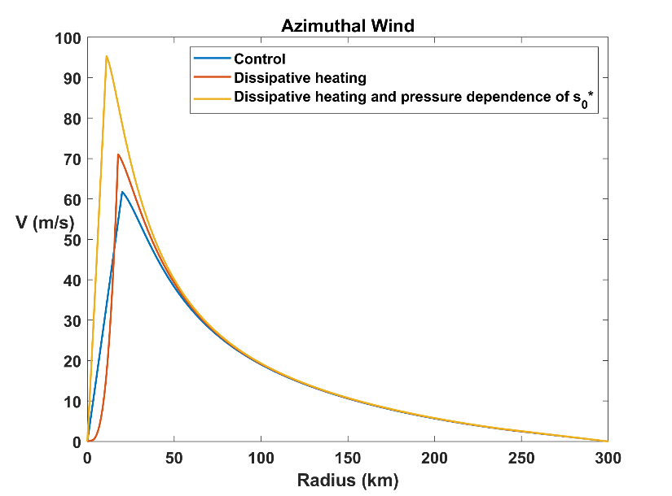
Numerical solution of full steady-state model, without approximations, available in MATLAB code steady_state_model.m at
https://zenodo.org/records/18635966
as part of a larger set of codes, including full-physics axisymmetric model. (Code can also be run in free Octave.)
Importance of isothermal expansion and dissipative heating:
Steady-state radial profiles of surface azimuthal wind for the standard experiment with neither dissipative heating nor pressure dependence of (blue), just dissipative heating (red), and both effects together (yellow)

Slide 54
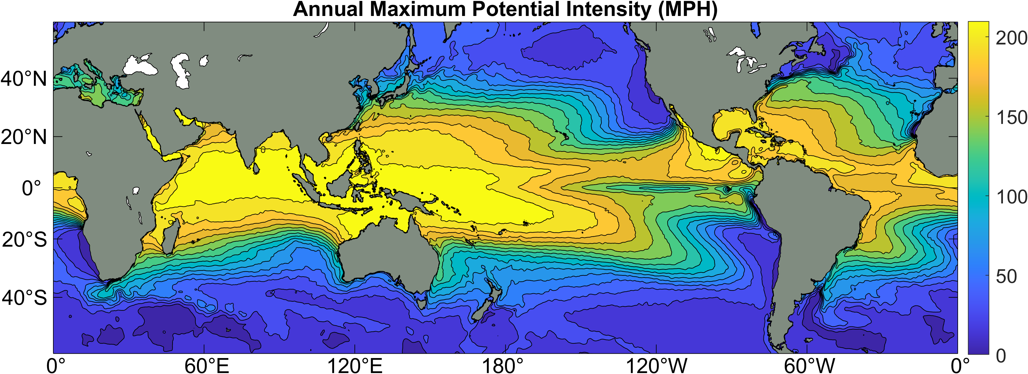
Annual Maximum Potential Intensity (miles per hour)

Slide 55
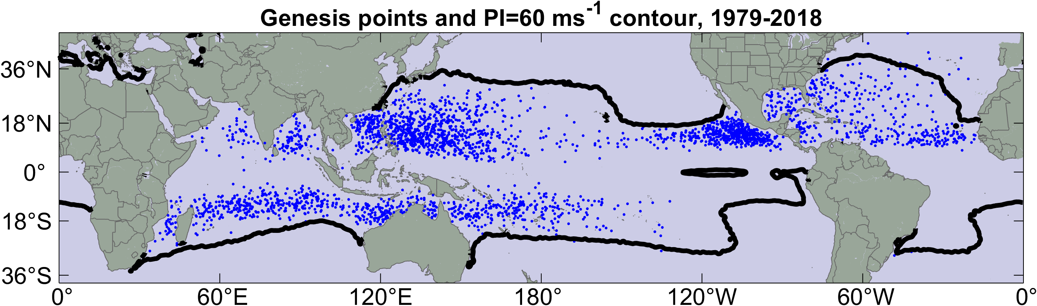
Hurricanes only form where potential intensity is large enough
Blue dots are locations of hurricane formation, 1979-2018
Black contour is contour of 130 MPH potential intensity

Slide 56
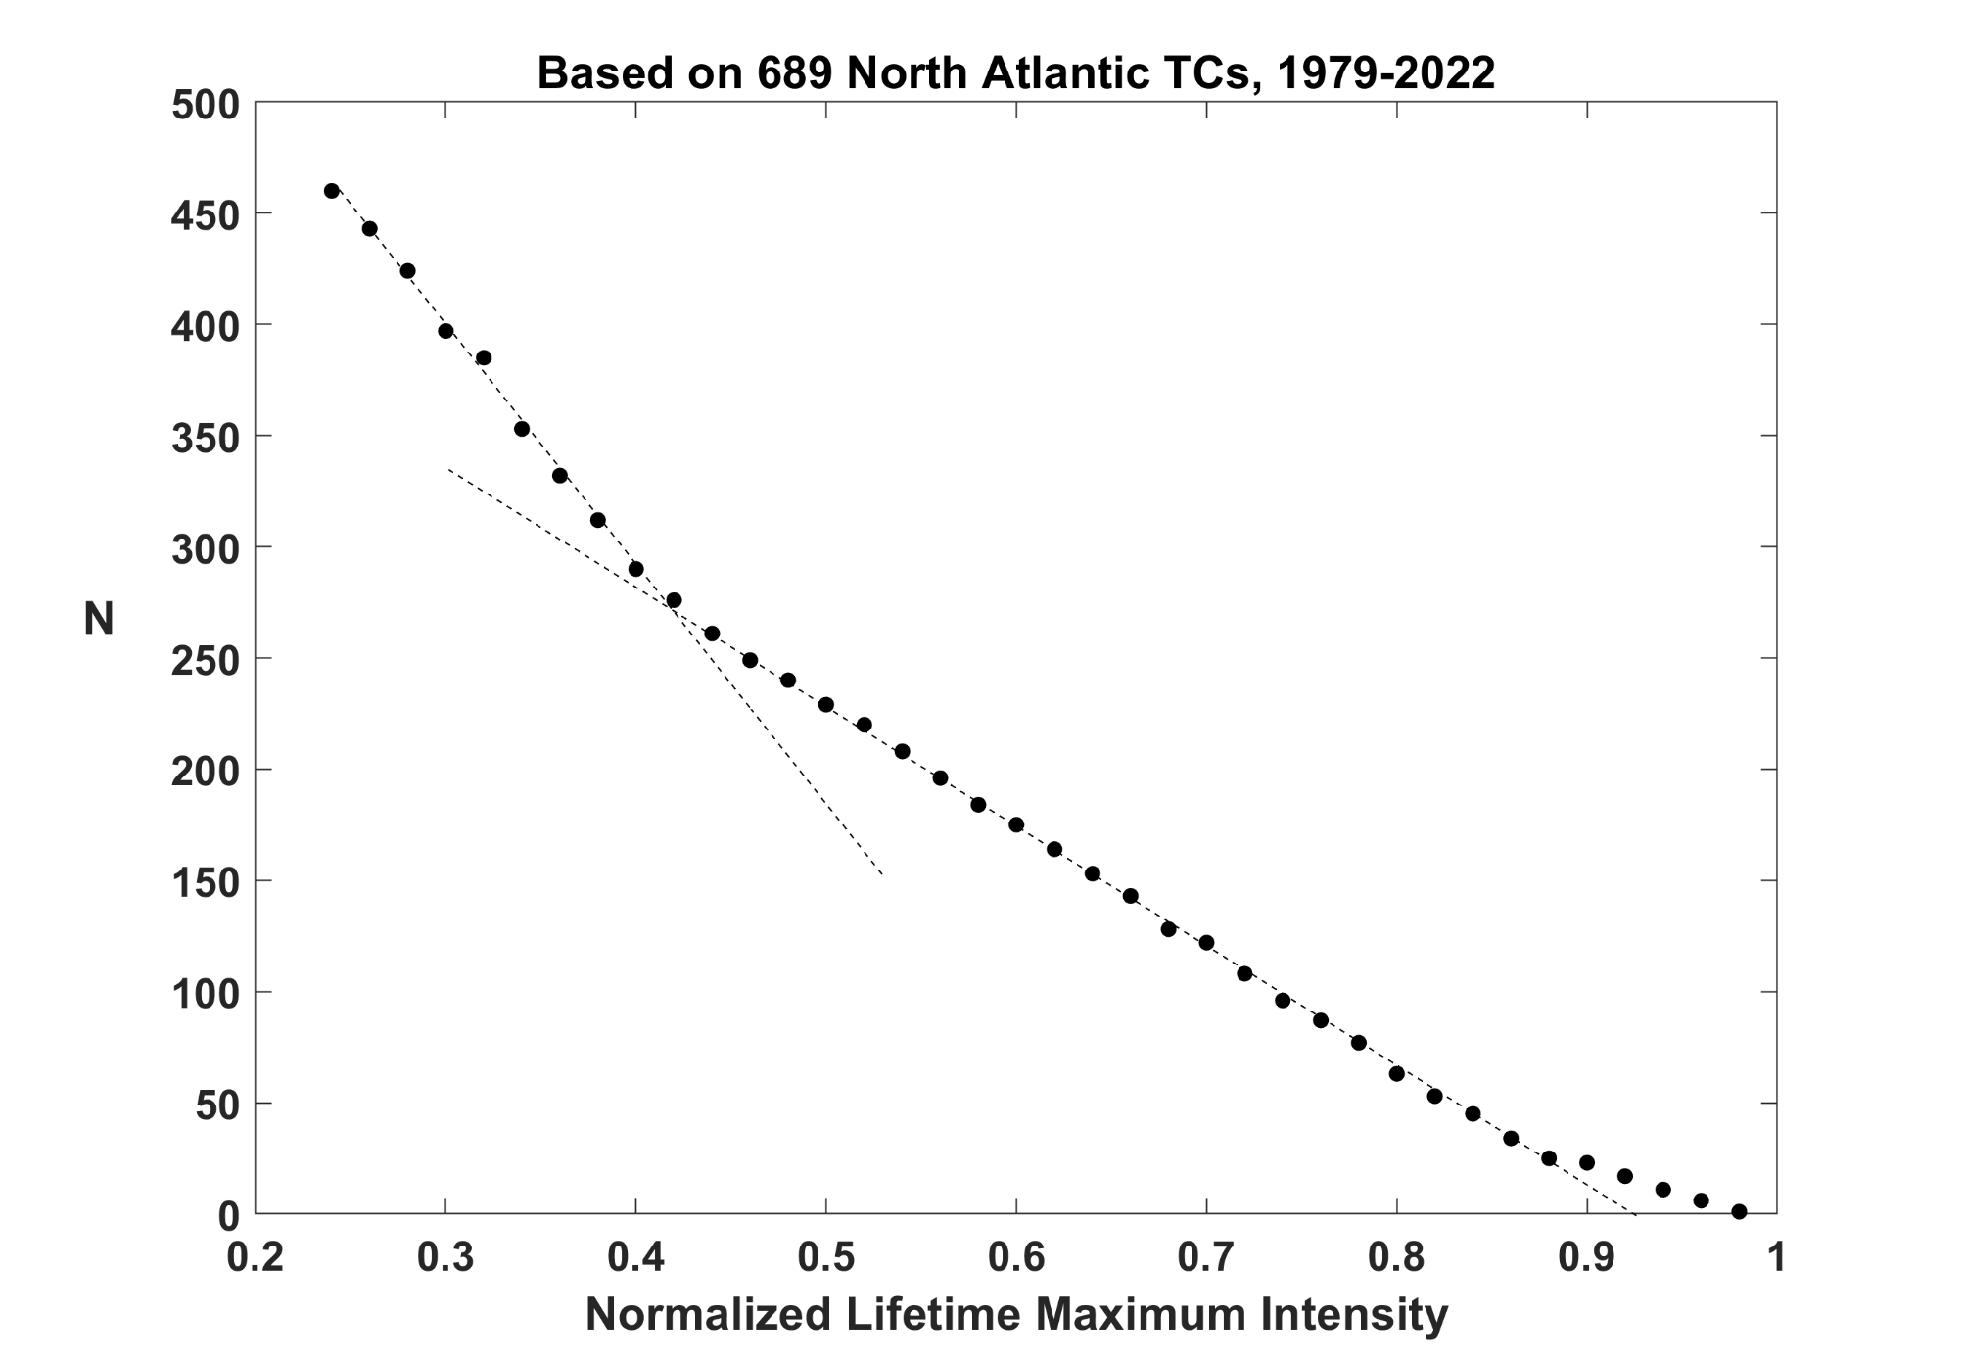
Limited by landfall
Limited by shear

Slide 57
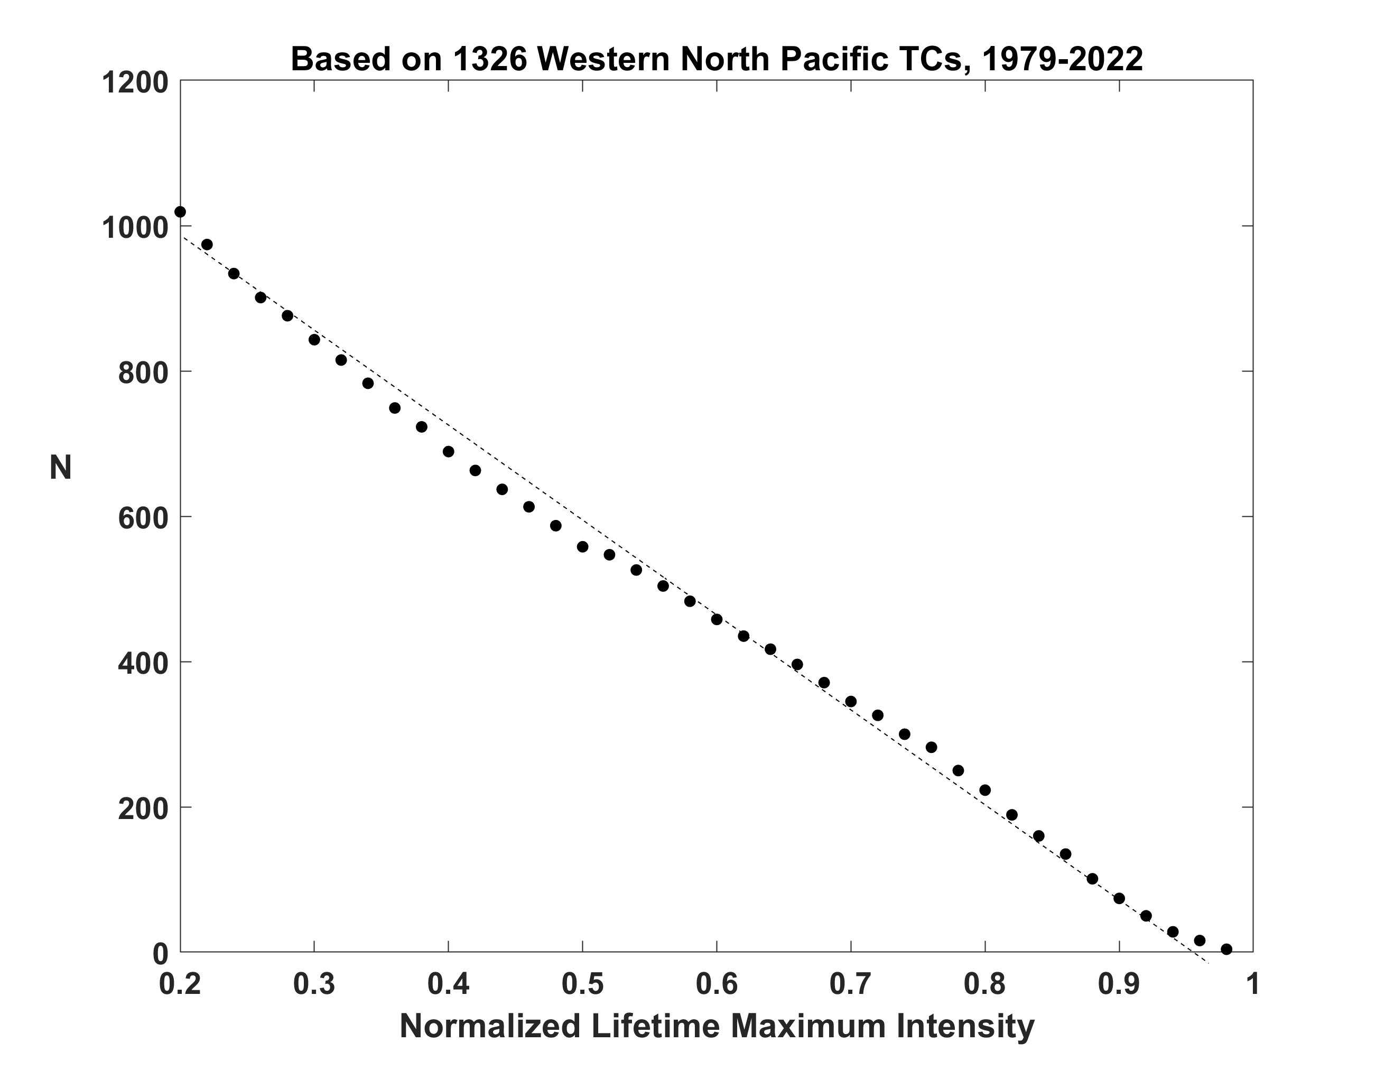
Same but for Western North Pacific

Slide 58
Summary
Tropical cyclones result from the thermodynamic disequilibrium between the troposphere and the ocean.
They form only when the turbulent heat flux from the ocean is rate-limited by near- surface shear-driven turbulence
TCs are good examples of Carnot heat engines except that they convert most of the work back into heat, which is fed back in to the front of the engine

Slide 59
The structure, intensity, and intensification of TCs apparently depends on self- stratification of their outflow, in which turbulence drives the outflow toward Richardson-Number criticality
Among many still-unsolved problems are how to calculate enthalpy and momentum fluxes through the air-sea emulsion that develops in high surface winds, and whether and how TCs feed back on climate

