Slide 1
Impending. Oil painting by American artist Amy Marx
The Voice of the Sea is never one voice, but a tumult of many voices—voices of drowned men,—the mutterings of multitudinous dead,—the moaning of innumerable ghosts, all rising, to rage against the living, at the great Witch-call of storms….—Lafcadio Hearn (1850–1904), Chita: A Memory of Last Island

Slide 2
Hurricane Risk in Tampa
Kerry Emanuel
Massachusetts Institute of Technology
Notes:
2

Slide 3
Program
Overview of Hurricanes
Using Physics to Assess Hurricane Risk
Hurricane Risk in Tampa: Present and Future

Slide 4
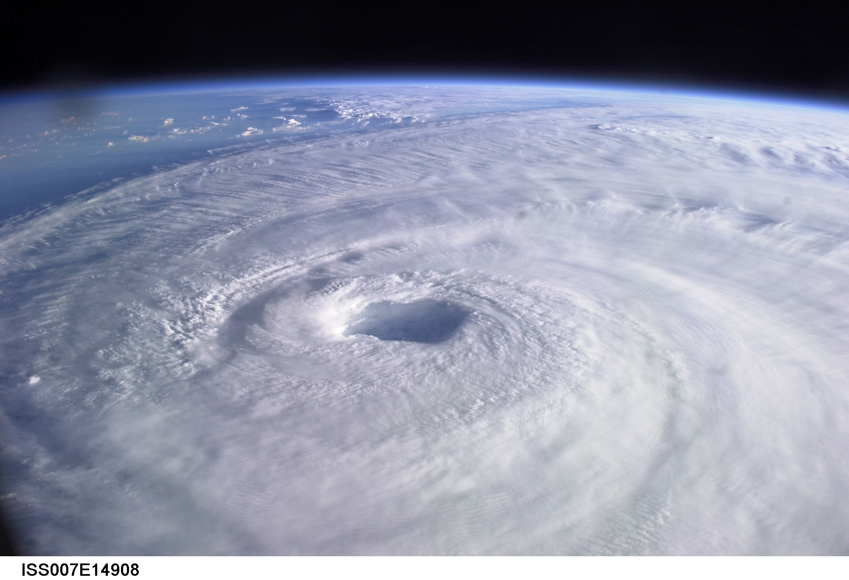
Brief Overview of Tropical Cyclones
Notes:
4

Slide 5
What is a Hurricane?
Formal definition: A tropical cyclone with 1-min average winds at 10 m altitude in excess of 32 m/s (64 knots or 74 MPH) occurring over the North Atlantic or eastern North Pacific

Slide 6
The word Hurricane is derived from the Mayan word Huracan and the Taino and Carib word Hunraken, a terrible God of Evil, and brought to the West by Spanish explorers
Blow, winds, and crack your cheeks! rage! blow! You cataracts and hurricanoes, spout Till you have drench’d our steeples, drown’d the cocks! -- King Lear

Slide 7
The View from Space
Notes:
The advent of reconnaissance aircraft and radar in the 1940s, and of satellites in the 1960s, gave scientists the means to determine the detailed structure and evolution of hurricanes. Today, almost everything we know about hurricanes is based on observations by aircraft, radar, and satellites. This satellite image shows Hurricane Floyd approaching the east coast of Florida in 1999. This image has been digitally enhanced to lend a three-dimensional perspective. The swirling mass of clouds is about 300 kilometers (180 miles) across, and Floyd’s eye is about 50 kilometers (30 miles) in diameter. Surrounding the eye is a deep ring of thick cloud called the eyewall. A thin veil of very high cloud covers most of the swirling mass of thicker clouds; this is the veil of cirrus, made up of tiny ice crystals. Underneath it, and thus invisible from above, are several spiral shaped bands of deep, thick cumulonimbus clouds, interspersed between relatively clear sky. These spiral bands produce heavy rains and gusty winds well outside the eyewall of the hurricane, where the strongest winds are found.
Image: Satellite image of Hurricane Floyd approaching the east coast of Florida in 1999. The image has been digitally enhanced to lend a three-dimensional perspective. Credit: NASA/Goddard Space Flight Center.
Description from “Divine Wind: The History and Science of Hurricanes”, Kerry Emanuel, 2005, Oxford University Press, 296 p.
Definitions
Reconnaissance is the military term for the active gathering of information about an enemy, or other conditions, by physical observation (from and for more information see http://en.wikipedia.org/wiki/Reconnaissance).
The eye is a region of mostly calm weather found at the center of strong tropical cyclones. The eye of a storm is usually circular and typically 25–40–65 kilometers (40 miles) in diameter. It is surrounded by the eyewall, where the most severe weather of a cyclone occurs (from and for more information see http://en.wikipedia.org/wiki/Eyewall).
Cirrus clouds are thin and often wispy clouds that are the most common form of high-level clouds. Typically found at heights greater than 20,000 feet (6,000 meters), cirrus clouds are composed of ice crystals that originate from the freezing of supercooled water droplets (from and for more information see http://weather.about.com/library/glossary/blglossary.htm).
Cumulonimbus clouds are large and vertically developed clouds that are fueled by vigorous convective updrafts (sometimes in excess 50 knots), the tops of cumulonimbus clouds can easily reach 39,000 feet (12,000 meters) or higher (from and for more information see http://weather.about.com/library/glossary/blglossary.htm).

Slide 8
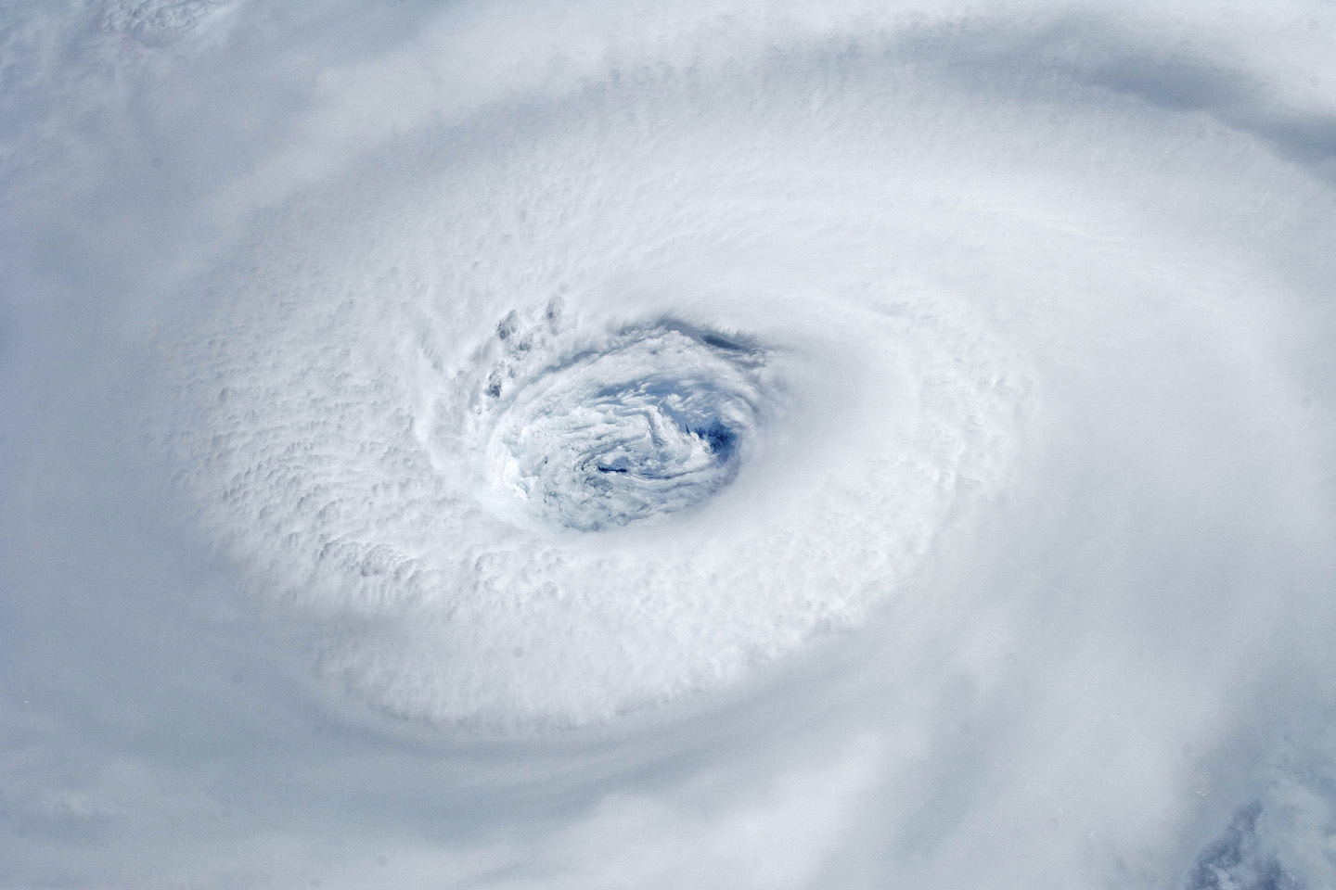
Igor, 2010
Notes:
Astronauts aboard the International Space Station took this digital photograph of the eye of Hurricane Igor at 10:56 Atlantic Daylight Time (13:56 UTC) on September 14, 2010. The storm was a category four hurricane on the Saffir-Simpson scale of intensity. At the time of the image, Igor was centered in the Atlantic Ocean near 18°N 52°W and slowly moving west-northwest at 11 kilometers (7 miles) per hour, according to the U.S. National Hurricane Center. Maximum sustained winds of 213 km (132 mi.) per hour, with gusts to 259 km (161 mi.) per hour. Credit: NASA

Slide 9
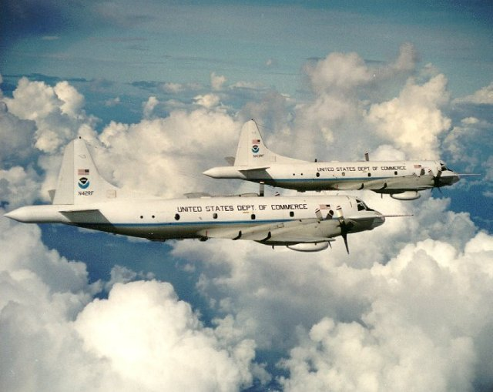

Slide 10
Notes:
The eye of Hurricane Georges in this photo taken from a reconnaissance aircraft gives some impression of a hurricane’s eye.
However impressive a hurricane’s visual appearance, it is the instruments aboard satellites and aircraft that reveal the essence of a hurricane’s structure and inner workings. In the early days of aircraft reconnaissance, the crew estimated wind speeds by looking down and noting how rough the sea appeared. Today, a sophisticated array of instruments automatically collects large quantities of high-quality data, which are taken back to laboratories and analyzed.
Image: The eye of Hurricane Georges in photo taken from a reconnaissance aircraft. The eyewall at right is casting a shadow across part of the eyewall ahead. Credit: Michael Black, Hurricane Research Division, NOAA-AOML, Miami, Florida.
Description from “Divine Wind: The History and Science of Hurricanes”, Kerry Emanuel, 2005, Oxford University Press, 296 p.

Slide 11
Hurricane Structure: Wind Speed
Azimuthal component of wind
< 11 mph - > 145 mph
Notes:
A composite view of the distribution of wind speed in a typical hurricane based on measurements made from research aircraft. In this image and the two that follow, the center of the hurricane is in the center of the panel and the cutaway extends outward about 200 km (125 miles) and upward to about 18 km (11 miles). A satellite image of the top of a storm has been superimposed.
This image shows the speed of the wind going counterclockwise around the center of the storm; the black dashed lines show the altitudes at which the aircraft were flying. The darkest shade of blue indicates the lightest winds, less than 5 meters/second (11 mph). Each successive color represents an increment of 5 meters/second (11 mph), with bright orange showing winds in excess of 65 meters/second (145 mph). The strongest winds occur just above the ocean in a ring around the center, slightly outside the eyewall of the storm. Winds decrease rapidly inward toward the center, which is practically calm. They also decrease outward from the ring of maximum wind , but much more slowly, so that strong winds can still be found 100 kilometers (60 miles) from the center of the storm. As we go up from the surface, the counterclockwise winds get lighter and lighter. If the highest aircraft had flown even higher, it would have actually encountered “negative” wind speed, which here means winds going the other way (clockwise) around the center.
Image is copyrighted 2005 by Oxford University Press.
Image and description from “Divine Wind: The History and Science of Hurricanes”, Kerry Emanuel, 2005, Oxford University Press, 296 p.

Slide 12
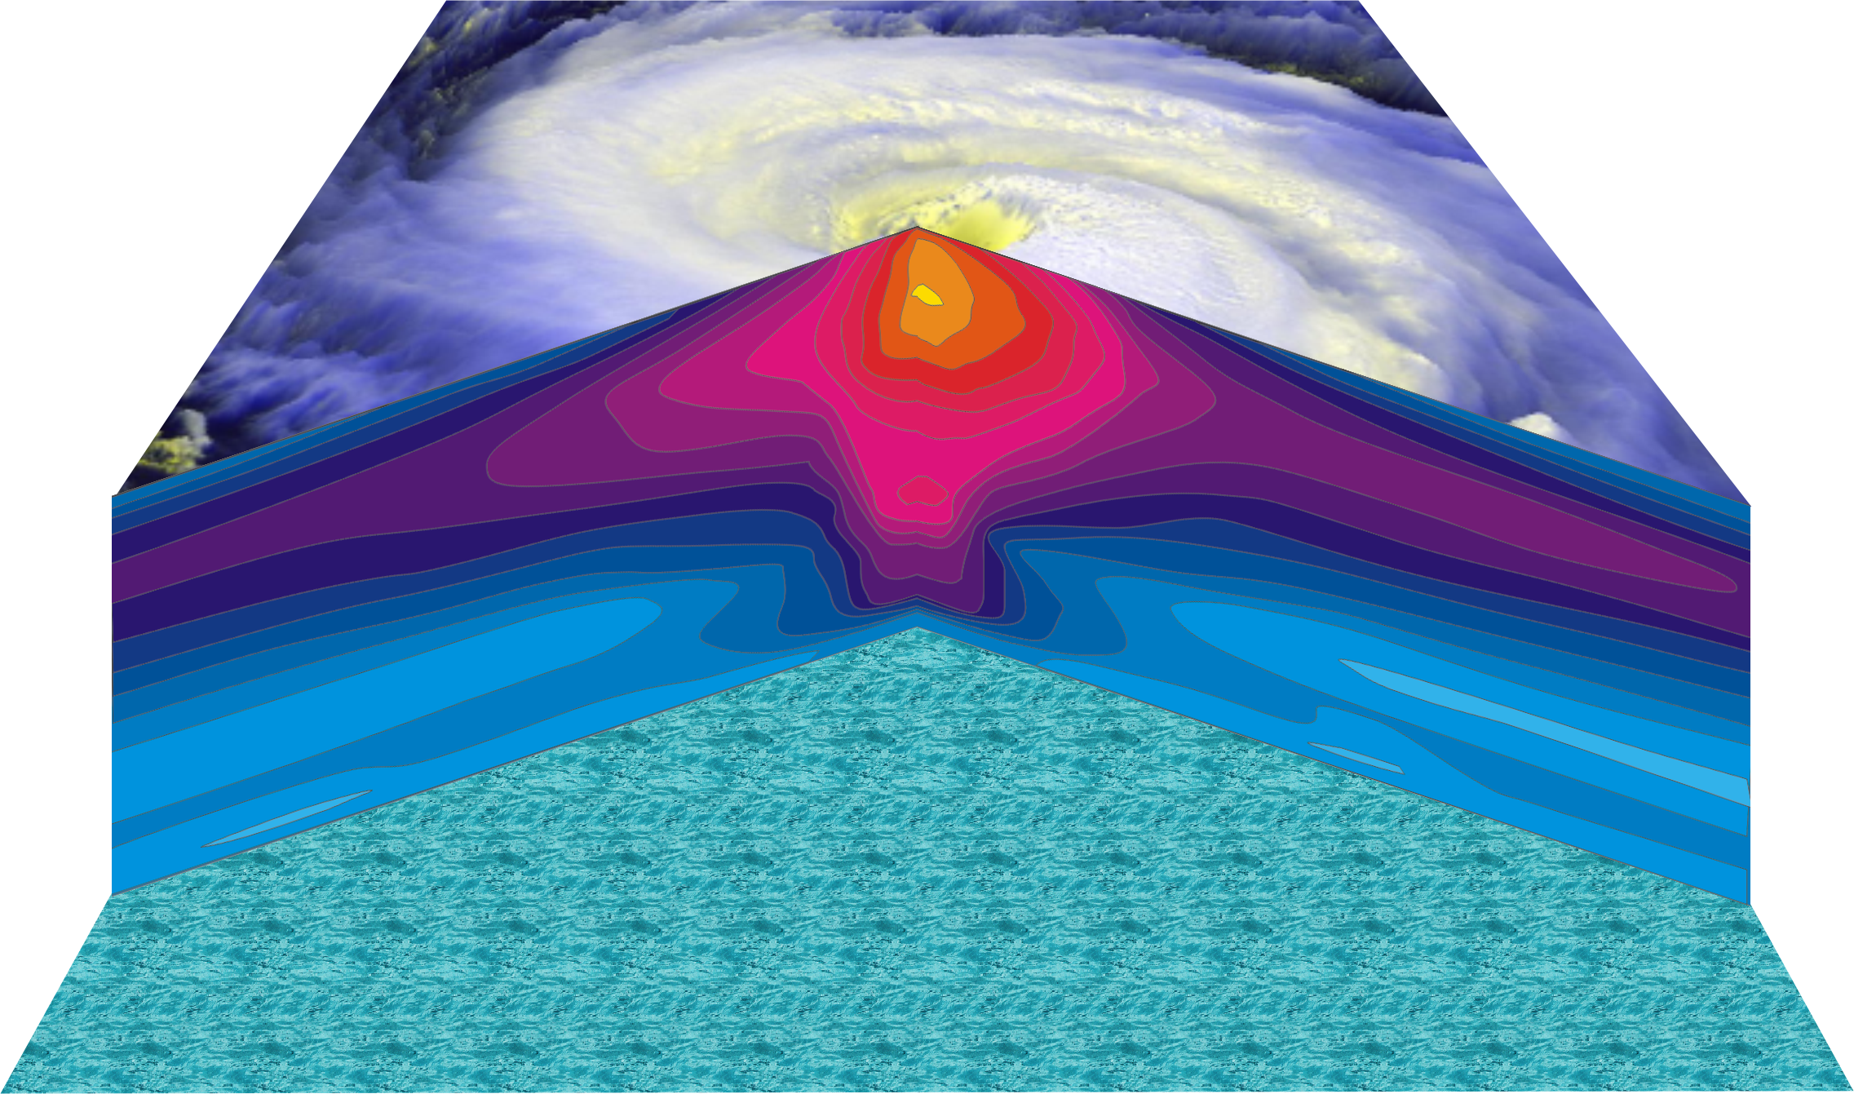
Hurricane Temperature Perturbations
No temperature difference - > 16°C (29°F) warmer
Notes:
This image shows a composite view of the distribution of temperature in a typical hurricane. This actually shows the difference between the temperature at any point and the temperature at the same altitude far away from the storm. The lightest shade of blue shows no temperature difference, while bright yellow shows air that is more than 16°C (29°F) warmer than its distant environment; each shade represents an increment of 1°C (1.8°F). Hurricanes are very hot in their centers, especially near their tops. This great warmth is one consequence of the enormous amount of heat sucked out of the ocean by the storm. On the other hand, there is very little change in temperature as you move in toward the eye along the surface of the ocean.
The distributions of temperature and wind in hurricanes are related to each other. Look carefully at the images in this slide and the slide that shows wind speed. Notice that the rate at which the wind decreases upward is proportional to the rate at which the temperature decreases outward. This relationship is fundamental to rotating fluid flows and is called the thermal wind relation.
Image is copyrighted 2005 by Oxford University Press.
Description from “Divine Wind: The History and Science of Hurricanes”, Kerry Emanuel, 2005, Oxford University Press, 296 p.
Definitions
Thermal wind is a theoretical concept that describes the wind shear between two levels in terms of the geostrophic wind at those two levels (from and for more information see http://wxman256.home.att.net/fcst/wf-pt5e.html). The basic principle of the thermal wind relationship is that in the presence of a horizontal temperature gradient, the wind speed must increase with increasing height (from and for more information see http://opwx.db.erau.edu/~mullerb/Therm_wind.html).
Wind shear is the change of wind speed or direction with distance, usually vertical (from http://ggweather.com/glossary.htm).

Slide 13
Tropical Cyclone Climatology

Slide 14
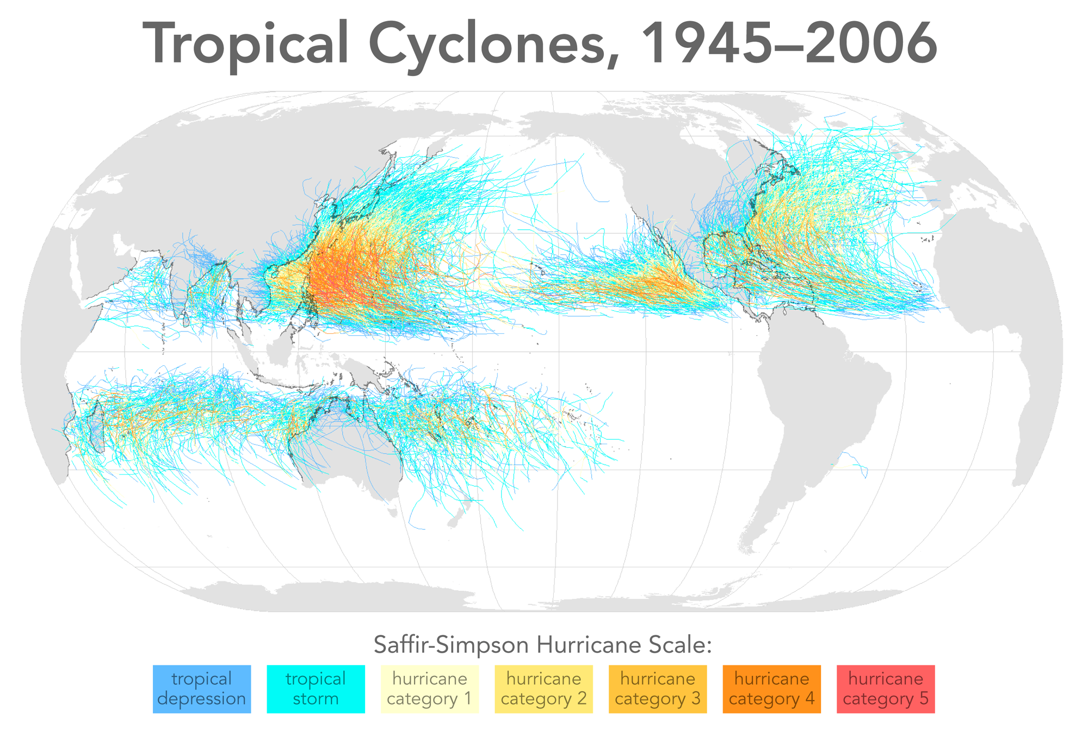

Slide 15
Annual Cycle of Tropical Cyclones
Number of Events per Month
a
Northern
Hemisphere
(NH)
a
Southern
Hemisphere
(SH)
Jan Feb Mar Apr May Jun Jul Aug Sep Oct Nov Dec NH
Jul Aug Sep Oct Nov Dec Jan Feb Mar Apr May Jun SH
Notes:
This graph shows the average number of tropical cyclones per month in the northern and southern hemispheres. Hurricanes tend to follow the sun, peaking in the summer and autumn and all but vanishing during the early spring. Typhoons can develop over the western North Pacific during any month of the year, but they are rare in the winter.
Image is copyrighted 2005 by Oxford University Press.
Image and description from “Divine Wind: The History and Science of Hurricanes”, Kerry Emanuel, 2005, Oxford University Press, 296 p.

Slide 16
Hurricanes in History

Slide 17
Galveston, 1900
The opinion held by some who are unacquainted with the actual conditions of things, that Galveston will at some time be seriously damaged by some such disturbance, is simply an absurd delusion
- Isaac Cline, Local Forecast Official and Section Director, U.S Weather Bureau, Galveston, Texas, in The Galveston News, 1891

Slide 18
Sunday, September 9, 1900, revealed one of the most horrible sights that ever a civilized people looked upon. - Isaac Cline

Slide 19
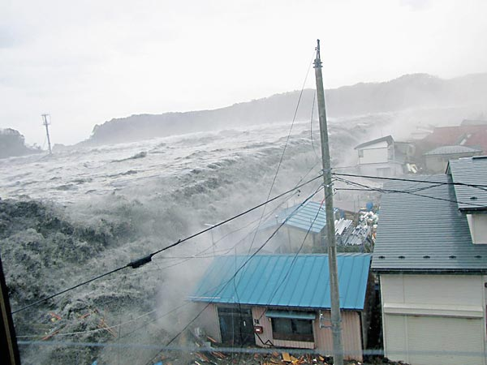

Slide 20
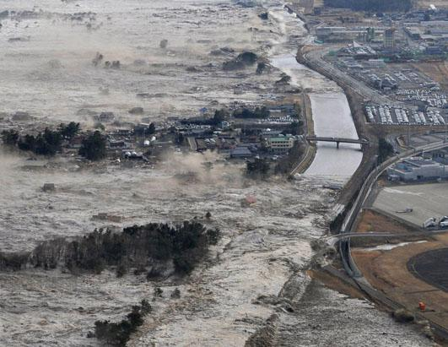

Slide 21
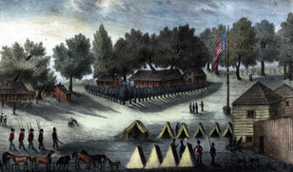
Tampa Hurricane of 1848
Population < 200
Garrison at Fort Brooke (now downtown Tampa)
Probably most intense historical hurricane to affect Tampa (~Cat 4)
15 foot storm surge, John’s Pass created
Almost complete destruction of town

Slide 22
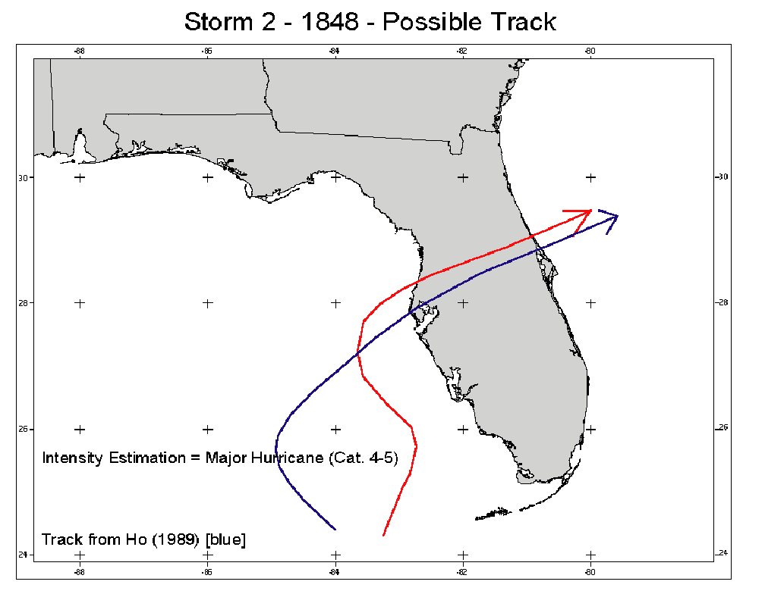

Slide 23
Tampa Hurricane of 1921
Landfall at Category 3, near Tarpon Springs
Combined population of Pinellas, Hillsborough, Pasco, Hernando and Citrus counties was 135,000. Today, it is 2.7 million.
Last MAJOR hurricane to affect Tampa
See Logan Johnson’s “Then and Now”:
http://www.srh.noaa.gov/media/tbw/1921/player.html

Slide 24
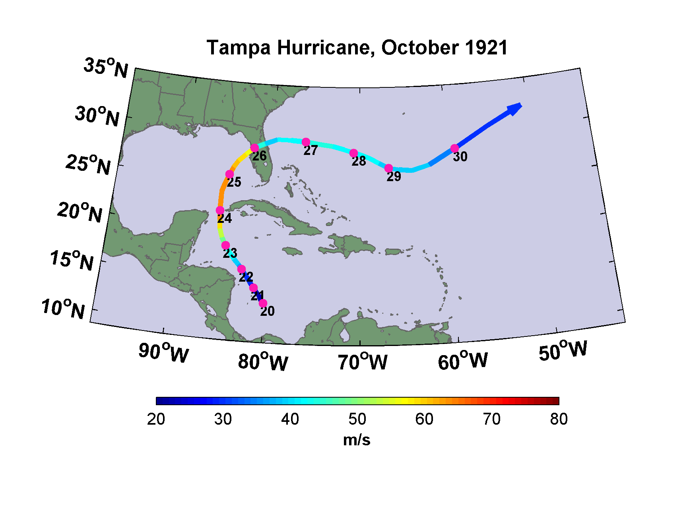

Slide 25
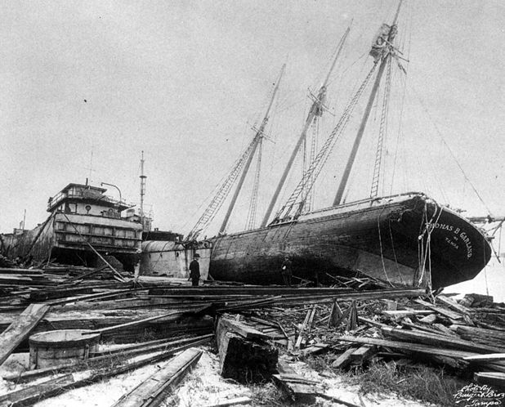

Slide 26
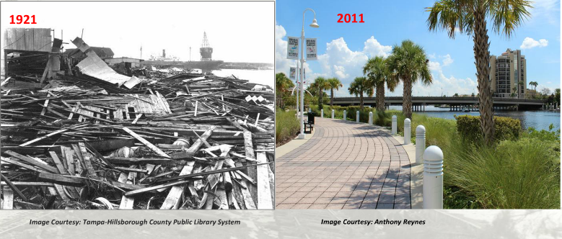

Slide 27
Using Physics to Assess Hurricane Risk
Notes:
Are hurricanes becoming more powerful and destructive? Are these changes due to a natural cycle of hurricane activity or are they caused by human-induced climate change? Although this is currently a hot debate among scientists, new research suggests that the destructive potential of hurricanes is increasing due to the heating of the oceans.
Image: Satellite image of Hurricane Floyd approaching the east coast of Florida in 1999. The image has been digitally enhanced to lend a three-dimensional perspective. Credit: NASA/Goddard Space Flight Center.

Slide 28
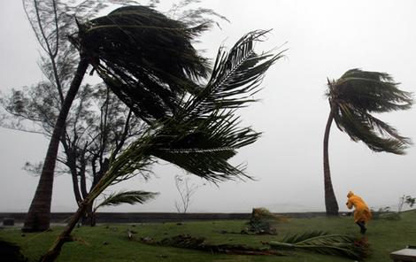
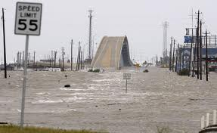
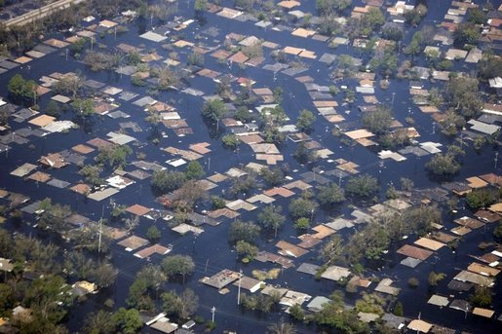
Hurricane Risks:
Wind
Storm Surge
Rain

Slide 29
Limitations of a strictly statistical approach
>50% of all normalized damage caused by top 8 events, all category 3, 4 and 5
>90% of all damage caused by storms of category 3 and greater
Category 3,4 and 5 events are only 13% of total landfalling events; only 30 since 1870
Landfalling storm statistics are inadequate for assessing hurricane risk
This is particularly true in places with few but devastating events, like Tampa

Slide 30
Additional Problem: Nonstationarity of climate

Slide 31
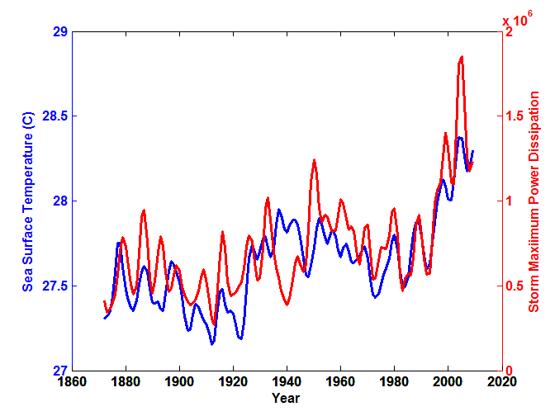
Atlantic Sea Surface Temperatures and Storm Max Power Dissipation
(Smoothed with a 1-3-4-3-1 filter)
Years included: 1870-2011
Data Sources: NOAA/TPC, UKMO/HADSST1
Notes:
31
The low value of storm power in the early 1940s is thought to be due to the lack of reports from ships at sea because of the radio silence imposed during WWII.

Slide 32
Risk Assessment by Direct Numerical Simulation of Hurricanes: The Problem
The hurricane eyewall is a strong front, attaining scales of ~ 1 km or less
At the same time, the storm’s circulation extends to ~1000 km and is embedded in much larger scale flows

Slide 33
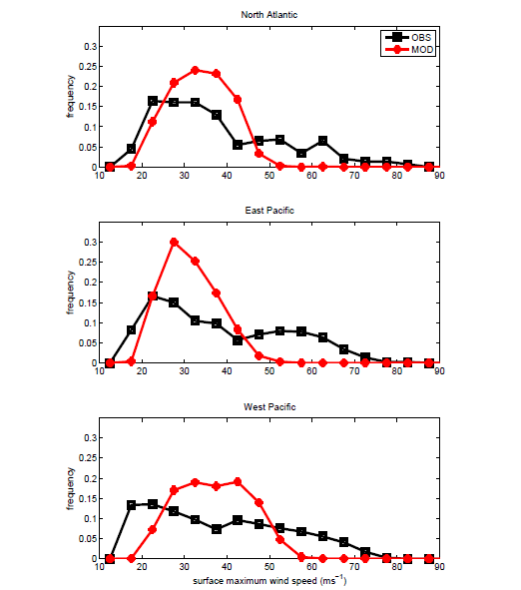
Histograms of Tropical Cyclone Intensity as Simulated by a Global Model with 50 km grid point spacing. (Courtesy Isaac Held, GFDL)
Modeled
Observed
Global models do not simulate the storms that cause destruction
Category 3

Slide 34
How to deal with this?
Option 1: Brute force and obstinacy

Slide 35
Multiply nested grids

Slide 36
How to deal with this?
Option 1: Brute force and obstinacy
Option 2: Applied math and modest resources

Slide 37
Time-dependent, axisymmetric model
Uses a flow-dependent coordinate system
Simplified Physics
Coupled to simple 1-D ocean model
Environmental wind shear effects parameterized

Slide 38
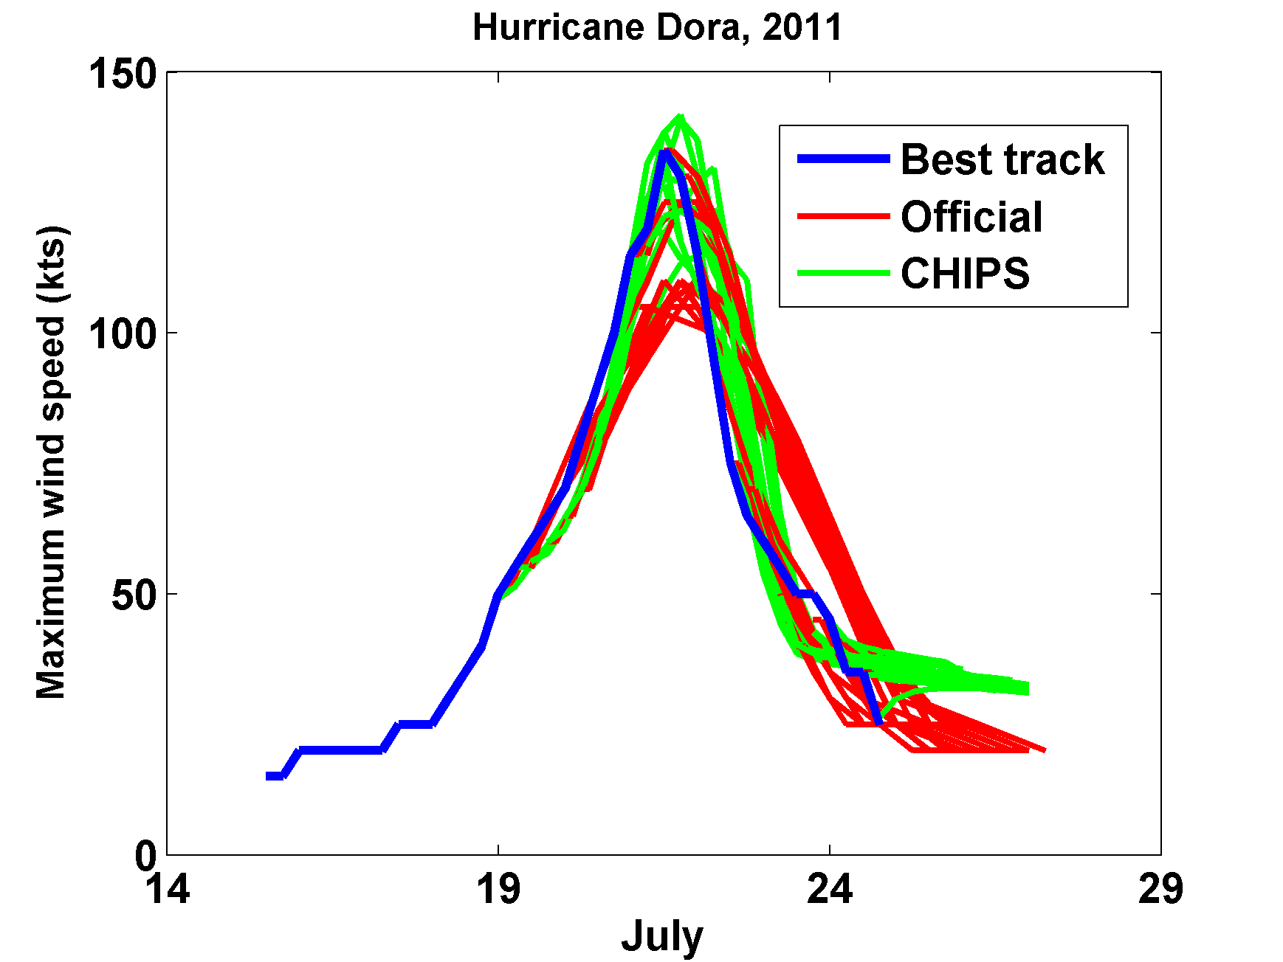

Slide 39
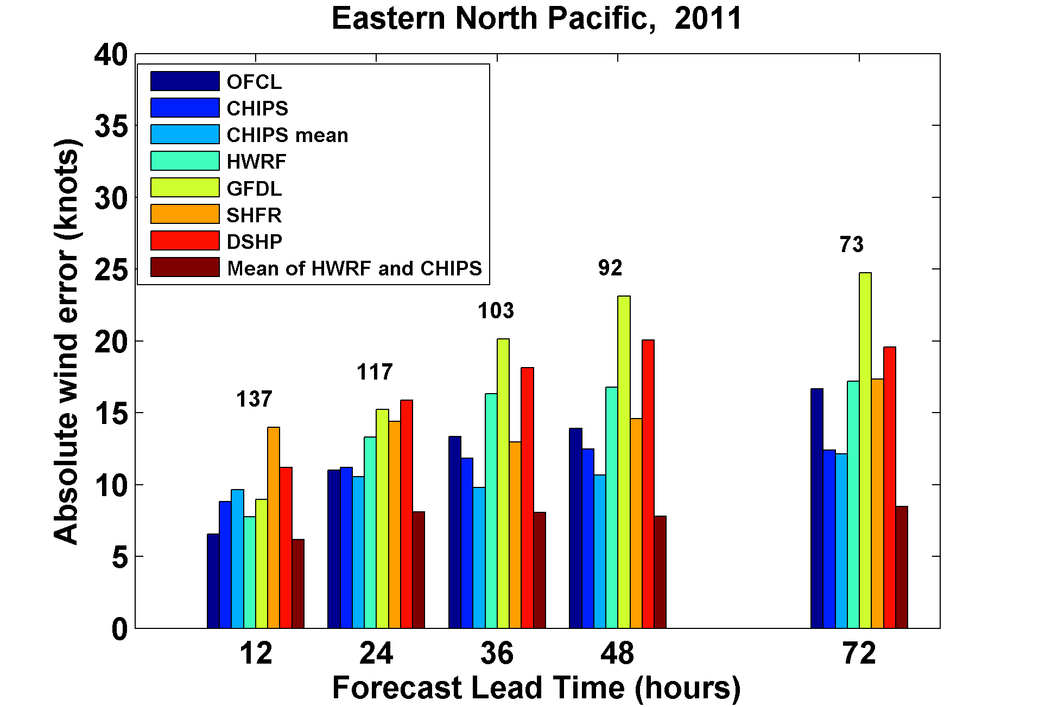

Slide 40
How Can We Use This Model to Help Assess Hurricane Risk in Current and Future Climates?

Slide 41
Risk Assessment Approach:
Step 1: Seed each ocean basin with a very large number of weak, randomly located cyclones
Step 2: Cyclones are assumed to move with the large scale atmospheric flow in which they are embedded, plus a correction for beta drift
Step 3: Run the CHIPS model for each cyclone, and note how many achieve at least tropical storm strength
Step 4: Using the small fraction of surviving events, determine storm statistics
Details: Emanuel et al., Bull. Amer. Meteor. Soc, 2008
Notes:
41

Slide 42
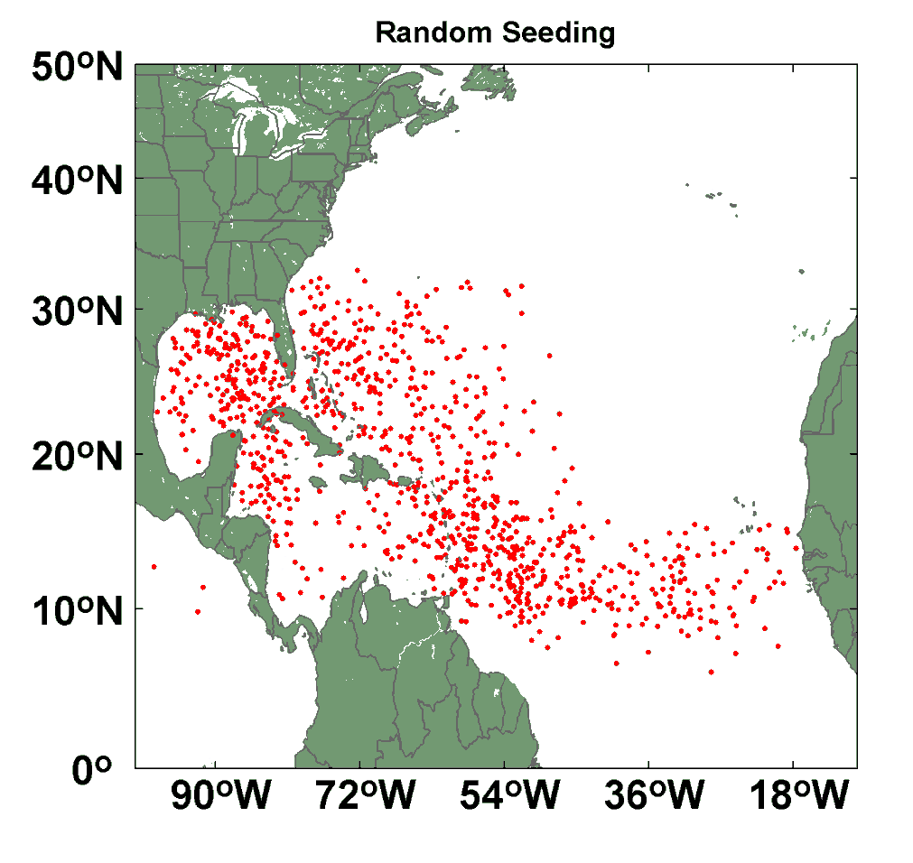
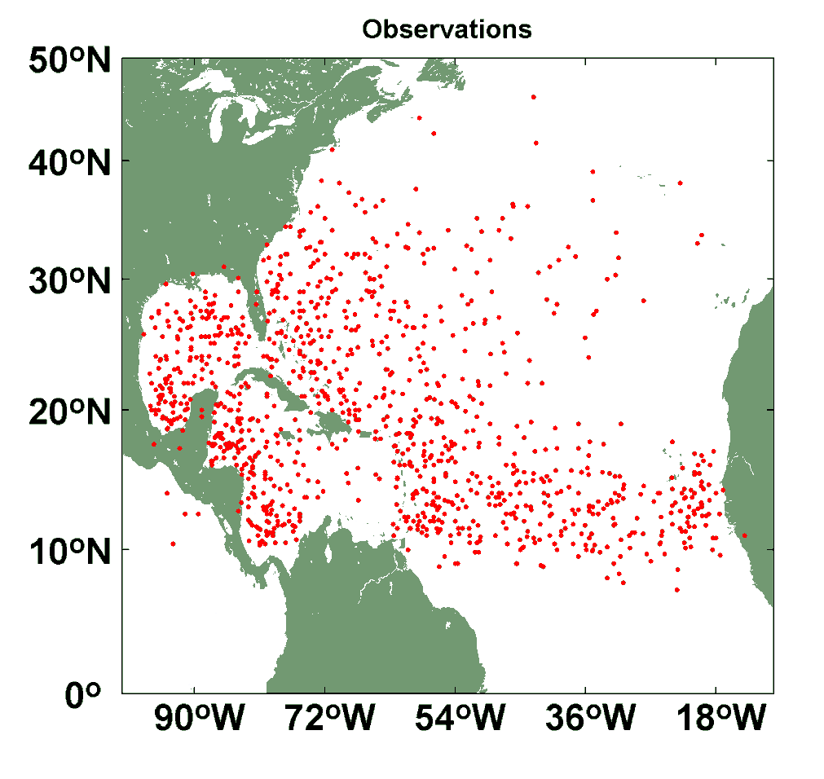
Comparison of Random Seeding Genesis Locations with Observations

Slide 44
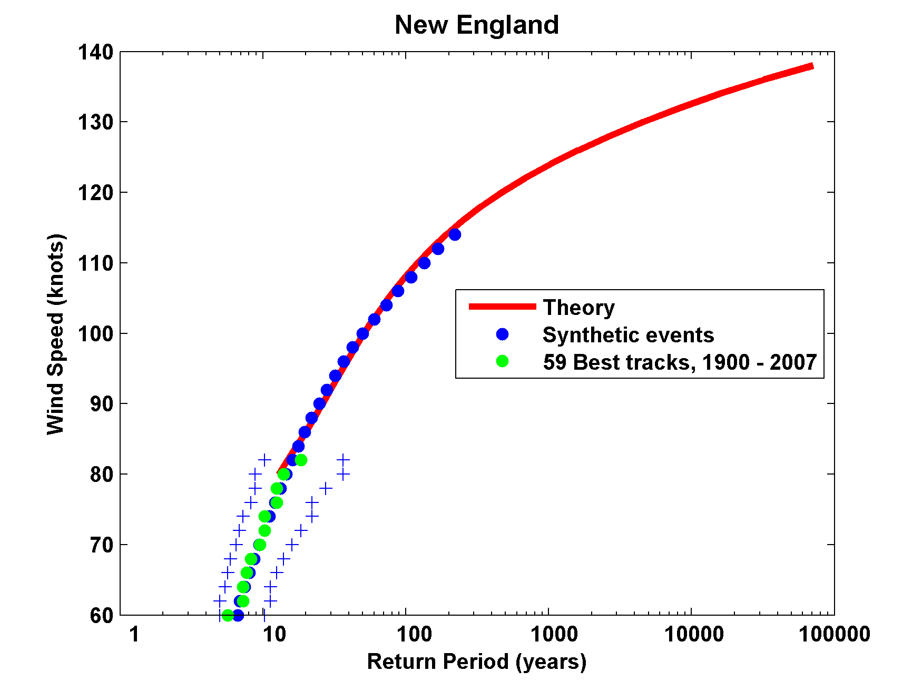
Return Periods

Slide 45
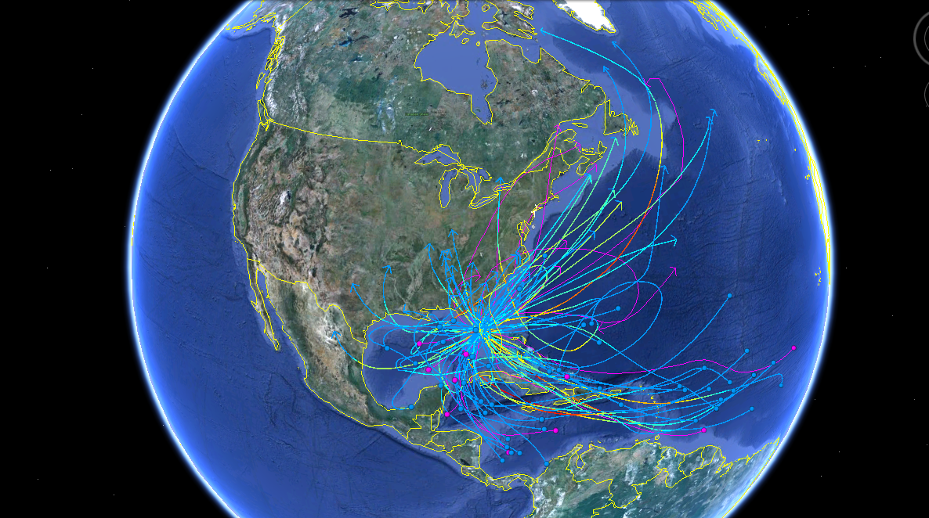
50 Synthetic and 10 Historical Tracks Affecting Tampa

Slide 46
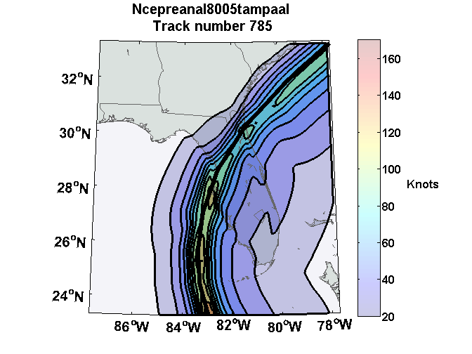
Peak Wind

Slide 47
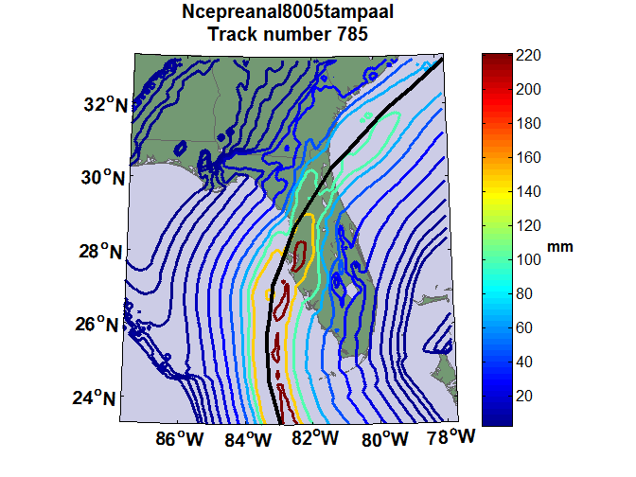
Accumulated Rainfall

Slide 48
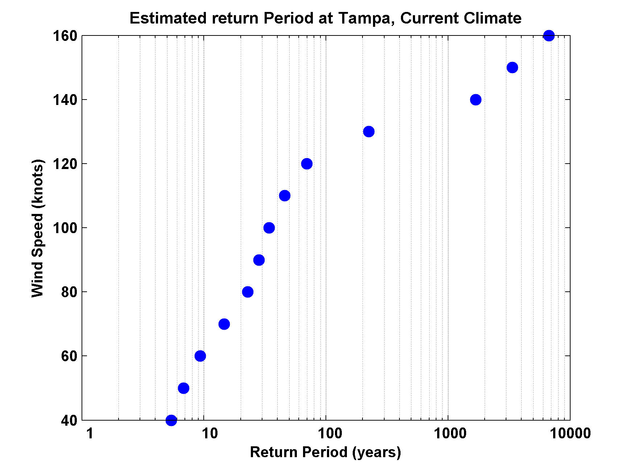

Slide 49
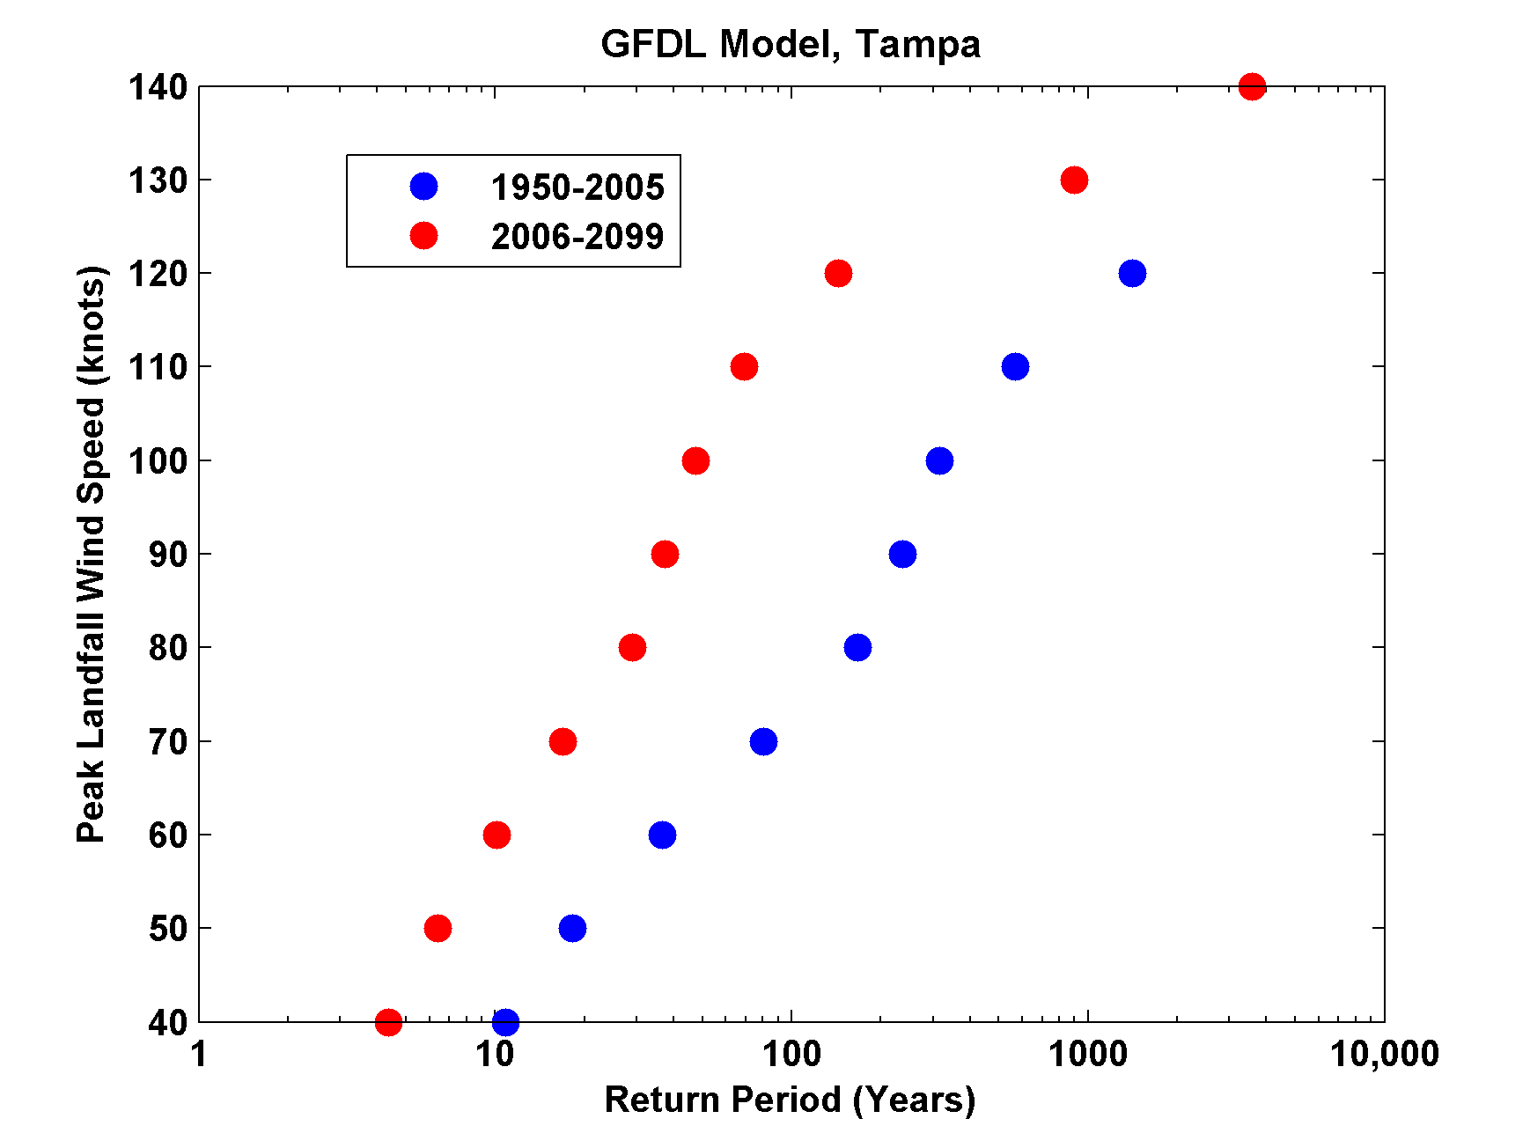
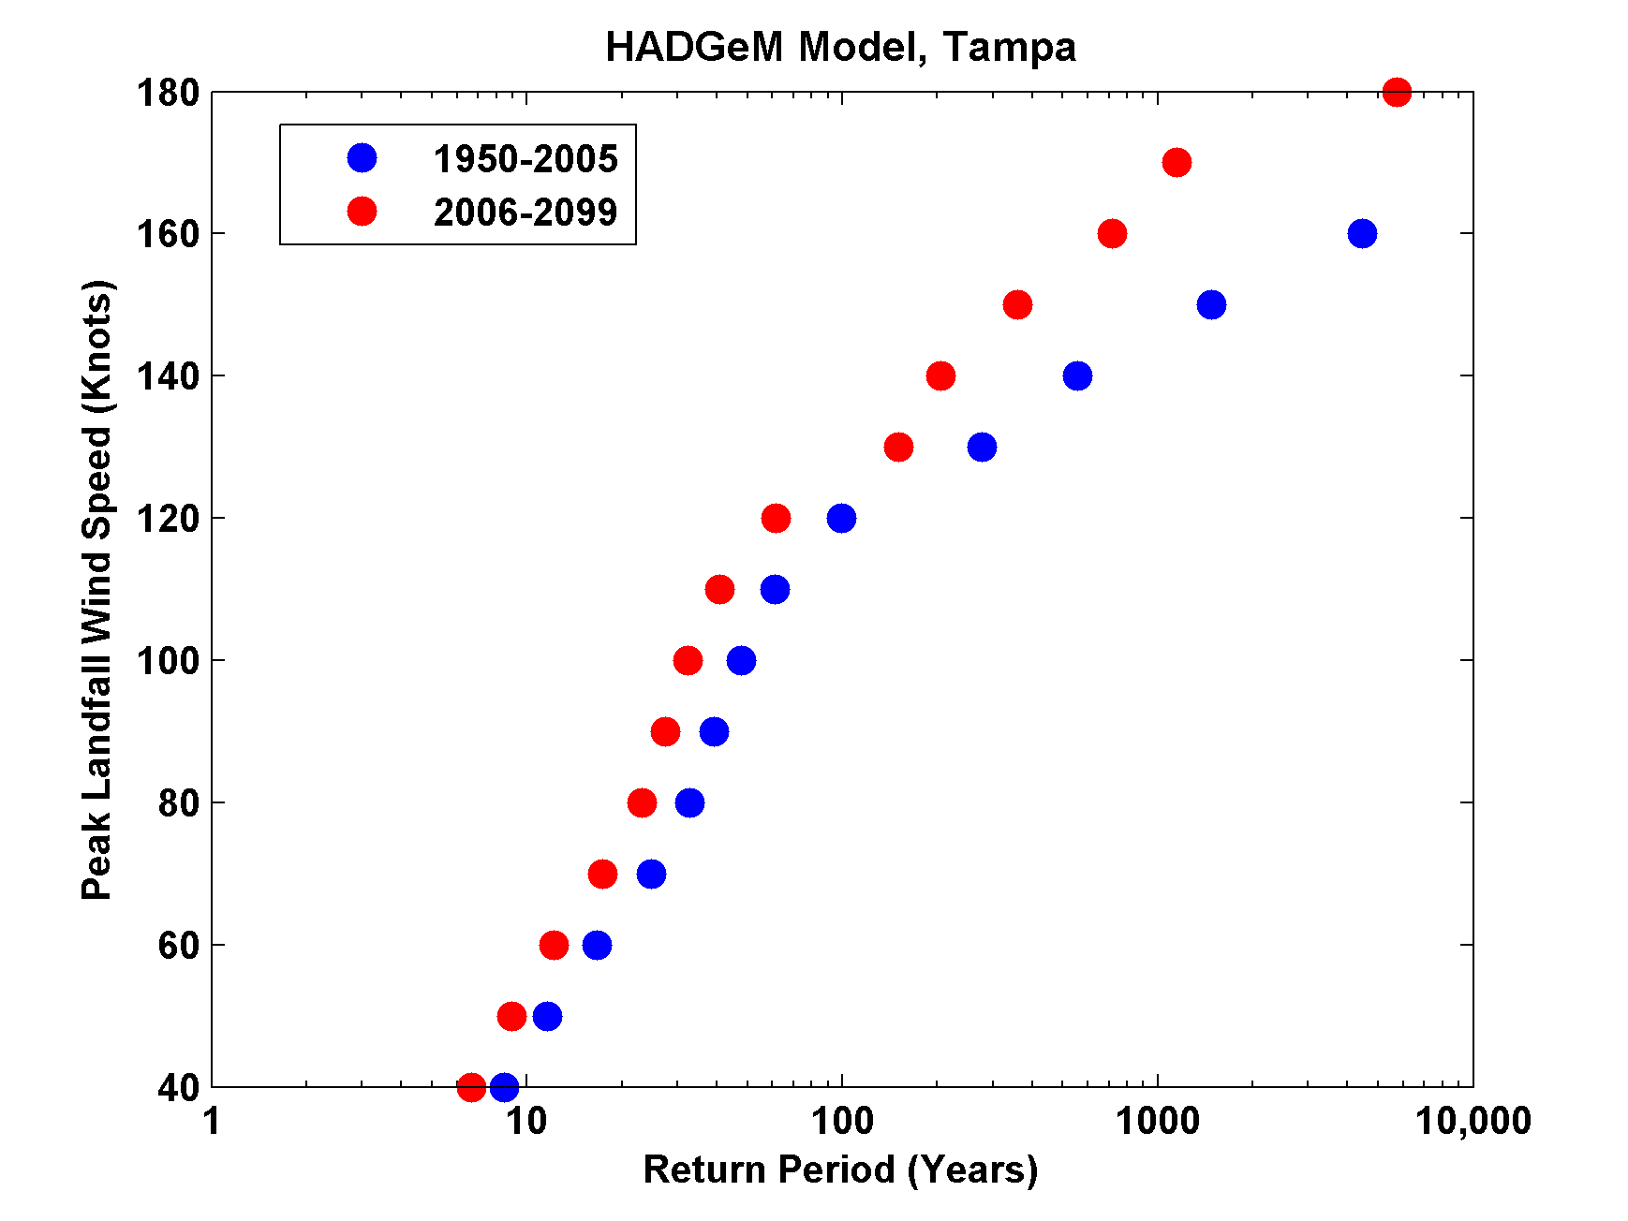
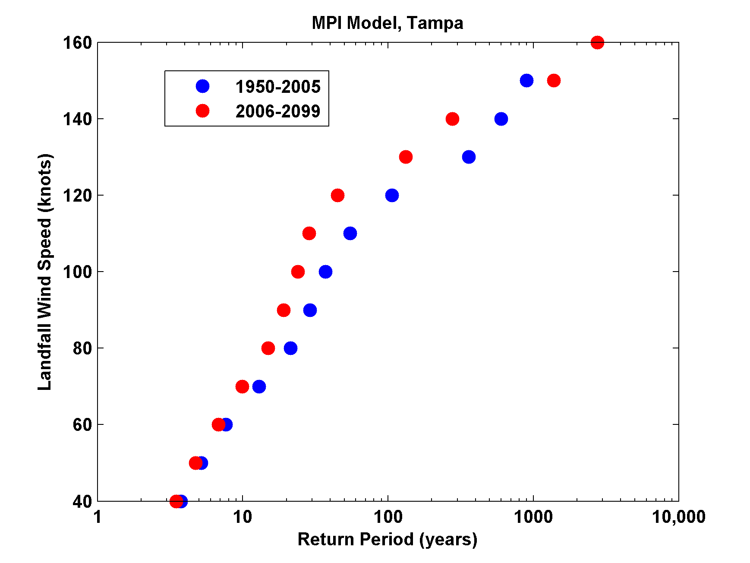
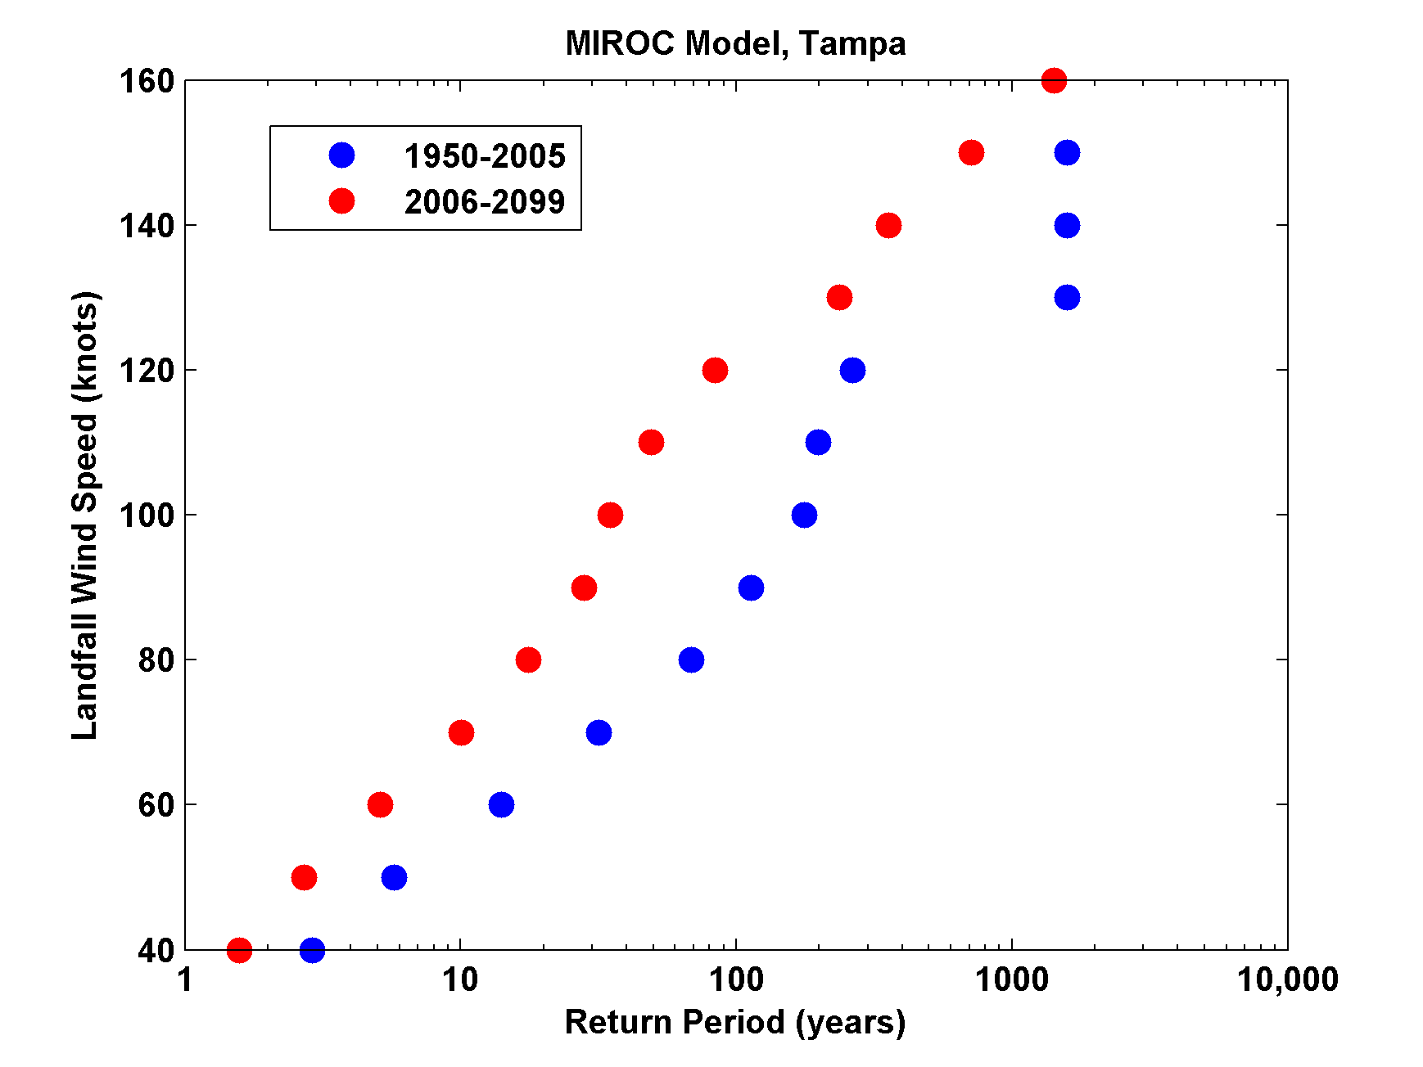
Wind

Slide 50
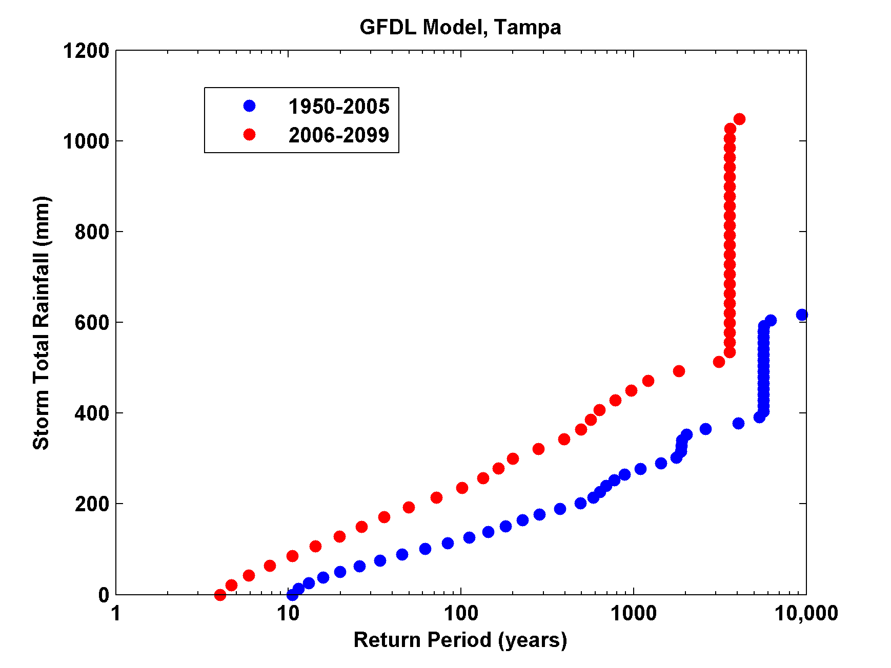
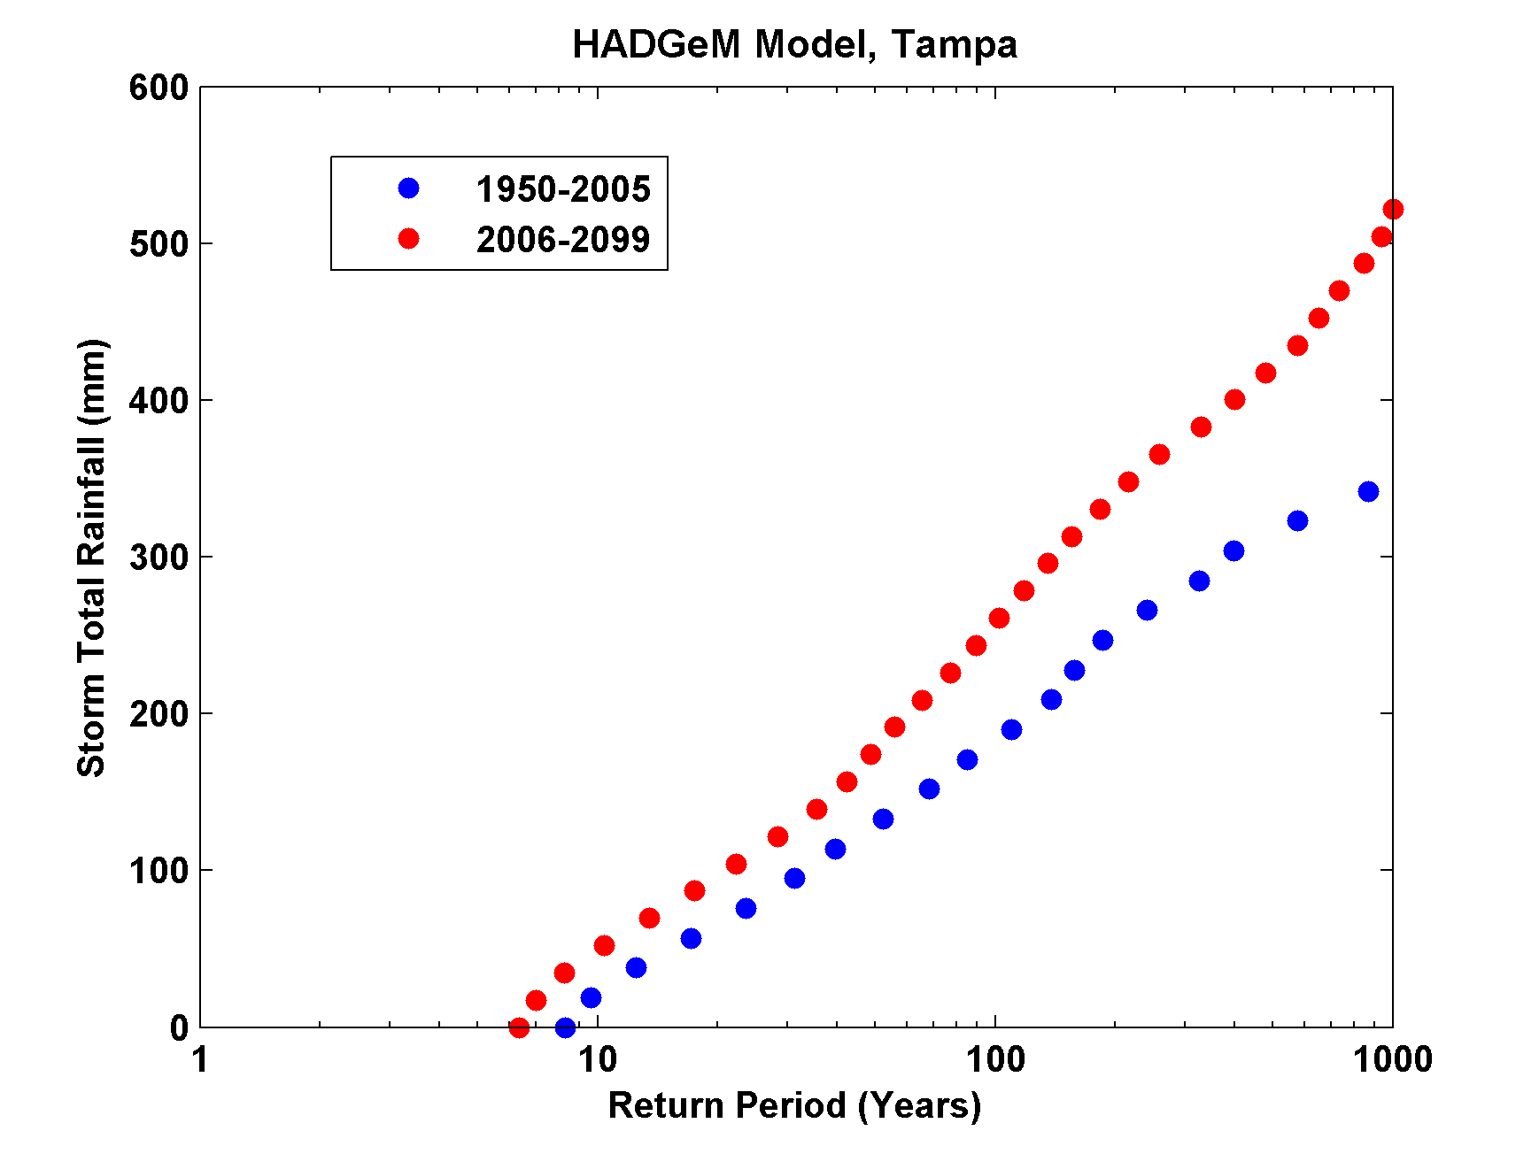
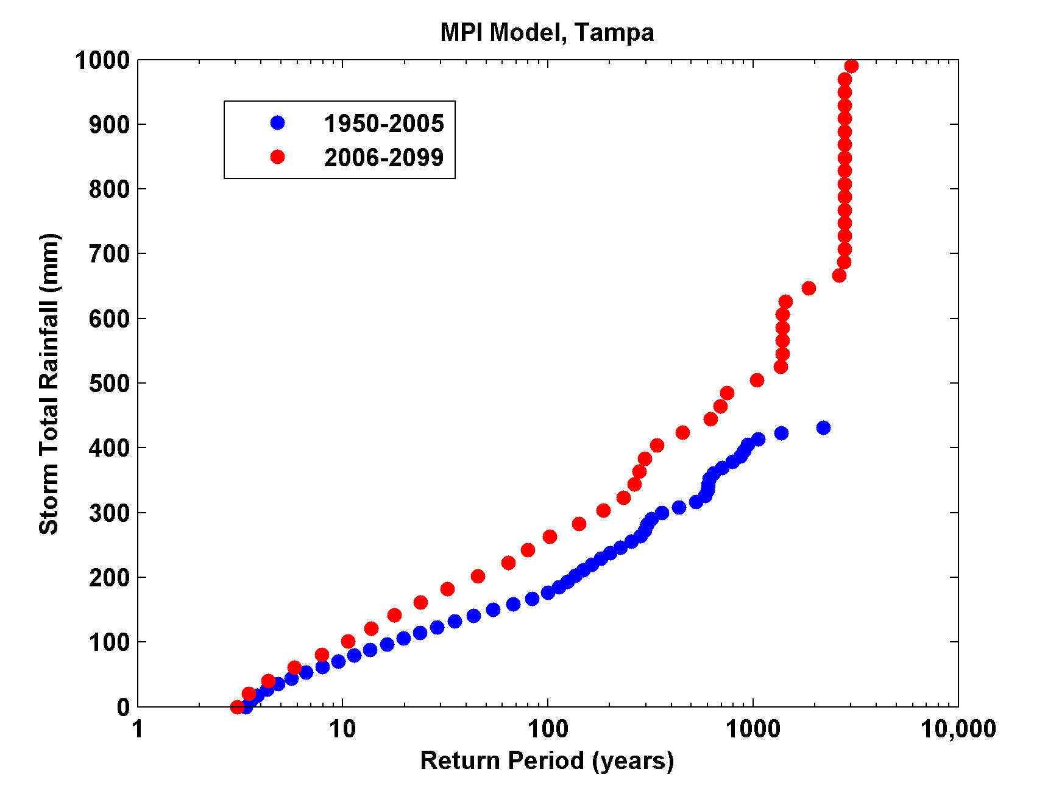
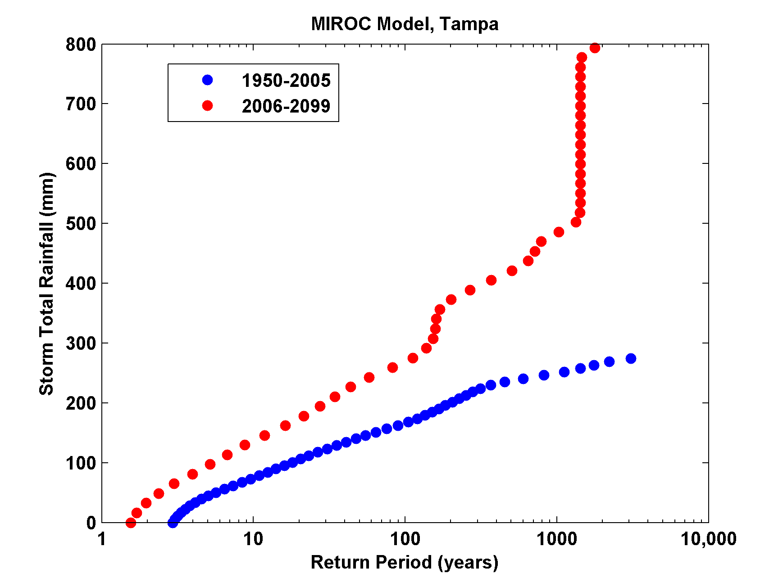
Rain

Slide 51
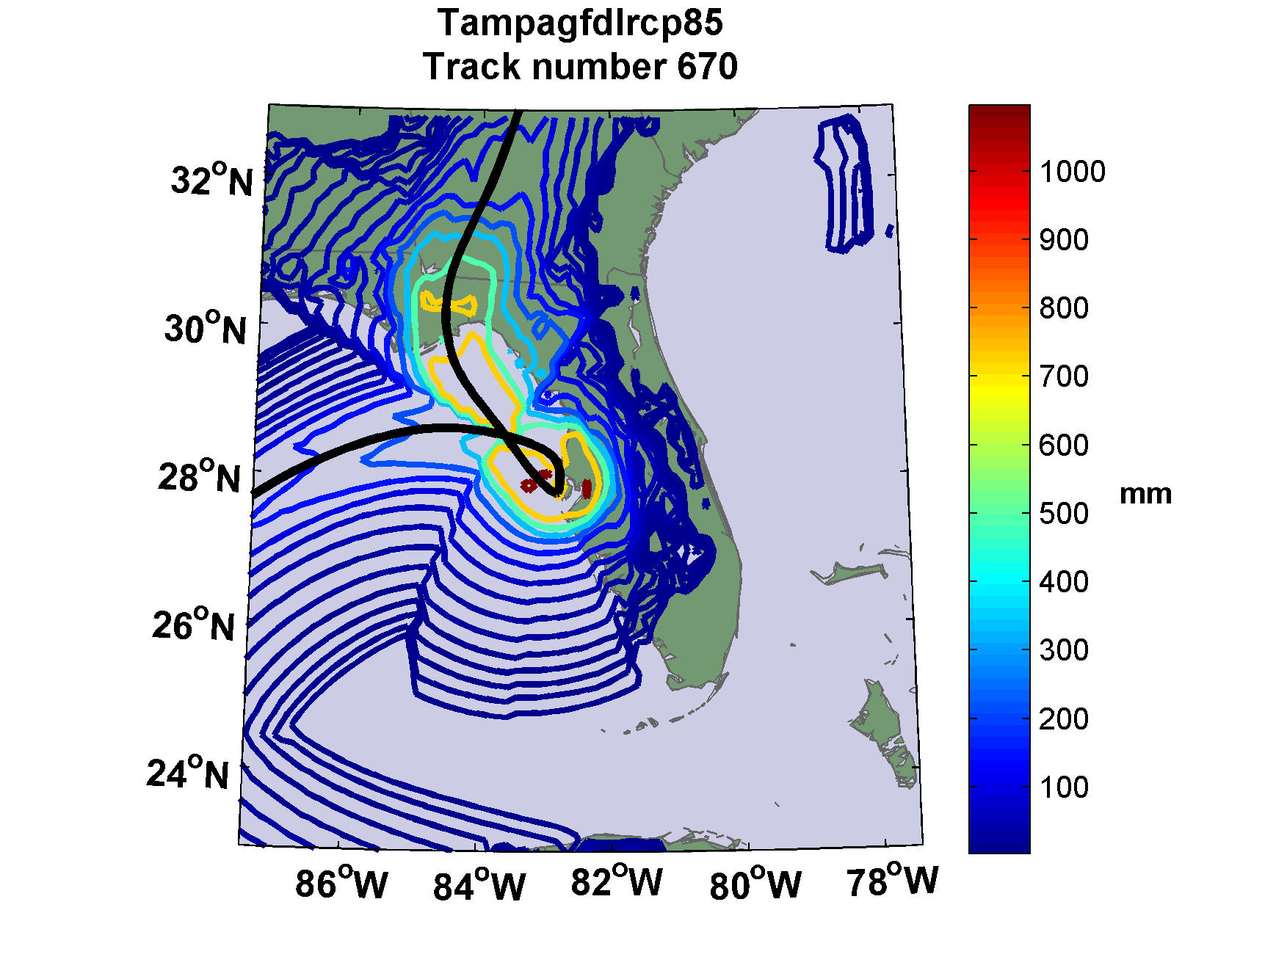

Slide 52
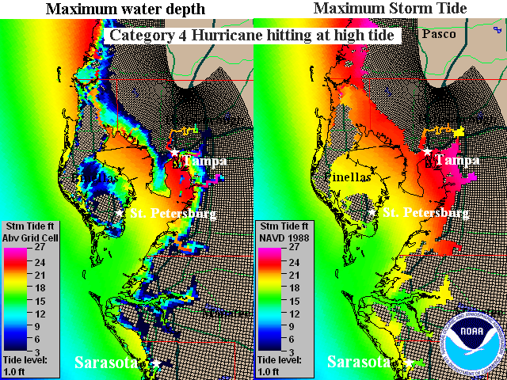

Slide 53
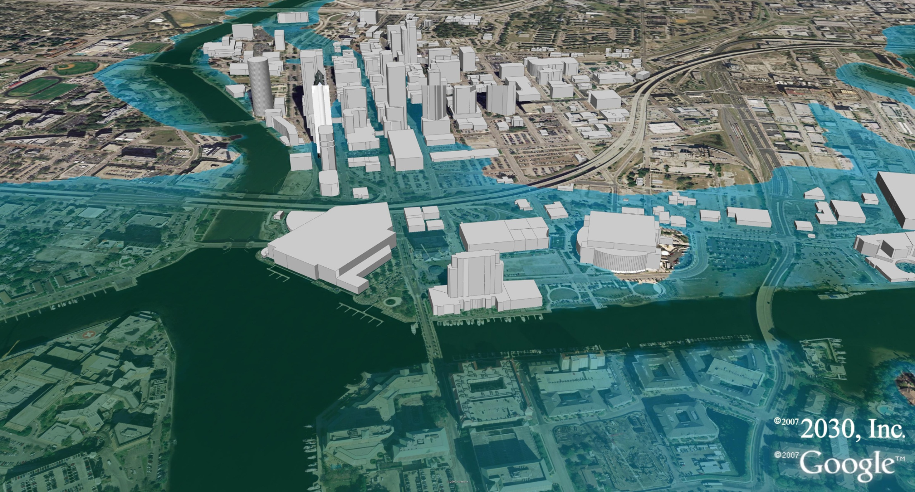
Tampa Under 5 Feet of Water

Slide 54
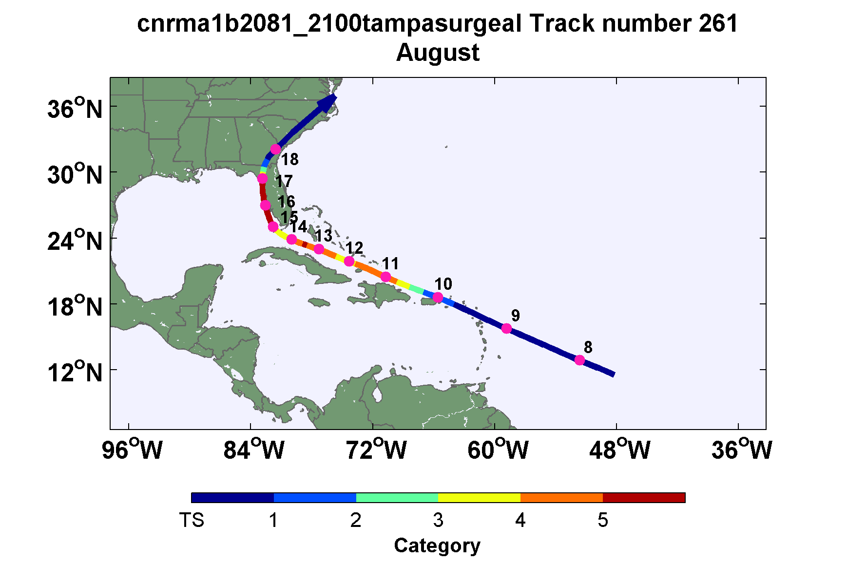
Black Swan Example: Tampa event in future climate downscaled from CNRM model

Slide 55
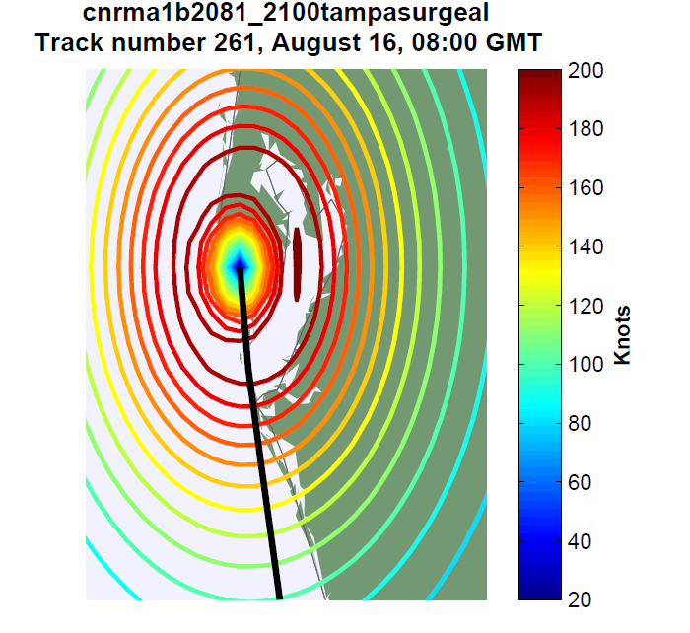

Slide 56
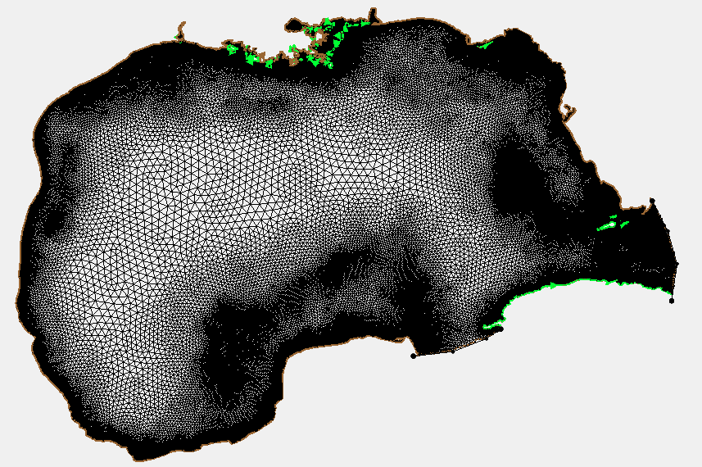
ADCIRC Mesh

Slide 57
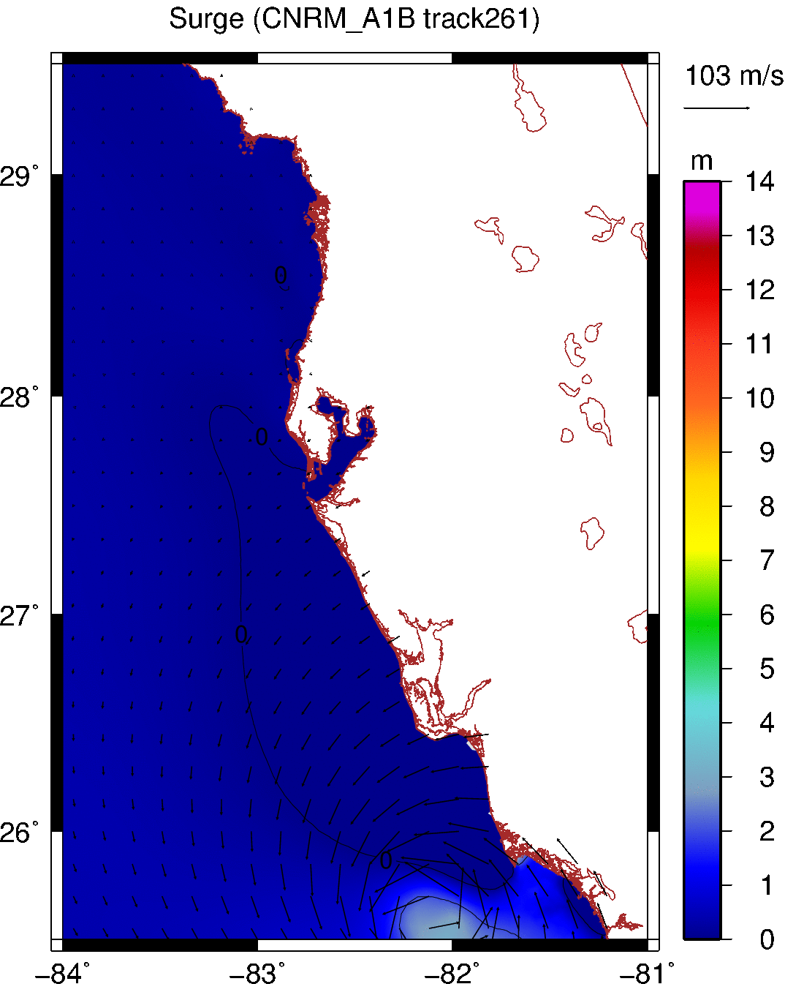
Notes:
This animation shows how the wave propagates almost at the same speed with the storm movement, resulting in the resonance.

Slide 58
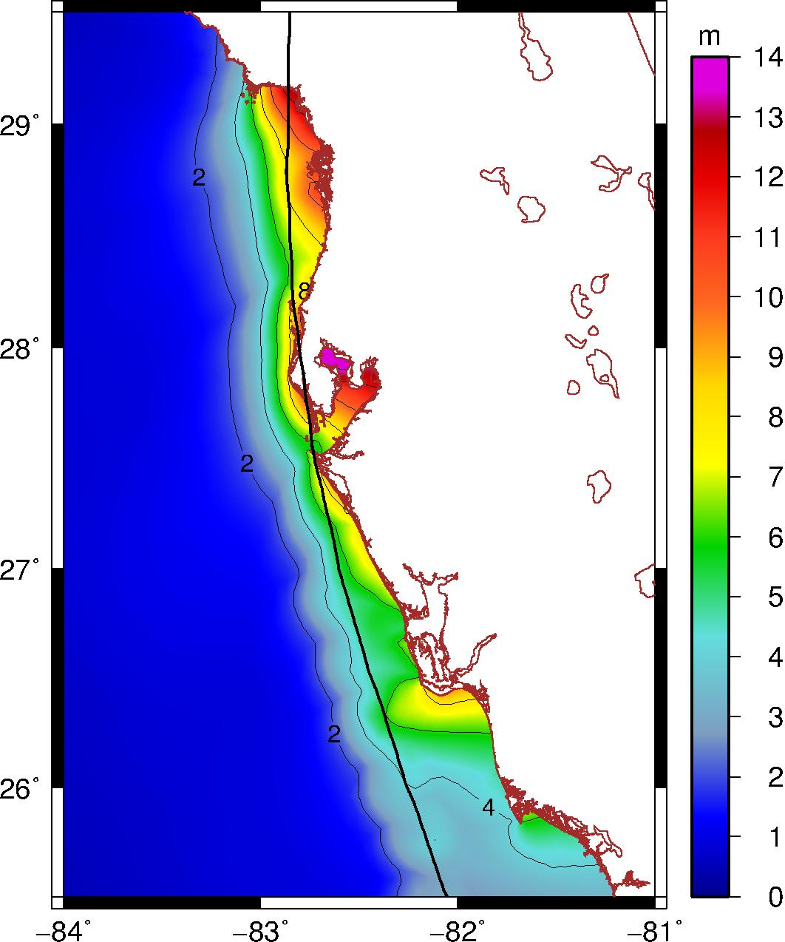
Tampa
Surge = 13 m
Prob. = 1/14500
Notes:
However, the black swan in our dataset may look very different. This storm moves along the coast, generating edge waves, which resonates with the surge and greatly enhances the water evaluation in Tampa Bay.
Tampa is highly vulnerable to storm surge due to its geophysical features. It is surrounded by low-lying lands and affected by edge waves trapped on the west Florida shelf. In extreme cases, resonance between the surge and the propagating wave may happen, which will greatly enhance the water elevation in the Tampa Bay, as shown in this worst case in our surge database.
Tampa black swans are identified as those that move northward parallel to the west Florida coast with high intensities and resonant with the Florida-shelf edge waves to generate extreme surges up to 10 m in Tampa Bay.
lands and affected by edge waves trapped on the west Florida shelf that can propagate along the coastline and contribute to the surge level in the Tampa Bay.
cnrm2100
Annual frequency=0.2068

Slide 59
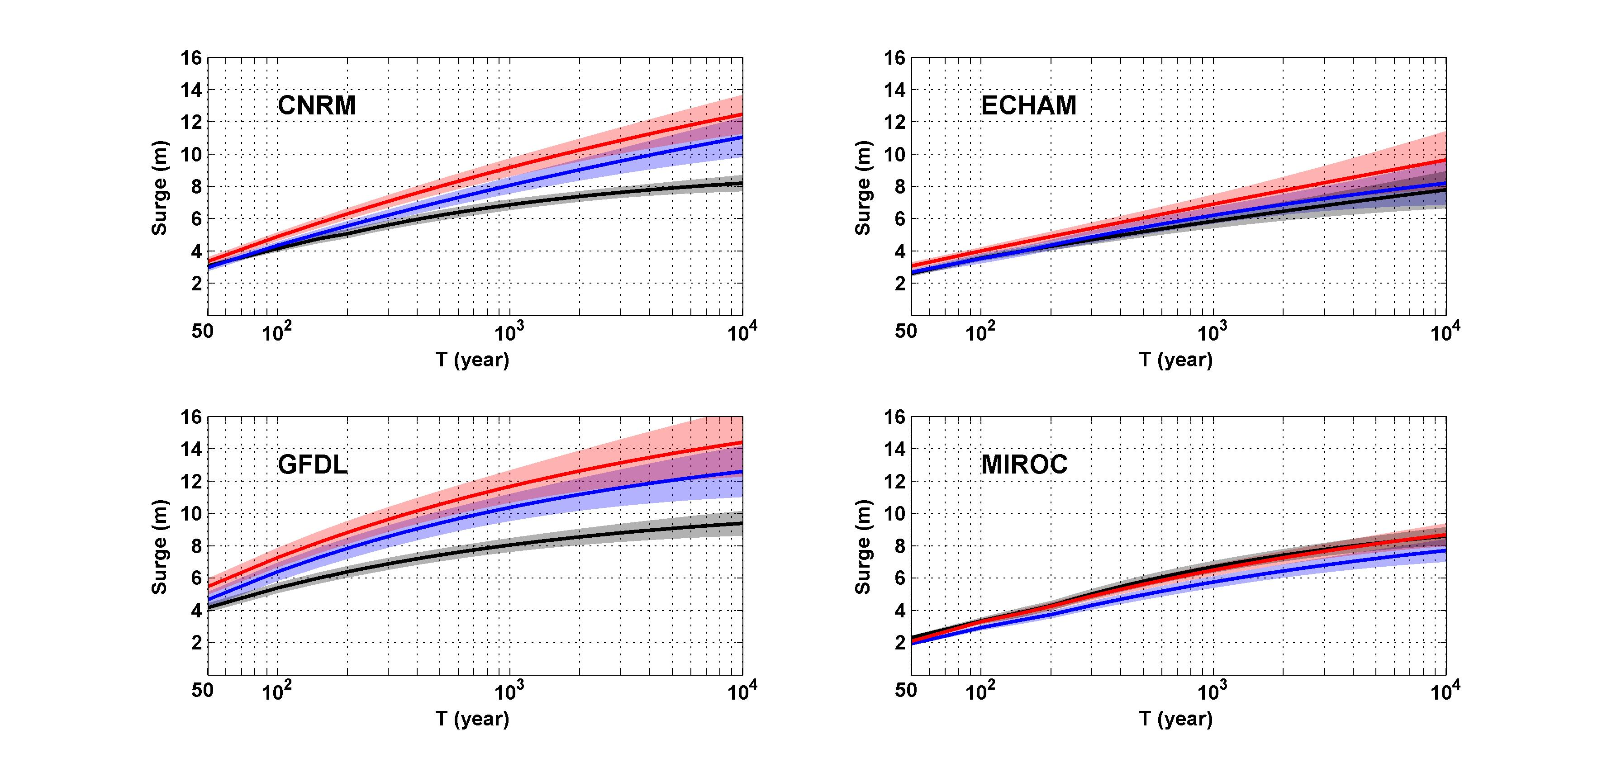
Tampa surge return level (not including tide or SLR)
Black: Current climate (1981-2000)
Blue: A1B future climate (2081-2100)
Red: A1B future climate (2081-2100) with R₀ increased by 10% and R_{m} increased by 21%
Notes:
Finally, as the method doesn’t rely on historical data, we can generate events for projected future climate. Here we show the surge return level curves for Tampa generated using four climate models, for current climate in black, for future climate in blue , and for future climate and assuming storm size increases with climate change in red.
CNRM and GFDL predicts the surge level to greatly increase in the future climate, (ECHAM predicts a slight increase, and MIROC predicts the surge level to slightly decrease if the storm size does not change or to remain almost the same if the storm size is increased.) And note that the horizontal axis is in log scale and the curves are very flat, so the changes in terms of return periods are dramatic.

Slide 60
Summary
Tampa is subject to infrequent but devastating hurricanes
Category 4 and 5 landfalls are possible and could produce enormous storm surges
Is Tampa the next New Orleans?

