Slide 1

A Sober Look at the Global Warming Problem
Kerry Emanuel
Program in Atmospheres, Oceans, and Climate
Department of Earth, Atmospheric and Planetary Sciences
MIT

Slide 2
Program
History of earth’s climate
A little climate science
Simple models and feedbacks
Possible effects of climate change

Slide 3
Climate Change Through Geologic Time

Slide 4

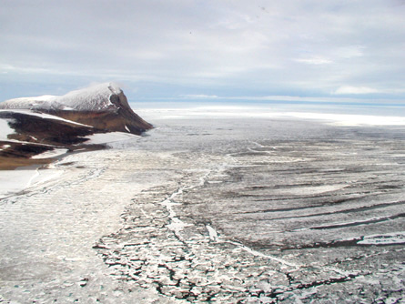

The Snowball Earth, 650-750 mya

Slide 5
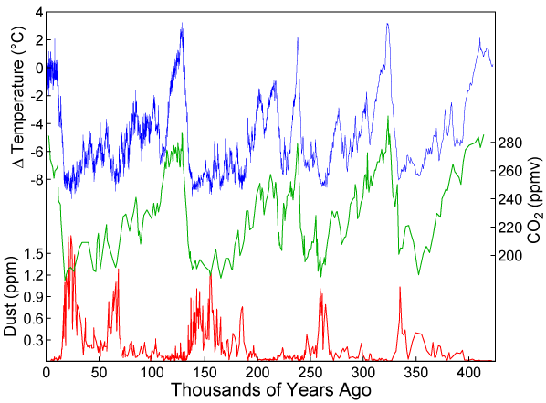
A detailed record of the earth’s climate has emerged over the last few decades, from analyses of ice cores and deep sea sediments

Slide 6
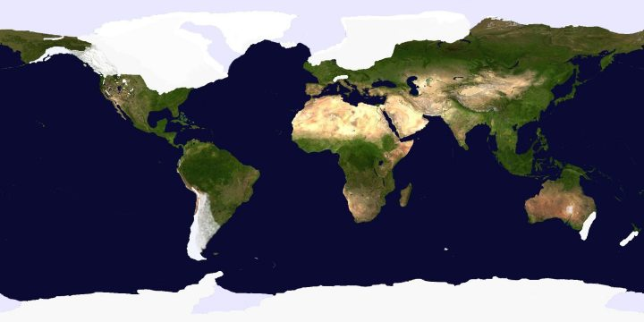
Ice Cover, Last Glacial Maximum (~18,000 years ago)
Notes:
6

Slide 7


Slide 8

Paleo reconstructions of temperature change over the last 2000 years
“Hockey Stick”
Instrumental Record
Year
Notes:
8

Slide 9
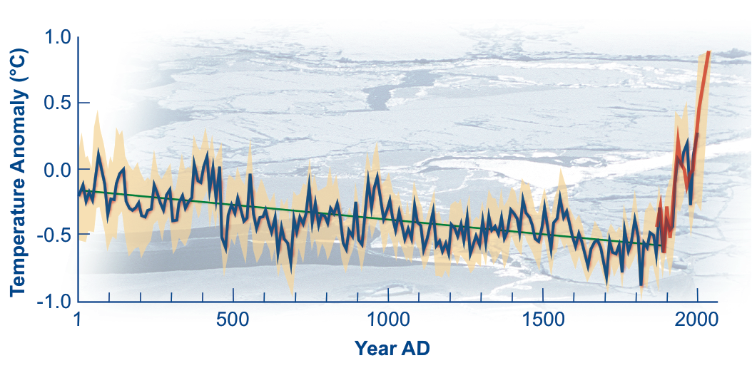
Arctic air temperature change reconstructed (blue), observed (red)

Slide 10
Estimates of Global Mean Surface Temperature from the Instrumental Record
Notes:
10

Slide 11
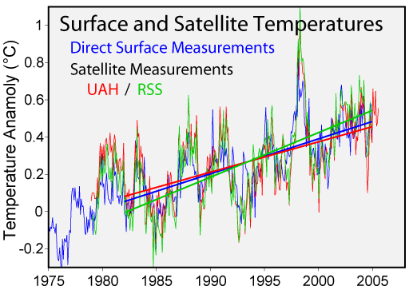

Slide 12
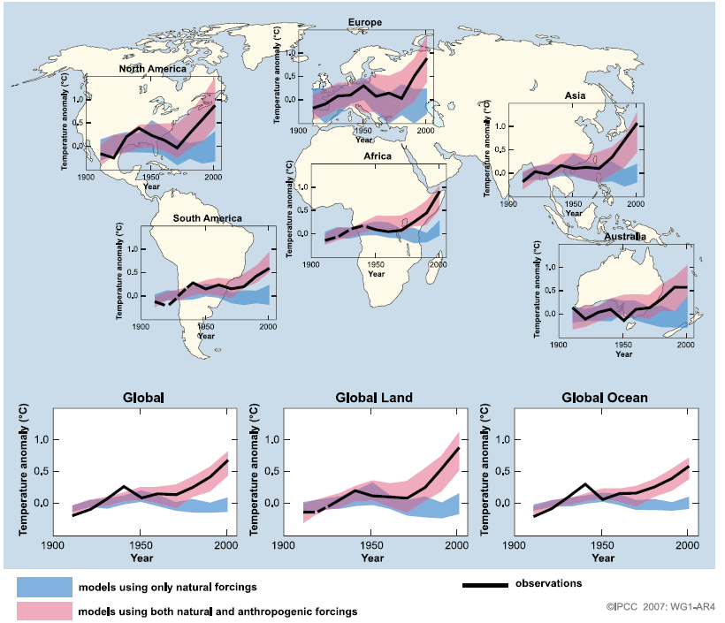
Global and Continental Temperature Change

Slide 13
Some Characteristics of Climate Science
Described by some as the most difficult scientific problem ever faced
Draws on all the major scientific disciplines:
  Chemistry, geology, atmospheric science, oceanography, solar physics, orbital mechanics, biology
  Climate prediction also requires understanding of economics, politics, human psychology
Very much a frontier science

Slide 14
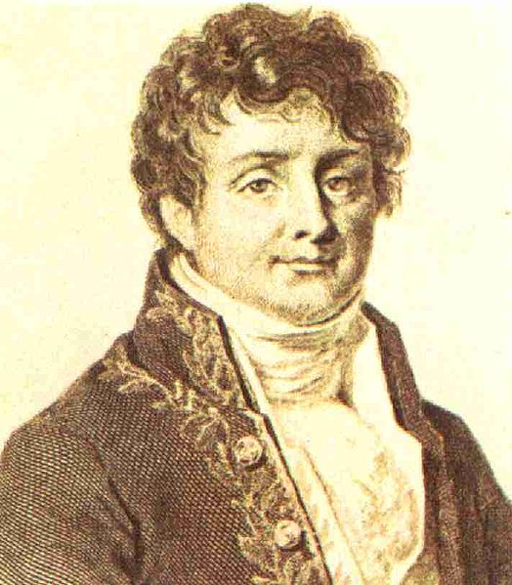


The Greenhouse Effect
Jean Baptiste Joseph Fourier
(1768-1830)
John Tyndall (1820-1893)

Slide 15
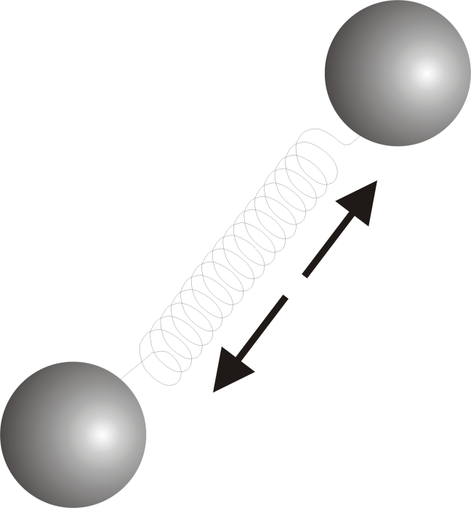
Tyndall’s Discovery:
Oxygen (O₂) and Nitrogen (N₂), which together comprise about 97% of the atmosphere, are transparent to solar and infrared radiation
If that’s all there were:
= Stefan-Boltzmann constant
a = Planetary albedo
= Solar constant

Slide 16
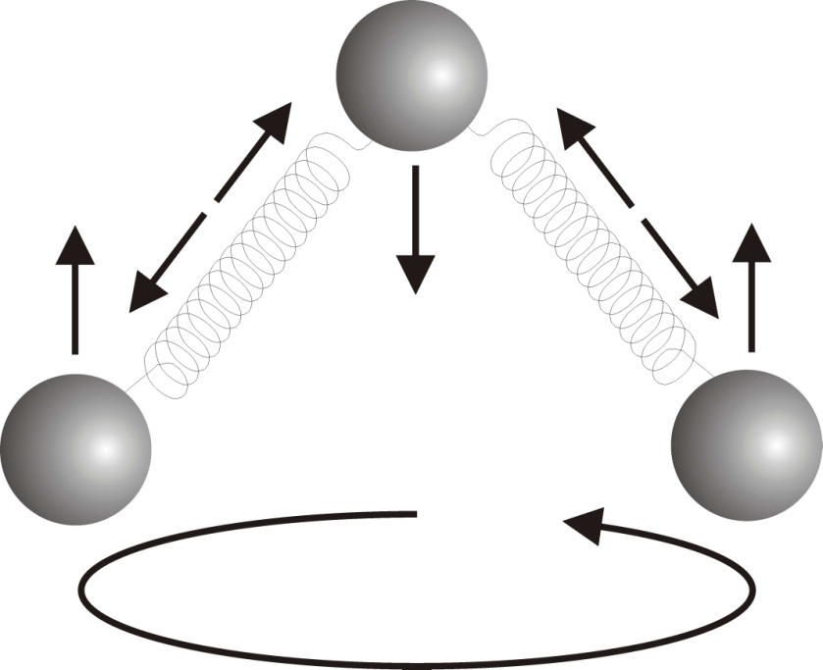
But certain trace gases interact strongly with radiation:
H₂0 (water vapor)
CO₂ (carbon dioxide)
CH₄ (methane)
Clouds also interact strongly with radiation. Together, they yield:

Slide 17
Elements of the Greenhouse Effect

Slide 18
If the Only Feedback Were Temperature, Doubling Carbon Dioxide would Increase Radiative Forcing by 4 W/m² and Thereby Increase Surface Temperature by about 1.1 ºC.

Slide 19
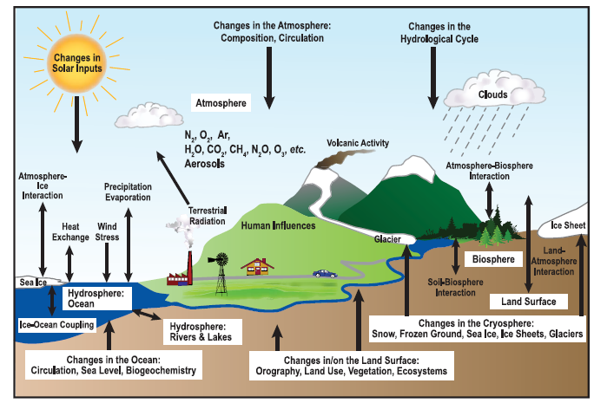
Climate Elements and Feedbacks

Slide 20
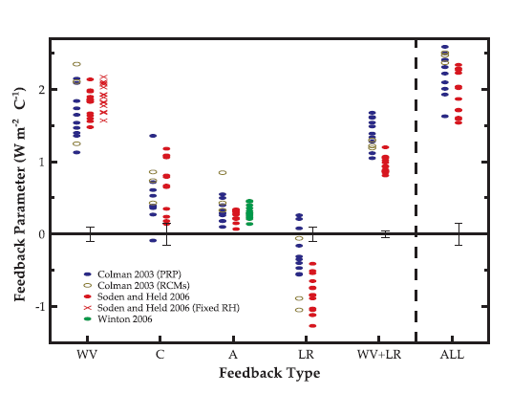
Feedbacks in Climate Models
Water vapor
Cloud
Surface albedo
Lapse rate
Water vapor + lapse rate

Slide 21

Svante Arrhenius, 1859-1927
Arrhenius was the first to suggest that fossil fuel combustion would lead to appreciable increases in atmospheric CO₂. In 1896, he estimated that doubling CO₂ would increase global temperatures by 5-6ºC.

Slide 22
Free versus Forced Climate Variability

Slide 23
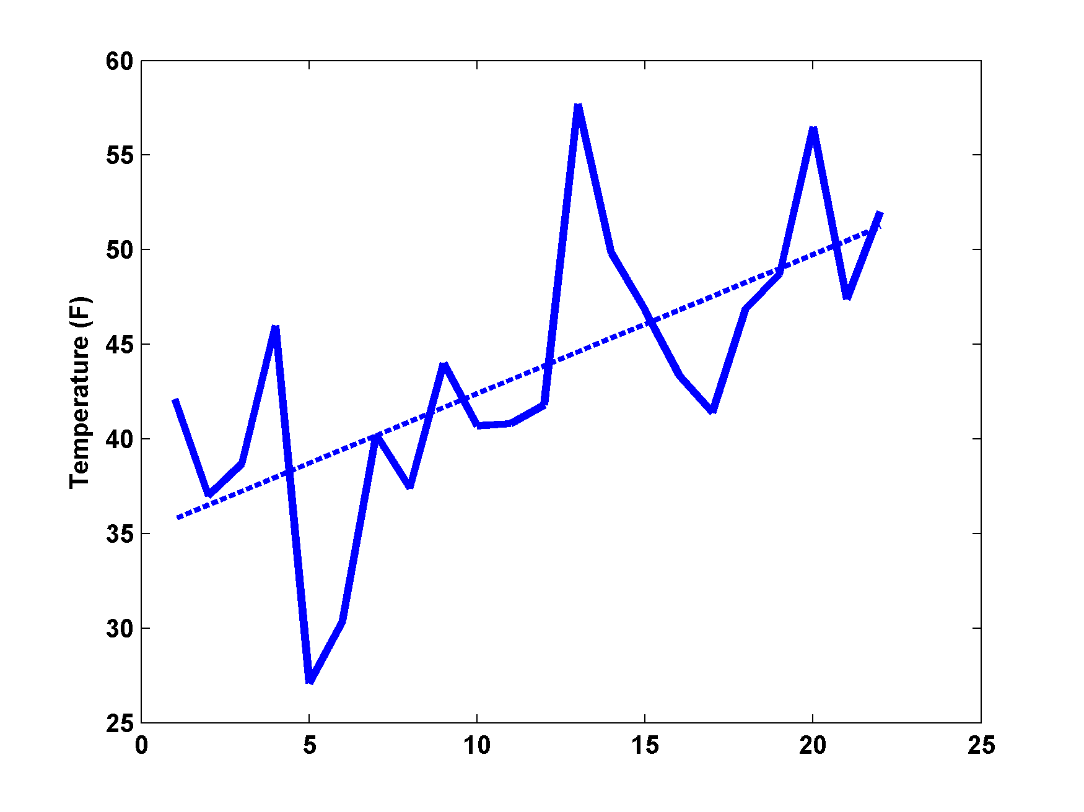
An example
It’s getting warmer!....
Time

Slide 24
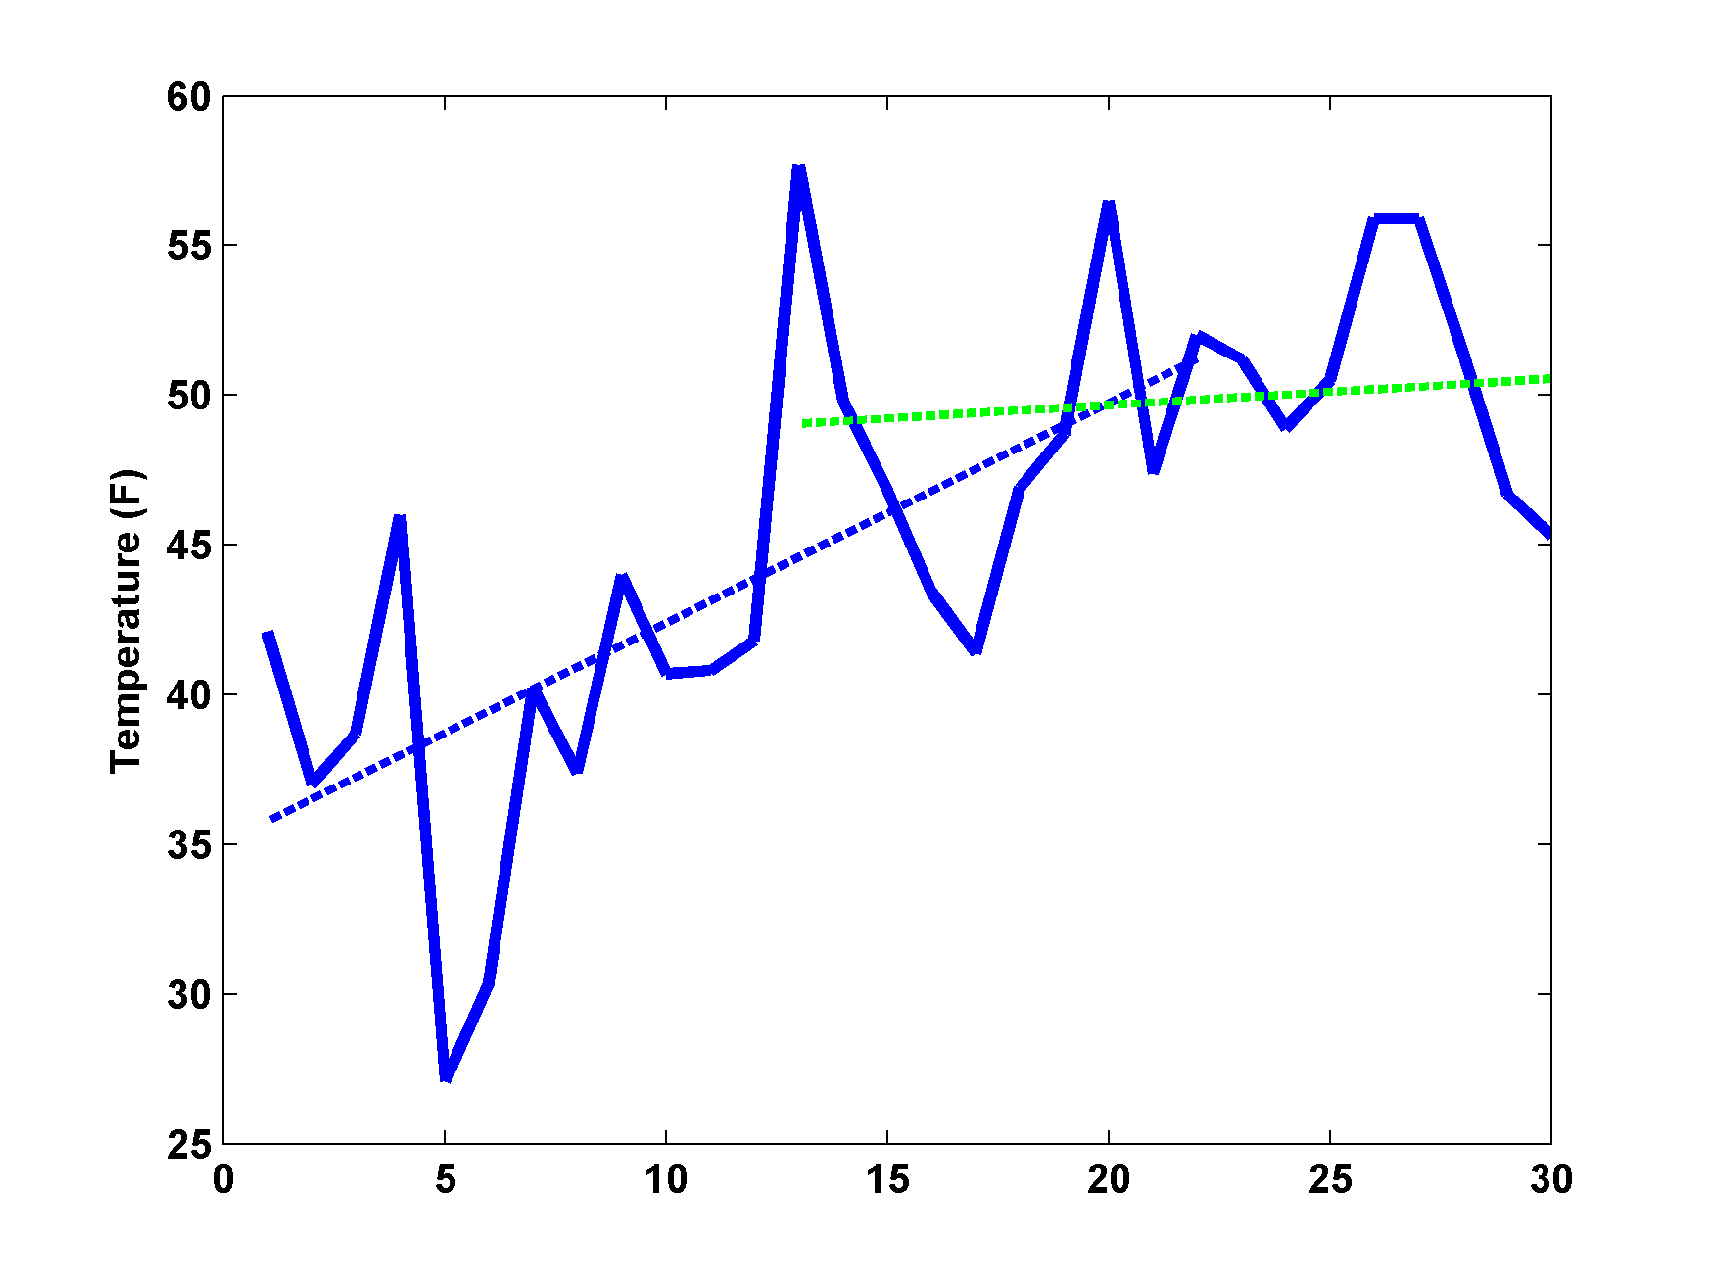
It’s getting warmer!....
No, it’s not! Warming stopped at 13! In fact, 13 was warmer than at any time since then!
Time

Slide 25
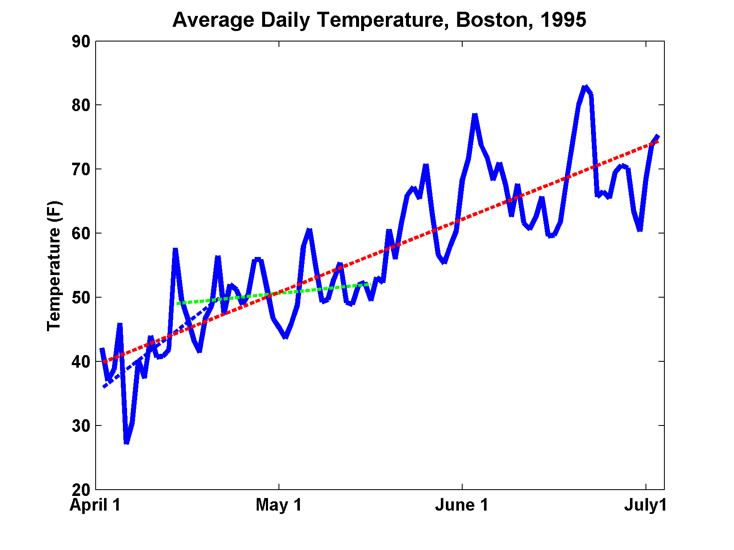
Note: We can forecast that summer will be warmer than winter, even though we cannot forecast the weather beyond a few days

Slide 26
Climate Forcing, Natural and Otherwise

Slide 27

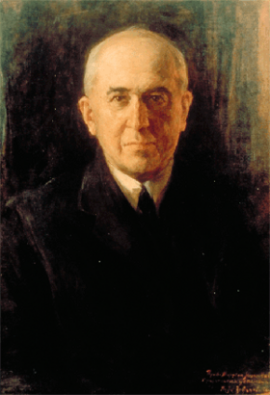
Climate Forcing by Orbital Variations
Milutin Milanković, 1879-1958

Slide 28
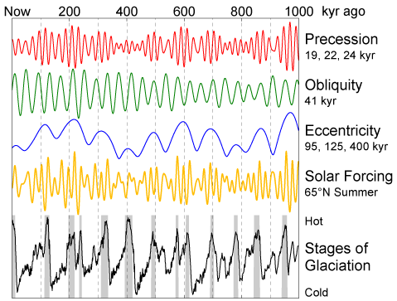
Climate Forcing and Response

Slide 29
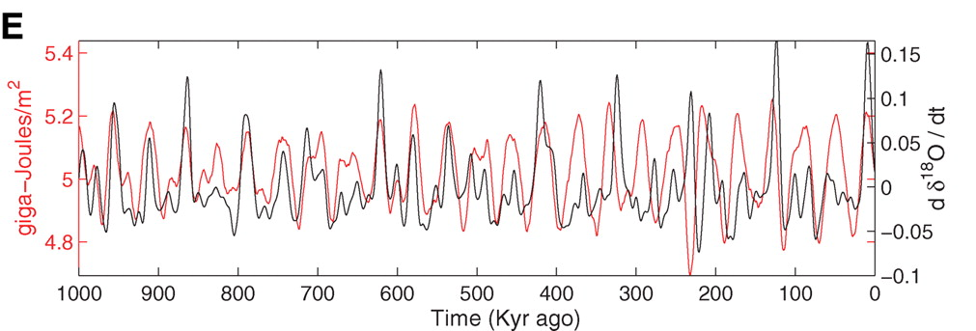
Strong Correlation between High Latitude Summer Insolation and Ice Volume
Black: Time rate of change of ice volume
Red: Summer high latitude sunlight
P. Huybers, Science, 2006

Slide 30
Causes of Recent Climate Change

Slide 31
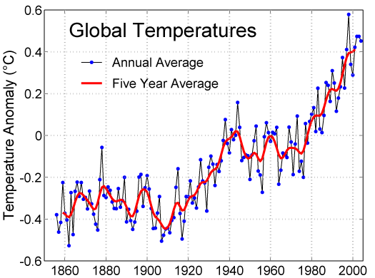

Slide 32
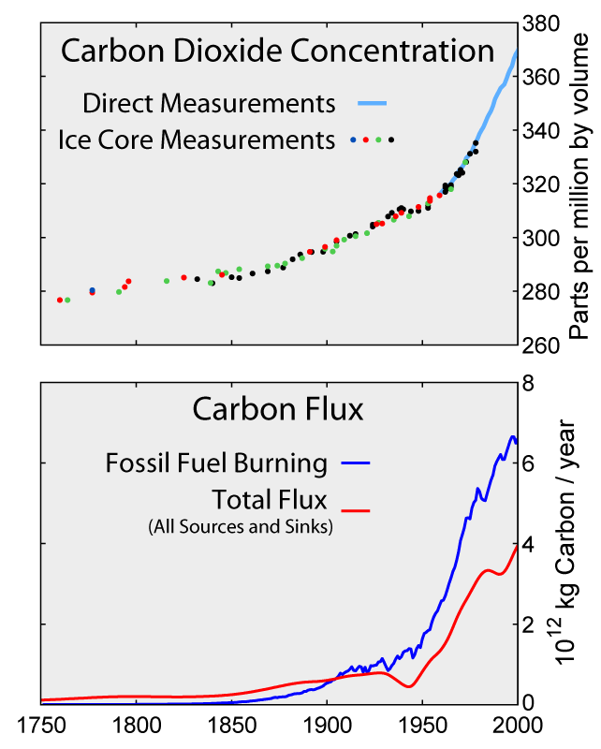

Slide 33
Variation in carbon dioxide and methane over the past 20,000 years, based on ice core and other records

Slide 34
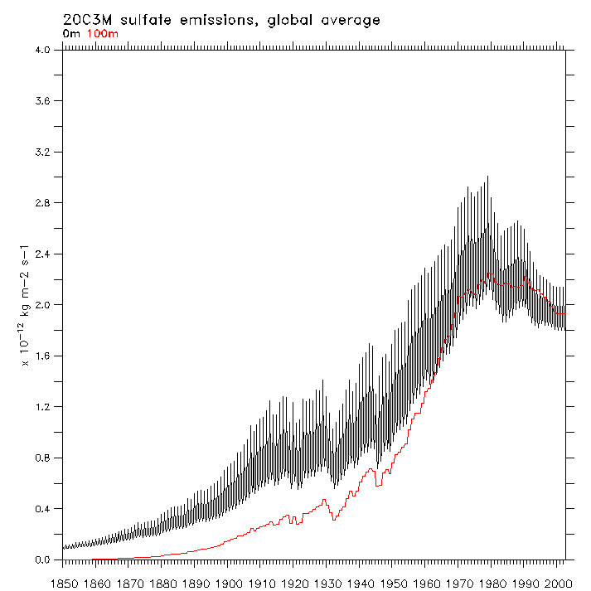
Global Sulfate Emissions

Slide 35
Recent History of Volcanic Eruptions

Slide 36
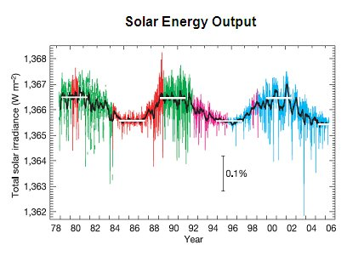
Normal solar cycle variations in solar radiation

Slide 37
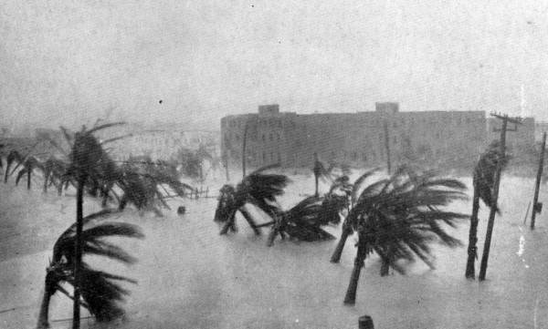
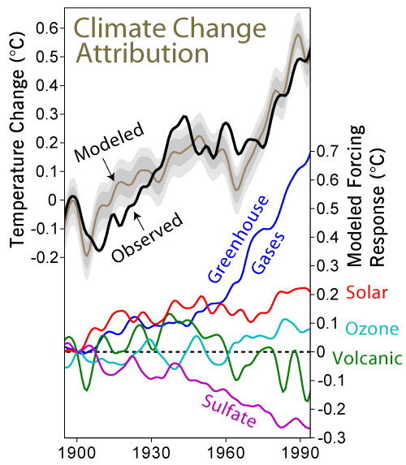

Slide 38
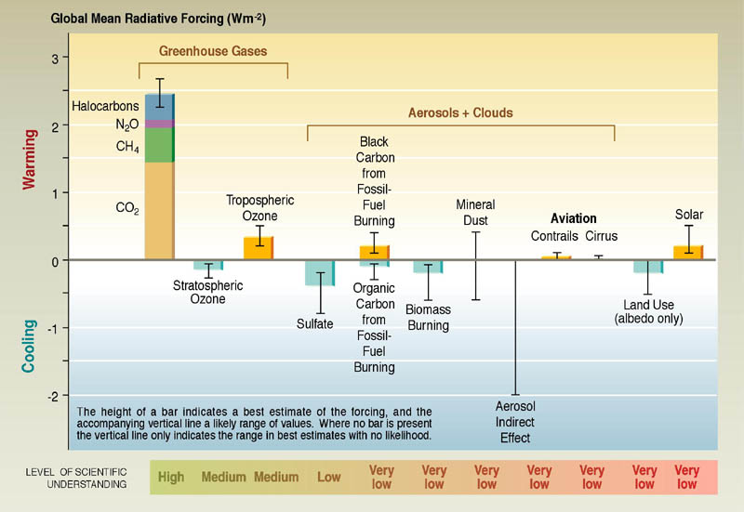
Contributions to net radiative forcing change, 1750-2004:

Slide 39
Distribution of temperature change, 1901-2005

Slide 40
Global Climate Models:
How Good Are They, and What Do They Tell Us about The Future?

Slide 41
Global Climate Modeling
General philosophy:
  Simulate large-scale motions of atmosphere, oceans, ice
  Solve approximations to full radiative transfer equations
  Parameterize processes too small to resolve
  Some models also try to simulate biogeochemical processes
  First General Circulation Models (GCMs) developed in 1960s
Notes:
41

Slide 42
Unresolved physical processes must be handled parametrically
Convection
Thin and/or broken clouds
Cloud microphysics
Aerosols and chemistry (e.g. photochemical processes, ozone
Turbulence, including surface fluxes
Sea ice
Land ice
Land surface processes

Slide 43
Climate Elements and Feedbacks

Slide 44
Global mean temperature (black) and simulations using many different global models (colors) including all forcings
Same as above, but models run with only natural forcings

Slide 45
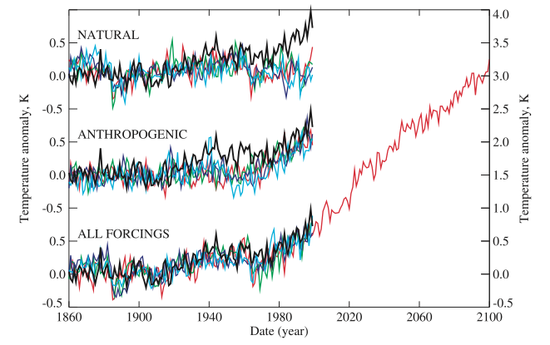

Slide 46
Ensemble of climate models, Scenario A1b

Slide 47
Projected Warming:

Slide 48
How Are We Doing So Far?

Slide 49
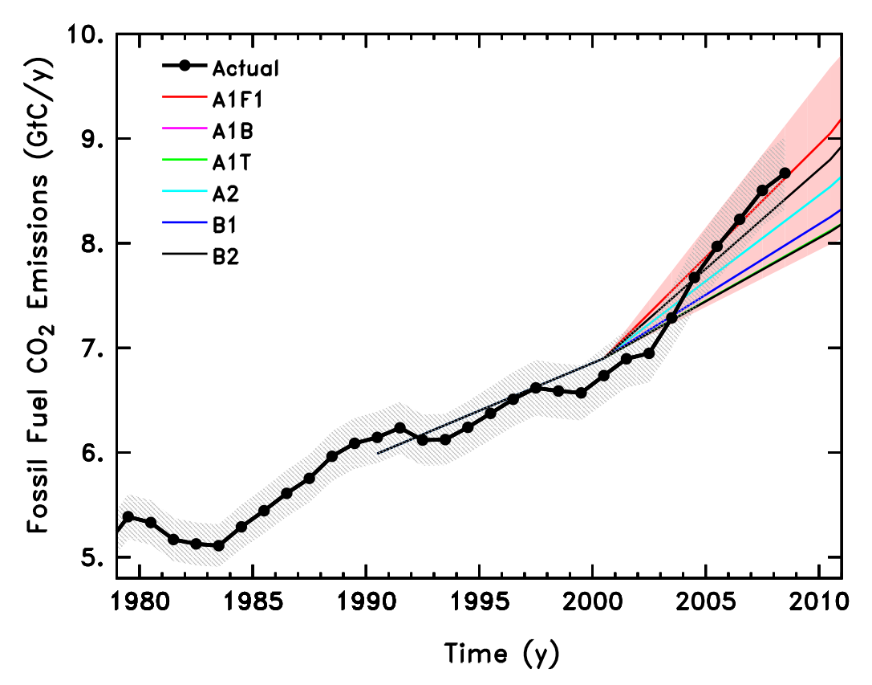
Figure 1: Global CO₂ Emissions from Fossil Fuels

Slide 50
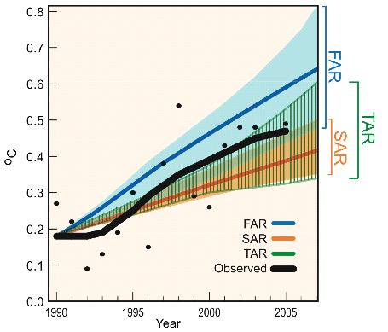
A genuine out-of-sample prediction
FAR:
1st Assessment
Report, 1990

Slide 51
C.f. another prediction made at the time
Lindzen (1992,1994):
Climate sensitivity = 0.3±0.2ºC

Slide 52
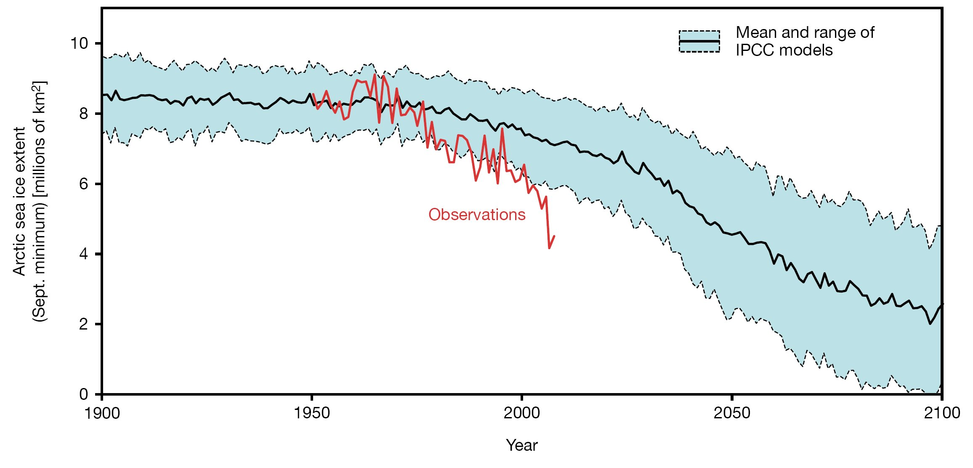
Observed and modeled Arctic sea-ice extent

Slide 53
Does Any of this Matter?

Slide 54
Possible Benefits of Warming:
Fewer deaths from exposure
More vigorous plant growth
Increase of arable land at high latitudes
Increased mining potential in current permafrost regions
Arctic waterways become navigable
Reduced heating costs

Slide 55
Warming Risks
Rising sea level
Concentration of rainfall into fewer but more intense events...more drought, floods
Increased incidence of some diseases
Increased production of allergens
Increased mortality from heat waves
Increased consumption of electricity
Possible increase in violent storms
Ocean acidification, increased species extinctions

Slide 56
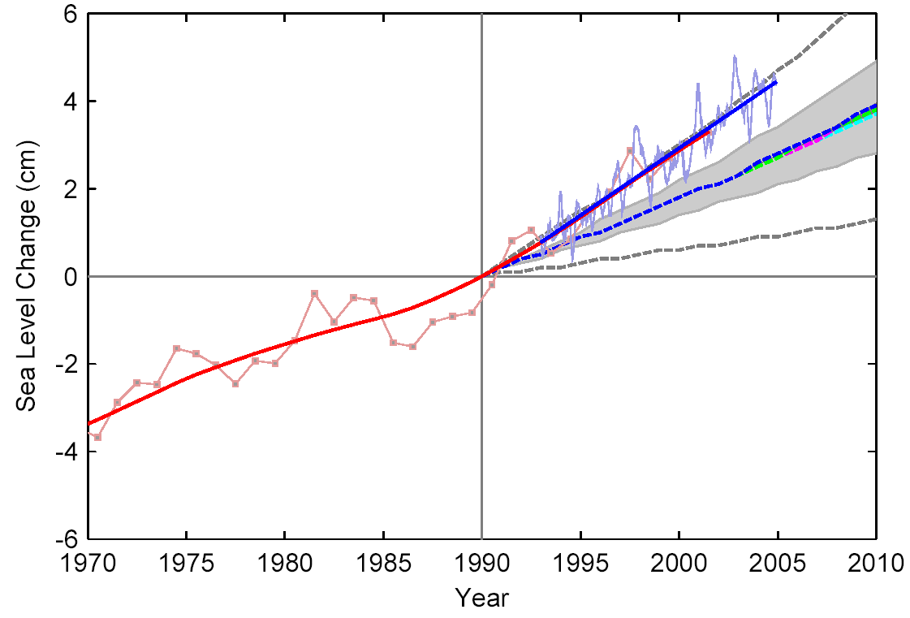
Sea Level Rise
Satellite Altimeter
IPCC
IPCC 2007:
for 1961–2003:
Models 1.2 mm/year
Data 1.8 mm/year
Tide Gauges

Slide 57
Past Sea Level vs. Temperature
(Source: WBGU after David Archer 2006)
Notes:
This graph shows how temperature and sea level were closely related in Earth’s history. During the last Ice Age, temperatures were about 6 ºC colder than now, while sea level was 120 meters lower. During the Pliocene, when it was last significantly warmer than now (by about 2 ºC), sea level was 20-30 meters higher. During the Eocene there was almost no ice on the planet, and sea level was about 70 meters higher.
The history of climate thus sends a strong warning: past climate changes by just a few degrees in global temperature have come with very large sea level changes, by tens of meters. In the long run, this is likely to happen again. The sea level rise by the year 2100 (likely below one meter) is only the small beginning of a much larger rise that will unfold over coming centuries and perhaps millennia, caused by our carbon emissions in this century.

Slide 58
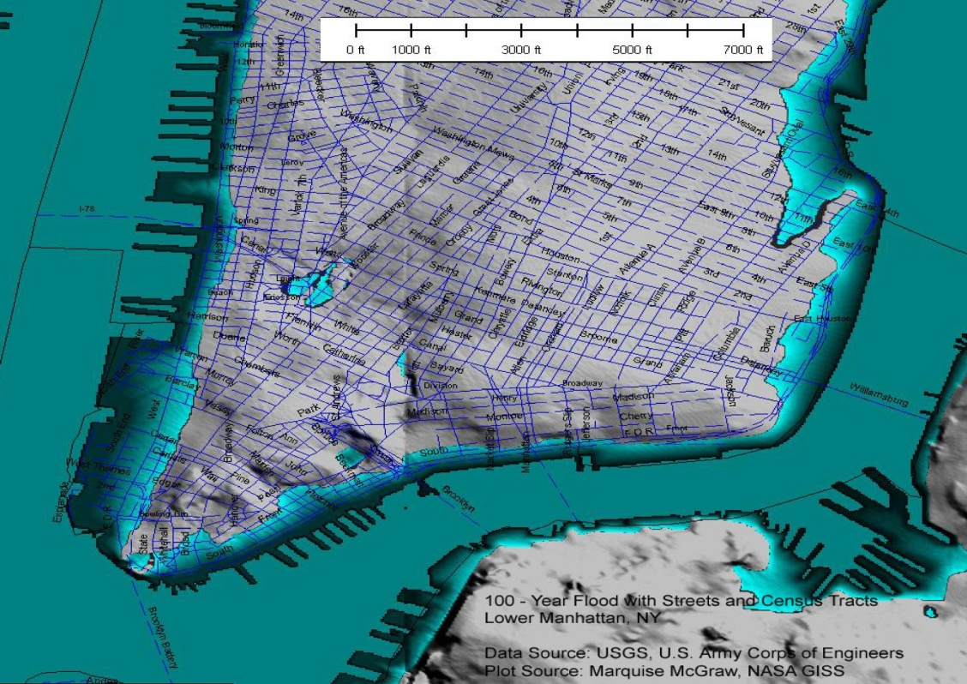
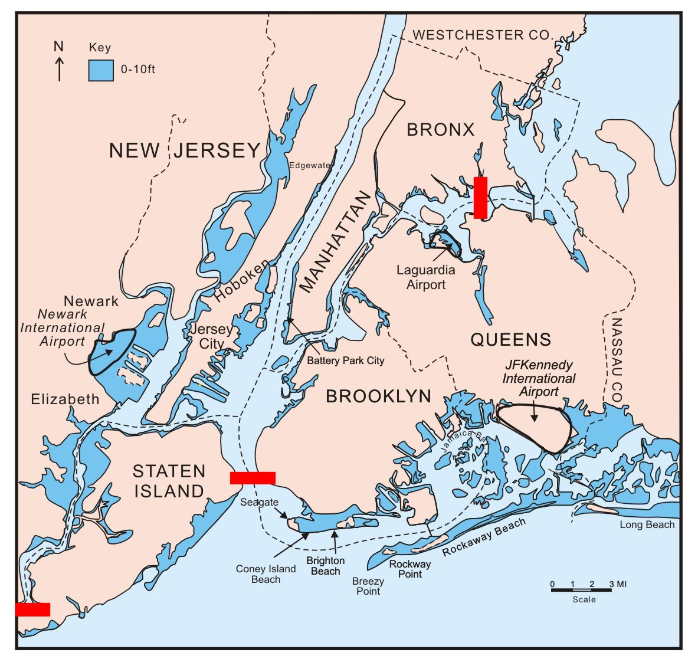
Storm Surge Risk in New York
Today: once in 100 years
After 1 m rise: once in 3 years
Notes:
„Kein Wissenschaftler sagt eine Überschwemmung New Yorks voraus, das bleibt allein dem Politiker Al Gore vorbehalten und den Klimahysterikern in Deutschland,“ so Report München am 9. Juli 2007.

Slide 59
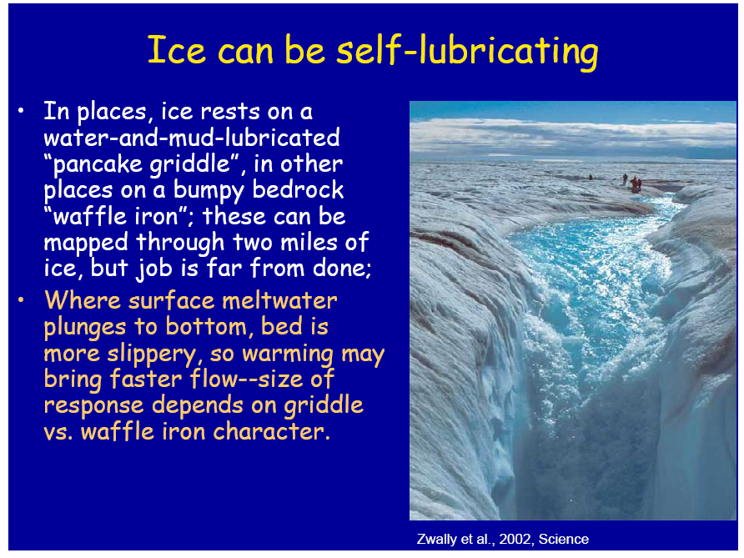

Slide 60
Greenland surface elevation change, 1989-2005

Slide 61
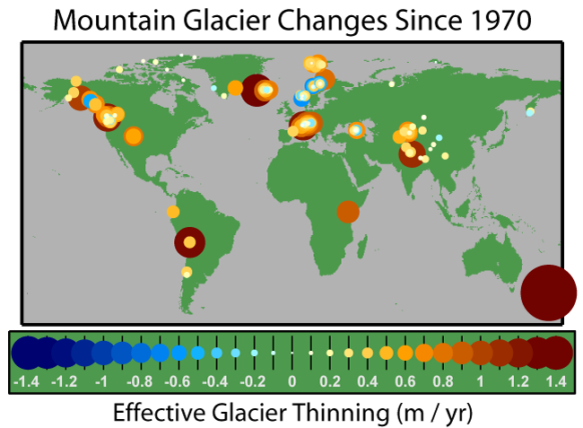

Slide 62
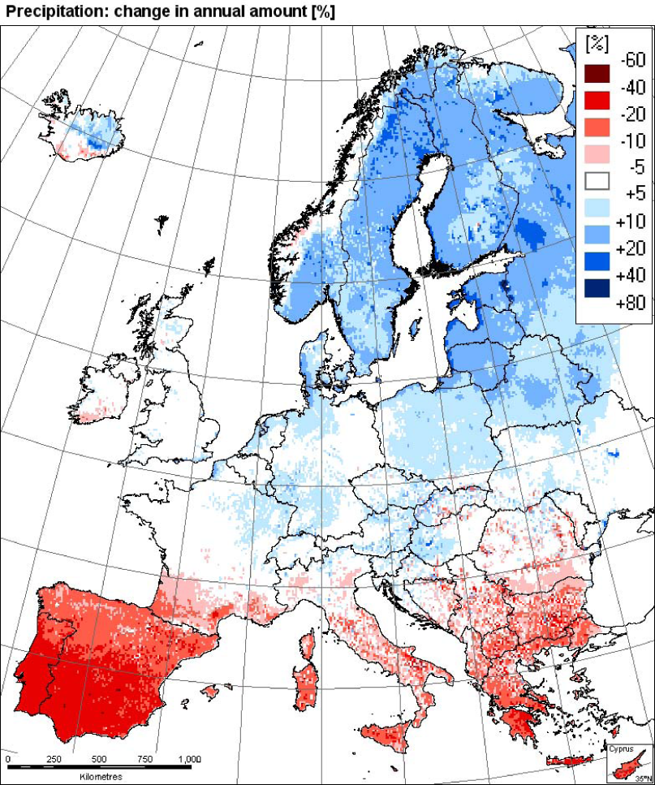
Changes in Precipitation
Observations: trend 1961-2006
Model simulation
Southern Europe
Is drying out
EEA
2008

Slide 63
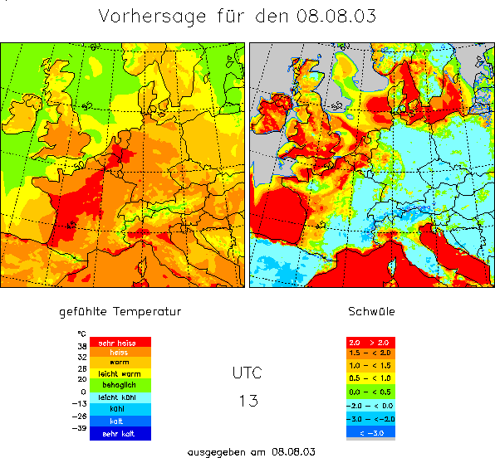
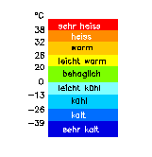
Heat Waves
Mortality and heat stress (8. August 2003, 13 UTC)
Summer 2003,
greatest natural disaster
in Europe
ca. 35.000 fatalities
2,000
†
2,000
†
Heat Stress
7,000
†
extreme
15,000
†
high
moderate
slight
4,000
†
leicht
mäßig
hoch
1,500
†
Mortality data: Earth Policy Institute
Heat Stress: Deutscher Wetterdienst
4,000
†
extrem
Kältestress
© 2007 Geo Risks Research, Munich Re

Slide 64
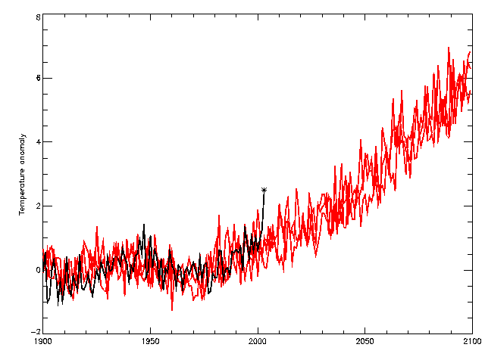
Heat Waves
2060s
observations
HadCM3 Medium-High (SRES A2)
2040s
2003
Temperature anomaly (wrt 1961-90) °C

Slide 65
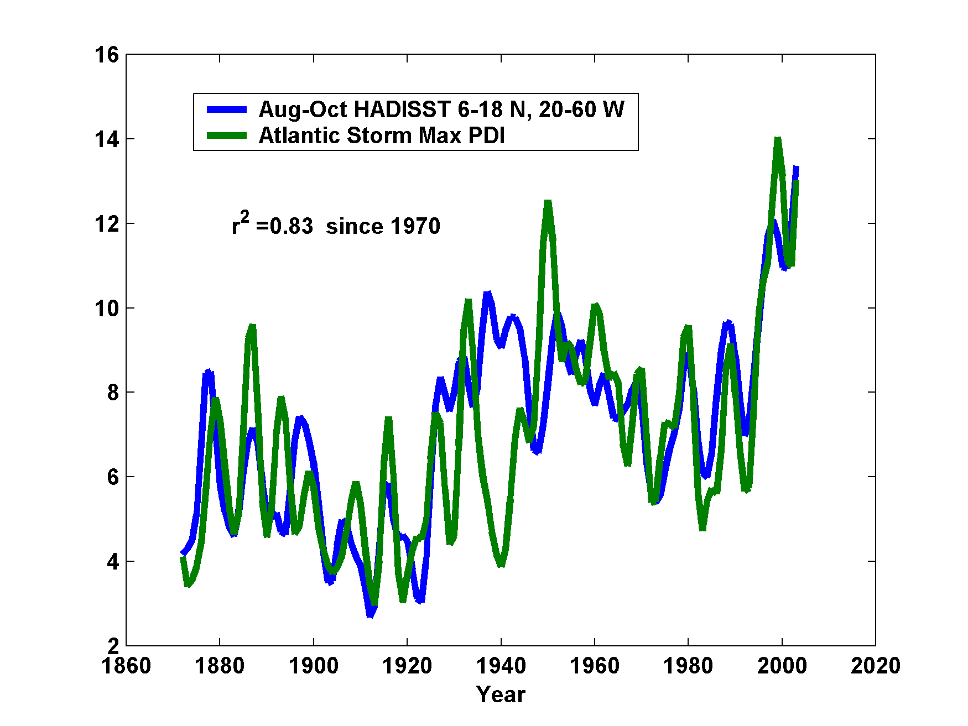
Hurricane Power is Changing in Concert with Tropical Ocean Temperature

Slide 66

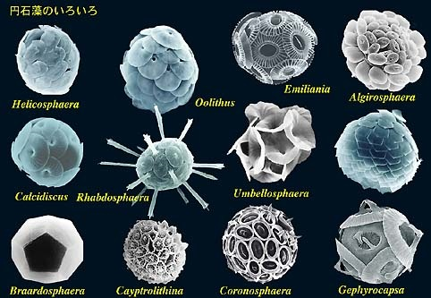

The Oceans are Turning Sour
Acidification through CO₂ threatens marine life
Plankton
Coral Reefs
Notes:
Abbildung 4.3-1
Aragonitsättigung und
gegenwärtige Riffstandorte
von Warmwasserkorallen
(blaue Punkte). (a)
vorindustrielle Werte
(ca. 1870, atmosphärische
CO2-Konzentration
280 ppm), (b) Gegenwart
(ca. 2005, 375 ppm CO2), (c)
Zukunft (ca. 2065, 517 ppm
CO2). Der Grad der
Aragonitsättigung (Ù)
bezeichnet das relative
Verhältnis zwischen dem
Produkt der Konzentrationen
von Kalzium- und
Karbonationen und dem
Löslichkeitsprodukt für
Aragonit. Standorte mit
einer Aragonitsättigung
unterhalb von 3,5 sind nur
noch bedingt für riffbildende
Warmwasserkorallen
geeignet (marginal),
unterhalb von 3 sind sie
ungeeignet.
Quelle: Steffen et al., 2004

Slide 67
Dealing with Climate Change
Winners and losers
Difficult but necessary cost-benefit analysis
Still large uncertainty in climate projections
Small but difficult-to-quantify risk of major climate shifts (e.g. collapse of Greenland ice sheet)

Slide 68
Atmospheric lifetime of CO₂ is centuries long
68
Hansen, 2007
Notes:
68

Slide 69
Strategies
Reduce emissions
  gasification of coal—potential CO₂ capture
  alternative sources– nuclear, wind, etc.
  unlikely to effect major reductions
  Fcous on non-CO₂ greenhouse gases
Carbon sequestration
Other geoengineering
  technically feasible, $20-30 billion/year
  Side effects, e.g. reduced precipitation
Adaptation

Slide 70
Summary
Earth’s climate has changed radically and often abruptly through time
Primary culprits:
  Changing insolation, through solar evolution and orbital variations
  Changing concentrations of trace greenhouse gases
  Changing concentration of aerosols: Volcanic eruptions
Evidence for human-induced climate change now very compelling

Slide 71
Many climate processes remain poorly understood. Past abrupt climate change remains enigmatic and future abrupt state transitions cannot be ruled out
The culture of climate science is overly reliant on large, complex models. The field is in need of a fresh approach and an influx of original thinkers

Slide 72
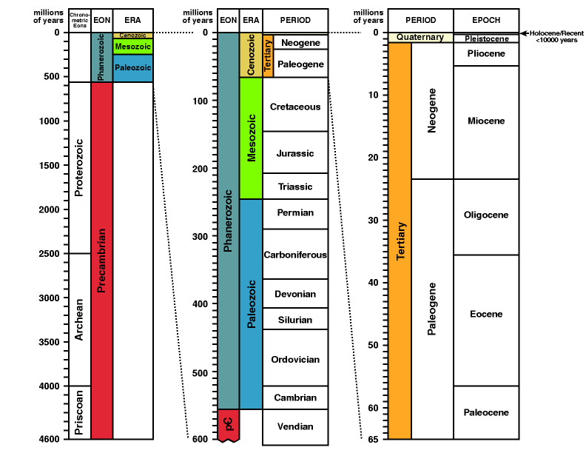

Slide 73
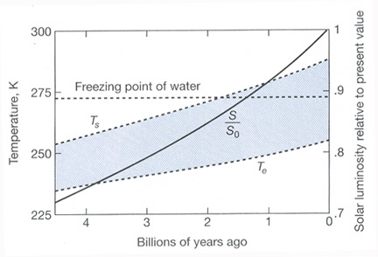
The Faint Young Sun Paradox: Why didn’t the Earth Freeze?

Slide 74
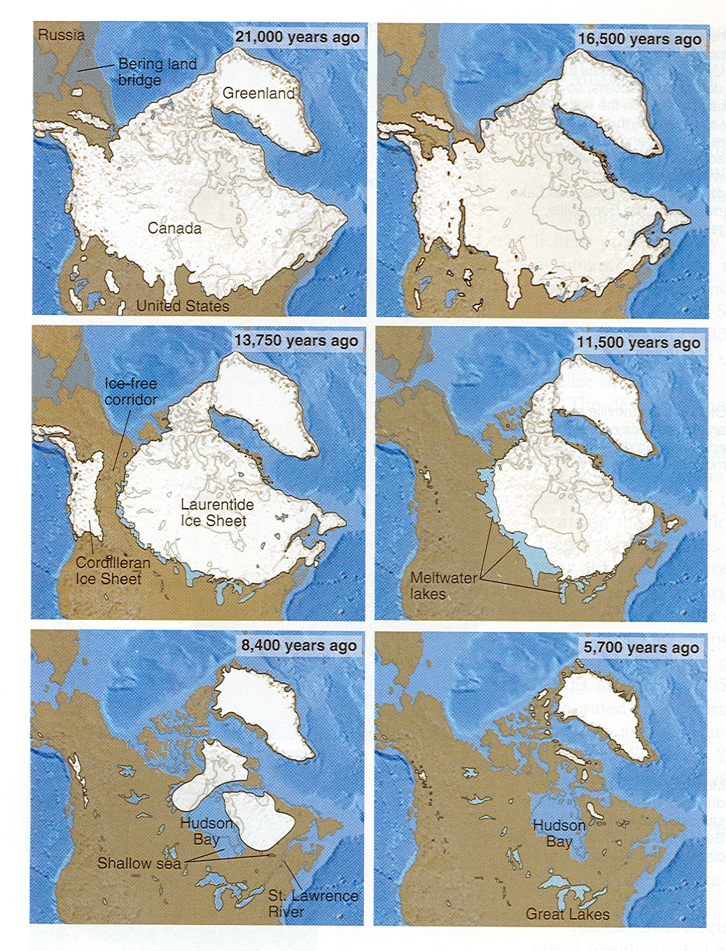
Rapid pace of deglaciation remains enigmatic

Slide 75
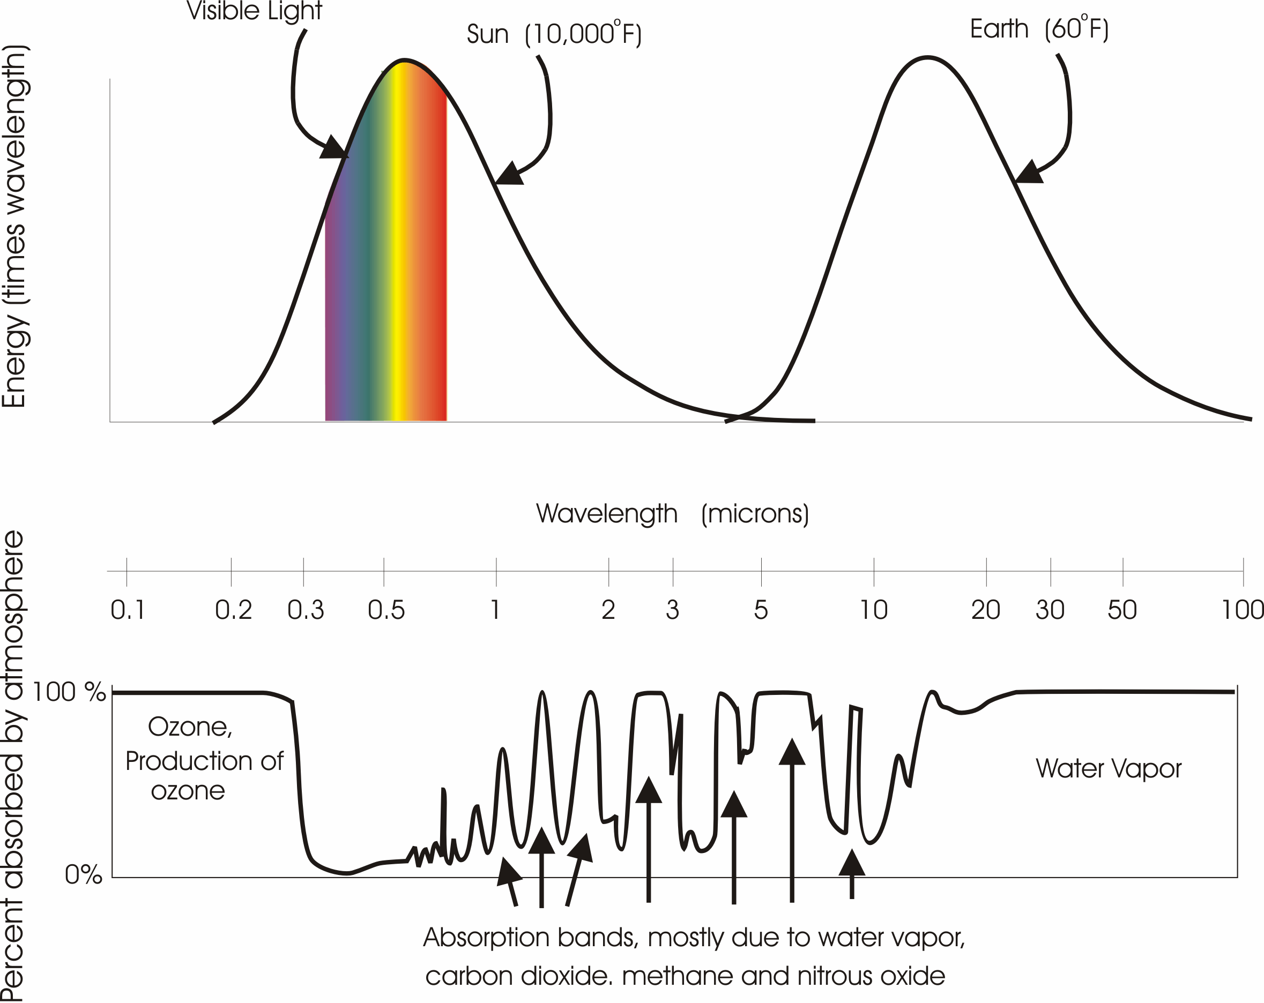

Slide 76
Rate of increase of CO₂ if all remained in atmosphere
Observed annual rate of increase of CO₂

Slide 77
Contributions to Radiative Climate Forcing
Proxy Temperature Reconstructions

Slide 78
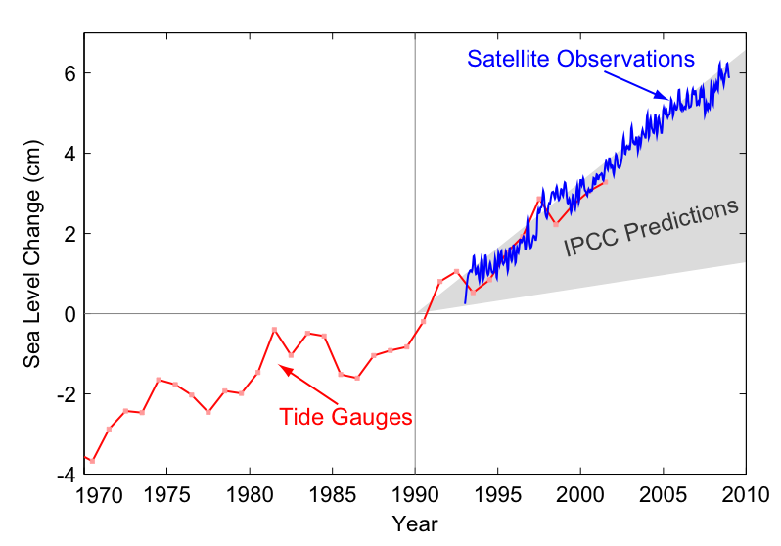
Sea-level change 1970-2010

Slide 79
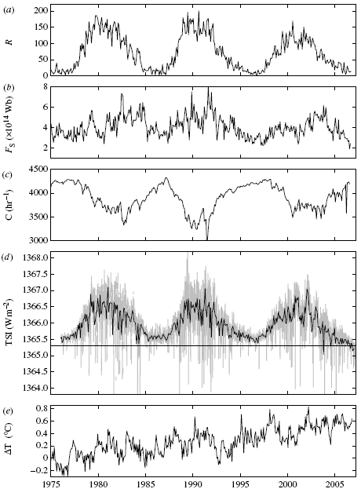
All indicators of solar forcing of climate indicate no trend since 1980
(a) Sunspot number
(b) Open solar flux
(c) Galactic cosmic ray flux
(d) Total Solar Irradiance
(e) global temperature
Lockwood and Fröhlich, 2007

Slide 80
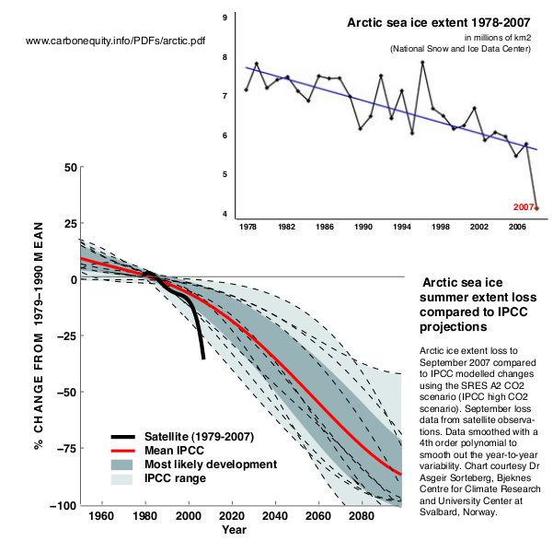
Arctic Minimum Sea Ice Extent

Slide 81
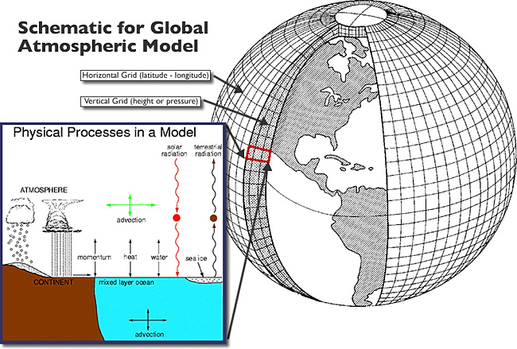
Equations solved by discretizing to finite volumes

Slide 82
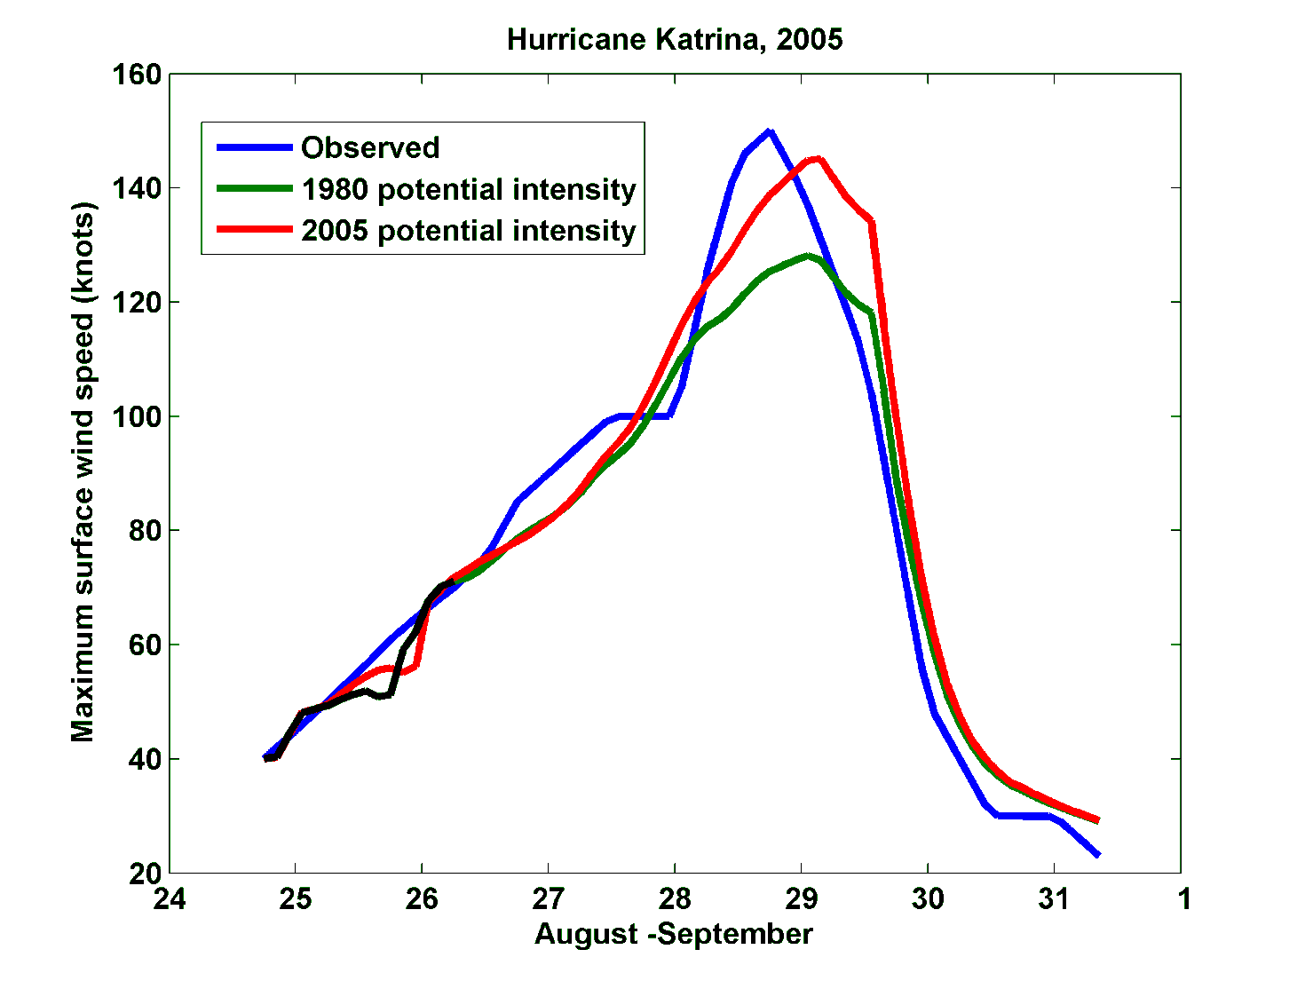
Effect of Increased Potential Intensity on Hurricane Katrina

Slide 83
