Slide 1

Impending. Oil painting by American artist Amy Marx
The Voice of the Sea is never one voice, but a tumult of many voices—voices of drowned men,—the mutterings of multitudinous dead,—the moaning of innumerable ghosts, all rising, to rage against the living, at the great Witch-call of storms….—Lafcadio Hearn (1850–1904), Chita: A Memory of Last Island

Slide 2

Hurricanes: Present and Future
Kerry Emanuel
Massachusetts Institute of Technology
Notes:
2

Slide 3

Program
Overview of Hurricanes
How does climate affect hurricanes?
How do hurricanes affect climate?
What have hurricanes been like in the past, and how will they be affected by global warming?

Slide 4

Brief Overview of Tropical Cyclones
Notes:
4

Slide 5
What is a Hurricane?
Formal definition: A tropical cyclone with 1-min average winds at 10 m altitude in excess of 32 m/s (64 knots or 74 MPH) occurring over the North Atlantic or eastern North Pacific

Slide 6


The word Hurricane is derived from the Mayan word Huracan and the Taino and Carib word Hunraken, a terrible God of Evil, and brought to the West by Spanish explorers
Blow, winds, and crack your cheeks! rage! blow! You cataracts and hurricanoes, spout Till you have drench’d our steeples, drown’d the cocks! -- King Lear

Slide 7
Hurricanes in History

Slide 8
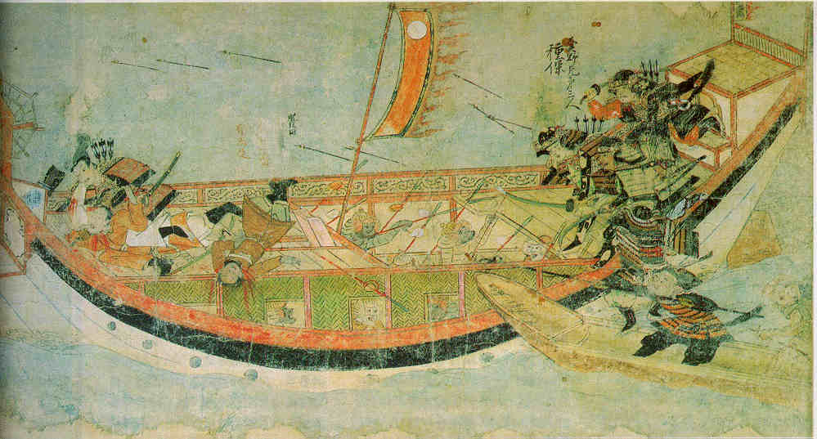
Early historical encounters: The Mongol invasions of Japan in 1274 and 1281
Scene from the 13th century Mongol invasion scrolls, based on a narrative written by the Japanese warrior Takezaki Suenaga.

Slide 9
Galveston, 1900
The opinion held by some who are unacquainted with the actual conditions of things, that Galveston will at some time be seriously damaged by some such disturbance, is simply an absurd delusion
- Isaac Cline, Local Forecast Official and Section Director, U.S Weather Bureau, Galveston, Texas, in The Galveston News, 1891

Slide 10
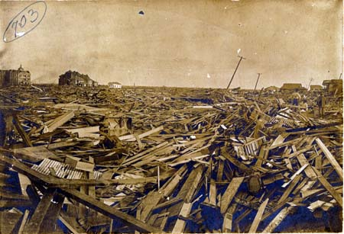
Sunday, September 9, 1900, revealed one of the most horrible sights that ever a civilized people looked upon. - Isaac Cline

Slide 11
The View from Space

Slide 12
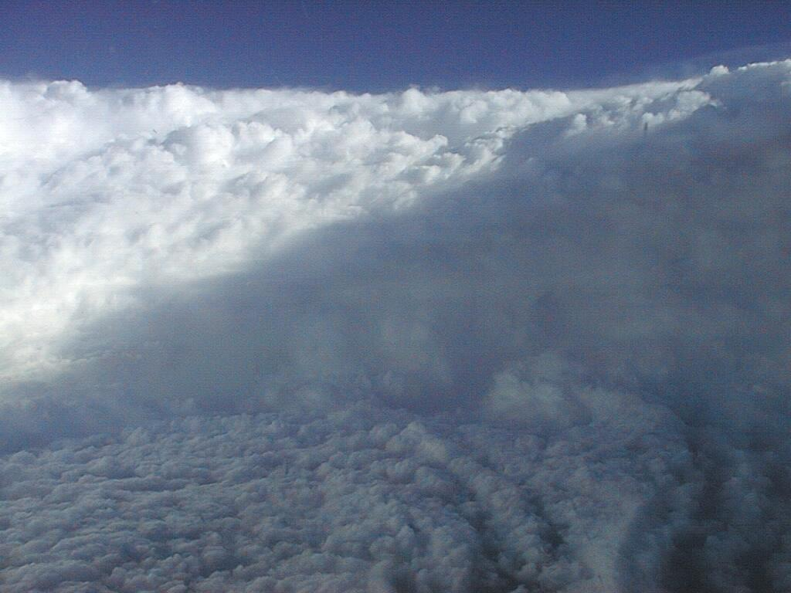

Slide 13
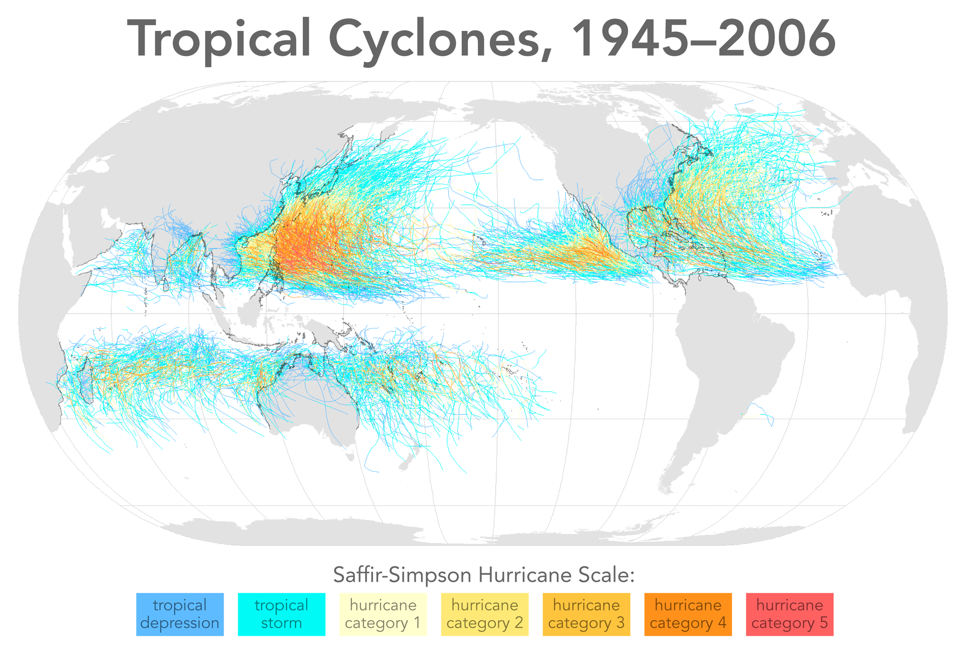

Slide 14
Physics of Mature Hurricanes

Slide 15
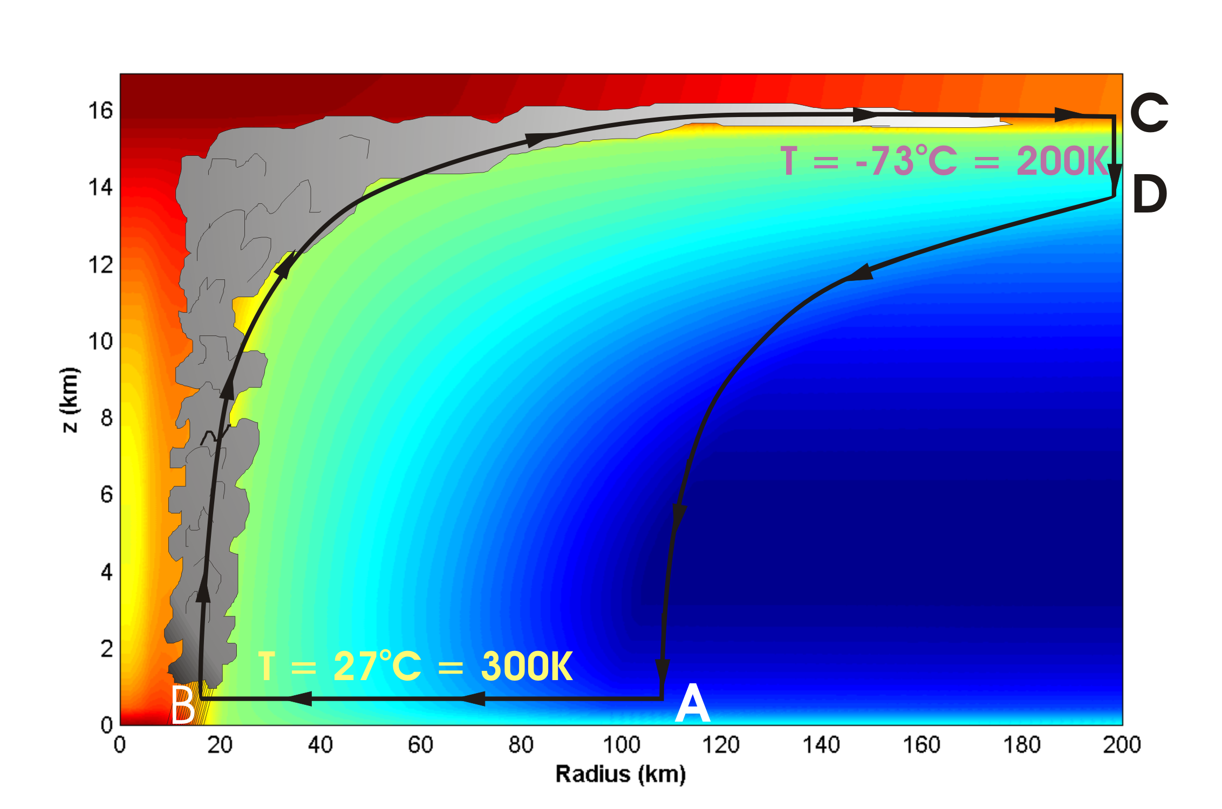
Energy Production

Slide 16
Carnot Theorem: Maximum efficiency results from a particular energy cycle:
Isothermal expansion
Adiabatic expansion
Isothermal compression
Adiabatic compression
Note: Last leg is not adiabatic in hurricane: Air cools radiatively. But since environmental temperature profile is moist adiabatic, the amount of radiative cooling is the same as if air were saturated and descending moist adiabatically.
Maximum rate of energy production:

Slide 17
Theoretical Upper Bound on Hurricane Maximum Wind Speed:
Surface temperature
Ratio of exchange coefficients of enthalpy and momentum
Outflow temperature
Air-sea enthalpy disequilibrium

Slide 18
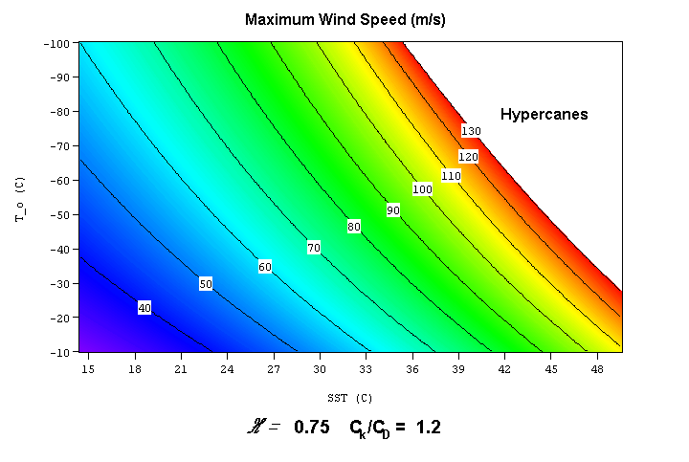

Slide 19
Annual Maximum Potential Intensity (m/s)

Slide 20
Atlantic Hurricanes and Climate Change

Slide 21
Intensity Metric:
Hurricane Power
(Power Dissipation Index)
A measure of the total frictional dissipation of kinetic energy in the hurricane boundary layer over the lifetime of the storm

Slide 22
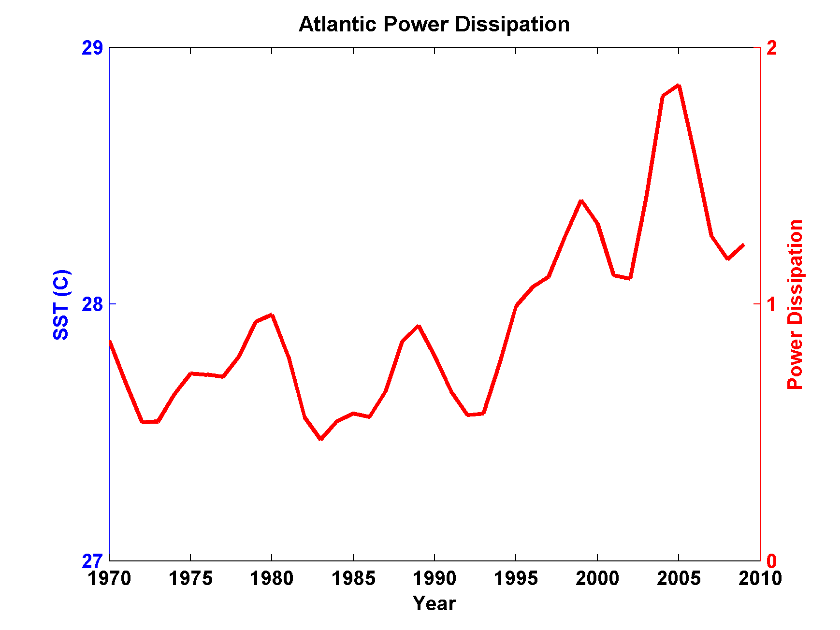
Atlantic Storm Maximum Tropical Cyclone Power Dissipation during an era of high quality measurements, 1970-2011 (smoothed with 1-3-4-3-1 filter)

Slide 23
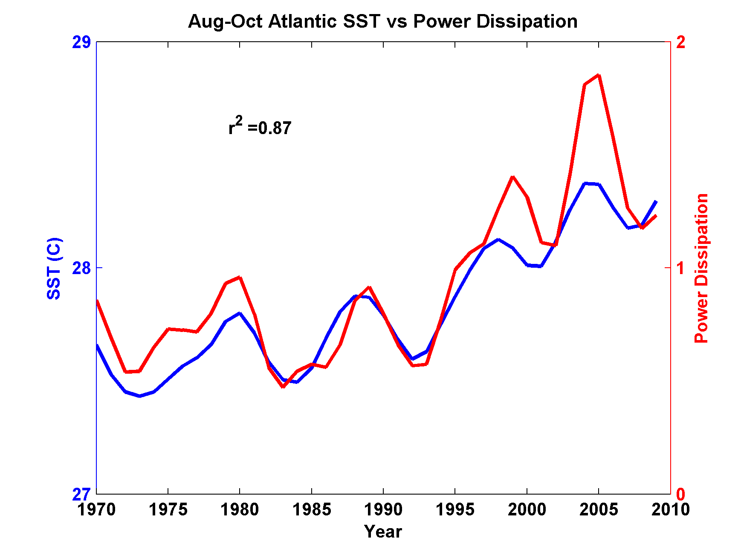
Atlantic Storm Maximum Tropical Cyclone Power Dissipation and Sea Surface Temperature during an era of high quality measurements, 1970-2011 (smoothed with 1-3-4-3-1 filter)

Slide 24
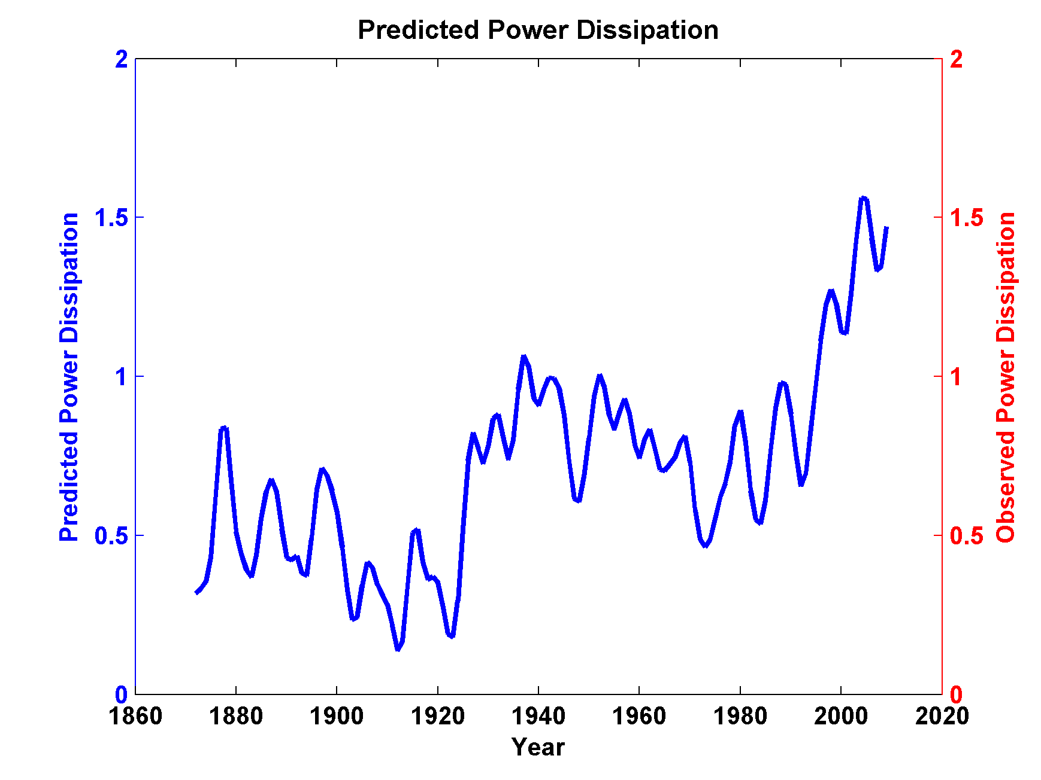
Use Linear Regression to Predict Power Dissipation back to 1870 based on SST:

Slide 25
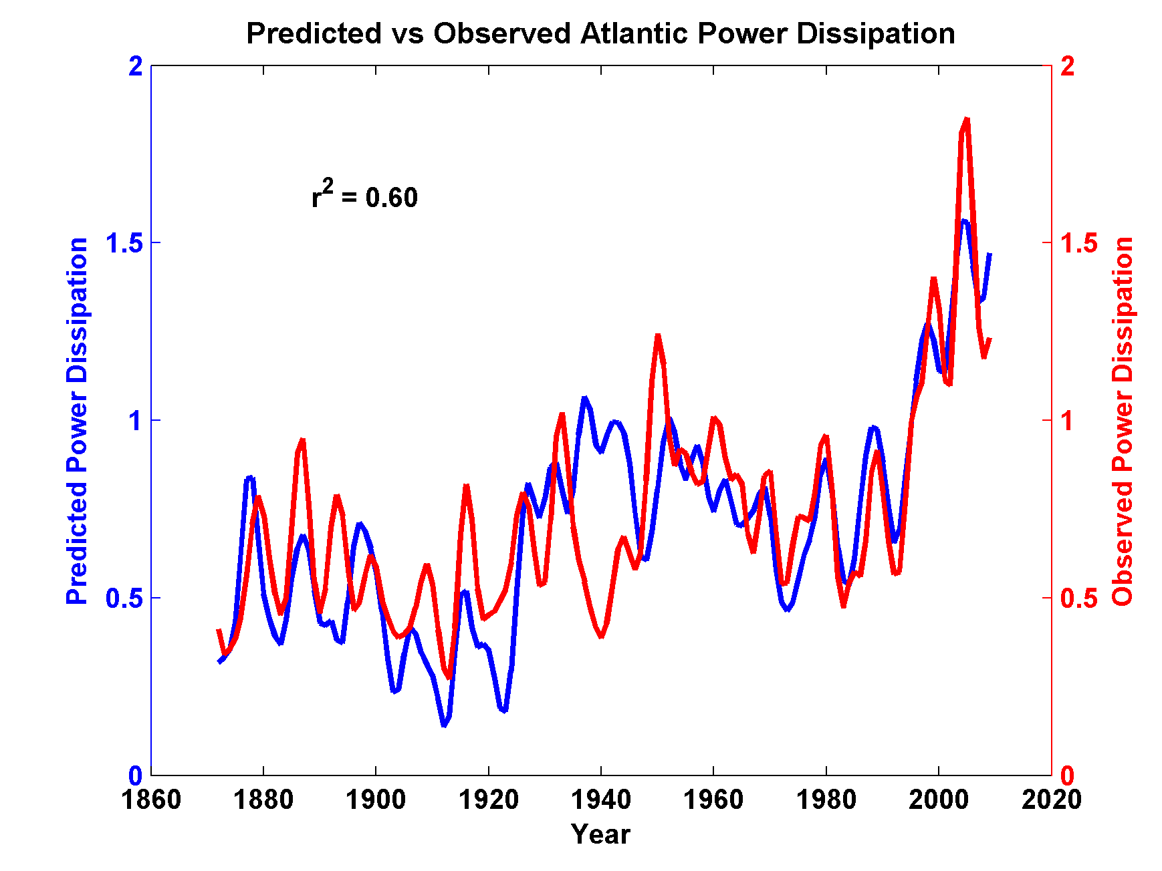
Now Compare to Observed Storm Maximum Power Dissipation

Slide 26
What is Causing Changes in Tropical Atlantic Sea Surface Temperature?

Slide 27
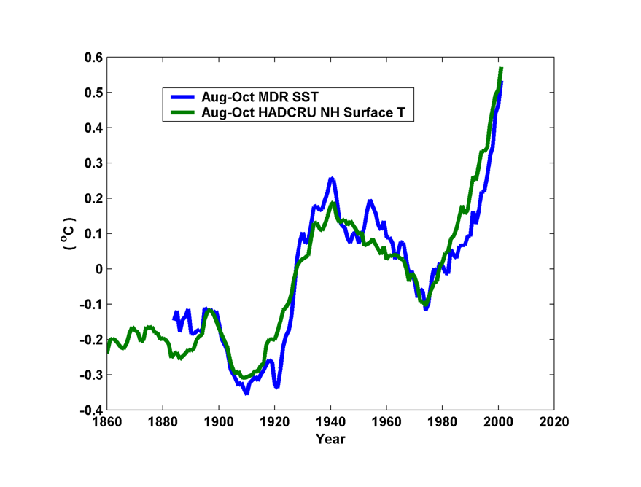
10-year Running Average of Aug-Oct Northern Hemisphere Surface Temp and Hurricane Region Ocean Temp

Slide 28
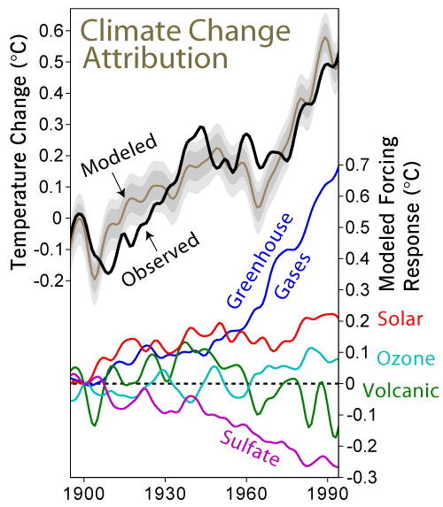

Slide 29
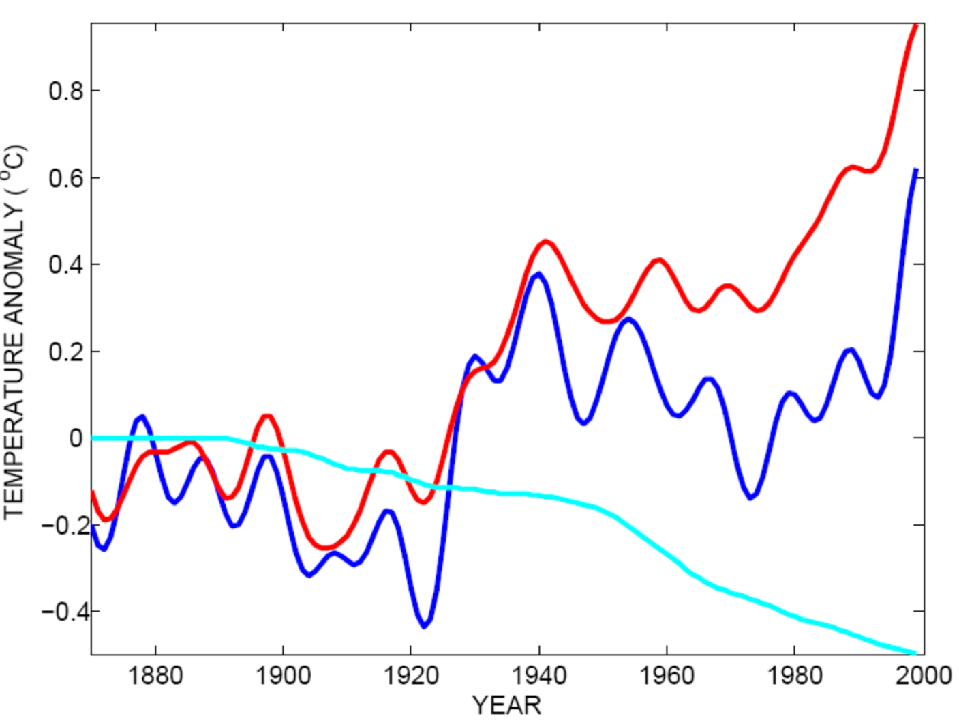
Tropical Atlantic SST(blue), Global Mean Surface Temperature (red),
Aerosol Forcing (aqua)
Global mean surface temperature
Tropical Atlantic sea surface temperature
Sulfate aerosol radiative forcing
Mann, M. E., and K. A. Emanuel, 2006. Atlantic hurricane trends linked to climate change. EOS, 87, 233-244.

Slide 30
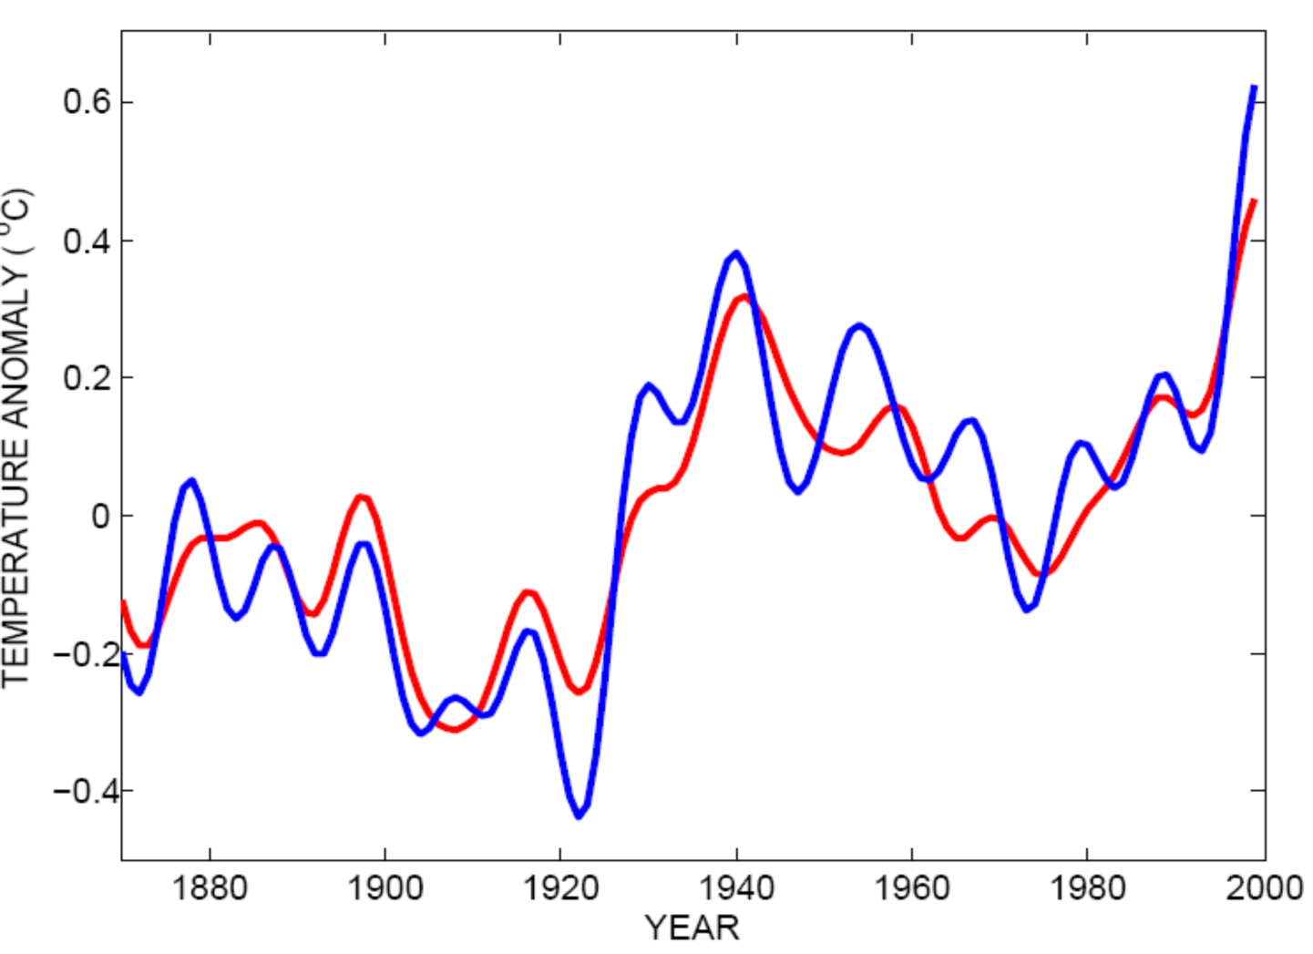
Best Fit Linear Combination of Global Warming and Aerosol Forcing (red) versus Tropical Atlantic SST (blue)
Tropical Atlantic Sea Surface Temperature
Global Surface T + Aerosol Forcing
Mann, M. E., and K. A. Emanuel, 2006. Atlantic hurricane trends linked to climate change. EOS, 87, 233-244.

Slide 31
Feedback of Global Tropical Cyclone Activity on the Climate System
Notes:
31

Slide 32
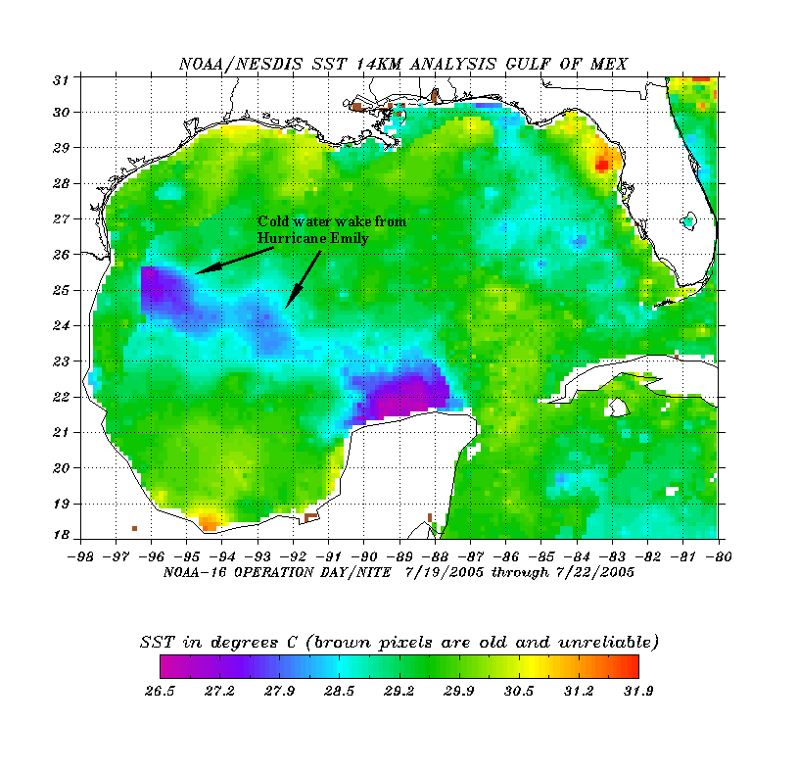
The wake of Hurricane Emily (July 2005)
Sea Surface Temperature in the Wakes of Hurricanes
Hurricane Dennis
(one week earlier)
Source: Rob Korty, CalTech
Notes:
32
We know that tropical cyclones are responsible for strong mixing of the upper oceans and this can be seen in satellite images…

Slide 33
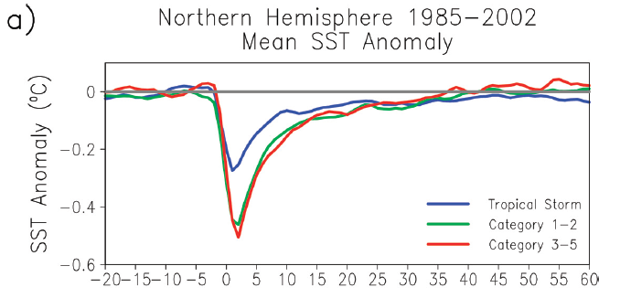
Wake Recovery
Hart, Maue, and Watson, Mon. Wea. Rev., 2007

Slide 34
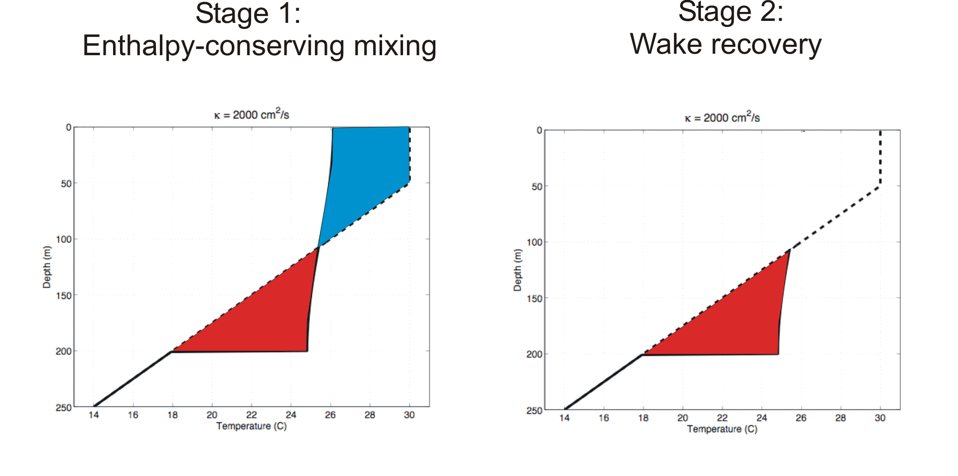
Direct mixing by tropical cyclones
Emanuel (2001) estimated global rate of heat input as 1.4 X 10¹⁵ Watts
Source: Rob Korty, CalTech
Notes:
34

Slide 35
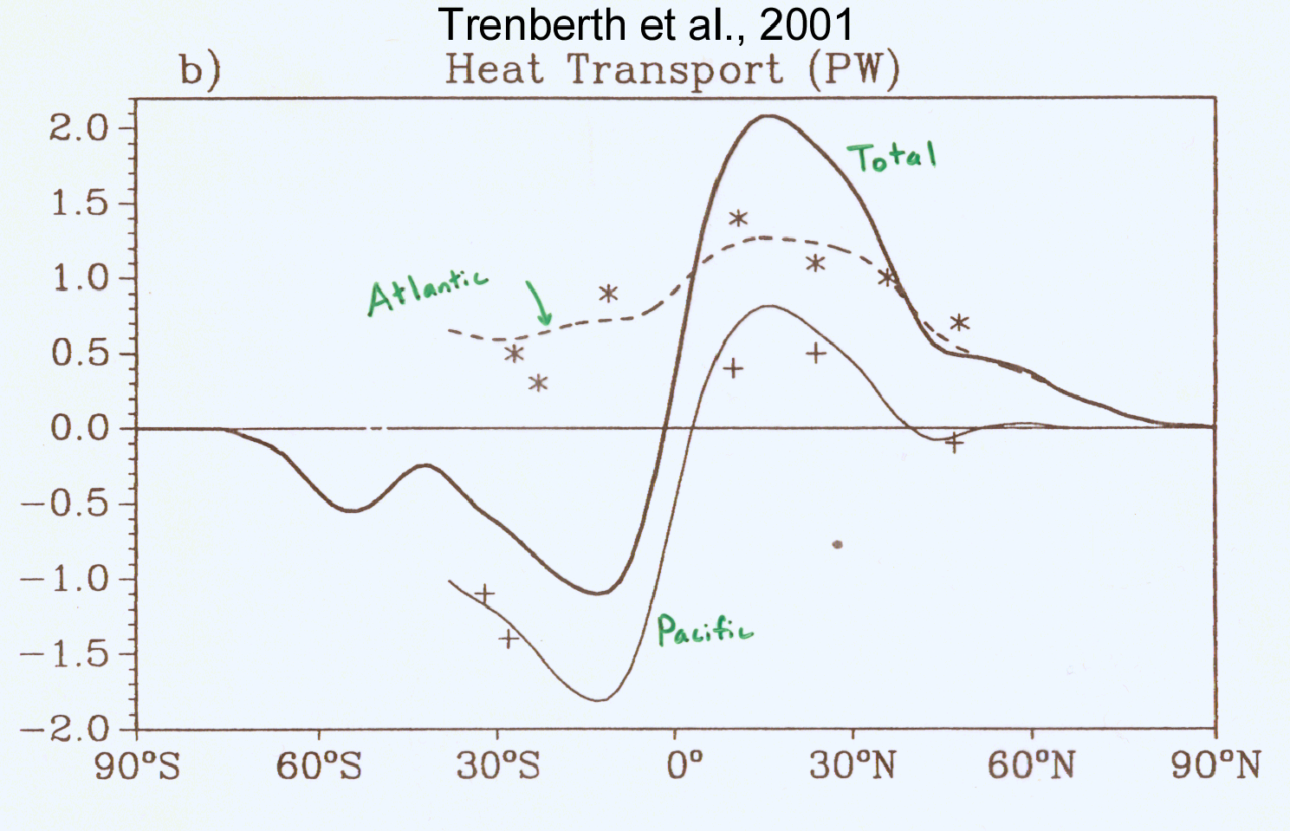
TC Mixing May Induce Much or Most of the Observed Poleward Heat Flux by the Oceans
Notes:
35

Slide 36
Estimate from satellite-derived wake recoveries
Extrapolation from detailed ocean measurements of one storm
Estimate of total heat uptake by tropical oceans

Slide 37

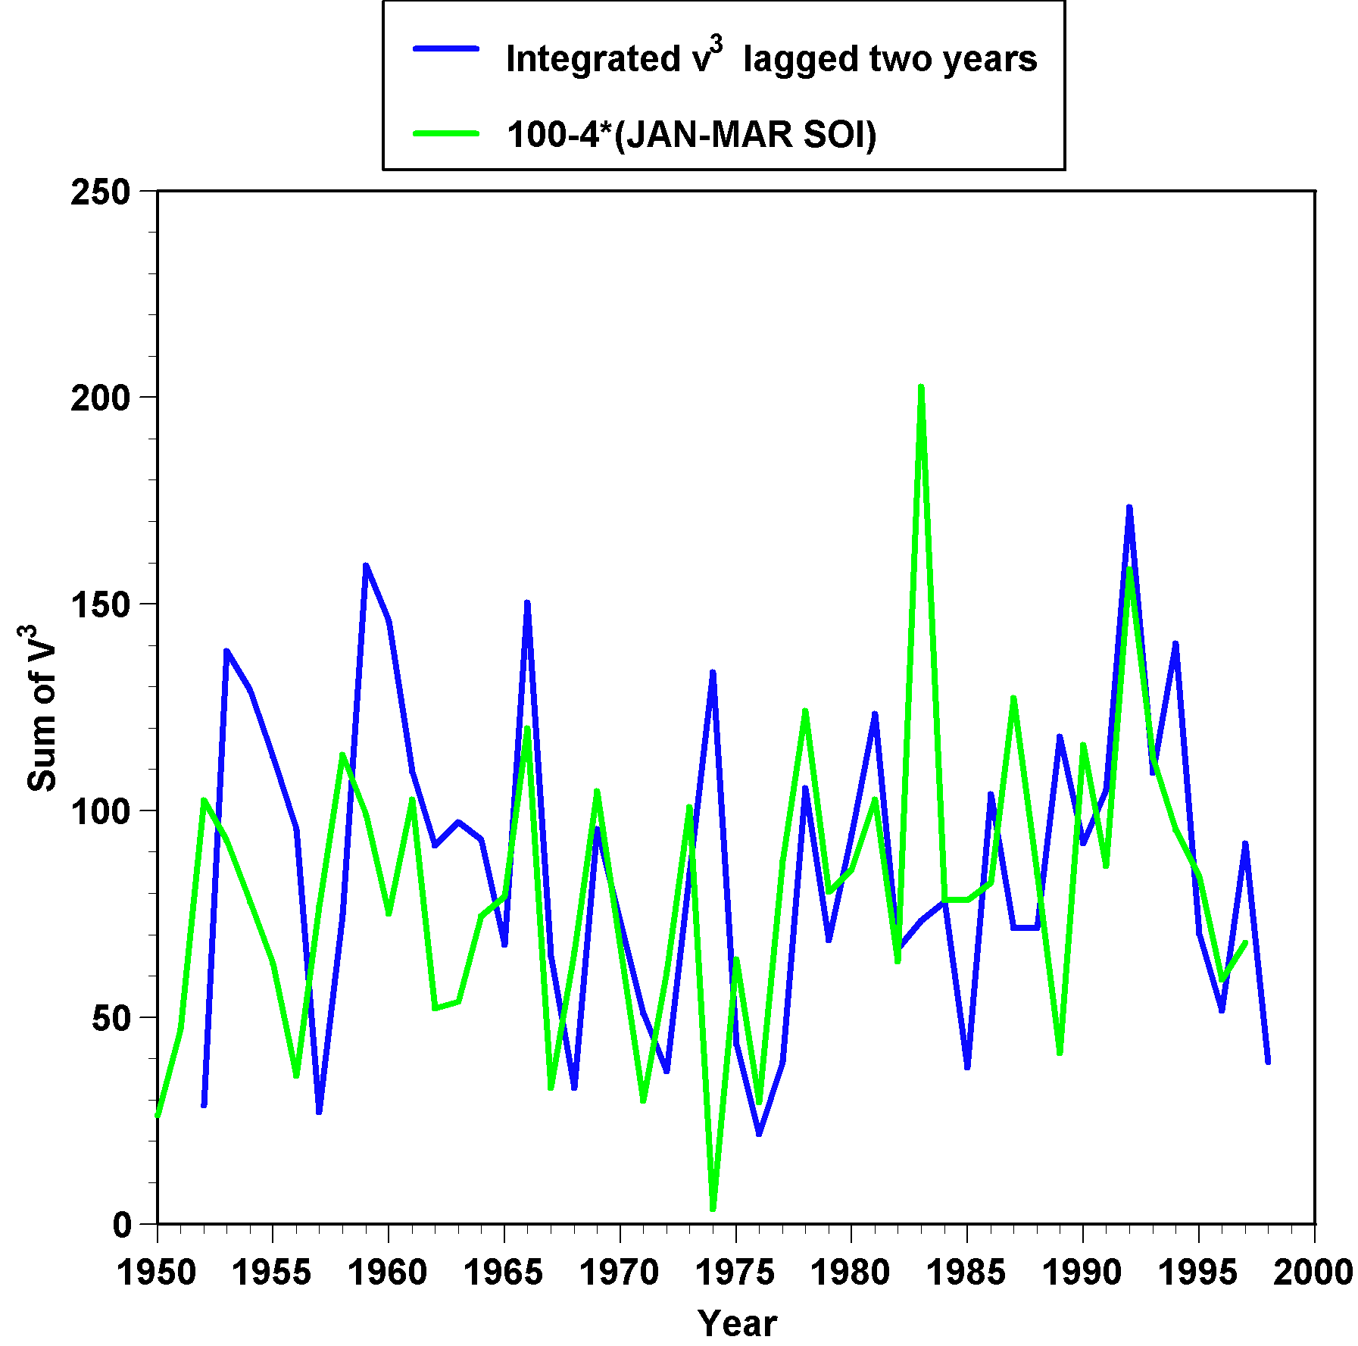
This plot shows a measure of El Niño/La Niña (green) and a measure of the power put into the far western Pacific Ocean by tropical cyclones (blue). The blue curve has been shifted rightward by two years on this graph. There is the suggestion that powerful cyclones in the western Pacific can trigger El Niño/La Niña cycles.

Slide 38
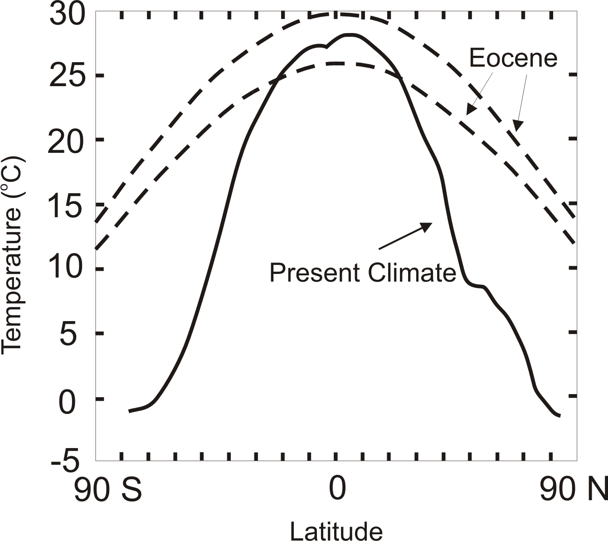
TC-Mixing may be Crucial for High-Latitude Warmth and Low-Latitude Moderation During Warm Climates, such as that of the Eocene
Notes:
38

Slide 39
Looking Ahead:
Using Physics to Assess Hurricane Risk

Slide 40
Our Approach to Downscaling Tropical Cyclones from Climate Models
Step 1: Seed each ocean basin with a very large number of weak, randomly located vortices
Step 2: Vortices are assumed to move with the large scale atmospheric flow in which they are embedded
Step 3: Run a coupled, ocean-atmosphere computer model for each vortex, and note how many achieve at least tropical storm strength; discard others
Step 4: Using the small fraction of surviving events, determine storm statistics.

Slide 42

Cumulative Distribution of Storm Lifetime Peak Wind Speed, with Sample of 1755 Synthetic Tracks
90% confidence bounds

Slide 43
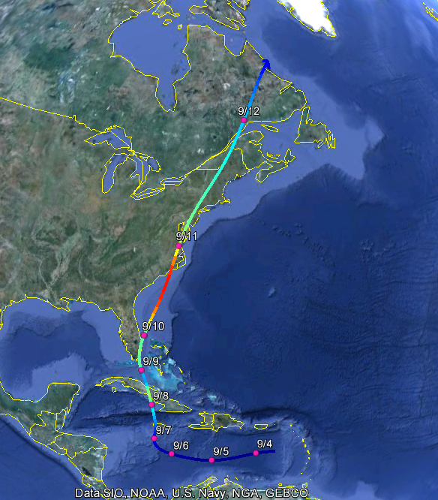
Example: Hurricane affecting New York City

Slide 44
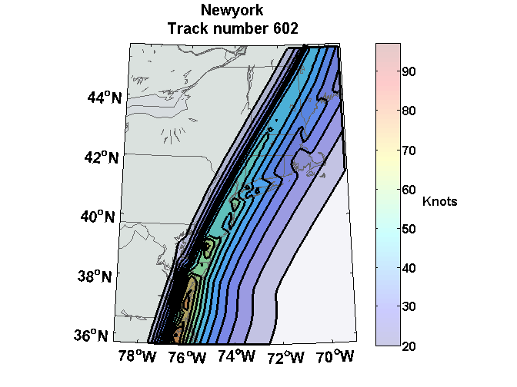
Wind Swath

Slide 45
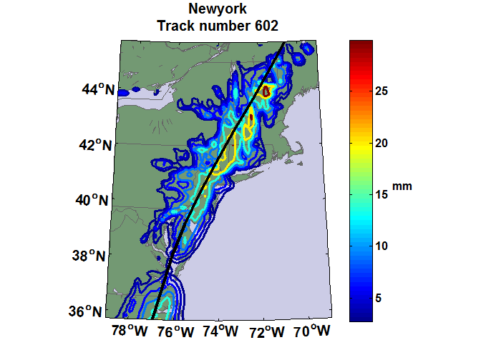
Accumulated Rainfall (mm)

Slide 46


Storm Surge Simulation
SLOSH model
(Jelesnianski et al. 1992)
SLOSH mesh
~ 10³ m
ADCIRC mesh
~ 10² m
Battery
ADCIRC model
(Luettich et al. 1992)
ADCIRC mesh
~ 10 m
(Colle et al. 2008)
Notes:
Given the storm wind and pressure fields (which is estimated from the Holland parametric pressure model) we can simulate the surge. Surge simulations with high resolution are computationally intensive, so to make it possible to simulate accurate surges for our large synthetic storm sets, we apply the two hydrodynamic models with girds of various resolutions in such a way that the main computational effort is concentrated on the storms that determine the risk. First, we apply the SLOSH model, using a mesh with resolution of about 1 km around NYC to simulate the surges for all storms and select the storms that have return periods, in terms of the surge height at the Battery, greater than 10 years. Second, we apply the ADCIRC simulation, using a grid mesh with resolution of ~100 m around NYC, to each of the selected storms. Then, we apply another ADCIRC mesh with resolution as high as ~10 m around NYC, for a set of the most extreme events, to check if the resolution of our ADCIRC grid is sufficient and if needed to make statistical correction to the results.

Slide 47
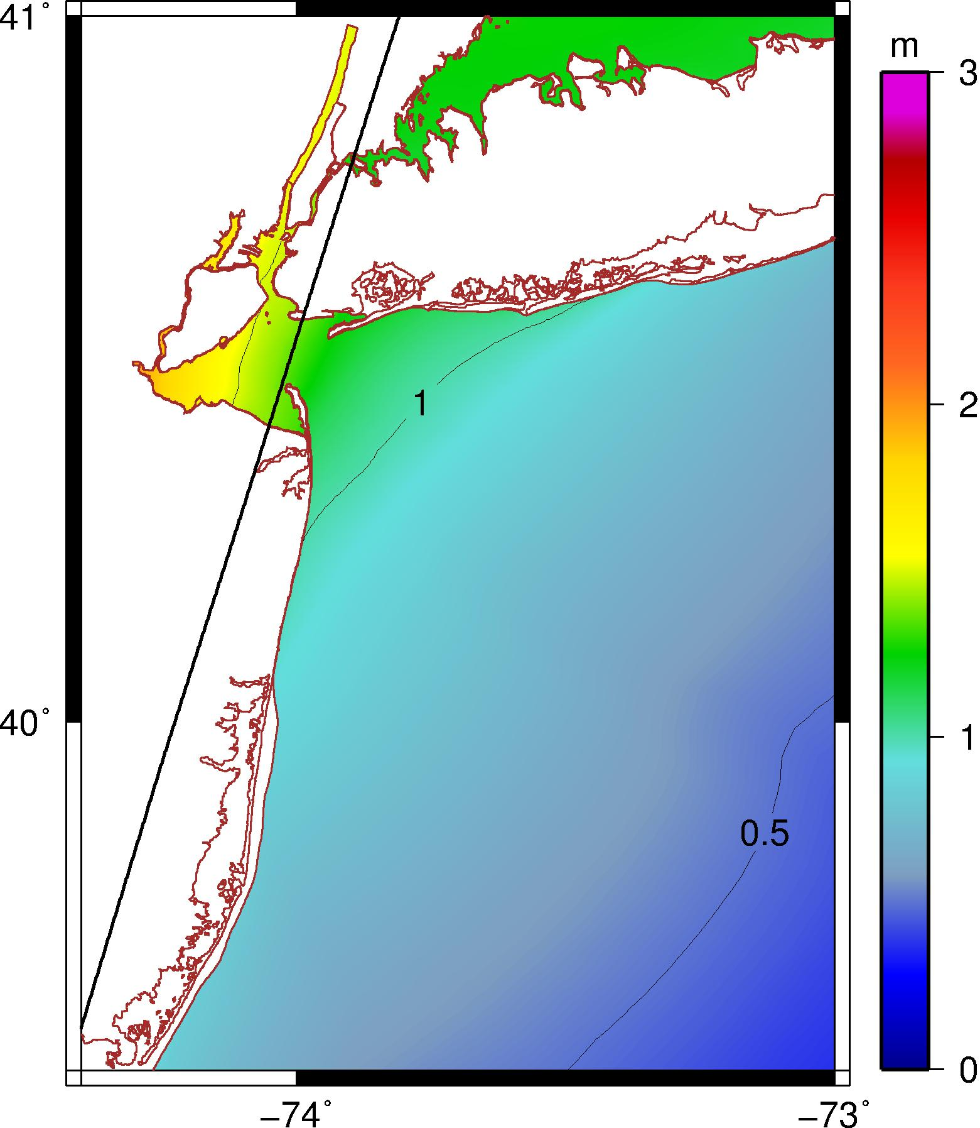
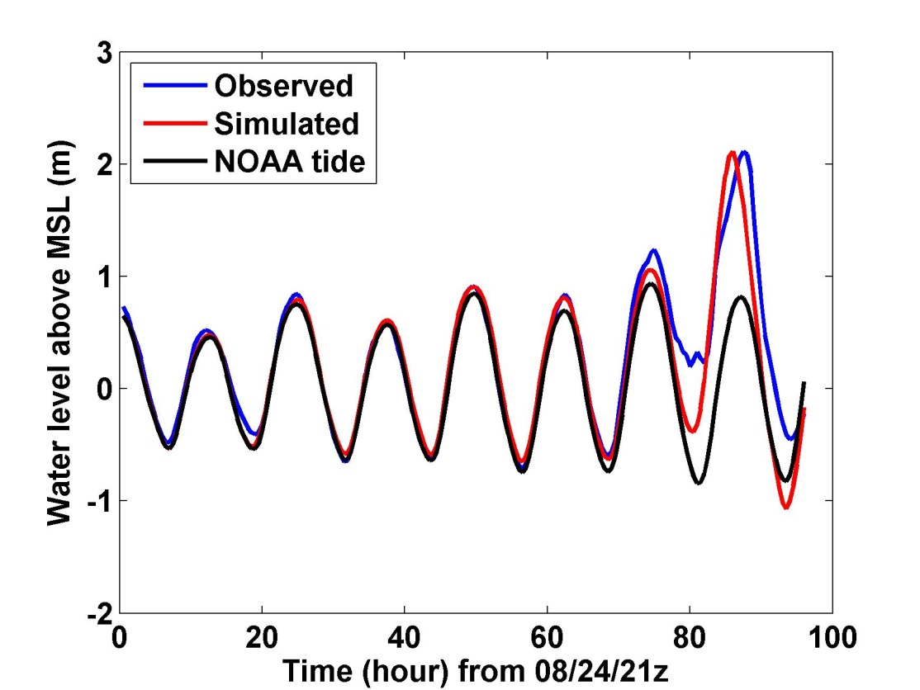
Hurricane Irene (2011) Hindcast
1.3 m
V_{m} = 17 m/s, P_{c} = 977 mb
R_{m}= 83 km, U_{t} = 12 m/s, ds = 9 km
Notes:
Our simulation for Hurricane Irene’s surge using the ADCIRC model. The storm track, intensity, and size are obtained from the observation. This storm passed to the right of the Battery with relatively low intensity and generated a peak surge of about 1.3 m at the Battery. The surge happened right at the high tide and thus the total water level was about 2.1 m above the MSL. The plot to the right shows that the simulated and observed water levels compare very well, thus Irene offered us a good opportunity to validate our wind field and storm surge modeling method.

Slide 48
Hurricane Sandy (2012) Hindcast
HWRF Forecast at 2012102818z
3.25 m
3.34 m
Notes:
ADCIRC simulation of surge (not including tide or wave setup), assuming hurricane parametric wind and pressure profiles, same methods as for Irene and synthetic storms.

Slide 49
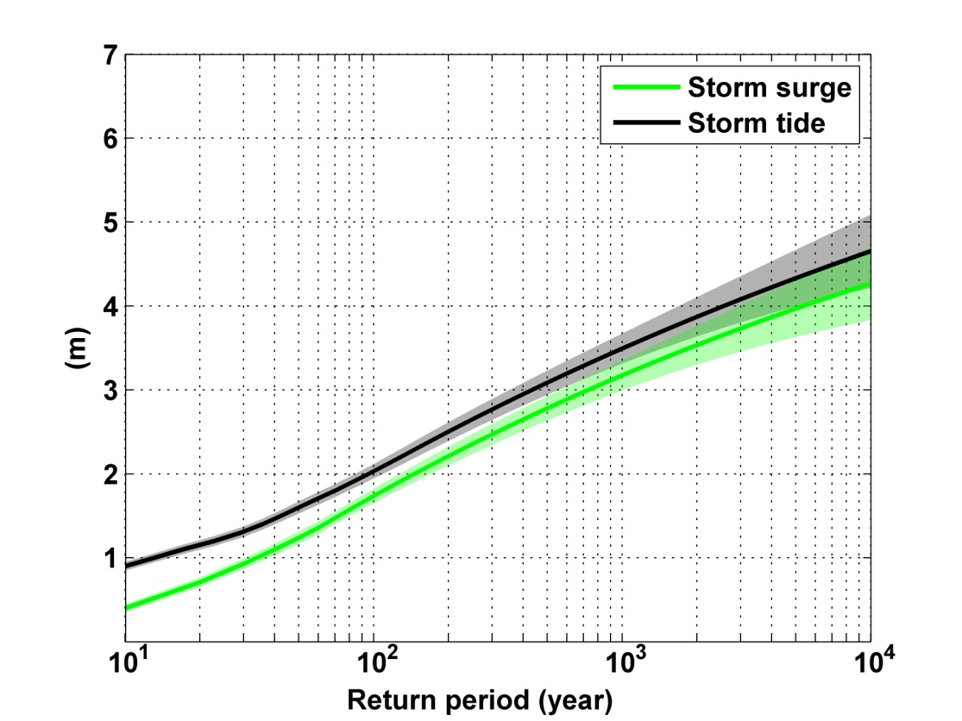
Notes:
Storm surge and storm tide (surge and tide) return level curves for the Battery, NYC, for the 1981-2000 NCAR/NCEP climate conditions (5000 synthetic storms). Astronomical tide and nonlinear interaction between surge and tide are accounted for statistically.

Slide 50
Looking Ahead

Slide 51
Downscaling of AR5 GCMs
GFDL-CM3
HadGEM2-ES
MPI-ESM-MR
MIROC-5
MRI-CGCM3
Historical: 1950-2005, RCP8.5 2006-2100

Slide 52
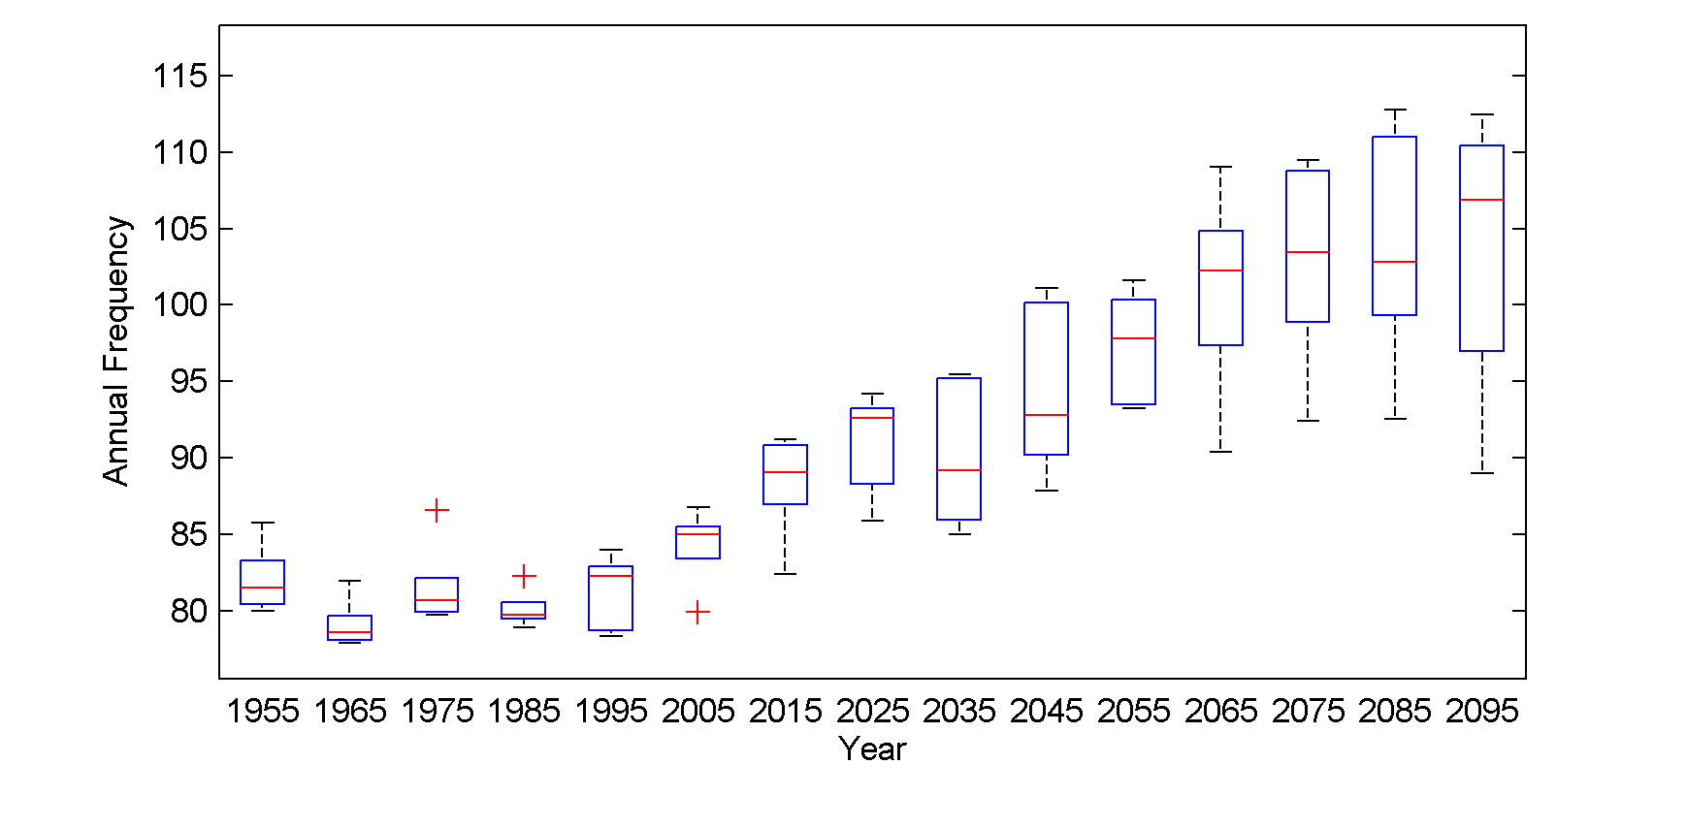
Global annual frequency of tropical cyclones averaged in 10-year blocks for the period 1950-2100, using historical simulations for the period 1950-2005 and the RCP 8.5 scenario for the period 2006-2100. In each box, the red line represents the median among the 5 models, and the bottom and tops of the boxes represent the 25th and 75th percentiles, respectively. The whiskers extent to the most extreme points not considered outliers, which are represented by the red + signs. Points are considered outliers if they lie more than 1.5 times the box height above or below the box.

Slide 53
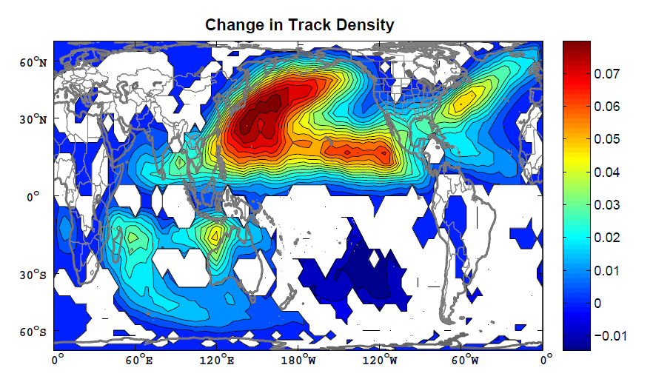
Change in track density, measured in number of events per 4º X 4º square per year, averaged over the five models. The change is simply the average over the period 2006-2100 minus the average over 1950-2005. The white regions are where fewer than 4 of the 5 models agree on the sign of the change.

Slide 54
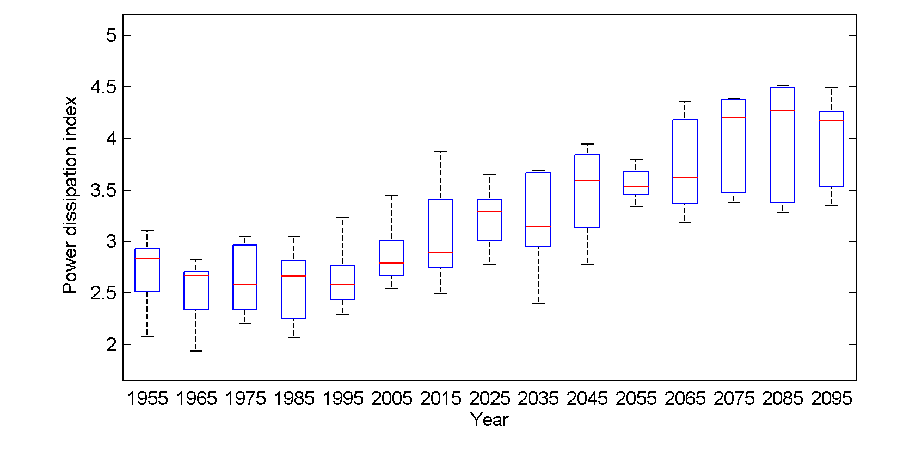
Global Tropical Cyclone Power Dissipation

Slide 55
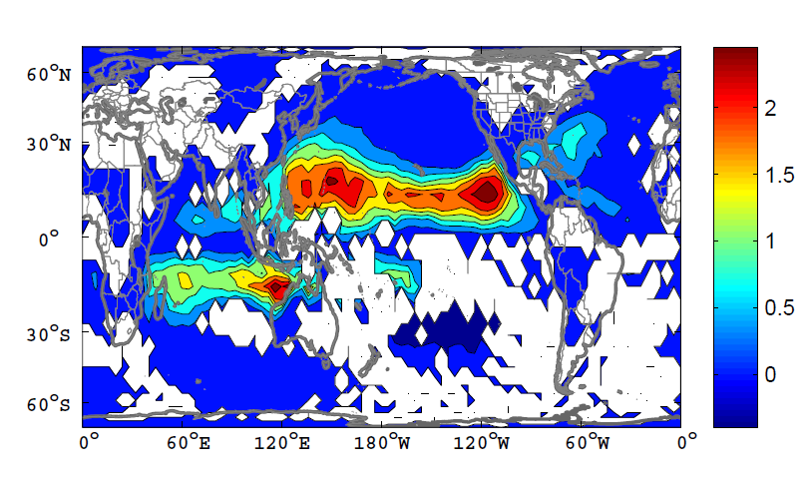
Change in Power Dissipation

Slide 56
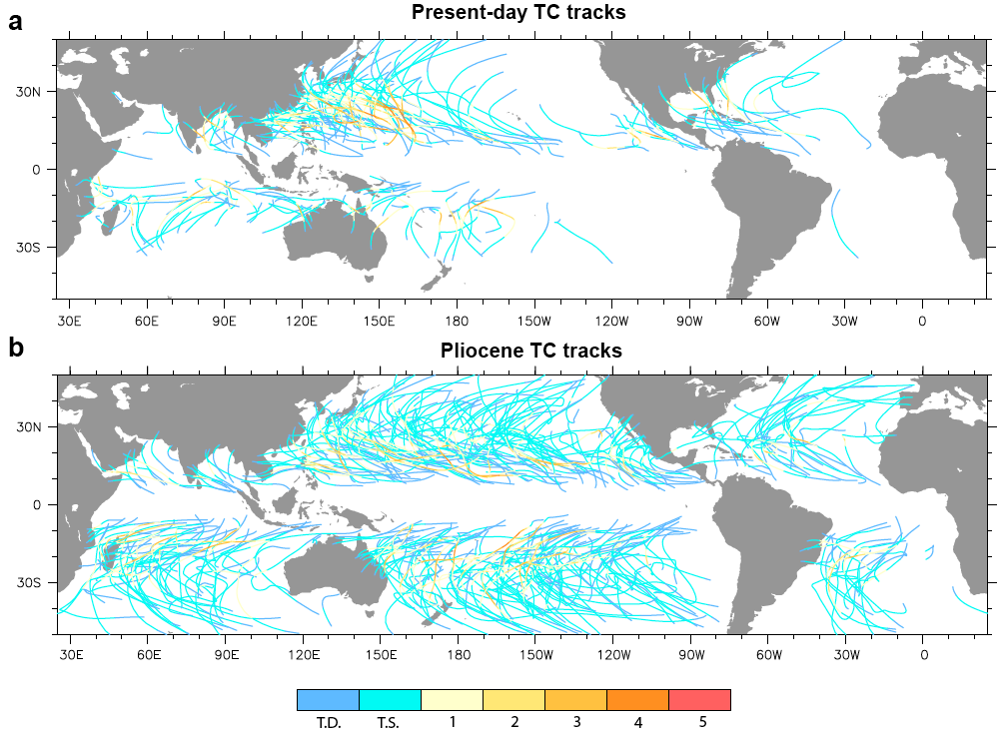
Application to Other Climates
Federov et al., 2010

Slide 57
Summary
Hurricanes have had a substantial influence on the course of history
Hurricanes are almost pure examples of Carnot heat engines
Hurricanes may have important feedbacks on climate

Slide 58
Simple but high resolution coupled hurricane model can be used to ‘downscale’ hurricane activity from global climate data sets
Studies based on this downscaling suggest some sensitivity of hurricanes to climate state, with increasing incidence of intense storms as the climate warms

Slide 59
Integrated Assessments with Robert Mendelsohn, Yale

Slide 60


Probability Density of TC Damage, U.S. East Coast
Damage Multiplied by Probability Density of TC Damage, U.S. East Coast

Slide 61
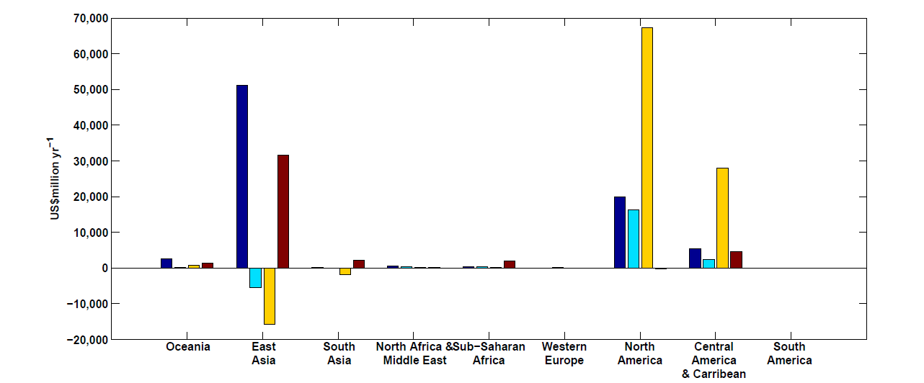
Mendelsohn et al., 2012
Climate change impacts on tropical cyclone damage by region in 2100. Damage is concentrated in North America, East Asia and Central America–Caribbean. Damage is generally higher in the CNRM and GFDL climate scenarios.

Slide 62
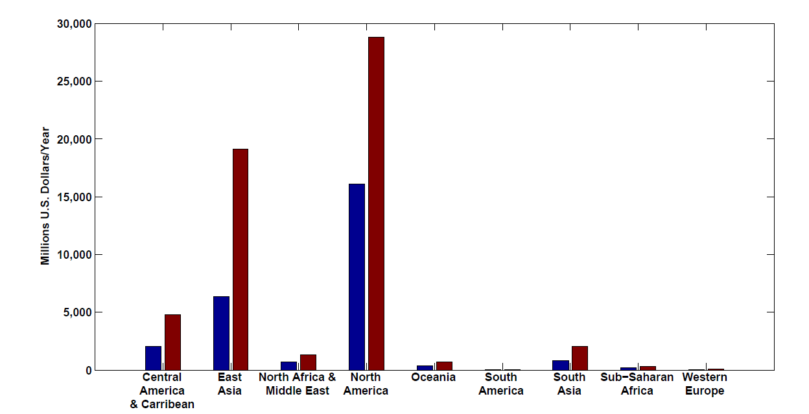
Present and future baseline tropical cyclone damage by region.
Changes in income will increase future tropical cyclone damages in 2100 in every region even if climate does not change. Changes are larger in regions experiencing faster economic growth, such as East Asia and the Central America–Caribbean region.

Slide 63
Climate change impacts on tropical cyclone damage by region in 2100. Damage is concentrated in North America, East Asia and Central America–Caribbean. Damage is generally higher in the CNRM and GFDL climate scenarios.

Slide 64
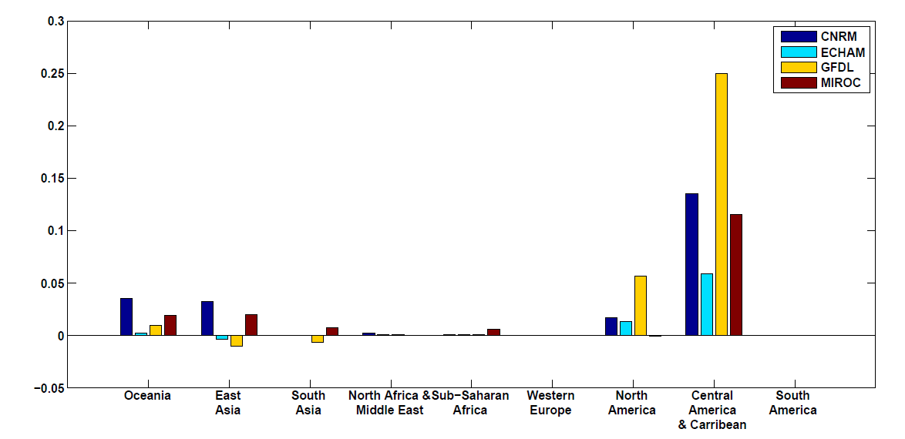
Climate change impacts on tropical cyclone damage divided by GDP by region in 2100. The ratio of damage to GDP is highest in the Caribbean–Central American region but North America, Oceania and East Asia all have above-average ratios.

Slide 65
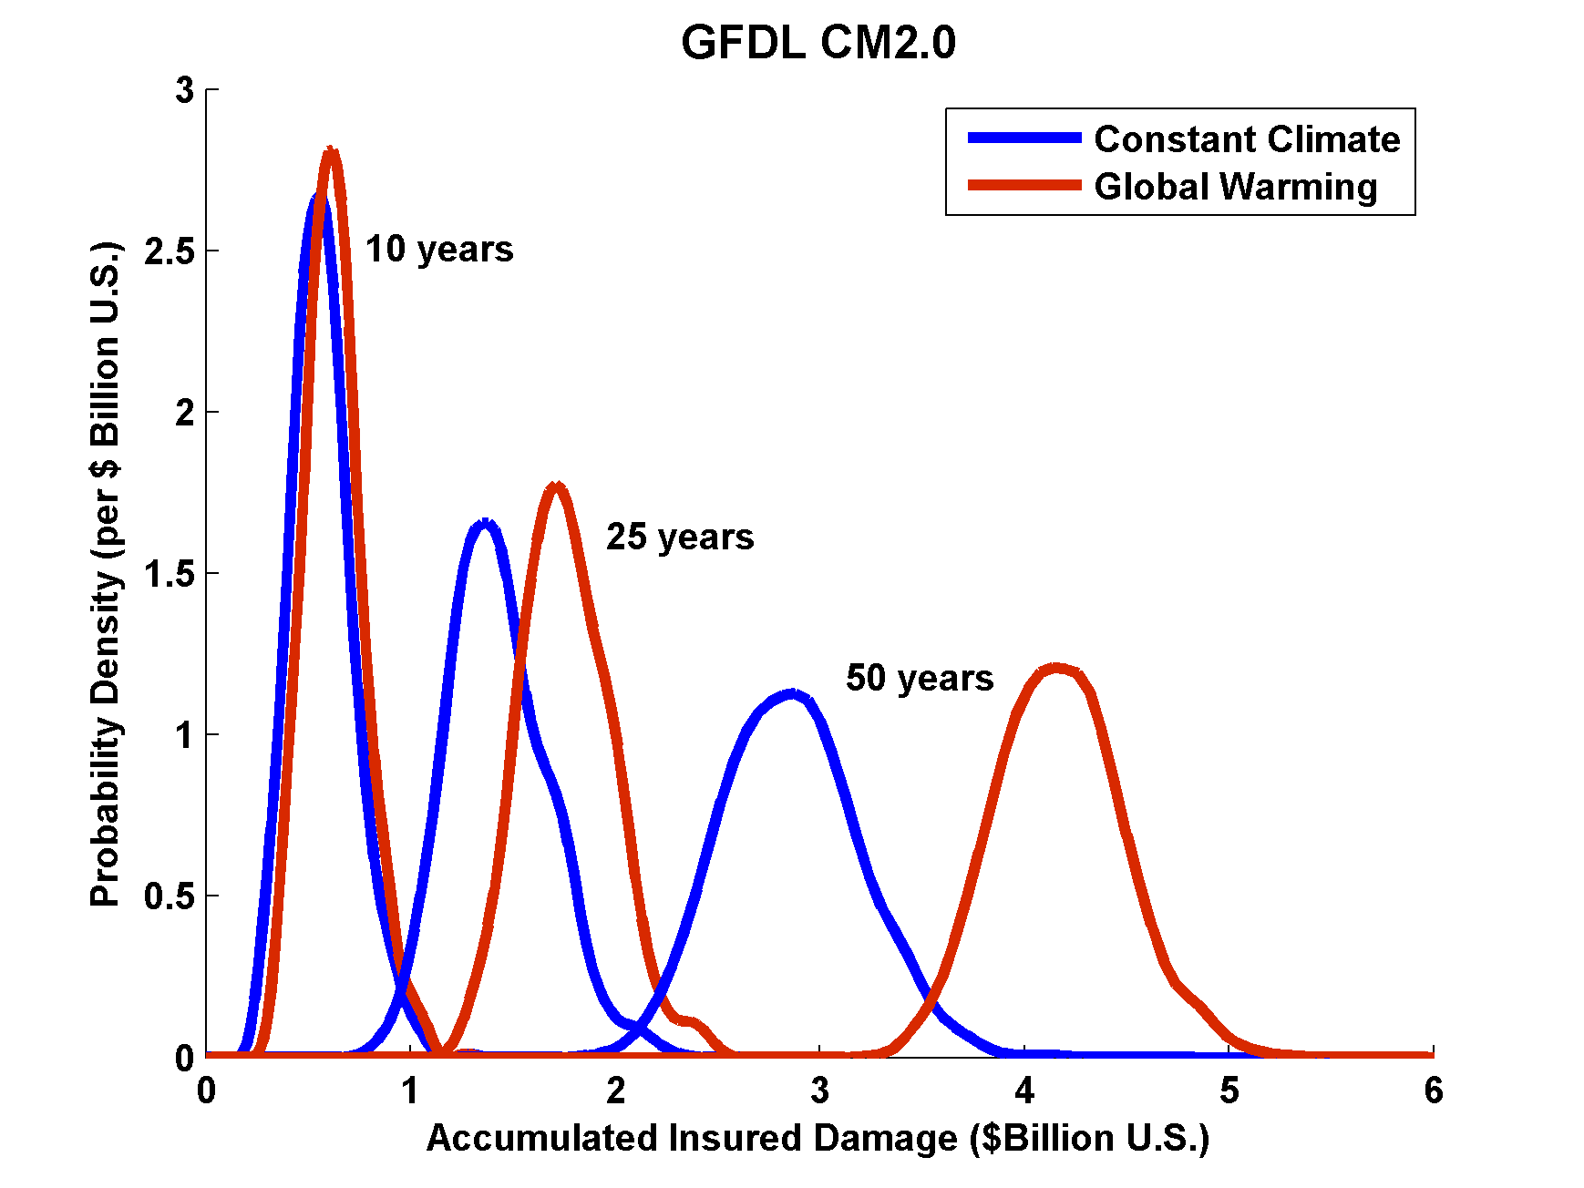
Projections of U.S. Insured Damage
Emanuel, K. A., 2012, Weather, Climate, and Society

Slide 66

Depiction of central North America, ~60 million years ago
Our future?
Figure courtesy of Rob Korty, CalTech
Notes:
66

Slide 67
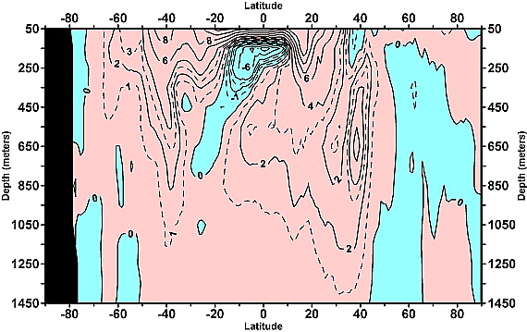
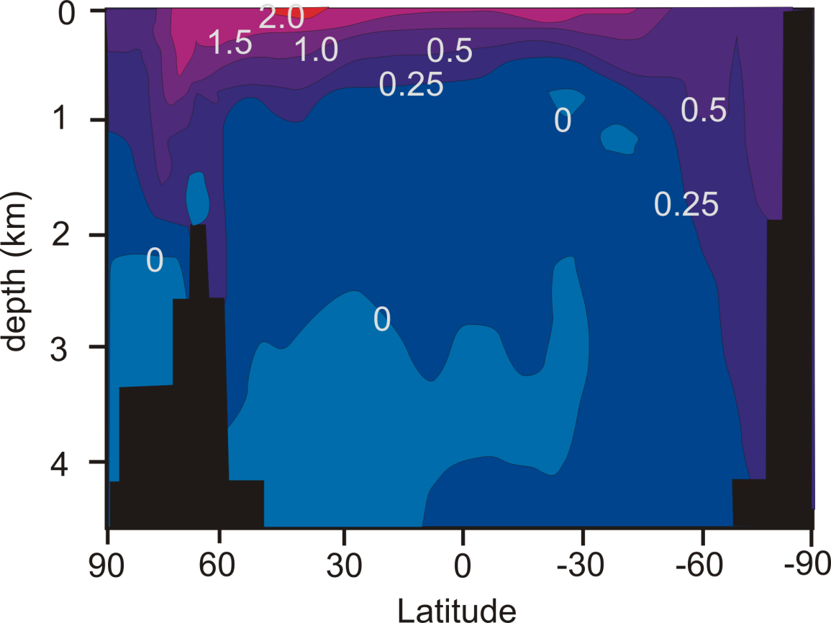
Linear trend (1955–2003) of the zonally integrated heat content of the world ocean by one-degree latitude belts for 100-m thick layers. Source: Levitus et al., 2005
TC-Mixing may explain difference between observed and modeled ocean warming
Zonally averaged temperature trend due to global warming in a coupled climate model. Source: Manabe et al, 1991
Notes:
67

Slide 68
What is Causing Changes in Tropical Atlantic Sea Surface Temperature?

Slide 69
10-year Running Average of Aug-Oct Northern Hemisphere Surface Temp and Hurricane Region Ocean Temp

Slide 70
Estimates of Global Mean Surface Temperature from the Instrumental Record
Notes:
70

Slide 71
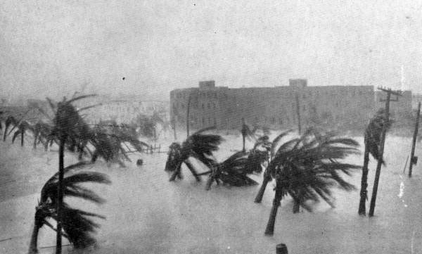

Slide 72
Tropical Atlantic SST(blue), Global Mean Surface Temperature (red),
Aerosol Forcing (aqua)
Global mean surface temperature
Tropical Atlantic sea surface temperature
Sulfate aerosol radiative forcing
Mann, M. E., and K. A. Emanuel, 2006. Atlantic hurricane trends linked to climate change. EOS, 87, 233-244.

Slide 73
Best Fit Linear Combination of Global Warming and Aerosol Forcing (red) versus Tropical Atlantic SST (blue)
Tropical Atlantic Sea Surface Temperature
Global Surface T + Aerosol Forcing
Mann, M. E., and K. A. Emanuel, 2006. Atlantic hurricane trends linked to climate change. EOS, 87, 233-244.

Slide 74
Pushing Back the Record of Tropical Cyclone Activity:
Paleotempestology
Notes:
74

Slide 75
Paleotempestology
barrier beach
upland
overwash fan
backbarrier marsh
a)
lagoon
barrier beach
upland
overwash fan
b)
backbarrier marsh
lagoon
terminal lobes
flood tidal delta
Source: Jeff Donnelly, WHOI
Notes:
75

Slide 76
Source: Jeff Donnelly, Jon Woodruff, Phil Lane; WHOI
Notes:
76

Slide 77
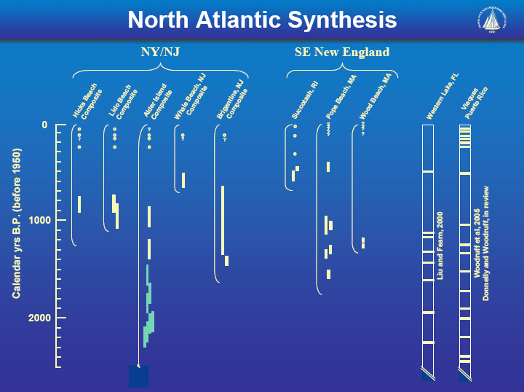
Source: Jeff Donnelly, Jon Woodruff, Phil Lane; WHOI
Notes:
77

Slide 78
Inferences from Modeling

Slide 79
The Problem:
Global models are far too coarse to simulate high intensity tropical cyclones
Embedding regional models within global models introduces problems stemming from incompatibility of models, and even regional models are usually too coarse

Slide 80

Histograms of Tropical Cyclone Intensity as Simulated by a Global Model with 50 km grid point spacing. (Courtesy Isaac Held, GFDL)
Category 3

Slide 81
Probability Density of TC Damage, U.S. East Coast
Damage Multiplied by Probability Density of TC Damage, U.S. East Coast

Slide 82
To the extent that they simulate tropical cyclones at all, global models simulate storms that are largely irrelevant to society and to the climate system itself, given that ocean stirring effects are heavily weighted towards the most intense storms

Slide 83
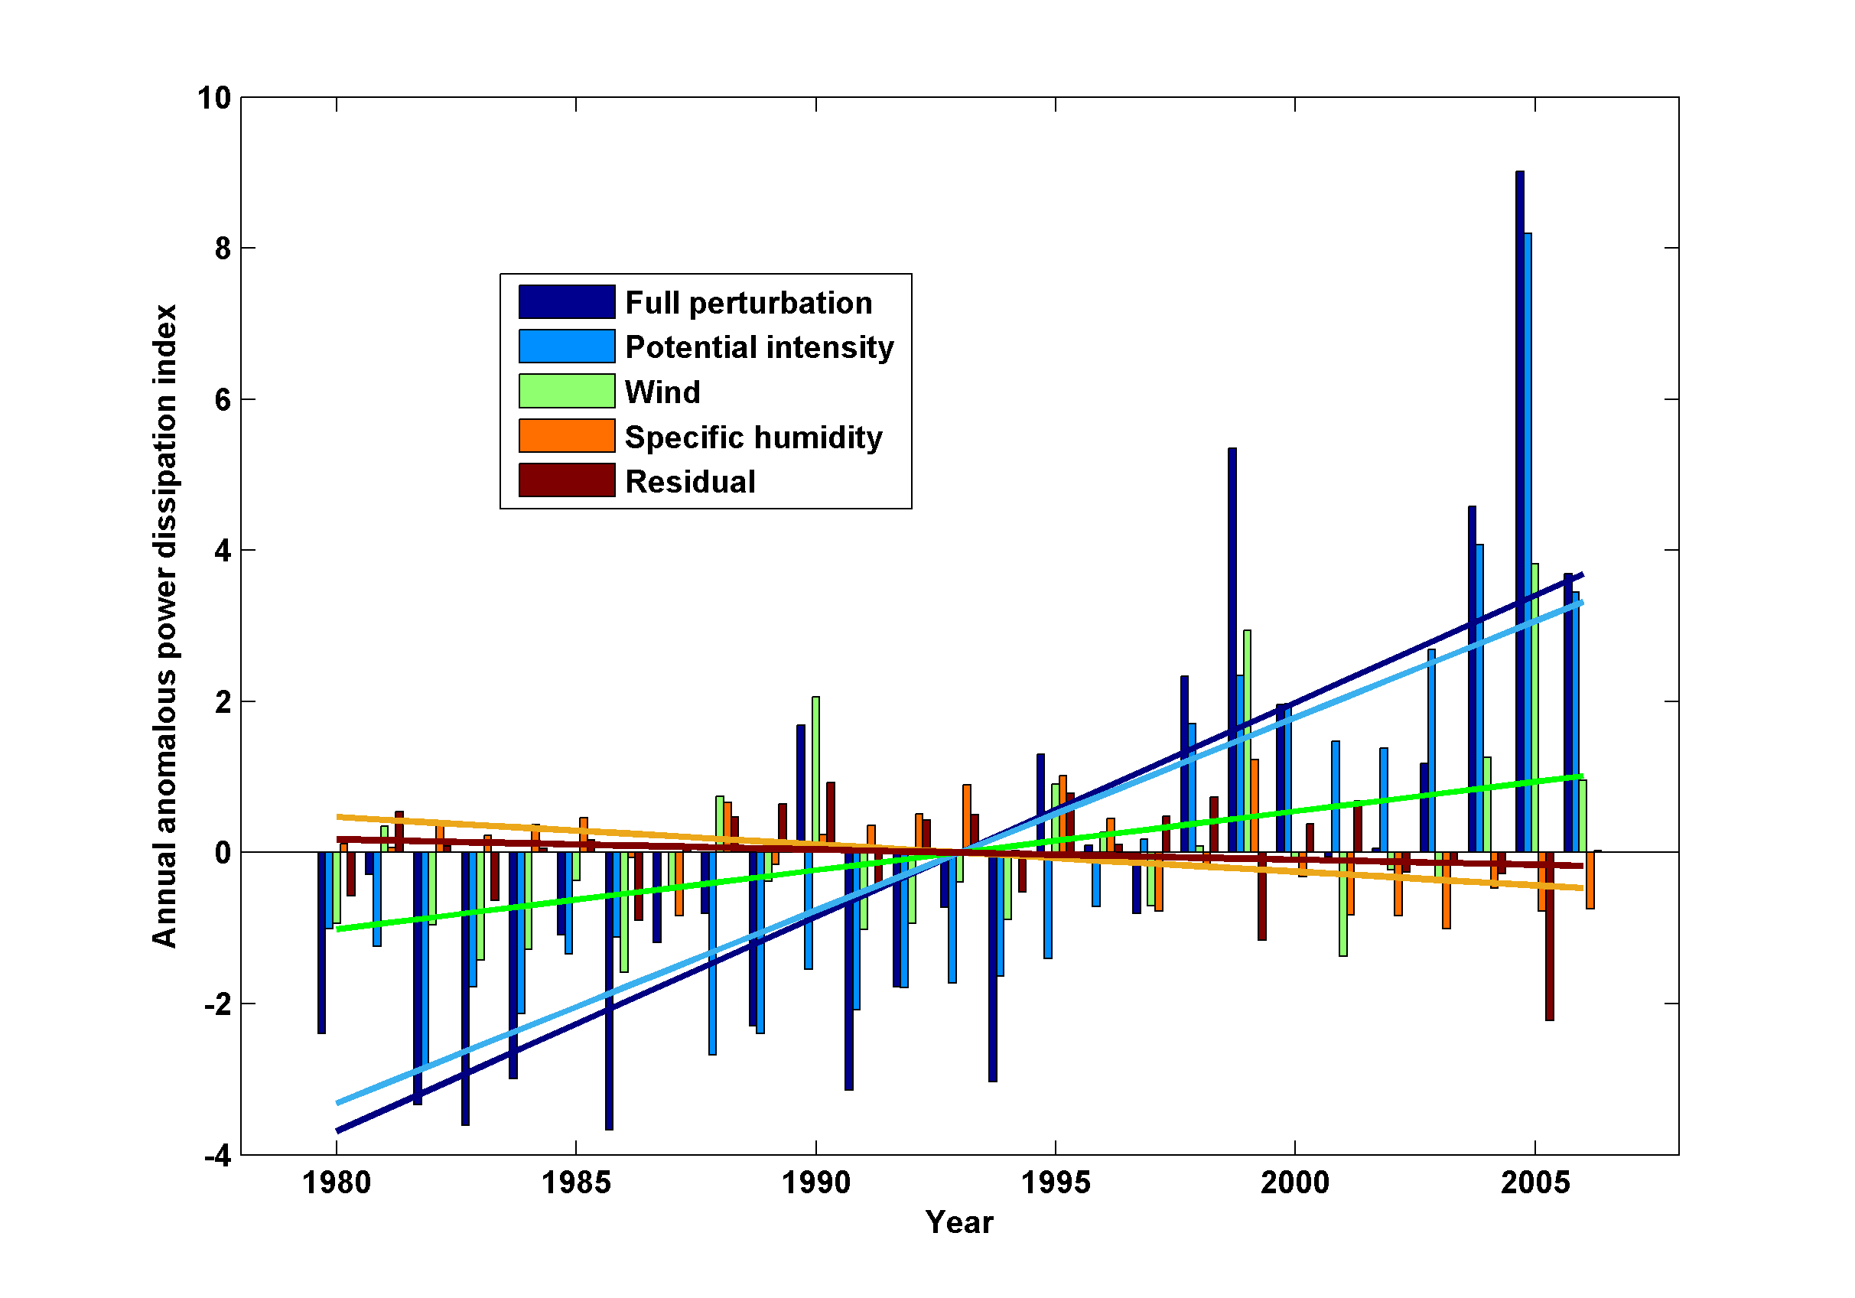
Decomposition of PDI Trends

Slide 84
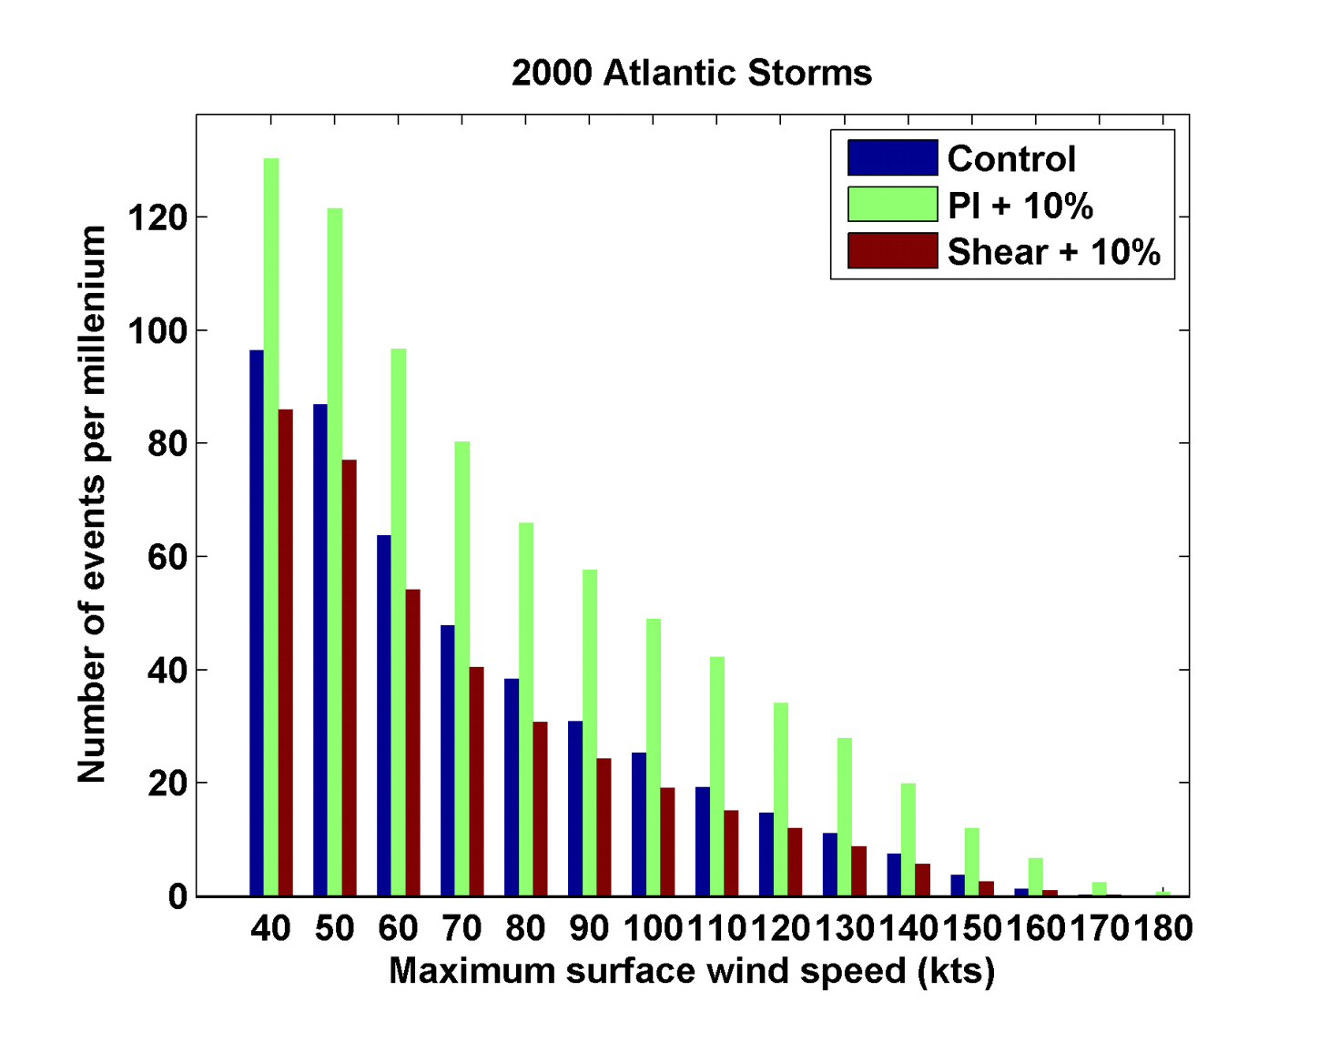
Sensitivity to Shear and Potential Intensity

Slide 85
Hydrostatic Compensation (following Holloway and Neelin)
Perturbations to moist adiabatic troposphere:
Stratospheric compensation:

Slide 86
For typical values of the parameters

Slide 87
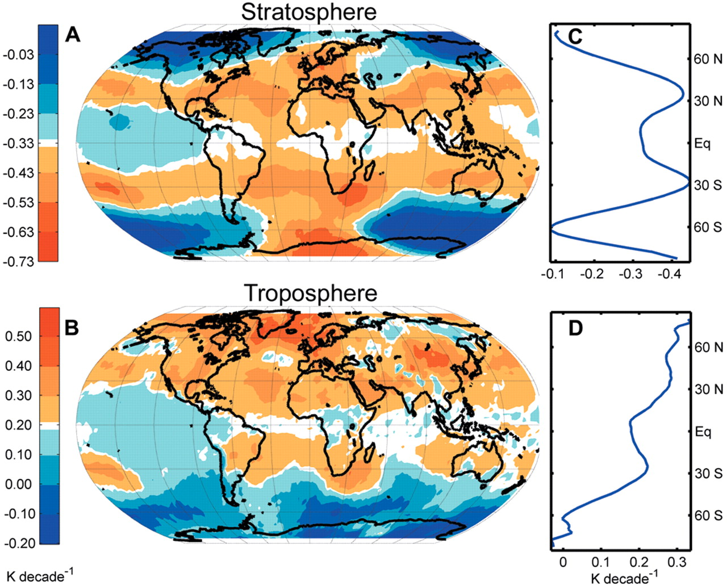
Ozone may not explain spatial pattern of cooling
(Fu and Wallace, Science, 2006)

Slide 88
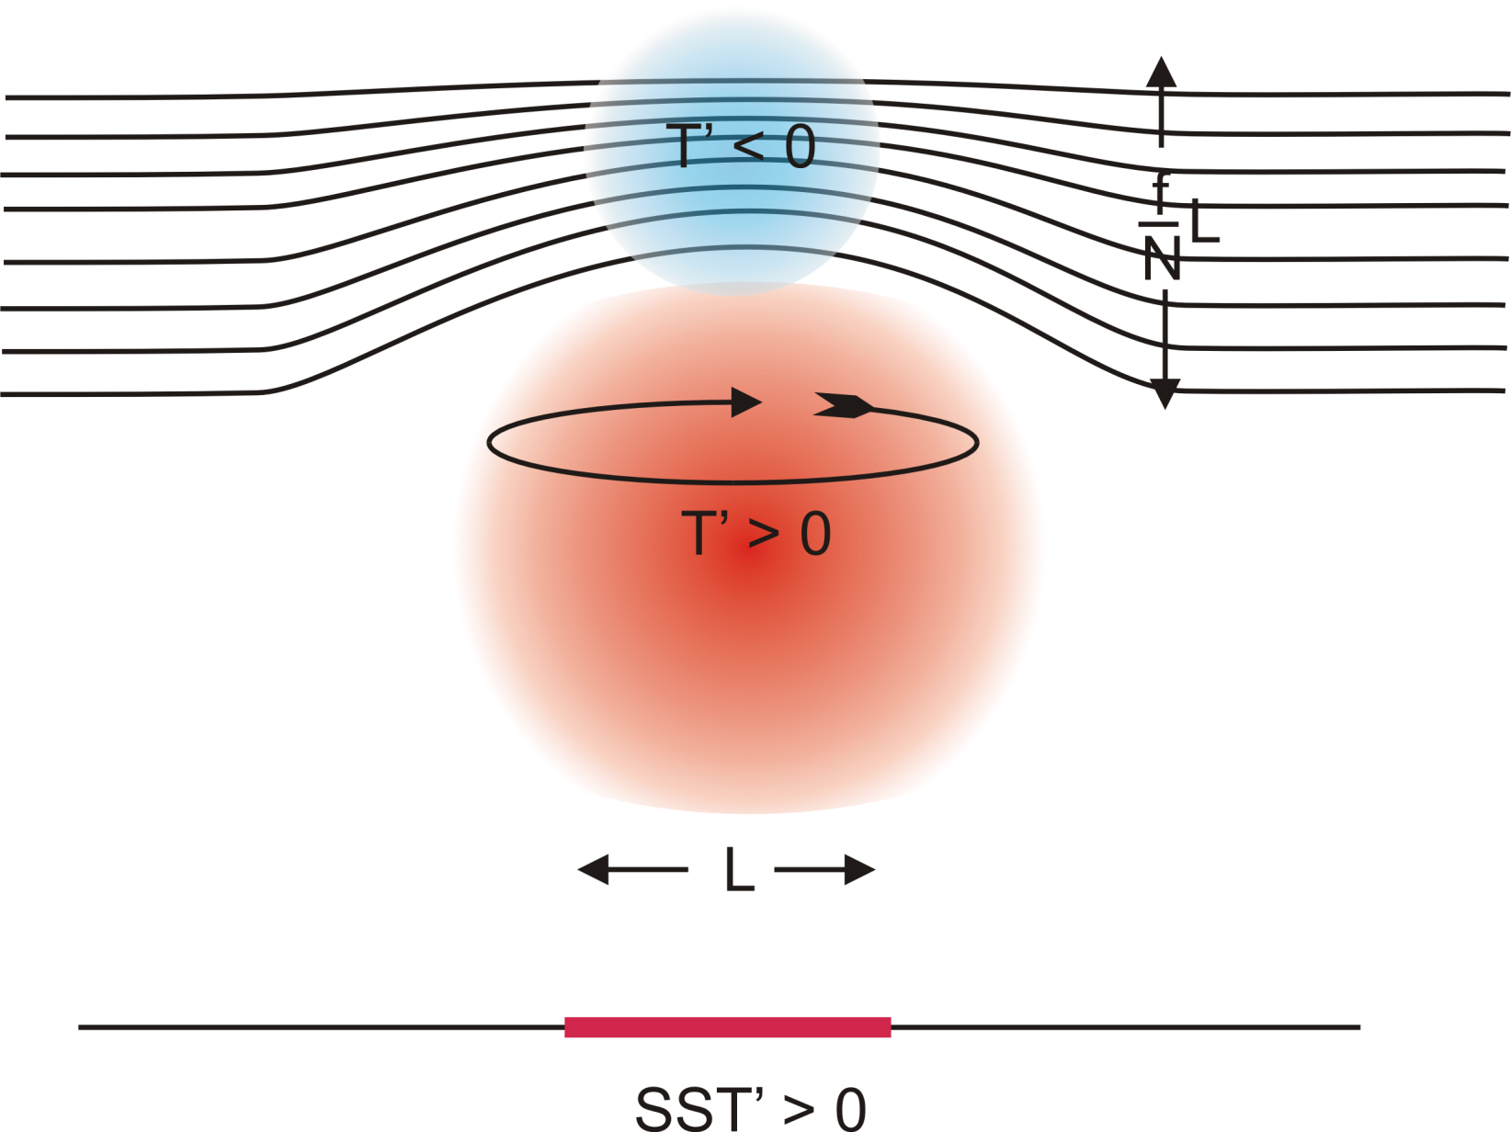
Stratospheric Compensation

Slide 89
Application to the Climate of the Pliocene

Slide 90
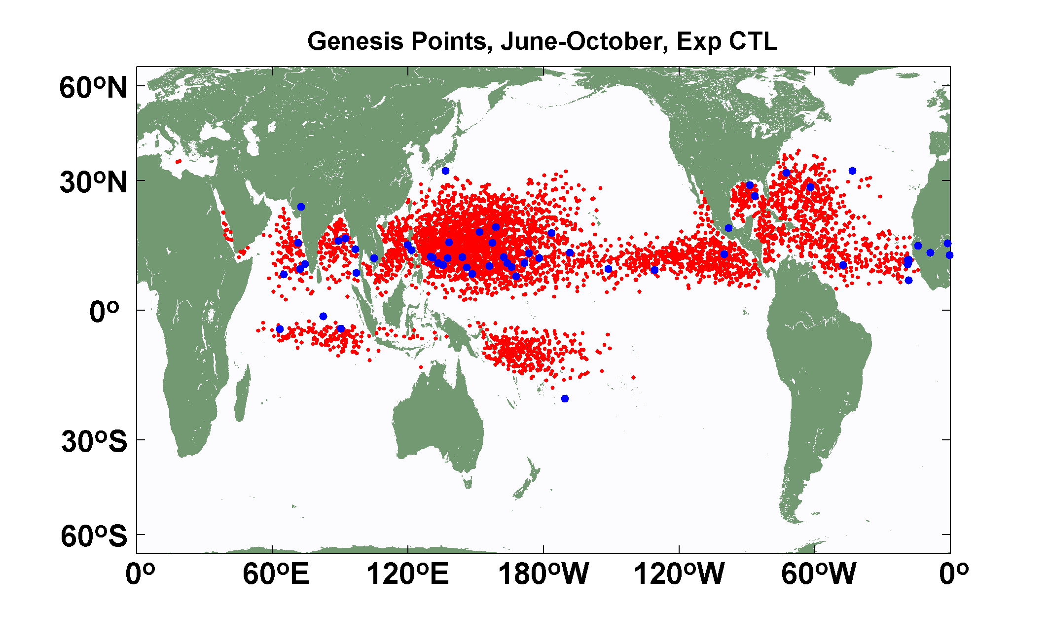
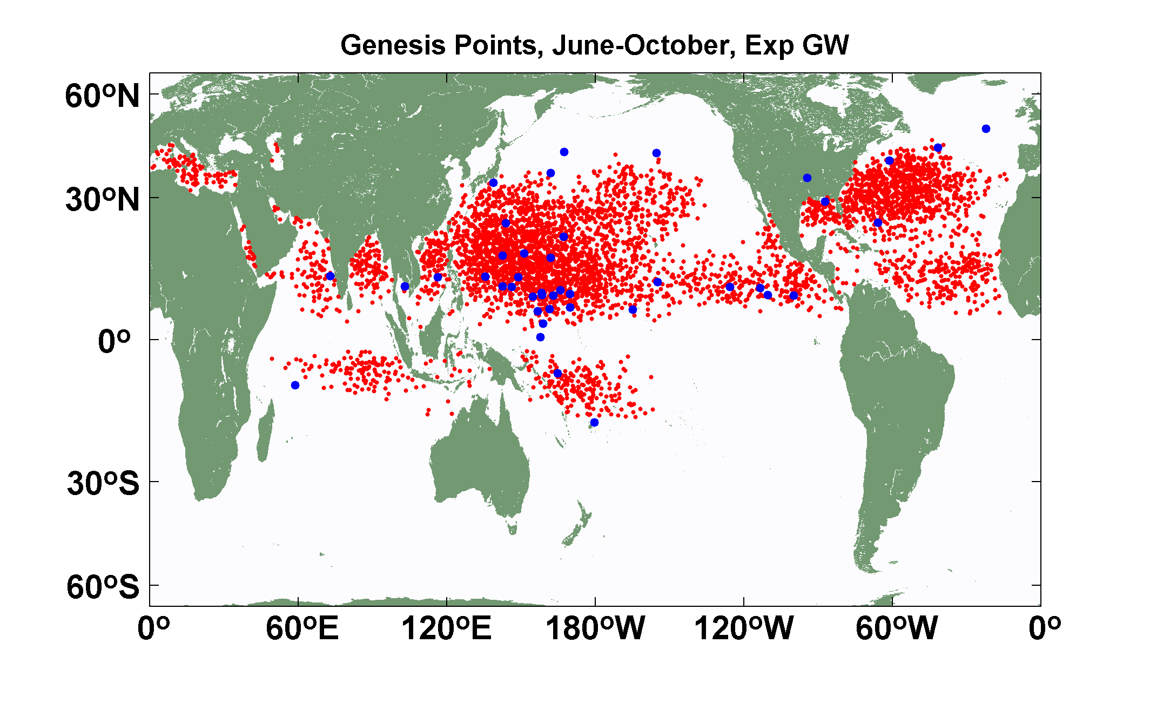
Explicit (blue dots) and downscaled (red dots) genesis points for June-October for Control (top) and Global Warming (bottom) experiments using the 14-km resolution NICAM model. Collaborative work with K. Oouchi.

Slide 91
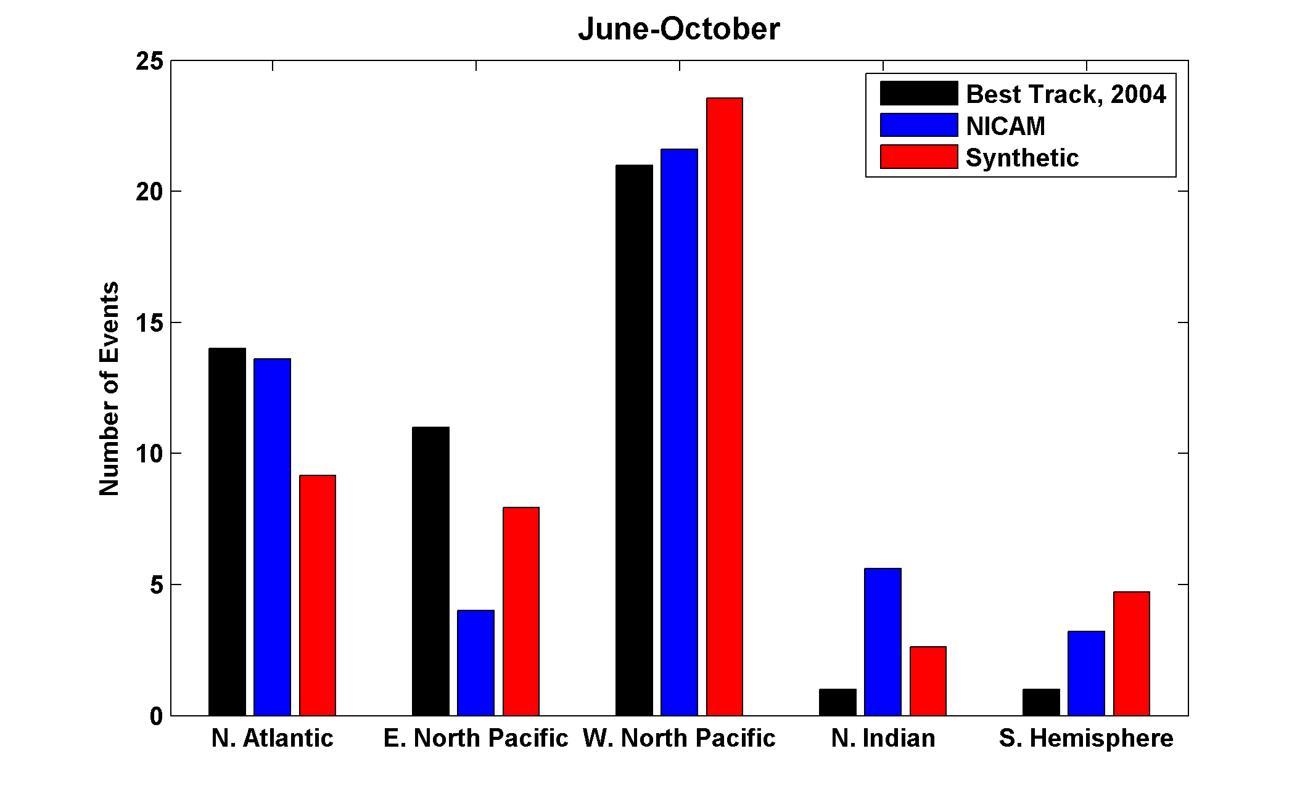

Slide 92
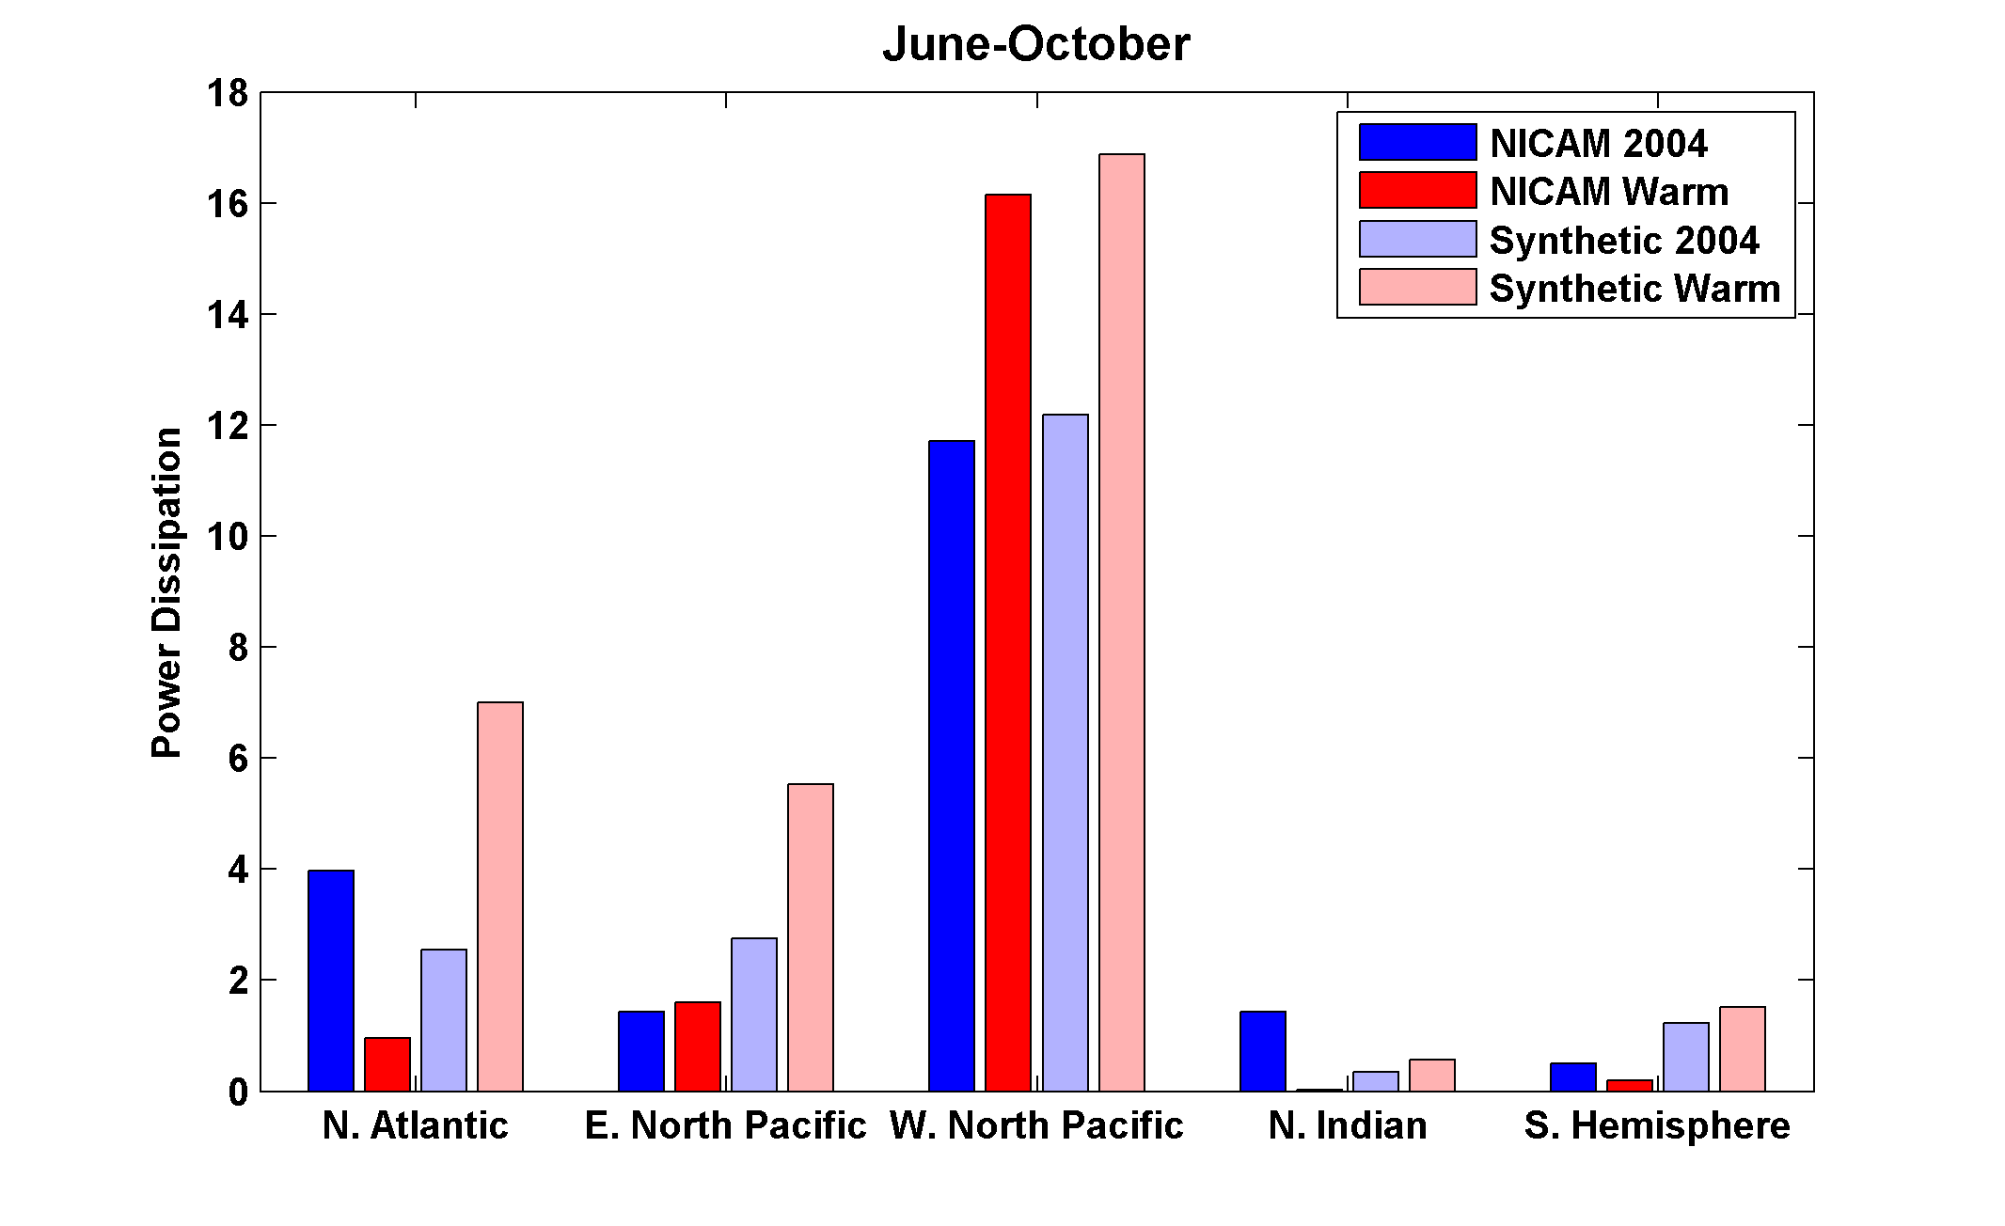
Change in Power Dissipation with Global Warming

Slide 93
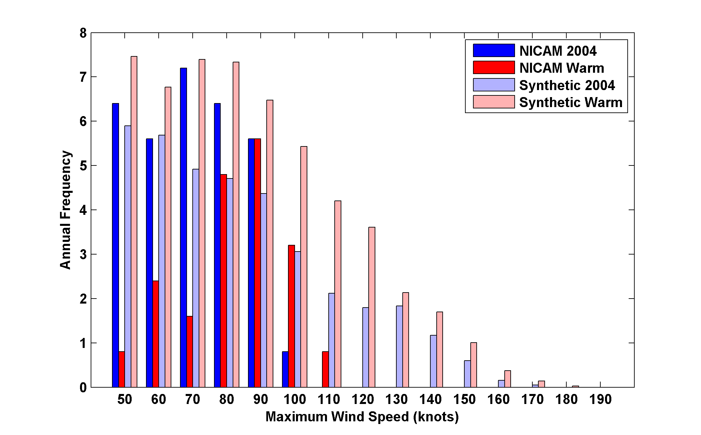
Probability Density by Storm Lifetime Peak Wind Speed, Explicit and Downscaled Events

Slide 94
The Genesis Puzzle

Slide 95
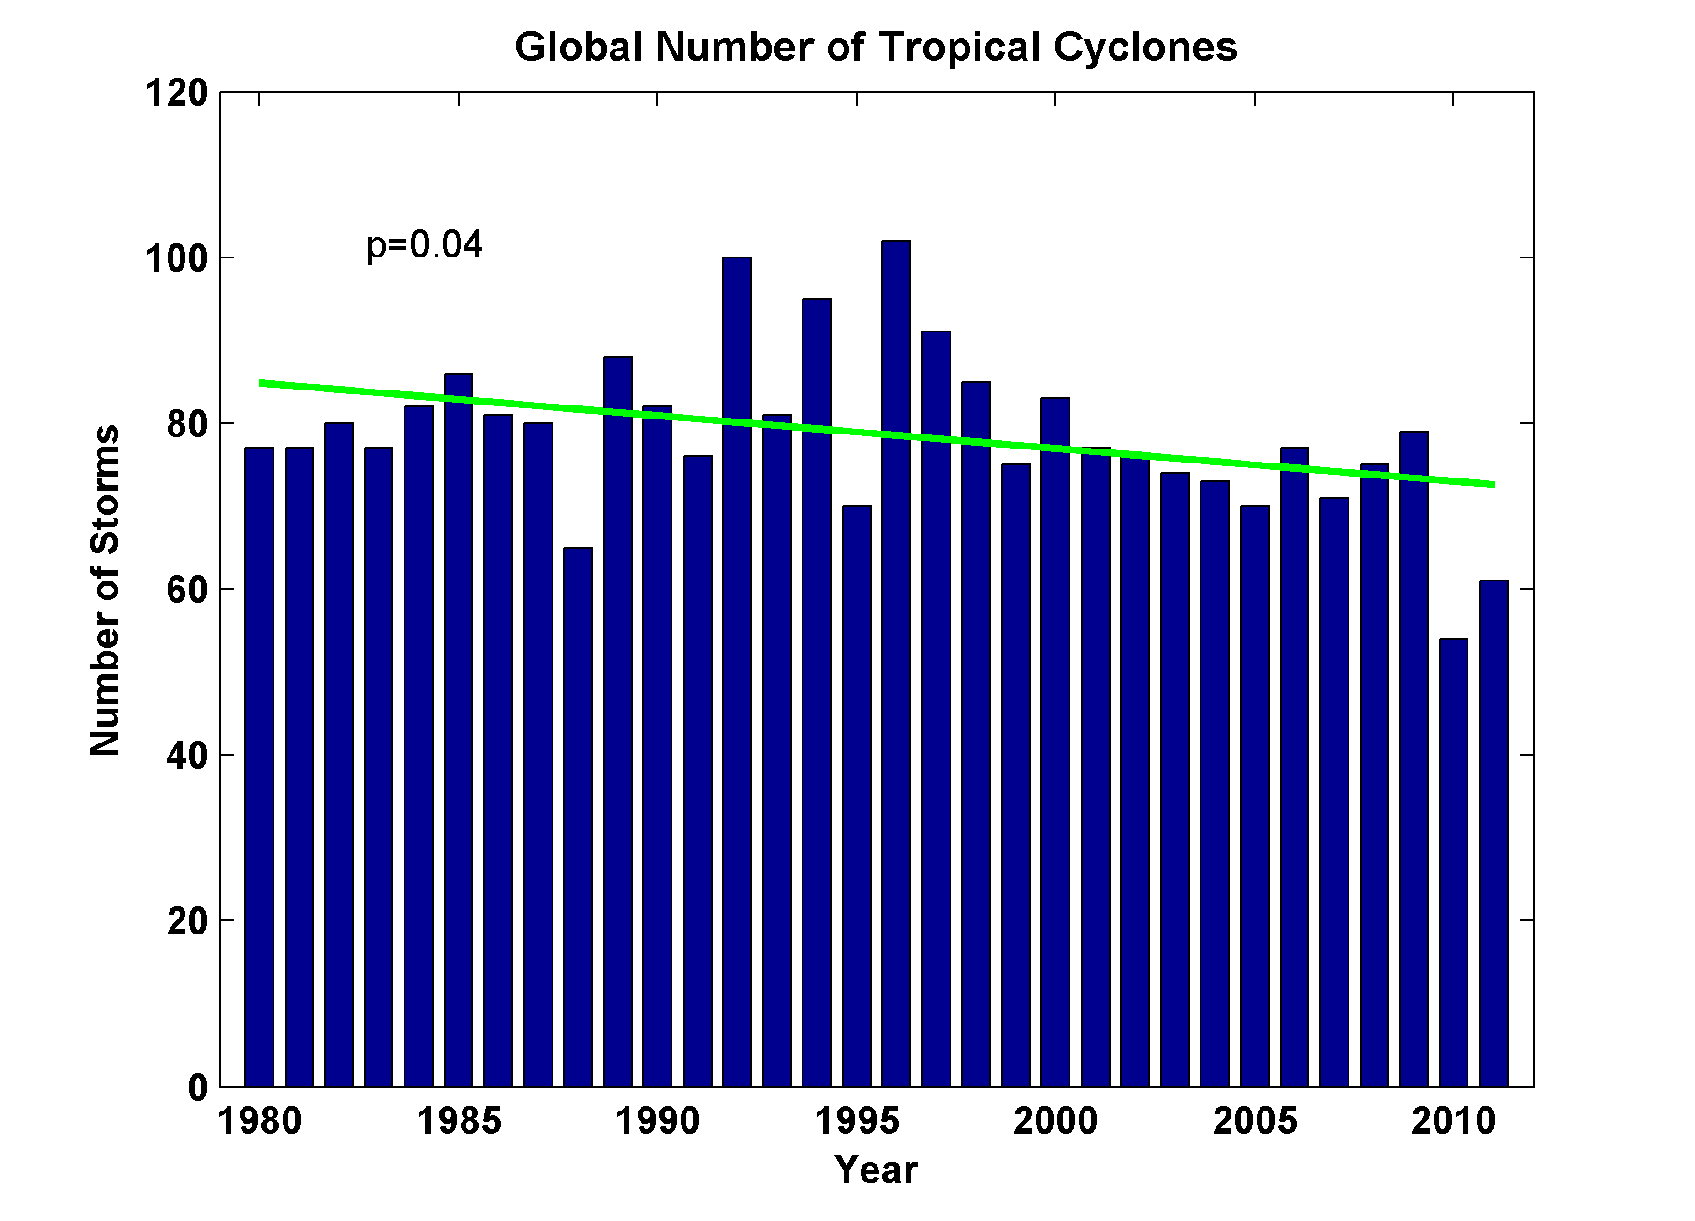
Global Tropical Cyclone Frequency, 1980-2011
2012
Data Sources: NOAA/TPC and NAVY/JTWC
Notes:
95

Slide 96
Tropical Cyclones Often Develop from Cloud Clusters:
When/Why Does Convection Form Clusters?

Slide 97
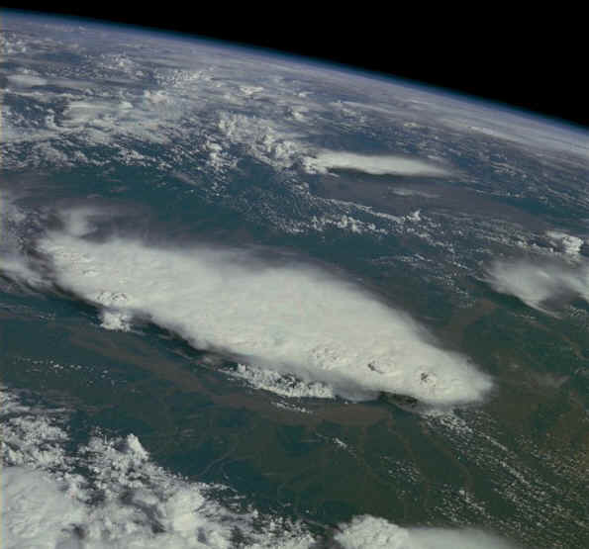
Monsoonal Thunderstorms, Bangladesh and India July 1985

Slide 98
Simplest Statistical Equilibrium State:
Radiative-Convective Equilibrium

Slide 99

Spontaneous Aggregation of Convection

Slide 100
Spontaneous Aggregation of Convection

Slide 101

Nolan et al., QJRMS, 2007

Slide 102

Variation of tropical relative humidity profiles with a Simple Convective Aggregation Index (SCAI).
Courtesy Isabelle Tobin, Sandrine Bony, and Remy Roca

Slide 103
Empirical Necessary Conditions for Self-Aggregation
(after Held et al., 1993; Bretherton et al., 2005; Nolan et al.; 2007)
Small vertical shear of horizontal wind
Interaction of radiation with clouds and/or water vapor
Feedback of convective downdraft surface winds on surface fluxes
Sufficiently high surface temperature

Slide 104

Self-Aggregation is Temperature-Dependent
(Nolan et al., 2007; Emanuel and Khairoutdinov, in preparation, 2012)

Slide 105


Vincent Van Gogh: Starry Night
Distance between vortex centers scales as V_{pot}/f

Slide 106
TC-World Scaling
Frequency ~
Intensity ~
Power Dissipation ~
Size ~

