Slide 1

Reconciling two disparate estimates of long-term trends in tropical cyclones
Kerry Emanuel
Lorenz Center
MIT

Slide 2
Two different methods:
Emanuel, K., 2021: Atlantic tropical cyclones downscaled from climate reanalyses show increasing activity over past 150 years. Nature Comm.
  100 TCs per year downscaled from three 20th century reanalyses including NOAA 20C ver. 2c. Random seeing approach using coupled deterministic CHIPS model for intensity
Chand, S. S., 2022: Declining tropical cyclone frequency under global warming. Nature Clim. Change
  Direct detection of tropical cyclones in NOAA 20C, ver. 2c using modified Okubo-Weiss parameter and other criteria.

Slide 3
Bottom line results
Chand et al. (direct detection): “We show robust declining trends in the annual number of TCs at global and regional scales during the twentieth century.”
Emanuel (MIT): “The [Atlantic] results show increasing tropical cyclone activity through the period…tropical cyclones downscaled over all the tropics show weak and/or insigniﬁcant trends over the last century”

Slide 4
Direct detection, Atlantic

Slide 5
MIT, Atlantic
7-year running means

Slide 6
MIT, Atlantic, CERA 20C
7-year running means

Slide 7
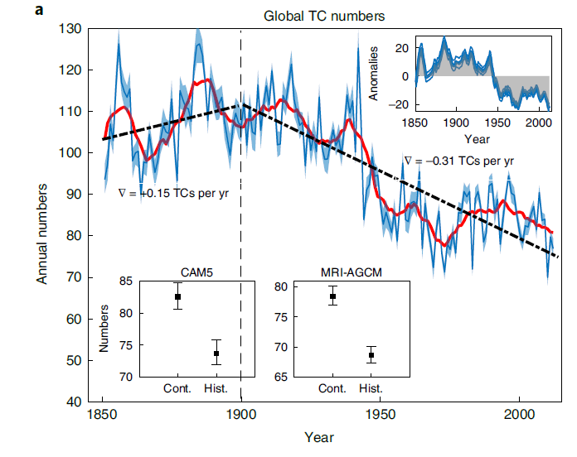
Direct detection, Global

Slide 8
MIT, Global

Slide 9
MIT, Global, Number of Major TCs

Slide 10
MIT, Global, All 3 20C Reanalyses

Slide 11
Flaws in Both Approaches:
MIT: Although method captures most well-measured TC variability, such as geographic, seasonal, and ENSO-related variations, no obvious way to test whether it can simulate truly global changes

Slide 12
Direct detection in 20C reanalyses: Very large increases in number of surface pressure observations (and best-track data) may bias trends
  Proxy for TCs: Number of OWZ counts in excess of a threshold
  Proxy for model-only TCs: Difference between mean TC proxy among ensemble members, and TC proxy applied to ensemble-mean fields
  Probability of detection: Estimated from monthly density of successfully assimilated observations

Slide 13
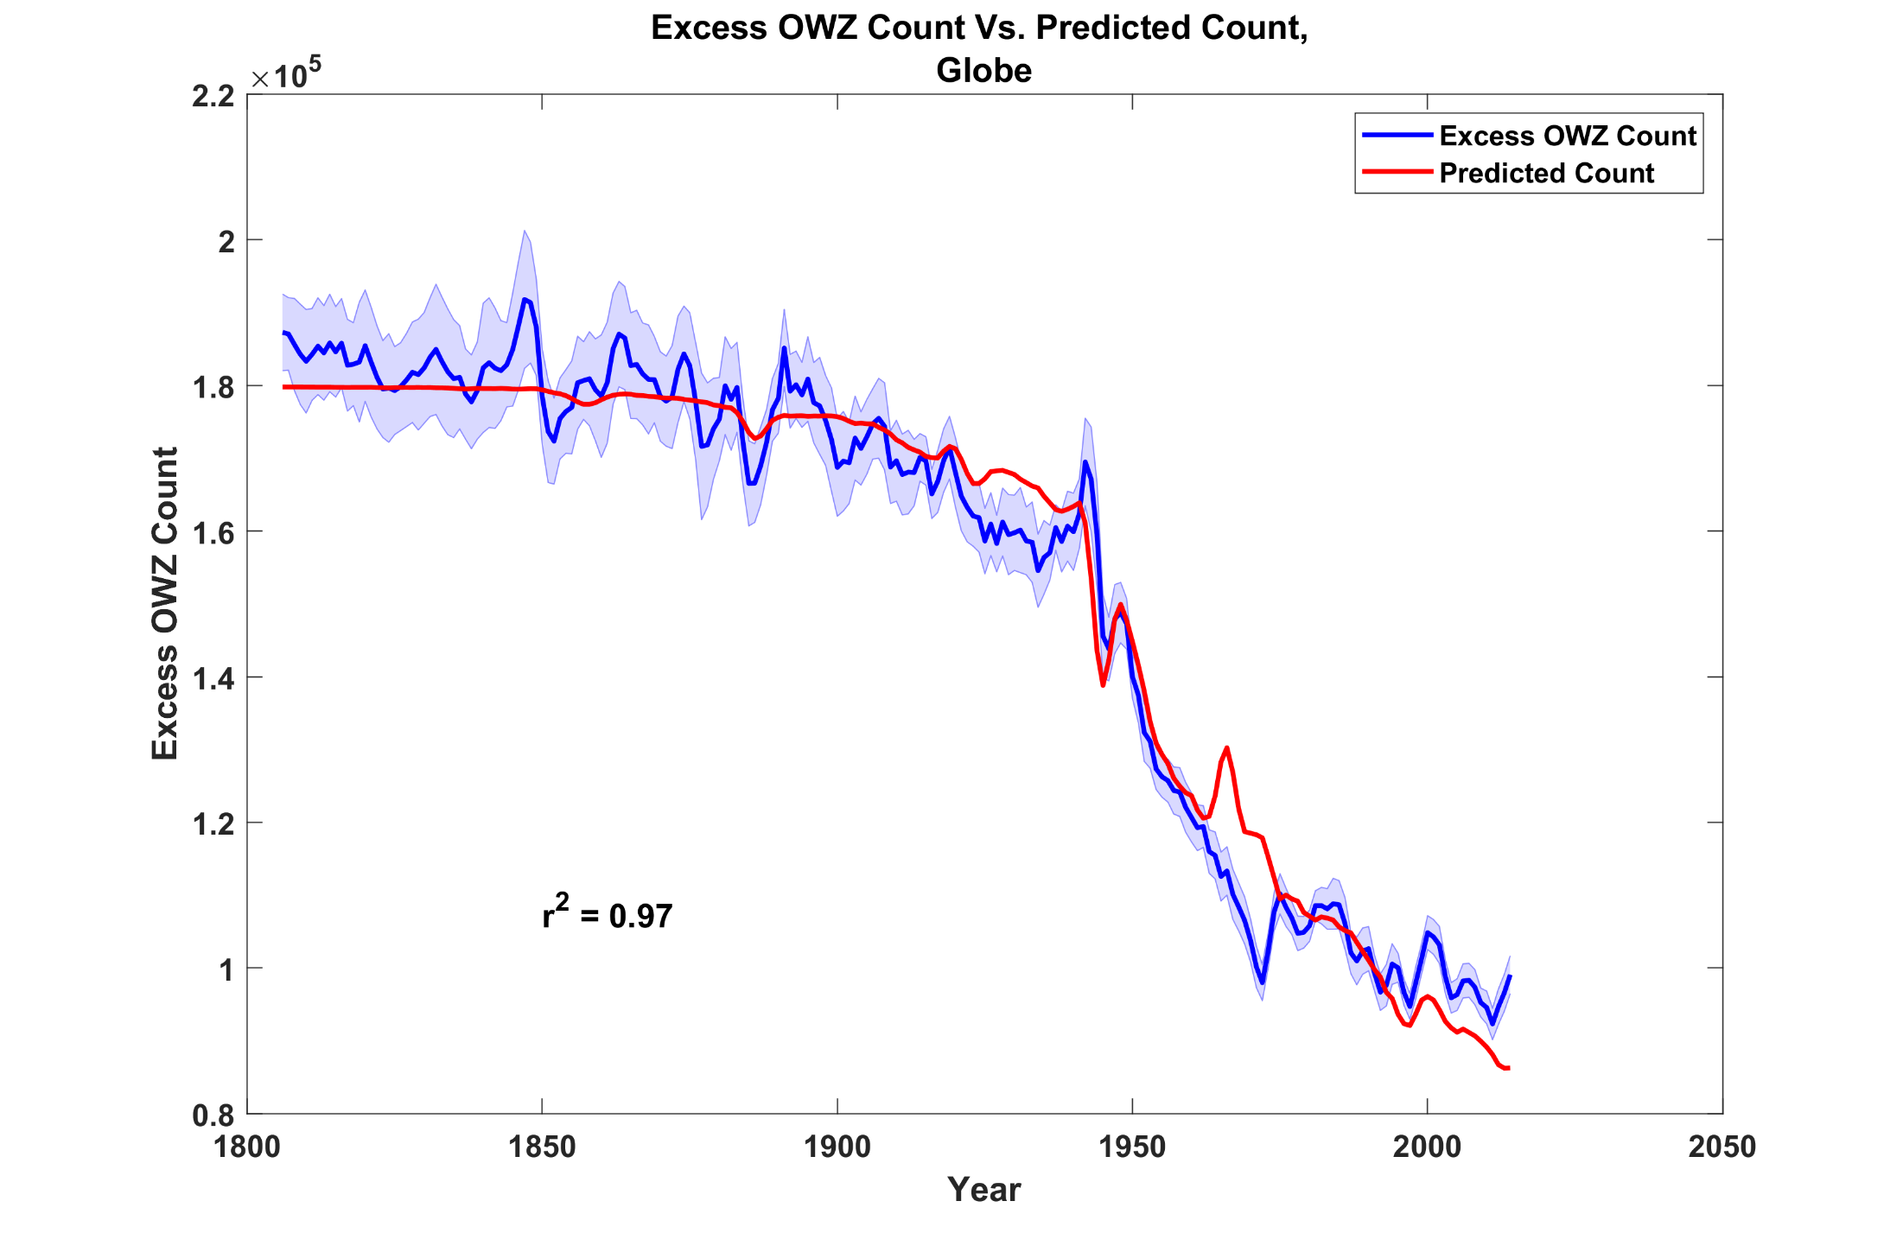
Difference between ensemble mean OWZ count and OWZ count of ensemble mean
Probability of observational detection

Slide 14
Summary
We compared direct detection of TCs in a 20th century reanalysis with downscaling of TCs from same reanalysis
While global TC counts from both methods show similar downward trends, downscaling of other 20C reanalyses show little trend
Downscaling of Atlantic shows significant upward trends while direct detection shows downward trends
Assimilation of strongly increasing number of obs may bias TC trends in reanalyses

