Slide 1

Tornadoes and Farms
Kerry Emanuel
Lorenz Center
MIT

Slide 2
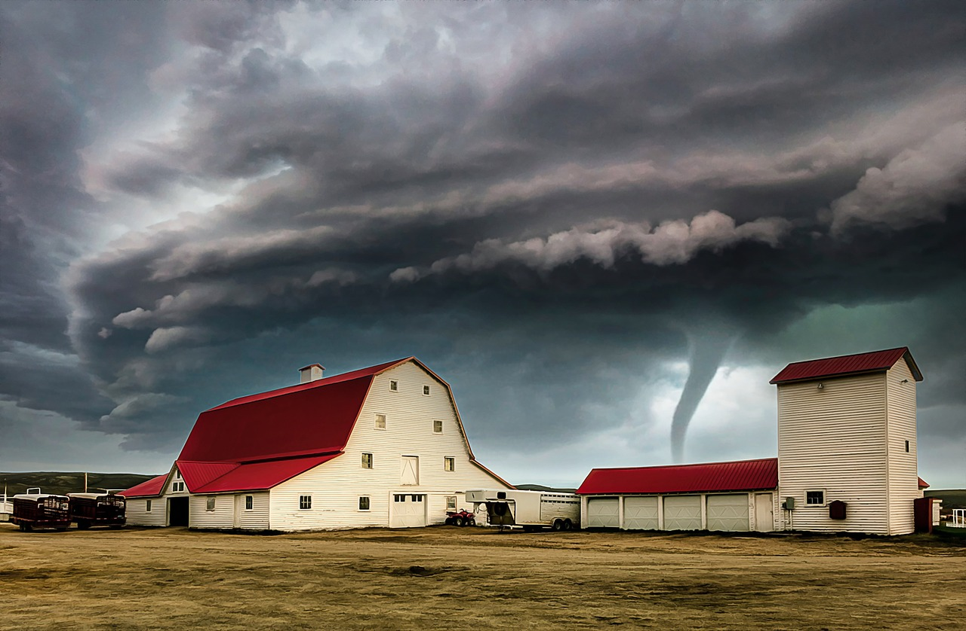
Why do so many photos and videos of tornadoes feature farms?

Slide 3
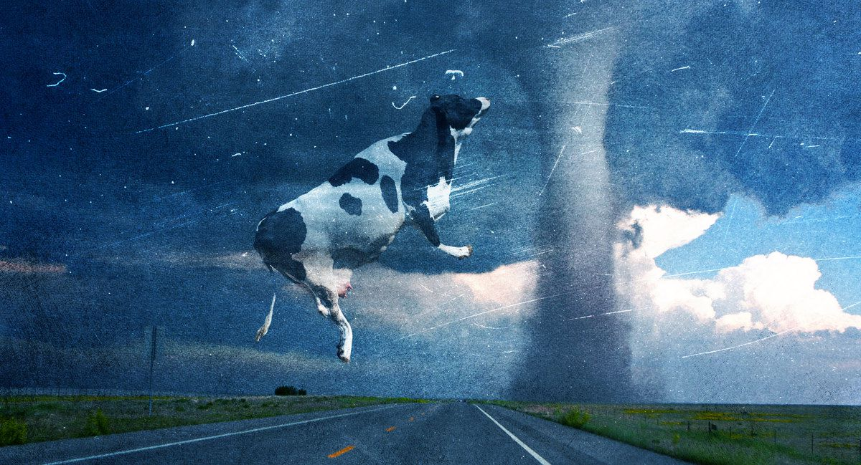
….and farm animals?

Slide 4
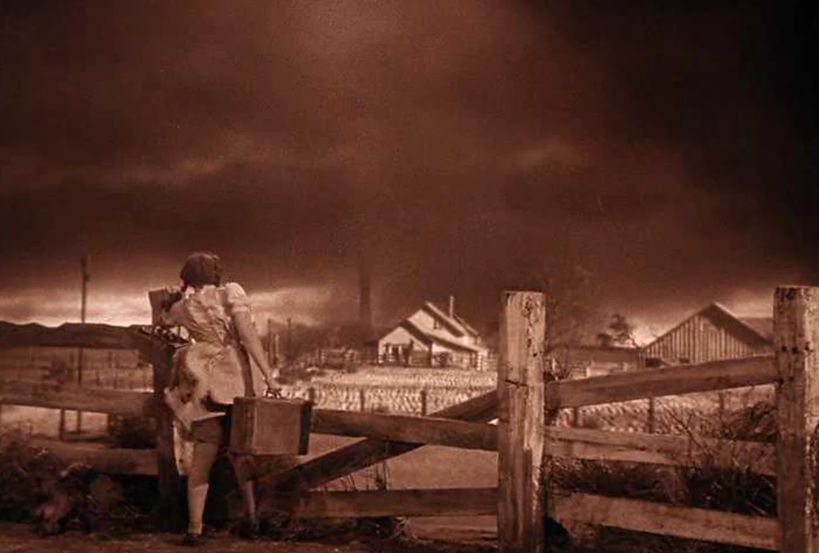
And, of course, in fiction

Slide 5
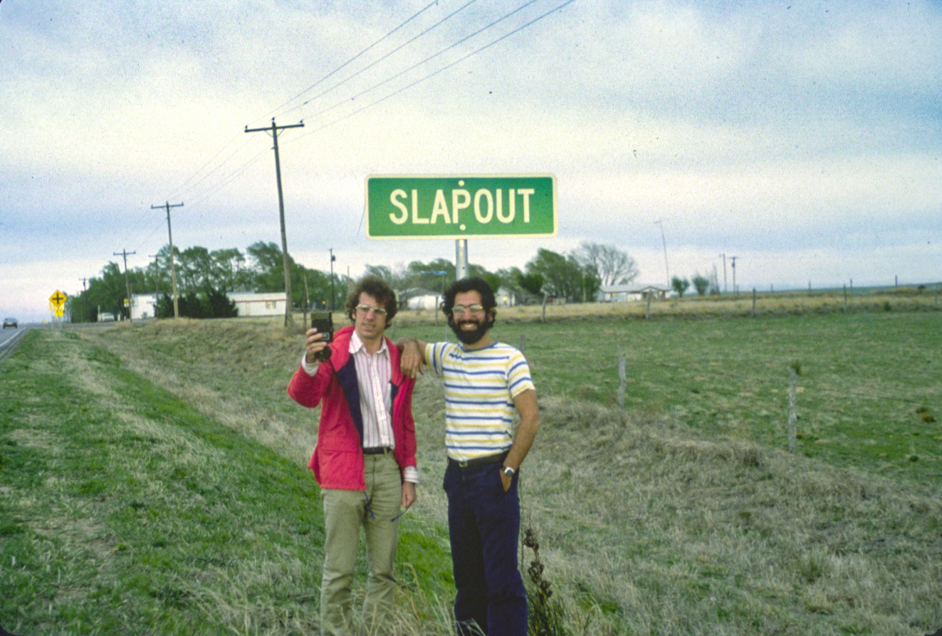
And, by the way, why do towns in tornado country have such weird names?

Slide 6
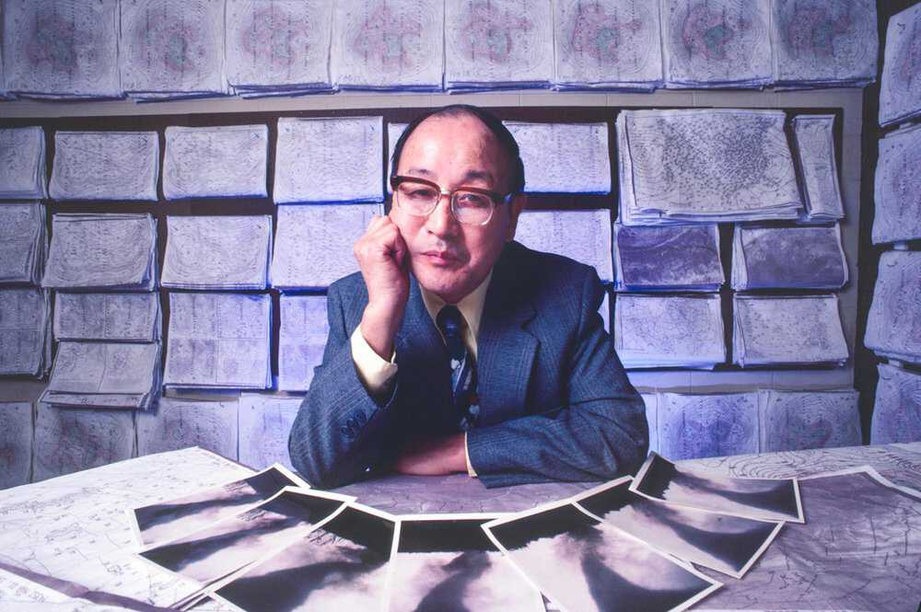
My quixotic quest began with this man:
Professor Ted Fujita
a.k.a. the “Tornado Man”

Slide 7
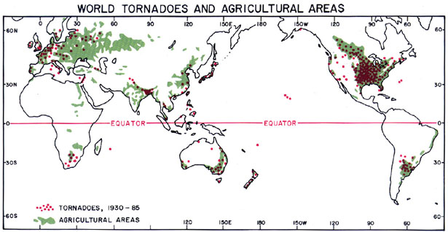
Global Distribution of Tornadoes
Why do tornadoes like farms? --Ted Fujita

Slide 8
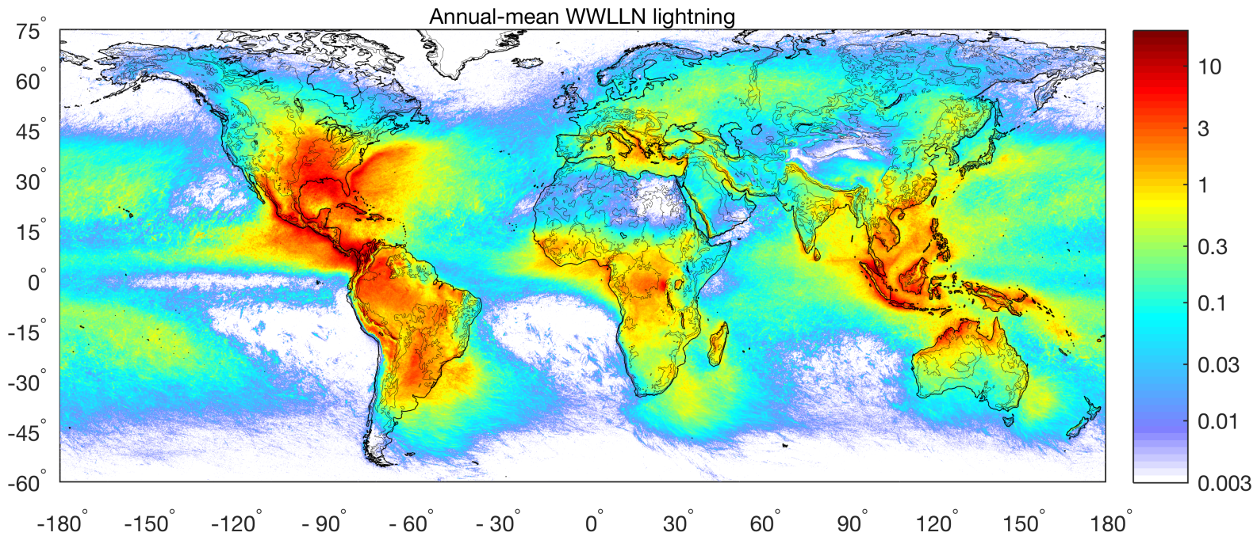
Annual Mean Lightning Discharges
Why does this distribution differ so much from the distribution of tornadoes and hail?

Slide 9
Why Should We Care?
Severe convective storms are a significant cause of damage and loss of crops worldwide
For example, hail losses are second only to flood losses among weather hazards in Switzerland
Comparatively little is know about how climate change affects this weather hazard
Convective Available Potential Energy (CAPE) is an important ingredient in severe convective storms
Understanding the climatology of CAPE in today’s climate is a step toward quantifying current and future severe convective storm risk
The rest of this talk will be about CAPE

Slide 10
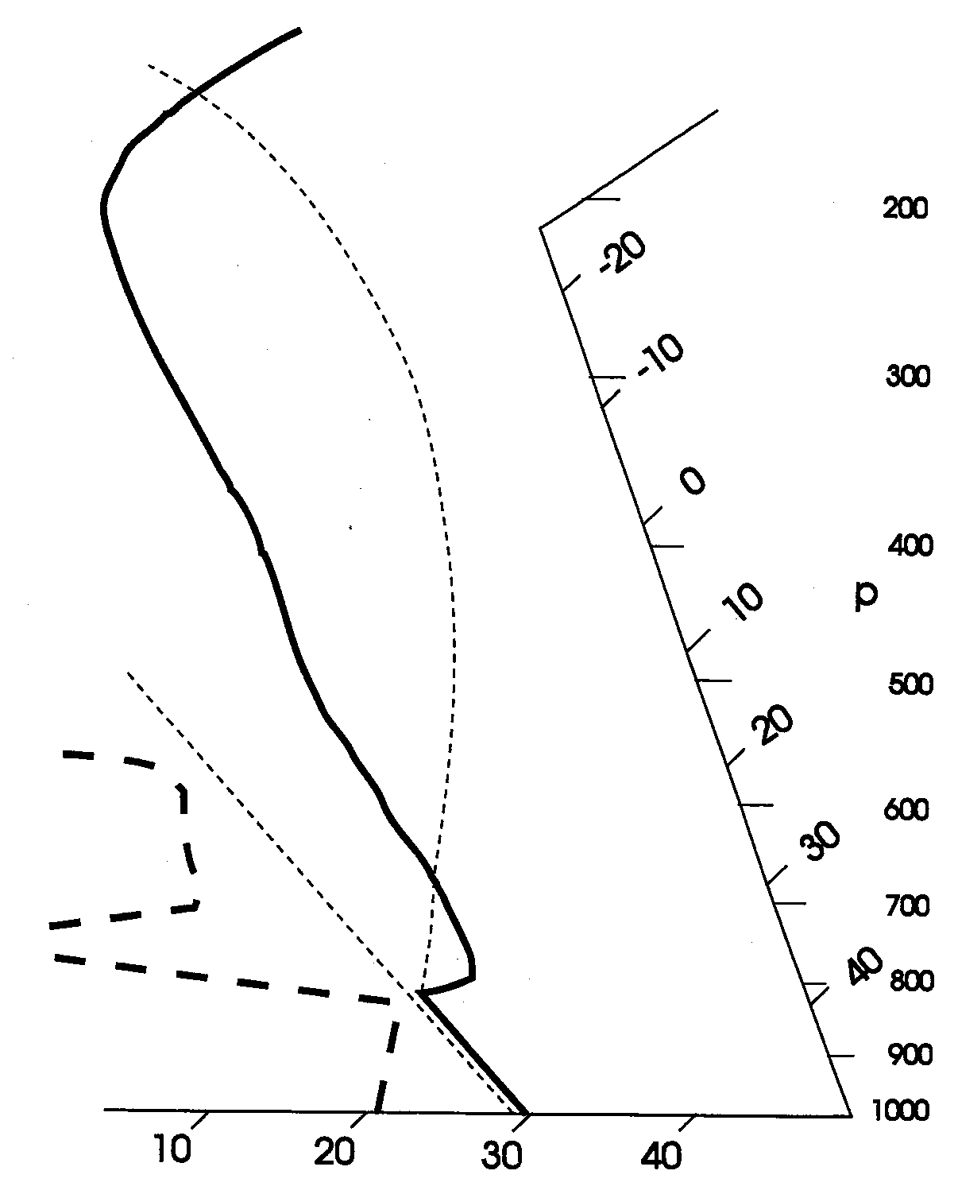
What is CAPE?
Moist adiabatic ascent from cloud base
Pressure (proxy for altitude)
Temperature profile measured by weather balloon
CAPE is proportional to the area enclosed by the sounding and the moist adiabat
Dry adiabatic ascent from surface
Convective Inhibition (CIN) is proportional to the ‘negative’ area enclosed by the sounding and the moist adiabat
Temperature (ºC) on skewed axis

Slide 11

Convection over the Tropical Oceans

Slide 12
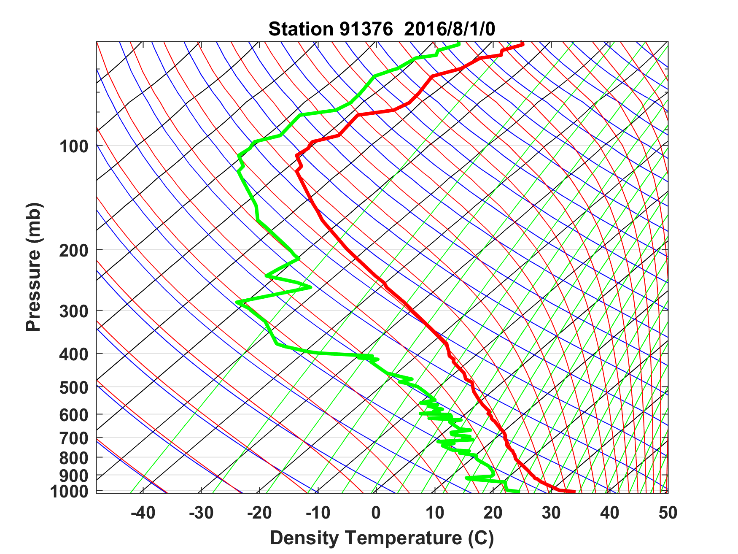
Sounding at Majuro, August 1 2016 0 GMT

Slide 13
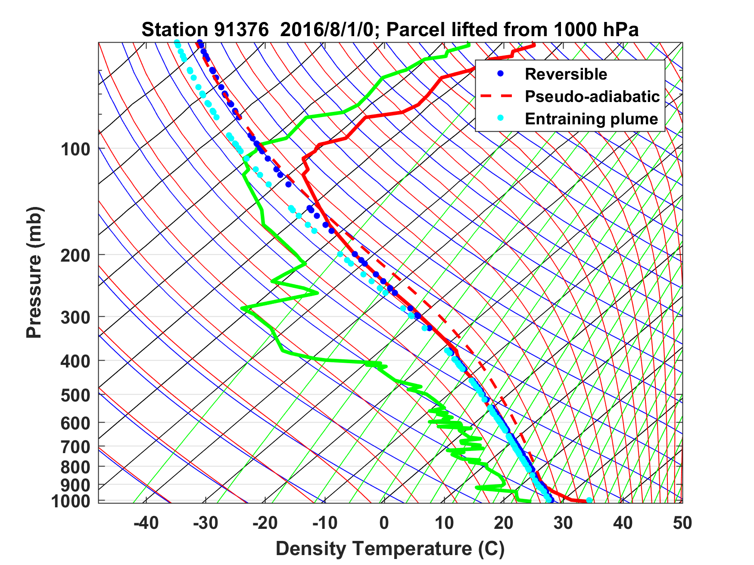
Sounding at Majuro, August 1 2016 0 GMT
Convection releases CAPE as fast as it is generated

Slide 14
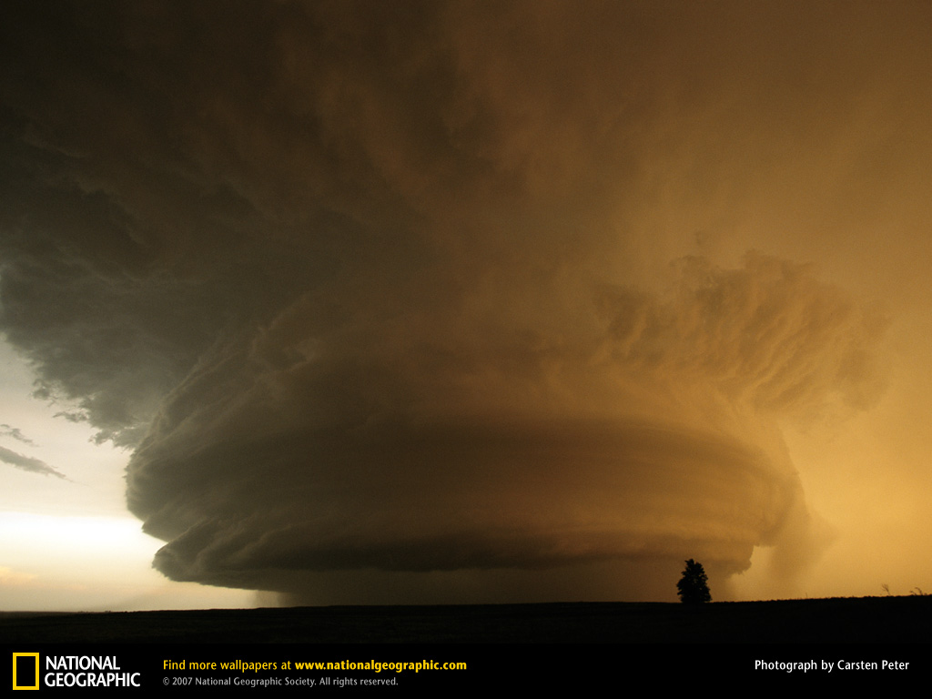
Stored-Energy Convection:
LOTS of CAPE!

Slide 15
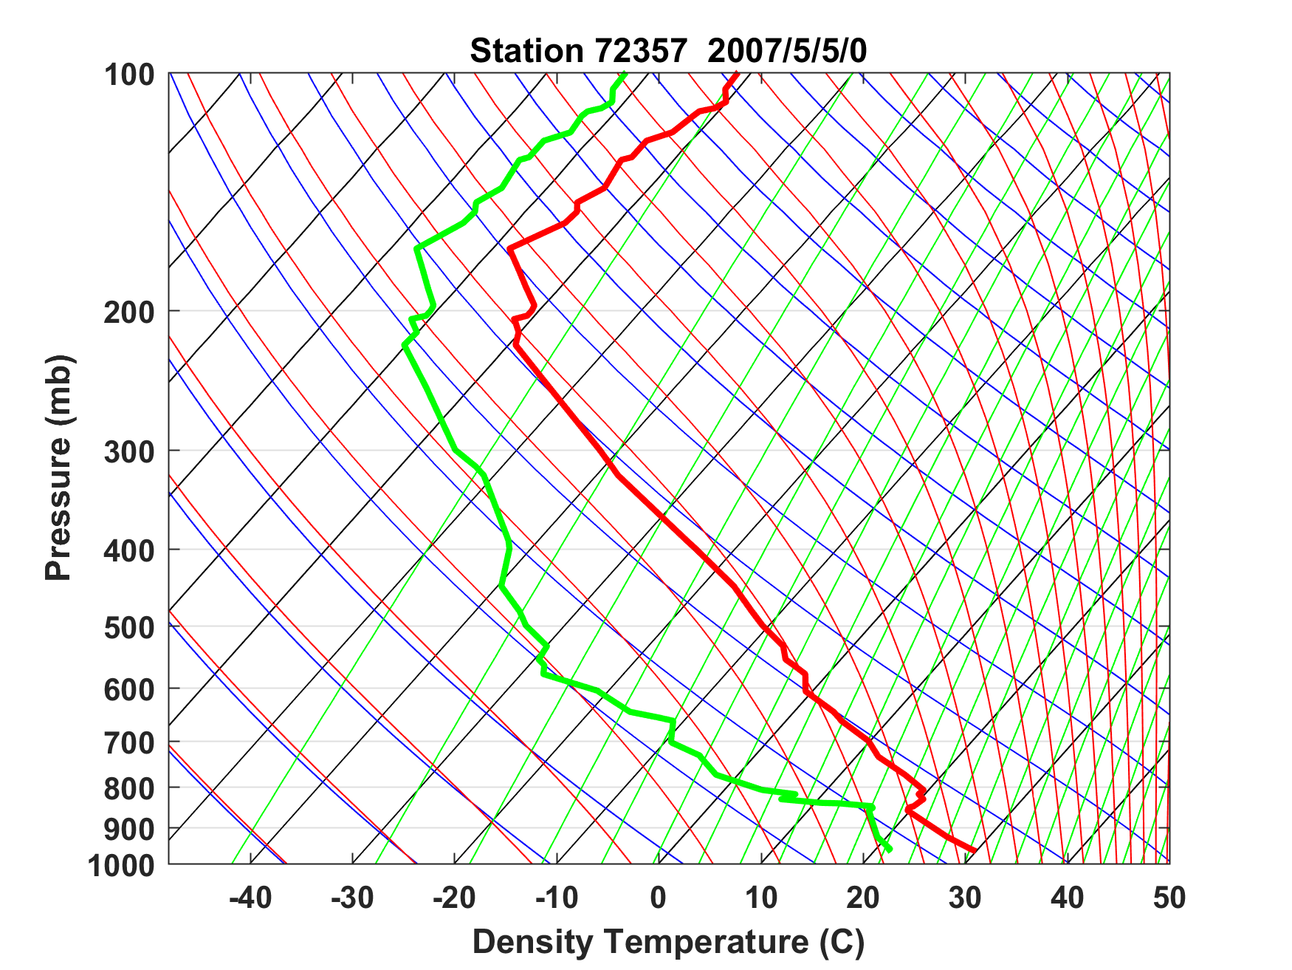
Sounding at Norman, Oklahoma, May 5th 2007
Capping inversion

Slide 16
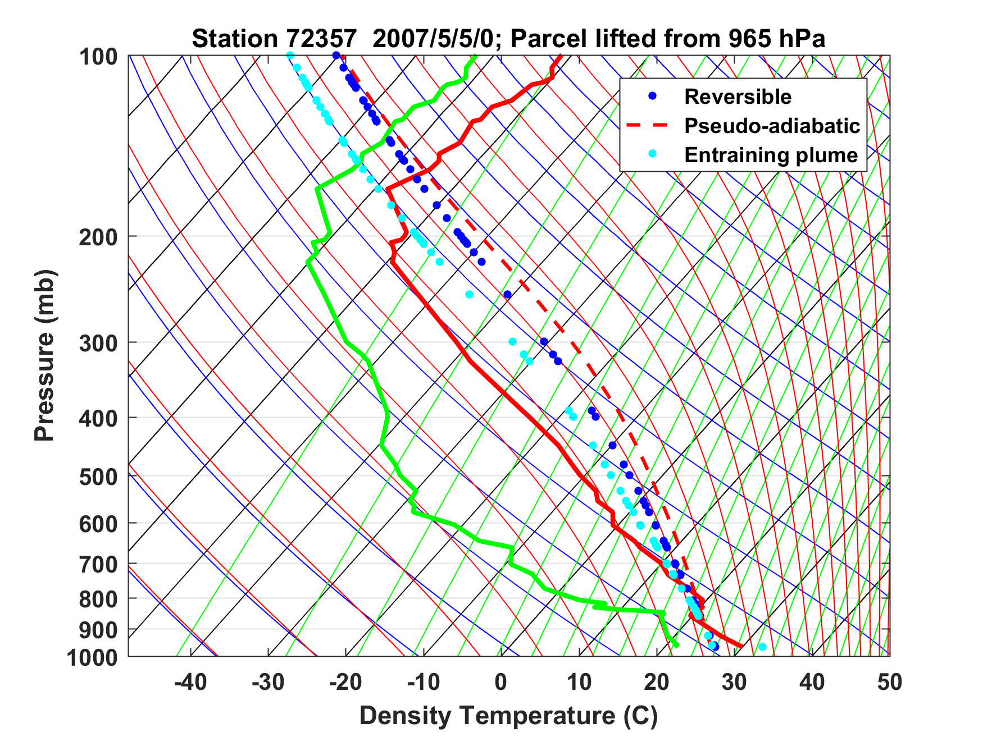
Sounding at Norman, Oklahoma, May 5th 2007

Slide 17
Sounding at Norman, Oklahoma, May 5th 2007
CAPE = 6900 J/Kg → w = 110 m/s =~ 250 MPH
Capping inversion

Slide 18
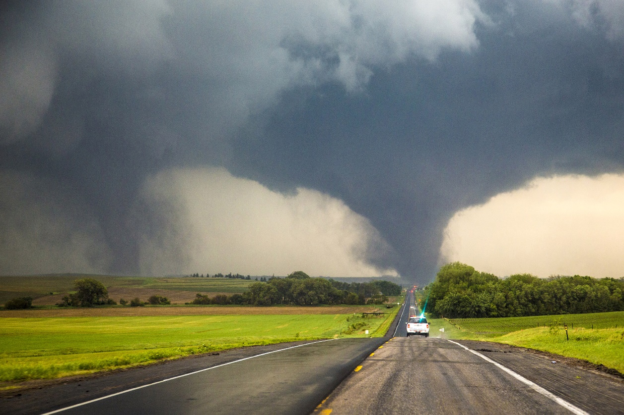
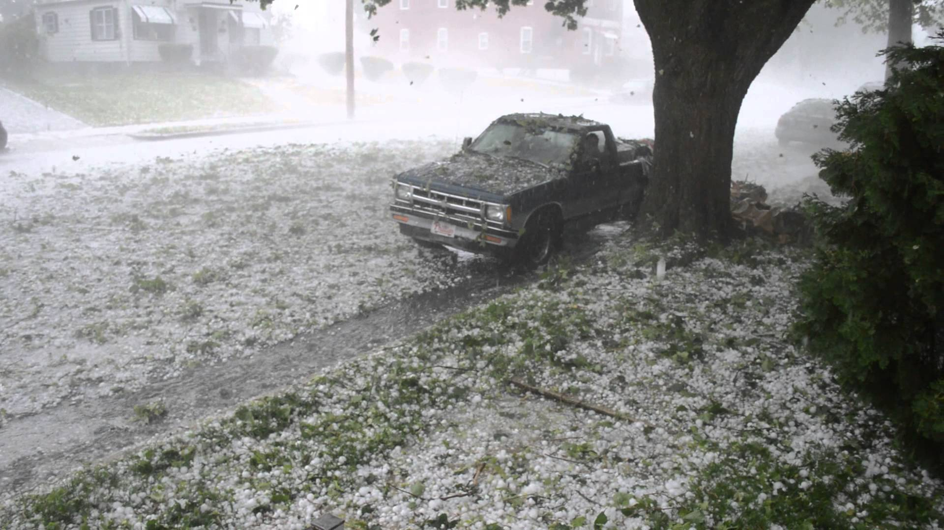
Each year in the U.S., 1,200 tornadoes on average kill 60 people, injure 1,500, and cause roughly $400 million in damages
Hail causes about $1 billion dollars in damage to crops and property each year, according to the National Oceanic Atmospheric Administration (NOAA)

Slide 19
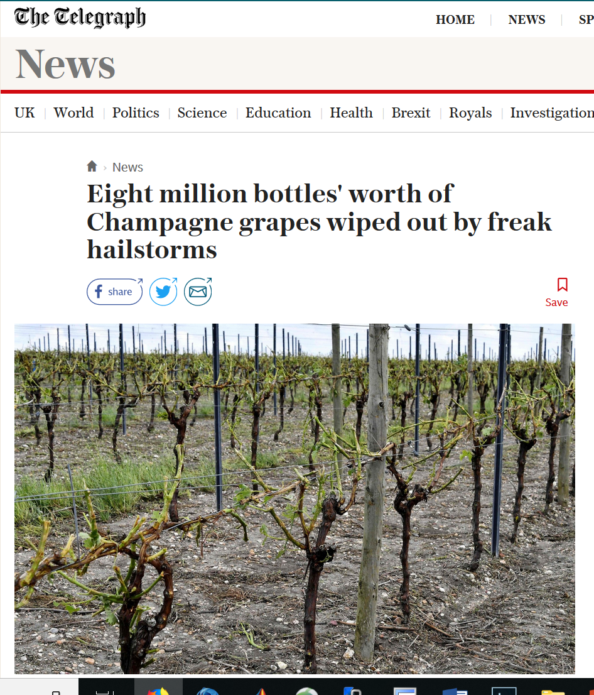
If that were not bad enough…..

Slide 20
How do these high CAPE soundings arise?
Clues in the climatology….

Slide 21
Days per year of hail > 2.5 cm in diameter

Slide 22
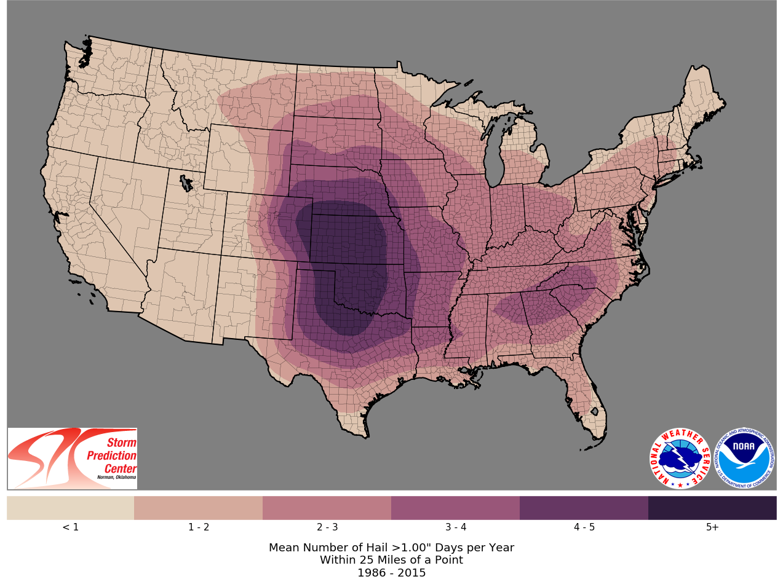
Days per year of hail > 1 inch in diameter

Slide 23
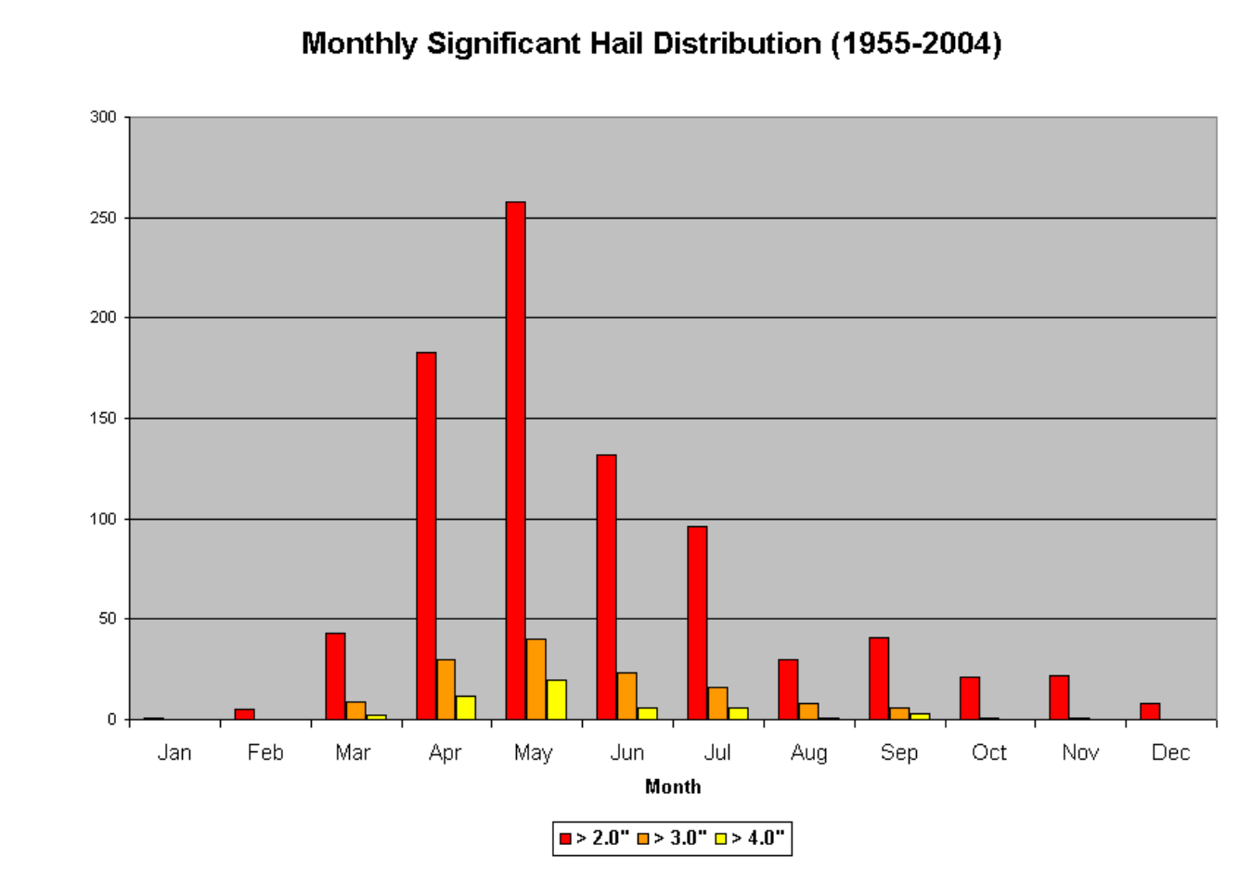
Illinois-Missouri Hail Climatology
Mark F. Britt, WFO St. Louis

Slide 24
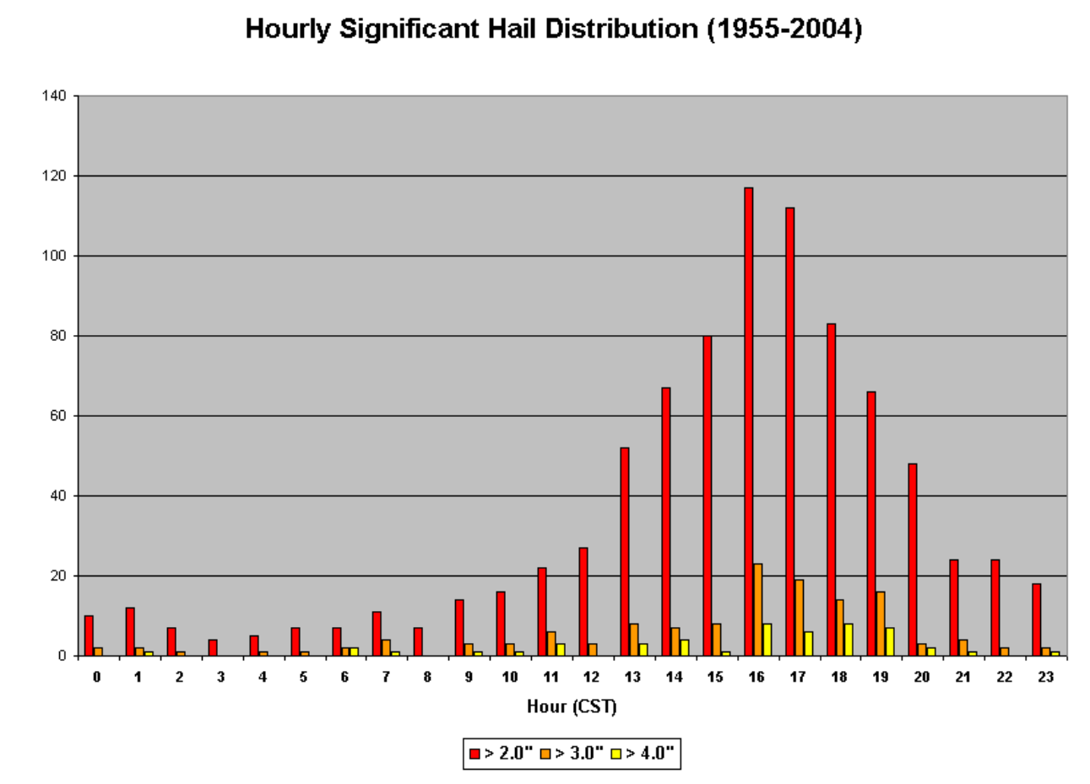
Mark F. Britt, WFO St. Louis

Slide 25
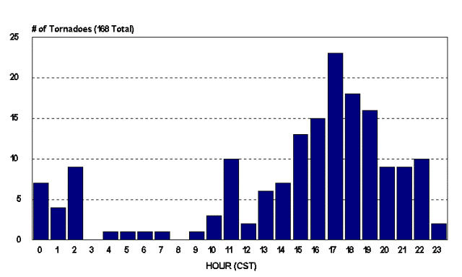
Diurnal Variation of Tornadoes

Slide 26

Necessary Conditions for Severe Thunderstorms:
High values of CAPE
Large vertical shear of horizontal wind, particularly at low levels

Slide 27
Necessary Conditions for Severe Thunderstorms:
High values of CAPE
Large vertical shear of horizontal wind, particularly at low levels

Slide 28
Key Questions:
What determines geographical distribution of stored- energy storms?
Why do tornadoes and hailstorms peak in late- afternoon to early evening?
Why are peak CAPE values around 3000-6000 J/Kg?
How might these values change with climate?

Slide 29
Hypothesis:
Large CAPE is produced when a deep, dry- adiabatic layer formed over dry land is advected over moist soil which is then subjected to solar heating.

Slide 30
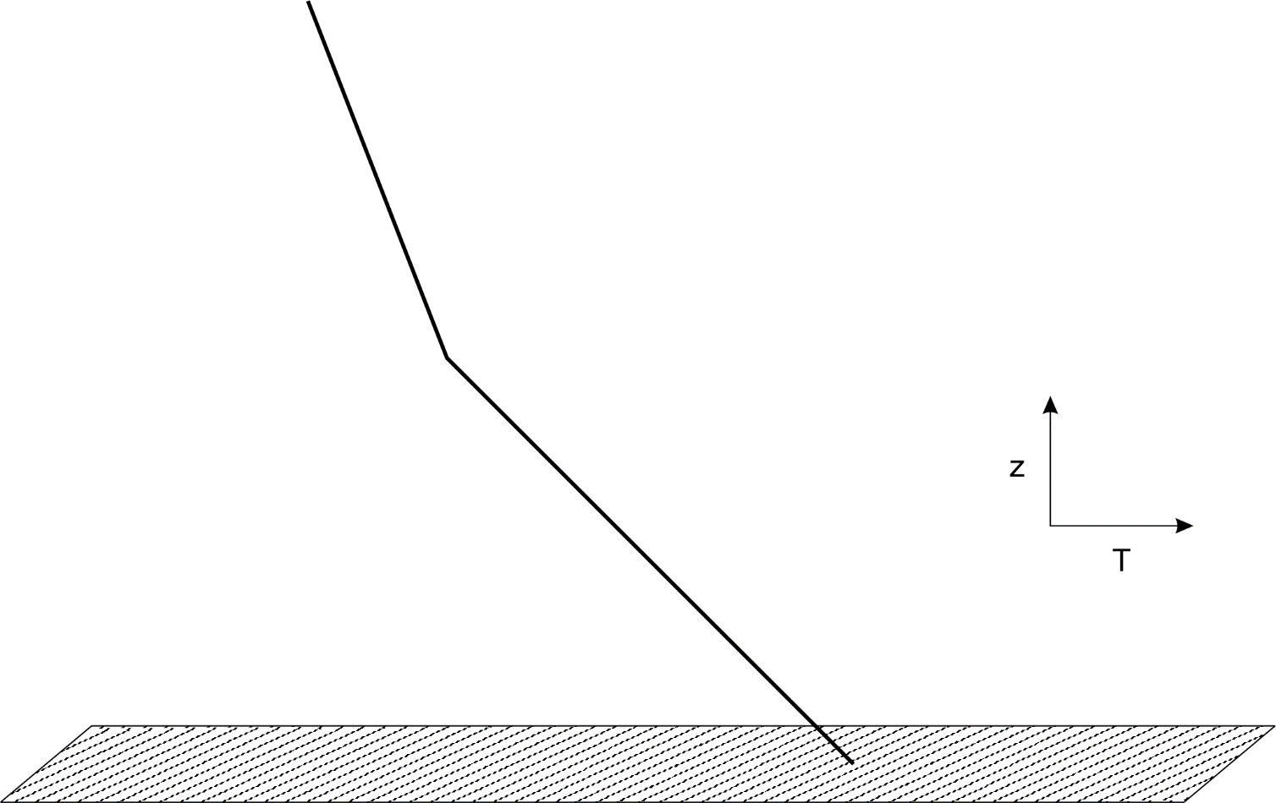
1. Start with deep dry adiabatic layer formed over dry soils

Slide 31
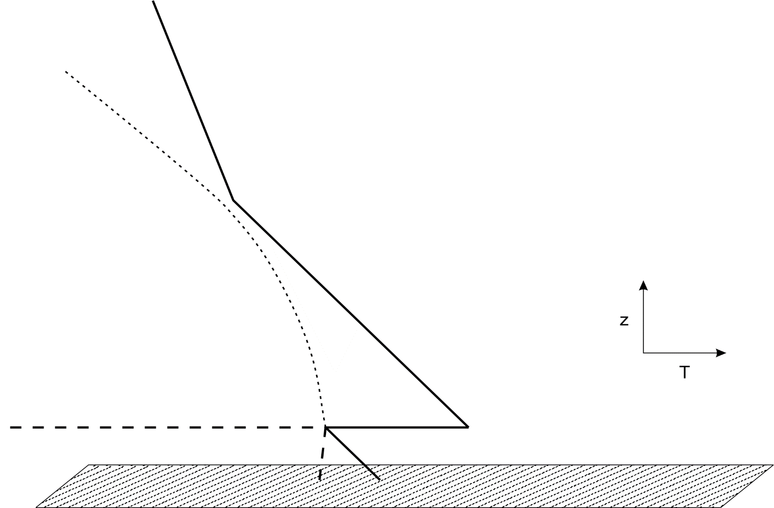
2. Move over moist and possibly vegetated soil, develop new shallow, wind-driven boundary layer, just saturated at its top

Slide 32
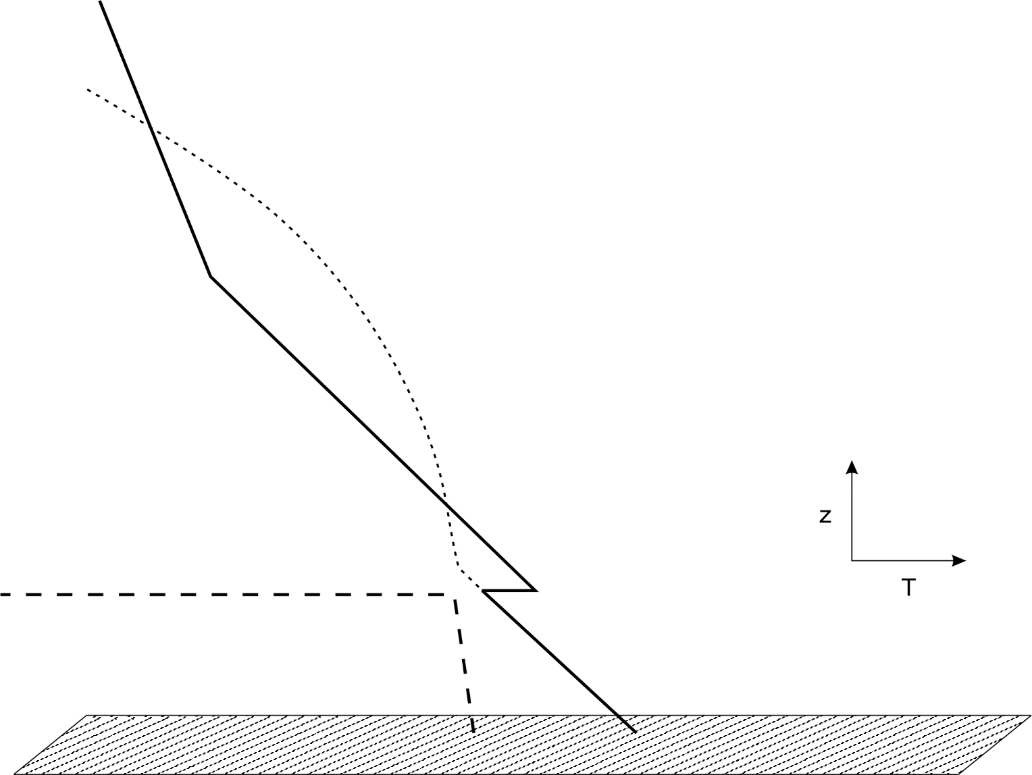
3. Sun rises and heats and moistens new boundary layer. Convective boundary layer grows; CAPE increases and CIN decreases

Slide 33

These basic physics can be encoded in a simply, one-dimensional model of the atmosphere and underlying ground. Start with a dry column of the atmosphere and place it over a wet and possibly vegetated soil. Soil physics include percolation, evaporation, transpiration, runoff.

Slide 34

Key Model Parameters
Desert air temperature
Initial depth of boundary layer
Surface wind speed
Initial surface moisture availability
Surface exchange coefficients
Magnitude and time evolution of insolation
Many more parameters added with soil/vegetation model

Slide 35
Impose a diurnal cycle of surface net radiative forcing

Slide 36
Results

Slide 37
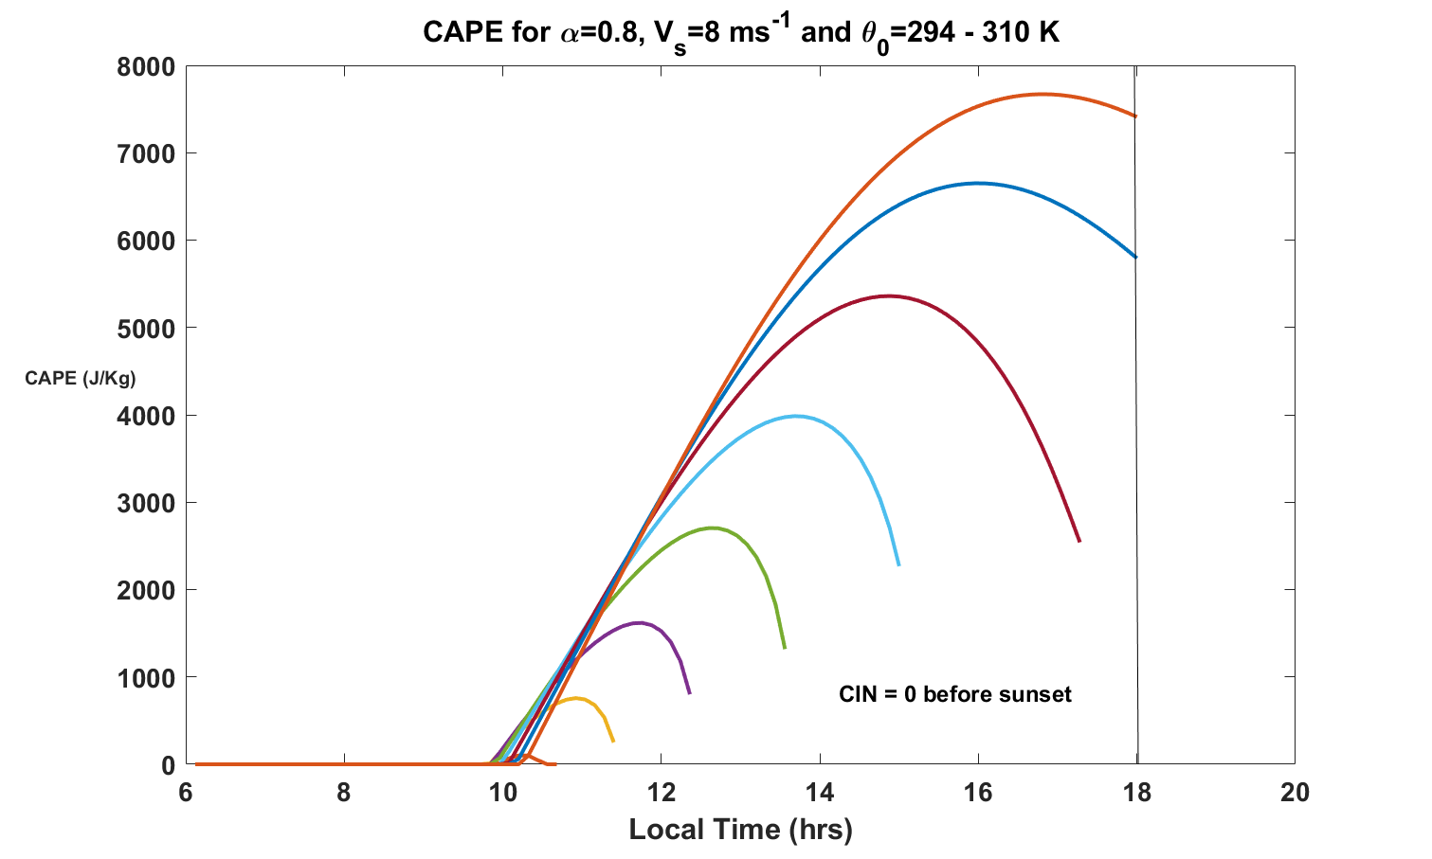
Bare soil CAPE dependence on temperature of desert-modified air
310
308
306
304
302
300
296
298

Slide 38
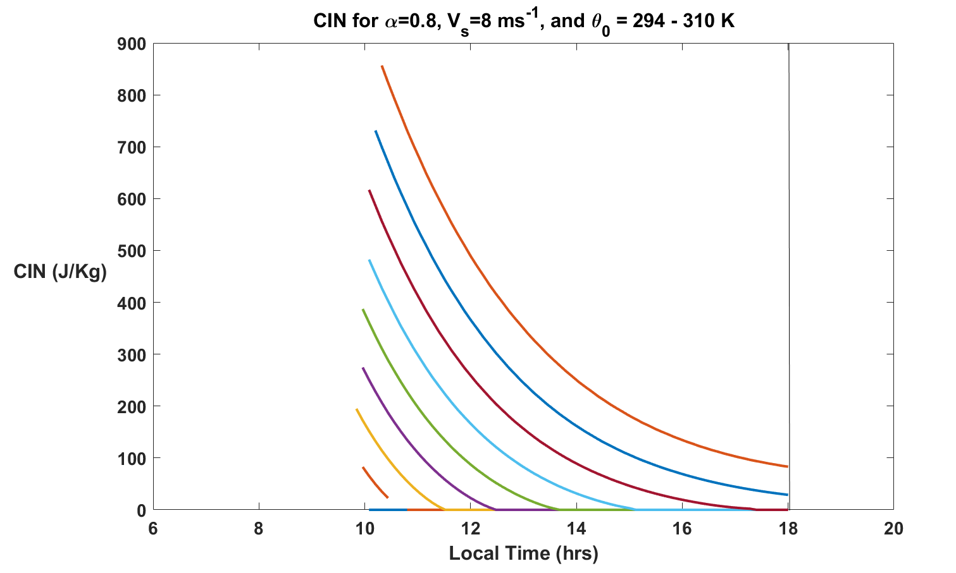
Bare soil CIN dependence on temperature of desert-modified air
310
308
306
304
302
300
298
Stranded CAPE
296

Slide 39
Dependence of CAPE Evolution on Soil Type

Slide 40
Dependence on Vegetative Coverage

Slide 41
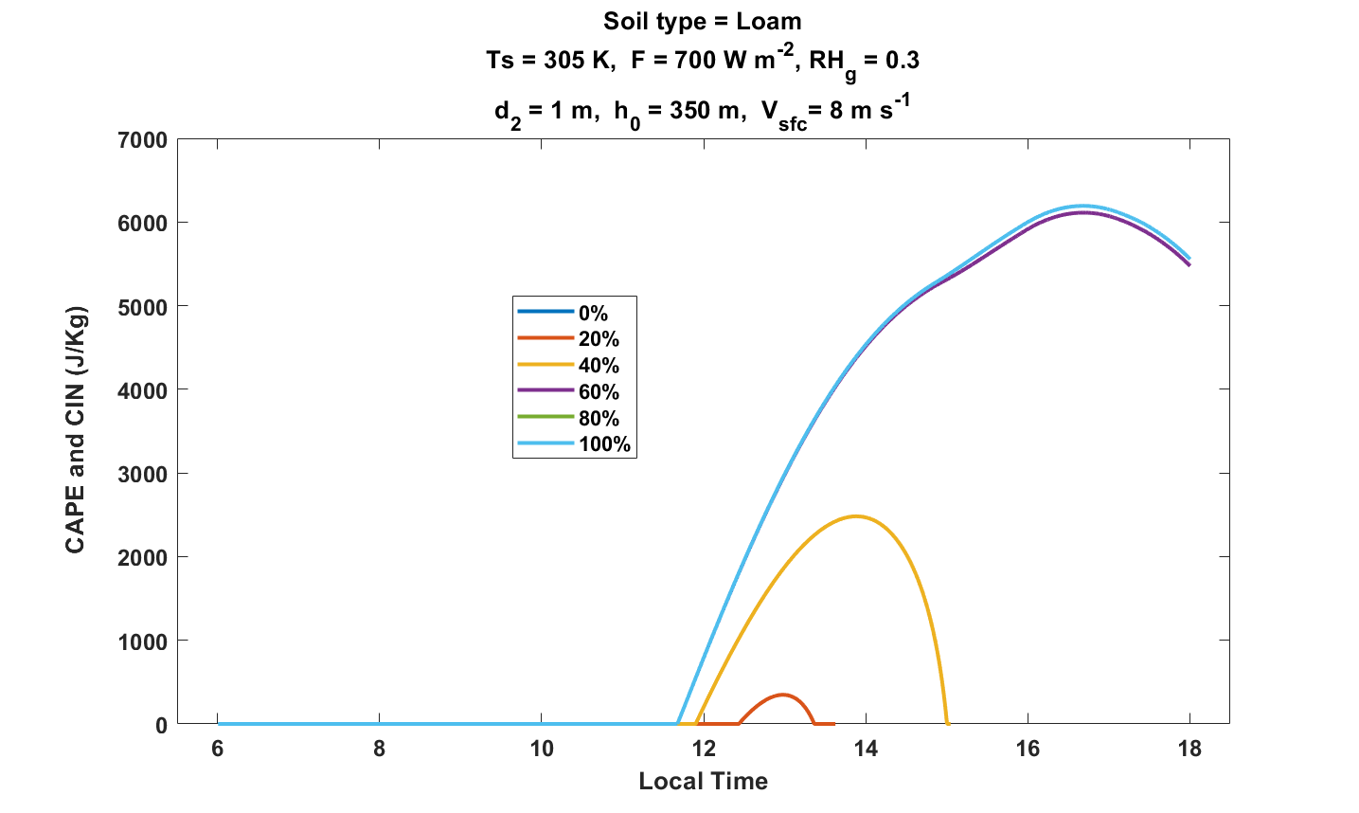
Dependence on root zone saturation level, 100% vegetative cover

Slide 42
Prescription for Large CAPE:
Moist and/or vegetated soils downwind of arid or semi- arid regions
Crops are usually irrigated and are darker than most native soils, absorbing more sunlight
Farms downwind of dry land are ideal for developing large CAPE

Slide 43
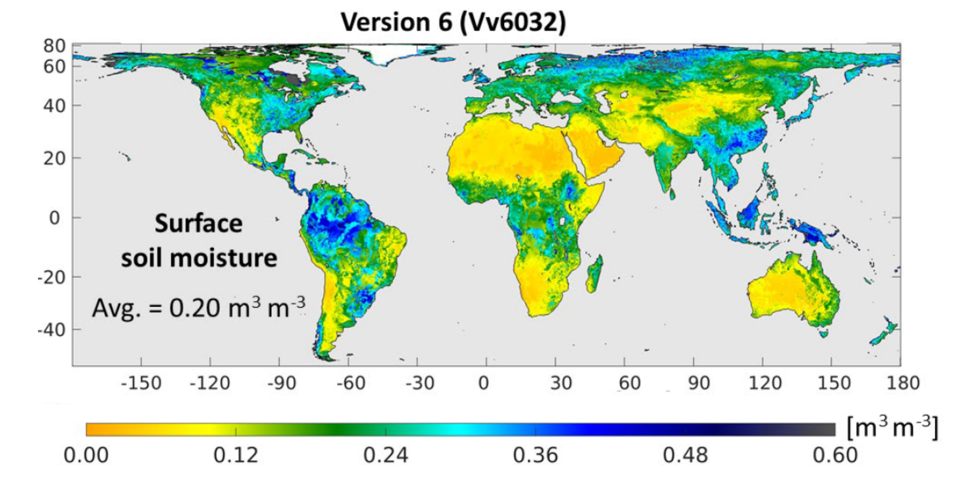
NASA Soil Moisture Active-Passive (SMAP) program
Surface Soil Moisture, April 2015-March 2021
Reichle, Rolf H., et al. Soil Moisture Active Passive (SMAP) Project Assessment Report for Version 6 of the L4_SM Data Product. Technical Report Series on Global Modeling and Data Assimilation 60 (2022).

Slide 44
Global Distribution of Tornadoes
Ted was Right!

Slide 45
Summary
Large CAPE occurs when desert air moves over moist and/or vegetated soils (connection to agriculture)
Diurnal peak values of CAPE increase monotonically with temperature of the desert-modified air
Peak CAPE also increases with surface wind speed and soil moisture, though it also large for very low wind speed
Coupling to soil thermodynamics and vegetation physics is important
Dependence on soil moisture may offer a degree of seasonal predictability of CAPE
Agricultural and other land use practices on regional scales may have altered severe storm climatology

Slide 46
Spare Slides

Slide 47
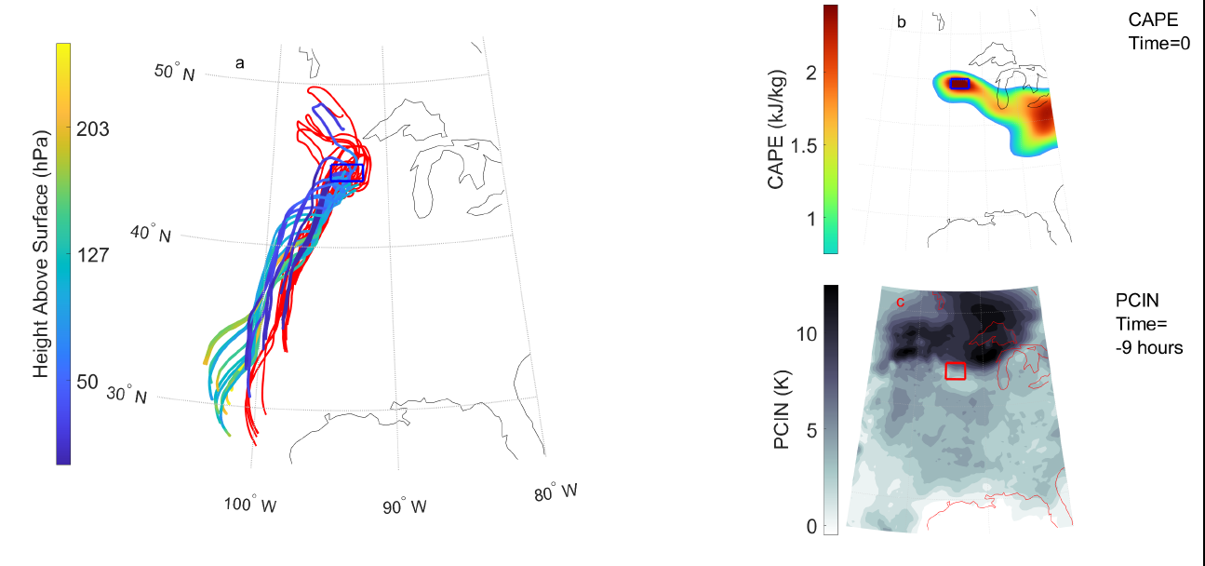
Analyze development of CAPE and CIN along trajectories
(PJ Tuckman et al., Mon. Wea. Rev., 2023)

Slide 49
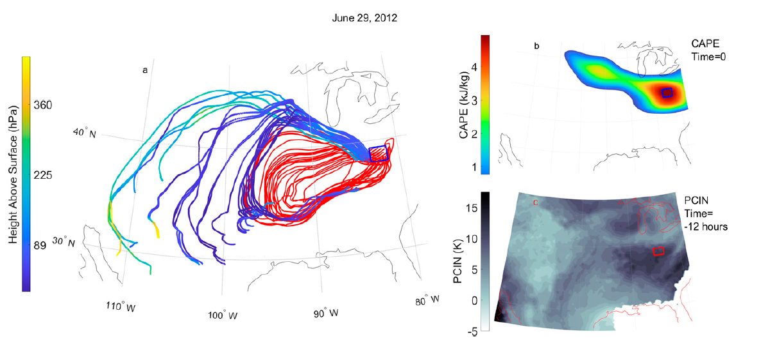
29 June 2012

Slide 50
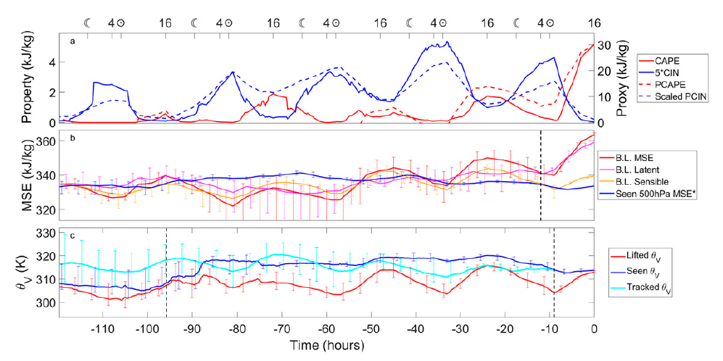
29 June 2012

Slide 51
Occurrence frequency of CIN and CAPE over CONUS, 20º-40º N during May and June, 2009-2013
Control
PGW - Control
WRF
CCSM4
Chen, J., A. Dai, Y. Zhang, and K. L. Rasmussen, 2020: Changes in convective available potential energy and convective inhibition under global warming. Journal of Climate, 33, 2025–2050

Slide 52
CCSM4 Control
1980-1999
CCSM4 RCP 8.5. 2081-2100, - Control
Tropics
Sub-tropics
Mid-latitudes
Chen, J., A. Dai, Y. Zhang, and K. L. Rasmussen, 2020: Changes in convective available potential energy and convective inhibition under global warming. Journal of Climate, 33, 2025–2050

Slide 53
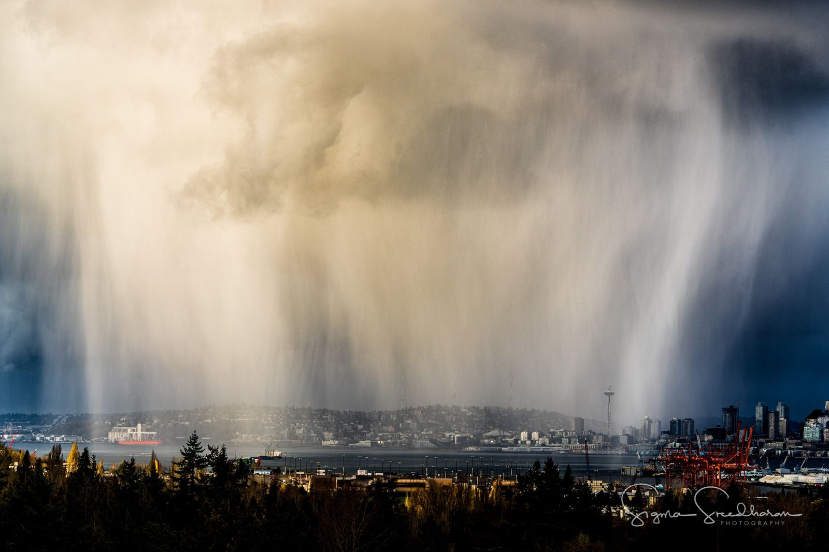

Slide 54
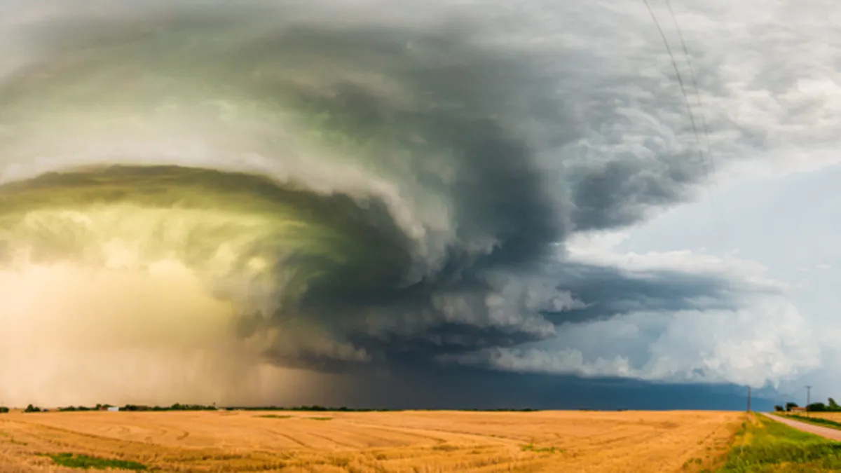

Slide 55
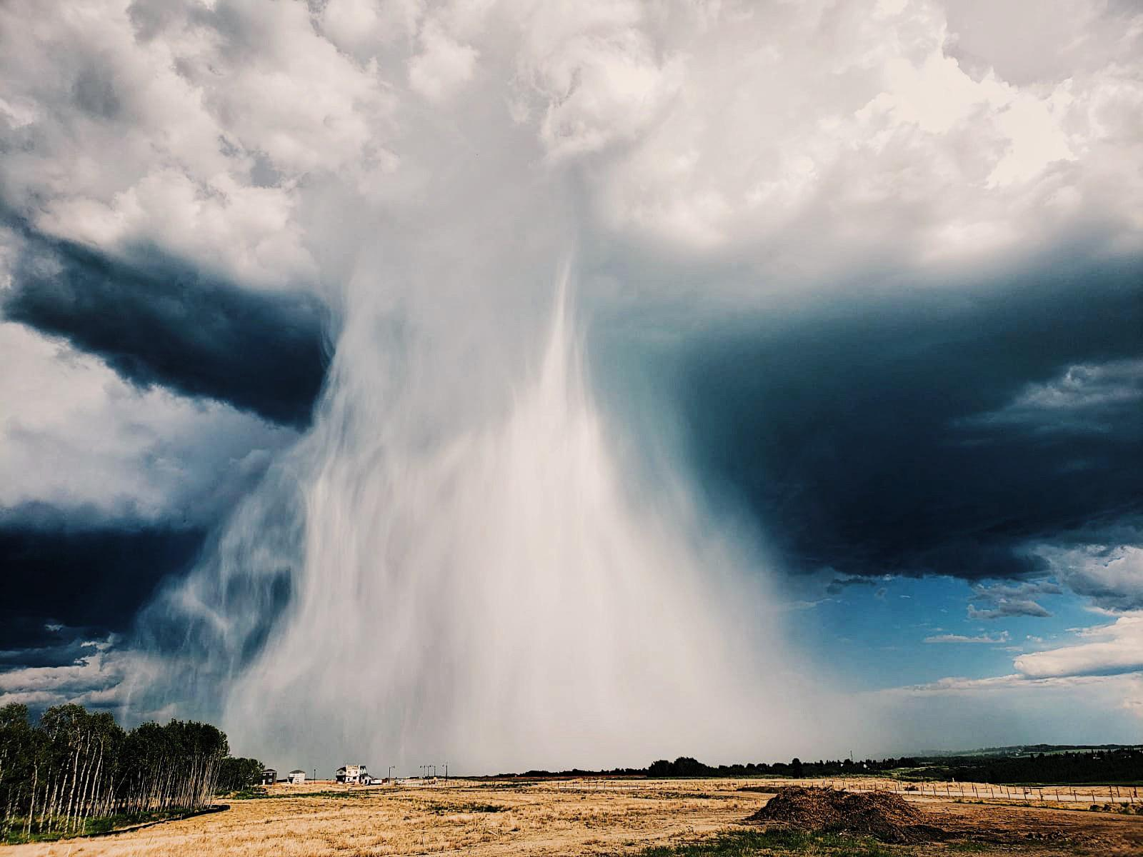

Slide 56
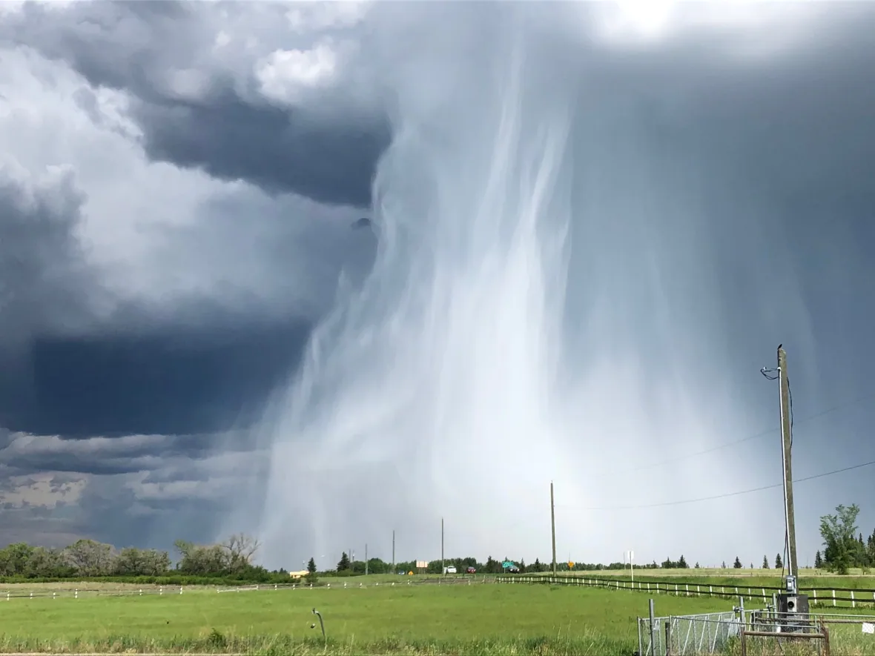

Slide 57
Formalized by very simple model whose variables are:
Dry static energy
Moist static energy
PBL depth
Entrainment velocity
Surface sensible heat flux
Surface latent heat flux
Agard and Emanuel, J. Atmos. Sci., 2017

Slide 58
Boundary Layer Equations
Dry static energy
Moist static energy
Lilly’s entrainment formulation
Surface sensible heat flux
Surface latent heat flux
Net surface flux
Boundary layer mass

Slide 59
Note: M_{s} is related to D_{s} by Clausius-Clapeyron Equation
Initial conditions:
M (t=0) = D₀
D (t=0) determined so that air is just saturated at boundary layer top
h=h₀
Initial dry static energy of free troposphere

Slide 60
Nondimensionalize:

Slide 61
Equations are normalized and recombined to arrive at
Determined so that air is initially just saturated at boundary layer top

Slide 62
Long-time Asymptotic Behavior
CAPE reaches a maximum at a particular time and then falls to zero at a later time, while the boundary layer depth goes to infinity at the later time and D, D_{s}, and M approach unity. T_{s} is the surface air temperature of the initial dry state.
CAPE still reaches a peak at a particular time and then falls off to or asymptotes to a positive long-time asymptotic value. The asymptotic limits are given by

Slide 63
Convective Available Potential Energy
(CAPE)
T_{top} determined by fixed anvil temperature hypothesis

Slide 64
Asymptotic Cape Scaling in ‘Warm’ Regime, Applicable at Time when PBL Growth Becomes Linear
CAPE rises exponentially with surface temperature
CAPE increases with increasing surface wind
CAPE increases with increasing soil moisture
For a given surface temperature, CAPE declines with absorbed solar radiation

Slide 65
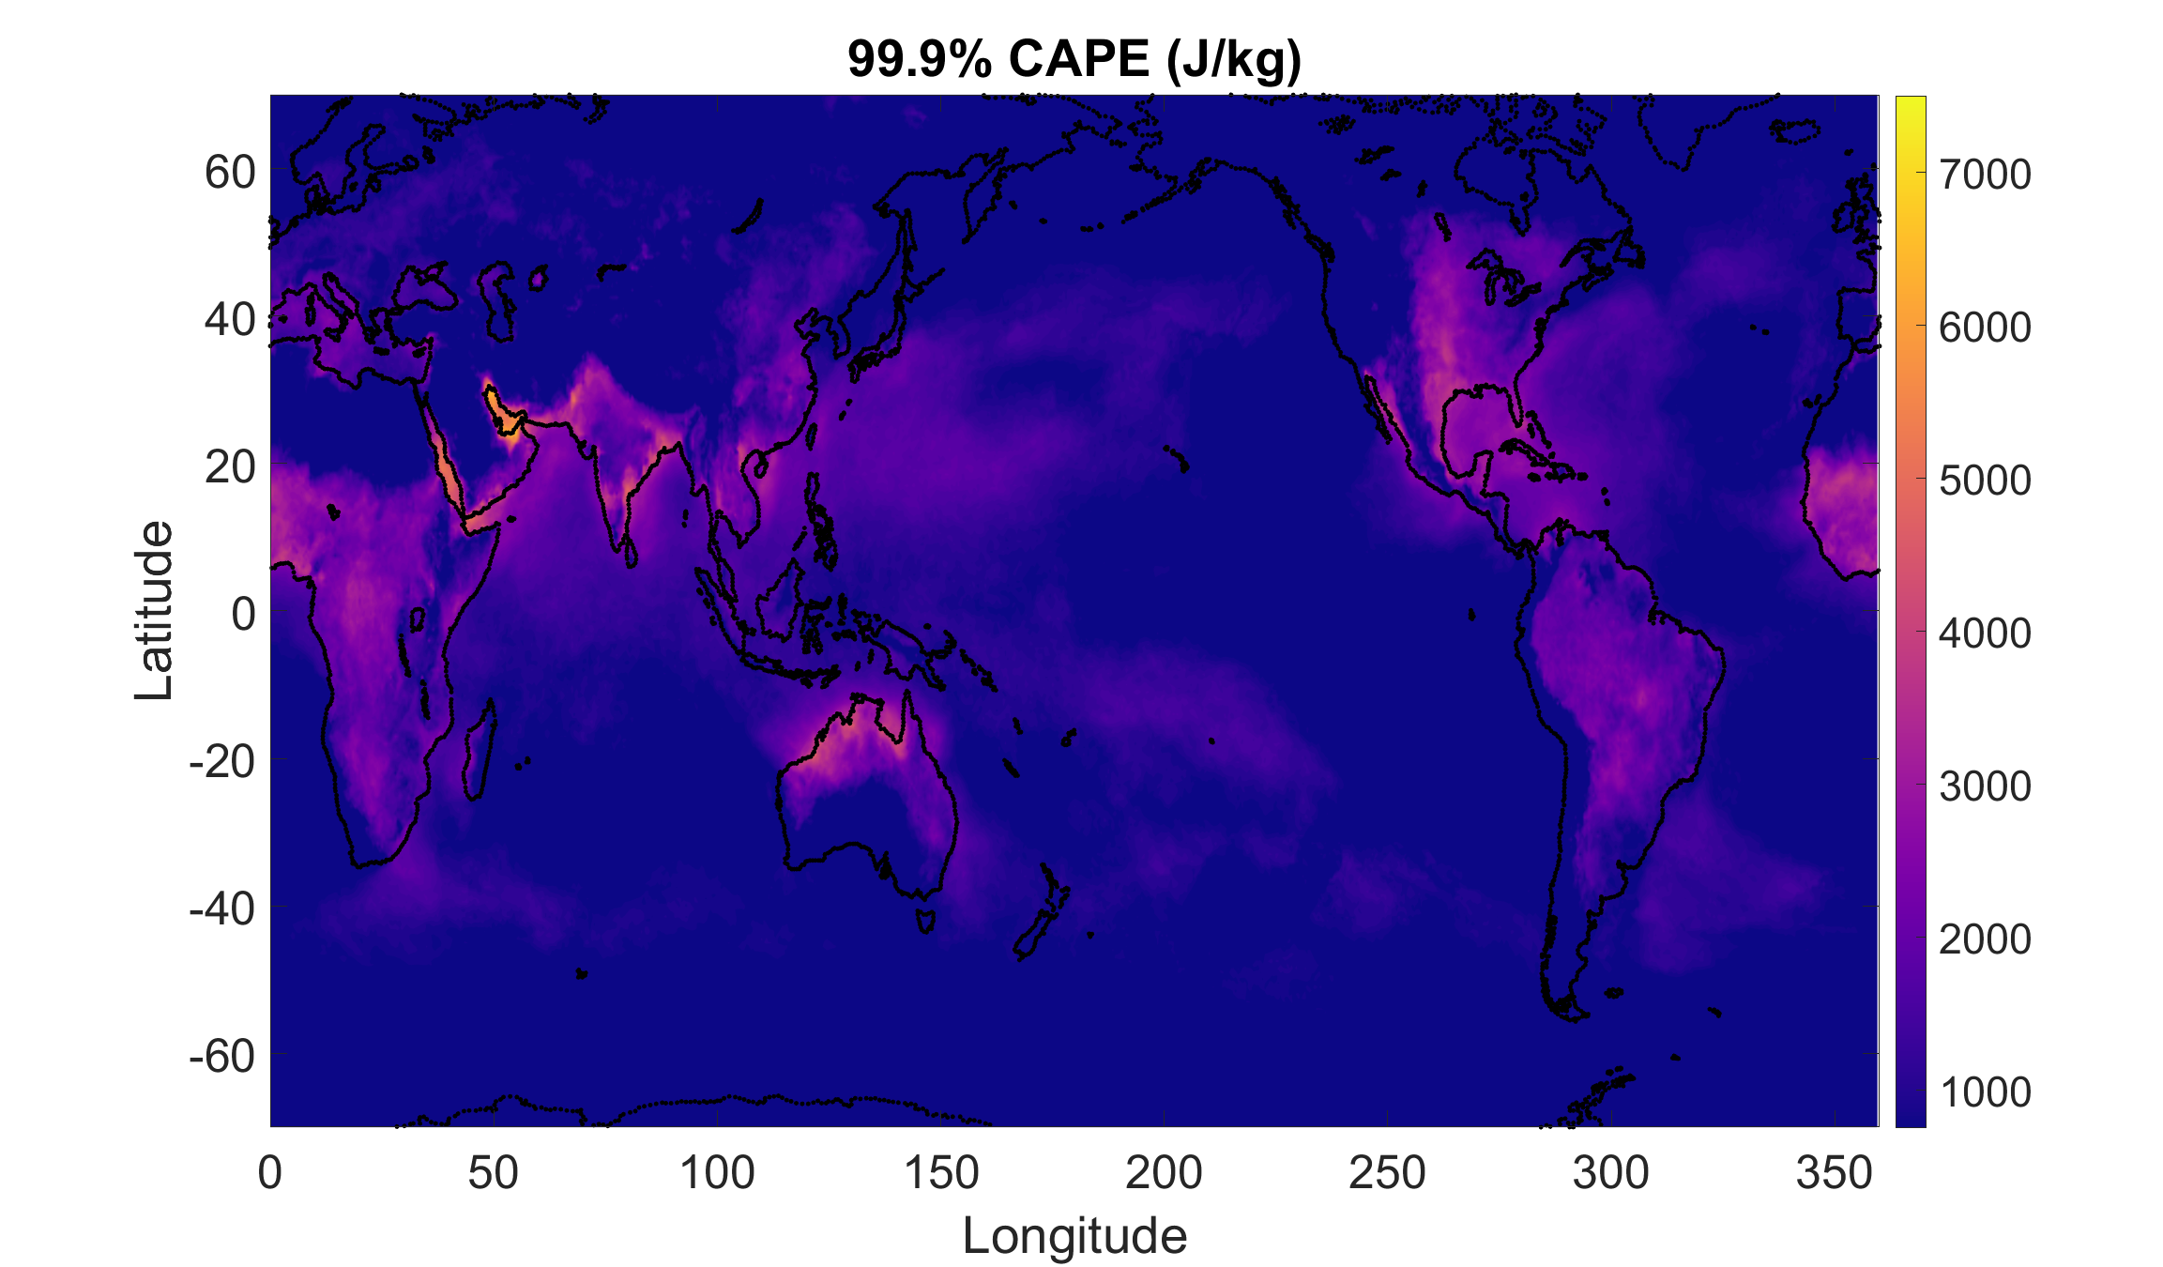
99.9% quantile of non-zero CAPE from ERA5 reanalysis hourly data over a single year. Courtesy PJ Tuckman, MIT

Slide 66
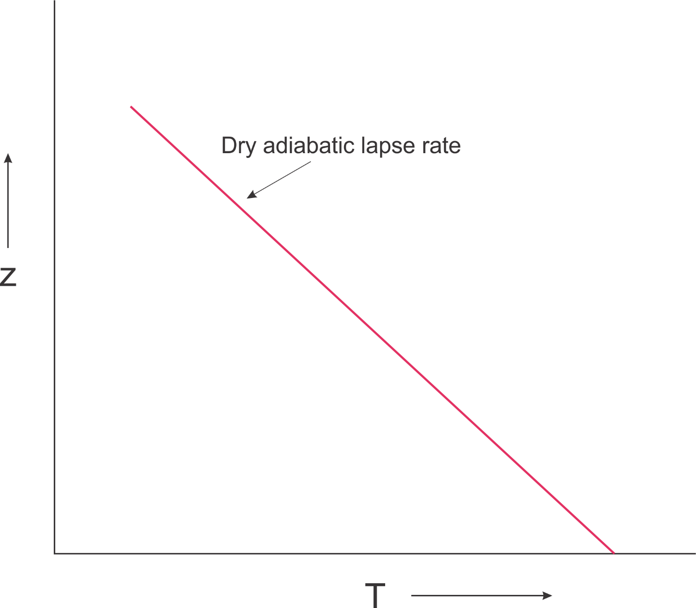

Slide 67
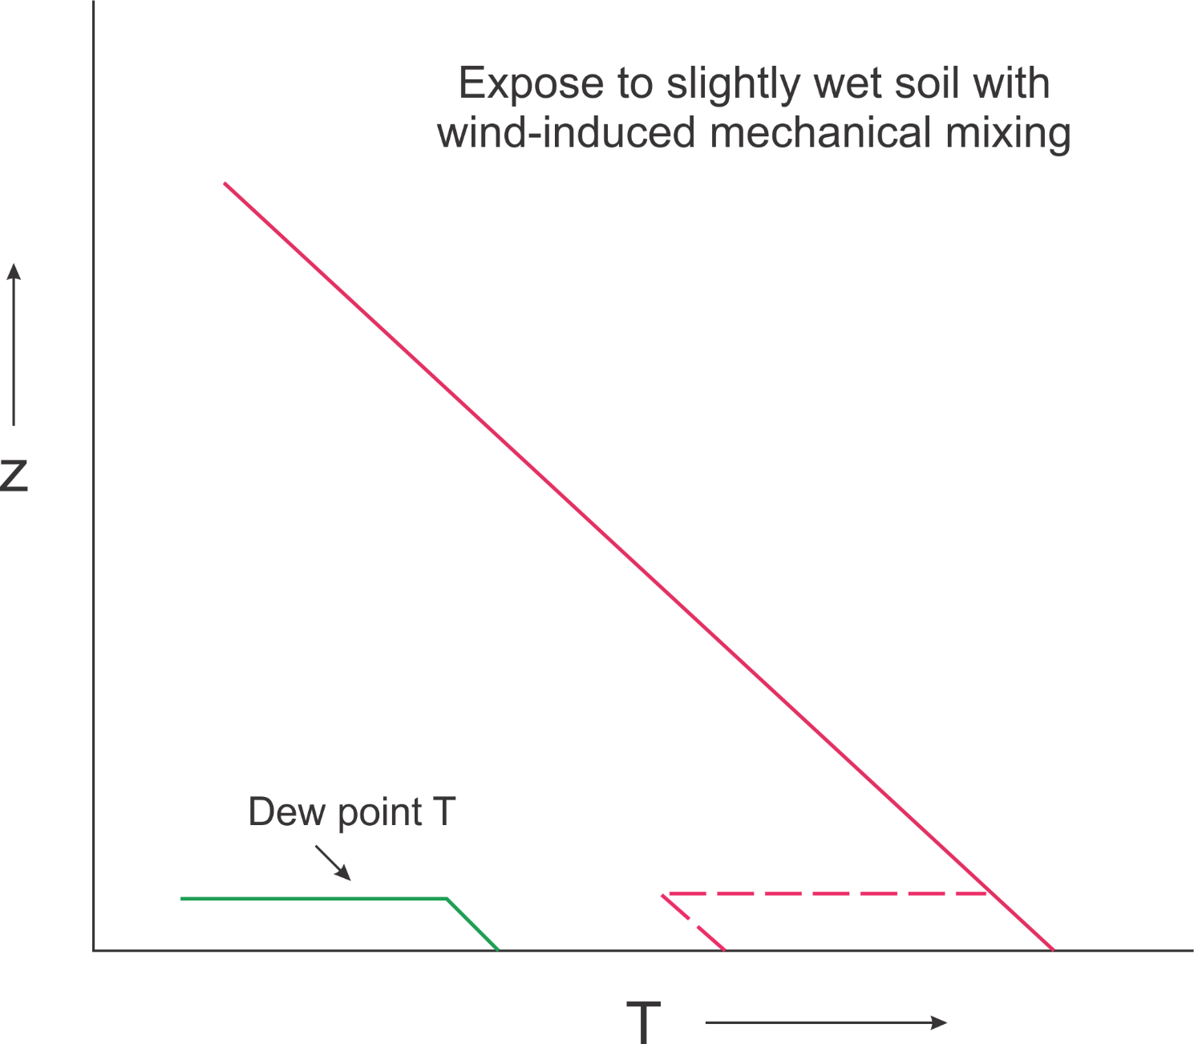

Slide 68
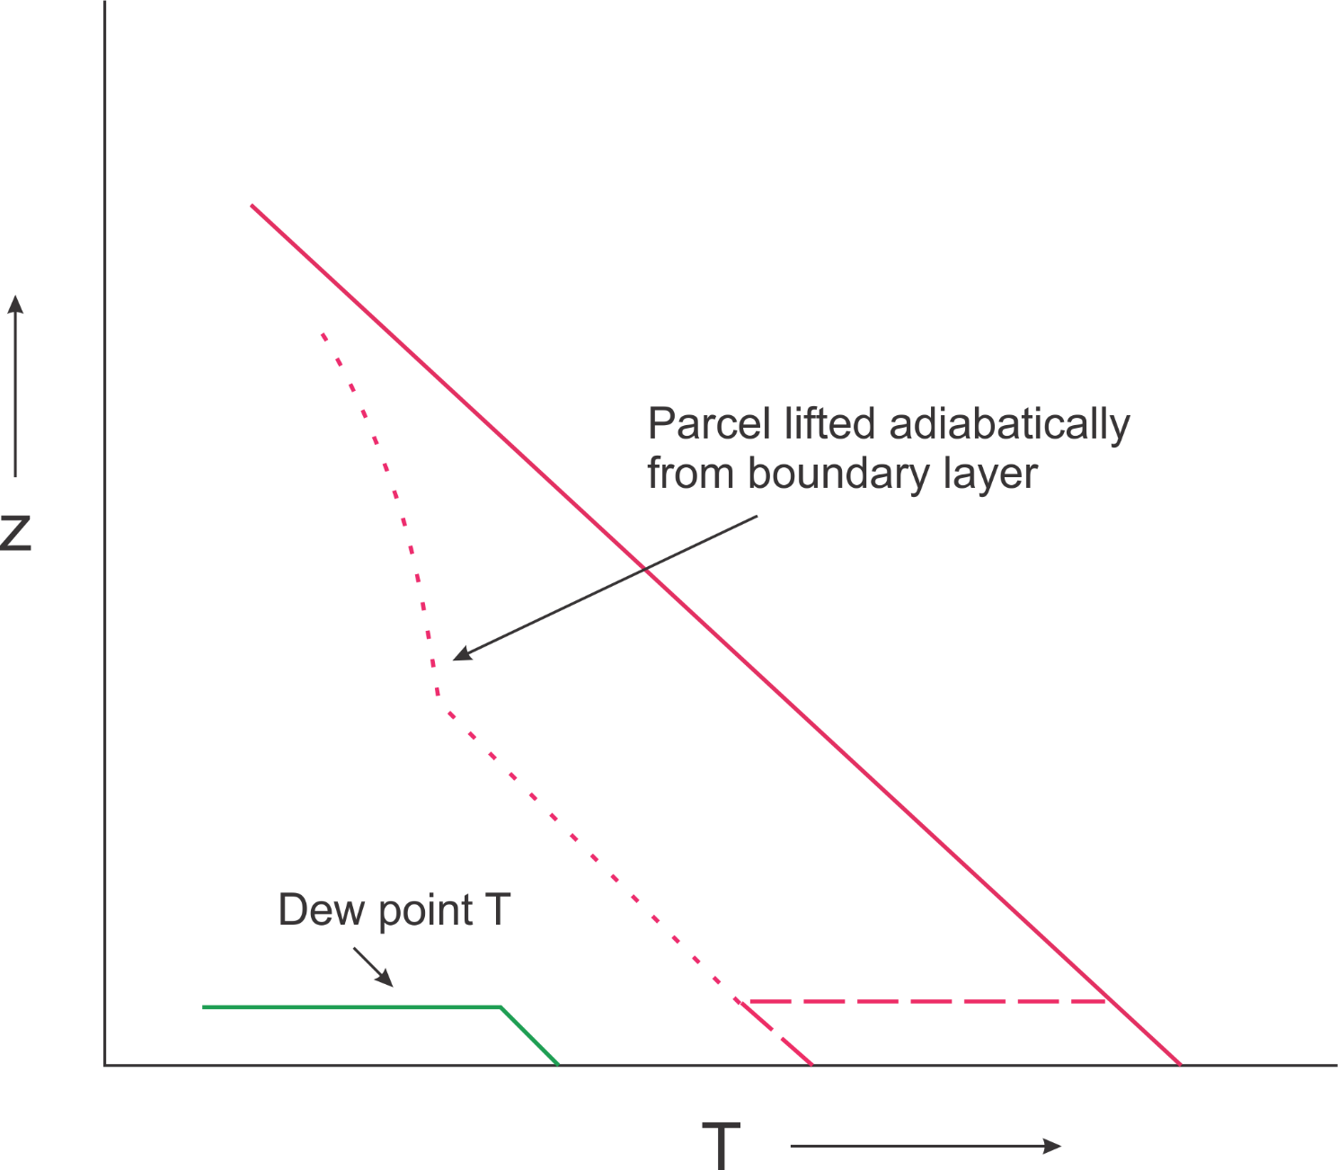

Slide 69
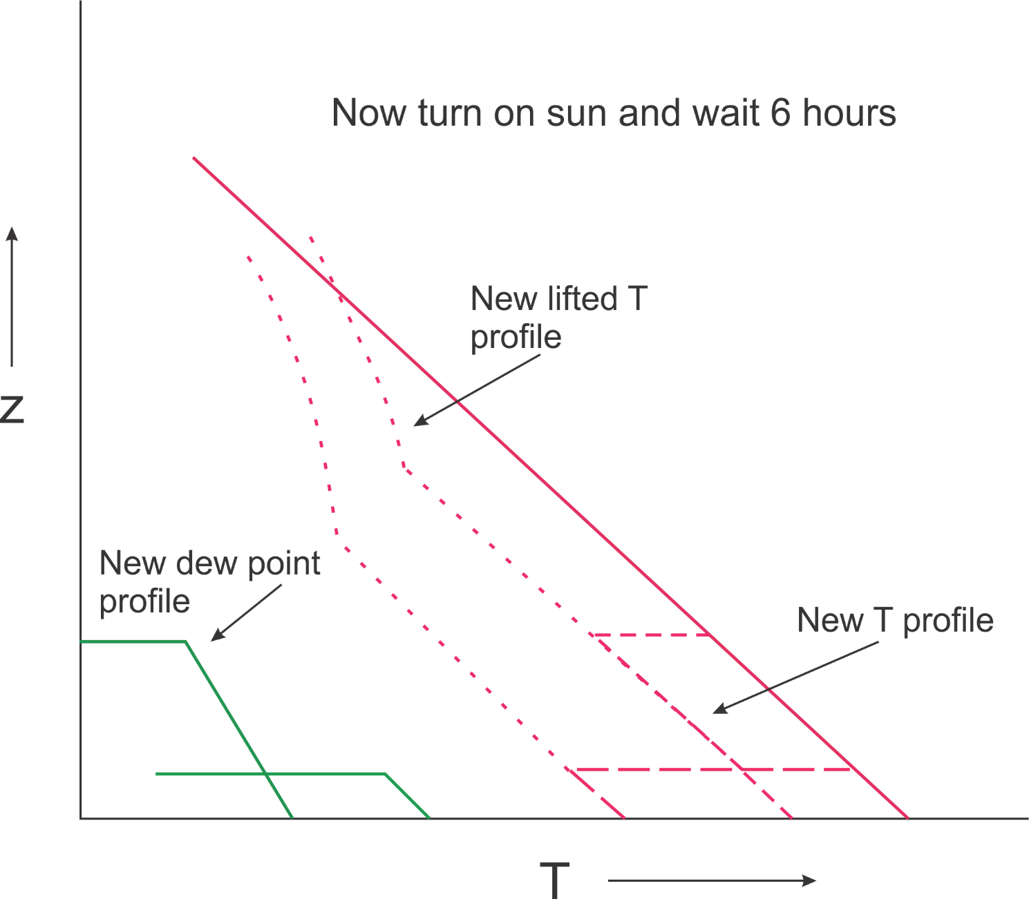

Slide 70
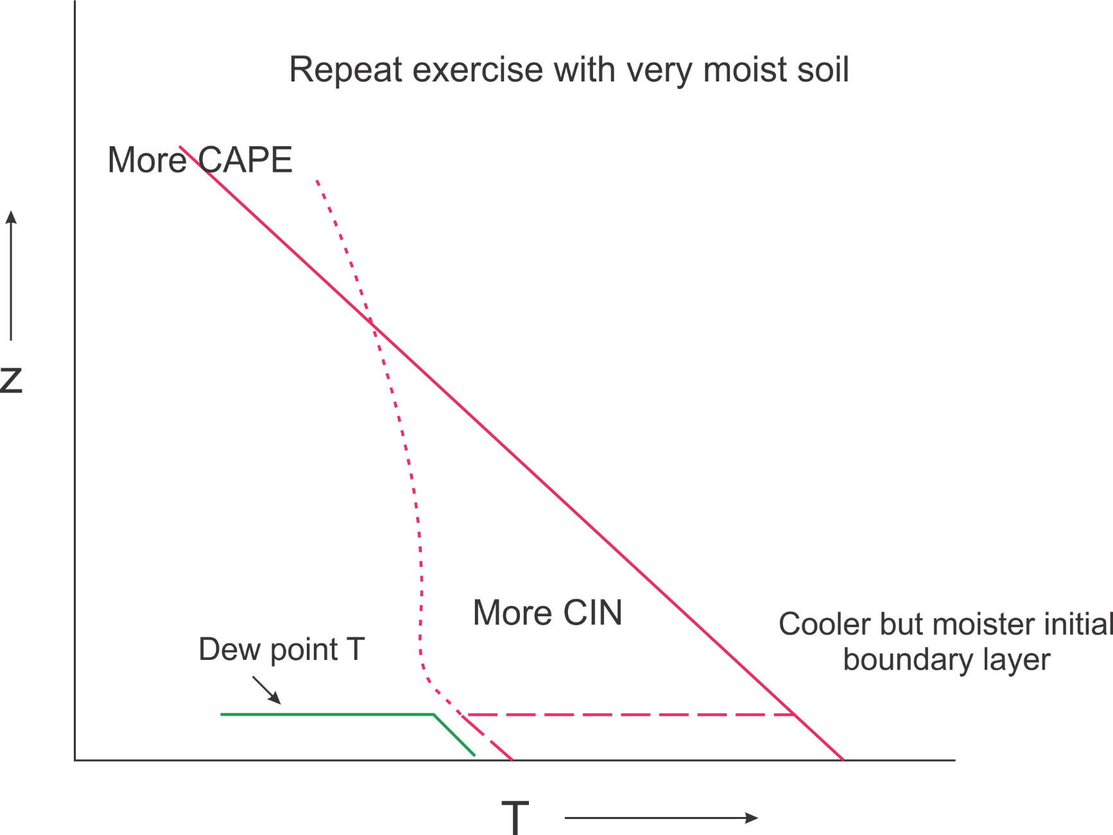

Slide 71
