Slide 1
Sulfate Aerosols and the Late 20th Century North Atlantic Hurricane Drought
Kerry Emanuel
Lorenz Center
Massachusetts Institute of Technology

Slide 2
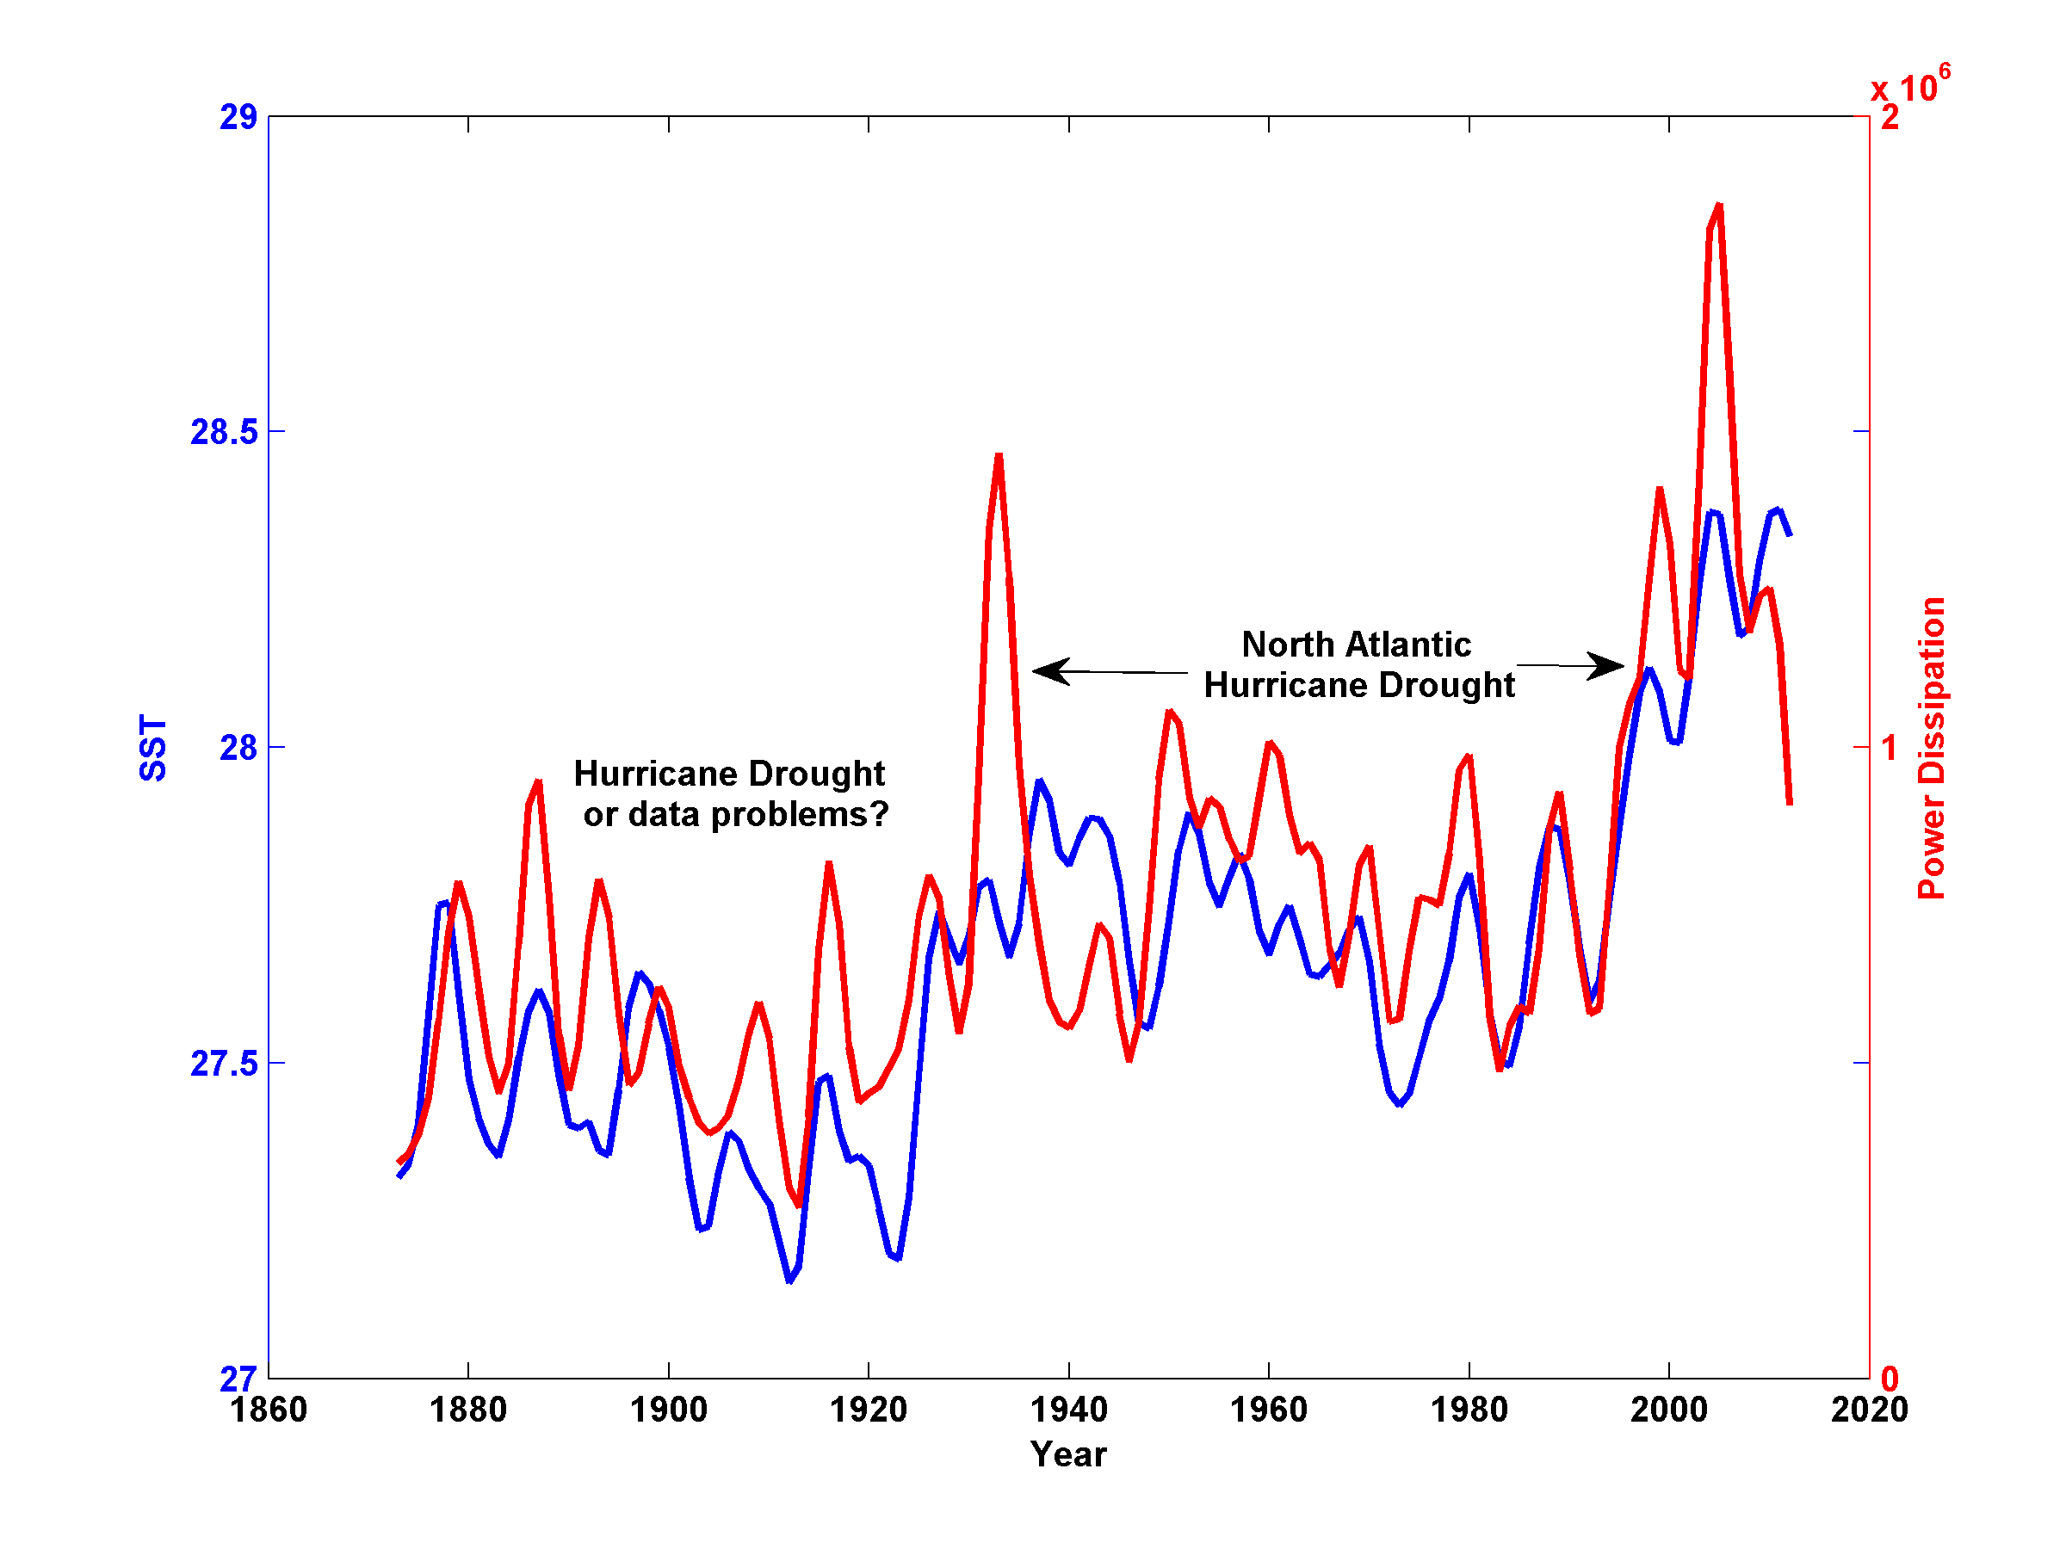
August-October MDR SST and Storm Lifetime Maximum Power Dissipation

Slide 3
U.S. Landfall Power Dissipation

Slide 4
Sulfate Aerosols and North Atlantic Hurricanes
During the late 20th Century, global aerosol radiative forcing is thought to be of the same order as CO₂ radiative forcing
Per unit sea surface temperature change, shortwave forcing is roughly twice as effective as longwave forcing in changing potential intensity
Much of the interannual variability of aerosol forcing over the tropical North Atlantic in summer is thought to be owing to the interaction of sulfate aerosols of European origin with African dust (Li-Jones and Prospero, 1998)

Slide 5
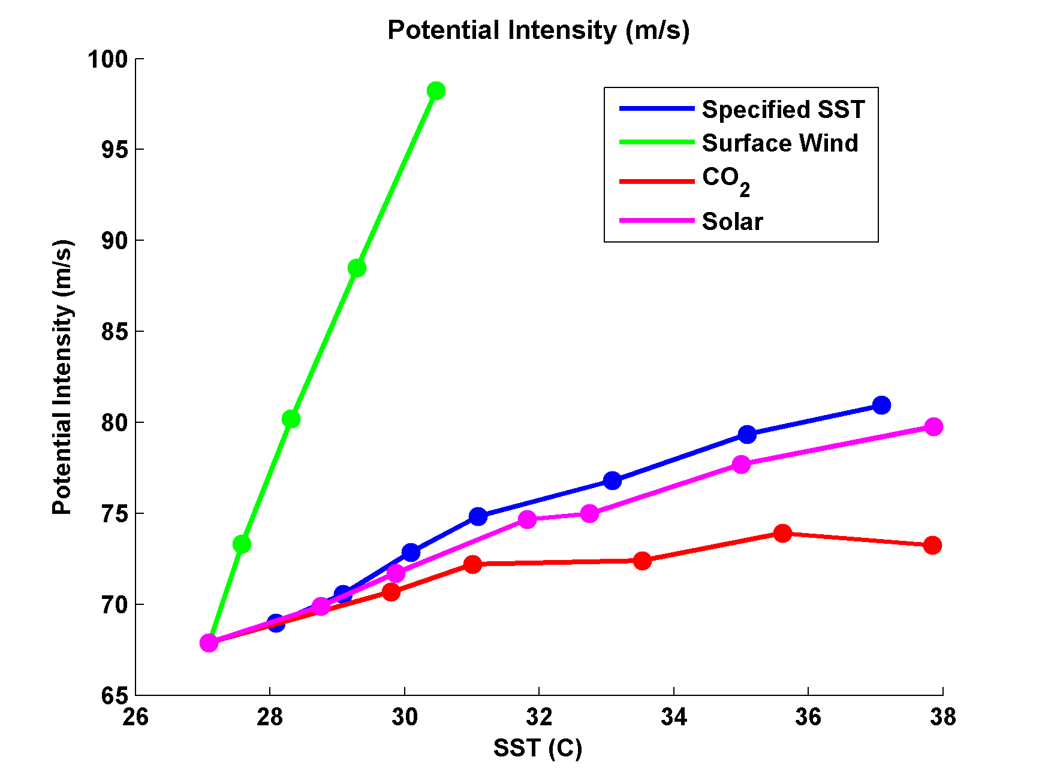
Variation of Potential Intensity with Ocean Heat Flux, Surface Wind Speed, CO₂, and Solar Forcing
Emanuel, K., and A. Sobel, 2013: Response of tropical sea surface temperature, precipitation, and tropical cyclone-related variables to changes in global and local forcing. J. Adv. Model. Earth Sys., 5, doi:10.1002/jame.20032

Slide 6
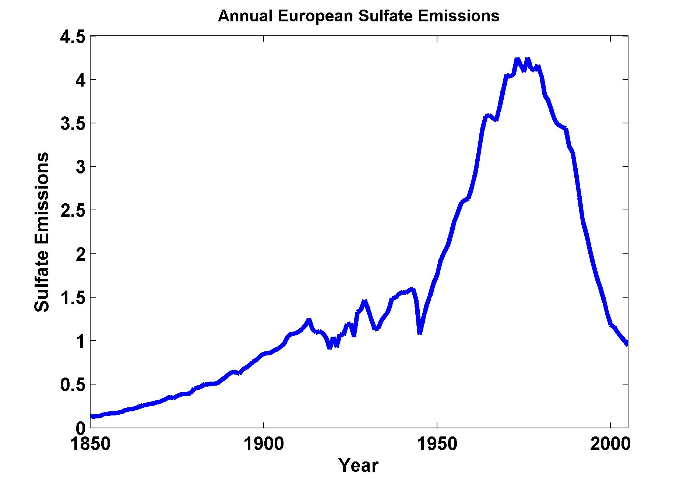

Slide 7
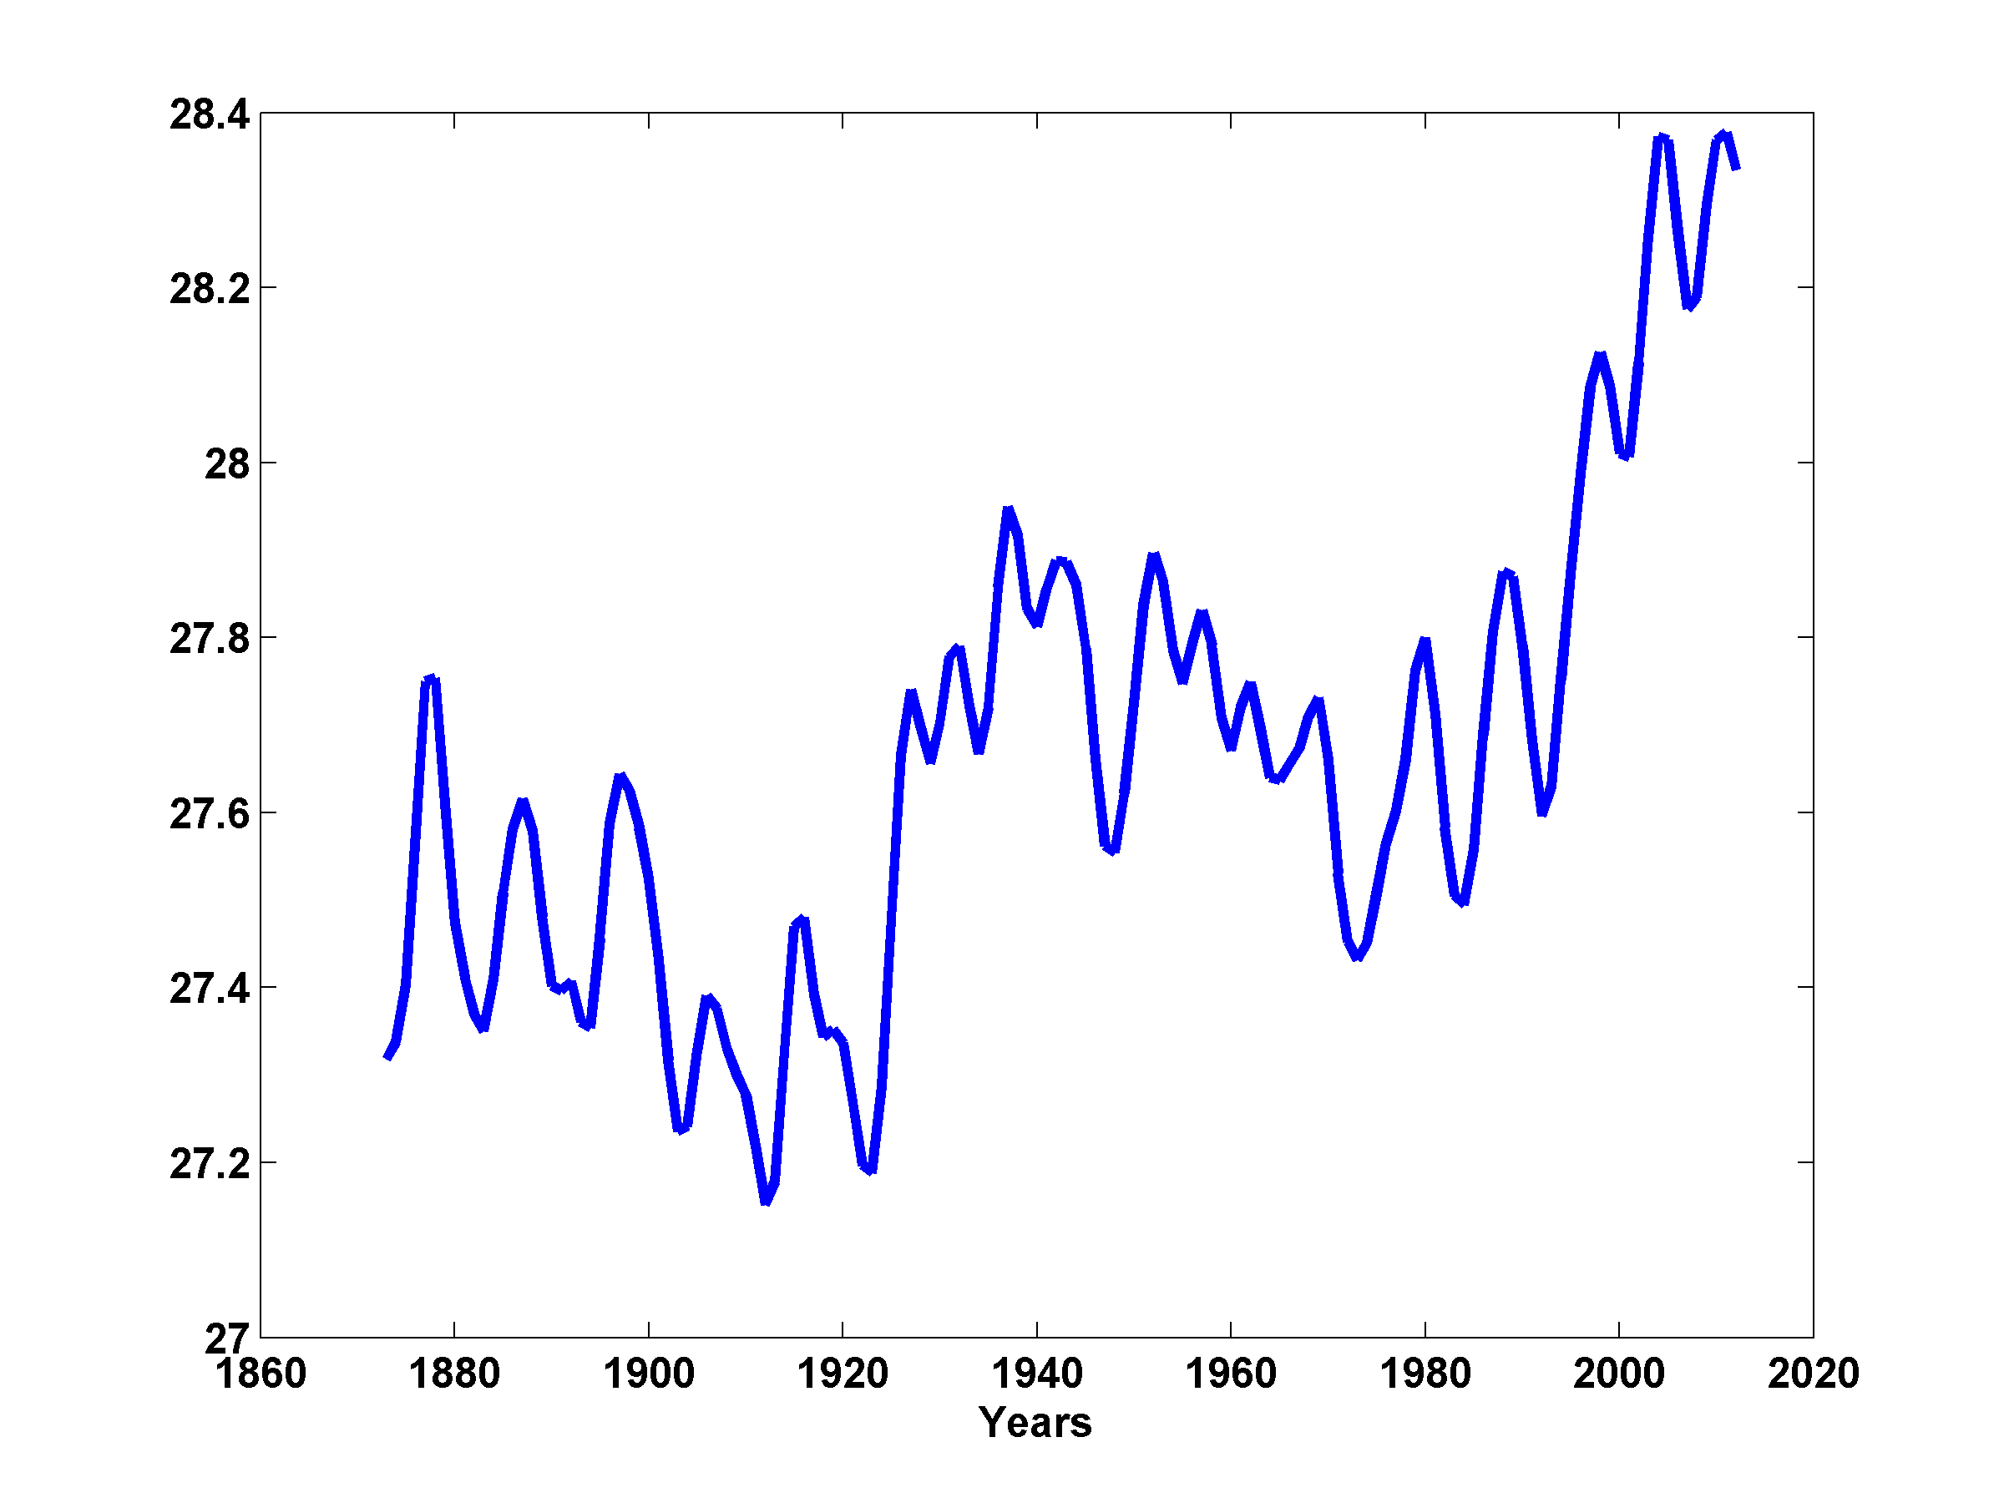
August-October MDR SST

Slide 8
Hypothesis:
Multi-decadal variability of North Atlantic hurricane activity in the late 20th Century is owing to variations in shortwave and longwave radiative forcing
Residual quasi-decadal hurricane variability is owing to a natural oscillatory mode of the North Atlantic, nominally equivalent to the Atlantic Multi-Decadal Oscillation (AMO)

Slide 9
Test:
Separate North Atlantic Storm Maximum Power Dissipation into two parts: a) Long-period variability (10-year running average) and b) quasi-decadal variability (residual)
Use multiple linear regression to regress long-period signal onto 20-year lagged log(CO₂) and European sulfate emissions
Correlate residual (quasi-decadal) signal in storm maximum power dissipation with North Atlantic potential intensity from NCEP reanalysis

Slide 10
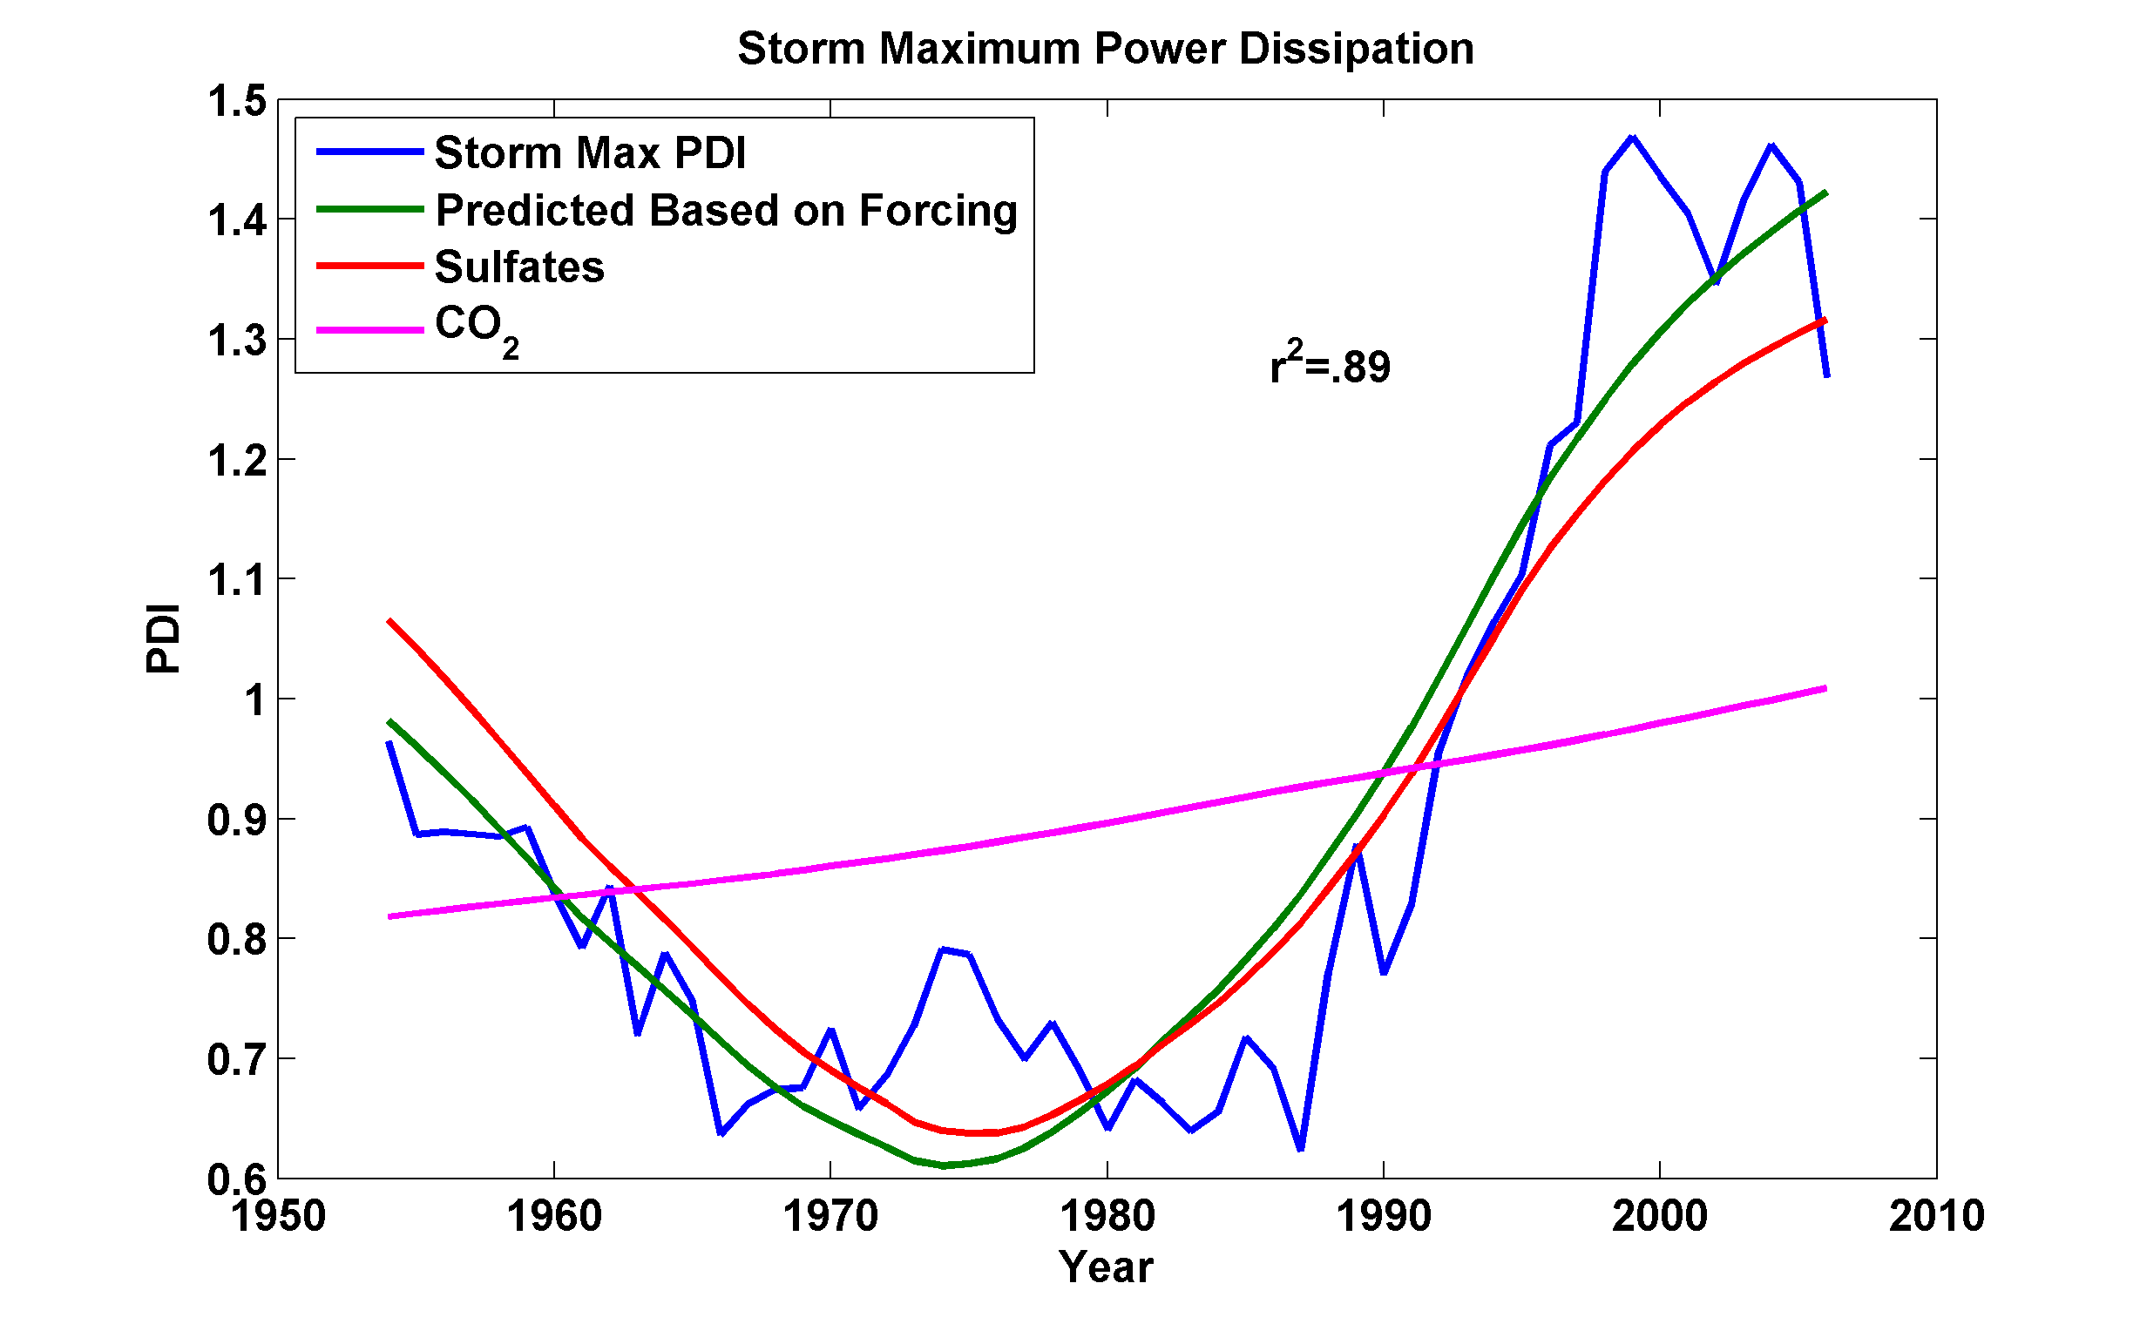
Linearly regress European sulfates and log (CO₂) onto low-pass-filtered storm maximum power dissipation

Slide 12
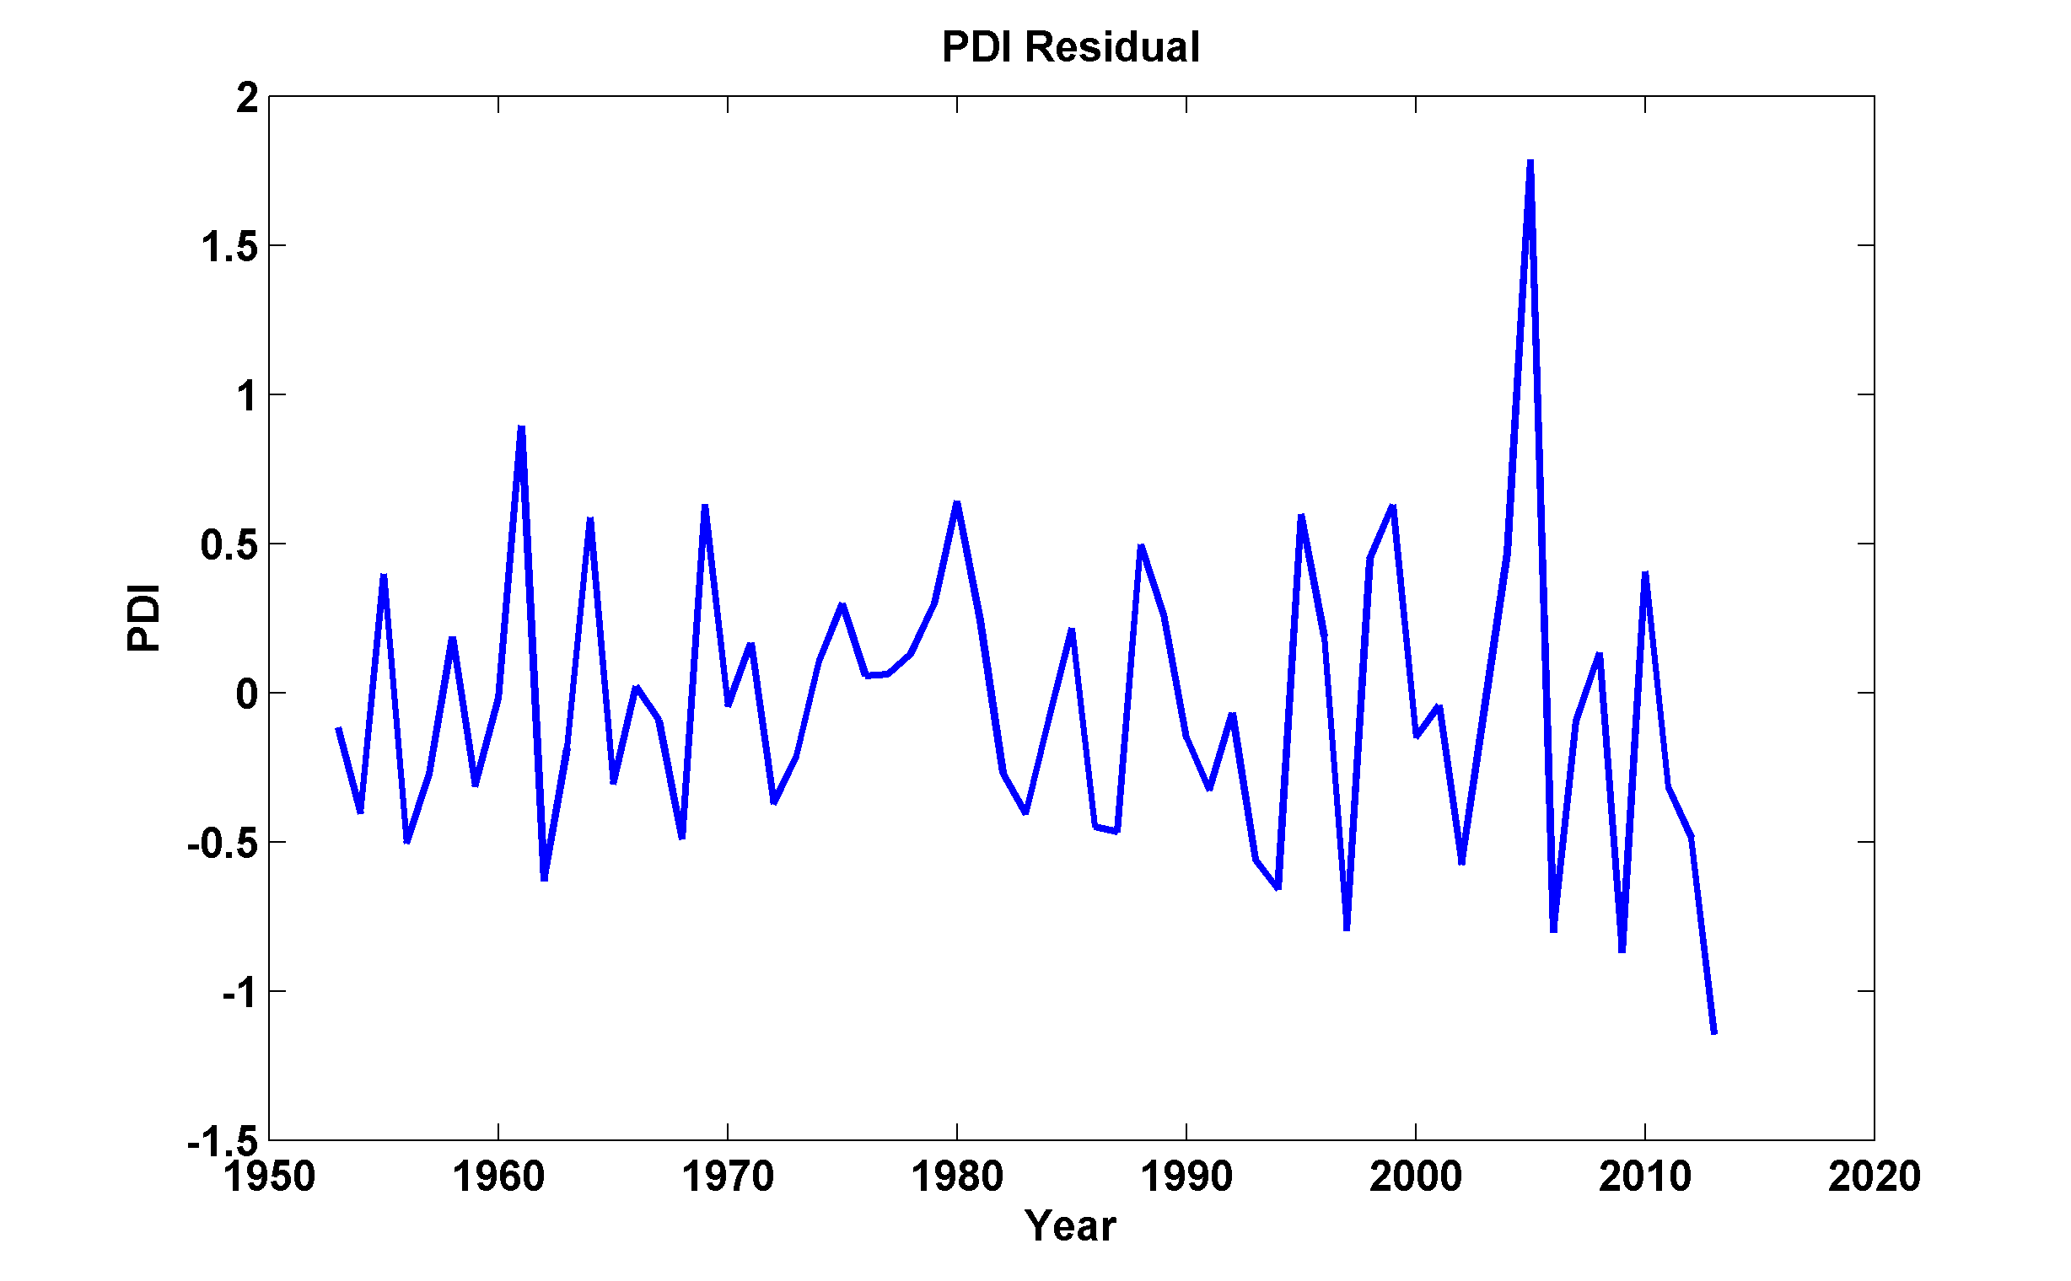
Spectral peak at ~6 years

Slide 14
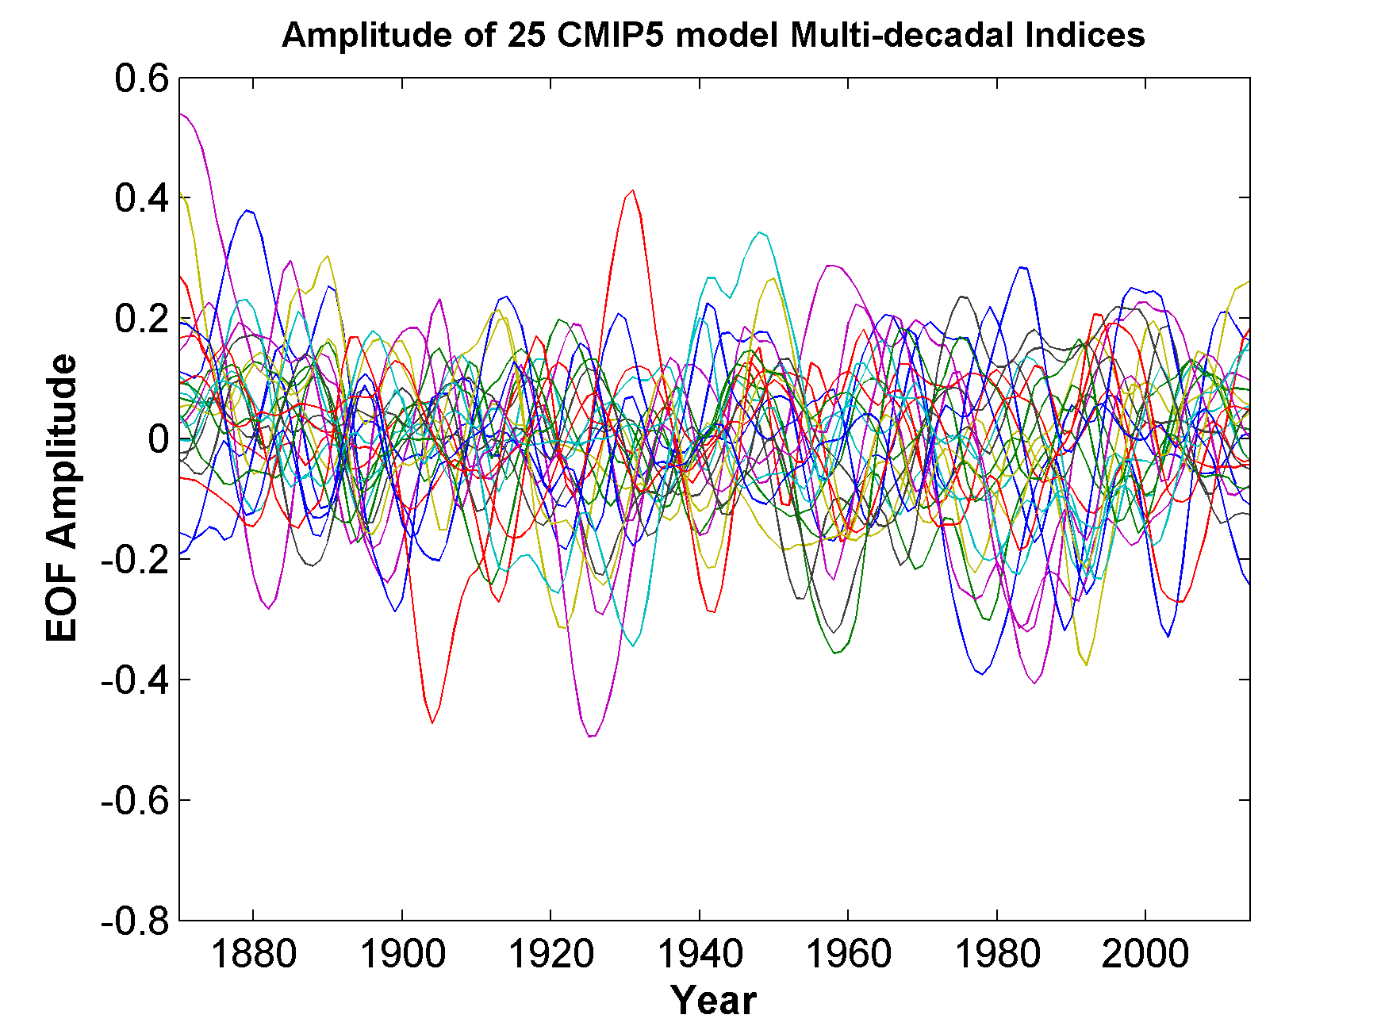
Multi-decadal Variability in 25 CMIP5 Climate Models
Spectral peaks from 5 to 20 years
From Ting et al, J. Climate, 2015. Data courtesy Mingfang Ting.

Slide 15
CMIP5 multi-decadal signal regressed onto potential intensity
From Ting et al, J. Climate, 2015. Data courtesy Mingfang Ting.

Slide 16
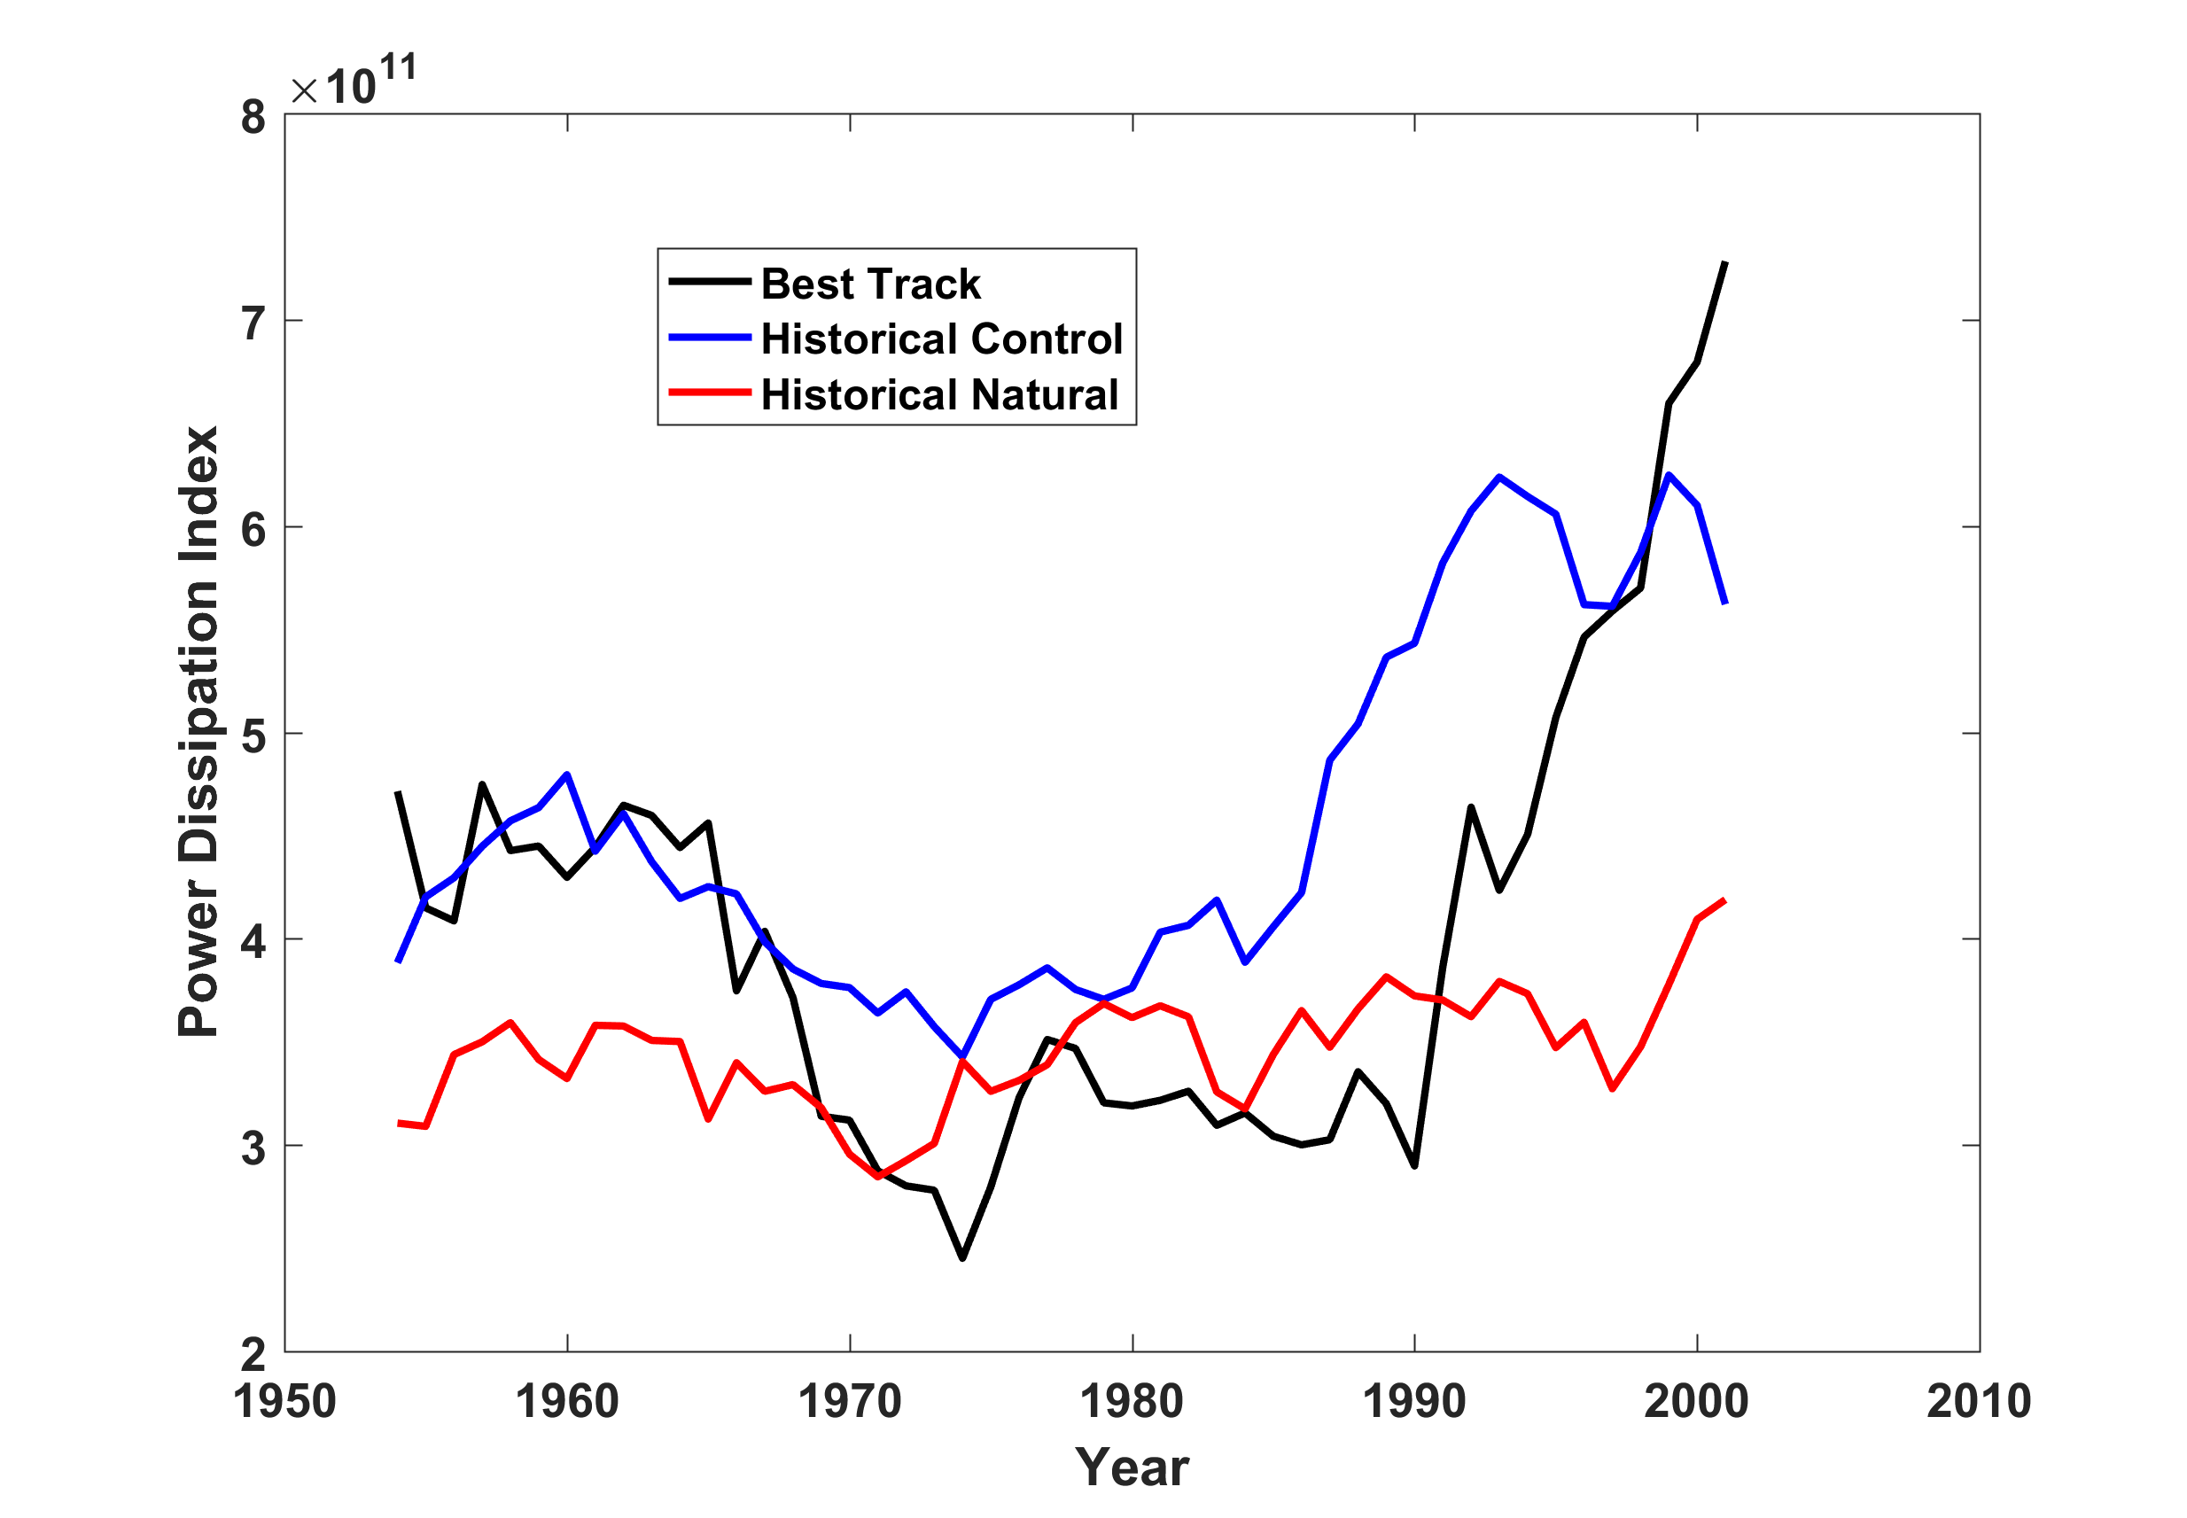
Results from downscaling tropical cyclones from HADGEM2-ES, 1950-2005, 100 North Atlantic events per year

Slide 17
Summary
A pronounced “hurricane drought” affected the North Atlantic from the 1960s through the early 1990s
Hurricane power dissipation during this period was strongly inversely correlated with European sulfur emissions
Spatial pattern of potential intensity projected onto hurricane power dissipation consistent with strong radiative forcing over the main development region
Spatial pattern of residual potential intensity changes, with multi-decadal signal removed, consistent with CMIP5 signatures of Atlantic quasi-decadal natural variability
Of 7 CMIP5 models downscaled, only the HADGEM model captures the Atlantic hurricane drought

