Slide 1

Impending. Oil painting by American artist Amy Marx
The Voice of the Sea is never one voice, but a tumult of many voices—voices of drowned men,—the mutterings of multitudinous dead,—the moaning of innumerable ghosts, all rising, to rage against the living, at the great Witch-call of storms….—Lafcadio Hearn (1850–1904), Chita: A Memory of Last Island

Slide 2

Hurricane Science
Kerry Emanuel
Massachusetts Institute of Technology
Notes:
2

Slide 3

Program
Overview of Tropical Cyclones
What processes control rates of formation of tropical cyclones?
What have TCs been like in the past, and how will they be affected by global warming?

Slide 4

Brief Overview of Tropical Cyclones
Notes:
4

Slide 5
What is a Hurricane?
Formal definition: A tropical cyclone with 1-min average winds at 10 m altitude in excess of 32 m/s (64 knots or 74 MPH) occurring over the North Atlantic or eastern North Pacific

Slide 6


The word Hurricane is derived from the Mayan word Huracan and the Taino and Carib word Hunraken, a terrible God of Evil, and brought to the West by Spanish explorers
Blow, winds, and crack your cheeks! rage! blow! You cataracts and hurricanoes, spout Till you have drench’d our steeples, drown’d the cocks! -- King Lear

Slide 7
Hurricanes in History

Slide 8
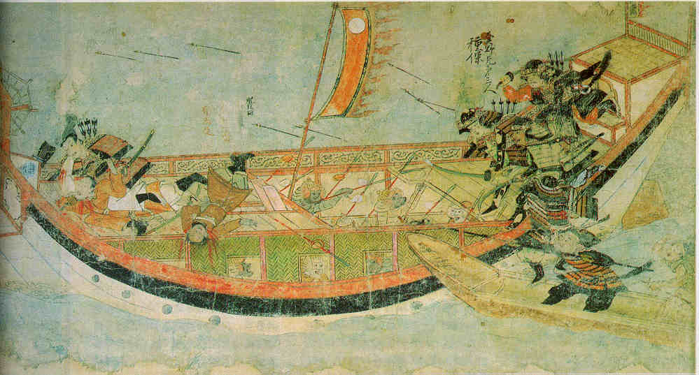
Early historical encounters: The Mongol invasions of Japan in 1274 and 1281
Scene from the 13th century Mongol invasion scrolls, based on a narrative written by the Japanese warrior Takezaki Suenaga.

Slide 9
Galveston, 1900
The opinion held by some who are unacquainted with the actual conditions of things, that Galveston will at some time be seriously damaged by some such disturbance, is simply an absurd delusion
- Isaac Cline, Local Forecast Official and Section Director, U.S Weather Bureau, Galveston, Texas, in The Galveston News, 1891

Slide 10
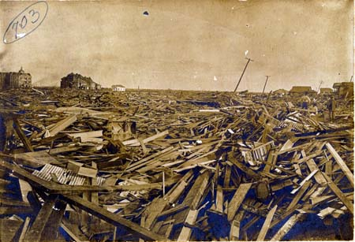
Sunday, September 9, 1900, revealed one of the most horrible sights that ever a civilized people looked upon. - Isaac Cline

Slide 11
The View from Space

Slide 12
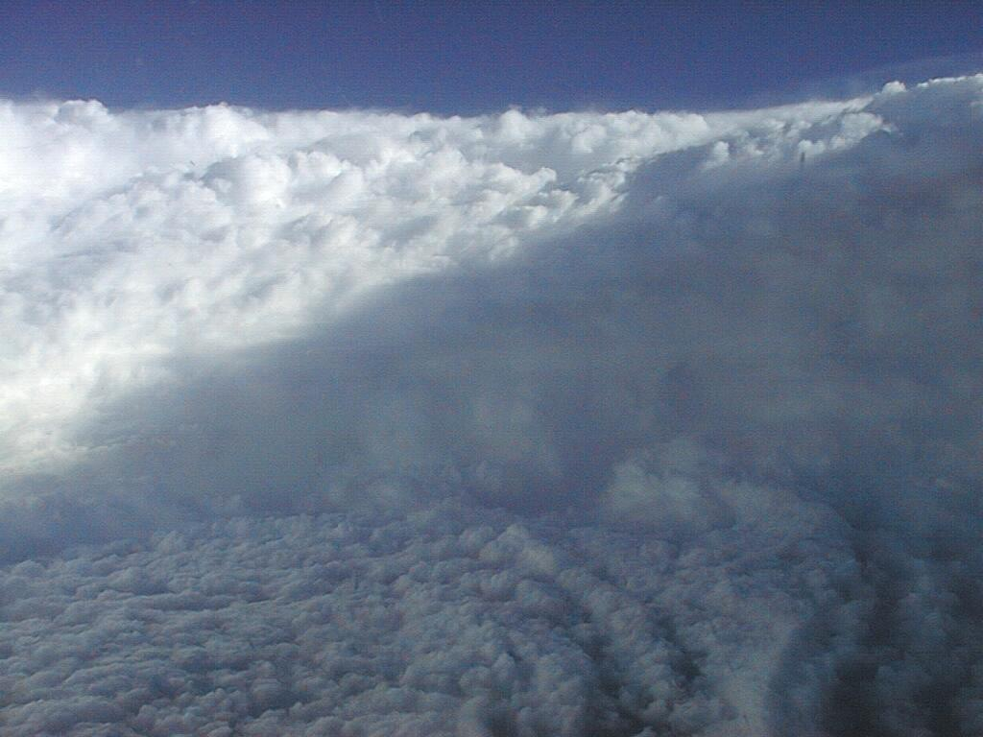

Slide 13
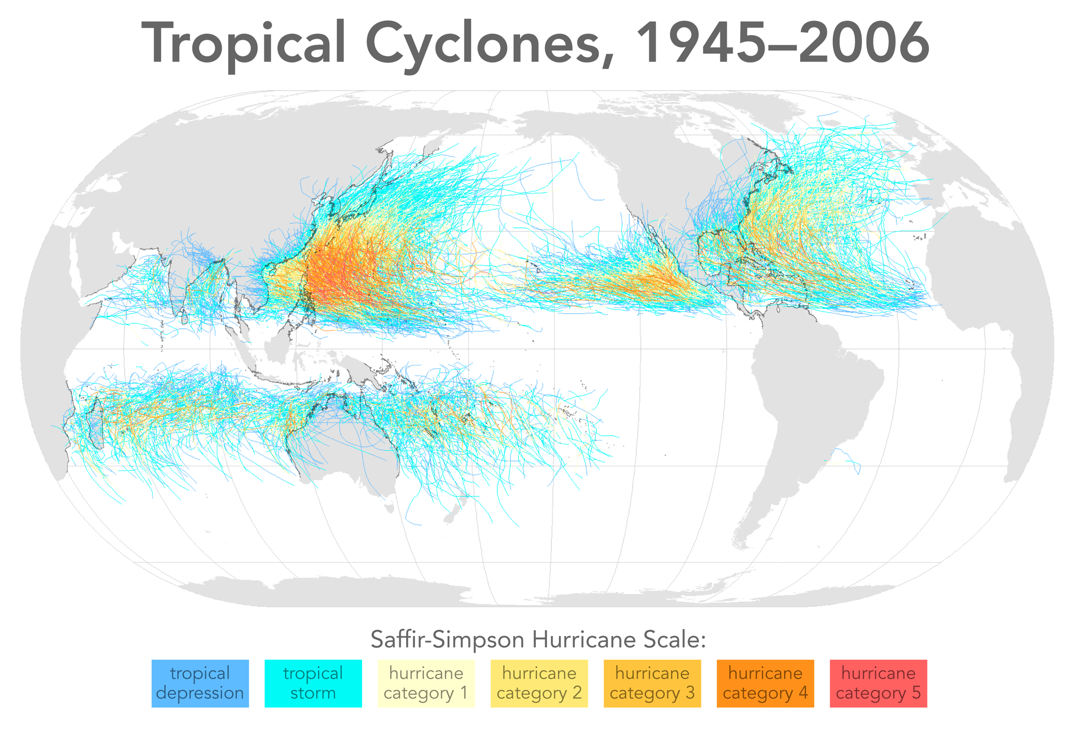

Slide 14
Physics of Mature Hurricanes

Slide 15
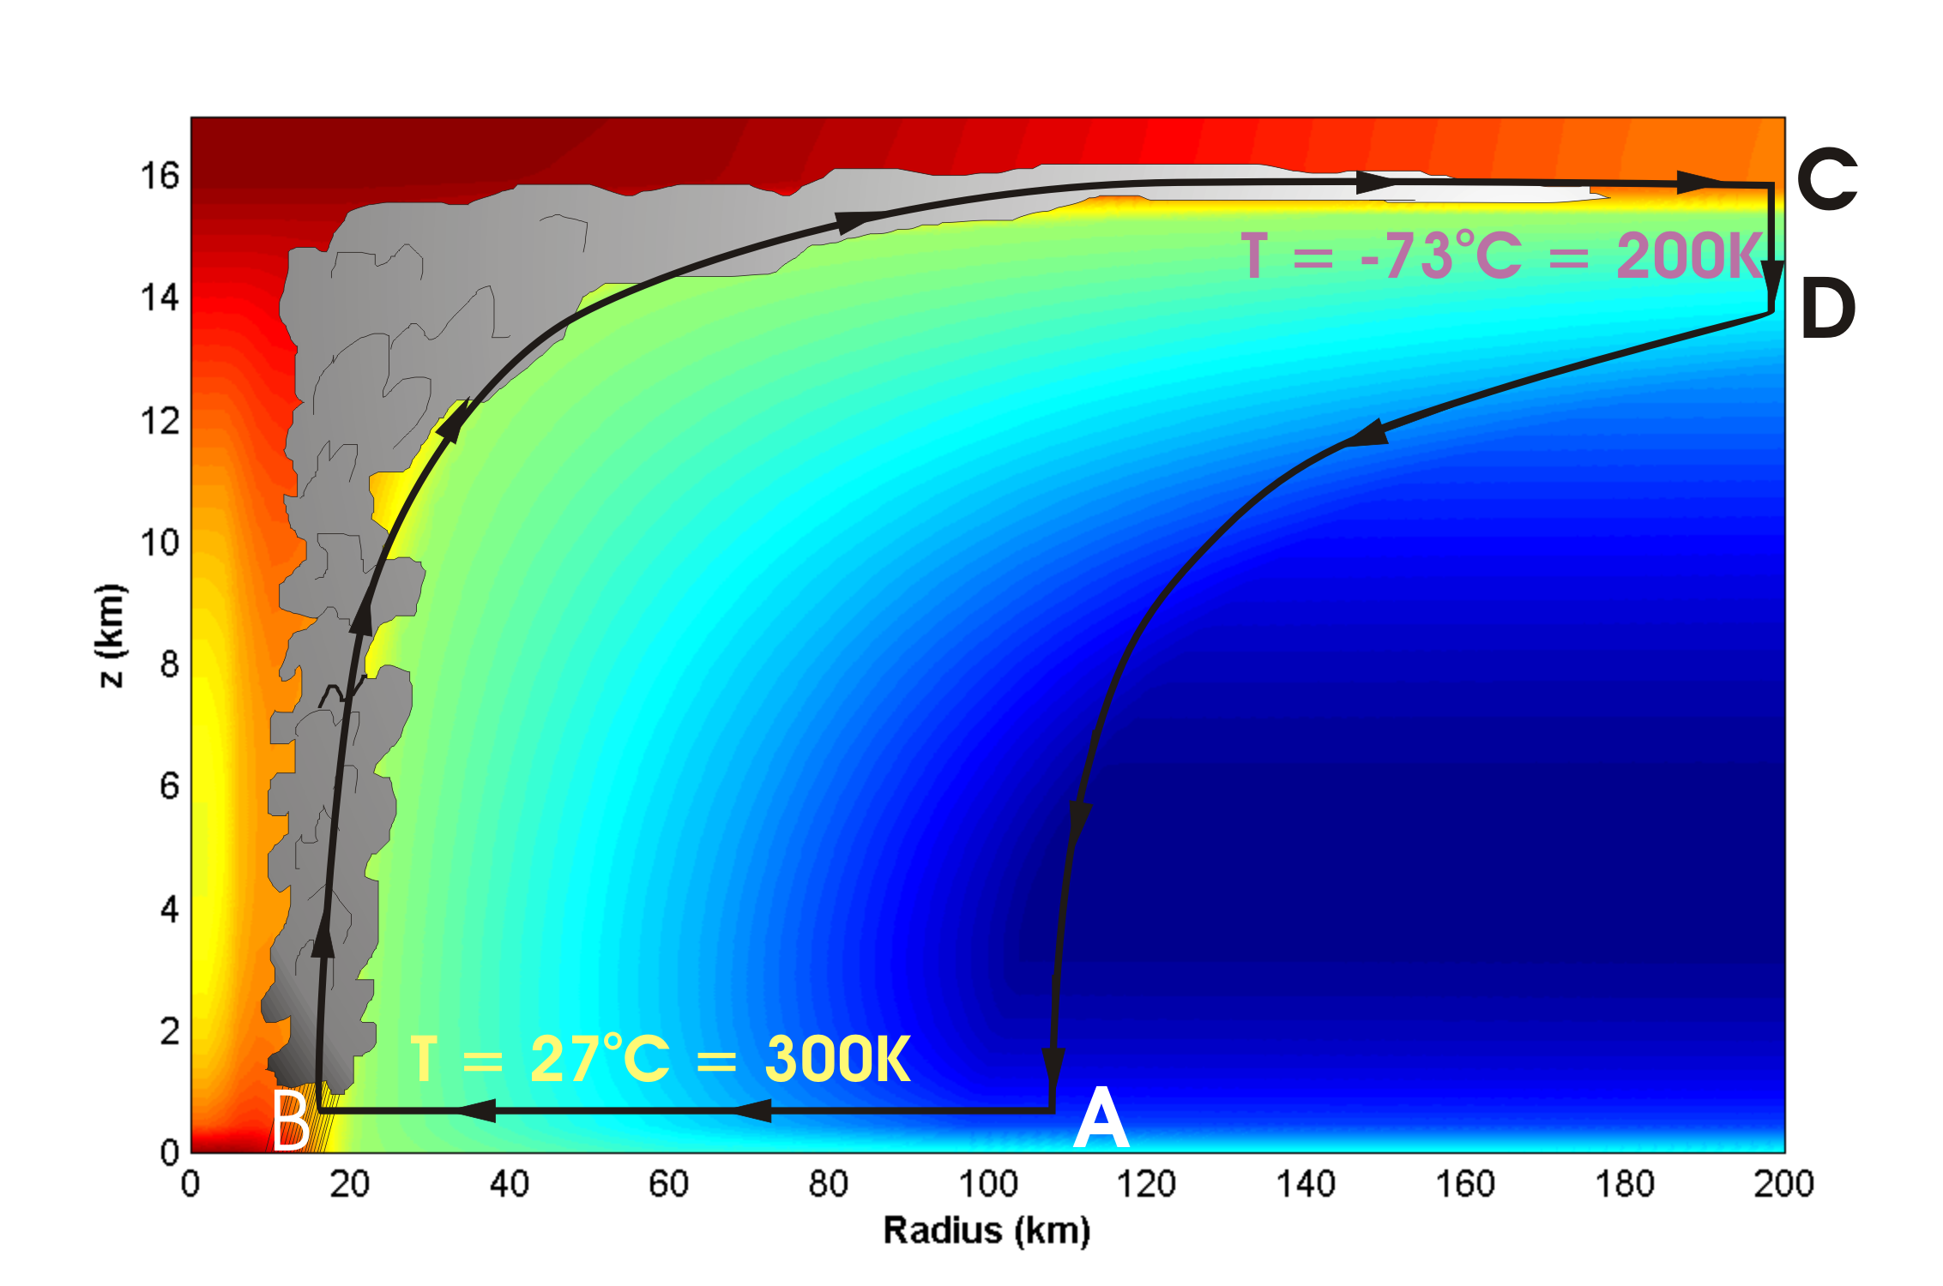
Energy Production

Slide 16
Carnot Theorem: Maximum efficiency results from a particular energy cycle:
Isothermal expansion
Adiabatic expansion
Isothermal compression
Adiabatic compression
Note: Last leg is not adiabatic in hurricane: Air cools radiatively. But since environmental temperature profile is moist adiabatic, the amount of radiative cooling is the same as if air were saturated and descending moist adiabatically.
Maximum rate of energy production:

Slide 17
Theoretical Upper Bound on Hurricane Maximum Wind Speed:
Surface temperature
Ratio of exchange coefficients of enthalpy and momentum
Outflow temperature
Air-sea enthalpy disequilibrium

Slide 18
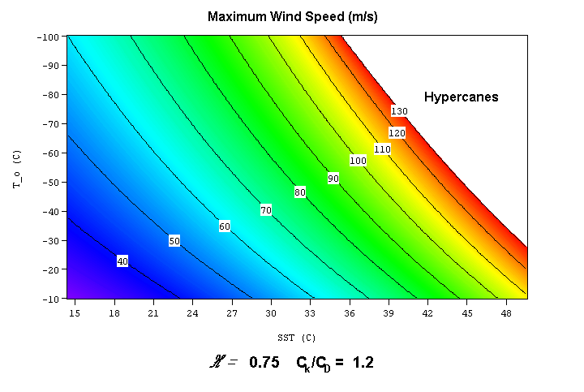

Slide 19
Annual Maximum Potential Intensity (m/s)

Slide 20
The Genesis Puzzle

Slide 21
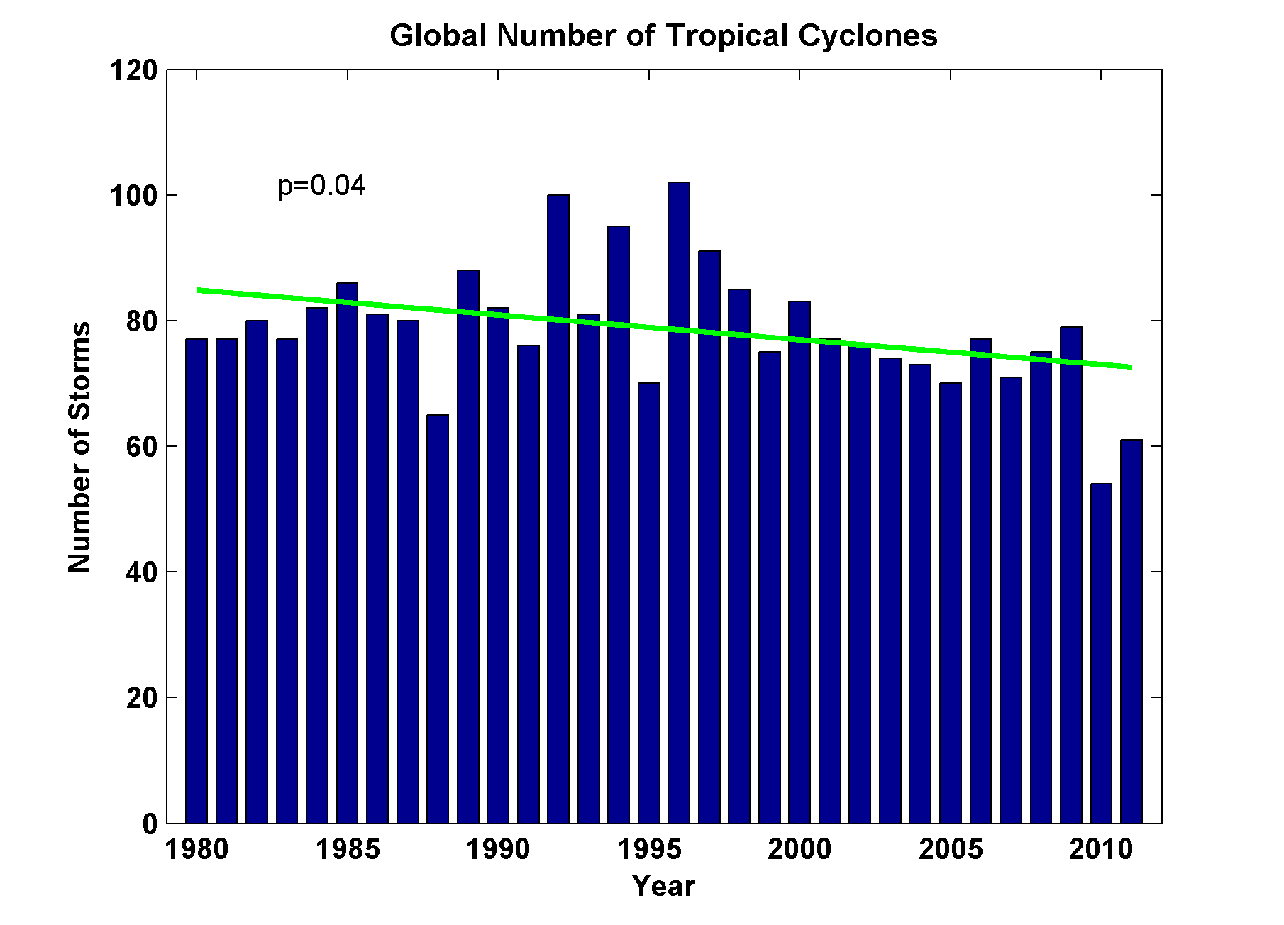
Global Tropical Cyclone Frequency, 1980-2011
Data Sources: NOAA/TPC and NAVY/JTWC
Notes:
21

Slide 22
Tropical Cyclones Often Develop from Cloud Clusters:
When/Why Does Convection Form Clusters?

Slide 23
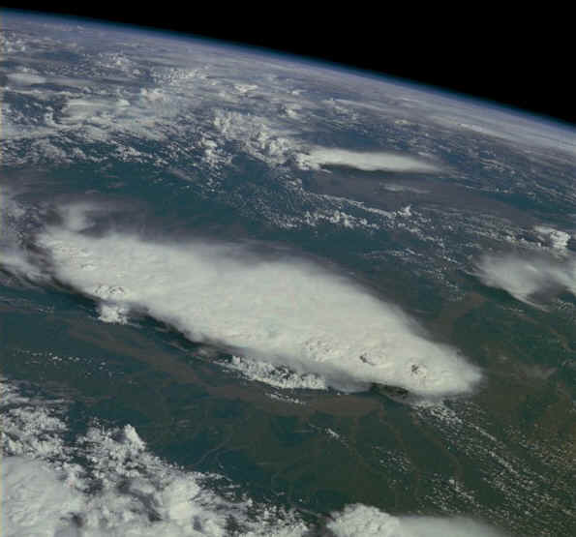
Monsoonal Thunderstorms, Bangladesh and India July 1985

Slide 24
Simplest Statistical Equilibrium State:
Radiative-Convective Equilibrium

Slide 25
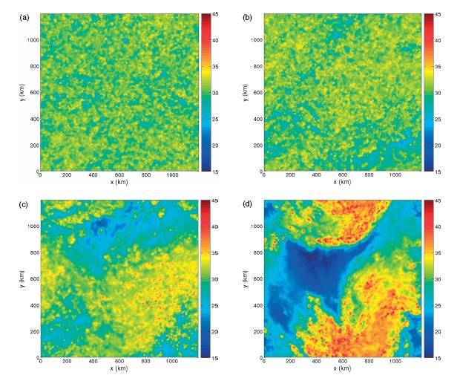
Vertically integrated water vapor at 4 days (Nolan et al., QJRMS, 2007)

Slide 26
Vertically integrated water vapor at 4 (a), 6 (b), 8 (c), and 10 (d) days (Nolan et al., QJRMS, 2007)

Slide 27
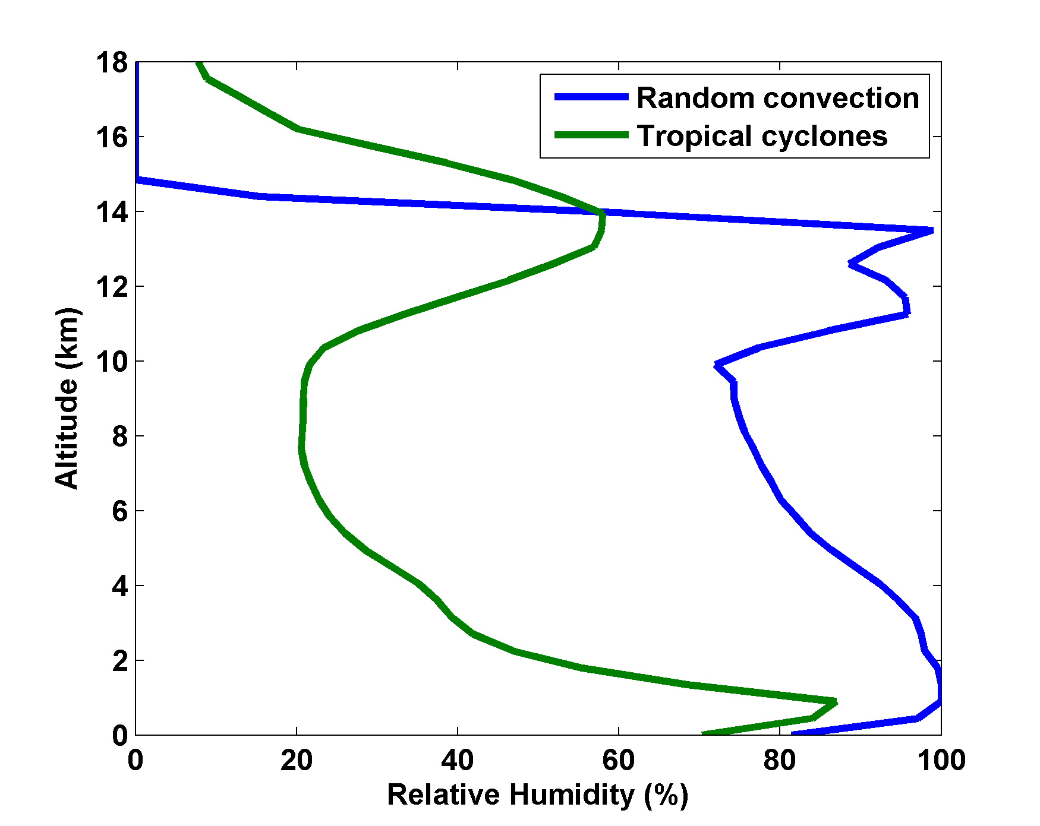
Nolan et al., QJRMS, 2007

Slide 28
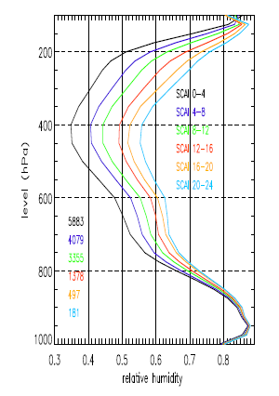
Variation of tropical relative humidity profiles with a Simple Convective Aggregation Index (SCAI).
Courtesy Isabelle Tobin, Sandrine Bony, and Remy Roca

Slide 29
Empirical Necessary Conditions for Self-Aggregation
(after Held et al., 1993; Bretherton et al., 2005; Nolan et al.; 2007)
Small vertical shear of horizontal wind
Interaction of radiation with clouds and/or water vapor
Feedback of convective downdraft surface winds on surface fluxes
Sufficiently high surface temperature

Slide 30
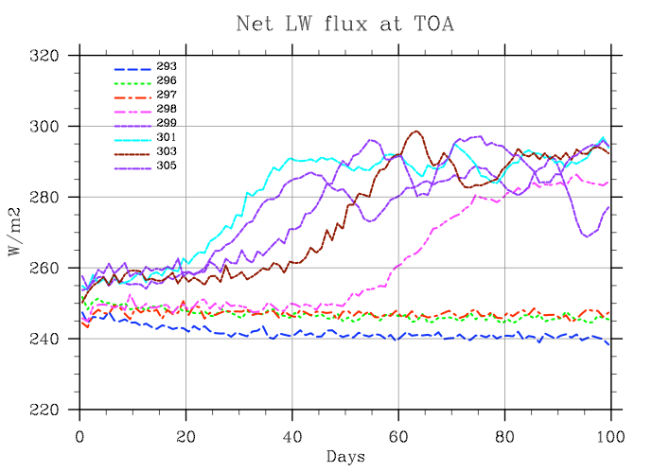
Self-Aggregation is Temperature-Dependent
(Nolan et al., 2007; Emanuel and Khairoutdinov, in preparation, 2012)

Slide 31
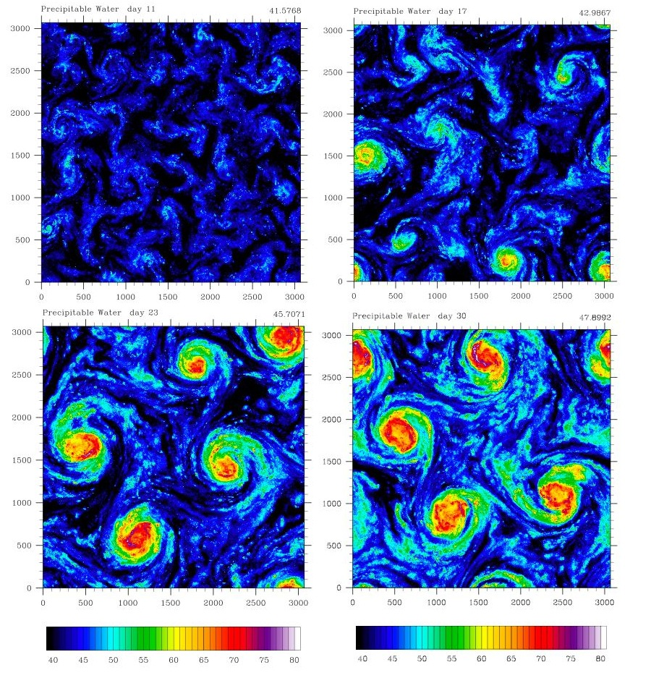

Extension to Rotating Planet
Distance between vortex centers scales as V_{pot}/f

Slide 32
TC-World Scaling
Frequency ~
Intensity ~
Power Dissipation ~

Slide 33
Hypothesis
At high temperature, convection self-aggregates
→Horizontally averaged humidity drops dramatically
→Reduced greenhouse effect cools system
→Convection disaggregates
→Humidity increases, system warms
→System wants to be near phase transition to aggregated state

Slide 34
Recipe for Self-Organized Criticality
(First proposed by David Neelin, but by different mechanism)
System should reside near critical threshold for self-aggregation
Convective cluster size should follow power law distribution

Slide 35
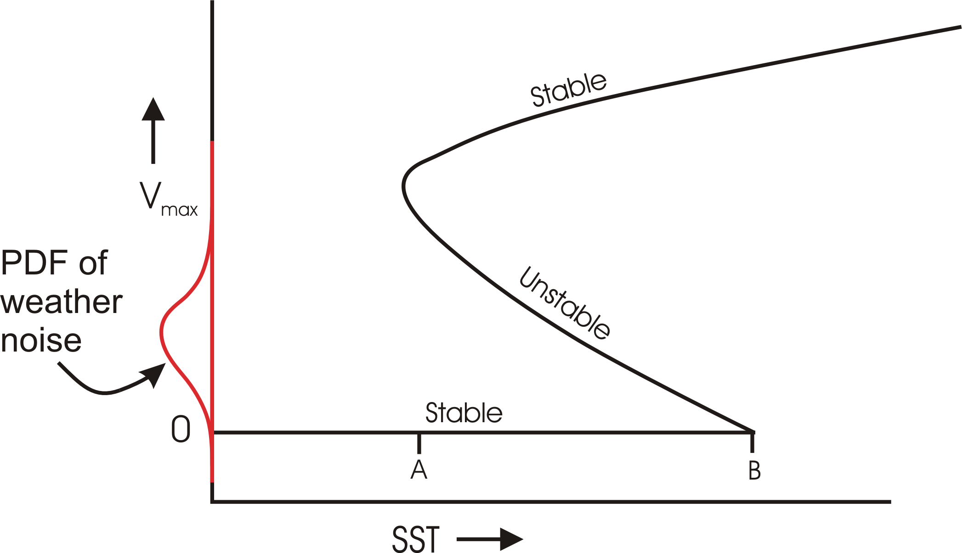
Hypothetical Subcritical Bifurcation

Slide 36
Atlantic Hurricanes and Climate Change

Slide 37
Intensity Metric:
Hurricane Power
(Power Dissipation Index)
A measure of the total frictional dissipation of kinetic energy in the hurricane boundary layer over the lifetime of the storm

Slide 38
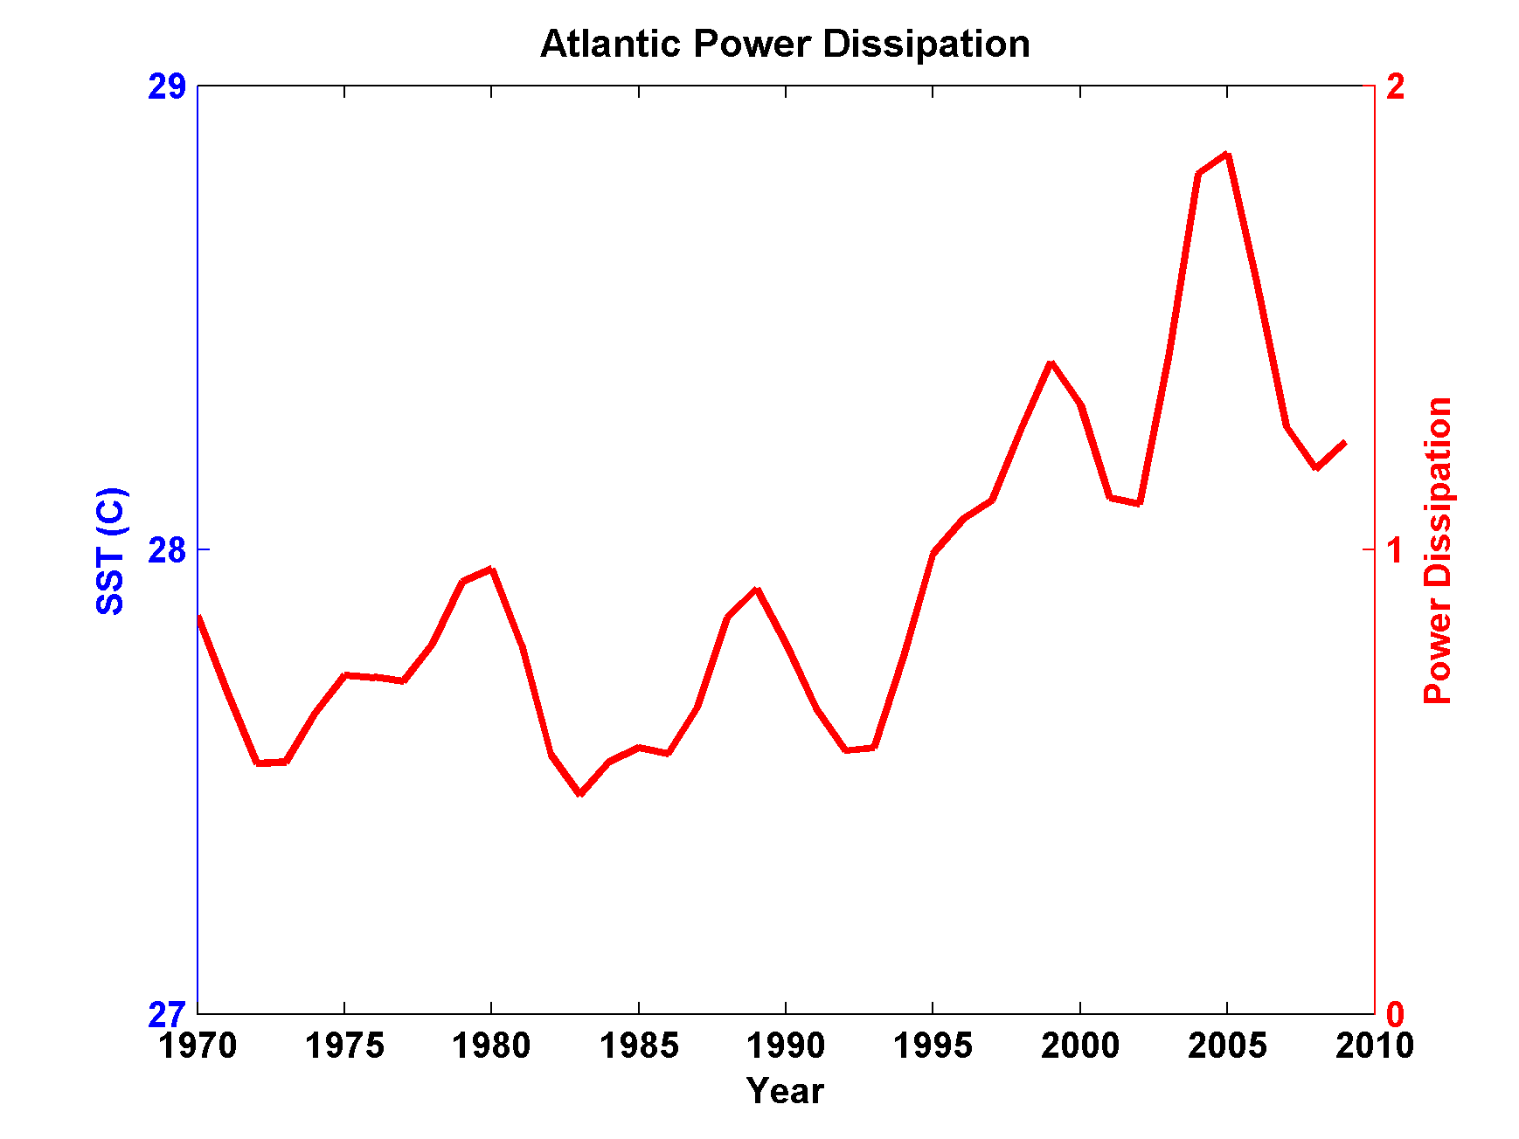
Atlantic Storm Maximum Tropical Cyclone Power Dissipation during an era of high quality measurements, 1970-2011 (smoothed with 1-3-4-3-1 filter)

Slide 39
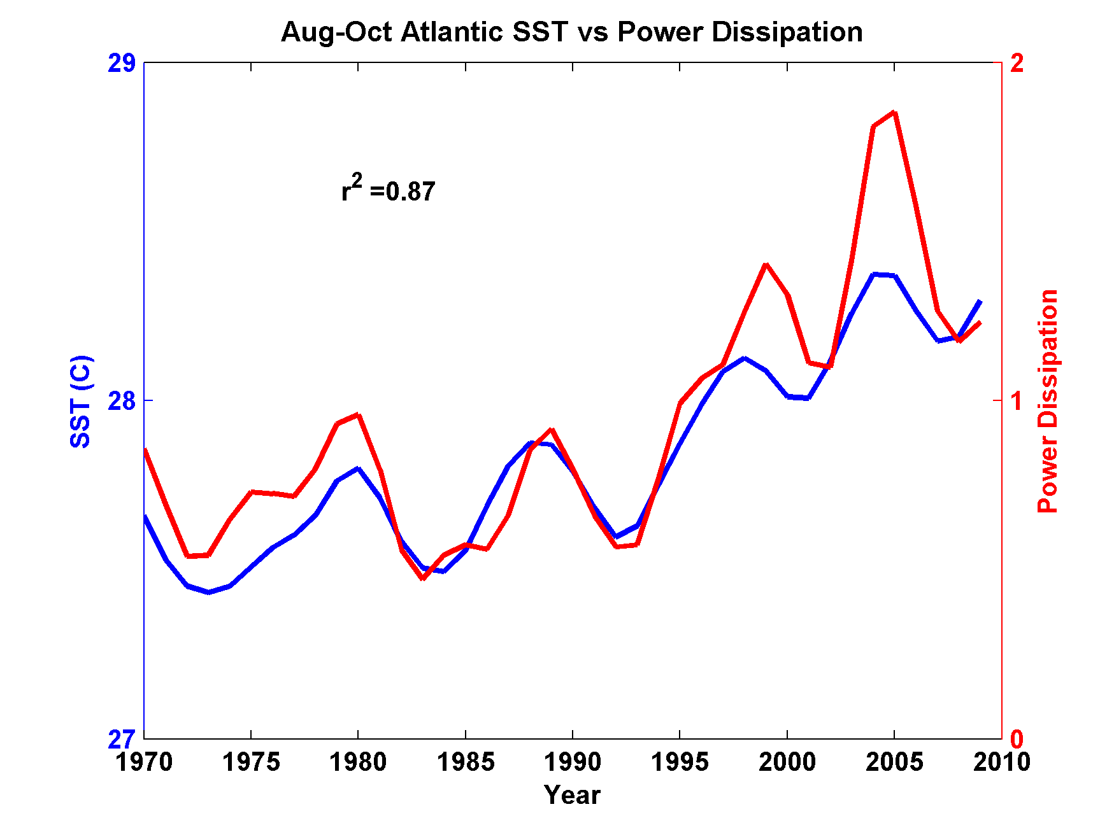
Atlantic Storm Maximum Tropical Cyclone Power Dissipation and Sea Surface Temperature during an era of high quality measurements, 1970-2011 (smoothed with 1-3-4-3-1 filter)

Slide 40
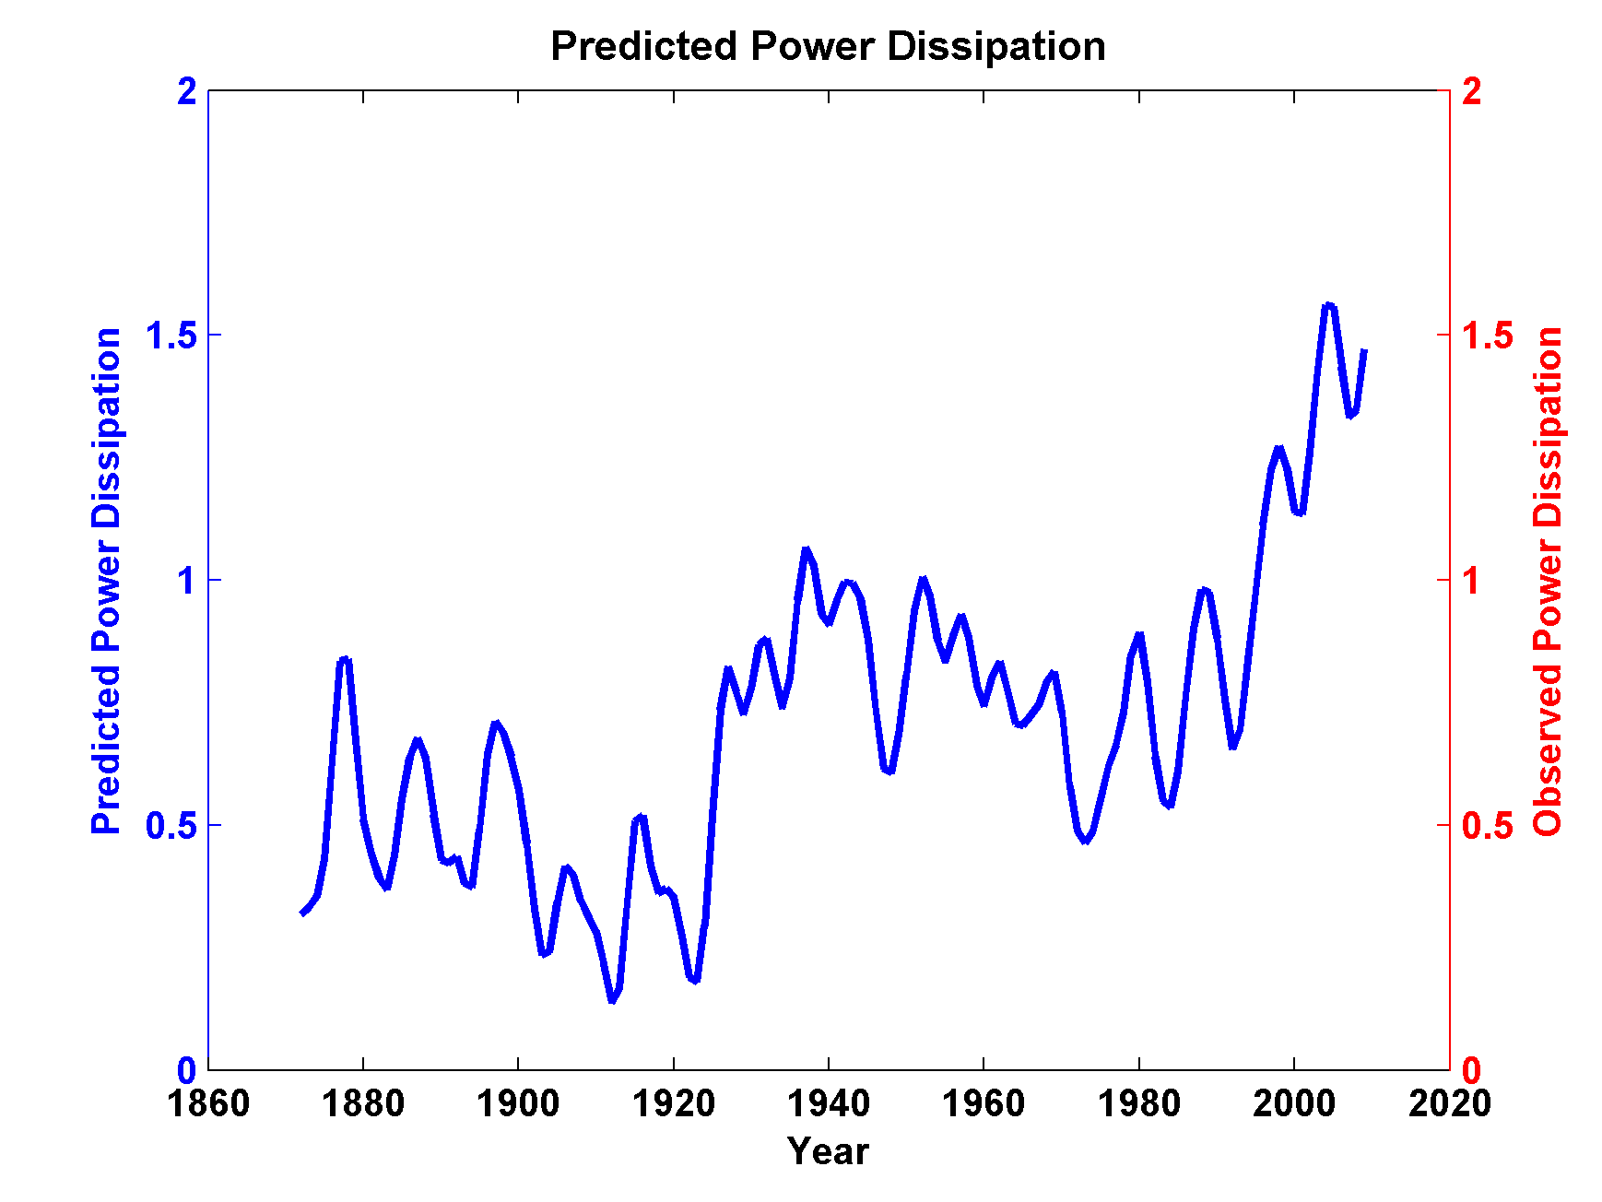
Use Linear Regression to Predict Power Dissipation back to 1870 based on SST:

Slide 41
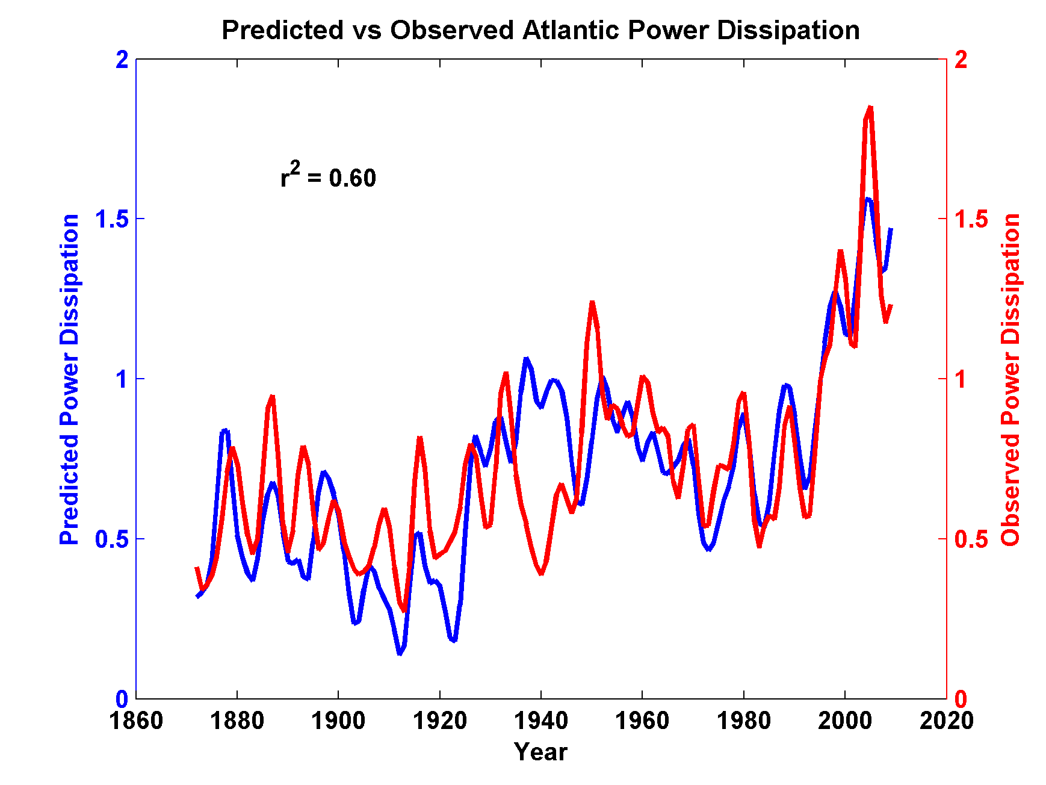
Now Compare to Observed Storm Maximum Power Dissipation

Slide 42
What is Causing Changes in Tropical Atlantic Sea Surface Temperature?

Slide 43
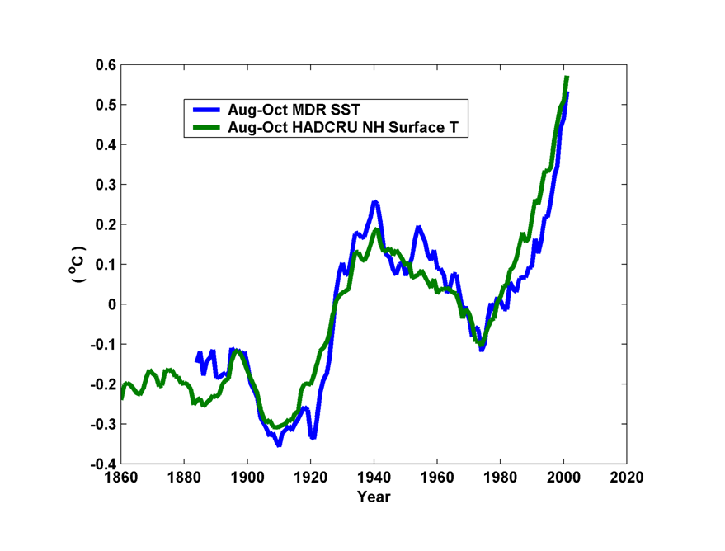
10-year Running Average of Aug-Oct Northern Hemisphere Surface Temp and Hurricane Region Ocean Temp

Slide 44
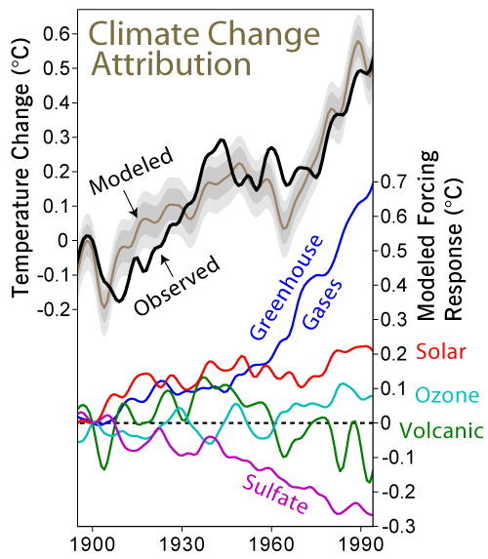

Slide 45
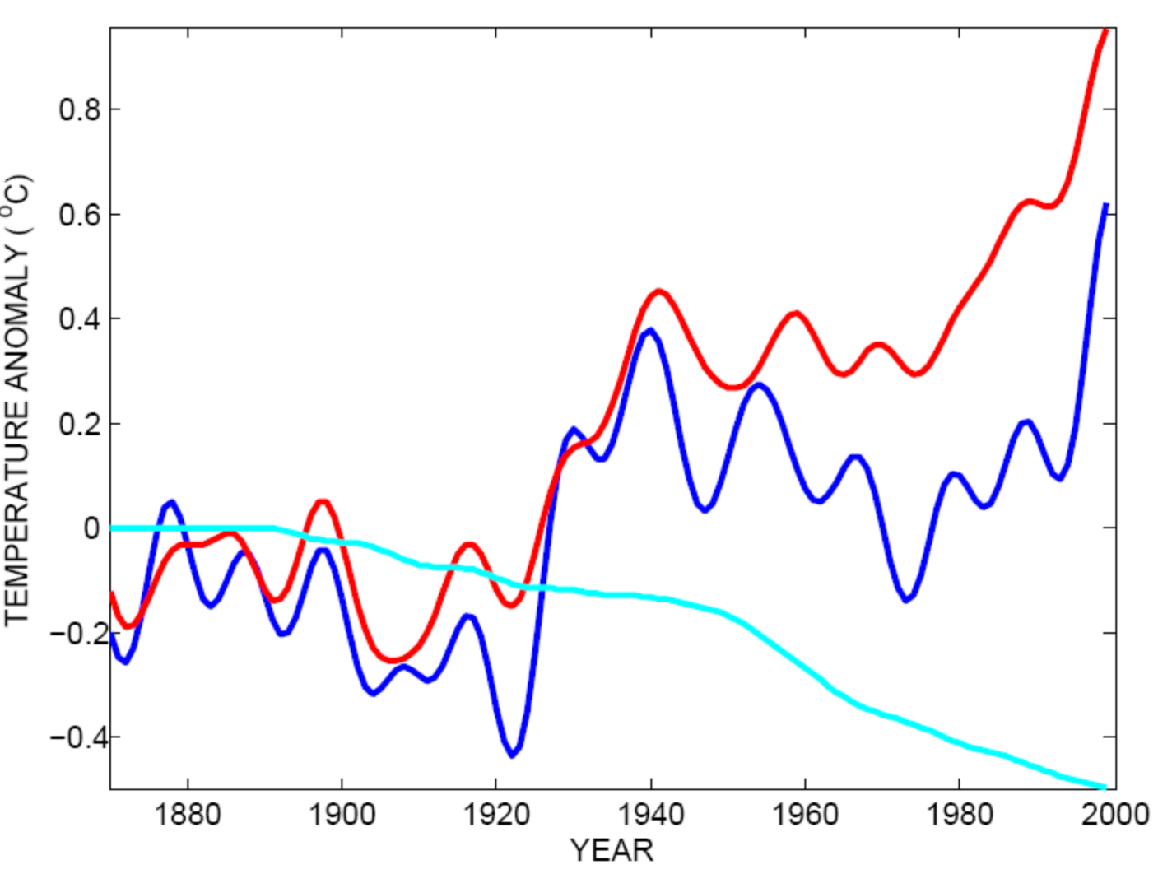
Tropical Atlantic SST(blue), Global Mean Surface Temperature (red),
Aerosol Forcing (aqua)
Global mean surface temperature
Tropical Atlantic sea surface temperature
Sulfate aerosol radiative forcing
Mann, M. E., and K. A. Emanuel, 2006. Atlantic hurricane trends linked to climate change. EOS, 87, 233-244.

Slide 46
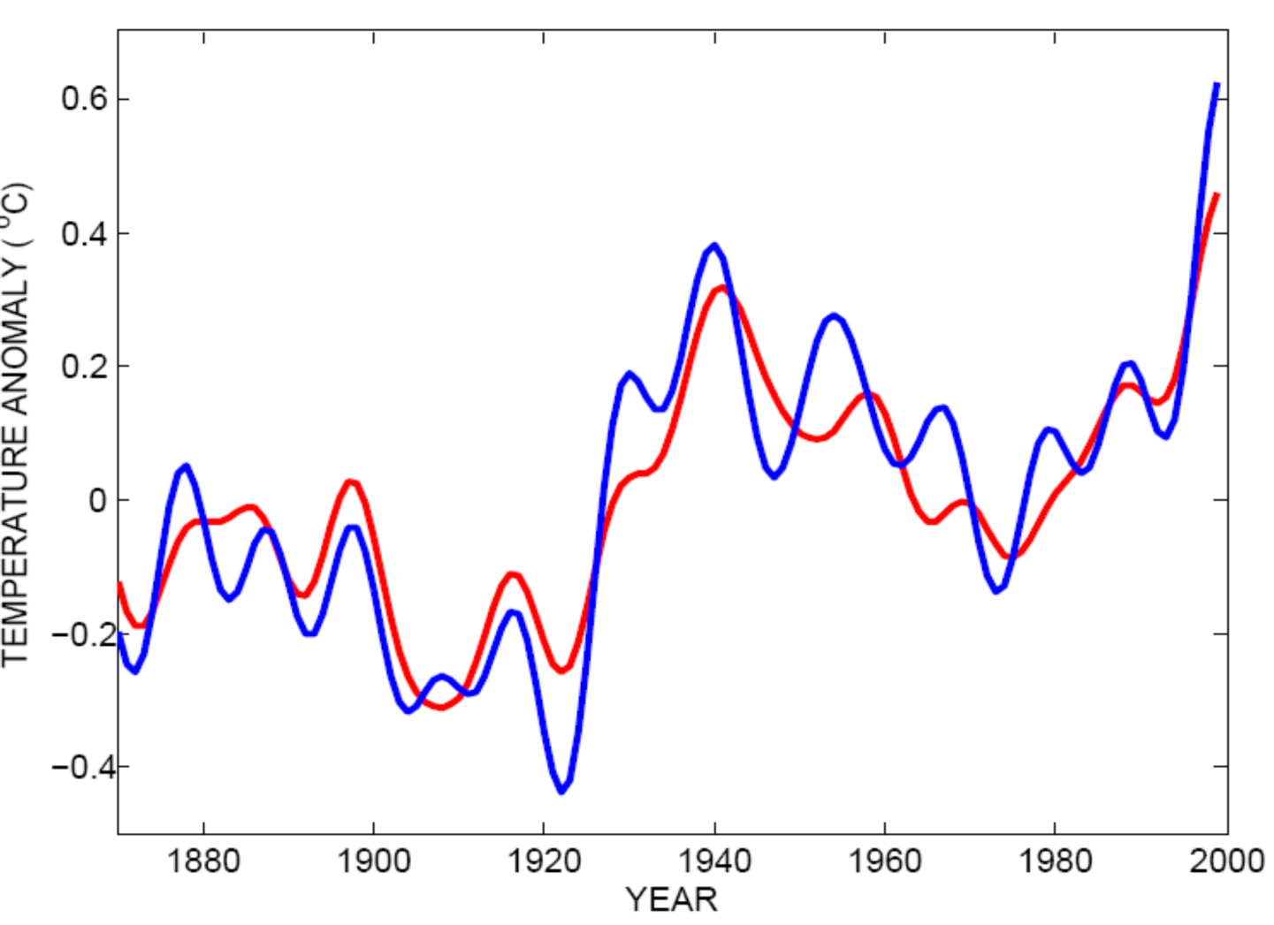
Best Fit Linear Combination of Global Warming and Aerosol Forcing (red) versus Tropical Atlantic SST (blue)
Tropical Atlantic Sea Surface Temperature
Global Surface T + Aerosol Forcing
Mann, M. E., and K. A. Emanuel, 2006. Atlantic hurricane trends linked to climate change. EOS, 87, 233-244.

Slide 47
Using Physics to Assess Hurricane Risk

Slide 48
Our Approach to Downscaling Tropical Cyclones from Climate Models
Step 1: Seed each ocean basin with a very large number of weak, randomly located vortices
Step 2: Vortices are assumed to move with the large scale atmospheric flow in which they are embedded
Step 3: Run a coupled, ocean-atmosphere computer model for each vortex, and note how many achieve at least tropical storm strength; discard others
Step 4: Using the small fraction of surviving events, determine storm statistics.

Slide 50
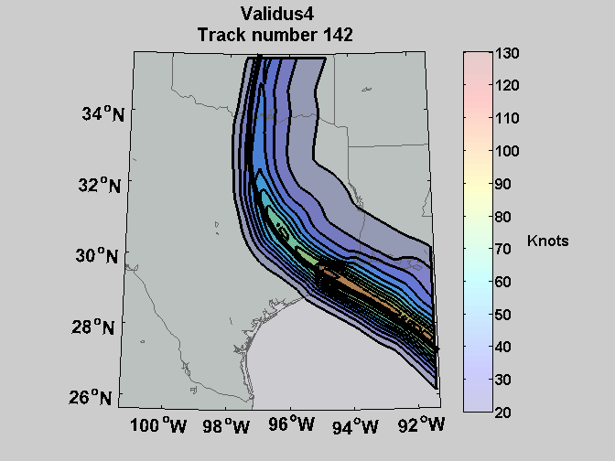
Sample Storm Wind Swath

Slide 51

Cumulative Distribution of Storm Lifetime Peak Wind Speed, with Sample of 1755 Synthetic Tracks
90% confidence bounds

Slide 52

Return Periods

Slide 53

Captures effects of regional climate phenomena (e.g. ENSO, AMM)

Slide 54
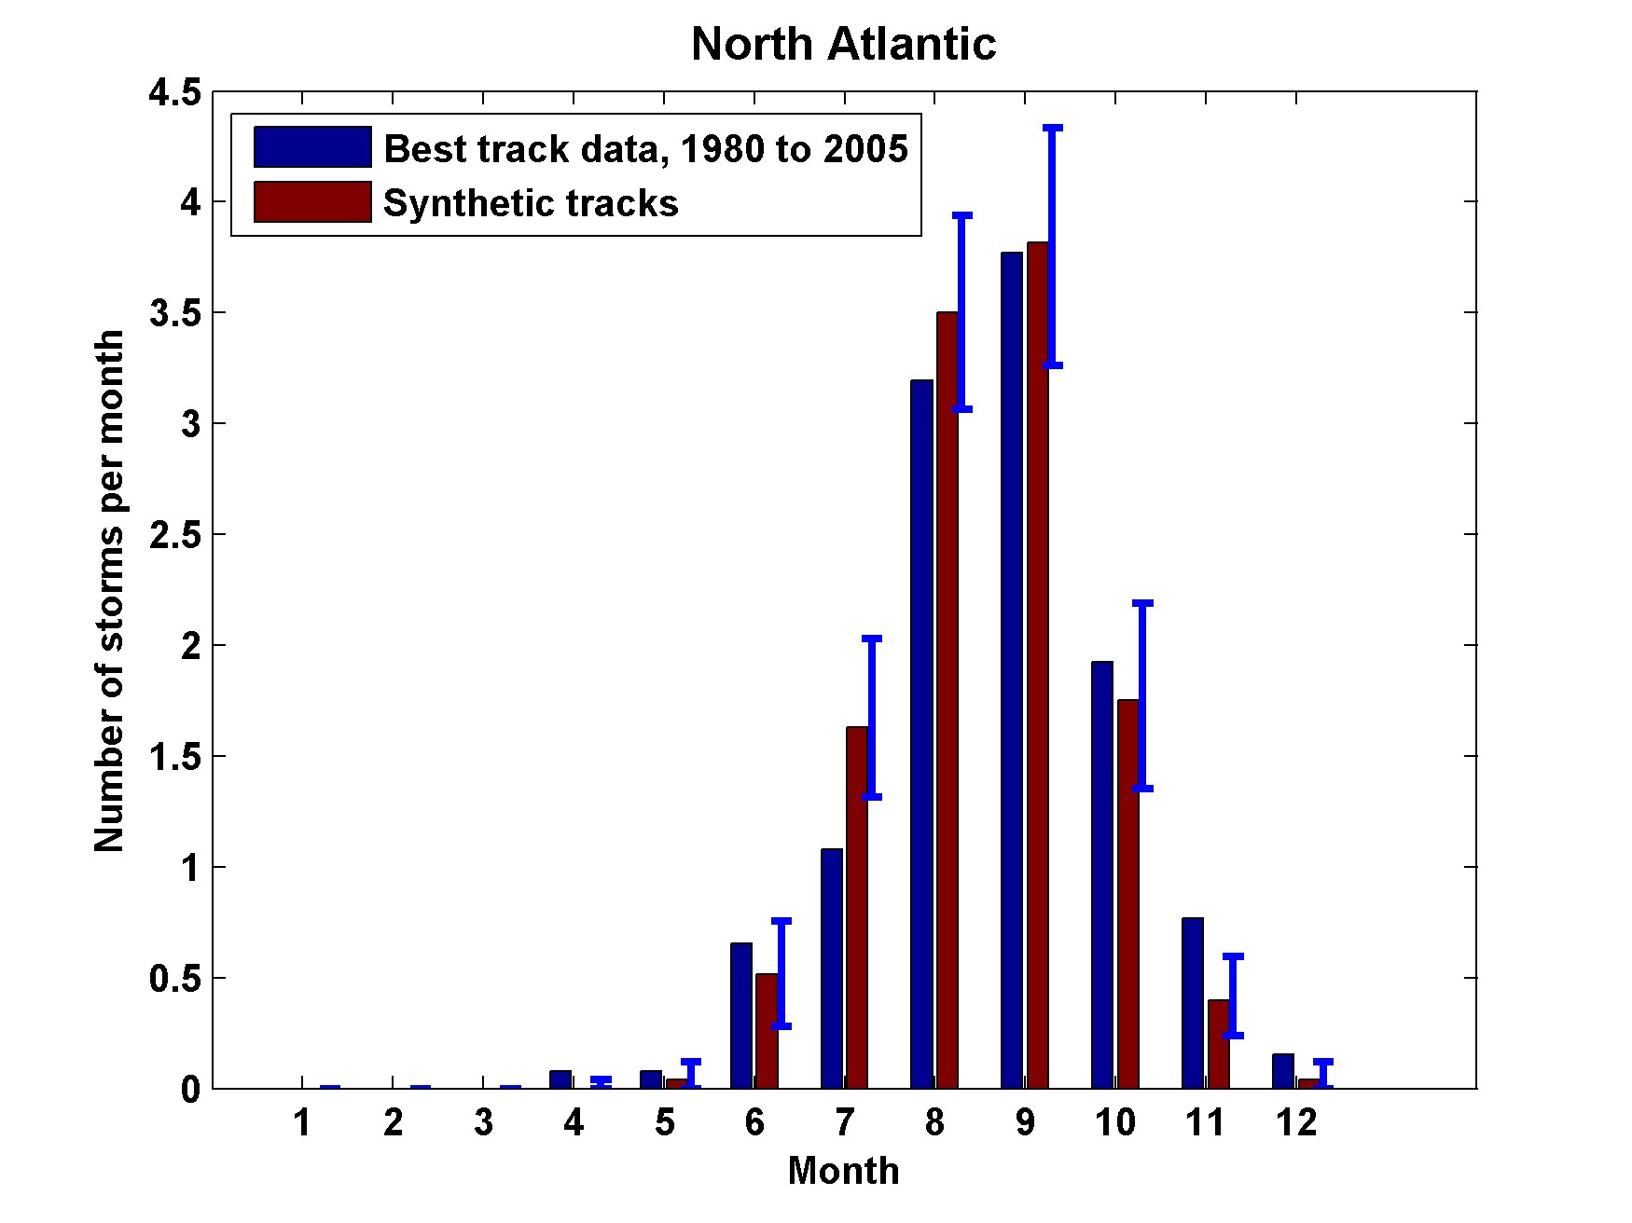
Seasonal Cycles
Atlantic
Notes:
54

Slide 55
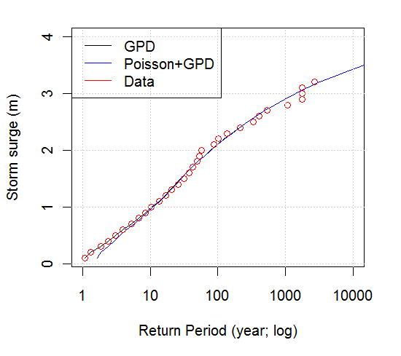
Surge Return Periods for The Battery, New York

Slide 56
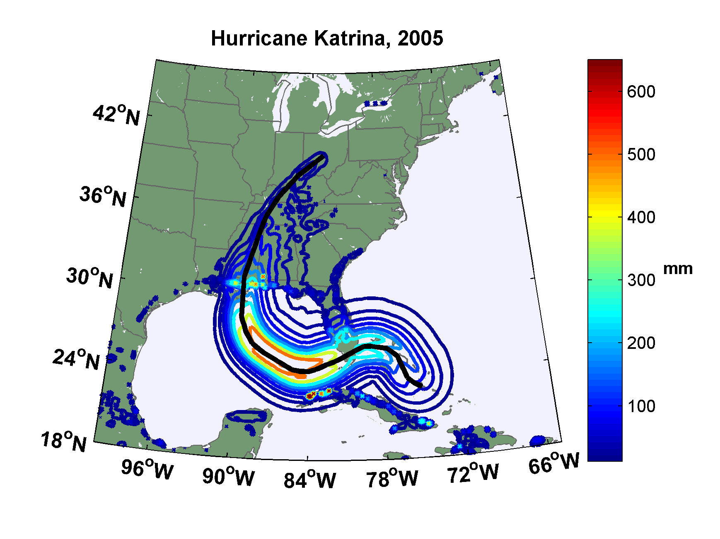
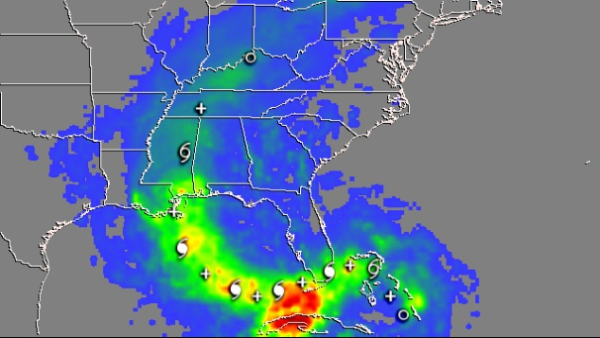
Observed (left) and simulated storm total rainfall accumulation during Hurricane Katrina of 2005. The plot at left is from NASA’s Multi-Satellite Precipitation Analysis, which is based on the Tropical Rainfall Measurement Mission (TRMM) satellite, among others. Dark red areas exceed 300 mm of rainfall; yellow areas exceed 200 mm, and green areas exceed 125 mm

Slide 57
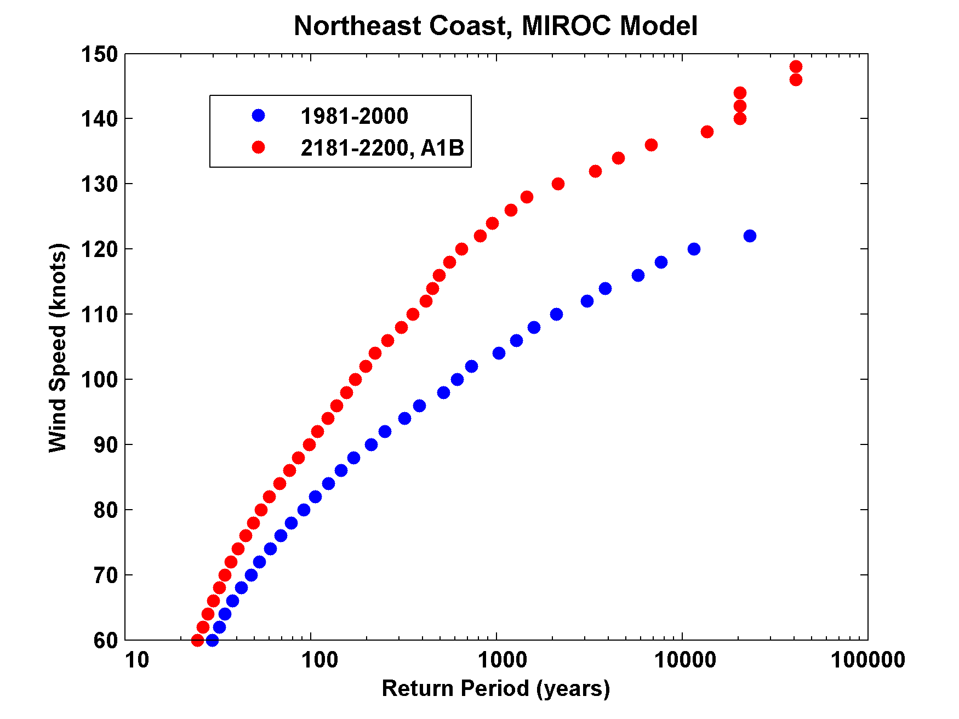

Slide 58
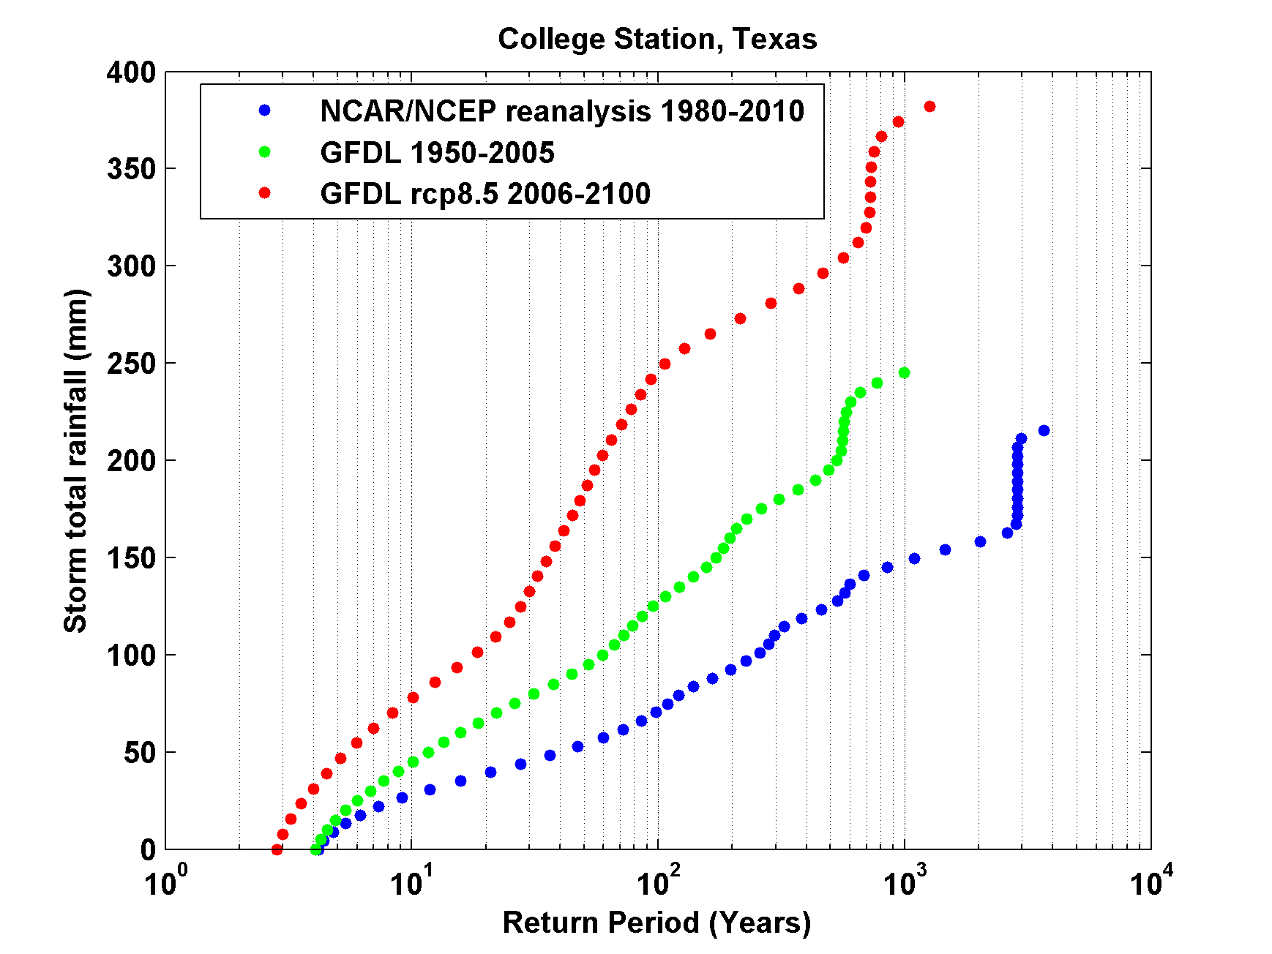
Storm Total Rainfall, College Station

Slide 59
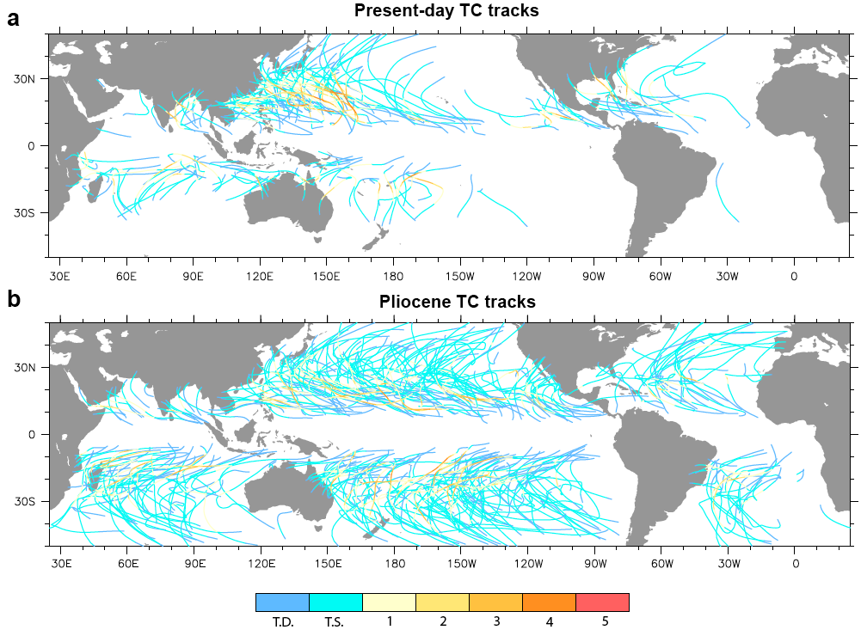
Application to Other Climates
Federov et al., 2010

Slide 60
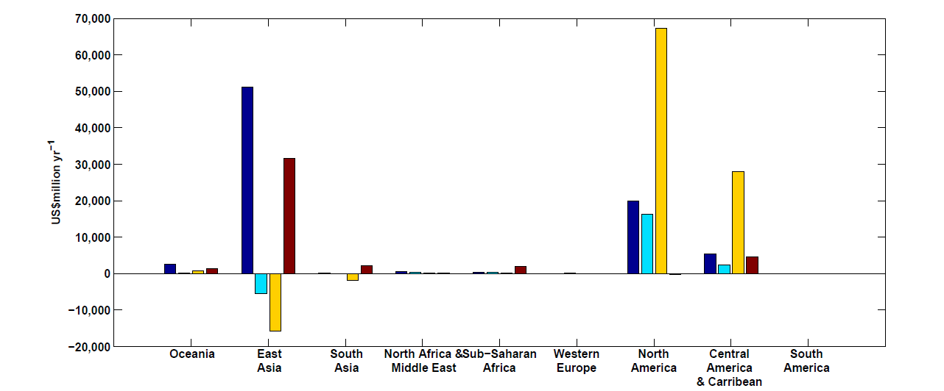
Mendelsohn et al., 2012
Climate change impacts on tropical cyclone damage by region in 2100. Damage is concentrated in North America, East Asia and Central America–Caribbean. Damage is generally higher in the CNRM and GFDL climate scenarios.

Slide 61
Summary
Hurricanes have had a substantial influence on the course of history
Hurricanes are almost pure examples of Carnot heat engines

Slide 62
Tropical cyclones may be a subclass of aggregated convection, which may tend toward self-organized critical states, thus stabilizing tropical climate

Slide 63
Simple but high resolution coupled TC model can be used to ‘downscale” TC activity from global climate data sets
Studies based on this downscaling suggest some sensitivity of TCs to climate state

Slide 64
Integrated Assessments with Robert Mendelsohn, Yale

Slide 65


Probability Density of TC Damage, U.S. East Coast
Damage Multiplied by Probability Density of TC Damage, U.S. East Coast

Slide 66
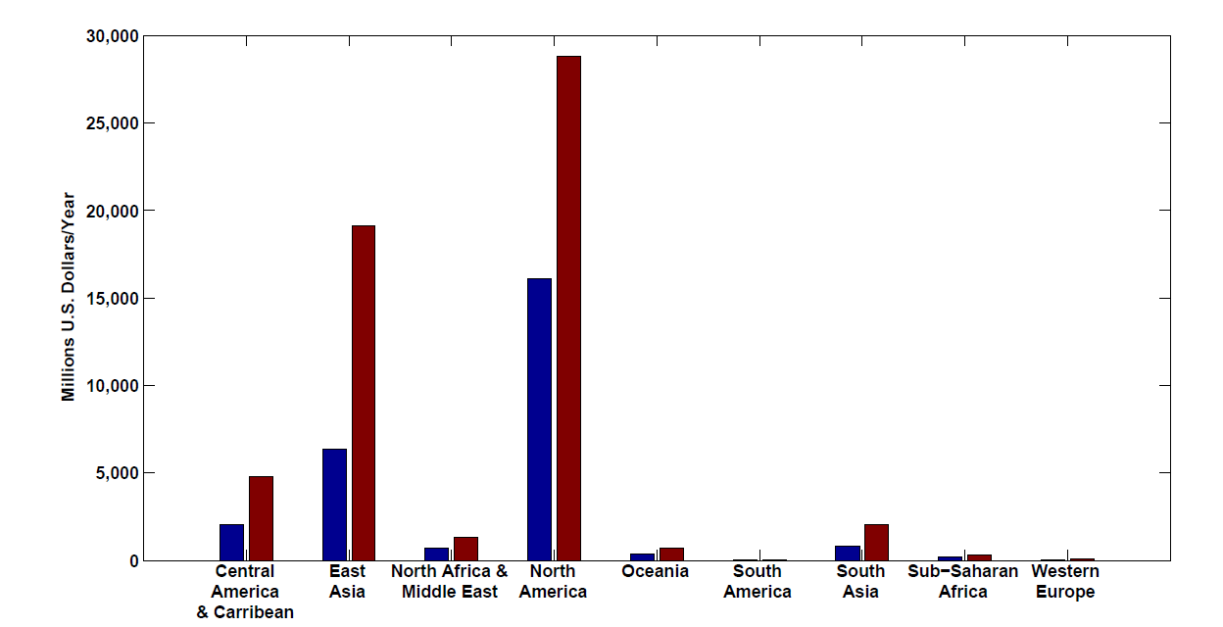
Present and future baseline tropical cyclone damage by region.
Changes in income will increase future tropical cyclone damages in 2100 in every region even if climate does not change. Changes are larger in regions experiencing faster economic growth, such as East Asia and the Central America–Caribbean region.

Slide 67
Climate change impacts on tropical cyclone damage by region in 2100. Damage is concentrated in North America, East Asia and Central America–Caribbean. Damage is generally higher in the CNRM and GFDL climate scenarios.

Slide 68
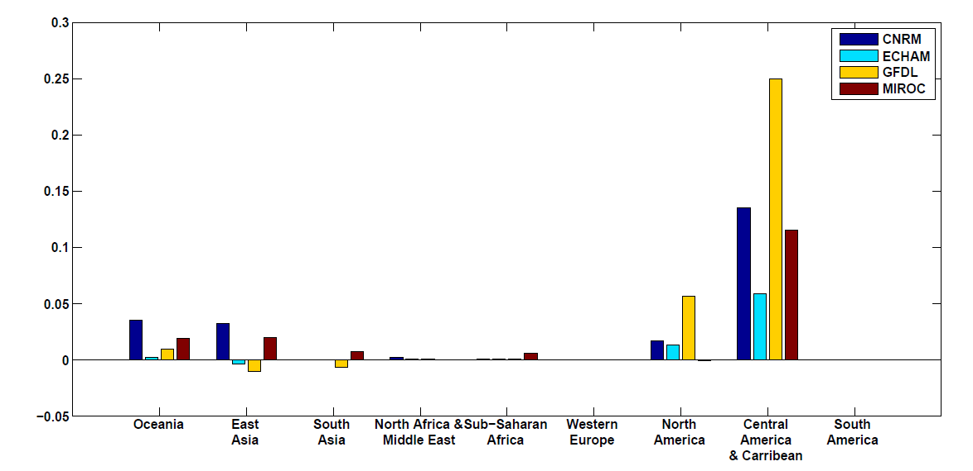
Climate change impacts on tropical cyclone damage divided by GDP by region in 2100. The ratio of damage to GDP is highest in the Caribbean–Central American region but North America, Oceania and East Asia all have above-average ratios.

Slide 69
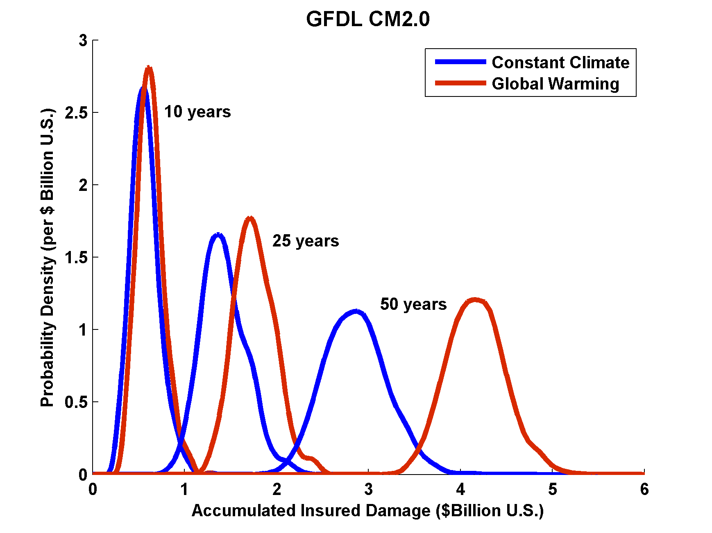
Projections of U.S. Insured Damage
Emanuel, K. A., 2012, Weather, Climate, and Society

Slide 70
Feedback of Global Tropical Cyclone Activity on the Climate System
Notes:
70

Slide 71
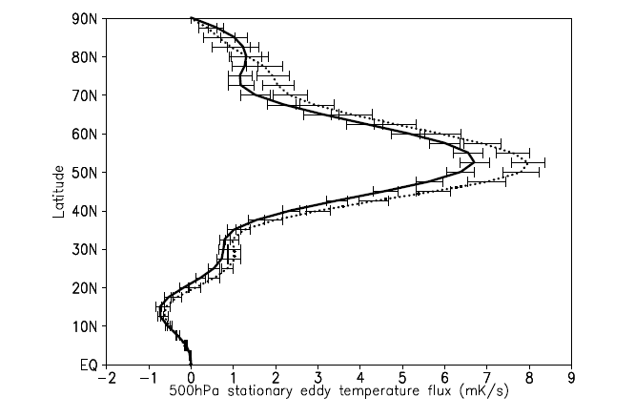
Hart, 2010
500hPa zonal mean meridional temperature flux (mK/s) of the stationary eddies for January through March. The dotted (solid) curve represents the composite mean of the winters following inactive (active) northern hemisphere TC seasons. Error bars represent the standard error of the mean for datasets of size varying from N=9 to 13. Flux calculated using NCAR/NCEP reanalysis for the period 1960‐2008

Slide 72
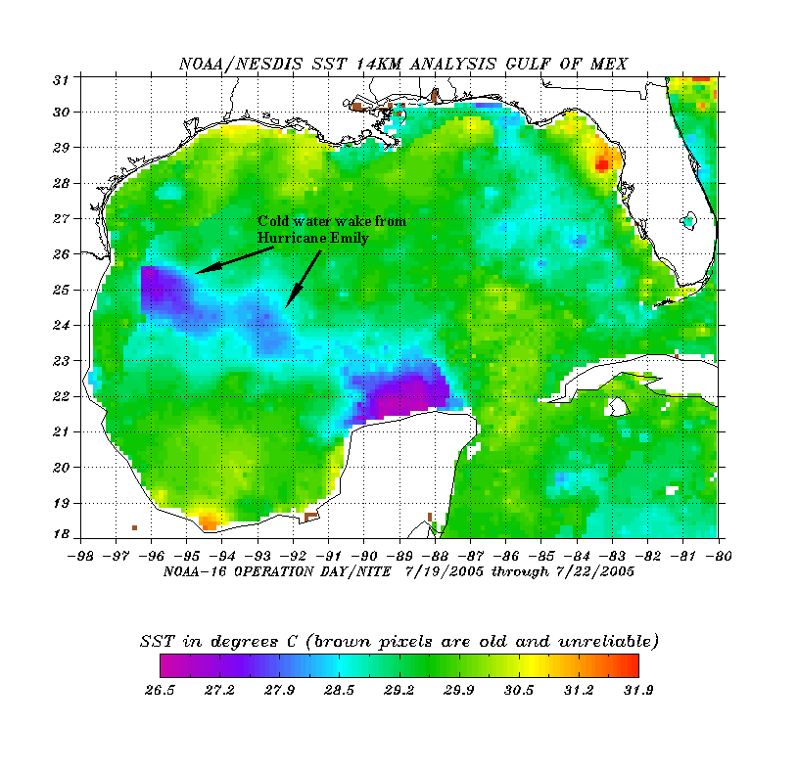
The wake of Hurricane Emily (July 2005)
Sea Surface Temperature in the Wakes of Hurricanes
Hurricane Dennis
(one week earlier)
Source: Rob Korty, CalTech
Notes:
72
We know that tropical cyclones are responsible for strong mixing of the upper oceans and this can be seen in satellite images…

Slide 73
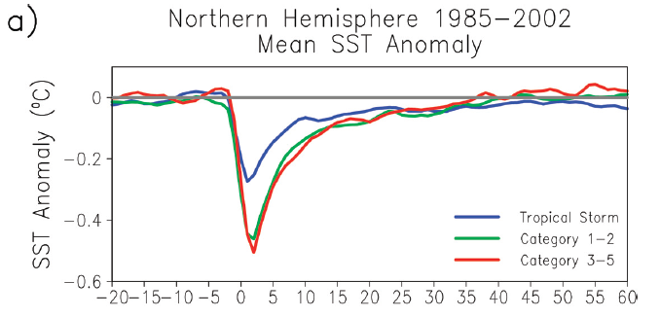
Wake Recovery
Hart, Maue, and Watson, Mon. Wea. Rev., 2007

Slide 74
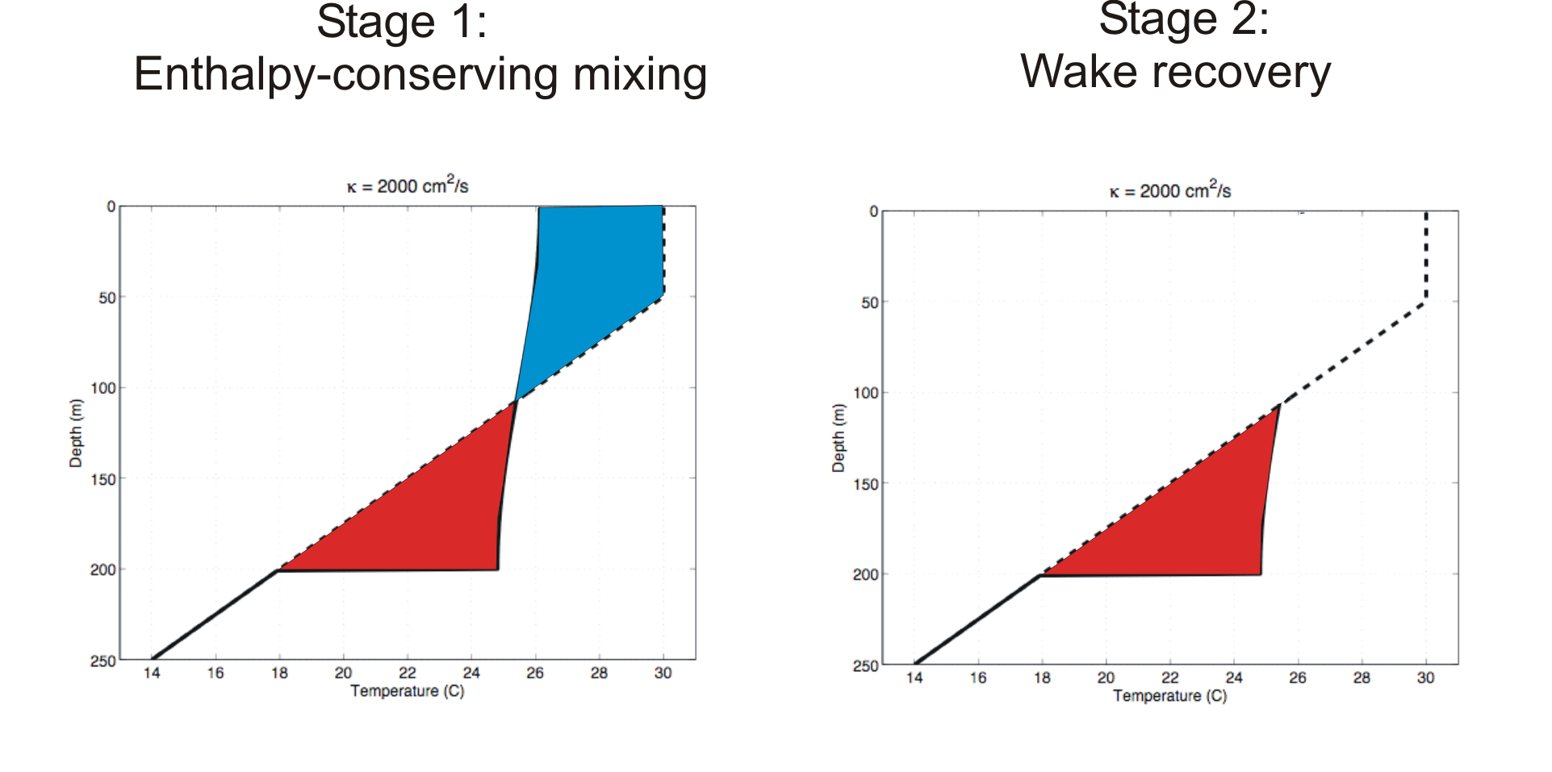
Direct mixing by tropical cyclones
Emanuel (2001) estimated global rate of heat input as 1.4 X 10¹⁵ Watts
Source: Rob Korty, CalTech
Notes:
74

Slide 75
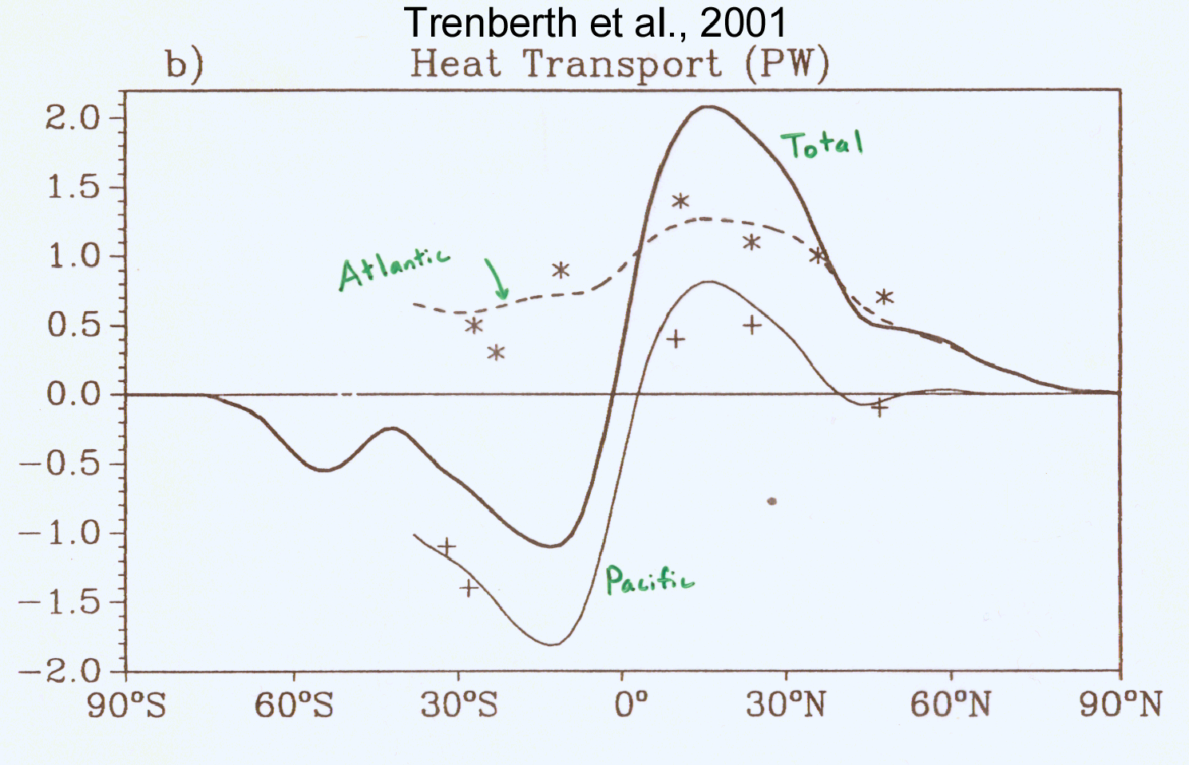
TC Mixing May Induce Much or Most of the Observed Poleward Heat Flux by the Oceans
Notes:
75

Slide 76
Estimate from satellite-derived wake recoveries
Extrapolation from detailed ocean measurements of one storm
Estimate of total heat uptake by tropical oceans

Slide 78
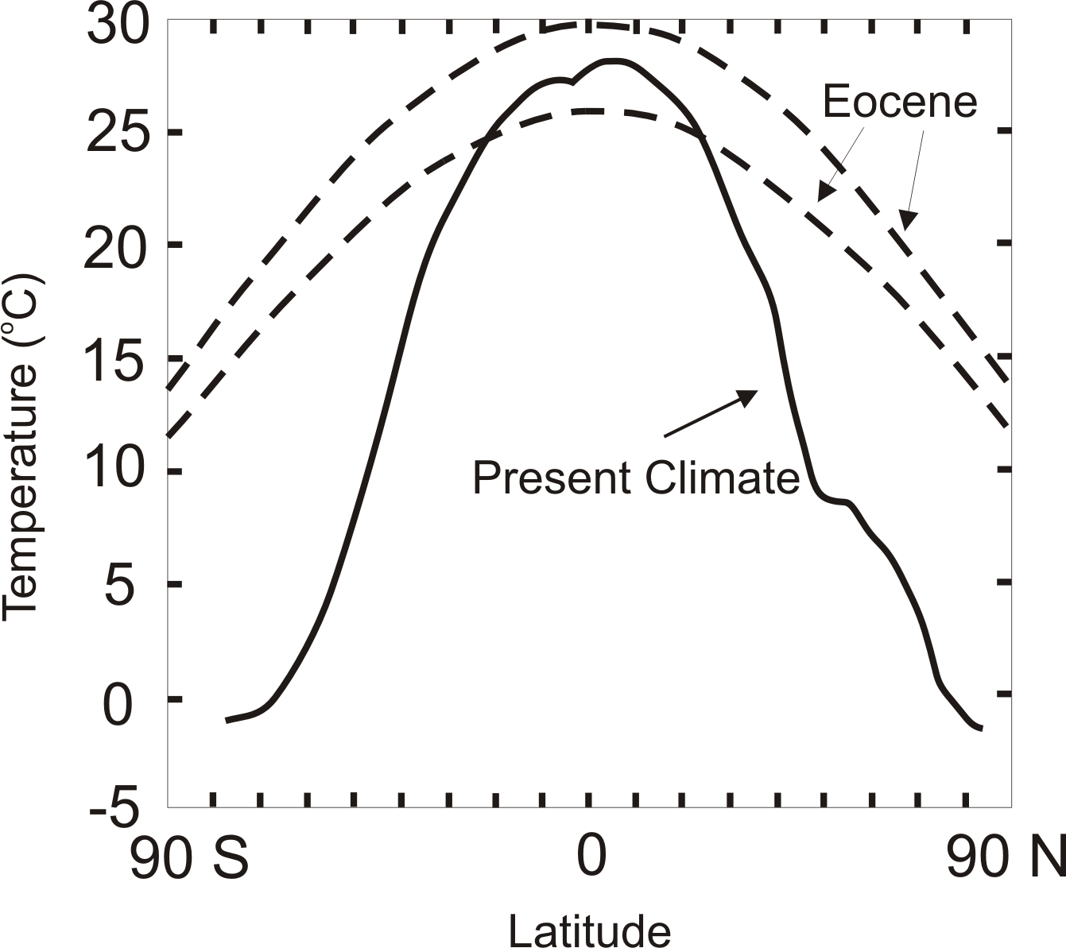
TC-Mixing may be Crucial for High-Latitude Warmth and Low-Latitude Moderation During Warm Climates, such as that of the Eocene
Notes:
78

Slide 79

Depiction of central North America, ~60 million years ago
Our future?
Figure courtesy of Rob Korty, CalTech
Notes:
79

Slide 80
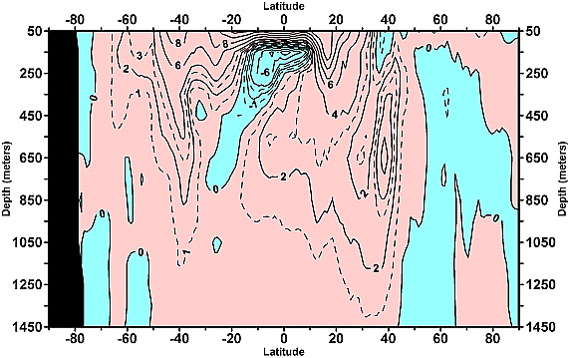
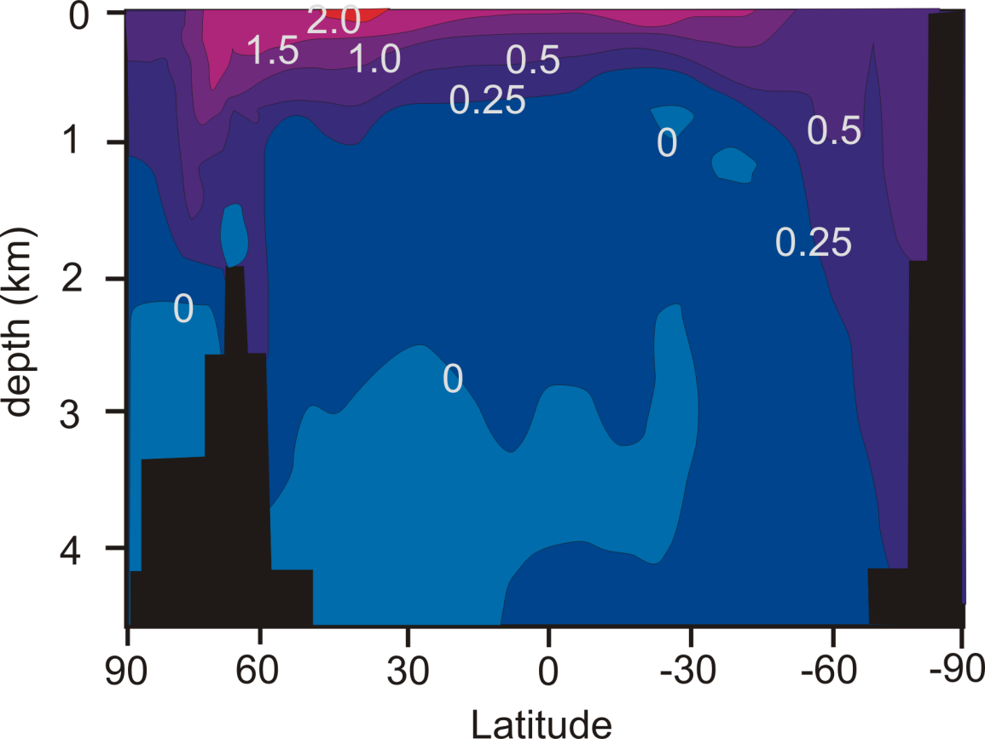
Linear trend (1955–2003) of the zonally integrated heat content of the world ocean by one-degree latitude belts for 100-m thick layers. Source: Levitus et al., 2005
TC-Mixing may explain difference between observed and modeled ocean warming
Zonally averaged temperature trend due to global warming in a coupled climate model. Source: Manabe et al, 1991
Notes:
80

Slide 81
What is Causing Changes in Tropical Atlantic Sea Surface Temperature?

Slide 82
10-year Running Average of Aug-Oct Northern Hemisphere Surface Temp and Hurricane Region Ocean Temp

Slide 83
Estimates of Global Mean Surface Temperature from the Instrumental Record
Notes:
83

Slide 84
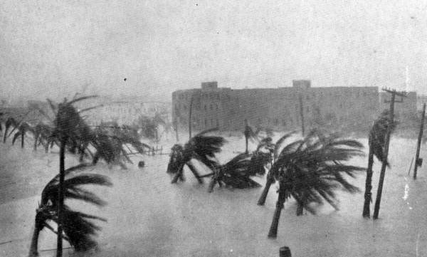

Slide 85
Tropical Atlantic SST(blue), Global Mean Surface Temperature (red),
Aerosol Forcing (aqua)
Global mean surface temperature
Tropical Atlantic sea surface temperature
Sulfate aerosol radiative forcing
Mann, M. E., and K. A. Emanuel, 2006. Atlantic hurricane trends linked to climate change. EOS, 87, 233-244.

Slide 86
Best Fit Linear Combination of Global Warming and Aerosol Forcing (red) versus Tropical Atlantic SST (blue)
Tropical Atlantic Sea Surface Temperature
Global Surface T + Aerosol Forcing
Mann, M. E., and K. A. Emanuel, 2006. Atlantic hurricane trends linked to climate change. EOS, 87, 233-244.

Slide 87
Pushing Back the Record of Tropical Cyclone Activity:
Paleotempestology
Notes:
87

Slide 88
Paleotempestology
barrier beach
upland
overwash fan
backbarrier marsh
a)
lagoon
barrier beach
upland
overwash fan
b)
backbarrier marsh
lagoon
terminal lobes
flood tidal delta
Source: Jeff Donnelly, WHOI
Notes:
88

Slide 89
Source: Jeff Donnelly, Jon Woodruff, Phil Lane; WHOI
Notes:
89

Slide 90
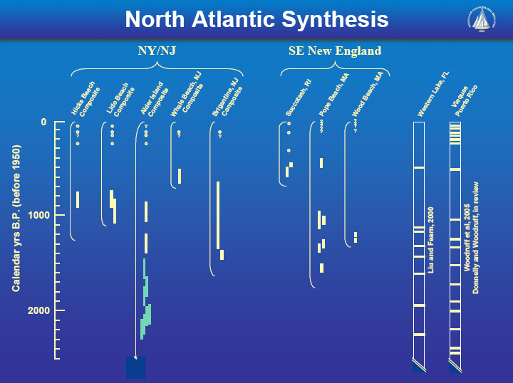
Source: Jeff Donnelly, Jon Woodruff, Phil Lane; WHOI
Notes:
90

Slide 91
Inferences from Modeling

Slide 92
The Problem:
Global models are far too coarse to simulate high intensity tropical cyclones
Embedding regional models within global models introduces problems stemming from incompatibility of models, and even regional models are usually too coarse

Slide 93

Histograms of Tropical Cyclone Intensity as Simulated by a Global Model with 50 km grid point spacing. (Courtesy Isaac Held, GFDL)
Category 3

Slide 94
Probability Density of TC Damage, U.S. East Coast
Damage Multiplied by Probability Density of TC Damage, U.S. East Coast

Slide 95
To the extent that they simulate tropical cyclones at all, global models simulate storms that are largely irrelevant to society and to the climate system itself, given that ocean stirring effects are heavily weighted towards the most intense storms

Slide 96
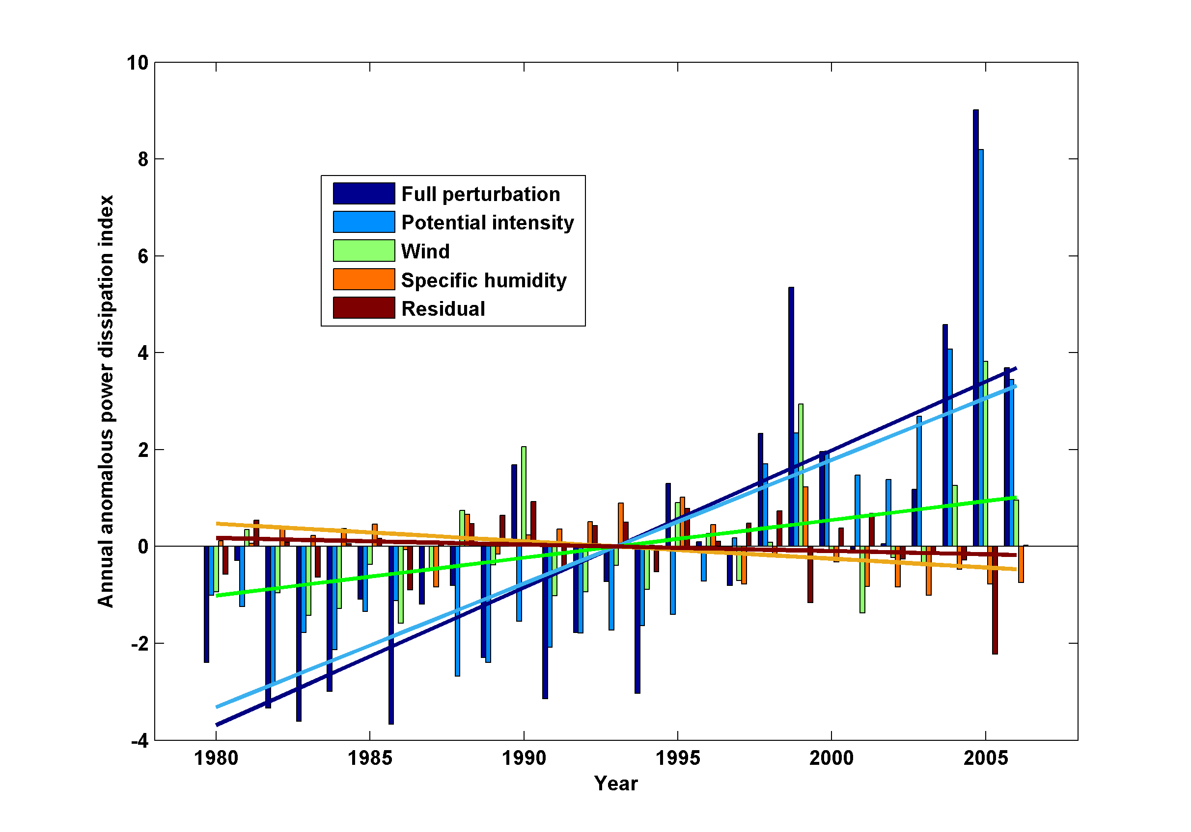
Decomposition of PDI Trends

Slide 97
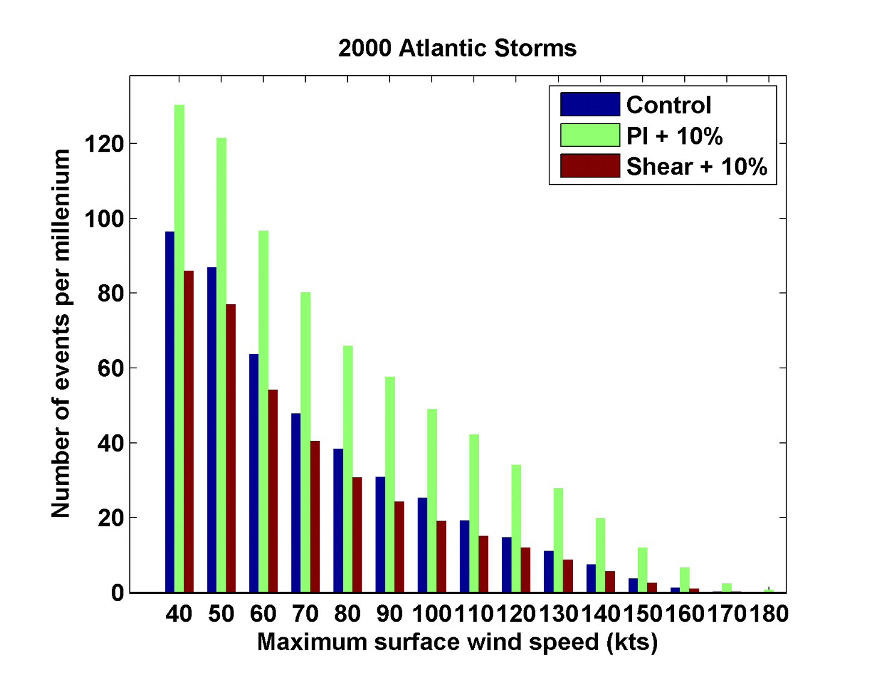
Sensitivity to Shear and Potential Intensity

Slide 98
Hydrostatic Compensation (following Holloway and Neelin)
Perturbations to moist adiabatic troposphere:
Stratospheric compensation:

Slide 99
For typical values of the parameters

Slide 100
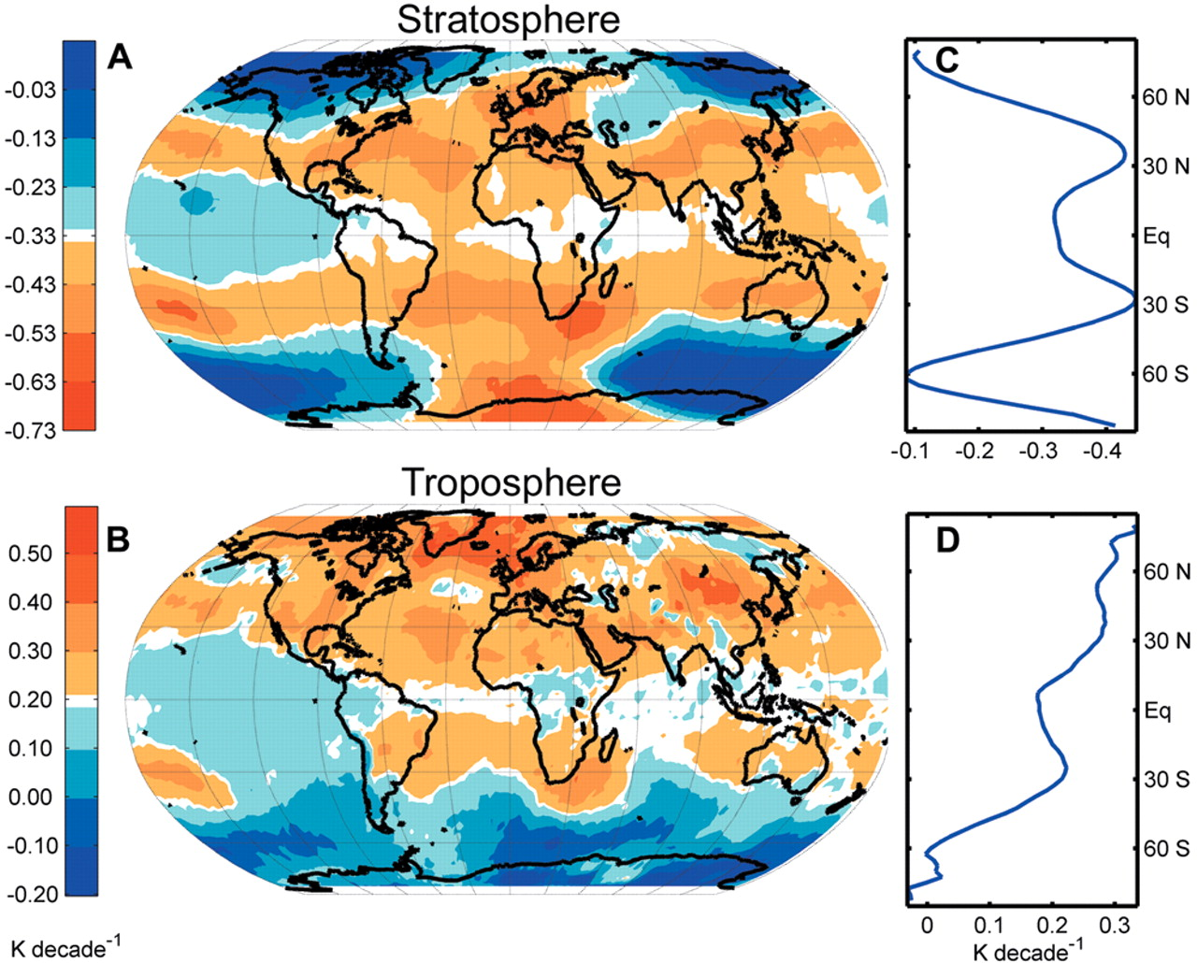
Ozone may not explain spatial pattern of cooling
(Fu and Wallace, Science, 2006)

Slide 101
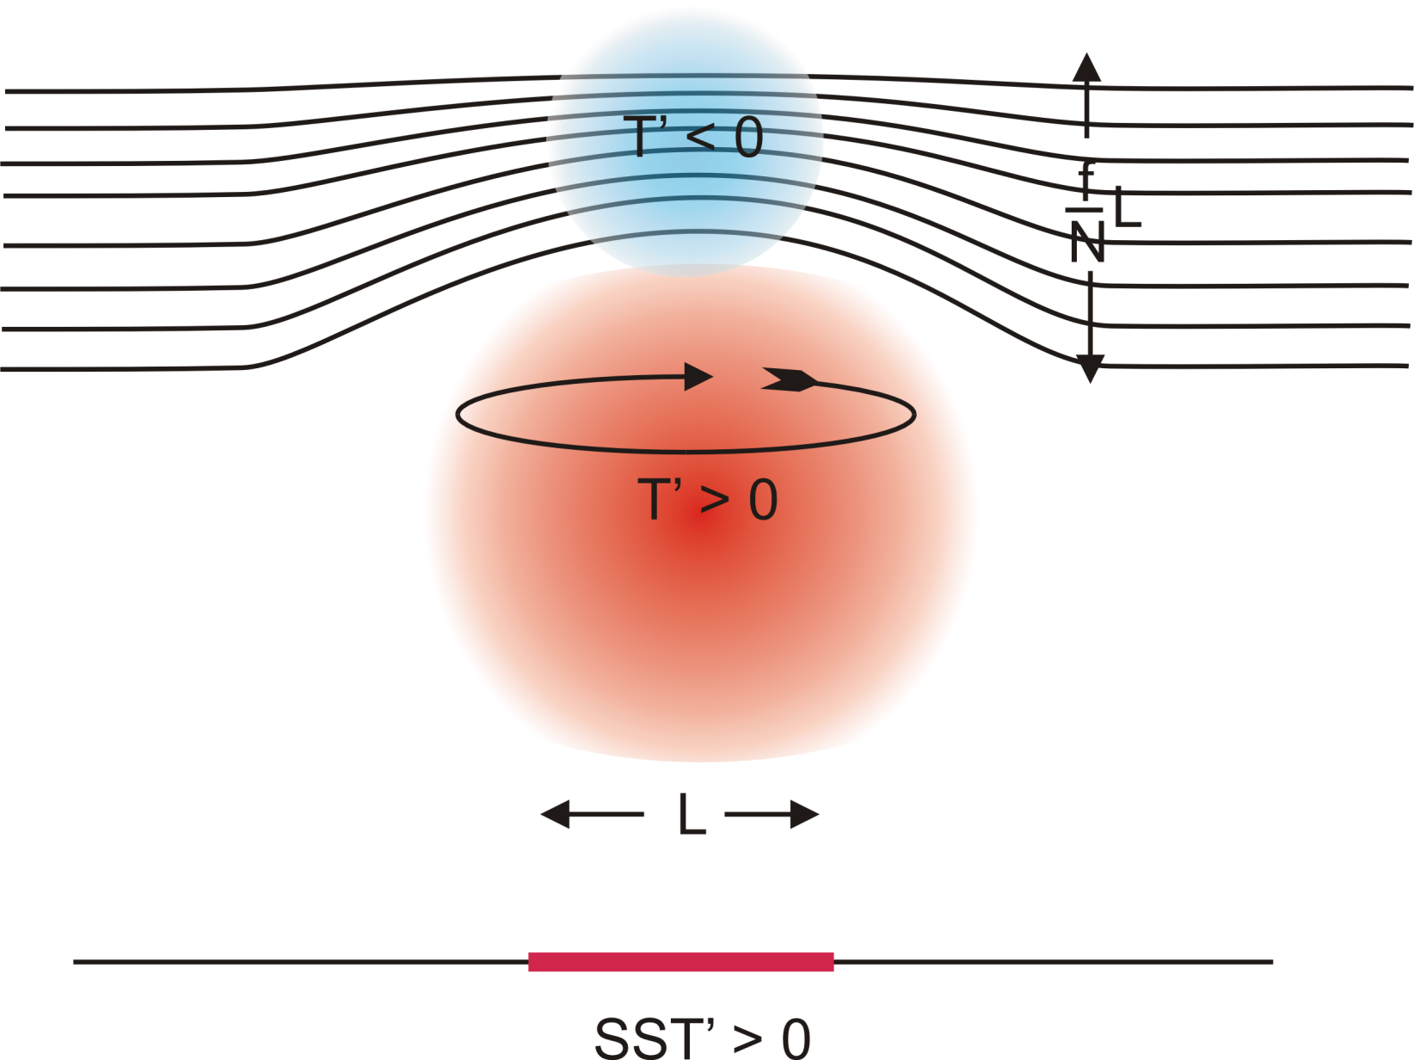
Stratospheric Compensation

Slide 102
Application to the Climate of the Pliocene

Slide 103
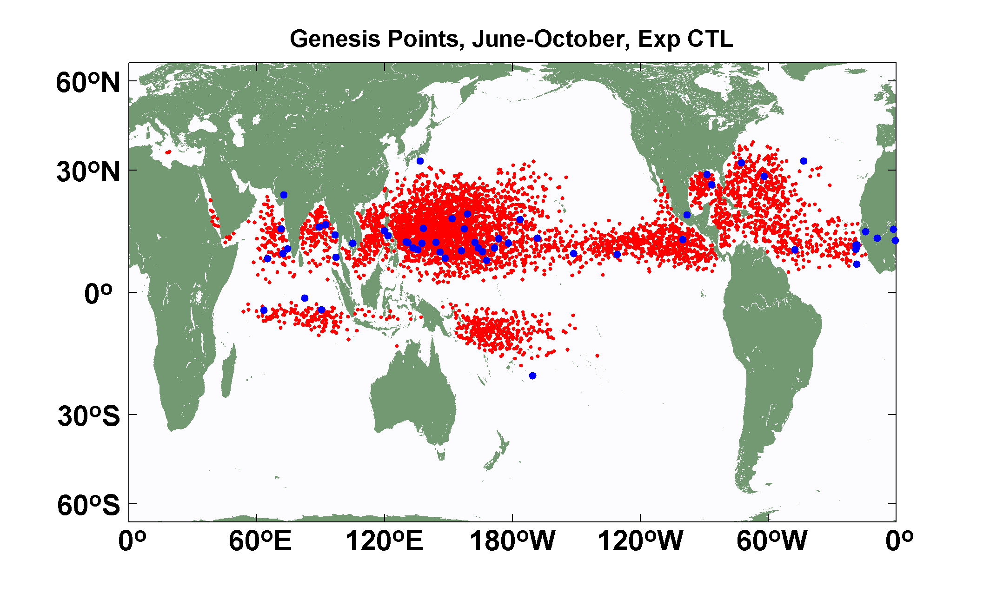
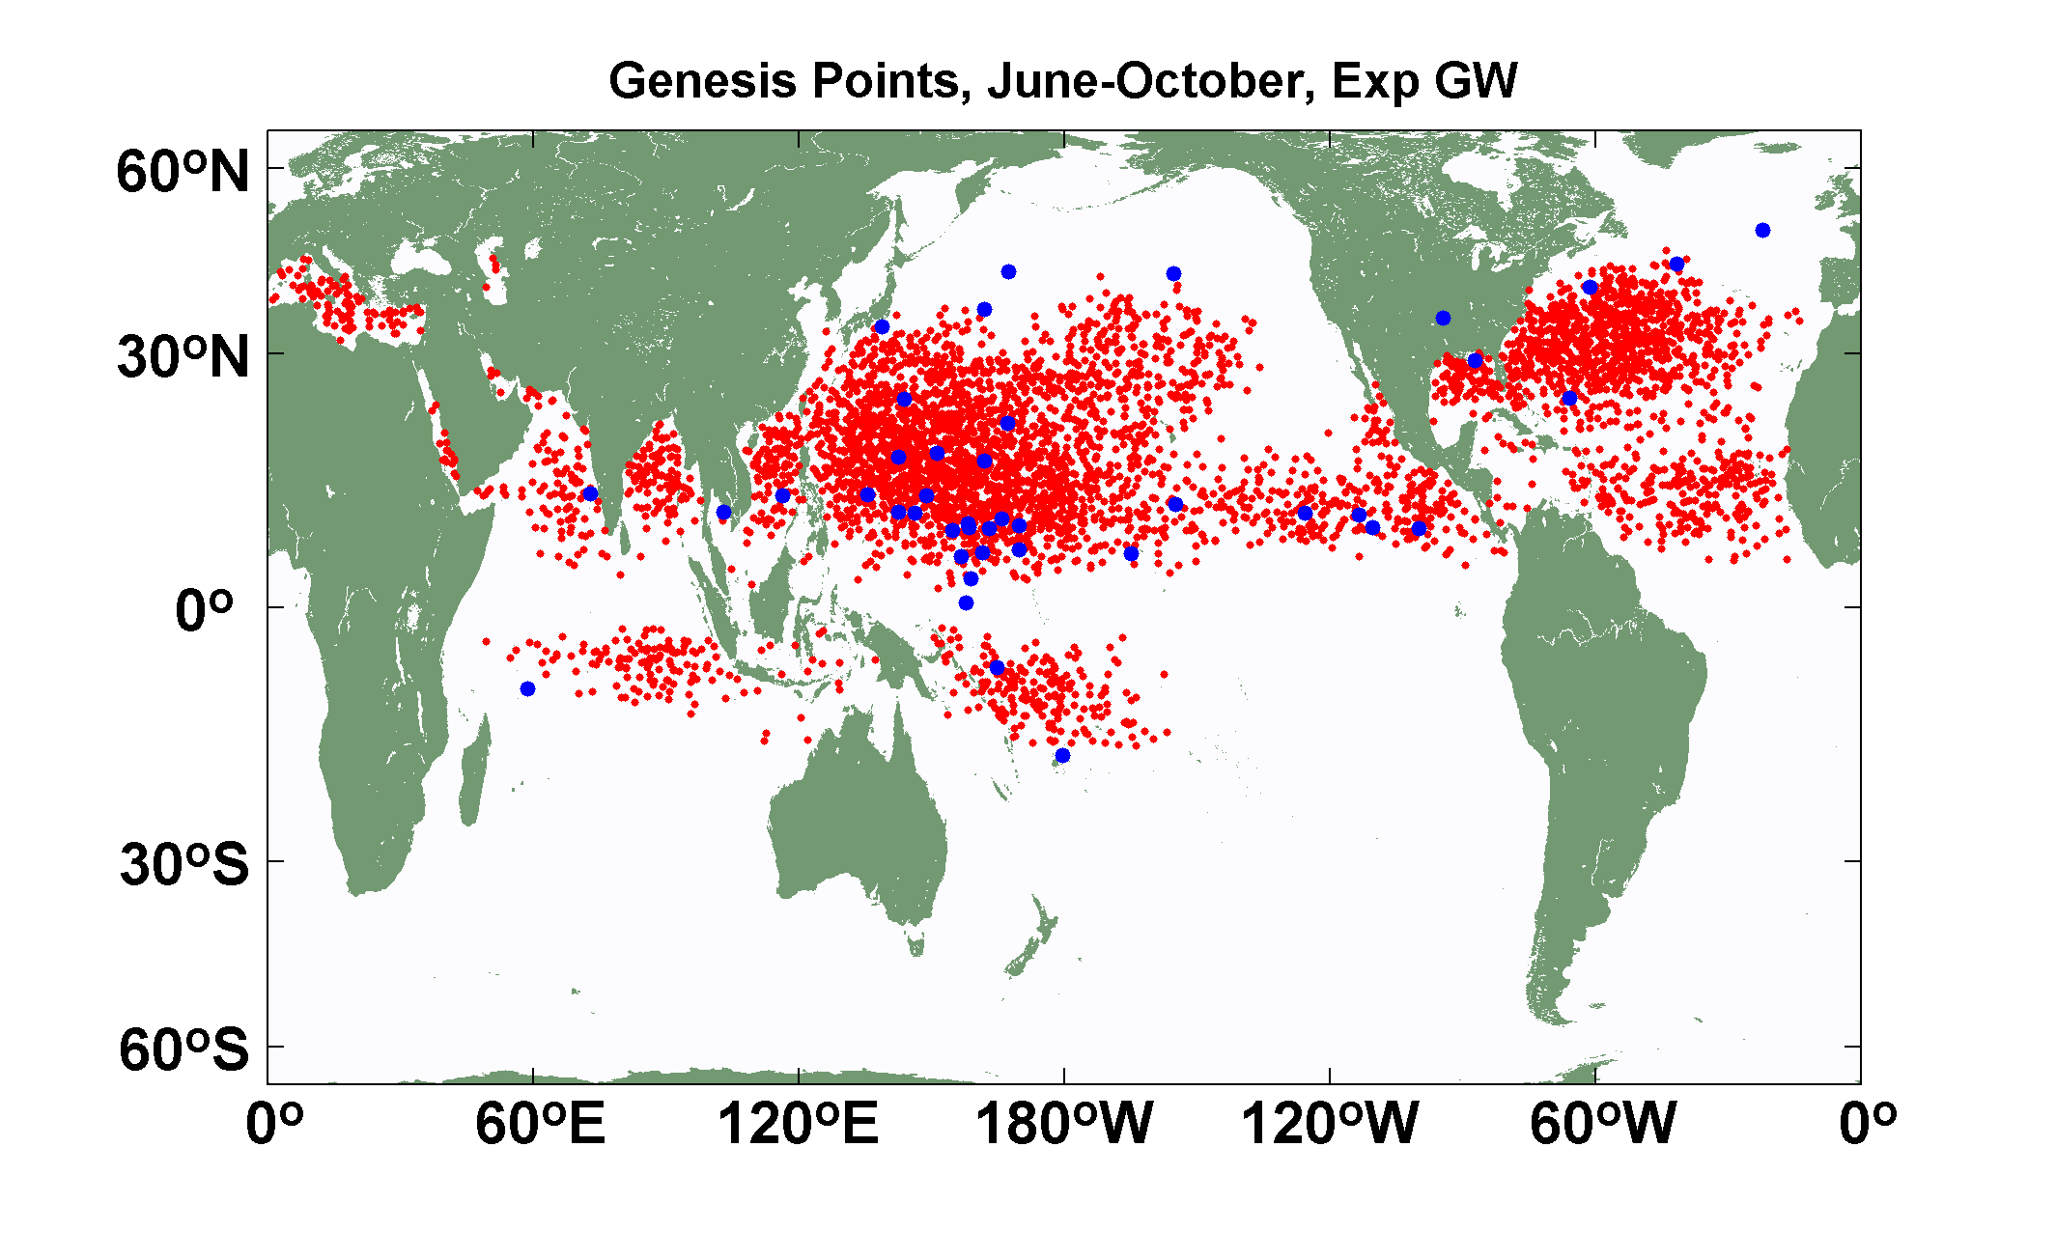
Explicit (blue dots) and downscaled (red dots) genesis points for June-October for Control (top) and Global Warming (bottom) experiments using the 14-km resolution NICAM model. Collaborative work with K. Oouchi.

Slide 104


Slide 105

Change in Power Dissipation with Global Warming

Slide 106

Probability Density by Storm Lifetime Peak Wind Speed, Explicit and Downscaled Events

