Slide 1
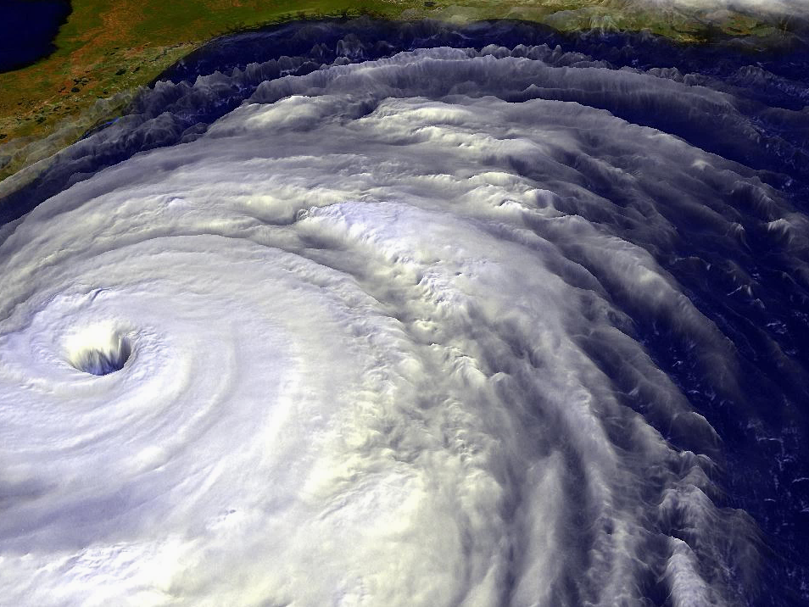
Hurricane Science Tutorial
Kerry Emanuel
Lorenz Center, MIT
Notes:
1

Slide 2
Why Should You Care?
Forecasting
  Much progress in social science of response to warnings, requests to evacuate, etc.
Forecasters are ambassadors to meteorology
  Opportunity to inform public
  Knowledge of hurricane science increases public interest and trust

Slide 3
Program
Brief overview of hurricanes
Current understanding
  Basic state of the tropical atmosphere
  Instability of the basic state – genesis
  Energy cycle of mature hurricanes – concept of potential intensity
  Negative influences on hurricanes
  Statistics of hurricane intensification
  Hurricane motion
  Hurricanes and climate change
Summary

Slide 4

Overview: What is a Hurricane?
Formal definition: A tropical cyclone with 1-min average winds at 10 m altitude in excess of 32 m/s (64 knots or 74 MPH) occurring over the North Atlantic or eastern North Pacific
A tropical cyclone is a nearly symmetric, warm-core cyclone powered by wind-induced enthalpy fluxes from the sea surface

Slide 5
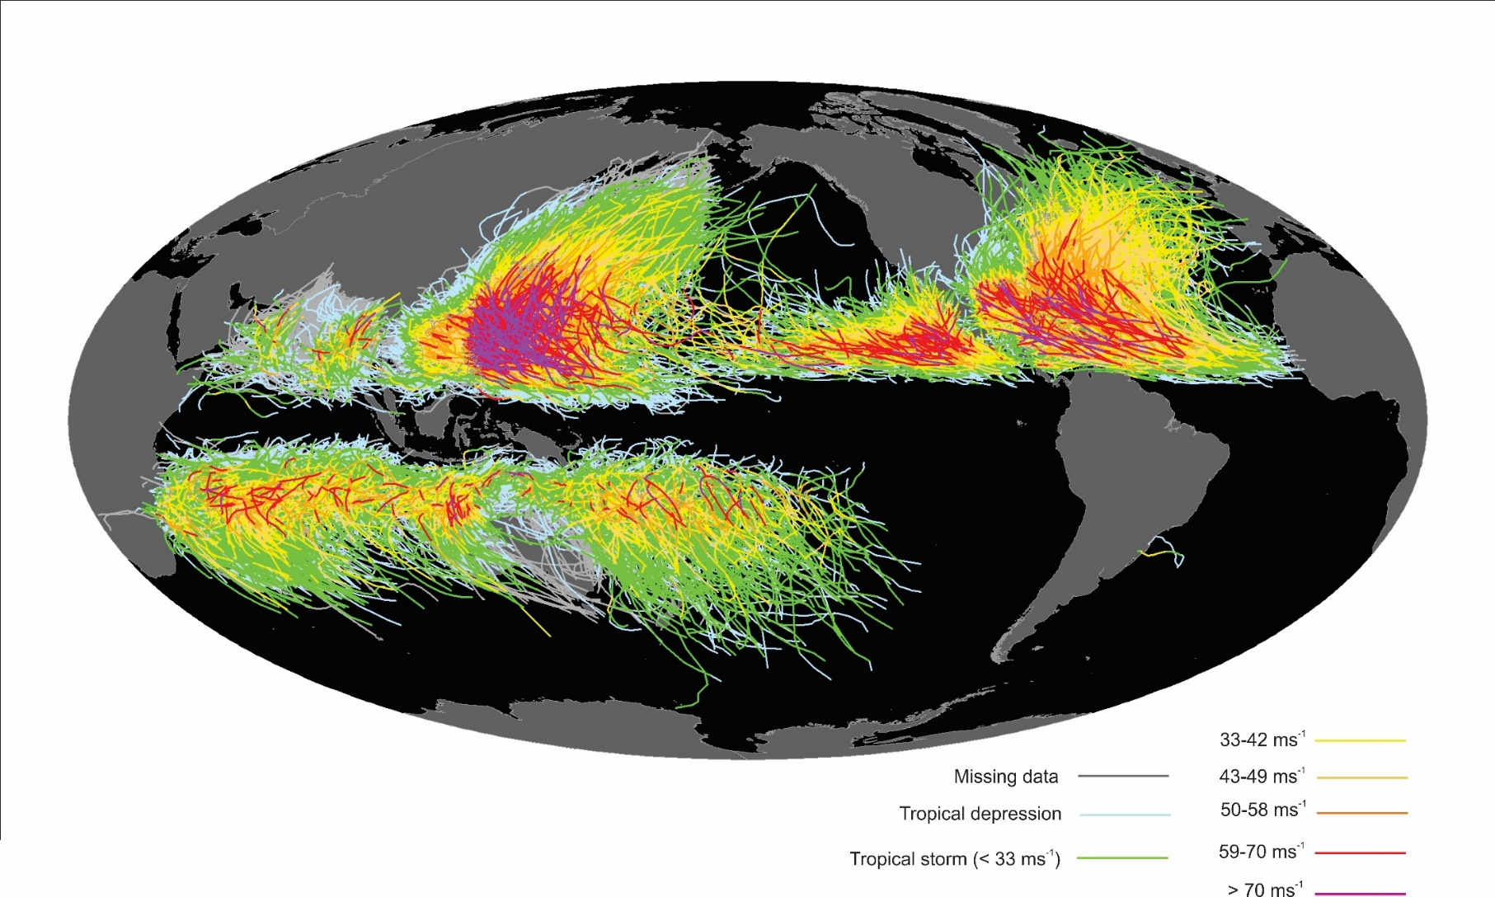
Global Climatology
Tracks of all tropical cyclones in the historical record from 1851 to 2010. The tracks are colored according to the maximum wind at 10 m altitude, on the scale at lower right.

Slide 6
Global Tropical Cyclone Frequency, 1980-2019
Data Sources: NOAA/TPC and NAVY/JTWC
Notes:
6

Slide 7
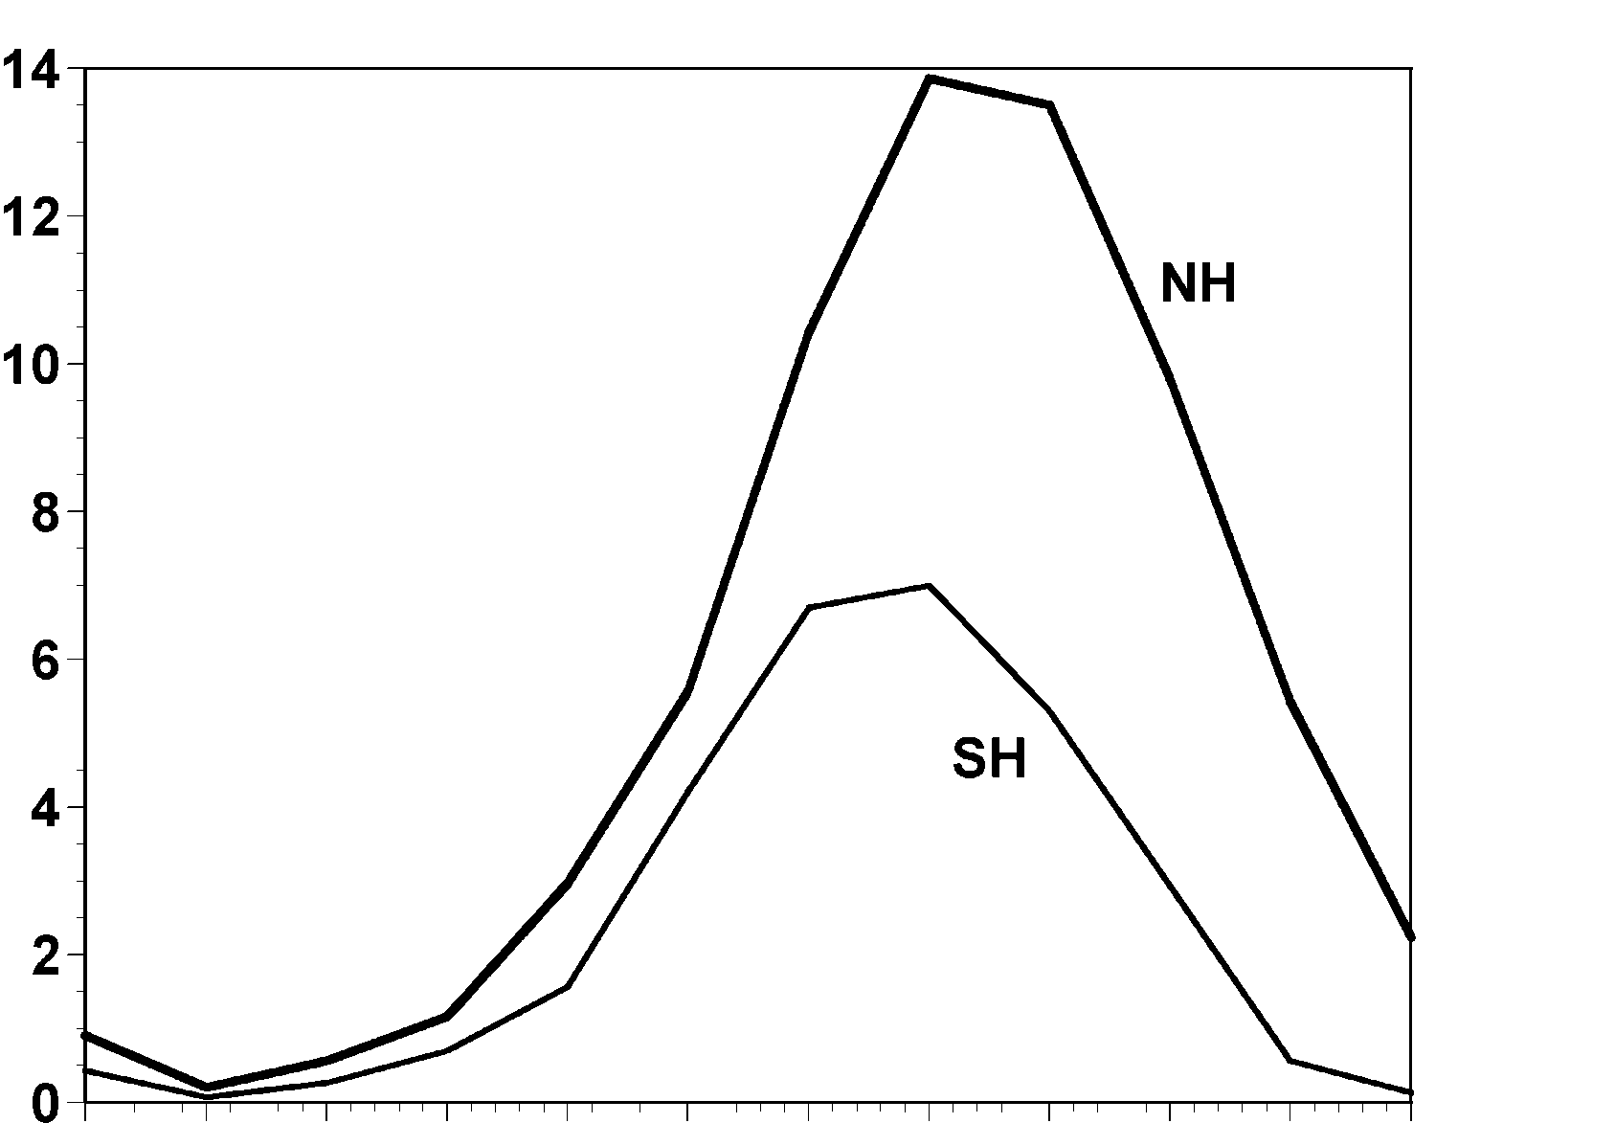
Annual Cycle of Tropical Cyclones
Number of Events per Month
a
Northern
Hemisphere
(NH)
a
Southern
Hemisphere
(SH)
Jan Feb Mar Apr May Jun Jul Aug Sep Oct Nov Dec NH
Jul Aug Sep Oct Nov Dec Jan Feb Mar Apr May Jun SH
Notes:
This graph shows the average number of tropical cyclones per month in the northern and southern hemispheres. Hurricanes tend to follow the sun, peaking in the summer and autumn and all but vanishing during the early spring. Typhoons can develop over the western North Pacific during any month of the year, but they are rare in the winter.
Image is copyrighted 2005 by Oxford University Press.
Image and description from “Divine Wind: The History and Science of Hurricanes”, Kerry Emanuel, 2005, Oxford University Press, 296 p.

Slide 8
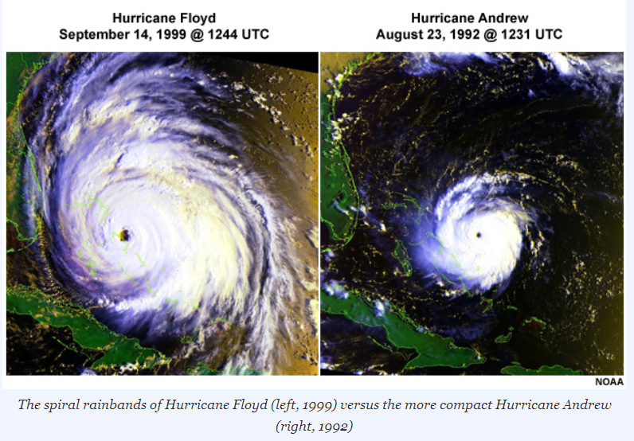

Slide 9
The Global Hurricane Hazard
About 15,000 deaths per year since 1971
$ 1.1 trillion 2015 U.S. dollars in damages ($21 billion/yr) since 1971
Global population exposed to hurricane hazards has tripled since 1970
EM-DAT, 2020: The OFDA/CRED International Disaster Database
http://www.emdat.be/.

Slide 10
Global Tropical Cyclone Damage Normalized by Gross World Product
380% increase since 1970
Population of TC-prone regions increased by ~200%
Suggests that climate change has contributed to increasing damage
EM-DAT, 2020: The OFDA/CRED International Disaster Database
http://www.emdat.be/.

Slide 11

Publicly
insured…
No $$$
Privately insured… $$$

Slide 12

The View from Space

Slide 13
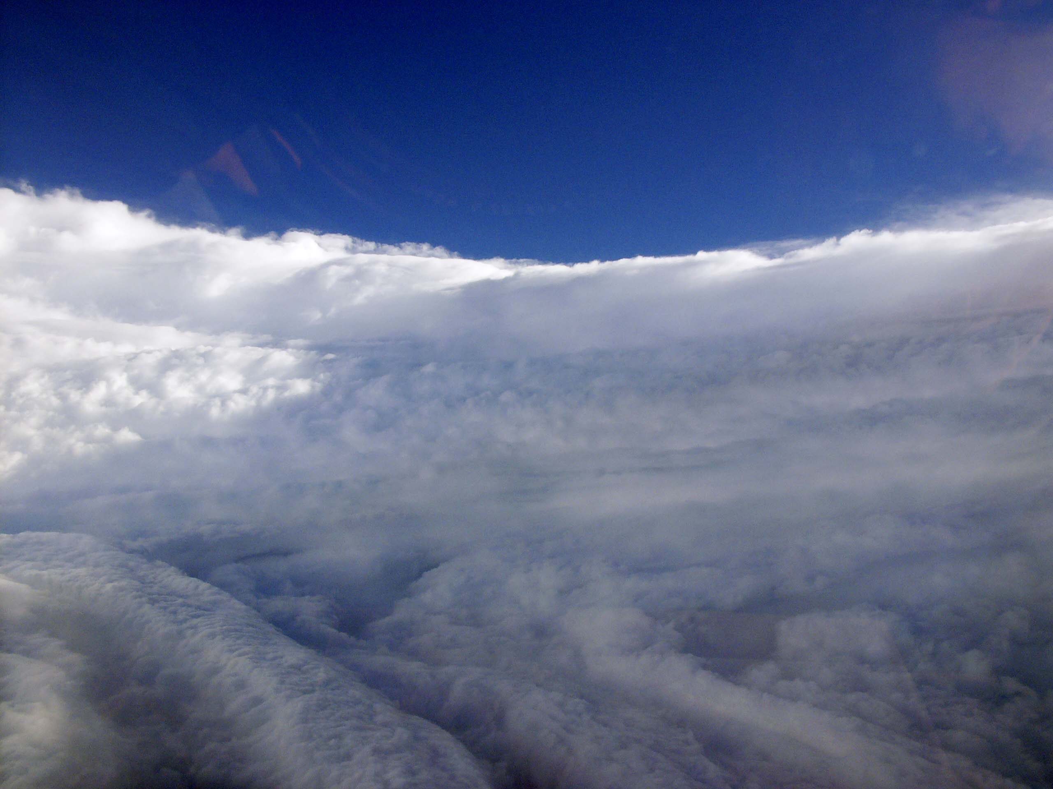
View of the eye of Hurricane Katrina on August 28th, 2005, as seen from a NOAA WP-3D hurricane reconnaissance aircraft.

Slide 14
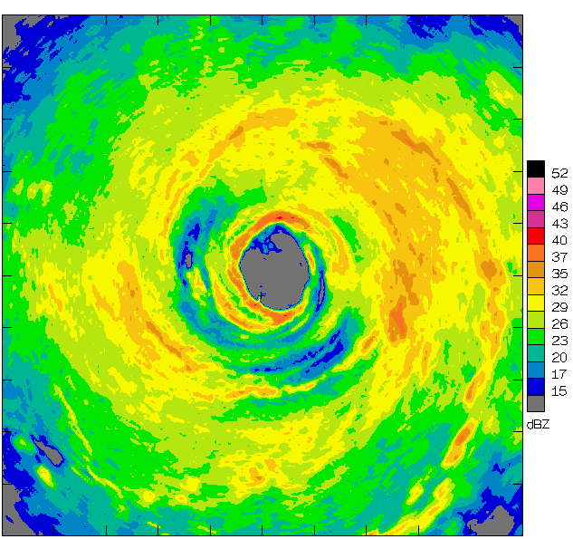
Airborne Radar: Horizontal Map
360 km
(220 mi)

Slide 15
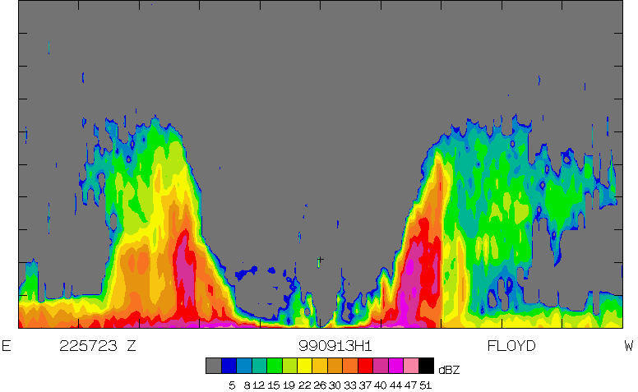
Airborne Radar: Vertical Slice
20 km
(12 mi)
120 km
(75 mi)

Slide 16
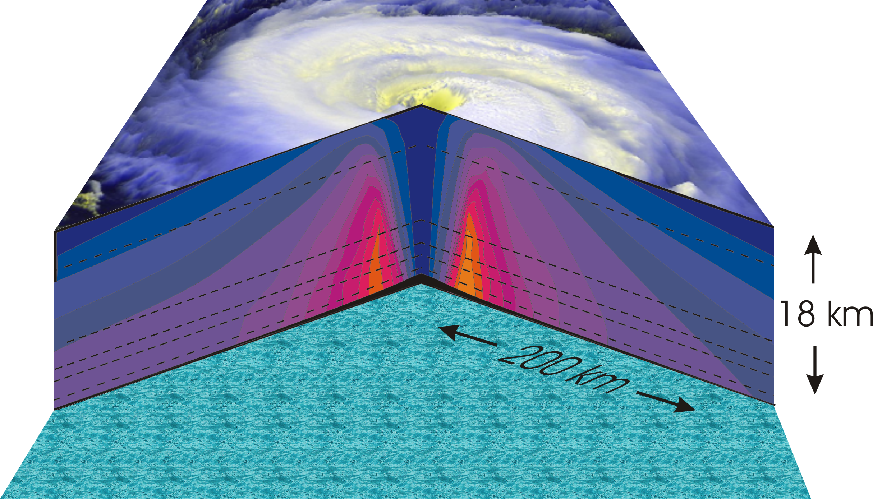
Hurricane Structure: Wind Speed
Azimuthal component of wind
< 11 5 ms⁻¹ - > 60 ms⁻¹
Notes:
A composite view of the distribution of wind speed in a typical hurricane based on measurements made from research aircraft. In this image and the two that follow, the center of the hurricane is in the center of the panel and the cutaway extends outward about 200 km (125 miles) and upward to about 18 km (11 miles). A satellite image of the top of a storm has been superimposed.
This image shows the speed of the wind going counterclockwise around the center of the storm; the black dashed lines show the altitudes at which the aircraft were flying. The darkest shade of blue indicates the lightest winds, less than 5 meters/second (11 mph). Each successive color represents an increment of 5 meters/second (11 mph), with bright orange showing winds in excess of 65 meters/second (145 mph). The strongest winds occur just above the ocean in a ring around the center, slightly outside the eyewall of the storm. Winds decrease rapidly inward toward the center, which is practically calm. They also decrease outward from the ring of maximum wind , but much more slowly, so that strong winds can still be found 100 kilometers (60 miles) from the center of the storm. As we go up from the surface, the counterclockwise winds get lighter and lighter. If the highest aircraft had flown even higher, it would have actually encountered “negative” wind speed, which here means winds going the other way (clockwise) around the center.
Image is copyrighted 2005 by Oxford University Press.
Image and description from “Divine Wind: The History and Science of Hurricanes”, Kerry Emanuel, 2005, Oxford University Press, 296 p.

Slide 17
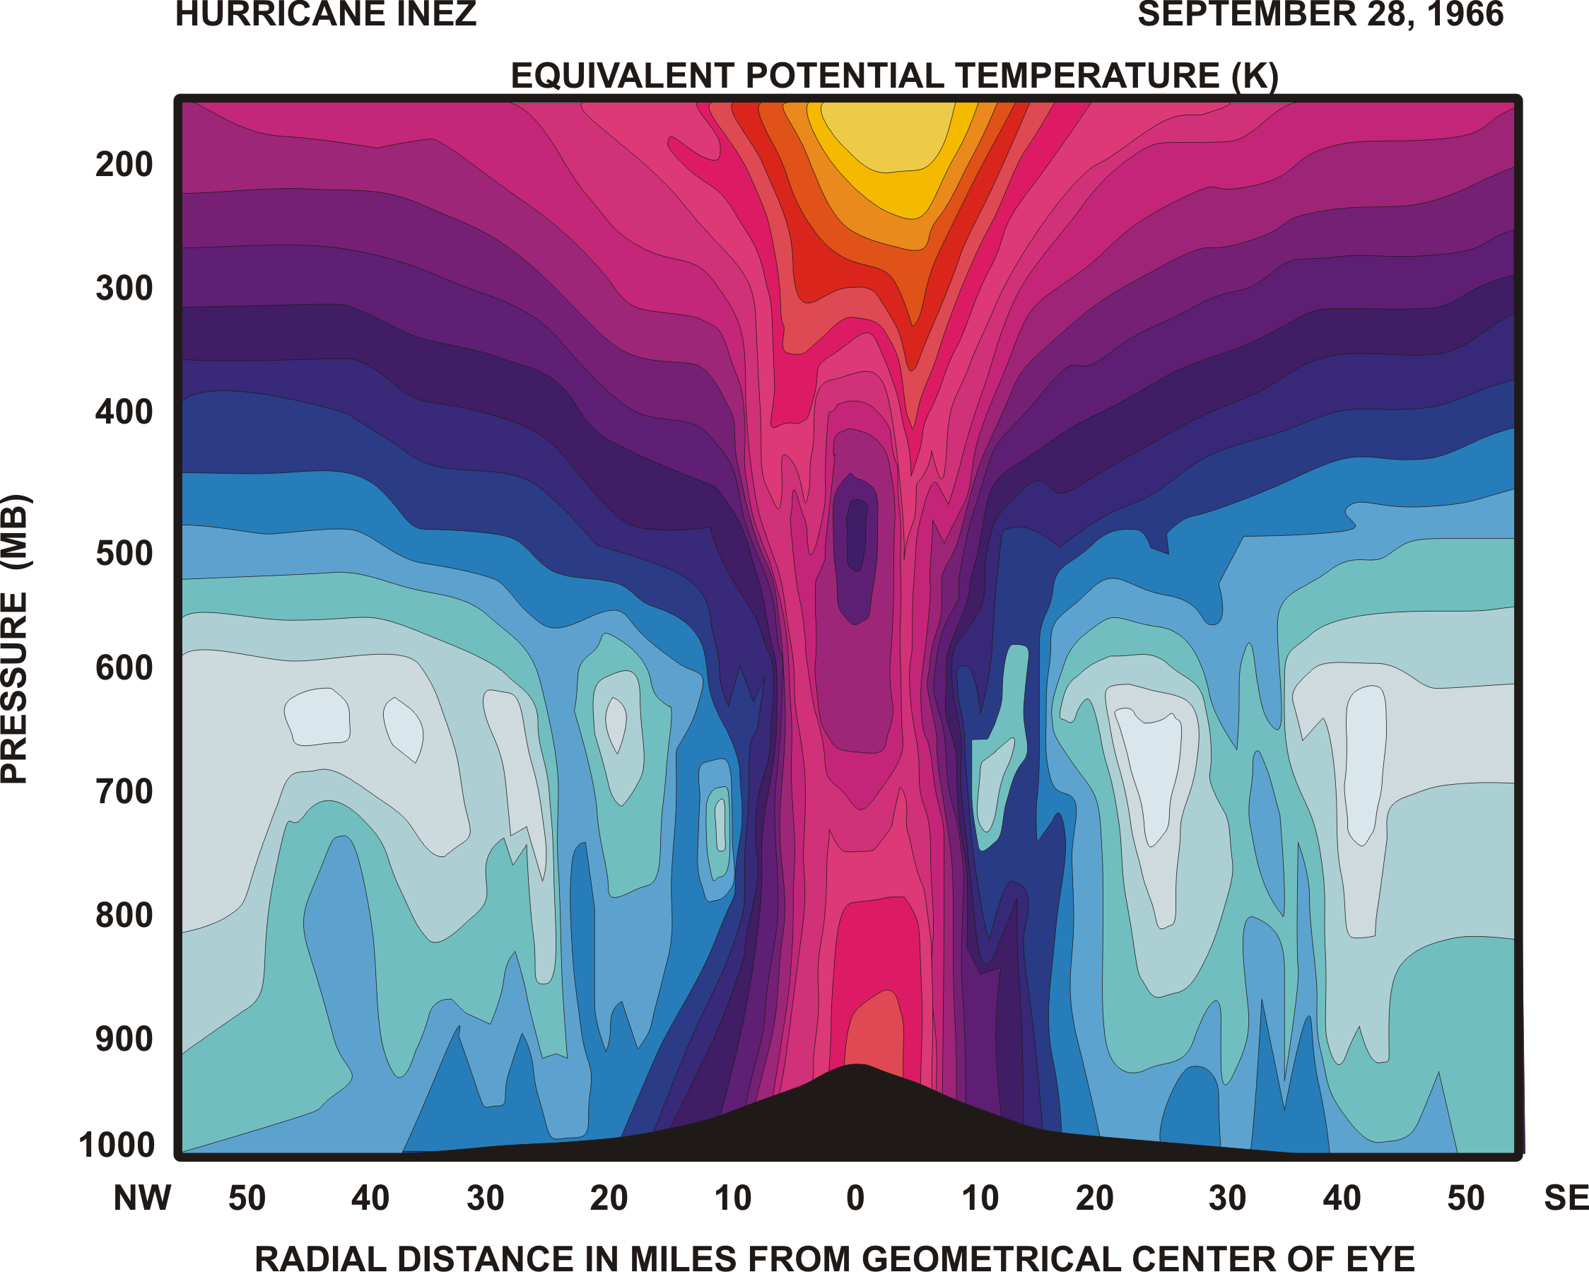
Specific entropy

Slide 18
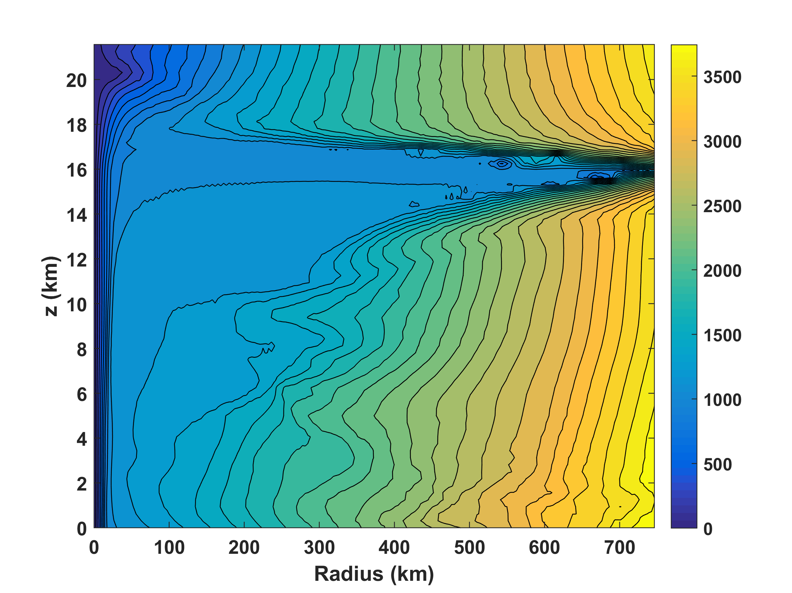
Absolute angular momentum per unit mass

Slide 19
Physics of Mature Hurricanes

Slide 20
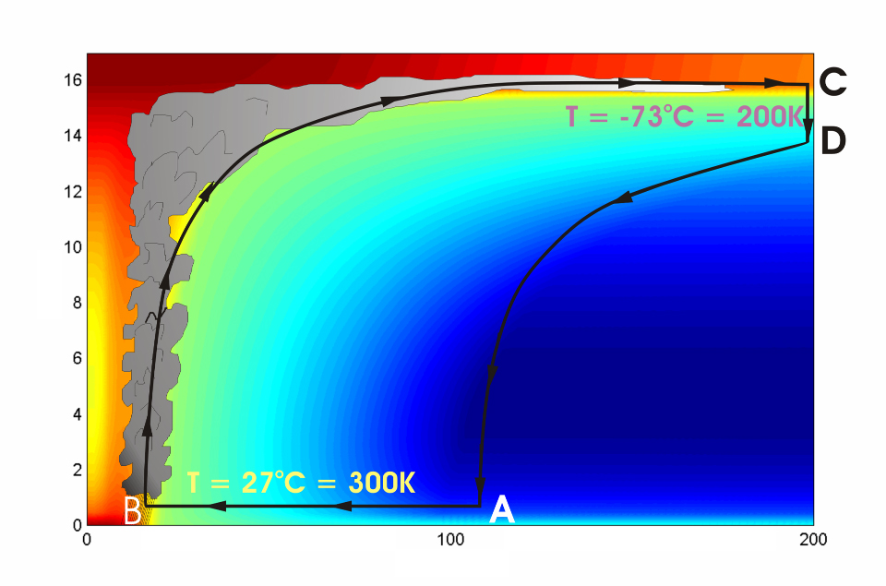




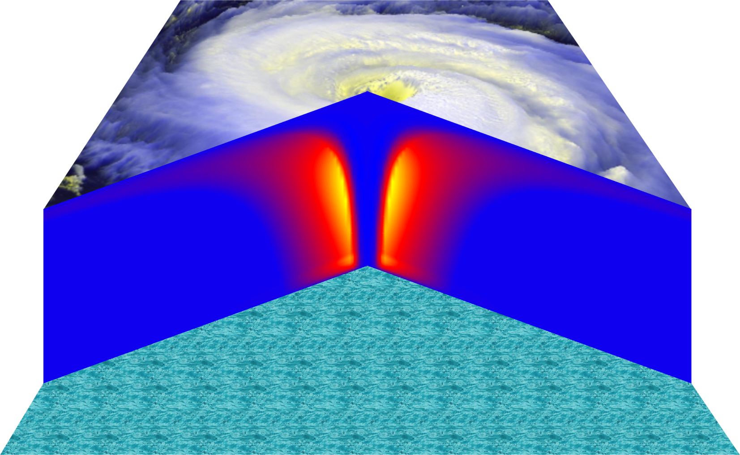
Cross-section through a Hurricane & Energy Production
eye
edge
Isothermal compression
Adiabatic expansion
Adiabatic compression
Height above ocean
Nearly isothermal expansion
Low entropy
Ocean surface
Radius (km)
Notes:
NOTE: We have animated the path of air for this slide and included labels to help our audience understand what you will be describing. Many of them will have never even heard of a Carnot heat engine and do not have a strong understanding of entropy. We would like to do whatever we can in to make this information accessible to our audience. Please let us know if you approve of these changes, and feel free to replace the labels as needed. The simpler you can keep your description of this, the better. You do an excellent job of describing the process in your book.
***
The energy cycle of a mature hurricane - the hurricane as a Carnot heat engine. This two-dimensional plot of the thermodynamic cycle shows a vertical cross section of the hurricane, whose storm center lies along the left edge. The colors depict the entropy distribution; cooler colors indicate lower entropy. Loosely, this means the total heat content of the air. Note that as air approaches the eyewall, its entropy increases rapidly, reflecting the large input of heat from the ocean.
Let’s follow a sample of air that begins at point A near the sea surface, a hundred kilometers or so from the storm center. The process mainly responsible for driving the storm is the evaporation of seawater, which transfers energy from sea to air. As a result of that transfer, air spirals inward close to the sea surface, between Points A and B. The storm center is an area of relatively low pressure, so the pressure on air decreases as it travels from A to B. But it is always in contact with the sea surface, which acts as an almost unlimited heat reservoir, so its temperature is approximately constant (acquiring entropy at a constant temperature). It is during this leg that enormous quantities of heat are added to the air from evaporation of seawater. Evaporation of water is a very efficient way to transfer heat from one body to another. That is why you feel cold when you are wet, especially if it is windy and/or dry: evaporation is taking heat from your body. Thus the addition of heat in leg A-B shows up mostly as an increase in humidity in the air. This form of heat is called latent heat. Evaporation of sea water into the inflowing air is by far the most important source of heat driving the hurricane, which makes leg A-B the firebox of the hurricane. When hurricanes reach land, they quickly die because they are cut off from their oceanic energy source. At point B, the air turns and flows upward through the towering cumulonimbus clouds that make up the hurricane’s eyewall. It is here that the latent heat is converted to sensible heat as water vapor condenses. But it is important to note that although there is enormous conversion between these two forms of heat, the total heat content (entropy, actually) remains approximately constant along this leg (note that the colors do not change along leg B-C). As the air flows upward, the pressure on it decreases very rapidly. What we have here is an example of adiabatic expansion. By the time the air reaches point C in the high troposphere or lower stratosphere, some 12 to 18 kilometers above the sea surface, the adiabatic expansion has lowered its temperature to a value close to that of the undisturbed upper tropical atmosphere, around -70°C or about 200 Kelvin. The air remains at approximately this temperature as it sinks down toward the tropopause (point D). Although the air is undergoing compression, it is losing heat by electromagnetic radiation to space. The depicted compression is very nearly isothermal. Finally, between D and A, the air returns to its starting point while undergoing an adiabatic compression. Voilà, the four legs of a Carnot cycle.
In a real hurricane, the energy cycle is open because hurricanes continuously exchange air with their environment.
Image is copyrighted 2005 by Oxford University Press.
Description from “Divine Wind: The History and Science of Hurricanes”, Kerry Emanuel, 2005, Oxford University Press, 296 p.

Slide 21
Annual Maximum Potential Intensity (m/s)

Slide 22
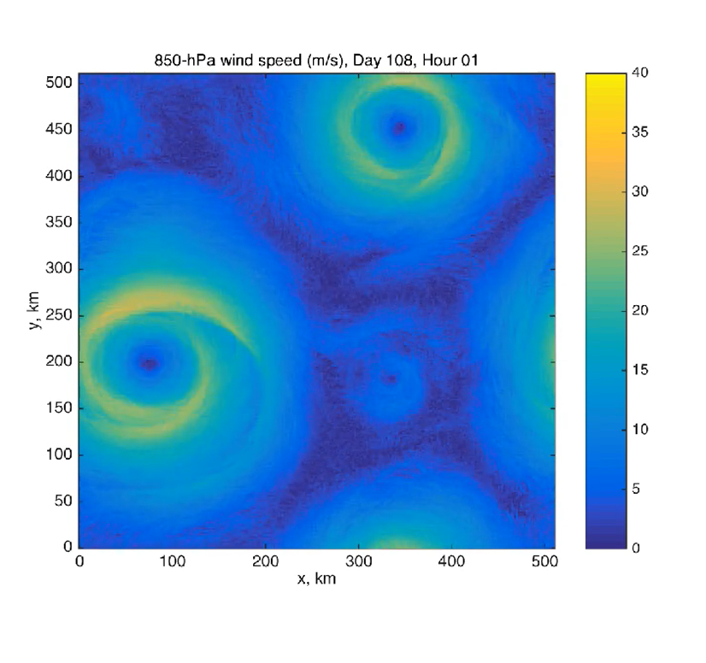

Slide 23
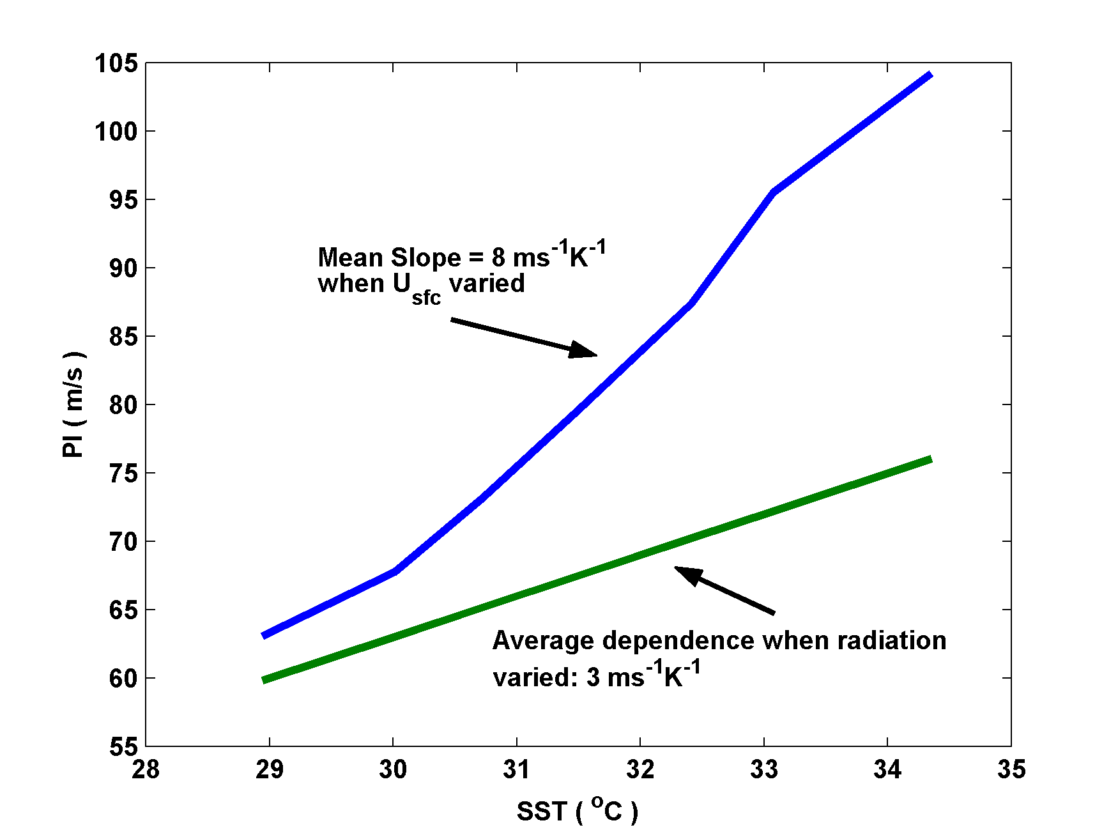
Dependence on Sea Surface Temperature (SST):
Potential Intensity is not the same thing as SST!

Slide 24
Why do real storms seldom reach their thermodynamic potential?
One Reason: Ocean Interaction

Slide 25
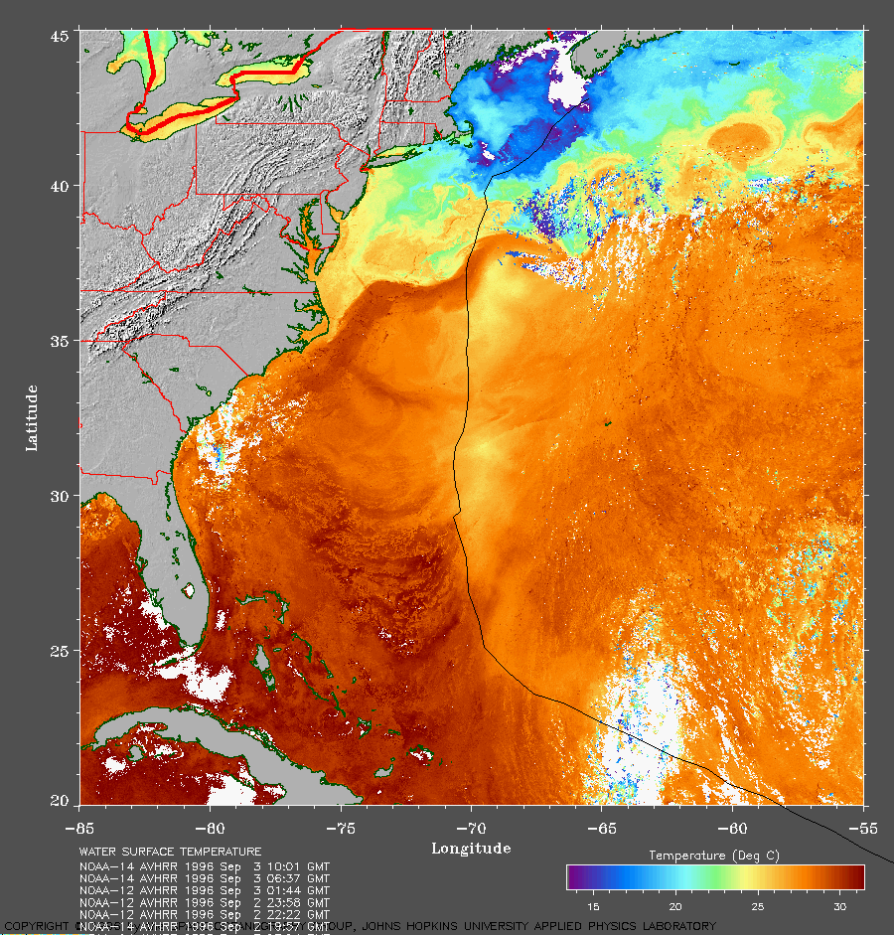
Strong Mixing of Upper Ocean

Slide 26
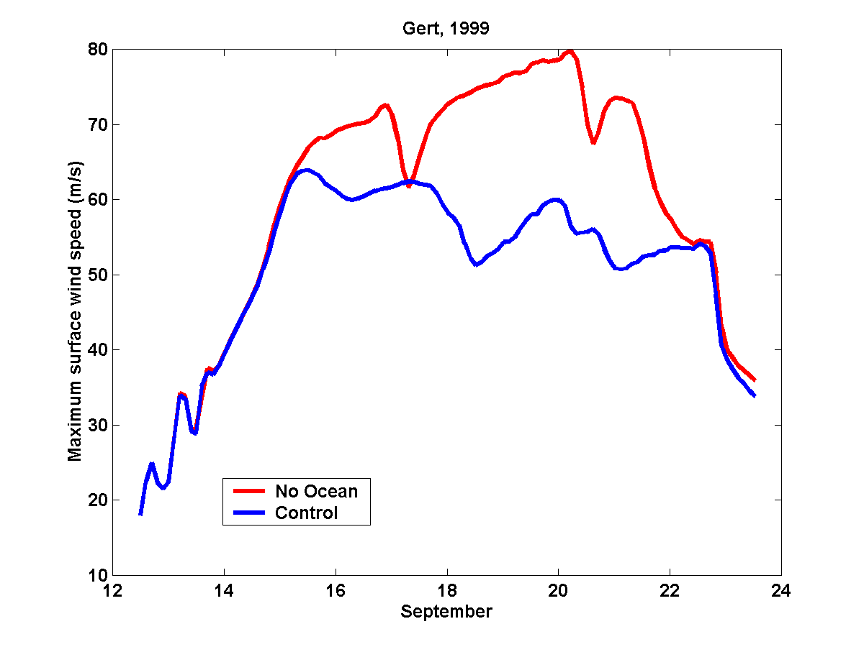
Comparing Fixed to Interactive SST:

Slide 27
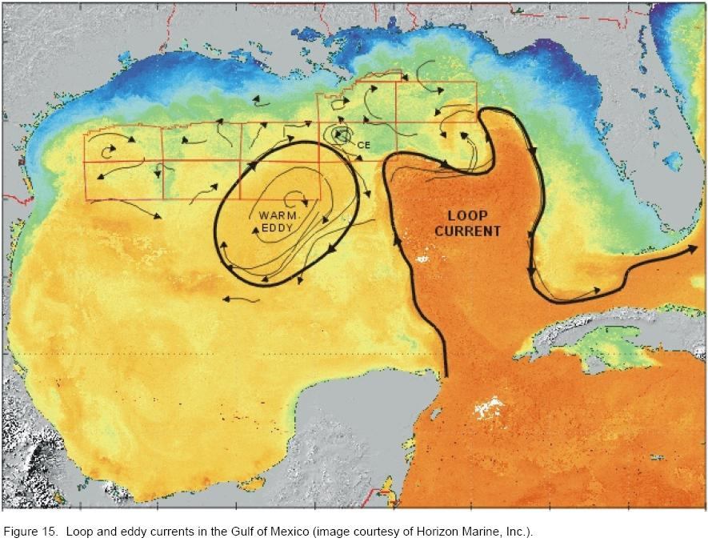

Slide 28
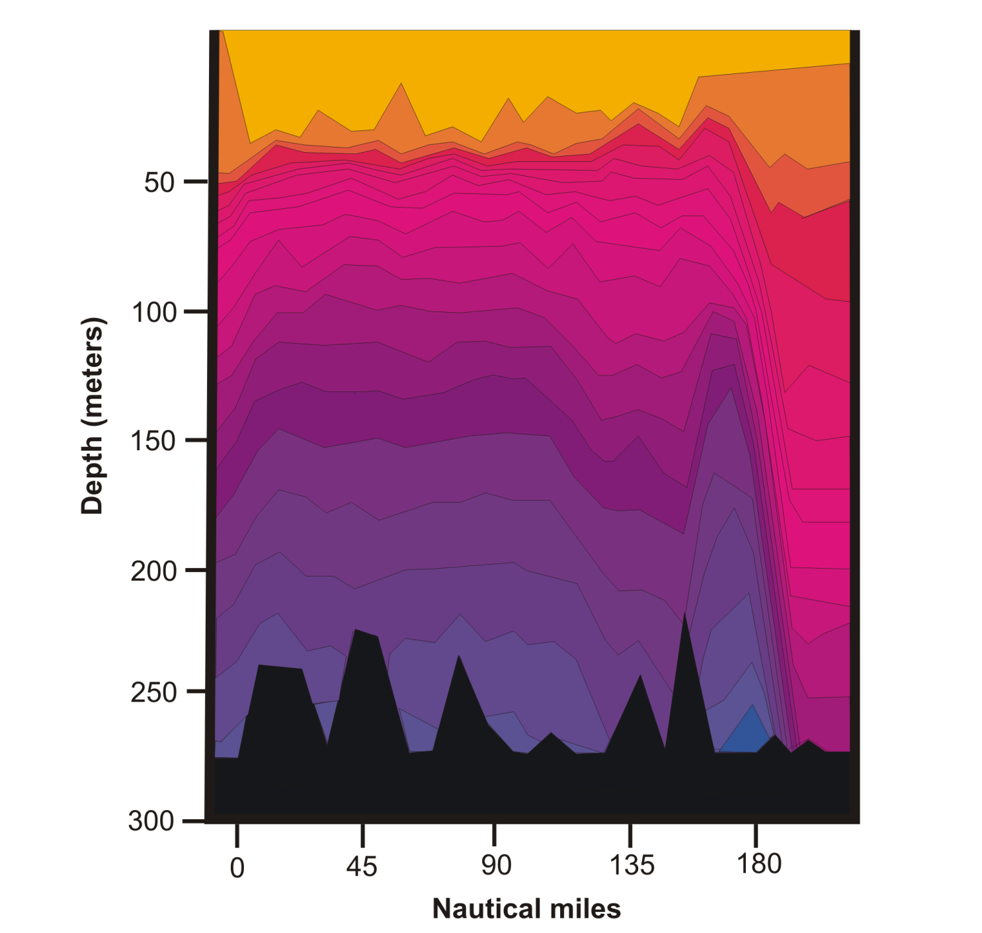
Loop Current

Slide 29
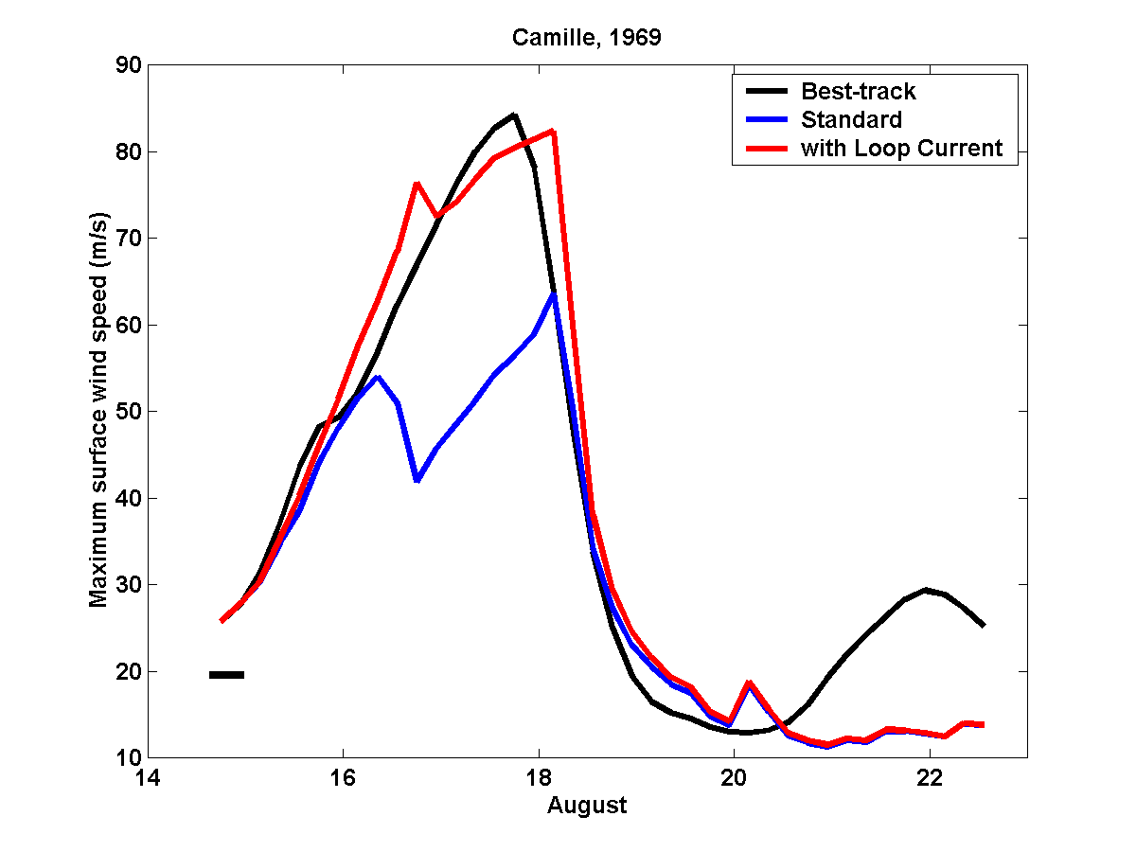
A good simulation of Camille can only be obtained by assuming that
it traveled right up the axis of the Loop Current:

Slide 30
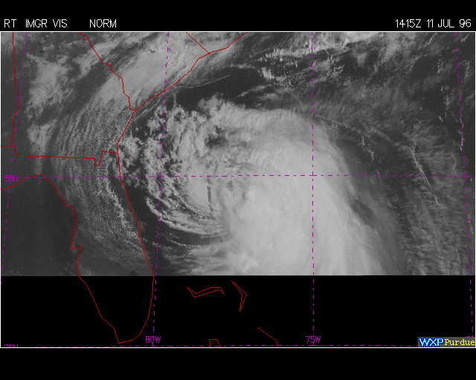
Wind Shear

Slide 31
Shear appears to weaken TCs by blowing dry, low theta_e air into the core

Slide 32
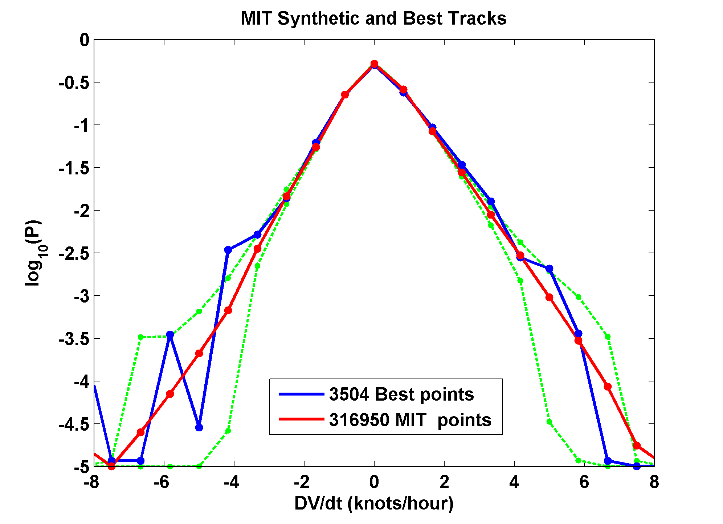
Statistics of Hurricane Intensification
Common logarithms of the probability densities of open-ocean tropical cyclone intensity change rates in the North Atlantic region from 3504 observations (blue) and from 316 950 synthetic samples (red) of hurricane-intensity storms. Green lines or dots indicate the 5th and 95th percentiles of 1000 subsamples of the synthetic tracks data at the rate of the observed data for each intensity change bin. All distributions are bounded below by 1025. The synthetic data are subsampled every 6 h and rounded to 5 kt to match the best track data

Slide 33
Tropical Cyclone Motion

Slide 34
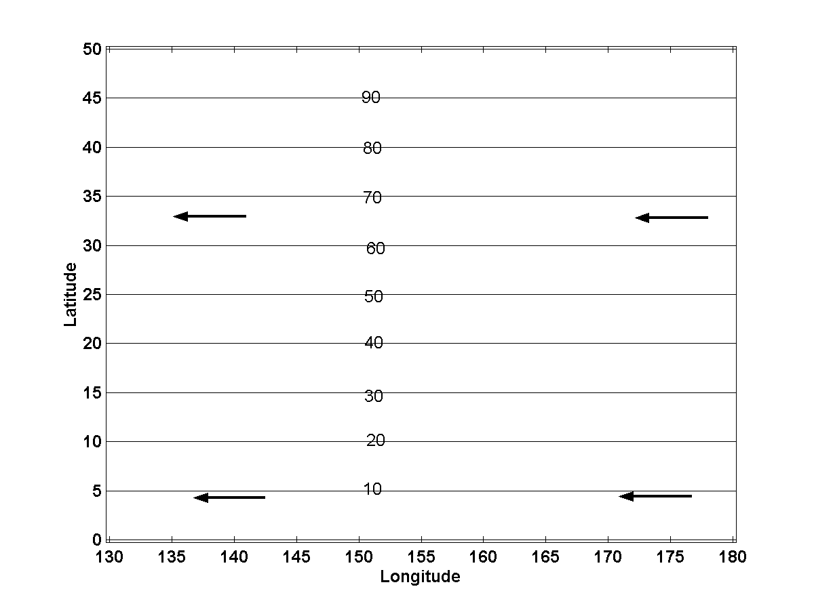
Tropical cyclones move approximately with a suitably defined vertical vector average of the flow in which they are embedded

Slide 35
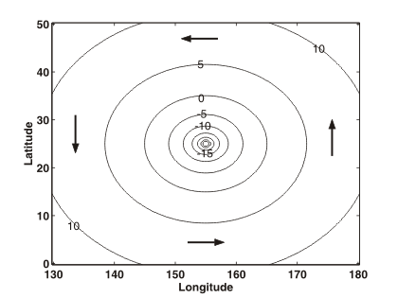

Slide 36
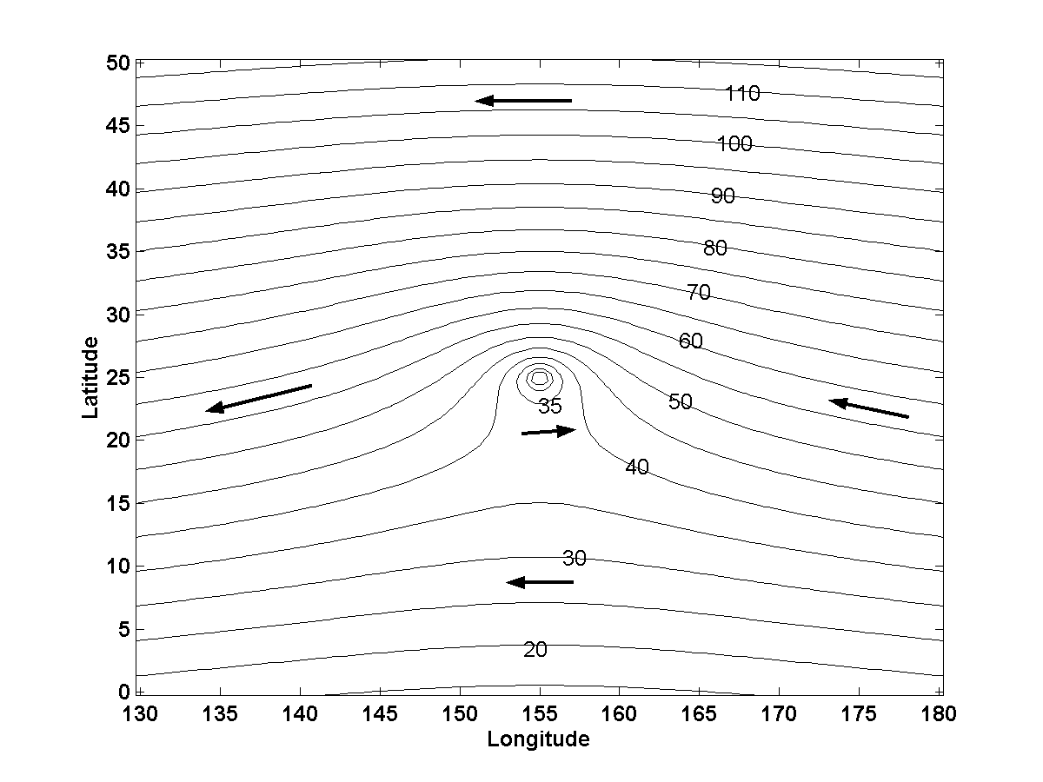

Slide 38
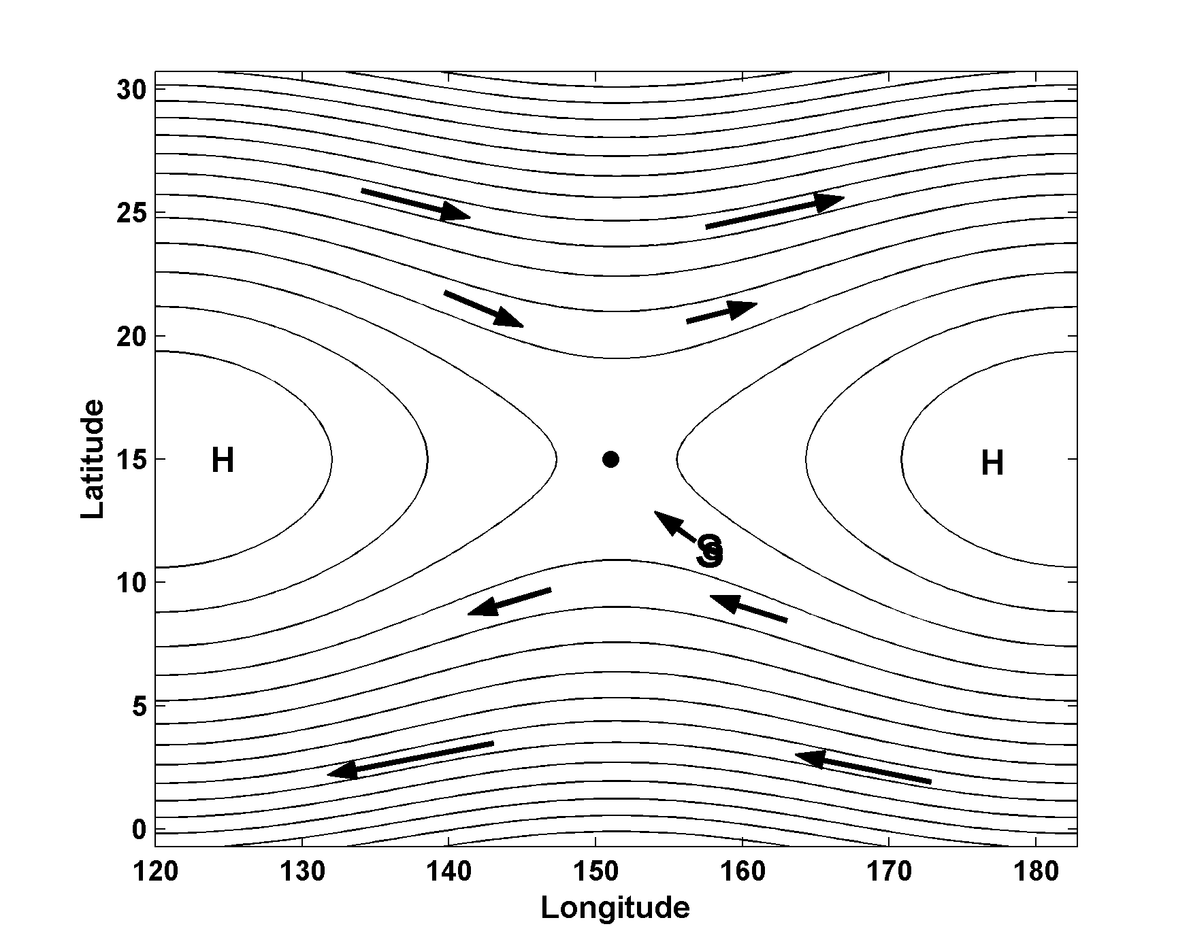
Lagrangian chaos:

Slide 39
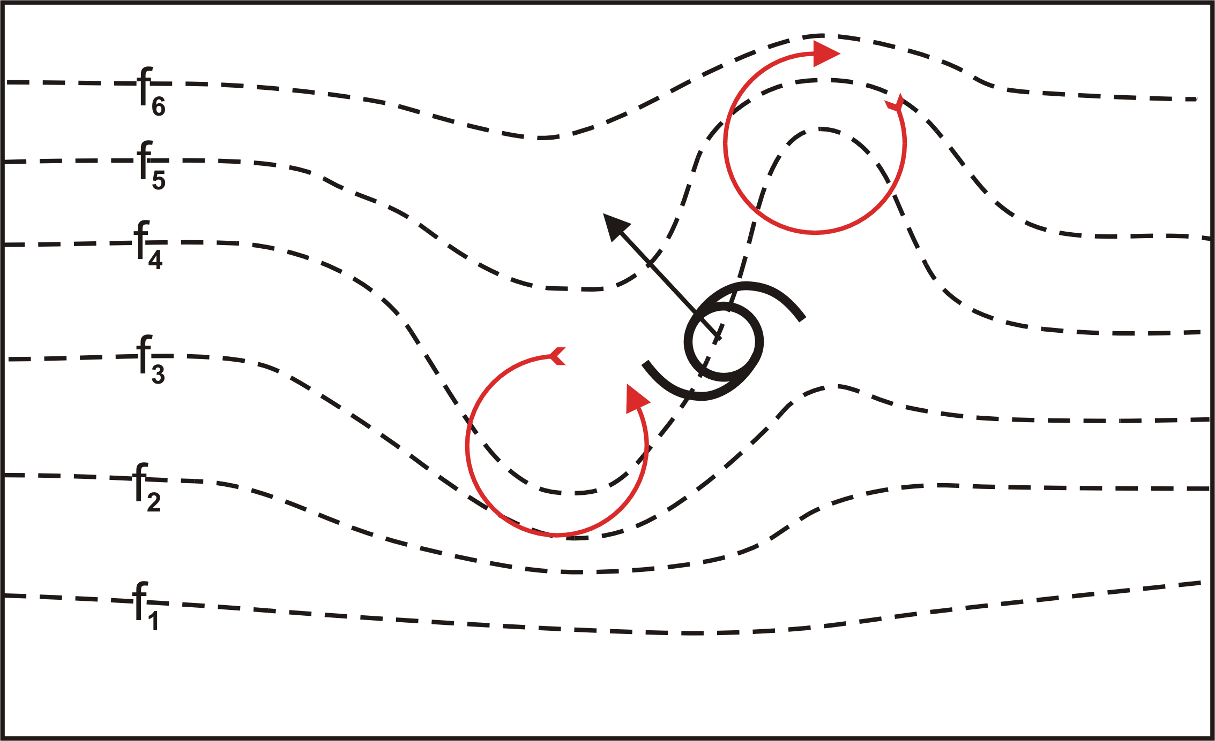
Vortices in interacting with Earth’s vorticity:

Slide 40
Hurricanes and Climate

Slide 41
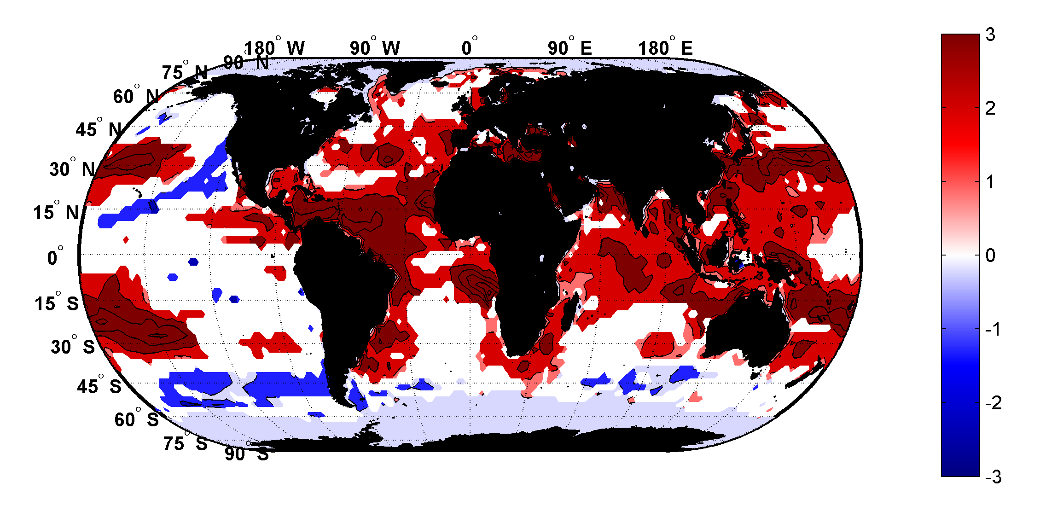
Trends in Thermodynamic Potential for Hurricanes, 1980-2010
(NCAR/NCEP Reanalysis)
ms⁻¹decade⁻¹

Slide 42

Inferences from Basic Theory:
Potential intensity increases with global warming
Incidence of high-intensity hurricanes should increase
Increases in potential intensity should be faster in sub-tropics
Hurricanes will produce substantially more rain: Clausius-Clapeyron yields ~7% increase in water vapor per 1ºC warming

Slide 43
Summary
Hurricanes are almost perfect Carnot heat engines, operating off the thermodynamic disequilibrium between the tropical ocean and atmosphere, made possible by the greenhouse effect

Slide 44
Most hurricanes are prevented from reaching their potential intensity by storm-induced ocean cooling and environmental wind shear
Hurricanes move with some vertical average of the environmental flow plus effects due to the earth’s rotation and curvature, and to wind shear

Slide 45
Hurricanes are expected to become more intense and rain more as the climate warms

