Slide 1

Effects of Climate Change on TC Freshwater Flooding
Kerry Emanuel
Lorenz Center
Massachusetts Institute of Technology

Slide 2

Water, not Wind, is the Dominant Problem in Hurricanes
~500 from water, ~80 from wind

Slide 3
Predicting Rainfall from Large Sets of Synthetic TCs
The CHIPS models predicts updraft and downdraft convective mass flux as a function of time and potential radius, BUT:
Storing these variables at all radii would increase overall storage requirements by a factor of ~50
(We are dealing with 10,000-100,000 individual events)

Slide 4
Basic strategy: Reconstruct time-evolving
2-D wind field by fitting a canonical radial wind profile to predicted values of V_{max} and r_{max}. Allow resulting vortex to interact with surface, including topography, and background wind and thermodynamic fields.
Application of Quasi-Balance Dynamics

Slide 5
Calculating vertical motion in middle troposphere from time-dependent azimuthal gradient wind. Four components:
Vertical motion at the top of the boundary layer owing to frictional effects within the boundary layer. This is estimated using a slab boundary layer model forced by the model gradient wind as well as the low-level environmental wind used as an input to the storm synthesizer. Use spatially varying drag coefficient.
Vertical motion at the top of the boundary layer forced by topography interacting with the combination of storm and environmental flow.

Slide 6
Vertical stretching between the top of the boundary layer and the middle troposphere associated with changes in the vorticity of the (axisymmetric) gradient wind.
Add mid-tropospheric vertical motion caused by the dynamical interaction of the axisymmetric vortical flow and the background shear/horizontal temperature gradient. Classical quasi-balance reasoning.

Slide 7
Given mid-tropospheric vertical motion, rainfall is calculated by assuming ascent along a moist adiabat, calculated using the environmental 600 hPa temperature plus a correction for the storm’s warm core

Slide 8
Evaluation against radar and rain gauge data (Monika Feldmann)
Estimated gauge sampling error
Estimated radar sampling error

Slide 9
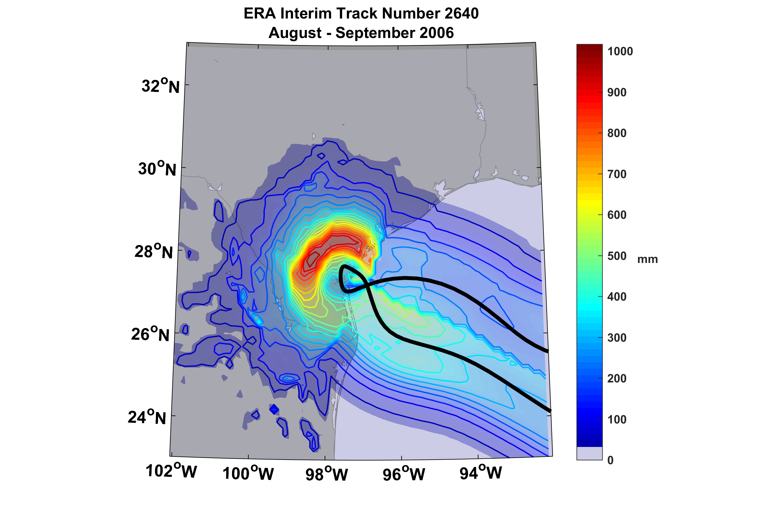
Example of Accumulated Rainfall from a Harvey-like Event Downscaled from ERA Interim Reanalysis

Slide 10
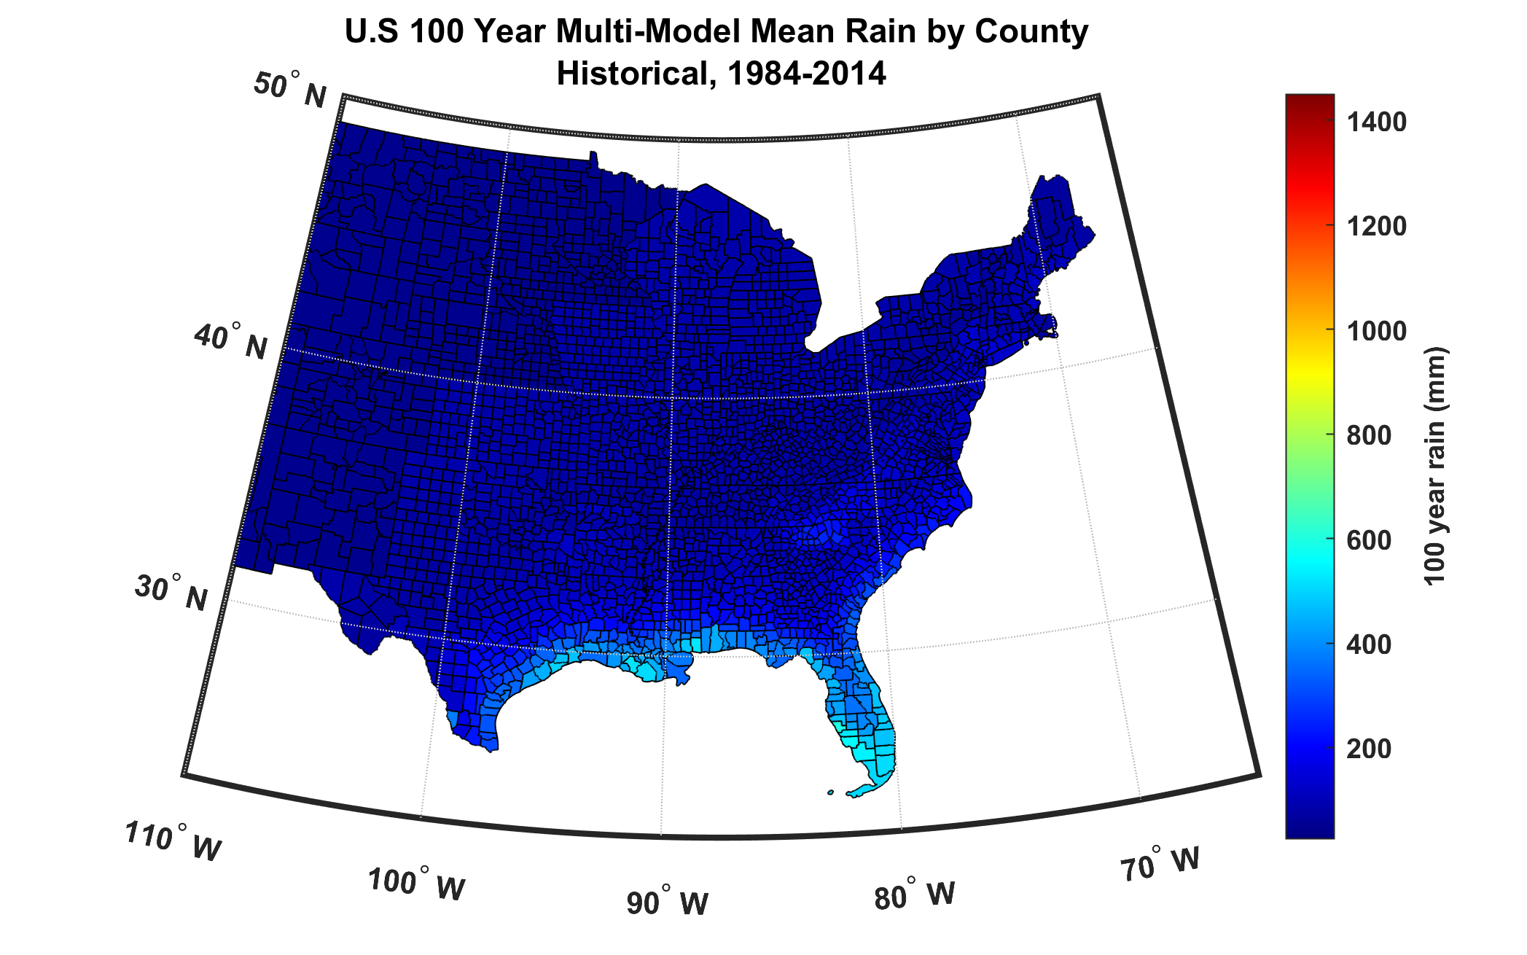
100-year hurricane storm total rain based on downscaling 8 CMIP6 climate models, 1984-2014

Slide 11
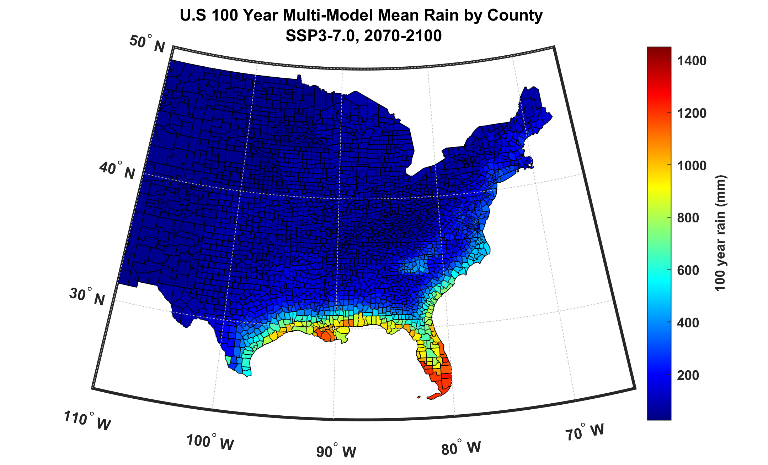
100-year hurricane storm total rain based on downscaling 8 CMIP6 climate models, 2070-2100

Slide 12
Disaggregating different contributions to 100-year rainfall at fixed locations
Storm total rainfall:
Define w50 as the median vertical velocity over the time series
Duration:
Moisture:

Slide 13
Now, using the whole TC set, find the subset of events whose rainfall exceeds the 100-year rainfall
Next, define a “mean log 100-year rainfall” as the integral over probability of the log of the rainfall over the whole subset defined above. (Denote this operation with an overbar.)
Do the same for the logs of w₅₀, Q, and D
Do this for each downscaled climate model (i) and define Δ as the difference between two climate states:
Finally, take the mean and standard deviation of the above over all climate models

Slide 14
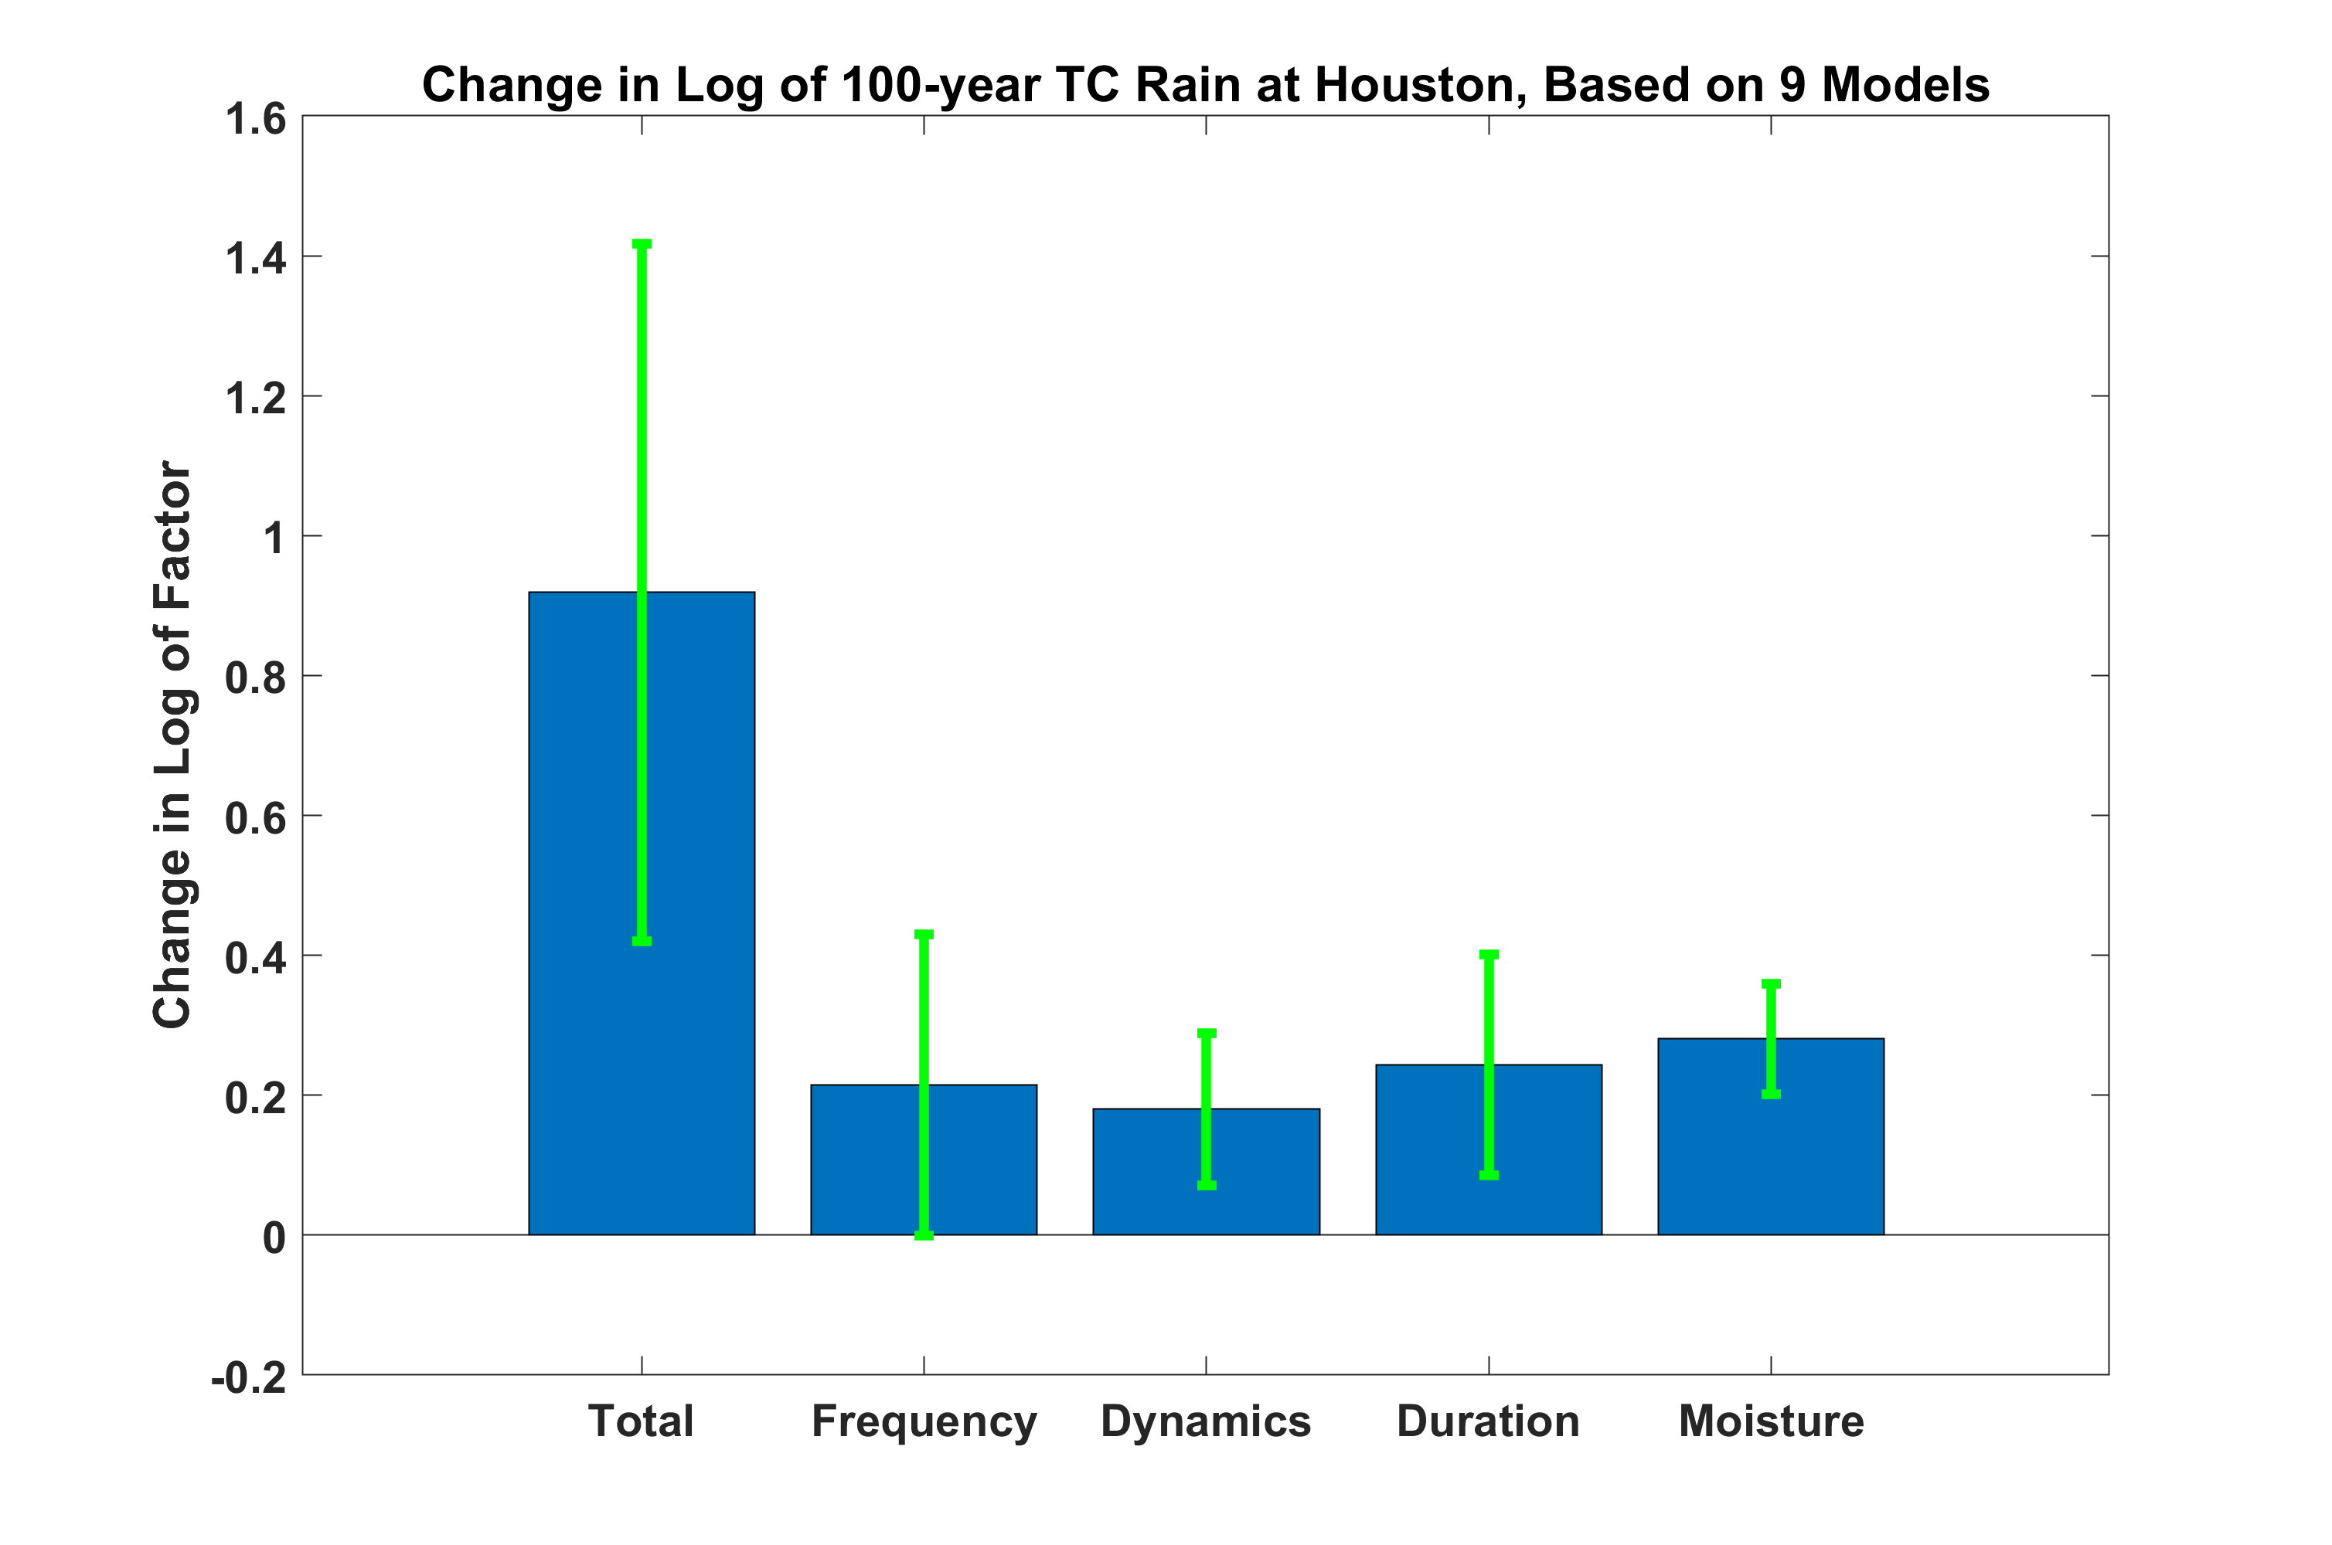
Example: Houston, Texas based on 9 CMIP6 models, comparing 1981-2010 to SSP 5-8.5 2071-2100:

Slide 15
Example: Gloucester, MA based on 8 CMIP6 models, comparing 1985-2014 to SSP 3-7.0 2071-2100:

Slide 16
Summary
Freshwater flooding is the costliest and deadliest sub-hazard of tropical cyclones
Downscaling of climate models indicates potentially large increases in this hazard
We developed a new method dis-aggregating the sources of increased rainfall
This shows that increased rainfall results from increases in basin frequency, duration of rainfall events, increased upward motion, and increased moisture in nearly equal proportion

