Slide 1

Hurricanes: Their physics and relationship to climate
Kerry Emanuel
Massachusetts Institute of Technology
Notes:
1

Slide 2

Topics
Overview of Tropical Cyclones
Tropical Cyclone Physics
What have TCs been like in the past, and how will they be affected by global warming?

Slide 3

Brief Overview of Tropical Cyclones
Notes:
3

Slide 4
The View from Space

Slide 5
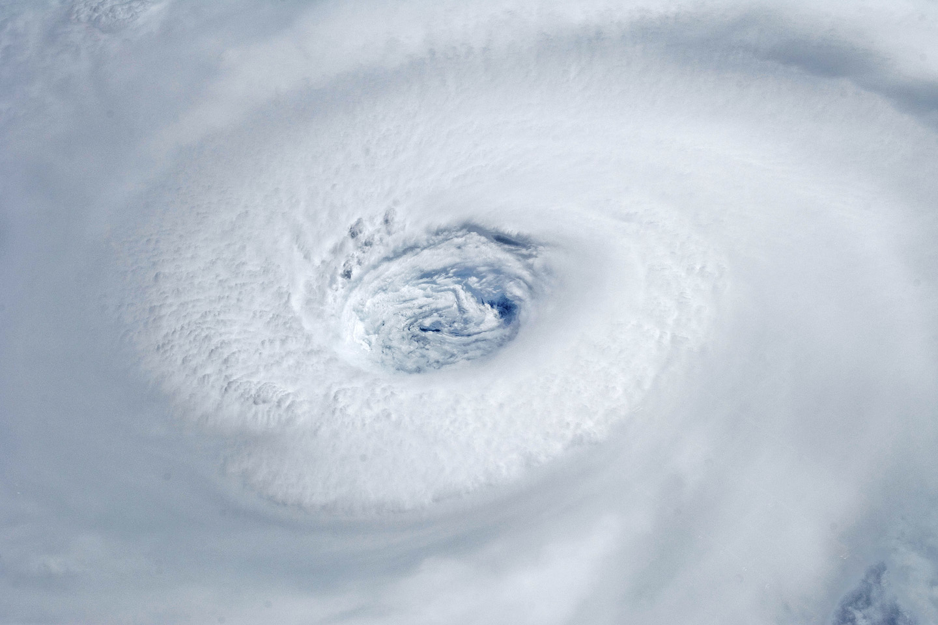
Igor, 2010
Notes:
Astronauts aboard the International Space Station took this digital photograph of the eye of Hurricane Igor at 10:56 Atlantic Daylight Time (13:56 UTC) on September 14, 2010. The storm was a category four hurricane on the Saffir-Simpson scale of intensity. At the time of the image, Igor was centered in the Atlantic Ocean near 18°N 52°W and slowly moving west-northwest at 11 kilometers (7 miles) per hour, according to the U.S. National Hurricane Center. Maximum sustained winds of 213 km (132 mi.) per hour, with gusts to 259 km (161 mi.) per hour. Credit: NASA

Slide 6
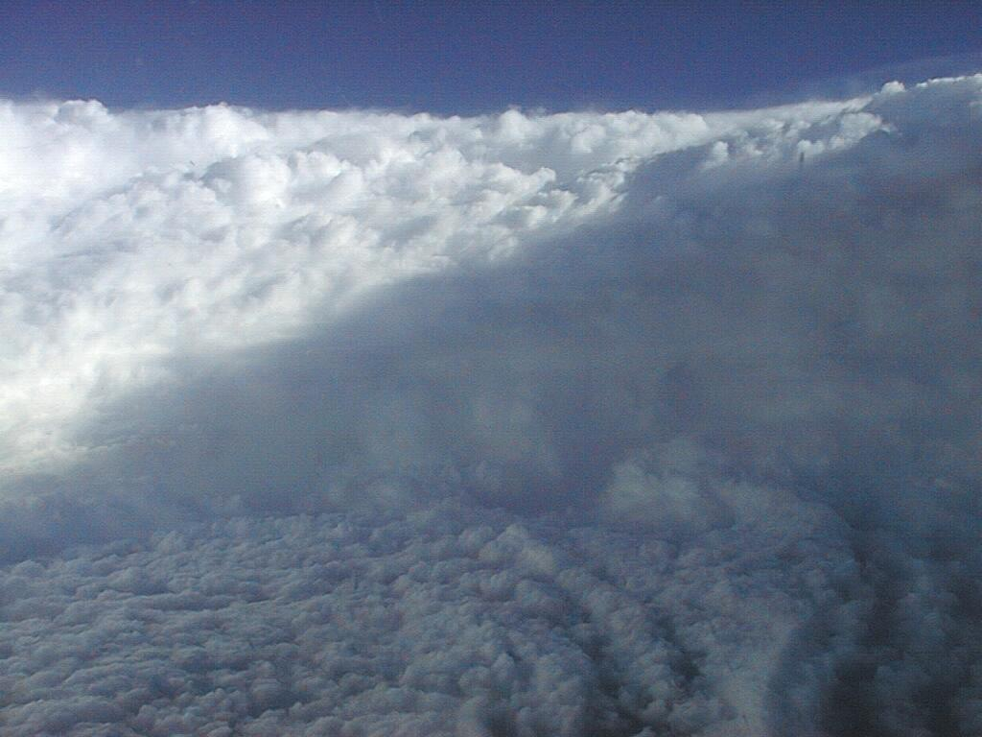
Notes:
The eye of Hurricane Georges in this photo taken from a reconnaissance aircraft gives some impression of a hurricane’s eye.
However impressive a hurricane’s visual appearance, it is the instruments aboard satellites and aircraft that reveal the essence of a hurricane’s structure and inner workings. In the early days of aircraft reconnaissance, the crew estimated wind speeds by looking down and noting how rough the sea appeared. Today, a sophisticated array of instruments automatically collects large quantities of high-quality data, which are taken back to laboratories and analyzed.
Image: The eye of Hurricane Georges in photo taken from a reconnaissance aircraft. The eyewall at right is casting a shadow across part of the eyewall ahead. Credit: Michael Black, Hurricane Research Division, NOAA-AOML, Miami, Florida.
Description from “Divine Wind: The History and Science of Hurricanes”, Kerry Emanuel, 2005, Oxford University Press, 296 p.

Slide 7
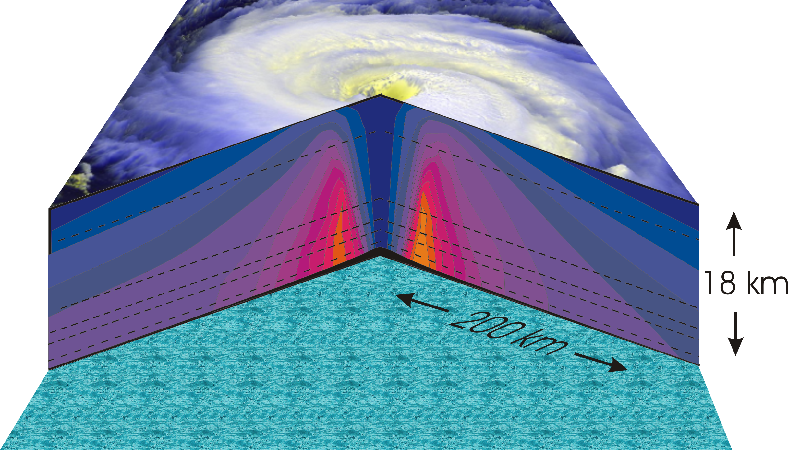
Hurricane Structure: Wind Speed
Azimuthal component of wind
< 5 m/s - > 70 m/s
Notes:
A composite view of the distribution of wind speed in a typical hurricane based on measurements made from research aircraft. In this image and the two that follow, the center of the hurricane is in the center of the panel and the cutaway extends outward about 200 km (125 miles) and upward to about 18 km (11 miles). A satellite image of the top of a storm has been superimposed.
This image shows the speed of the wind going counterclockwise around the center of the storm; the black dashed lines show the altitudes at which the aircraft were flying. The darkest shade of blue indicates the lightest winds, less than 5 meters/second (11 mph). Each successive color represents an increment of 5 meters/second (11 mph), with bright orange showing winds in excess of 65 meters/second (145 mph). The strongest winds occur just above the ocean in a ring around the center, slightly outside the eyewall of the storm. Winds decrease rapidly inward toward the center, which is practically calm. They also decrease outward from the ring of maximum wind , but much more slowly, so that strong winds can still be found 100 kilometers (60 miles) from the center of the storm. As we go up from the surface, the counterclockwise winds get lighter and lighter. If the highest aircraft had flown even higher, it would have actually encountered “negative” wind speed, which here means winds going the other way (clockwise) around the center.
Image is copyrighted 2005 by Oxford University Press.
Image and description from “Divine Wind: The History and Science of Hurricanes”, Kerry Emanuel, 2005, Oxford University Press, 296 p.

Slide 8
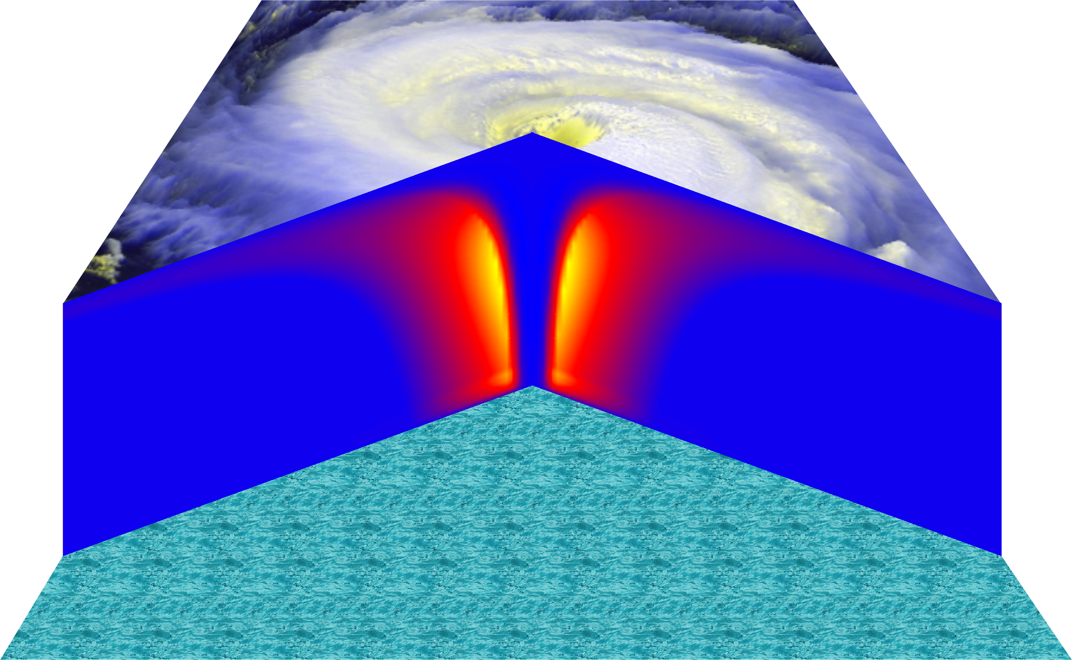
Vertical Air Motion
Updraft Speed
Strong upward motion in the eyewall
Notes:
This image shows a composite view of the distribution of updraft (vertical air motion) in a typical hurricane based on computer model calculations. The yellow and orange represent a strong upward motion in the eyewall. Although it is too weak to be seen in this figure, there is downward motion in the eye itself, strongest right next to the eyewall, and also in a broad region outside the eyewall. But since this figure is made by averaging the air motion along circles centered at the storm center, the strong updrafts associated with the spiral rain bands are missed.
Image is copyrighted 2005 by Oxford University Press.
Description from “Divine Wind: The History and Science of Hurricanes”, Kerry Emanuel, 2005, Oxford University Press, 296 p.

Slide 9
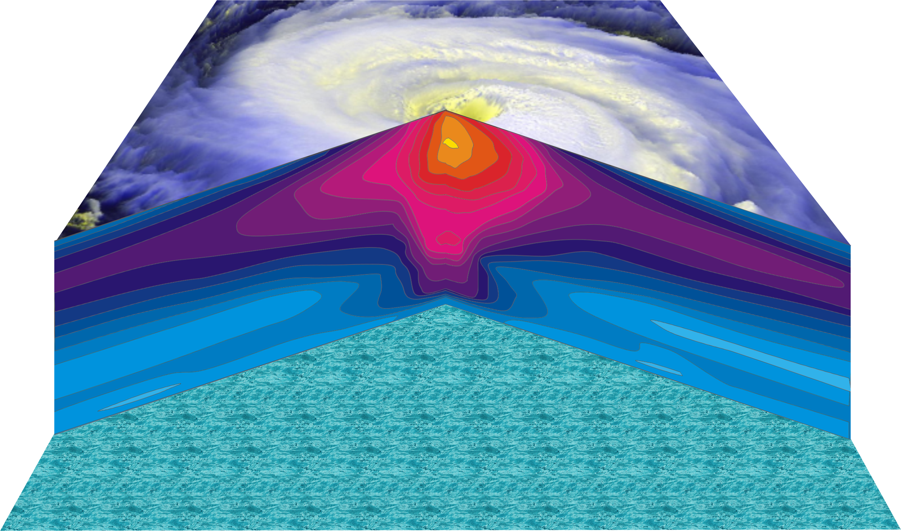
Hurricane Temperature Perturbations
No temperature difference - > 16°C (29°F) warmer
Notes:
This image shows a composite view of the distribution of temperature in a typical hurricane. This actually shows the difference between the temperature at any point and the temperature at the same altitude far away from the storm. The lightest shade of blue shows no temperature difference, while bright yellow shows air that is more than 16°C (29°F) warmer than its distant environment; each shade represents an increment of 1°C (1.8°F). Hurricanes are very hot in their centers, especially near their tops. This great warmth is one consequence of the enormous amount of heat sucked out of the ocean by the storm. On the other hand, there is very little change in temperature as you move in toward the eye along the surface of the ocean.
The distributions of temperature and wind in hurricanes are related to each other. Look carefully at the images in this slide and the slide that shows wind speed. Notice that the rate at which the wind decreases upward is proportional to the rate at which the temperature decreases outward. This relationship is fundamental to rotating fluid flows and is called the thermal wind relation.
Image is copyrighted 2005 by Oxford University Press.
Description from “Divine Wind: The History and Science of Hurricanes”, Kerry Emanuel, 2005, Oxford University Press, 296 p.
Definitions
Thermal wind is a theoretical concept that describes the wind shear between two levels in terms of the geostrophic wind at those two levels (from and for more information see http://wxman256.home.att.net/fcst/wf-pt5e.html). The basic principle of the thermal wind relationship is that in the presence of a horizontal temperature gradient, the wind speed must increase with increasing height (from and for more information see http://opwx.db.erau.edu/~mullerb/Therm_wind.html).
Wind shear is the change of wind speed or direction with distance, usually vertical (from http://ggweather.com/glossary.htm).

Slide 10
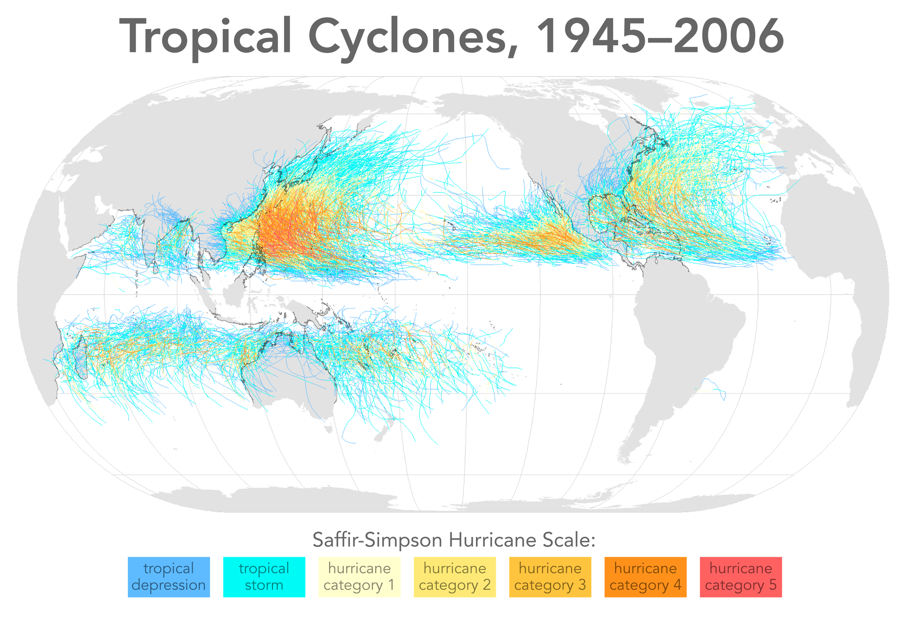

Slide 11
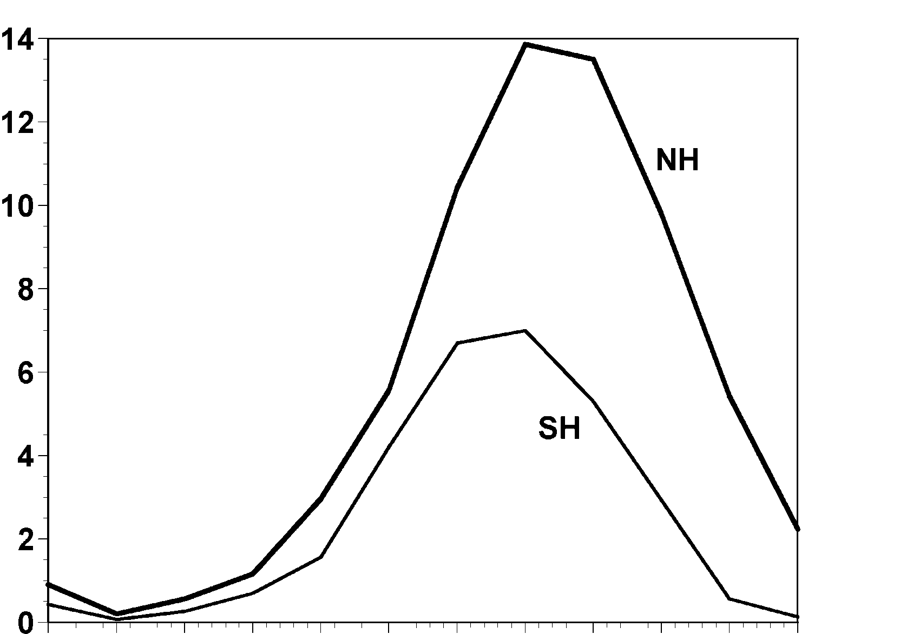
Annual Cycle of Tropical Cyclones
Number of Events per Month
a
Northern
Hemisphere
(NH)
a
Southern
Hemisphere
(SH)
Jan Feb Mar Apr May Jun Jul Aug Sep Oct Nov Dec NH
Jul Aug Sep Oct Nov Dec Jan Feb Mar Apr May Jun SH
Notes:
This graph shows the average number of tropical cyclones per month in the northern and southern hemispheres. Hurricanes tend to follow the sun, peaking in the summer and autumn and all but vanishing during the early spring. Typhoons can develop over the western North Pacific during any month of the year, but they are rare in the winter.
Image is copyrighted 2005 by Oxford University Press.
Image and description from “Divine Wind: The History and Science of Hurricanes”, Kerry Emanuel, 2005, Oxford University Press, 296 p.

Slide 12
Physics of Mature Hurricanes

Slide 13
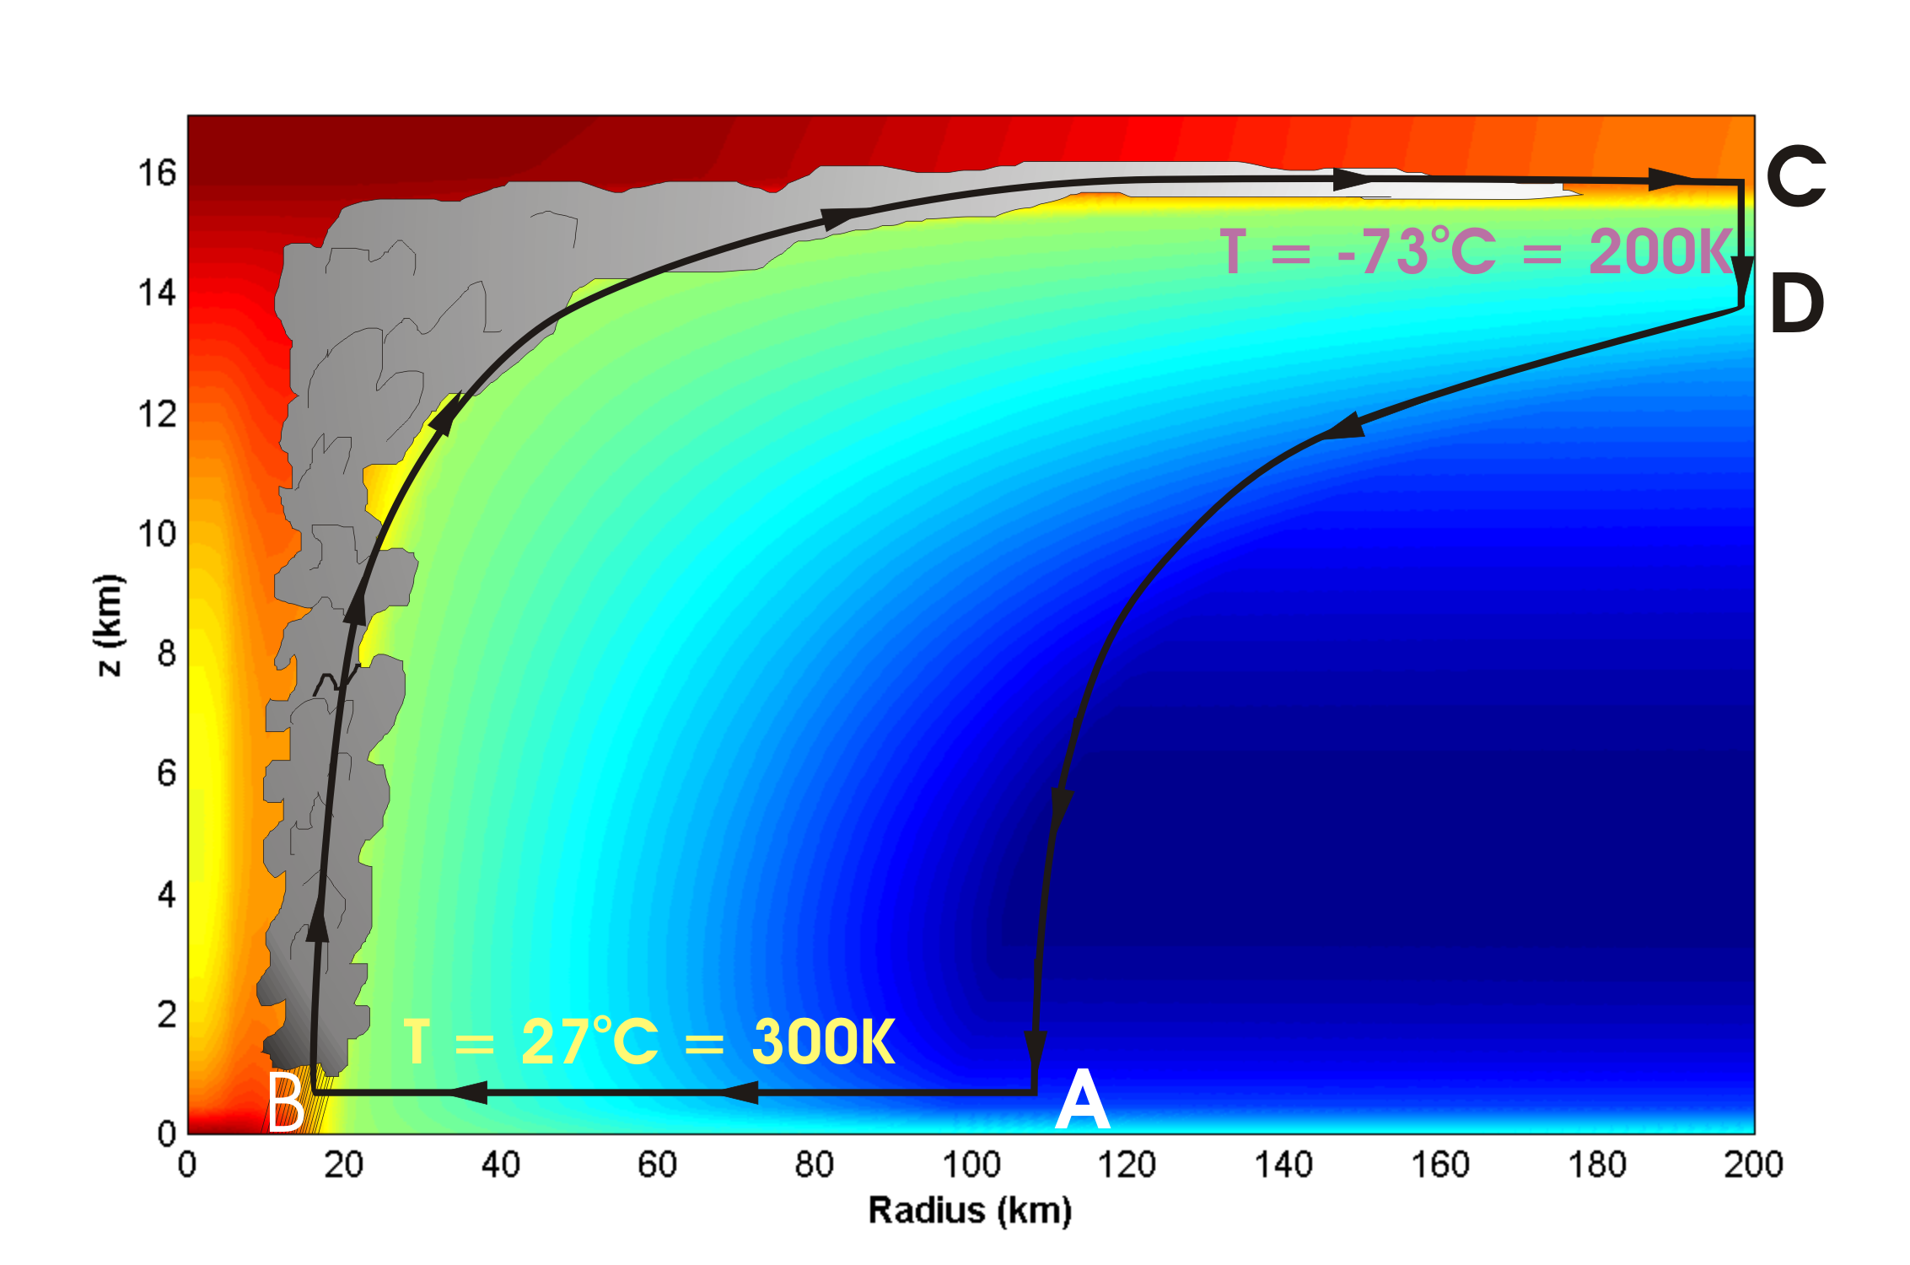
Energy Production

Slide 14
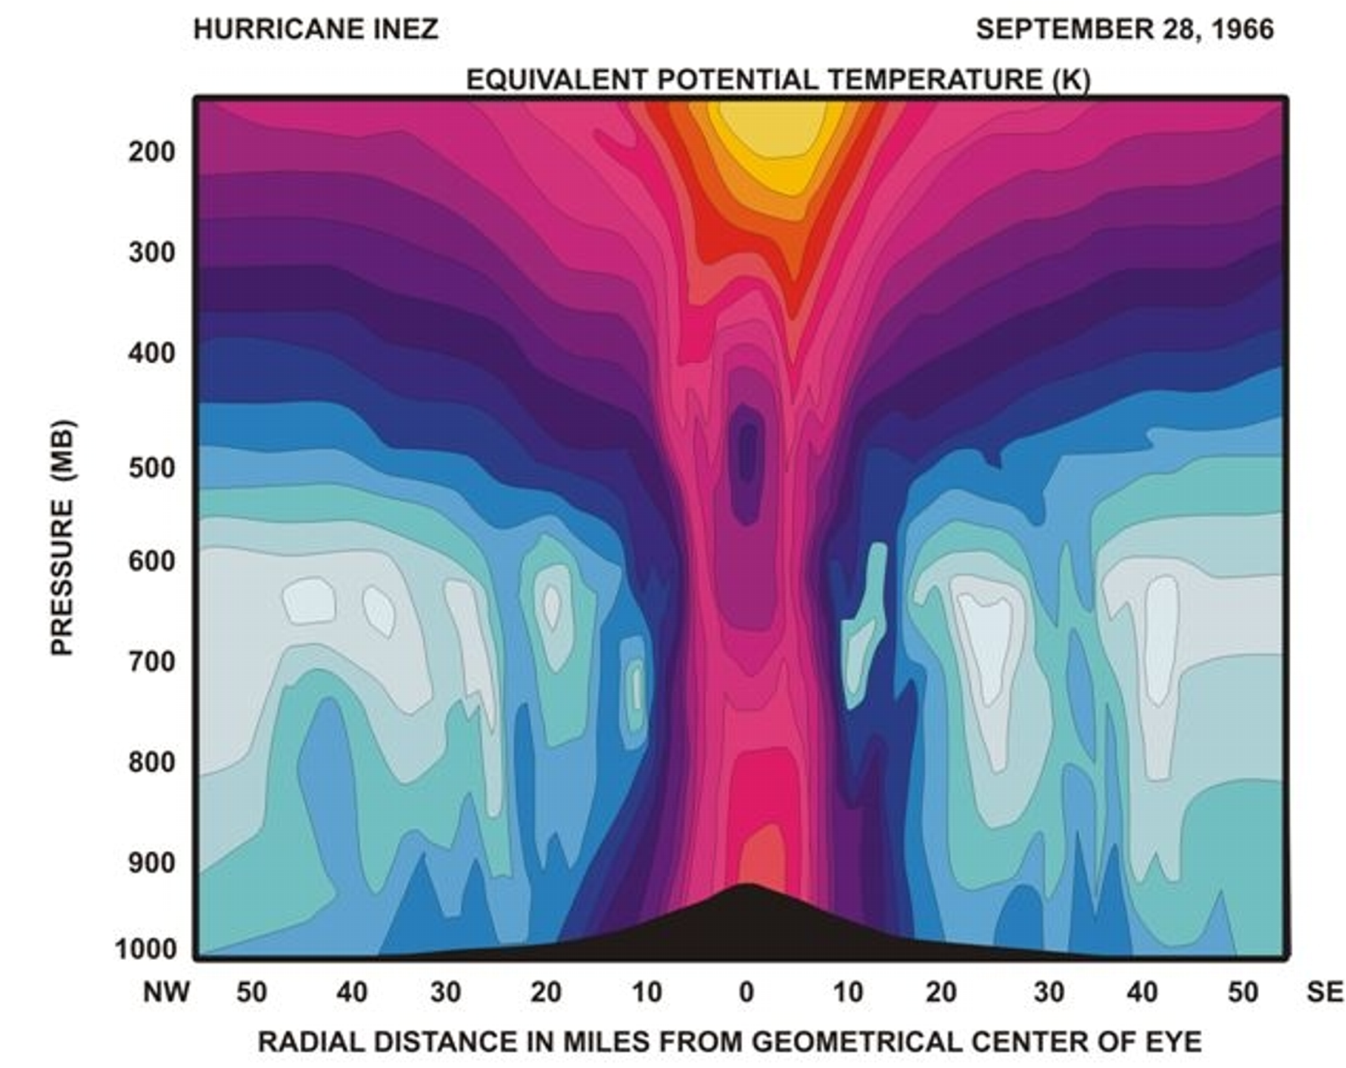
Distribution of Entropy in Hurricane Inez, 1966
Source: Hawkins and Imbembo, 1976

Slide 15
Carnot Theorem: Maximum efficiency results from a particular energy cycle:
Isothermal expansion
Adiabatic expansion
Isothermal compression
Adiabatic compression
Note: Last leg is not adiabatic in hurricane: Air cools radiatively. But since environmental temperature profile is moist adiabatic, the amount of radiative cooling is the same as if air were saturated and descending moist adiabatically.
Maximum rate of energy production:

Slide 16
Theoretical Upper Bound on Hurricane Maximum Wind Speed:
Surface temperature
Ratio of exchange coefficients of enthalpy and momentum
Outflow temperature
Air-sea enthalpy disequilibrium

Slide 17
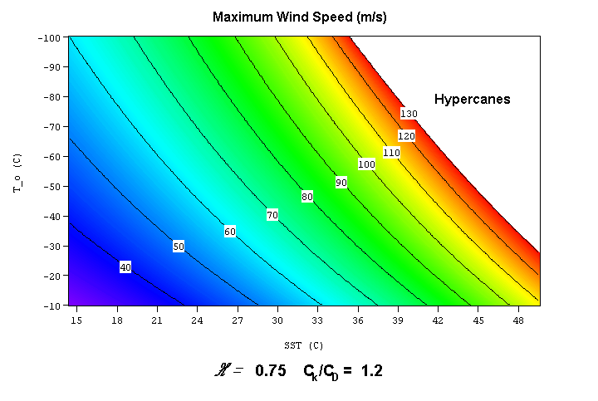

Slide 18
Annual Maximum Potential Intensity (m/s)

Slide 19
Hurricanes and Climate:
Some Empirical Results

Slide 20
Intensity Metric:
Hurricane Power
(Power Dissipation Index)
A measure of the total frictional dissipation of kinetic energy in the hurricane boundary layer over the lifetime of the storm

Slide 21
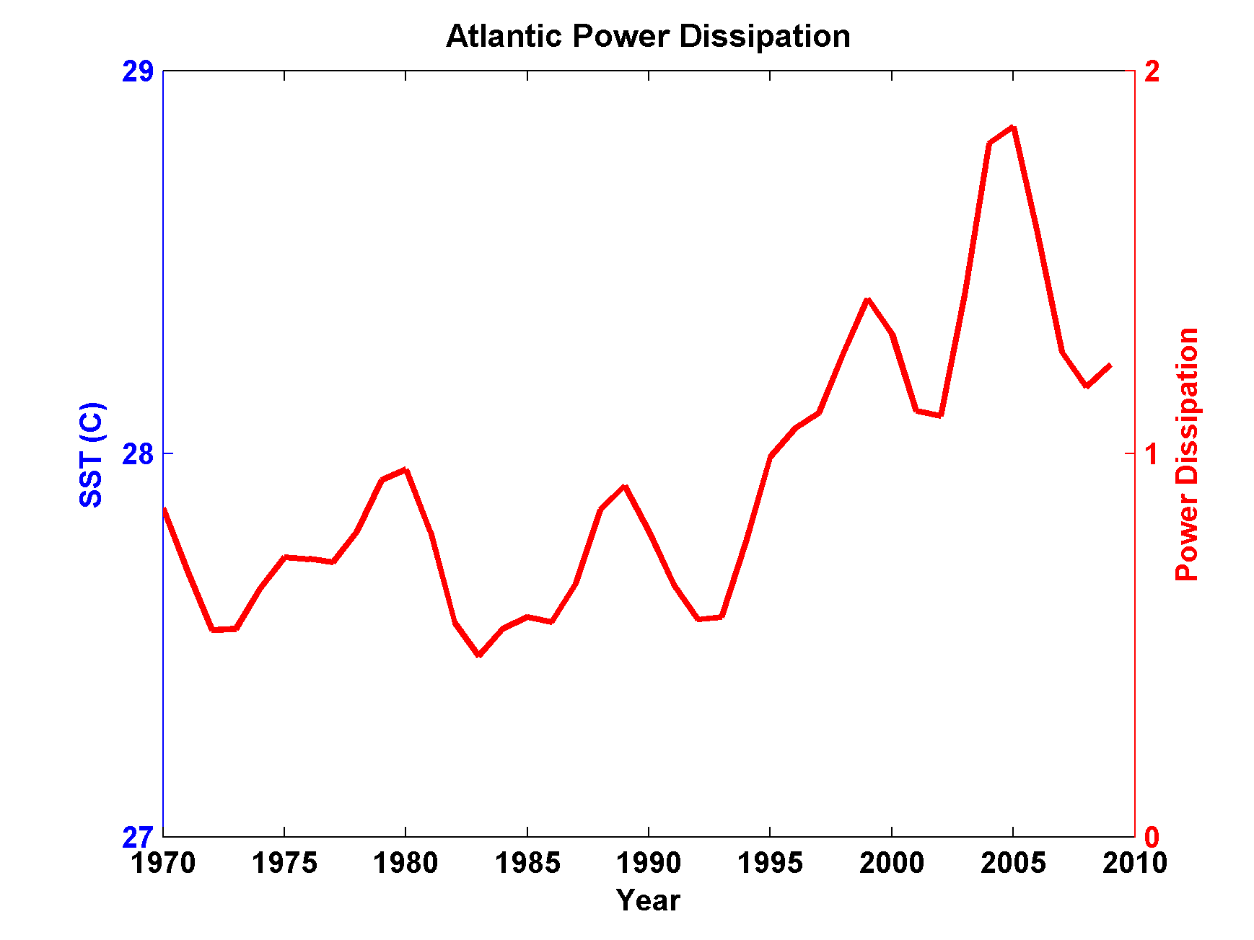
Atlantic Tropical Cyclone Power Dissipation during an era of high quality measurements, 1970-2011 (smoothed with 1-3-4-3-1 filter)

Slide 22
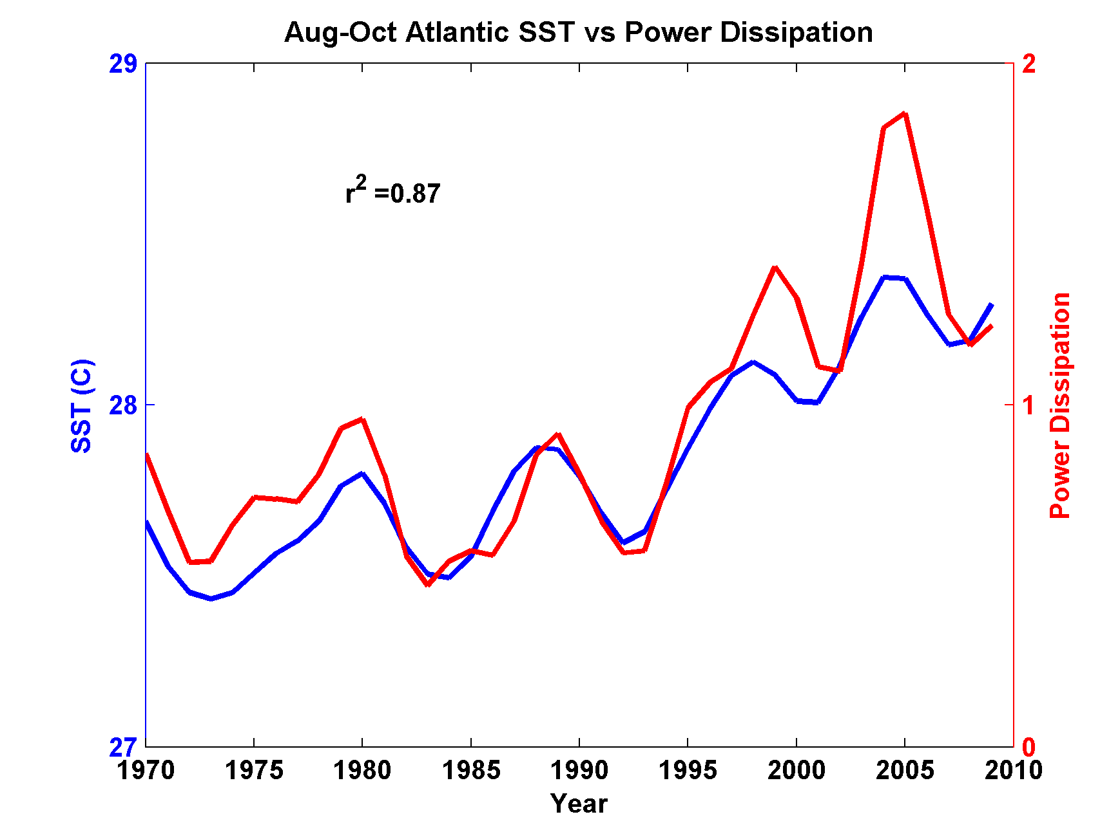
Atlantic Tropical Cyclone Power Dissipation and Sea Surface Temperature during an era of high quality measurements, 1970-2011 (smoothed with 1-3-4-3-1 filter)

Slide 23
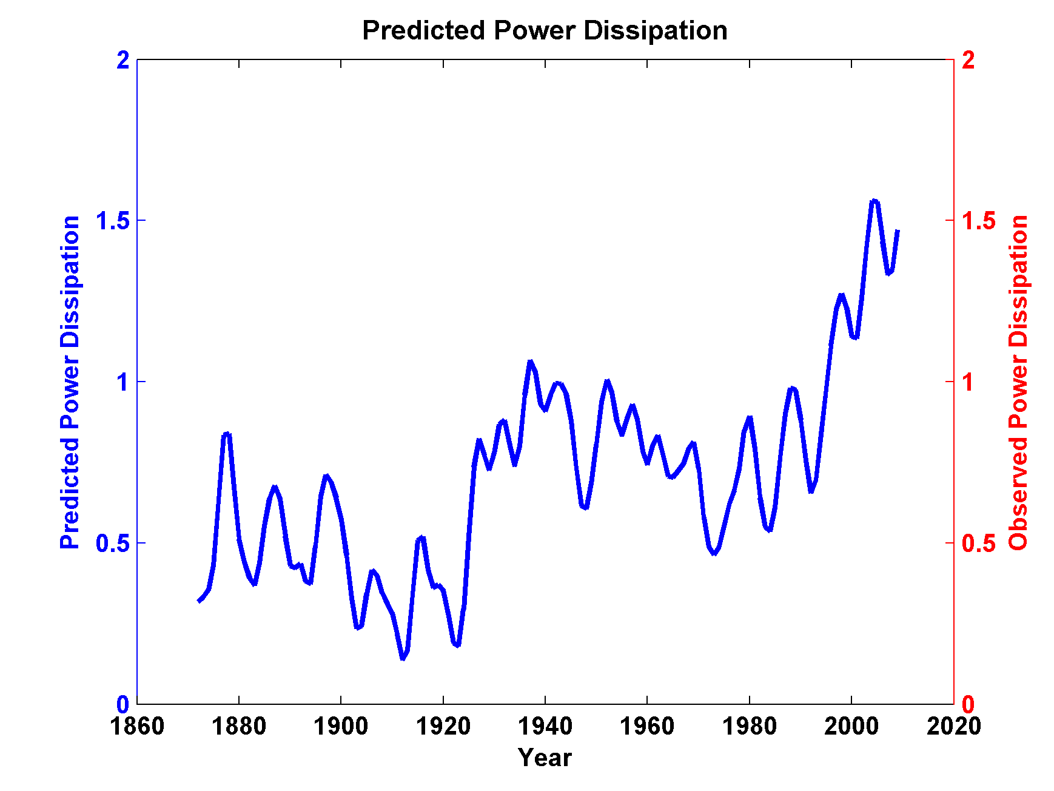
Use Linear Regression to Predict Power Dissipation back to 1870 based on sea surface temperature:

Slide 24
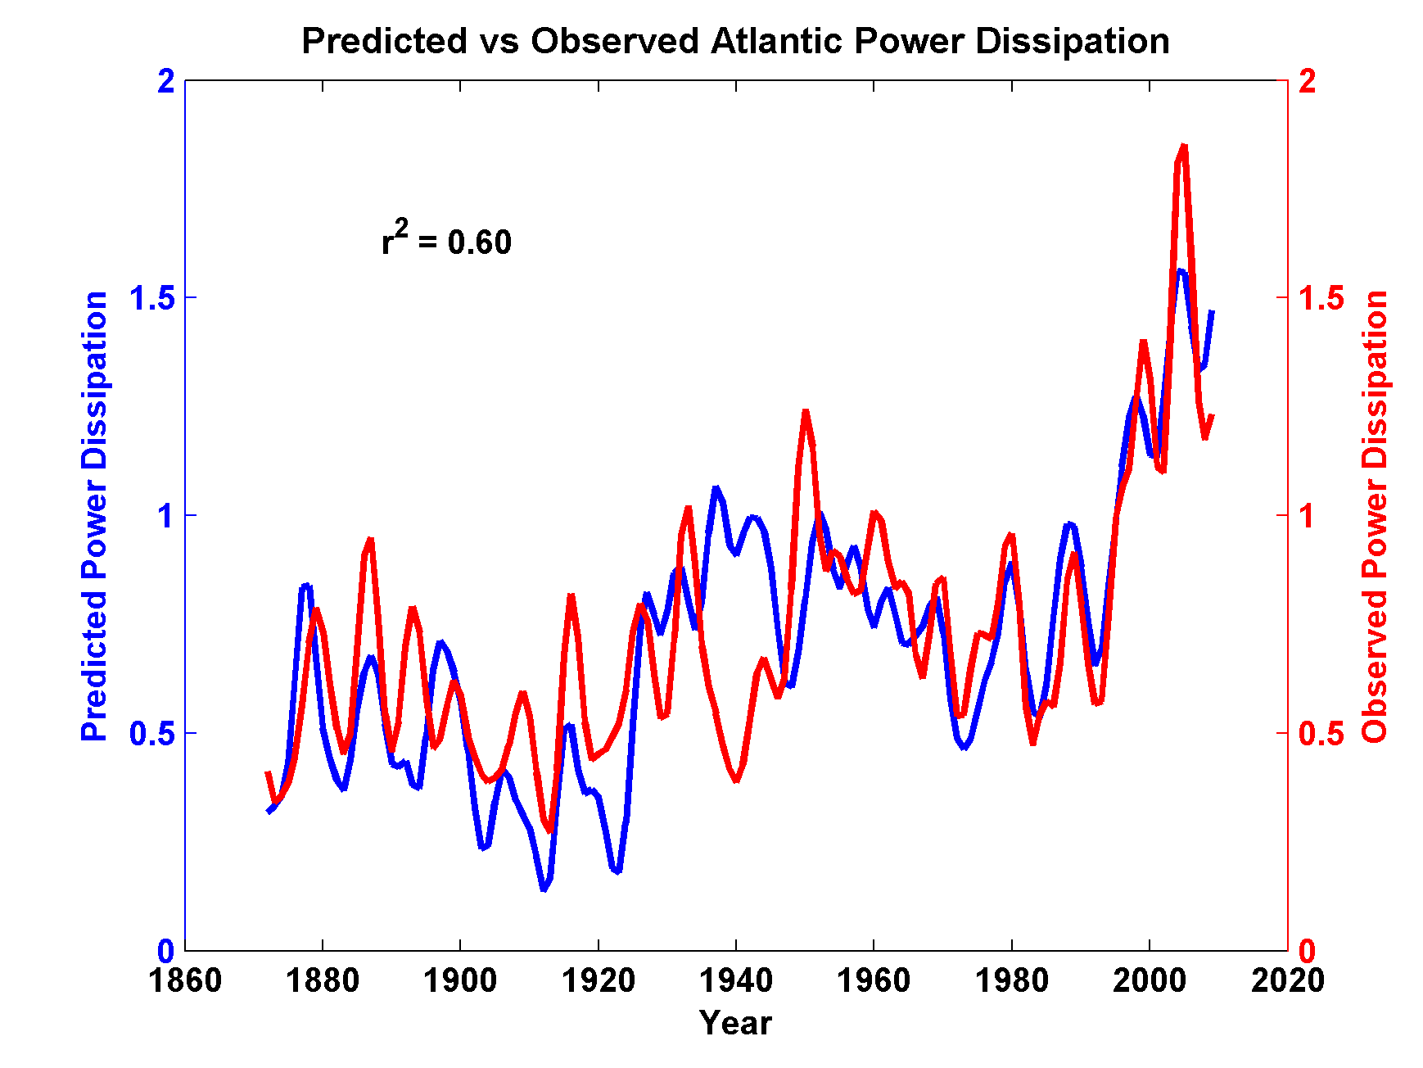
Now Compare to Observed Power Dissipation

Slide 25
Tropical cyclone power dissipation has more than doubled since the 1980s, though there has been an increase of only 0.5º C in sea surface temperature

Slide 26
What is Causing Changes in Tropical Atlantic Sea Surface Temperature?

Slide 27
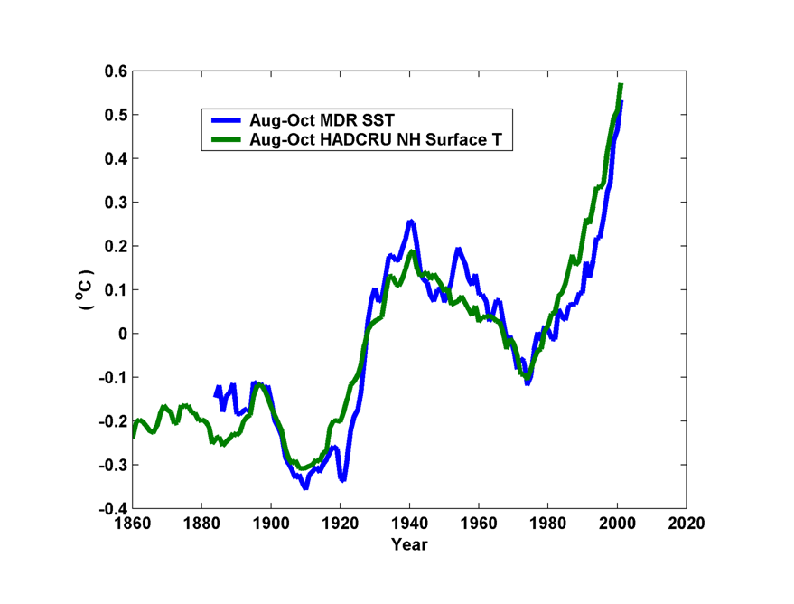
10-year Running Average of Aug-Oct Northern Hemisphere Surface Temp and Hurricane Region Ocean Temp

Slide 28
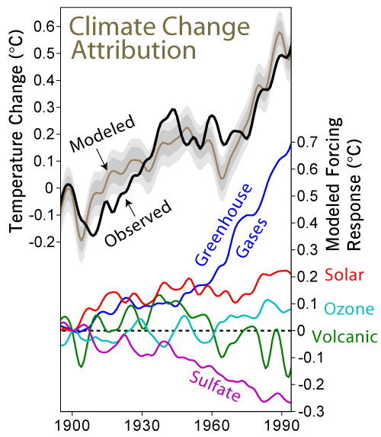

Slide 29
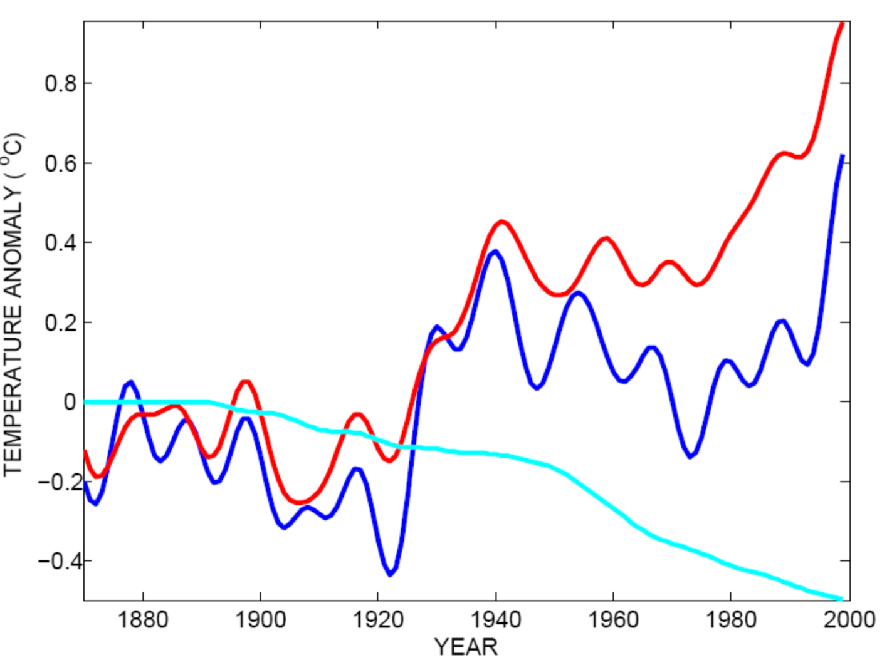
Tropical Atlantic SST(blue), Global Mean Surface Temperature (red),
Aerosol Forcing (aqua)
Global mean surface temperature
Tropical Atlantic sea surface temperature
Sulfate aerosol radiative forcing
Mann, M. E., and K. A. Emanuel, 2006. Atlantic hurricane trends linked to climate change. EOS, 87, 233-244.

Slide 30
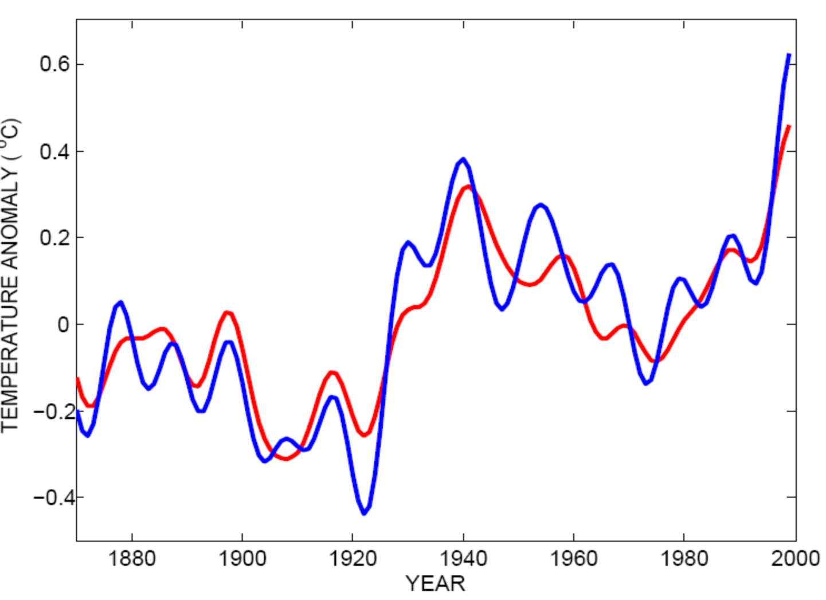
Best Fit Linear Combination of Global Warming and Aerosol Forcing (red) versus Tropical Atlantic SST (blue)
Tropical Atlantic Sea Surface Temperature
Global Surface T + Aerosol Forcing
Mann, M. E., and K. A. Emanuel, 2006. Atlantic hurricane trends linked to climate change. EOS, 87, 233-244.

Slide 31
The Genesis Puzzle

Slide 32
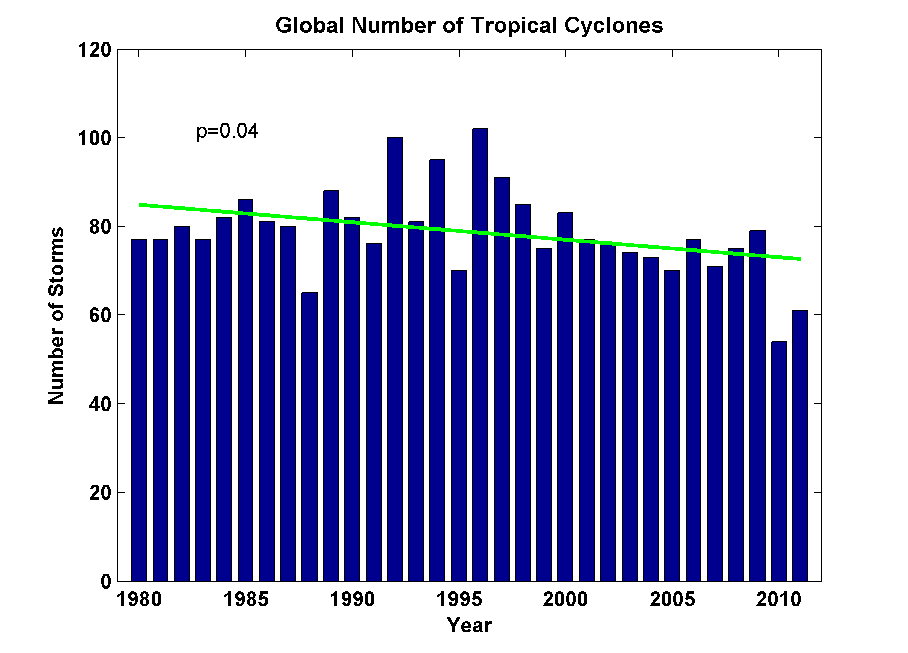
Global Tropical Cyclone Frequency, 1980-2011
Data Sources: NOAA/TPC and NAVY/JTWC
Notes:
32

Slide 33
Tropical Cyclones Often Develop from Cloud Clusters:
When/Why Does Convection Form Clusters?

Slide 34
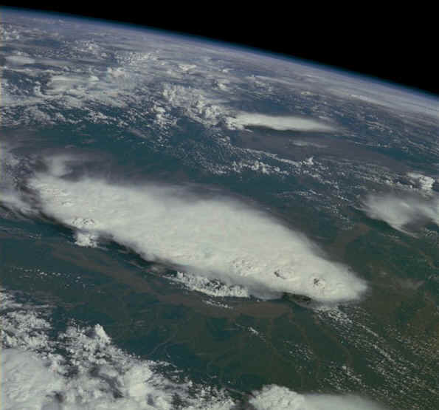
Monsoonal Thunderstorms, Bangladesh and India July 1985

Slide 35
Simplest Statistical Equilibrium State:
Radiative-Convective Equilibrium

Slide 36
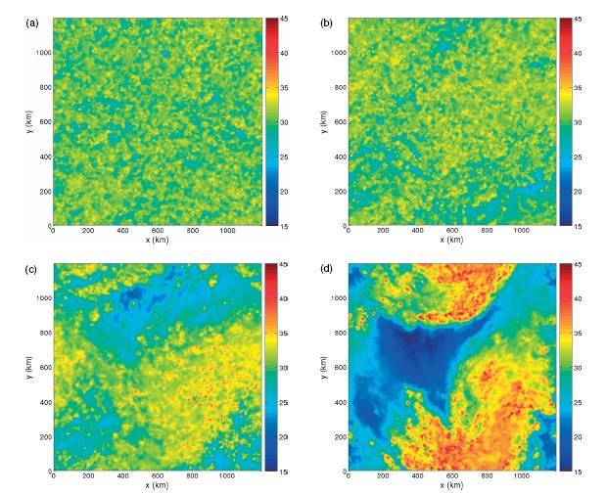
Vertically integrated water vapor at 4 days (Nolan et al., QJRMS, 2007)

Slide 37
Vertically integrated water vapor at 4 (a), 6 (b), 8 (c), and 10 (d) days (Nolan et al., QJRMS, 2007)

Slide 38
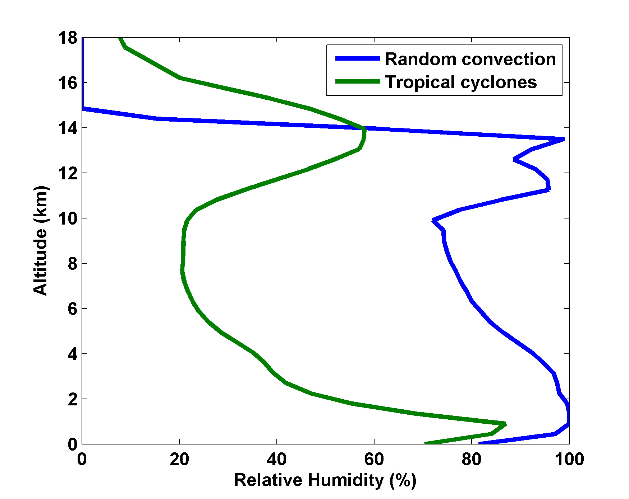
Nolan et al., QJRMS, 2007

Slide 39
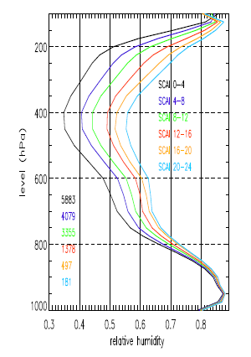
Variation of tropical relative humidity profiles with a Simple Convective Aggregation Index (SCAI).
Courtesy Isabelle Tobin, Sandrine Bony, and Remy Roca

Slide 40
Empirical Necessary Conditions for Self-Aggregation
(after Held et al., 1993; Bretherton et al., 2005; Nolan et al.; 2007)
Small vertical shear of horizontal wind
Interaction of radiation with clouds and/or water vapor
Feedback of convective downdraft surface winds on surface fluxes
Sufficiently high surface temperature

Slide 41
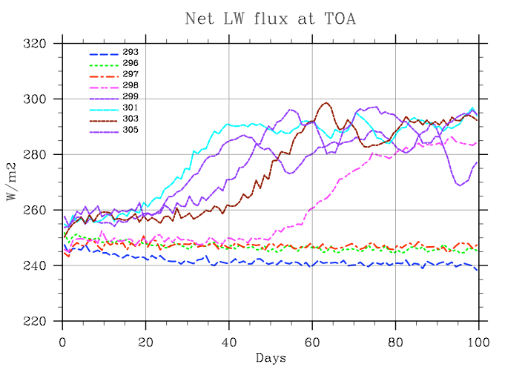
Self-Aggregation is Temperature-Dependent
(Nolan et al., 2007; Emanuel and Khairoutdinov, in preparation, 2012)

Slide 42
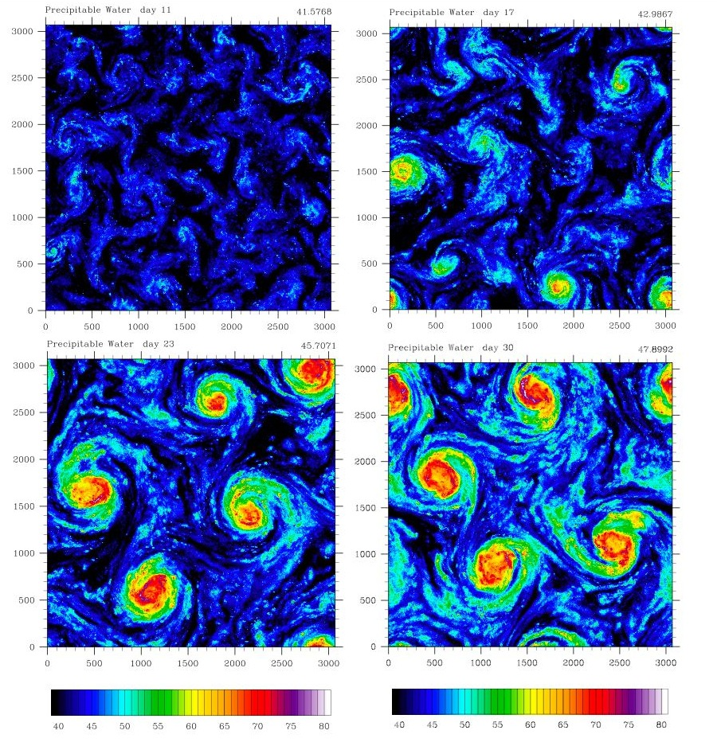
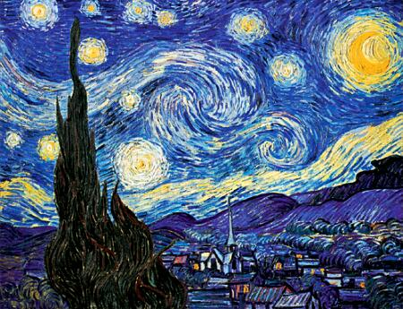
Extension to Rotating Planet
Distance between vortex centers scales as V_{pot}/f

Slide 43
TC-World Scaling
Frequency ~
Intensity ~
Power Dissipation ~

Slide 44
Hypothesis
At high temperature, convection self-aggregates
→Horizontally averaged humidity drops dramatically
→Reduced greenhouse effect cools system
→Convection disaggregates
→Humidity increases, system warms
→System wants to be near phase transition to aggregated state

Slide 45
Recipe for Self-Organized Criticality
(First proposed by David Neelin, but by different mechanism)
System should reside near critical threshold for self-aggregation
Convective cluster size should follow power law distribution

Slide 46
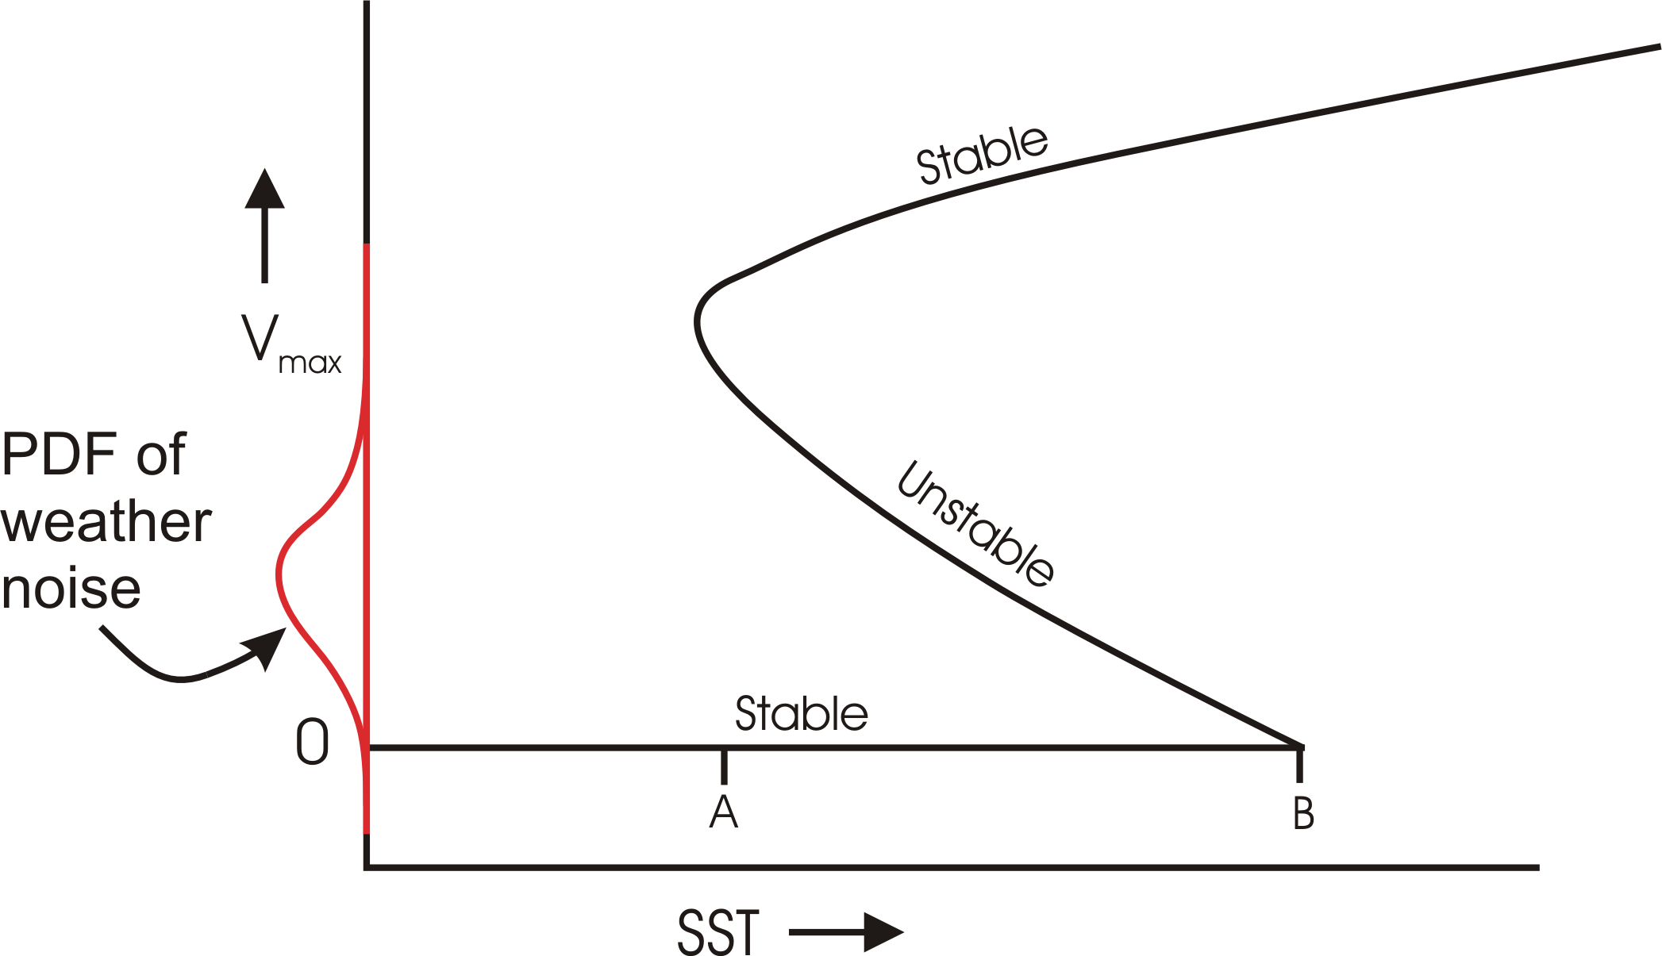
Hypothetical Subcritical Bifurcation

Slide 47
Future Tropical Cyclone Risk

Slide 48
MIT Approach to Downscaling Tropical Cyclones from Climate Models
Step 1: Seed each ocean basin with a very large number of weak, randomly located vortices
Step 2: Vortices are assumed to move with the large scale atmospheric flow in which they are embedded
Step 3: Run a coupled, ocean-atmosphere computer model for each vortex, and note how many achieve at least tropical storm strength; discard others
Step 4: Using the small fraction of surviving events, determine storm statistics.

Slide 50
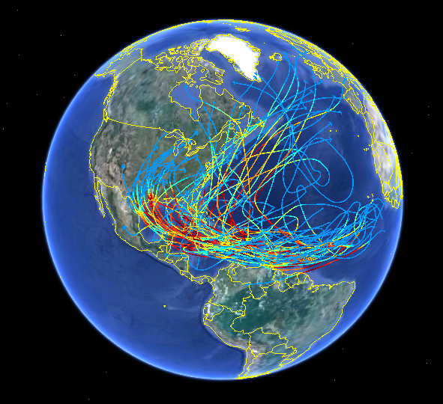
60 Synthetic U.S. Landfalling tracks (color coded by Saffir-Simpson Scale)

Slide 51
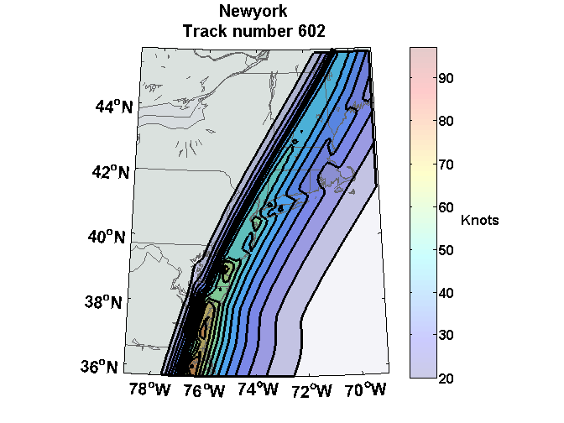
Wind Swath

Slide 52
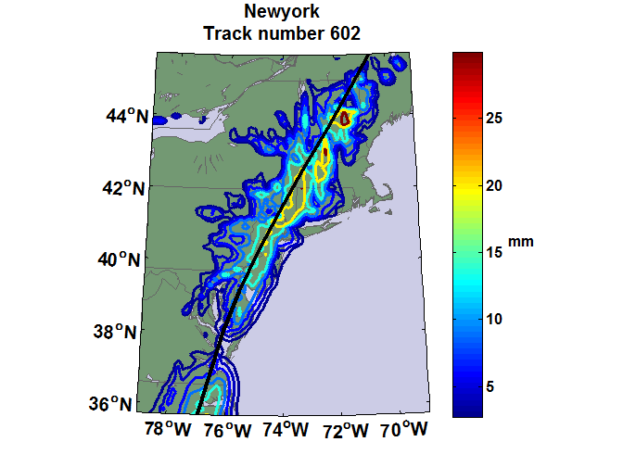
Accumulated Rainfall (mm)

Slide 53

Cumulative Distribution of Storm Lifetime Peak Wind Speed, with Sample of 1755 Synthetic Tracks
90% confidence bounds

Slide 54
Application to Future Climates
Apply to global climate model simulations run in support of the upcoming IPCC report
Run for historical simulations, 1950-2005
Run for CMIP5 emissions scenario RCP 8.5

Slide 55
(Slides Omitted)

Slide 56
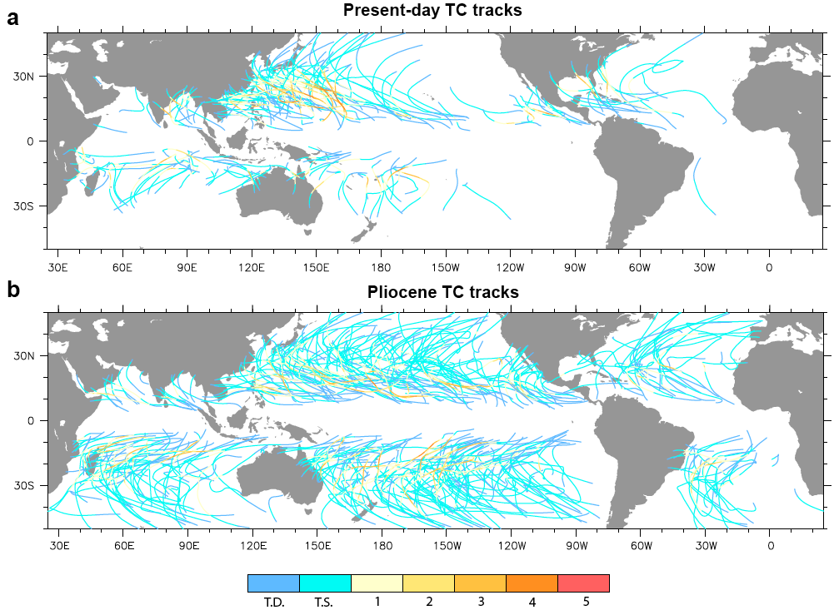
Application to Other Climates
Federov et al., 2010

Slide 57
Summary
Hurricanes are giant Carnot heat engines that convert thermal energy into wind
Tropical cyclones may be a subclass of aggregated convection, which may tend toward self-organized critical states, thus stabilizing tropical climate

Slide 58
Simple but high resolution coupled TC model can be used to ‘downscale” TC activity from global climate data sets
Hurricane power is increasing in the Atlantic and is projected to increase globally as temperatures rise

