Slide 1

Climate, Energy, Poverty and Population: Four Interwoven Challenges of Our Times
Kerry Emanuel
Lorenz Center
MIT

Slide 2
Some Pressing Global Problems
Climate change
Energy
Poverty
Population

Slide 3
Main Thesis of this Talk:
These 4 problems are tightly interwoven and should not be decoupled

Slide 4
Climate Change and Climate Risks

Slide 5

Svante Arrhenius, 1859-1927
“Any doubling of the percentage of carbon dioxide in the air would raise the temperature of the earth's surface by 4°; and if the carbon dioxide were increased fourfold, the temperature would rise by 8°.” – Världarnas utveckling (Worlds in the Making), 1906

Slide 7
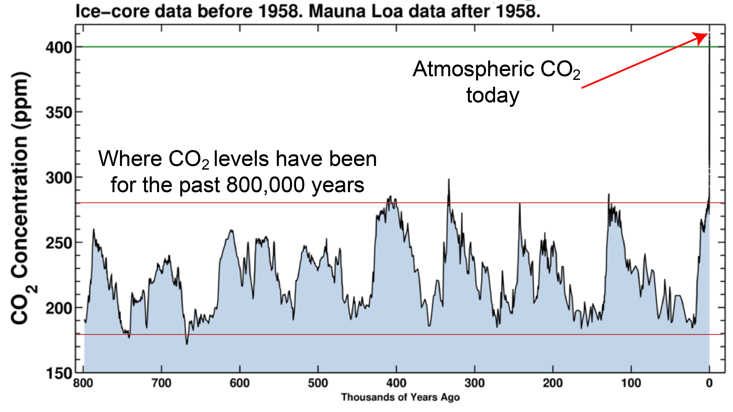

Slide 8

CO₂ May Go Well Beyond Doubling
Double Pre-Industrial

Slide 9
Climate Risks
Rising global mean temperature does not directly affect many people or enterprises
Climate change risk dominated by extreme, rare events: Storms, droughts, heat waves, floods

Slide 10
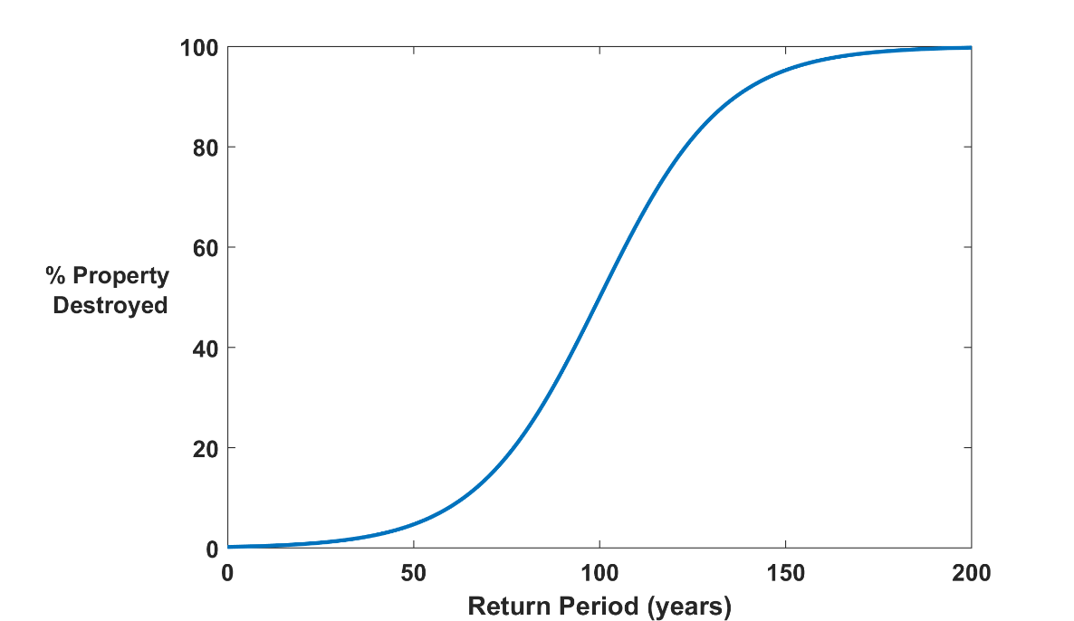

Why Climate Risk is Dominated by Extreme Events:
Societies are usually well adapted to frequent events (> 1/100 yr)
Societies are often poorly adapted to rare events (< 1/100 yr)
Large cost increases result when > 100-yr events become < 100-yr events
Largest slope (1 in 100 year event)

Slide 11
Known Risks
Increasing sea level
Increasing hydrological events… droughts and floods
Increasing incidence of high category hurricanes and associated storm surges and freshwater flooding
More heat stress and other health risks
Armed conflict
Some increase in plant productivity
Reduction in health problems related to cold weather
Benefits

Slide 12
“Taken as a whole, the range of published evidence indicates that the net damage costs of climate change are likely to be significant and to increase over time.”
- Intergovernmental Panel on Climate Change

Slide 13
Hydrological Extremes
Rainfall intensity (how hard it rains when/where it is raining) doubles for every 10º C temperature increase
Wet places get wetter, dry places get drier; incidence of both floods and droughts increases
Large potential effects on food and water supplies; major national security issue

Slide 14
“Climate change could have significant geopolitical impacts around the world, contributing to poverty, environmental degradation, and the further weakening of fragile governments. Climate change will contribute to food and water scarcity, will increase the spread of disease, and may spur or exacerbate mass migration.”
    -- Quadrennial Defense Review, U.S. Department of Defense, February, 2010

Slide 15
Risk and Responsibility

Slide 16


Slide 17
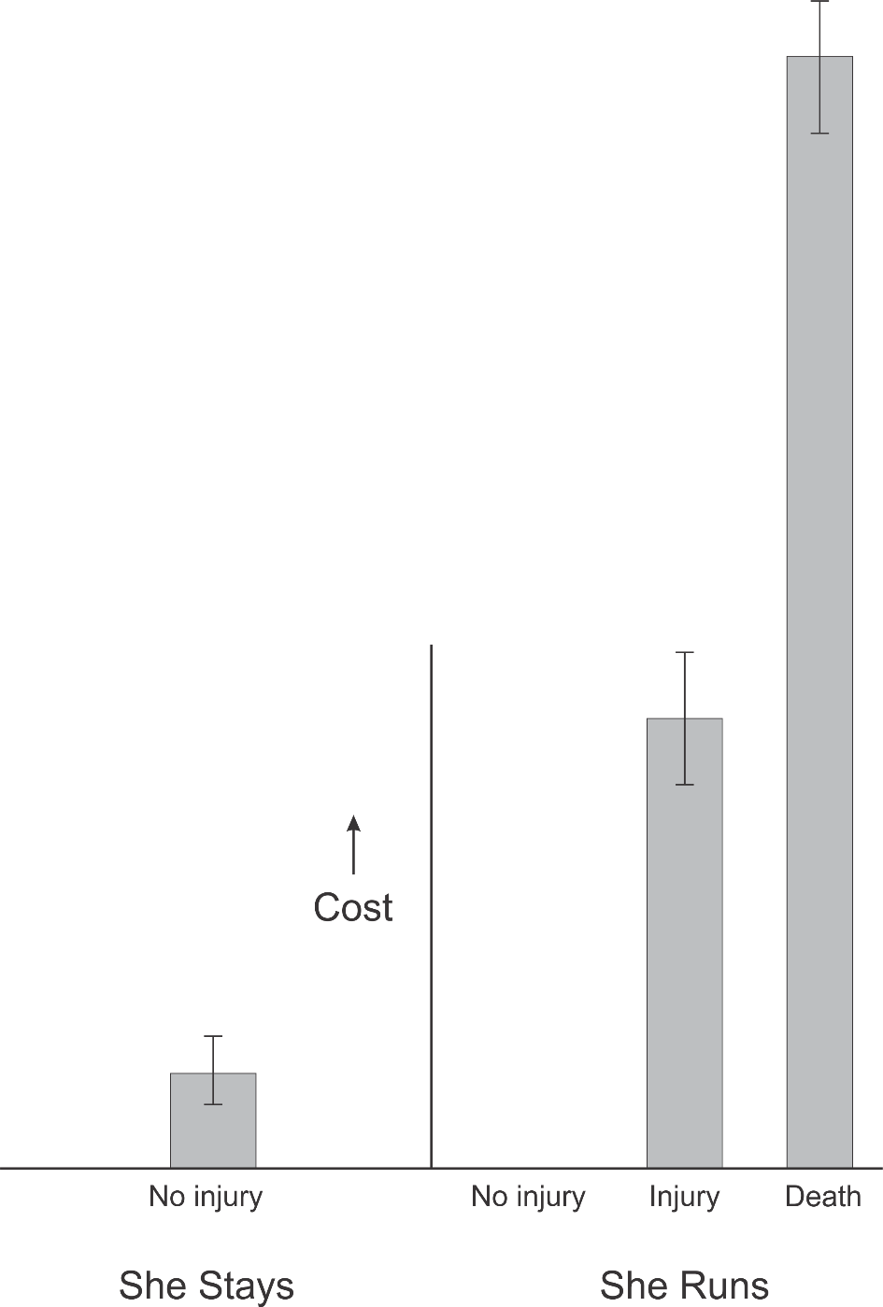
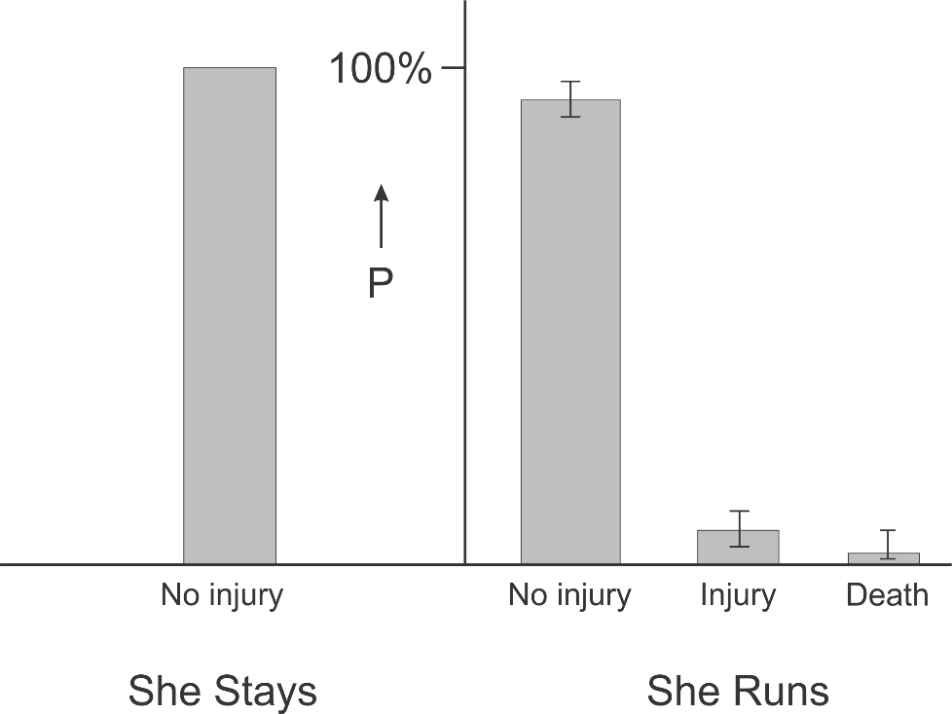
Expected cost = probability x cost
Decision is Binary
(Let her run, or not)
Event Probability
Cost
Uncertainty
Math + Physics, etc.
Social Science, Economics

Slide 18
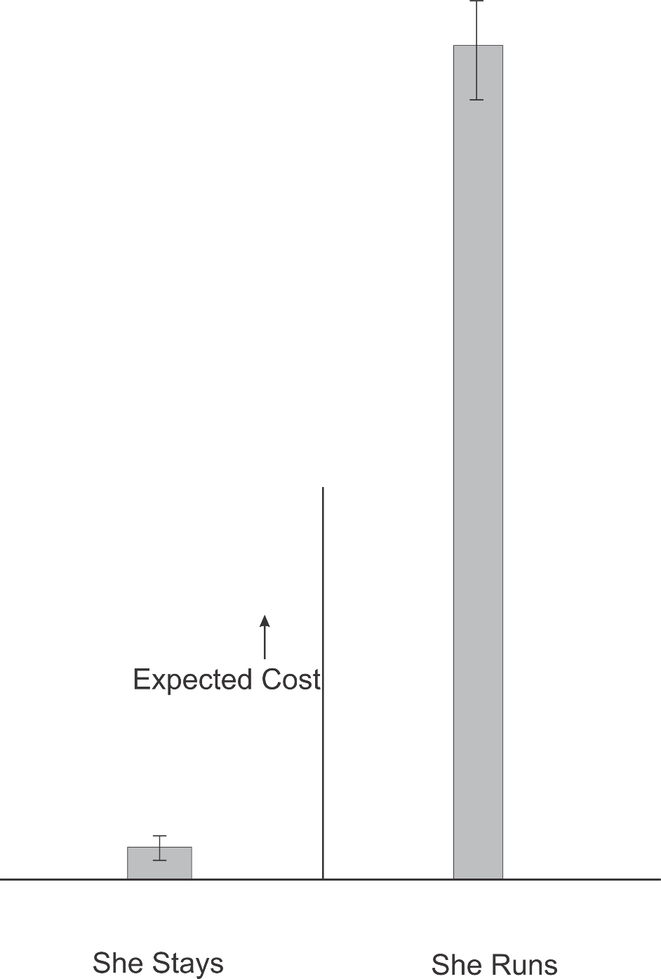
Expected cost = probability x cost
Although the probability of being injured or killed is low, the expected cost is very high. Drive her to school!

Slide 19
Influence of ‘priors’:
Examples
I do not recall any pedestrian ever being run over at this intersection
There have never been serious accidents in my family as long as anyone can remember
My daughter’s teacher might lower her grade. Maybe she won’t get into college….
I hate being late for work; I might get penalized

Slide 20
What Makes the Climate Problem So Difficult?
Both the decisions and the costs are continuous, not binary
Weather event probabilities have large uncertainty
Cost estimates of mitigation and adaptation have large uncertainty
Costs of inaction borne mostly by future generations
Pernicious influence of ‘priors’

Slide 21
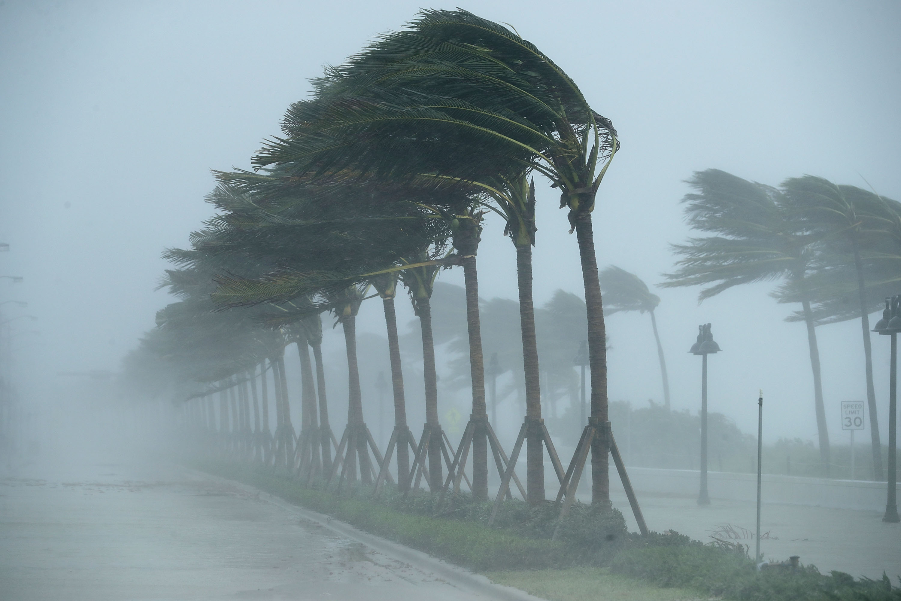
An Example of Climate Risks:
Hurricanes

Slide 22
The Global Hurricane Hazard
About 10,000 deaths per year since 1971
$700 Billion 2015 U.S. dollars in damages since 1971
Global population exposed to hurricane hazards has tripled since 1970
EM-DAT, 2016: The OFDA/CRED International Disaster Database
http://www.emdat.be/.

Slide 23
Global Tropical Cyclone Damage Normalized by Gross World Product
380% increase since 1970
Population of TC-prone regions increased by ~200%
Suggests that climate change has contributed to increasing damage
EM-DAT, 2020: The OFDA/CRED International Disaster Database
http://www.emdat.be/.

Slide 24
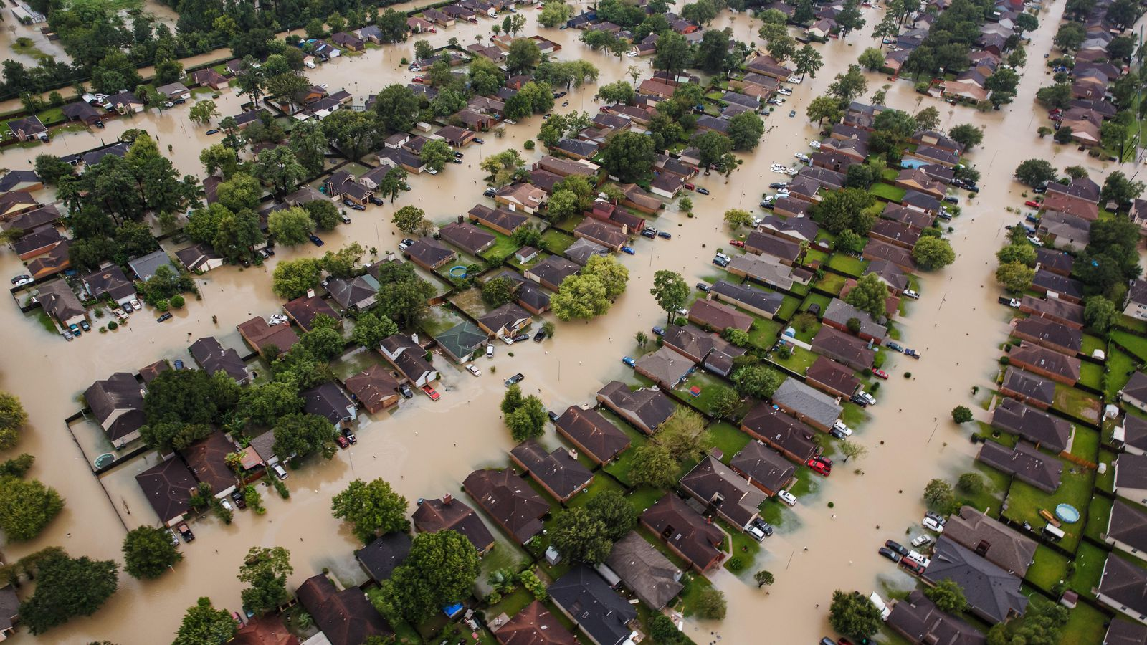
Flooding from Hurricane Harvey

Slide 25
Historical Records
Riverine floods: ~100 years of good records (U.S.)
Flash floods and tropical-cyclones: Somewhat less than 100 years
Even if we had 100 years of great records, the past is no longer a good guide to the present
We need to turn to physical models to get better estimates of current (and future) weather risks

Slide 26
Using Physical Models to Estimate Weather Risk

Slide 27
Procedure:
Generate 6,200 synthetic hurricane events affecting eastern U.S. from each of 8 global climate models for two period of time: 1984 – 2014 and 2070 – 2100 (SSP3 7.0)
Calculate peak wind speed at each zip code centroid for each hurricane event
Use damage function to convert peak wind to percentage of insured value destroyed
Apply to total insured value at each of the 12,968 zip codes and sum over them to estimate total loss to insurance firm

Slide 28
The nature of financial risks from weather hazards:
Hurricanes as an example
Total Insured Values of particular insurance firm aggregated over zip codes
Net TIV: $ 2 trillion
12,968 zip codes

Slide 29
Typical loss:
  1984-2014: $12
  2070-2100: $3.5 million
Average annual loss:
  1984-2014: $530 million Main contribution: 880-year event
  2070-2100: $4.1 billion Main contribution: 120-year event

Slide 30
Hsiang et al., Science, 2017
Total direct damage to U.S. economy, summed across all assessed sectors, as a function of global mean temperature change. Dot-whiskers indicate the distribution of direct damages in 2080 to 2099 (averaged) for multiple realizations of each combination of climate models and scenario projection (dot, median; dark line, inner 66% credible interval; medium line, inner 90%; light line, inner 95%). Green are from RCP2.6, yellow from RCP4.5, red from RCP8.5

Slide 31
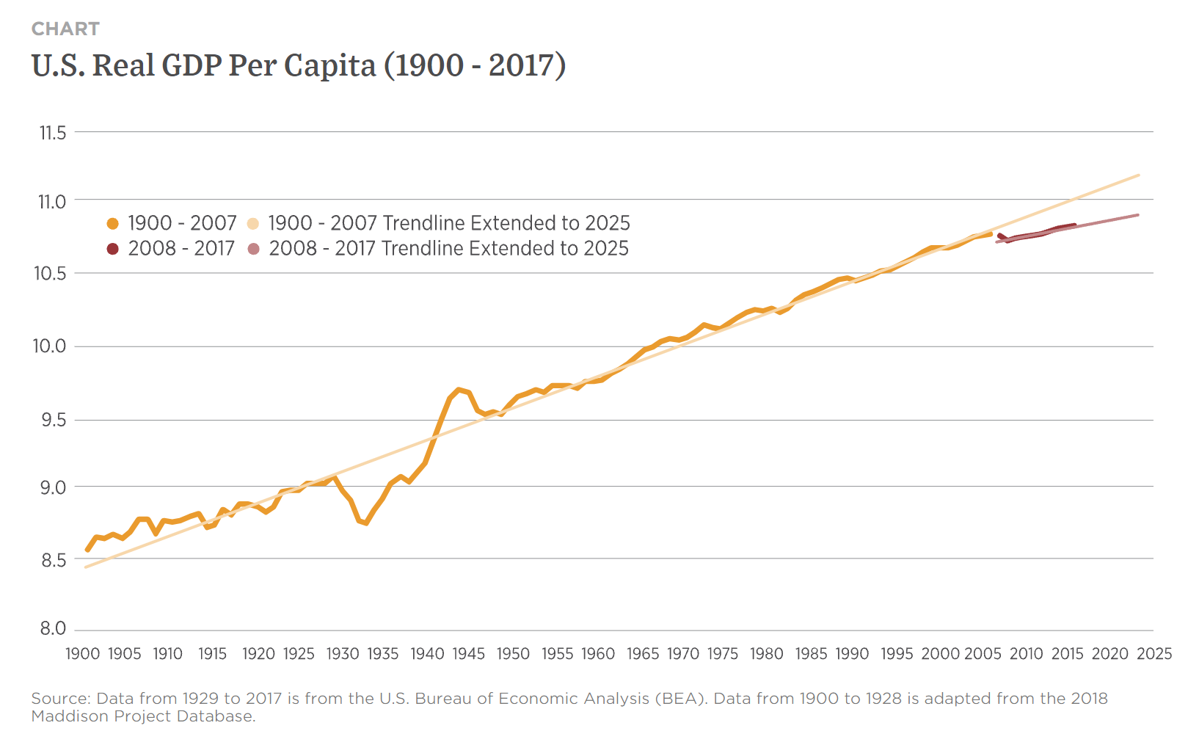
At peak, U.S spent ~40% of its GDP on war effort
But loss of GDP from climate change likely to be sustained over many years.
“Many people do not appreciate that this is actually a few percent per year, every year.” – Amir Jina, co-author
Great Depression
3.3% drop

Slide 32
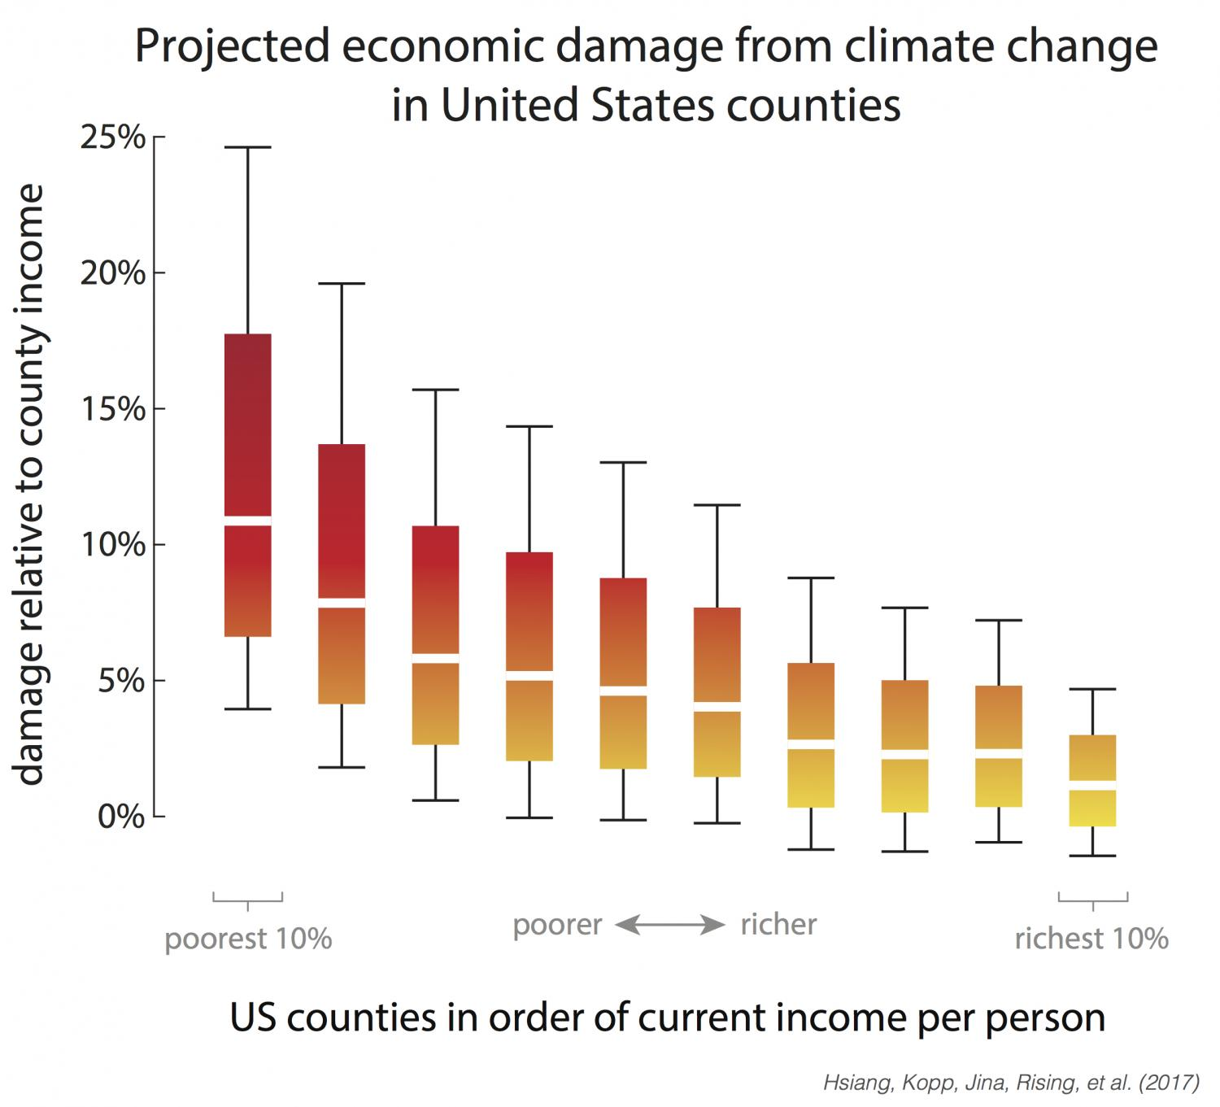
Range of economic damages per year for groupings of US counties, based on their income (29,000 simulations for each of 3,143 counties). The poorest 10% of counties are the leftmost box plot. The richest 10% are the rightmost box plot. Damages are fraction of county income. White lines are median estimates, boxes show the inner 66% of possible outcomes, outer whiskers are inner 90% of possible outcomes.

Slide 33
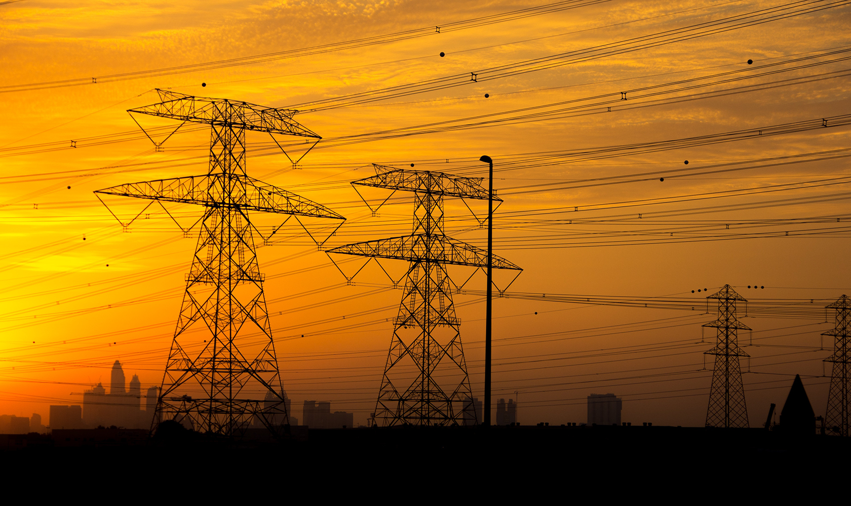
Energy

Slide 34
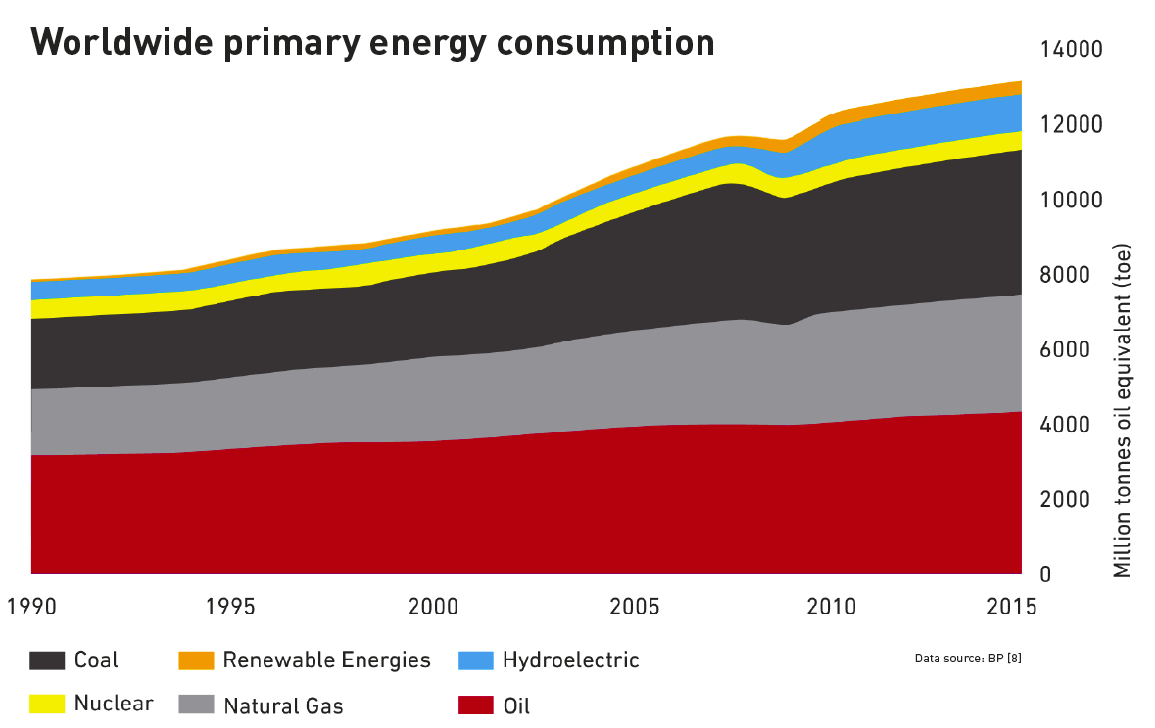
Global Response to Climate Risk
Low Carbon
Fossil fuels
Courtesy Jacopo Buongiorno, MIT

Slide 35
Political Priors
From the Right:
From the Left:
Investor’s Business Daily, 4/10/2018: “As we've said many times, evidence continues to show weaknesses in climate models used to predict future warming. Nor have various calamities that were supposed to have occurred by now materialized.”
Translation: There is no problem to solve
Massachusetts Sierra Club: “Climate change is an existential threat facing humanity and many other species.” “The goal of fully transitioning the world's energy mix toward renewable energy sources is no longer a utopian ideal; it is being achieved in a number of places around the world today.”
Translation: Goal is to move to renewables, not a) to solve climate/energy problem, not b) to address poverty/population

Slide 36
Estimated Costs to Decarbonize Energy
By 2040 will need 5 trillion W capacity globally
Solar and Wind: Increasingly cheap, if storage not included
  For 12-hours storage capacity, $4000/Kwh projected for 2025¹
  Will cost $ 1 trillion/yr for 20 years
  But current lifetime of Li-ion is only 10 years
  Addition $2 trillion/yr maintenance costs. Only buys 12 hrs storage
Nuclear fission: Can be ramped up in 10-12 years
  Would need to build 125 2-GW reactors per year for 20 years
  Current cost to build one 2-GW reactor in South Korea: $4 billion
  Would need to spend $500 billion per year (0.6% of current world domestic product) for 20 years
  Service life > 80 years
¹ U.S. department of Energy: “Energy Storage Technology and Cost Characterization Report”, July 2019

Slide 37
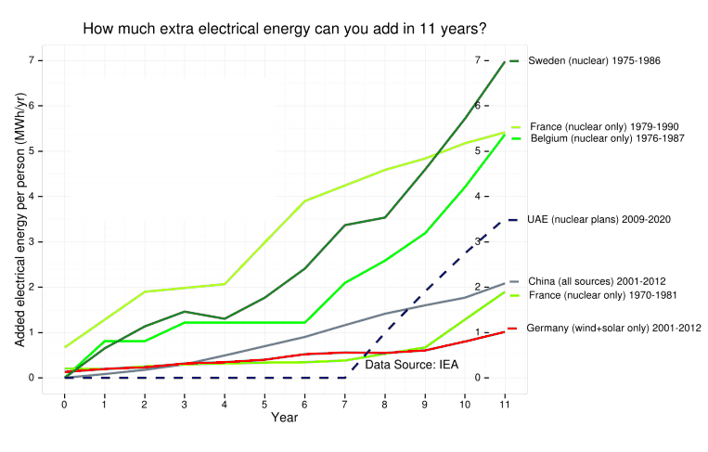
Ramping up of Carbon-Free Power

Slide 38
“The Sierra Club remains unequivocally opposed to nuclear energy. Although nuclear plants have been in operation for less than 60 years, we now have seen three serious disasters. As the disasters at Chernobyl, Three Mile Island and Fukushima have shown, nuclear power can cause catastrophic damage to land, human health, and our food supply.”

Slide 39
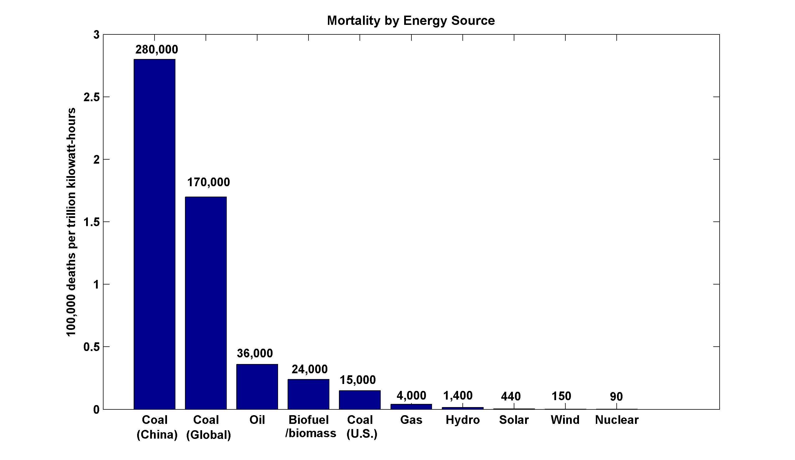
~13,000 premature deaths annually in the U.S. from coal production and combustion, 8.7 million globally
More people die every 3 days from fossil fuel particulates than have died in the whole history of nuclear power
(includes Chernobyl, Fukushima)

Slide 40
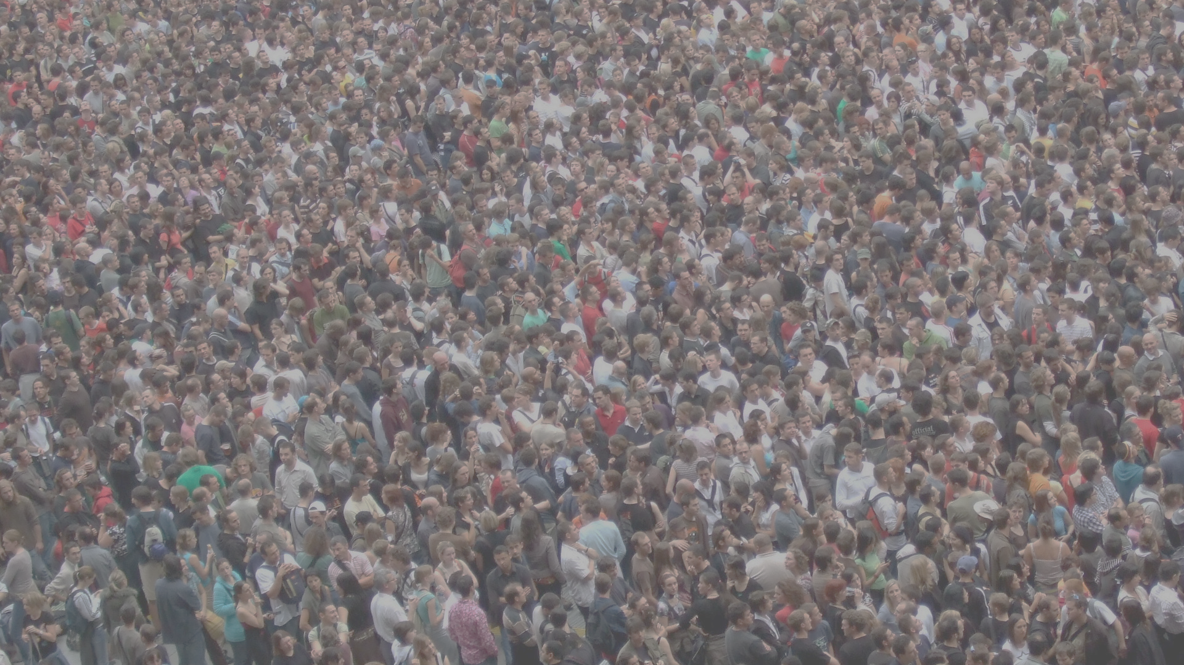
Energy, Population and Poverty

Slide 41
Per capita emissions go down as per capita income goes up

Slide 42
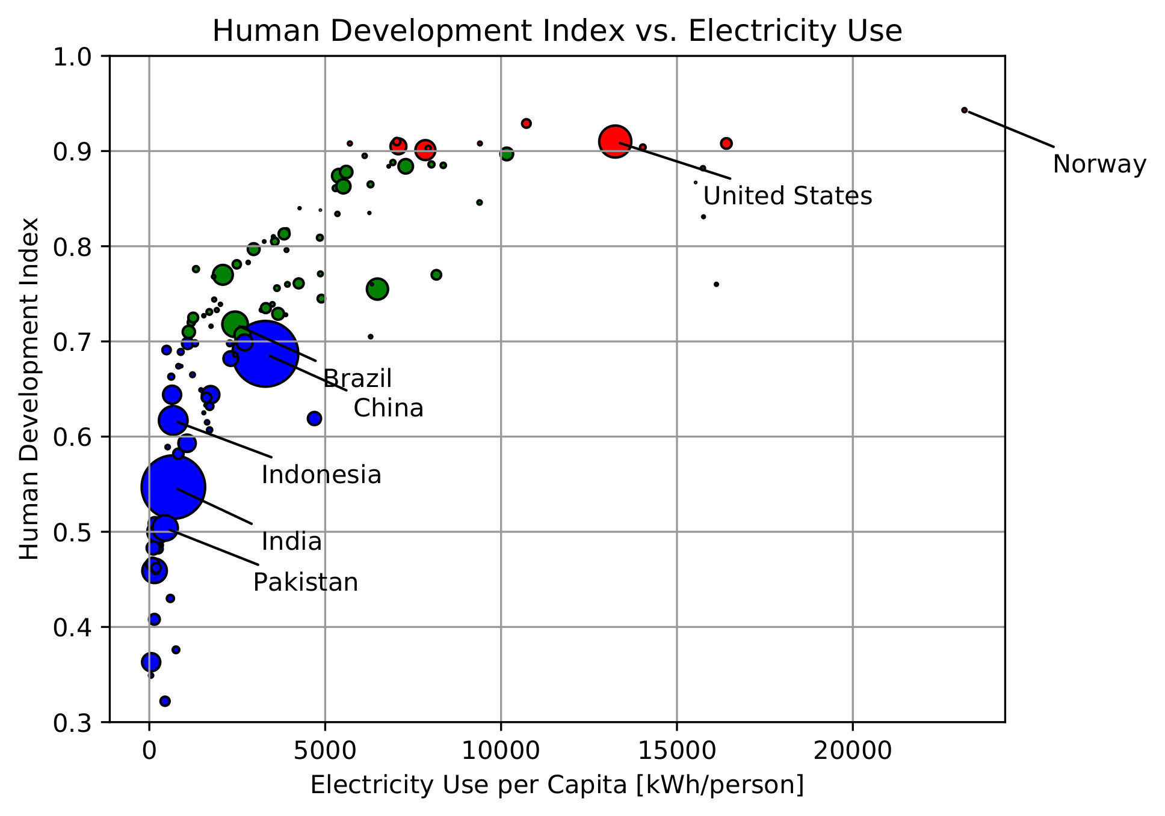
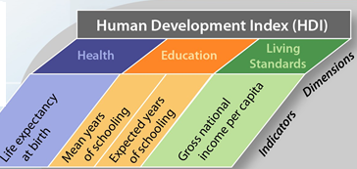
Access to energy is key to human development
Courtesy Jacopo Buongiorno, MIT
More than ½ the World’s population is yet to climb this curve

Slide 43
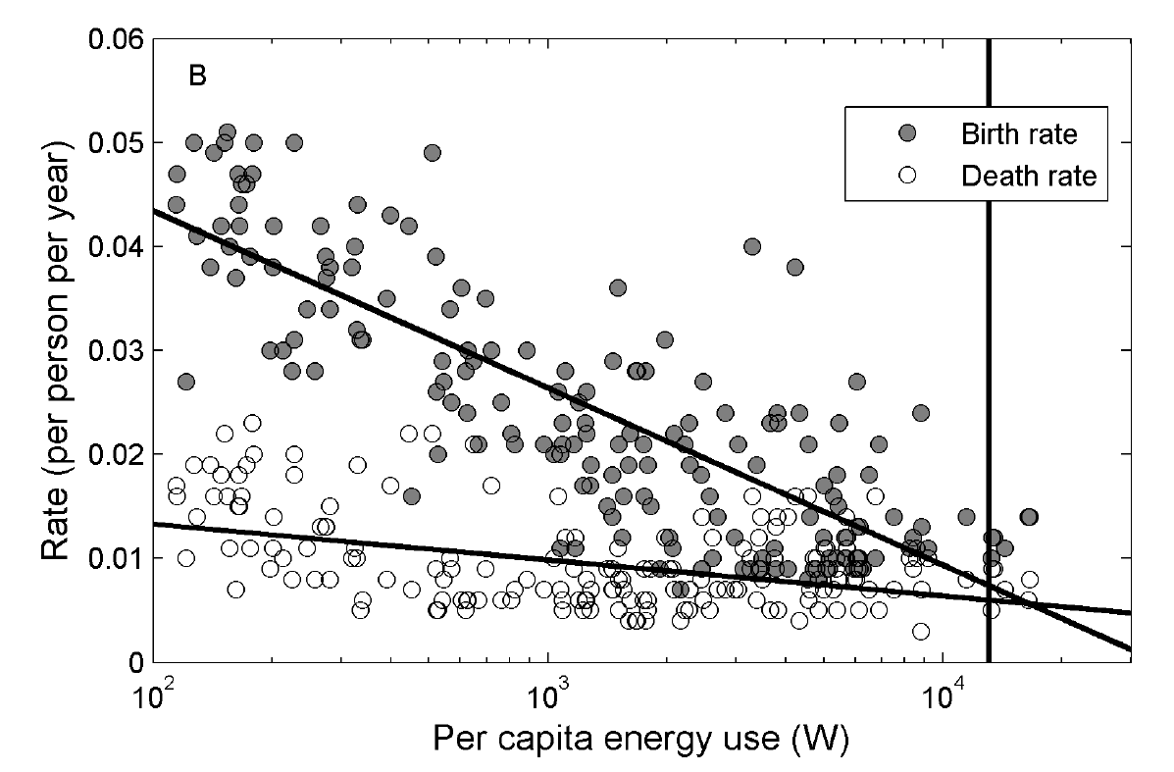

…and is key to controlling population growth
Current world’s average (∼2.5 kW)
DeLong et al, PLoS ONE, 5(10), 2010
Average per capita primary energy use rate (W)
Courtesy Jacopo Buongiorno, MIT
At ∼13 kW per capita, population levels off to ∼10 billions by 2050.
At <10 kW there is no leveling off

Slide 44
Summary
The climate problem is difficult because event probabilities, societal costs, and mitigation costs are all continuous (not binary) and uncertain, beneficiaries are distant, and decision-making hobbled by many ‘priors’. Tail risk may be existential.
From the right: Global warming is an excuse by Al Gore and his buddies to implement long-term leftist agenda of socialism and big government. It will cripple the economy.
From the left: The goal is 100% renewable energy, empowering people and crippling the fossil fuel industry. Nuclear is scary and an example of big business and must be avoided at all costs.

Slide 45
Summary (continued)
Deployment of combinations of renewables, carbon capture and sequestration, and nuclear power can mitigate climate risk at reasonable cost, if priors can be disregarded in favor of a rational approach to risk
Rapid increase in affordable energy in developing countries is imperative to increasing per-capita wealth and decreasing population growth

Slide 46
Spare Slides

Slide 47
Three Studies of Harvey’s Rain:
Emanuel, PNAS, 2017: 4-fold increase in annual probability of Harvey-magnitude rainfall from 1990- 2017. Based on models only.
Risser and Wehner, Geophys. Res. Lett., 2017: ~10-fold increase in annual probability of Harvey-magnitude rainfall from 1950-2016. Based on historical records only.
van Oldenborgh et al., Environ, Res. Lett., 2017: ~4-fold increase in Harvey-magnitude rainfall from 1900 to 2017. Based on observations and models.

Slide 48
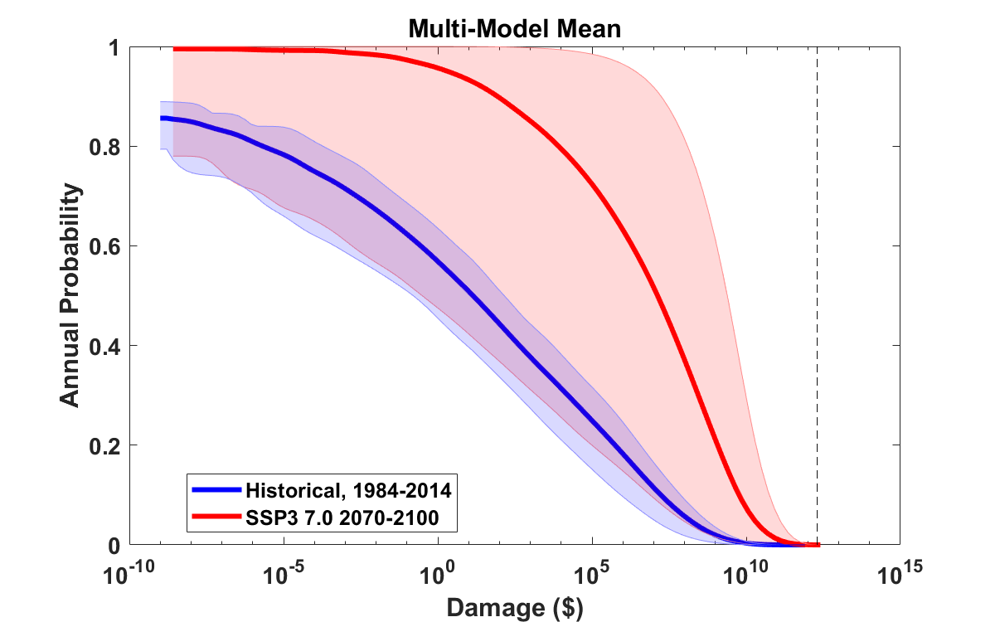
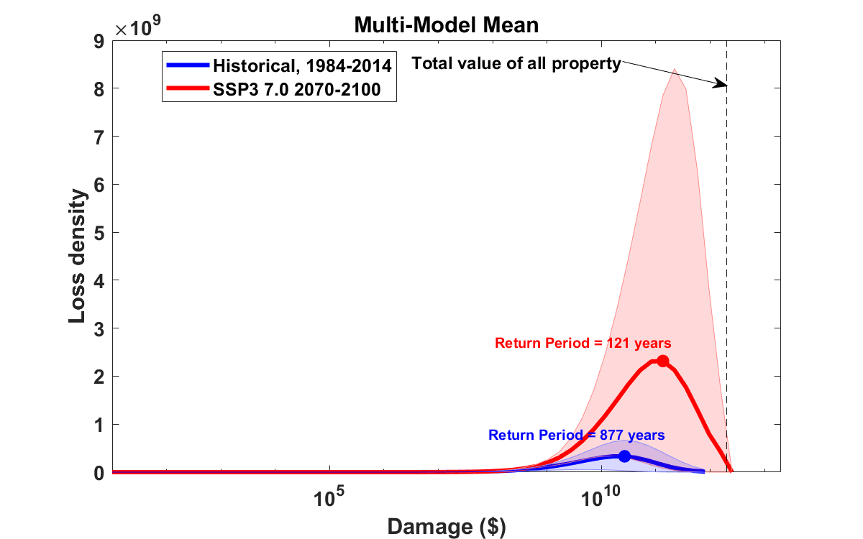
Median annual loss (2-year return period)
1984 – 2014: $ 12 ($2 – $34)
2070 – 2100: $ 3.5 million ($260 k – $56 million)
Average annual loss:
1984 – 2014: $ 536 million ($108 million – $1.25 billion)
2070 – 2100: $ 4.1 billion ($590 million – $13.7 billion)
Annual average loss strongly dominated by VERY rare events!
These will not be evident in historical records

Slide 49
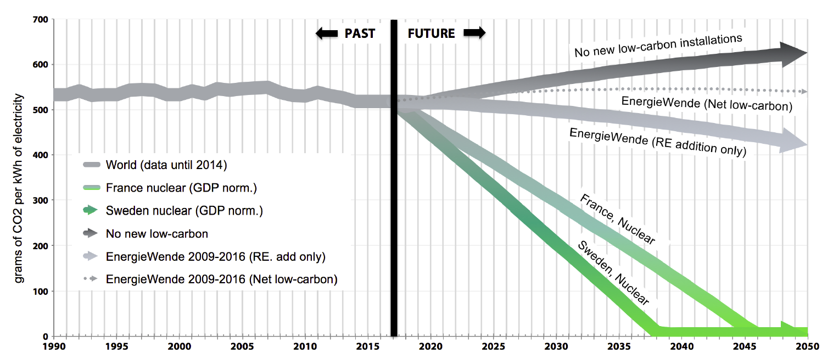
A nuclear build-up (at demonstrably feasible rate) can completely decarbonize the World’s power sector within 30 years
Target for 2°C scenario
Courtesy Jacopo Buongiorno, MIT
Source: Staffan Qvist, 2018

