Slide 1

Effects of climate change on hurricanes, medicanes and severe thunderstorms
Kerry Emanuel
Lorenz Center
Massachusetts Institute of Technology

Slide 2
Program
Tropical cyclones: Theory and observations
Using physics to downscale TCs, medicanes, and polar lows
Severe convective storms: Some theoretical considerations
Summary

Slide 3
Tropical Cyclone Potential Intensity:
A thermodynamic upper bound on the maximum magnitude of surface winds

Slide 4
Seasonal cycle of potential intensity (PI) and observed distributions of tropical cyclone intensity in the western North Pacific region
From Gilford et al., Mon. Wea. Rev., 2019

Slide 5
Annual Maximum Potential Intensity (m/s)
Derived from Carnot Theorem

Slide 6
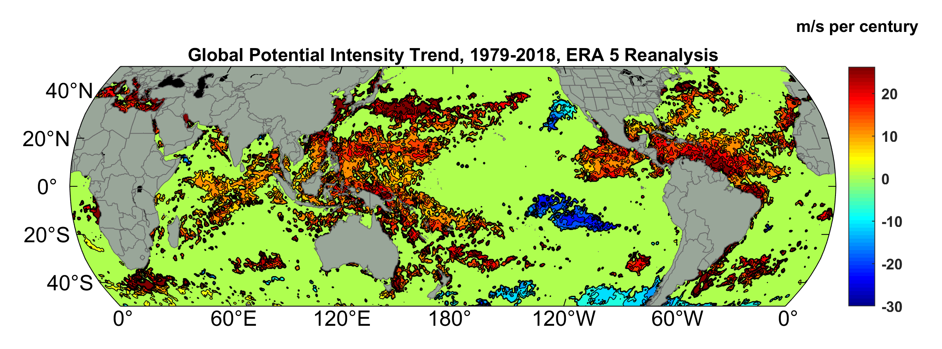
Potential Intensity Trend, 1979-2018, ERA 5 Reanalysis
(Trend shown only where p value < 0.05)

Slide 7
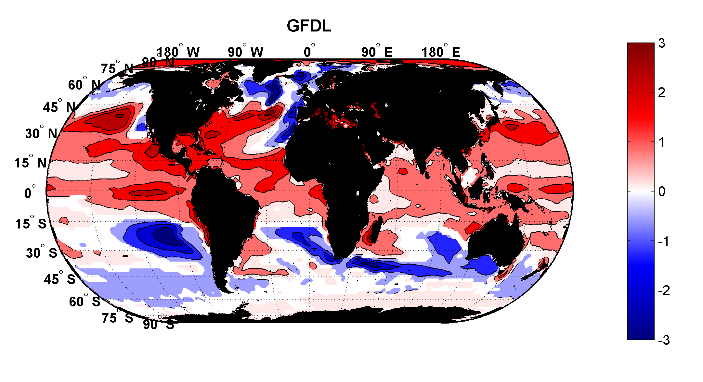
Projected Trend Over 21st Century: GFDL model under RCP 8.5
ms⁻¹decade⁻¹

Slide 8

Inferences from Basic Theory:
Potential intensity increases with global warming
Incidence of high-intensity hurricanes should increase
Increases in potential intensity should be faster in sub-tropics
Hurricanes will produce substantially more rain: Fundamental physics yields a ~7% increase in water vapor per 1ºC warming

Slide 9
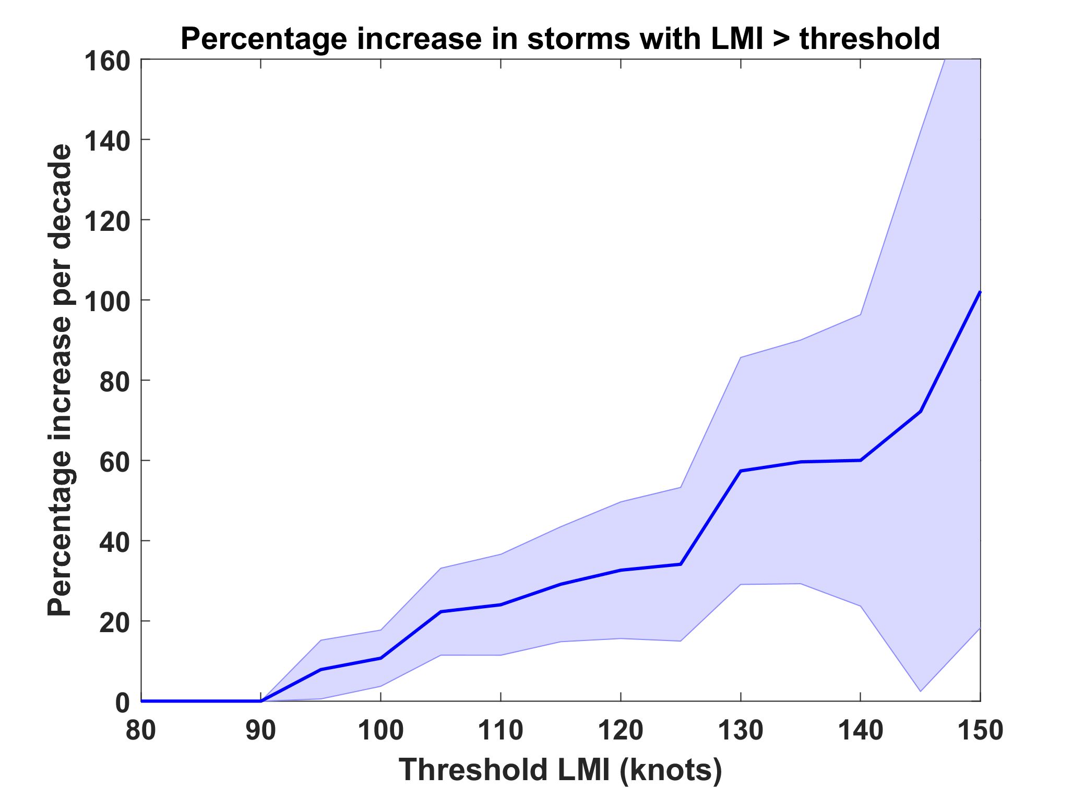
Trends in Global TC Frequency Over Threshold Intensities, from Historical TC Data, 1980-2016. Trends Shown Only When p < 0.05.
Category

Slide 10
Using Physics to Estimate Tropical Cyclone Activity

Slide 11

Embed high-resolution, fast coupled ocean- atmosphere hurricane model in global climate model or climate reanalysis data
Coupled Hurricane Intensity prediction Model (CHIPS) has been used for ~20 years to forecast real hurricanes in near- real time
Initialize with random seeding
Can easily generate > 100,000 storms

Slide 12
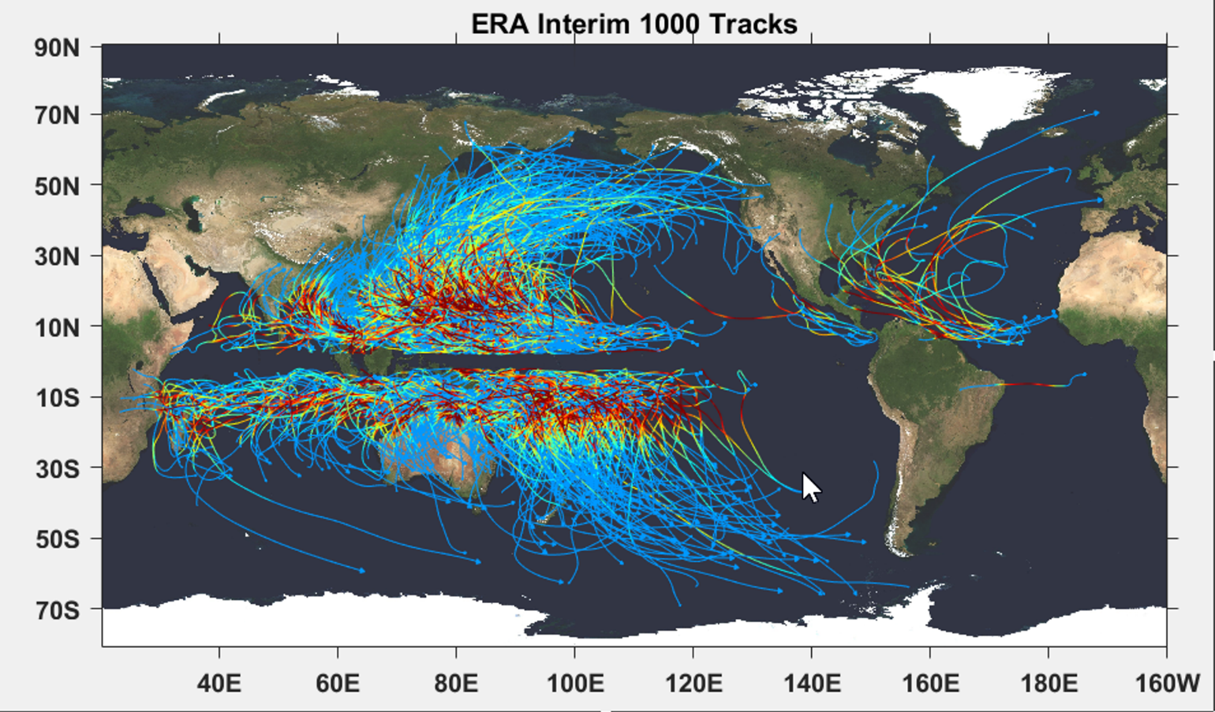

Slide 13

Cumulative Distribution of Storm Lifetime Peak Wind Speed, with Sample of 1755 Synthetic Tracks
90% confidence bounds

Slide 14
Atlantic Annual Cycle

Slide 15
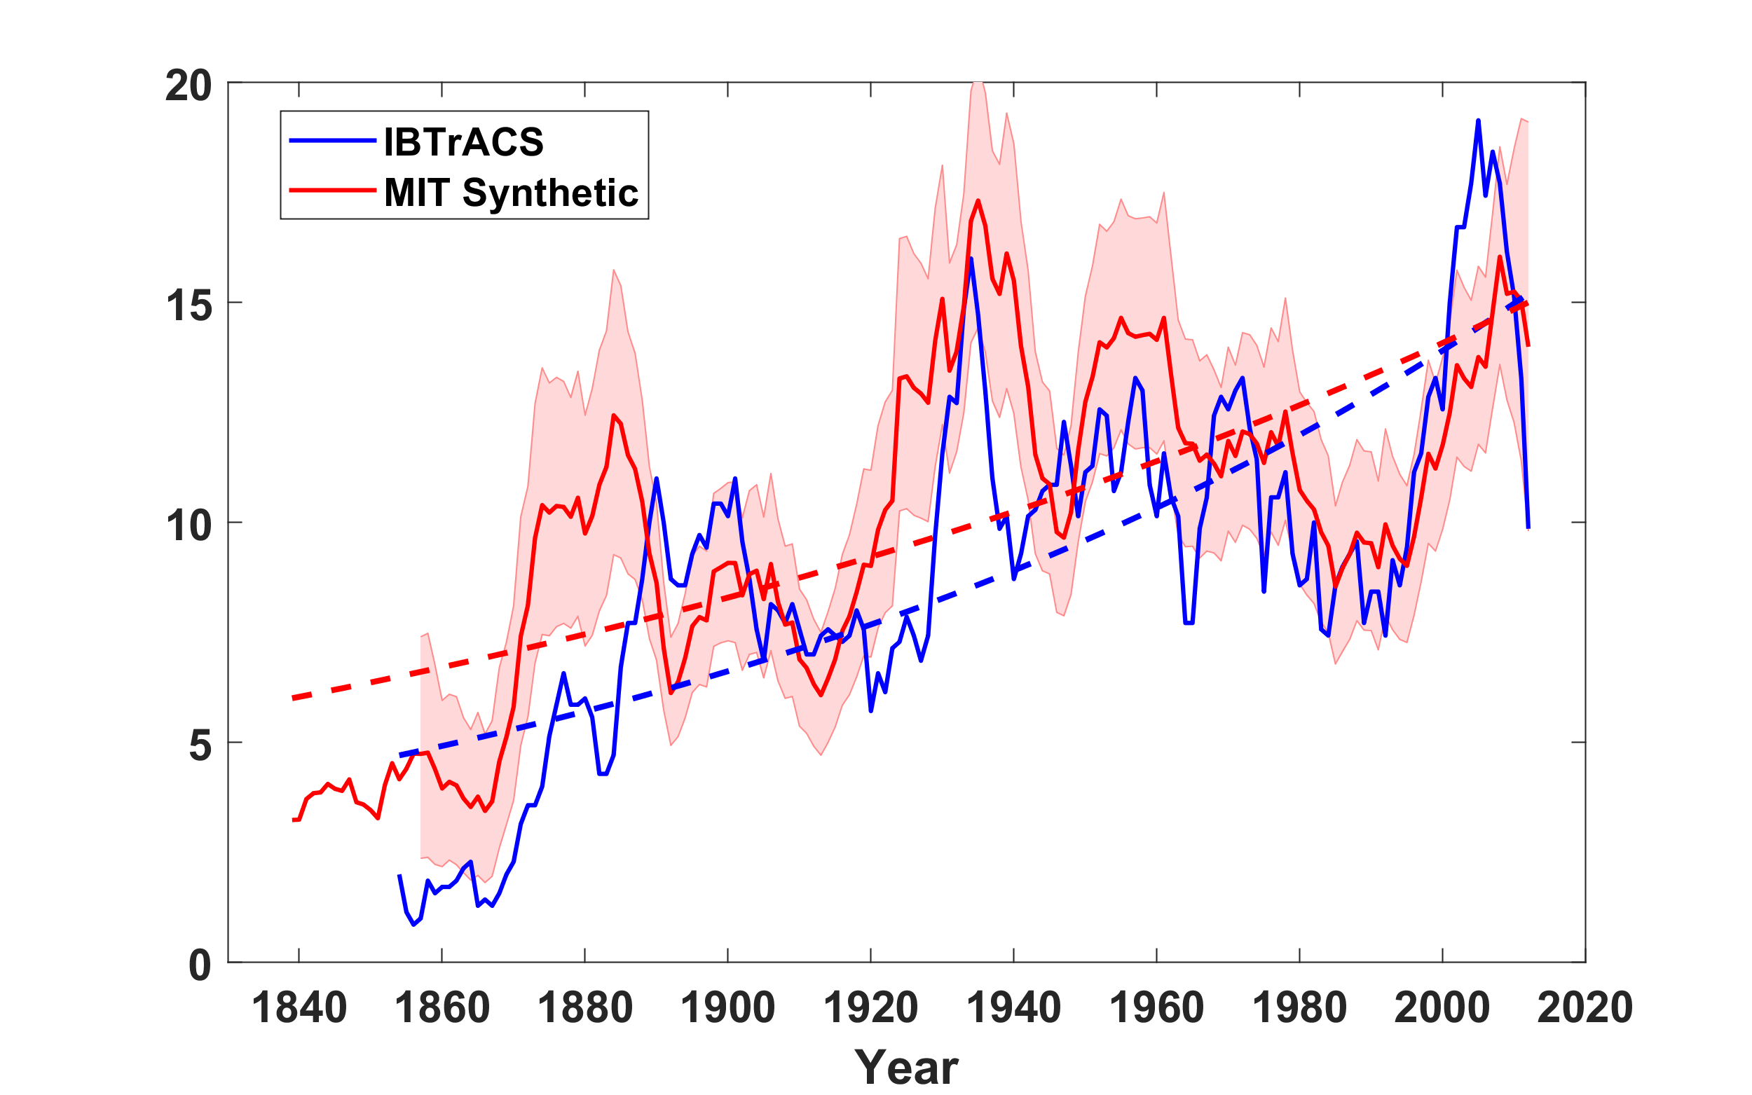
Downscale NOAA 20th century v.3 for all landfalling Atlantic tropical cyclones; compare to observations (IBTrACS)
Dashed lines: Poisson regression curves

Slide 16
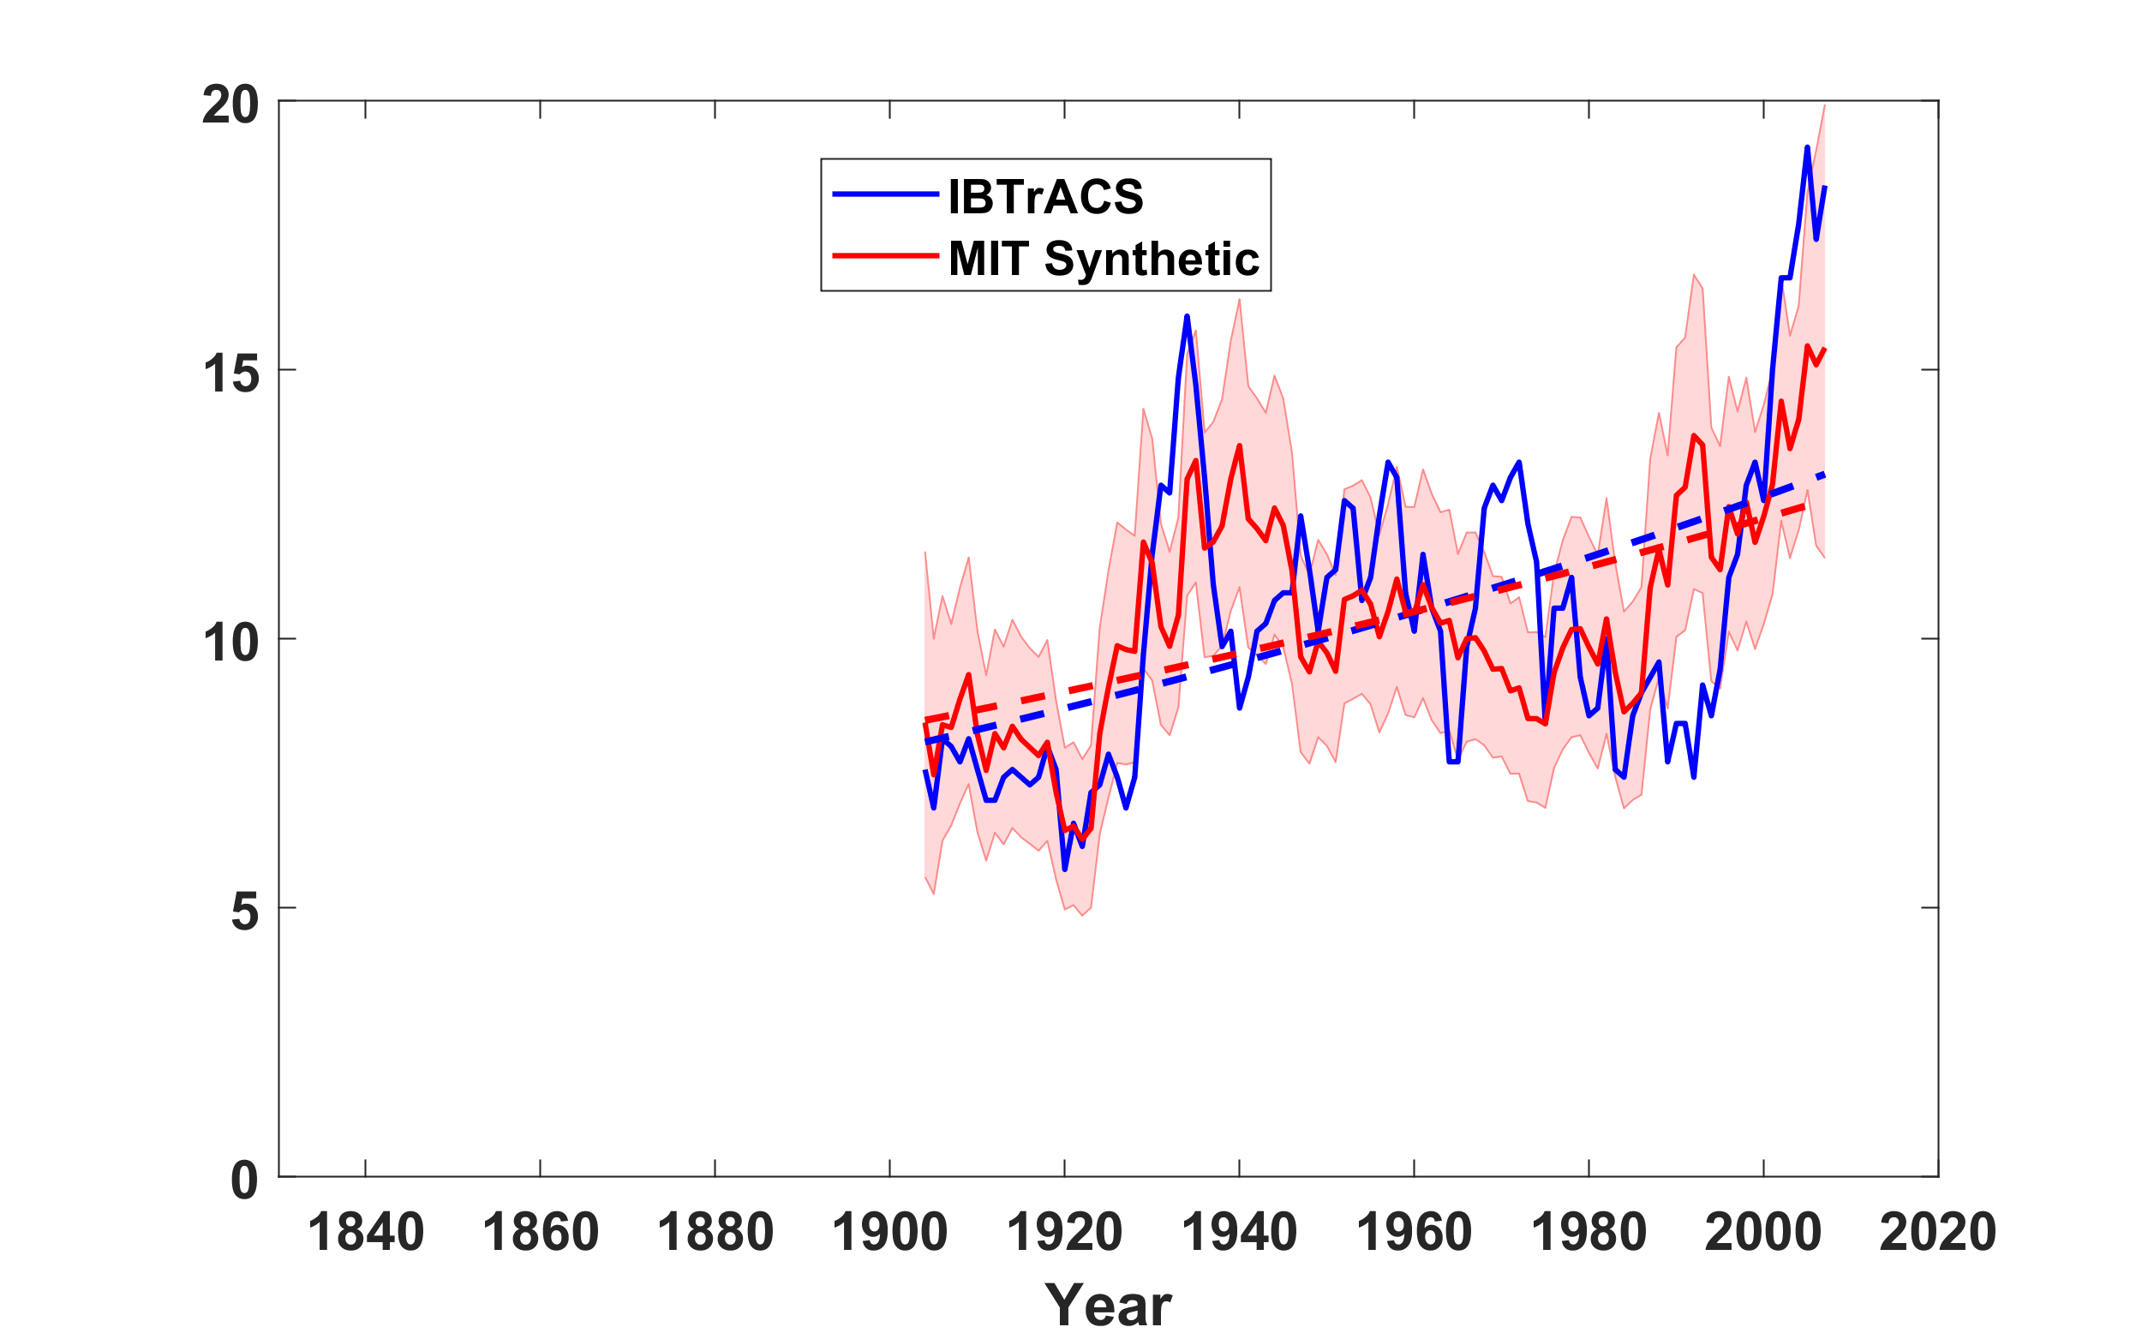
Same, but downscaling CERA 20th century reanalyses
Hurricane drought induced by anthropogenic sulfate aerosols

Slide 17
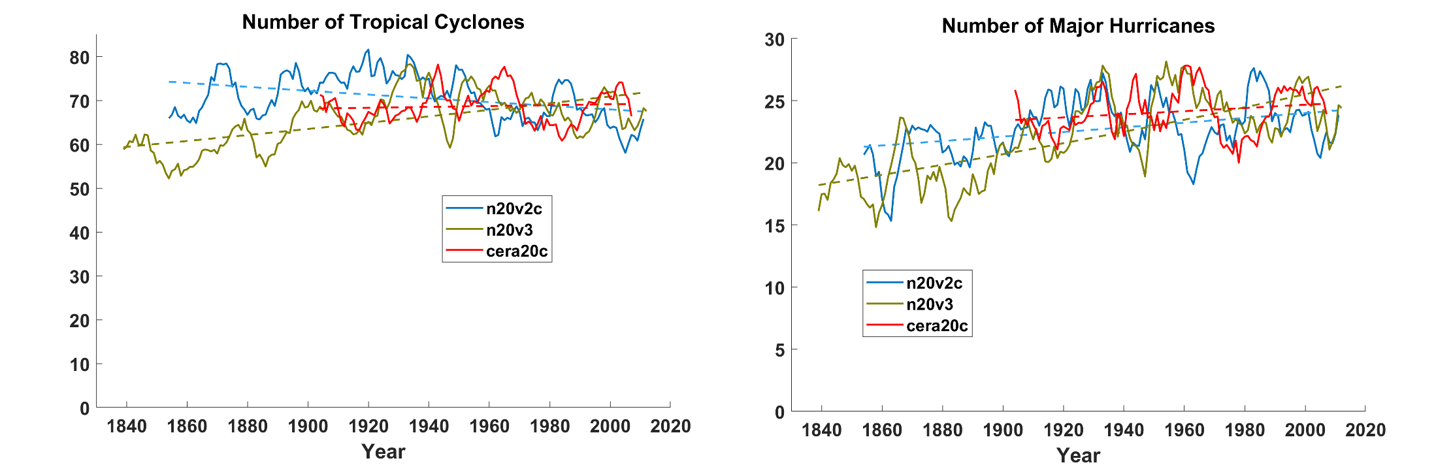
Global downscaling of 20th century-type reanalyses shows no significant trends

Slide 18
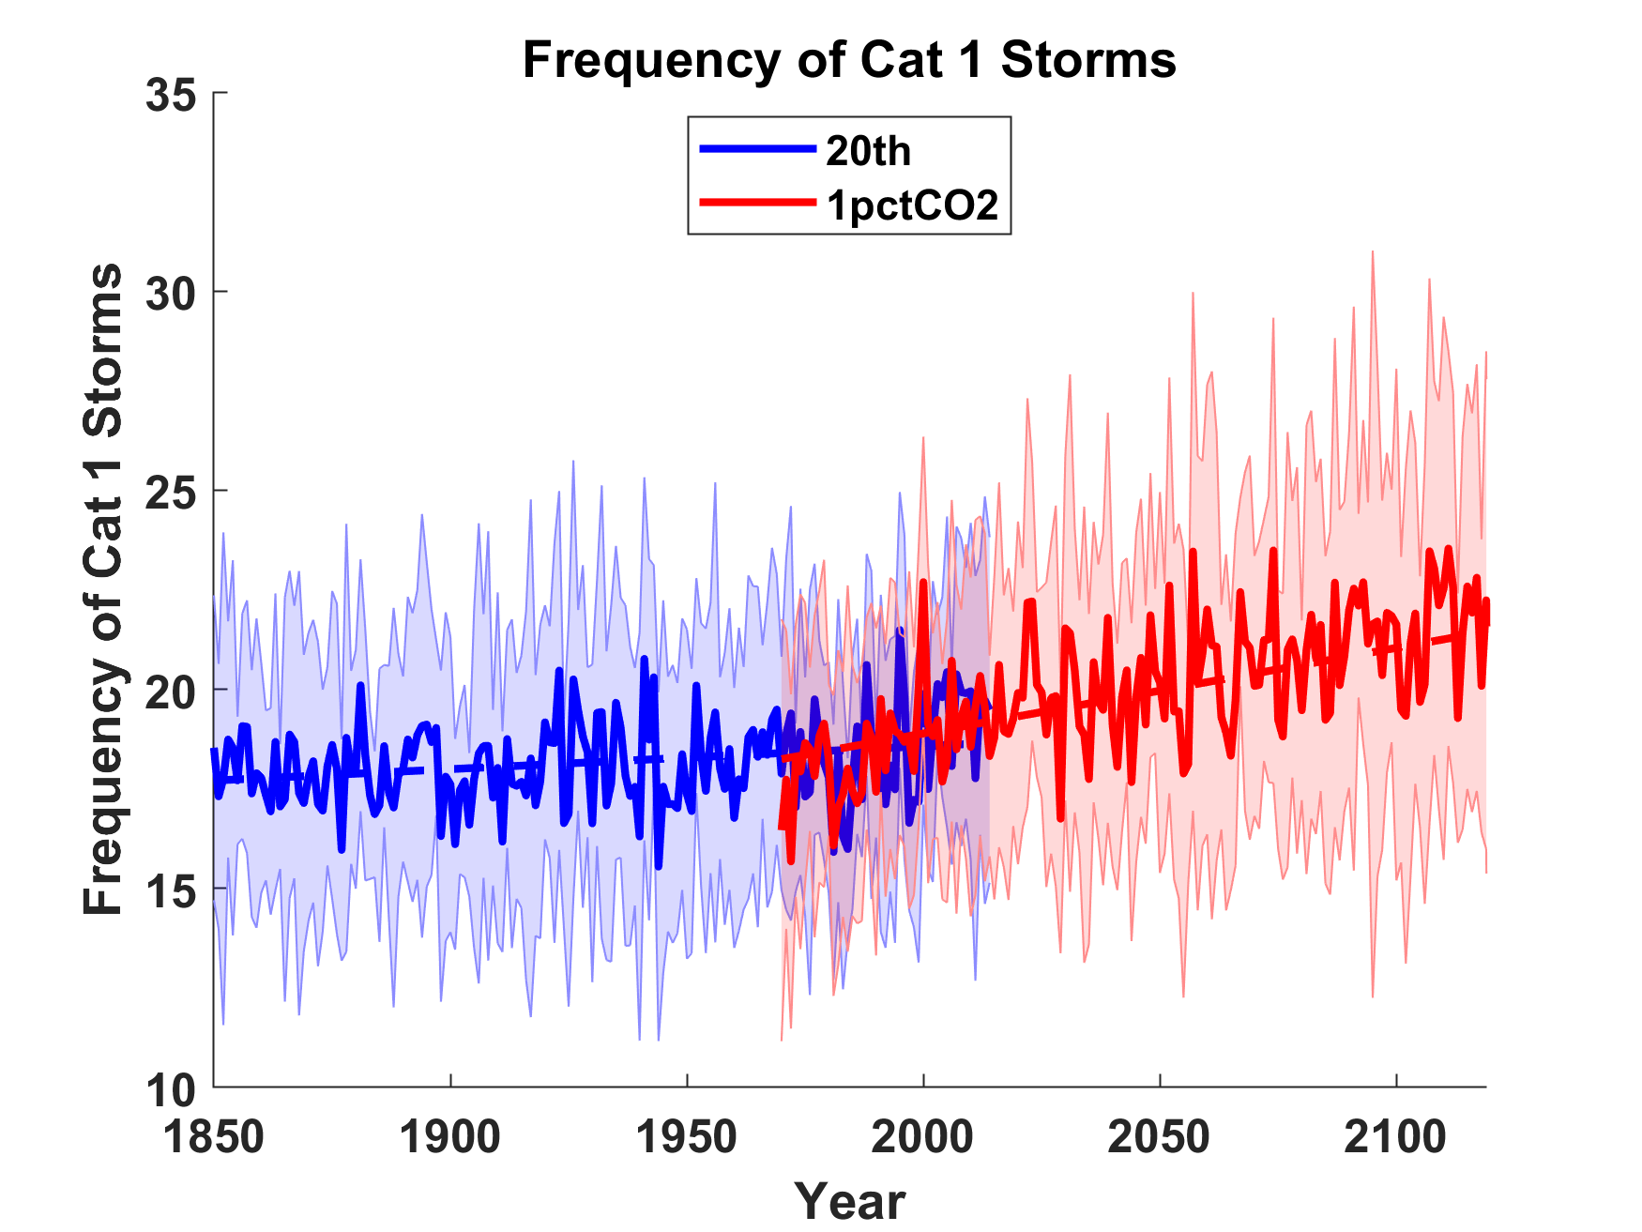
Global downscaling of 9 CMIP6 models suggest that trend may emerge in this century

Slide 19
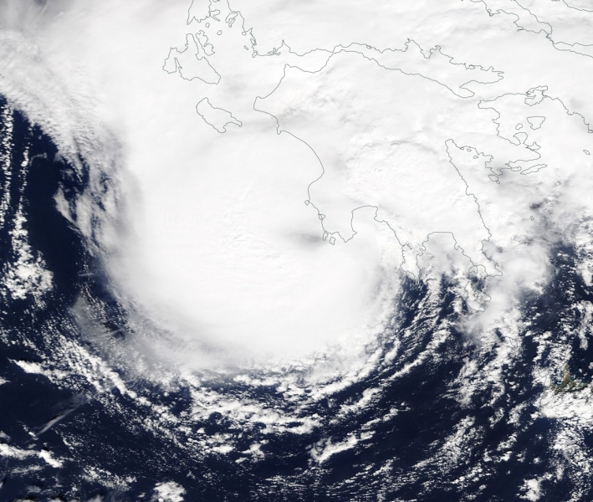
Mediterranean Hurricanes (“Medicanes”)
Medicane “Zorba” making landfall in southwest Peloponnese, September 29th 2018

Slide 20
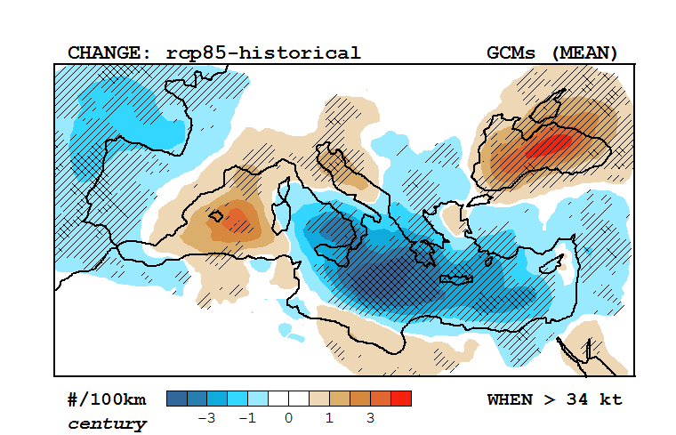
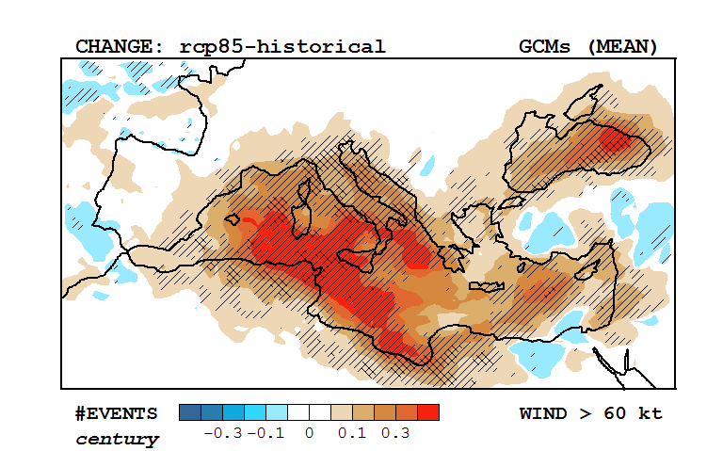
Response of Medicanes to a Changing Climate
Change in multi-model mean track density, RCP 8.5 –historical (2090-1995)
Based on downscaling of 30 CMIP5 models
(light and dark hatching; > 66% and 80% consensus)
Change in multi-model mean frequency of winds > 60 knots, RCP 8.5 –historical (2090-1995)
Romero and Emanuel, J. Clim., 2017

Slide 21
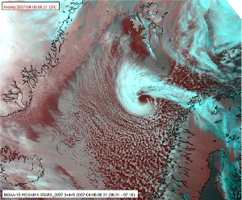
Polar Lows

Slide 22
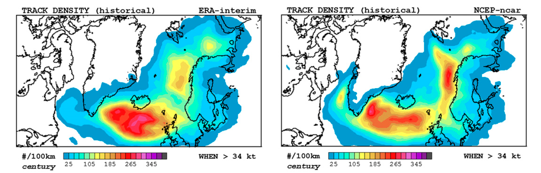
Response of Polar Lows to a Changing Climate
Change in multi-model mean track density, RCP 8.5 –historical (2090-1995)
Romero and Emanuel, J. Clim., 2017

Slide 23

The future of severe convective storms

Slide 24

Even worse consequences…

Slide 25
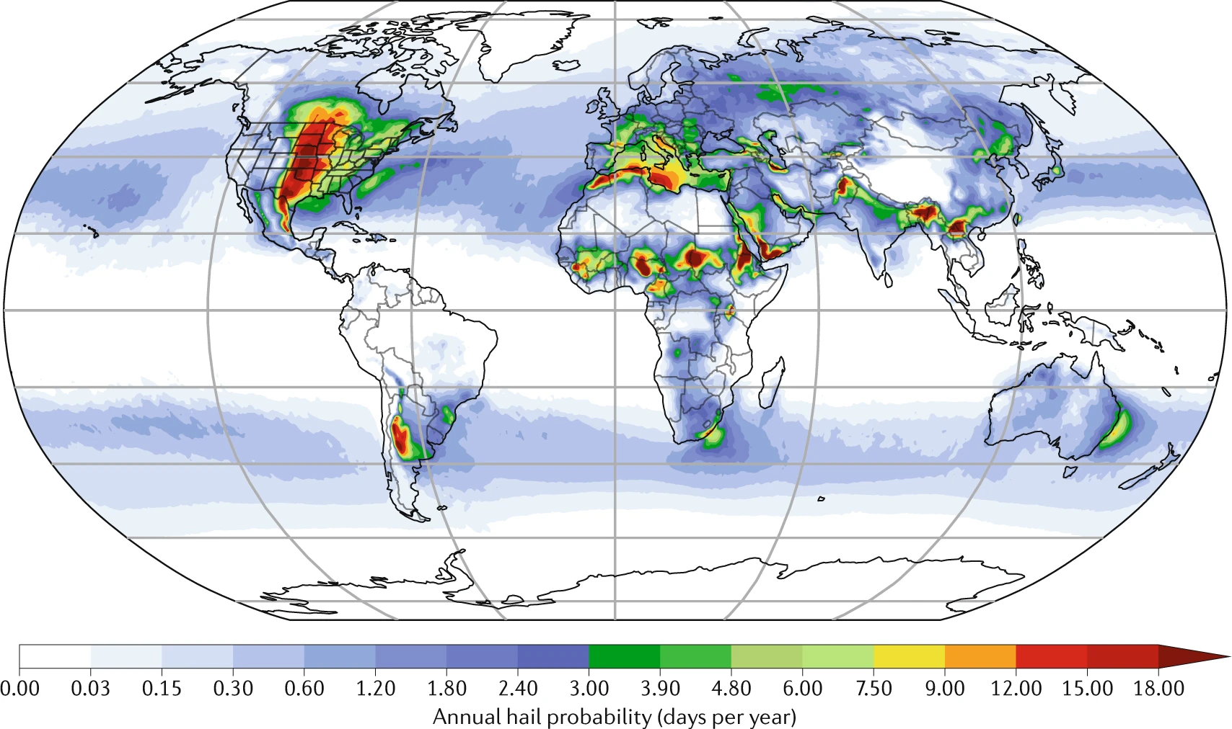
Global Hail Climatology
Raupach et al., Nature, 2021

Slide 26
Hypothesis:
Large CAPE is produced when a deep, dry- adiabatic layer is advected over moist soil which is then subjected to solar heating.
Agard, V., and K. Emanuel, 2017: Clausius–Clapeyron scaling of peak CAPE in continental convective storm environments. J. Atmos. Sci., 74, 3043-3054.

Slide 27
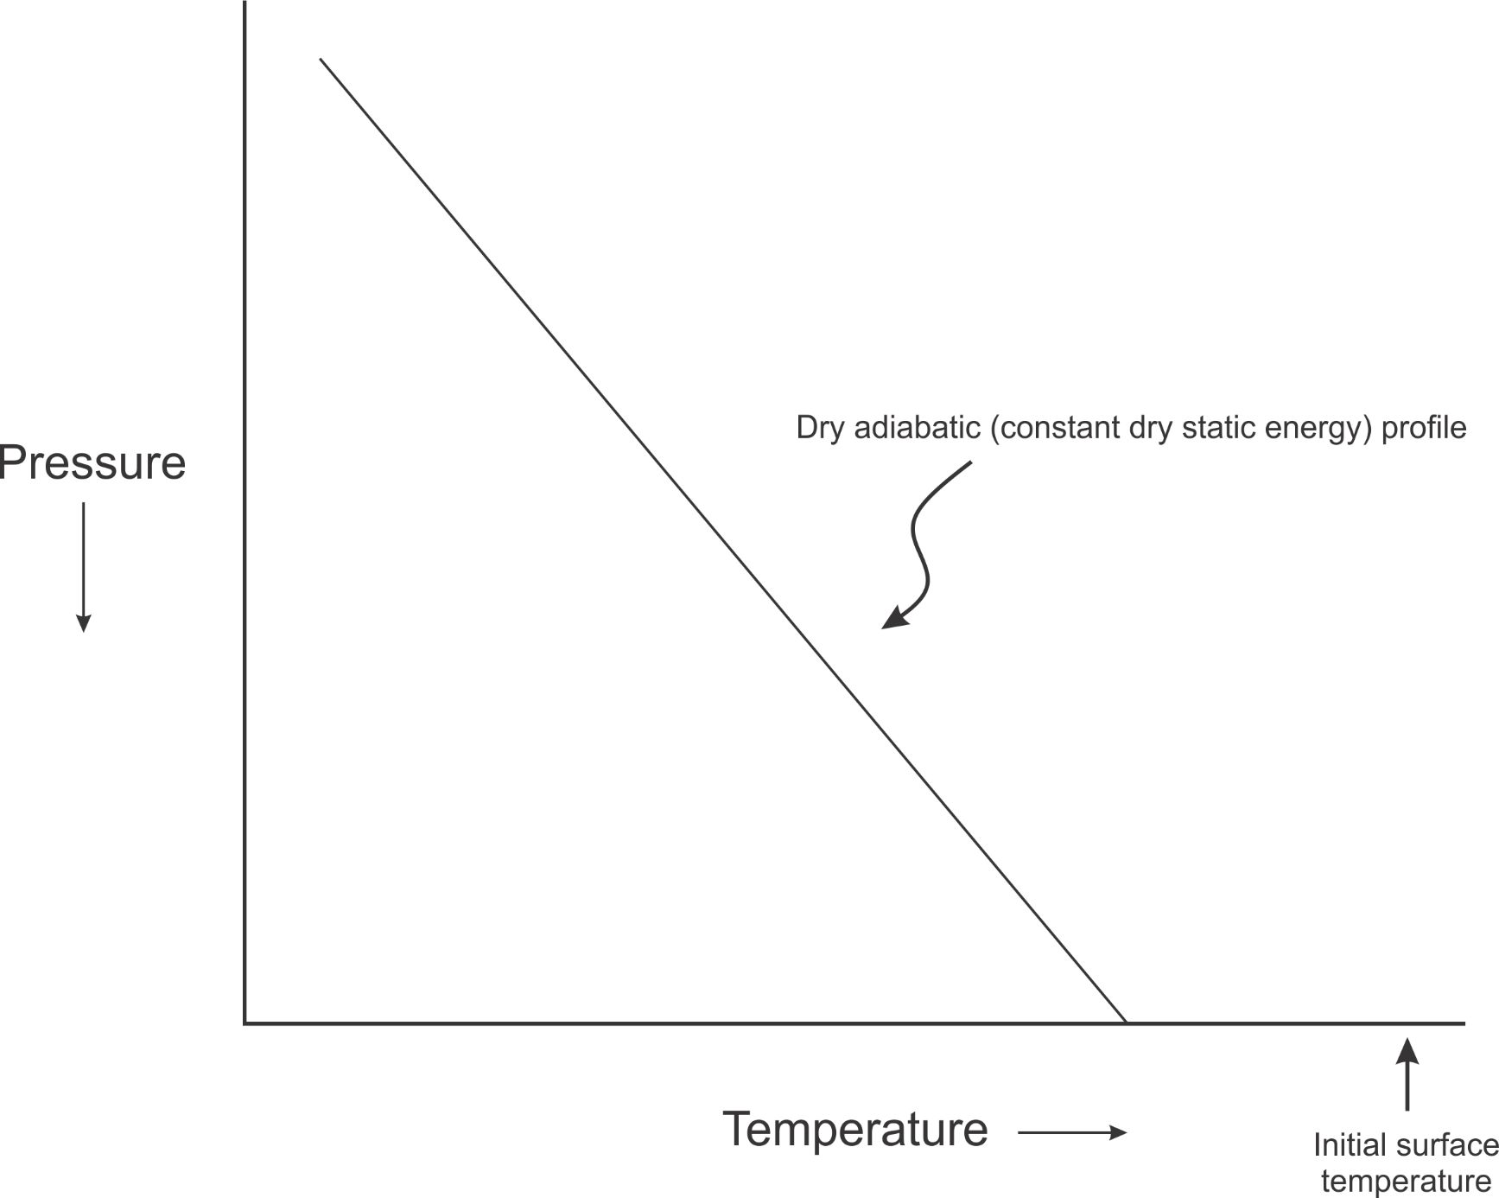
We can model these circumstances with an idealized initial value problem
Start with a dry-adiabatic column over a heated, dry surface
Dry static energy=D₀
Moist static energy=D₀
T_{s}
Notes:
So now we can think about this problem in terms of the dry and moist static energies in the different parts of the column. Initially, before the BL forms, the entire column is just a solid block with constant dry static energy (dry adiabatic), and since there’s no moisture anywhere, its moist static energy is just equal to its dry static energy. That all remains true in the free troposphere even after the BL forms. However, in the BL, we make that requirement that moist static energy be conserved upon contact with the moist surface. That means that the dry static energy must decrease when this happens, so D<D0 in the BL, and we have a deficit of DSE between the BL and the FT. On the other hand, we start off with M in the BL equal to D0, and it’s going to increase as heat and moisture get fluxed in. Therefore, we have a *surplus* of MSE in the BL wrt the FT. Since CAPE can be expressed as the vertical integral of the MSE difference between a lifted parcel and its environment, we can interpret the MSE surplus as an indicator of CAPE, and likewise, the DSE deficit is an indicator of CIN (convective inhibition).

Slide 28
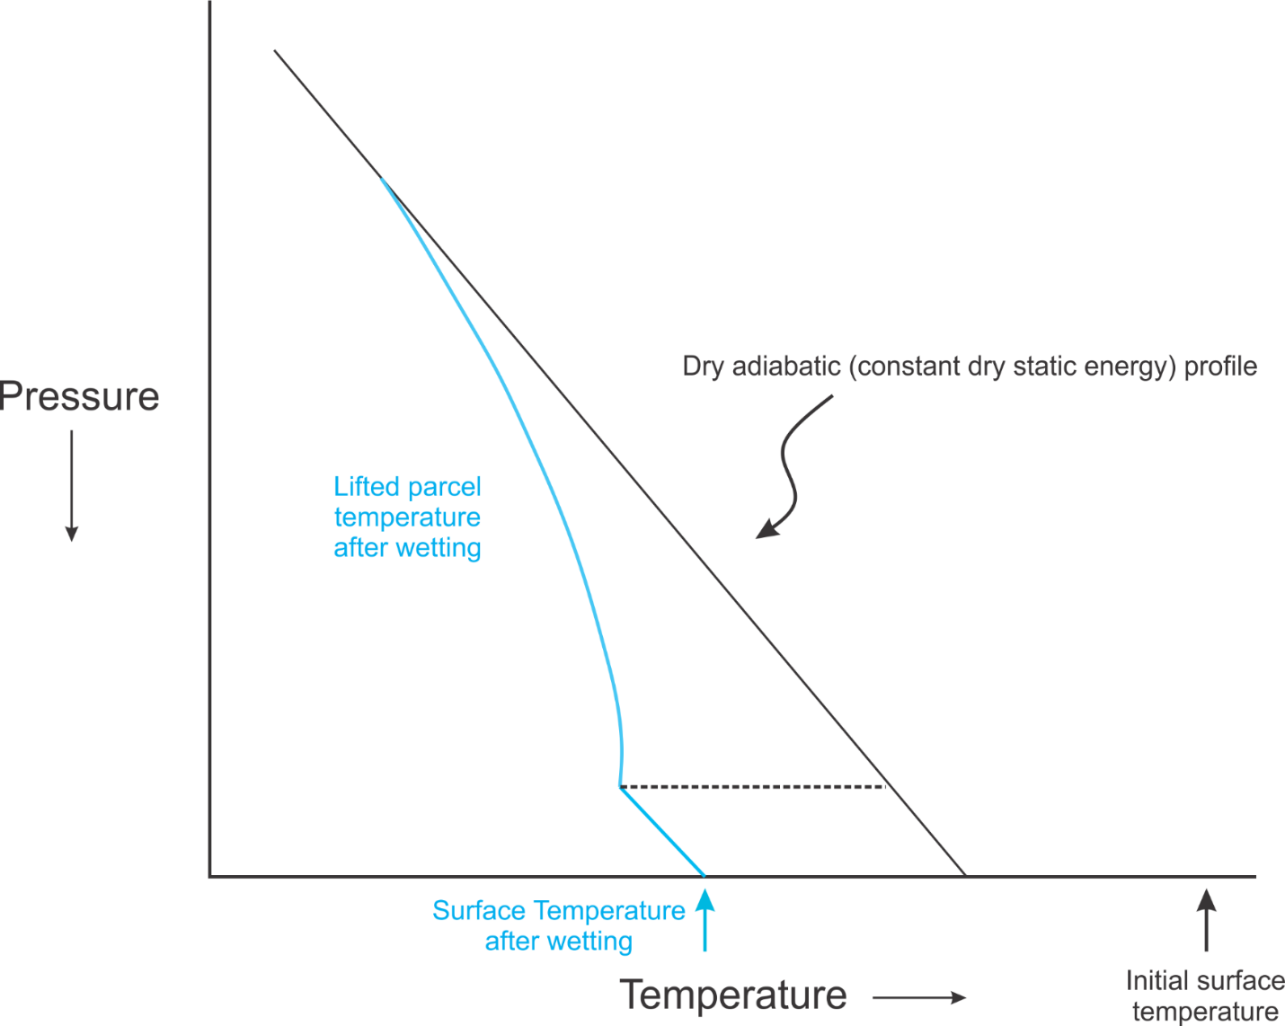
Replace lower boundary by a moist soil surface and create an initially thin, moist boundary layer. Then heat surface with solar radiation and allow new boundary layer to develop.
Notes:
So now we can think about this problem in terms of the dry and moist static energies in the different parts of the column. Initially, before the BL forms, the entire column is just a solid block with constant dry static energy (dry adiabatic), and since there’s no moisture anywhere, its moist static energy is just equal to its dry static energy. That all remains true in the free troposphere even after the BL forms. However, in the BL, we make that requirement that moist static energy be conserved upon contact with the moist surface. That means that the dry static energy must decrease when this happens, so D<D0 in the BL, and we have a deficit of DSE between the BL and the FT. On the other hand, we start off with M in the BL equal to D0, and it’s going to increase as heat and moisture get fluxed in. Therefore, we have a *surplus* of MSE in the BL wrt the FT. Since CAPE can be expressed as the vertical integral of the MSE difference between a lifted parcel and its environment, we can interpret the MSE surplus as an indicator of CAPE, and likewise, the DSE deficit is an indicator of CIN (convective inhibition).

Slide 29
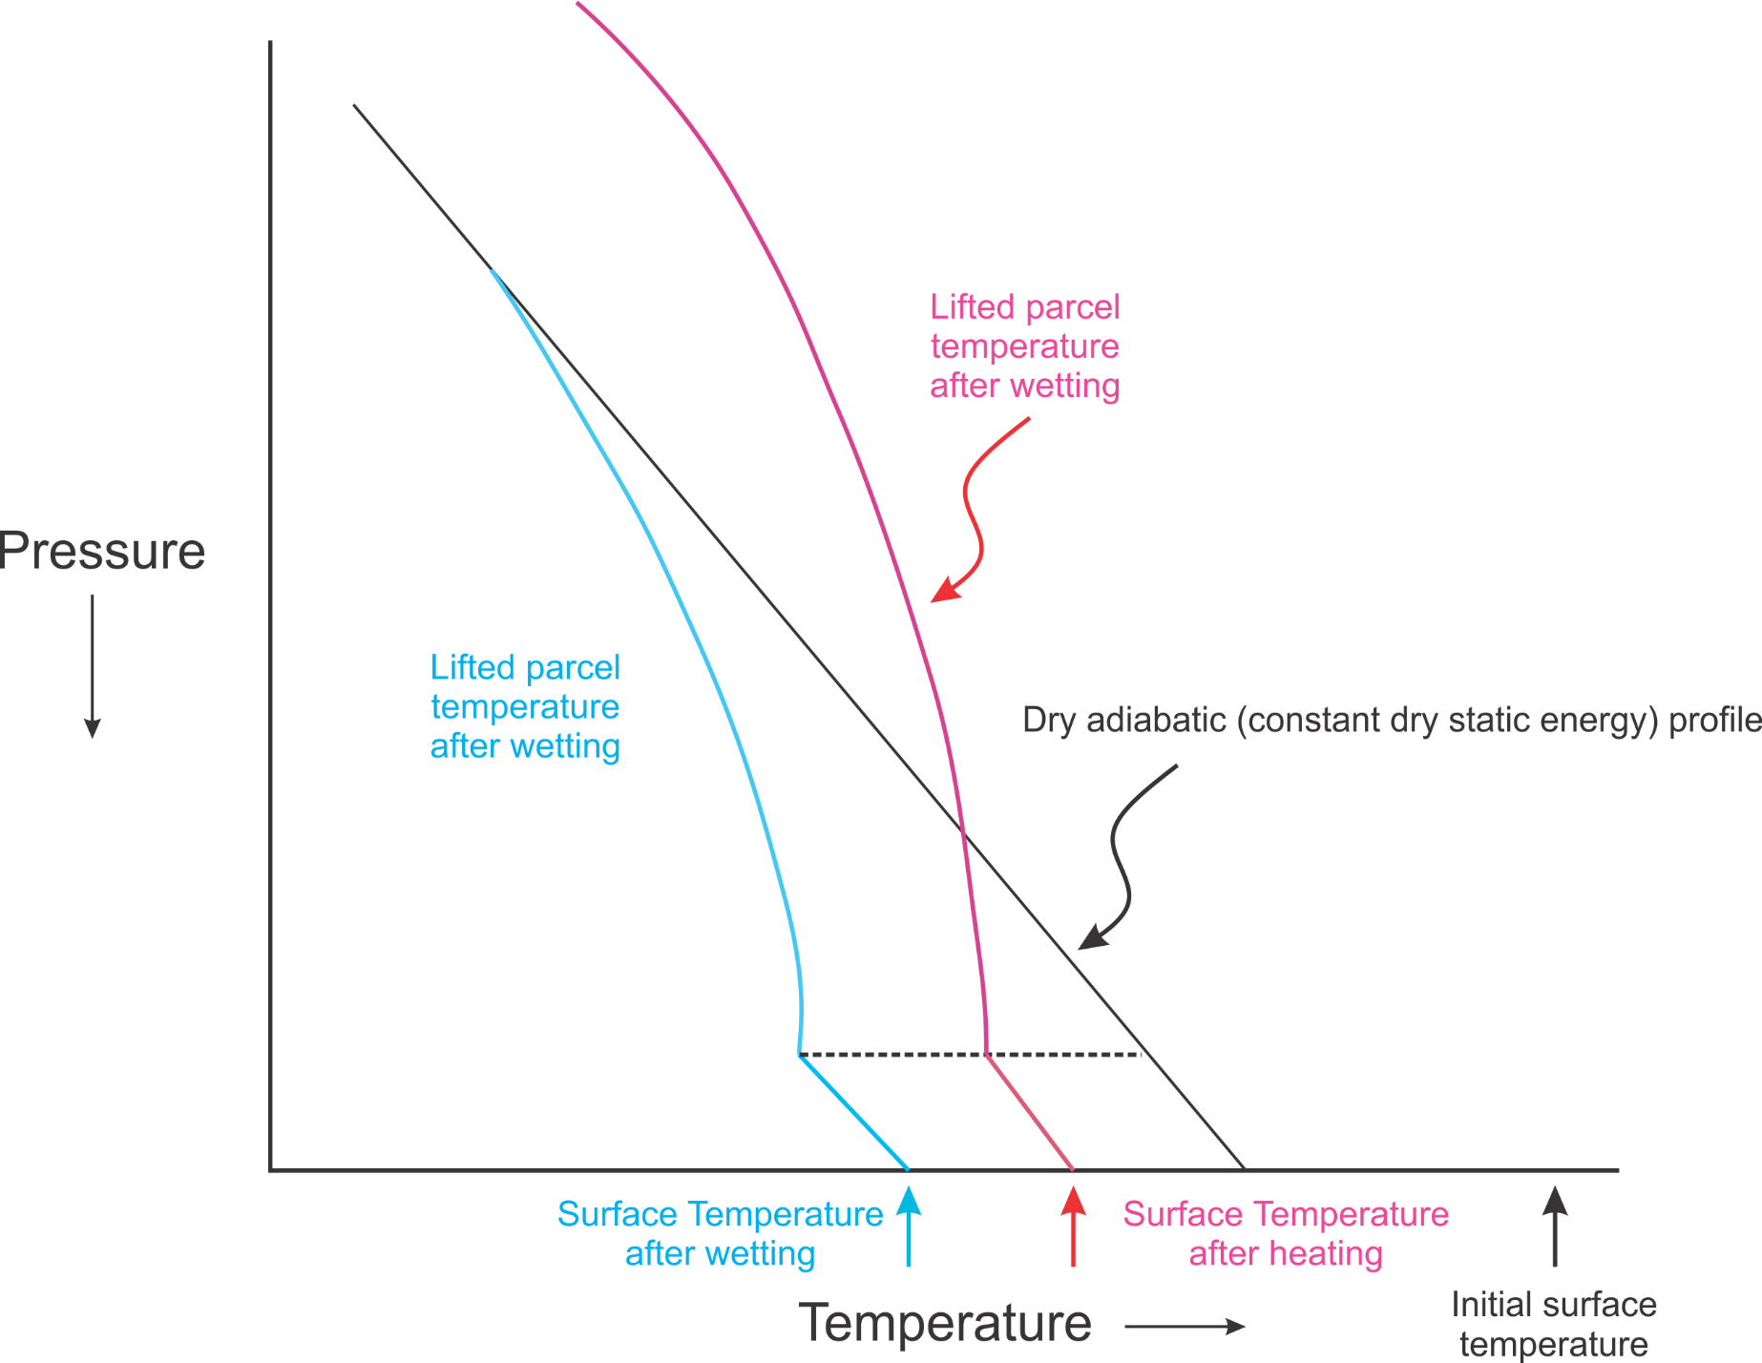

Slide 30
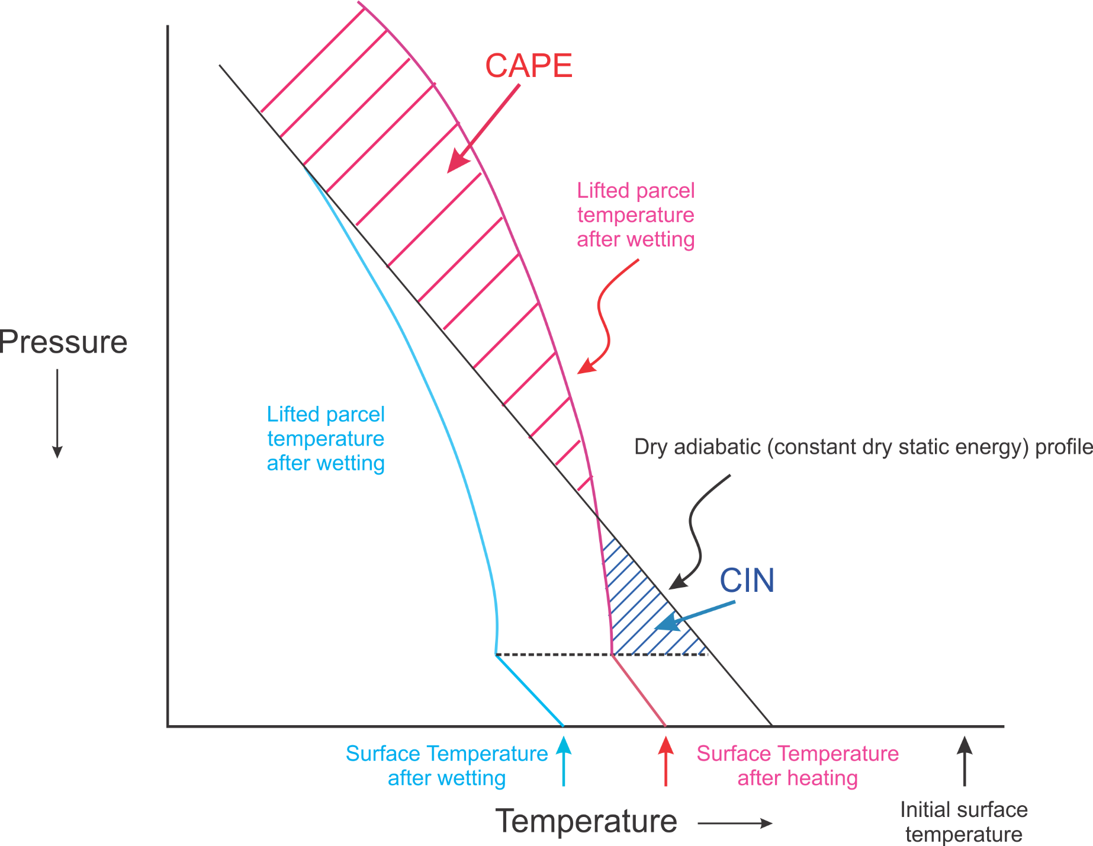

Slide 31
Long-time Asymptotic Cape Scaling
CAPE increases with surface wind speed
CAPE increases with soil moisture
Clausius-Clapeyron scaling of peak CAPE
Net turbulent surface flux
Agard, V., and K. Emanuel, 2017: Clausius–Clapeyron scaling of peak CAPE in continental convective storm environments. J. Atmos. Sci., 74, 3043-3054.

Slide 32
Summary
Extreme weather events are both early harbingers of climate change and among its worst consequences
Tropical cyclones and severe convective storms are among the most damaging and lethal of extreme weather phenomena

Slide 33
Summary (continued)
Potential intensity theory demonstrates that the thermodynamic limit on hurricane intensity rises with temperature
Observations show that this limit is indeed increasing
Physics can be used to model hurricane, medicane and polar low risk in current and future climates

Slide 34
Summary (continued)
Severe convection depends on large values of Convective Available Potential Energy (CAPE)
Large CAPE occurs when deep dry-adiabatic layers are advected over moist soils which are then heated by the sun
Peak values of both CAPE and CIN scale approximately with the difference between wet- and dry-bulb temperature, which increases exponentially with surface temperature
In general, this suggests that severe convective storms will become less frequent but more intense

Slide 35
Spare Slides

Slide 36
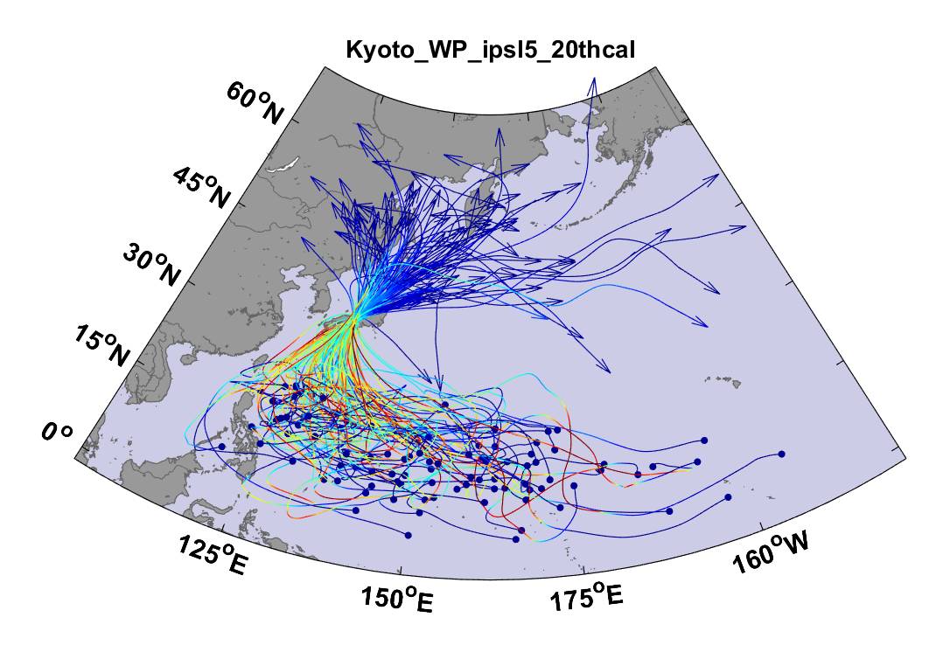
Top 100 out of 2000 TCs Affecting Kyoto, 1981-2000

Slide 37
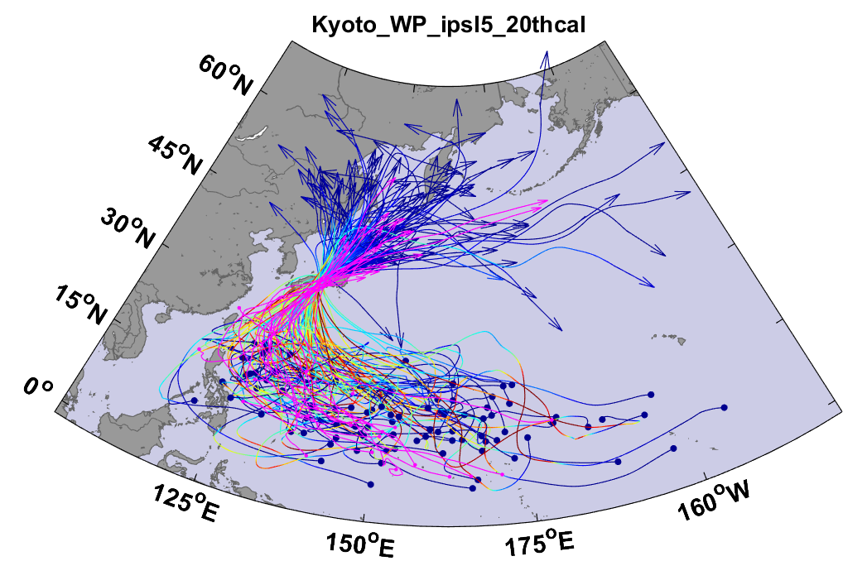
Same, but with top 20 historical tracks

