Slide 1

History of the Scientific Understanding of Hurricanes
Kerry Emanuel
Lorenz Center, MIT
Notes:
1

Slide 2
Four Eras
Early inferences
The Post-War era
The 1960s-70s
1980s - Present

Slide 3


The word Hurricane is derived from the Mayan word Huracan and the Taino and Carib word Hunraken, a terrible God of Evil, and brought to the West by Spanish explorers, beginning with Columbus

Slide 4
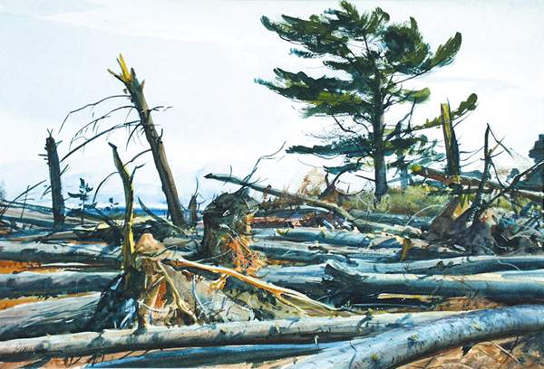
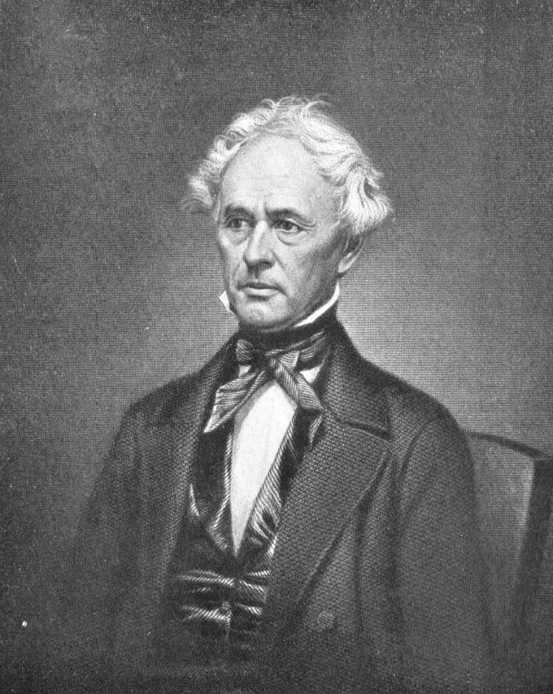
Scientific research into hurricanes might be said to have begun in 1821, when William C. Redfield, a saddler by trade, rode across southern Connecticut to examine the damage wrought by a hurricane, and determined that the storm had to have been rotating.
William C. Redfield
1789-1857
After the Hurricane, Ogden Milton Pleissner

Slide 5
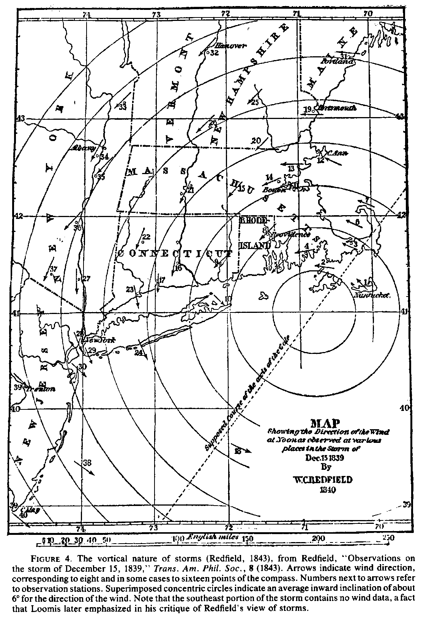
Early weather map, constructed by William Redfield, showing the winds around a winter storm in New England in 1839

Slide 6
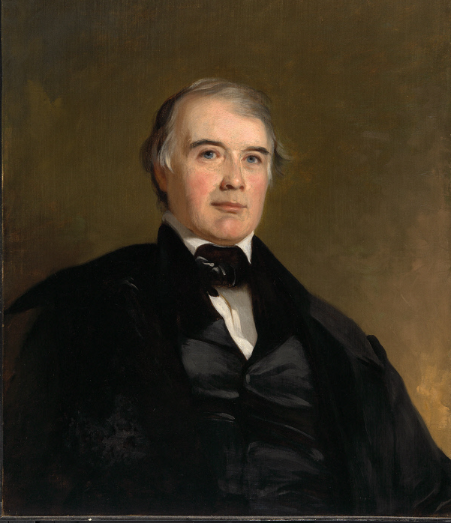
James Pollard Espy
1785-1860
Developed a theory of convection emphasizing the importance of adiabatic expansion and latent heating, publishing in 1841 a synthesis The Philosophy of Storms
He debated Redfield, insisting that physics dictated that air should flow radially into storms, not around them.

Slide 7
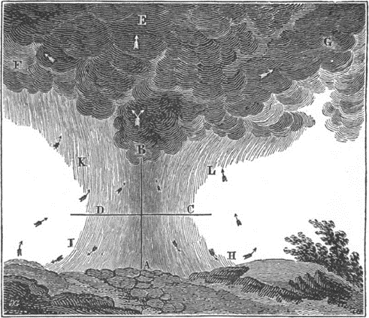
From James Pollard Espy: Second report of the joint committee on meteorology of the American philosophical society and Franklin Institute. In: Journal of the Franklin Institute 21(6), June 1836

Slide 8
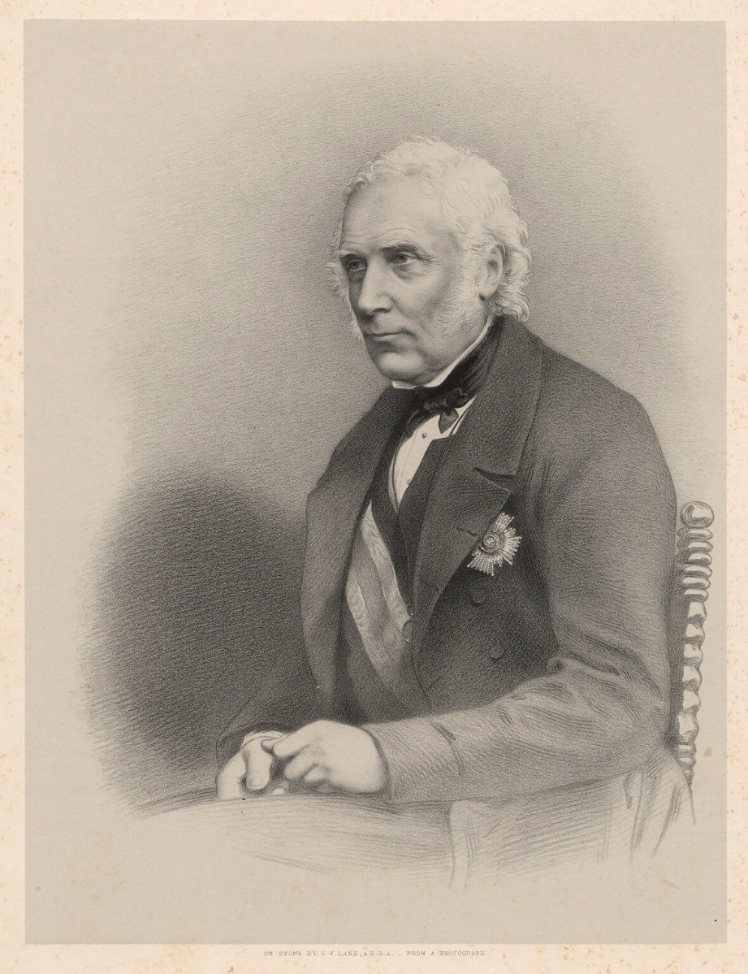

Sir William Reid
1791-1858
Governor of Bermuda, 1839 to 1846
Wrote first comprehensive analyses of hurricane, The Law of Storms, in 1838
Practical guide to signs of approaching hurricanes

Slide 10
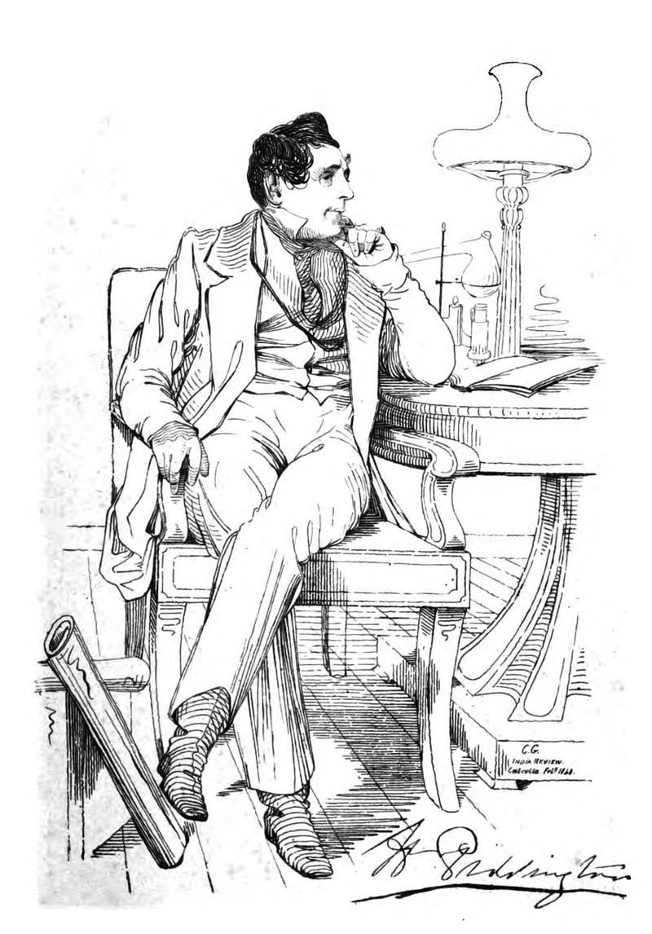
Henry Piddington
1797-1858
British sea captain in the India and China trade
Noting circular winds around a calm center recorded by ships caught in storms, coined the name cyclone in 1848
In 1844 he published The Horn-Book for the Law of Storms for the Indian and China Seas -- first practical guide for sailors to avoid hurricanes.
A portrait sketch by Colesworthey Grant published in 1839 in the India Review

Slide 11
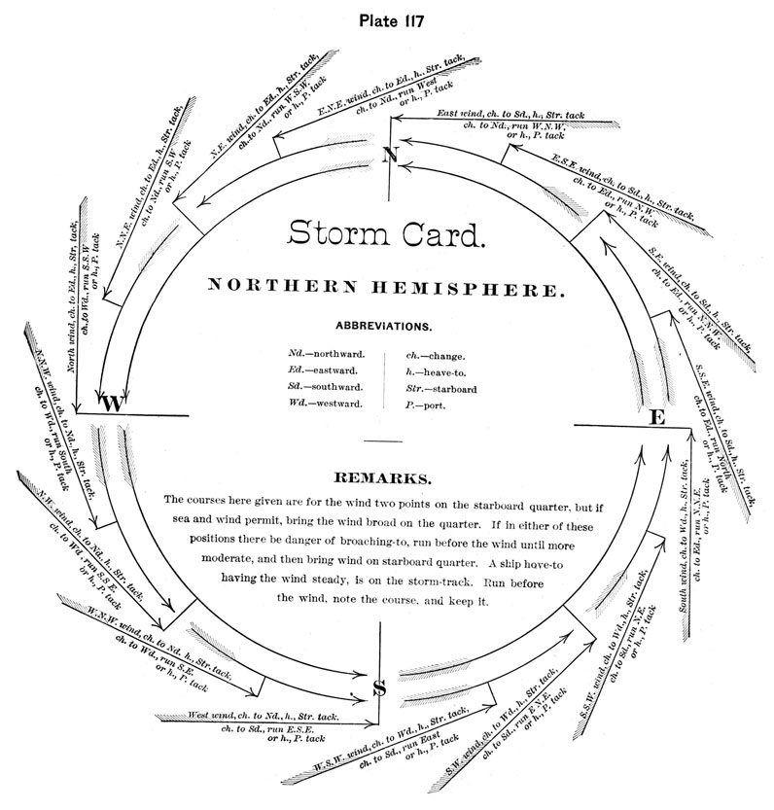

Slide 12
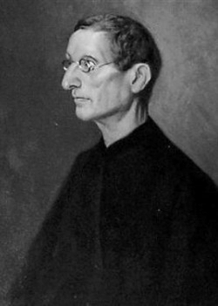
Benito Viñes
1837-1893
Jesuit priest in Havana, head of Meteorological Observatory at El Colegio Belen, 1870
Established network of observations in the Caribbean
First to recognize importance of upper level winds in steering hurricanes
Published Practical hints in regard to West Indian hurricanes in 1885.

Slide 13
WWII and Post-War Years

Slide 14

27 July 1943: Army Air Corps Colonel Joseph Duckworth took an Air Force AT-6 trainer from an airfield in Texas and became the first aviator to penetrate the eye of a hurricane.
Shortly thereafter, routine hurricane reconnaissance began in the North Atlantic and western North Pacific
AT-6

Slide 15
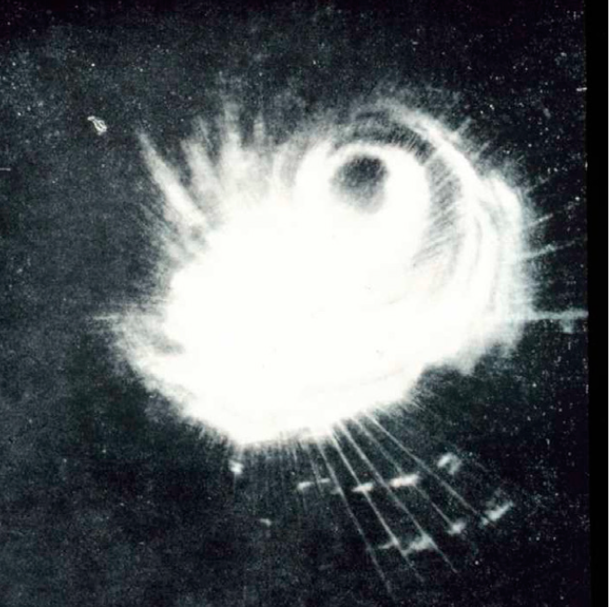
Radar
Radar image of Typhoon Cobra captured from one of
the ships of Admiral Halsey’s Third Fleet, east of the Philippines.
This was only the second tropical cyclone captured on radar.

Slide 16
Radar was invented to detect aircraft. The first dedicated meteorological radar, the CPS-9, was developed by the Signal Corps Engineering Laboratories of the U.S. Army in the late 1940s and 1950s.
A key player in the development of meteorological radar was David Atlas, who was an MIT faculty member from 1964 to 1978. He used the observed log-normal distribution of raindrop size to deduce a relationship between radar reflectivity and rainfall intensity.

Slide 17
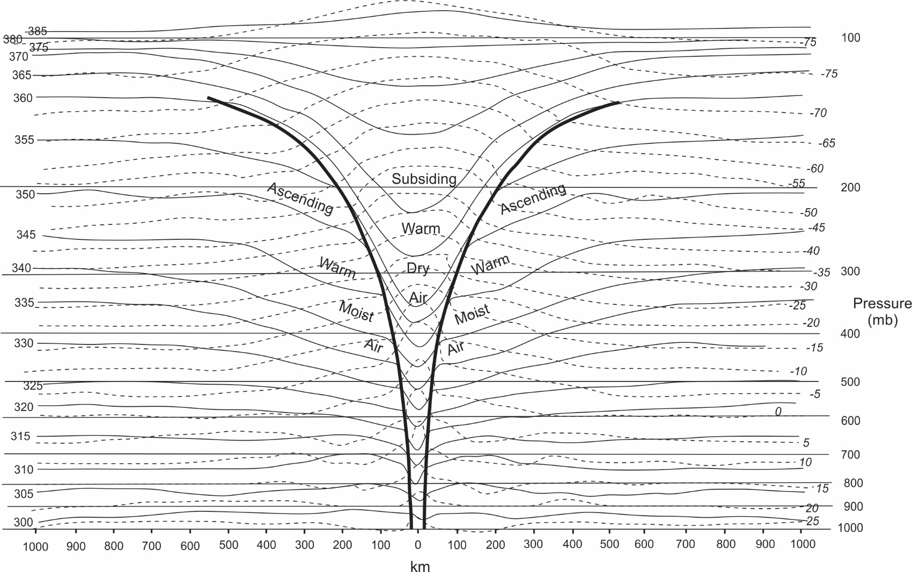
The Post-War Research Boom
Palmén, 1948, based on a single radiosonde ascent through the eye of a hurricane in 1944

Slide 18
Herbert Riehl, 1950: Recognized that latent heat is an internal conversion, and not the source of energy for a hurricane. He emphasized that the flow of enthalpy from the ocean to the atmosphere is the energy source for a hurricane
Ernst Kleinschmidt, 1951: “The heat removed from the sea by the storm is the basic energy source of the typhoon” (translation from German)
E=Energy from tephigram above
q= Fraction of angular momentum lost in transit to eyewall

Slide 19
Riehl and Malkus, 1960: Again recognizing that hurricanes are powered by heat fluxes from the sea, they came close to deriving a bound for the surface winds:
Empirical relation between increase in equivalent potential temperature and drop in pressure in PBL air in transit to eyewall:
Conservation of equivalent potential temperature:
Combine:
Work done against friction in PBL:
Had they combined above two:

Slide 20
Some other notable contributions, 1948-1958:
Rossby, 1948: “Beta drift” of closed isopleths of vorticity on a sphere
Bergeron, 1954: Reasoned that cold convective downdrafts should lead to initial cold-core cyclone aloft; surface fluxes would later “invert” the cyclone
1955: Troika of 3 damaging U.S. hurricanes in 1954 (Carol, Edna, and Hazel) leads to the establishment of the National Hurricane Research Program, led by Robert Simpson
Late 1950s: Rapid progress in numerical solution of the vorticity equation

Slide 21
Then something strange happened!
From 1958-1969, research reverted to Espy’s idea that tropical cyclones are modes of release of conditional instability. Work of Riehl, Malkus, Kleinschmidt and Bergeron cast aside; surface fluxes omitted.
Miller, 1958: Estimated pressure drop from compressional heating in eye
Kasahara (1961), Rosenthal (1964), Kuo (1965), Yamasaki (1968): First attempts to numerically simulate tropical cyclones regarded them as modes of release of conditional instability and did not include surface heat fluxes. They recognized they had failed.
Charney and Eliassen, 1964: “Conditional Instability of the Second Kind” (CISK): Rotation inhibits release of CAPE; needs Ekman boundary layer

Slide 22
J. Charney and A. Eliassen, J. Atmos. Sci., 1964: Conditional Instability of the Second Kind
Significant departure from earlier theoretical development
Emphasized thermodynamic interaction of vortex with cumulus convection, rather than with the ocean
Energetically inconsistent, but largely displaced Riehl-Malkus-Kleinschmidt view during 1970s and 80s

Slide 23
V. Ooyama, J. Atmos. Sci., 1969:
Regarded as first successful numerical model of tropical cyclone; included surface fluxes
Sensitivity experiments demonstrated the critical importance of surface enthalpy fluxes
Nevertheless, results interpreted by some as supporting CISK theory, because Ooyama started from a very unstable initial condition and showed that it was linearly unstable to vortex amplification

Slide 24
Ooyama’s 1969 Model
Time evolutions of maximum wind speed, and radius of maximum winds
First successful numerical simulation of a tropical cyclone by Vic Ooyama in 1969.
Model Structure

Slide 25
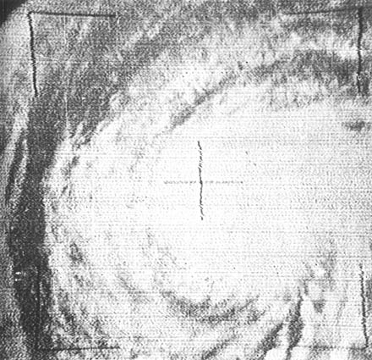
1960s-1970s:
Rapid technological development
Hurricane Esther of 1961, as photographed from TIROS III. This was first tropical cyclone to have been discovered from space.

Slide 26
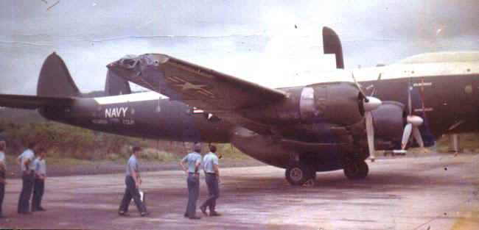
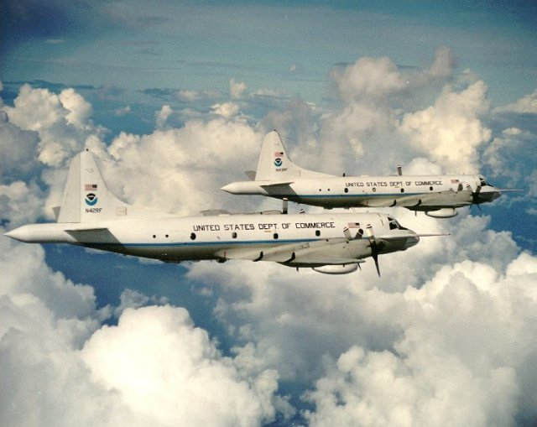
Airborne Reconnaissance
WV-2, 1964
NOAA WP-3Ds
Mid 1970s

Slide 27
Cross-section of equivalent potential temperature through Hurricane Inez of 1966, from aircraft and dropsondes

Slide 28
1970s-1980s:
Slow return to idea of flux-powered vortex:
S. Rosenthal, J. Atmos. Sci., 1978: Accidentally turned off cumulus parameterization in numerical model but found that vortex amplified anyway; sensitive to surface fluxes
D. Lilly, late 1970s: Developed theory of steady axisymmetric hurricane, motivated by Rosenthal results, but did not publish this work
1985: K. Emanuel and R. Rotunno worked on steady state theory and discovered earlier work of Lilly

Slide 29
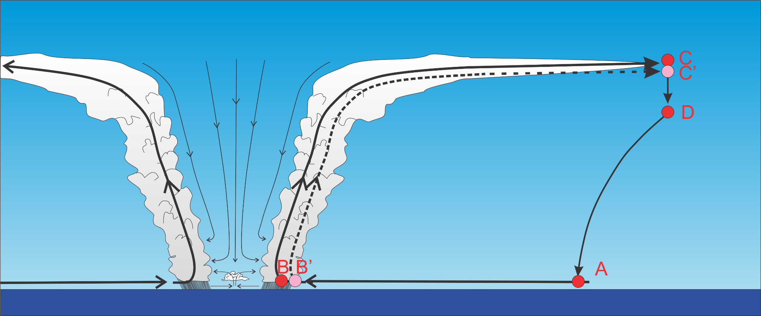
Differential Carnot Cycle

Slide 30
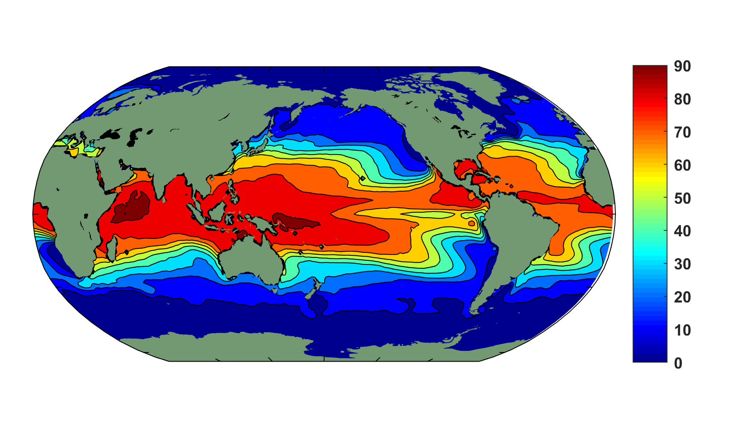
Annual maximum of the potential intensity (m/s) using ERA-Interim data averaged over 1979–2016.

Slide 31
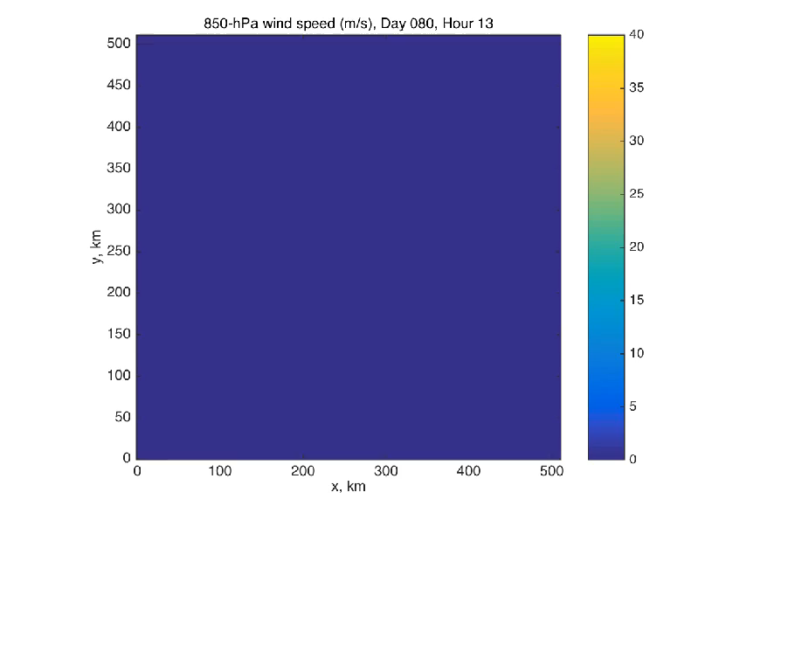
Explicit numerical simulation of rotating radiative-convective equilibrium
Courtesy Tim Cronin

Slide 32
Yet most contemporary textbooks and even some research papers continue to state that tropical cyclones are driven by latent heat release

Slide 33
1980s to Present: Rapid Advances in Basic Understanding, Measurement Technology, and Forecasting Skill

Slide 34
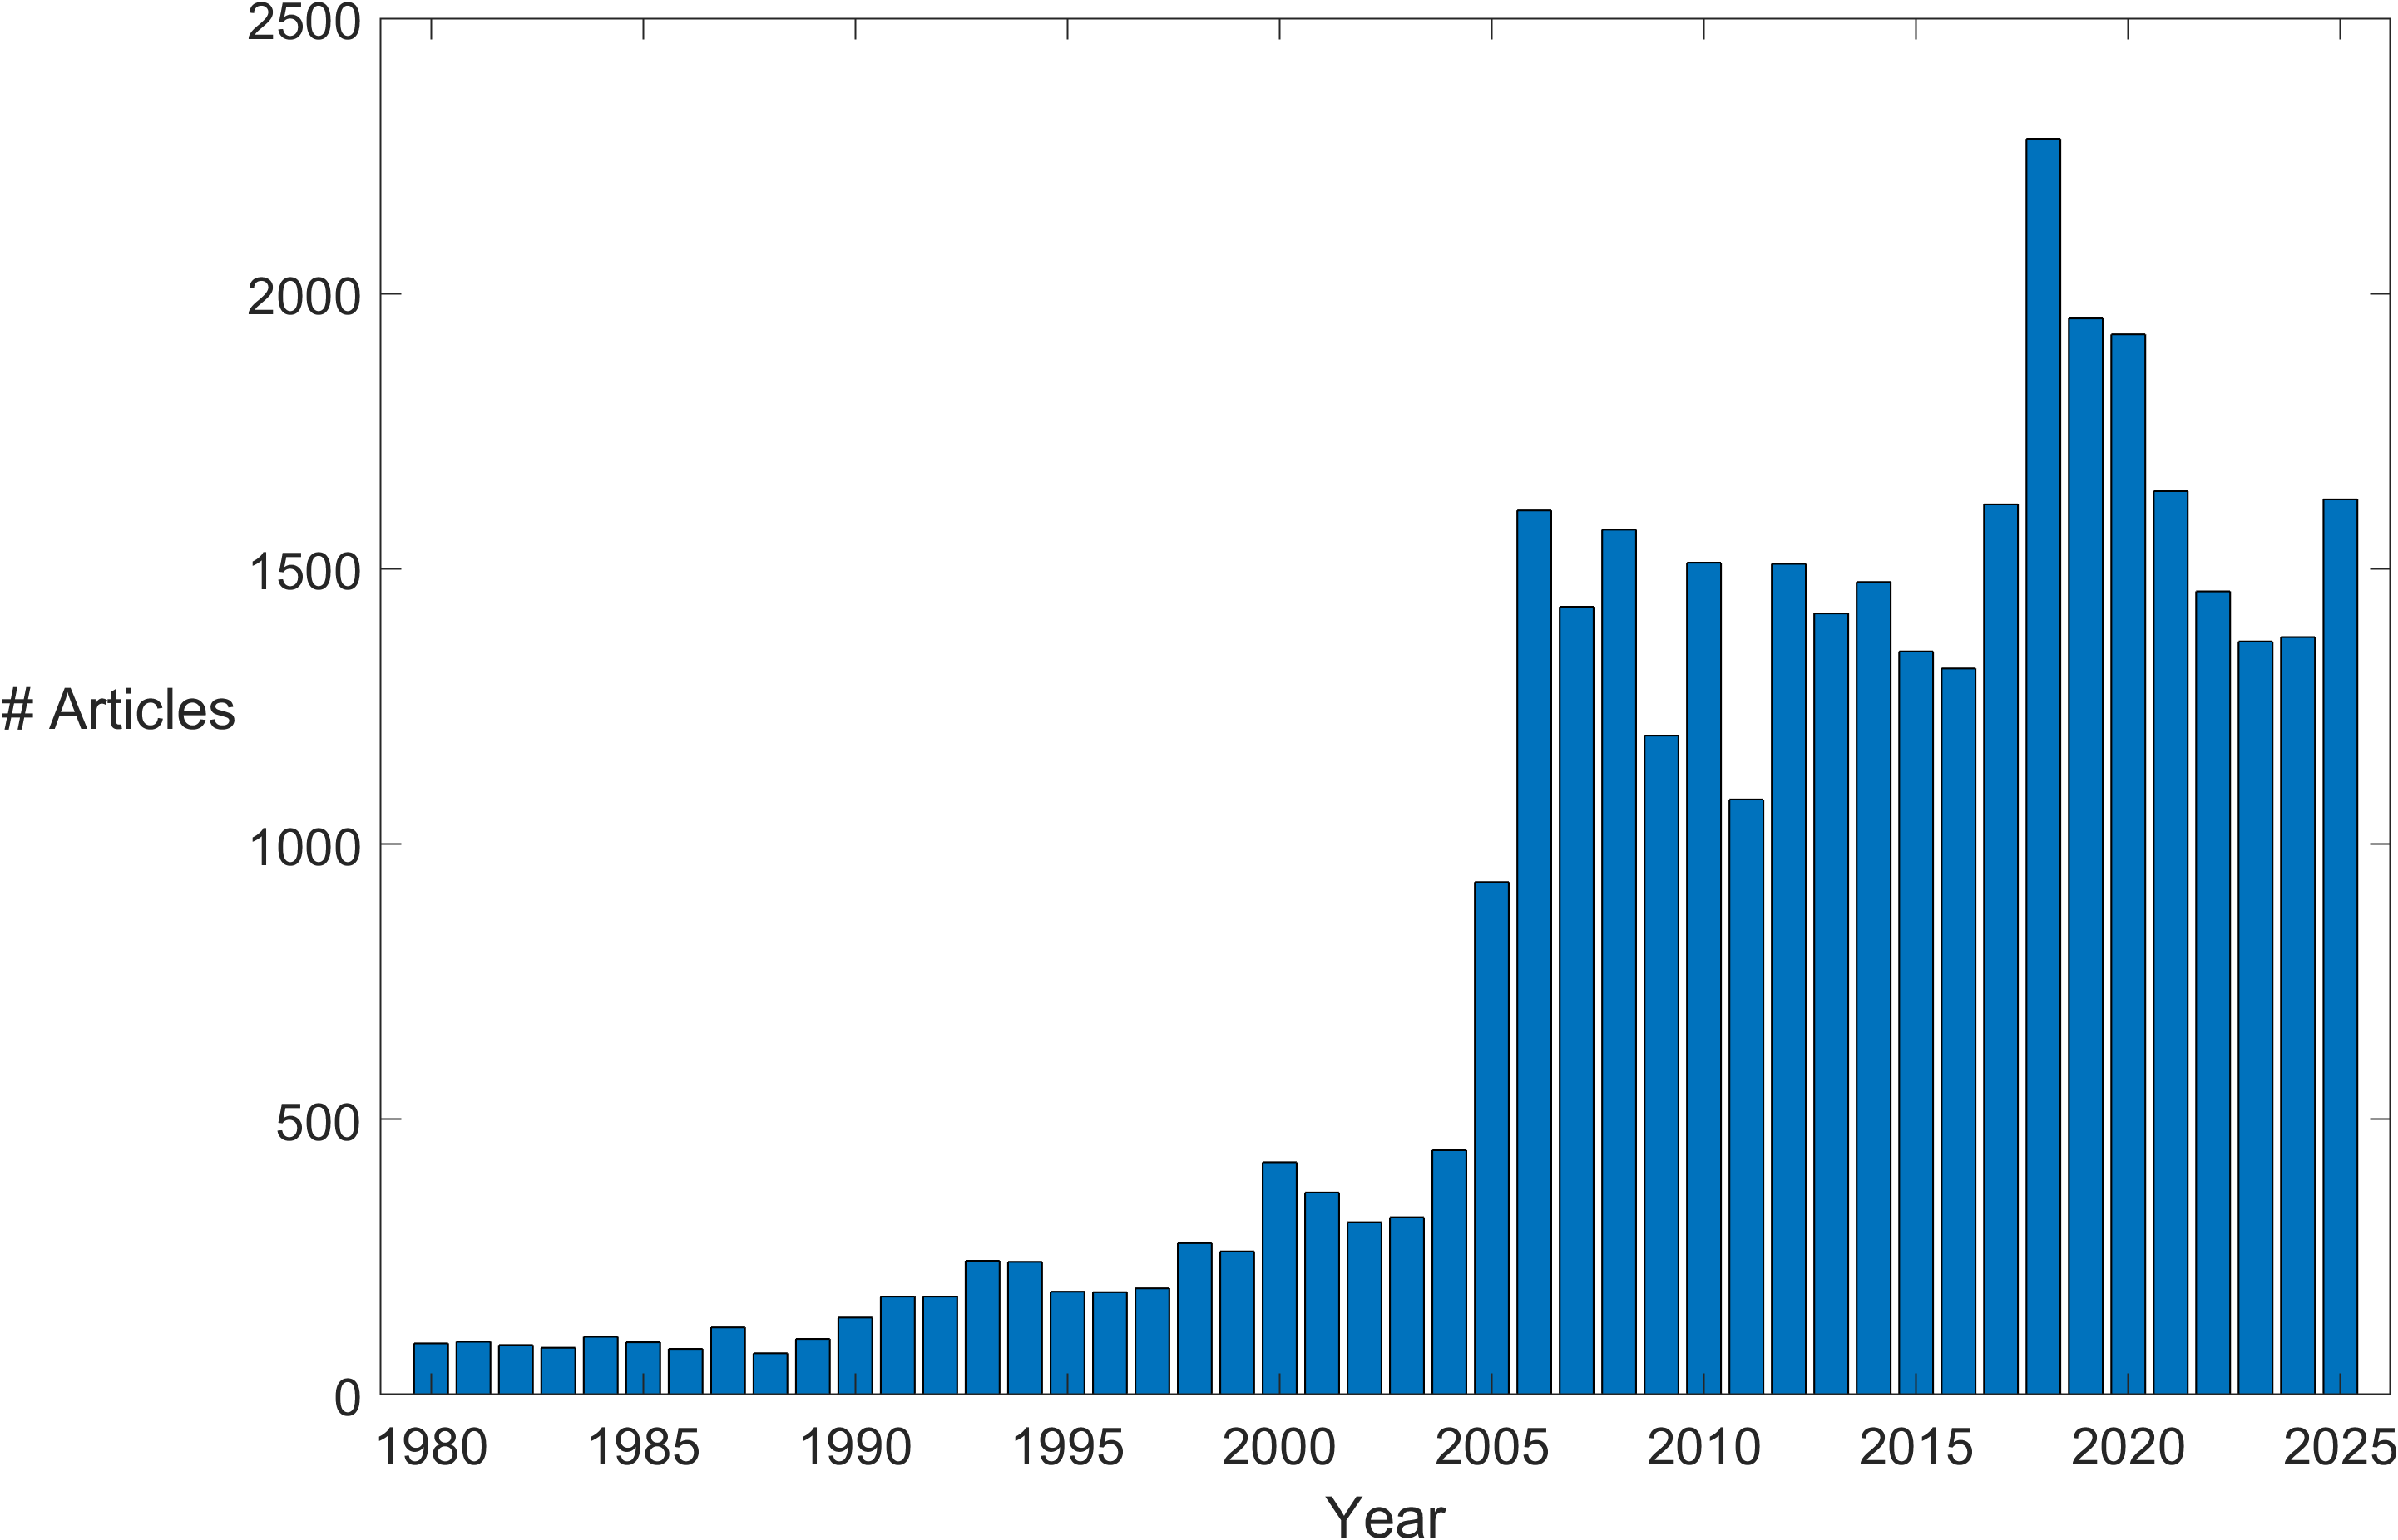
Annual Number of Peer-Reviewed Articles with “Hurricane” or “Tropical Cyclone” in their Titles, from Web of Science

Slide 35
Basic Research Highlights:
Rejection of CISK
Return to older view of Kleinschmidt and Riehl
Development of physically consistent potential intensity theory
Conclusive demonstration of ocean feedback on hurricane intensity
Refinement of theory of tropical cyclone motion

Slide 36
Quantification of structure of vertical motions
Secondary eyewalls: Discovery and dynamics
Identification of eddy PV (angular momentum) fluxes in outflow layer as an influence on intensity change
Further quantification of vertical shear effects on storm motion, structure, and intensity
Further quantification of ENSO effects on NH TCs
Modulation of TC activity by the Madden-Julian Oscillation

Slide 37
Reemergence of interest in vortex Rossby waves
Progress in understanding TC genesis through large-scale field experiments
Accelerated research in extratropical transition
Importance of surface effects: waves and spray
Identification and understanding of superintensity

Slide 38
Development of paleotempestology
Emergence of research on long-term climate change effects on hurricanes
Identification of physical and biological feedbacks of hurricanes upon climate

Slide 39
Advancing Measurement Technology

Slide 40
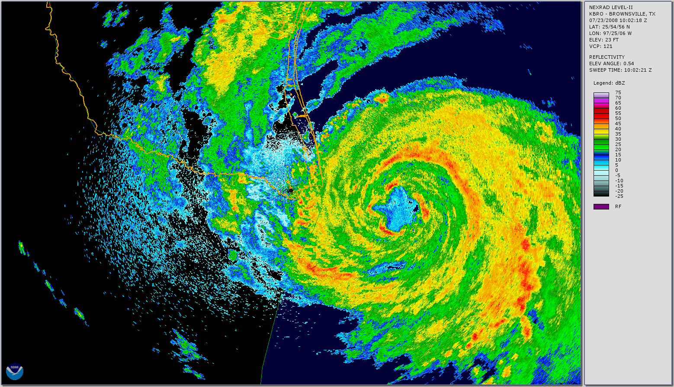
Radar
NOAA/NEXRAD image from Brownsville, Texas, showing Hurricane Dolly approaching the Texas–Mexico border on 23 Jul 2008. The radar reflectivity scale (dBZ) is given at the right.

Slide 41
First Doppler winds in a hurricane: Marks and Houze, BAMS, 1984
Hurricane Debby, 1982

Slide 42
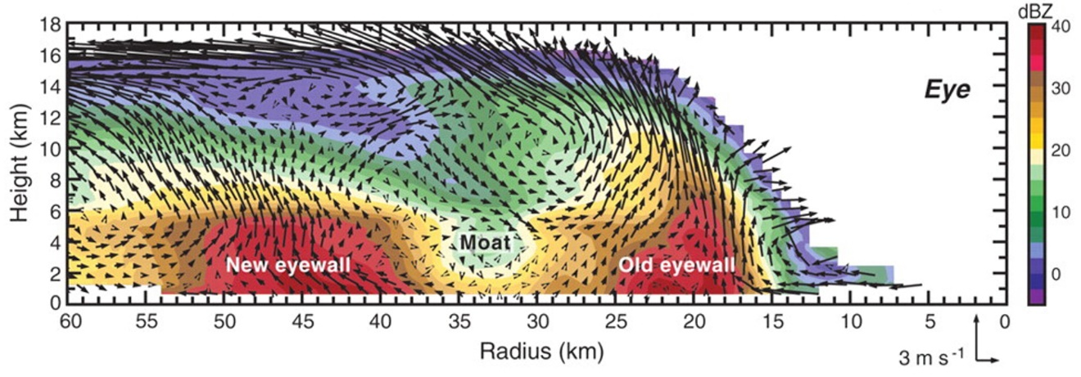
Doppler winds are now routinely collected by aircraft in Atlantic tropical cyclones

Slide 43
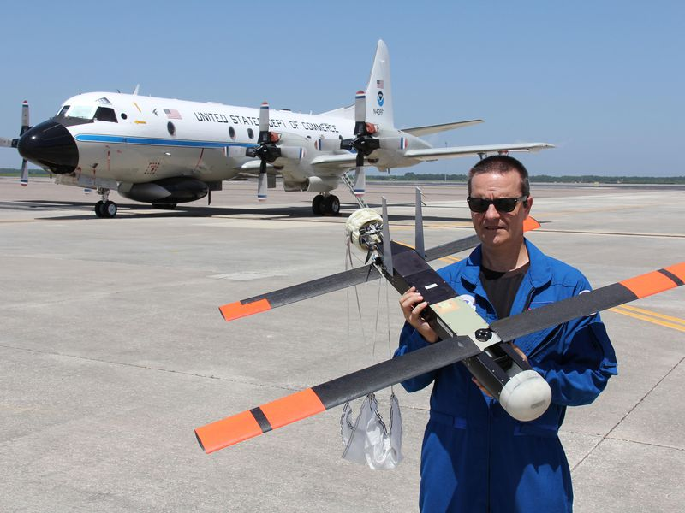
Drones!
Joseph Cione shows a Coyote drone, soon to be dropped into a hurricane from the P-3 behind them. (NOAA/AOML)

Slide 44
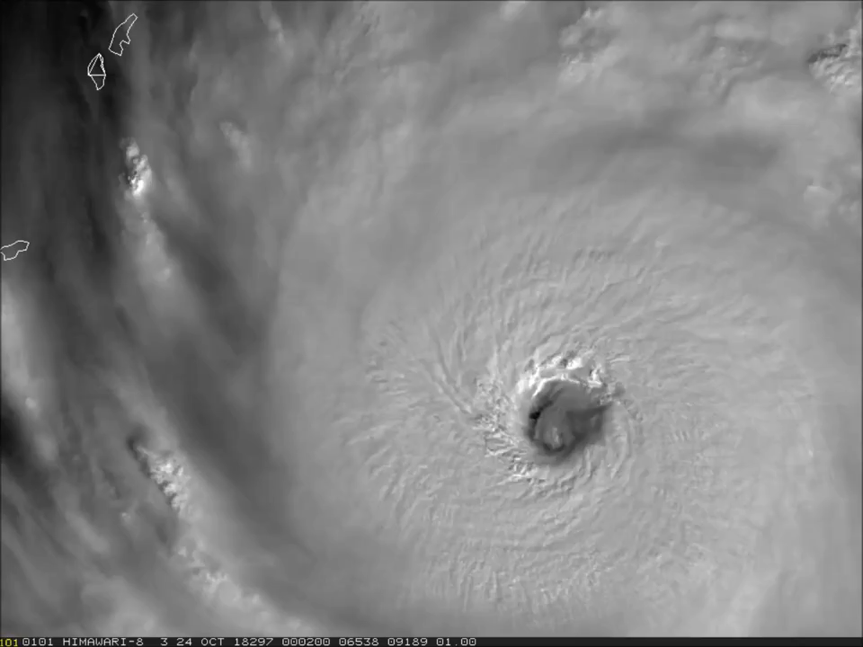
Satellite Imagery: Unprecedented resolution
Typhoon Yutu on 24 October 2018

Slide 45
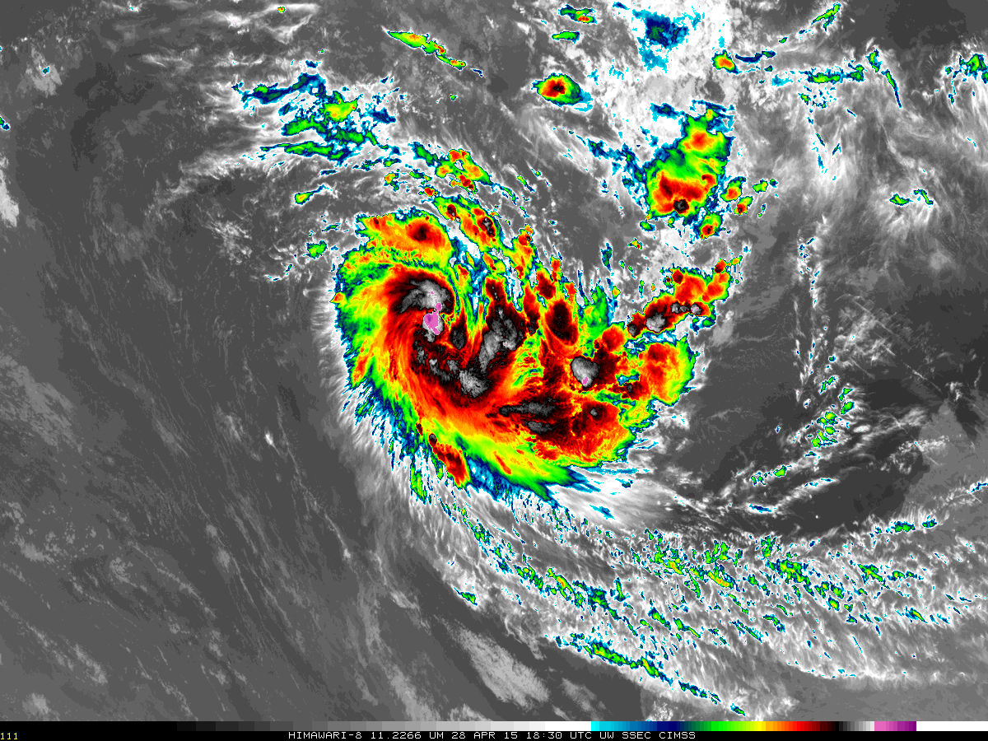
Himawari image of Depression 24S northwest of Australia, 1830 UTC 28 April 2015

Slide 46
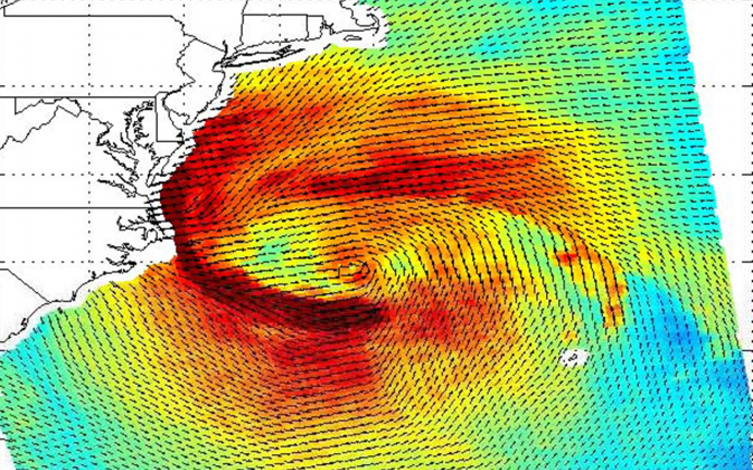
Scatterometer winds in Hurricane Sandy, 04 GMT 29 October 2012

Slide 47
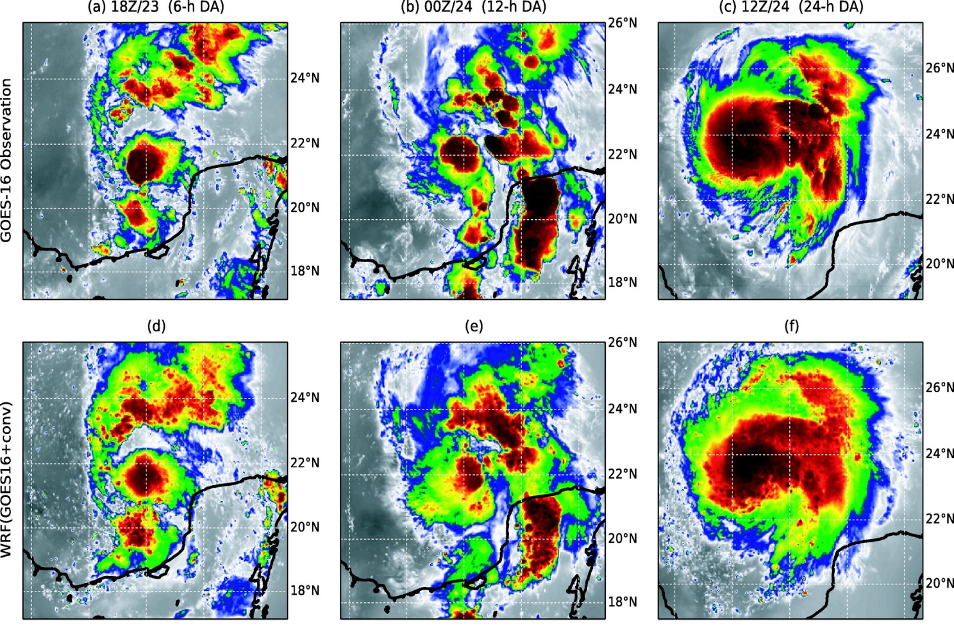

Numerical Simulation:
Observed Brightness Temperature, TC Harvey of 2012
WRF-simulated Brightness Temperature
Zhang, F., M. Minamide, R. G. Nystrom, X. Chen, S.-J. Lin, and L. M. Harris, 2019: Improving Harvey forecasts with next-generation weather satellites: Advanced hurricane analysis and prediction with assimilation of GOES-r all-sky radiances. Bull. Amer. Meteor. Soc., 100, 1217-1222, doi:10.1175/bams-d-18-0149.1.
.

Slide 48
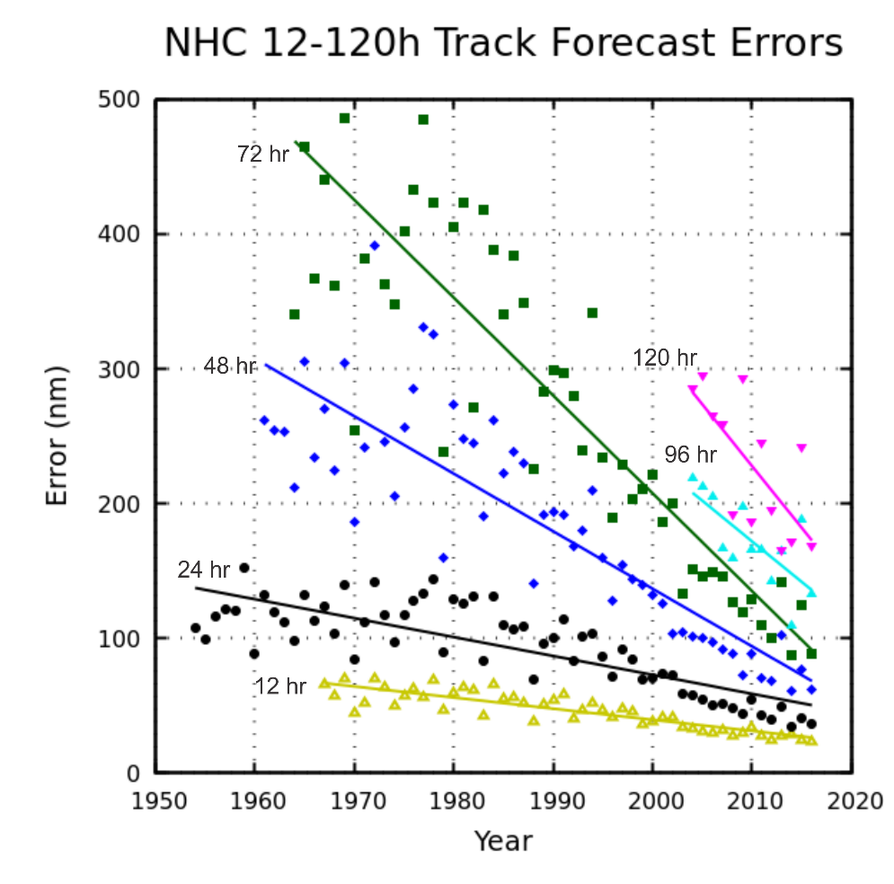
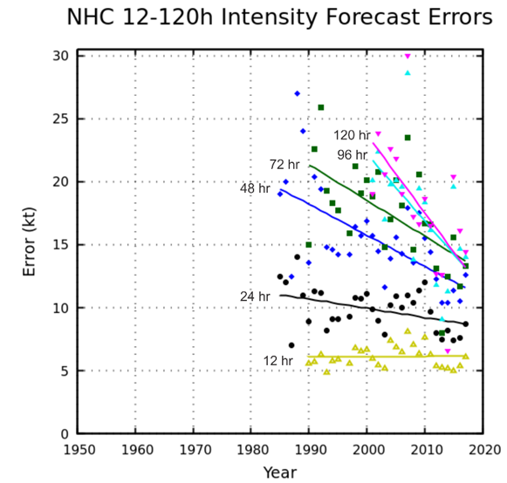
Forecasting
Track
Intensity
Note: Not easy to rule out the hypothesis that all of the improvement in the intensity skill came from improvements in track forecasts

Slide 49
A Look Ahead

Slide 50

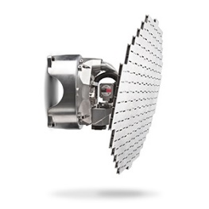
The Future of TC Observations:
Solar-powered stratospheric UAV
Dual-scanning X-band Doppler (~15 kg)

Slide 51
Forecasting: We will move away from track and intensity to pointwise probabilities of wind, surge, and freshwater flooding
50-km strike probability (color), for Hurricane Irma in the Atlantic Basin, using 1000 synthetic tracks generated from the ECMWF ensemble. Forecast initialized on September 5th, 2017, 00z. Overlaid lines (black) depict TC centers from the ECMWF ensemble.
Courtesy Jonathan Lin, MIT

Slide 52
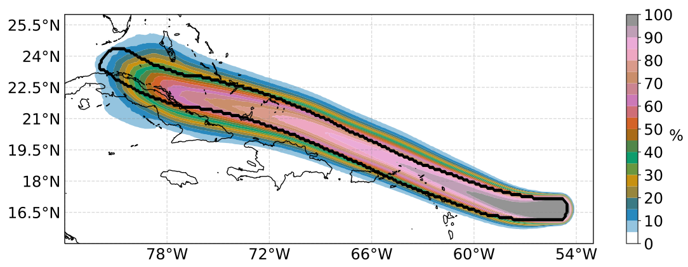
Probabilistic Winds
Probability of wind exceeding 64-kts over a 5-day period (color), for Hurricane Irma in the Atlantic Basin, using 1000 ensemble members bootstrapped from the ECMWF ensemble. Forecast initialized on September 5th, 2017, 00z. Black contour depicts extent of the observed 64-kt winds.
Courtesy Jonathan Lin, MIT
Notes:
Probability of wind exceeding 64-kts over a 5-day period (color), for Hurricane Irma in the Atlantic Basin, using 1000 ensemble members bootstrapped from the ECMWF ensemble. Forecast initialized on September 5th, 2017, 00z. Black contour depicts extent of the observed 64-kt winds.

Slide 53
Will We Finally Crack the Genesis Problem?
5-member ensemble of radiative-convective equilibrium simulations
Individual terms in the budget of the variance of vertically integrated moist static energy
Tang et al, 2020: Tropical Cyclone Research and Review 9, 87-105

Slide 54
Summary
The history of the scientific understanding of tropical cyclones is rich and very interesting!
In the 1960s and 1970s, research into the basic energy source of tropical cyclones took a step backward, with researchers either ignorant of or unwilling to acknowledge progress made in the 1950s
Tropical cyclone research greatly accelerated in the 1980s and 1990s and there has been much progress in basic understanding as well as the ability to measure and forecast hurricanes
Basic understanding of such issues as secondary eyewalls, spiral rainbands, the control and predictability of hurricane intensity, and genesis remain challenging for the future

Slide 55
Up Next:
Tropical Cyclone Physics, Part I
Tropical Cyclone Physics, Part II
Using Physics to Catalyze Climate Action, Part I
Using Physics to Catalyze Climate Action, Part II

