Slide 1
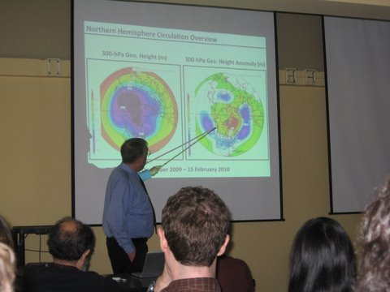
How Will Climate Change Affect Weather Forecasting?
Kerry Emanuel
Lorenz Center
Massachusetts Institute of Technology

Slide 2
Topics
Day-to-Day weather in middle and high latitudes
Extreme events
  Explosive cyclogenesis
  Flash floods
  Severe thunderstorms
  Hurricanes

Slide 3
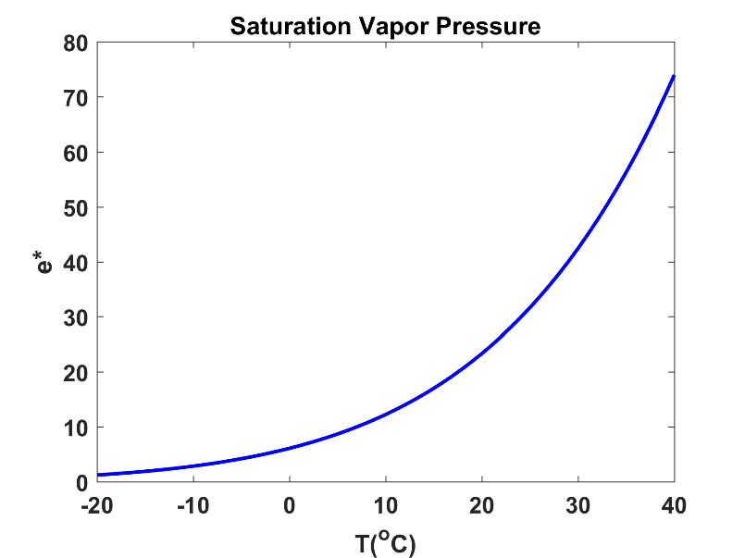
A Few Basic Points:
Water vapor content of troposphere
increases ~ Clausius-Clapeyron
Dry static stability along moist
adiabat also increases with C.-C.
Pole-to-equator temperature gradient (and vertical wind shear) decrease at low levels, increases in upper troposphere

Slide 4
Extratropical Cyclones, Anticyclones
As climate warms, deformation radius (NH/f) increases at fixed latitude → Distance between cyclone centers increases, precipitation area contracts (Emanuel, Fantini, and Thorpe, 1987), precipitation becomes more intense
Increased wavelength → surface Eady wave moves faster; smaller surface T gradient → Eady wave moves slower
→ Extratropical cyclone precipitation increases in intensity but decreases in frequency (phase speed roughly the same, but wavelength longer)
Decrease of tropospheric net shear and increase in stratification should lead to decrease in Eady growth rate, fU_{z}/N²
Increase in pole-to-equator moist entropy gradient should increase upper bound on cyclone amplitudes
Storm tracks generally migrate poleward as Hadley circulation expands. Increase of f along tracks partially offsets increase of stratification in deformation radius and growth rate

Slide 5
Results of Global Model Studies
DJF
JJA
Change in multi-model eddy kinetic energy from 1981-2000 to 2081-2100 under RCP 8.5 (colors). Present day EKE in black contours.
-- Lehmann et al., 2014, Environ. Res. Lett.

Slide 6
Multi-model difference in extratropical cyclone track density, from 1976-2005 to 2070-2099 under RCP 8.5.
-- Zappa et al. J. Clim, 2013

Slide 7
Change (m/s) in 99.5 percentile 925 hPa winds from 1959-1990 to 2069-2100 under Scenario A1B. -- Bengtsson et al., J. Clim., 2009

Slide 8
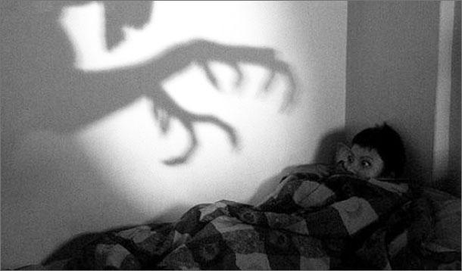
Tropical Cyclone Forecasting Nightmares

Slide 9
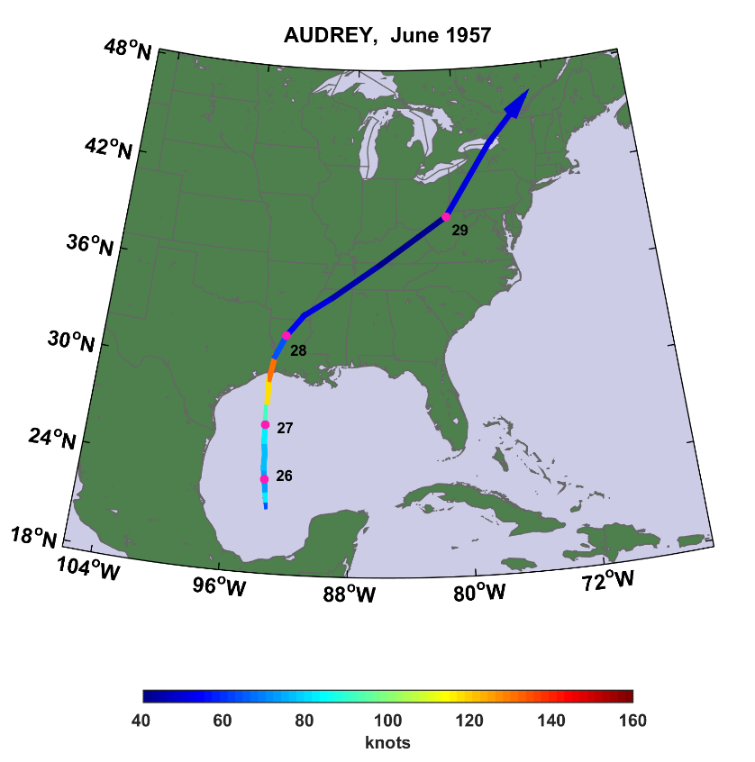
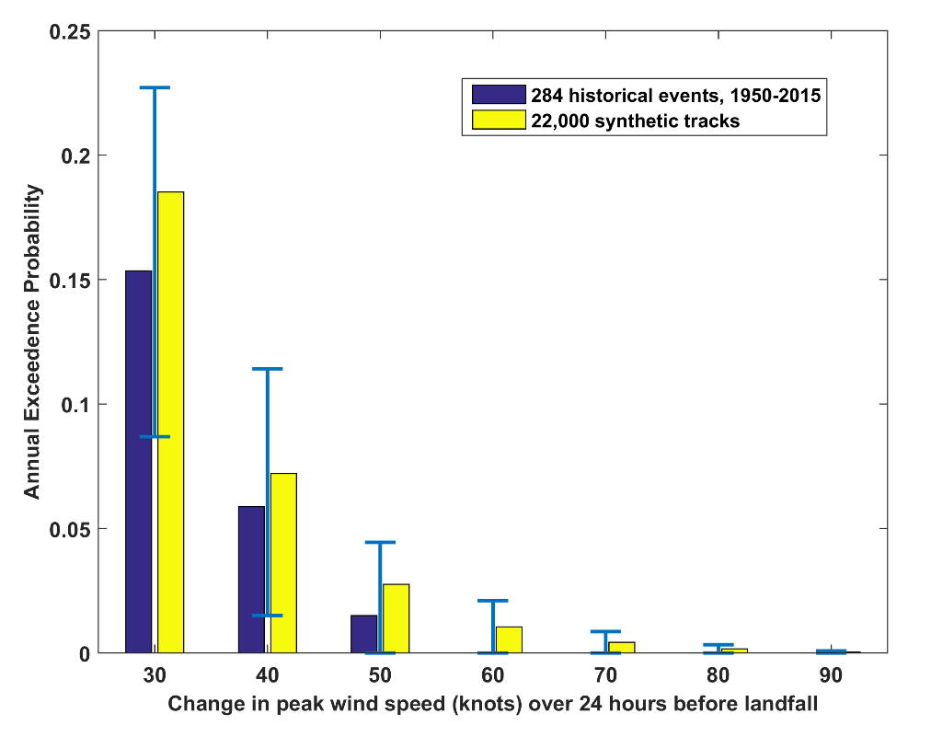
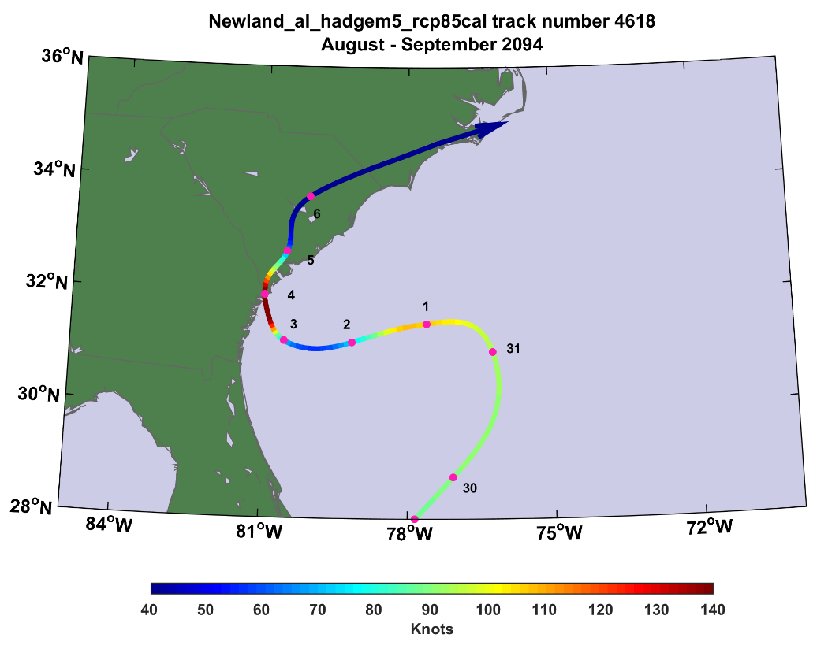
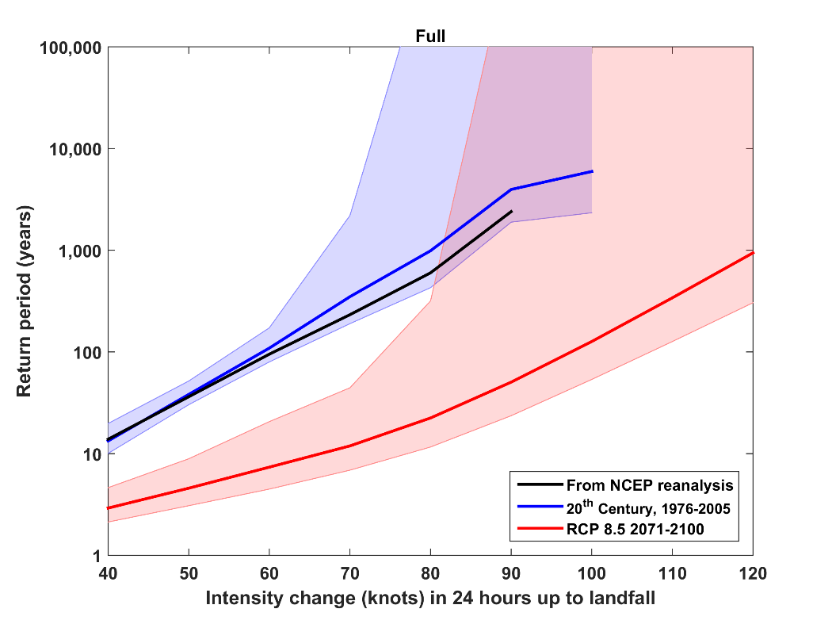
56 knots/24 hrs
120 knots/24 hrs

Slide 10
Multi-model change in polar low track density from 1986-2005 to 2081-2100 under RCP 8.5. Hatching and cross-hatching represent model consensus of 66% and 80%, respectively.
-- Romero and Emanuel, J. Clim., 2017

Slide 11
Change in medicane track density
Change in the frequency of medicane winds > 60 kts
-- Romero and Emanuel, J. Clim., 2017

Slide 12
Convective Rainfall: Lessons from Radiative-Convective Equilibrium
Total rainfall proportional to latent heating, which balances net radiative cooling of troposphere
Net radiative cooling increases only slowly with global warming
But amount of water vapor going up into clouds increases with Clausius-Clapeyron
→ Rainfall intensity must go up but fraction of time/area that is raining must go down.
Convective rainfall becomes more intense but less frequent. Flash flood forecasting may become more challenging.

Slide 13
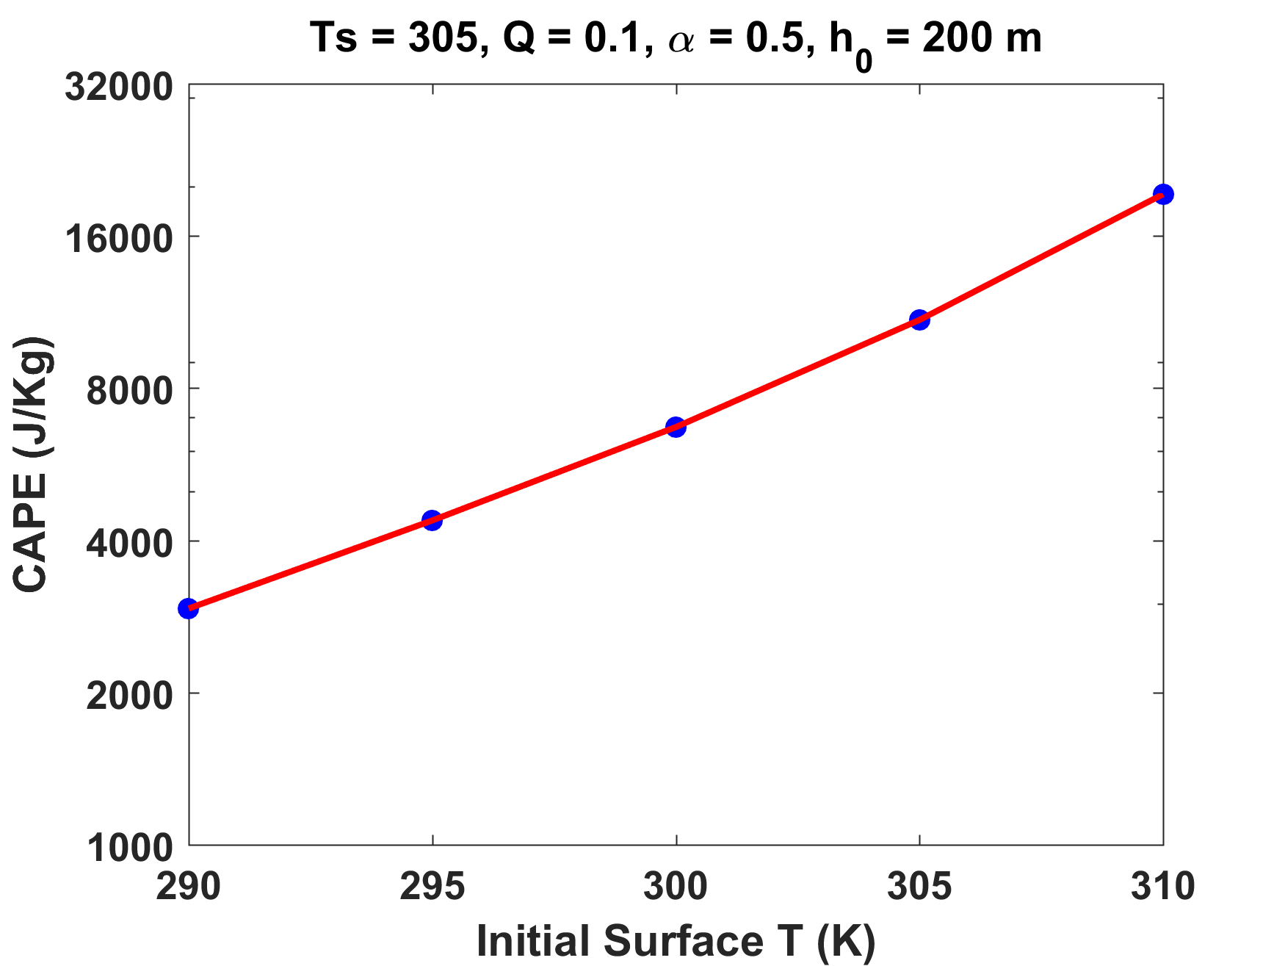
The relation between initial surface temperature and peak CAPE is slightly faster than exponential. CIN also increases exponentially
Severe Convective Storms: CAPE
→ Severe thunderstorms may become more intense but less frequent.
-- Agard and Emanuel, J. Atmos. Sci., submitted
Notes:
And indeed it does. Here’s the big takeaway: In this idealized analytical model, transient peak CAPE scales with the difference between dry bulb and wet bulb temperatures, and thereby increases with increasing temperature according to the Clausius-Clapeyron relation.
I’ve written this up into a paper (which I’ve rewritten a couple of times) and I hope to be able to submit it soon (journal undecided).

Slide 14
Summary
Little change in day-to-day forecasting in middle latitudes
Quantitative precipitation forecasting may become more difficult, but predictability of other variables may actually increase
Greatly increased incidence of rapid intensification of tropical cyclones is indicated – major forecast headaches ahead
Summertime convective rainfall should become more intense but less frequent
Incidence of severe (high CAPE) convection may decline (CIN increases) but severity may increase (peak diurnal CAPE increases)

Slide 15
