Slide 1
The Tropics
(as seen in everyone’s imagination)

Slide 2
“Warmest climes but nurse the cruellest fangs. [The typhoon] will sometimes burst from out that cloudless sky, like an exploding bomb upon a dazed and sleepy town.”
-- Herman Melville, Moby Dick

Slide 3
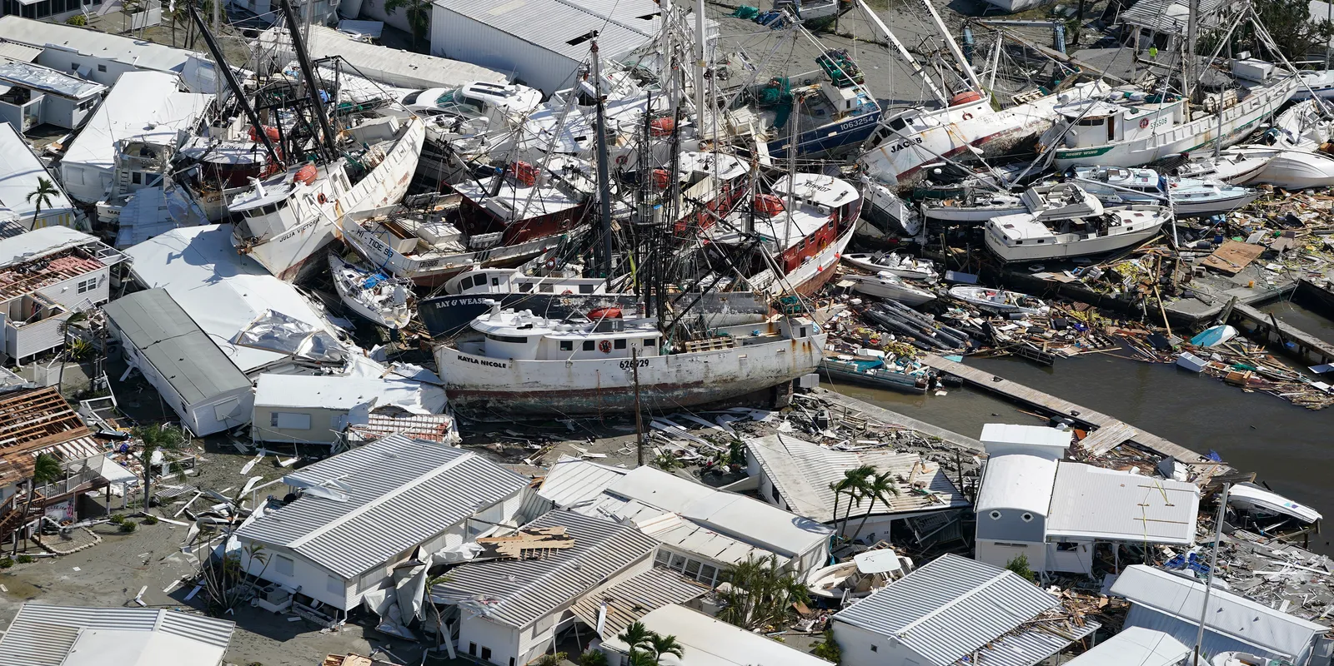
Preliminary damage estimates: > $65 billion insured loss, >$100 billion total loss

Slide 4
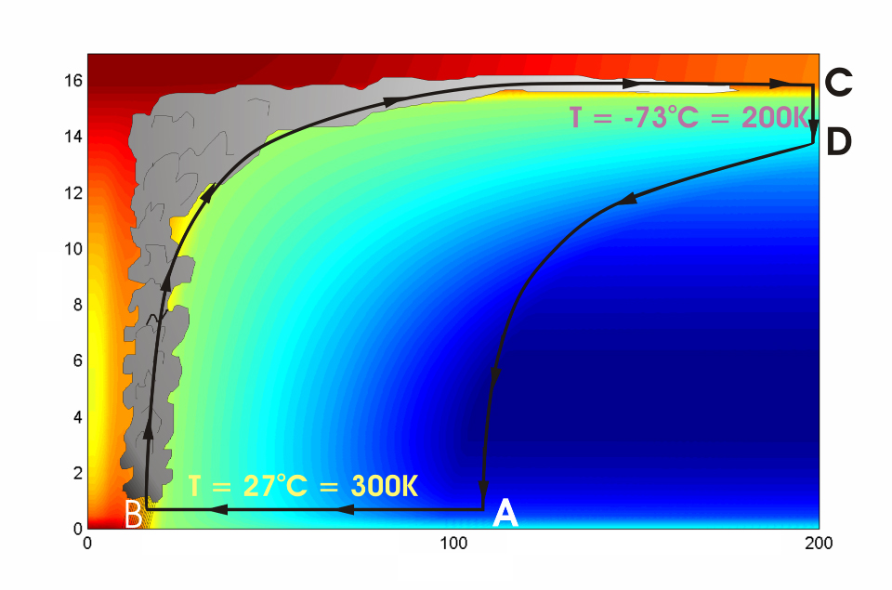
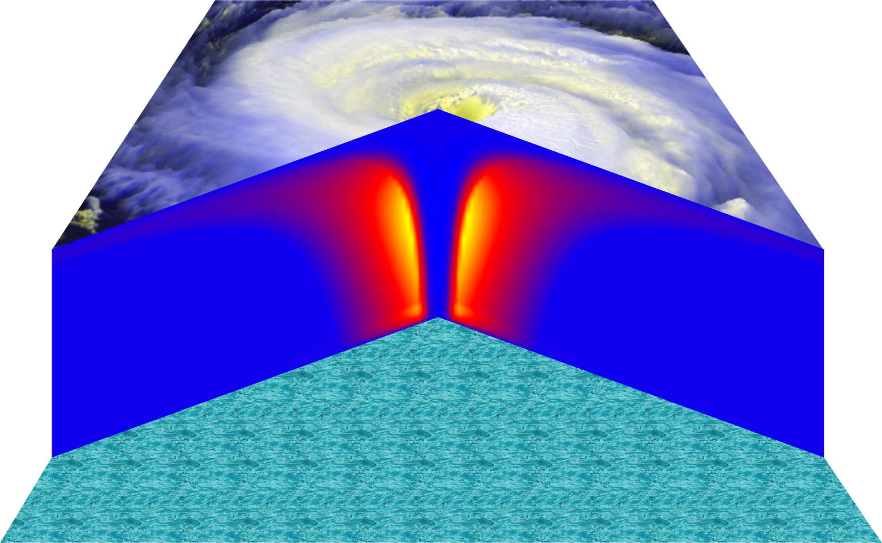
Cross-section through a Hurricane & Energy Production
eye
edge
Air loses energy
Hot air rises
Height above ocean (km)
Cooled air sinks
Low entropy (temperature)
Air spirals inward and gains energy from the ocean
Ocean surface
Radius (km)
Notes:
The energy cycle of a mature hurricane - the hurricane as a Carnot heat engine. This two-dimensional plot of the thermodynamic cycle shows a vertical cross section of the hurricane, whose storm center lies along the left edge. The colors depict the entropy distribution; cooler colors indicate lower entropy. Loosely, this means the total heat content of the air. Note that as air approaches the eyewall, its entropy increases rapidly, reflecting the large input of heat from the ocean.
Let’s follow a sample of air that begins at point A near the sea surface, a hundred kilometers or so from the storm center. The process mainly responsible for driving the storm is the evaporation of seawater, which transfers energy from sea to air. As a result of that transfer, air spirals inward close to the sea surface, between Points A and B. The storm center is an area of relatively low pressure, so the pressure on air decreases as it travels from A to B. But it is always in contact with the sea surface, which acts as an almost unlimited heat reservoir, so its temperature is approximately constant (acquiring entropy at a constant temperature). It is during this leg that enormous quantities of heat are added to the air from evaporation of seawater. Evaporation of water is a very efficient way to transfer heat from one body to another. That is why you feel cold when you are wet, especially if it is windy and/or dry: evaporation is taking heat from your body. Thus the addition of heat in leg A-B shows up mostly as an increase in humidity in the air. This form of heat is called latent heat. Evaporation of sea water into the inflowing air is by far the most important source of heat driving the hurricane, which makes leg A-B the firebox of the hurricane. When hurricanes reach land, they quickly die because they are cut off from their oceanic energy source. At point B, the air turns and flows upward through the towering cumulonimbus clouds that make up the hurricane’s eyewall. It is here that the latent heat is converted to sensible heat as water vapor condenses. But it is important to note that although there is enormous conversion between these two forms of heat, the total heat content (entropy, actually) remains approximately constant along this leg (note that the colors do not change along leg B-C). As the air flows upward, the pressure on it decreases very rapidly. What we have here is an example of adiabatic expansion. By the time the air reaches point C in the high troposphere or lower stratosphere, some 12 to 18 kilometers above the sea surface, the adiabatic expansion has lowered its temperature to a value close to that of the undisturbed upper tropical atmosphere, around -70°C or about 200 Kelvin. The air remains at approximately this temperature as it sinks down toward the tropopause (point D). Although the air is undergoing compression, it is losing heat by electromagnetic radiation to space. The depicted compression is very nearly isothermal. Finally, between D and A, the air returns to its starting point while undergoing an adiabatic compression. Voilà, the four legs of a Carnot cycle.
In a real hurricane, the energy cycle is open because hurricanes continuously exchange air with their environment.
Image is copyrighted 2005 by Oxford University Press.
Description from “Divine Wind: The History and Science of Hurricanes”, Kerry Emanuel, 2005, Oxford University Press, 296 p.
Definitions
The Carnot heat engine uses a particular thermodynamic cycle studied by Nicolas Léonard Sadi Carnot in the 1820s and expanded upon by Thomas Benoit in the 1840s and 50s. A heat engine is an engine that uses heat to produce mechanical work by carrying a working substance through a cyclic process from and for more information see http://en.wikipedia.org/wiki/Carnot_heat_engine).
Entropy is the measure of disorganization or degradation in the universe that reduces available energy, or tendency of available energy to dwindle. Chaos, opposite of order (from www.himalayasaltcrystal.com/glossary.htm).
Latent heat is the energy released or absorbed during a change of state (from www.indiaweather.in/gloss_j.asp).
Sensible heat is the heat that can be felt or sensed. The energy input which causes an increase or decrease in temperature (from www.aaronprocess.com/glossary.asp).
Adiabatic refers to changes in temperature caused by the expansion (cooling) or compression (warming) of a body of air as it rises or descends in the atmosphere, with no exchange of heat with the surrounding air (www.bbc.co.uk/weather/weatherwise/glossary/).
The troposphere is the lowest layer of the atmosphere and contains about 95 percent of the mass of air in the Earth's atmosphere. The troposphere extends from the Earth's surface up to about 10 to 15 kilometers. All weather processes take place in the troposphere. Ozone that is formed in the troposphere plays a significant role in both the greenhouse gas effect and urban smog (from ilrdss.sws.uiuc.edu/glossary/glossary_allresults.asp?glosID=T&page=5).
The Stratosphere is the layer of atmosphere that lies about 15 to 50 kilometres above the Earth's surface. In the stratosphere, the temperature rises with increasing height, which is the opposite of the situation in the lower atmosphere. Ozone occurs in minute quantities throughout the full depth of the atmosphere, but its concentration peaks within the stratosphere at an altitude of about 35 kilometres. This is referred to as the ozone layer. There is little up-and-down air movement in the stratosphere, so the ozone layer stays in position (from www.science.org.au/nova/004/004glo.htm)/
The tropopause is a boundary region in the atmosphere between the troposphere and the stratosphere (from en.wikipedia.org/wiki/Tropopause).
Electromagnetic radiation refers to energy transfer in the form of electric and magnetic waves that travel at the speed of light. Examples: light, radio waves, gamma rays, x-rays (from ie.lbl.gov/education/glossary/Glossary.htm).
Isothermal means to have equal or constant temperature with respect to either space or time (from www.4wx.com/glossary/i.php).

Slide 5
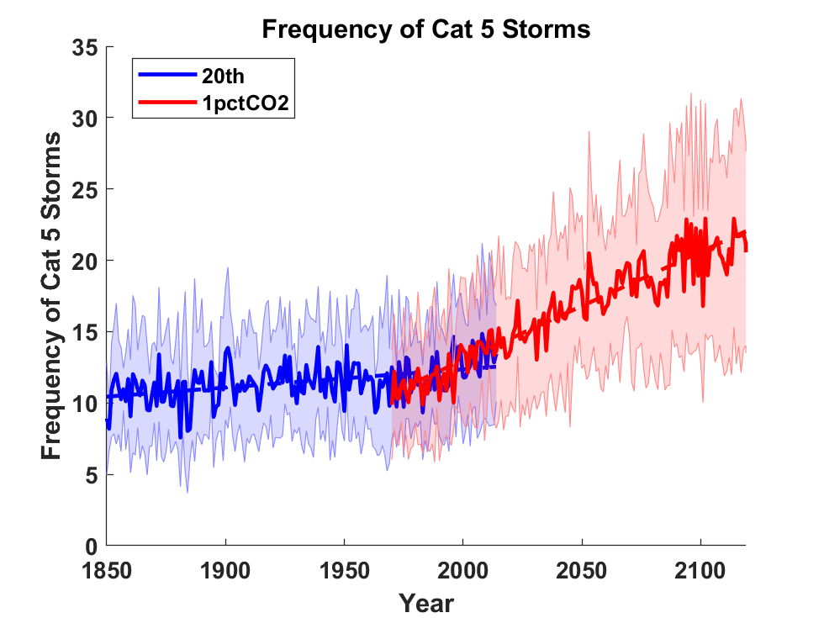
Global Tropical Cyclone Frequency from 9 Current Generation (CMIP6) Climate Models

Slide 6
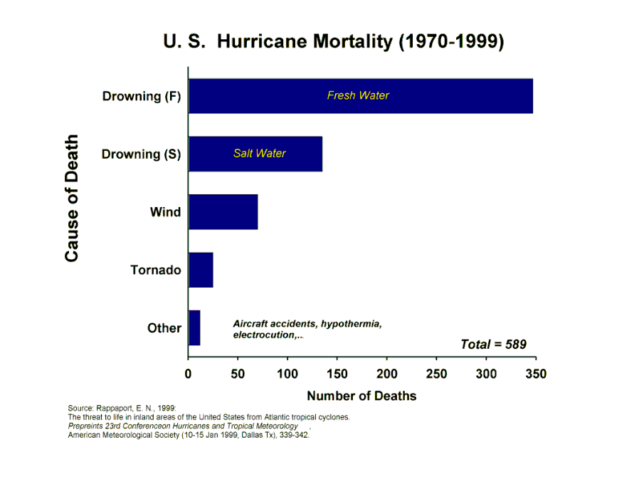

Slide 7
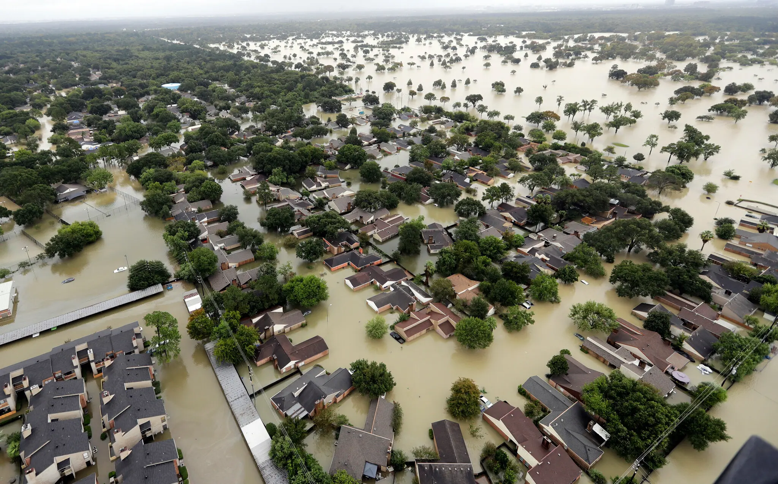
Flooding During Hurricane Harvey (2017)

