Slide 1

Hurricanes and Climate:
The Challenge of Estimating Long-term Tropical Cyclone Risk
Why we need to bring physics to bear on estimating natural hazard risk
Kerry Emanuel
Lorenz Center
Massachusetts Institute of technology

Slide 2
Flawed Basis of Current Risk Modeling
Almost all current risk assessments are based on historical statistics
Historical records are flawed and short
Moreover, the past 50-150 years is a poor guide to the present owing to climate change that has already occurred
Risk modelers have been slow to migrate to a physics-based approach
Risk modeling industry is being challenged by non-profits and start-ups
Government and the insurance industry should accelerate this transition
TC researchers are getting involved in physical modeling of risk

Slide 3
The Nature of the Beast
Start with total insured values (TIVs) of a particular insurance firm aggregated over zip codes
Net TIV: $ 2 trillion
12,968 zip codes

Slide 4
Procedure
Apply a set of 49,600 tropical cyclones making landfall in the continental U.S.
These have been generated using a physical model applied to the present climate (technique to be described shortly)
At each centroid, calculate the peak wind generated and apply a damage function that estimates the fraction of property value destroyed
Using insured value, calculate loss at each zip code and sum over all zip codes
From the set of 49,600 storms randomly draw 3 each year and create 1,000-year time series of damage
This is for a stationary climate but the same idea can be applied to evolving climate states

Slide 5
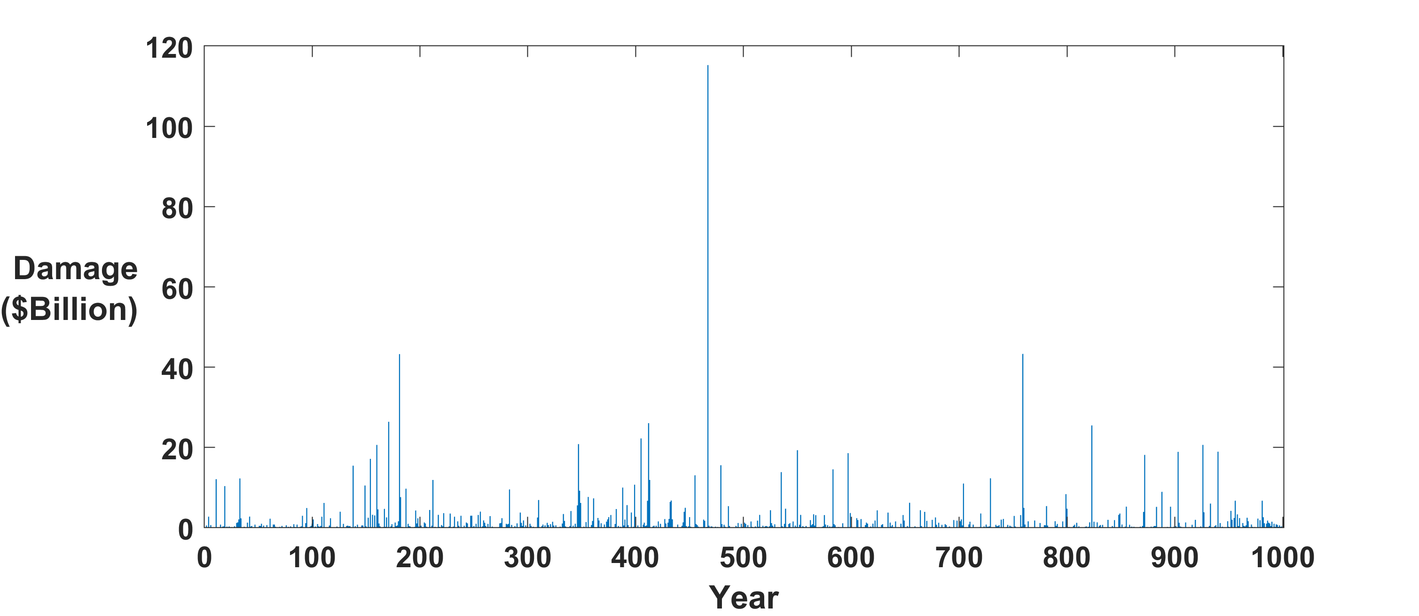
Example:
A single 1000-year time series of annual damage to portfolio
Question: Can we estimate average annual loss (AAL) from 50-100 years of record?
Answer: Good luck with that!

Slide 6
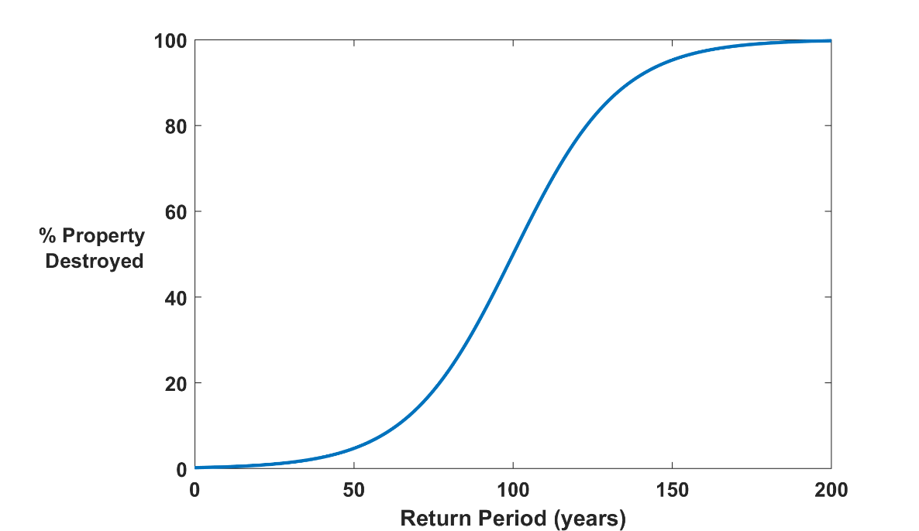

Why Climate Risk is Dominated by Extreme Events:
Societies are usually well adapted to frequent events (> 1/100 yr)
Societies are often poorly adapted to rare events (< 1/100 yr)
Large cost increases result when > 100-yr events become < 100-yr events
Largest slope

Slide 7
Historical Records
Tropical cyclones: ~< 100 years of good records (U.S.)
Even if we had 1000 years of great records, the past is no longer a good guide to the present
We need to turn to physical models to get better estimates of current (and future) weather risks

Slide 8
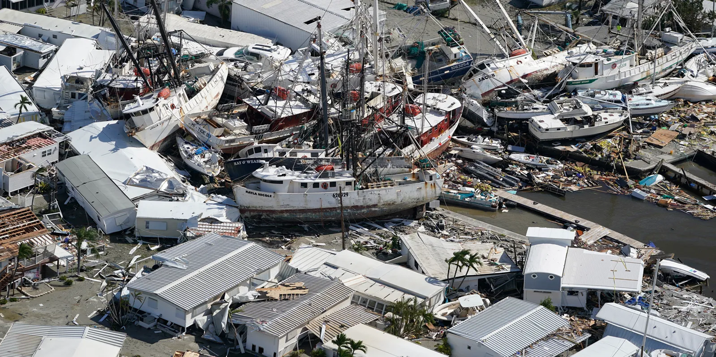
How can we bring physical modeling to bear on weather risk assessment?

Slide 9
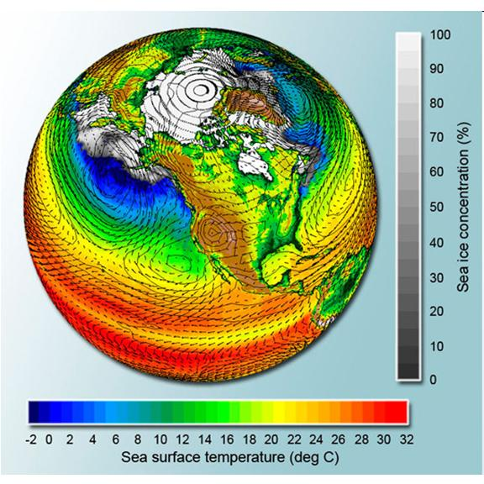
Global climate models are far too coarse for purpose

Slide 10

Problem: Today’s models are far too coarse to simulate destructive hurricanes
Histograms of Tropical Cyclone Intensity as Simulated by a Global Model with 50 km grid point spacing. (Courtesy Isaac Held, GFDL)
Category 3
Modeled
Observed
Global models do not simulate the storms that cause destruction
Wind Speed (meters per second)

Slide 11
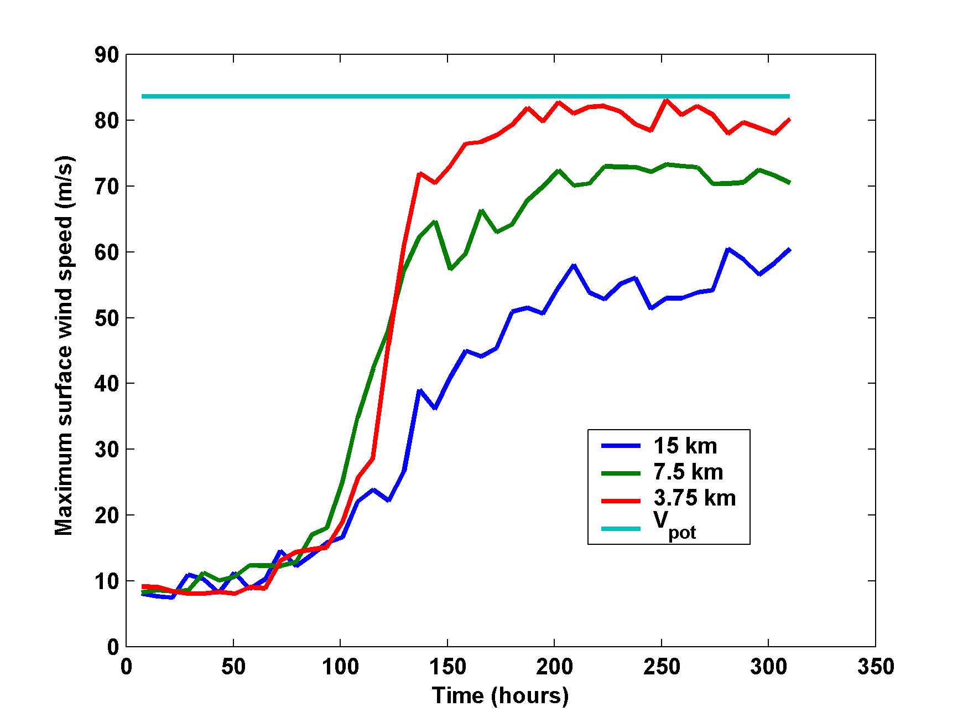
What it Takes to Simulate a Hurricane Accurately
Distance between computational nodes
Typical Climate Model Grid spacings: of 50-200 km
We need high resolution AND O(1000 yr) simulations

Slide 12
Using Physics to Assess Hurricane Risk
(Downscaling)
Reliable, global records of coarse-scale climate are robust and widely available
Cull from these datasets the key statistics known to control tropical cyclone generation, movement, and intensity evolution
Bootstrap these key statistic to create unlimited synthetic time series of the hurricane-relevant environmental variables
Use these to drive specialized, very high resolution physical hurricane models
Extensively evaluate the results against historical hurricane data
Exact same method can be applied to output of climate models

Slide 13

Risk Assessment Approach:
Step 1: Seed each ocean basin with a very large number of weak, randomly located cyclones
Step 2: Cyclones are assumed to move with the large scale atmospheric flow in which they are embedded, plus a correction for the earth’s rotation and sphericity (beta-drift)
Step 3: Run the CHIPS coupled intensity model for each cyclone, and note how many achieve at least tropical storm strength (CHIPS is phrased in angular momentum coordinates. Flow-dependent resolution)
Step 4: Using the small fraction of surviving events, determine storm statistics. Can generate 100,000 events
Details: Emanuel et al., Bull. Amer. Meteor. Soc, 2008
Notes:
13

Slide 14
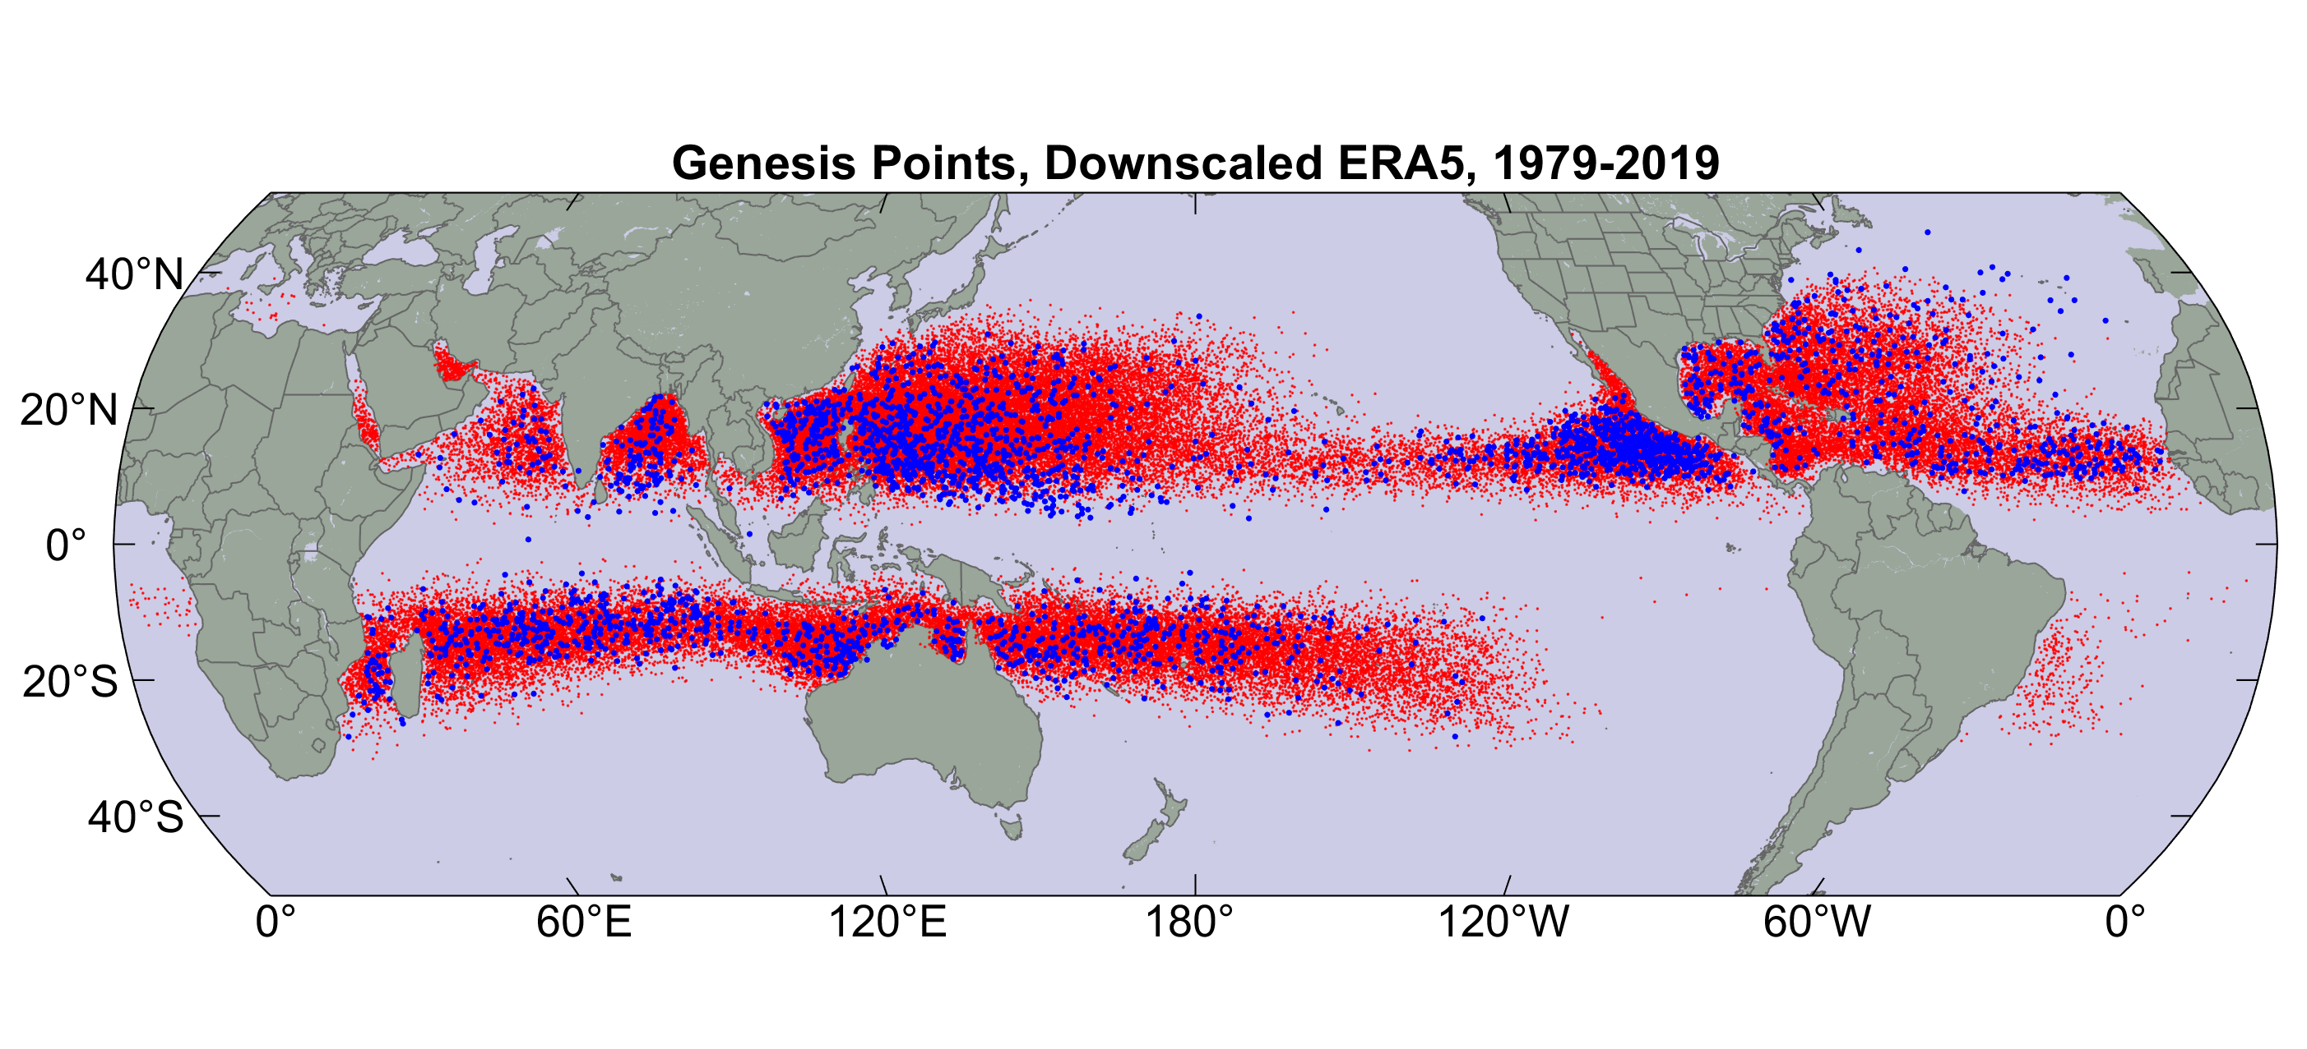
Origin points of successful seeds (red); observed genesis locations (blue)

Slide 15
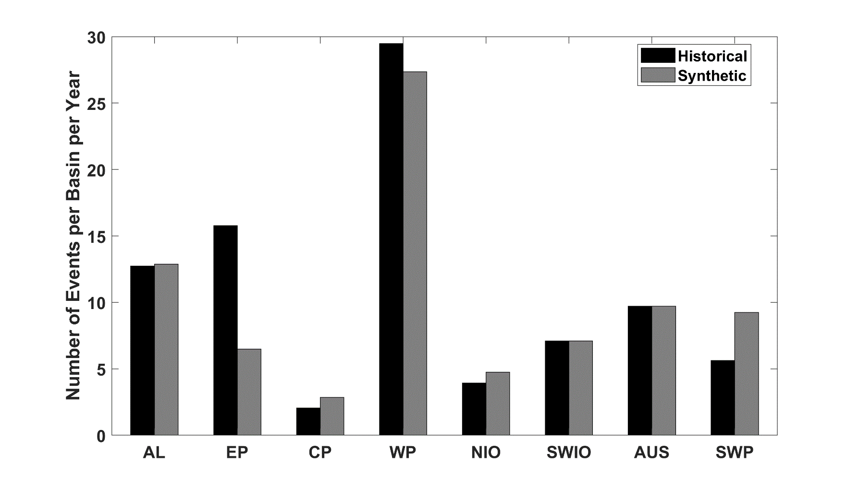
Average annual number of tropical cyclones over the period 1980-2020 in observations (IBTrACS; Knapp et al. 2010; black bars) and from random seeding of ERA-5 (gray bars)

Slide 16
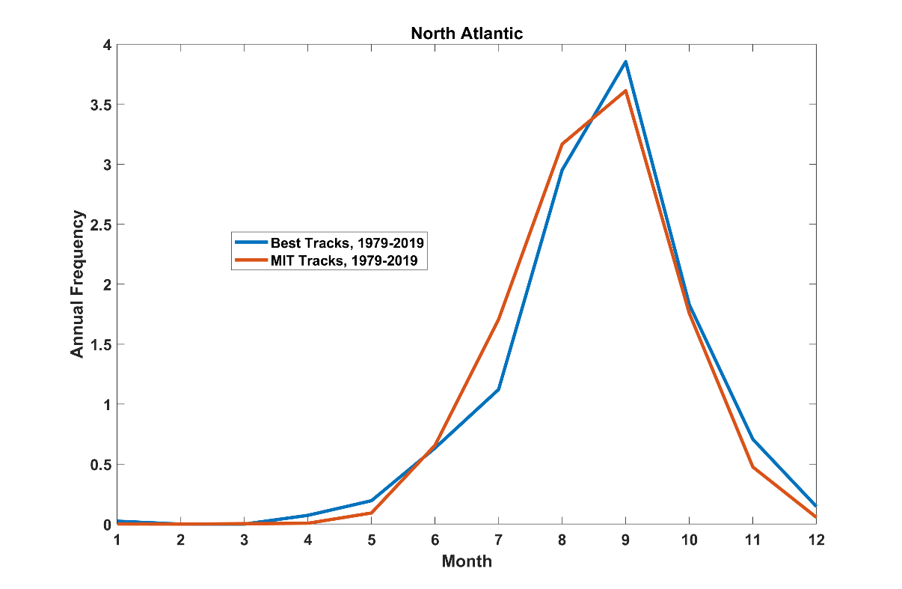
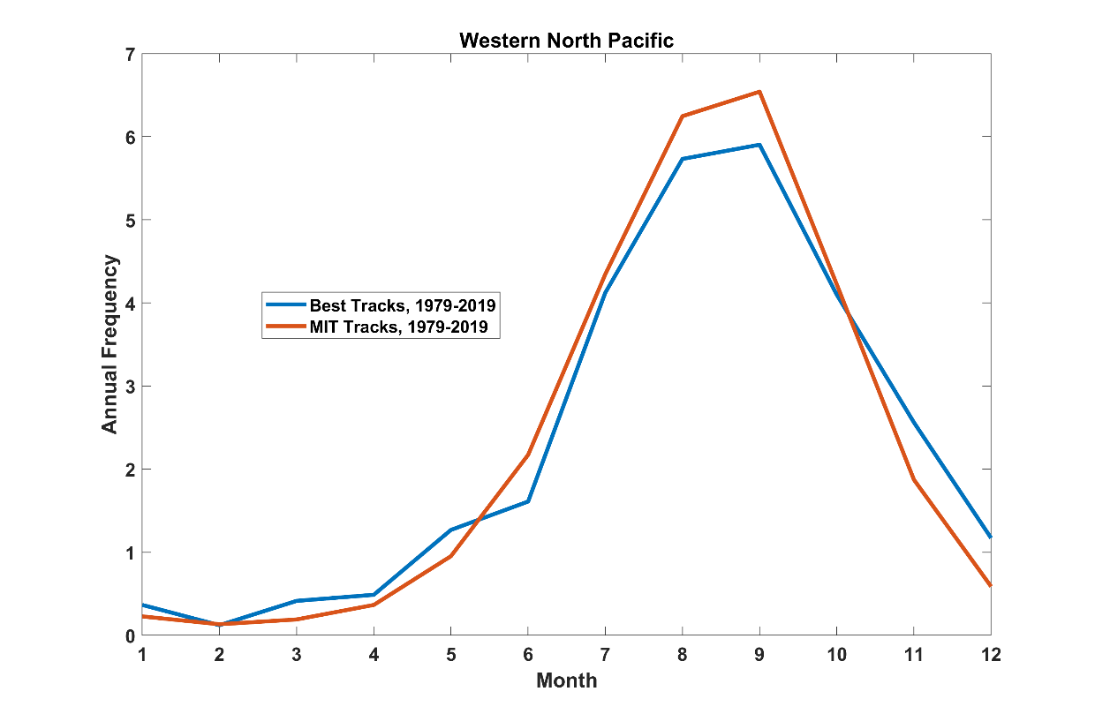
Seasonal Cycle
North Atlantic
Seasonal Cycle
Northwest Pacific

Slide 17
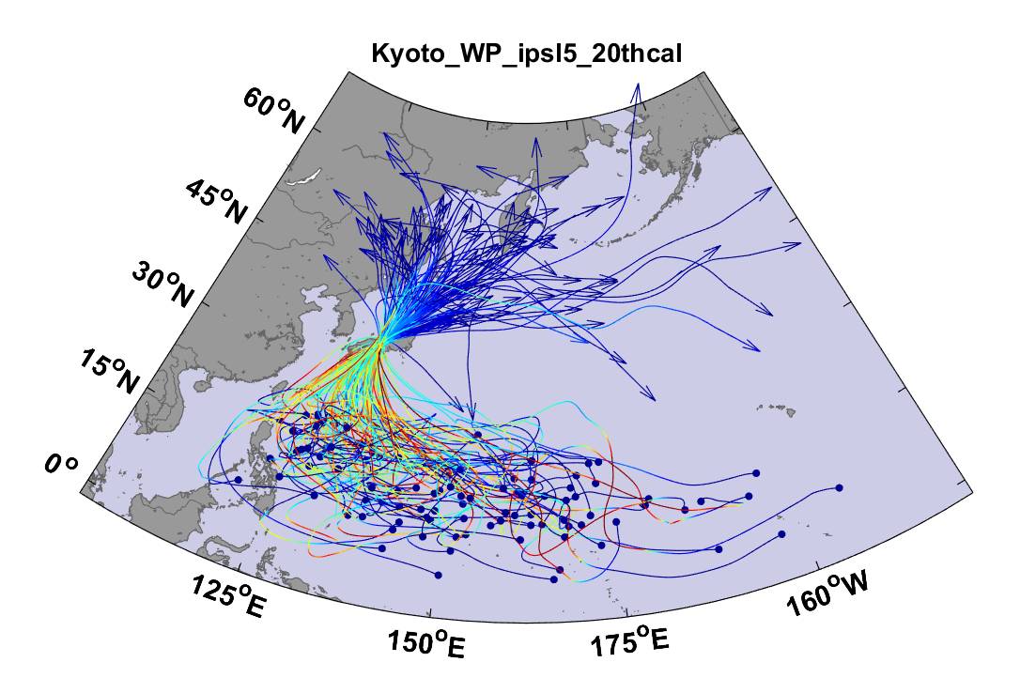
Example:
Top 100 out of 2000 TCs Affecting Kyoto, 1981-2000

Slide 18
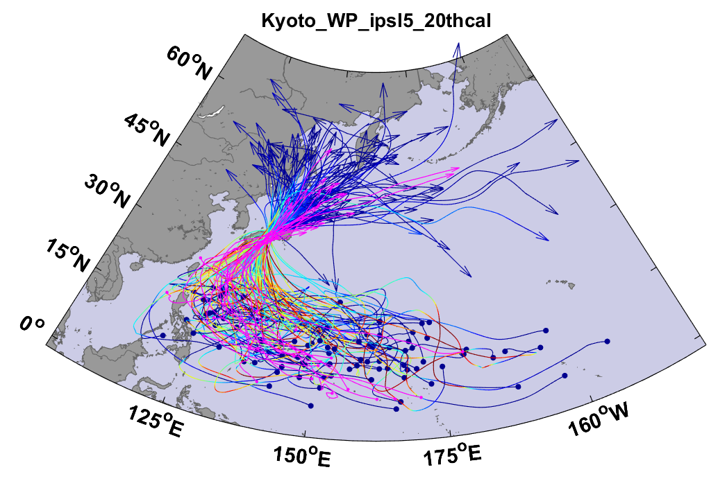
Same, but with top 20 historical tracks

Slide 19

Cumulative Distribution of Storm Lifetime Peak Wind Speed, with Sample of 1755 Synthetic Tracks
Blue bars: Actual
Red bars: Predicted
90% confidence bounds

Slide 20
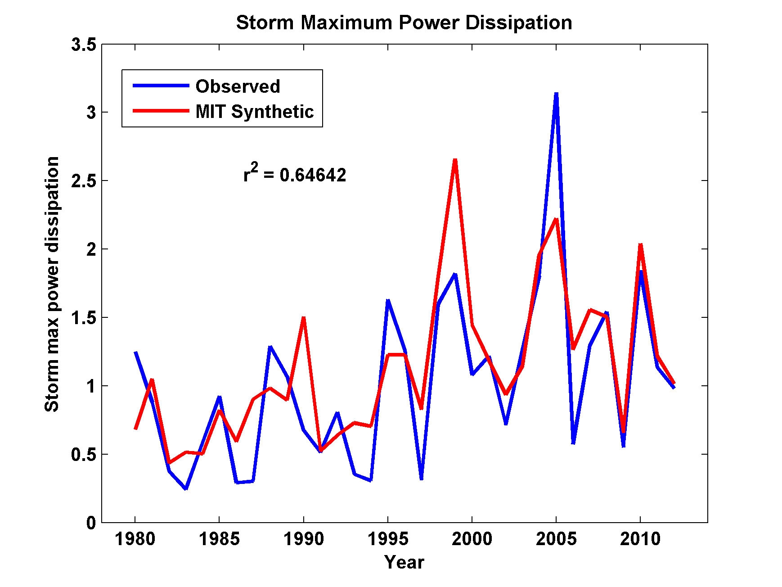
Captures Much of the Observed North Atlantic Interannual Variability
r²=0.65

Slide 21
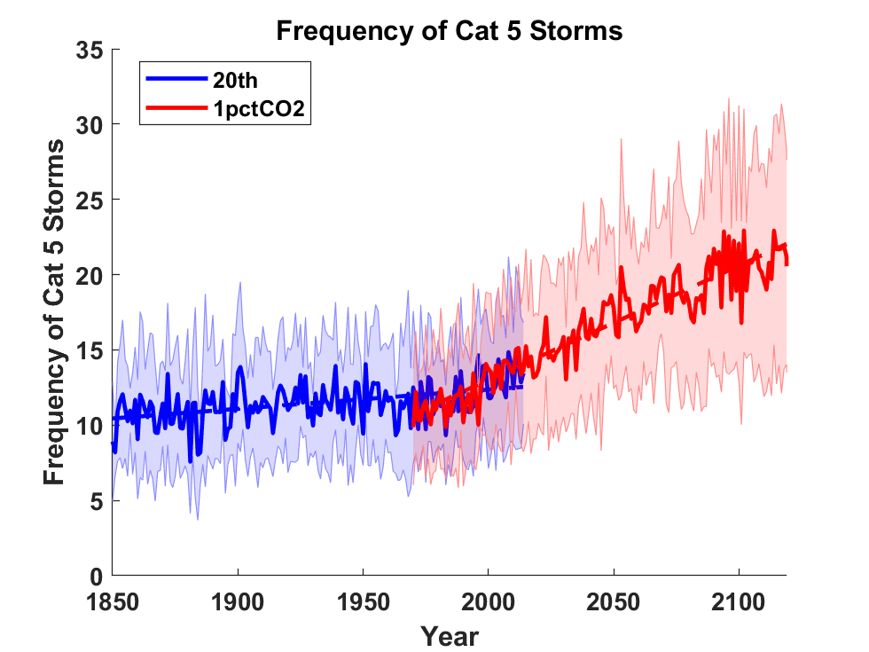
Application to Global Climate Change Simulations:
Global CAT 5 Tropical Cyclone Frequency from 9 Current Generation (CMIP6) Climate Models

Slide 22
Satellite-derived proportion of major hurricane fixes
Time series of fractional proportion of global major hurricane estimates to all hurricane estimates for the period 1979–2017. Each point, except the earliest, represents the data in a sequence of 3-y periods. The first data point is based on only 2 y (1979 and 1981) to avoid the years with no eastern hemisphere coverage. The linear Theil−Sen trend (black line) is significant at the 98% confidence level (Mann−Kendall P value = 0.02). The proportion increases by 25% in the 39-y period (about 6% per decade).
Kossin et al., PNAS, 2020

Slide 23
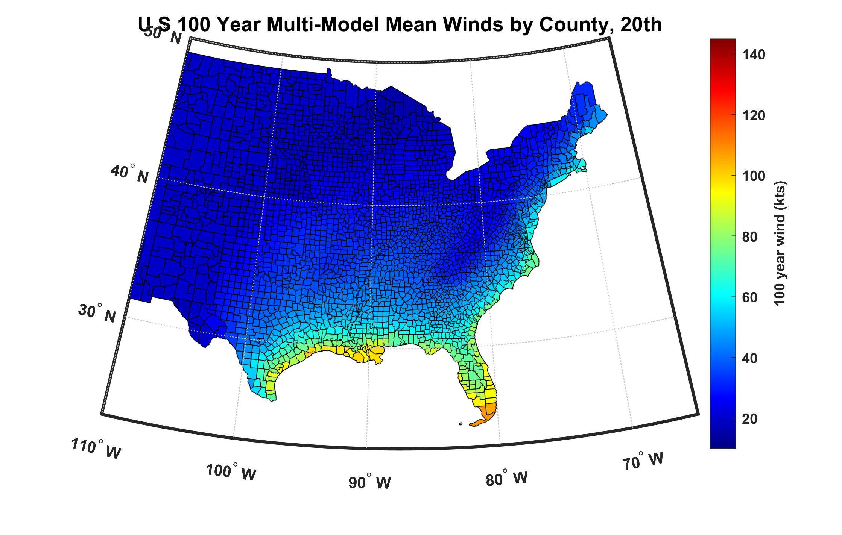
100-year hurricane peak wind based on downscaling 8 CMIP6 climate models, 1984-2014

Slide 24
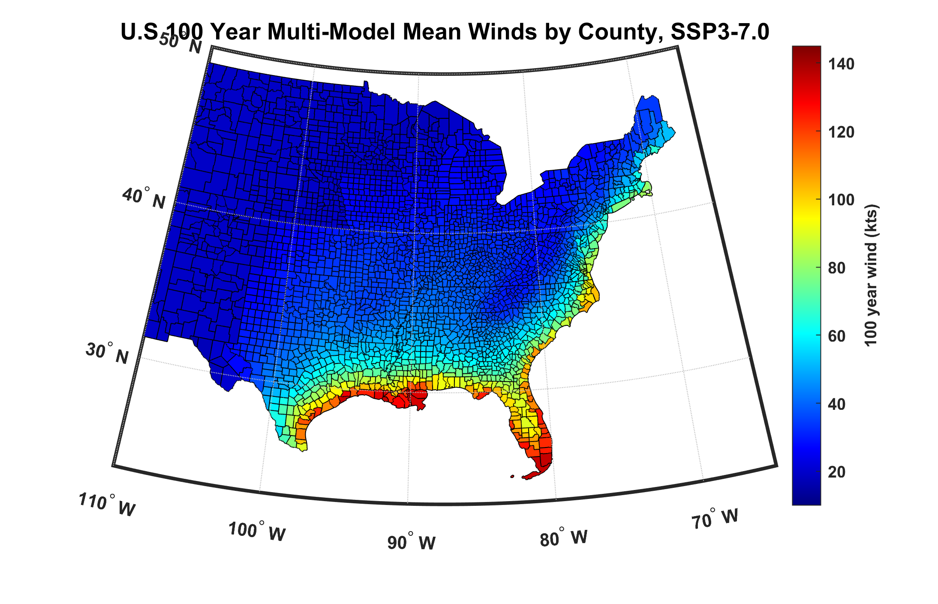
100-year hurricane peak wind based on downscaling 8 CMIP6 climate models, 2070-2100

Slide 25
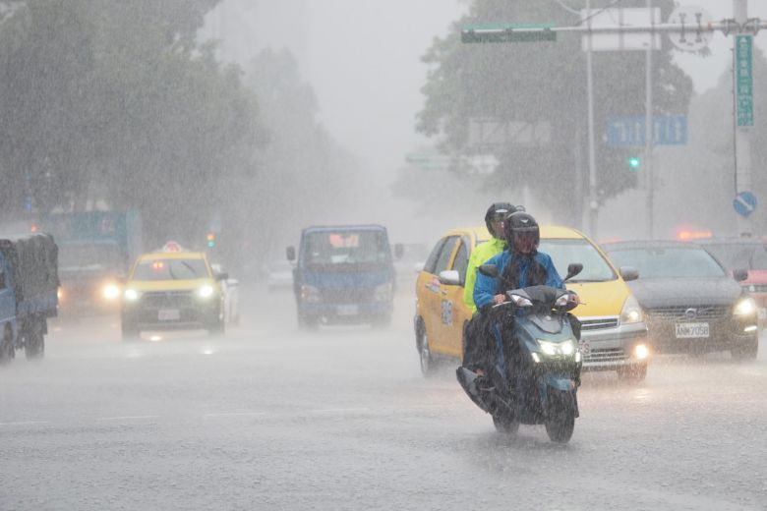
Hurricane Rain

Slide 26
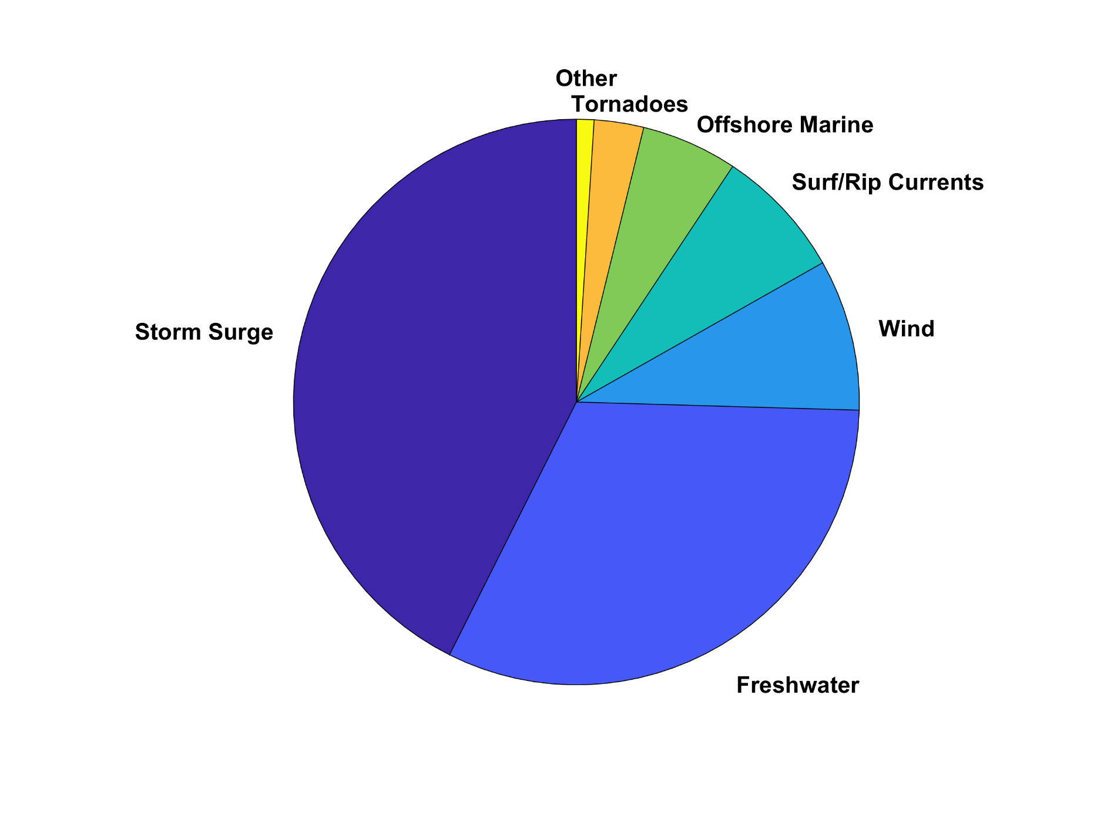
U.S. Hurricane Fatalities, 1963-2022

Slide 27
Predicting Rainfall
The CHIPS models predicts updraft and downdraft convective mass flux as a function of time and potential radius, BUT:
Storing these variables at all radii would increase overall storage requirements by a factor of ~50
(We are dealing with 10,000-100,000 individual events)

Slide 28
An Example of Estimated Long-Term Rain Risk:
Estimated gauge sampling error
Estimated radar sampling error
Feldmann et al, J. App. Meteor. Clim., 2019

Slide 29
2,000 year rain event for Houston

Slide 30
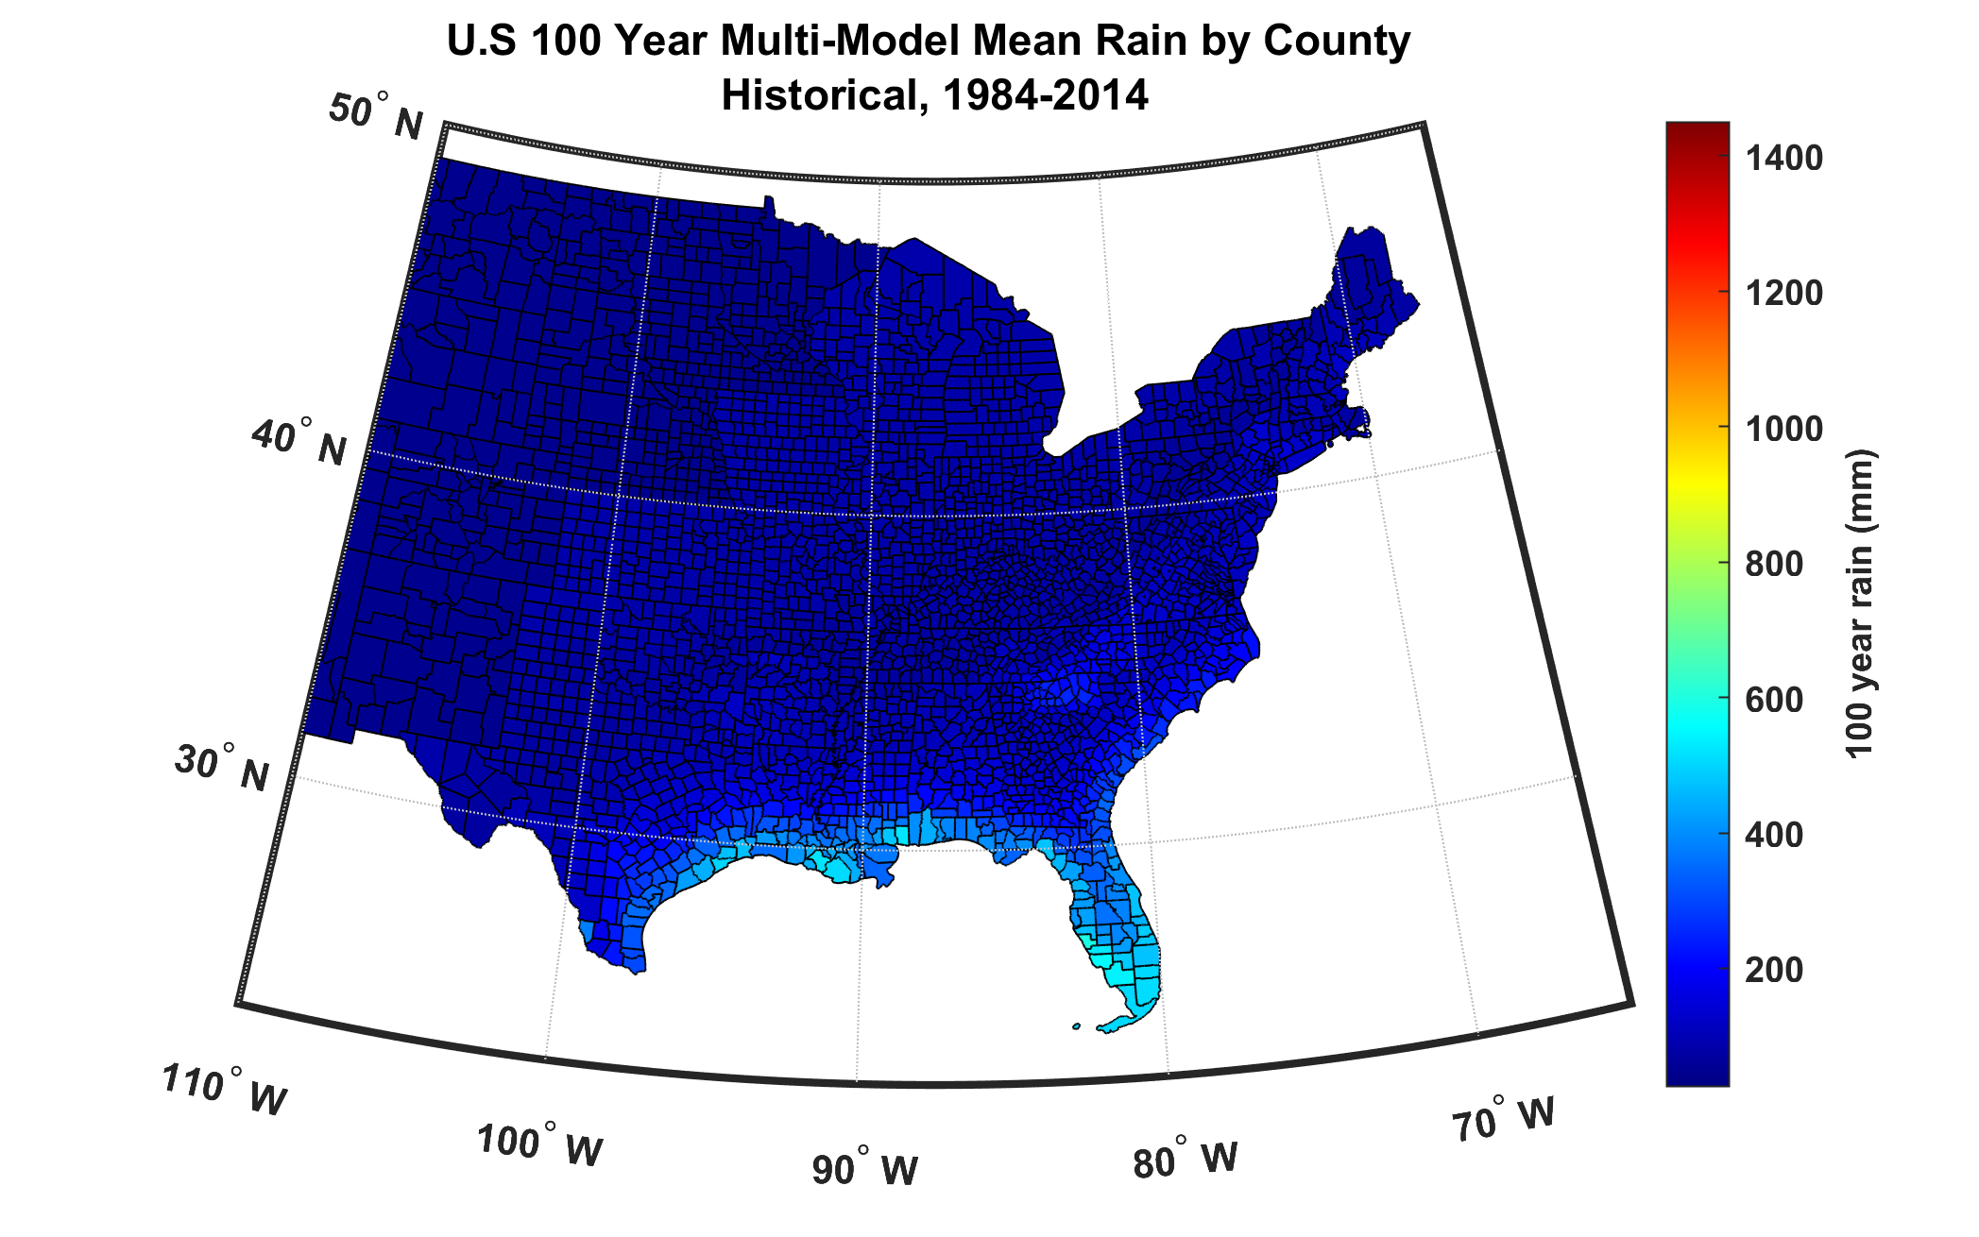
100-year hurricane storm total rain based on downscaling 8 climate models, 1984-2014

Slide 31
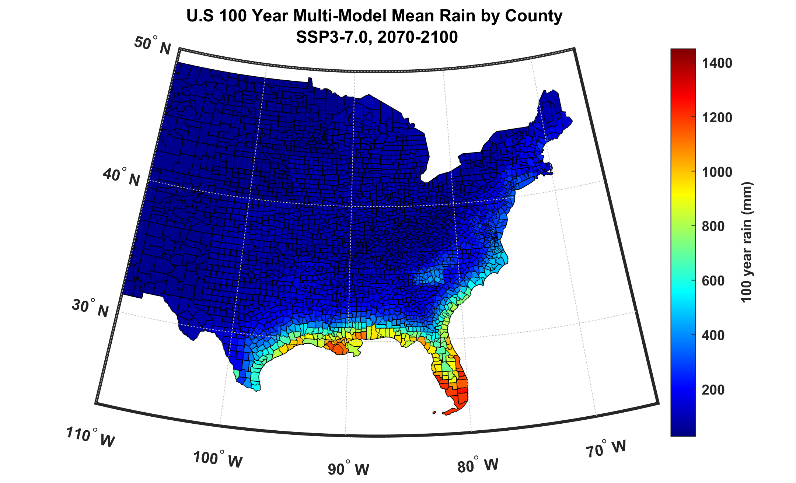
100-year hurricane storm total rain based on downscaling 8 climate models, 2070-2100

Slide 32

Hurricane Risk in Miami

Slide 33
Miami
Downscale 4500 events from ERA-5 reanalyses, 1985-2014, passing within 150 km of Miami
Downscale 4500 events from historical simulations of 9 CMIP6-generation climate models, 1985-2014
Downscale 4500 events from SSP3-7.0 simulations of 9 CMIP6-generation climate models, 2071-2100
If you would like to use these tropical cyclone sets for research purposes, please write me (emanuel@mit.edu)

Slide 35
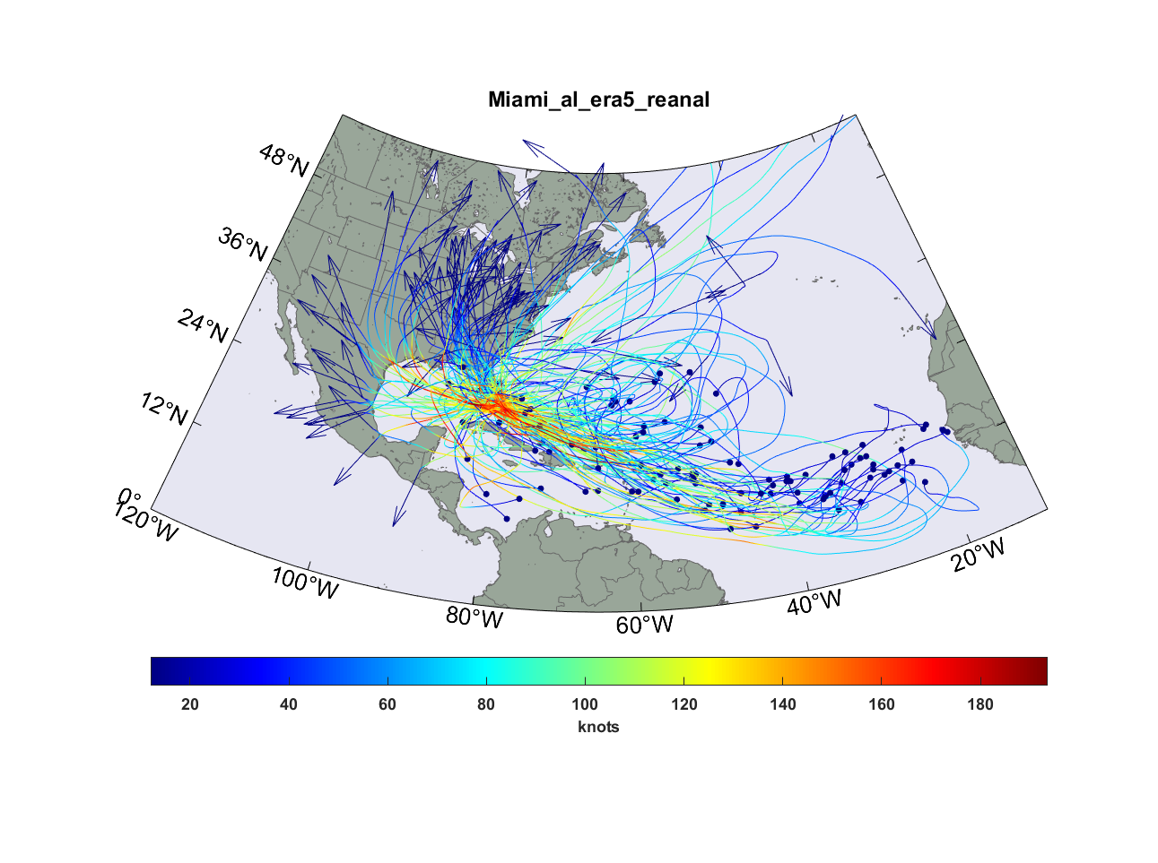
Top 100 out of 4,500 TCs passing within 150 km of Miami, downscaled from ERA-5 reanalyses

Slide 36
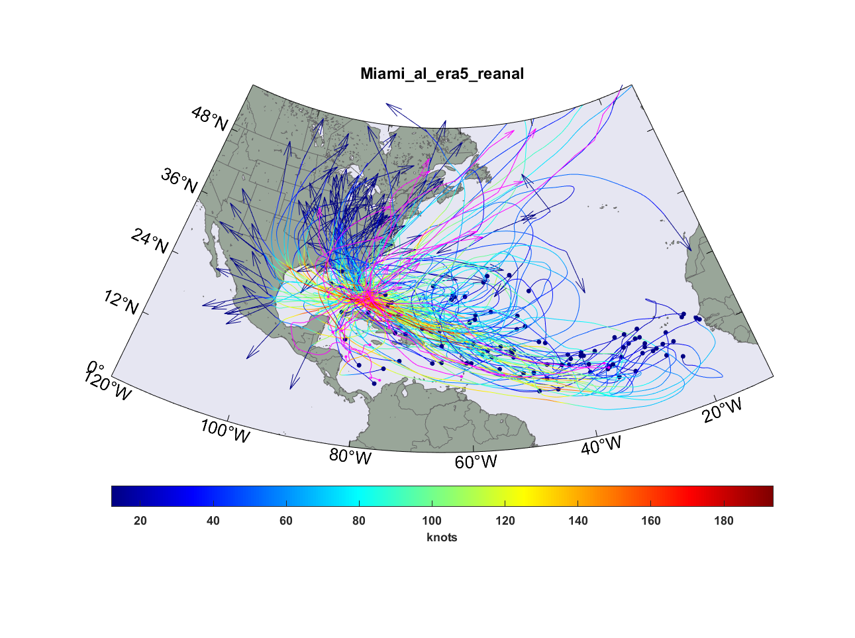
Same but with top 15 hurricanes passing within 150 km of Miami, 1970-2022 superimposed (magenta curves)

Slide 37
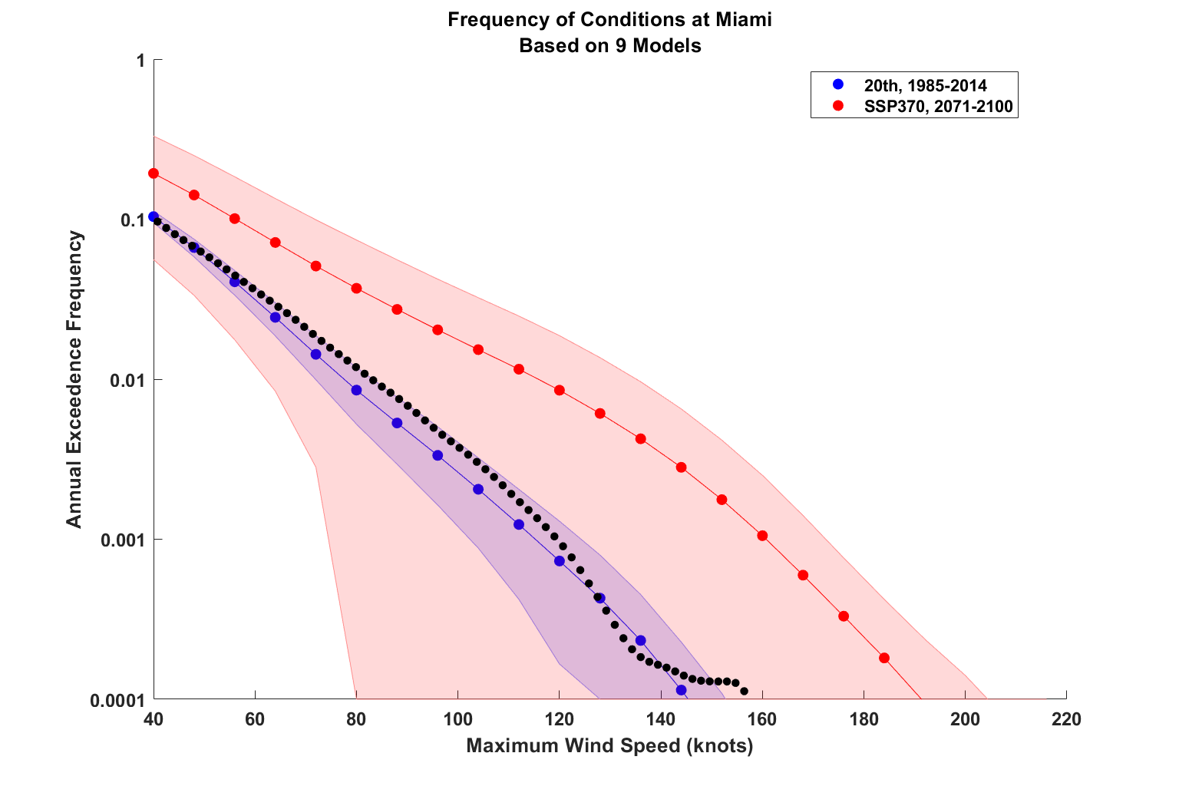

Slide 38
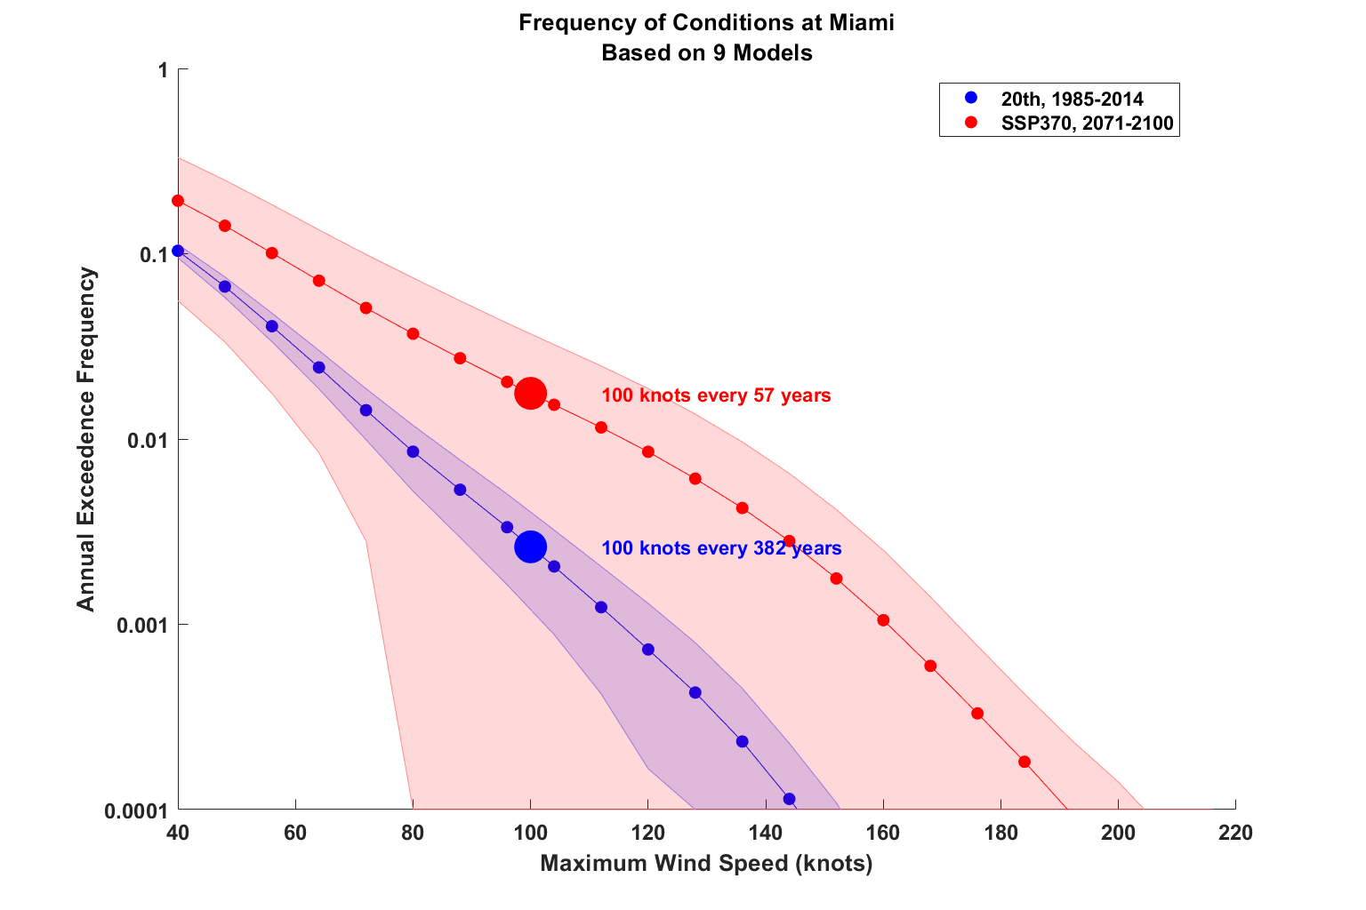

Slide 39
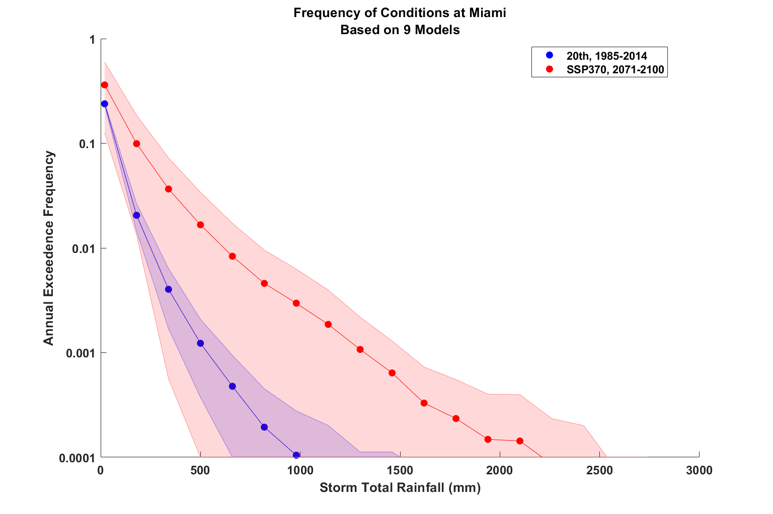

Slide 40
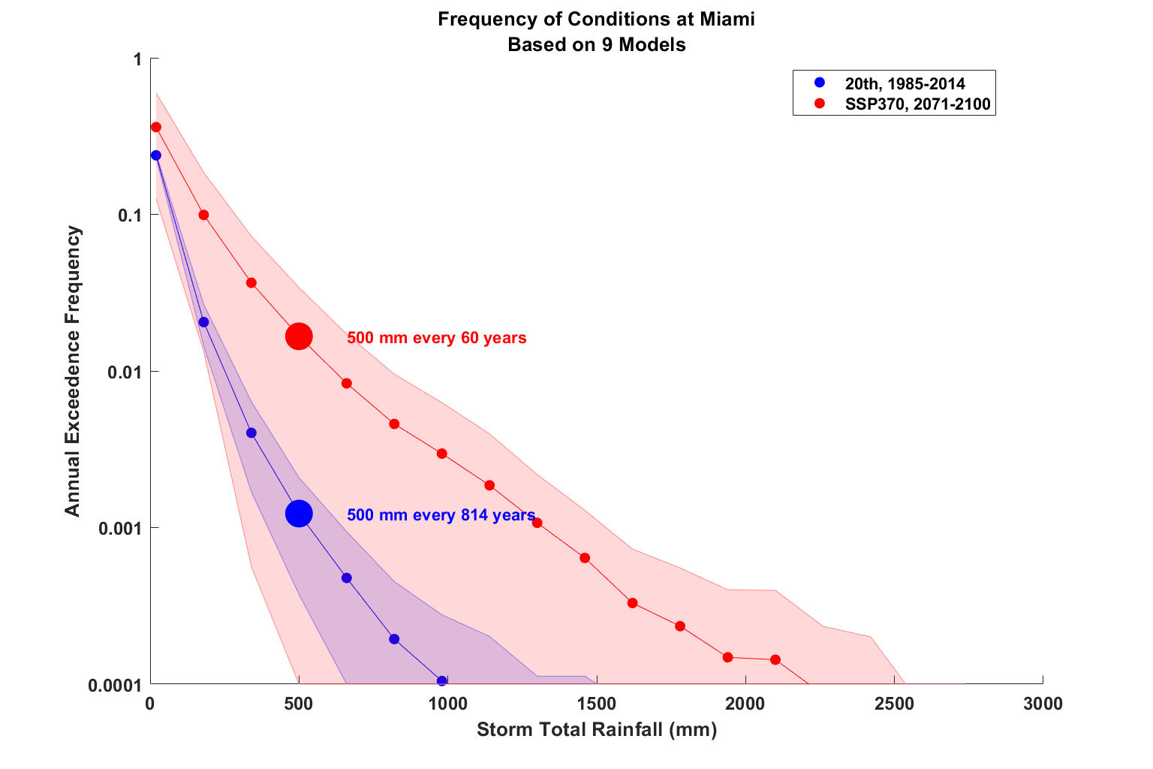

Slide 41
Use synthetic tracks to estimate current and future TC economic risk
Procedure:
Generate 6,200 synthetic hurricane events affecting eastern U.S. from each of 8 global climate models for two periods of time: 1985 – 2014 and 2071 – 2100 (SSP3 7.0)
Calculate peak wind speed at each zip code centroid for each hurricane event
Use damage function to convert peak wind to percentage of insured value destroyed
Apply to the total insured value (TIV) aggregated across each of the 12,968 zip codes and sum over them to estimate total loss to insurance firm

Slide 42
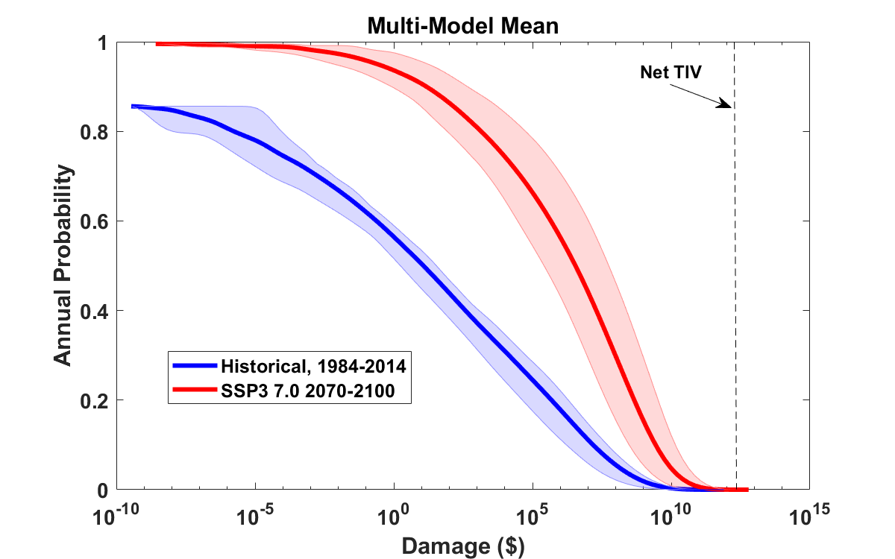
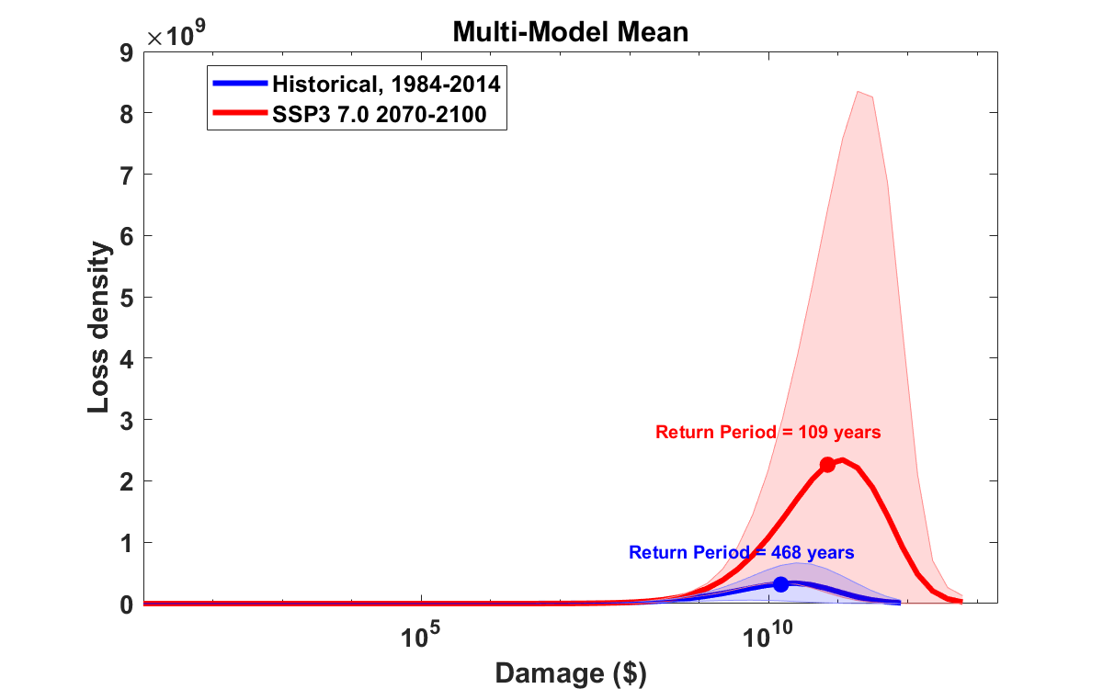
Median annual loss (2-year return period)
1984 – 2014: $ 12 ($2 – $34)
2070 – 2100: $ 3.5 million ($260 k – $56 million)
Average annual loss:
1984 – 2014: $ 536 million ($108 million – $1.25 billion)
2070 – 2100: $ 4.1 billion ($590 million – $13.7 billion)
Annual average loss strongly dominated by VERY rare events!
These will not be evident in historical records

Slide 43
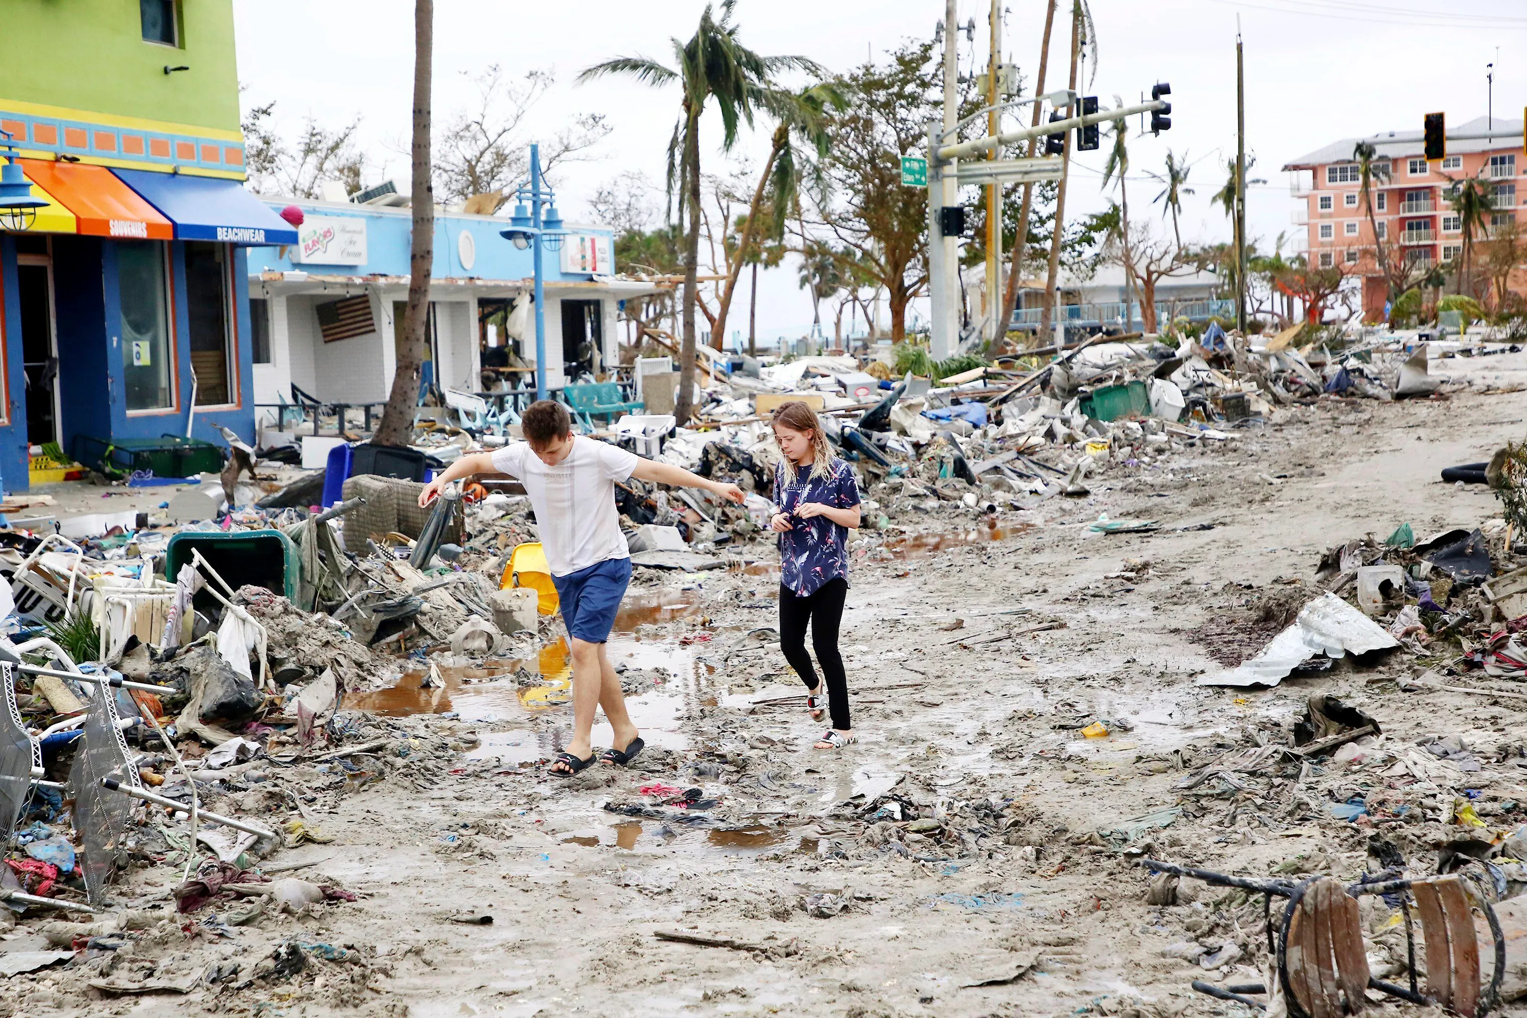
Making Risk Personal:
All Climate Change is Local!

Slide 44
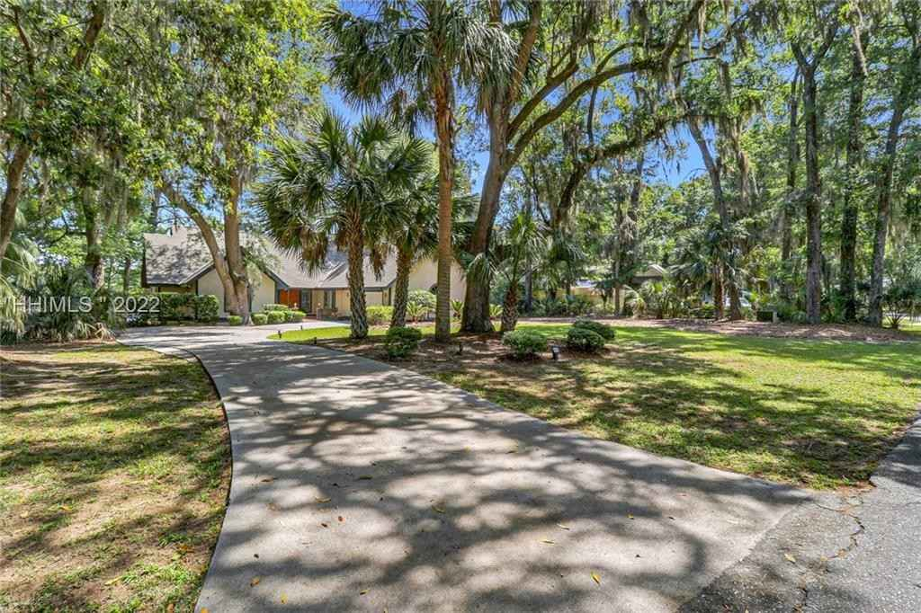
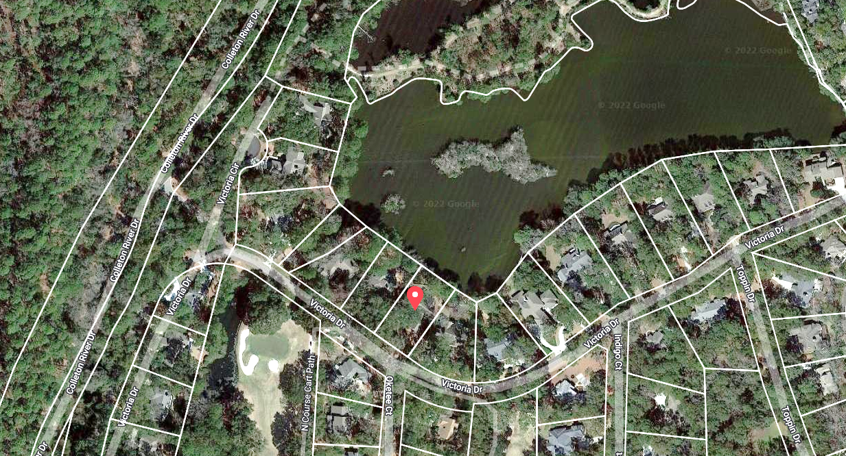
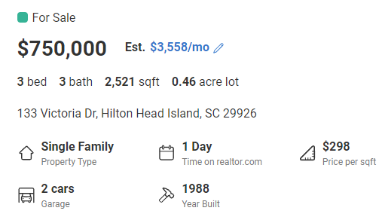


Property for sale in Hilton Head, SC
Realtor.com
Work of First Street Foundation

Slide 45
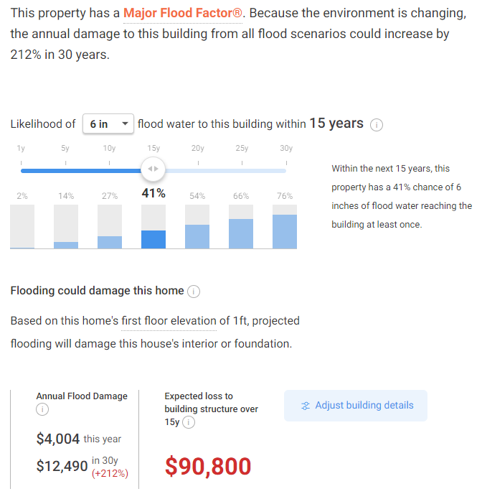

Slide 46
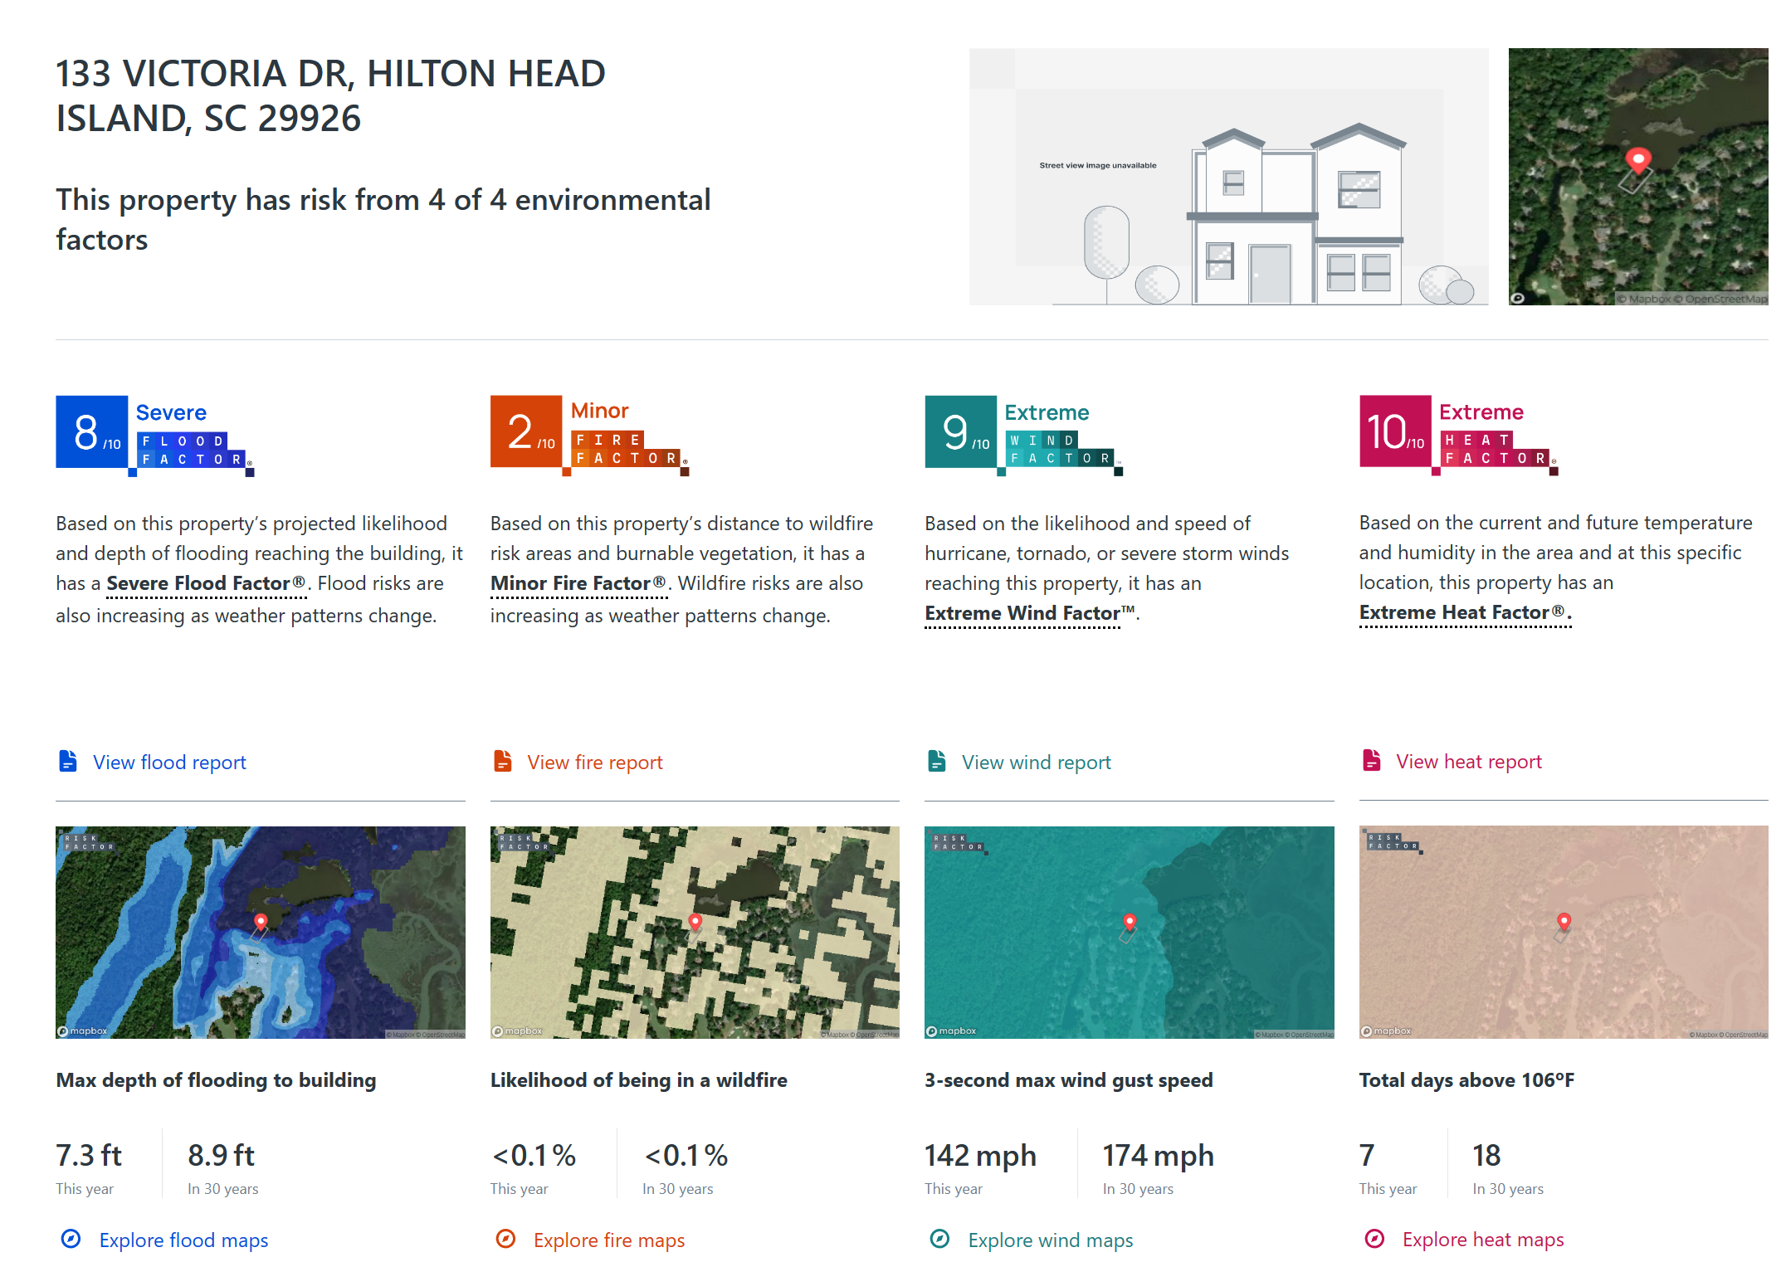
Type address into RiskFactor (https://riskfactor.com)

Slide 47
Take-Away Points
We are moving away from sole dependence on flawed historical data in assessing climate- and weather-related natural hazard risks and embrace advanced physical modeling techniques
Government, the insurance industry, research laboratories, and institutions of higher education are crucial to this effort
We can no longer regard climate change as a problem for the future; it has already tangibly affected important risks, e.g. Hurricane Harvey’s rainfall was ~3 times more likely in 2017 than in 1970
We are just beginning to fill the large gap between current practice and what is possible and desirable.

Slide 48
Spare Slides

Slide 49
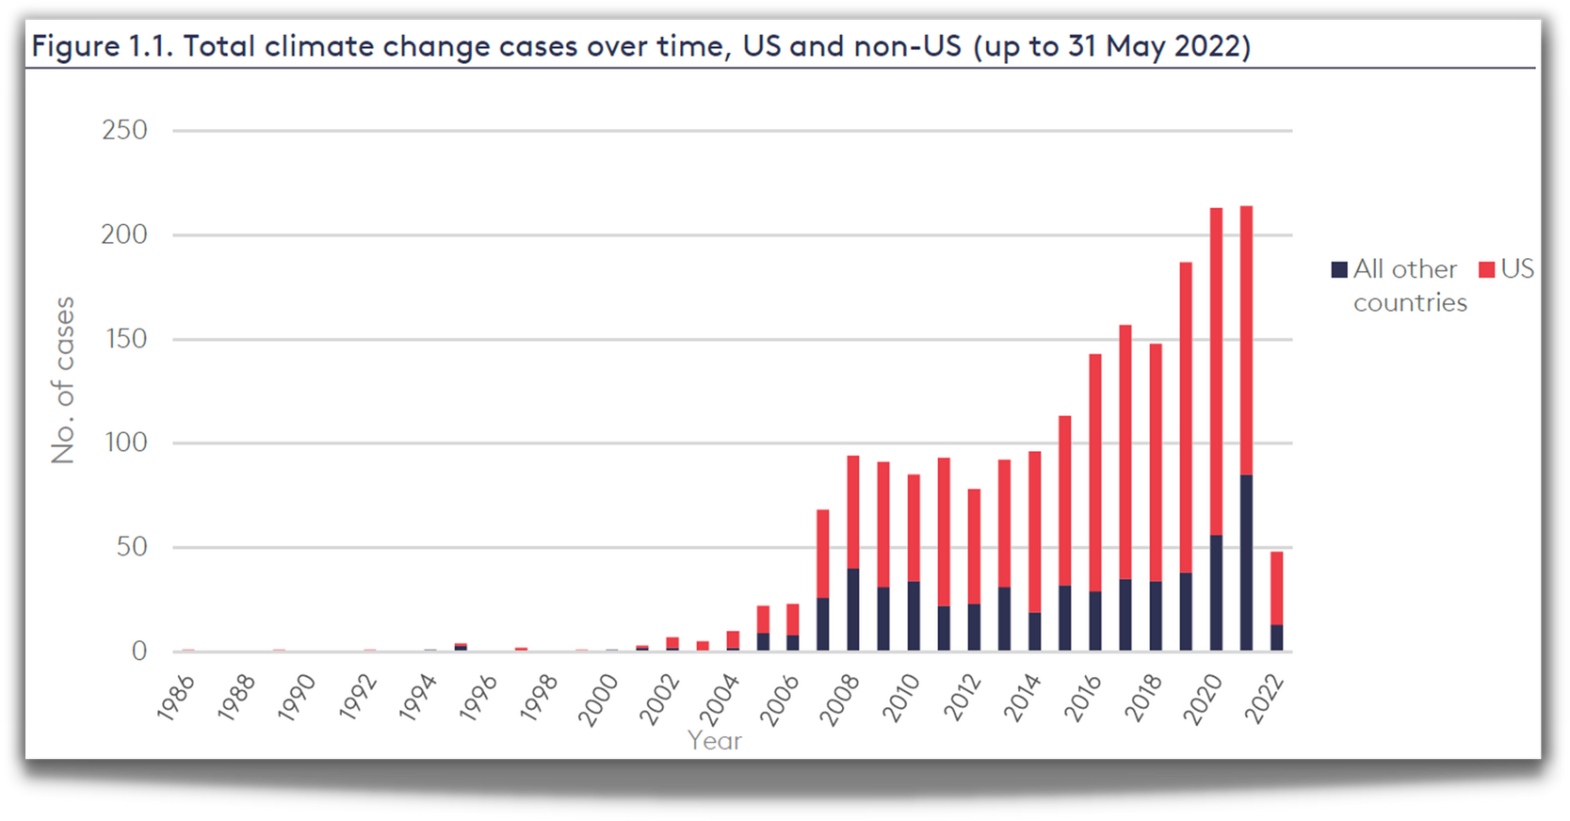

CLIMATE
LITIGATION
TRENDS
Currently 2,000+ U.S. climate cases
Source: Joana Setzer & Catherine Higham, Global Trends in Climate Change Litigation 9 (June 2022) (based on data from the Sabin Center and Climate Change Laws of the World databases)
Courtesy Sandra Thiam and Jarryd Page of the Climate Judiciary Project of the Environmental Law Institute

Slide 50
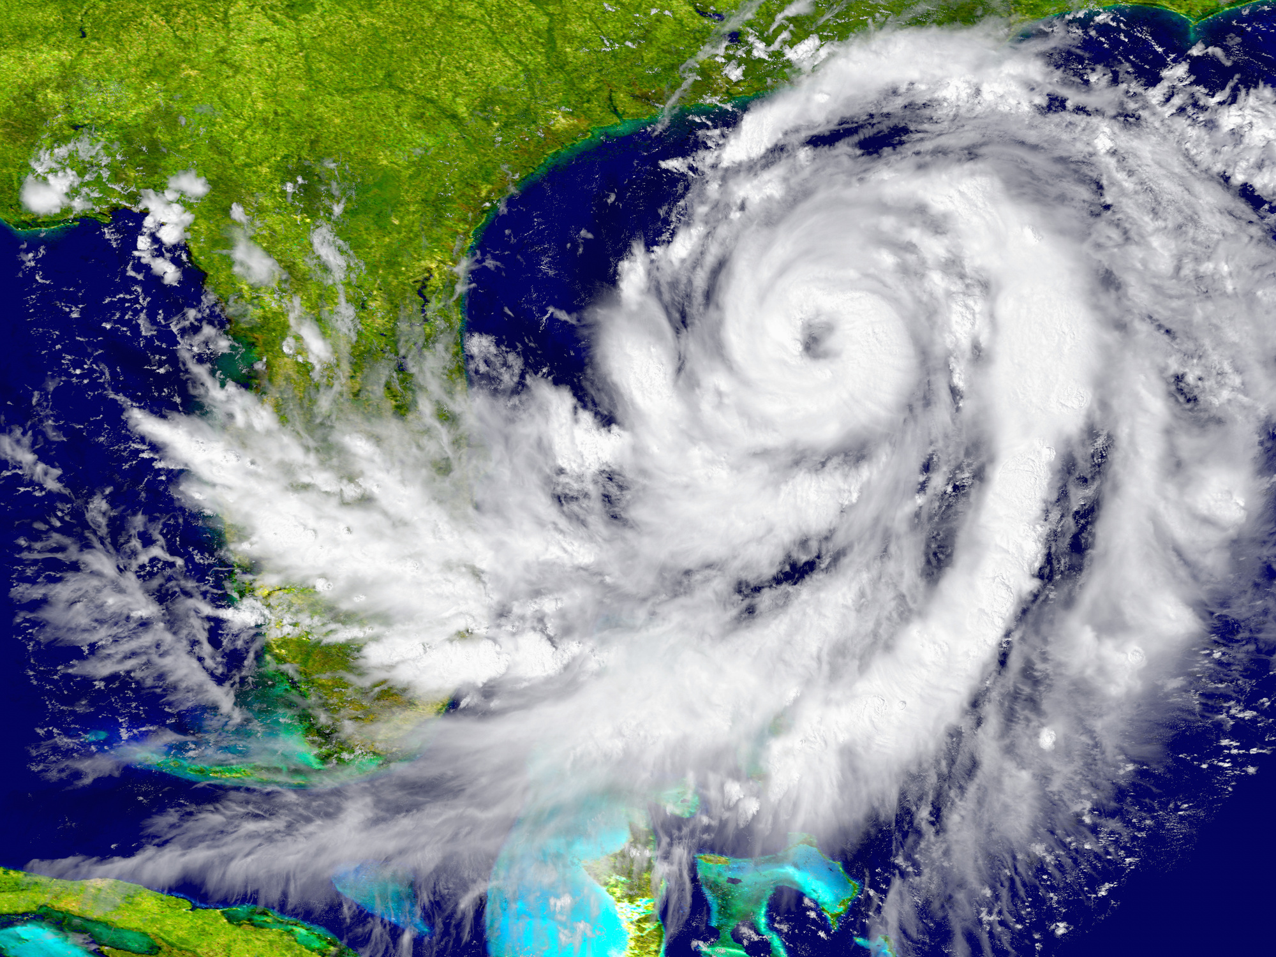
HURRICANE LITIGATION
Litigation happens before (planning and preparation) and after (impacts)
Can include:
  Torts (negligence, nuisance, trespass)
  Zoning and land use
  Impact assessments
  Insurance claims
Courtesy Sandra Thiam and Jarryd Page of the Climate Judiciary Project of the Environmental Law Institute

Slide 51
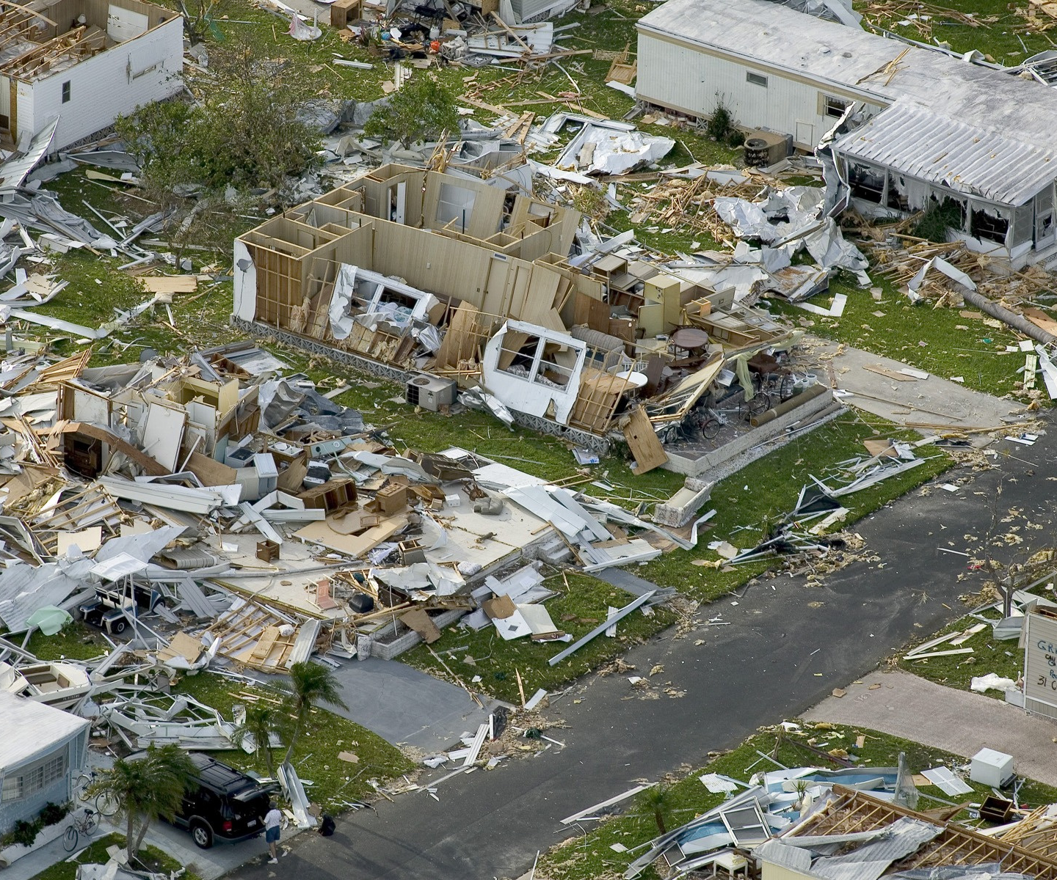
LEGAL ISSUES RELATED
TO HURRICANES:
INSURANCE
  whether homeowners' insurance settlements with insurance companies for damages sustained in a hurricane were appropriate
    (class action following Hurricane Sandy)
Courtesy Sandra Thiam and Jarryd Page of the Climate Judiciary Project of the Environmental Law Institute

Slide 52
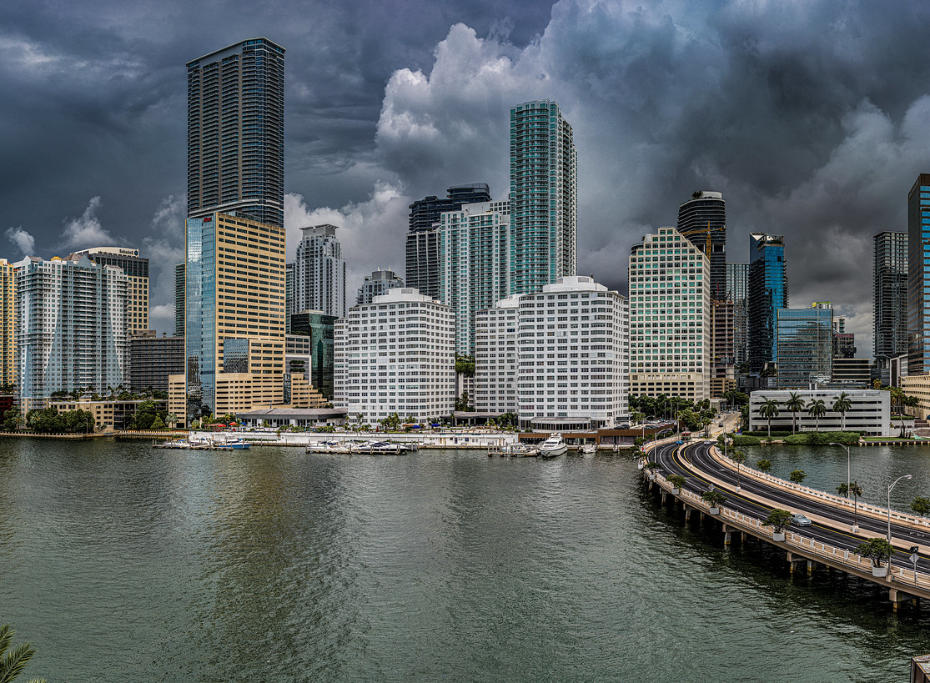
Hurricane Risk in Miami

Slide 53
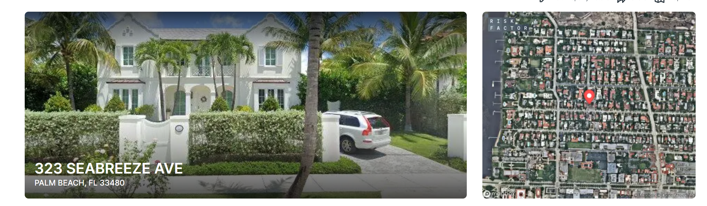
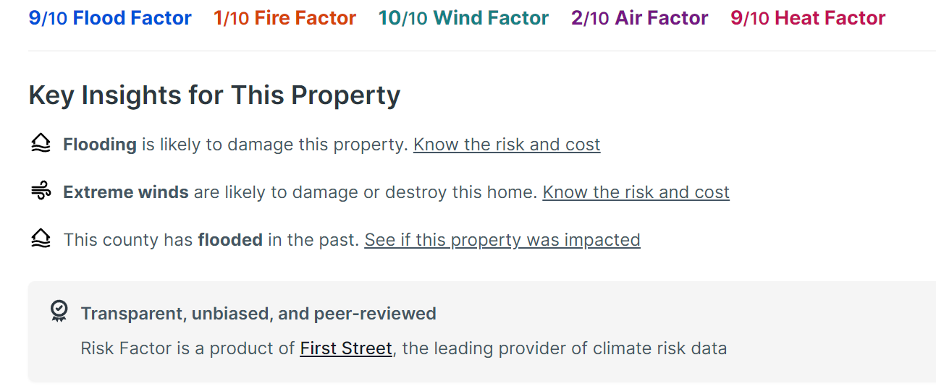
https://RiskFactor.com

