Slide 1

Climate Change and Severe Convective Storms
Kerry Emanuel
Lorenz Center
MIT

Slide 2
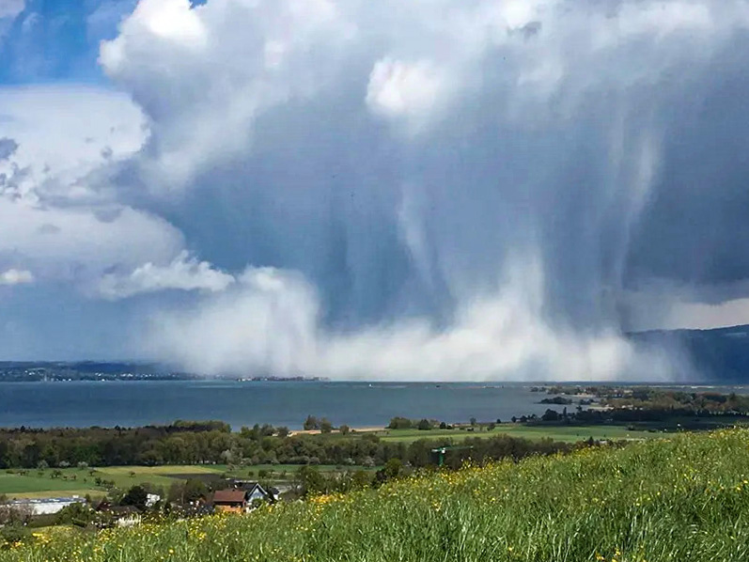
Hailstorm over Lake Constance, Switzerland
Credit: Kurt Abderhalden

Slide 3
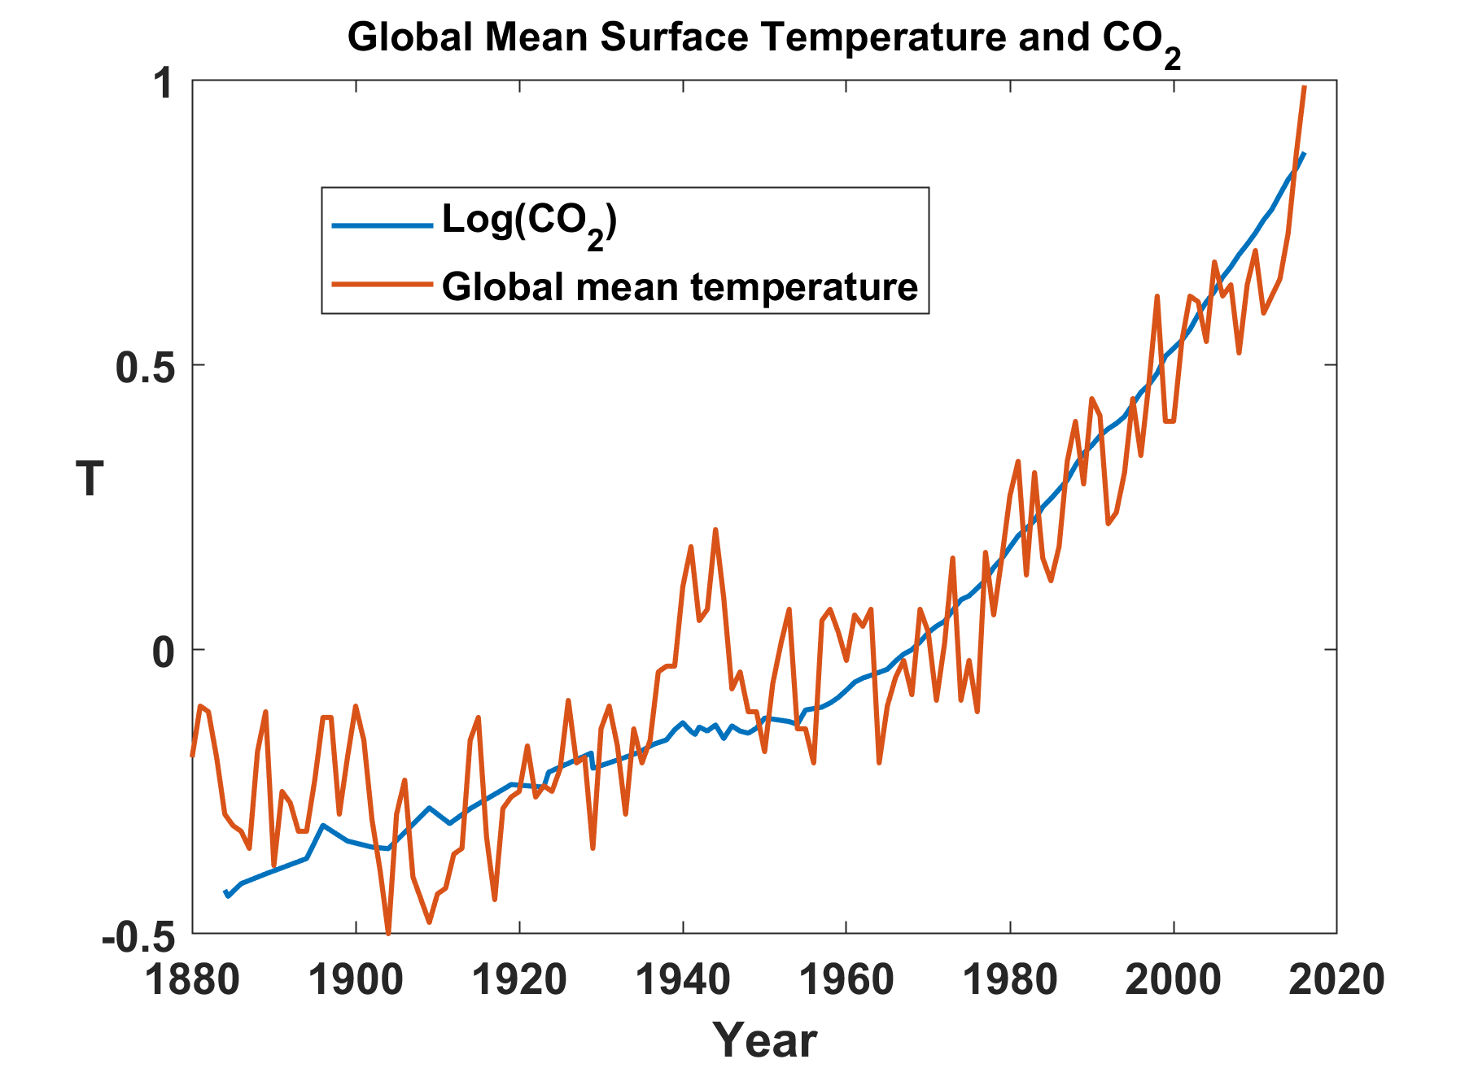

Slide 4
Some Preliminaries:
Two Broad Categories of Convection
Quasi-equilibrium convection
  Convection consumes available energy at about the rate that large- scale processes generate it
  Most tropical convection and middle-latitude summer convection is of this type
  Generally benign
  Responsible for significant fraction of global mean, annual mean rainfall
Stored-energy convection
  Convective available energy builds up over time and is then suddenly released
  Comparatively rare
  Responsible for most convection-related problems: tornadoes, hailstorms, flash-floods, and straight-line wind storms

Slide 5

Quasi-Equilibrium Convection

Slide 6
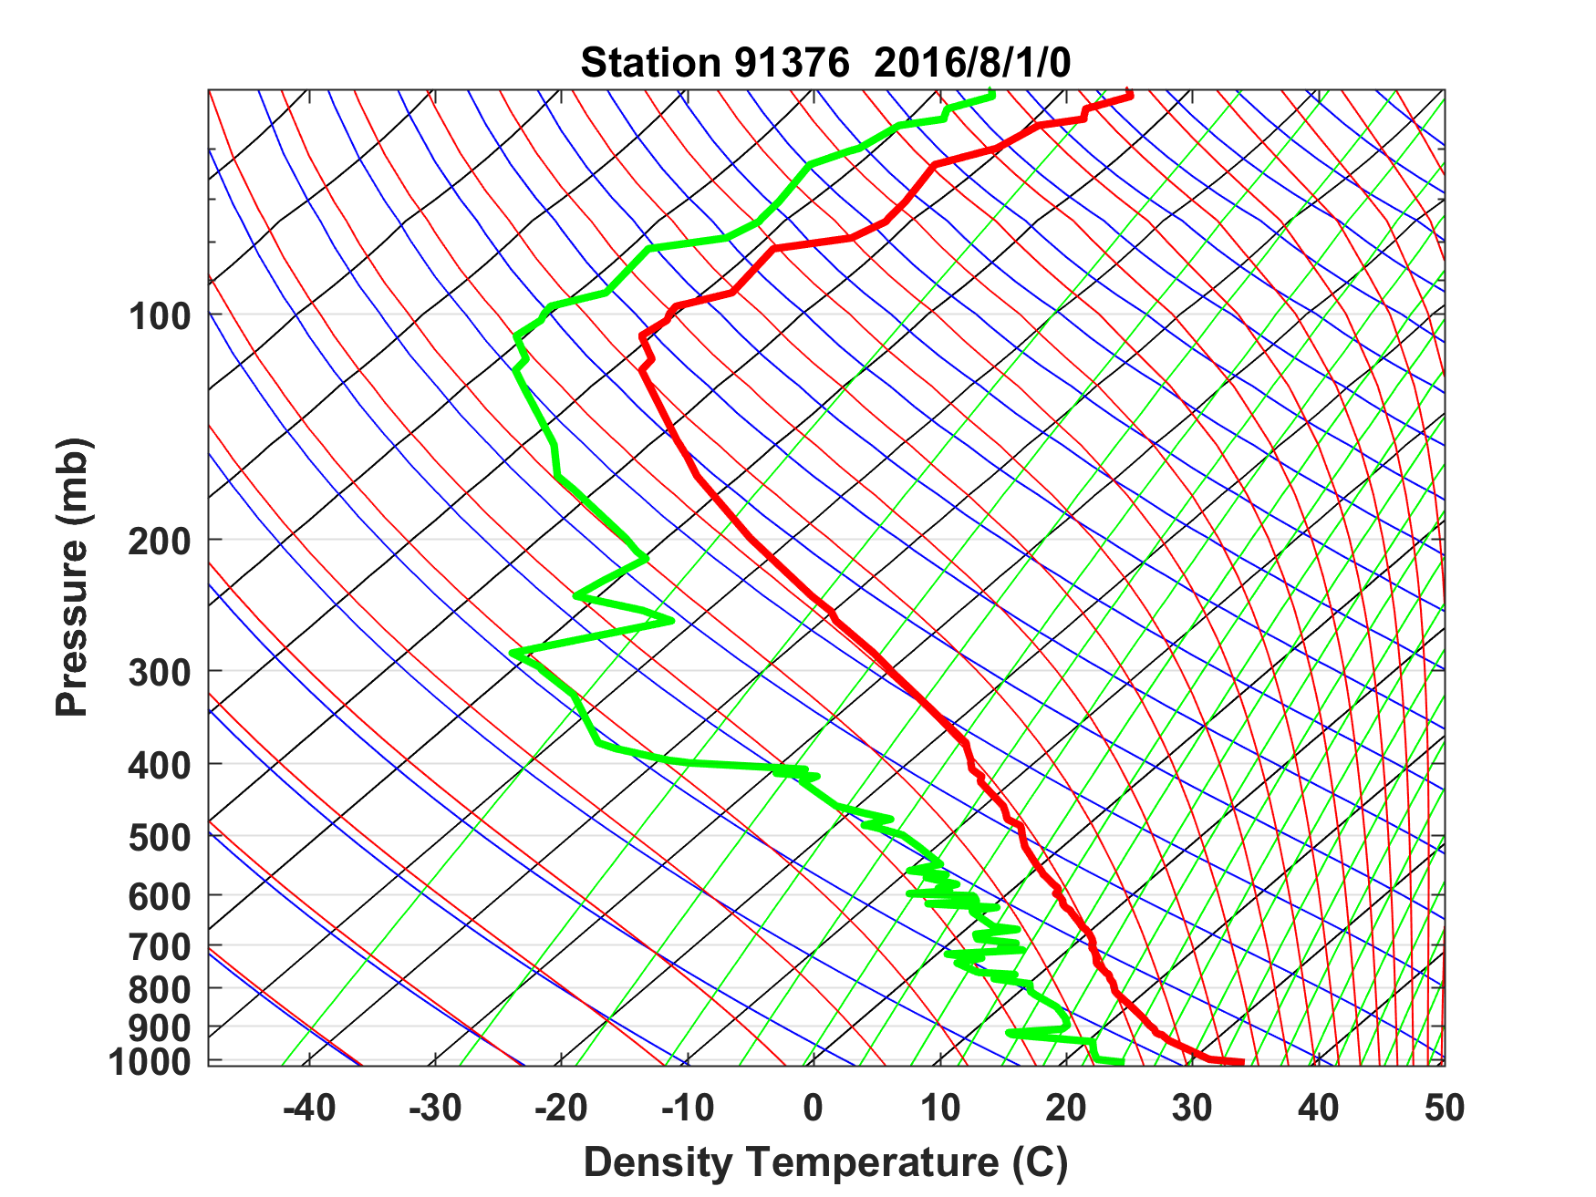
Sounding at Majuro, August 1 2016 0 GMT

Slide 7
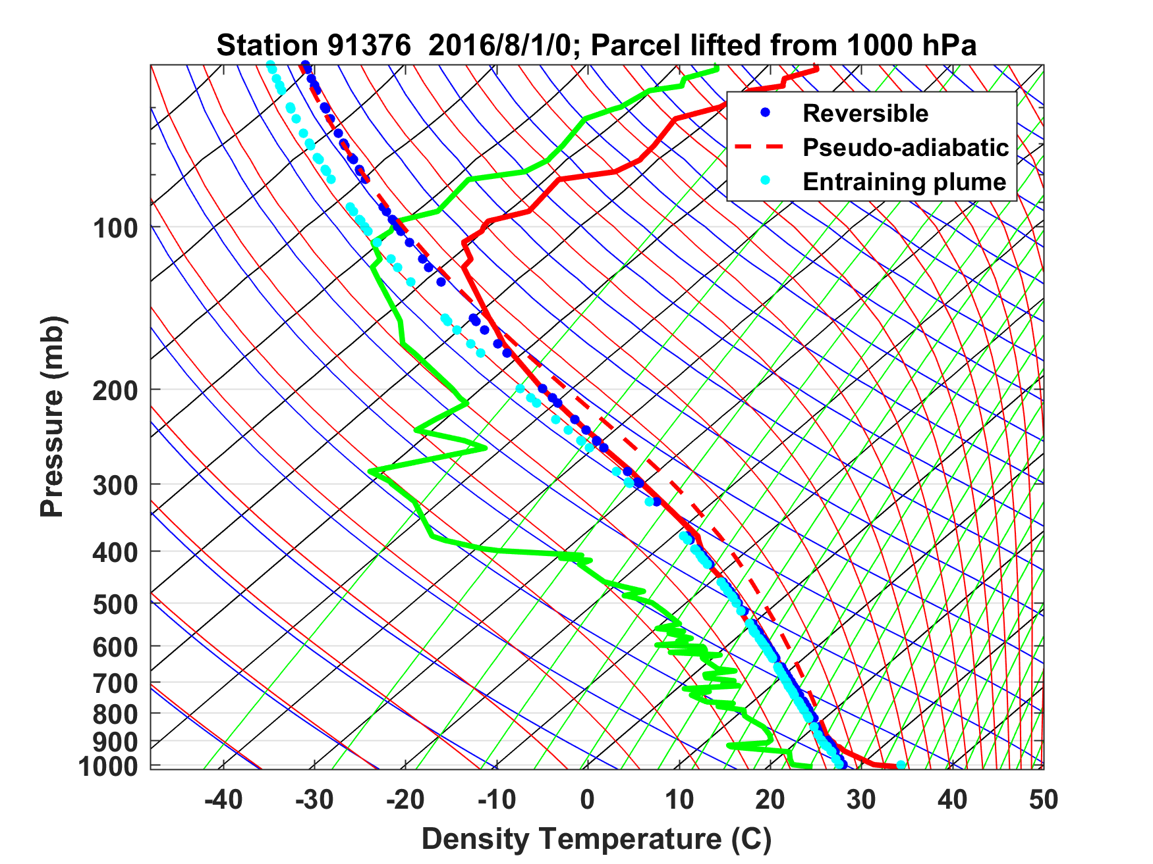
Sounding at Majuro, August 1 2016 0 GMT

Slide 8

Stored-Energy Convection

Slide 9
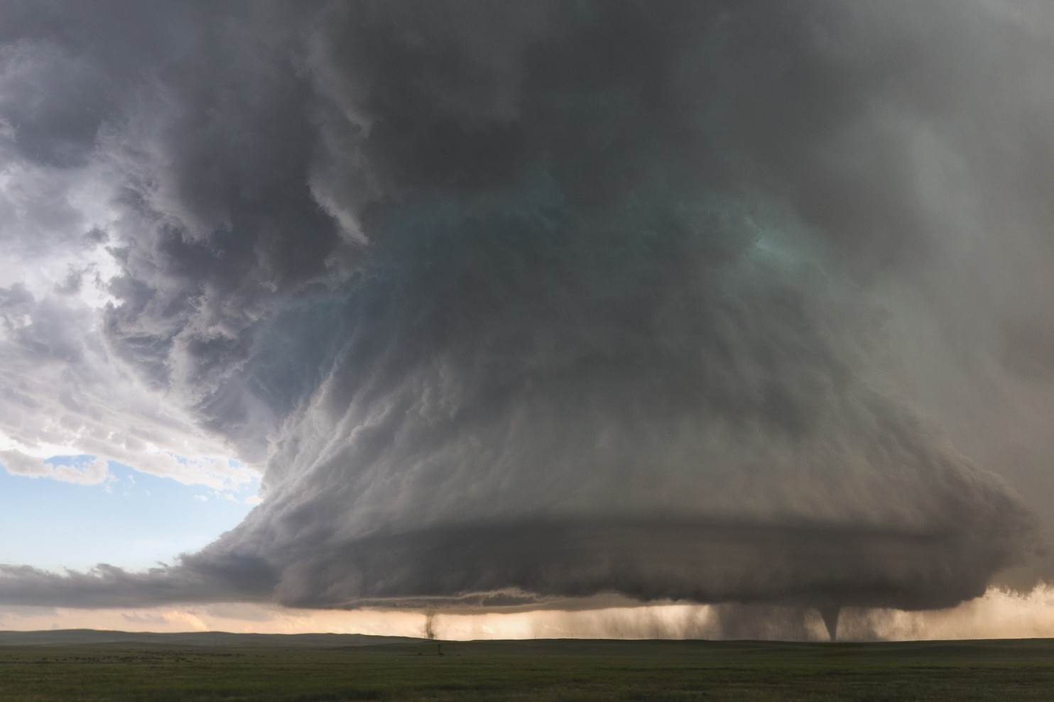

Slide 10
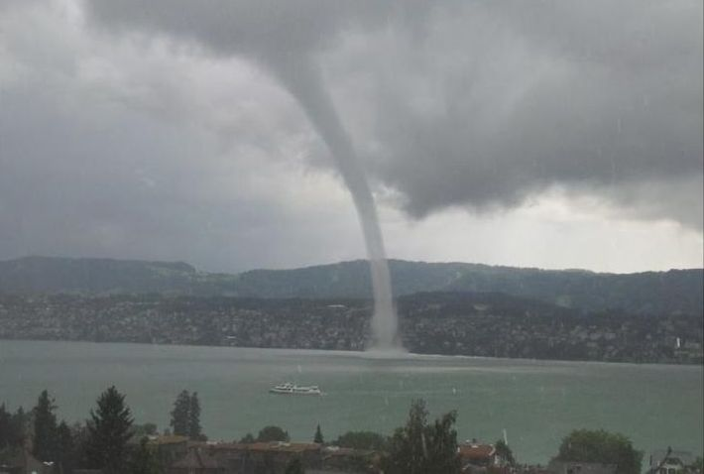
Waterspout on Zürisee, 21 July 2012

Slide 11
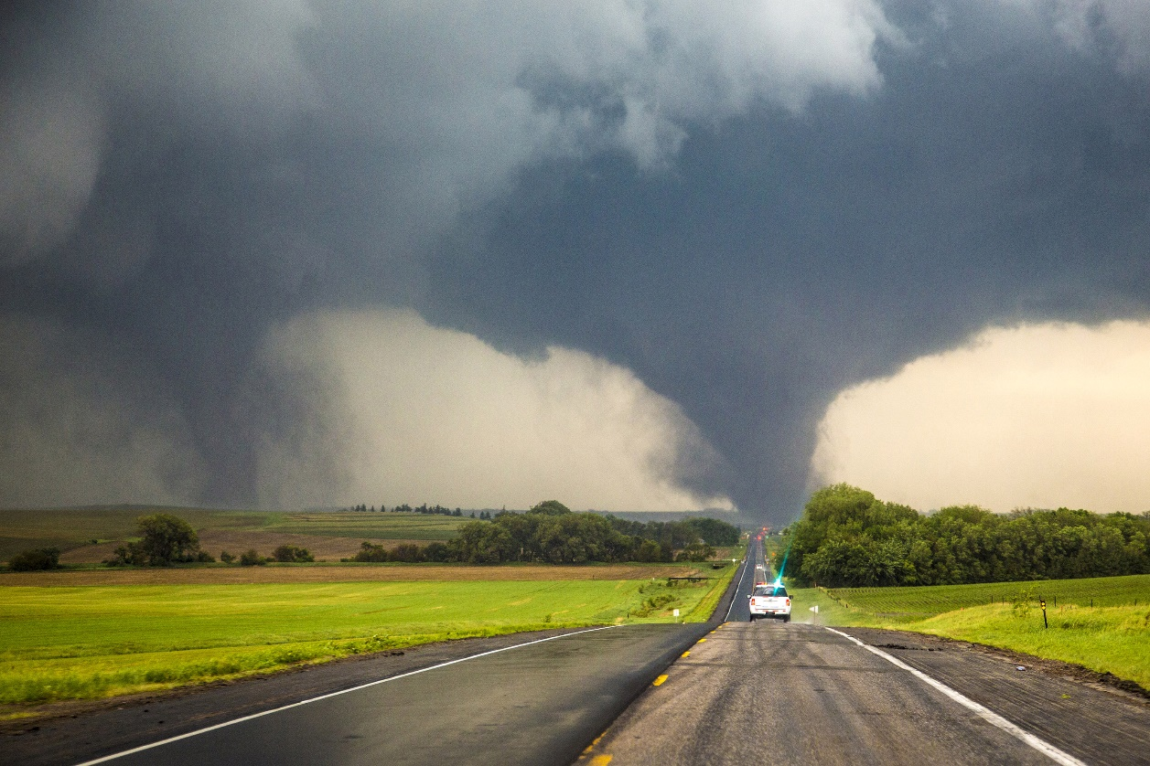
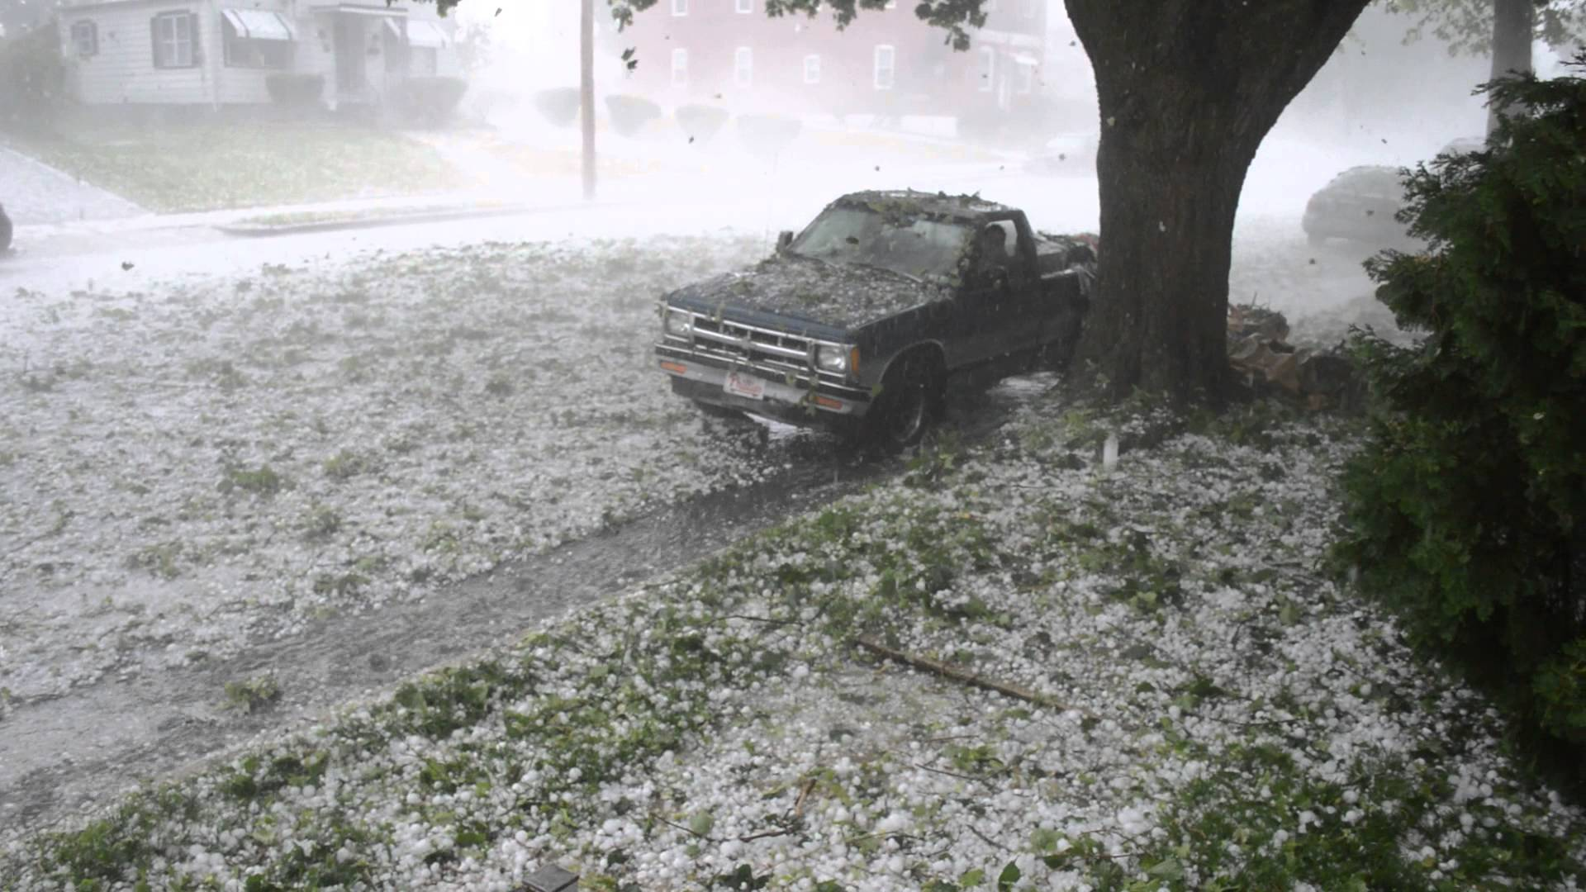
Each year in the U.S., 1,200 tornadoes on average kill 60 people, injure 1,500, and cause roughly $400 million in damages
Hail causes about $1 billion dollars in damage to crops and property each year, according to the National Oceanic Atmospheric Administration (NOAA)

Slide 12

Even worse…..

Slide 13
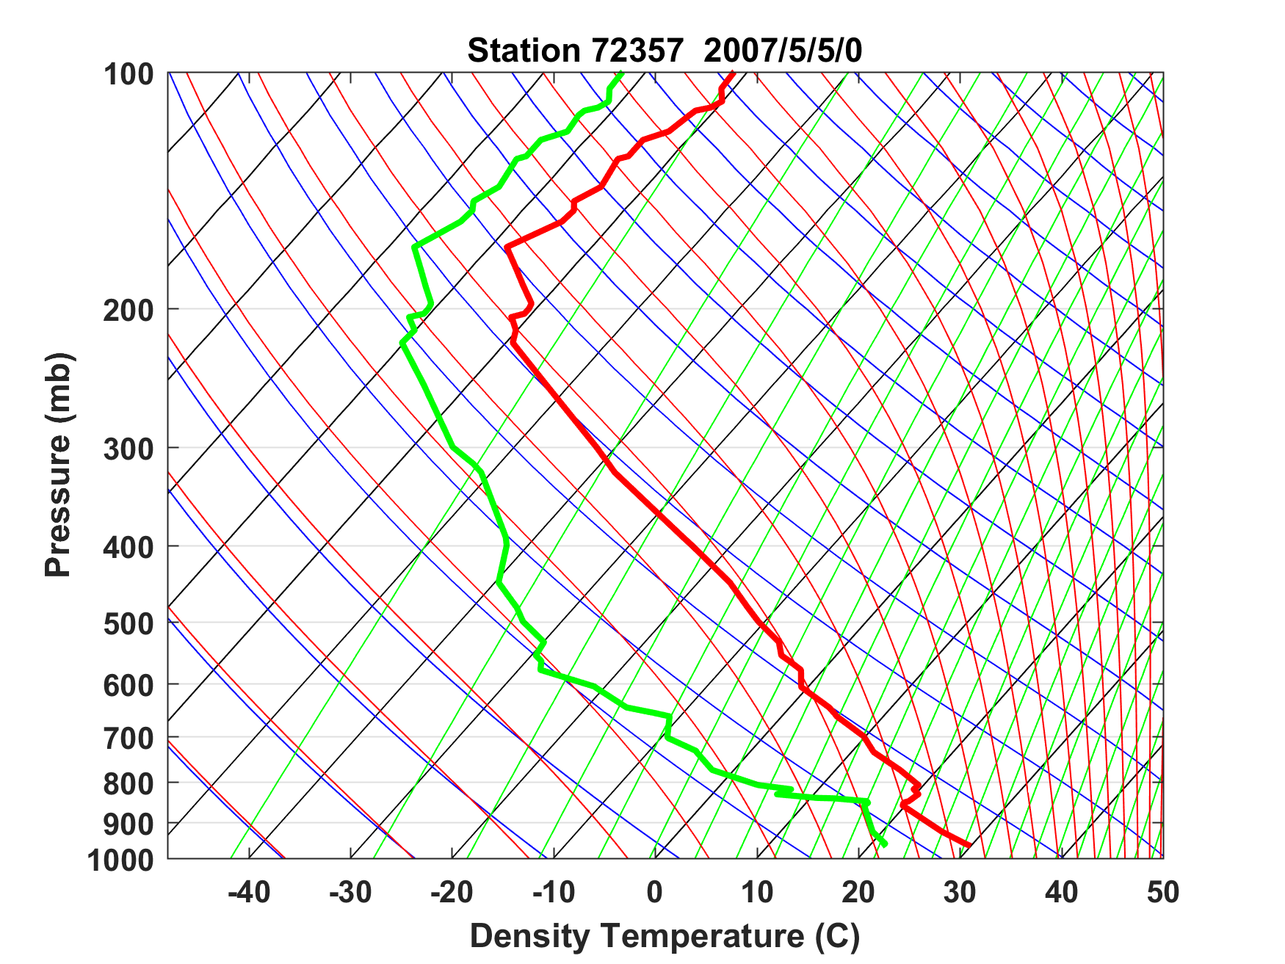
Sounding at Norman, Oklahoma, May 5th 2007
Capping inversion

Slide 14
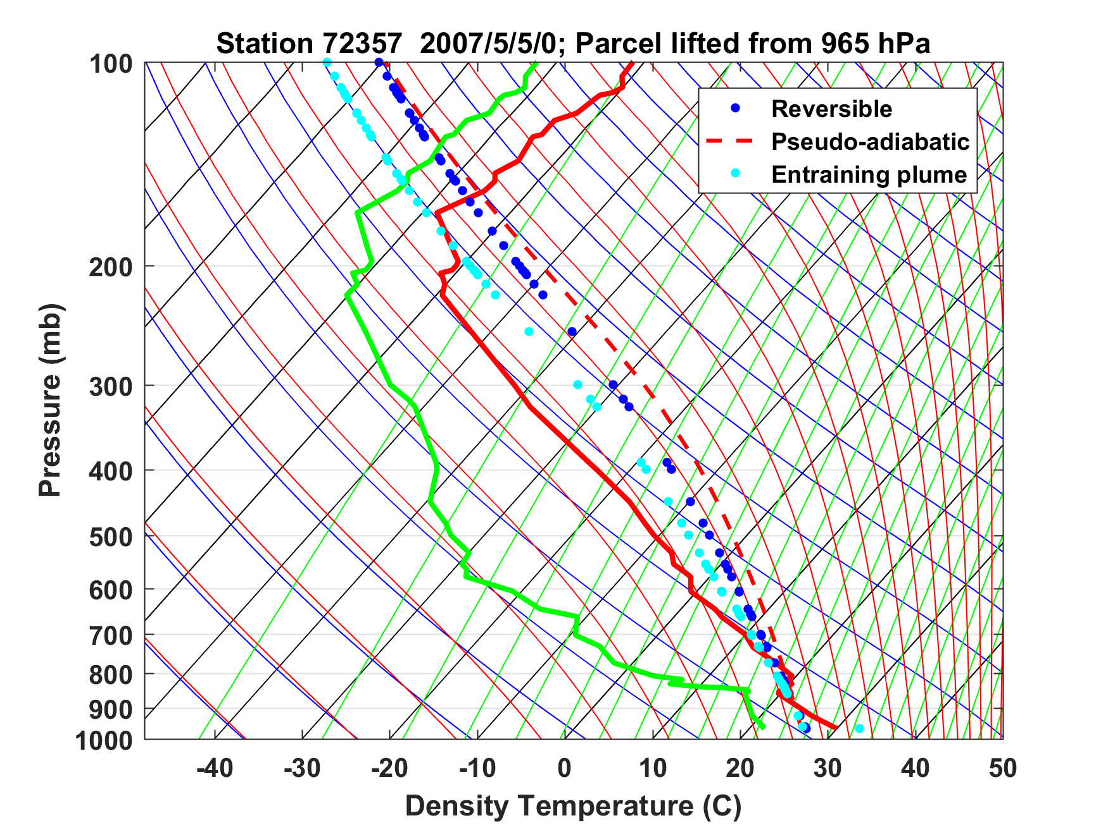
Sounding at Norman, Oklahoma, May 5th 2007

Slide 15
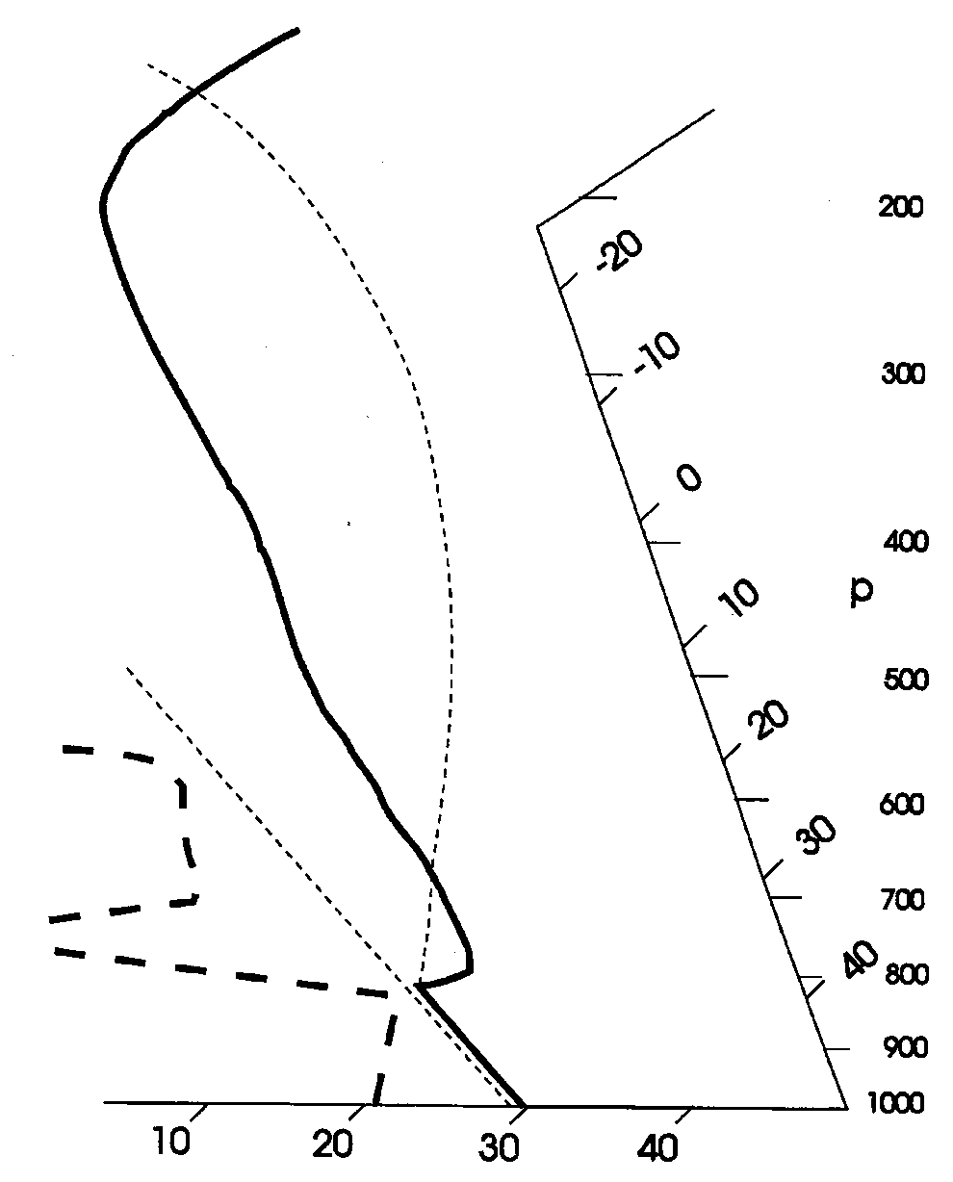
Stability Assessment using Tephigrams:
Convective Available Potential Energy
(CAPE):

Slide 16
Sounding at Norman, Oklahoma, May 5th 2007
CAPE = 6900 J/Kg → w = 110 m/s
Capping inversion

Slide 17
How do these high CAPE soundings arise?
Clues in the climatology….

Slide 18
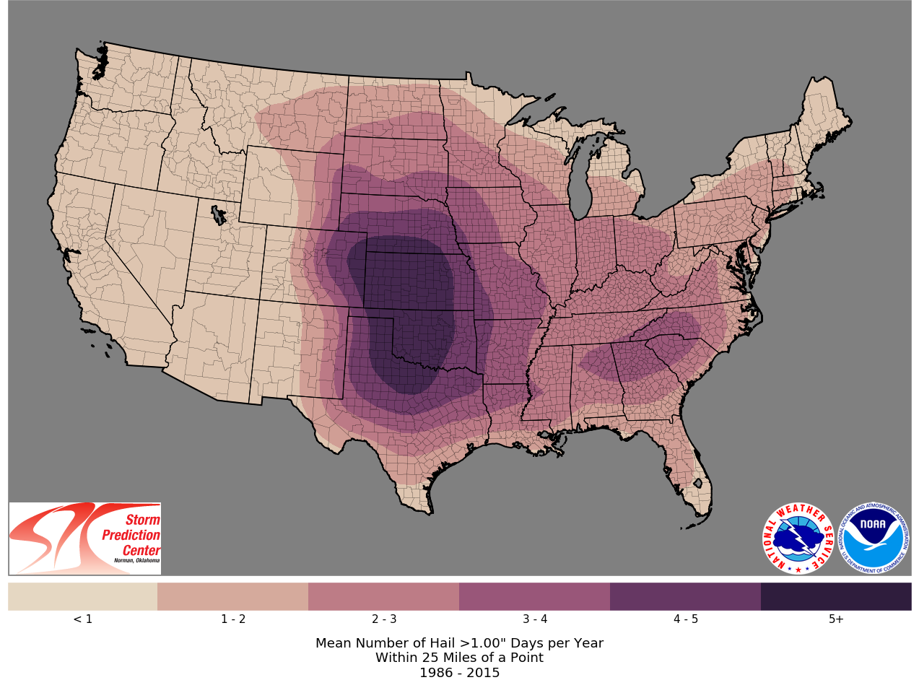

Slide 19
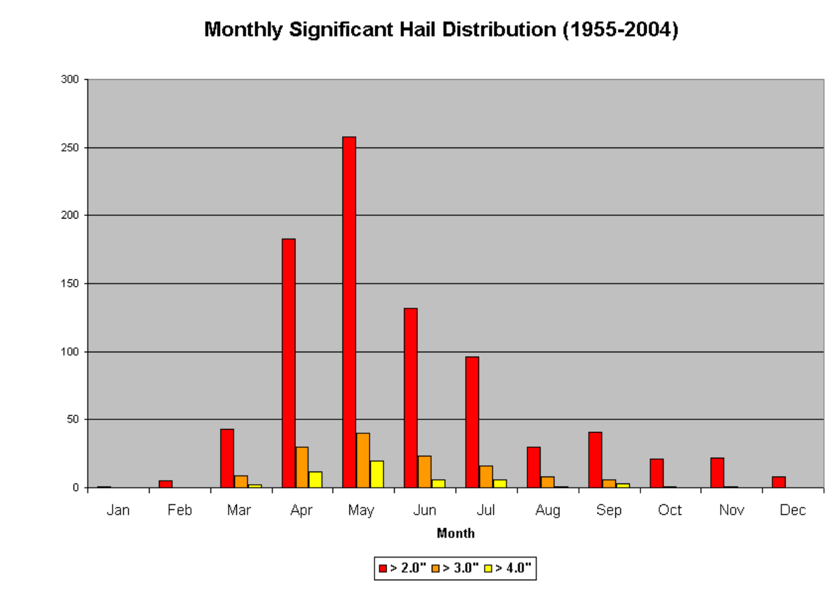
Illinois-Missouri Hail Climatology
Mark F. Britt, WFO St. Louis

Slide 20
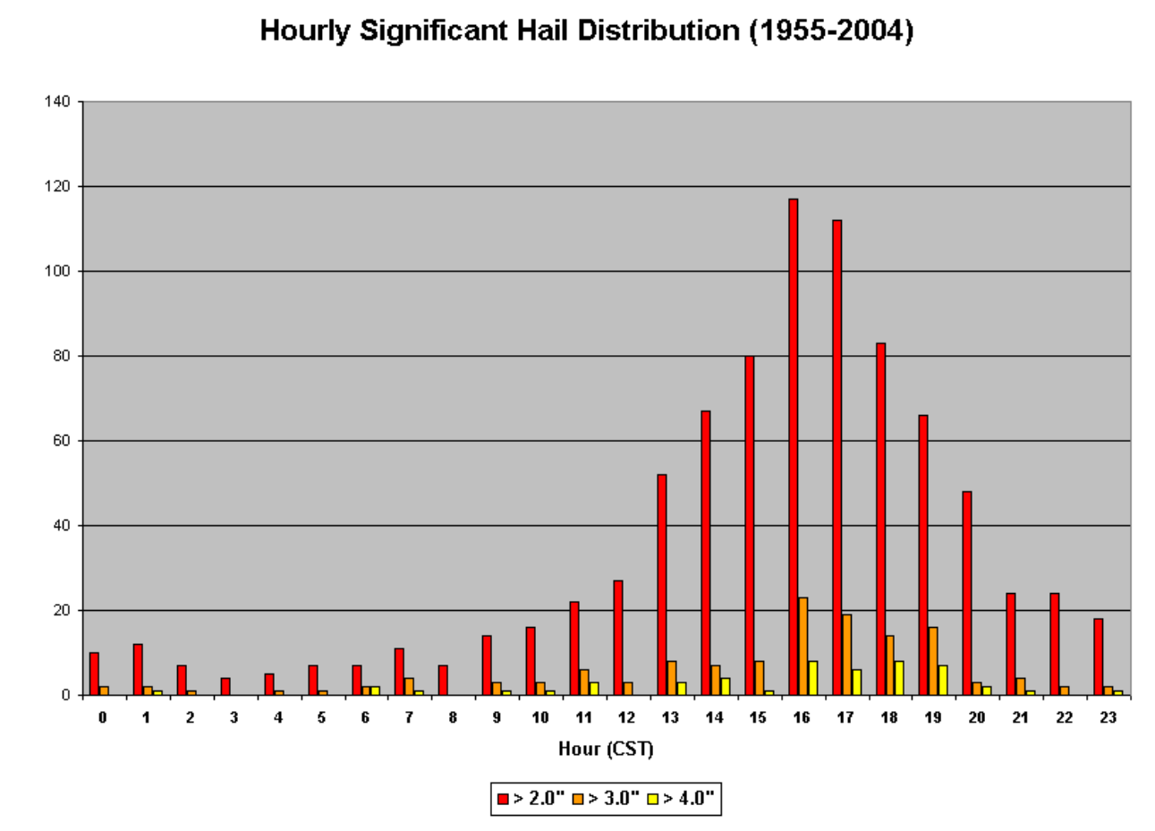
Mark F. Britt, WFO St. Louis

Slide 21
Trends in a Measure of Favorable Environments for Hailstorms (shaded) and annual mean number of hail days (contoured)
Tang, B.H., Gensini, V.A. & Homeyer, C.R. Trends in United States large hail environments and observations. npj Clim Atmos Sci 2, 45 (2019). https://doi.org/10.1038/s41612-019-0103-7

Slide 22
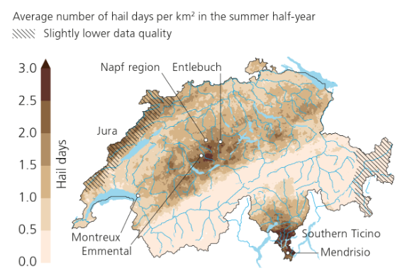
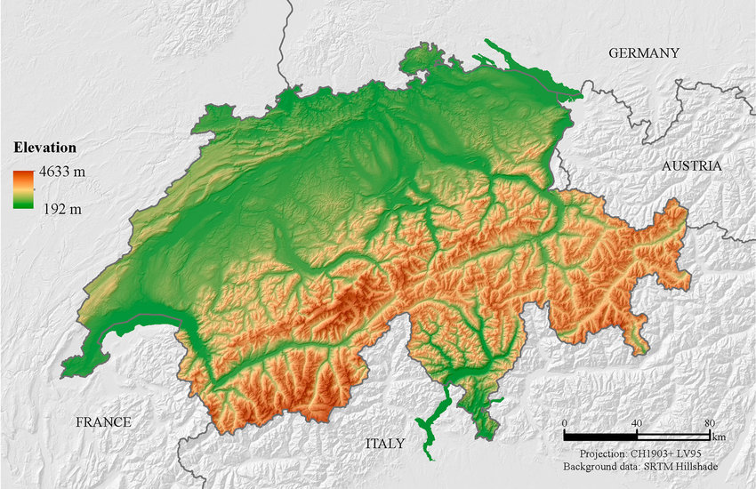
Hail Frequency in Switzerland
Swiss National Center for Climate Services

Slide 23

Necessary Conditions for Severe Thunderstorms:
High values of CAPE
Large vertical shear of horizontal wind, particularly at low levels

Slide 24
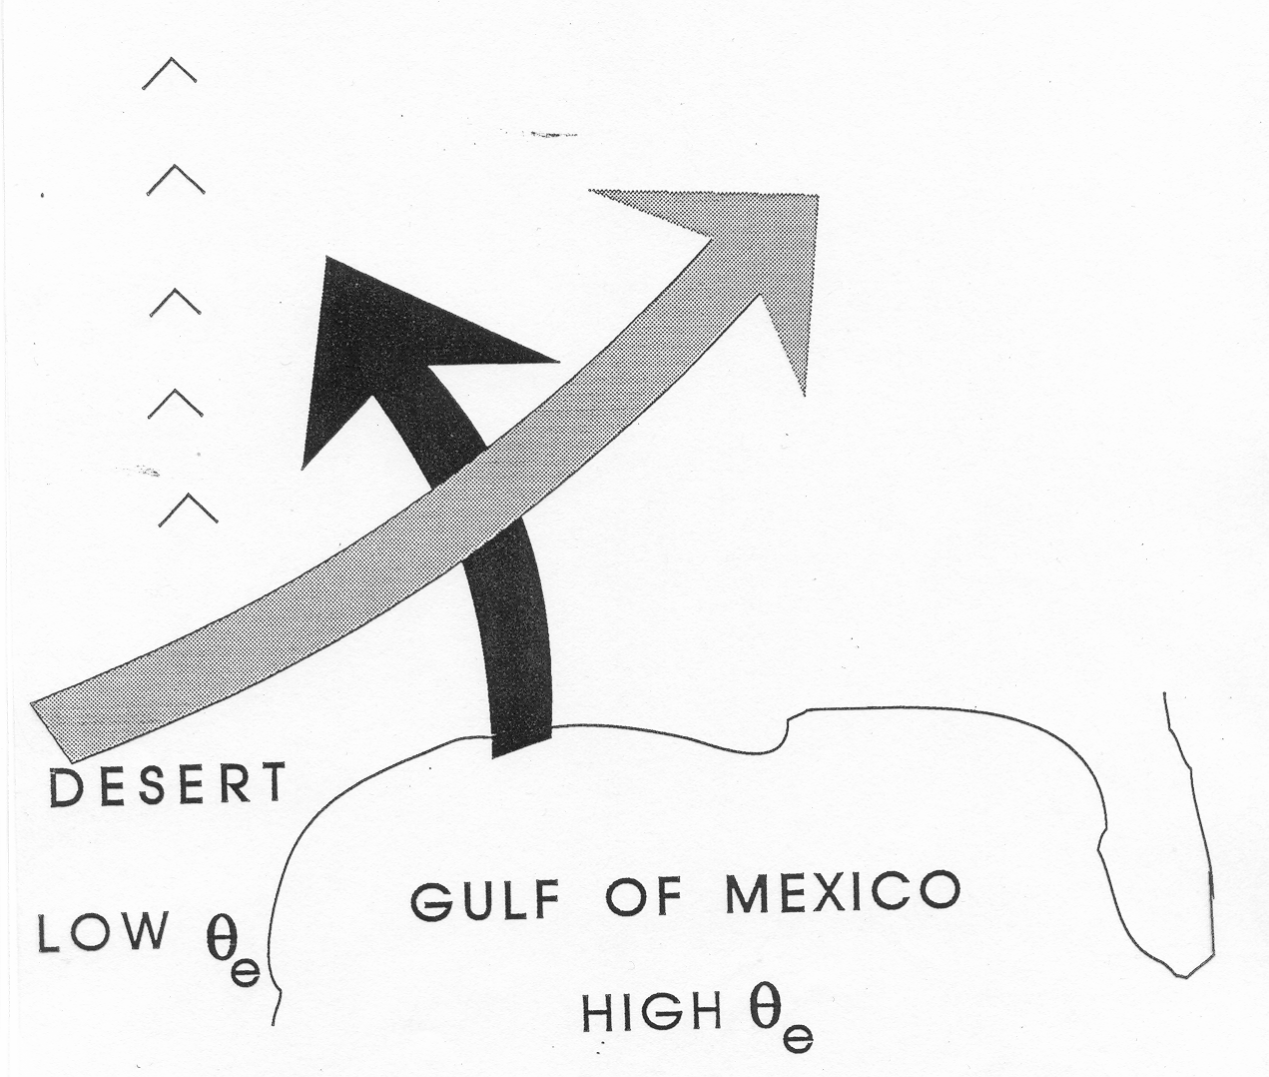
Conventional View:
Differential Advection
Emanuel, Atmospheric Convection, 1994

Slide 25
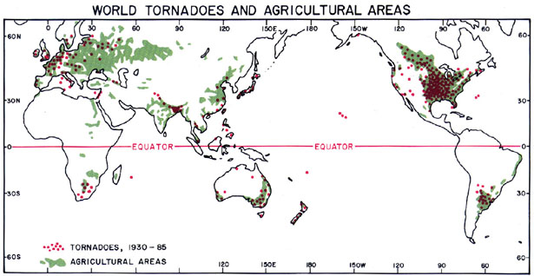
Global Distribution of Tornadoes
Ted Fujita

Slide 26
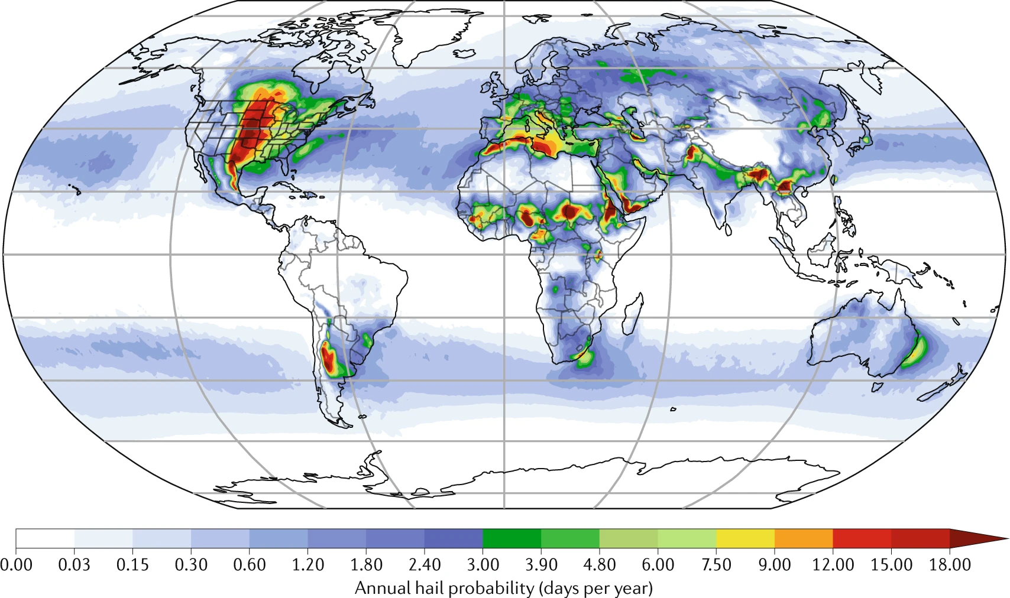
Global Hail Climatology
The global estimated average annual probability of hail with a diameter >2.5 cm, normalized to areas of 100 km × 100 km, for 1979–2015.
Raupach et al., Nature, 2021, based on Prein and Holland, 2018

Slide 27
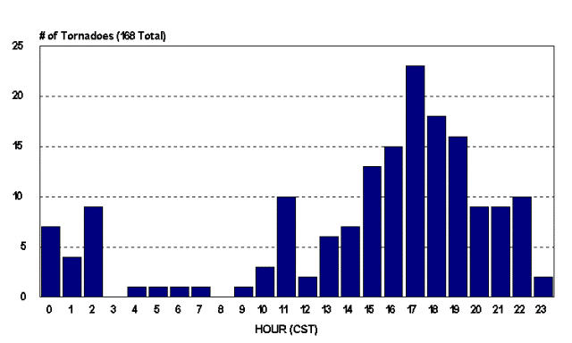
Diurnal Variation of Tornadoes

Slide 28
Mark F. Britt, WFO St. Louis

Slide 29
Key Questions:
What determines geographical distribution of stored- energy storms?
Why do tornadoes and hailstorms peak in late- afternoon to early evening?
Why are peak CAPE values around 3000-6000 J/Kg?
How might these values change with climate?

Slide 30
Hypothesis:
Large CAPE is produced when a deep, dry- adiabatic layer is advected over moist soil which is then subjected to solar heating.
Agard and Emanuel, J. Atmos. Sci., 2017

Slide 31
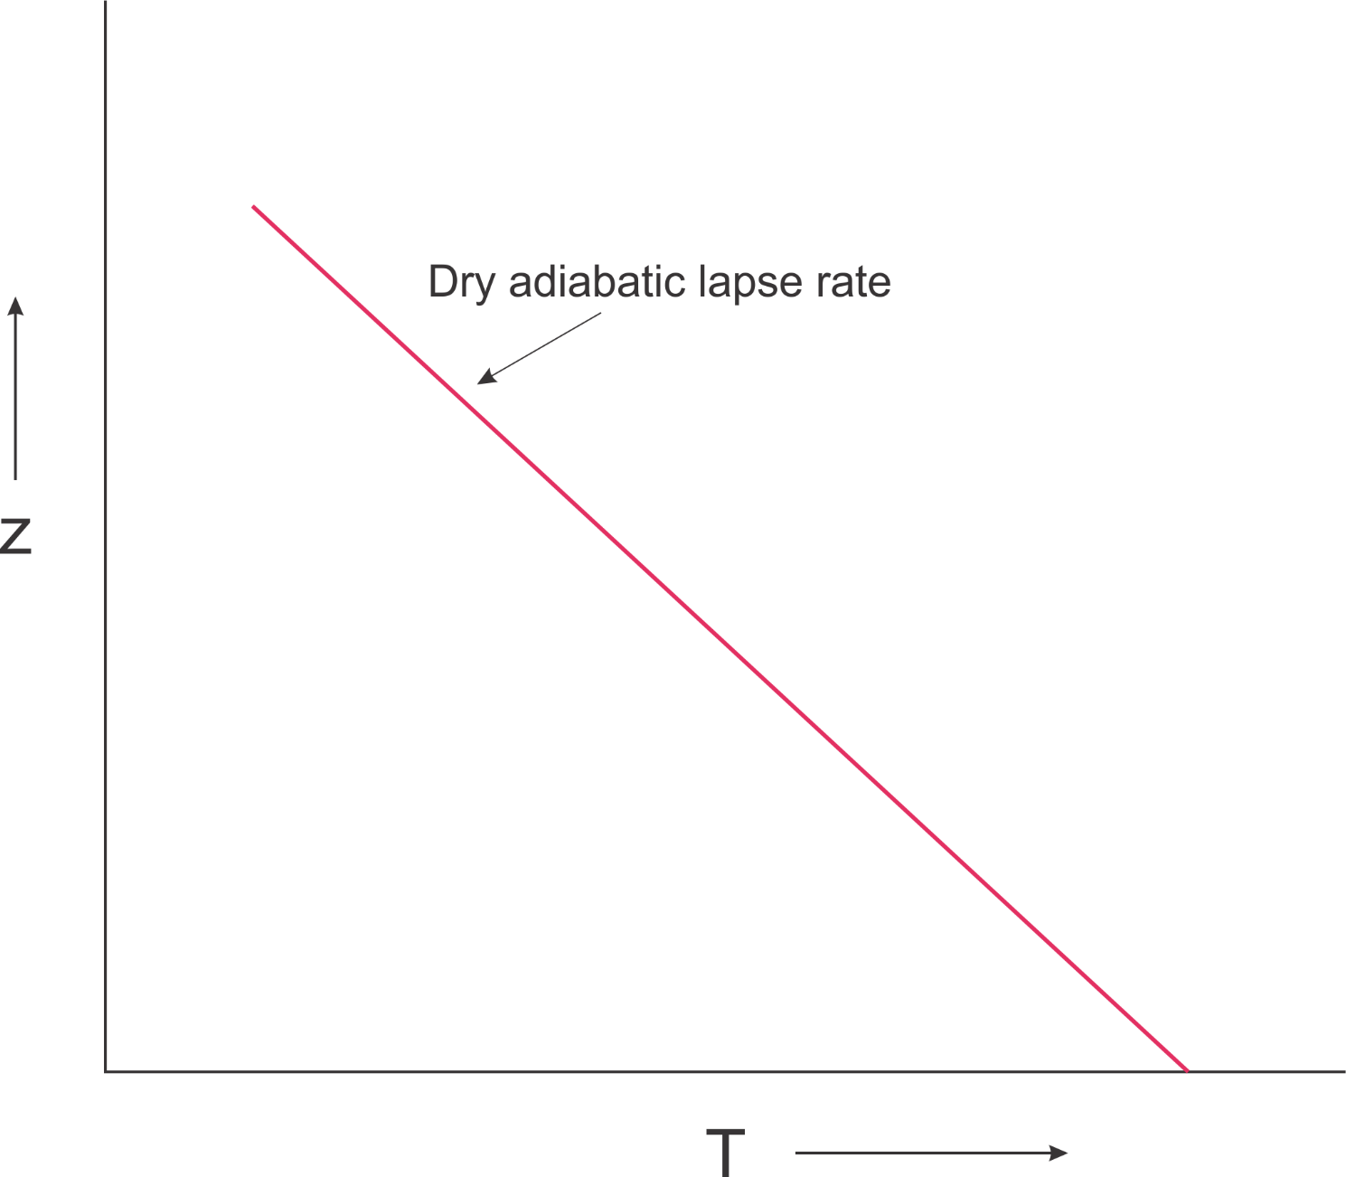

Slide 32
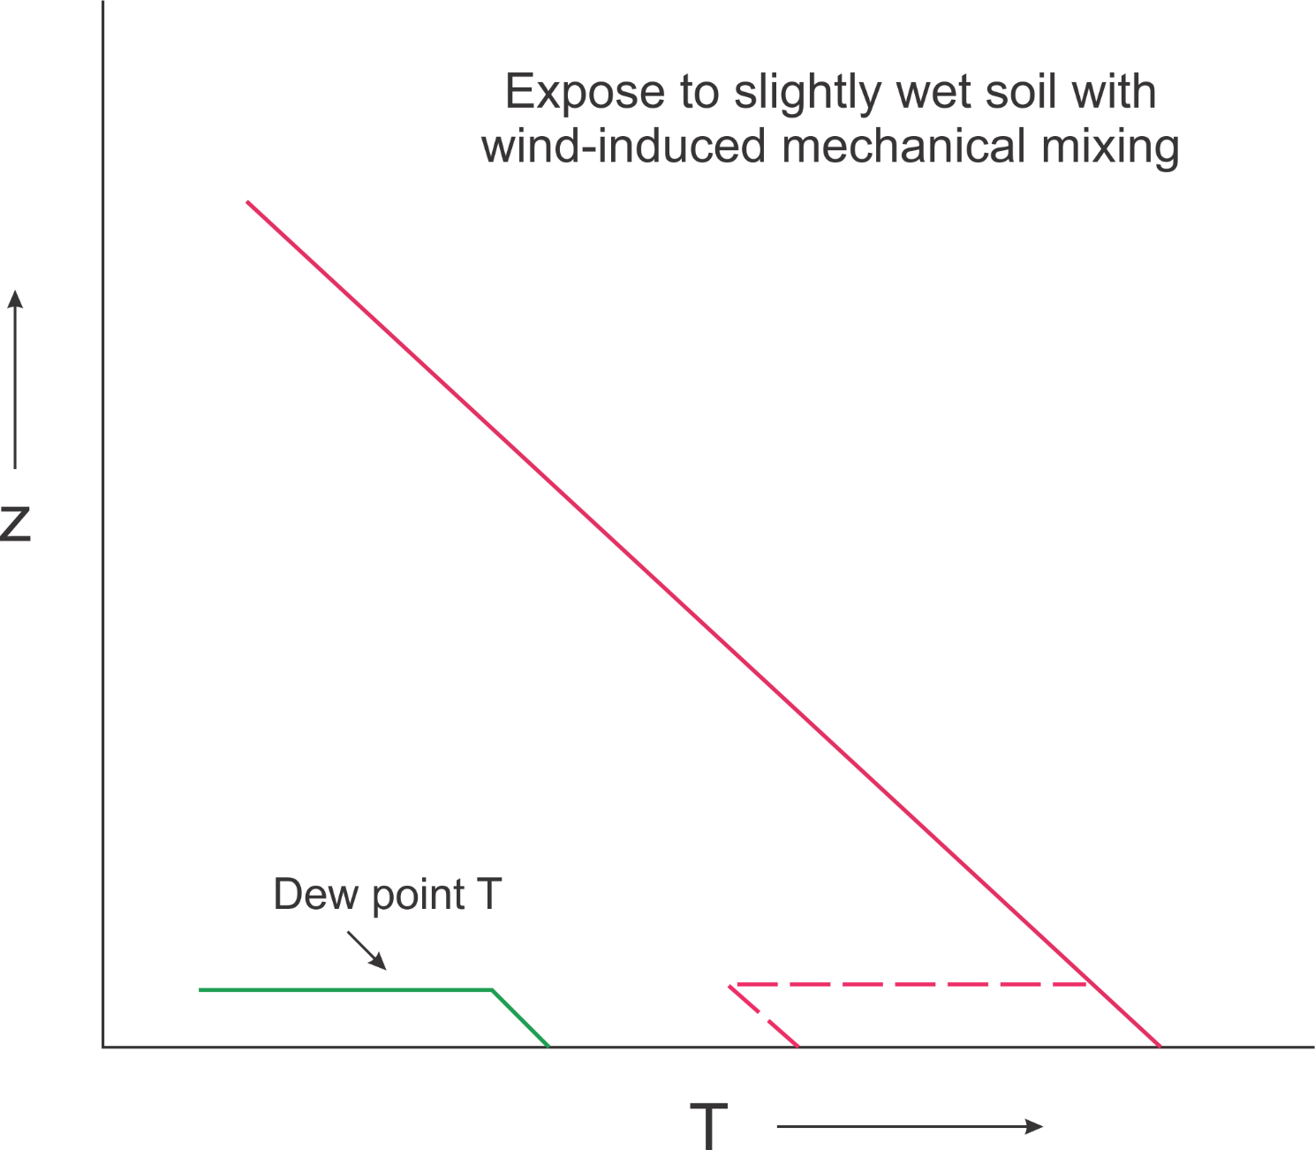

Slide 33
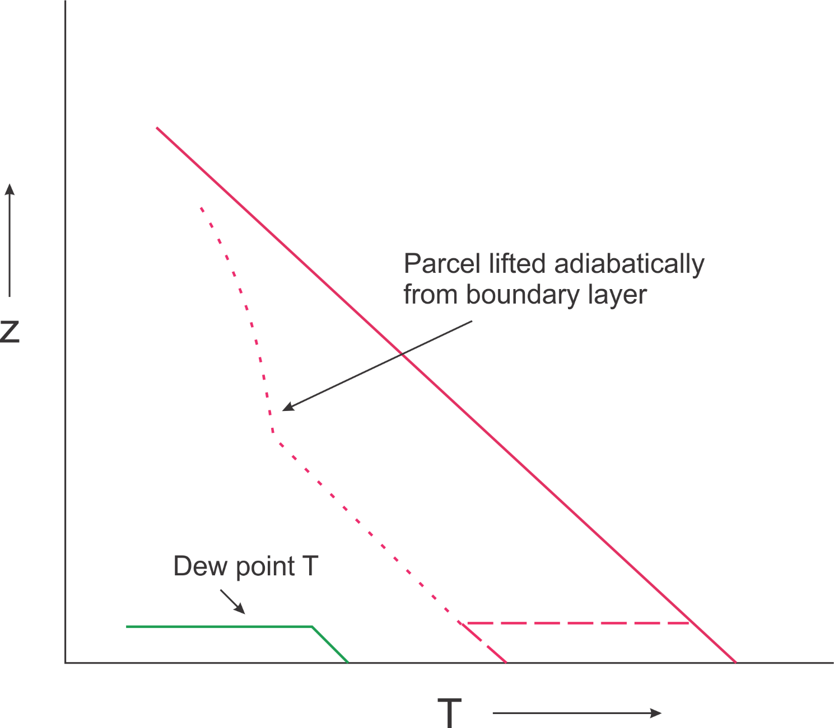

Slide 34
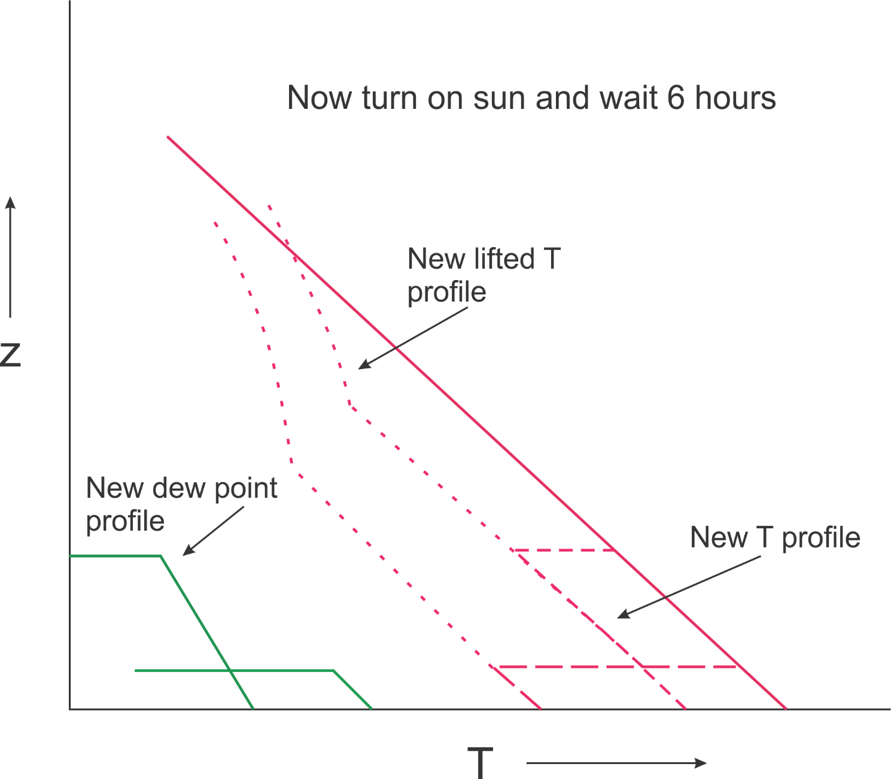

Slide 35
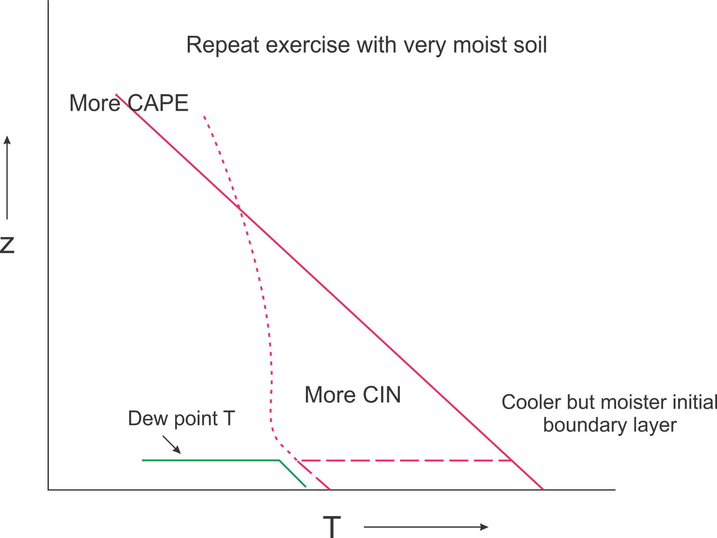

Slide 36
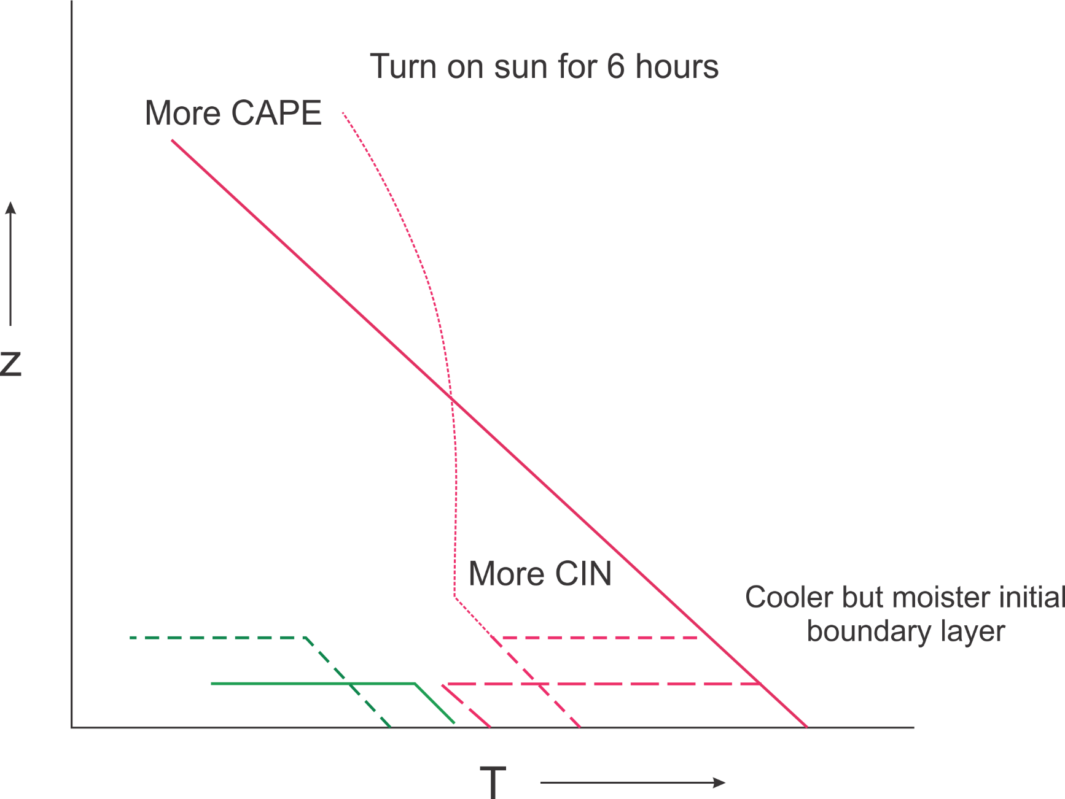

Slide 37
Key features of PBL model
Well mixed boundary layer
Dry adiabatic elevated mixed layer giving way to stable troposphere
Surface energy balance (later replaced by soil model)
Specified surface moisture (later replaced by soil model)
Neutral aerodynamic surface sensible and latent fluxes
Lilly’s PBL-top entrainment formulation
Entrainment of dry and moist static energy from elevated mixed layer during PBL growth
Based on conservation of mass and moist and dry static energies
Agard and Emanuel, J. Atmos. Sci., 2017

Slide 38
Key Model Parameters
Elevated mixed layer potential temperature
Initial boundary layer temperature and humidity
Initial depth of boundary layer
Surface wind speed
Fraction of saturated surface moisture availability
Surface exchange coefficients
Magnitude and time evolution of insolation

Slide 39
Impose a diurnal cycle of forcing

Slide 40
Results

Slide 41
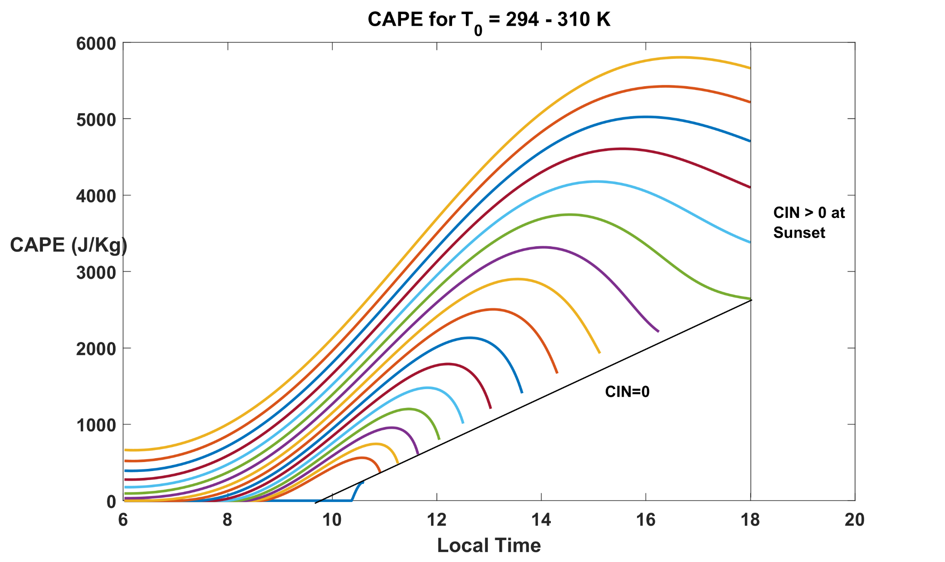

Slide 42
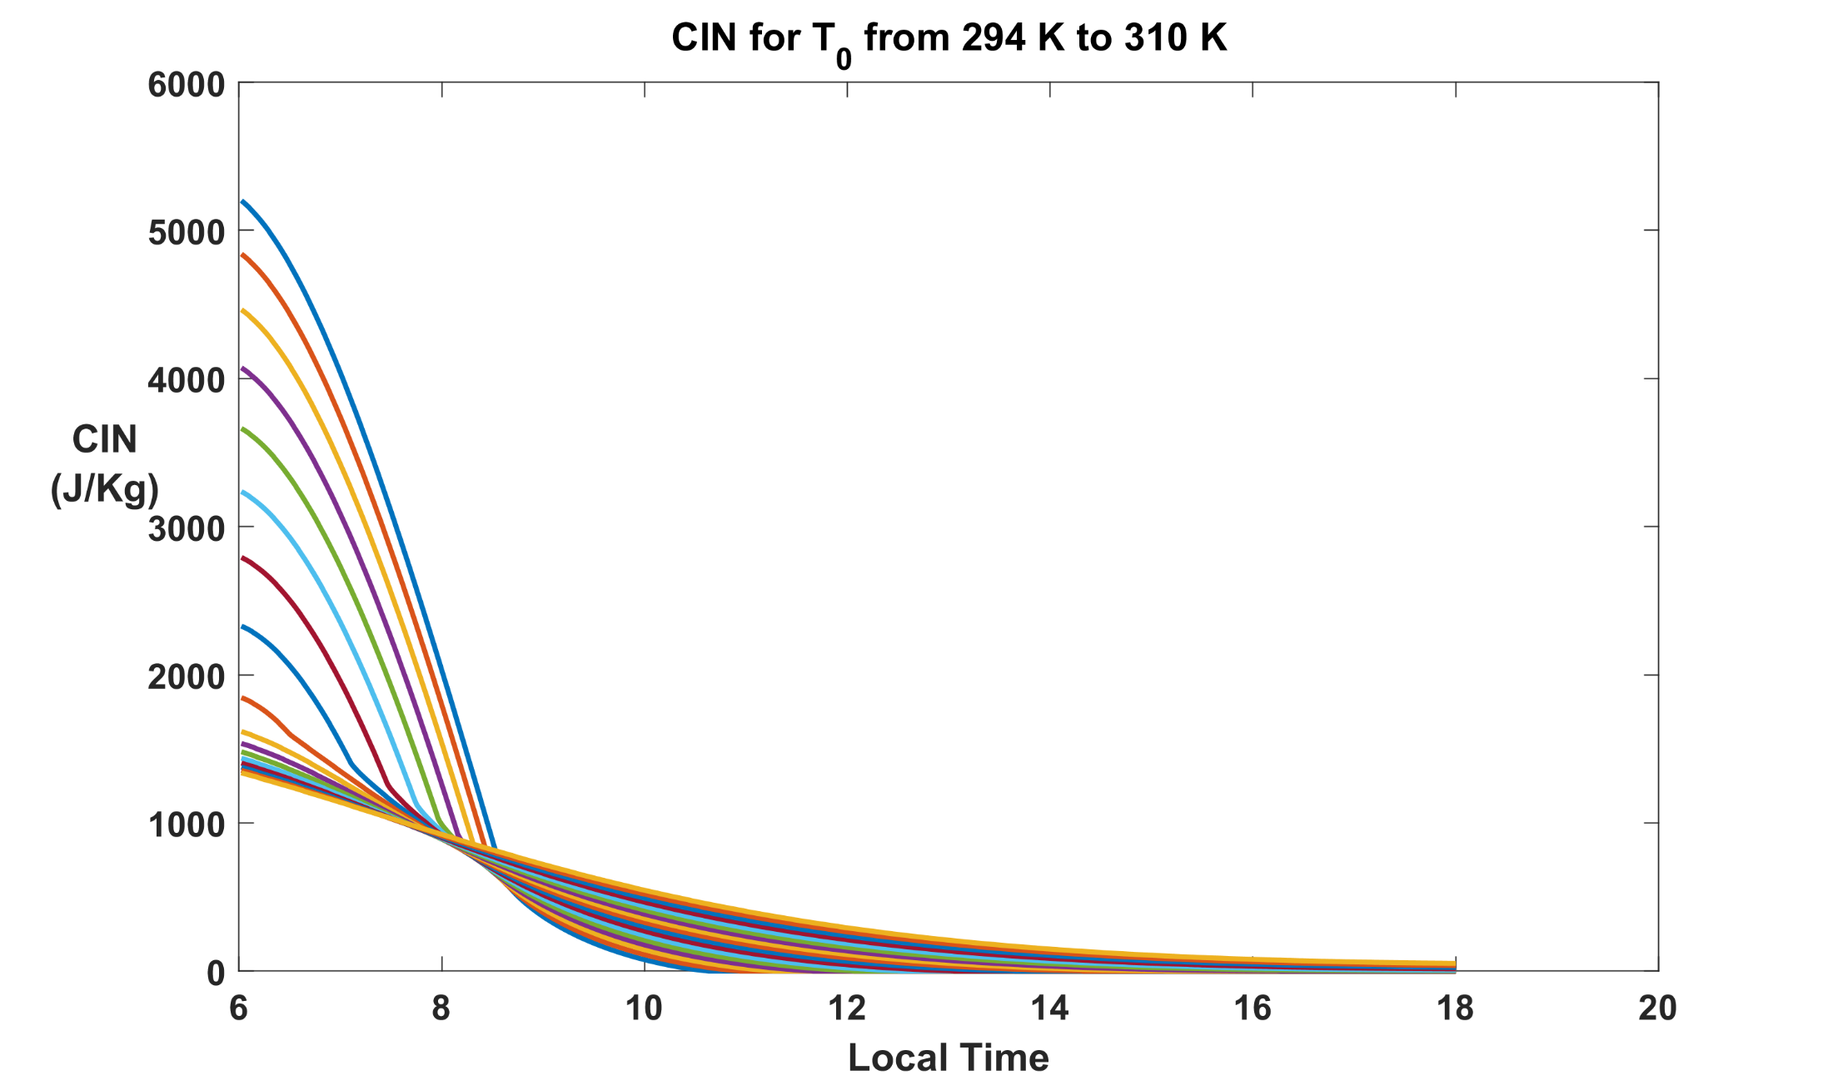

Slide 43
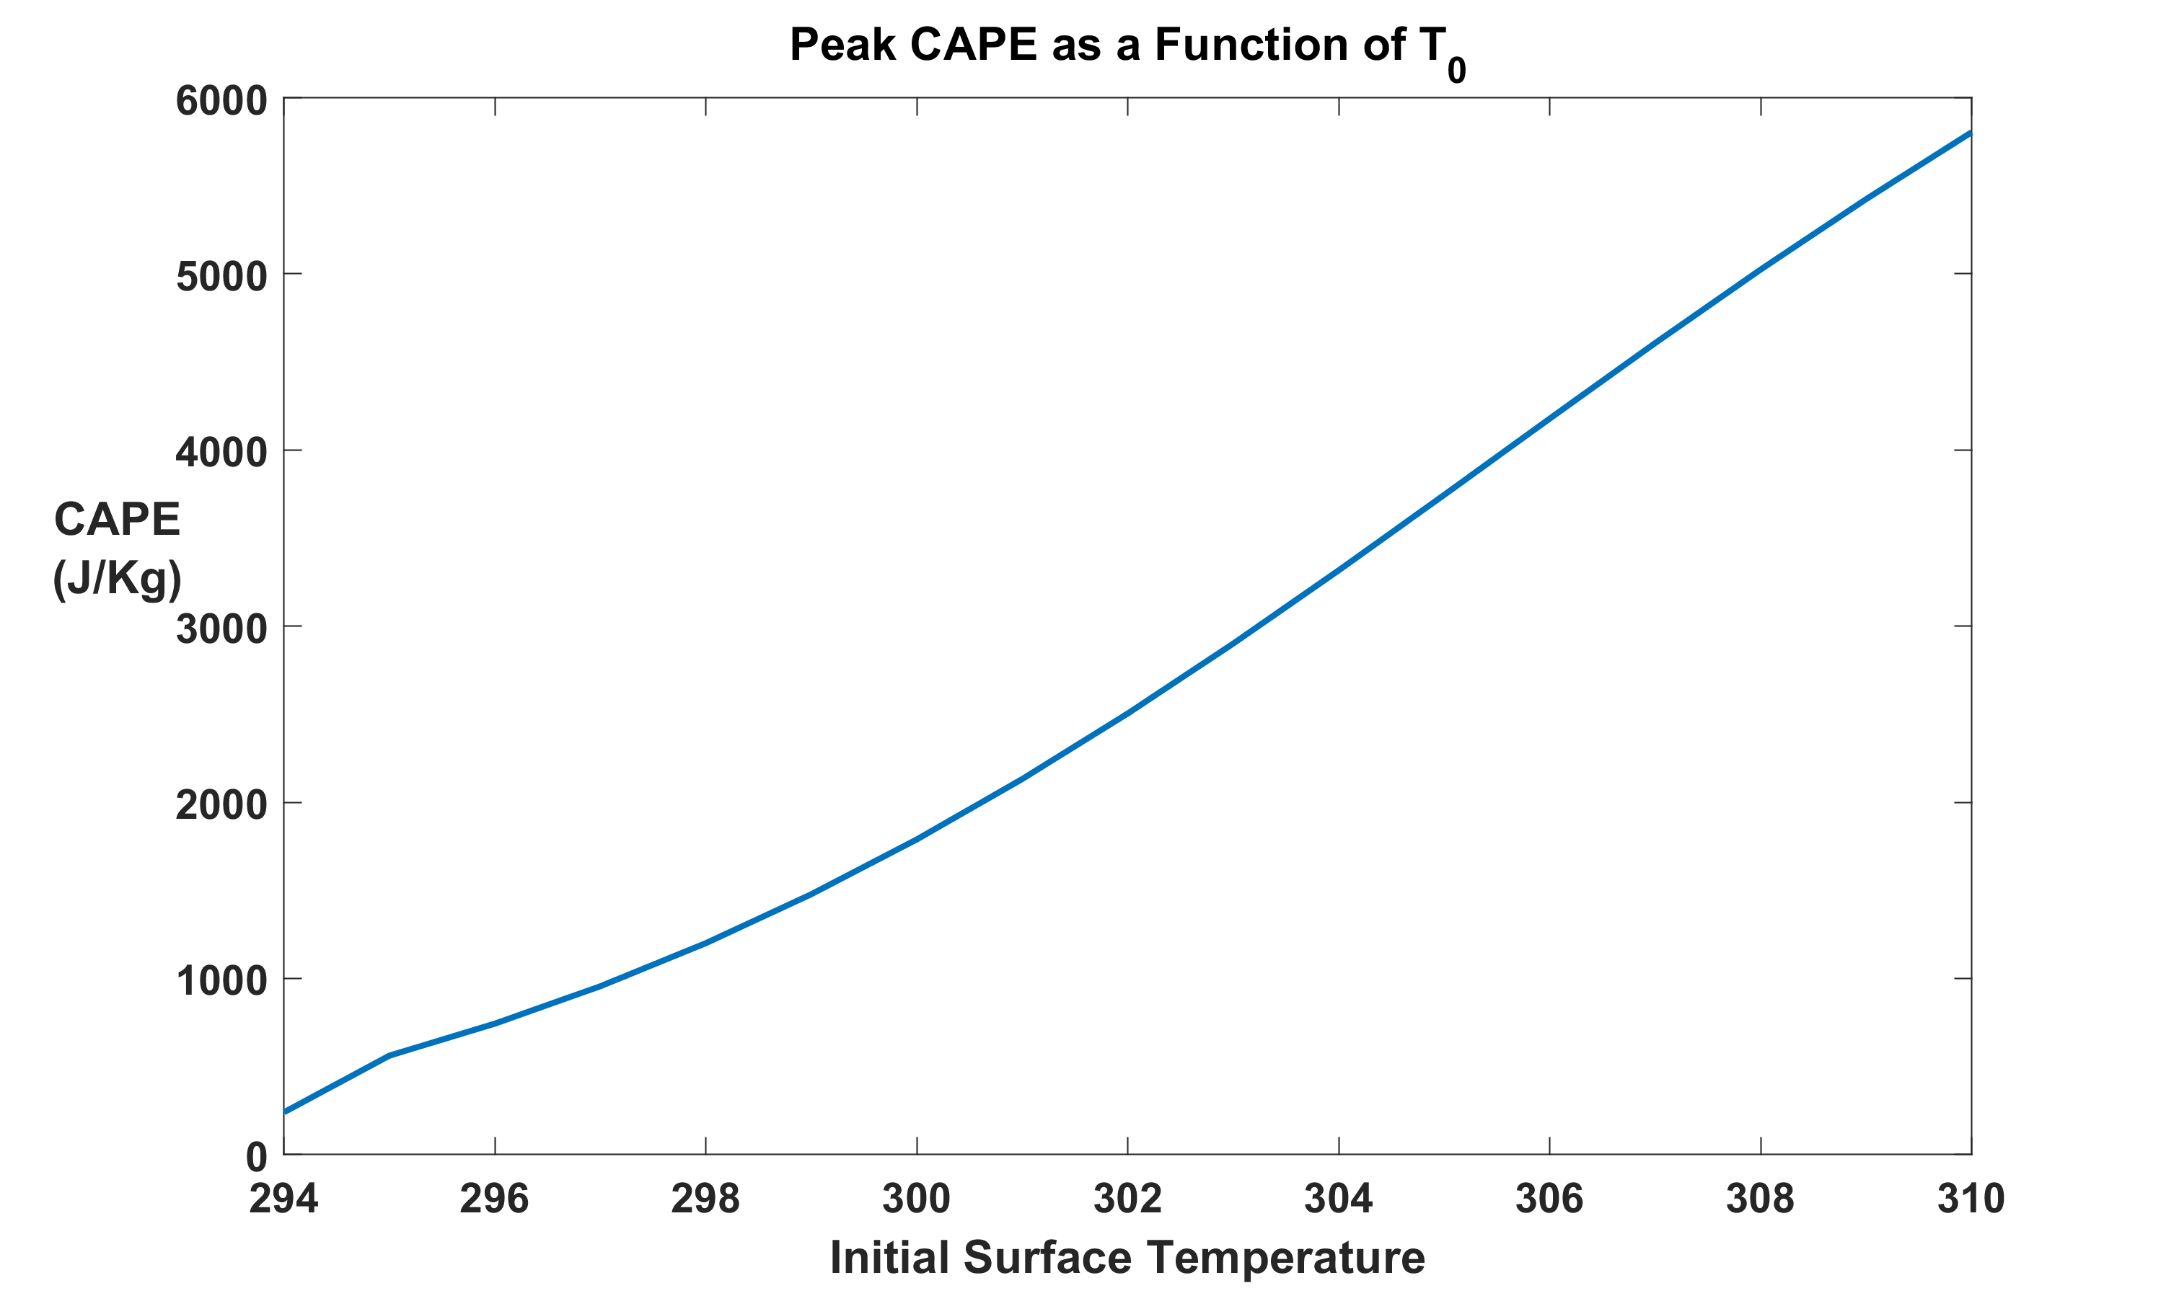

Slide 44
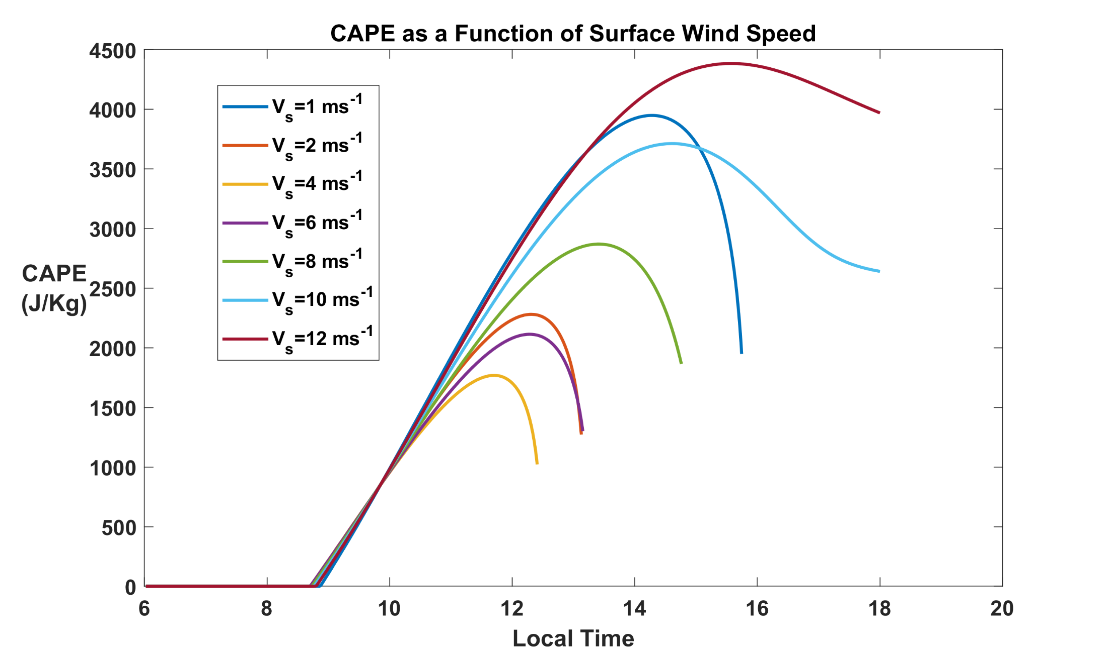

Slide 45
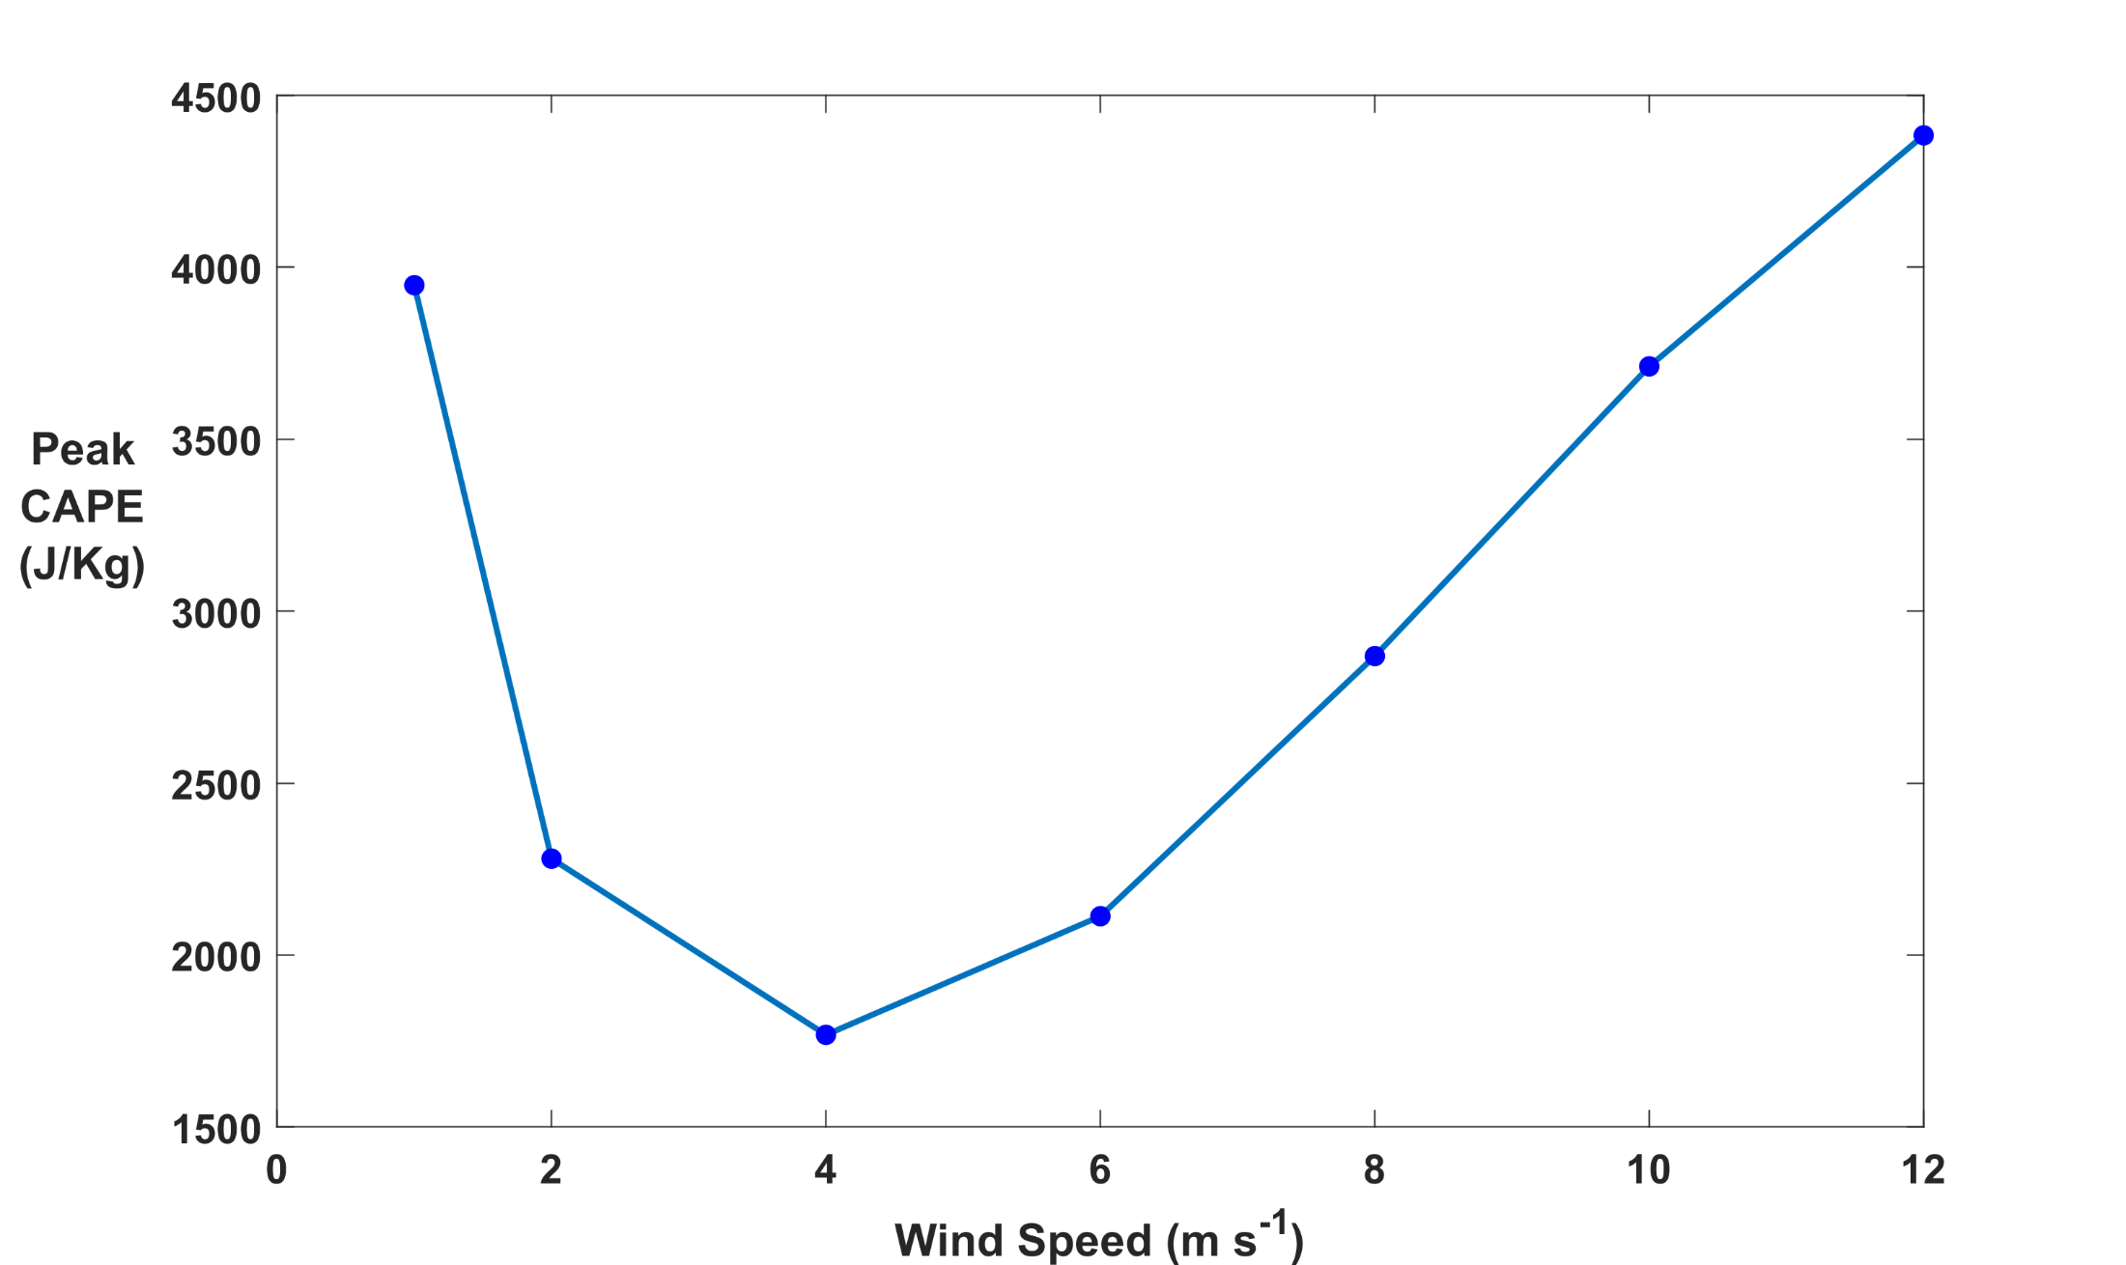

Slide 47
Coupling to Soil Model (Preliminary)
Force-restore representation of soil (Noilhan and Planton, 1989)
Surface and shallow soil variables: temperatures and volumetric moisture contents
Key soil variables include porosity, thermal conductivity and heat capacity, transmission of water through soil, vegetation cover, and variables controlling transpiration

Slide 48
Dependence of CAPE Evolution on Soil Type

Slide 49
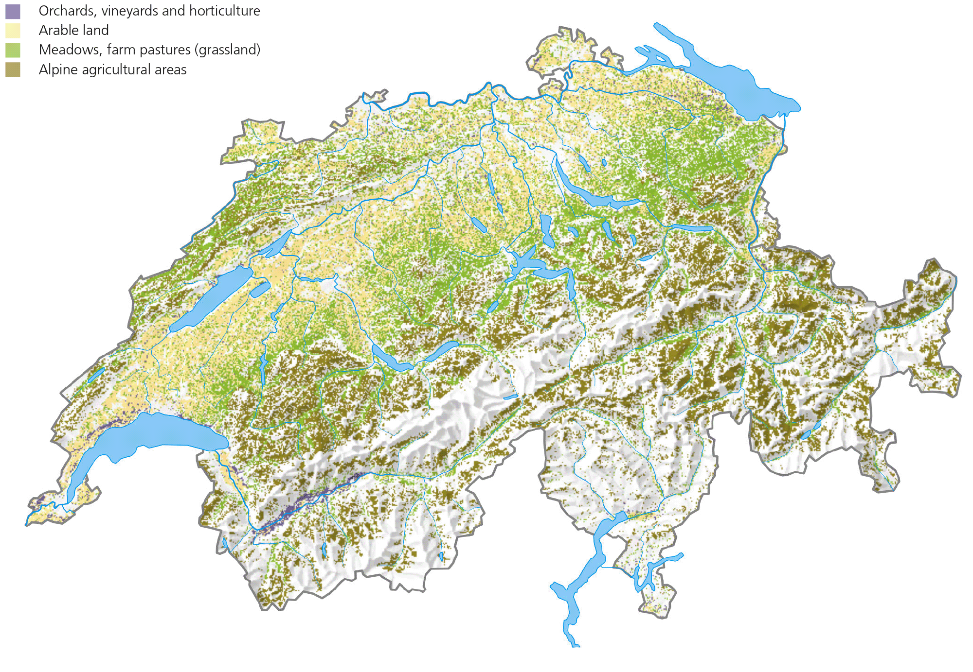
vogelwarte.ch

Slide 50
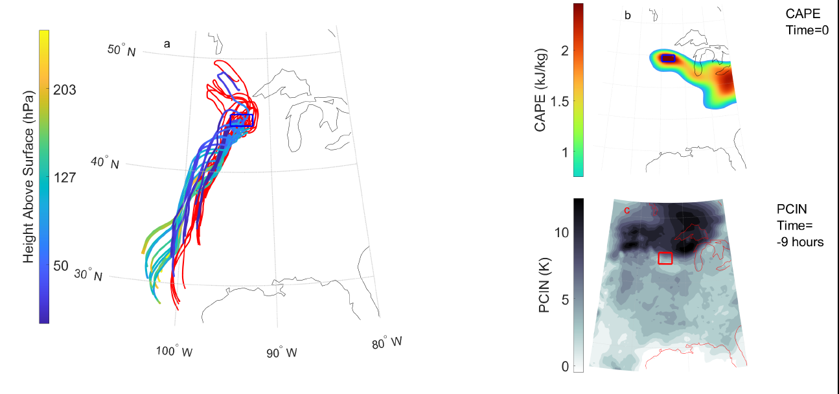
Analyze development of CAPE and CIN along trajectories
(PJ Tuckman and K. Emanuel, Mon. Wea. Rev., in press)

Slide 52
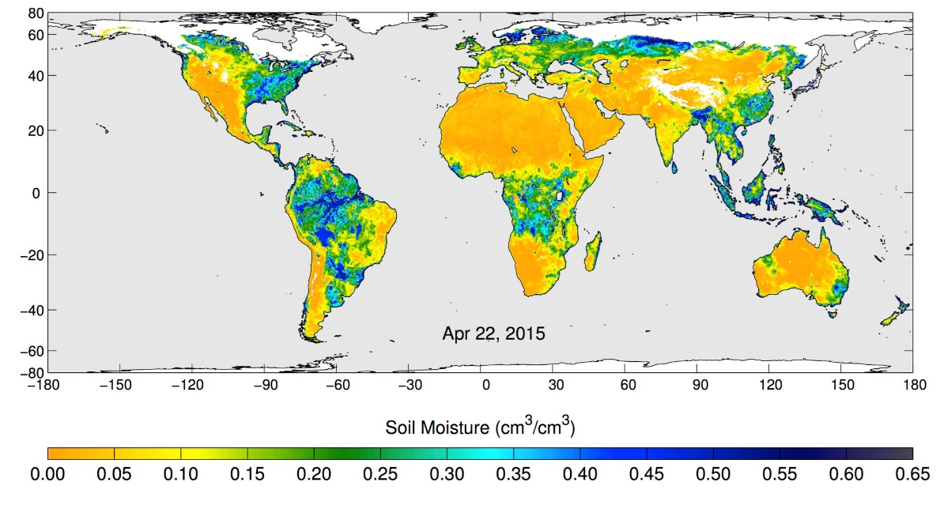
Volumetric water content in the top 5 centimeters of soil, from NASA's Soil Moisture Active Passive (SMAP) observatory, 22 April 2015
Notes:
These maps of global soil moisture were created using data from the radiometer instrument on NASA's Soil Moisture Active Passive (SMAP) observatory. Each image is a composite of three days of SMAP radiometer data, centered on April 15, 18 and 22, 2015. The images show the volumetric water content in the top 2 inches (5 centimeters) of soil. Wetter areas are blue and drier areas are yellow. White areas indicate snow, ice or frozen ground.

Slide 53
Global Distribution of Tornadoes

Slide 54
Summary
Large CAPE occurs when deep dry-adiabatic layers are advected over moist soils (connection to agriculture?)
Diurnal peak values of CAPE increase nearly linearly with surface temperature of the dry land
Imposing a diurnal cycle limits the growth of peak CAPE with surface temperature
Peak CAPE also increases with surface wind speed and soil moisture, though it also large for very low wind speed
Dependence on soil moisture may offer a degree of seasonal predictability of CAPE
Coupling to soil thermodynamics is important

Slide 55
Spare Slides

Slide 56
We can model these circumstances with an idealized initial value problem
z=H
Dry Static Energy:
D = c_{p}T + gz
Moist Static Energy:
M = c_{p}T + L_{v}q + gz
Dry adiabatic
free troposphere
Start with a dry-adiabatic column over a heated, dry surface
D = D₀
M = D₀
q = 0
Q_{rad}
Q_{S}
T=T₀
T = T_{sfc0}; q = 0
dry surface
Agard and Emanuel, J. Atmos. Sci., 2017
Notes:
So now we can think about this problem in terms of the dry and moist static energies in the different parts of the column. Initially, before the BL forms, the entire column is just a solid block with constant dry static energy (dry adiabatic), and since there’s no moisture anywhere, its moist static energy is just equal to its dry static energy. That all remains true in the free troposphere even after the BL forms. However, in the BL, we make that requirement that moist static energy be conserved upon contact with the moist surface. That means that the dry static energy must decrease when this happens, so D<D0 in the BL, and we have a deficit of DSE between the BL and the FT. On the other hand, we start off with M in the BL equal to D0, and it’s going to increase as heat and moisture get fluxed in. Therefore, we have a *surplus* of MSE in the BL wrt the FT. Since CAPE can be expressed as the vertical integral of the MSE difference between a lifted parcel and its environment, we can interpret the MSE surplus as an indicator of CAPE, and likewise, the DSE deficit is an indicator of CIN (convective inhibition).

Slide 57
Replace lower boundary by a moist soil surface and create an initially thin, moist boundary layer. Then heat surface with solar radiation and allow new boundary layer to develop.
z=H
D = c_{p}T + gz
M = c_{p}T + L_{v}q + gz
Dry adiabatic
free troposphere
D = D₀
M = D₀
q = 0
z=h
Q_{e}
D < D₀
M > D₀
q > 0
Q_{rad}
Moist
boundary layer
Q_{S}
T=T_{BL}
Q_{L}
T = T_{sfc}; q = q*(T_{sfc})
moist surface
Agard and Emanuel, J. Atmos. Sci., 2017
Notes:
So now we can think about this problem in terms of the dry and moist static energies in the different parts of the column. Initially, before the BL forms, the entire column is just a solid block with constant dry static energy (dry adiabatic), and since there’s no moisture anywhere, its moist static energy is just equal to its dry static energy. That all remains true in the free troposphere even after the BL forms. However, in the BL, we make that requirement that moist static energy be conserved upon contact with the moist surface. That means that the dry static energy must decrease when this happens, so D<D0 in the BL, and we have a deficit of DSE between the BL and the FT. On the other hand, we start off with M in the BL equal to D0, and it’s going to increase as heat and moisture get fluxed in. Therefore, we have a *surplus* of MSE in the BL wrt the FT. Since CAPE can be expressed as the vertical integral of the MSE difference between a lifted parcel and its environment, we can interpret the MSE surplus as an indicator of CAPE, and likewise, the DSE deficit is an indicator of CIN (convective inhibition).

Slide 58
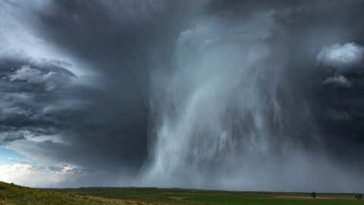
Hailstorm in Nebraska, USA

Slide 59
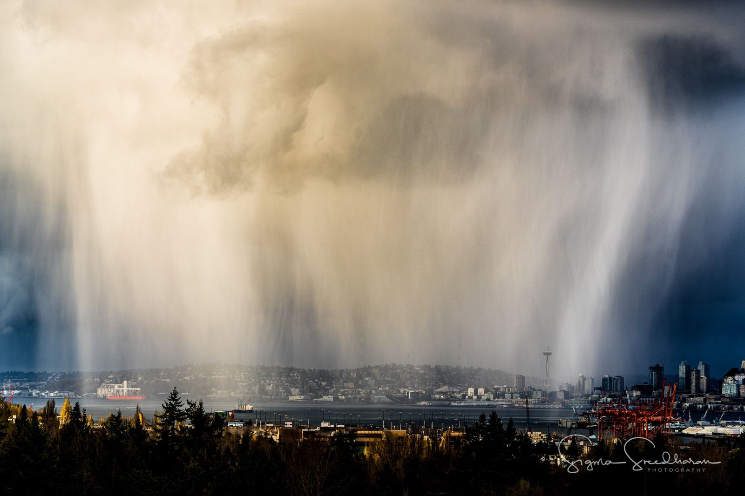

Slide 60


Slide 61
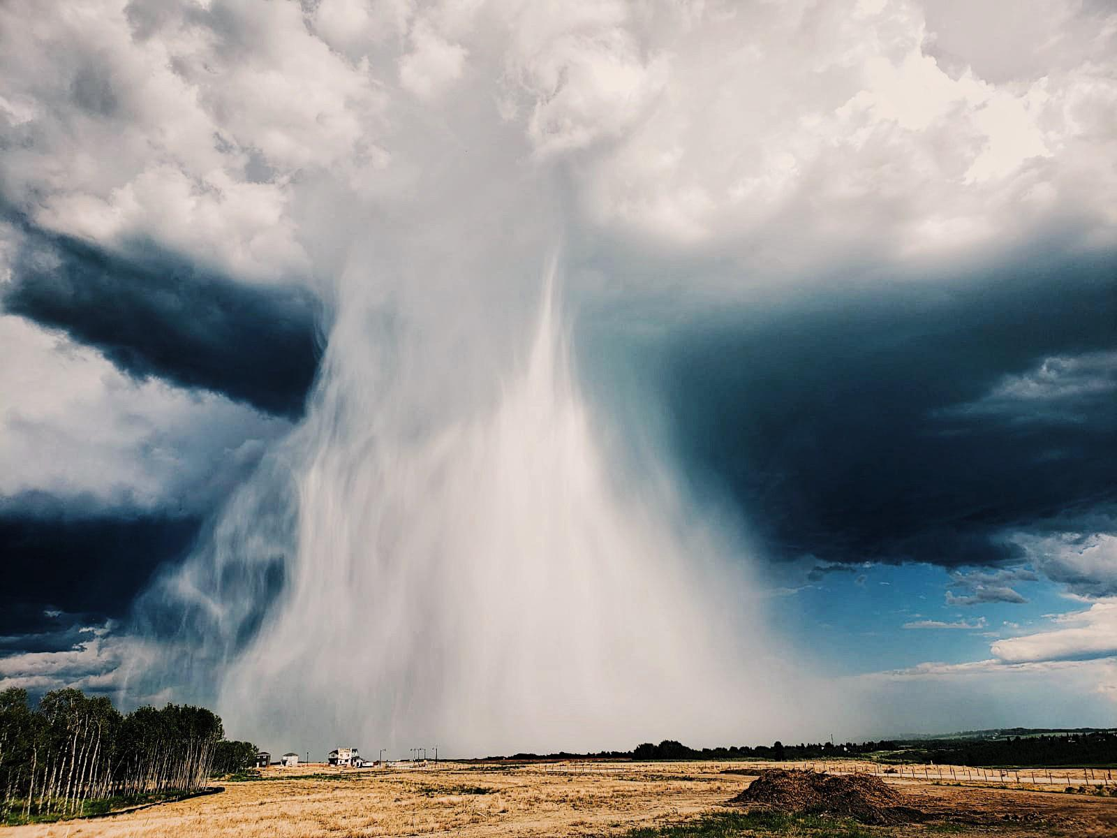

Slide 62
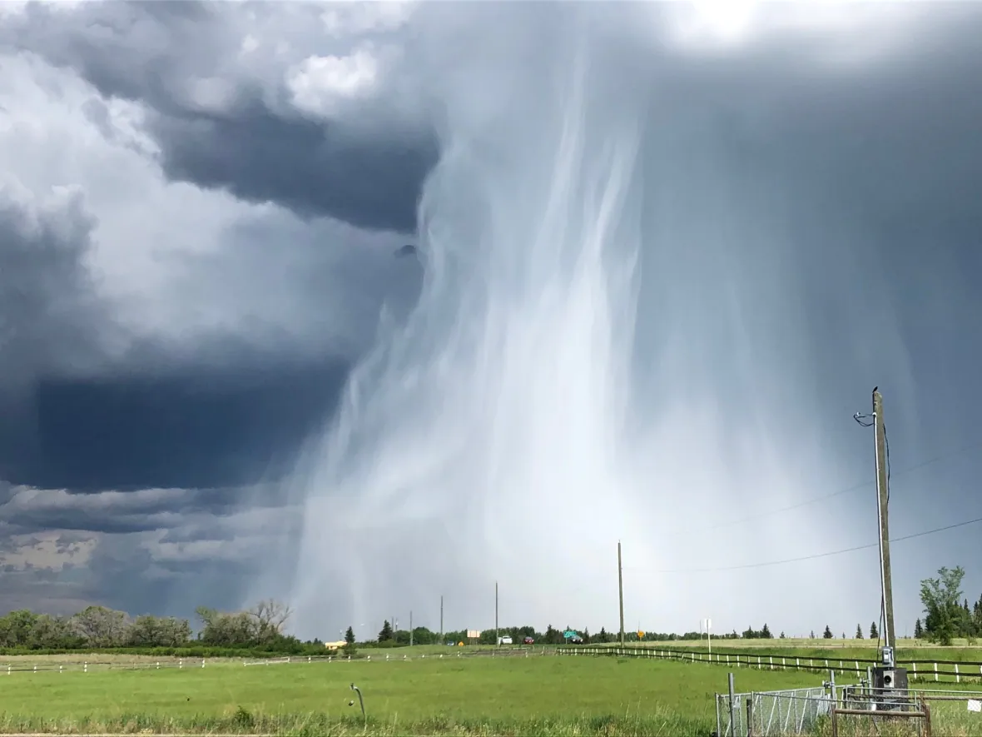

Slide 63
Formalized by very simple model whose variables are:
Dry static energy
Moist static energy
PBL depth
Entrainment velocity
Surface sensible heat flux
Surface latent heat flux
Agard and Emanuel, J. Atmos. Sci., 2017

Slide 64
Boundary Layer Equations
Dry static energy
Moist static energy
Lilly’s entrainment formulation
Surface sensible heat flux
Surface latent heat flux
Net surface flux
Boundary layer mass

Slide 65
Note: M_{s} is related to D_{s} by Clausius-Clapeyron Equation
Initial conditions:
M (t=0) = D₀
D (t=0) determined so that air is just saturated at boundary layer top
h=h₀
Initial dry static energy of free troposphere

Slide 66
Nondimensionalize:

Slide 67
Equations are normalized and recombined to arrive at
Determined so that air is initially just saturated at boundary layer top

Slide 68
Long-time Asymptotic Behavior
CAPE reaches a maximum at a particular time and then falls to zero at a later time, while the boundary layer depth goes to infinity at the later time and D, D_{s}, and M approach unity. T_{s} is the surface air temperature of the initial dry state.
CAPE still reaches a peak at a particular time and then falls off to or asymptotes to a positive long-time asymptotic value. The asymptotic limits are given by

Slide 69
Convective Available Potential Energy
(CAPE)
T_{top} determined by fixed anvil temperature hypothesis

Slide 70
Asymptotic Cape Scaling in ‘Warm’ Regime, Applicable at Time when PBL Growth Becomes Linear
CAPE rises exponentially with surface temperature
CAPE increases with increasing surface wind
CAPE increases with increasing soil moisture
For a given surface temperature, CAPE declines with absorbed solar radiation

