Slide 1
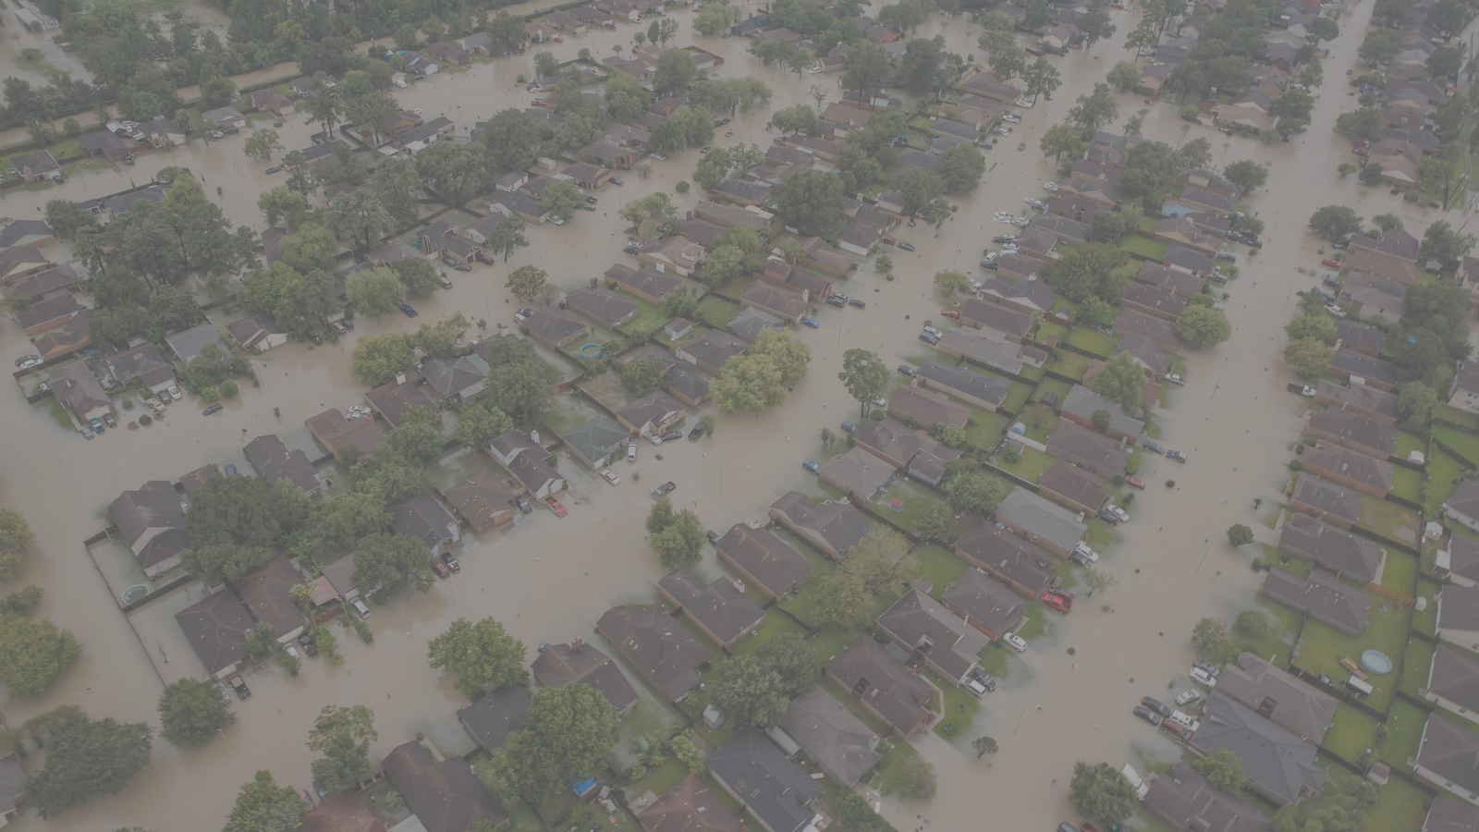
Urban Climate Risks
Kerry Emanuel
Lorenz Center, MIT
Notes:
1

Slide 2

Urban Climate Risks
Heat
  Cities are ‘heat islands’ and are generally warmer than surrounding countryside
Water
  Owing to extensive building and pavement, cities are susceptible to flooding
  Many cities are built on flood plains and/or near the sea

Slide 3
A Few Essential Points
55% of global population resides in cities; will rise to 68% by 2050
Global population exposed to coastal risks has tripled since 1970
Sea level is rising and will continue to do so
In many cities, the most serious consequences come from storm surges and freshwater flooding
Coastal storm intensity and freshwater flooding are expected to increase as the climate warms

Slide 4
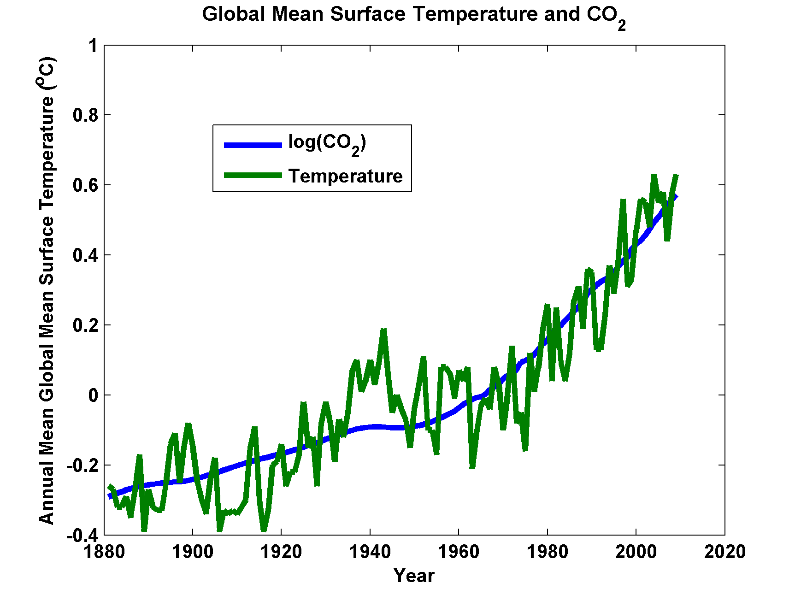

Slide 5
Heat: The Importance of Wet-Bulb Temperature
Wet-bulb T

Slide 6
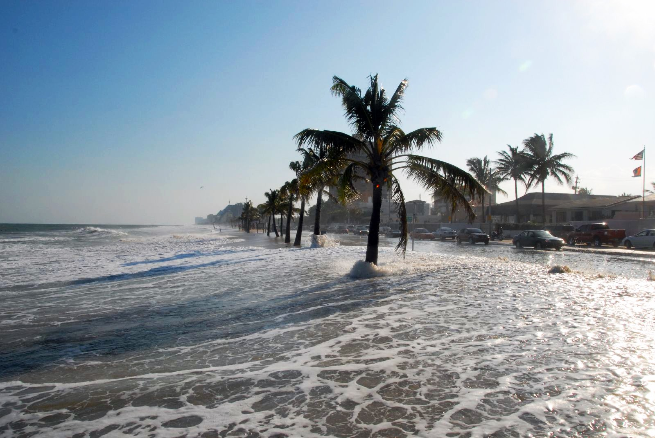
Sea Level Rise

Slide 7
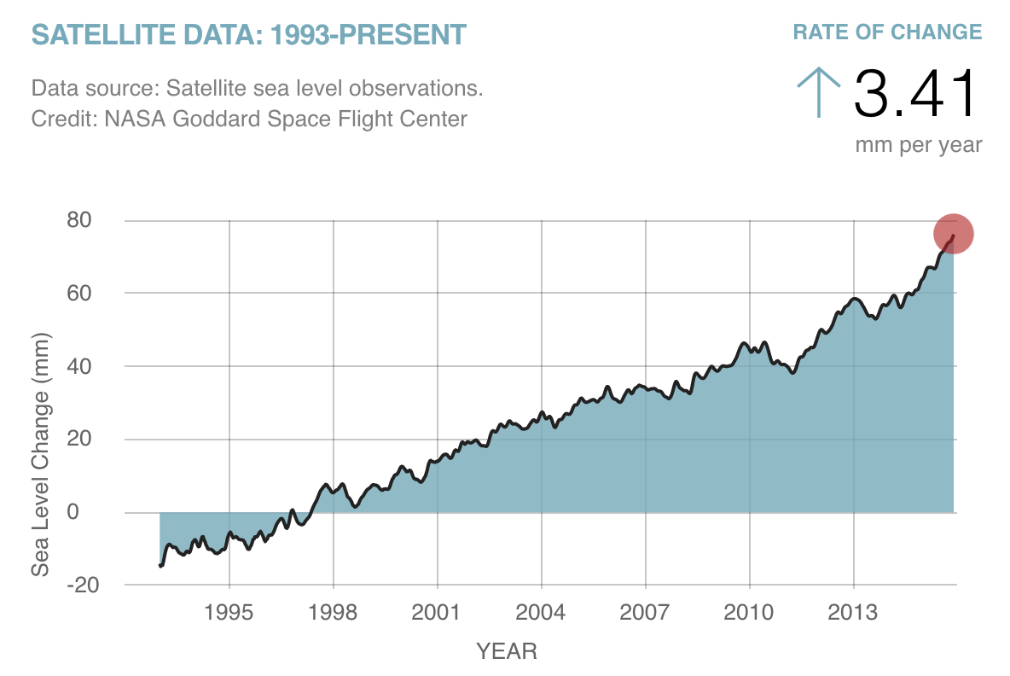

Slide 8
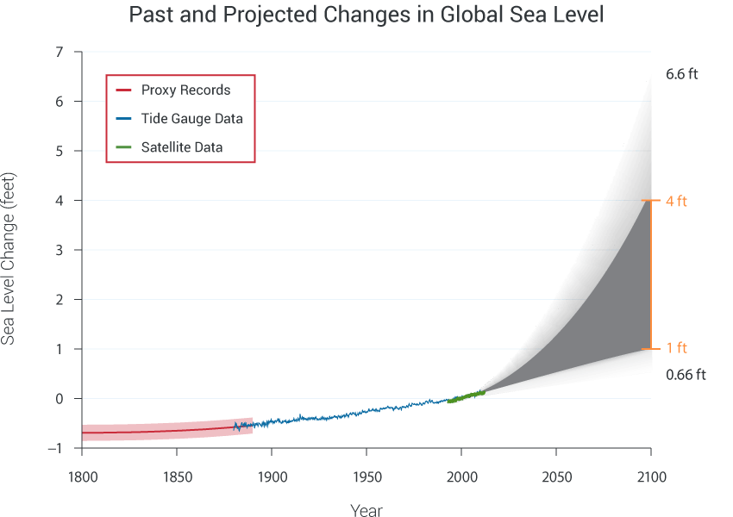
Today

Slide 9
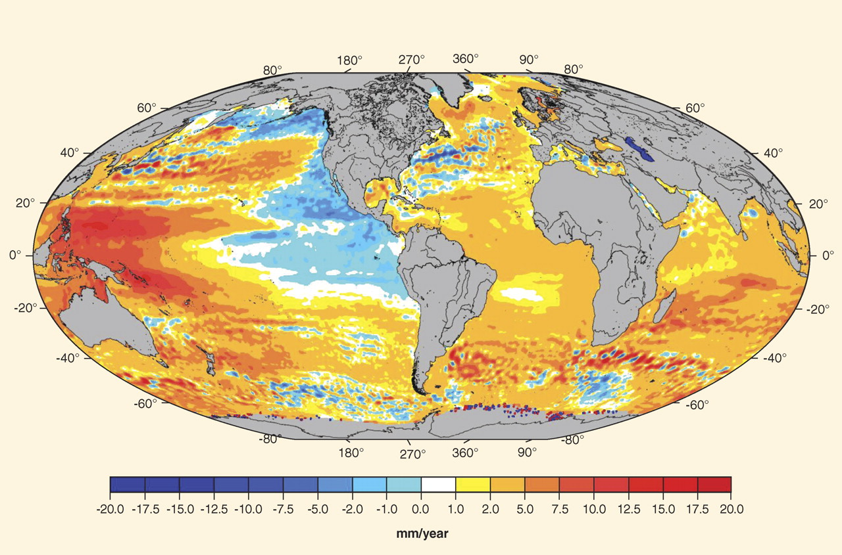
Regional sea-level trends from satellite altimetry (Topex/Poseidon, Jason-1&2, GFO, ERS-1&2, and Envisat missions) for the period October 1992 to July 2009. AVISO (Archiving, Validation and Interpretation of Satellite Oceanographic data), available at www.aviso.oceanobs.com/

Slide 10
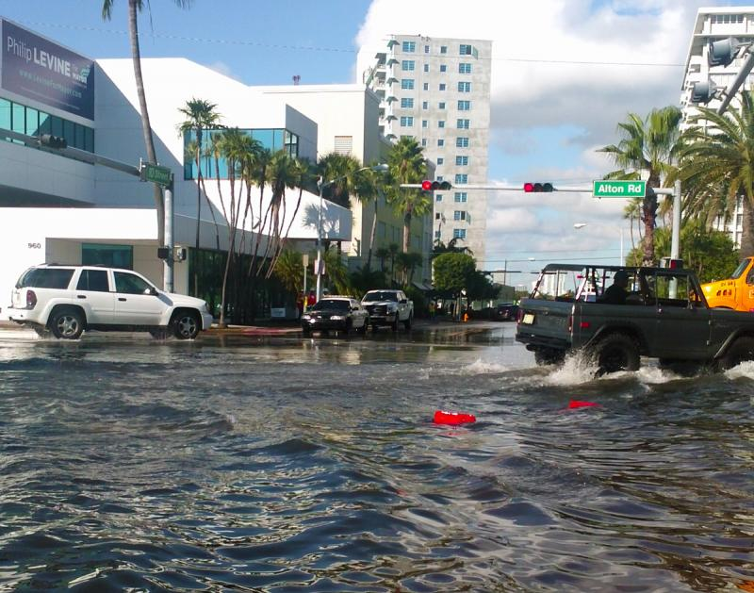
“Nuisance Flooding”, Miami Beach

Slide 11
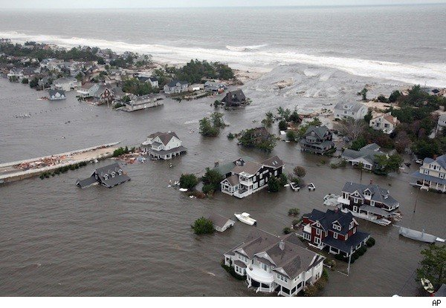
Coastal Storm Surge Flooding
Flooding from Hurricane Sandy
Credit: Associated Press

Slide 12
The Global Hurricane Hazard
About 10,000 deaths per year since 1971
$700 Billion 2015 U.S. Dollars in Damages Annually since 1971
Global population exposed to hurricane hazards has tripled since 1970
EM-DAT, 2016: The OFDA/CRED International Disaster Database
http://www.emdat.be/.

Slide 13

Publicly
insured…
No $$$
Privately insured… $$$

Slide 14
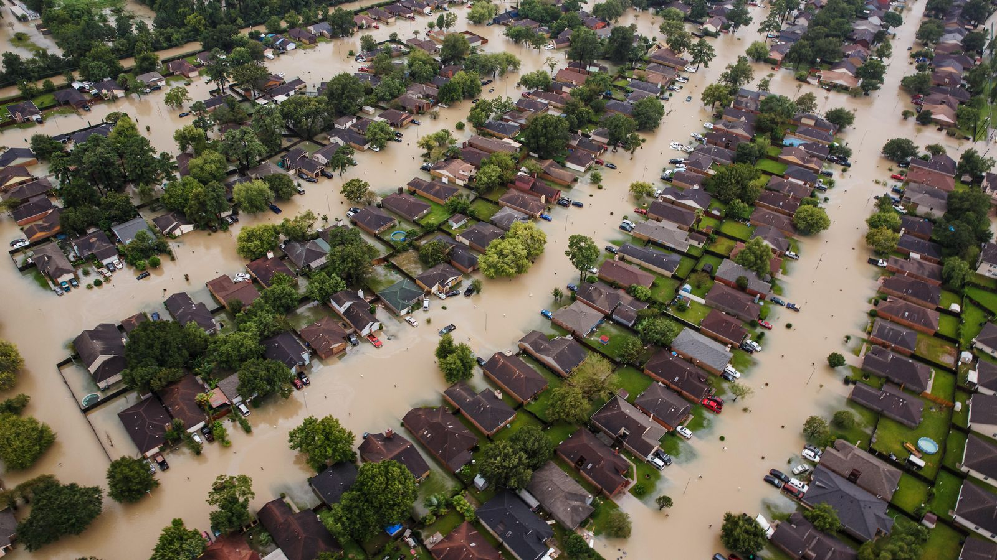
Flooding from Hurricane Harvey

Slide 15

MIT Research:
Embed Detailed Hurricane Model within Global Climate Models
Notes:
15

Slide 16
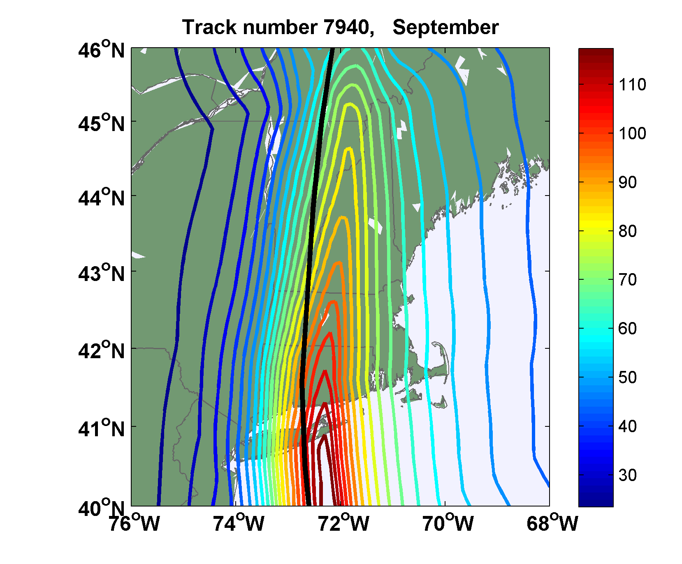
Sample Storm Wind Swath

Slide 17
Case Study: Cambridge and MIT

Slide 18
MIT Tropical Storm Model
Hourly Precipitation
5Km by 5 km Grid

Slide 19
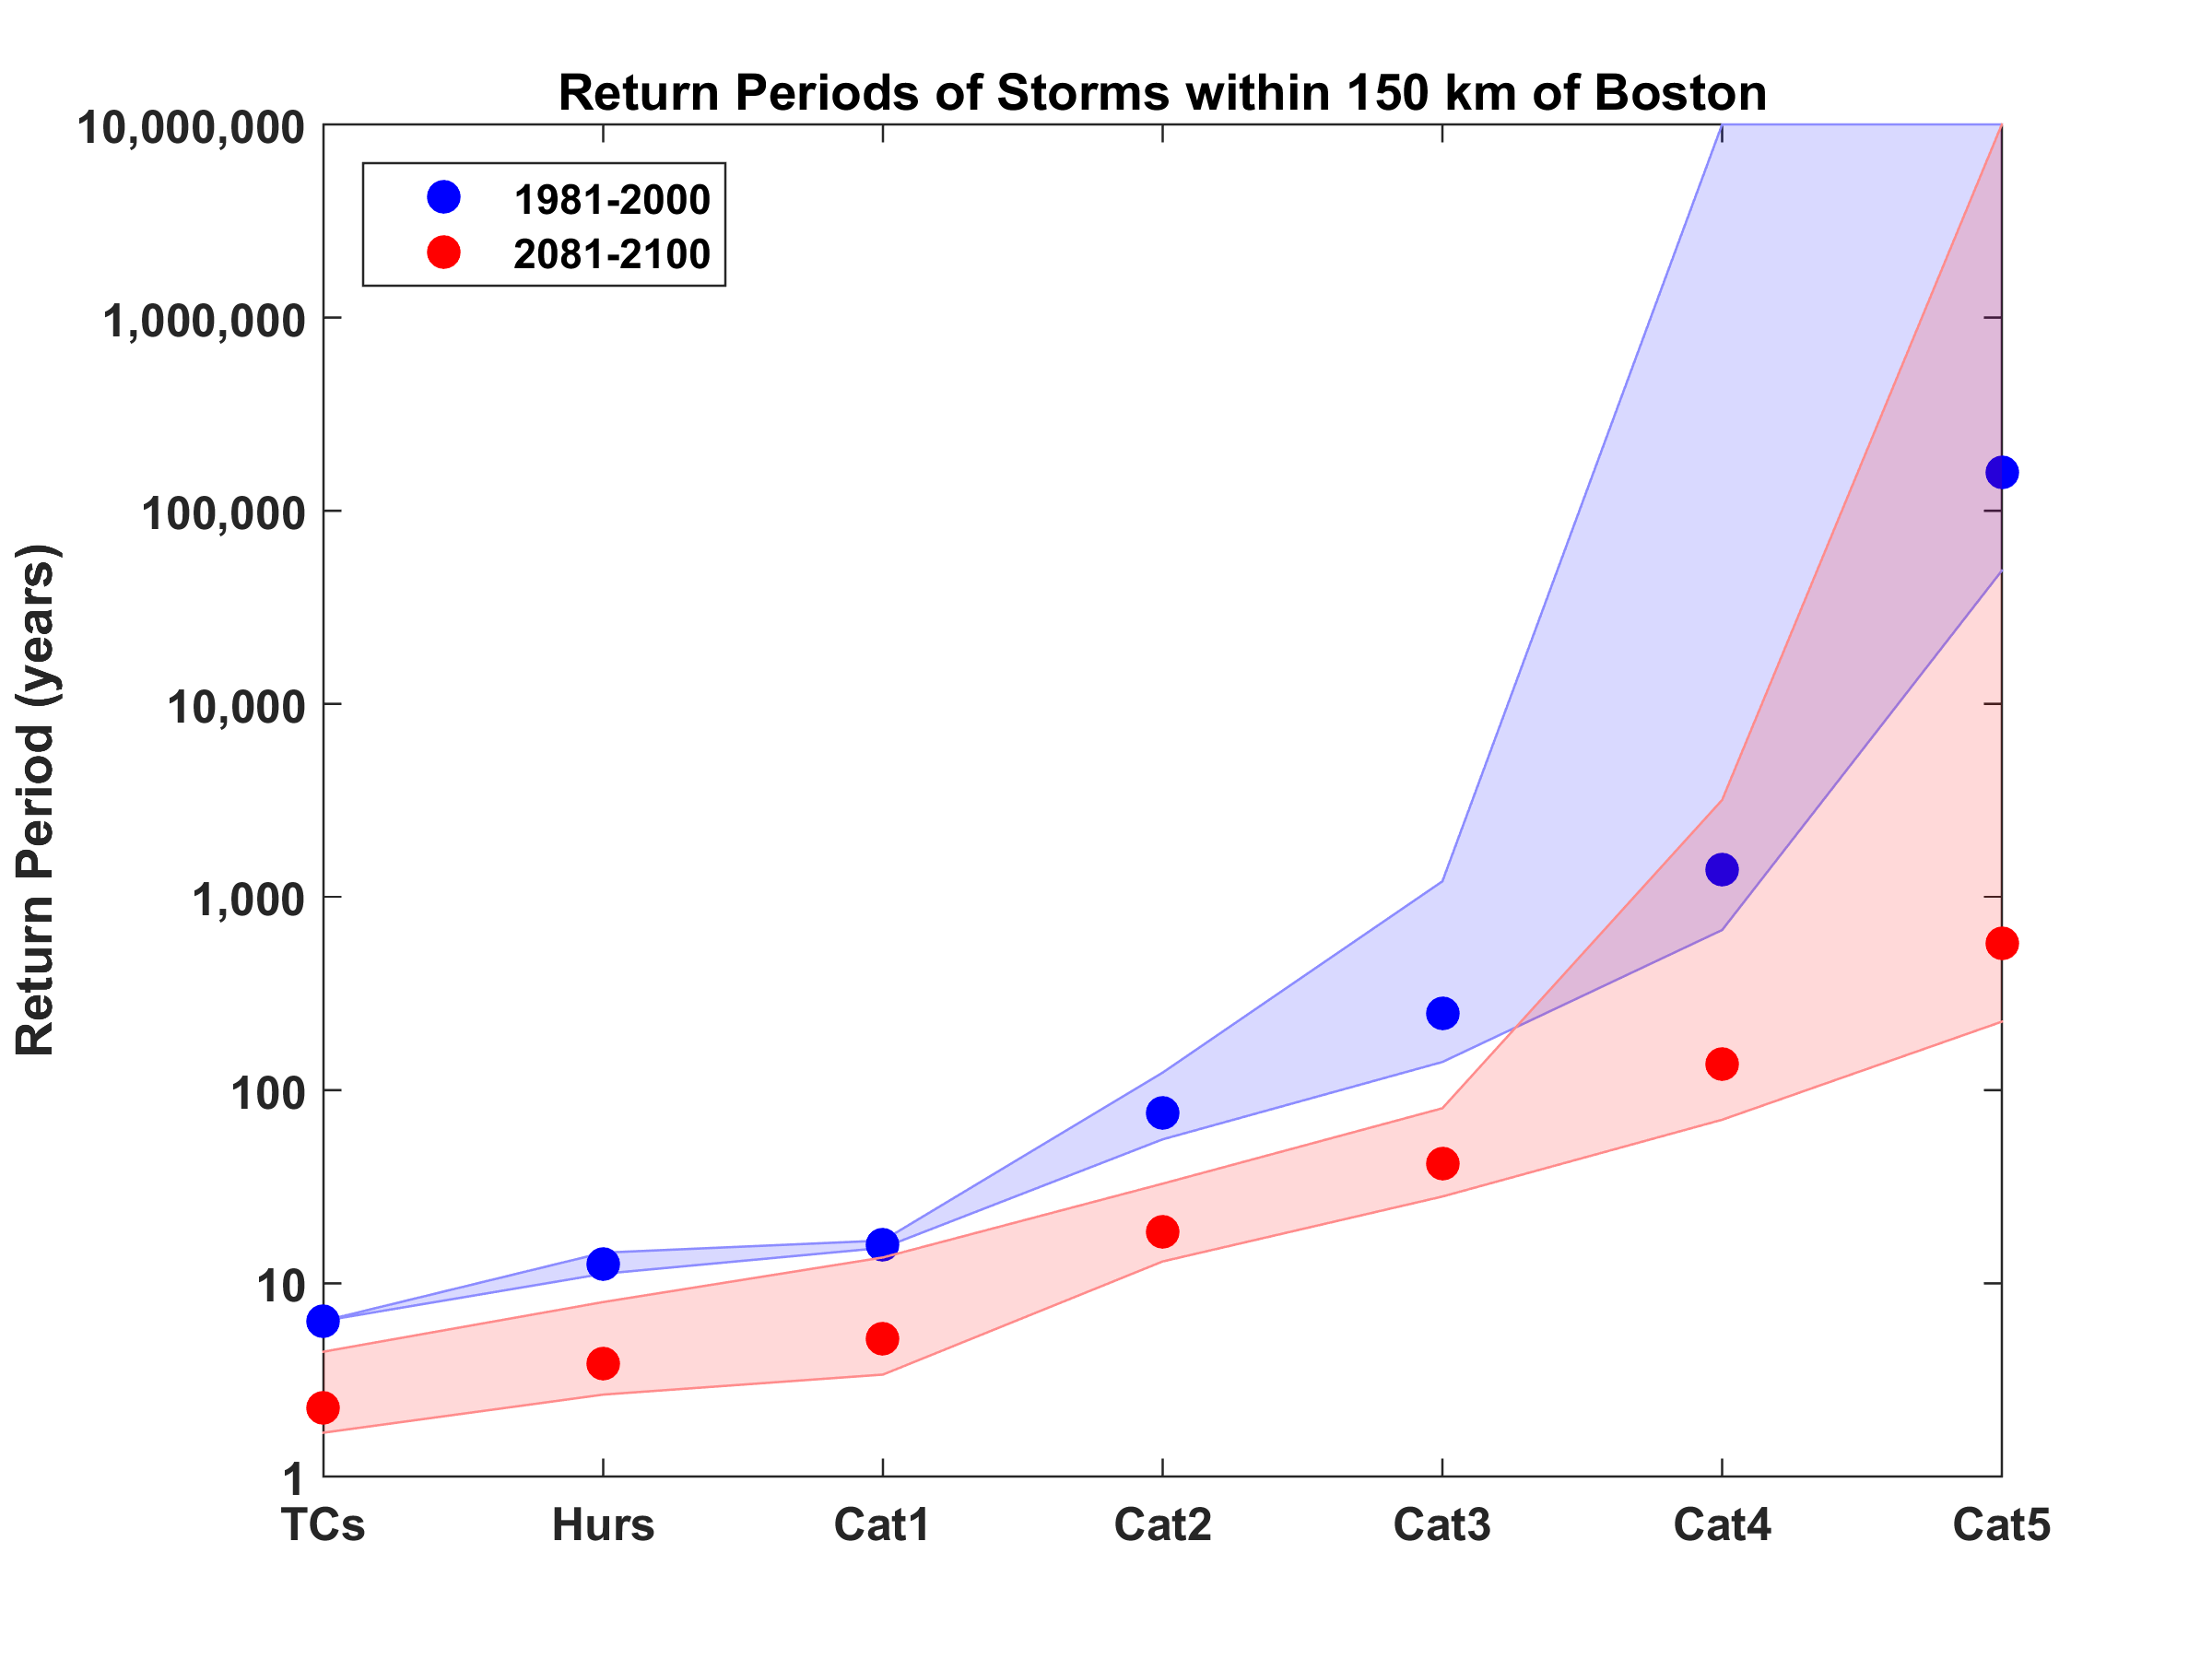
Hurricanes Passing within 150 km of Boston
Downscaled from 5 climate models

Slide 20
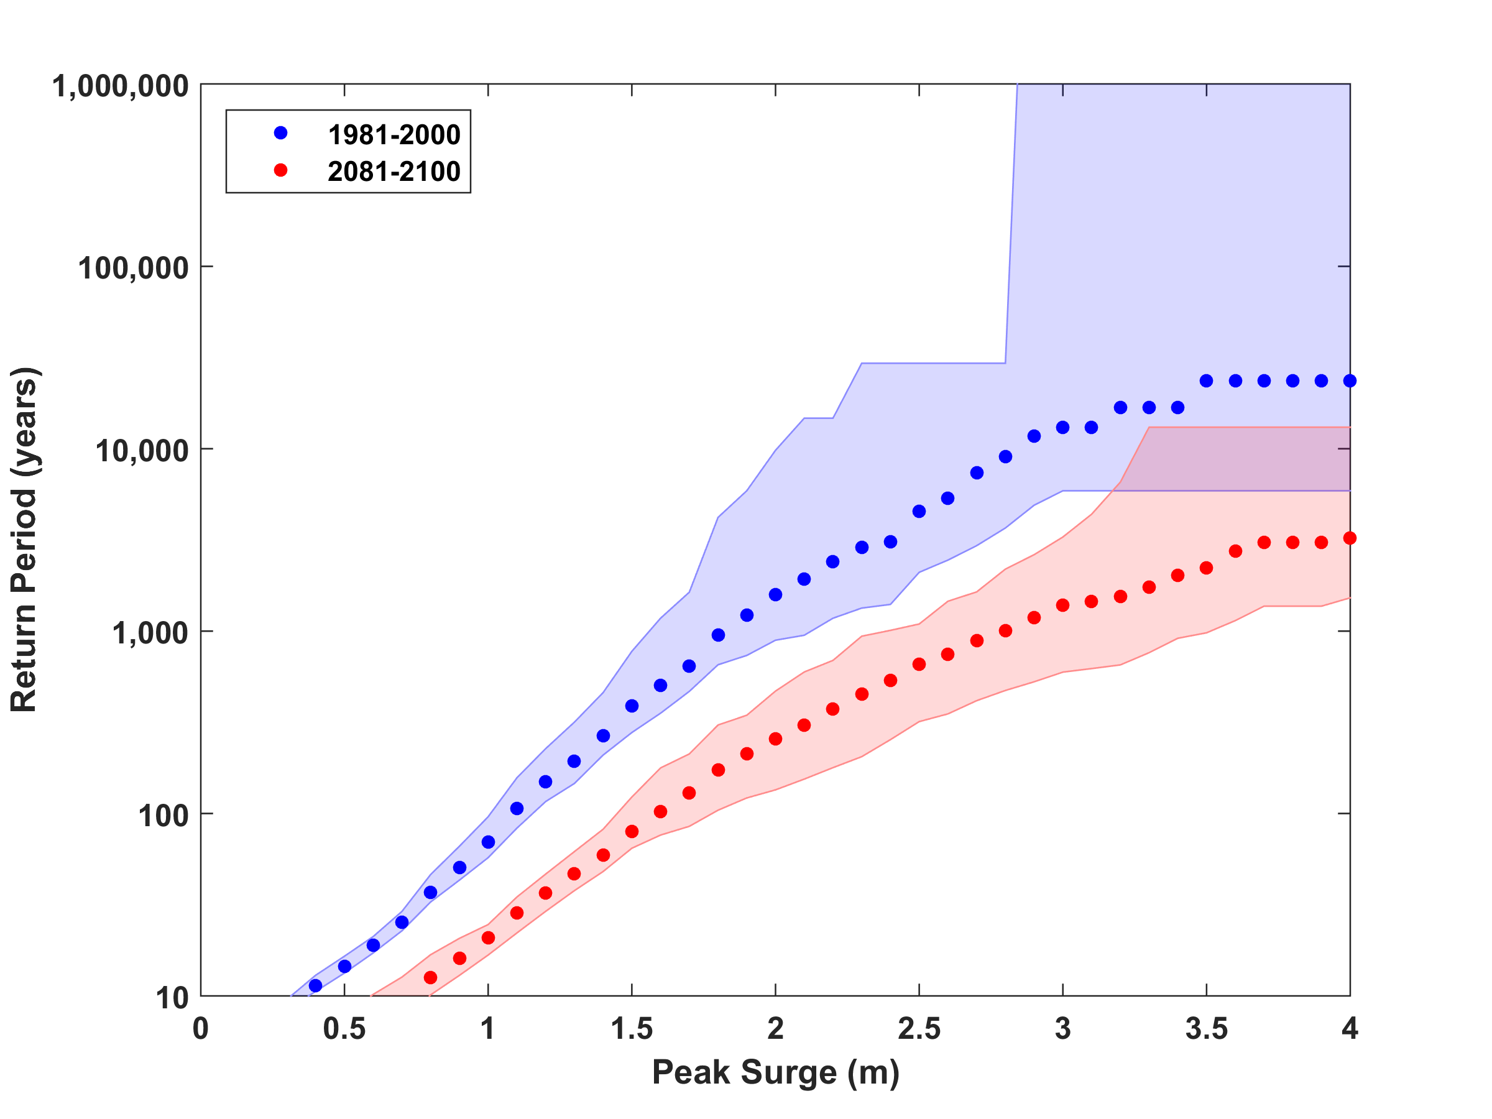
Boston Harbor Surge Risk

Slide 21
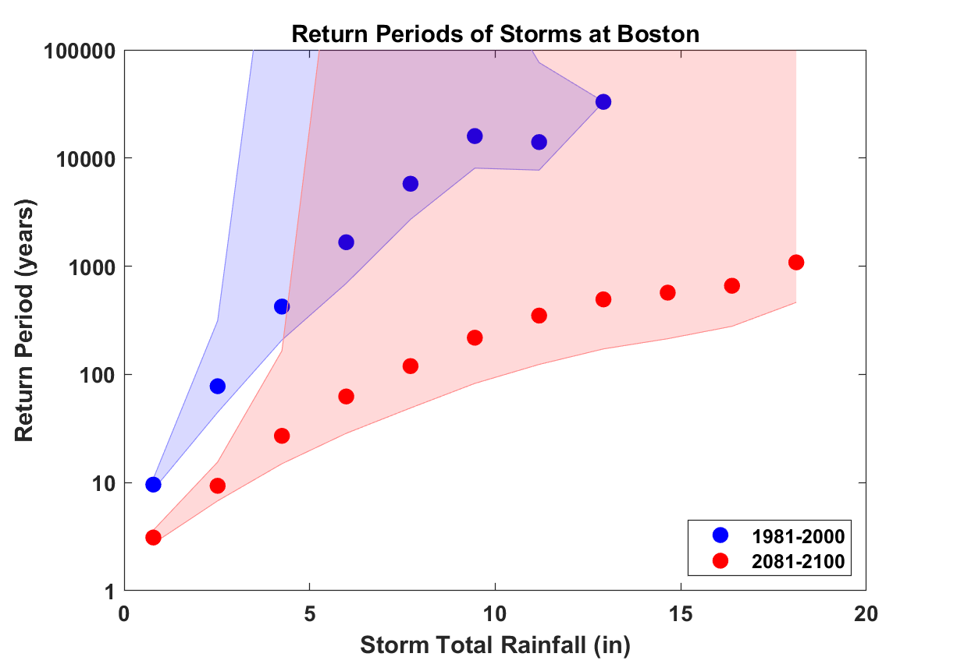

Slide 22
Sea Level Rise / Storm Surge Propagation (2070)
Courtesy Ken Strzepek
1-3 feet peak
<1 foot peak
1% or 100 year SLR/SS event under climate change conditions (2070) (precipitation not yet included)
Note: not for distribution – in-progress MIT Flood Vulnerability Study (Jun 2017); based on MassDOT/Central Artery Flood Modelling assumptions for river levels
Notes:
Scenario shows 1% probability storm surge event in 2070 (with sea level rise and climate changes)
Surge would flank the Charles River dam and flood areas of the campus with 1-3 feet of peak flood water.
Rather than overtop the seawall along Memorial Drive, surge water would propagate stormwater drainage pipes and flood lowest campus elevation areas along Vassar and Albany and Main St.
Areas that would likely be flooded include many of the same lower elevation areas that are of risk and noted below under probable precipitation-flooding areas.
Scenario only accounts for a surge of seawater, not precipitation run-off from Cambridge land.
Surge would likely bring salty water into campus utility and building systems.
KEY ASSUMPTIONS FOR MODELLING: MassDOT/Central Artery Tunnel Flood Study - https://www.massdot.state.ma.us/Portals/8/docs/environmental/SustainabilityEMS/Pilot_Project_Report_MassDOT_FHWA.pdf

Slide 23

Summary
Large actual and projected increases in populations of urban areas, especially coastal cities
Confluence with climate change yields possibly large increases in urban climate risks, especially heat and flooding risk
We are getting better at estimating the magnitude of urban climate risks

Slide 24
Spare Slides

Slide 25
Aerts, C. J. H. J., W. J. W. Botzen, K. Emanuel, N. Lin, H. de Moel, and E. O. Michel-Kerjan, 2014: Evaluating flood resilience strategies for coastal megacities. Science, 344, 473-475.

Slide 26
Benefit-Cost Ratios

Slide 27
Sea level rise + changing storms
Sea level rise alone
From: American Climate Prospectus Economic Risks in the United States

