Slide 1

Climate Science: A Quick Tutorial
Kerry Emanuel
Lorenz Center
Department of Earth, Atmospheric, and Planetary Sciences, MIT
Web: emanuel.mit.edu

Slide 2

Program:
Brief history of earth’s climate and climate science
Anthropogenic effects on climate
Climate risks
Dealing with climate change

Slide 3
Earth’s Natural Climate Variations

Slide 4
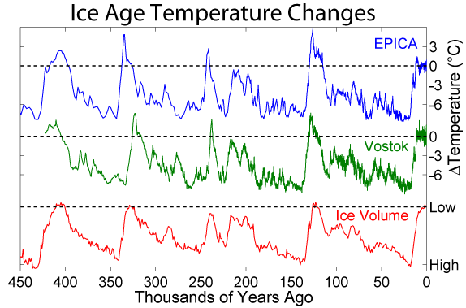
Last 450 Thousand Years

Slide 5
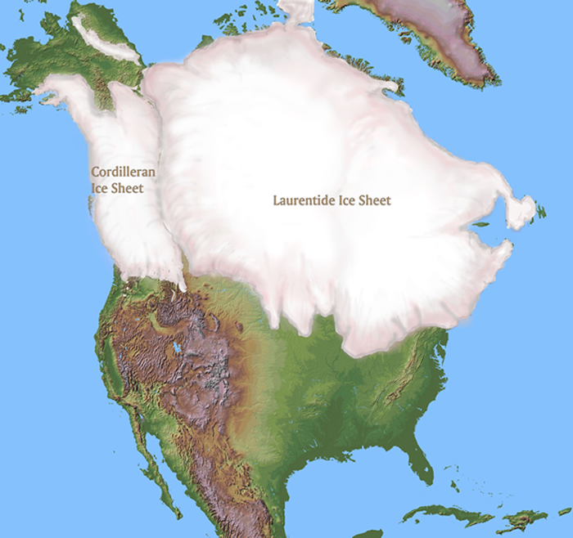
~ 20,000 years before present

Slide 6

Polar radiative forcing: 10 W/m² (4 W/m² for 2 x CO₂)
Global mean temperature fluctuation: ~5 C

Slide 7

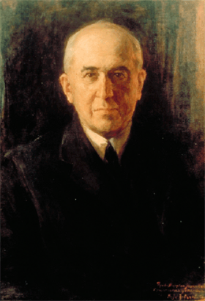
Climate Forcing by Orbital Variations (1912)
Milutin Milanković, 1879-1958

Slide 8
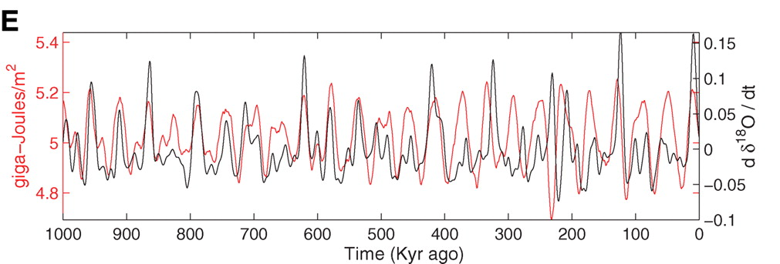
Strong Correlation between High Latitude Summer Insolation and Ice Volume
Black: Time rate of change of ice volume
Red: Summer high latitude sunlight
P. Huybers, Science, 2006

Slide 9
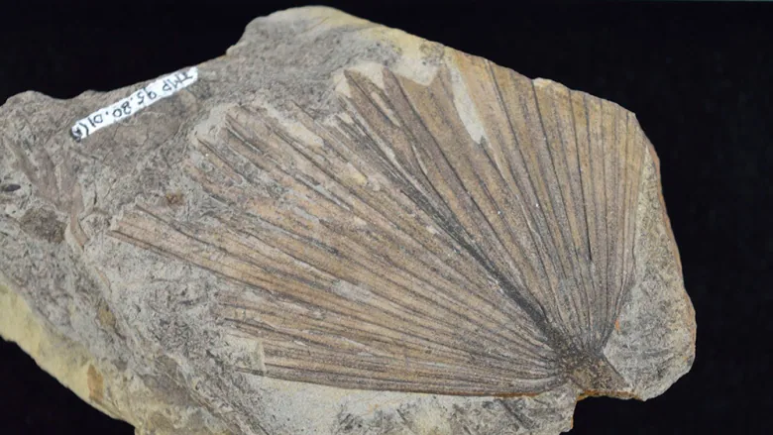
Fossil of palm leaf from ~65 million years ago, found near Edmonton, Alberta, Canada

Slide 10
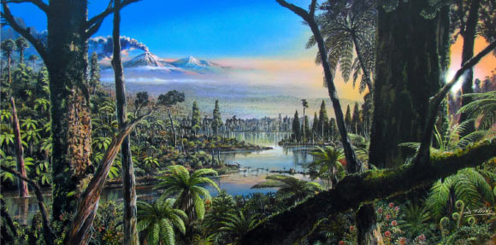
Reconstruction of the West Antarctic mid-Cretaceous (~100 million years ago) temperate rainforest.
Image credit: J. McKay / Alfred-Wegener-Institut

Slide 11
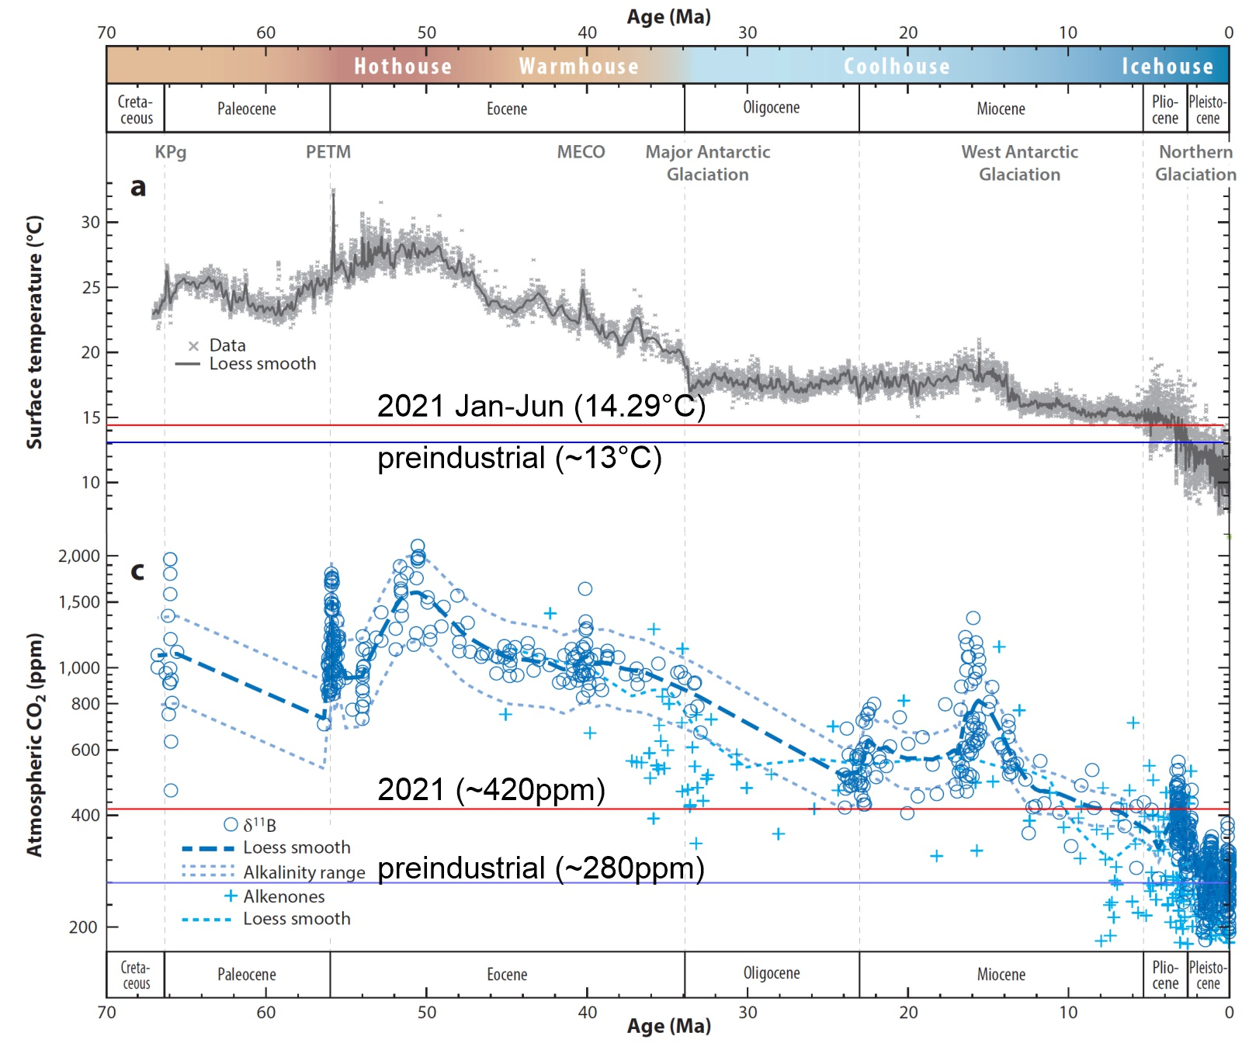

Slide 12
The Greenhouse Effect

Slide 13


John Tyndall (1820-1893)

Slide 14
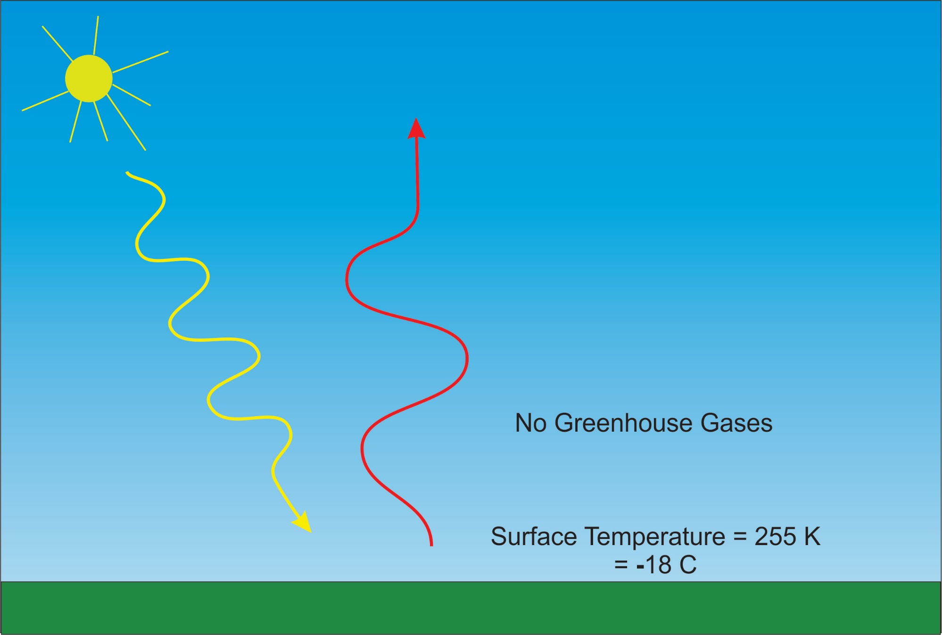

Slide 15
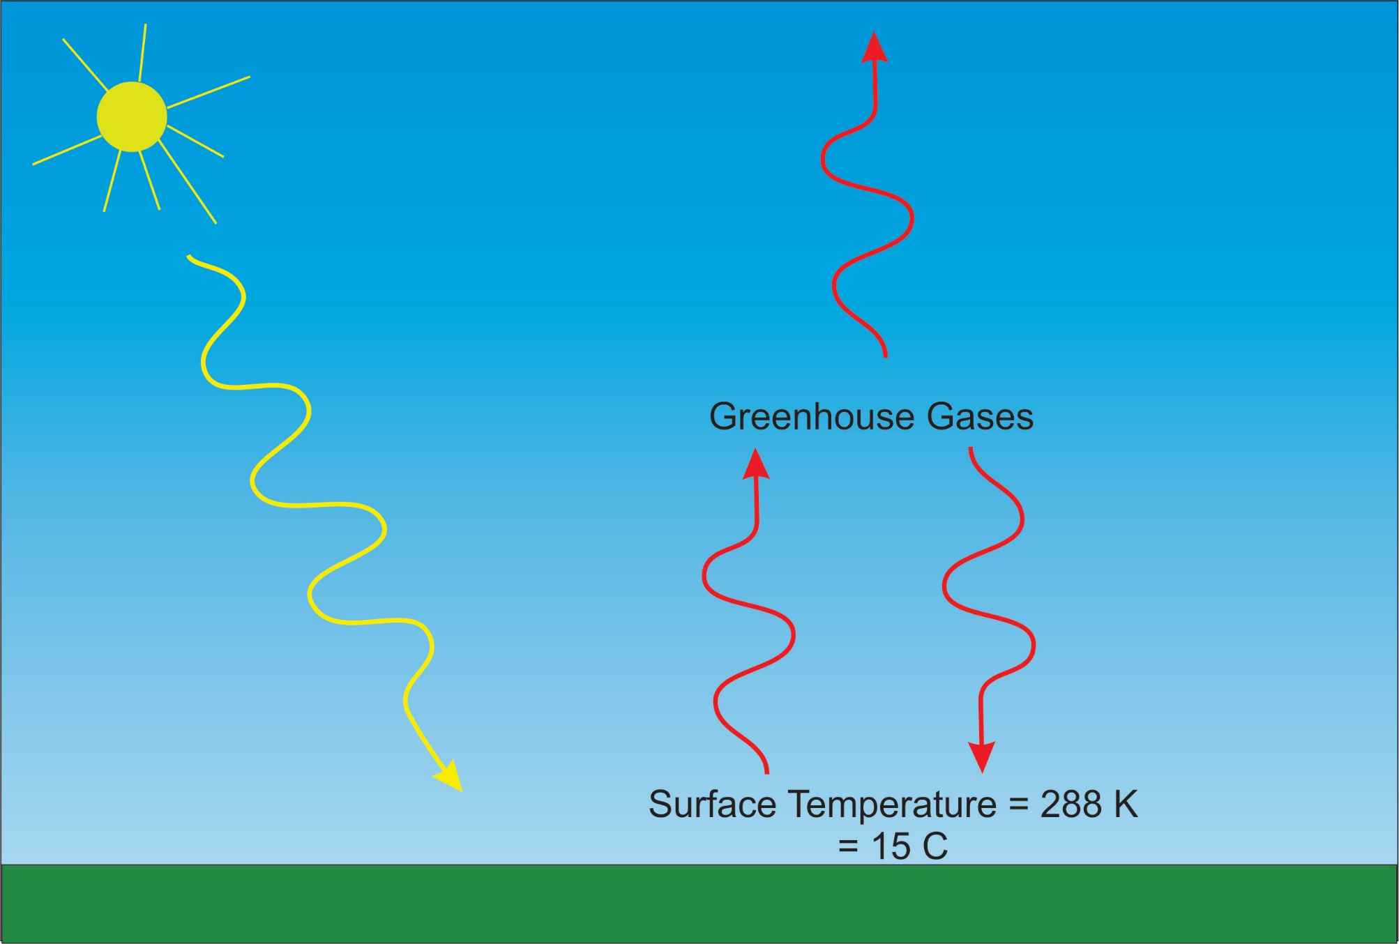

Slide 16
Tyndall’s Essential Results:
Oxygen (O₂ ), nitrogen (N₂), and argon (Ar), though they make up ~99% of the atmosphere, are almost entirely transparent to solar and terrestrial radiation
Water vapor (H₂O), carbon dioxide (CO₂), nitrous oxide (N₂O), and a handful of other trace gases make the lower atmosphere nearly opaque to infrared radiation, though still largely transparent to solar radiation (but clouds have strong effects on radiation at all wavelengths). Together they increase the Earth’s surface temperature from about 0ºF to around 60ºF.

Slide 17
Atmospheric Composition
The orange sliver makes the difference between a mean surface temperature of 0ºF and of 60ºF.

Slide 18
Water Vapor (H₂O), about 0.25% of the mass of the atmosphere, is the most important greenhouse gas, but responds to atmospheric temperature change on a time scale of about 2 weeks
Climate is therefore strongly influenced by long-lived greenhouse gases (e.g. CO₂, CH₄, N₂O) that together comprise about 0.04% of the mass of the atmosphere. Concentration of CO₂ has increased by 46% since the dawn of the industrial revolution

Slide 19
Our Influence on Greenhouse Gases

Slide 20

Svante Arrhenius, 1859-1927
“Any doubling of the percentage of carbon dioxide in the air would raise the temperature of the earth's surface by 4°; and if the carbon dioxide were increased fourfold, the temperature would rise by 8°.” – Världarnas utveckling (Worlds in the Making), 1906

Slide 21
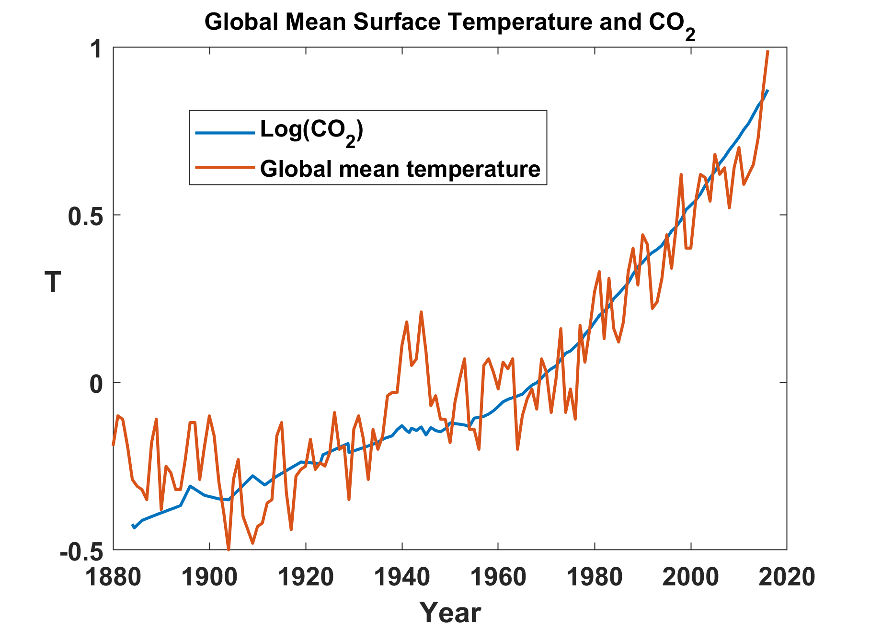

Slide 22
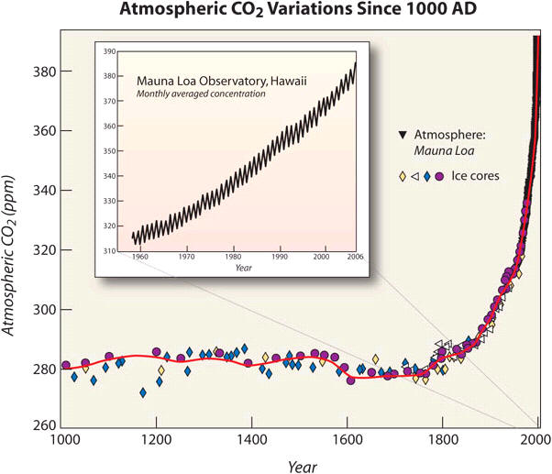
Today

Slide 23
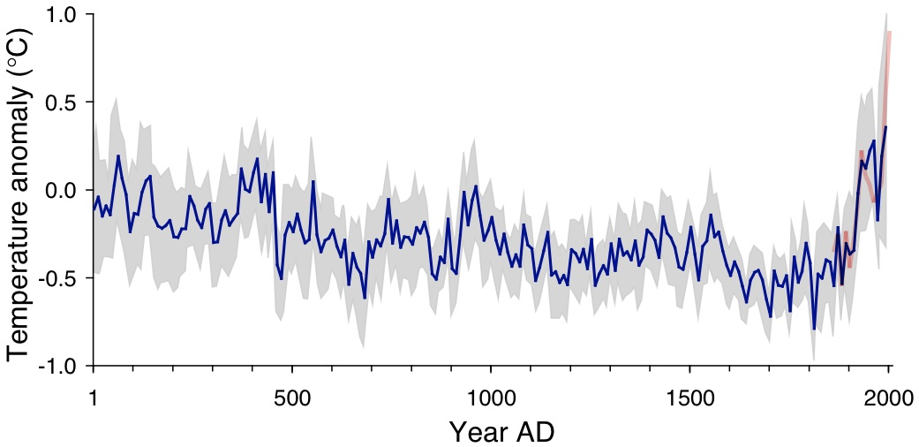
Arctic air temperature change reconstructed (blue), observed (red)
The long-term cooling trend in the Arctic was reversed during recent decades. The blue line shows the estimated Arctic average summer temperature over the last 2000 years, based on proxy records from lake sediments, ice cores, and tree rings. The shaded area represents variability among the 23 sites use for the reconstruction. The red line shows the recent warming based on instrumental temperatures. From Kaufman et al. (2009).

Slide 24
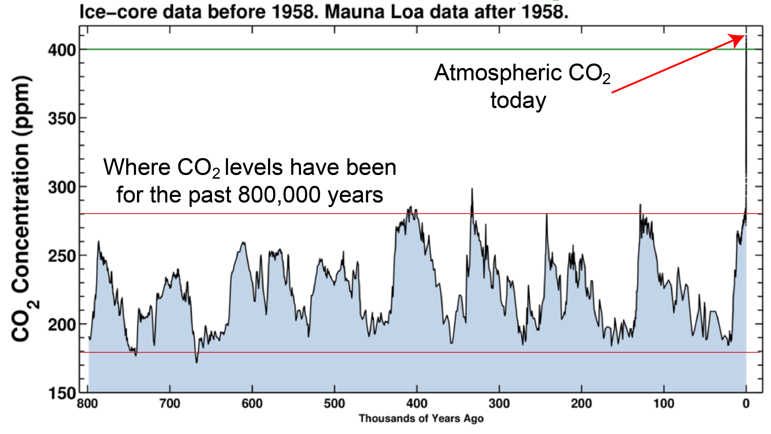

Slide 25
Other Trends

Slide 26
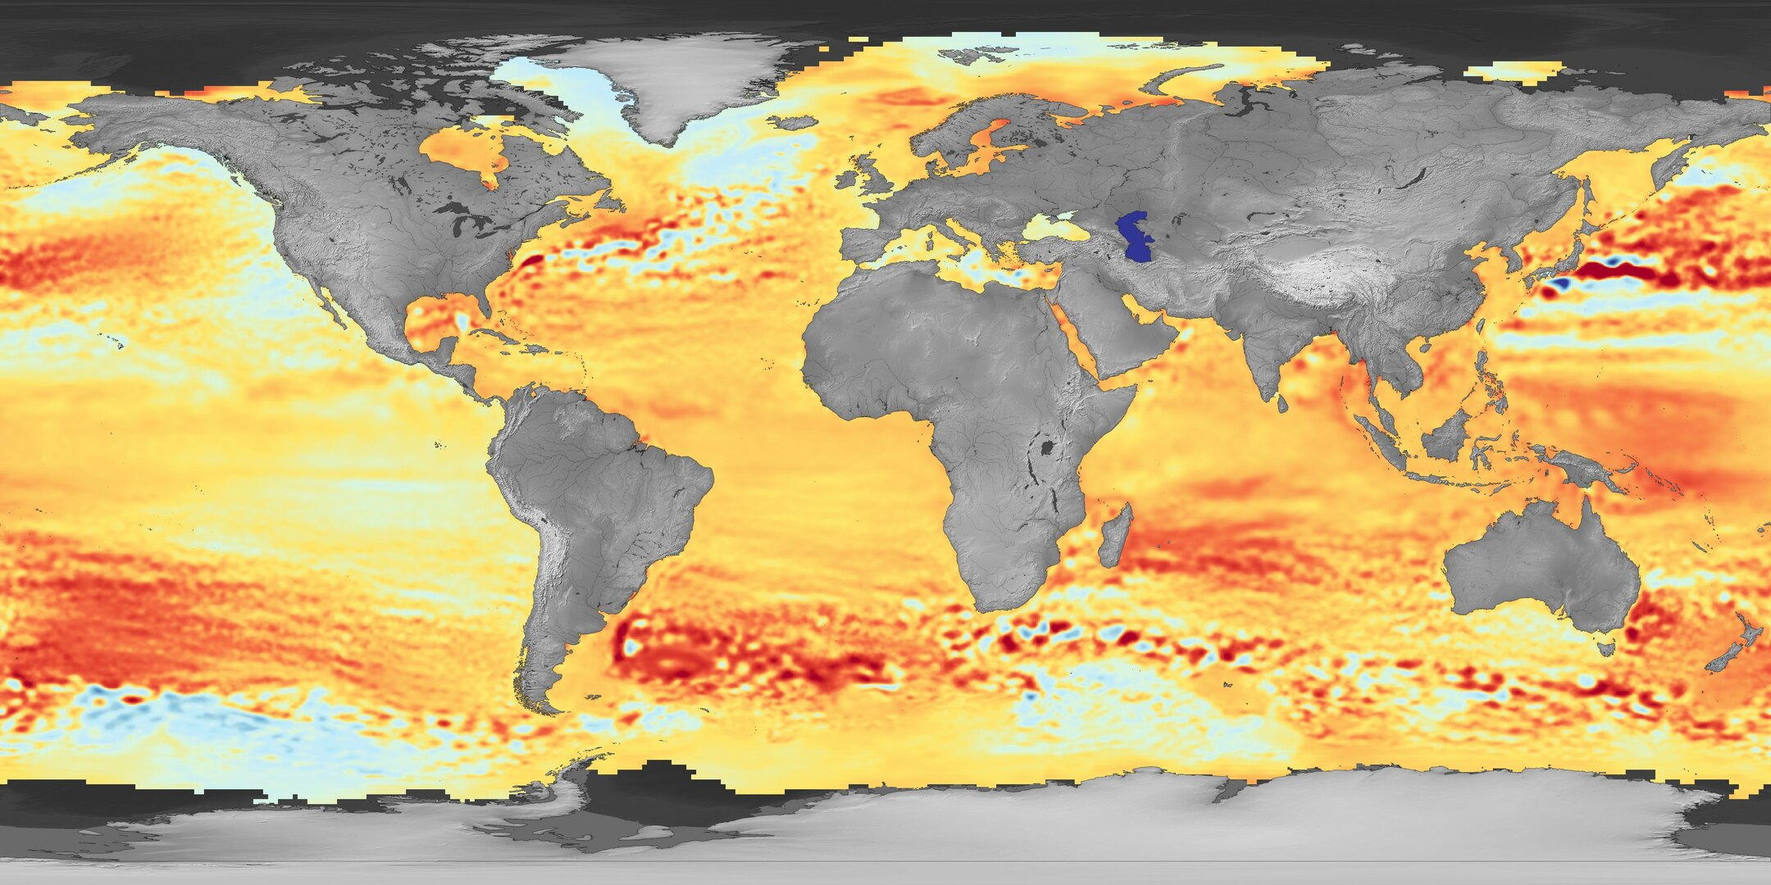

Regional mean sea-level trends between January 1993 and October 2019
Melting ice caps
Changing winds over the sea
Changing ocean temperature
Changing gravitational attraction by land ice

Slide 27

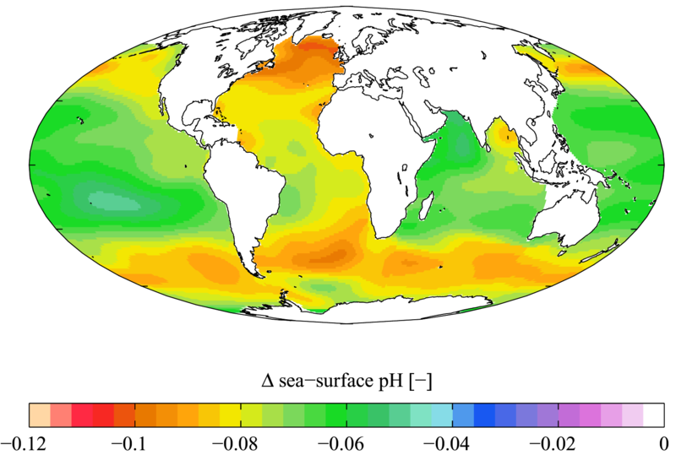

Slide 28

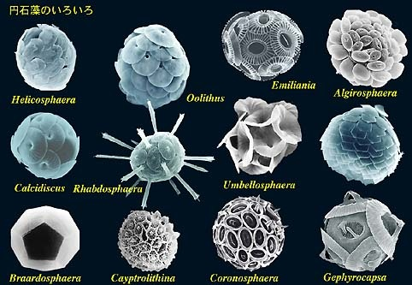

Acidification through CO₂ threatens marine life
Plankton
Coral Reefs
Notes:
Abbildung 4.3-1
Aragonitsättigung und
gegenwärtige Riffstandorte
von Warmwasserkorallen
(blaue Punkte). (a)
vorindustrielle Werte
(ca. 1870, atmosphärische
CO2-Konzentration
280 ppm), (b) Gegenwart
(ca. 2005, 375 ppm CO2), (c)
Zukunft (ca. 2065, 517 ppm
CO2). Der Grad der
Aragonitsättigung (Ù)
bezeichnet das relative
Verhältnis zwischen dem
Produkt der Konzentrationen
von Kalzium- und
Karbonationen und dem
Löslichkeitsprodukt für
Aragonit. Standorte mit
einer Aragonitsättigung
unterhalb von 3,5 sind nur
noch bedingt für riffbildende
Warmwasserkorallen
geeignet (marginal),
unterhalb von 3 sind sie
ungeeignet.
Quelle: Steffen et al., 2004

Slide 29
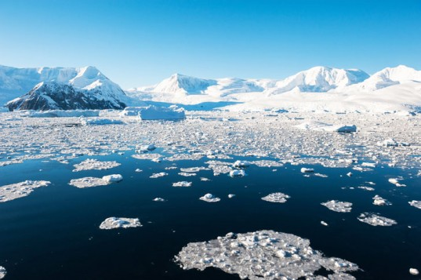
Global Climate Models

Slide 30
20th Century With and Without Human Influences
Based on 4-member PCM ensembles, Meehl et al., J. Climate, 2004

Slide 31
The Future

Slide 32
Sources of Uncertainty
Cloud Feedback
Water Vapor Feedback
Ocean Response
Aerosols

Slide 33


Estimate of how much global climate will warm as a result of doubling CO₂: a probability distribution
Source: 100000 PAGE09 runs
Chris Hope, U. Cambridge
courtesy Tim Palmer
Notes:
Describe pdf. Reflects post-IPCC knowledge as well as IPCC AR4.

Slide 34
The nature of financial risks from weather hazards:
Hurricanes as an example
Total Insured Values of particular insurance firm aggregated over zip codes
Net TIV: $ 2 trillion
12,968 zip codes

Slide 35

Hurricane Losses to Insurance Company Portfolio
Typical annual loss:
  1984-2014: $12
  2070-2100: $3.5 million
Average annual loss:
  1984-2014: $530 million Main contribution: 880-year event
  2070-2100: $4.1 billion Main contribution: 120-year event
The Risk is in the Tails!

Slide 36

CO₂ Will Go Well Beyond Doubling
Double Pre-Industrial

Slide 37

IPCC 2007: Doubling CO₂ will lead to an increase in mean global surface temperature of 2 to 4.5 ºC.
Atmospheric CO₂ assuming that emissions stop altogether after peak concentrations
Global mean surface temperature corresponding to atmospheric CO₂ above
Courtesy Susan Solomon

Slide 38
Known Risks
Increasing sea level
Increasing hydrological events… droughts and floods
Increasing incidence of high category hurricanes and associated storm surges and freshwater flooding
More heat stress and other health risks
Armed conflict
Some increase in plant productivity
Reduction in health problems related to cold weather
Benefits

Slide 39
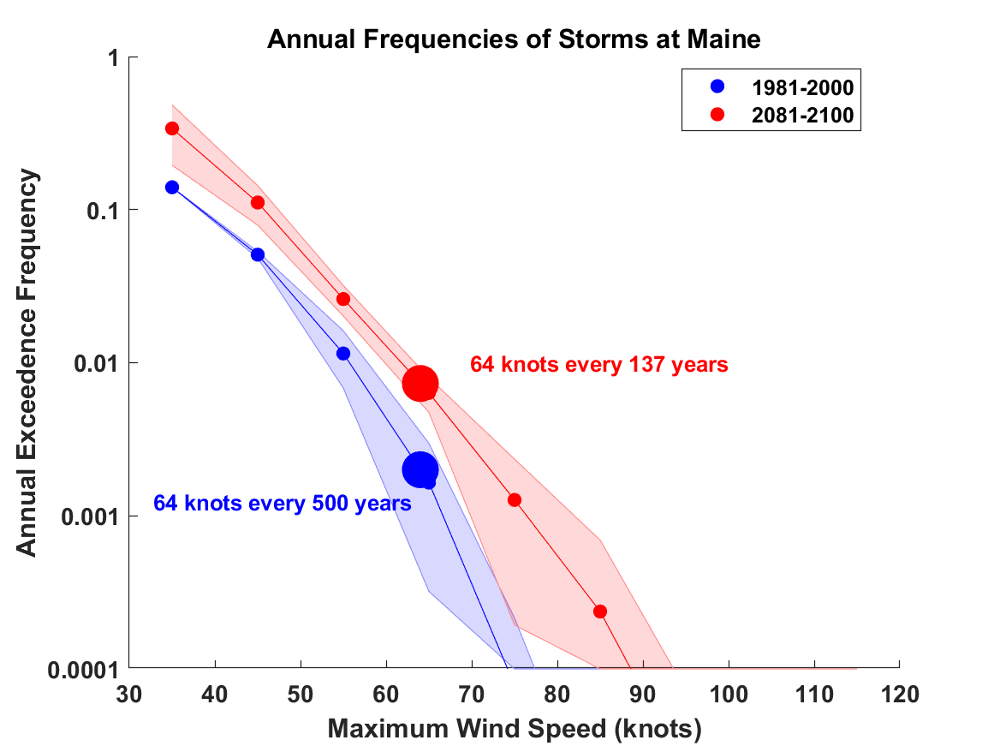
Estimates of hurricane wind risk along the Maine coast from 5 climate models
(shading shows spread among the different climate models)

Slide 40
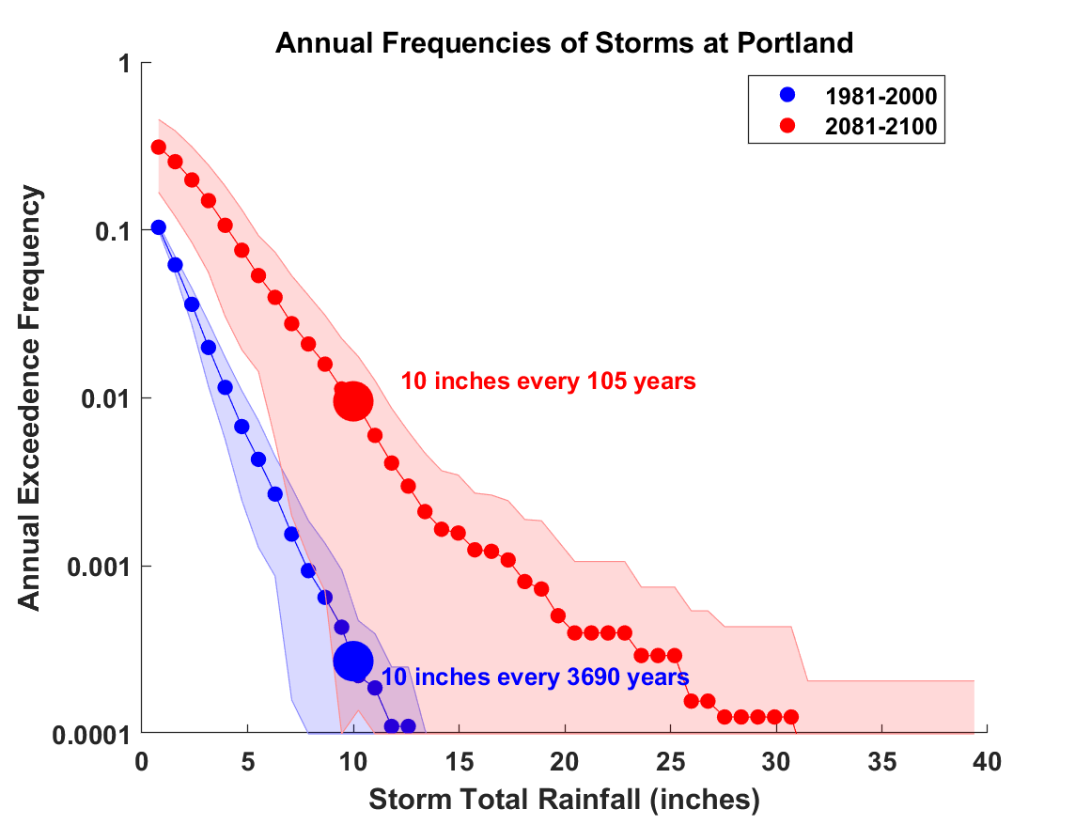
Estimates of hurricane rain risk along the Maine coast from 5 climate models

Slide 41
“Taken as a whole, the range of published evidence indicates that the net damage costs of climate change are likely to be significant and to increase over time.”
- Intergovernmental Panel on Climate Change

Slide 42
Greenhouse Gas Emissions and Projected Energy Demand

Slide 43
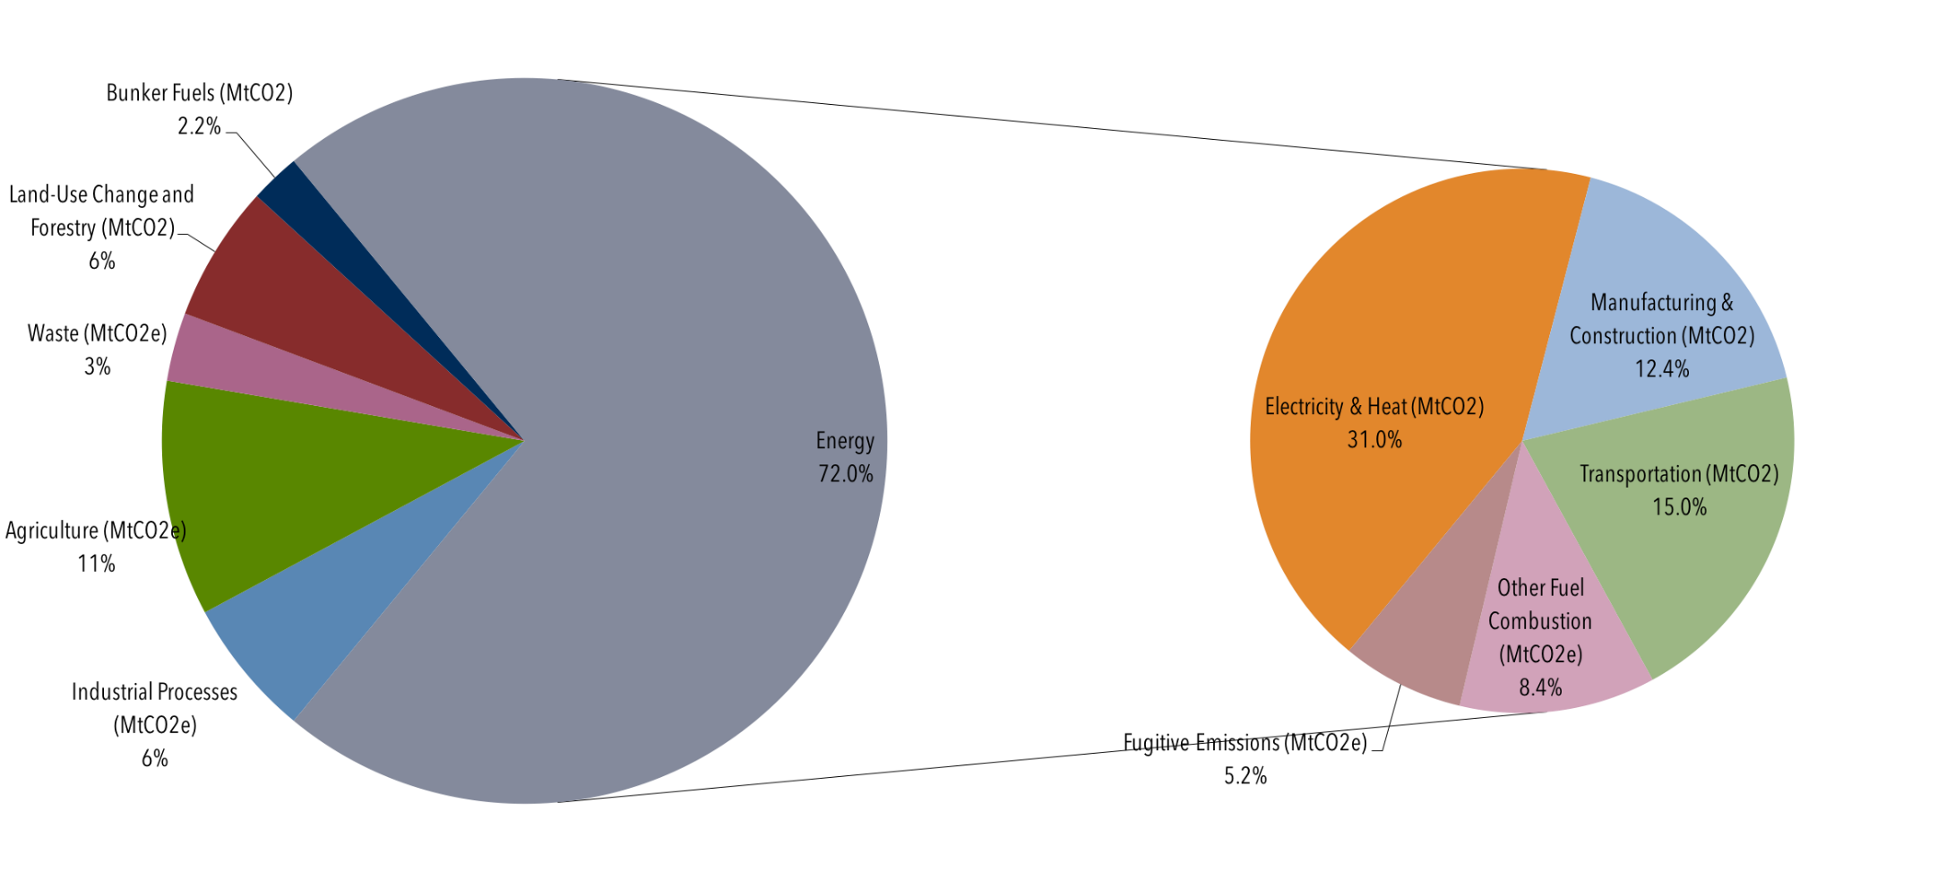
Global Manmade Greenhouse Gas Emissions by Sector, 2013
Source: Center for Climate and Energy Solutions: https://www.c2es.org/content/international-emissions/

Slide 44
Share of industrial heat demand by temperature level
Cannot feasibly be electrified
Data for 2003, 32 countries: EU25 + Bulgaria, Romania, Turkey, Croatia, Iceland, Norway and Switzerland. Source: International Energy Association: https://archive.iea-shc.org/data/sites/1/publications/task33-potential_for_Solar_Heat_in_Industrial_Processes.pdf

Slide 45
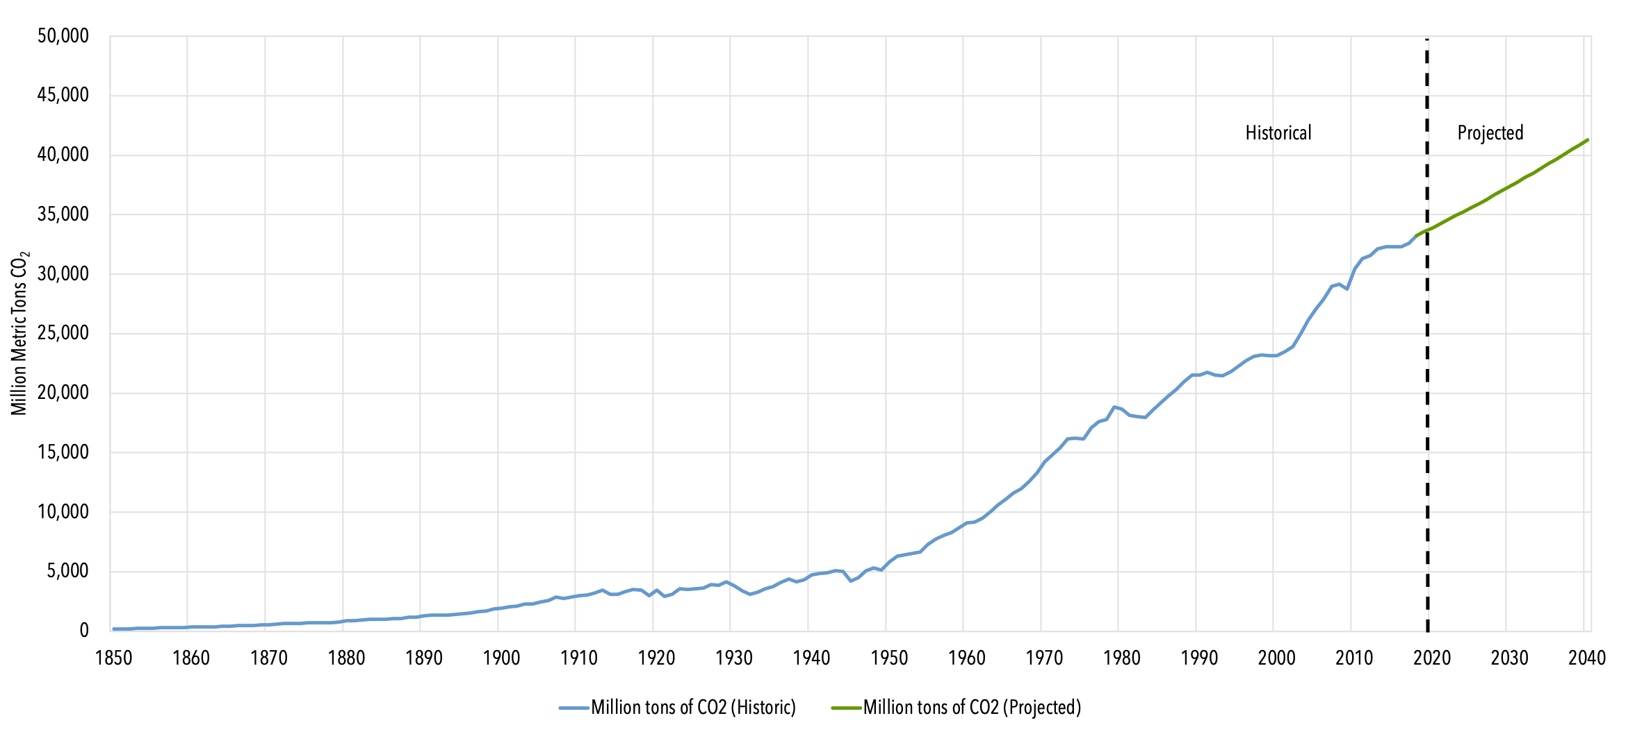
Projected growth in greenhouse gas emissions
Source: Center for Climate and Energy Solutions: https://www.c2es.org/content/international-emissions/

Slide 46
In a Nutshell:
We must rapidly decarbonize the global economy
Economic development of poor nations depends crucially on greatly increasing per-capita energy consumption
Far more rapid growth in electricity production required to decarbonize transportation (batteries, synthetic fuels)
Still need non-electrical energy for high-temperature industrial applications
Conservation will help, but not nearly enough

Slide 47
What it would take to decarbonize the global economy by 2040
Projected global electrical power consumption in 2040: 5 trillion Watts: includes vehicle electrification. (2.5 trillion Watts today)
Total projected global energy consumption ~ 25 trillion Watts

Slide 48
Solutions and Opportunities
Renewables (solar and wind)
  Rapidly falling PV and wind turbine costs
  At low (<~30%) market penetration, intermittency dealt with through baseload (mostly coal, natural gas) backup --- must maintain full baseload capacity
  At high market penetration must rely on storage
  Best current and near-term projected method: Lithium-ion batteries¹
  For 12-hours storage capacity, $4000/Kwh projected for 2025¹
  By 2040 will need 5 trillion W capacity globally
  Will cost $ 1 trillion/yr for 20 years
  But current lifetime of Li-ion is only 10 years
  Addition $2 trillion/yr maintenance costs. Only buys 12 hrs storage
¹ U.S. department of Energy: “Energy Storage Technology and Cost Characterization Report”, July 2019

Slide 49
Solutions and Opportunities
Gas with Carbon sequestration
  Sequestration currently $200/ton
  Prospects for $100/ton
  Projected emissions in 2040: 40 billion tons/yr
  Cost: $ 4 trillion/yr
  Need to add projected costs of natural gas: ~$ 2 trillion/yr
  Total cost per year: ~$ 6 trillion (just electricity)

Slide 50
Solutions and Opportunities
Nuclear fission
  Projected electricity demand equivalent to output of 2500 2- GW nuclear reactors
  Would need to build 125 2-GW reactors per year
  Current cost to build one 2-GW reactor in South Korea: $4 billion
  Would need to spend $500 billion per year
  This is about 0.6% of current world domestic product
  Service life > 80 years
  In 1970s and 1980s Sweden built one 4 GW reactor per 10 million residents per year
  Scaled up to world population: 750 4-GW reactors/year

Slide 51
Non-climate savings from elimination of fossil fuels
World Health Organization: 4.2 million premature deaths annually from particulate pollution
Global “economic value of life”: $100,000
By 2040 we would be saving $400 billion per year in the economic value of lives saved
Brings net costs (of nuclear) to $100 billion /year, 0.1% of WDP
In addition, cheap green energy would permit large increases in per capita wealth in developing world
Energy conversion would likely yield NET benefit even before climate change is considered
Climate costs of continued dependence on fossil fuels could be very, very large compared to these numbers ($3 trillion/yr estimated by Intelligence Unit of Economist Magazine)

Slide 52
Summary of Main Points
Several aspects of climate science are well established
Earth’s climate is strongly bounded but shows strong sensitivity within the bounds
Climate science dates back well into the 19th century and is well established

Slide 53
Summary of Main Points
Earth’s greenhouse effect triples the amount of radiation absorbed by the surface though it is regulated by trace gases comprising no more than 0.04% of the mass of the atmosphere. The concentration of CO₂ has increased by ~45% since the dawn of the industrial revolution
Beginning with the calculations of Arrhenius more than 100 years ago, simple models predict an increase in global mean surface temperature of around 3 ºC for each doubling of CO₂. These are consistent with the results of global climate models
Long atmospheric lifetime (~1000 years) of CO₂ limits window of time in which serious risks could be curtailed

Slide 54
Summary of Main Points
We are altering the composition of our atmosphere at considerable risk to ourselves and to future generations
Where there is risk there is also opportunity: Cheap clean power offers pathways to increase the quality of life globally
We need to adopt a combination of different energy sources to most rapidly and inexpensively decarbonize our economy

