Slide 1

Quantifying Climate Risks
Kerry Emanuel
Lorenz Center, MIT
Notes:
1

Slide 2
Program
Global warming in context
Climate risks
Quantitative estimates of climate risks
Implications for legal proceedings

Slide 3

Svante Arrhenius, 1859-1927
“Any doubling of the percentage of carbon dioxide in the air would raise the temperature of the earth's surface by 4°; and if the carbon dioxide were increased fourfold, the temperature would rise by 8°.” – Världarnas utveckling (Worlds in the Making), 1906

Slide 5
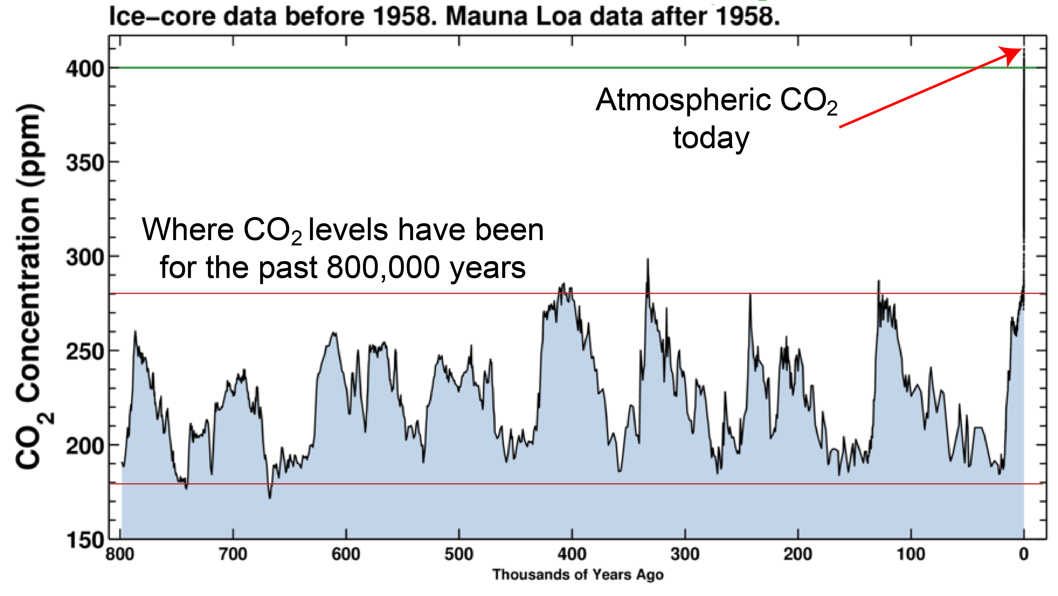

Slide 6

CO₂ May Go Well Beyond Doubling
Double Pre-Industrial

Slide 7

IPCC 2007: Doubling CO₂ will lead to an increase in mean global surface temperature of 2 to 4.5 ºC.
Atmospheric CO₂ assuming that emissions stop altogether after peak concentrations
Global mean surface temperature corresponding to atmospheric CO₂ above
Courtesy Susan Solomon

Slide 8
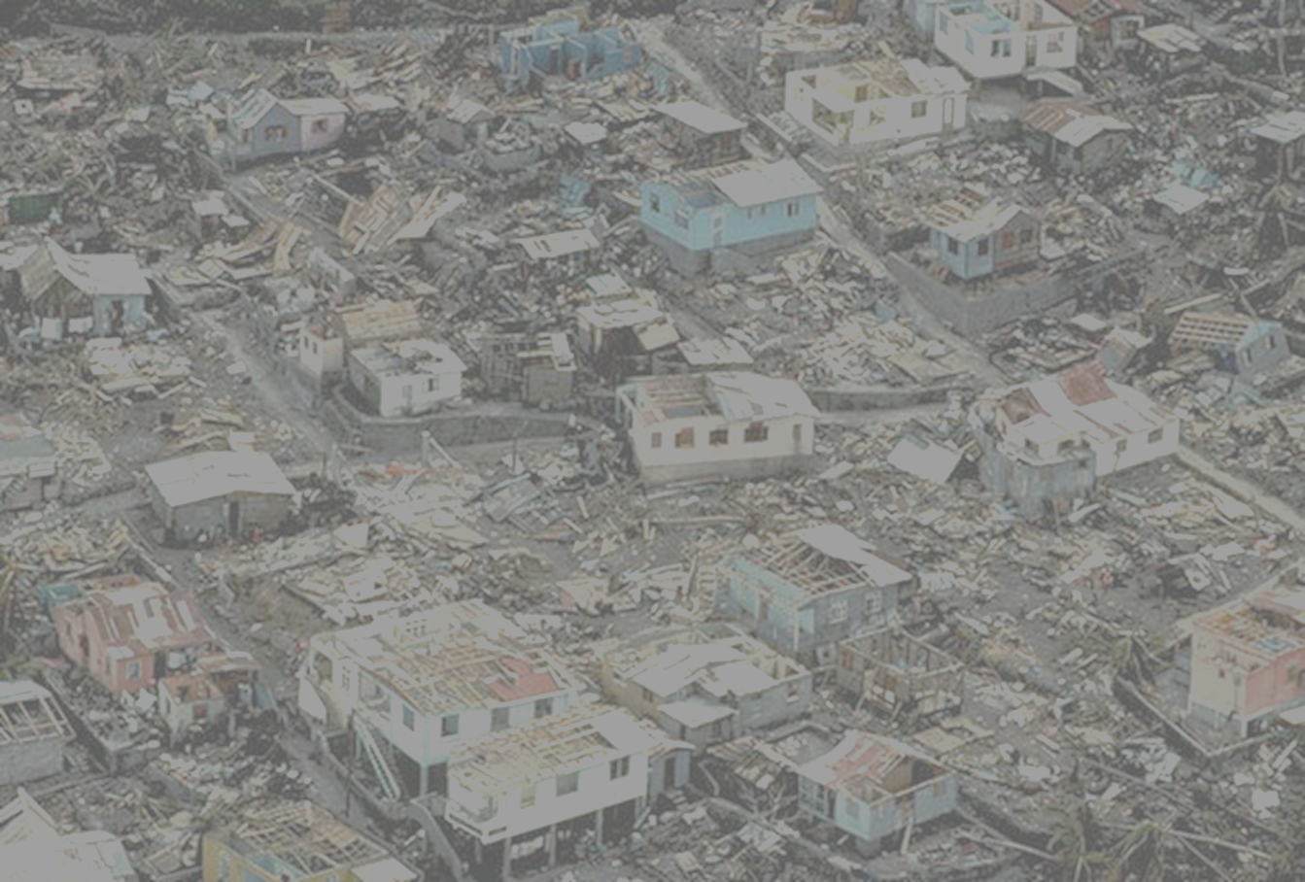
Climate Risks

Slide 9
Climate Risks
No one really cares whether the world will warm up by 3-5 C (nor should they)
We care about real risks: Heat waves, wild fires, hurricanes, droughts, floods, etc.
We need to quantify these risks, including uncertainty, to position ourselves to make intelligent choices
Insurance is one instrument for quantifying risk, but it is not currently even accounting for climate change that has already occurred
Science is positioned to make rapid progress in quantifying climate risk

Slide 10
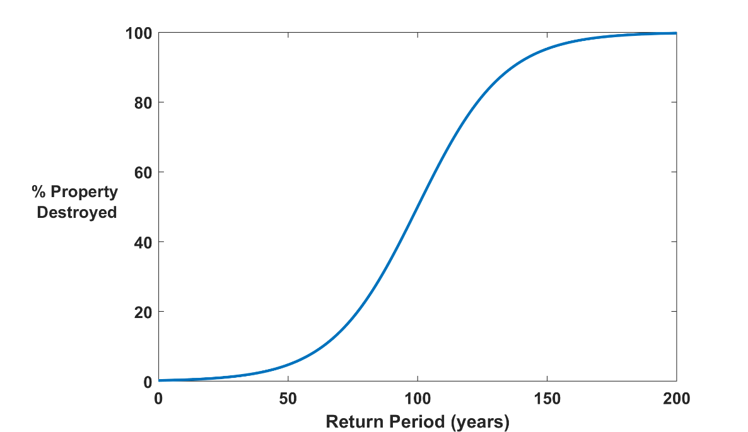

Why Climate Risk is Dominated by Extreme Events:
Societies are usually well adapted to frequent events (> 1/100 yr)
Societies are often poorly adapted to rare events (< 1/100 yr)
Large cost increases result when > 100-yr events become < 100-yr events
Largest slope

Slide 11
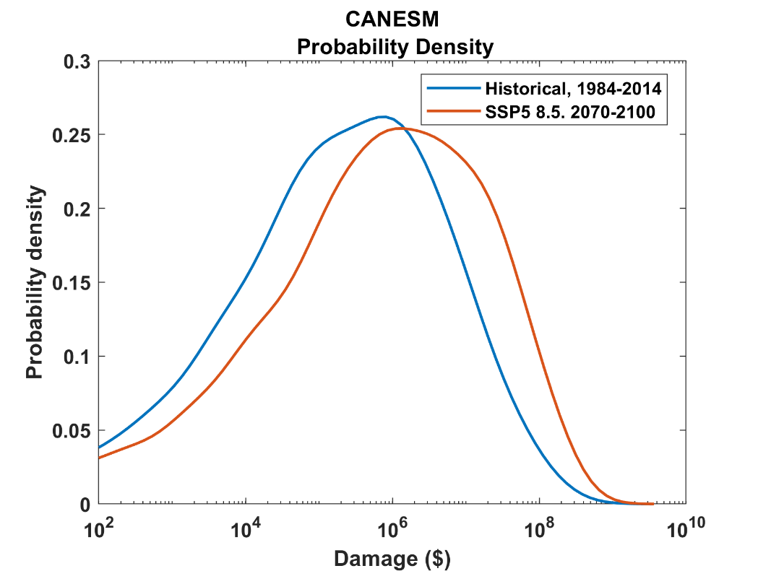
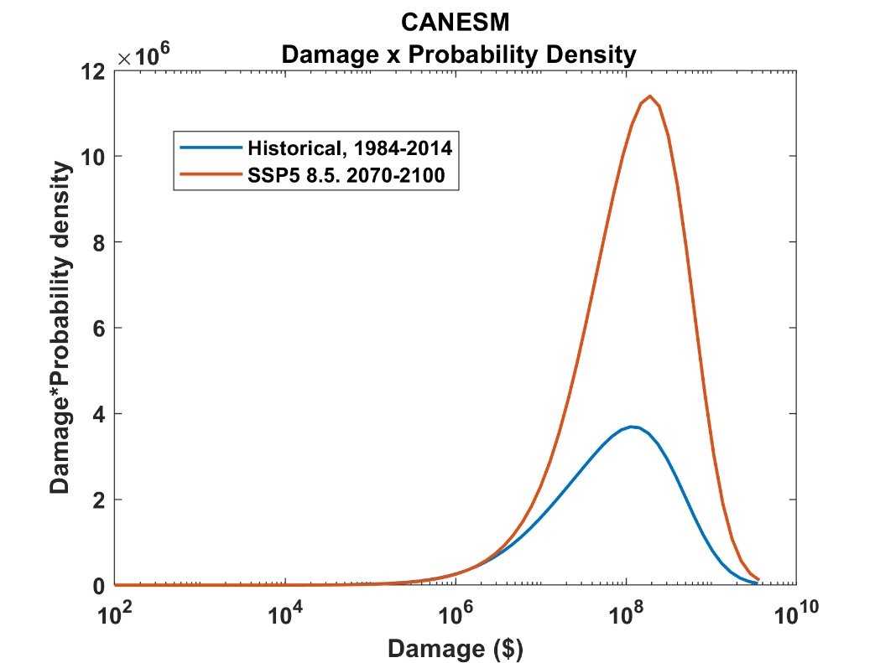
Getting it right means getting the low-probability, high cost events. For example, hurricanes:
1984-2014
2070-2100
2070-2100
1984-2014
Probability
Cost

Slide 12
Flawed Basis of Current Risk Assessments
Almost all current risk assessments, including those used in legal proceedings, are based on historical statistics.
Historical records are flawed and short, particularly outside North America
Moreover, the past 50-150 years is a poor guide to the present owing to climate change that has already occurred
Industry risk modelers have been slow to migrate to a physics- based approach

Slide 13
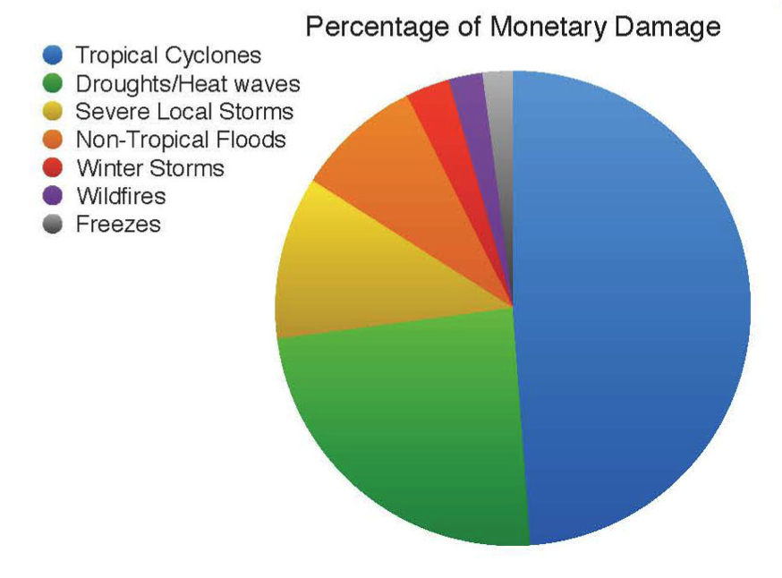
Total US Damages by Natural Hazard, 1980-2012
Source: NOAA

Slide 14
Quantifying Climate Risks:
Hurricanes as an Example

Slide 15
The Global Hurricane Hazard
About 10,000 deaths per year since 1971
$700 Billion 2015 U.S. Dollars in Damages since 1971
Global population exposed to hurricane hazards has tripled since 1970
EM-DAT, 2016: The OFDA/CRED International Disaster Database
http://www.emdat.be/.

Slide 16
Questions So Far?

Slide 17
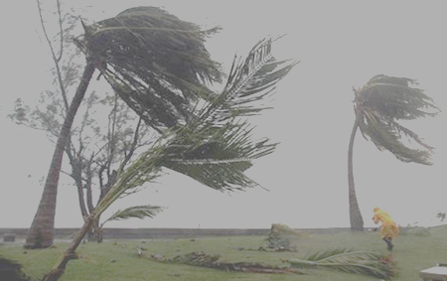
Is Hurricane Risk Changing?

Slide 18
Global Tropical Cyclone Damage Normalized by Gross World Product
380% increase since 1970
Population of TC-prone regions increased by ~200%
Suggests that climate change has contributed to increasing damage
EM-DAT, 2020: The OFDA/CRED International Disaster Database
http://www.emdat.be/.

Slide 19
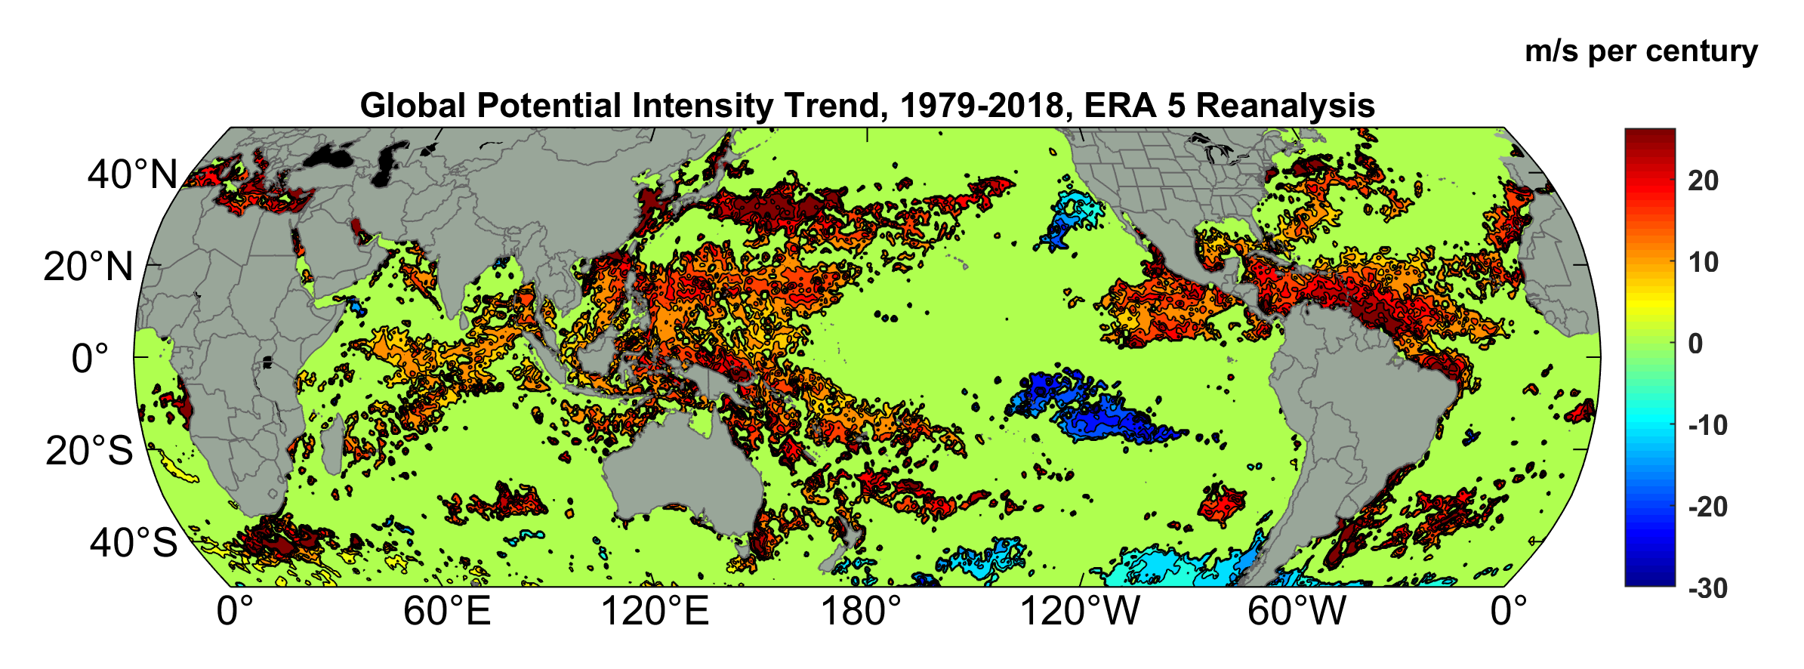
Observed Trend in “Speed Limit” for Hurricanes
Potential Intensity Trend, 1979-2018, ERA 5 Reanalysis
(Trend shown only where p value < 0.05)

Slide 20
Satellite-derived proportion of major hurricane fixes
Time series of fractional proportion of global major hurricane estimates to all hurricane estimates for the period 1979–2017. Each point, except the earliest, represents the data in a sequence of 3-y periods. The first data point is based on only 2 y (1979 and 1981) to avoid the years with no eastern hemisphere coverage. The linear Theil−Sen trend (black line) is significant at the 98% confidence level (Mann−Kendall P value = 0.02). The proportion increases by 25% in the 39-y period (about 6% per decade).
Kossin et al., PNAS, 2020

Slide 21
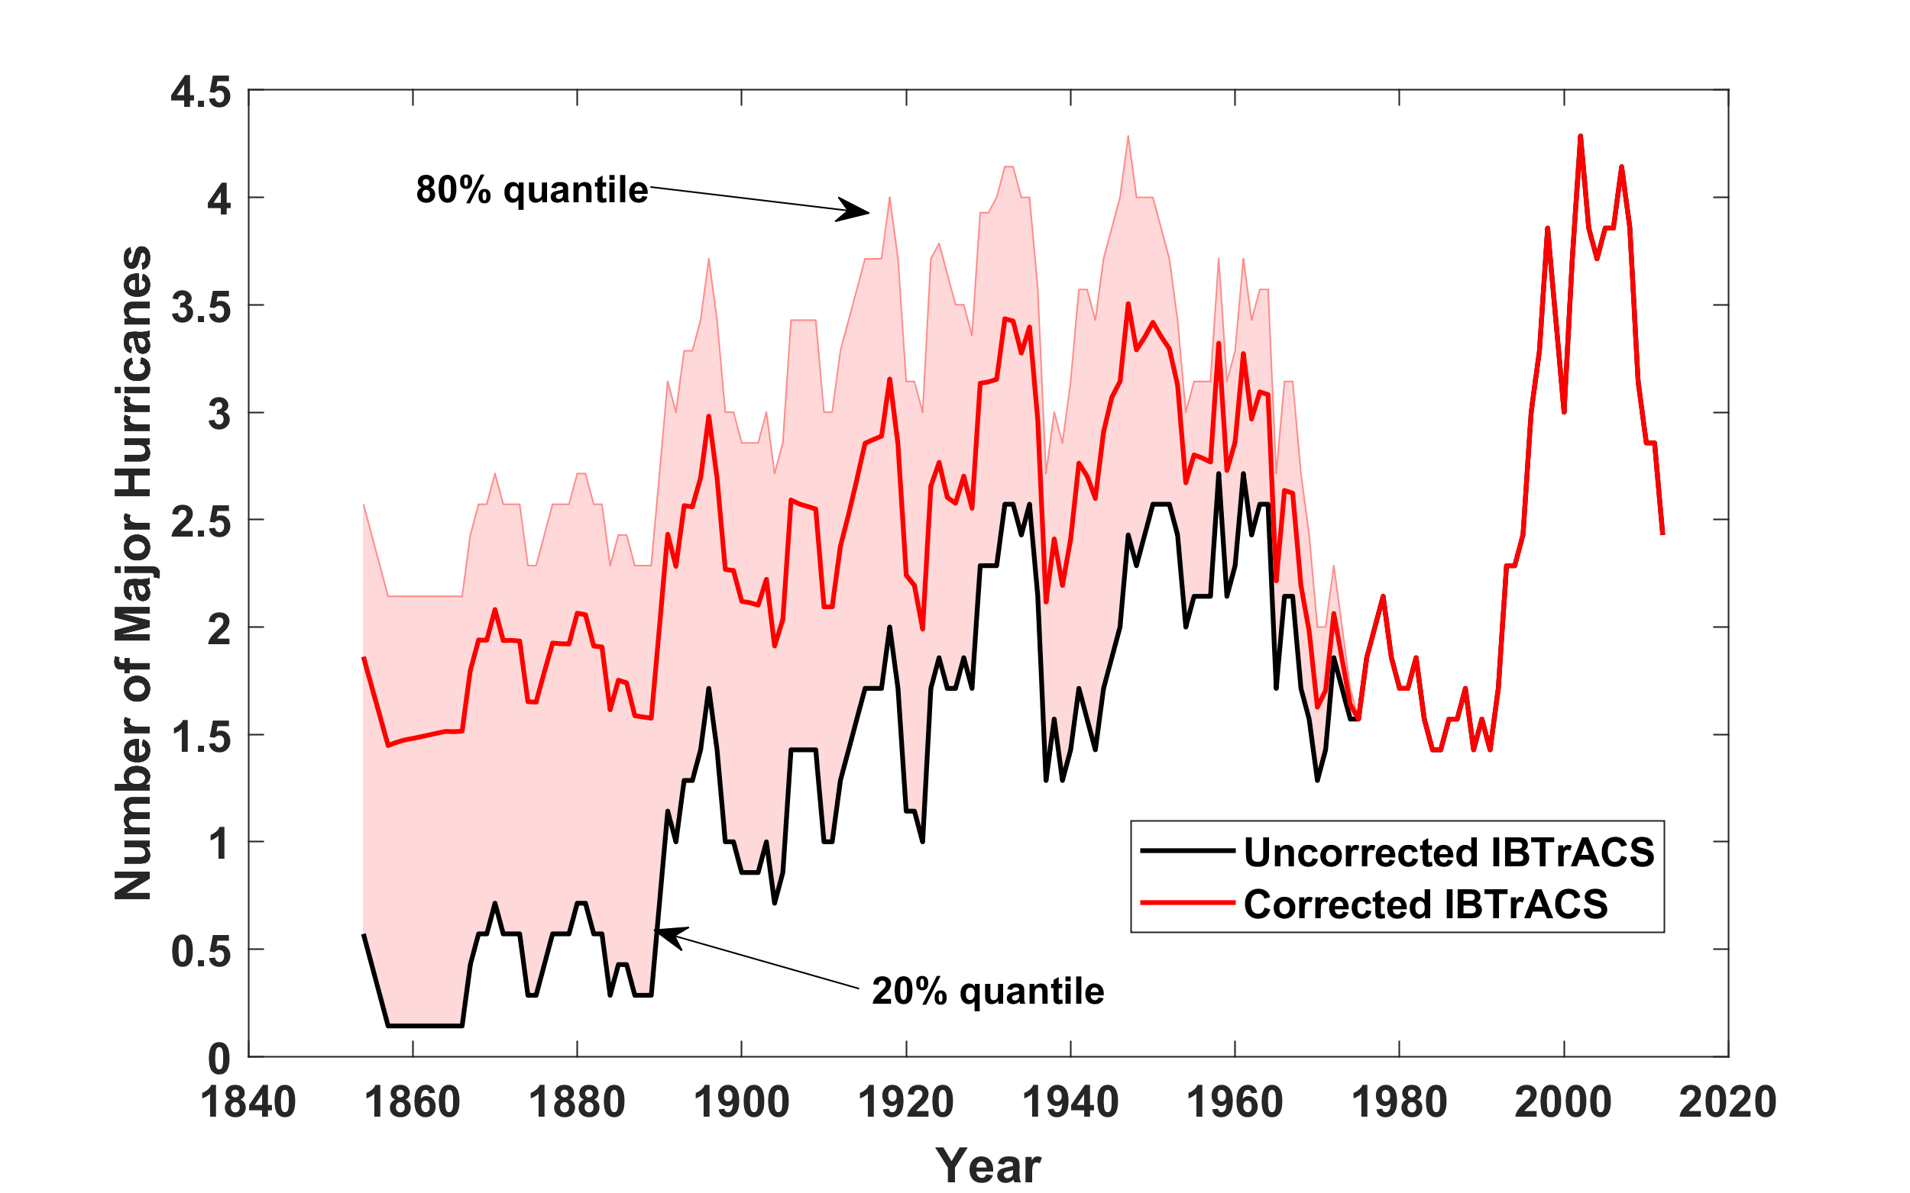
Red Shading Shows Uncertainty in North Atlantic Hurricane Occurrence
Data from Vecchi et al., Nature Comm., 2021

Slide 22
Historical tropical cyclone database vastly insufficient for quantitative evaluation of current risk and risk trends

Slide 23
Doing it right:
Bring Physical Models to Bear on Risk Estimation
Satellite Image
Global Weather Forecast Model

Slide 24
But today’s global climate models cannot simulate hurricane at all well

Slide 25
To get the tails right we need to simulate many events
We have learned how to downscale ~100,000 hurricanes from climate models, using an advanced, very high resolution hurricane model embedded in global climate analyses or models

Slide 26
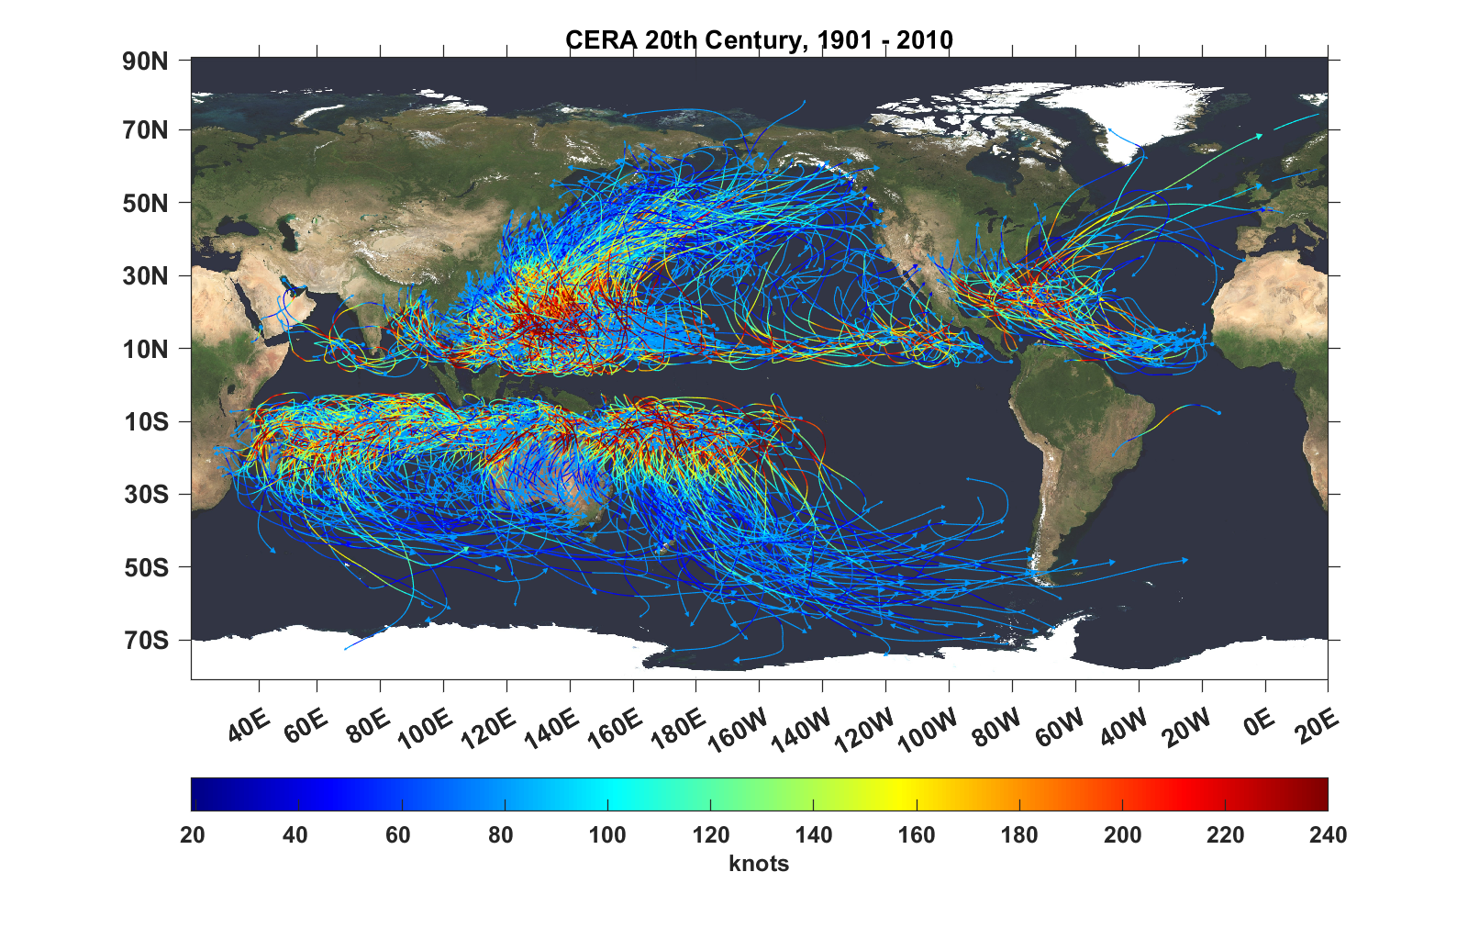
Top 1,000 storms Downscaled from CERA 20th Century Reanalysis

Slide 27
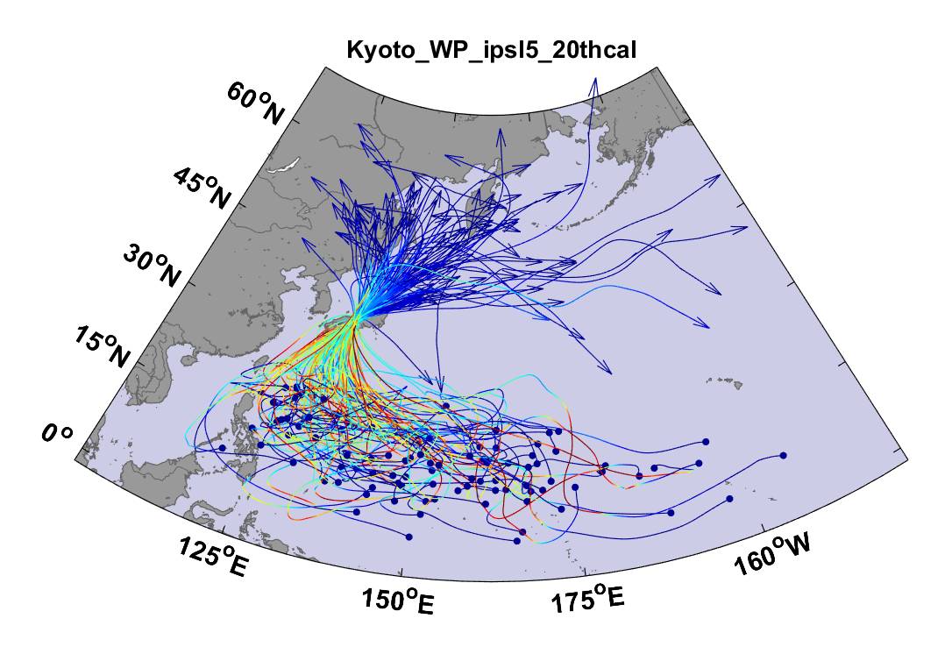
Example:
Top 100 out of 2000 TCs Affecting Kyoto, 1981-2000

Slide 28
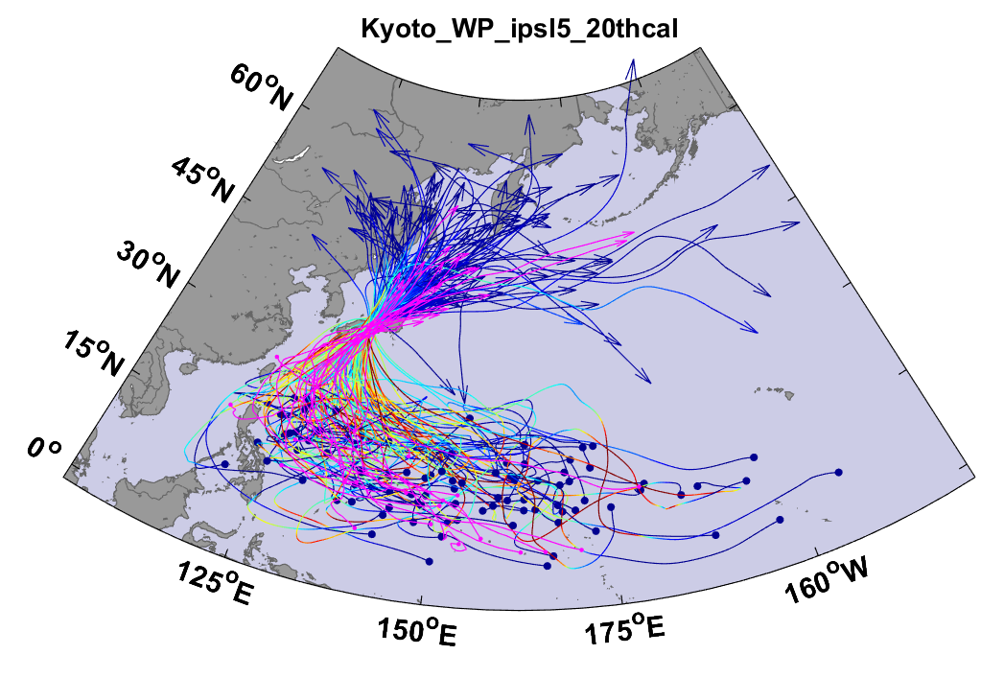
Same, but with top 20 historical tracks

Slide 29
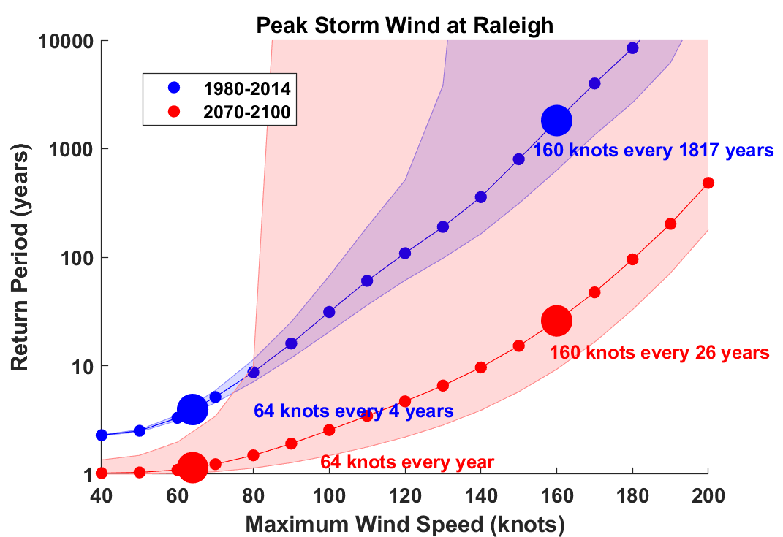

Slide 30
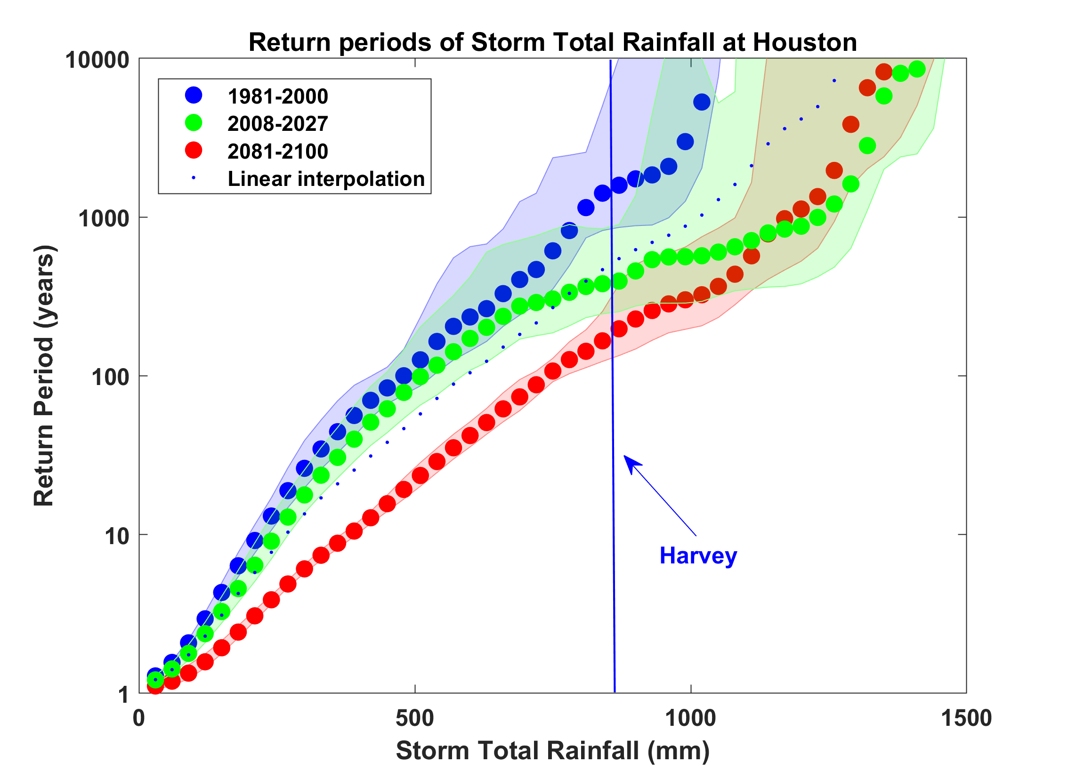
Probability of Storm Accumulated Rainfall in Harris County, from 6 Climate models, 1981-2000, 2008-2027, and 2081-2100, Based on 2000 Events Each, and Using RCP 8.5. Shading Shows Spread Among the Models.

Slide 31
Example: Flooding from Hurricane Harvey, 2017
Three independent scientific studies appeared in 2017:
van Oldenborgh et al: “We conclude that global warming made the precipitation about 15% (8%–19%) more intense, or equivalently made such an event three (1.5–5) times more likely.”
Risser and Wehner: “We find that human-induced climate change likely increased the chances of the observed precipitation accumulations during Hurricane Harvey in the most affected areas of Houston by a factor of at least 3.5.”
Emanuel: “In 2017 the annual probability [of Hurricane Harvey’s rainfall in Harris County] would be 6%, a sixfold increase since the late 20th century.

Slide 32
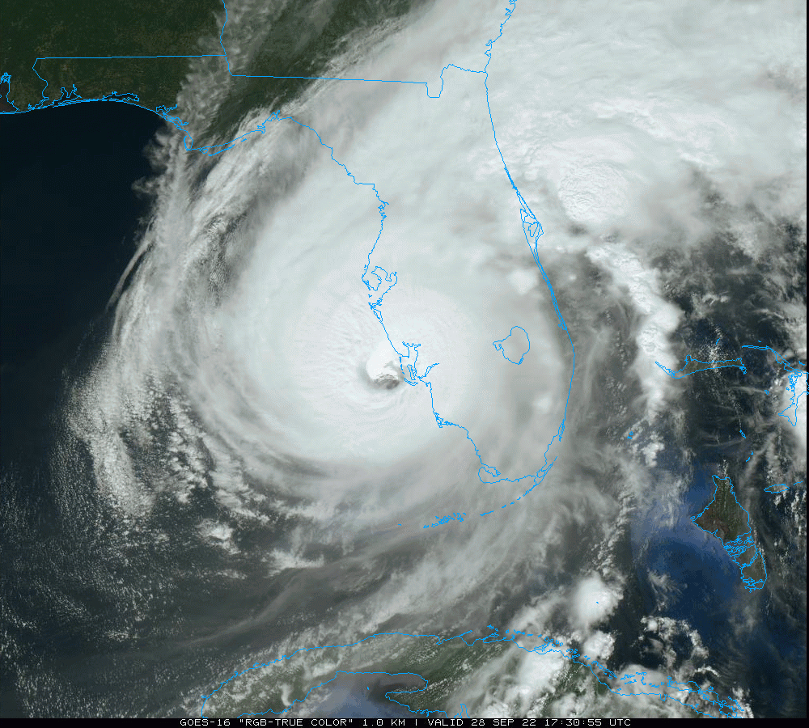
Questions So Far?
Hurricane Ian, 2022

Slide 33
Accounting for All Climate Risks

Slide 34
Hsiang et al., Science, 2017

Slide 35
Hsiang et al., Science, 2017
Total direct damage to U.S. economy, summed across all assessed sectors, as a function of global mean temperature change. Dot-whiskers indicate the distribution of direct damages in 2080 to 2099 (averaged) for multiple realizations of each combination of climate models and scenario projection (dot, median; dark line, inner 66% credible interval; medium line, inner 90%; light line, inner 95%). Green are from RCP2.6, yellow from RCP4.5, red from RCP8.5

Slide 36
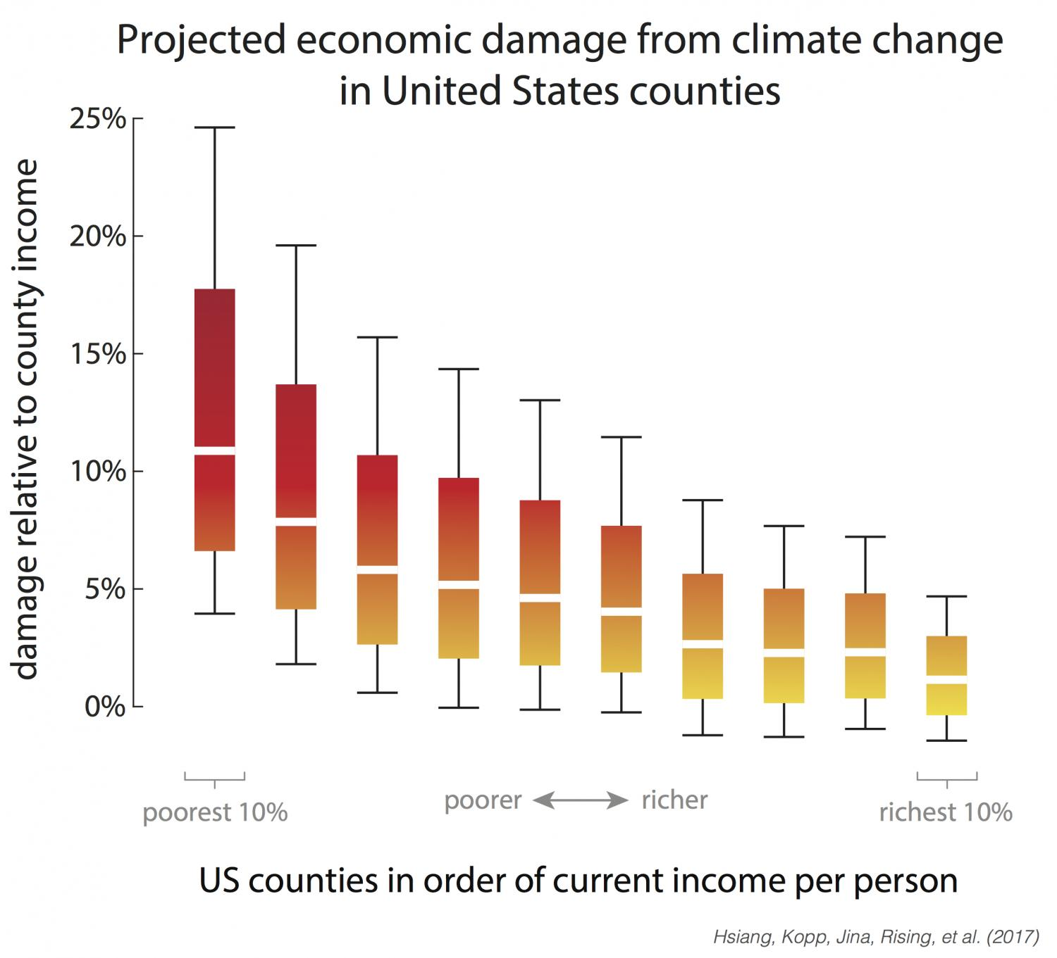
Range of economic damages per year for groupings of US counties, based on their income (29,000 simulations for each of 3,143 counties). The poorest 10% of counties are the leftmost box plot. The richest 10% are the rightmost box plot. Damages are fraction of county income. White lines are median estimates, boxes show the inner 66% of possible outcomes, outer whiskers are inner 90% of possible outcomes.

Slide 37
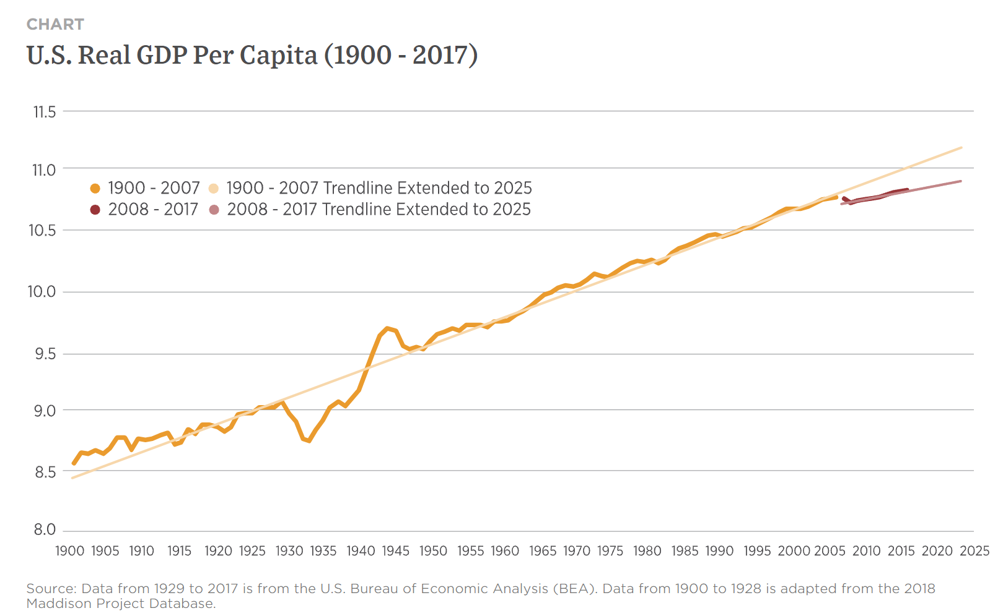
At peak, U.S spent ~40% of its GDP on war effort
But loss of GDP from climate change likely to be sustained over many years.
“Many people do not appreciate that this is actually a few percent per year, every year.” – Amir Jina, co-author
Great Depression
3.3% drop

Slide 38

Summary of Main Points
We are altering the composition of our atmosphere at considerable risk to ourselves and to future generations
Long-term risk is dominated by extreme events
Historical records inadequate for estimating future and current weather risks

Slide 39
Summary of Main Points
We need to embrace advanced physical modeling techniques for assessing climate risks
It is likely that expert witnesses in future legal proceedings will increasingly rely on physical modeling as evidence of current and future climate risk

Slide 40
At best, climate science will only be able to quantify the probability that climate change has and/or will contribute to some particular weather event or class of events
How do courts deal with probabilistic information?

