Slide 1
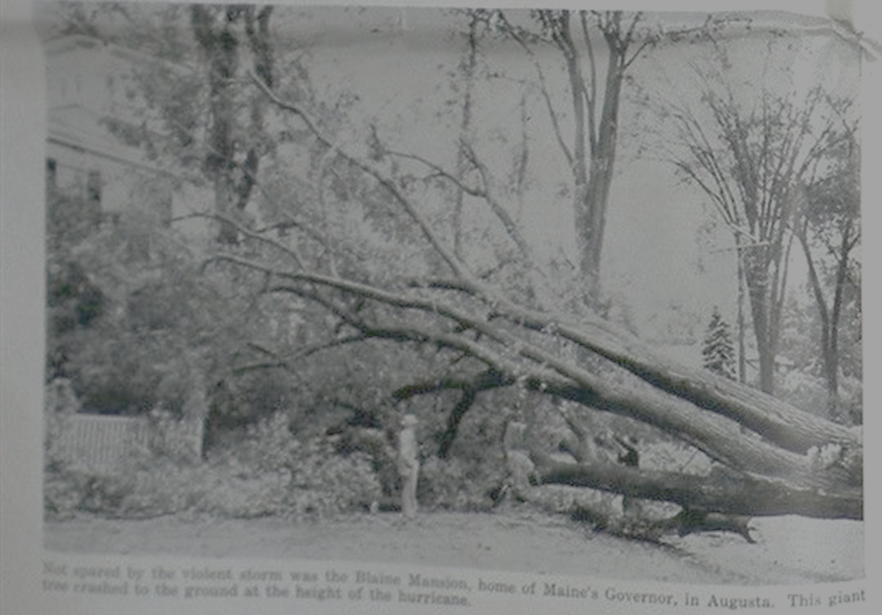
Hurricanes in Midcoast Maine: Past, Present, & Future
Kerry Emanuel
Massachusetts Institute of Technology

Slide 2
Program
Historical and recent storms affecting midcoast Maine
The nature of natural hazard risk
Using physics to assess long-term hurricane risk in Maine
Hurricane risk in a changing climate

Slide 3

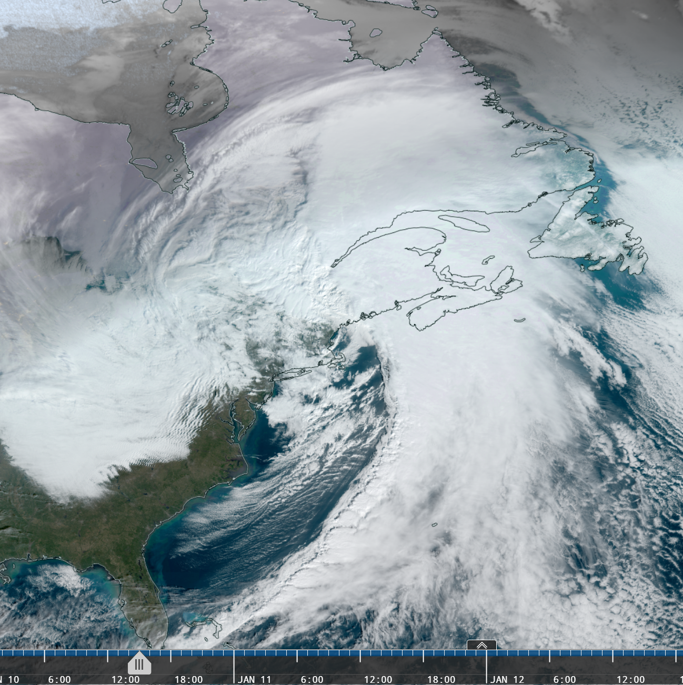
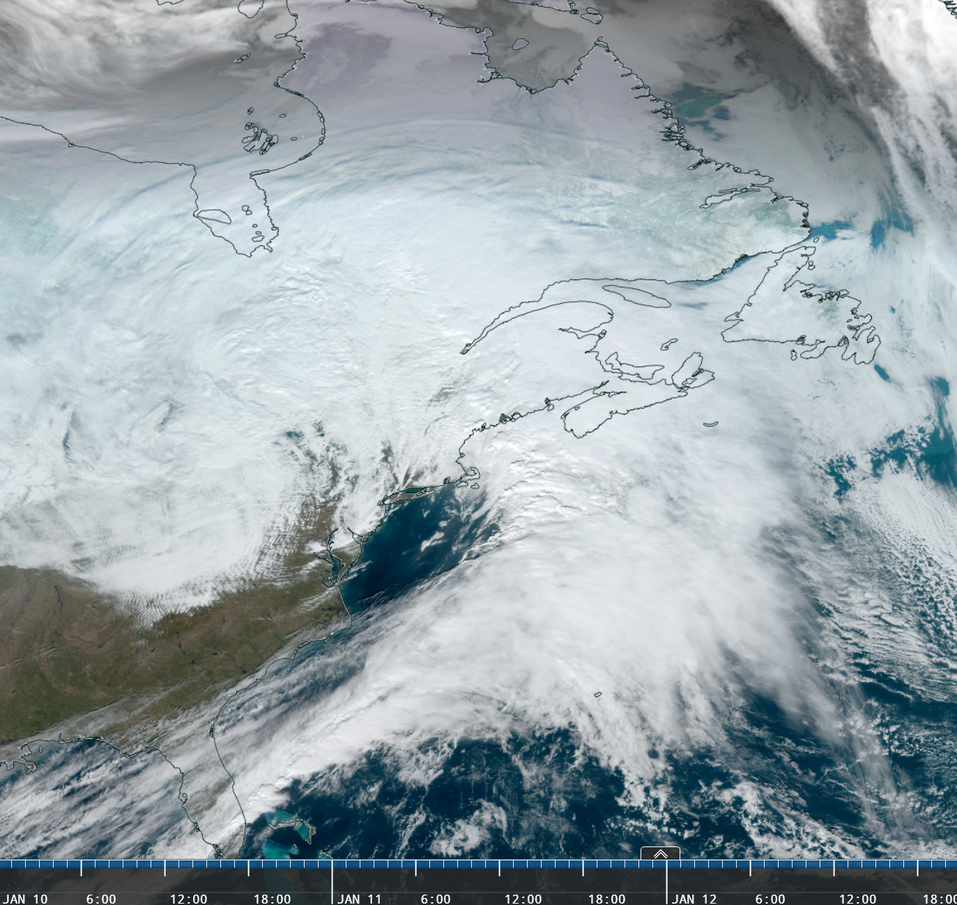
Winter Storms of January 10 and 13, 2024
GOES-East Geocolor
1500 UTC 10 Jan 2024 1800 UTC 13 Jan 2024
Prepared by Joseph Sienkiewicz - NOAA
Notes:
Subtle differences in satellite presentation – the cold front with the 10th storm is much stronger and better defined with very active convective cells. Also, from SW New England, across weather Long Island and southern NJ into SE PA, looks to be a secondary cold front. No such feature in the Jan 10th storm.

Slide 4
Hurricane Force
Storm
Gale
High
Tide
Prepared by Joseph Sienkiewicz - NOAA
Notes:
MISM1 – wind observations for both the Jan 10th and 13th storms – 10 min wind speeds and hourly peak gusts. The graphs are adjusted as close as possible to the same time in a relative sense to the high waters for Camden at 0924 EST 10 Jan and 1154 EST 13 Jan.

Slide 5
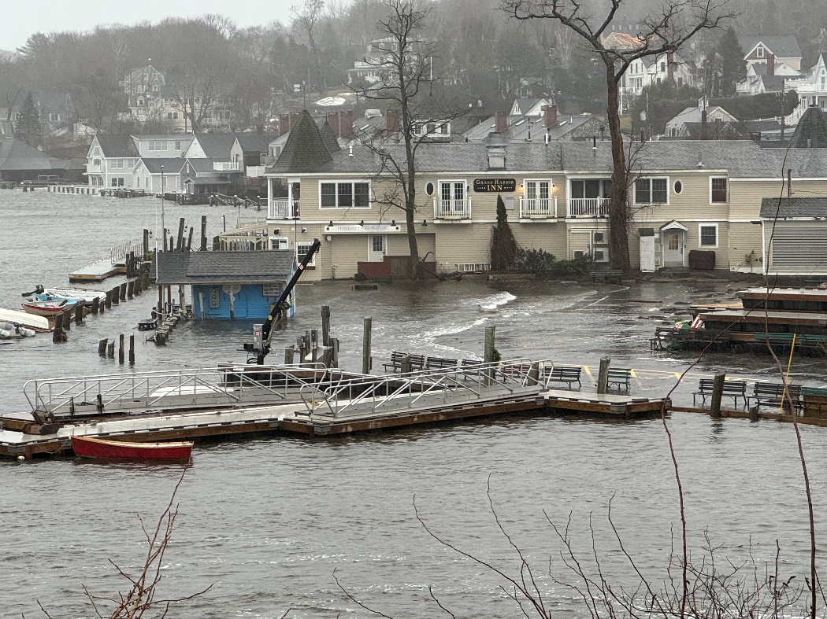
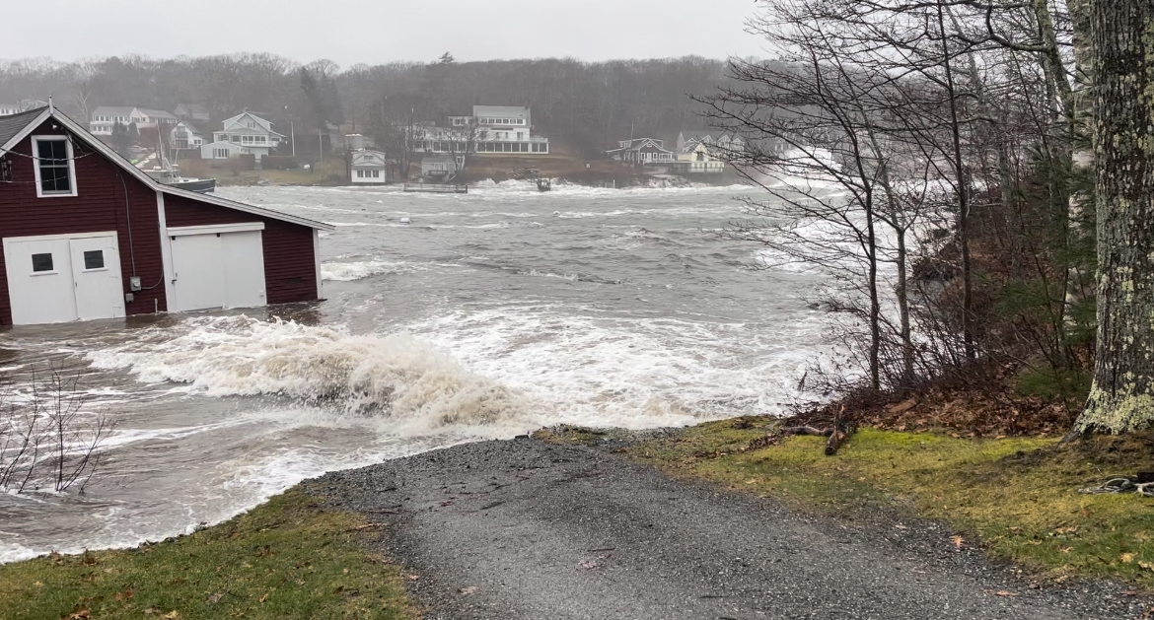
Camden
Estimated damage of $70 million from both storms across Maine
New Harbor

Slide 6
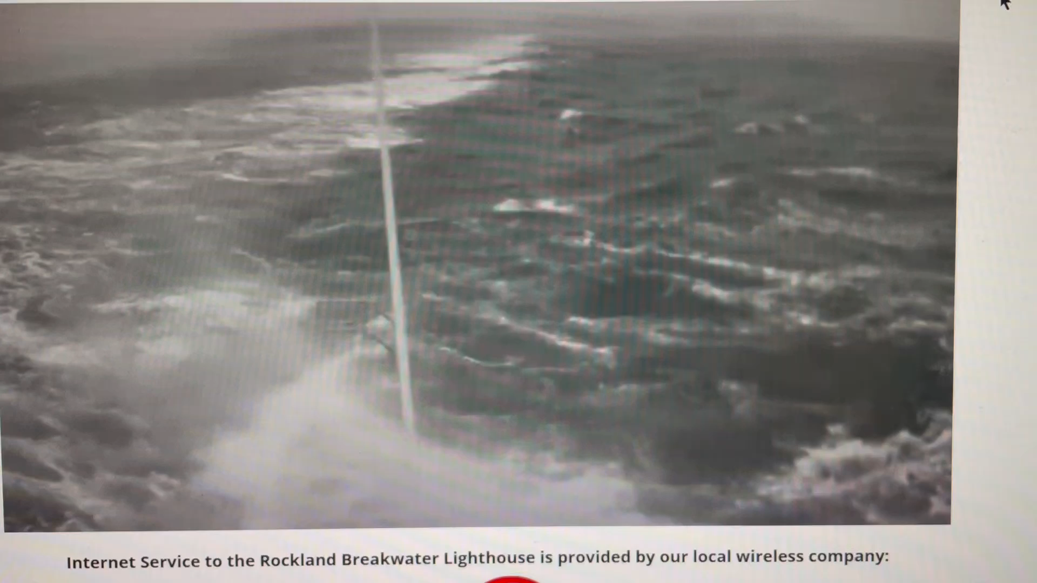
Rockland Breakwater

Slide 7
Storm name | Surge level (ft) | Normal Tide Level (STND, ft) at Rockland | Estimated max water level (ft) | Interpolated Maximum Water level (STND)
2024-01-13 | 2.75 | 15 | 17.75 | 21.04
2024-01-10 | 2.78 | 14.5 | 17.28 | 20.42
2007-04-16 | 1.65 | 14 | 15.65 | 20.4
1976-03-16 | 0.75 | 13 | 13.75 | 20.36
1978-01-09 | 2.7 | 15 | 17.7 | 20.17
1978-02-07 | 2 | 12 | 14 | 20.16
2018-01-04 | 3.23 | 10.5 | 13.73 | 20
2022-12-23 | 2.5 | 12.8 | 15.3 | 19.9
1959-12-29 | 1.53 | 16 | 17.53 | 19.9
1979-01-28 | 0.69 | 16.2 | 16.89 | 19.72
2020-04-10 | 0.75 | 12.7 | 13.45 | 19.7
1990-12-04 | 1.86 | 15 | 16.86 | 19.7
1987-01-02 | 2.44 | 15 | 17.44 | 19.6
1958-04-07 | 1.38 | 15 | 16.38 | 19.45
1944-11-30 | 2.74 | 16 | 18.74 | 19.37
1963-01-27 | 3.04 | 13.5 | 16.54 | 19.2
1931-03-04 | 1.8 | 15 | 16.8 | 19.17
1953-02-16 | 2.8 | 15 | 17.8 | 19.1
1940-04-21 | 1.64 | 16 | 17.64 | 19.07
2020-11-16 | 1.58 | 15 | 16.58 | 19
1972-02-19 | 3.13 | 14 | 17.13 | 18.9
1945-12-20 | 1.27 | 16 | 17.27 | 18.32
Carol-1954 | 2.36 | 13 | 15.36 | 18.1
Bob-1991 | 1.46 | 12 | 13.46 | 16.8
Edna-1954 | 2.84 | 12.5 | 15.34 | 16.6
Donna-1960 | 2.41 | 8 | 10.41 | 16.5
Ginny-1963 | 0.95 | 4 | 4.95 | 16.3
Gerda-1969 | 1.23 | 10 | 11.23 | 16
Water Levels at Rockland (interpolated between Bar Harbor and Portland)
Sorted by Maximum Water Level
(colored lines are events since 2018)

Slide 8
Storm name | Surge level (ft) | Normal Tide Level (STND, ft) at Rockland | Estimated max water level (ft) | Interpolated Maximum Water level (STND)
2018-01-04 | 3.23 | 10.5 | 13.73 | 20
1972-02-19 | 3.13 | 14 | 17.13 | 18.9
1963-01-27 | 3.04 | 13.5 | 16.54 | 19.2
Edna-1954 | 2.84 | 12.5 | 15.34 | 16.6
1953-02-16 | 2.8 | 15 | 17.8 | 19.1
2024-01-10 | 2.78 | 14.5 | 17.28 | 20.42
2024-01-13 | 2.75 | 15 | 17.75 | 21.04
1944-11-30 | 2.74 | 16 | 18.74 | 19.37
1978-01-09 | 2.7 | 15 | 17.7 | 20.17
2022-12-23 | 2.5 | 12.8 | 15.3 | 19.9
1987-01-02 | 2.44 | 15 | 17.44 | 19.6
Donna-1960 | 2.41 | 8 | 10.41 | 16.5
Carol-1954 | 2.36 | 13 | 15.36 | 18.1
1978-02-07 | 2 | 12 | 14 | 20.16
1990-12-04 | 1.86 | 15 | 16.86 | 19.7
1931-03-04 | 1.8 | 15 | 16.8 | 19.17
2007-04-16 | 1.65 | 14 | 15.65 | 20.4
1940-04-21 | 1.64 | 16 | 17.64 | 19.07
2020-11-16 | 1.58 | 15 | 16.58 | 19
1959-12-29 | 1.53 | 16 | 17.53 | 19.9
Bob-1991 | 1.46 | 12 | 13.46 | 16.8
1958-04-07 | 1.38 | 15 | 16.38 | 19.45
1945-12-20 | 1.27 | 16 | 17.27 | 18.32
Gerda-1969 | 1.23 | 10 | 11.23 | 16
Ginny-1963 | 0.95 | 4 | 4.95 | 16.3
1976-03-16 | 0.75 | 13 | 13.75 | 20.36
2020-04-10 | 0.75 | 12.7 | 13.45 | 19.7
1979-01-28 | 0.69 | 16.2 | 16.89 | 19.72
Water Levels at Rockland (interpolated between Bar Harbor and Portland)
Sorted by Maximum Surge
(colored lines are events since 2018)

Slide 9
Storm name | Surge level (ft) | Normal Tide Level (STND, ft) at Rockland | Estimated max water level (ft) | Interpolated Maximum Water level (STND)
2018-01-04 | 3.23 | 10.5 | 13.73 | 20
1972-02-19 | 3.13 | 14 | 17.13 | 18.9
1963-01-27 | 3.04 | 13.5 | 16.54 | 19.2
Edna-1954 | 2.84 | 12.5 | 15.34 | 16.6
1953-02-16 | 2.8 | 15 | 17.8 | 19.1
2024-01-10 | 2.78 | 14.5 | 17.28 | 20.42
2024-01-13 | 2.75 | 15 | 17.75 | 21.04
1944-11-30 | 2.74 | 16 | 18.74 | 19.37
1978-01-09 | 2.7 | 15 | 17.7 | 20.17
2022-12-23 | 2.5 | 12.8 | 15.3 | 19.9
1987-01-02 | 2.44 | 15 | 17.44 | 19.6
Donna-1960 | 2.41 | 8 | 10.41 | 16.5
Carol-1954 | 2.36 | 13 | 15.36 | 18.1
1978-02-07 | 2 | 12 | 14 | 20.16
1990-12-04 | 1.86 | 15 | 16.86 | 19.7
1931-03-04 | 1.8 | 15 | 16.8 | 19.17
2007-04-16 | 1.65 | 14 | 15.65 | 20.4
1940-04-21 | 1.64 | 16 | 17.64 | 19.07
2020-11-16 | 1.58 | 15 | 16.58 | 19
1959-12-29 | 1.53 | 16 | 17.53 | 19.9
Bob-1991 | 1.46 | 12 | 13.46 | 16.8
1958-04-07 | 1.38 | 15 | 16.38 | 19.45
1945-12-20 | 1.27 | 16 | 17.27 | 18.32
Gerda-1969 | 1.23 | 10 | 11.23 | 16
Ginny-1963 | 0.95 | 4 | 4.95 | 16.3
1976-03-16 | 0.75 | 13 | 13.75 | 20.36
2020-04-10 | 0.75 | 12.7 | 13.45 | 19.7
1979-01-28 | 0.69 | 16.2 | 16.89 | 19.72
Water Levels at Rockland (interpolated between Bar Harbor and Portland)
Sorted by Maximum Surge
(colored lines are events since 2018; yellow lines are hurricanes)

Slide 10
Should we be worried about hurricanes in Maine?
YES!
Much rarer than winter storms, BUT
Can be somewhat more violent
Maine experienced quite a few hurricanes during 1950s and 60s, but only one serious hurricane (Bob) since 1972

Slide 11
Some Famous Maine Hurricanes

Slide 12
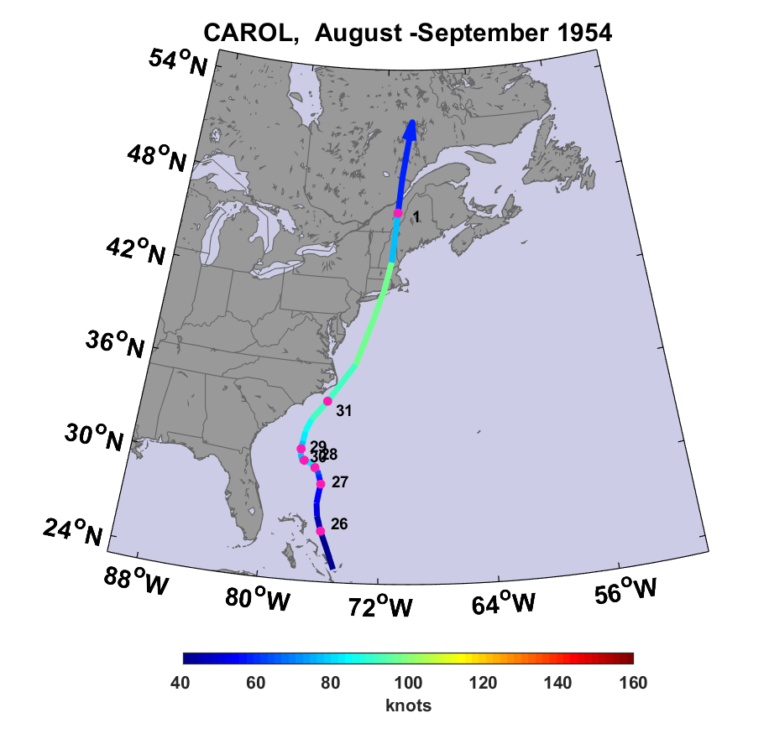
Red dots show 00 GMT positions

Slide 13
Hurricane Carol of 1954 in Maine
Three deaths in Maine; 65 deaths and 1,000 injuries in New England
$10 million in damages in Maine ($250 million in 2019 dollars)
$500 million in damages, New England ($12.5 billion 2019)
Peak wind gusts of 78 MPH in mid-coast Maine
2.25 inches of rain in places (not that much, but played into the Edna disaster a few weeks later)
Power lost in all of greater Portland
Most lobster fisherman reported damage
Three-quarters of the Maine apple crop destroyed
Closest approach to Rockland within 1 hour of low tide

Slide 14
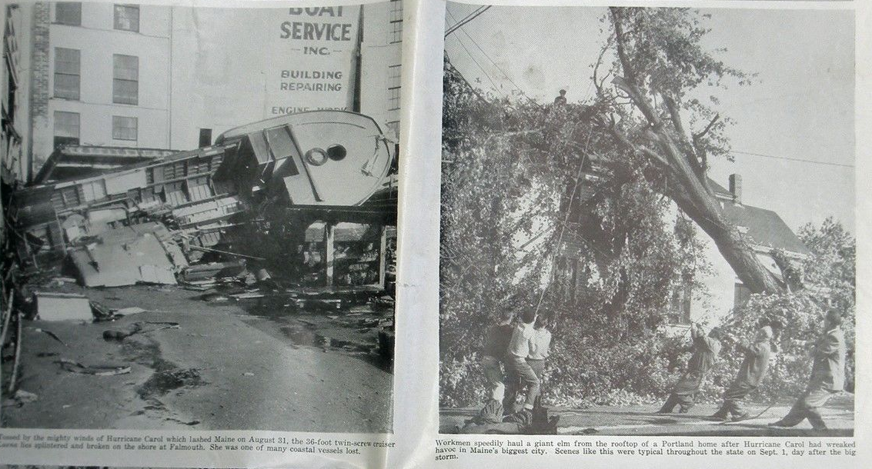
Falmouth, ME
Portland, ME

Slide 15
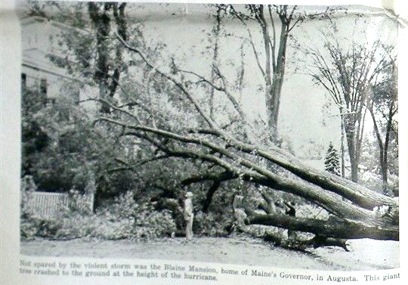
The Blaine Mansion, Augusta

Slide 16
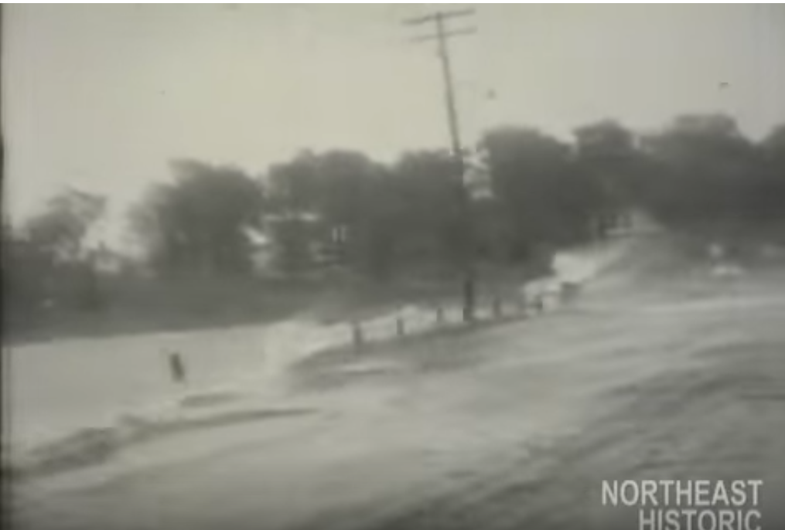
A scene in Maine during Carol

Slide 17
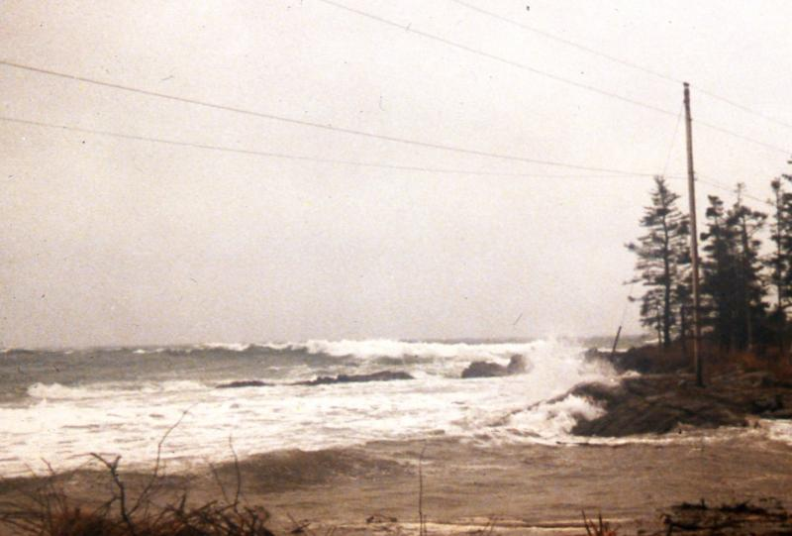
Looking SW from Ocean Point, Boothbay during Carol

Slide 18
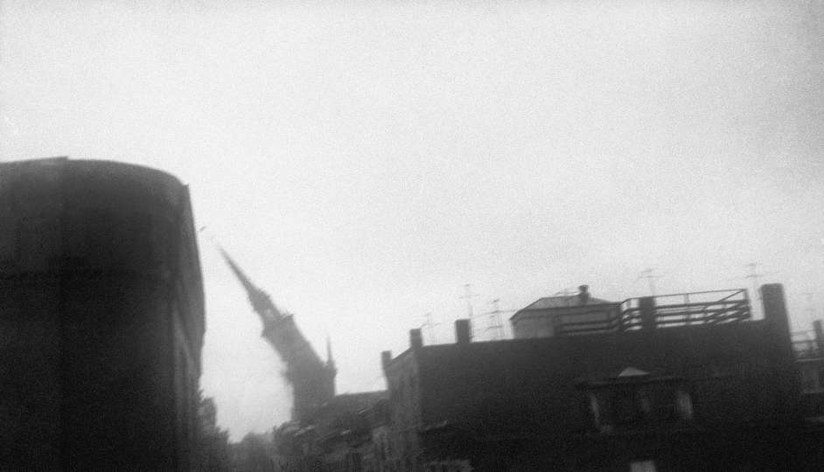
148-year-old steeple of the Old North Church in Boston falling during Hurricane Carol, 1954

Slide 19
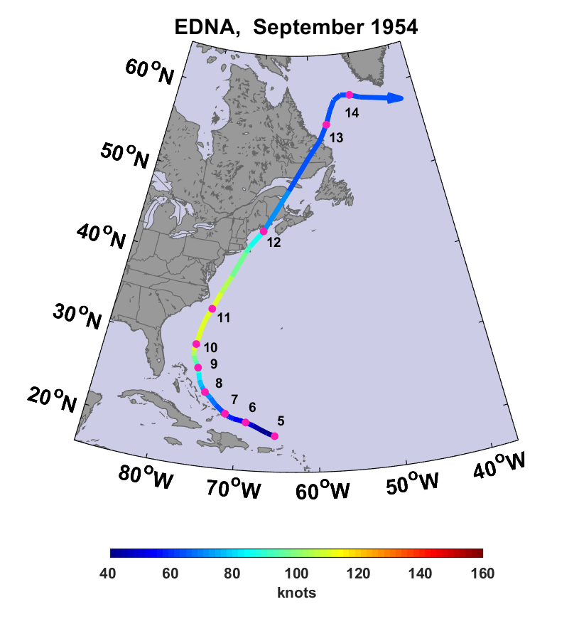

Slide 20
Hurricane Edna of 1954 in Maine
Eight deaths in Maine
$25 million damage in Maine ($240 million in 2019 dollars)
Peak wind gusts of 75 MPH in Maine
Rainfall totals as high as 7.5 inches
The Androscoggin and Kennebec rivers both reached above- normal levels, causing flooding and washing out roads
President Eisenhower declared Maine a disaster area
Closest approach to Rockland about 2.3 hours before high tide

Slide 21
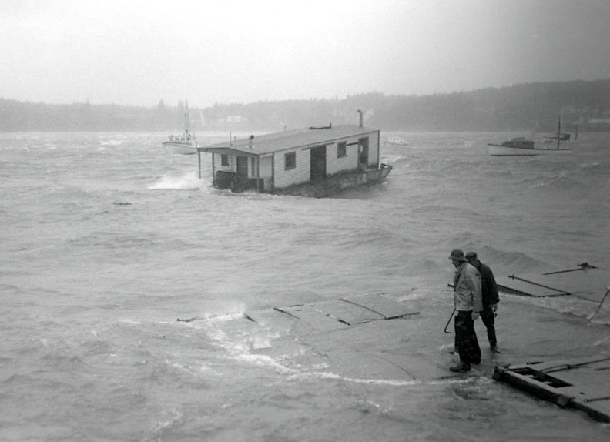
Harvard Beal's Bait Scow and Beal's Boat Yard, Southwest Harbor, during Hurricane Edna

Slide 22
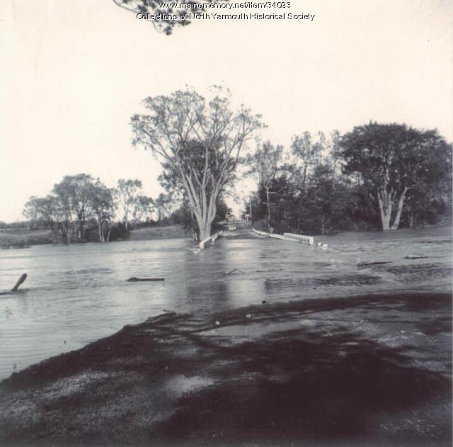
Memorial Highway near Dunn's Corner, Yarmouth (now Rt. 9)

Slide 23

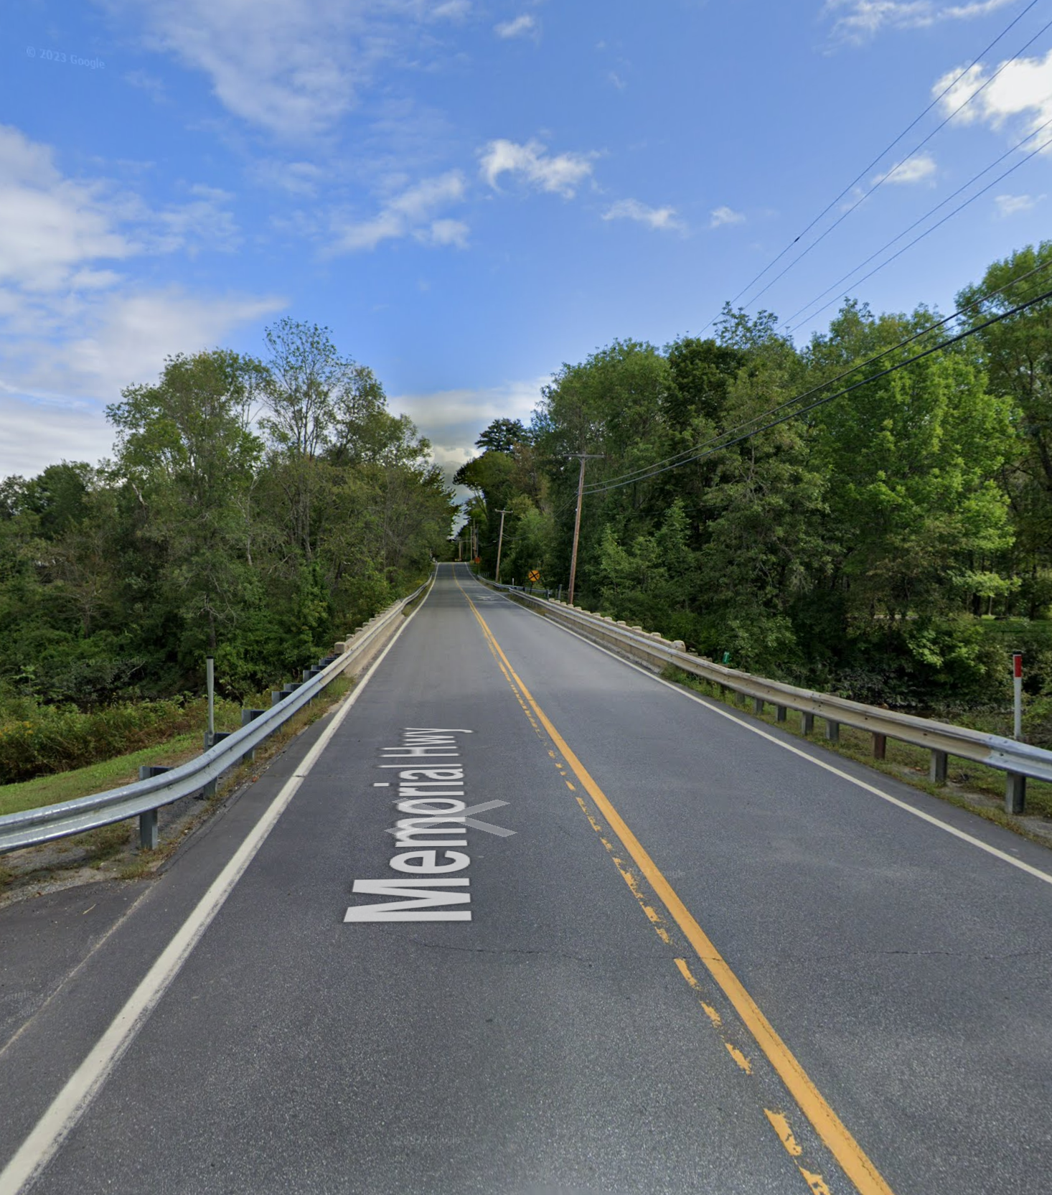
Then
Now

Slide 24
Damage to dam in Limestone, ME

Slide 25
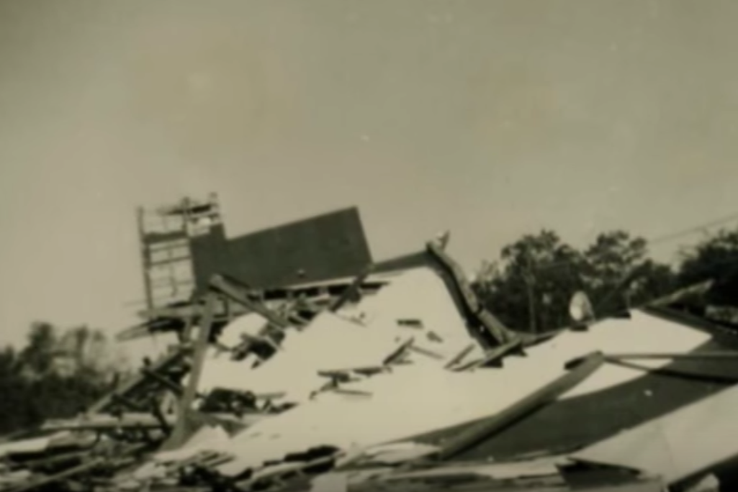
Remains of the drive-in movie theater in Rockport, ME, after Edna

Slide 26
Article by E.B. White, The New Yorker, Sept. 25th 1954
(White resided in North Brooklin, Maine)
Notes:
“At 8:44 PM the power failed, the house went dark, and it was a whole lot easier to see Edna. In almost no time the storm grew to its greatest height: the wind (NW by this time) chased black clouds across the ailing moon. The woods to the south of us bent low, as though the trees prayed for salvation. In front of the house, a large branch of the biggest balm-of Gilead tree snapped and crashed down across the driveway, closing it off. On the north side, an apple tree split clean up the middle. And for half an hour or so Edna held us in her full embrace.”

Slide 27
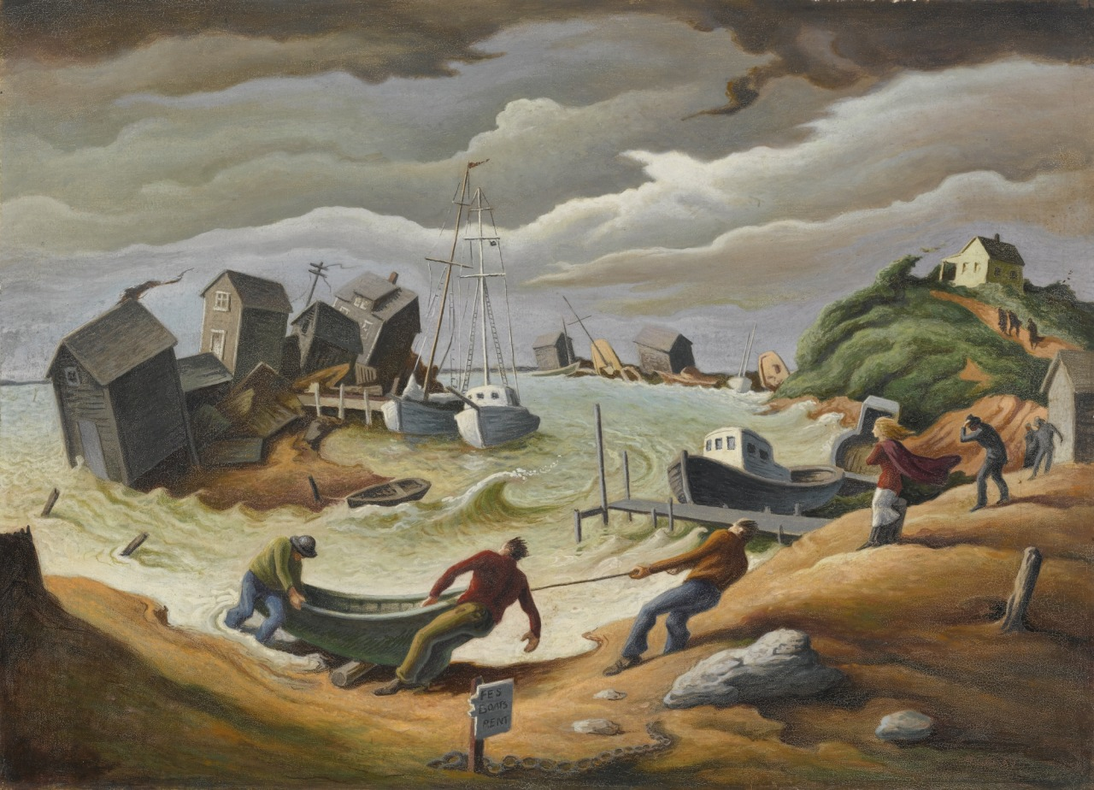
Menemsha hurricane - Thomas Hart Benton (1954). The painting depicts 1954’s Hurricane Edna which highly damaged the coast of New England. Menemsha, a small fishing village on Martha’s Vineyard, was hit especially hard.

Slide 28
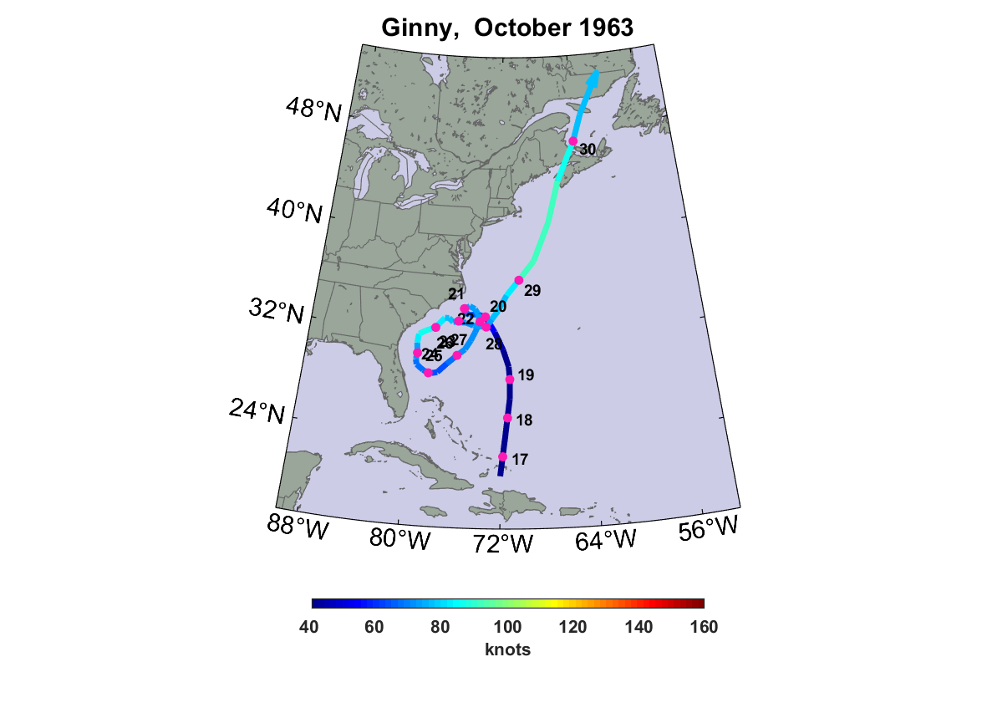
Gusts to 100 MPH at Rockland Coast Guard station. Many trees were knocked over and a barn at the Maine State Prison farm in South Warren was destroyed.
Affected midcoast around time of low tide. Likely a hybrid storm (like Sandy).

Slide 29
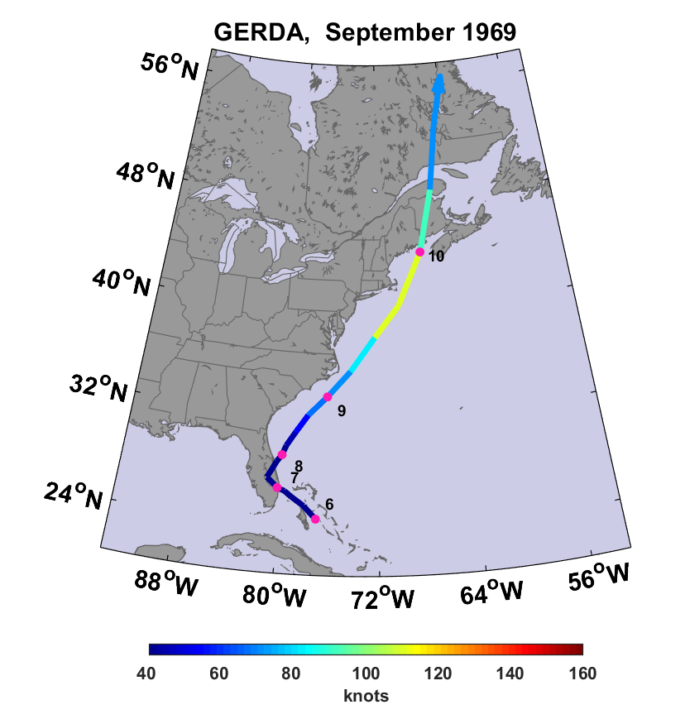
Landfall near Eastport as a Category 2 hurricane…probably strongest hurricane to strike Maine in recorded history. Struck about 2.5 hours before high tide at Eastport.

Slide 30
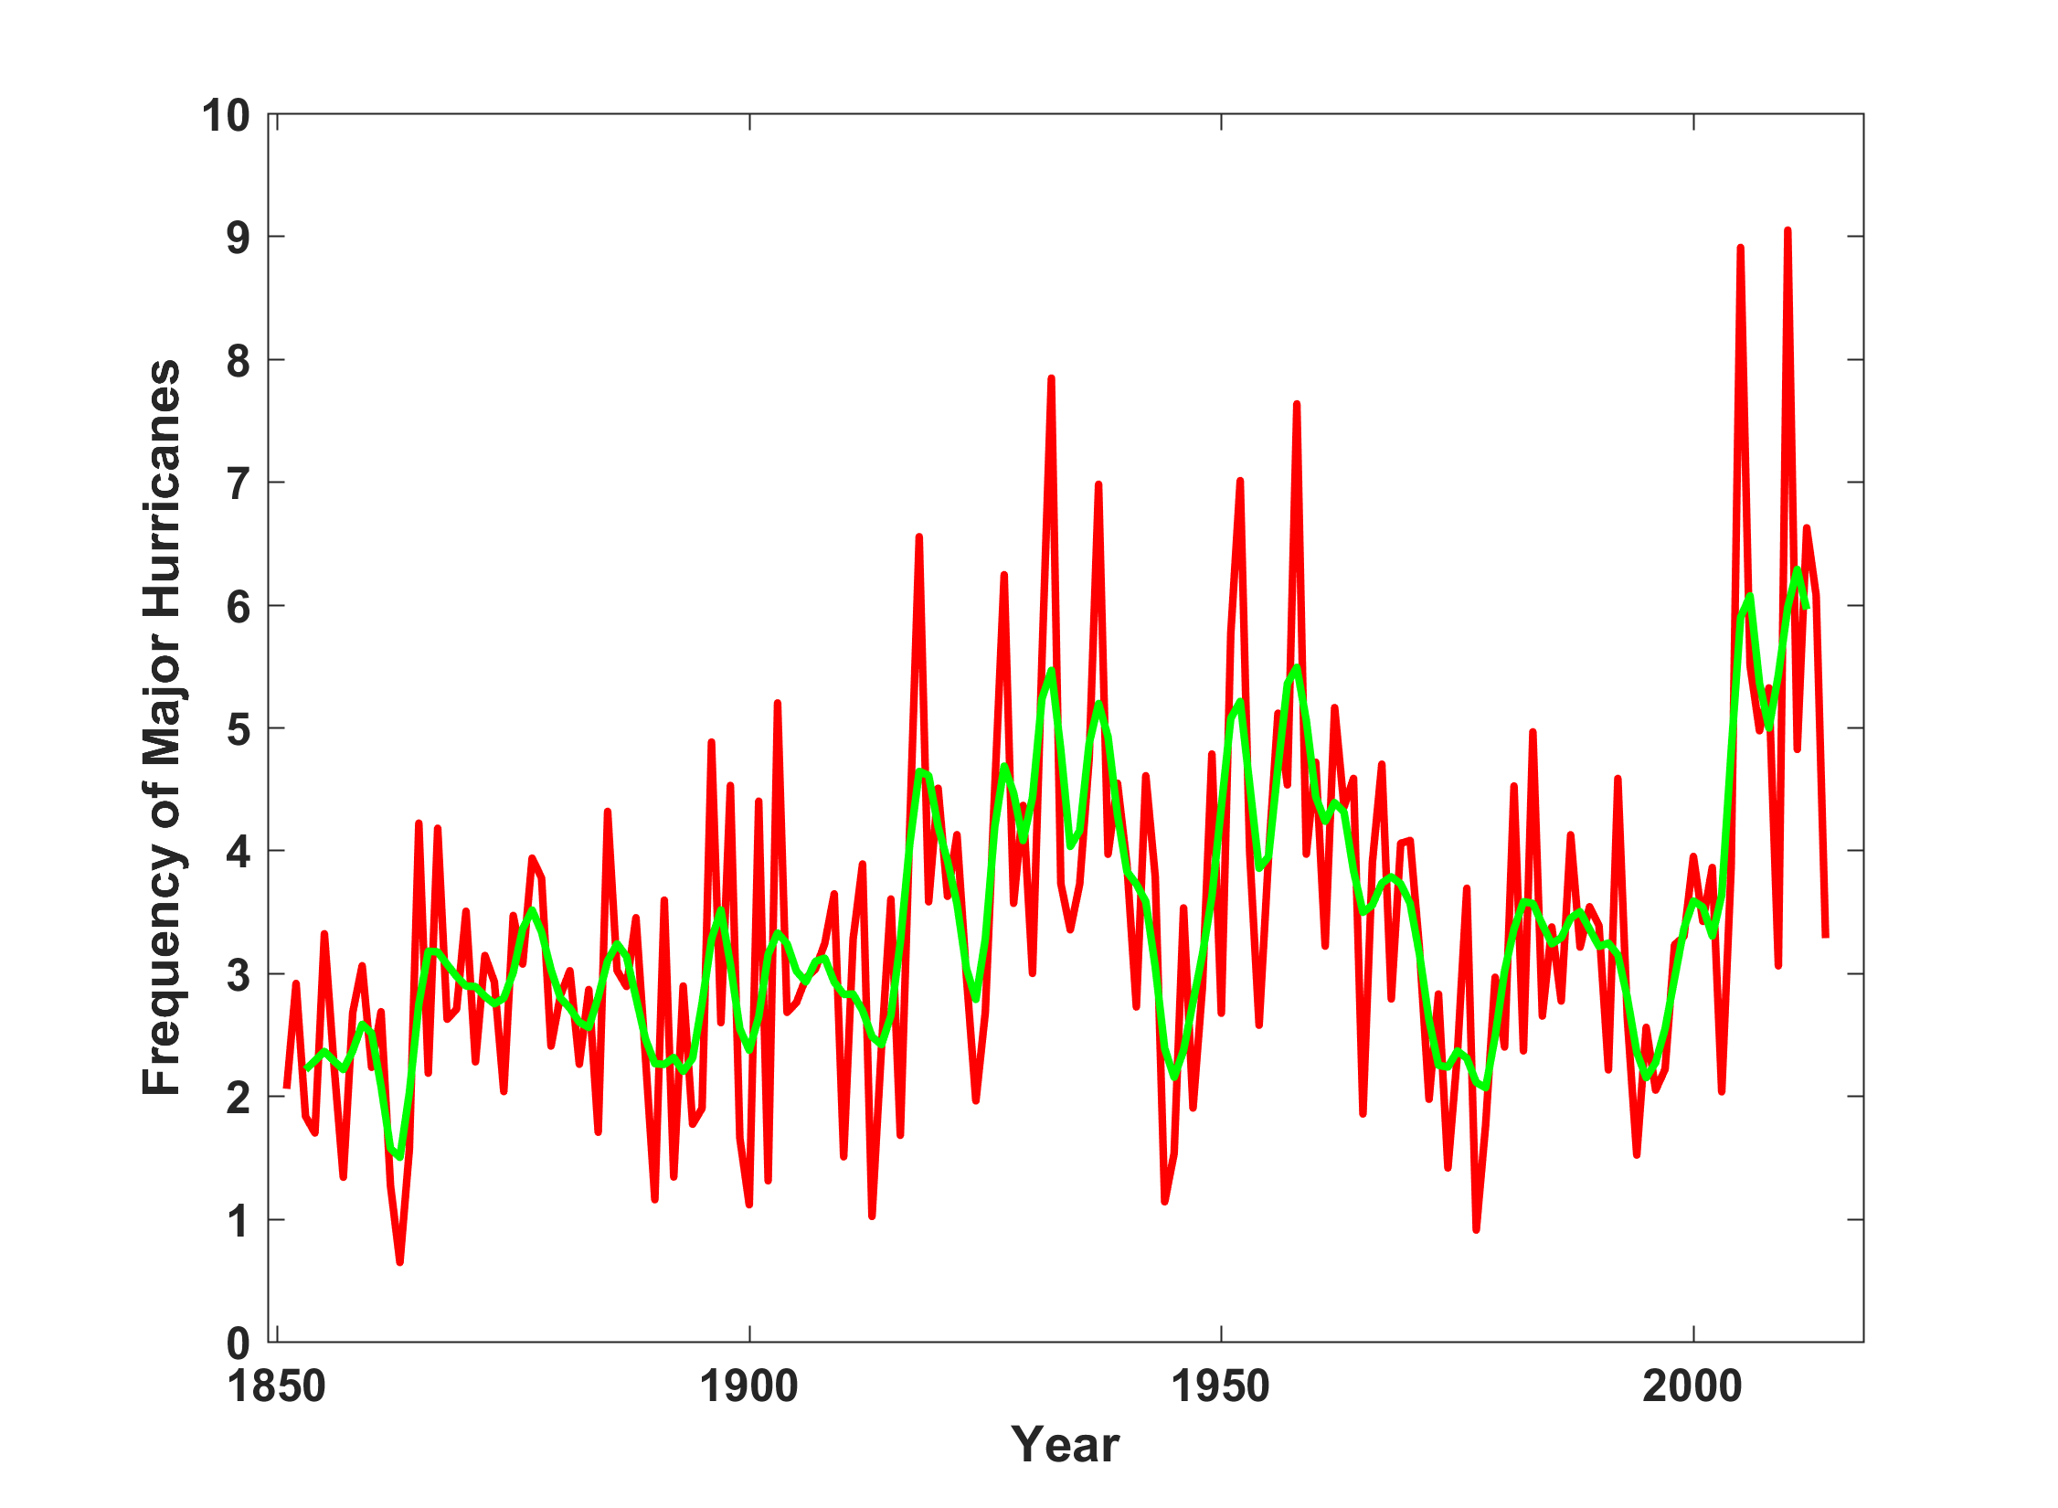
North Atlantic Major Hurricanes Downscaled from NOAA 20th Century Reanalysis
(Forced by sea surface temperature, surface pressure, and sea ice only)
Hurricane drought

Slide 31
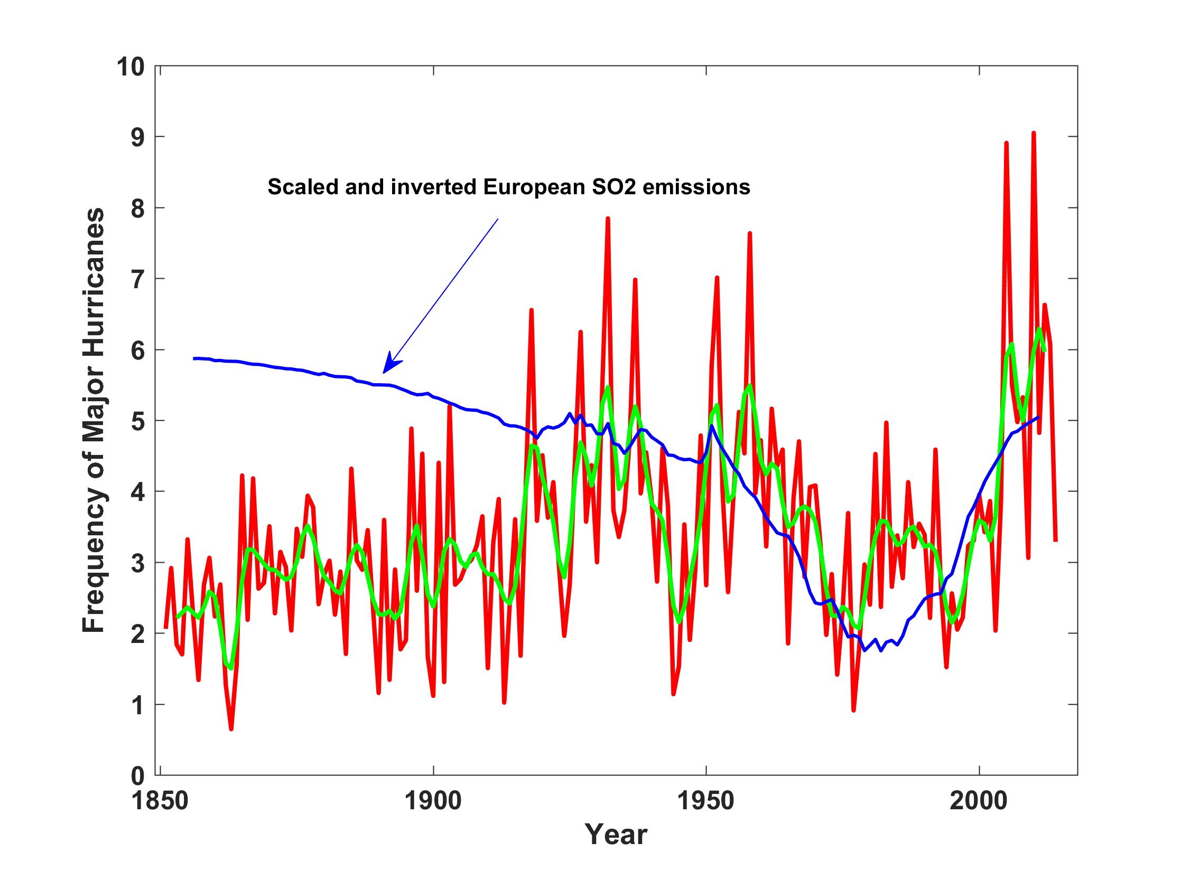
North Atlantic Major Hurricanes Downscaled from NOAA 20th Century Reanalysis
(Forced by sea surface temperature, surface pressure, and sea ice only)
Hurricane drought

Slide 32
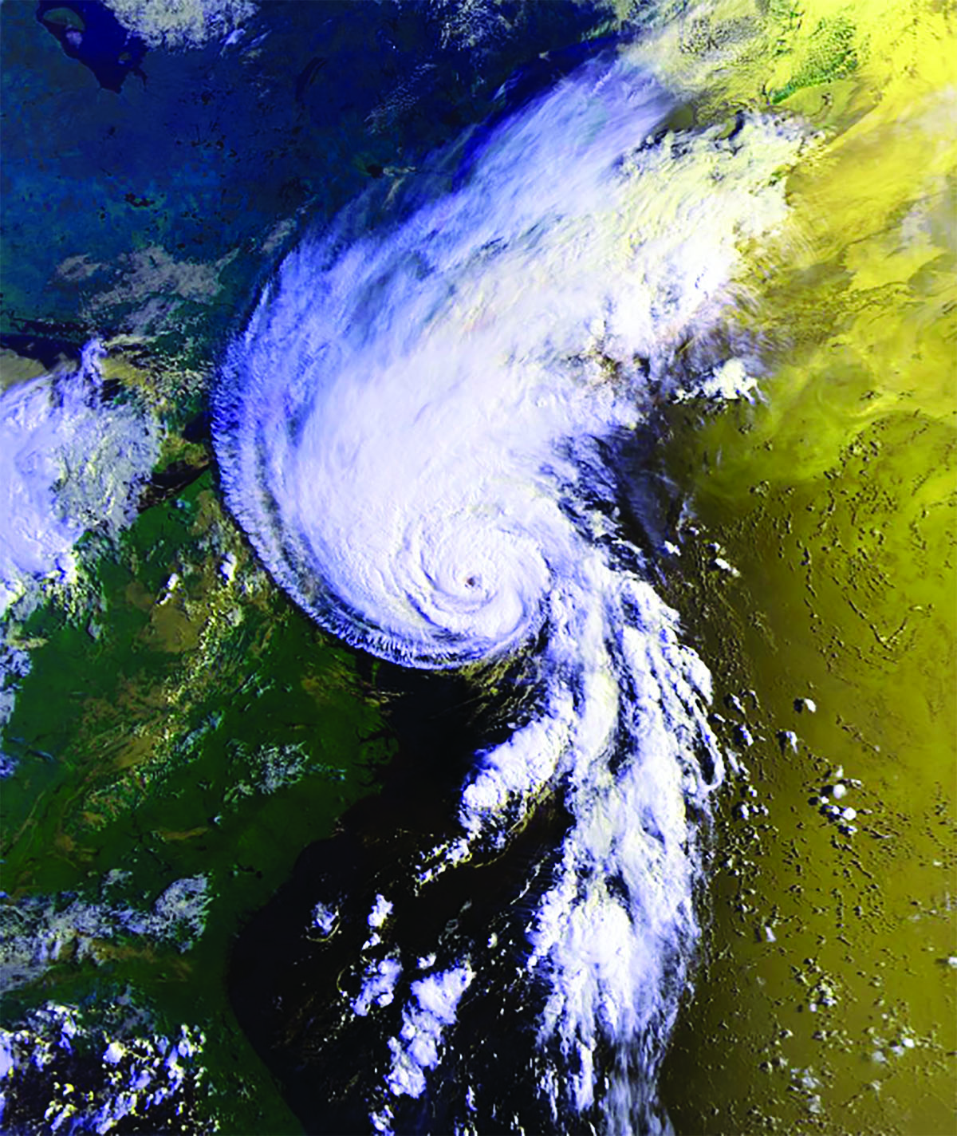
Hurricane Bob approaching Maine, August 20, 1991

Slide 34
Hurricane Bob in Maine
Landfall near Rockland, ME
One of the costliest hurricanes ever to strike New England… $1.5 billion 1991 dollars ($2.75 billion in 2019)
3 deaths in Portland
Gusts to 70 MPH in Portland, 92 MPH in Wiscasset
8.25 inches of rain at Portland
170,000 lost power, some for more than a week
Tornado at St. Albans (unconfirmed)
2-3 ft storm surge
River flooding washed out five bridges and roads across southwestern Maine
Bob affected midcoast Maine near the time of low tide

Slide 35
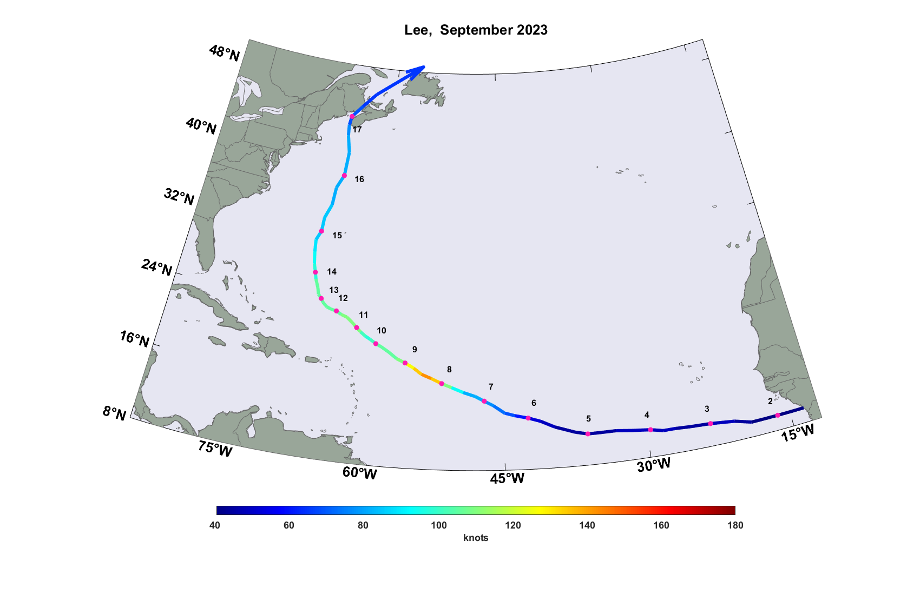
Hurricane Lee, 2023
1 death and 94,000 residential power outages
President Biden declares disaster emergency in Maine

Slide 36

The Heart of the Problem:
Societies are usually well adapted to frequent events (> 1/100 yr)
Societies are often poorly adapted to rare events (< 1/100 yr)
Robust direct estimates of the character of ~100 yr events require ~1,000 years of data
We do not have ~1,000 years of meteorological observations

Slide 37

MIT Approach: Use Physics to Estimate Hurricane Risk
Embed high-resolution, fast coupled ocean-atmosphere hurricane model in global climate model or climate reanalysis data
Coupled Hurricane Intensity prediction Model (CHIPS) has been used for 22 years to forecast real hurricanes in near-real time

Slide 38
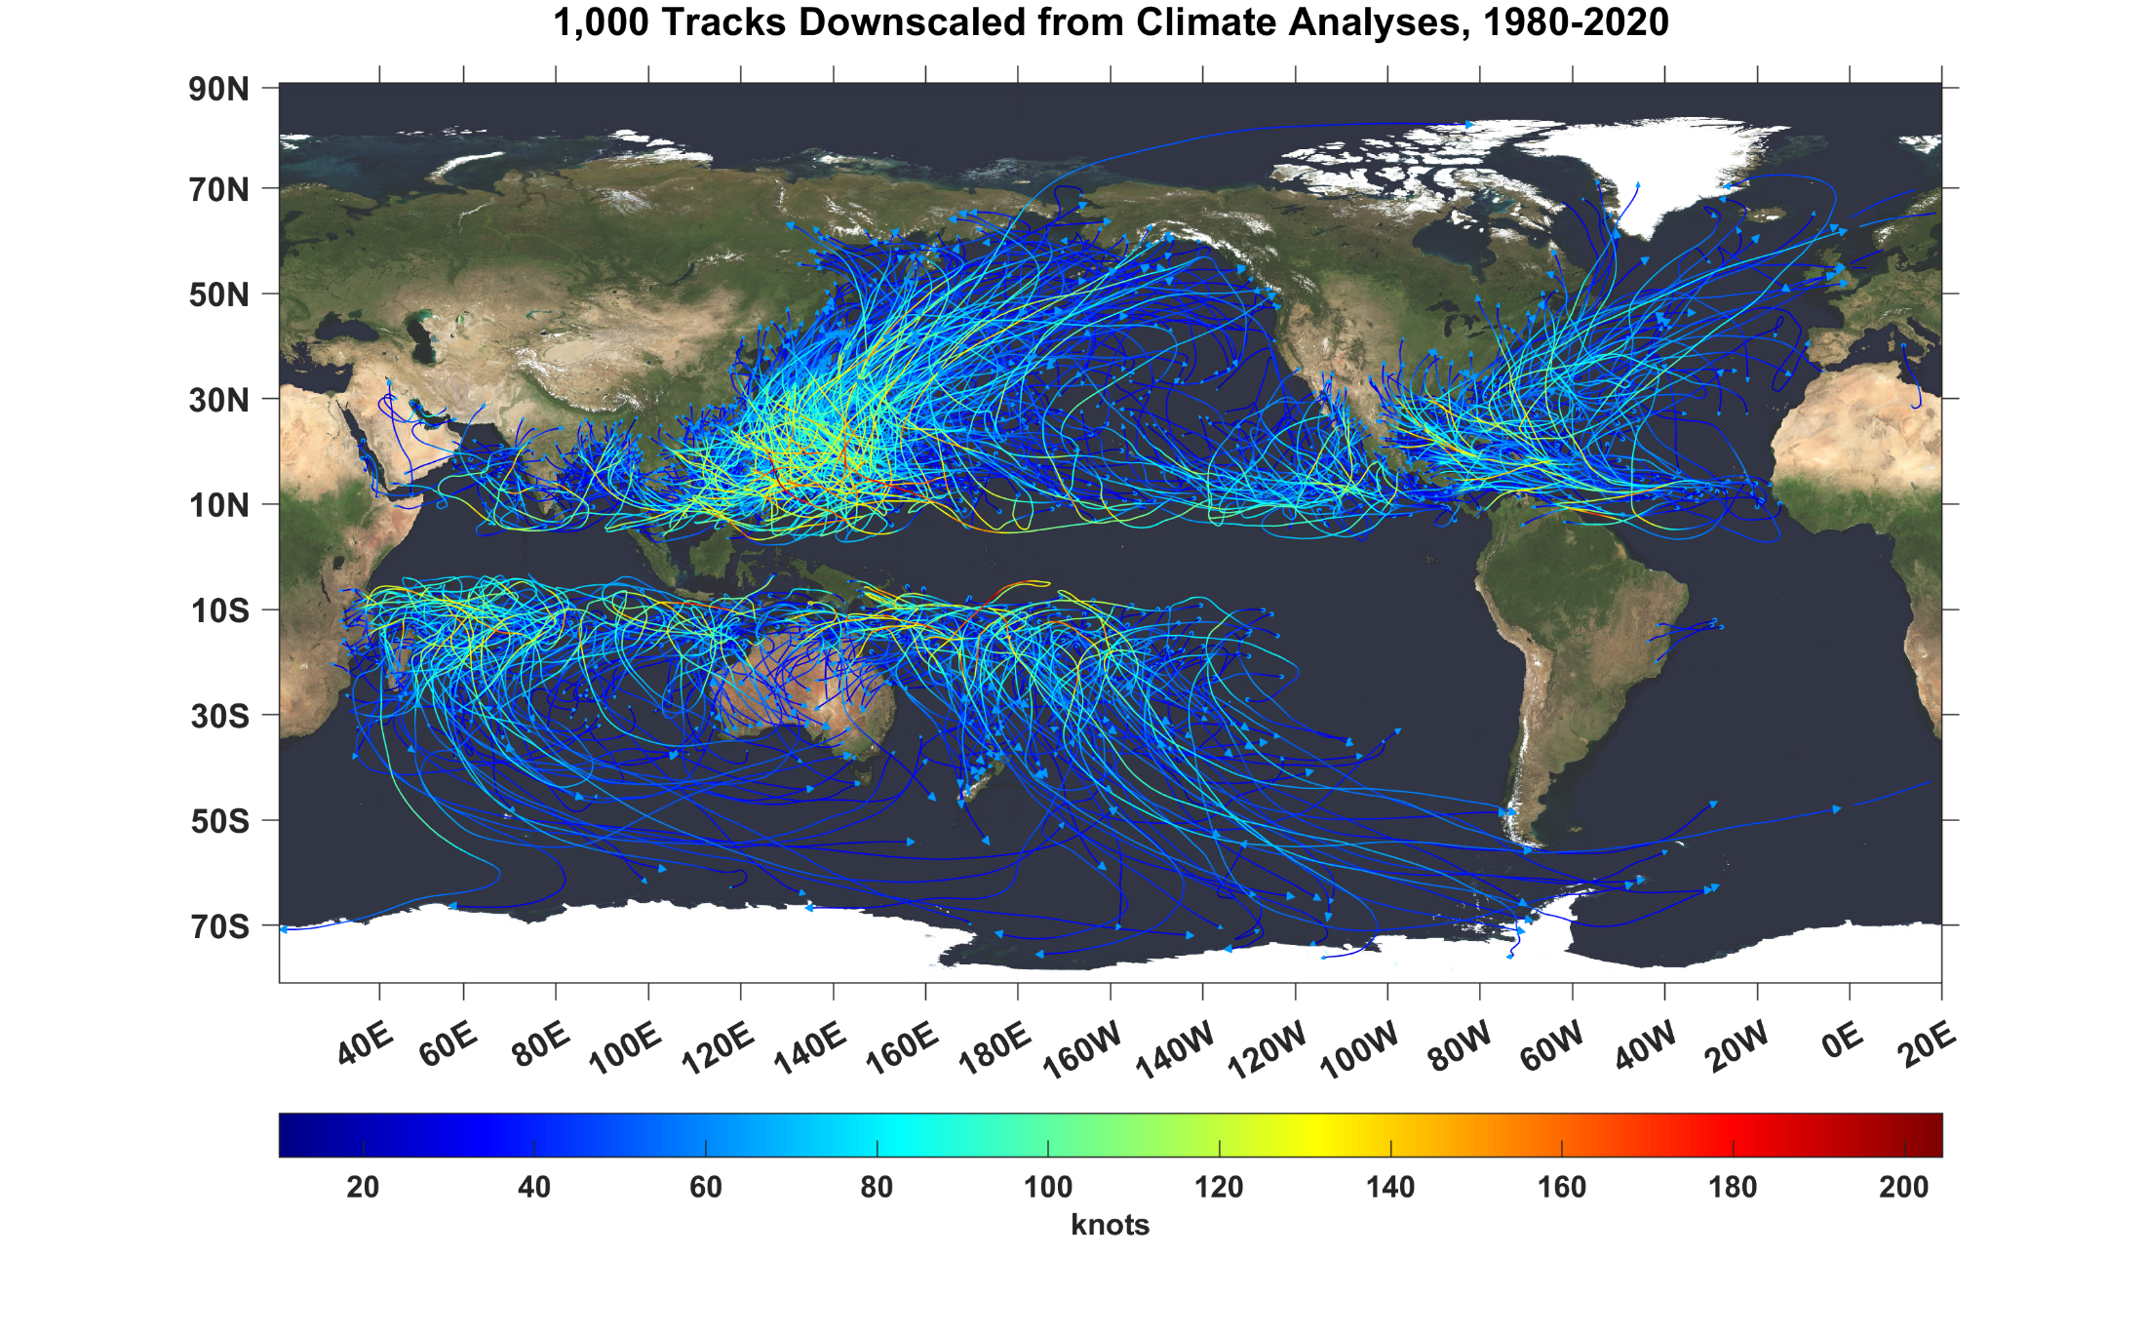

Slide 39
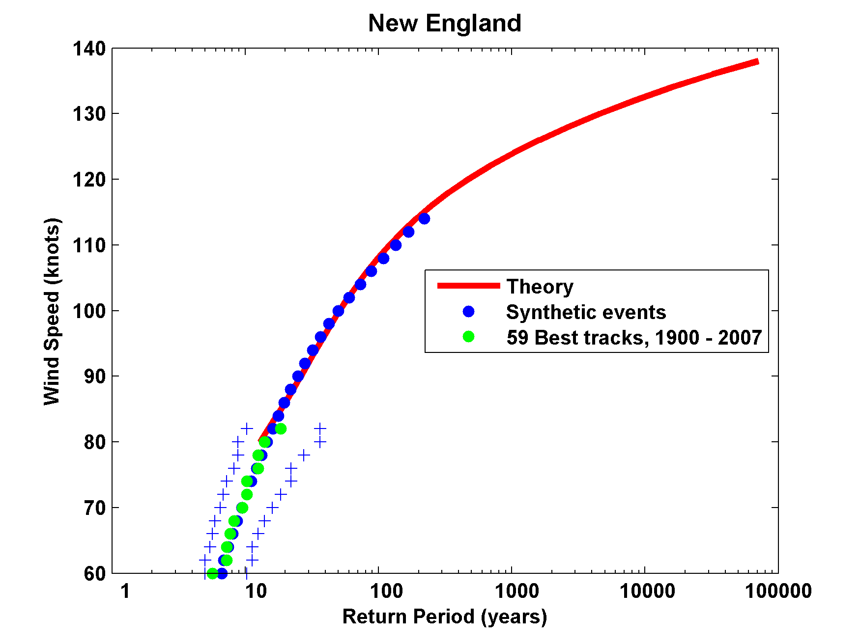
Return Periods

Slide 40
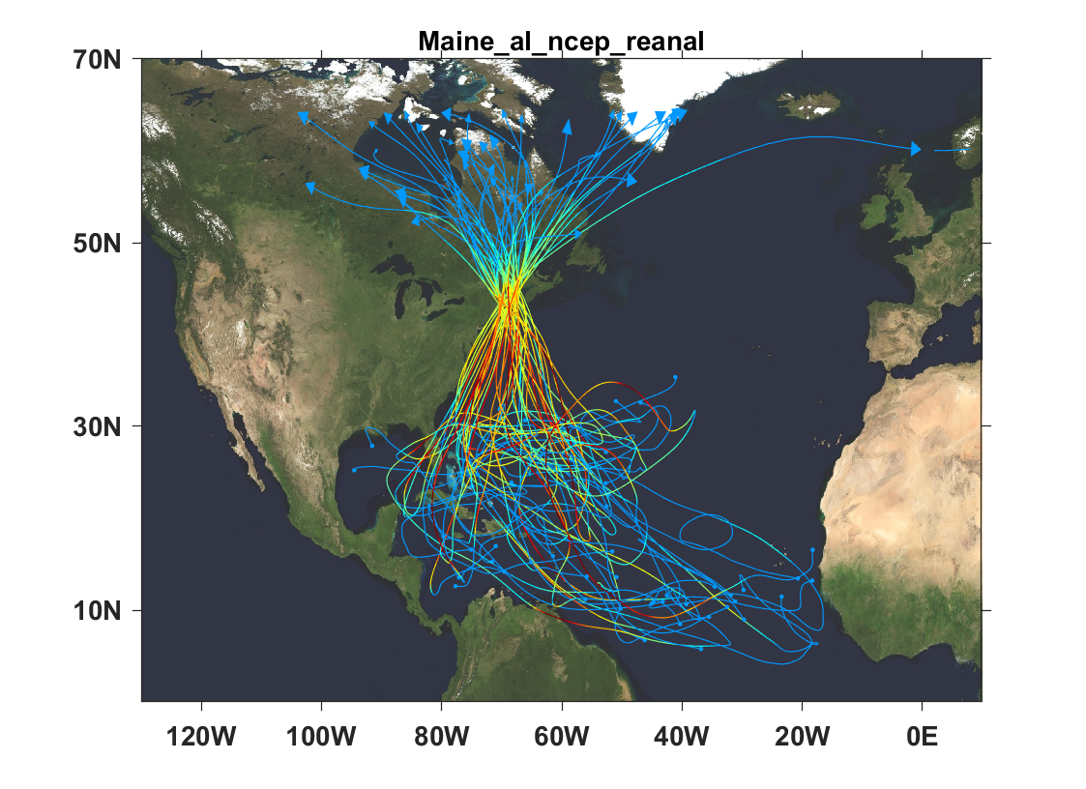
Top 50 of 1800 tropical cyclones affecting the coast of Maine

Slide 41
Wind Risk on the Maine Coast

Slide 42
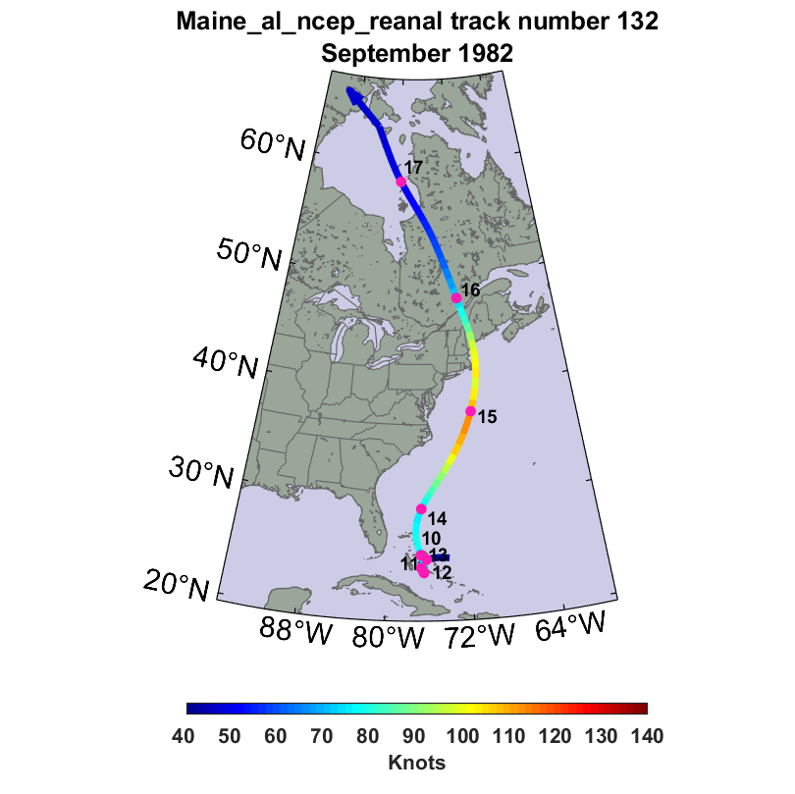
A 500-year windstorm in mid-coast Maine

Slide 43
A 500-Year Wind Storm
Black curve shows track of storm; shading shows peak wind speed experienced at each point

Slide 44
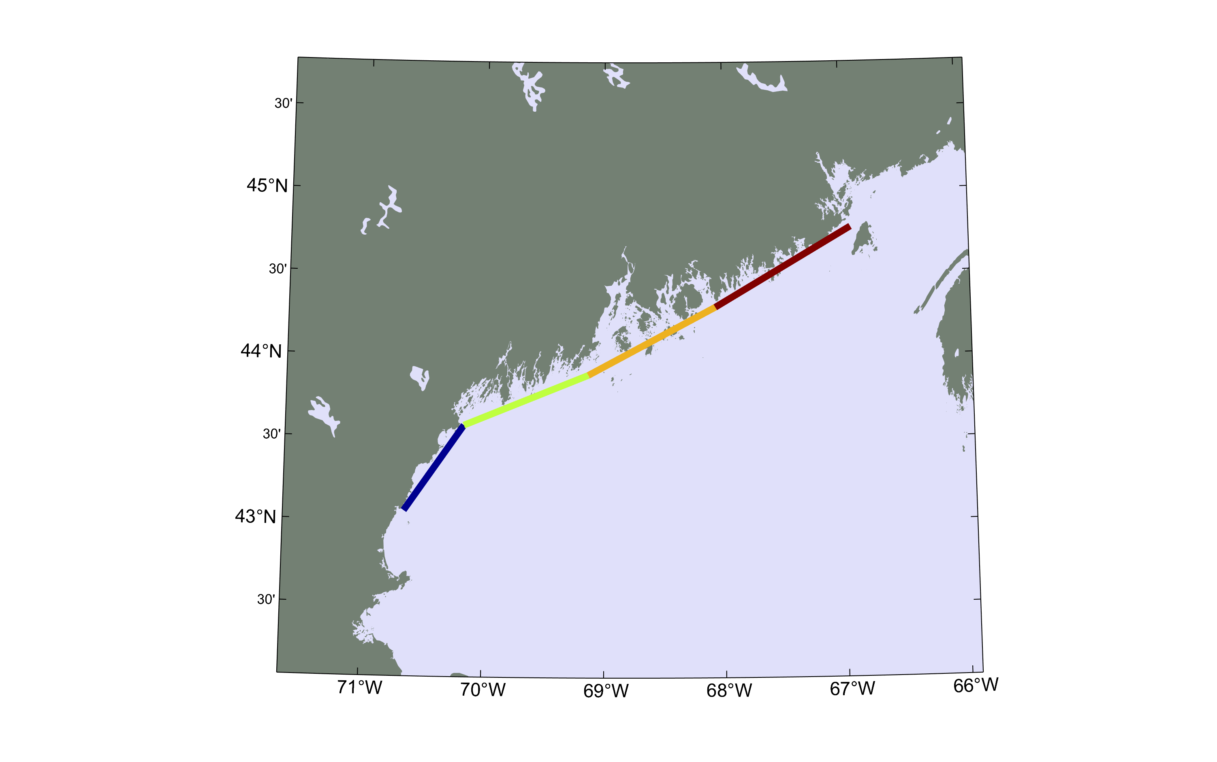
This chart shows power dissipation, a measure of destructive potential, per unit length along 4 segments of the Maine coast.
Power dissipation is largest from Penobscot Bay eastward.

Slide 45
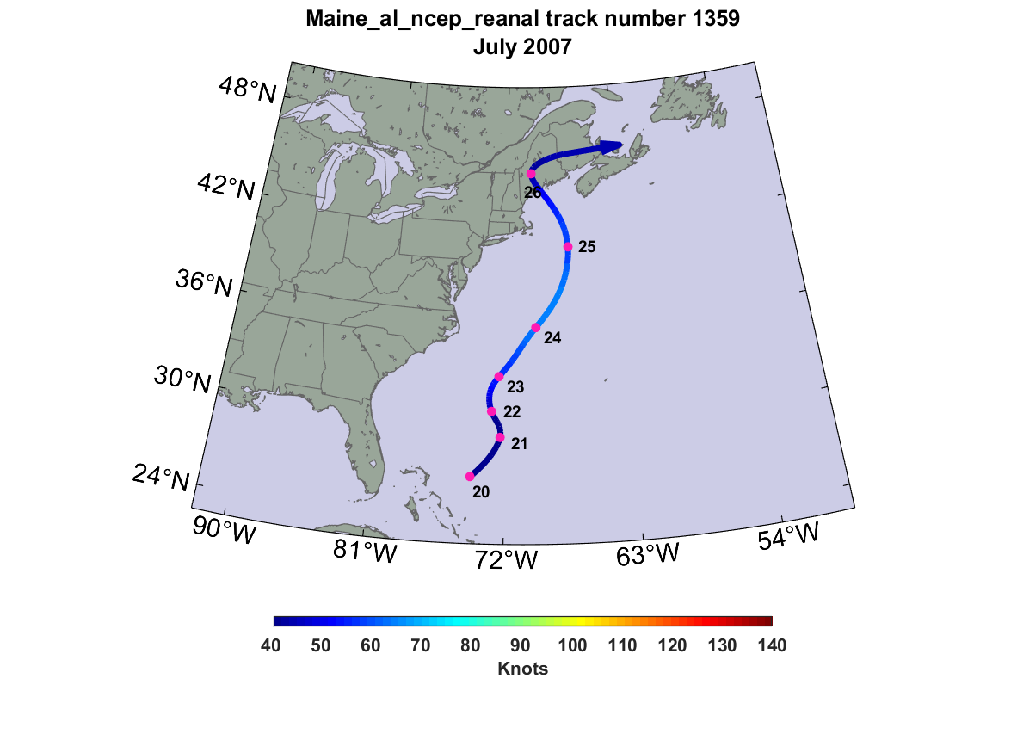
A 500-year rainstorm in mid-coast Maine

Slide 46
A 500-Year Rain Storm

Slide 47
How will Climate Change Affect Maine Hurricanes?
Apply technique to 7 of the most recent generation of global climate models, running 1,600 tracks for each model for each of two time periods: 1971-2010 and 2061-2100. Each track passes within 125 km of New Harbor, ME

Slide 48
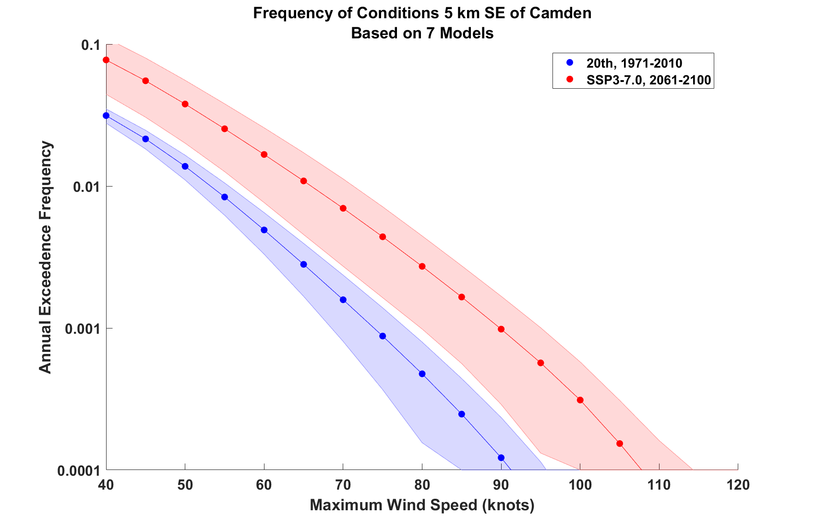
Estimates of hurricane wind risk at point 5 km SE of Camden, from 7 climate models
(shading shows spread among the different climate models)

Slide 49
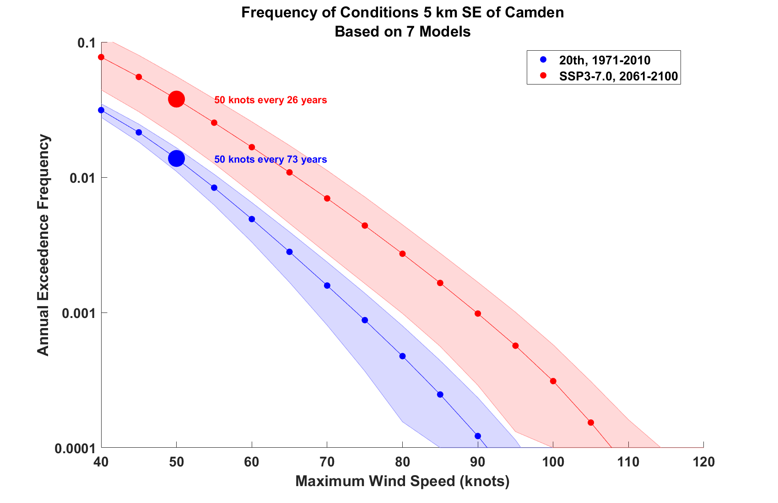
Estimates of hurricane wind risk at point 5 km SE of Camden, from 7 climate models
(shading shows spread among the different climate models)

Slide 50
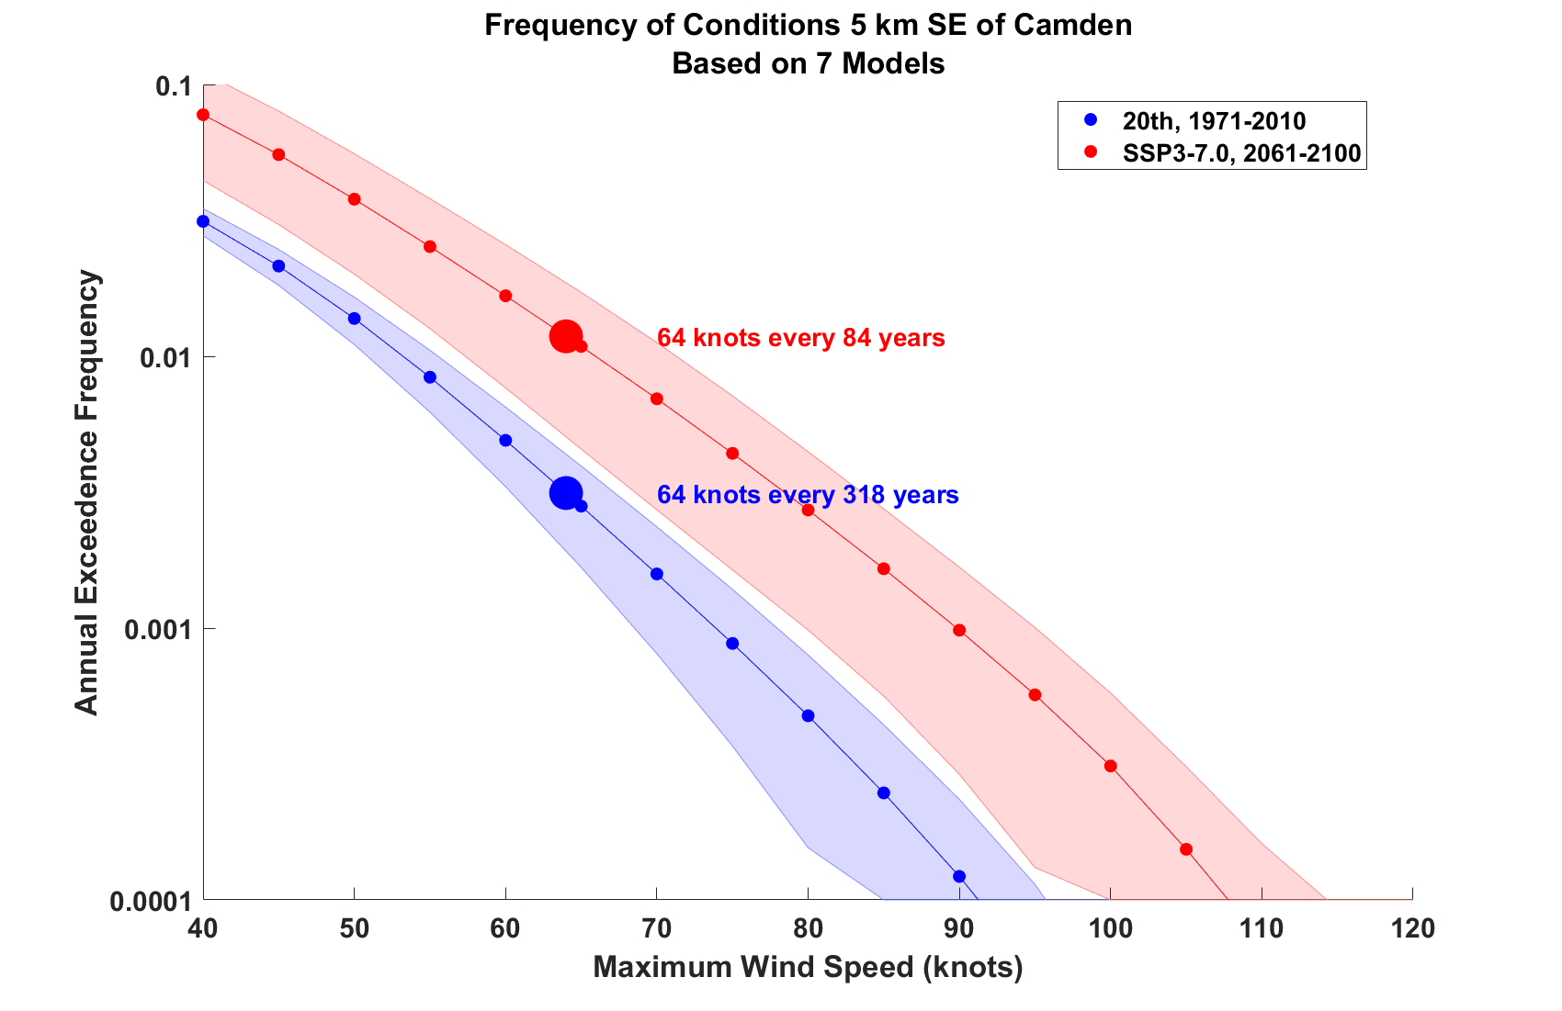
Estimates of hurricane wind risk at point 5 km SE of Camden, from 7 climate models
(shading shows spread among the different climate models)

Slide 51
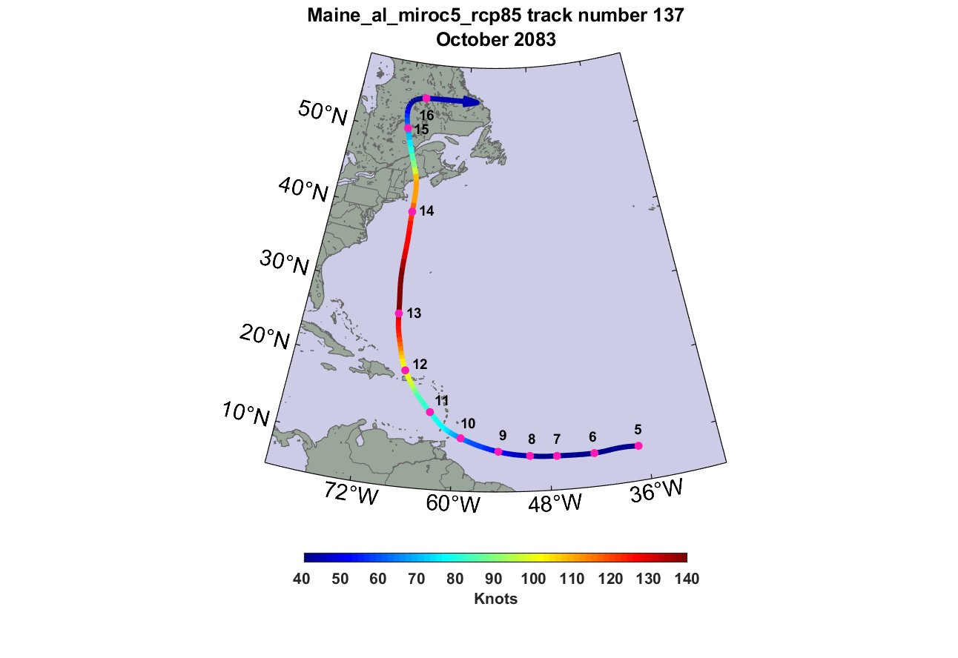
A 500-year windstorm in mid-coast Maine, in 2083

Slide 52
A 500-year wind storm at the end of the century
Black curve shows track of storm; shading shows peak wind speed experienced at each point

Slide 53
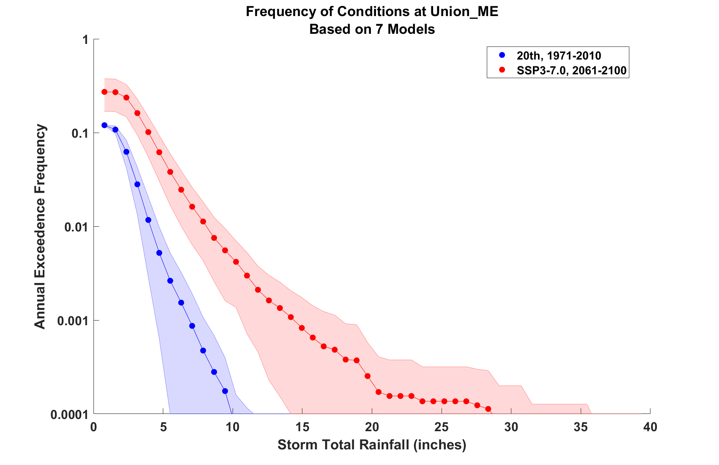
Estimates of hurricane rain risk at Union, from 7 climate models
(shading shows spread among the different climate models)

Slide 54
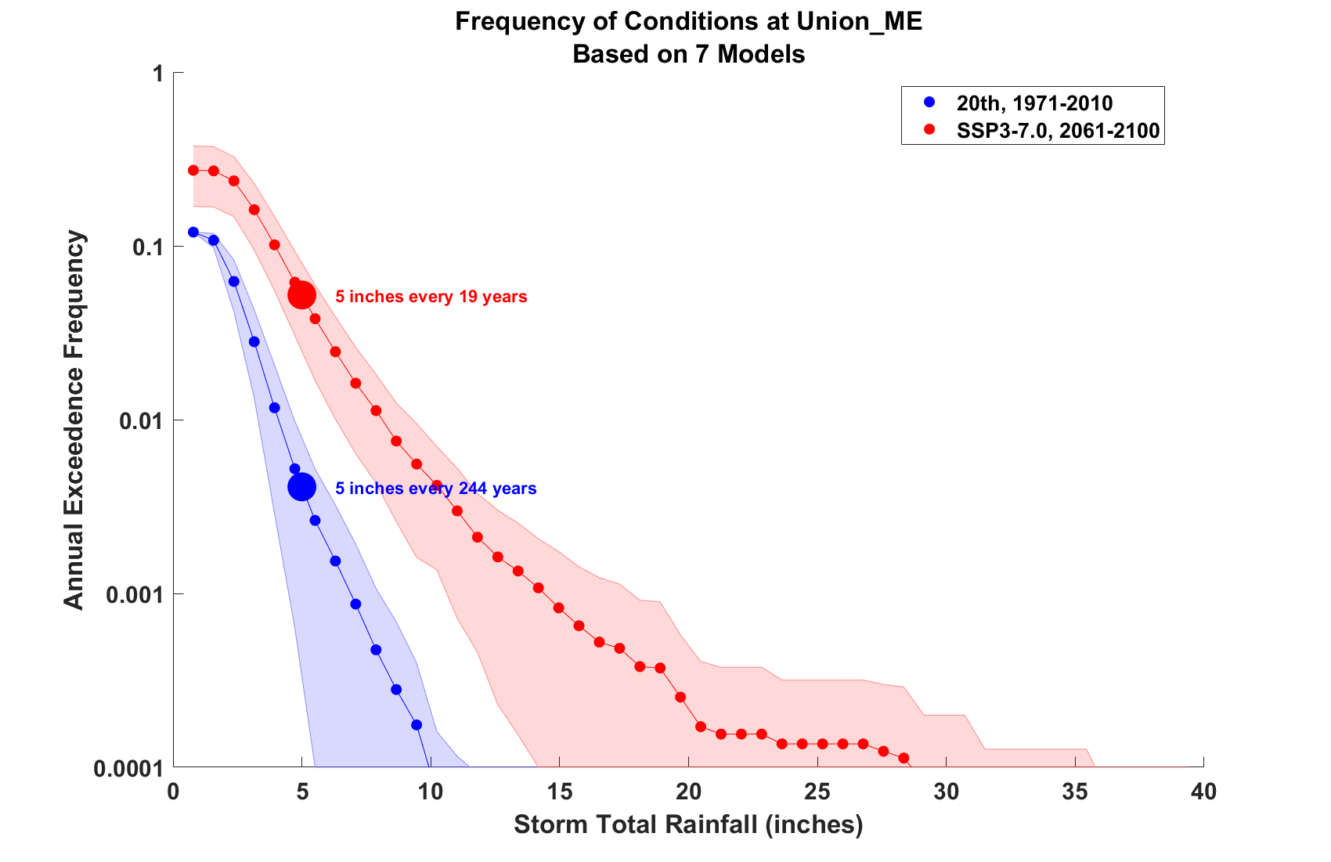
Estimates of hurricane rain risk at Union, from 7 climate models
(shading shows spread among the different climate models)

Slide 55
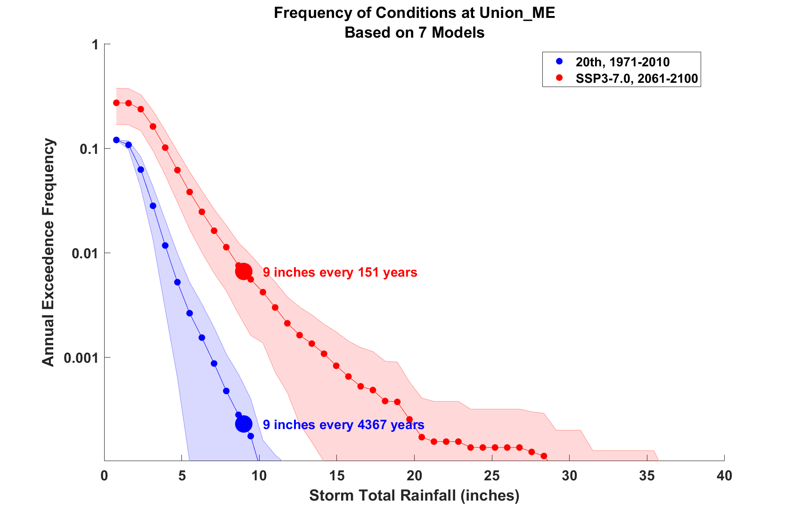
Estimates of hurricane rain risk at Union, from 7 climate models
(shading shows spread among the different climate models)

Slide 56
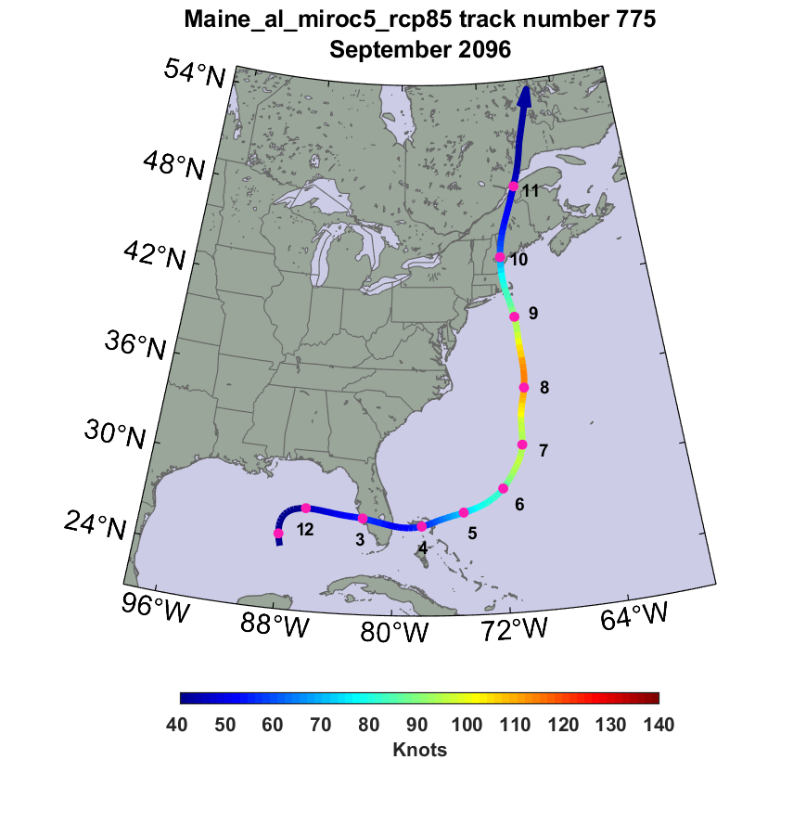
A 500-year rainstorm in mid-coast Maine, in 2096

Slide 57
A 500-year Rain Event, end of century

Slide 58
Summary
Maine is mostly protected from hurricane by cold water north of the Gulf Stream and by Cape Cod and the islands
Nonetheless, it has experienced several low category hurricanes and tropical storms which have taken lives and caused much damage through Maine’s history
Hurricane risk increases going downeast along the coast
Barring efforts to curb increases in greenhouse gases, projections suggest a modest increase in the frequency and severity of hurricanes in Maine by the end of this century
Large projected increases in hurricane rainfall are of particular concern and could lead to substantially elevated flood risk
We are concerned also about hybrid storms, like Hurricane Sandy, which may not be well simulated with this technique

Slide 59
Spare Slides

Slide 60
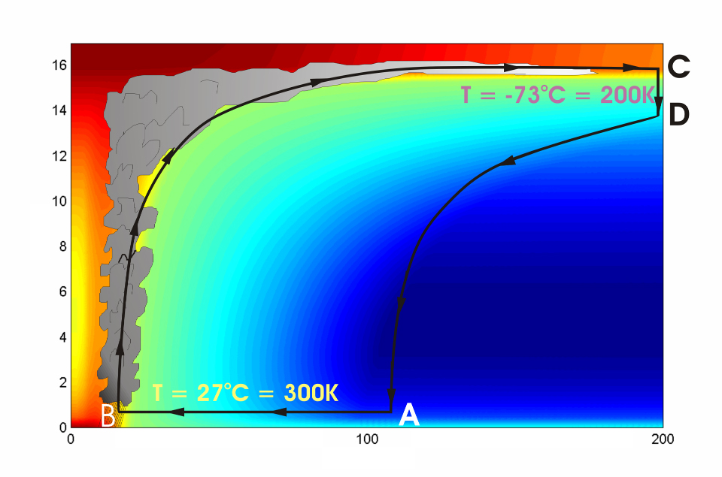




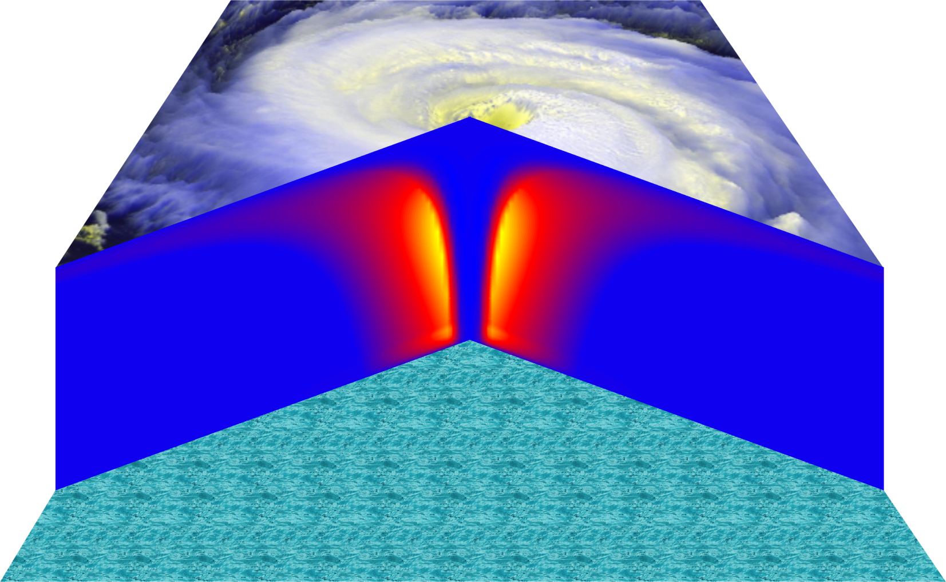
Cross-section through a Hurricane & Energy Production
eye
edge
Isothermal compression
Adiabatic expansion
Adiabatic compression
Height above ocean
Nearly isothermal expansion
Low entropy
Ocean surface
Radius (km)
Notes:
NOTE: We have animated the path of air for this slide and included labels to help our audience understand what you will be describing. Many of them will have never even heard of a Carnot heat engine and do not have a strong understanding of entropy. We would like to do whatever we can in to make this information accessible to our audience. Please let us know if you approve of these changes, and feel free to replace the labels as needed. The simpler you can keep your description of this, the better. You do an excellent job of describing the process in your book.
***
The energy cycle of a mature hurricane - the hurricane as a Carnot heat engine. This two-dimensional plot of the thermodynamic cycle shows a vertical cross section of the hurricane, whose storm center lies along the left edge. The colors depict the entropy distribution; cooler colors indicate lower entropy. Loosely, this means the total heat content of the air. Note that as air approaches the eyewall, its entropy increases rapidly, reflecting the large input of heat from the ocean.
Let’s follow a sample of air that begins at point A near the sea surface, a hundred kilometers or so from the storm center. The process mainly responsible for driving the storm is the evaporation of seawater, which transfers energy from sea to air. As a result of that transfer, air spirals inward close to the sea surface, between Points A and B. The storm center is an area of relatively low pressure, so the pressure on air decreases as it travels from A to B. But it is always in contact with the sea surface, which acts as an almost unlimited heat reservoir, so its temperature is approximately constant (acquiring entropy at a constant temperature). It is during this leg that enormous quantities of heat are added to the air from evaporation of seawater. Evaporation of water is a very efficient way to transfer heat from one body to another. That is why you feel cold when you are wet, especially if it is windy and/or dry: evaporation is taking heat from your body. Thus the addition of heat in leg A-B shows up mostly as an increase in humidity in the air. This form of heat is called latent heat. Evaporation of sea water into the inflowing air is by far the most important source of heat driving the hurricane, which makes leg A-B the firebox of the hurricane. When hurricanes reach land, they quickly die because they are cut off from their oceanic energy source. At point B, the air turns and flows upward through the towering cumulonimbus clouds that make up the hurricane’s eyewall. It is here that the latent heat is converted to sensible heat as water vapor condenses. But it is important to note that although there is enormous conversion between these two forms of heat, the total heat content (entropy, actually) remains approximately constant along this leg (note that the colors do not change along leg B-C). As the air flows upward, the pressure on it decreases very rapidly. What we have here is an example of adiabatic expansion. By the time the air reaches point C in the high troposphere or lower stratosphere, some 12 to 18 kilometers above the sea surface, the adiabatic expansion has lowered its temperature to a value close to that of the undisturbed upper tropical atmosphere, around -70°C or about 200 Kelvin. The air remains at approximately this temperature as it sinks down toward the tropopause (point D). Although the air is undergoing compression, it is losing heat by electromagnetic radiation to space. The depicted compression is very nearly isothermal. Finally, between D and A, the air returns to its starting point while undergoing an adiabatic compression. Voilà, the four legs of a Carnot cycle.
In a real hurricane, the energy cycle is open because hurricanes continuously exchange air with their environment.
Image is copyrighted 2005 by Oxford University Press.
Description from “Divine Wind: The History and Science of Hurricanes”, Kerry Emanuel, 2005, Oxford University Press, 296 p.

Slide 61
Annual Maximum Potential Intensity (m/s)

Slide 62
Risk Assessment Approach:
Step 1: Seed each ocean basin with a very large number of weak, randomly located cyclones
Step 2: Cyclones are assumed to move with the large scale atmospheric flow in which they are embedded, plus a correction for the earth’s rotation and sphericity
Step 3: Run hurricane intensity model for each cyclone, and note how many achieve at least tropical storm strength
Step 4: Using the small fraction of surviving events, determine storm statistics. Can easily generate 100,000 events
Details: Emanuel et al., Bull. Amer. Meteor. Soc, 2008
Notes:
62

Slide 63
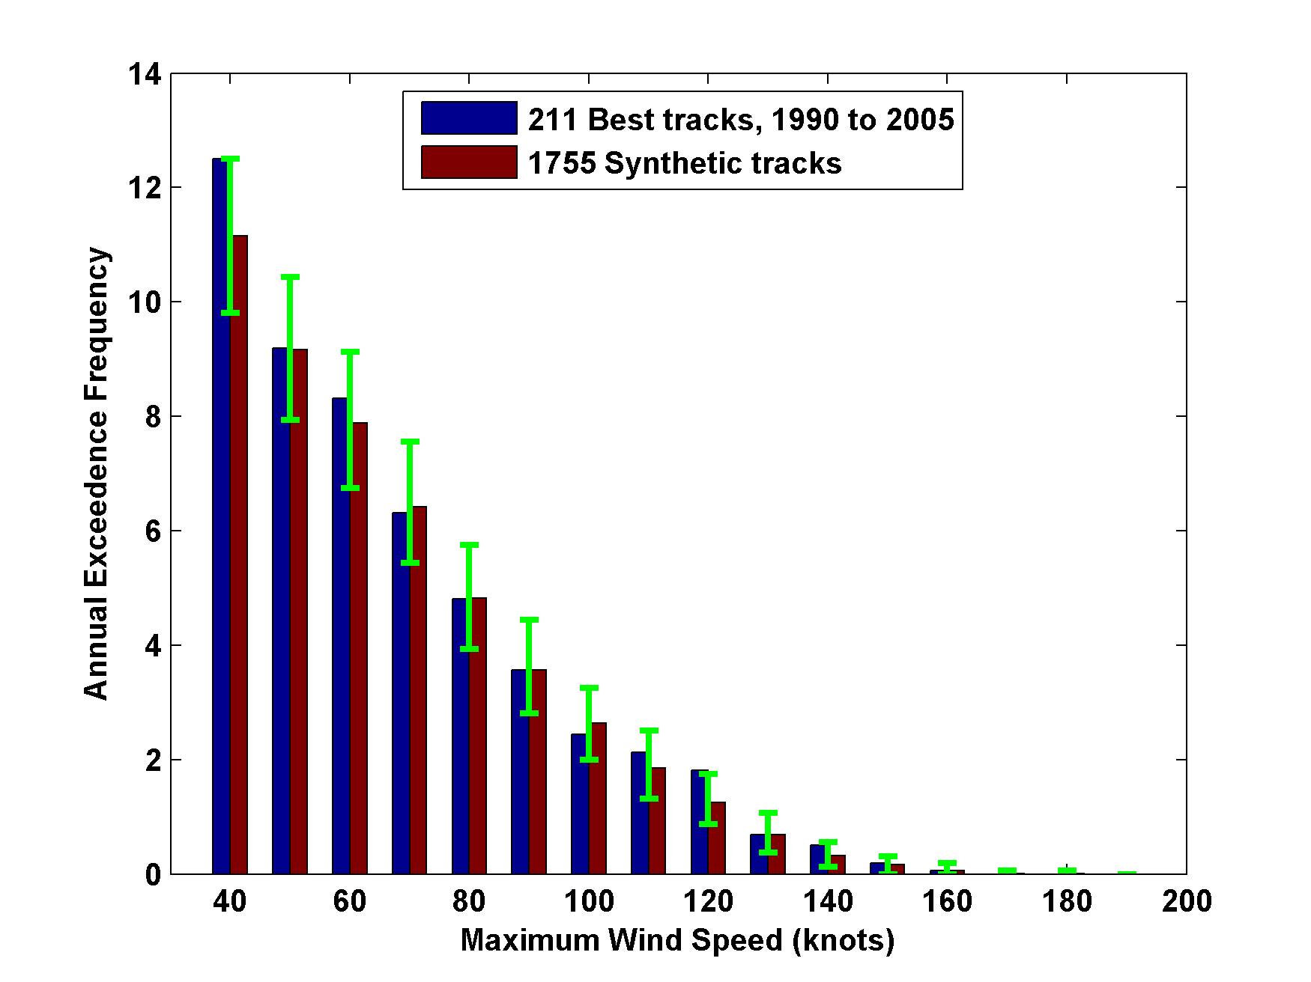
Cumulative Distribution of Storm Lifetime Peak Wind Speed, with Sample of 1755 Synthetic Tracks
90% confidence bounds

Slide 64
Atlantic Annual Cycle

Slide 65
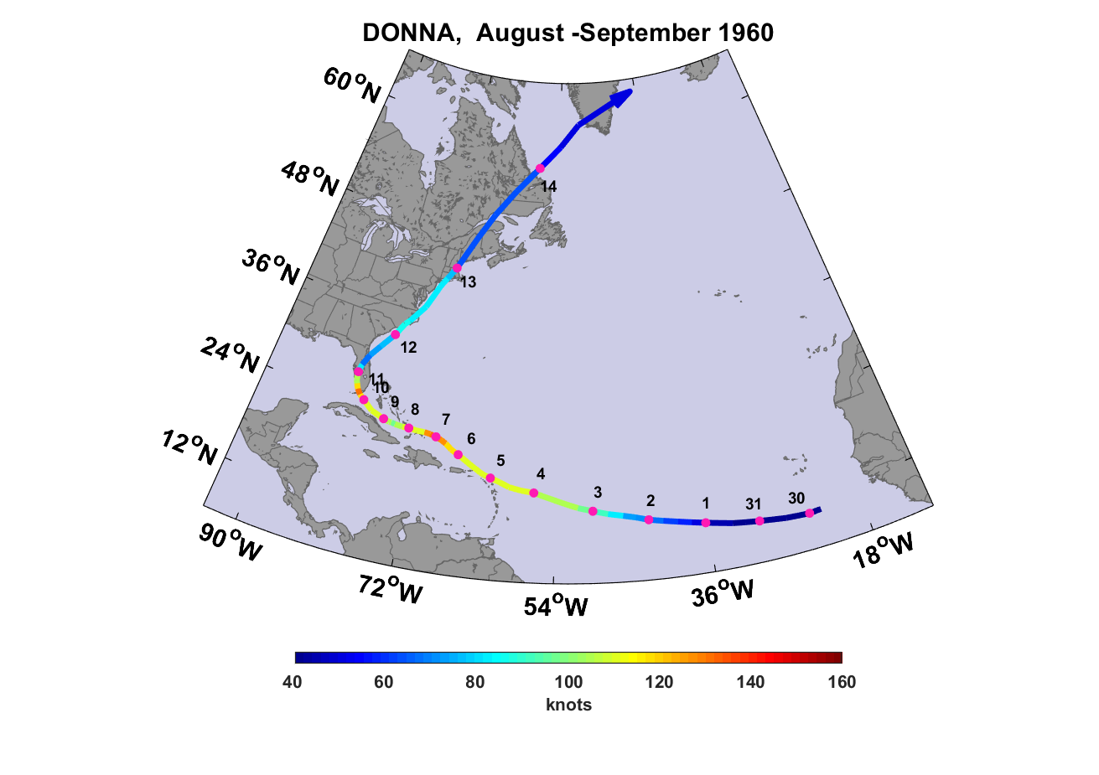
Relatively light damage in Maine, but 20-40% of apple crop destroyed
Struck very close to time of low tide

Slide 66
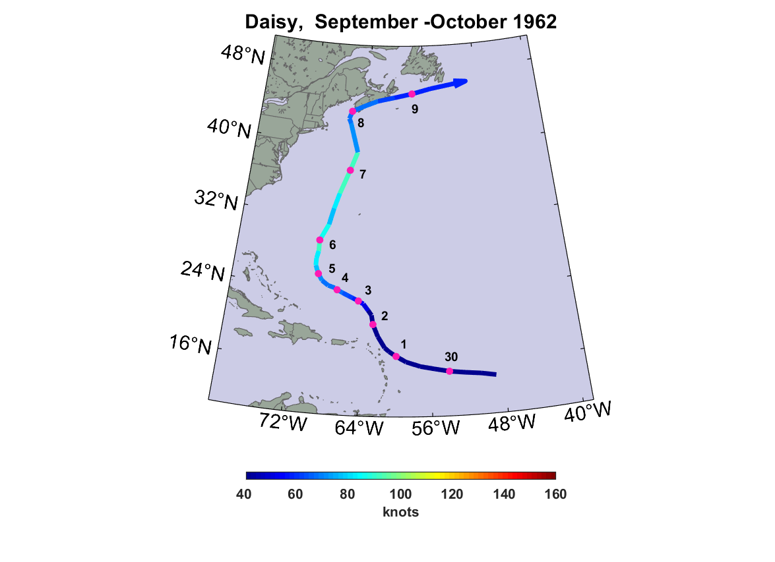

Slide 67
Hurricane Daisy in Maine
Two deaths from falling branches, in Thomaston and Rockland
9.5 inches of rain fell in Portland, an all-time record that held until Hurricane Bob of 1991
Wind gusts to 70 MPH in coastal Maine
Closest approach around mid-tide, falling

Slide 68
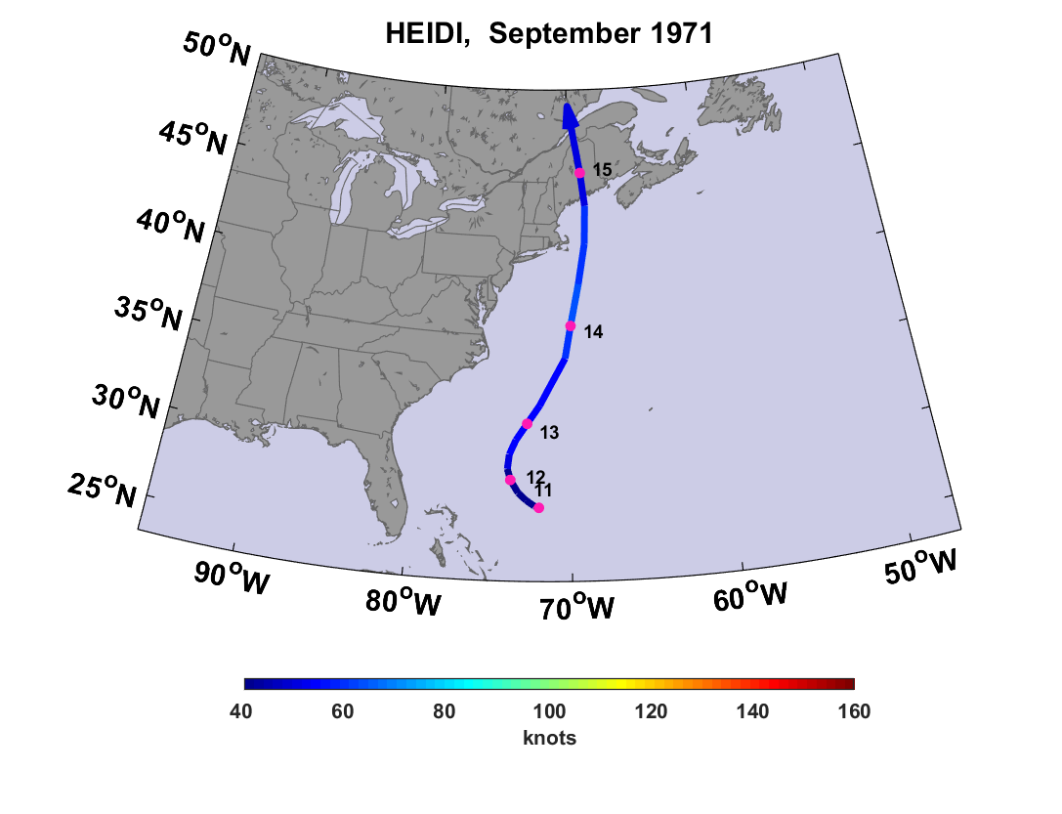

Slide 69
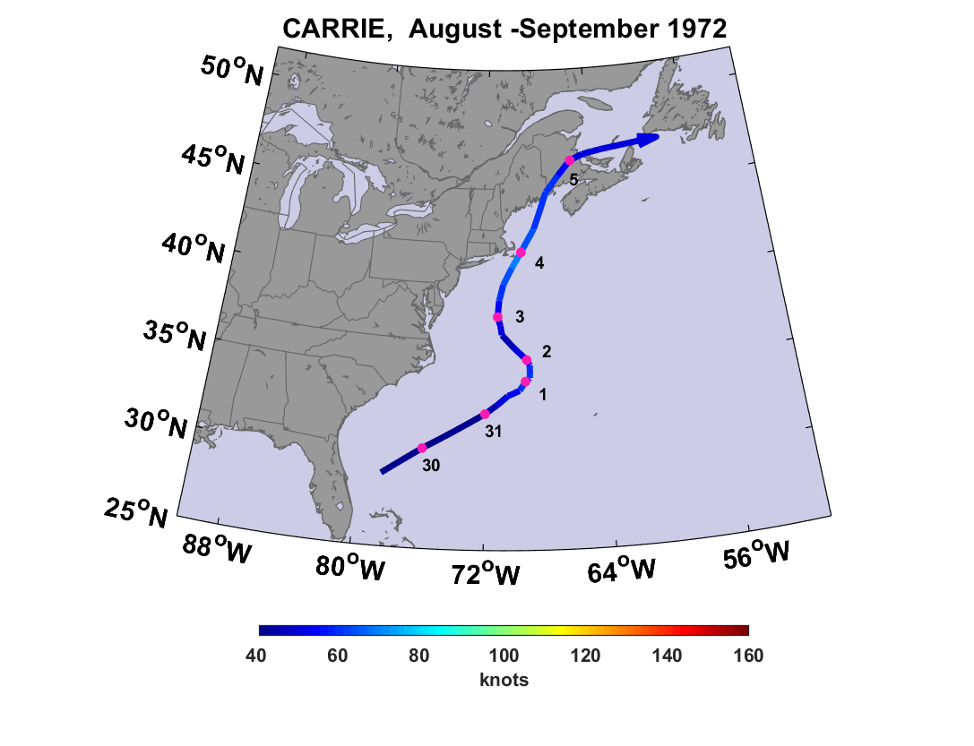
Two deaths in Maine from high surf
Affected midcoast 1-2 hrs after low tide

Slide 70
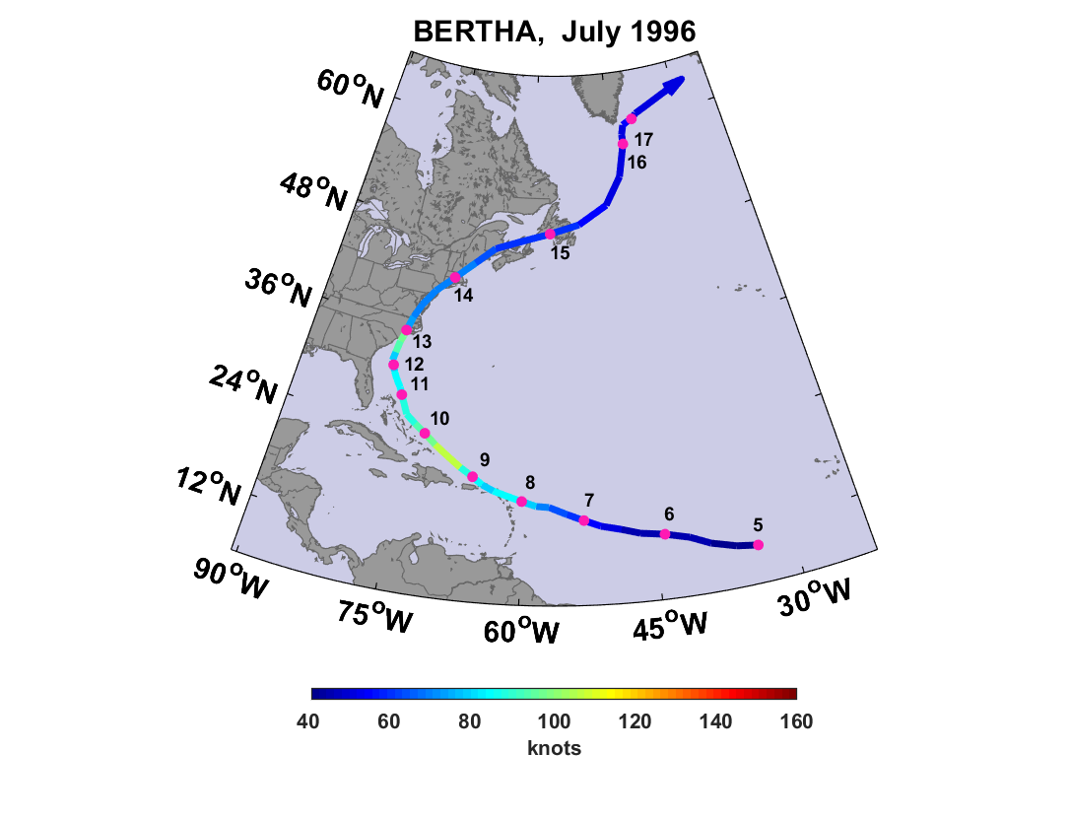

Slide 71
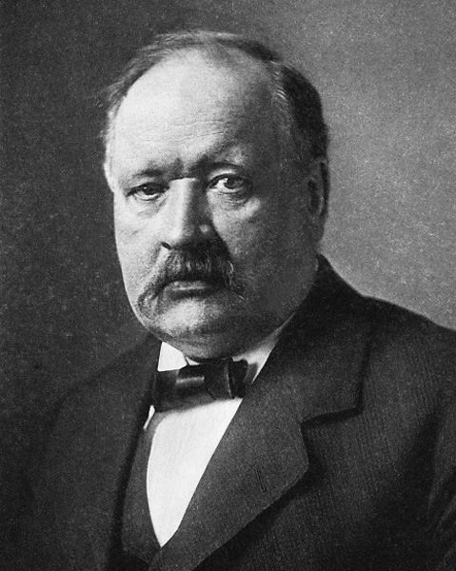
Svante Arrhenius, 1859-1927
“Any doubling of the percentage of carbon dioxide in the air would raise the temperature of the earth's surface by 4°; and if the carbon dioxide were increased fourfold, the temperature would rise by 8°.” – Världarnas utveckling (Worlds in the Making), 1906
Notes:
In the year 1906, the Swedish chemist Svante Arrhenius, published the results of a painstaking analysis of the absorption in our atmosphere of infrared radiation emitted by the moon, getting a rough estimate of the effect of carbon dioxide on climate. On that basis, he predicted that doubling the CO2 concentration would warm the annual mean, global average surface temperature by 4 degrees Celsius. He was the first scientist to suggest that human emission of greenhouse gases could materially change the climate, and his calculations were done by hand based on elementary physics and chemistry.
Note Arrhenius’s aura of grim determination. This set the standard for the demeanor of climate scientists ever since.
The next slide shows how Arrhenius’s prediction has fared:

Slide 72
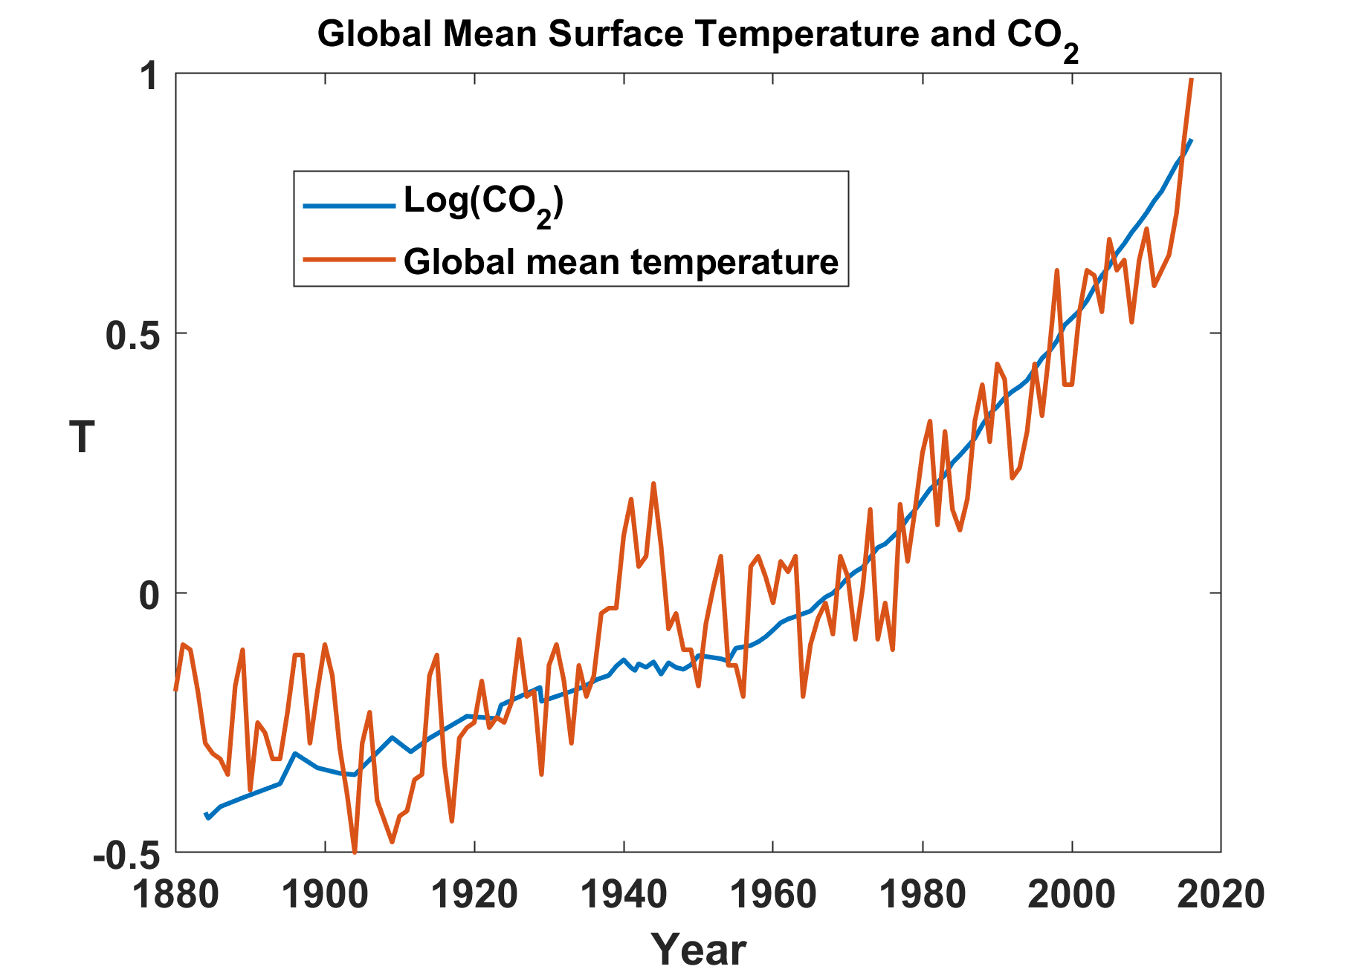
Notes:
The blue line represents the annual average, global mean surface temperature predicted by Arrhenius’s relationship between CO2 and temperature, based on observed concentrations of CO2. The red line is the observed annual average, global mean temperature. You can see that Arrhenius’s prediction is pretty well verified by what has actually happened, and this is also supported by contemporary numerical models of the climate system.
There is no longer a debate in the field of climate science that the increase in CO2 is owing to human emissions and that it is responsible for most of the warming over the past half century. The scientific issues revolve around how much warming will occur and what tangible risks this presents to human welfare.

Slide 73
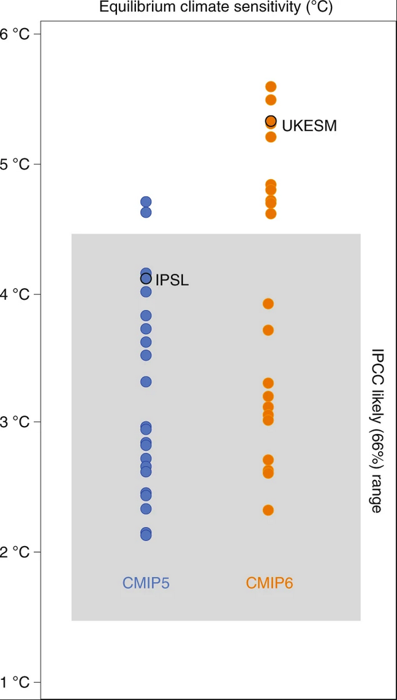
Equilibrium global temperature response to doubling of CO₂ in two generations of global climate models
Arhennius
Previous generation models
Current generation models
Notes:
Climate models are highly complex models of the climate system. There are many different such models run by different laboratories in different countries. The blue dots at the left show the equilibrium global temperature response to a doubling of CO2 by a large set of such models, run in support of the last IPCC report. The orange dots show the equilibrium temperature from the simulations run in support of the upcoming IPCC report. The horizontal black line is the Arrhenius prediction.
To quote the Danish physicist Neils Bohr, “Prediction is very difficult, especially about the future”. But uncertainty about the future is an inherent feature of risk and has never stopped intelligent people from taking measures to mitigate their risk. My own recent work is an attempt to quantify climate risk under uncertainty in a way that will be useful to businesses and planners. Presently I will show you an example of our approach to making useful, quantitative estimates of climate risk, both at present and in the future.

Slide 74
Wind Power Dissipation, 1981-2000

Slide 75
Wind Power Dissipation, 2081-2100

Slide 76
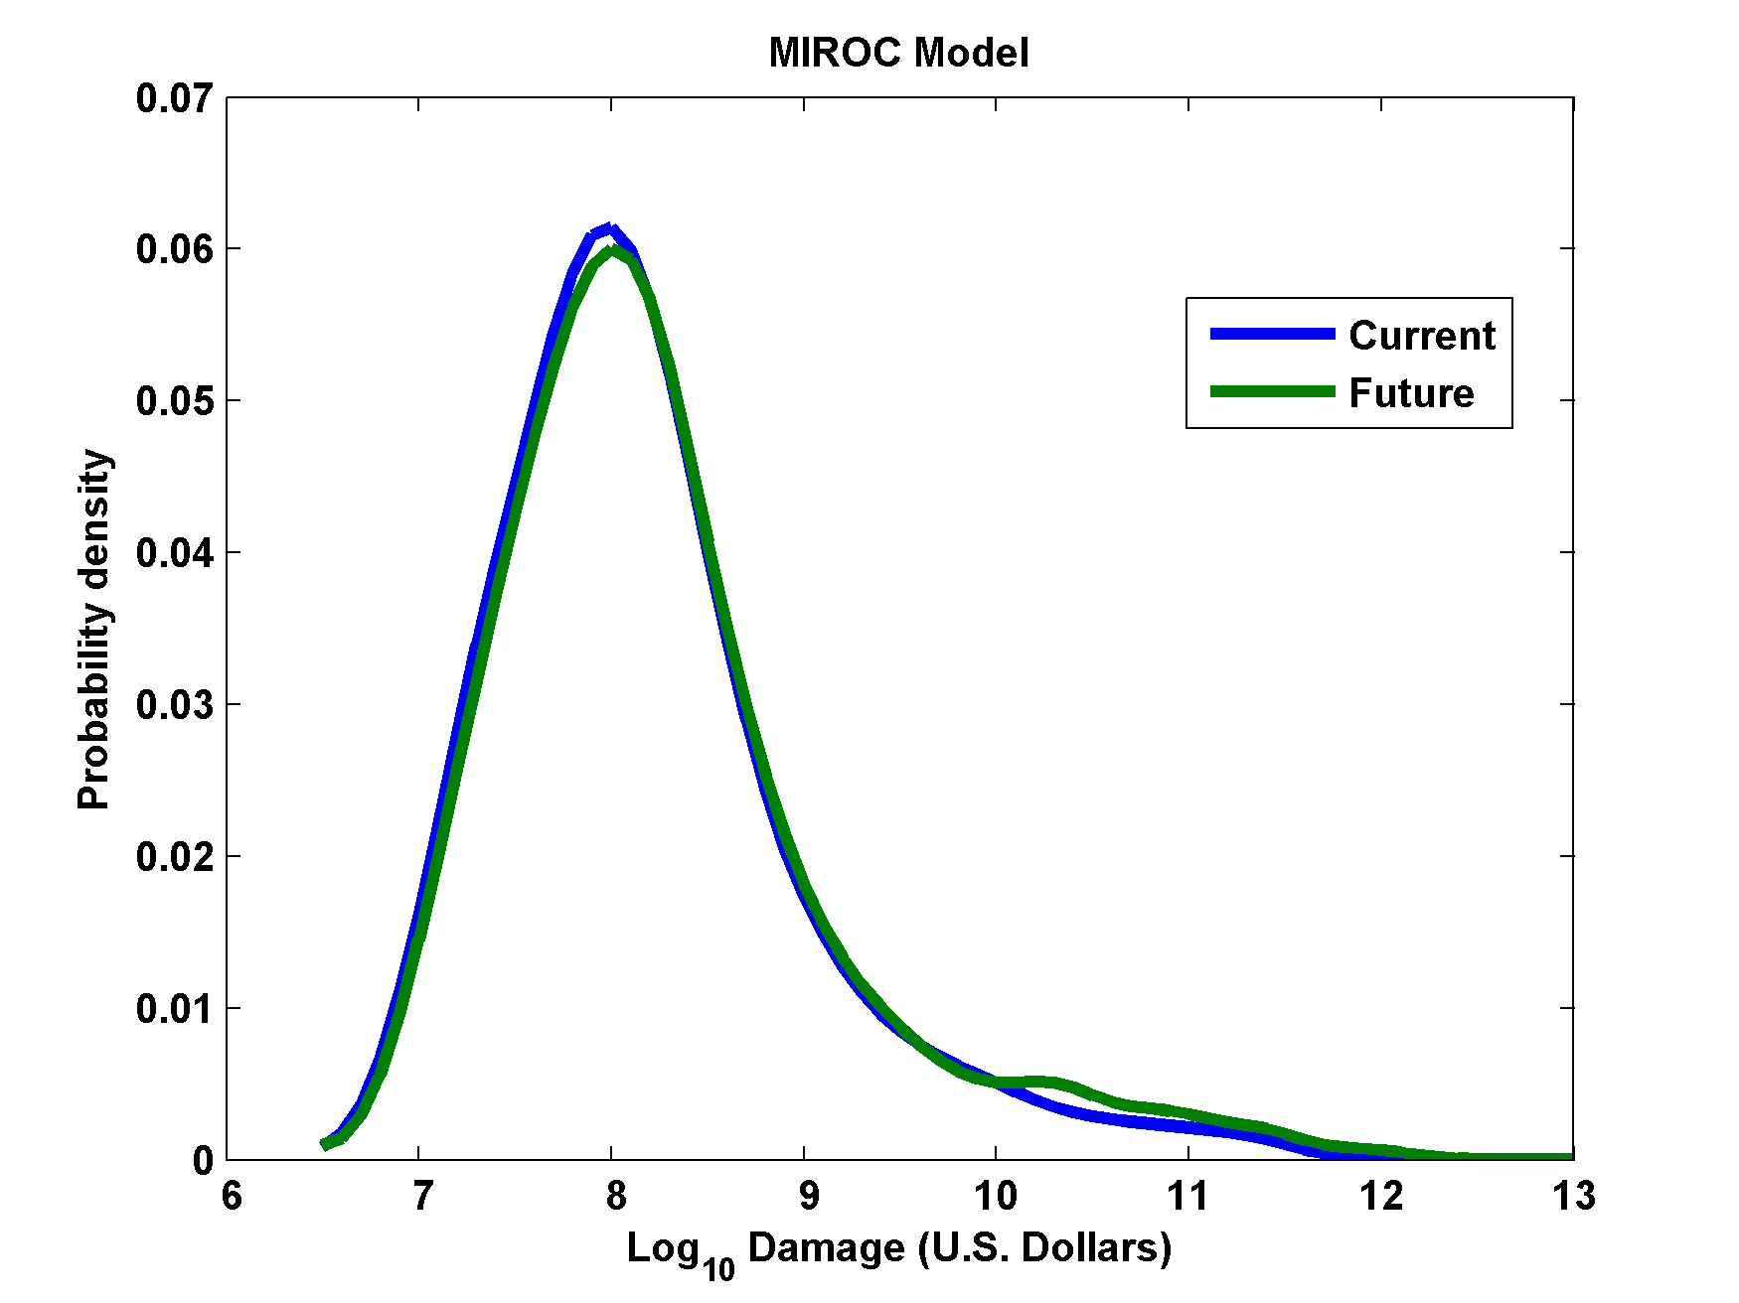

Hurricane Risk Assessment: The Problem
Event Probability
Damage Probability
Current and Future Probability Density of U.S. TC Wind Damages
Current and Future Damage Probability

Slide 77


