Slide 1

The Changing Tropical Cyclone Risk Landscape
Kerry Emanuel
Lorenz Center
Massachusetts Institute of Technology

Slide 2
Program
Past trends in TC activity and loss
The case for using physics, as encoded in numerical models, to quantify TC risk in the current and future climates
Modeling TC loss: The importance of volatility

Slide 3
Global Damage Normalized by Gross World Product
Storms, droughts, floods, wildfires
270% increase since 1970
Population of TC-prone regions increased by ~200%
Suggests that climate change may have contributed to increasing damage
EM-DAT, 2024: The OFDA/CRED International Disaster Database
http://www.emdat.be/.

Slide 4
Global Damage Normalized by Gross World Product
Tropical Cyclones
Global Damage
WDP

Slide 5
Two trends to contend with:
Demographic
Climate Change

Slide 6
SFHA=special flood hazard area
Whose paying for this?
Kansas!
Courtesy First Street Foundation

Slide 7
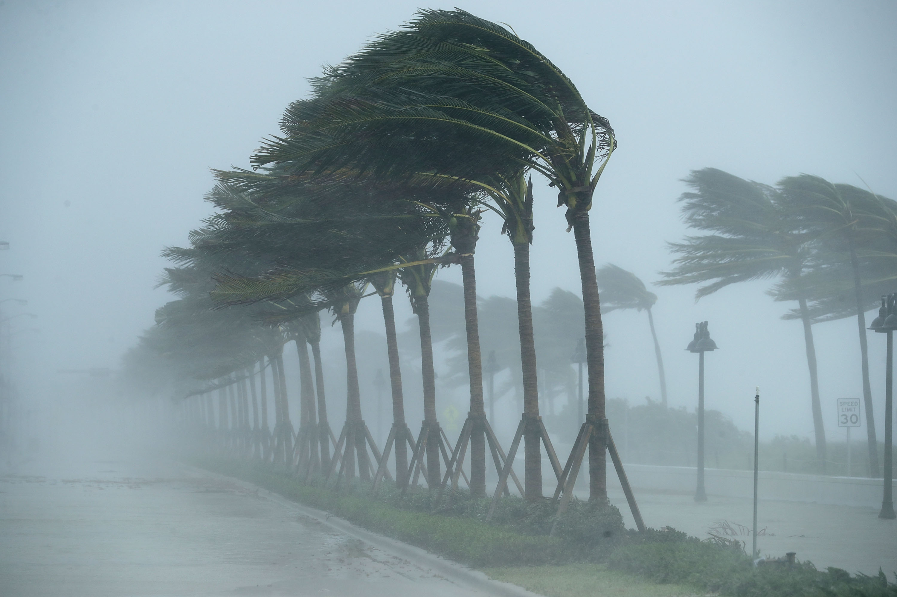
Trends in Tropical Cyclones

Slide 8
Global Hurricane Records
Global detection of tropical cyclones dates back to about 1970
Before 1980, hurricane records outside the Atlantic region are very poor
Even today, satellite-based estimates of intensity and rain are not of high quality

Slide 9

What Are Atlantic Historical TC Records Based On?
Pre-1943: Anecdotal accounts from coastal cities and ships
1943: Introduction of routine aircraft reconnaissance in Atlantic, western North Pacific
1958: Inertial navigation permits quantitative measurement of wind speed at flight level
1970: Complete global detection by satellites
1978: Introduction of satellite scatterometry

Slide 10
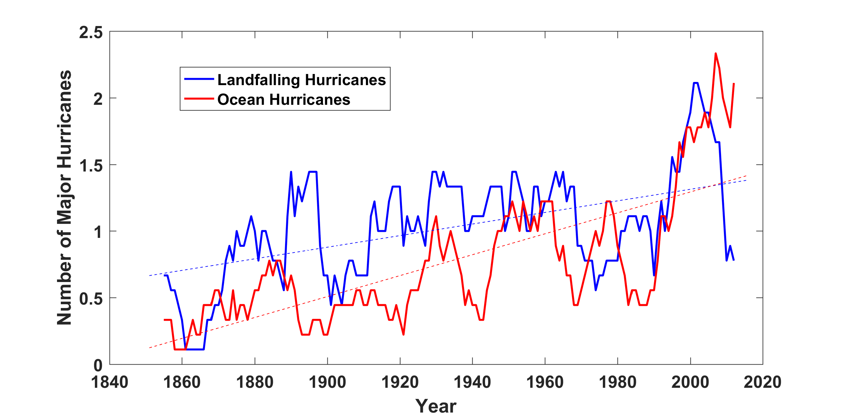
Historical Records:
Prior to ~1970, Many Storms Were Missed
Major hurricanes in the North Atlantic, 1851-2016, smoothed using a 10-year running average. Shown in blue are storms that either passed through the chain of Lesser Antilles or made landfall in the continental U.S.; all other major hurricanes are shown in red. The dashed lines show the best fit trend lines for each data set.

Slide 11
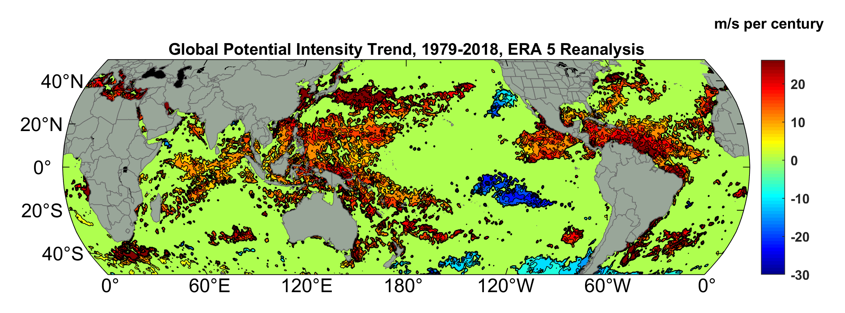
Potential Intensity Trend, 1979-2018, ERA 5 Reanalysis
Potential intensity is a thermodynamic upper bound on TC wind speeds, easily calculated from climate data
(Trend shown only where p value < 0.05)
Simple physics suggest that potential intensity should increase by 15-20% per doubling of CO₂ (result published in Nature in 1987)

Slide 12
Satellite-derived proportion of major hurricane fixes
Time series of fractional proportion of global major hurricane estimates to all hurricane estimates for the period 1979–2017. Each point, except the earliest, represents the data in a sequence of 3-y periods. The first data point is based on only 2 y (1979 and 1981) to avoid the years with no eastern hemisphere coverage. The linear Theil−Sen trend (black line) is significant at the 98% confidence level (Mann−Kendall P value = 0.02). The proportion increases by 25% in the 39-y period (about 6% per decade).
Kossin et al., PNAS, 2020

Slide 13
Flawed Basis of Current Risk Modeling
Most current risk assessments are based on historical statistics
Historical records are flawed and too short
Moreover, the past 50-150 years is a poor guide to the present owing to climate change that has already occurred
We need to bring physics to bear on weather hazard risk
Climate and weather researchers are getting more involved in physical modeling of risk
Government and the insurance/reinsurance industries should encourage this development

Slide 14
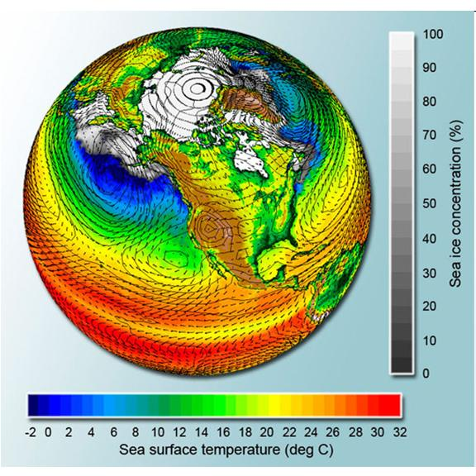
Applying Physics to Risk
Global climate models can potentially simulate droughts and heatwaves…..

Slide 15
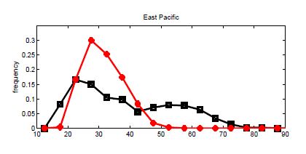
…. but are far too coarse to simulate, e.g., destructive hurricanes
Histograms of Tropical Cyclone Intensity as Simulated by a Global Model with 50 km grid point spacing. (Courtesy Isaac Held, GFDL)
Category 3
Modeled
Observed
Global models do not simulate the storms that cause destruction
Wind Speed (meters per second)
Detailed, high-resolution modeling suggests grid spacing of no more than 3 km required
HighResMip: Grid spacings of 20-200 km (NICAM has short run at 14 km)
We need high resolution and O(1000 yr) simulations

Slide 16
Using Physics to Assess Hurricane Risk
(Downscaling)
Reliable, global records of coarse-scale climate are robust and widely available
Cull from these datasets the key statistics known to control tropical cyclone generation, movement, and intensity evolution
Bootstrap these key statistic to create unlimited synthetic time series of the hurricane-relevant environmental variables
Use these to drive specialized, very high resolution physical hurricane models (algorithms for solving governing equations)
Extensively evaluate the results against historical hurricane data
Exact same method can be applied to output of climate models

Slide 17
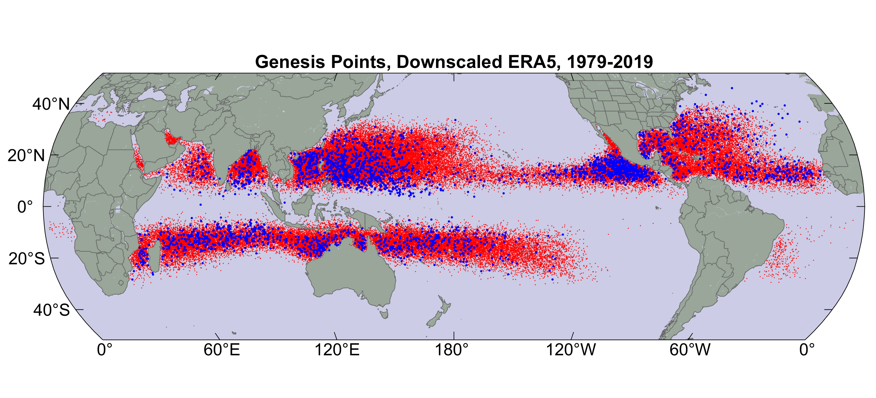
Origin points of successful seeds (red); observed genesis locations (blue)

Slide 18
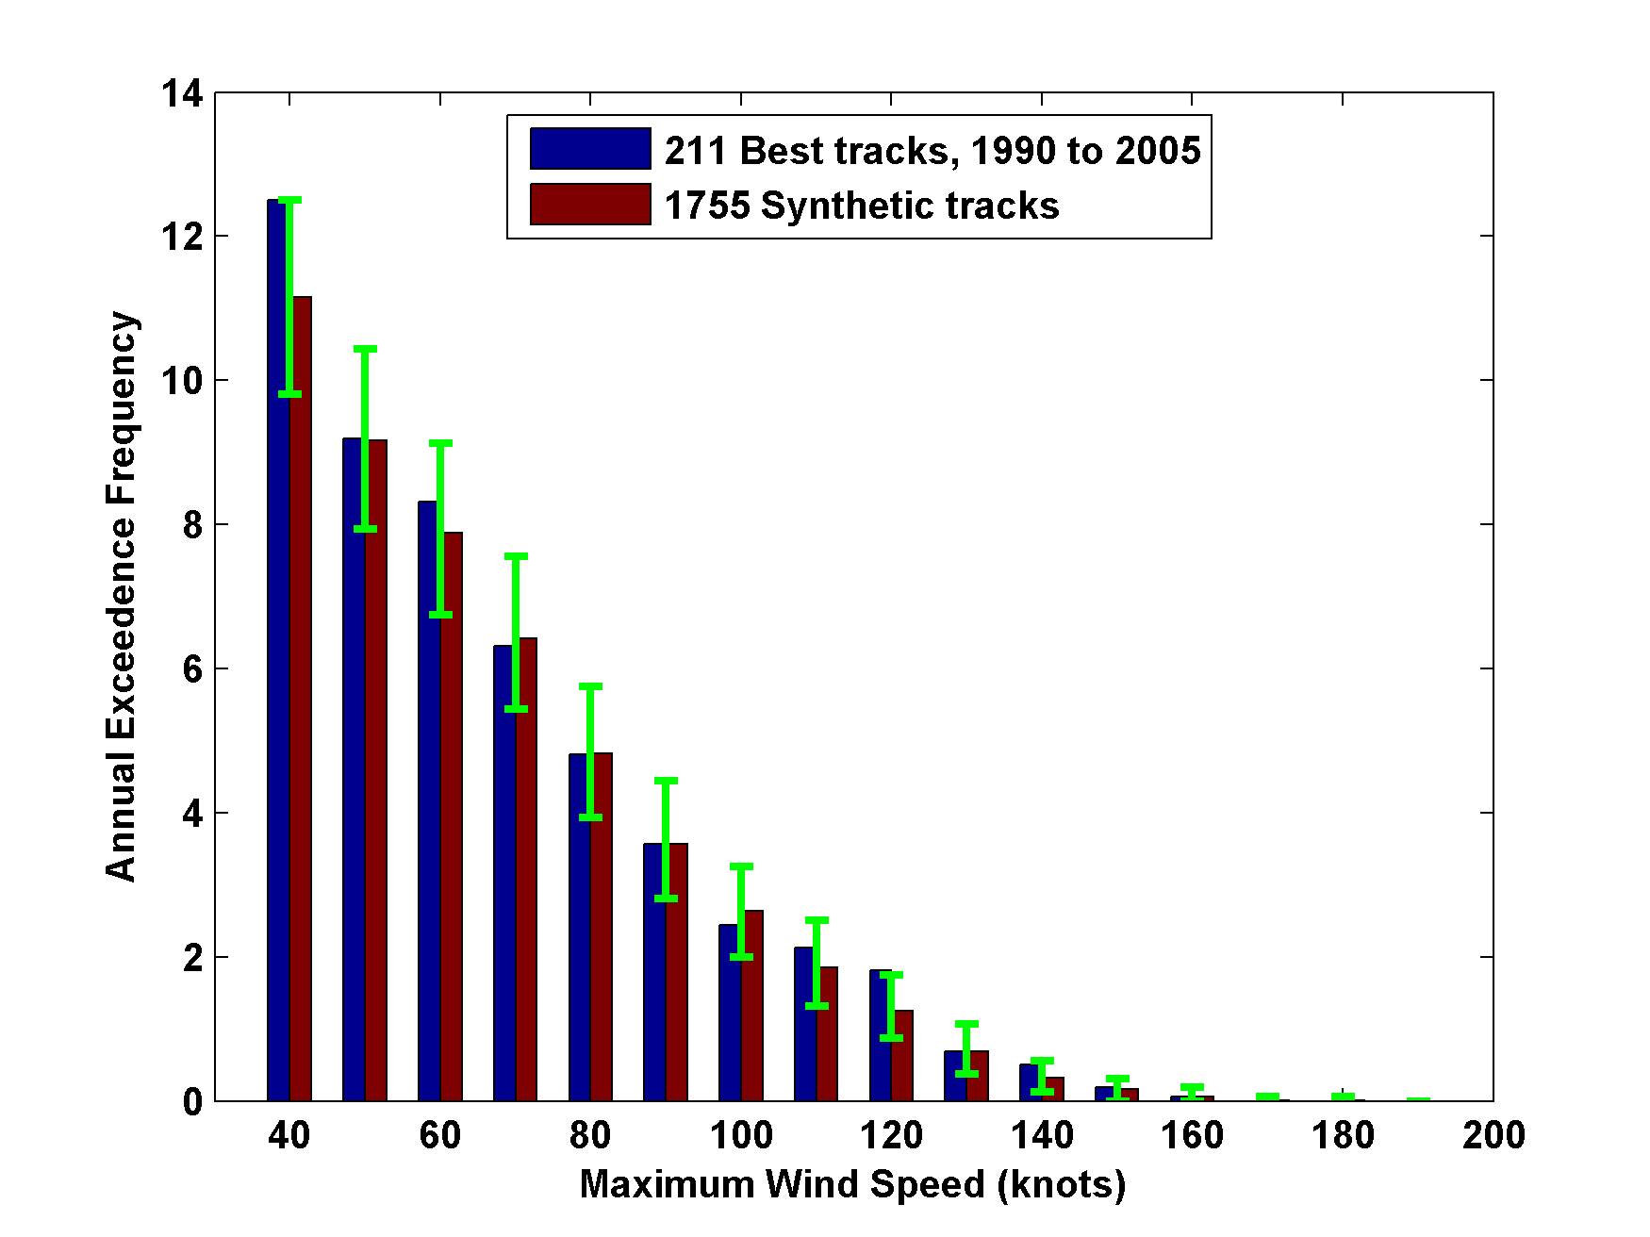
Cumulative Distribution of Storm Lifetime Peak Wind Speed, with Sample of 1755 Synthetic Tracks
Blue bars: Actual
Red bars: Predicted
90% confidence bounds

Slide 19
Atlantic Annual Cycle

Slide 20
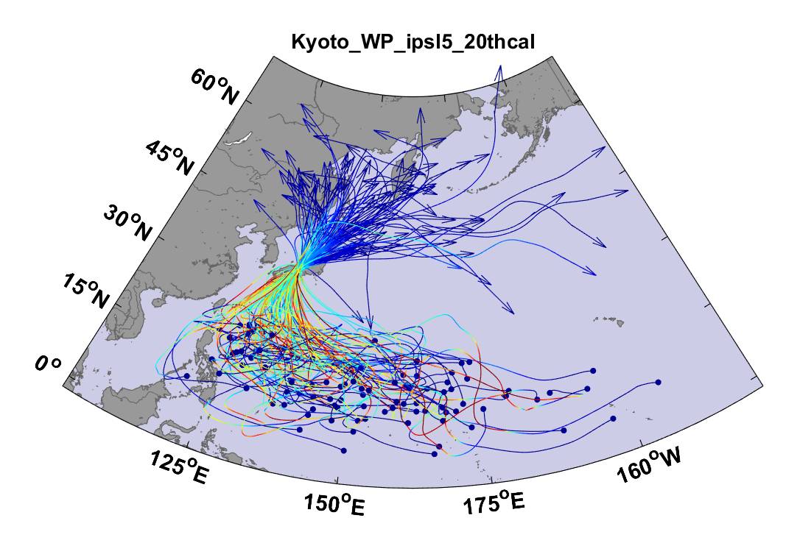
Example:
Top 100 out of 2000 TCs Affecting Kyoto, 1981-2000

Slide 21
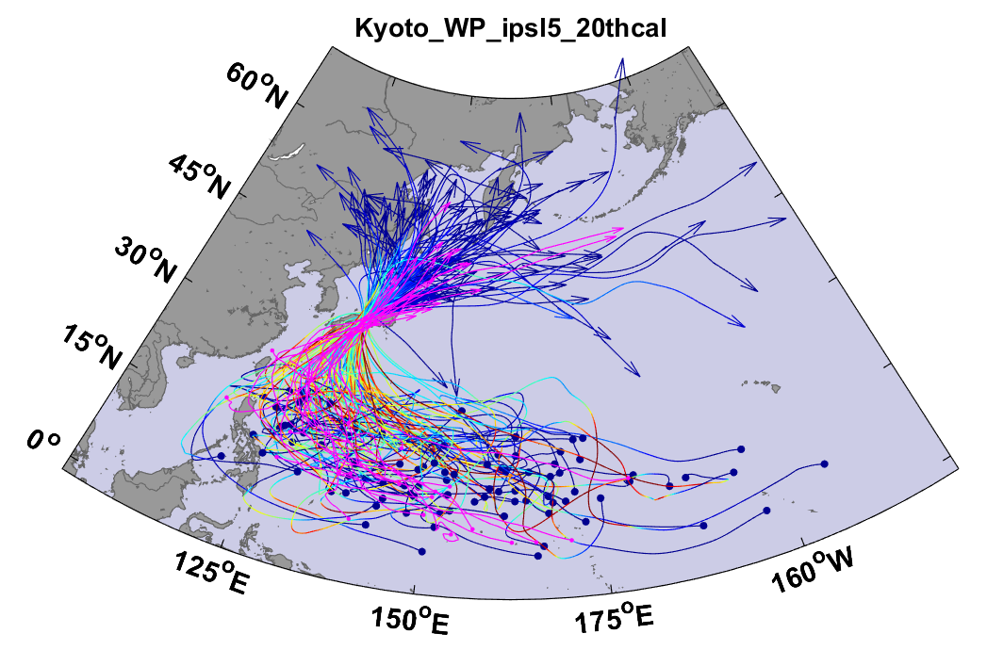
Same, but with top 20 historical tracks

Slide 22
All Landfalls, NOAA 20th Century v.3
7-year running averages
Suggests some landfalls missed prior to 1900

Slide 23
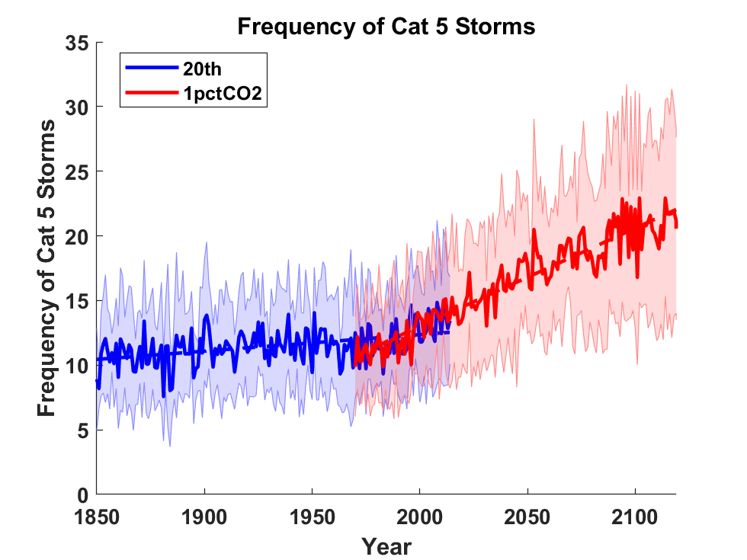
Application to Global Climate Change Simulations:
Global CAT 5 Tropical Cyclone Frequency from 8 Current Generation (CMIP6) Climate Models

Slide 24
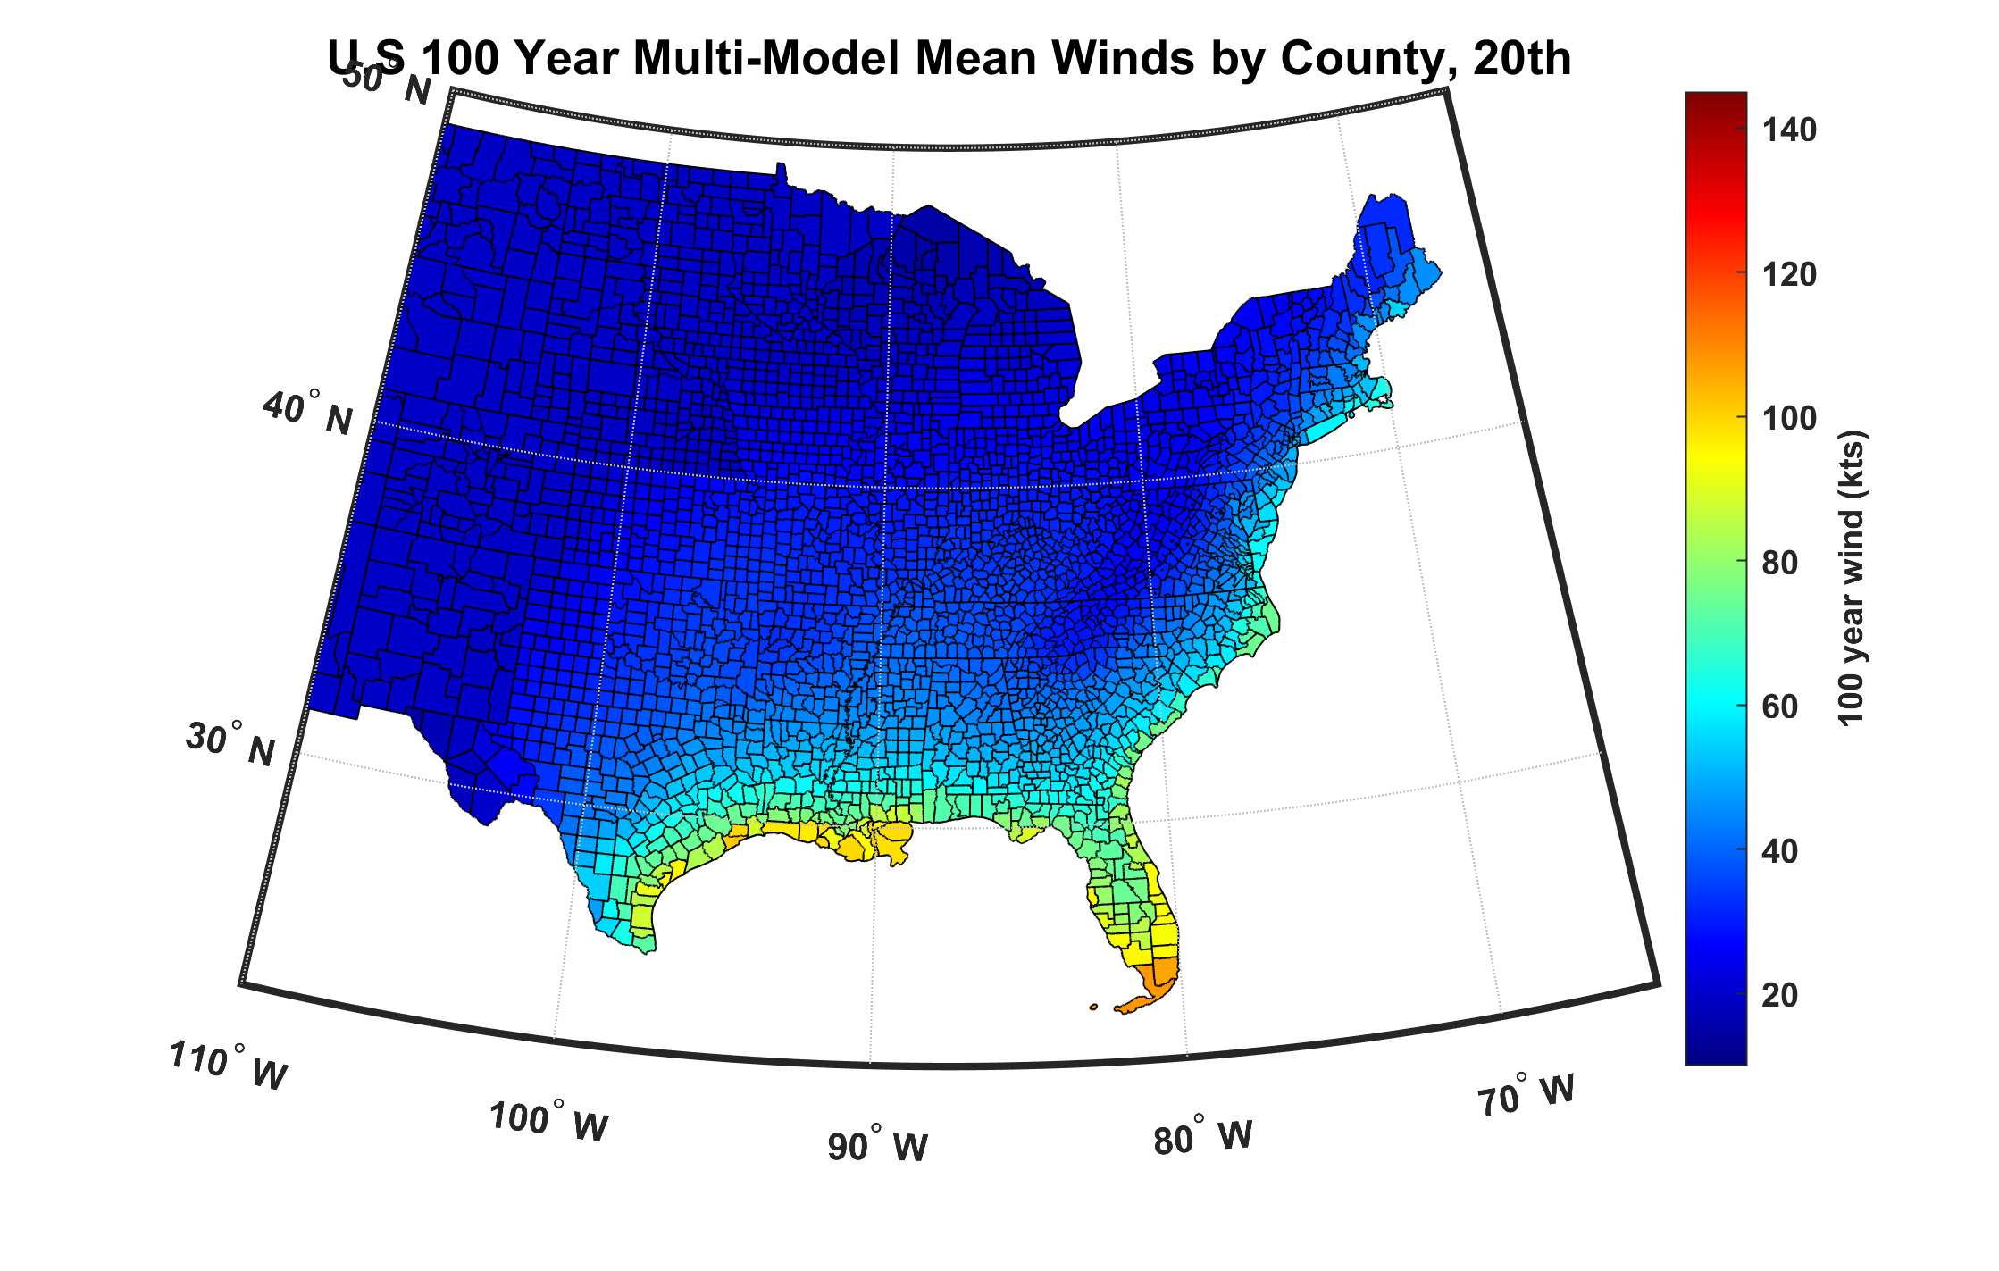
100-year hurricane peak wind based on downscaling 8 CMIP6 climate models, 1984-2014

Slide 25
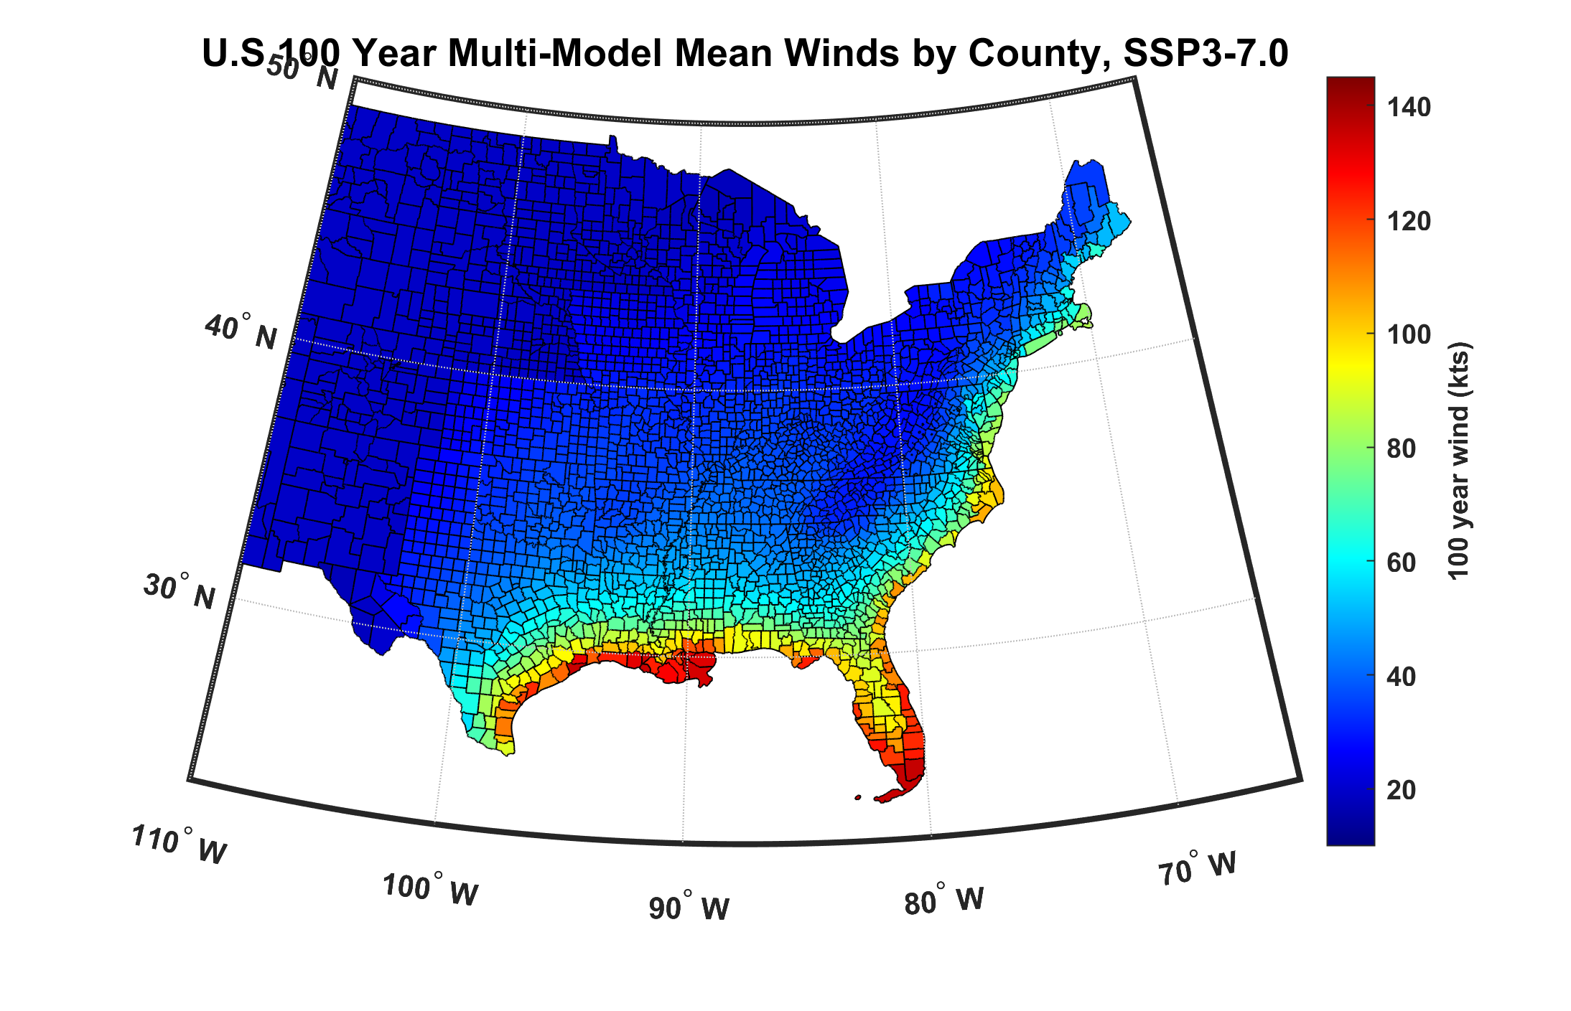
100-year hurricane peak wind based on downscaling 8 CMIP6 climate models, 2070-2100

Slide 26
2,000 year rain event for Houston

Slide 27
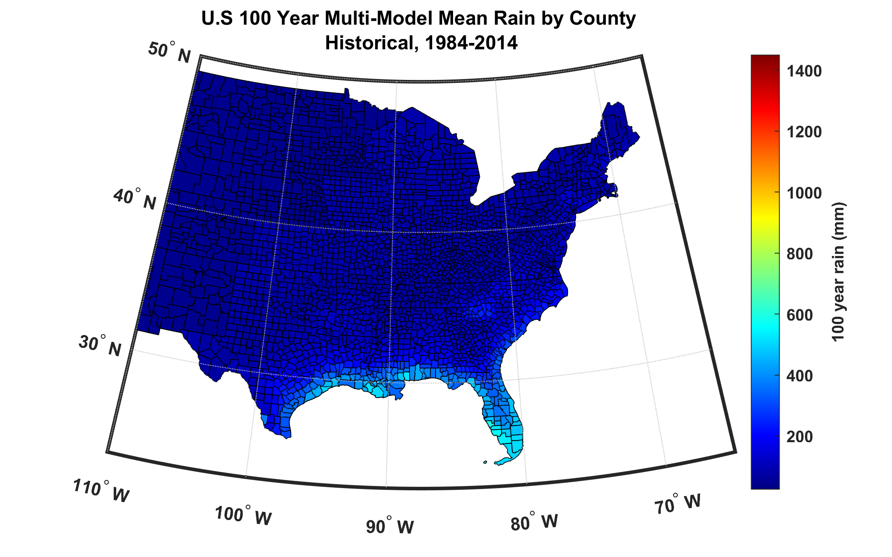
100-year hurricane storm total rain based on downscaling 8 climate models, 1984-2014

Slide 28
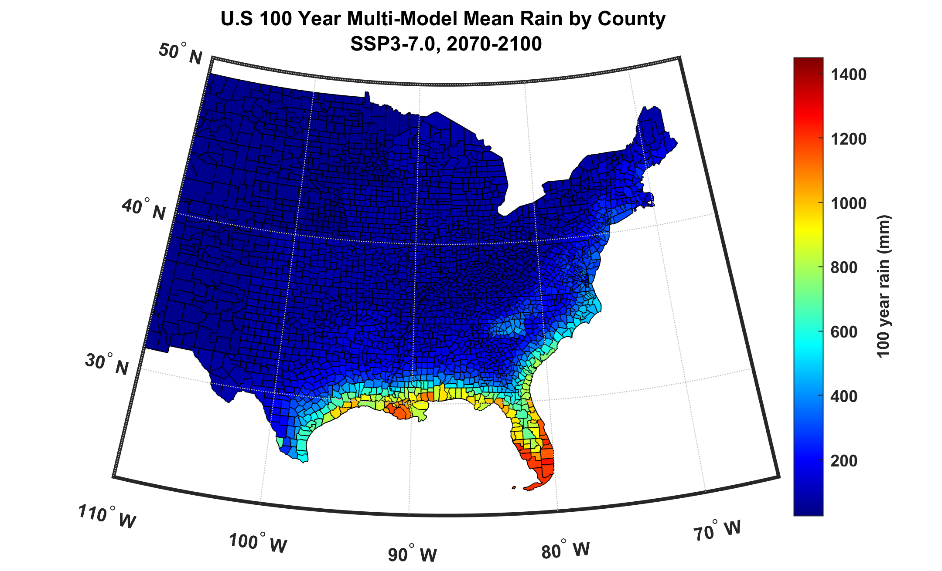
100-year hurricane storm total rain based on downscaling 8 climate models, 2070-2100

Slide 29
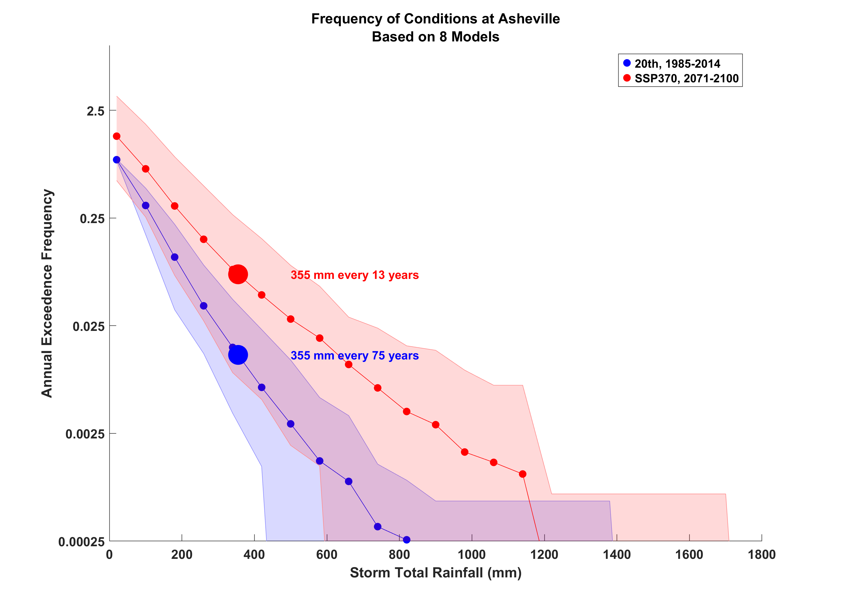

Slide 30
Use very large set of synthetic hurricanes to construct many 1,000-year times series of wind damage to a portfolio of properties in coastal U.S. valued at $1.8 trillion. (Here is 1 out of 10,000 such series:)
You want to estimate average annual loss with 100 years of loss data?
Even with this very large portfolio, volatility masks any plausible climate change signal for at least 50 years
Climate signals in loss data over the past 50 years are almost certainly not detectable

Slide 31
Summary
Historical hurricane and loss records are not fit for purpose in estimating current risk
Atmospheric and climate modelers are starting to apply physics-based models to natural hazard risk
These models generally show rising risk in response to climate change, especially hurricane-induced flood risk
Annual hurricane wind losses, even over all of the U.S., are extremely volatile

Slide 32
Spare Slides

Slide 33
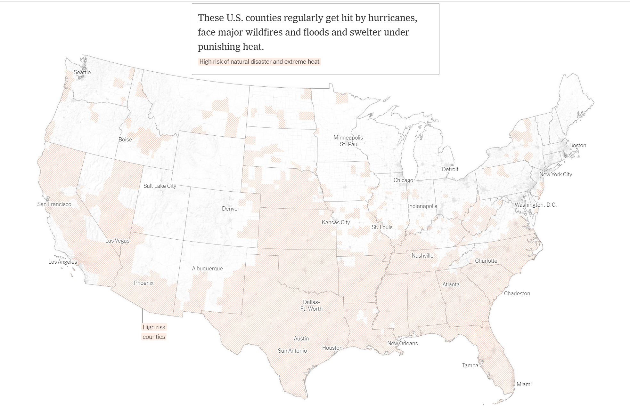
Source: New York Times

Slide 34
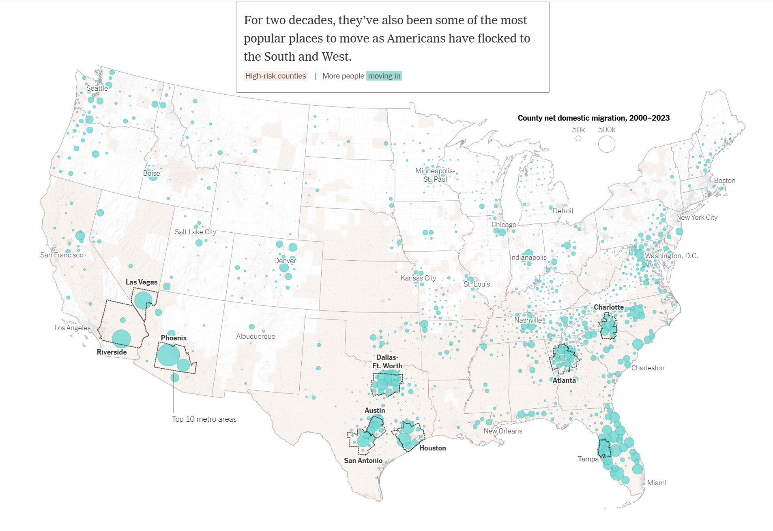
Source: New York Times

Slide 35
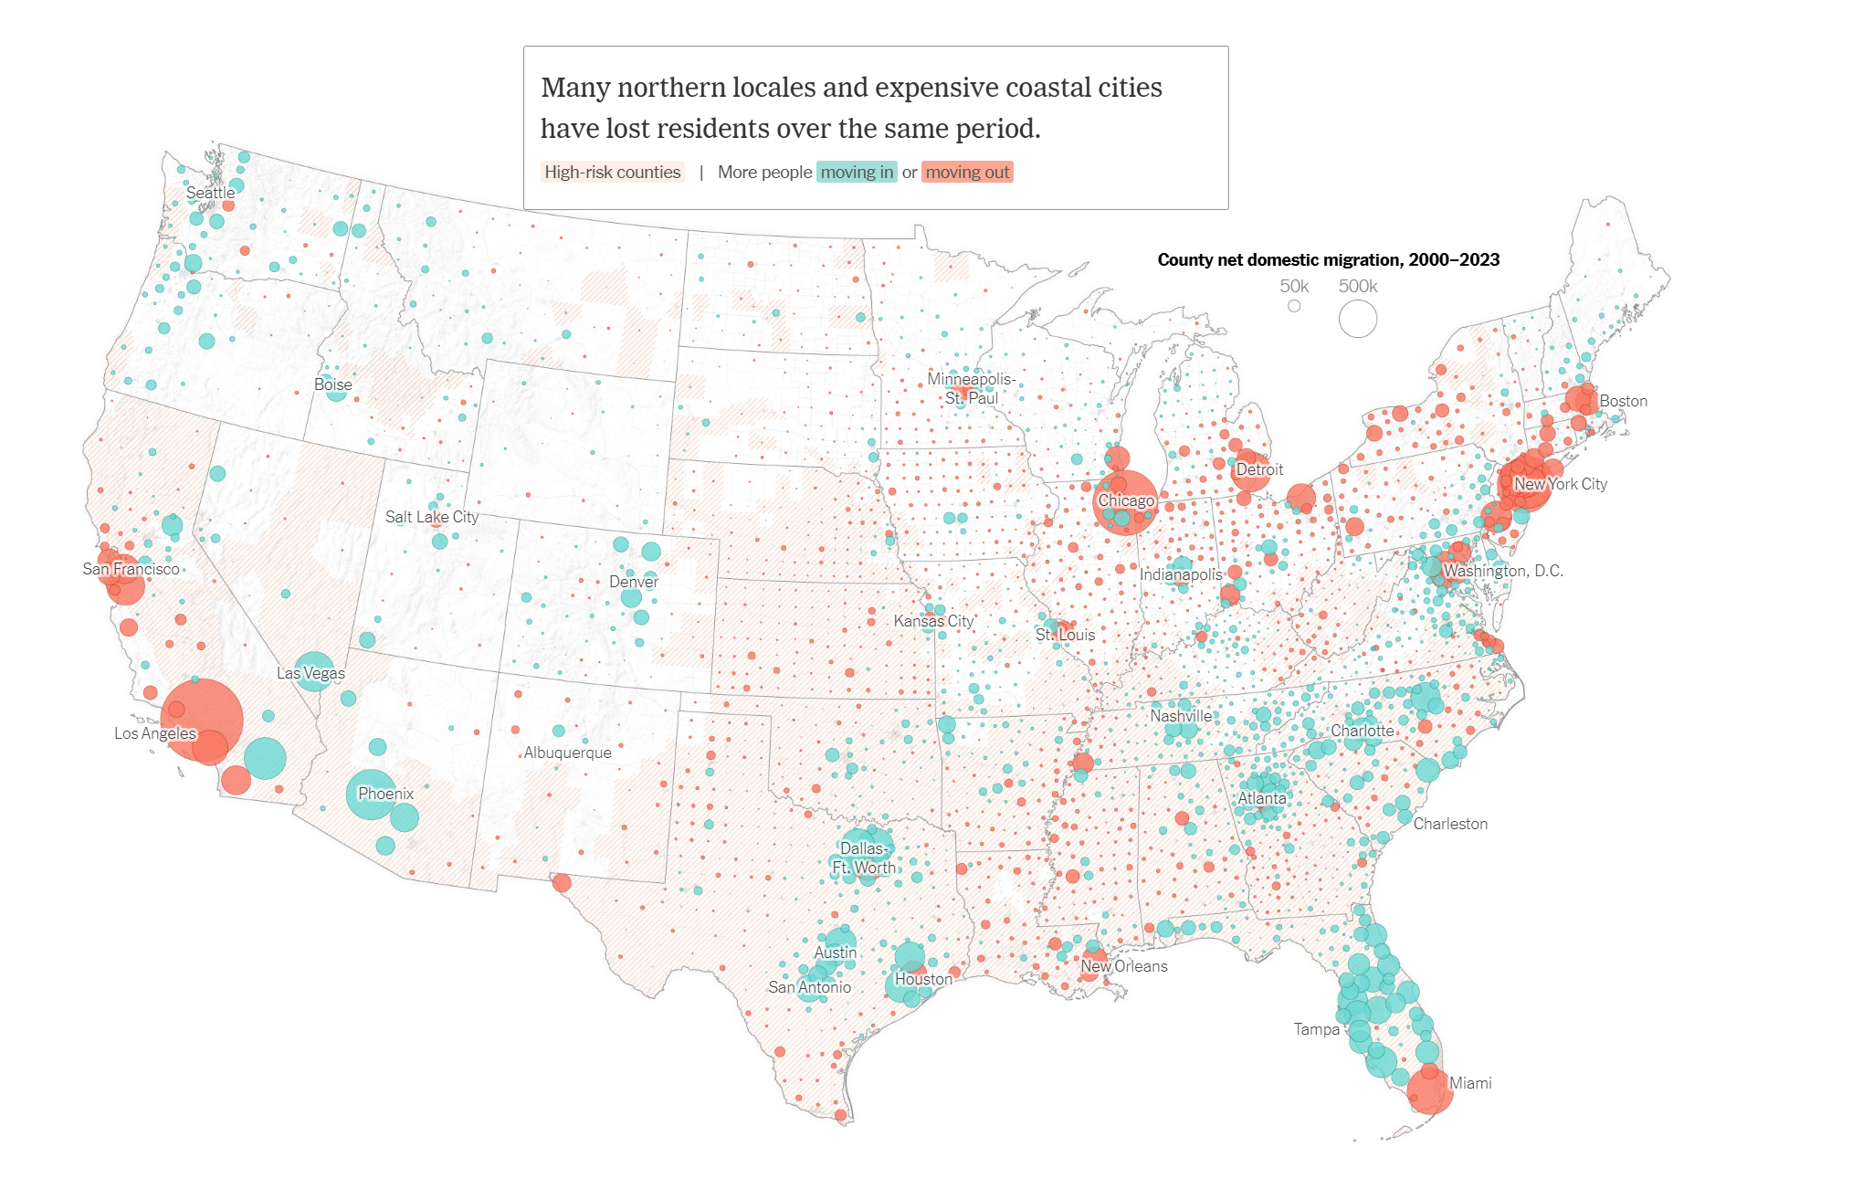
Source: New York Times

