Slide 1

Climate Change and Hurricanes
Kerry Emanuel
Lorenz Center
Massachusetts Institute of Technology

Slide 2

Program
The global record of tropical cyclones
The Atlantic record
Understanding the physics
Tropical cyclones affecting Los Angeles

Slide 3
Global records prior to ~1980 are unreliable

Slide 4
Hurricanes are reaching peak intensity at higher latitudes
Time series of the latitudes at which tropical cyclones reach maximum intensity.
From Kossin et al. (2014)

Slide 5
Satellite-derived proportion of major hurricane fixes
Time series of fractional proportion of global major hurricane estimates to all hurricane estimates for the period 1979–2017. Each point, except the earliest, represents the data in a sequence of 3-y periods. The first data point is based on only 2 y (1979 and 1981) to avoid the years with no eastern hemisphere coverage. The linear Theil−Sen trend (black line) is significant at the 98% confidence level (Mann−Kendall P value = 0.02). The proportion increases by 25% in the 39-y period (about 6% per decade).
Kossin et al., PNAS, 2020

Slide 6
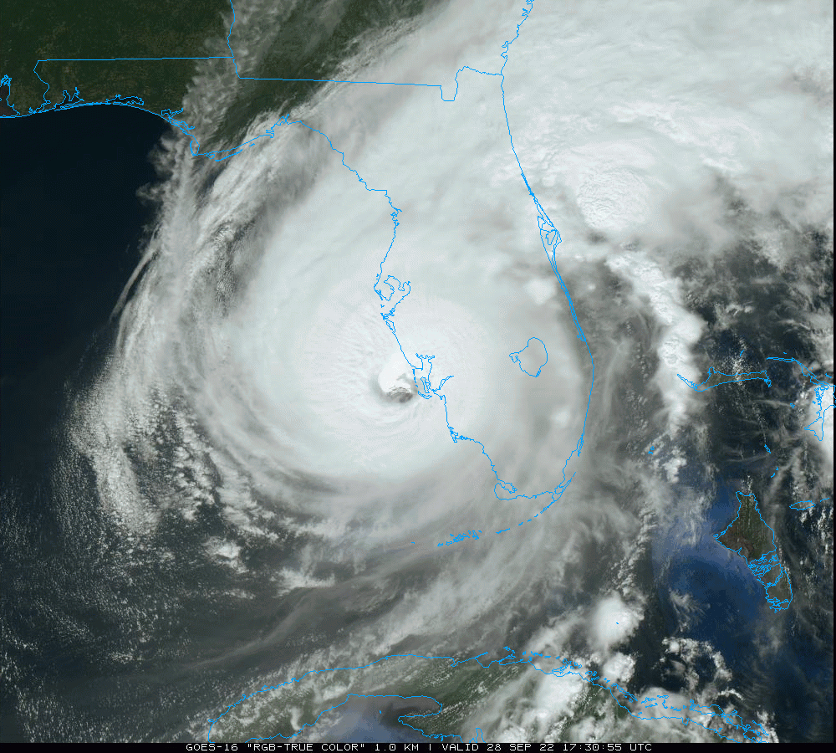
The North Atlantic tropical cyclone record
Hurricane Ian, 2022

Slide 7
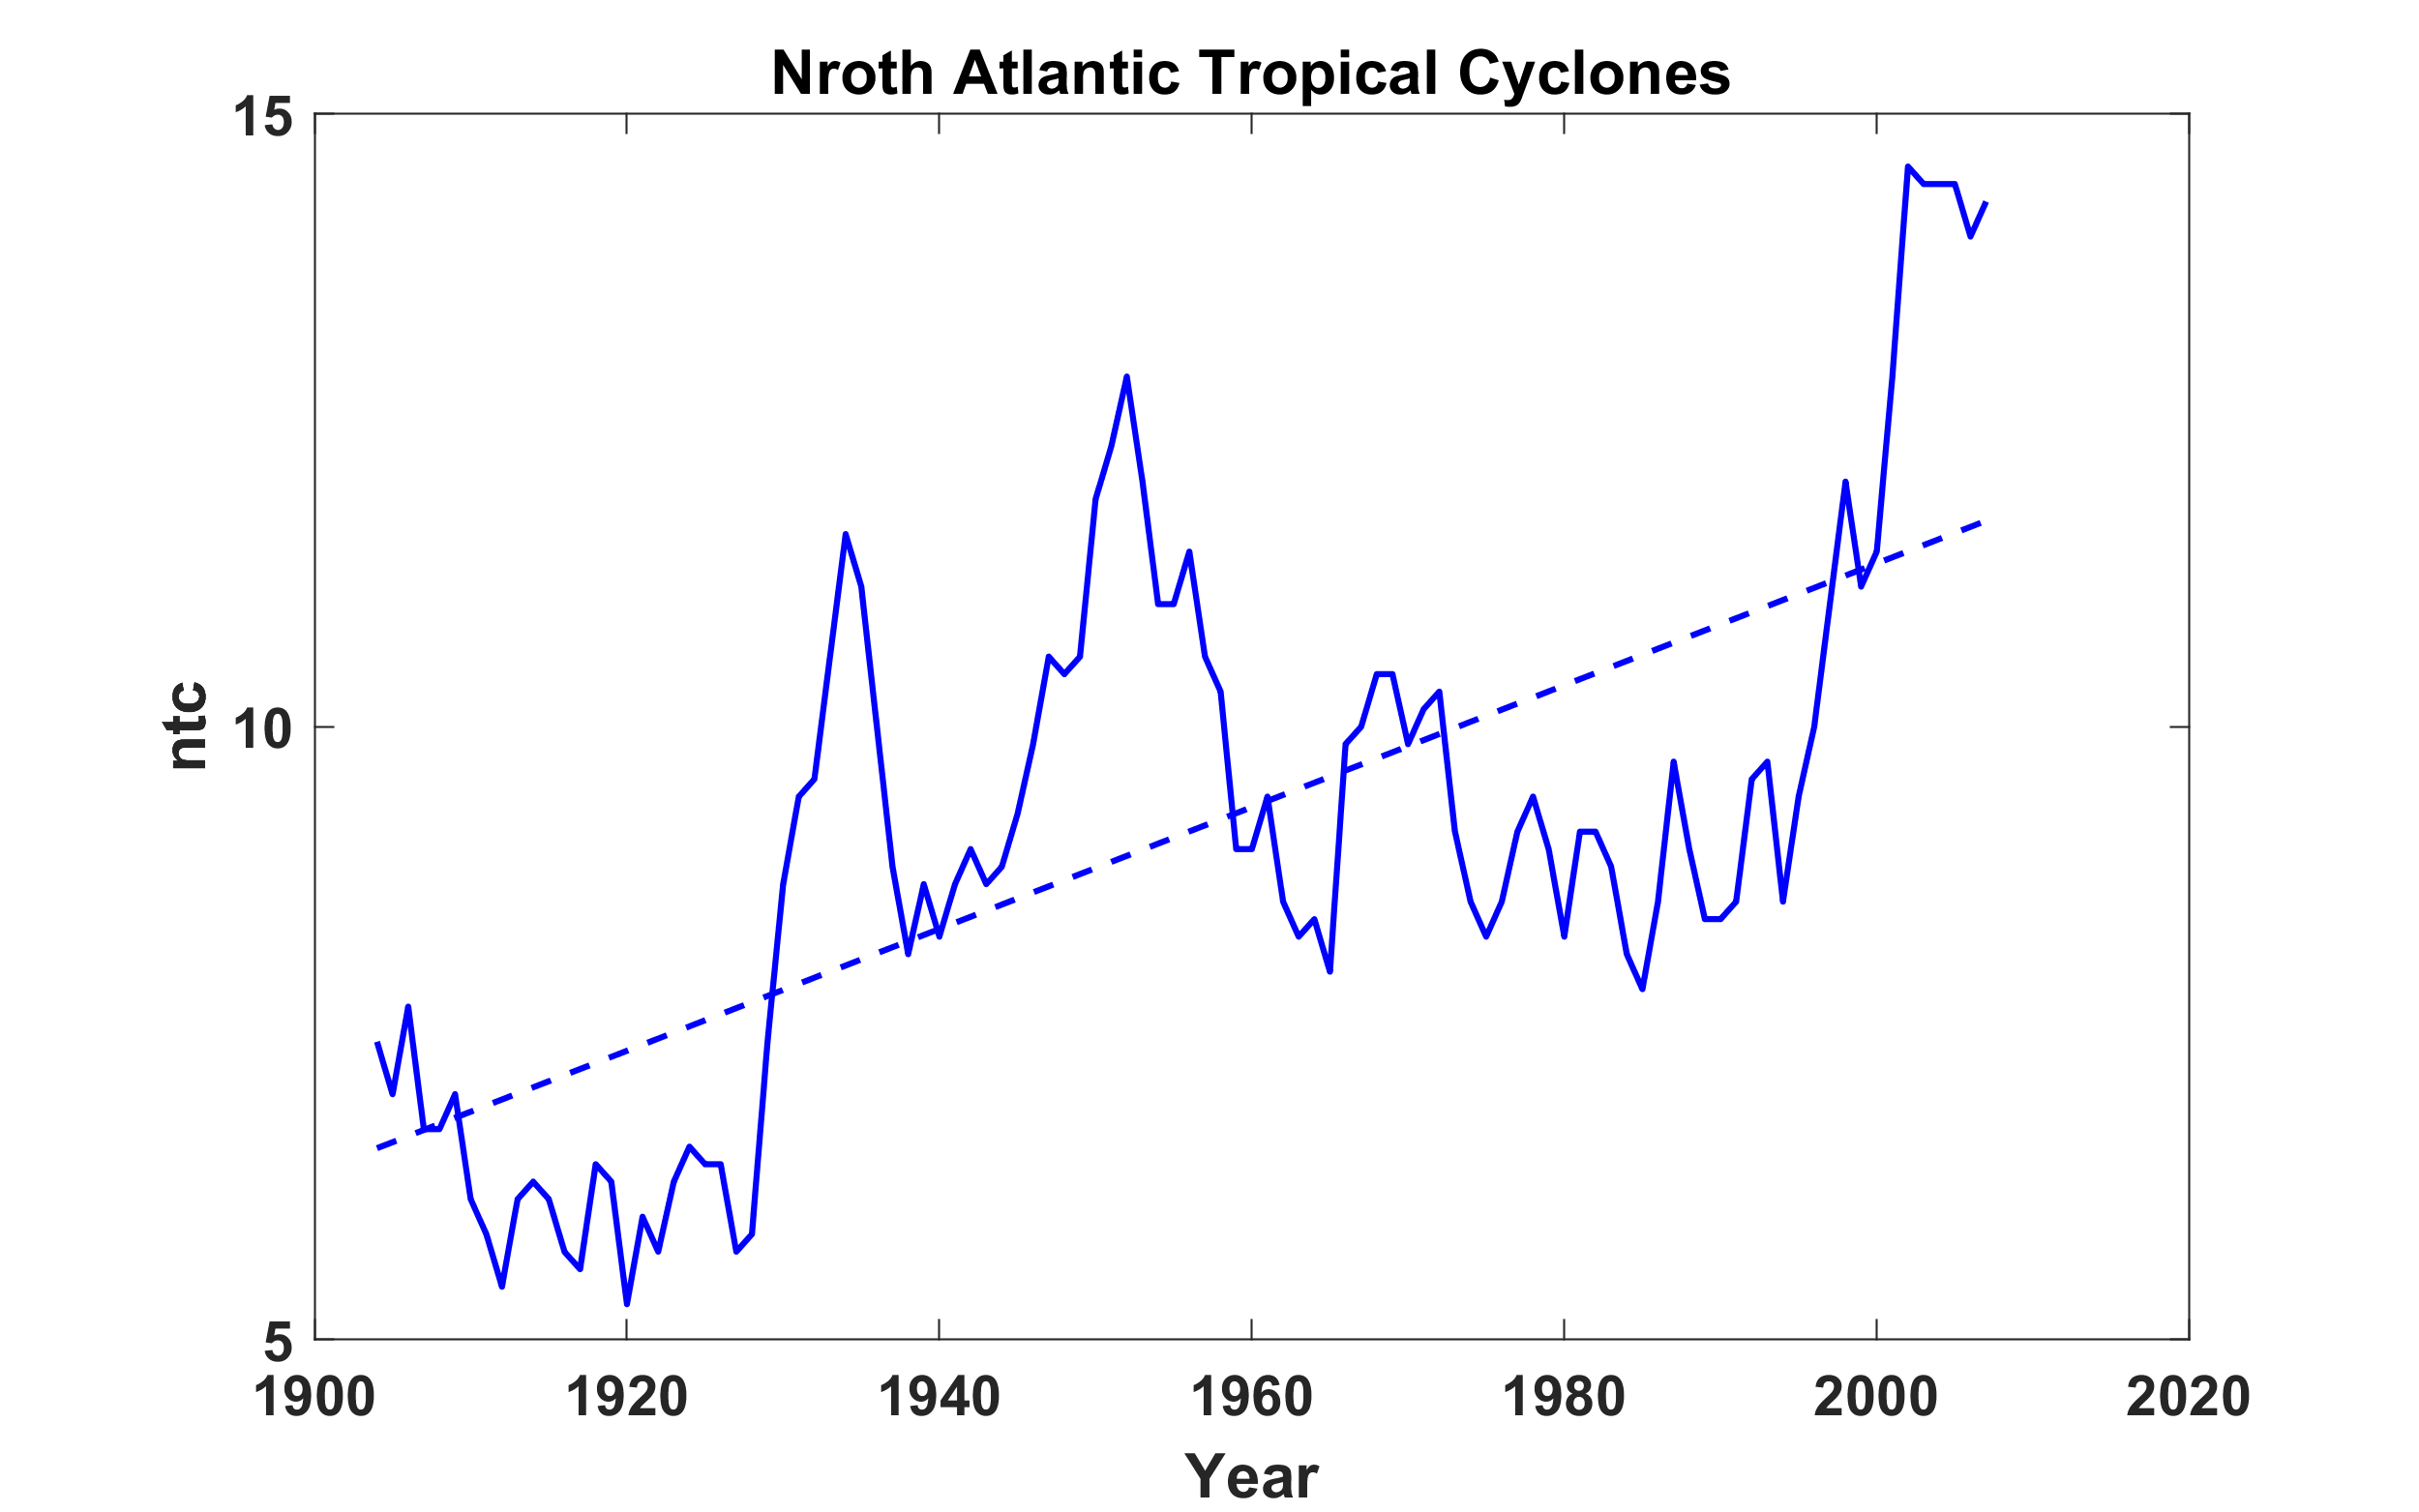
North Atlantic tropical cyclone database extends back to 19th century
North
Hurricane Drought

Slide 8
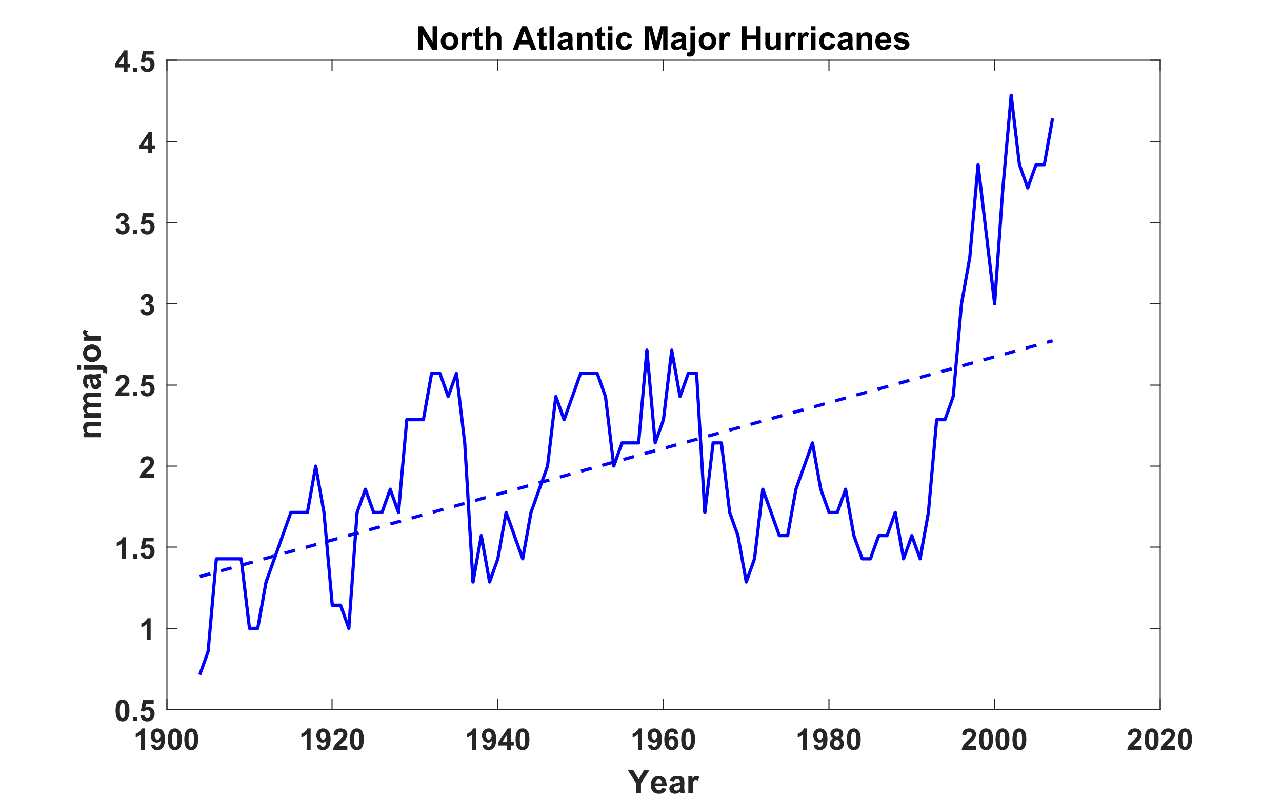

Slide 9
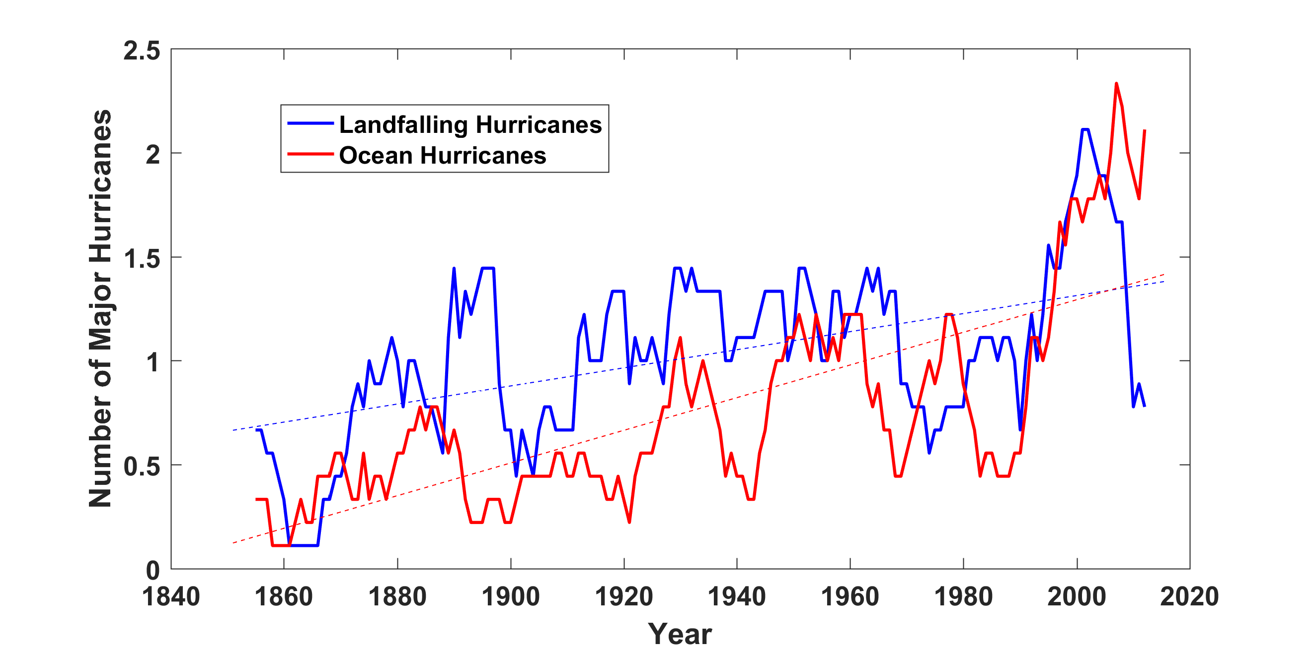
North Atlantic standard database extends back to 1851 but there are problems
Major hurricanes in the North Atlantic, 1851-2016, smoothed using a 10-year running average. Shown in blue are storms that either passed through the chain of Lesser Antilles or made landfall in the continental U.S.; all other major hurricanes are shown in red. The dashed lines show the best fit trend lines for each data set.

Slide 10
Statistical Corrections to Early Record
Vecchi et al., Nature Comm., 2021
Resample post-1971 historical record with digitized ship tracks (ICOADS) before 1971 to estimate number of missing storms
Add estimated number of missing storms to original historical record

Slide 11
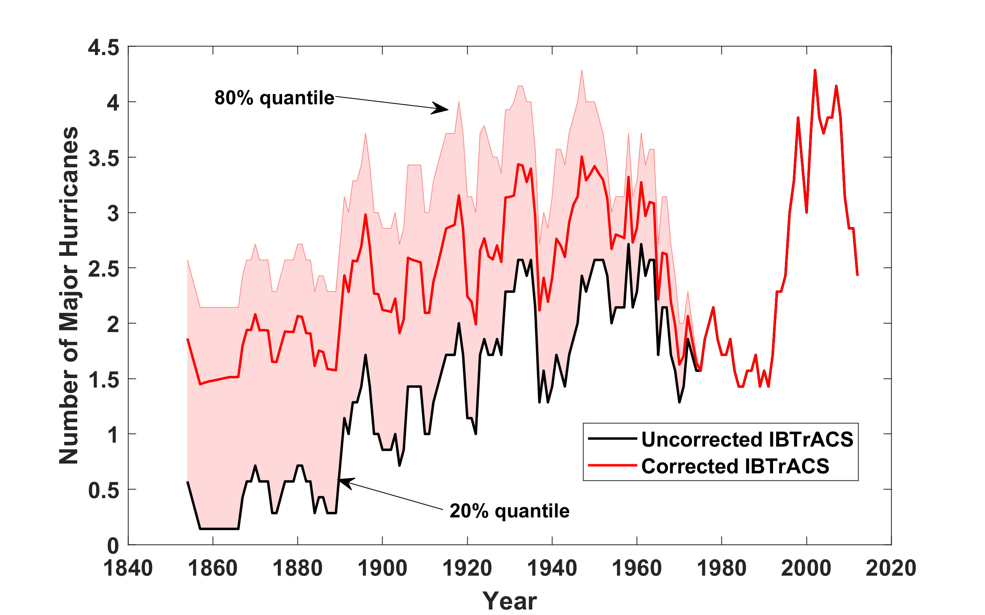
Note: ~20% of the bootstrapped samples agree with the historical record
Data from Vecchi et al., Nature Comm., 2021

Slide 12
Potential problems with corrections
Weights the null hypothesis of no change. For example, an early year that actually had no cyclones but some ship tracks would be corrected to a number equal to the number missed in sampling of modern storms by those ship tracks
ICOADS only contains ship logs that have been digitized. Many have not. Historical track reconstructions relied on other data sources, such as newspaper reports of ship encounters with storms at sea

Slide 13
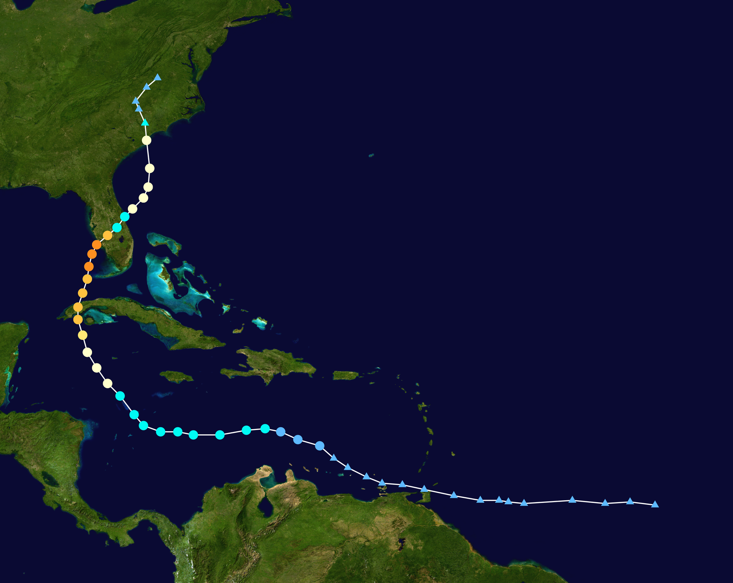
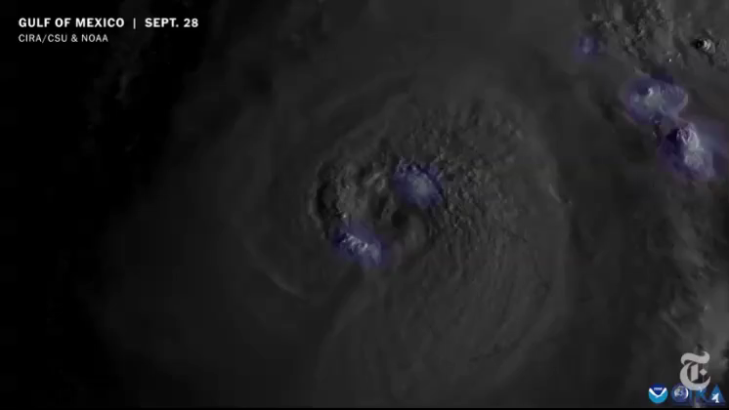
Some Physics
Hurricane Ian
September 23-October 2, 2022

Slide 14
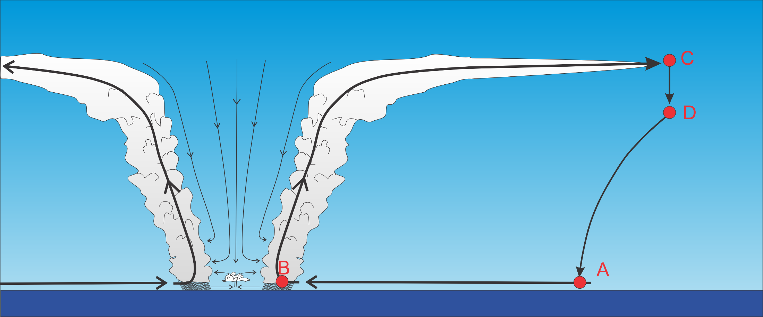
Basic Physics: Energy Production
Isothermal
Loss
Moist adiabatic
Moist adiabatic
Isothermal; large input of heat from sea

Slide 15
Annual Maximum Potential Intensity (m/s)

Slide 16
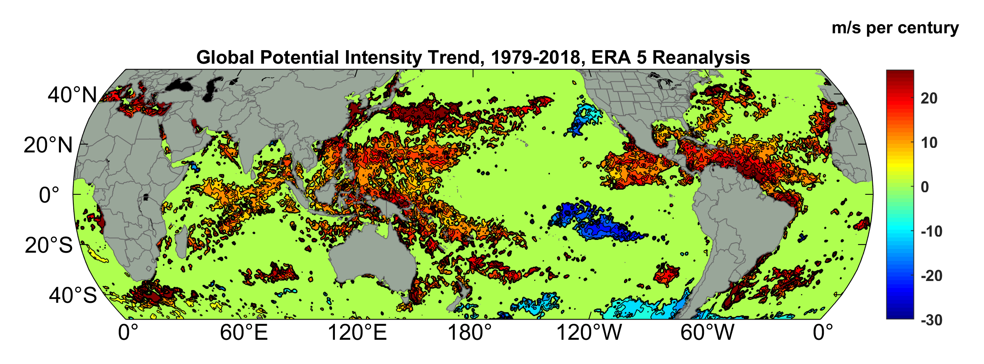
Potential Intensity Trend, 1979-2018, ERA 5 Reanalysis
(Trend shown only where p value < 0.05)

Slide 17
Using physics to estimate hurricane risk

Slide 18
MIT Synthetic Hurricanes
Embed high-resolution, fast coupled ocean-atmosphere hurricane model in global climate model or climate reanalysis data
Coupled Hurricane Intensity prediction Model (CHIPS) has been used for 20 years to forecast real hurricanes in near-real time

Slide 19
Risk Assessment Approach:
Step 1: Seed each ocean basin with a very large number of weak, randomly located cyclones
Step 2: Cyclones are assumed to move with the large scale atmospheric flow in which they are embedded, plus a correction for the earth’s rotation and sphericity (beta-drift)
Step 3: Run the CHIPS coupled intensity model for each cyclone, and note how many achieve at least tropical storm strength
Step 4: Using the small fraction of surviving events, determine storm statistics. Can easily generate 100,000 events
Details: Emanuel et al., Bull. Amer. Meteor. Soc, 2008
Notes:
19

Slide 20
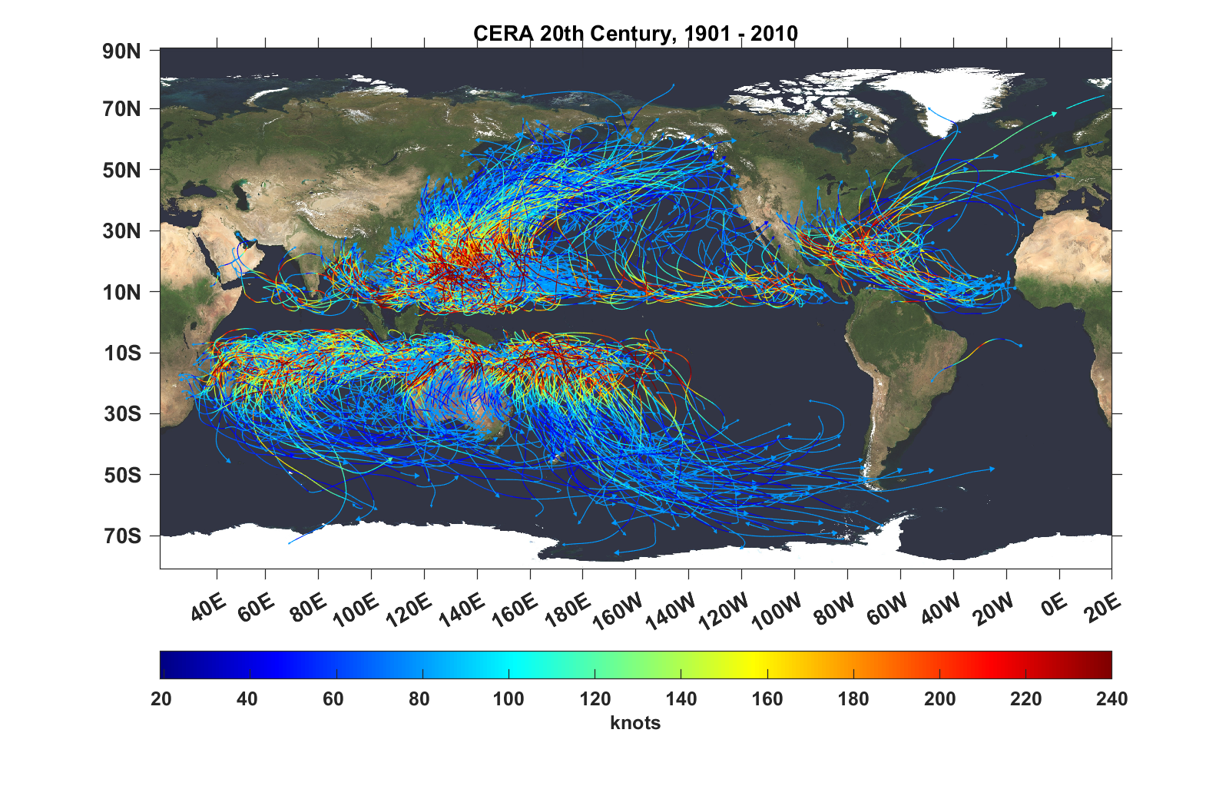
Top 1,000 storms Downscaled from CERA 20th Century Reanalysis

Slide 21
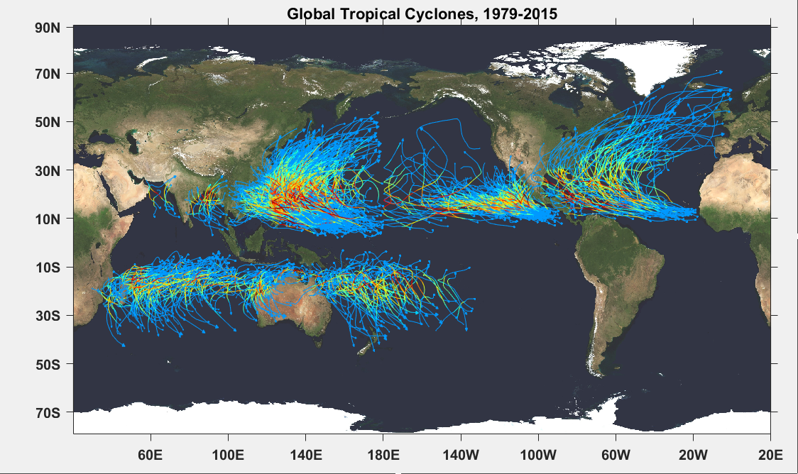

Slide 22

Cumulative Distribution of Storm Lifetime Peak Wind Speed, with Sample of 1755 Synthetic Tracks
Blue bars: Actual
Red bars: Predicted
90% confidence bounds

Slide 23
Atlantic Annual Cycle
Blue dots: Actual
Red line: Predicted

Slide 24

Captures effects of regional climate phenomena (e.g. ENSO, AMM)
Blue bars: Actual
Red bars: Predicted

Slide 25
Application to Global and Regional Climate Change

Slide 26
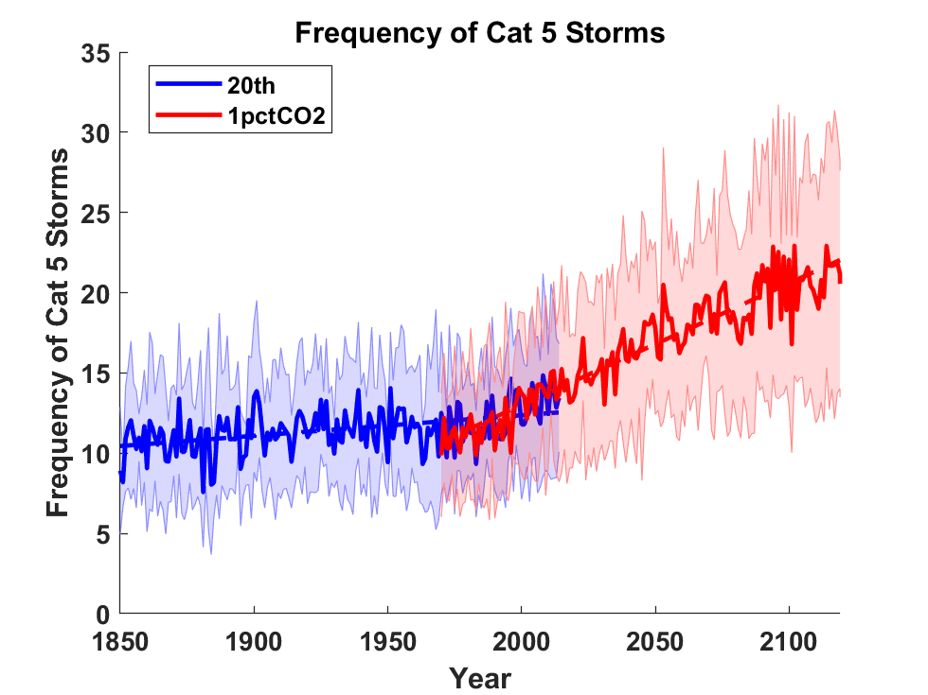
Global Tropical Cyclone Frequency from 9 Current Generation (CMIP6) Climate Models

Slide 27
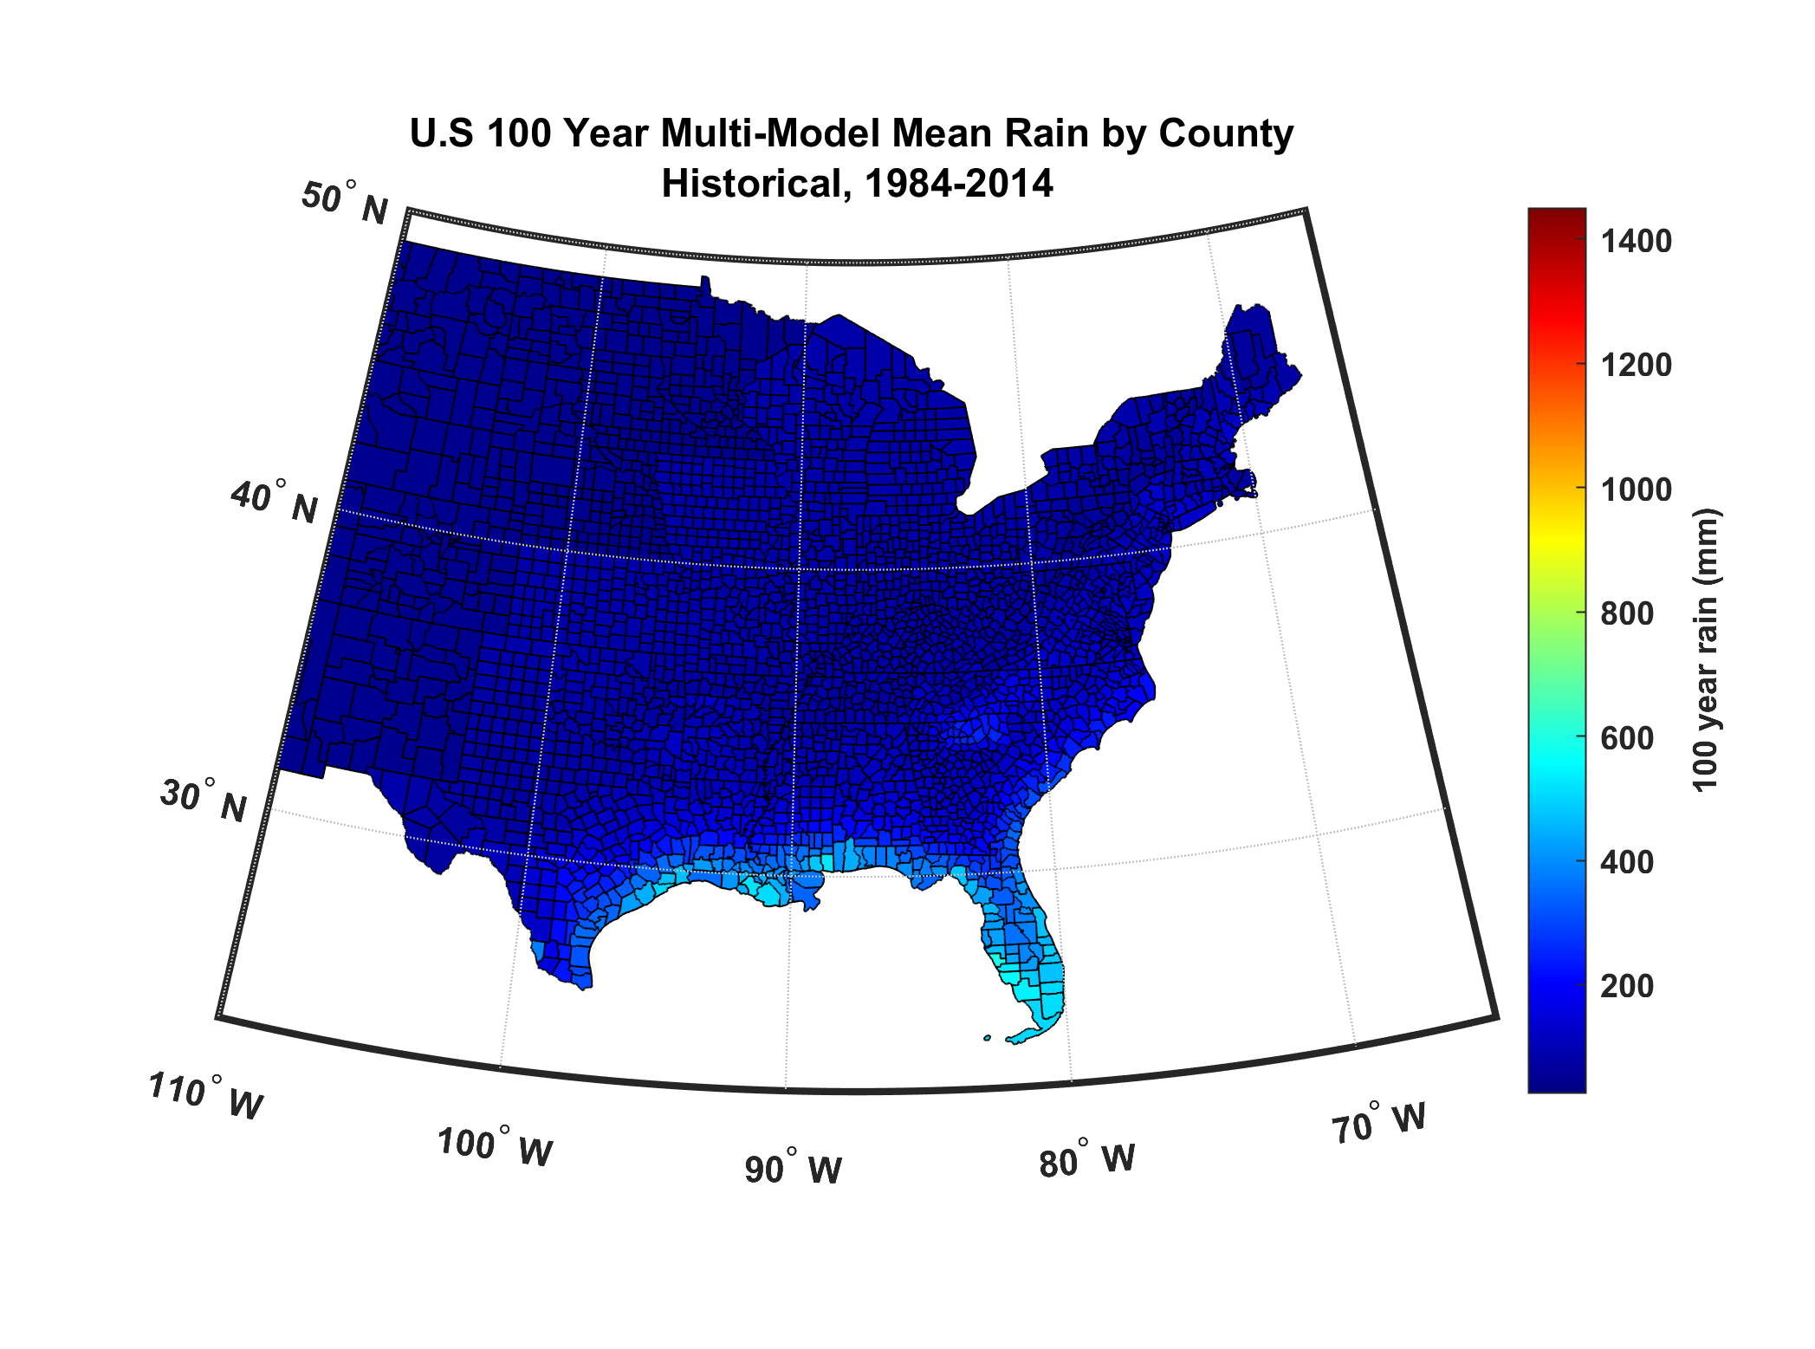

Slide 28
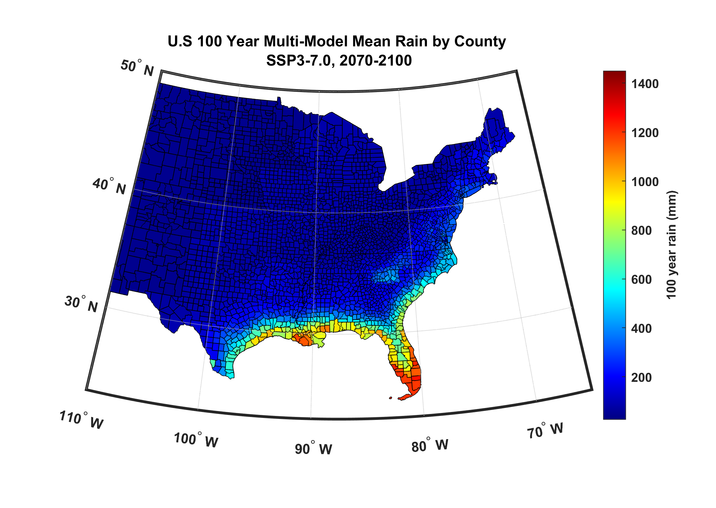

Slide 29
Application to The North Atlantic Hurricane Record: Downscale Three 20th Century Reanalyses: NOAA v.2c, NOAA v.3 and CERA 20c
Run 100 synthetic TCs for each year of the reanalysis data record
Retain only storms whose lifetime maximum intensity exceeds 40 kts
Do this for the North Atlantic and separately for the world

Slide 30
Major Hurricanes
7-year running averages

Slide 31
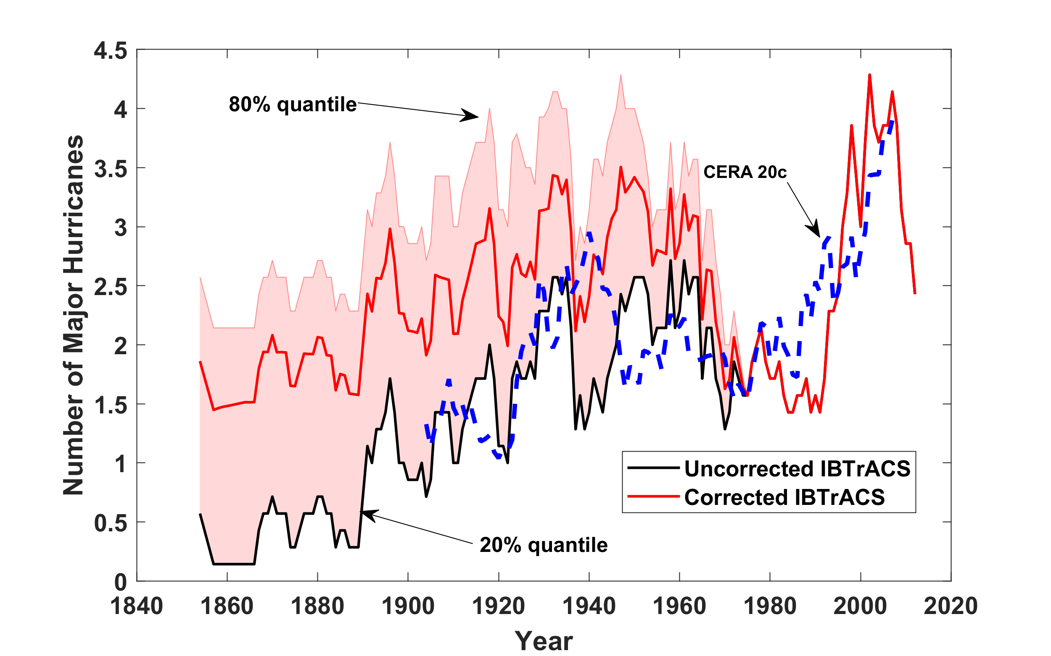
Number of North Atlantic Major Hurricanes

Slide 32
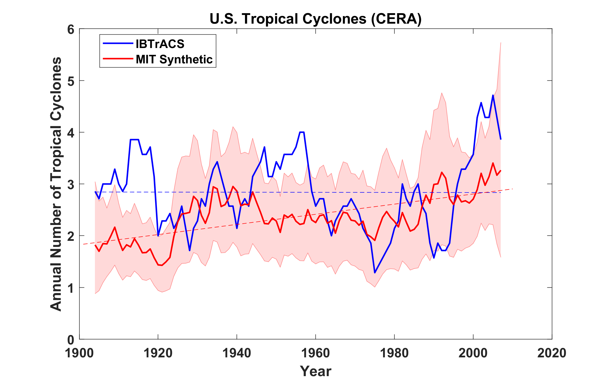
U.S. Landfalling Tropical Cyclones

Slide 33
All landfalls (not just USA)
7-year running averages

Slide 34
All Landfalls, NOAA 20th Century v.3
7-year running averages
Suggests some landfalls missed prior to 1900

Slide 35
What may have caused the North Atlantic TC trends and variability?
North Atlantic tropical cyclone frequency strongly correlated with potential intensity (PI), the theoretical upper bound on TC intensity that can be calculated from coarse climate data.
Technique developed by R. Rousseau-Rizzi partitions PI change into a part owing to global climate change and a separate part due to local or regional climate change
We apply this technique to the North Atlantic main genesis region using the reanalysis data to calculate PI and the mean temperature of the tropical free troposphere

Slide 36
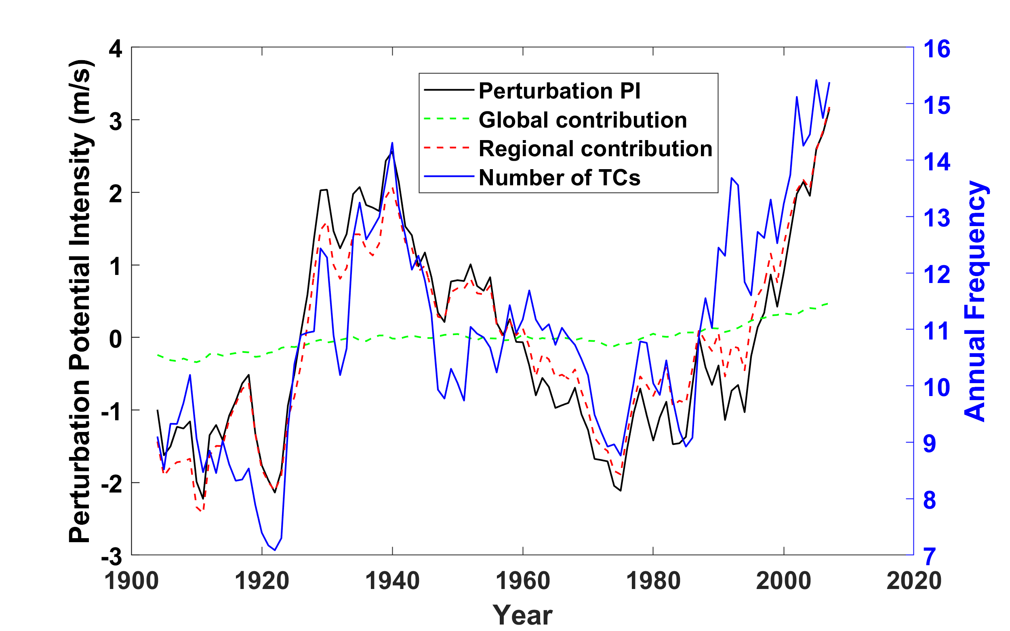
Results:

Slide 37
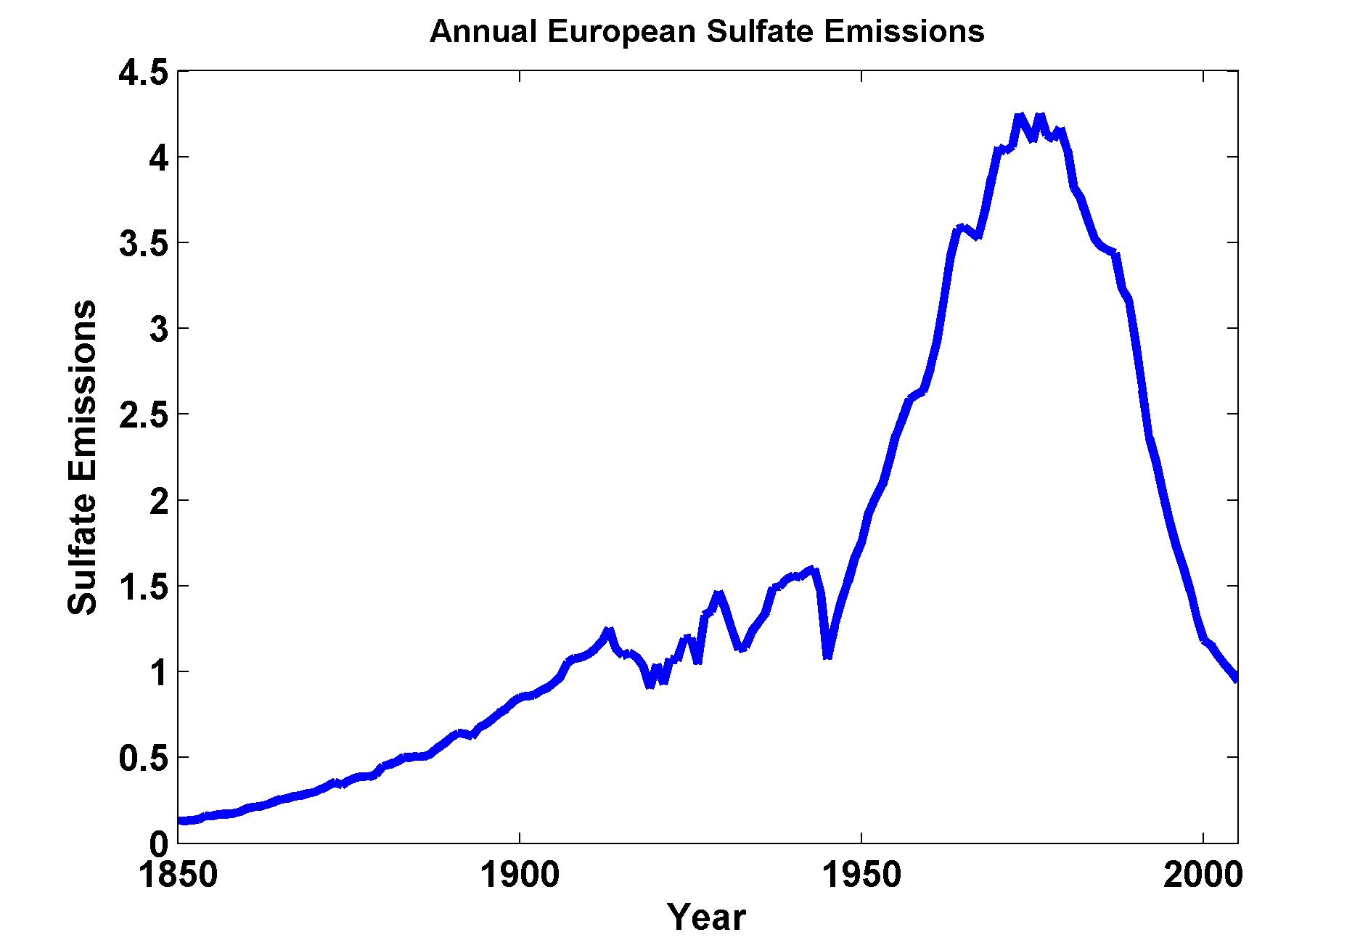
Annual European Sulfur Emissions

Slide 38
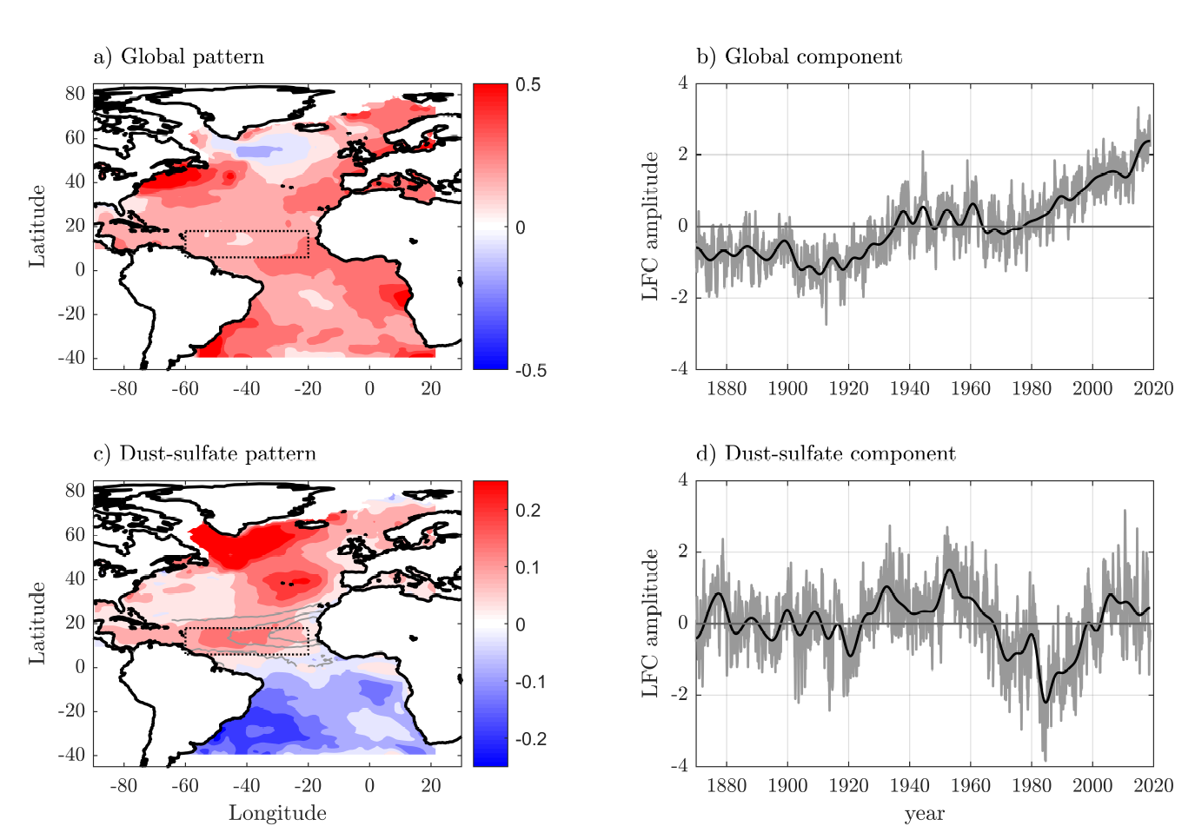
Patterns of sea-surface temperature (color shading) associated with the global mode (a) and the dust-sulfate mode (c). The dust-sulfate pattern is plotted along with dust aerosol optical depth contours from [14] for τ = [0:150:30:45] (gray contours), and the main development region is indented (dotted black box). Associated components for the global mode (b) and the dust-sulfate mode (d), including variability at all frequencies (gray) and only at low frequencies (black).
Rousseau-Rizzi and Emanuel, Nature Comm., 2022

Slide 39
But the general upward trends in North Atlantic TC metrics are not explained. They are mostly owing to regional SST increases, not the global increase. It is possible that this is related to a trend in the Atlantic sector meridional overturning circulation of the ocean; this may be natural and/or a response to anthropogenic forcing.

Slide 40
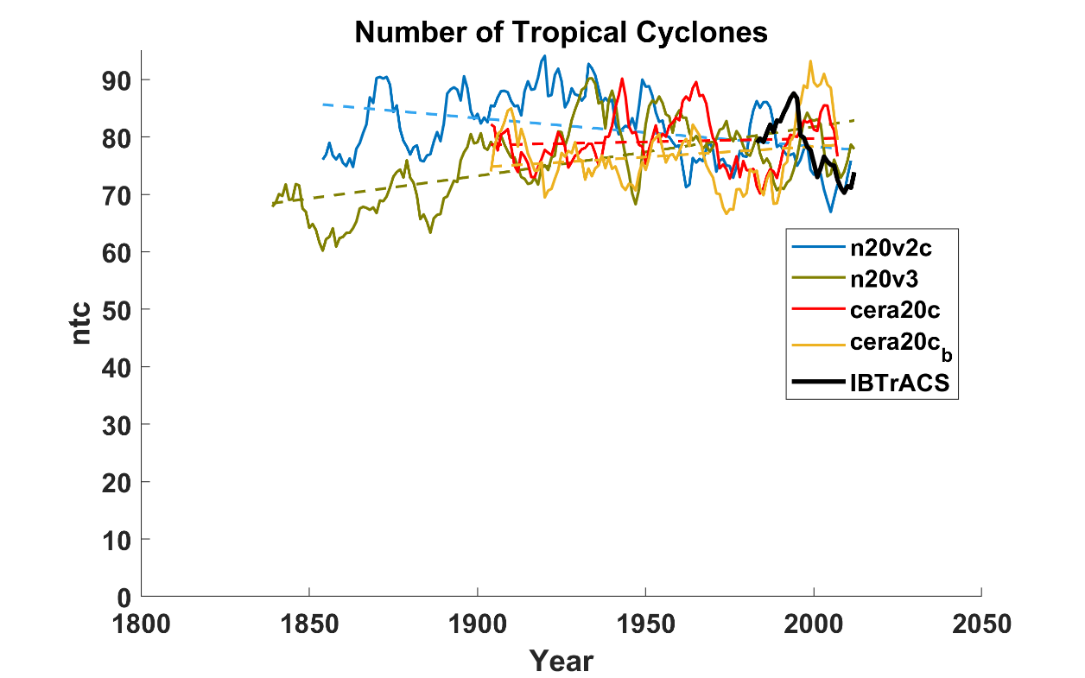
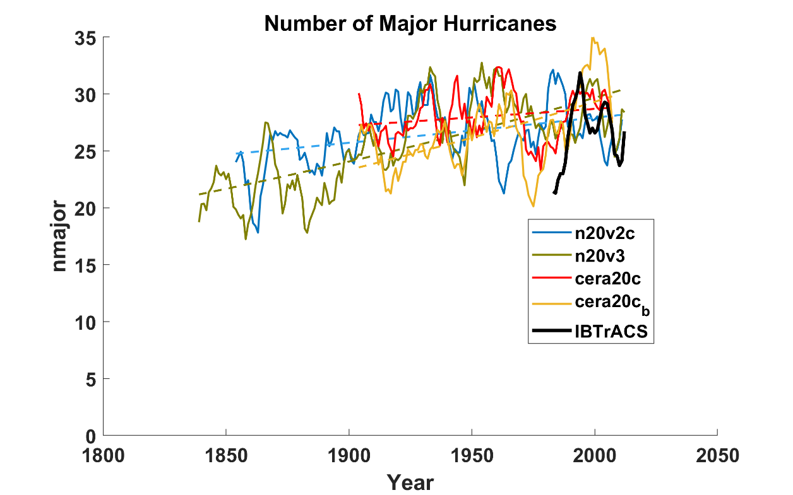
No significant trends in global downscaled tropical cyclone frequency!
Some upward trend in global downscaled major hurricanes

Slide 41

Tropical Cyclones Affecting Los Angeles
Notes:
41

Slide 42
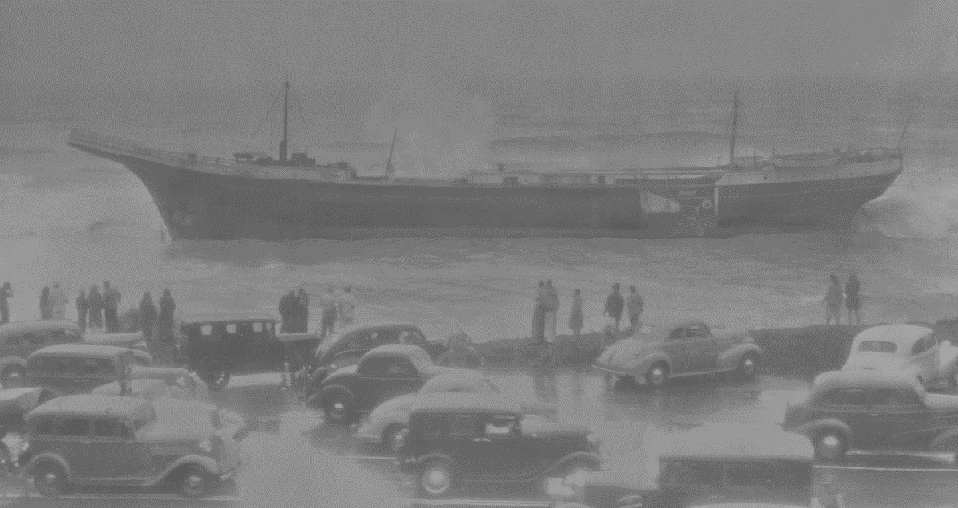
Los Angeles Tropical Cyclone History with thanks to Steve Krueger

Slide 43
TCs in the Southwestern U.S.
Only 4 storms brought tropical storm-force winds to the SW U.S. during the 20th Century
Only a single storm made direct landfall in Southern California
No storms have made landfall in the SW U.S. as hurricanes
Notwithstanding the above, many TC remnants, or TCs passing close by have affected the SW U.S.
Main problem is rainfall-induced flooding

Slide 44
Strongest tropical cyclone to affect Los Angeles since records began:
Cyclone of September 24-26 1939
Wind gusts to 65 knots, 5.6” of rain at LA
Mt. Wilson recorded storm total of 11.6”
45 deaths from flooding, 48 lost at sea
Circulation in advance of cyclone responsible for intense heat wave (107 in LA)
See article by Paul Duginski, LA Times, 22 August 2019

Slide 45
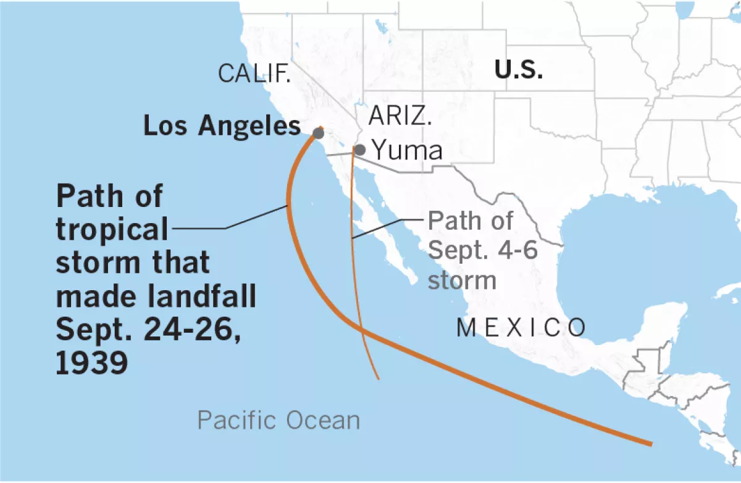
Paths of the first and fourth in a series of September 1939 storms that affected Southern California, with the fourth one making landfall as a tropical storm. Two others dissipated before reaching the Southland, but influenced the area. (Paul Duginski / Los Angeles Times)

Slide 46
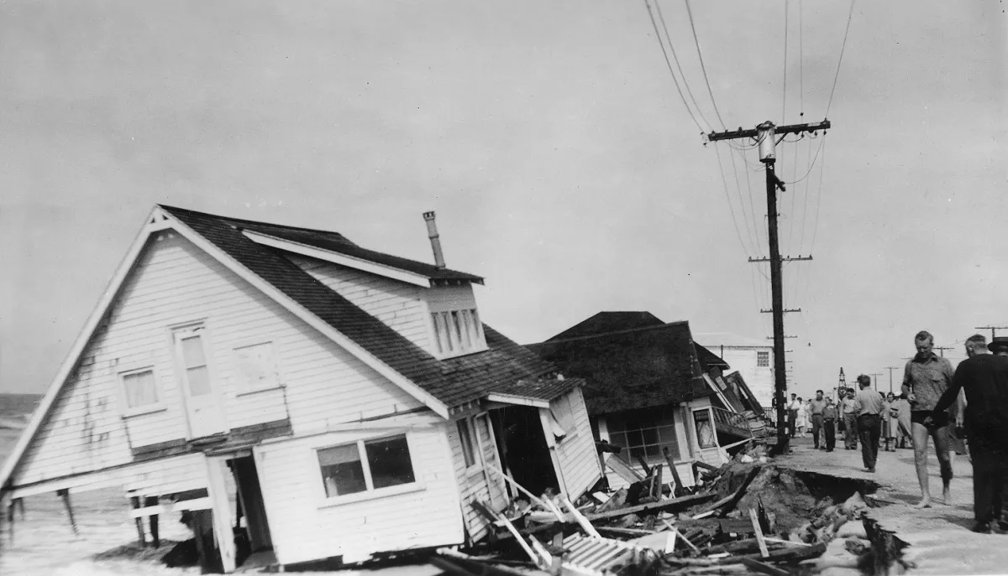
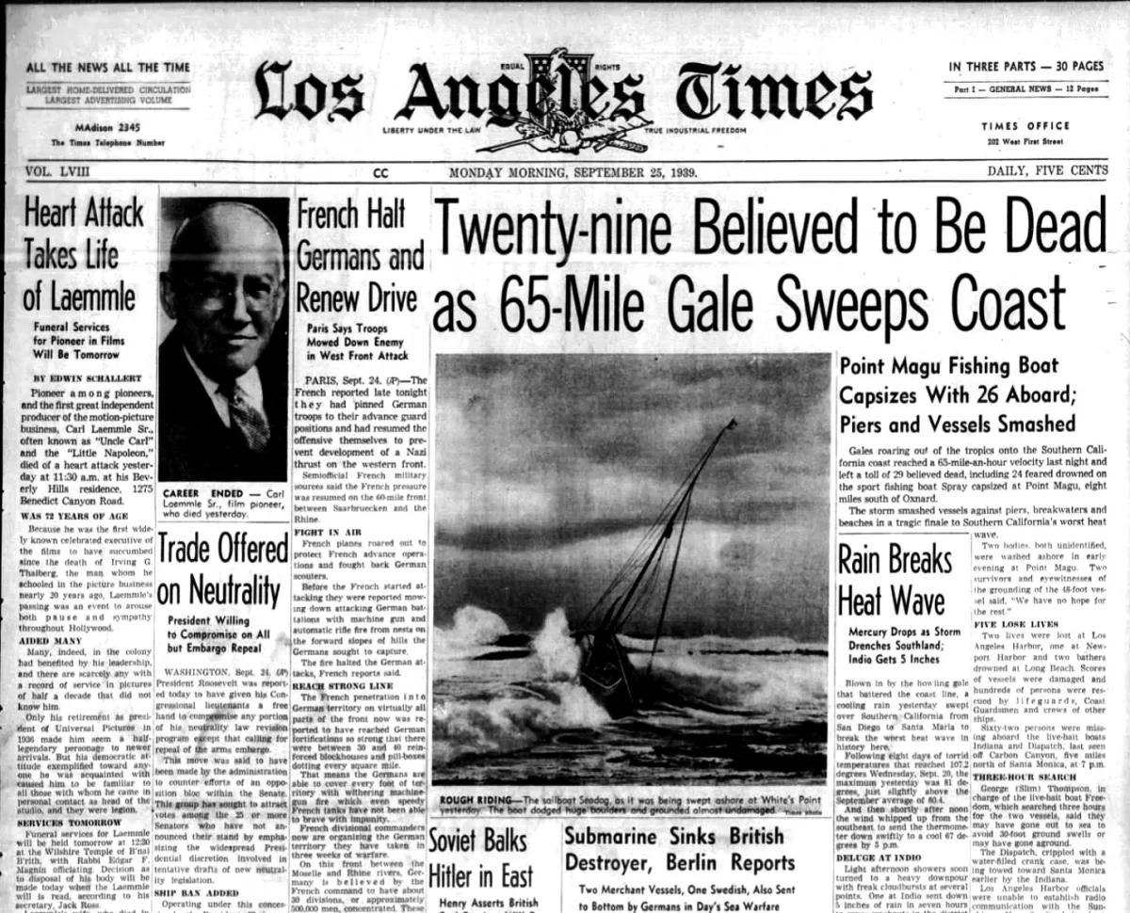
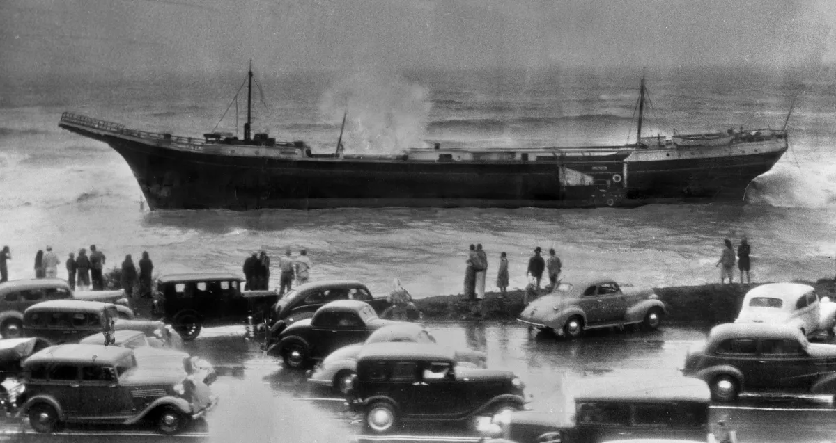
Sunset Beach, Orange County
September 25th, 1939
The 247-foot fishing barge Minnie A. Caine was washed ashore off Sunset Boulevard north of Santa Monica. Her six crew members were rescued. The fishing barge was one of several craft, large and small, battered by heavy seas and 60 mph winds. This photo appeared in the Sep. 25, 1939, editions of the Los Angeles Times.(Los Angeles Times)

Slide 47
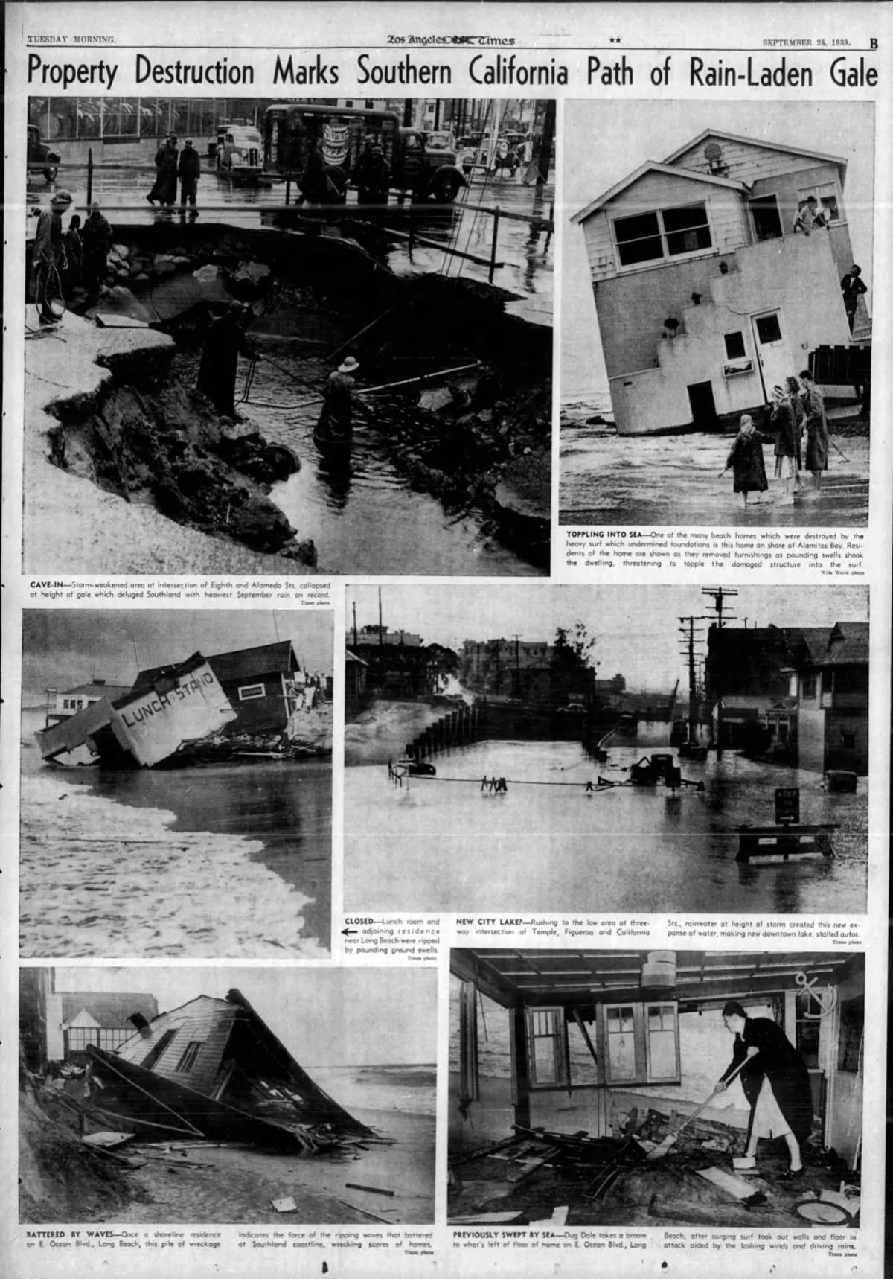
Los Angeles Times, September 26 1939

Slide 48
Application of MIT downscaling to assess long term TC risk near Los Angeles
All events passing within 150 km of downtown Los Angeles with winds in excess of 30 kts within that circle
1,260 events downscaled from ERA-5 reanalyses, 1979-2020
1,200 events downscaled from each of 9 CMIP6- generation climate models for:
  20th century: 1971-2010
  SSP3 7.0 2061-2100

Slide 49
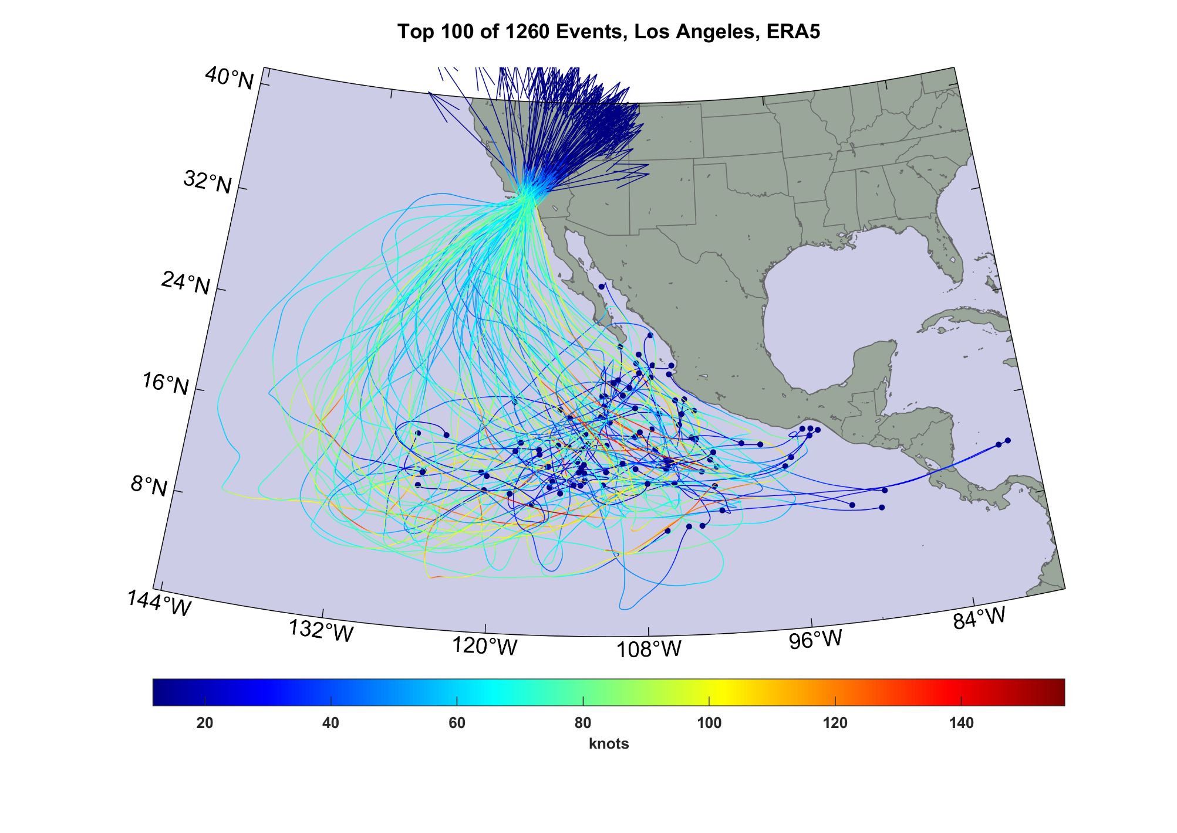
Strongest 100 of 1260 events downscaled from ERA-5 reanalyses

Slide 50
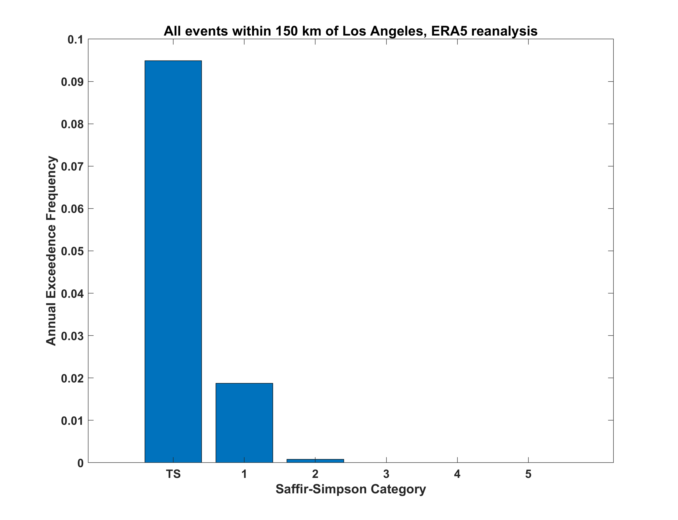
Note: Very difficult to calibrate against observations

Slide 51
Global warming effects on tropical cyclone affecting Los Angeles
Notes:
51

Slide 52
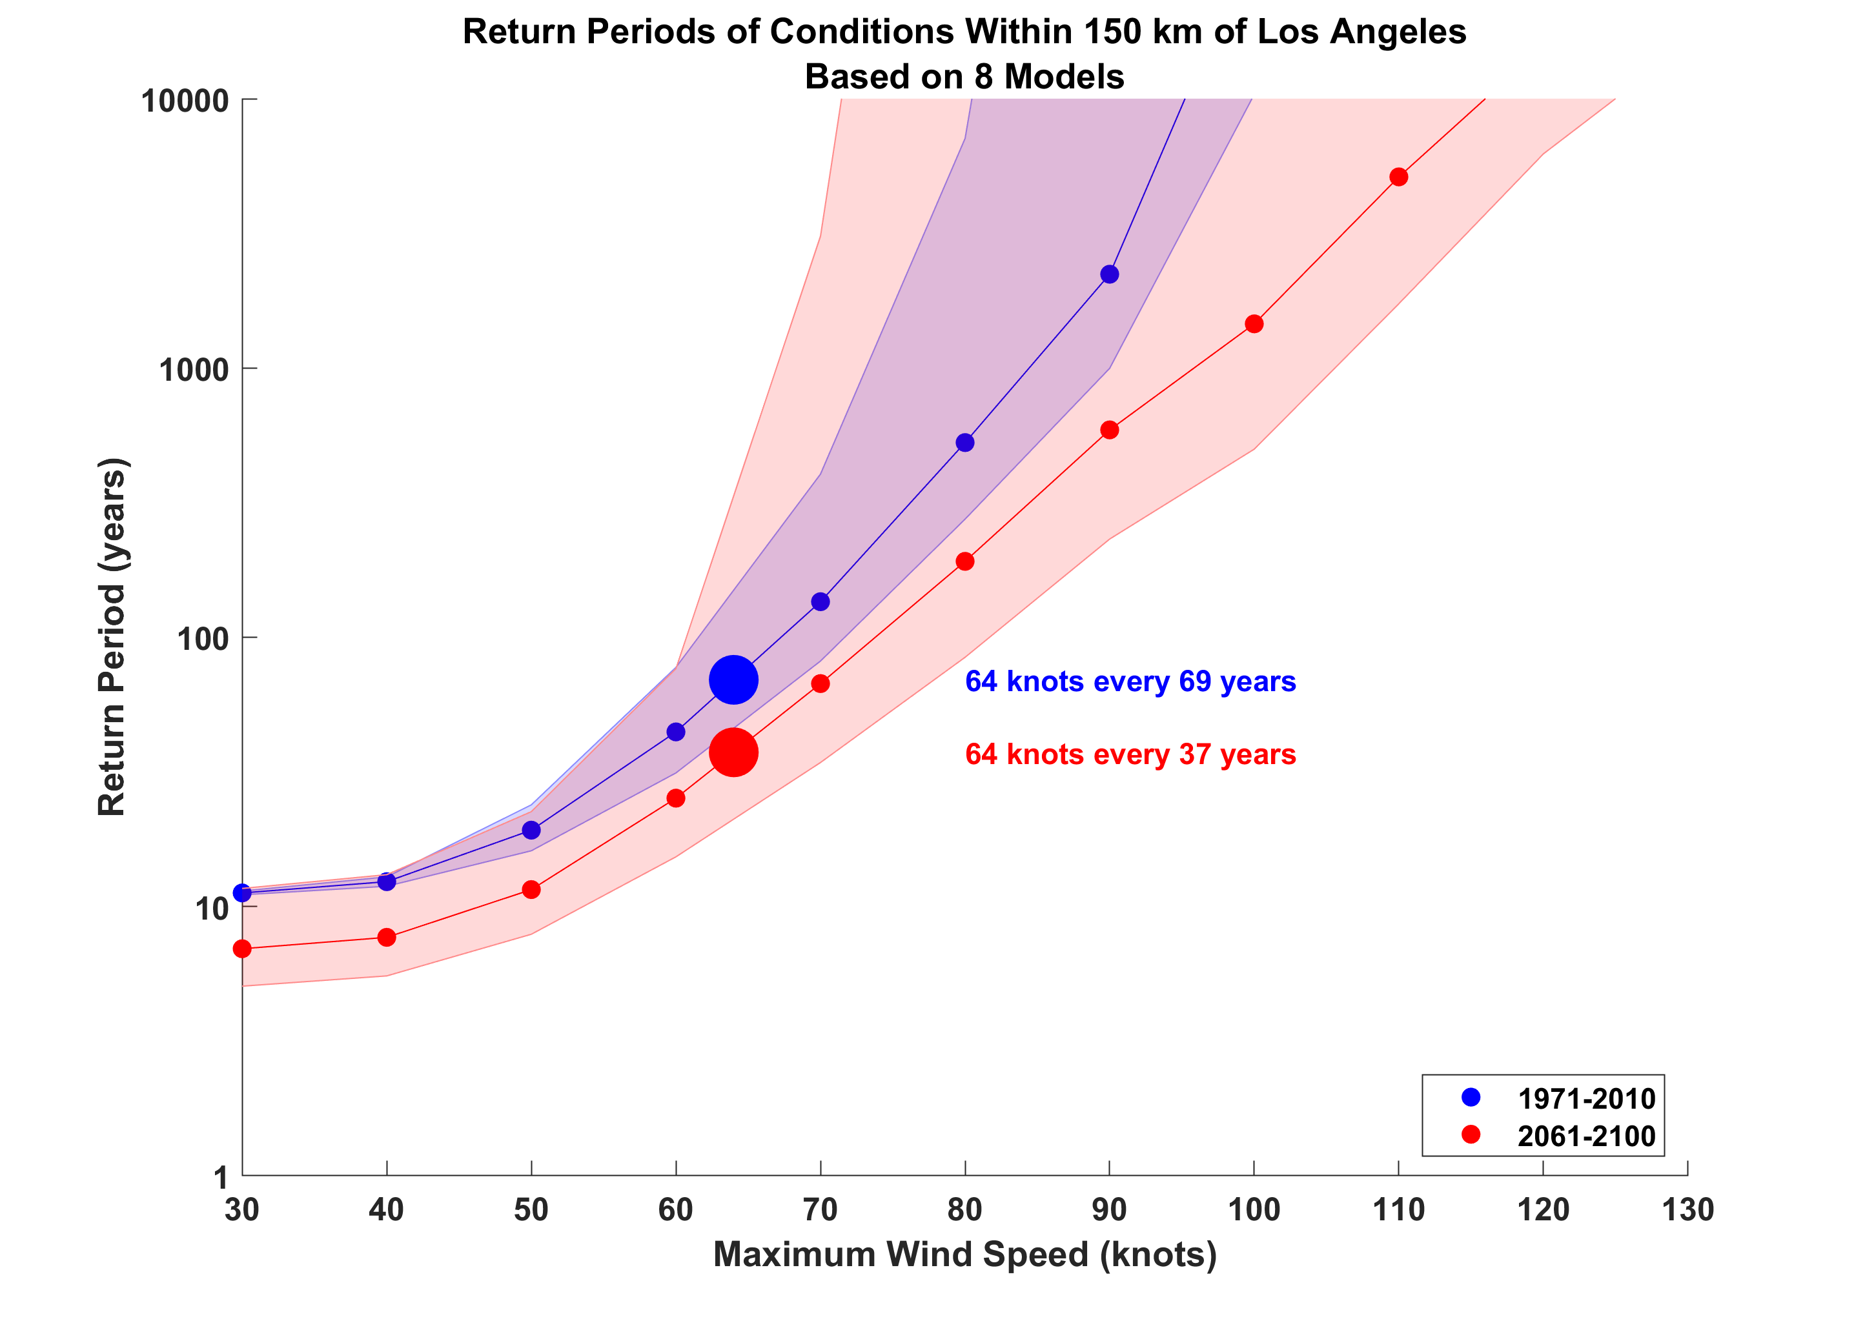

Slide 53
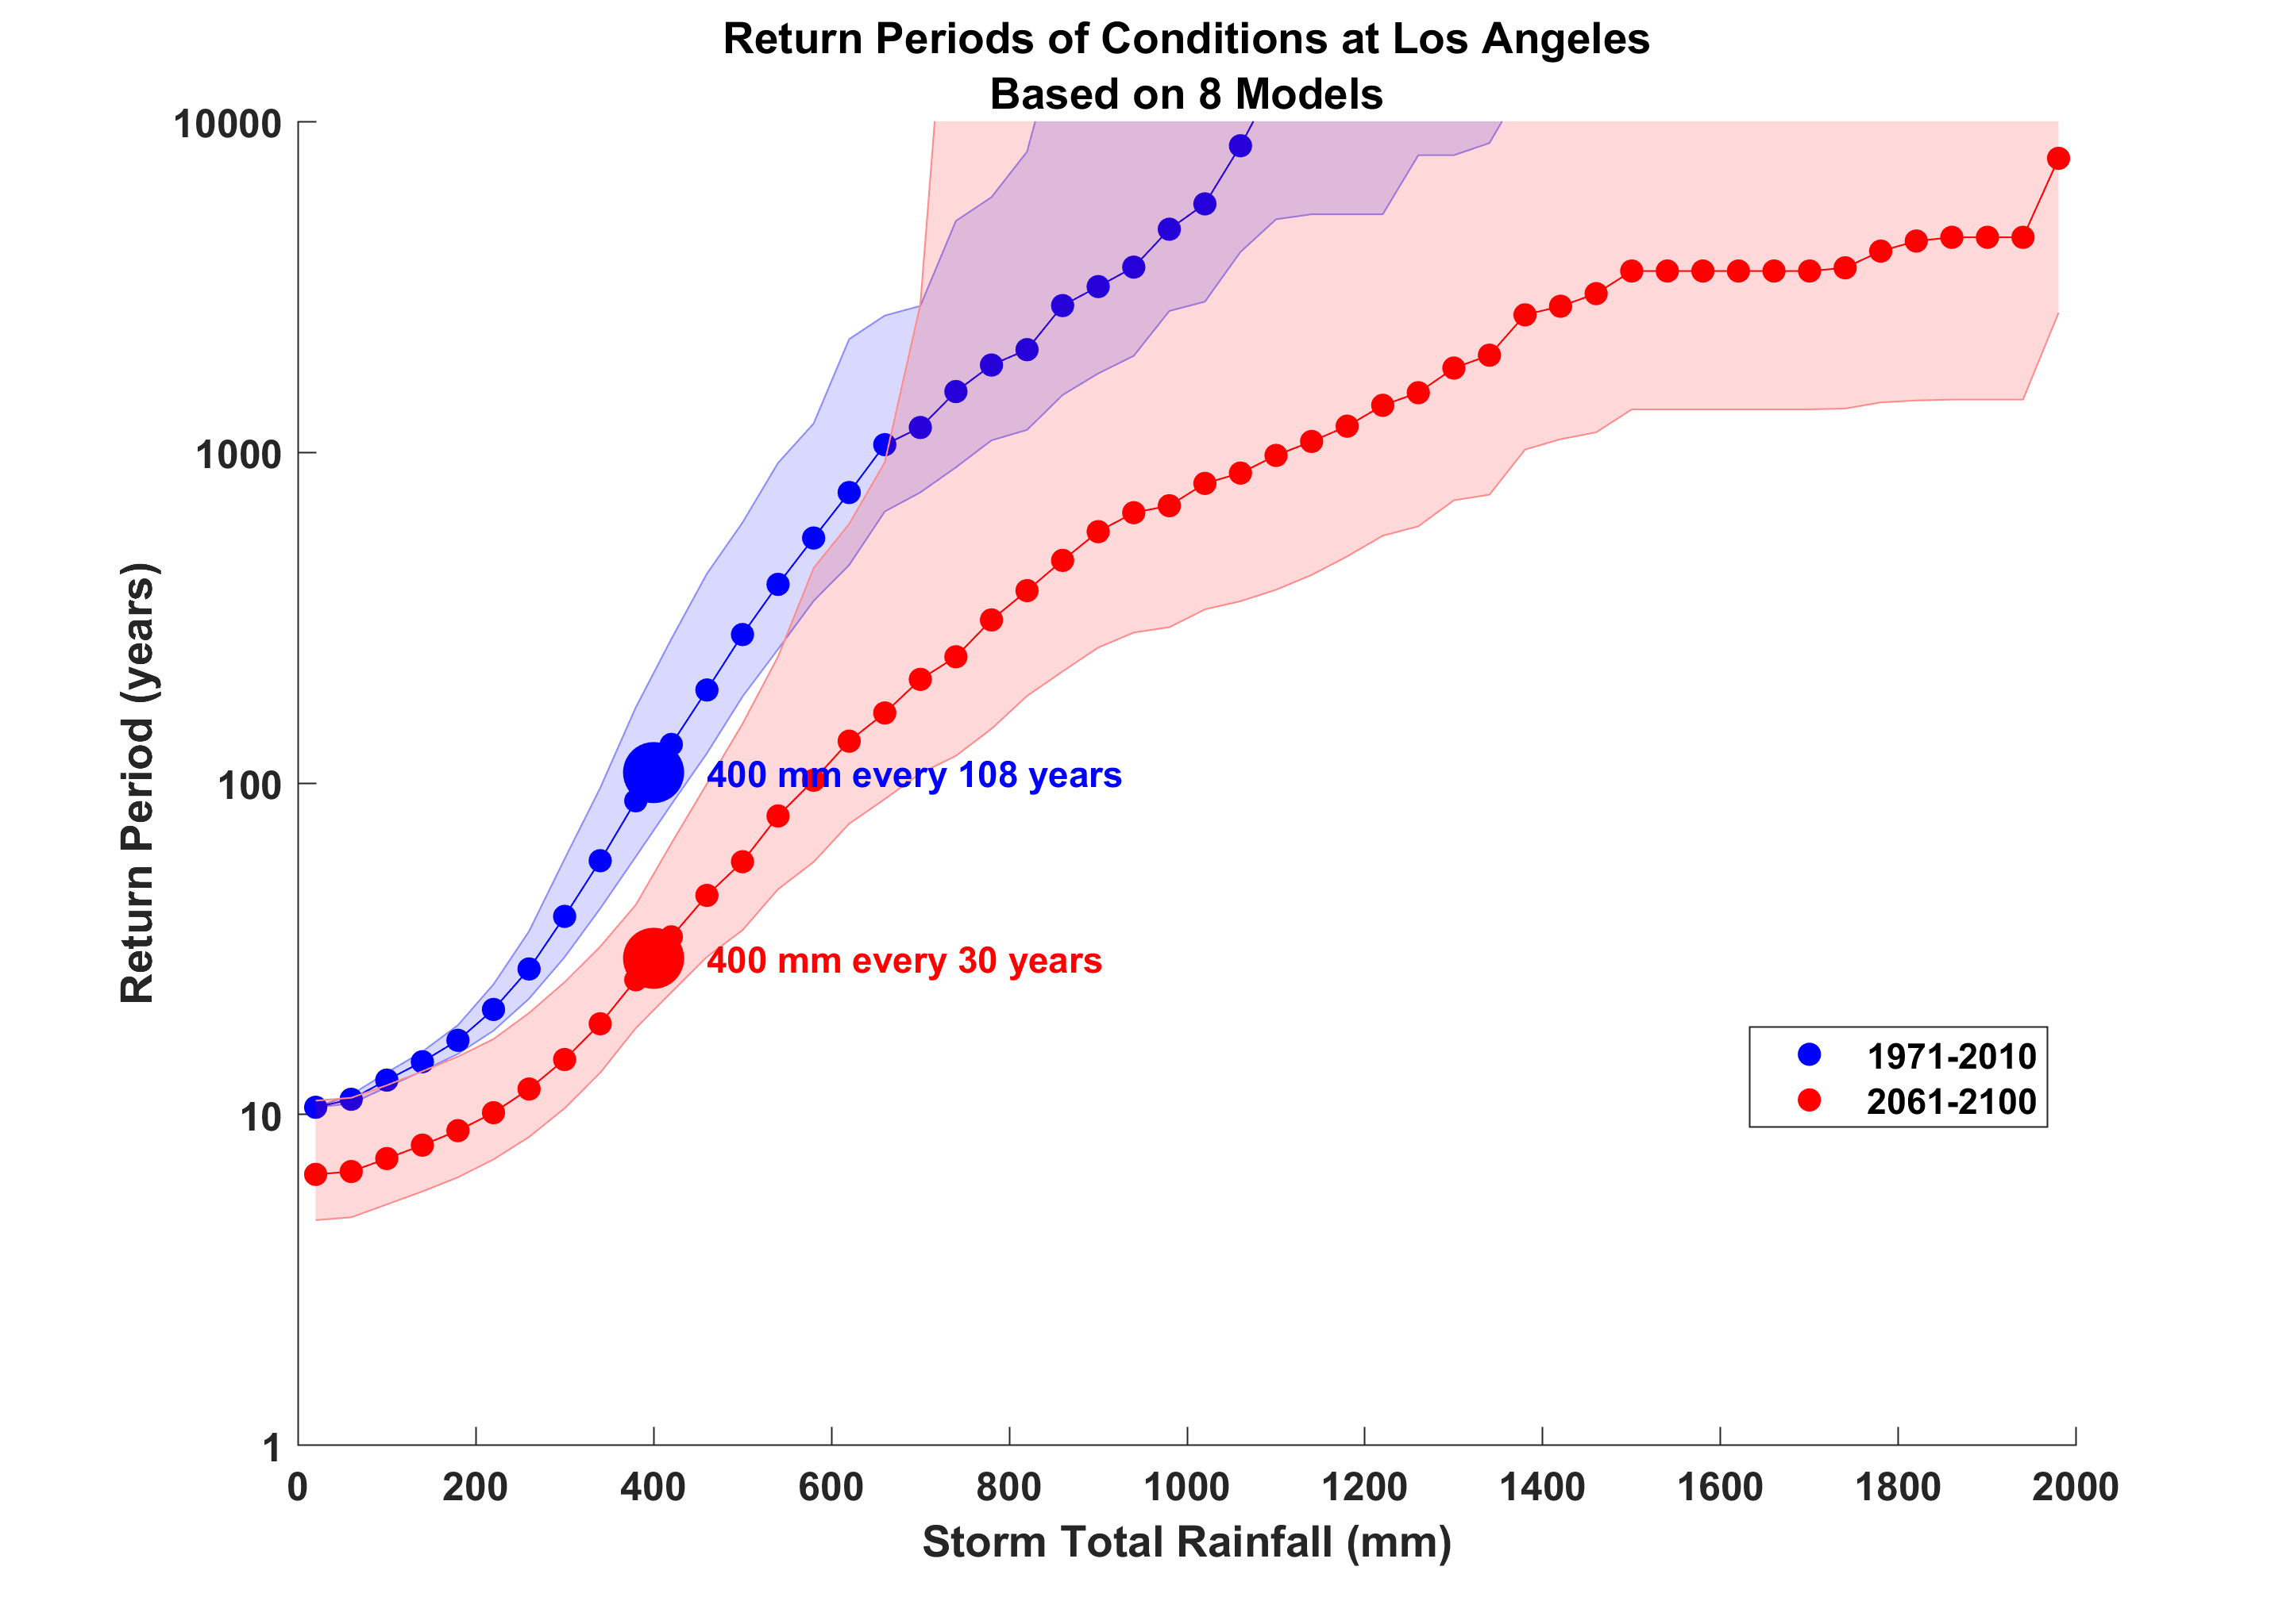
Rainfall at single point, downtown Los Angeles

Slide 54
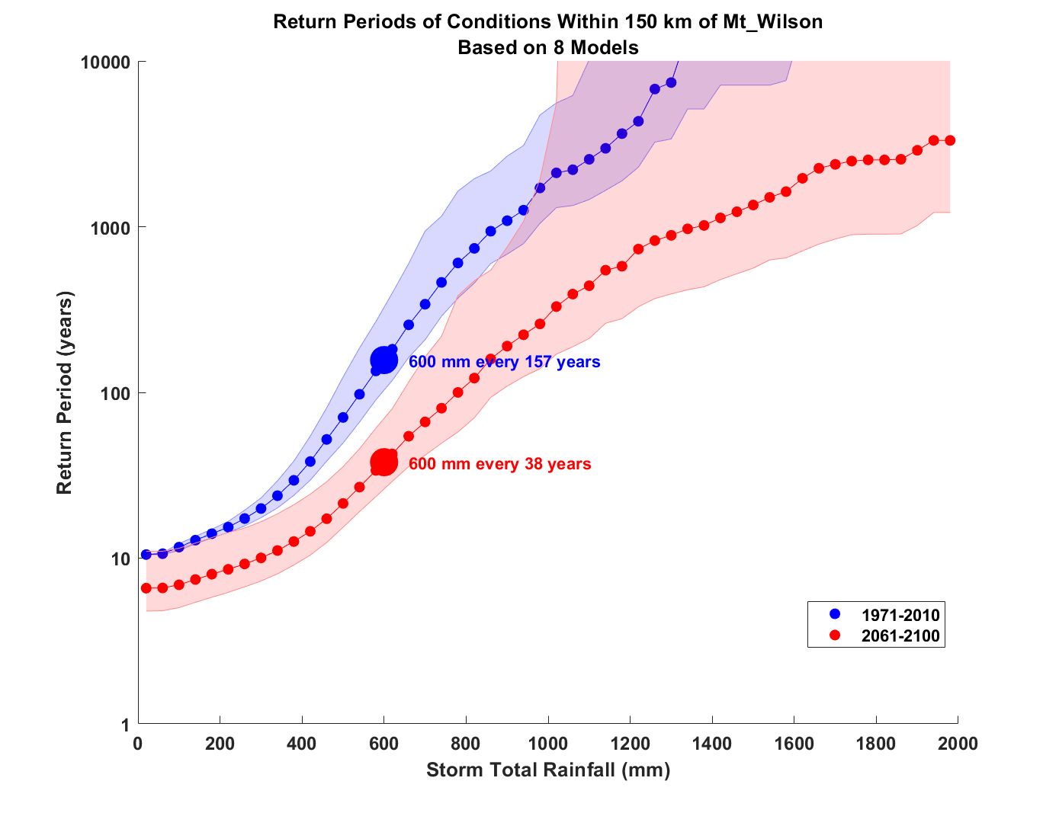
Mt. Wilson

Slide 55
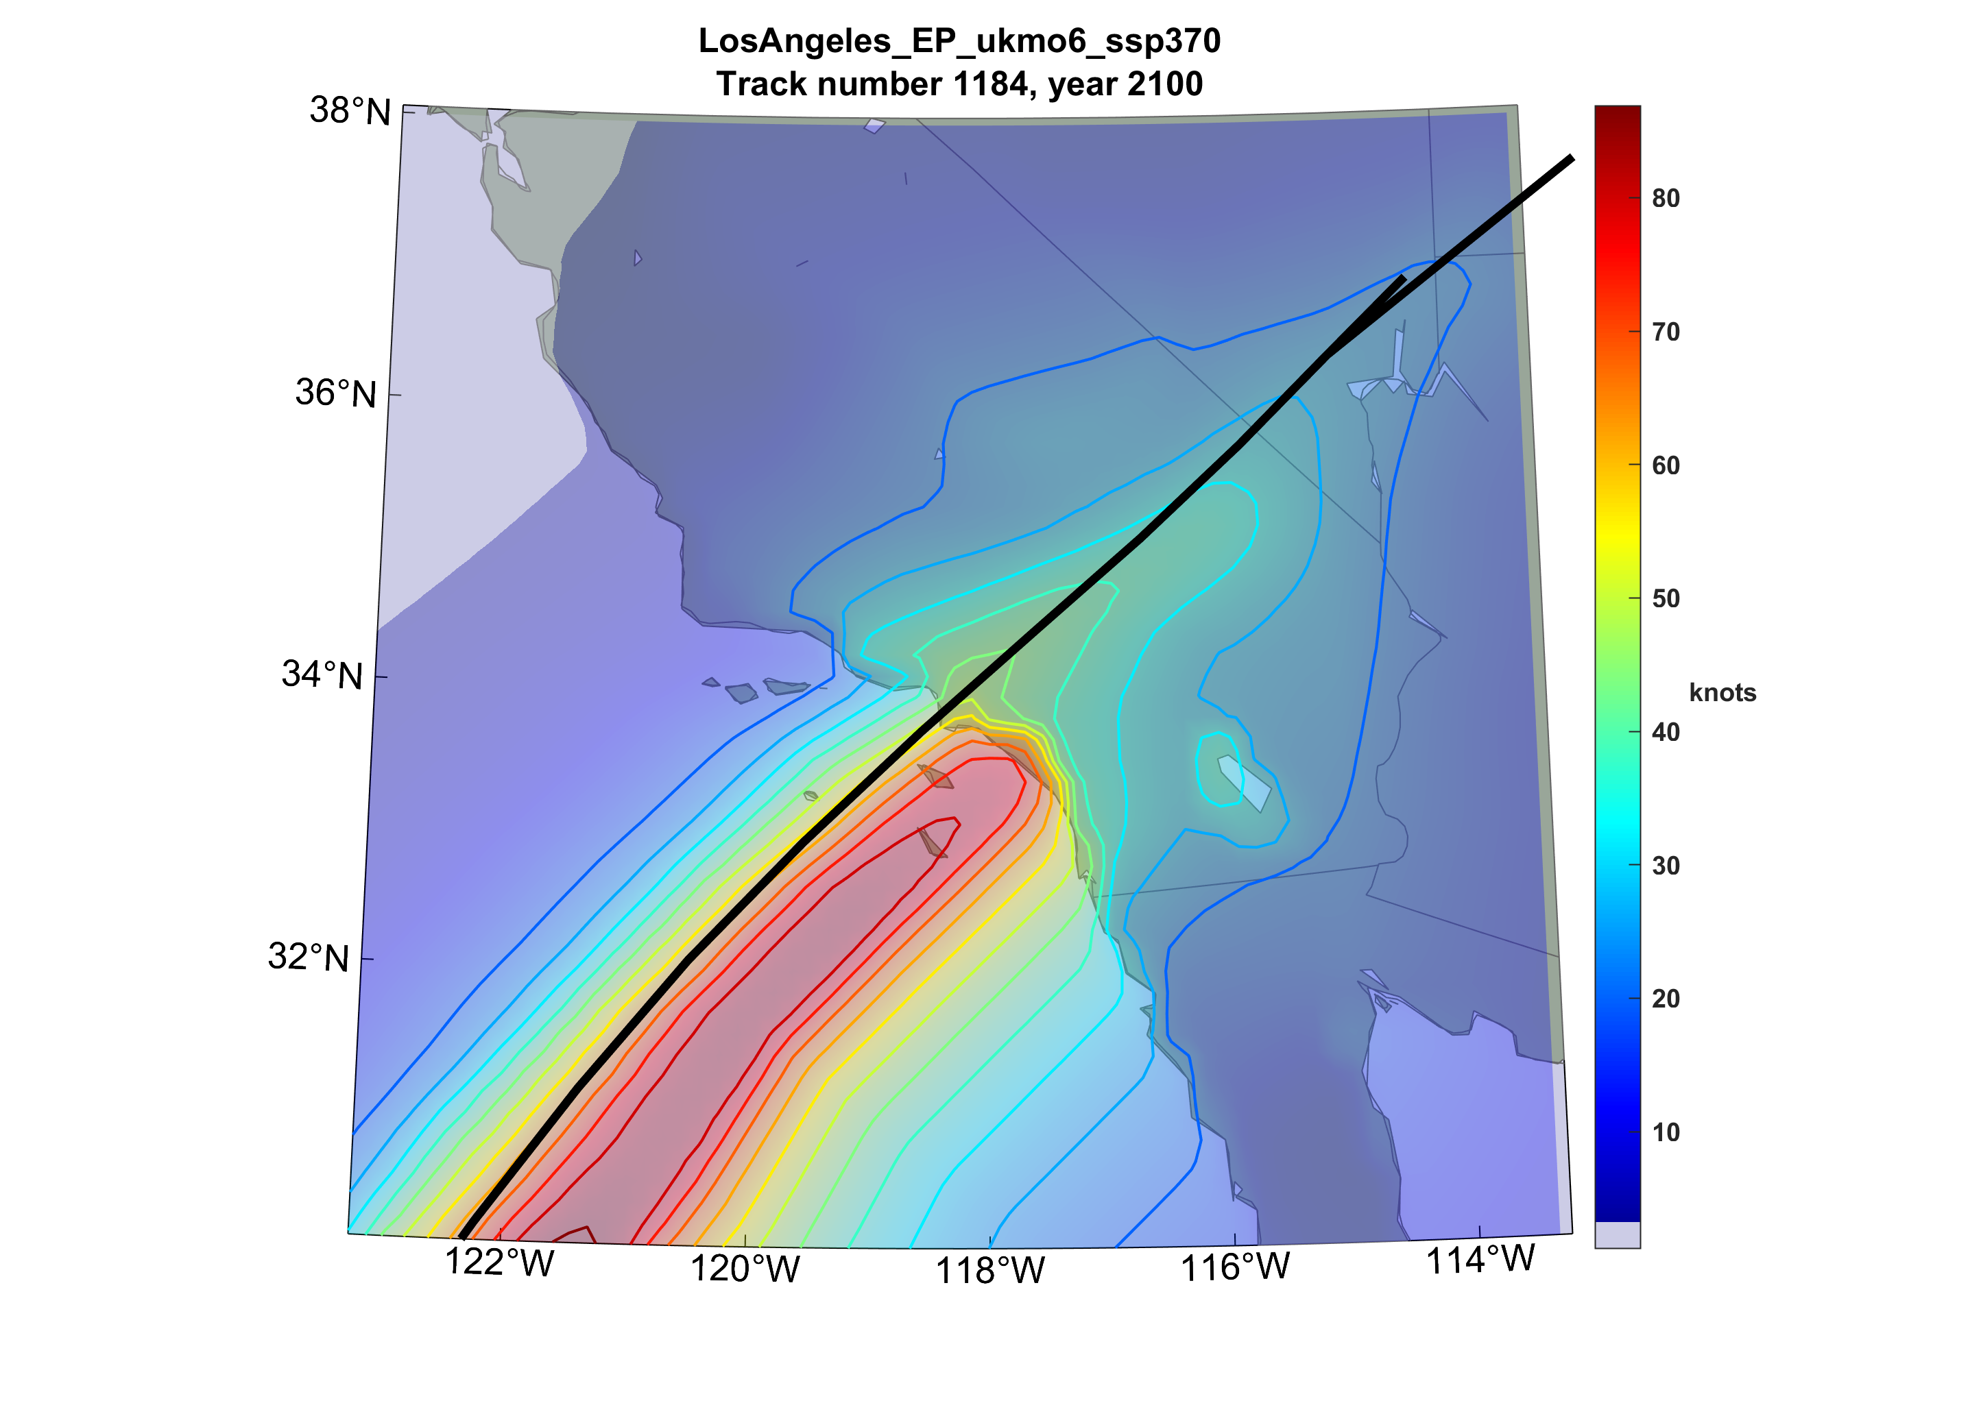

Slide 56
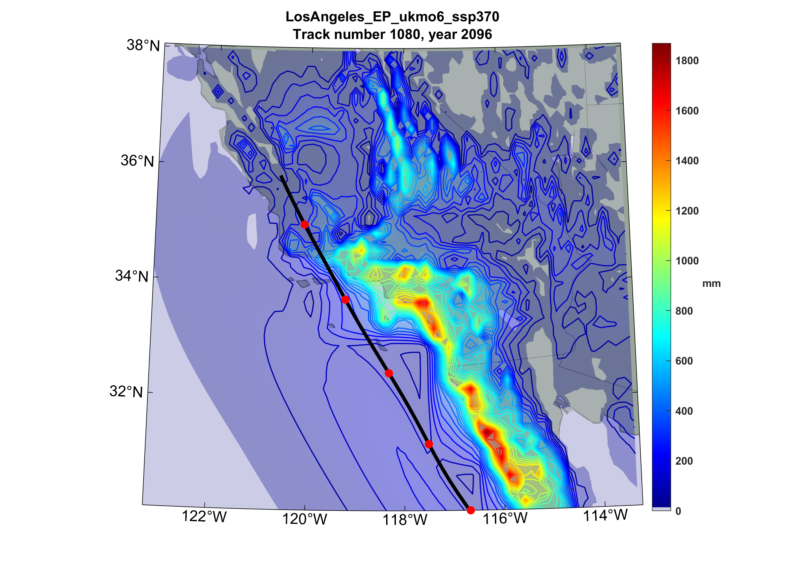

Slide 57
Summary
Historical observations and synthetic tropical cyclones both show substantial upward trends in the North Atlantic, interrupted by a prominent “hurricane drought” in the 1970s and 80s
Previous work may have overestimated the number of missing storms earlier in the record

Slide 58
Hurricane drought was probably caused by Saharan dust anomalies associated with drought caused by European sulfate aerosol-induced cooling
No detectable frequency trend in global tropical cyclones
Upward trend in the Atlantic may be related to changes in the meridional overturning circulation of the ocean

Slide 59
Very modest wind threat of tropical cyclones to Los Angeles
Tropical cyclones and their remnants do pose a serious flooding threat to the region
We project that unchecked global warming will roughly double the TC wind risk and triple heavy rain risk in southern California

Slide 60
Feedback of Global Tropical Cyclone Activity on the Climate System
Notes:
60

Slide 61
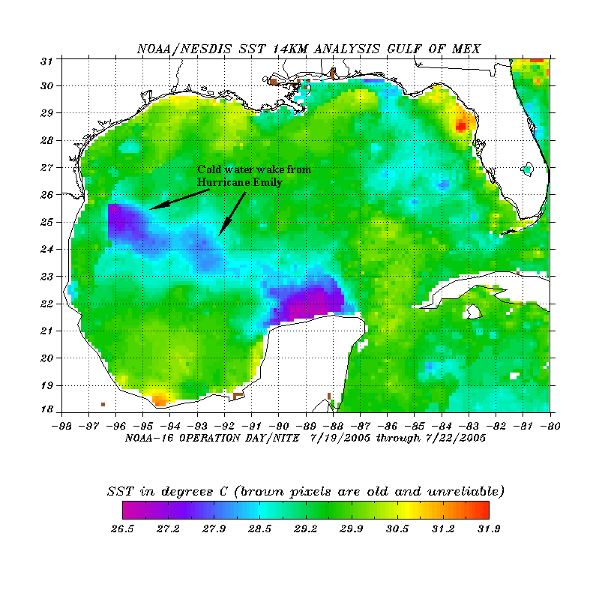
The wake of Hurricane Emily (July 2005)
Sea Surface Temperature in the Wakes of Hurricanes
Hurricane Dennis
(one week earlier)
Source: Rob Korty, CalTech
Notes:
61
We know that tropical cyclones are responsible for strong mixing of the upper oceans and this can be seen in satellite images…

Slide 62
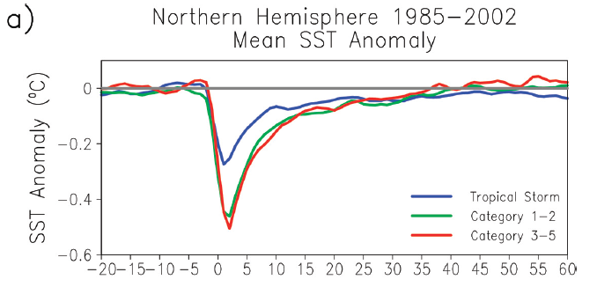
Wake Recovery
Hart, Maue, and Watson, Mon. Wea. Rev., 2007

Slide 63
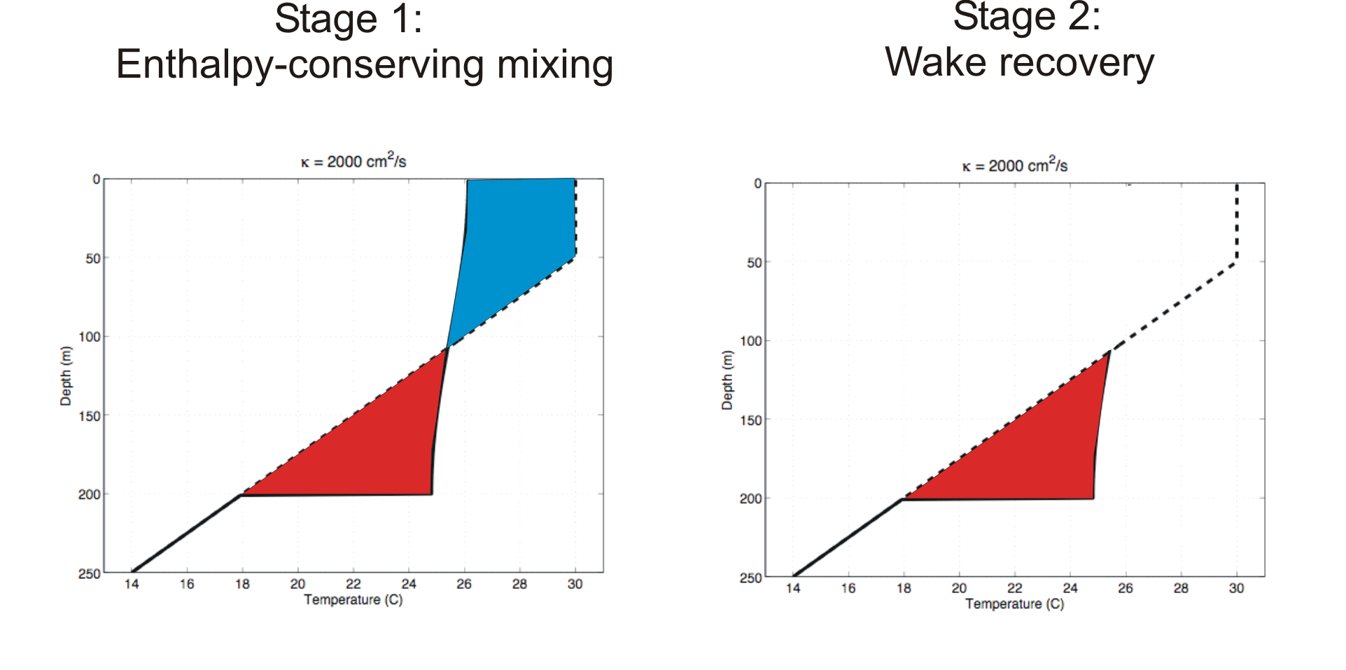
Direct mixing by tropical cyclones
Emanuel (2001) estimated global rate of heat input as 1.4 X 10¹⁵ Watts
Source: Rob Korty, CalTech
Notes:
63

Slide 64
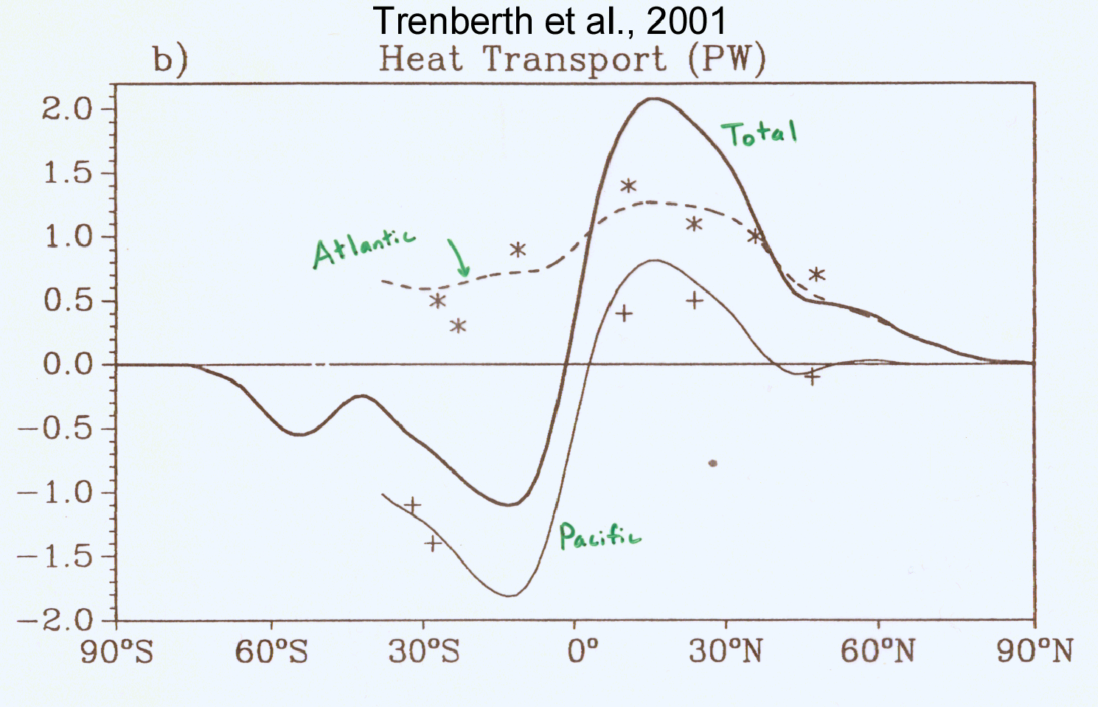
TC Mixing May Induce Some of the Observed Poleward Heat Flux by the Oceans
Notes:
64

Slide 65
Estimate from satellite-derived wake recoveries
Extrapolation from detailed ocean measurements of one storm
Estimate of total heat uptake by tropical oceans

Slide 66

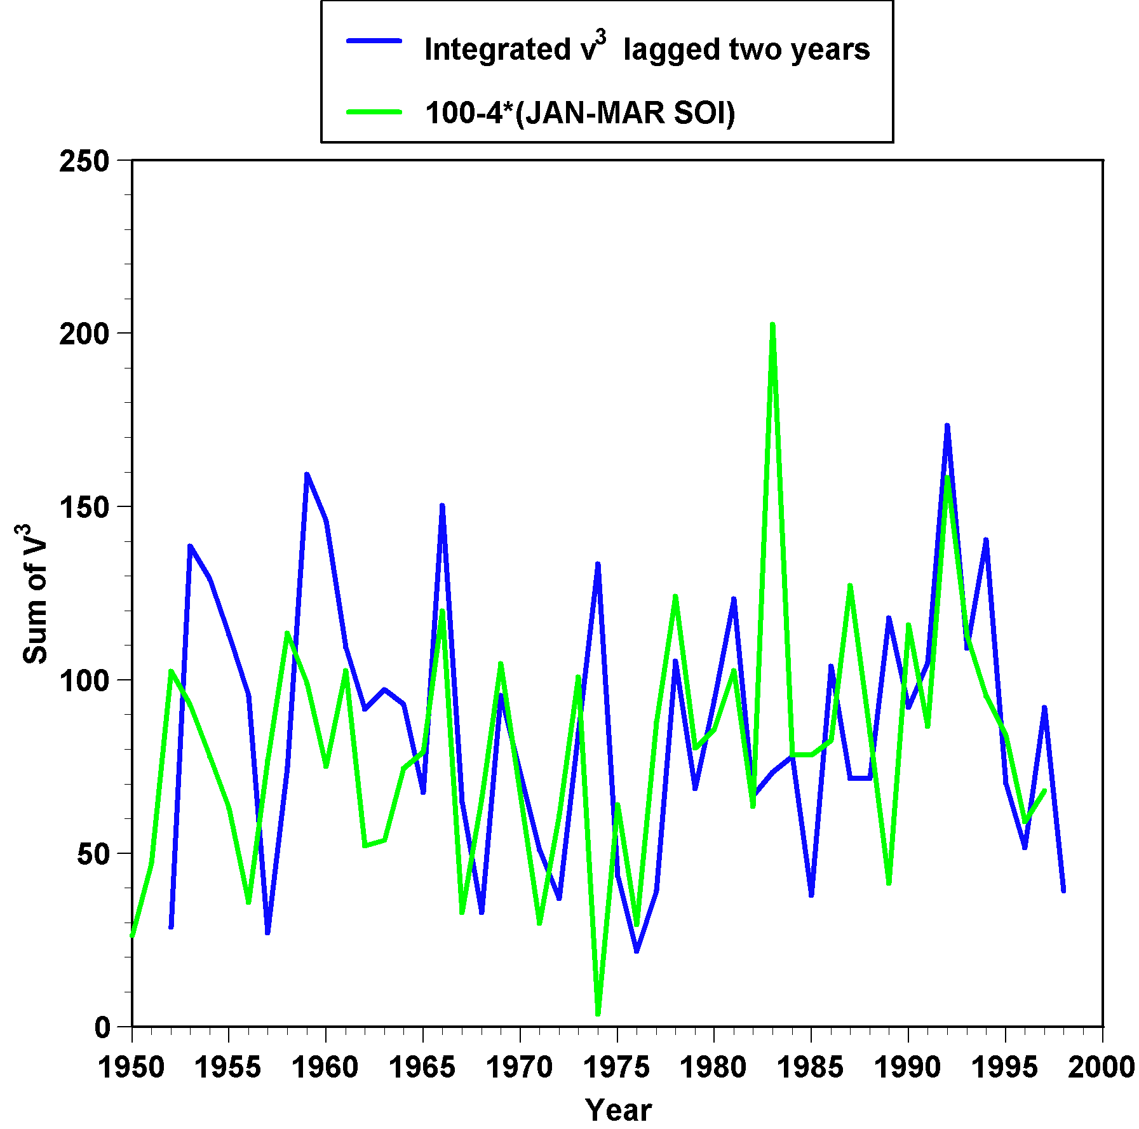
ENSO index
This plot shows a measure of El Niño/La Niña (green) and a measure of the power put into the far western Pacific Ocean by tropical cyclones (blue). The blue curve has been shifted rightward by two years on this graph. There is the suggestion that powerful cyclones in the western Pacific can trigger El Niño/La Niña cycles.
TC power dissipation
two years before

Slide 67
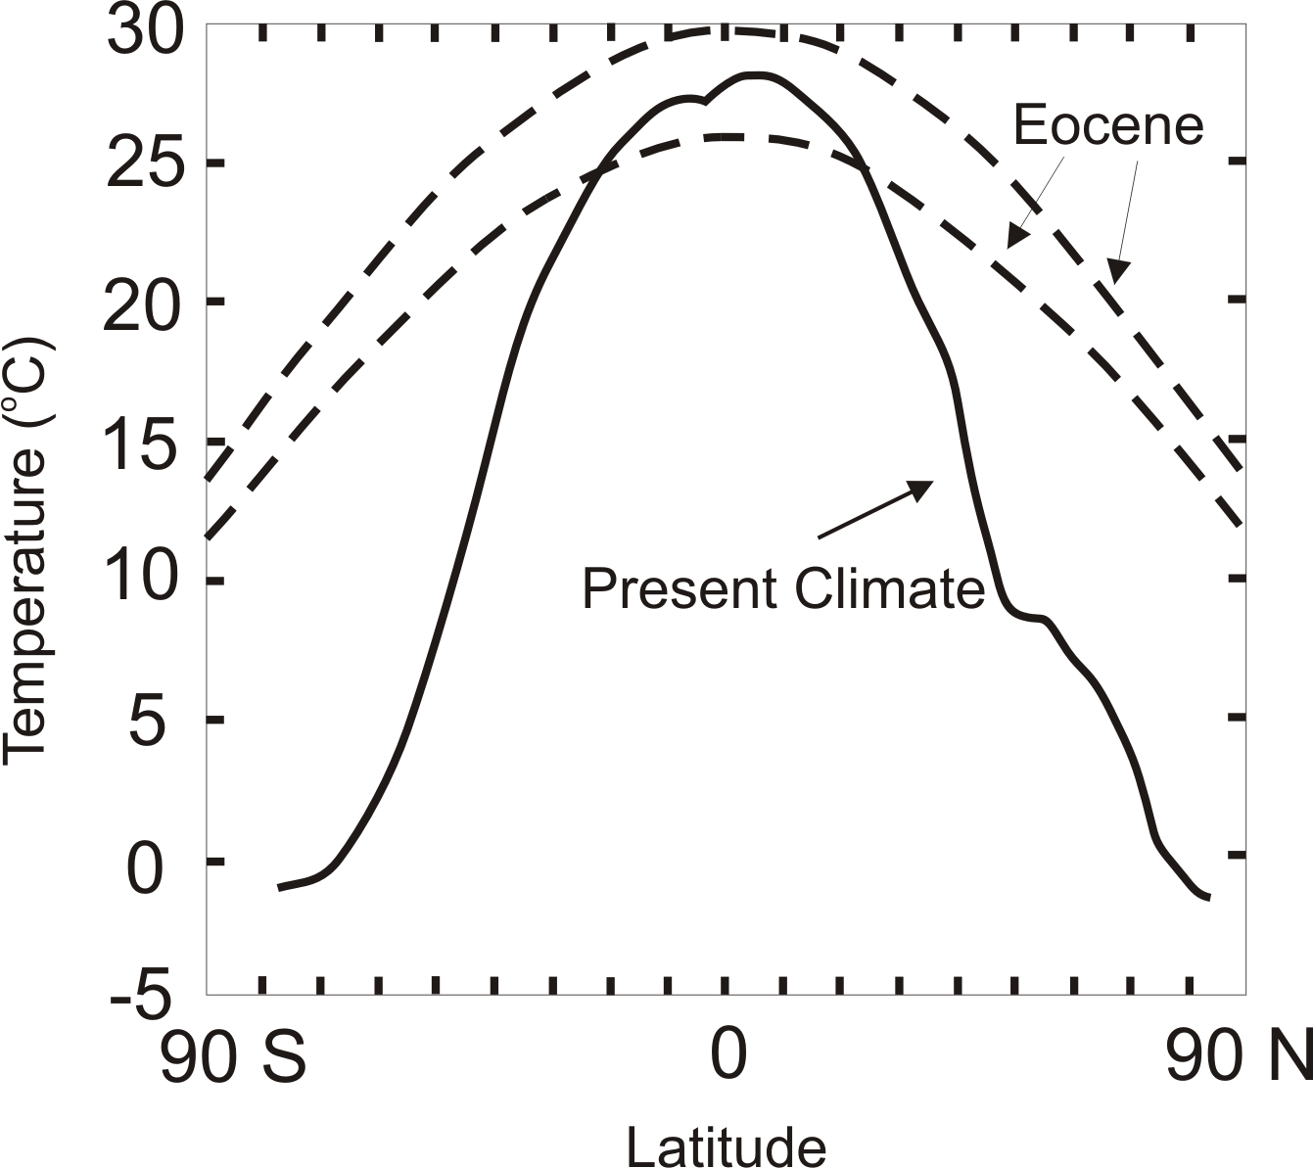
TC-Mixing may be Crucial for High-Latitude Warmth and Low-Latitude Moderation During Warm Climates, such as that of the Eocene
Notes:
67

Slide 68
Summary
Historical observations and synthetic tropical cyclones both show substantial upward trends in the North Atlantic, interrupted by a prominent “hurricane drought” in the 1970s and 80s
Previous work may have overestimated the number of missing storms earlier in the record

Slide 69
Hurricane drought was probably caused by Saharan dust anomalies associated with drought caused by European sulfate aerosol-induced cooling
No detectable frequency trend in global tropical cyclones
Upward trend in the Atlantic may be related to changes in the meridional overturning circulation of the ocean.

Slide 70
Tropical cyclones dry the atmosphere and may thereby cool the tropics through increase in OLR
While TCs operate by extracting heat from the ocean, their net effect is to export heat away in ocean currents, thus cooling the tropics

Slide 71
Paleotempestology
barrier beach
upland
overwash fan
backbarrier marsh
a)
lagoon
barrier beach
upland
overwash fan
b)
backbarrier marsh
lagoon
terminal lobes
flood tidal delta
Source: Jeff Donnelly, WHOI
Notes:
71

Slide 72
Jeffrey P. Donnelly and Jonathan D. Woodruff, Nature, 2007

Slide 73
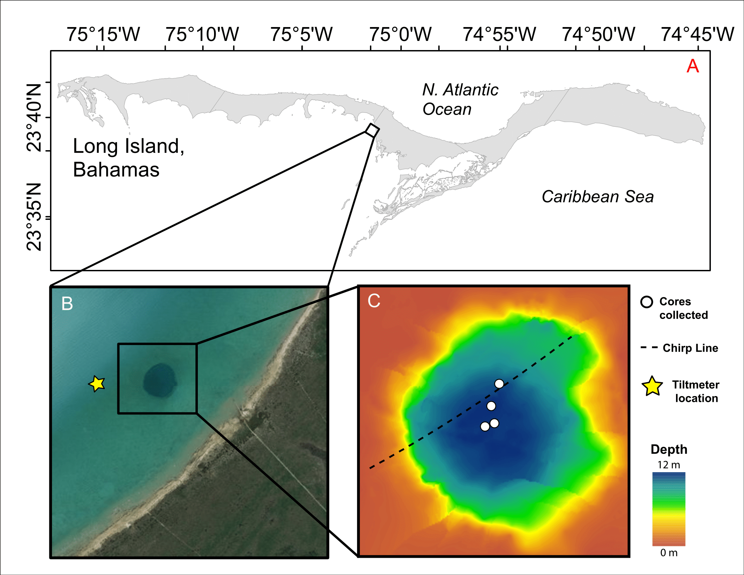
Extension to “Blue Holes” (e.g. in the Bahamas)
Courtesy Lizzie Wallace, WHOI

Slide 74
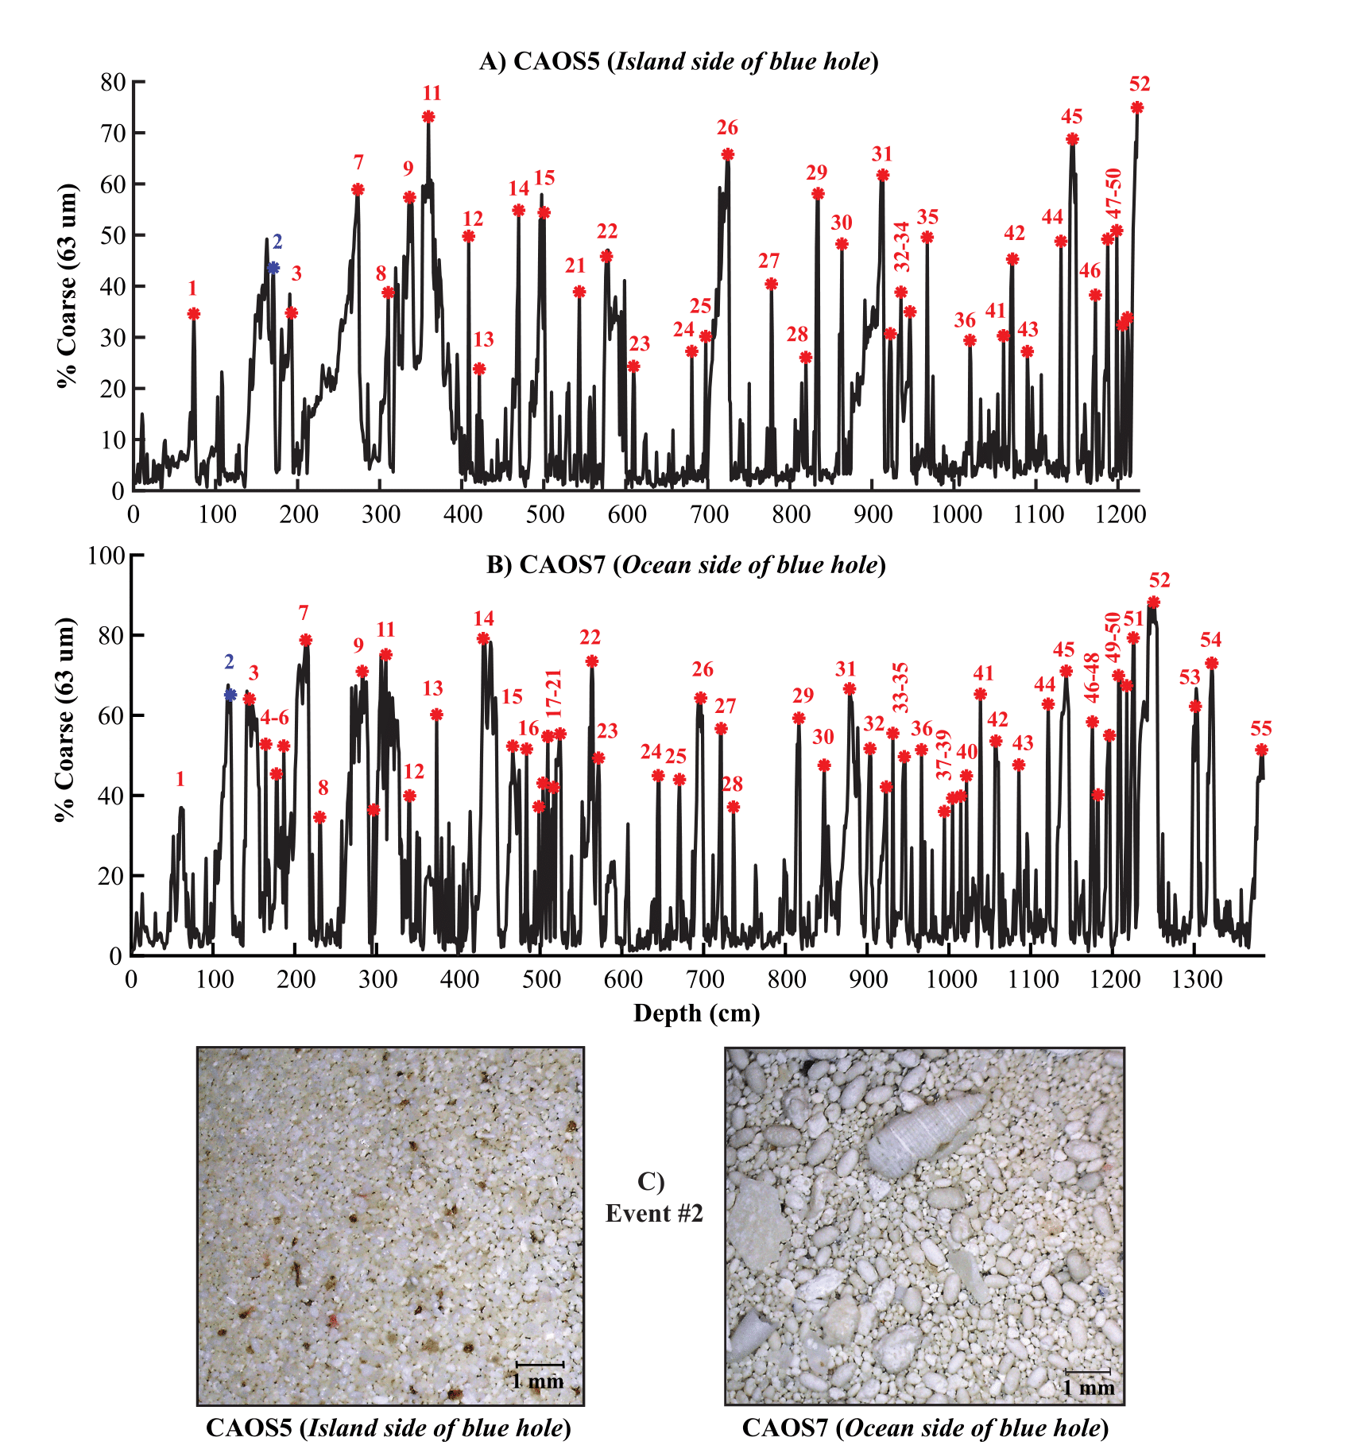
Courtesy Lizzie Wallace, WHOI

Slide 75
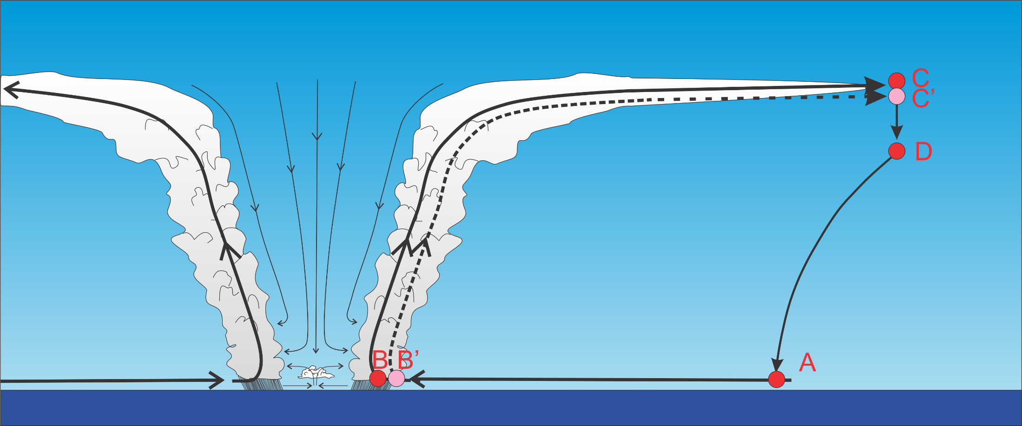
Add nearby cycle; take difference between two cycles

Slide 76
Theoretical Steady-State Maximum Hurricane Wind Speed:
Surface temperature
Saturation static energy of sea surface
Saturation static energy of the boundary layer
Ratio of surface exchange coefficients of enthalpy and momentum
Outflow temperature
Air-sea enthalpy disequilibrium of moist static energy

Slide 77
Comparison of numerically simulated and theoretical intensities
Courtesy Raphael Rousseau-Rizzi

Slide 78
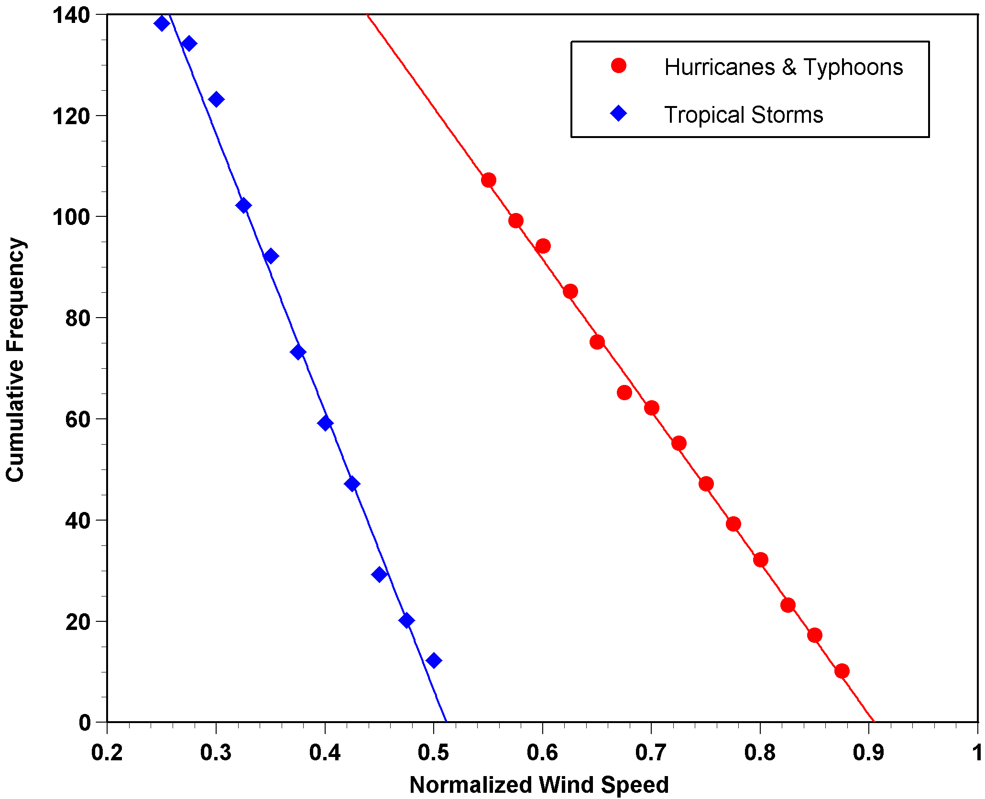
Cumulative Frequency of Storm Lifetime Maximum Intensity Normalized by Potential Intensity

Slide 79
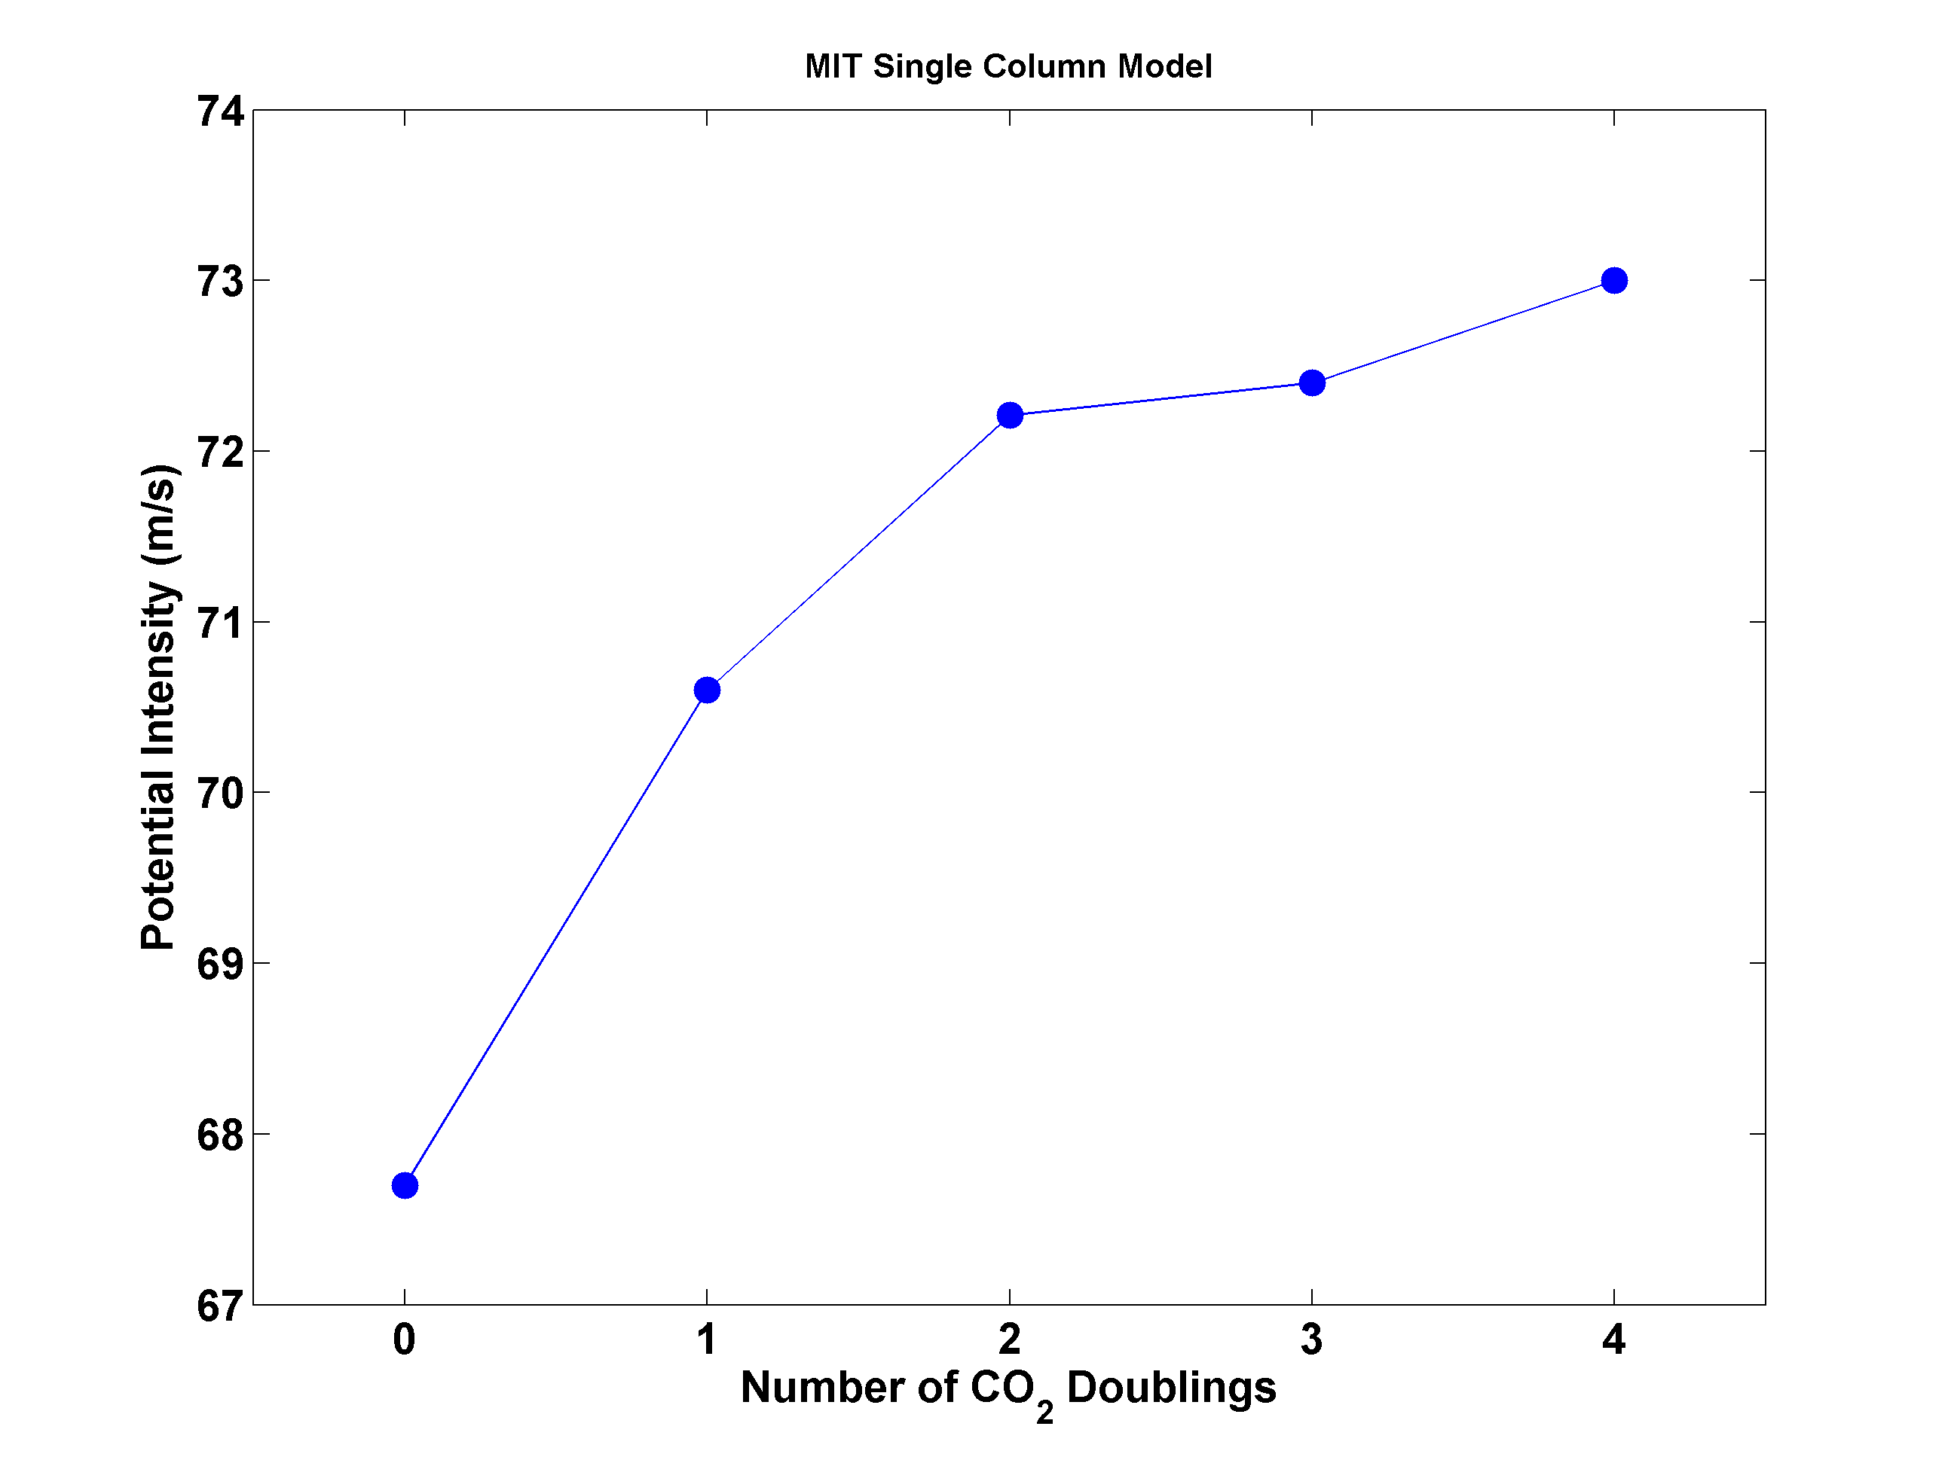
Potential Intensity and CO₂

Slide 80
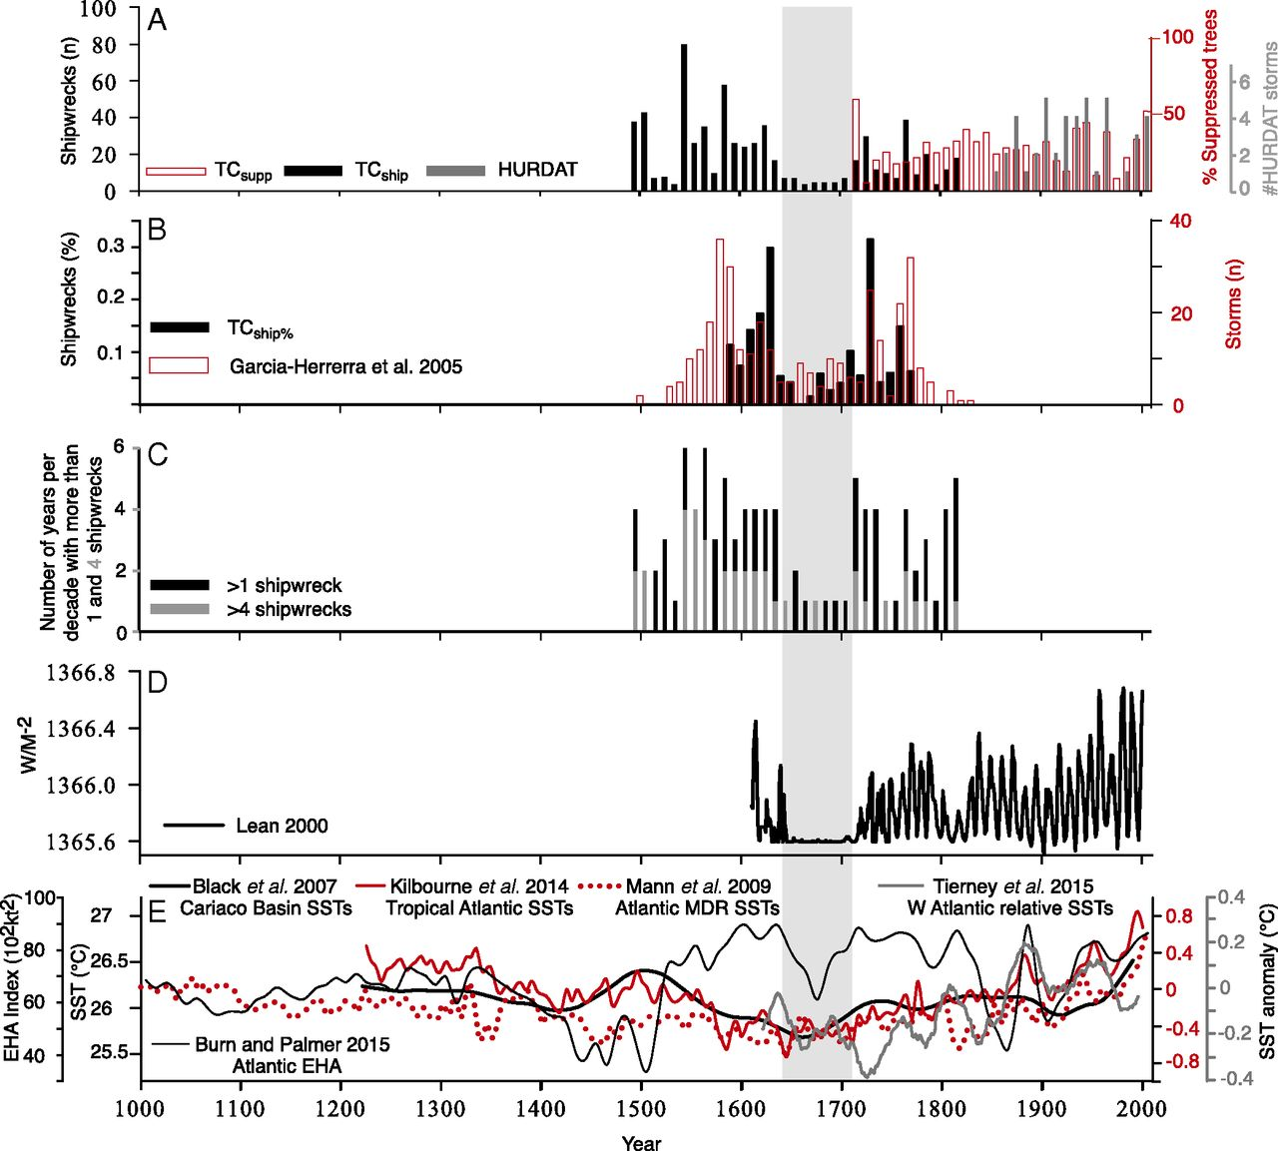
Inferences from Spanish Shipwrecks
Trouet at al., PNAS. 2016

Slide 81
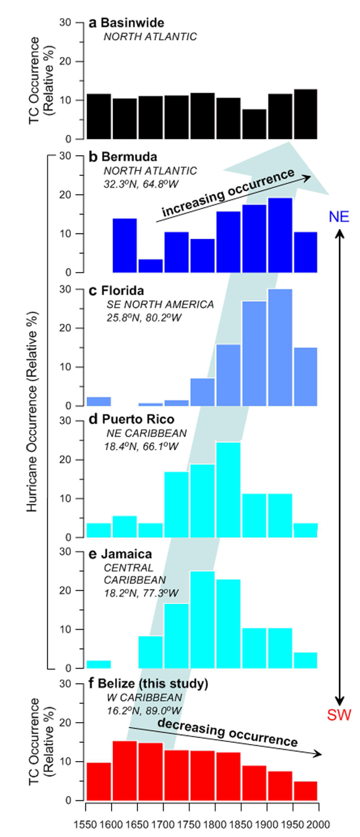
The YOK-GTC reconstruction compared to documentary records of hurricane landfall in the Caribbean and North Atlantic Basins. Frequency distributions (relative %) of hurricanes affecting (a) the entire North Atlantic Basin and locations along the western margin of the North Atlantic (b) Bermuda, (c)
Florida, (d) Puerto Rico, and (e) Jamaica, calculated from previously published documentary data. From Baldini et al., Nature Scientific Reports, 2016, DOI: 10.1038/srep37522
Belize data based on stable isotope analysis of stalagmites at Yoks Balum cave in southern Belize

Slide 82

Problem: Today’s models are far too coarse to simulate destructive hurricanes
Histograms of Tropical Cyclone Intensity as Simulated by a Global Model with 30 mile grid point spacing. (Courtesy Isaac Held, GFDL)
Category 3
Modeled
Observed
Global models do not simulate the storms that cause destruction
Wind Speed (meters per second)

Slide 83
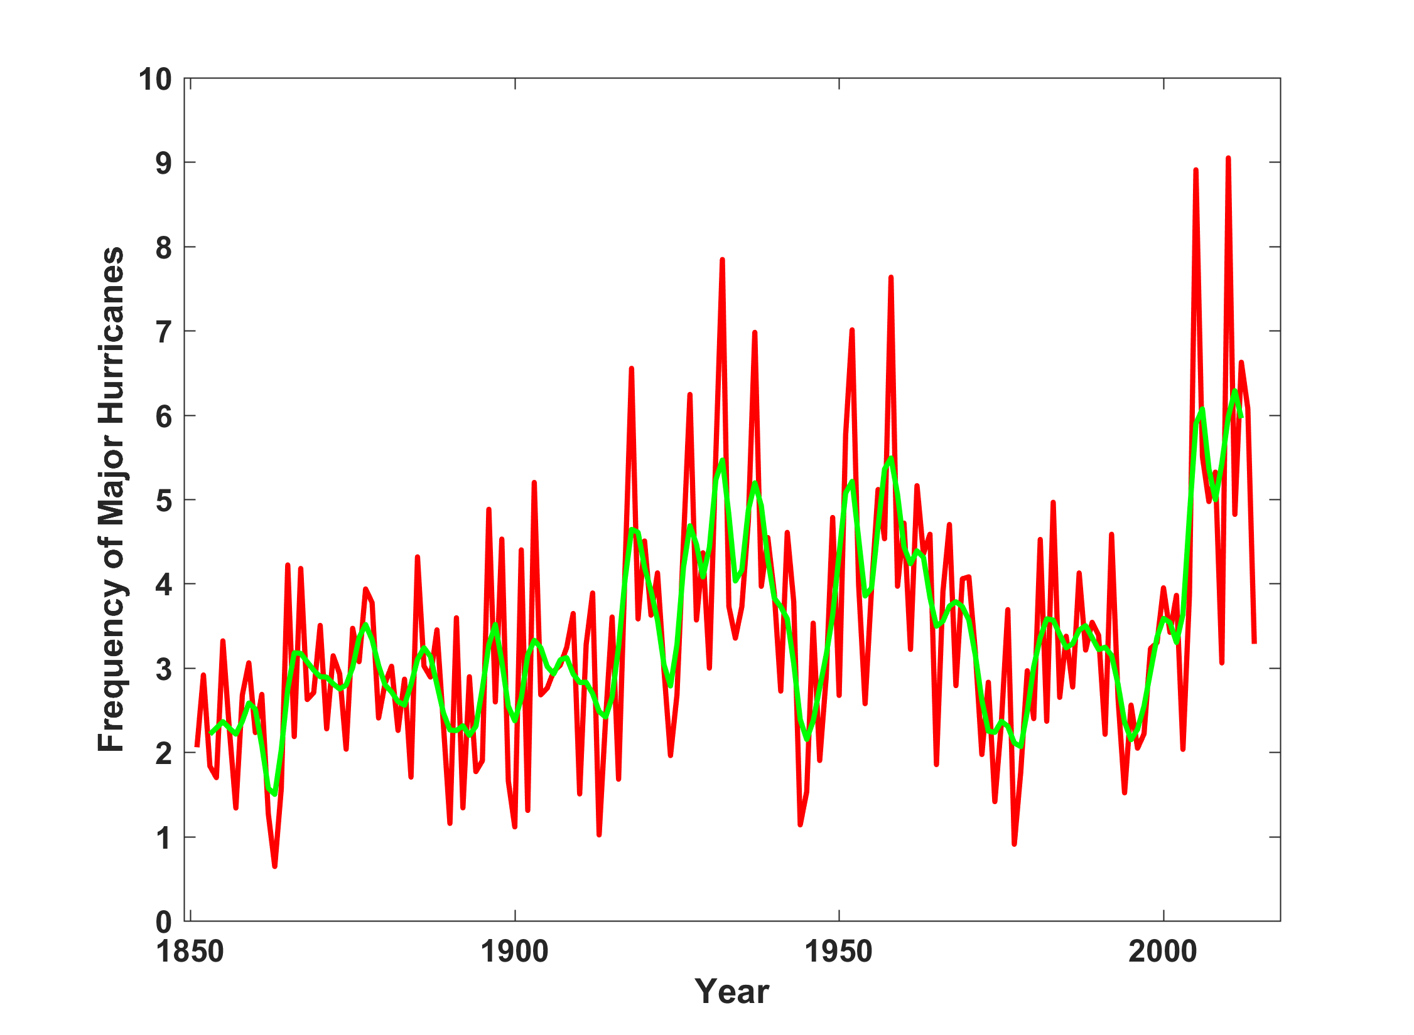
North Atlantic Major Hurricanes Downscaled from NOAA 20th Century Reanalysis
(Forced by sea surface temperature, surface pressure, and sea ice only)

Slide 84
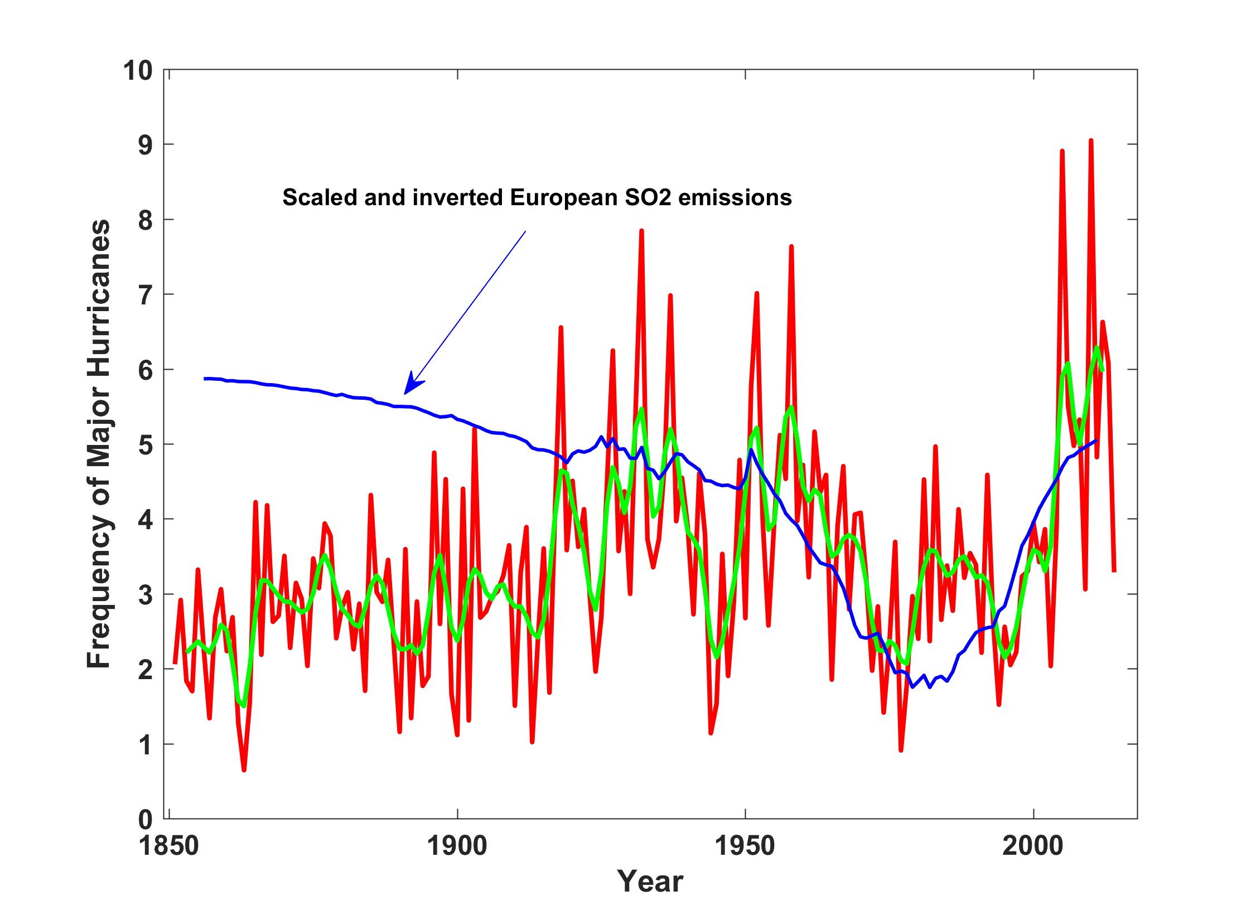
North Atlantic Major Hurricanes Downscaled from NOAA 20th Century Reanalysis
(Forced by sea surface temperature, surface pressure, and sea ice only)

Slide 85
Our Approach
Apply dynamical tropical cyclone downscaling to 20th century reanalyses
These reanalyses, in contrast with standard reanalyses (like ERA 5) assimilate ONLY sea surface temperature, sea level pressure, and sea ice
We use three 20th century reanalyses: NOAA v. 2c (1851-2014), NOAA v.3 (1836-2015), and CERA 20c (1901-2010).
CERA 20c assimilates marine surface winds and uses a coupled model with SSTs relaxed back to HadISST 2

