Slide 1

David Raymond’s Work on Tropical Cyclogenesis: The Tropical Experiment in Mexico (TEXMEX), 1991
Kerry Emanuel
EAPS and Lorenz Center, MIT
Notes:
1

Slide 2
Program
The historical context
Research leading up to TEXMEX, 1991
The TEXMEX project
What we learned
Recap of Dave Raymond’s contributions to the tropical cyclone research

Slide 3
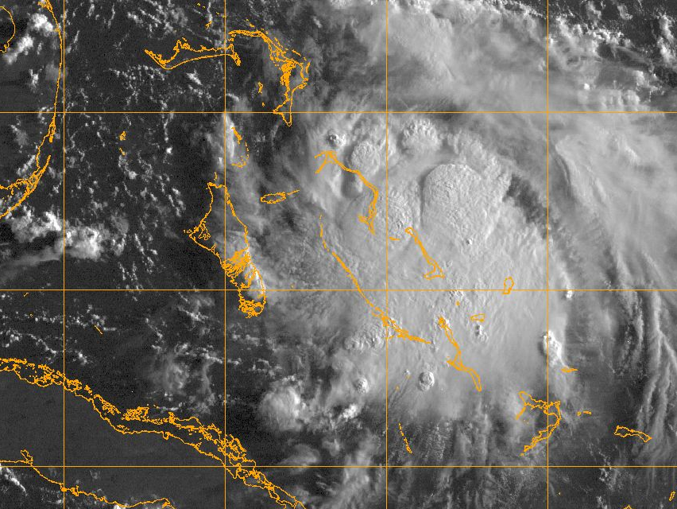
Two Distinct Threads of Genesis Theories

Slide 4
TC formation as a mode of release of conditional instability
  Espy (1841), The Philosophy of Storms
  Palmén (1948), On the formation and structure of tropical hurricanes
  Charney and Eliassen (1964): On the growth of the hurricane depression
  Yamasaki (1968): Numerical simulation of tropical cyclone development with the use of primitive equations
Example:
Numerous cumulonimbus clouds warm and gradually moisten their environment. This warming…produces a pressure fall at the surface, because warm air weighs less than cool air. The slowly converging horizontal winds near the surface respond to this slight drop of pressure by accelerating inward. But the increased inflow produces increased lifting, so that the thunderstorms become more numerous and intense. The feedback loop is now established.
-- from a textbook published in the late 1970s

Slide 5
Already in 1901 Julius von Hann voiced an objection:
“Since a thundercloud does not give any appreciable pressure fall [at the surface] but even a pressure rise, it would be unreasonable to assume that a magnifying of this process would cause the strongest pressure falls known”
-- As paraphrased by Bergeron, QJRMS, 1954

Slide 6
Diagram from Bergeron, QJRMS, 1954
z
x
y
x

Slide 7
TC formation as a flux-driven phenomenon
  Riehl (1950): A model for hurricane formation
  Kleinschmidt (1951): Principles of the theory of tropical cyclones (in German)
  Ooyama (1969): Numerical simulation of the life cycle of tropical cyclones (Note: A foot in both camps)
  Rosenthal (1971): The response of a tropical cyclone model to variations in boundary layer parameters, initial conditions, lateral boundary conditions, and domain size
  Gray (1975): Tropical Cyclone Genesis. (First to note role of cloud- radiation interactions)
Example:
The heat removed from the sea by the storm is the basic energy
source of typhoon. In comparison to it, the latent heat of the water vapour, which the air carries with it from the outside, plays no more than a secondary role.
- Ernst Kleinschmidt, 1951

Slide 8
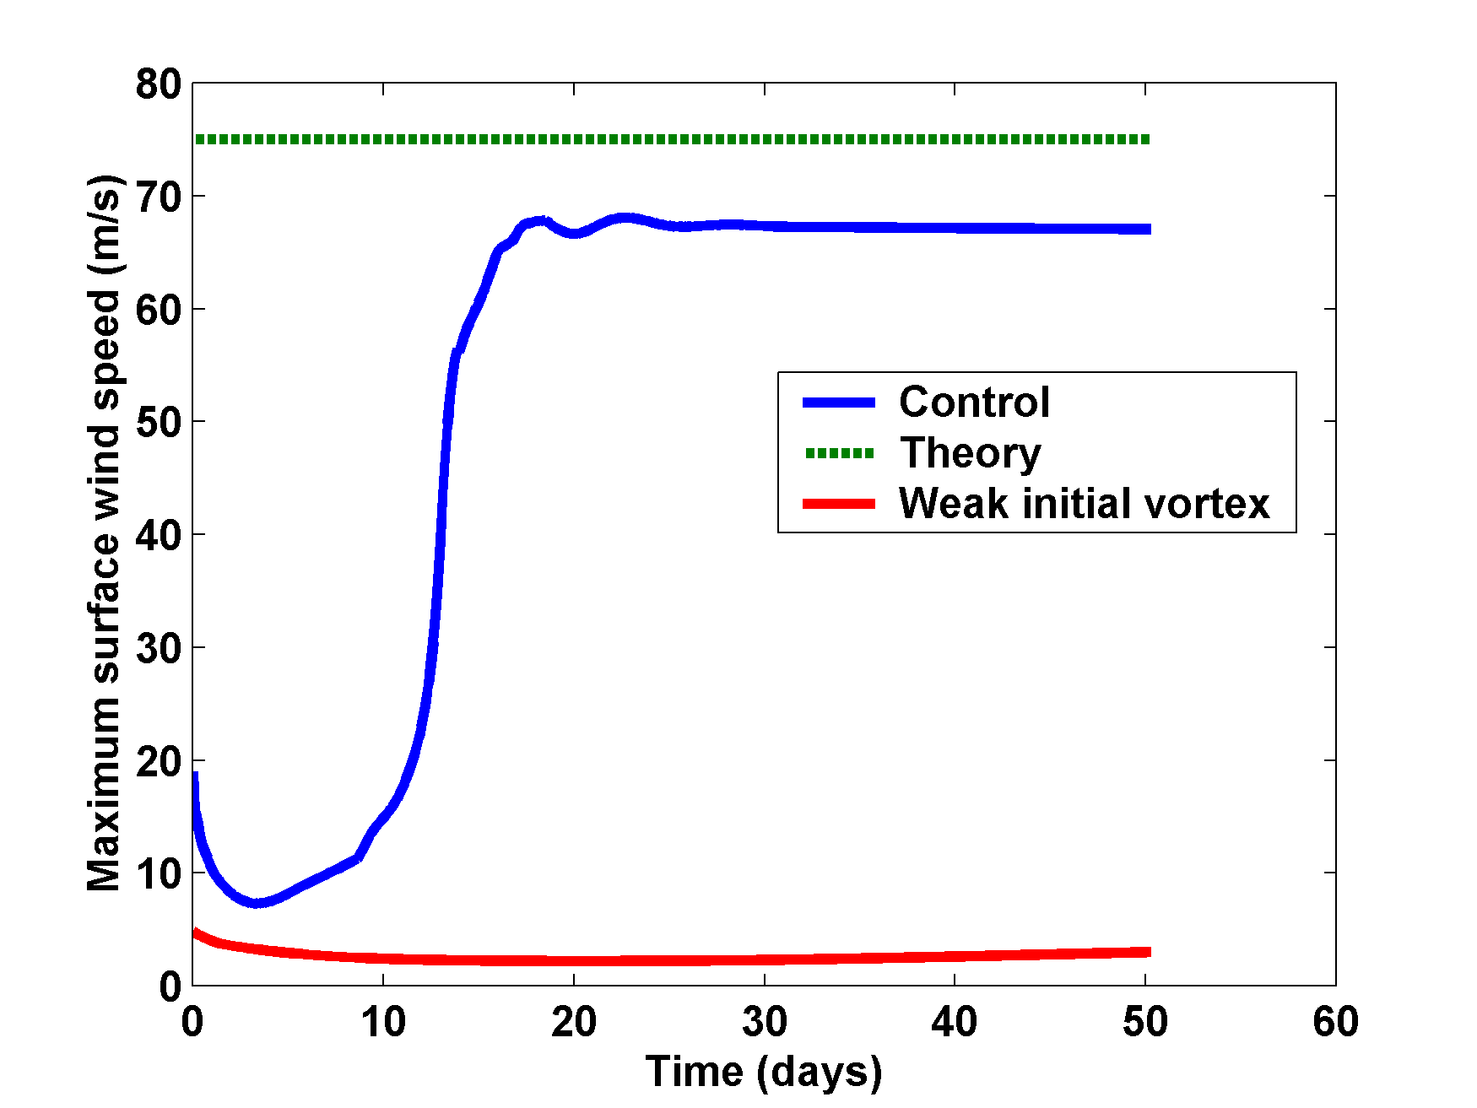
Simulations Using Balanced Axisymmetric Model

Slide 9
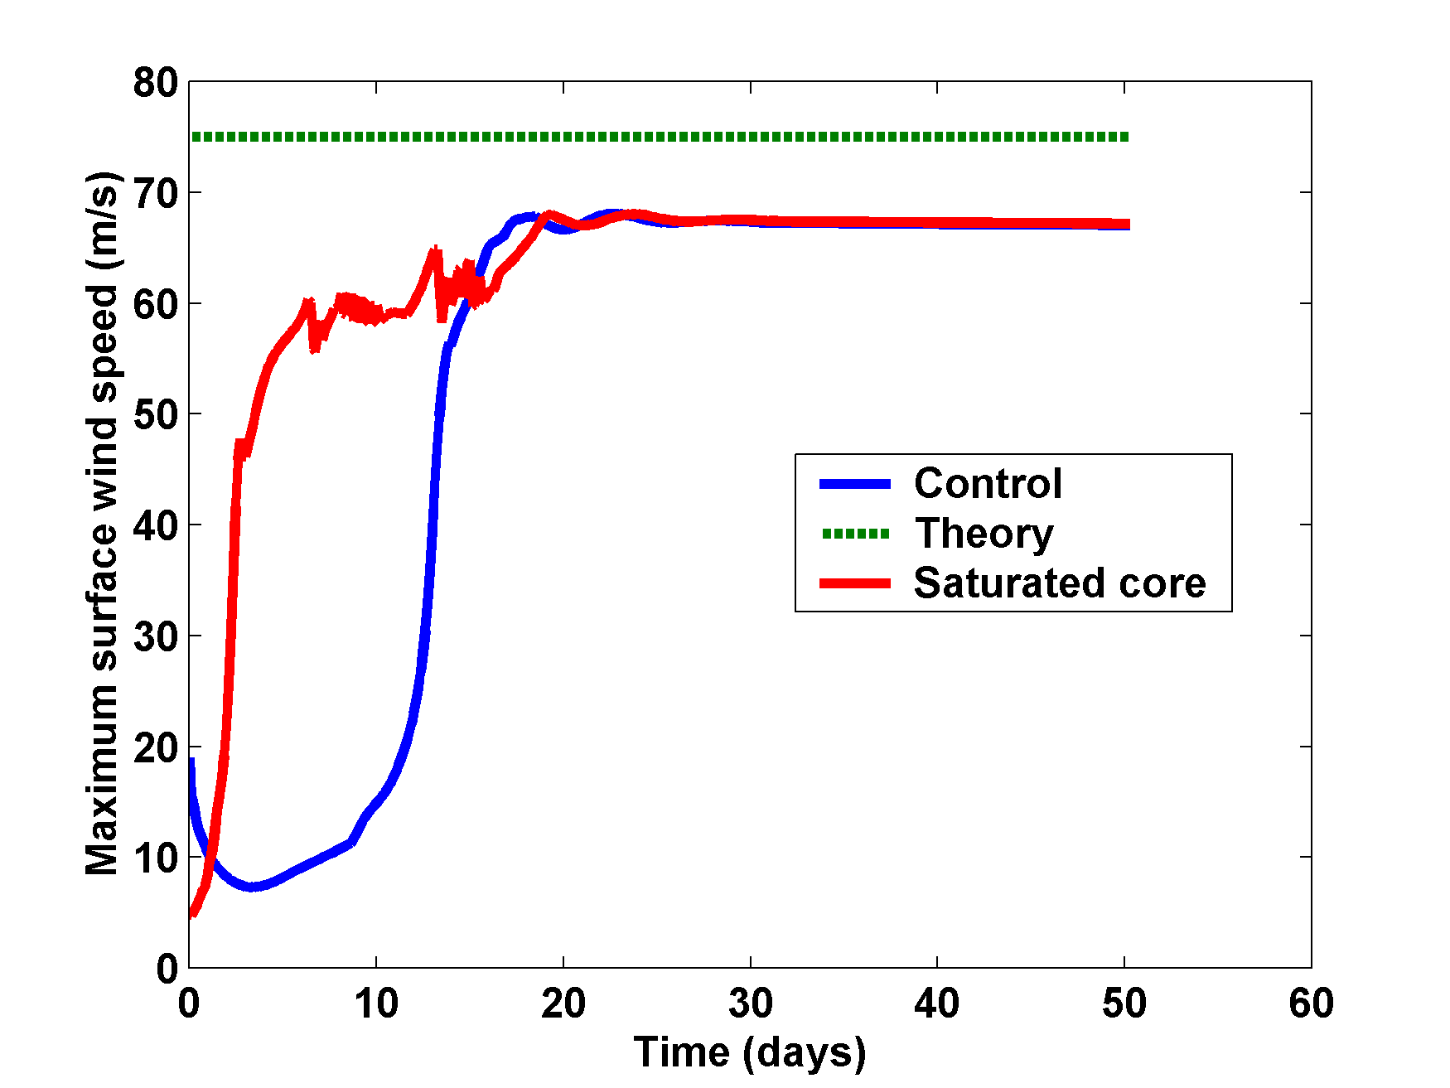
Saturate troposphere inside 100 km in initial state:

Slide 10
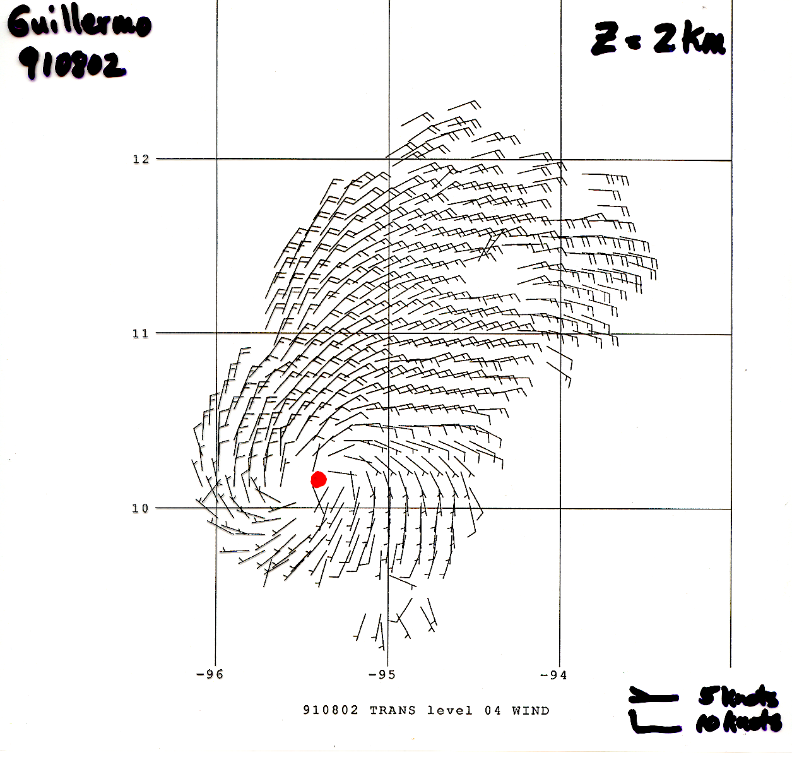

Slide 11
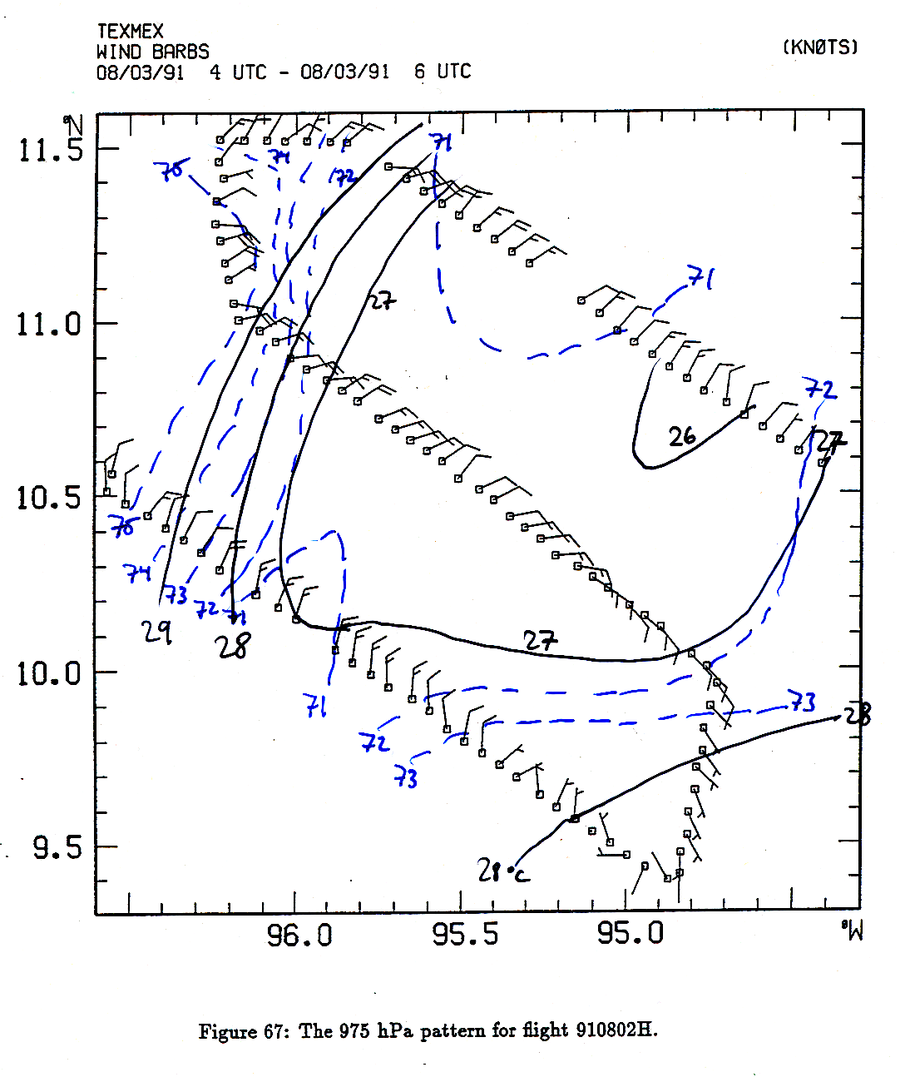

Slide 12
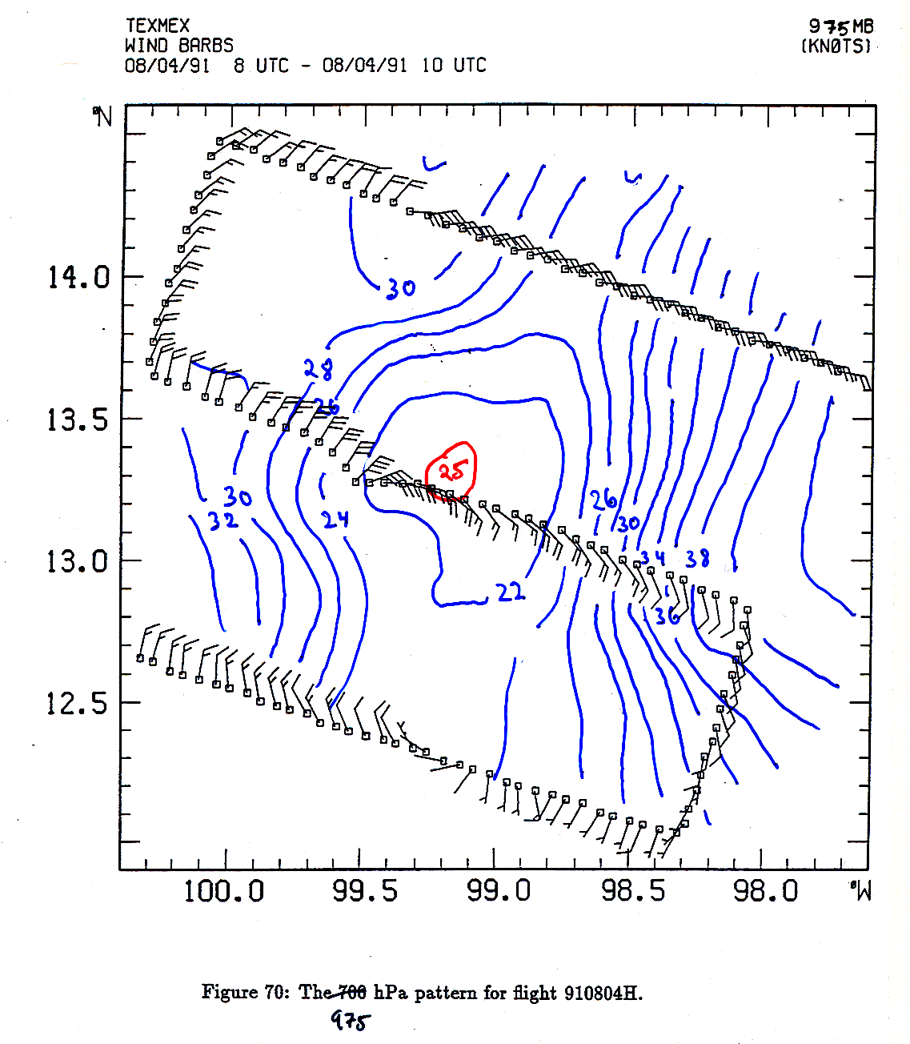

Slide 13
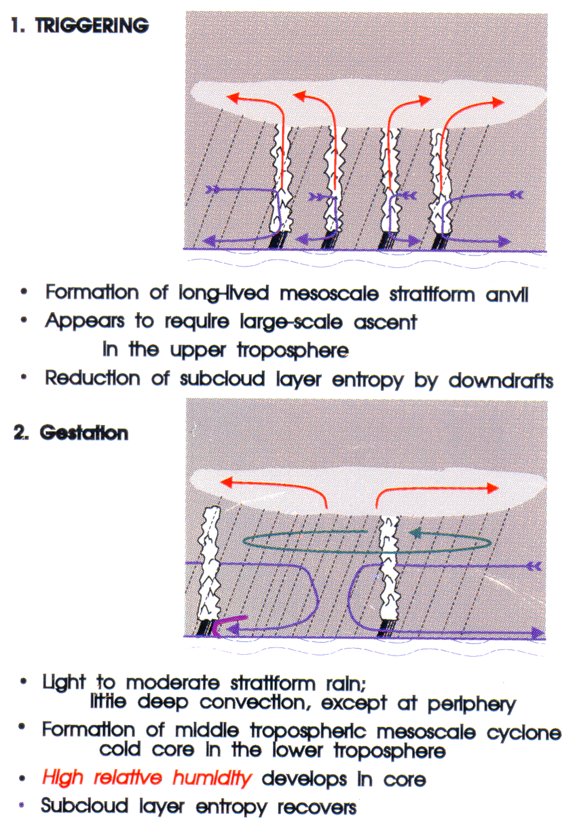
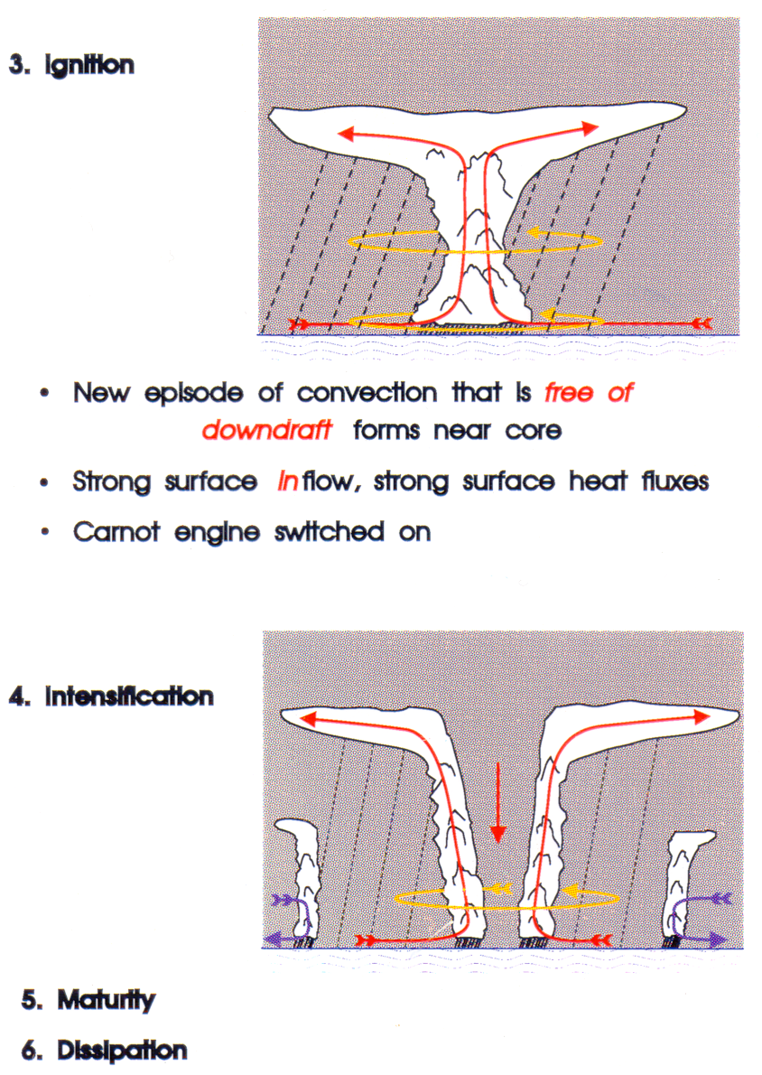

Slide 14
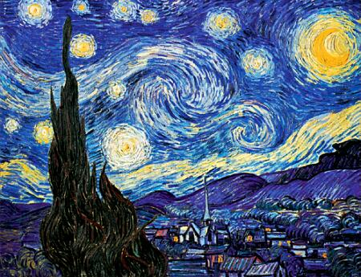
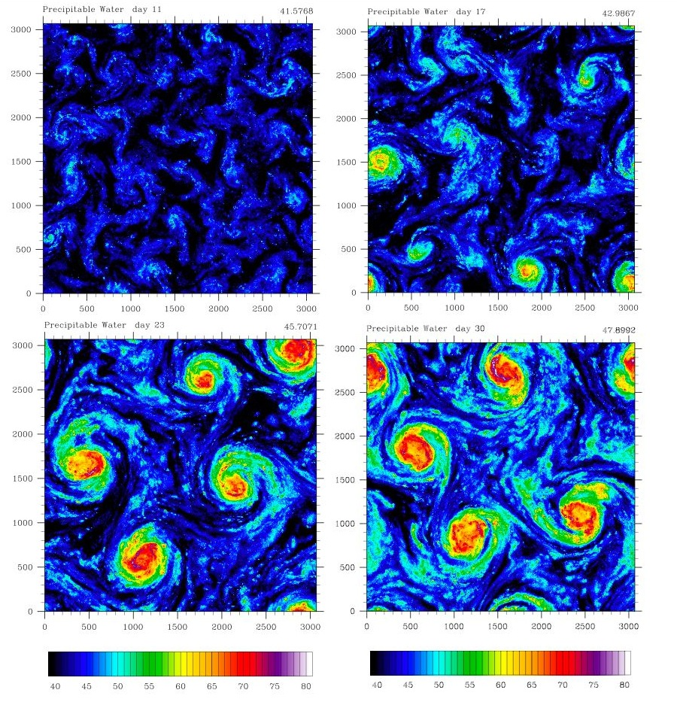
Self-Aggregation on an f-plane
Vincent Van Gogh: Starry Night

Slide 15
David Raymond’s Published Research on Tropical Cyclones
Raymond, D. J., 1992: Nonlinear Balance and Potential Vorticity Thinking at
Large Rossby Number. QJRMS 116, D18101, doi:10.1029/2011JD015624
Raymond, D. J., and S. A. Lewis, 1995: Rotating convective disturbances in the trades, Quart. J. Roy. Meteor. Soc., 121, 271-299.
Raymond, D. J., C. Lopez-Carrillo, and L. Lopez Cavazos, 1998: Case-studies of developing east Pacific easterly waves. Quart. J. Roy. Meteor. Soc., 124, 2005-2034
Raymond, D. J., and S. L. Sessions, 2007: Evolution of convection during tropical cyclogenesis, Geophys. Res. Lett., 34, L06811, doi:10.1029/2006GL028607
Raymond, D. J., S. Sessions, and Z. Fuchs, 2007: A theory for the spinup of tropical depressions, Quarterly Journal of the Royal Meteorological Society, 133, 1743-1754
Marin, J. C., D. J. Raymond, and G. B. Raga, 2009: Intensification of tropical cyclones in the GFS model. Atmos. Chem. Phys., 9, 1407-1417
Raymond, D. J. and C. Lopez Carrillo, 2011: The vorticity budget of developing typhoon Nuri (2008), Atmos. Chem. Phys., 11, 147-163, doi:10.5194/acp-11-147-2011

Slide 16

Raymond, D. J., 2012: Balanced thermal structure of an intensifying tropical cyclone. Tellus-A, 64, 19181, doi.org/10.3402/tellusa.v64i0.19181
Gjorgjievska, S. and D. J. Raymond, 2014: Interaction between dynamics and thermodynamics during tropical cyclogenesis, Atmos. Chem. Phys., 14, 3065-3082
Raymond, D. J., S. Gjorgjievska, S. Sessions, and Z. Fuchs, 2014: Tropical cyclogenesis and mid-level vorticity. Australian Meteorological and Oceanographic Journal, 64, 11-25
Fuchs, Z, M. J. Herman, and D. J. Raymond, 2014: Frictional convergence in a decaying weak vortex, J. Atmos. Sci., 71, 2467-2475
Juracic, A., and D. J. Raymond, 2016: The effects of moist entropy and moisture budgets on tropical cyclone development. J. Geophys. Res., 121, 9458-9473

