Slide 1
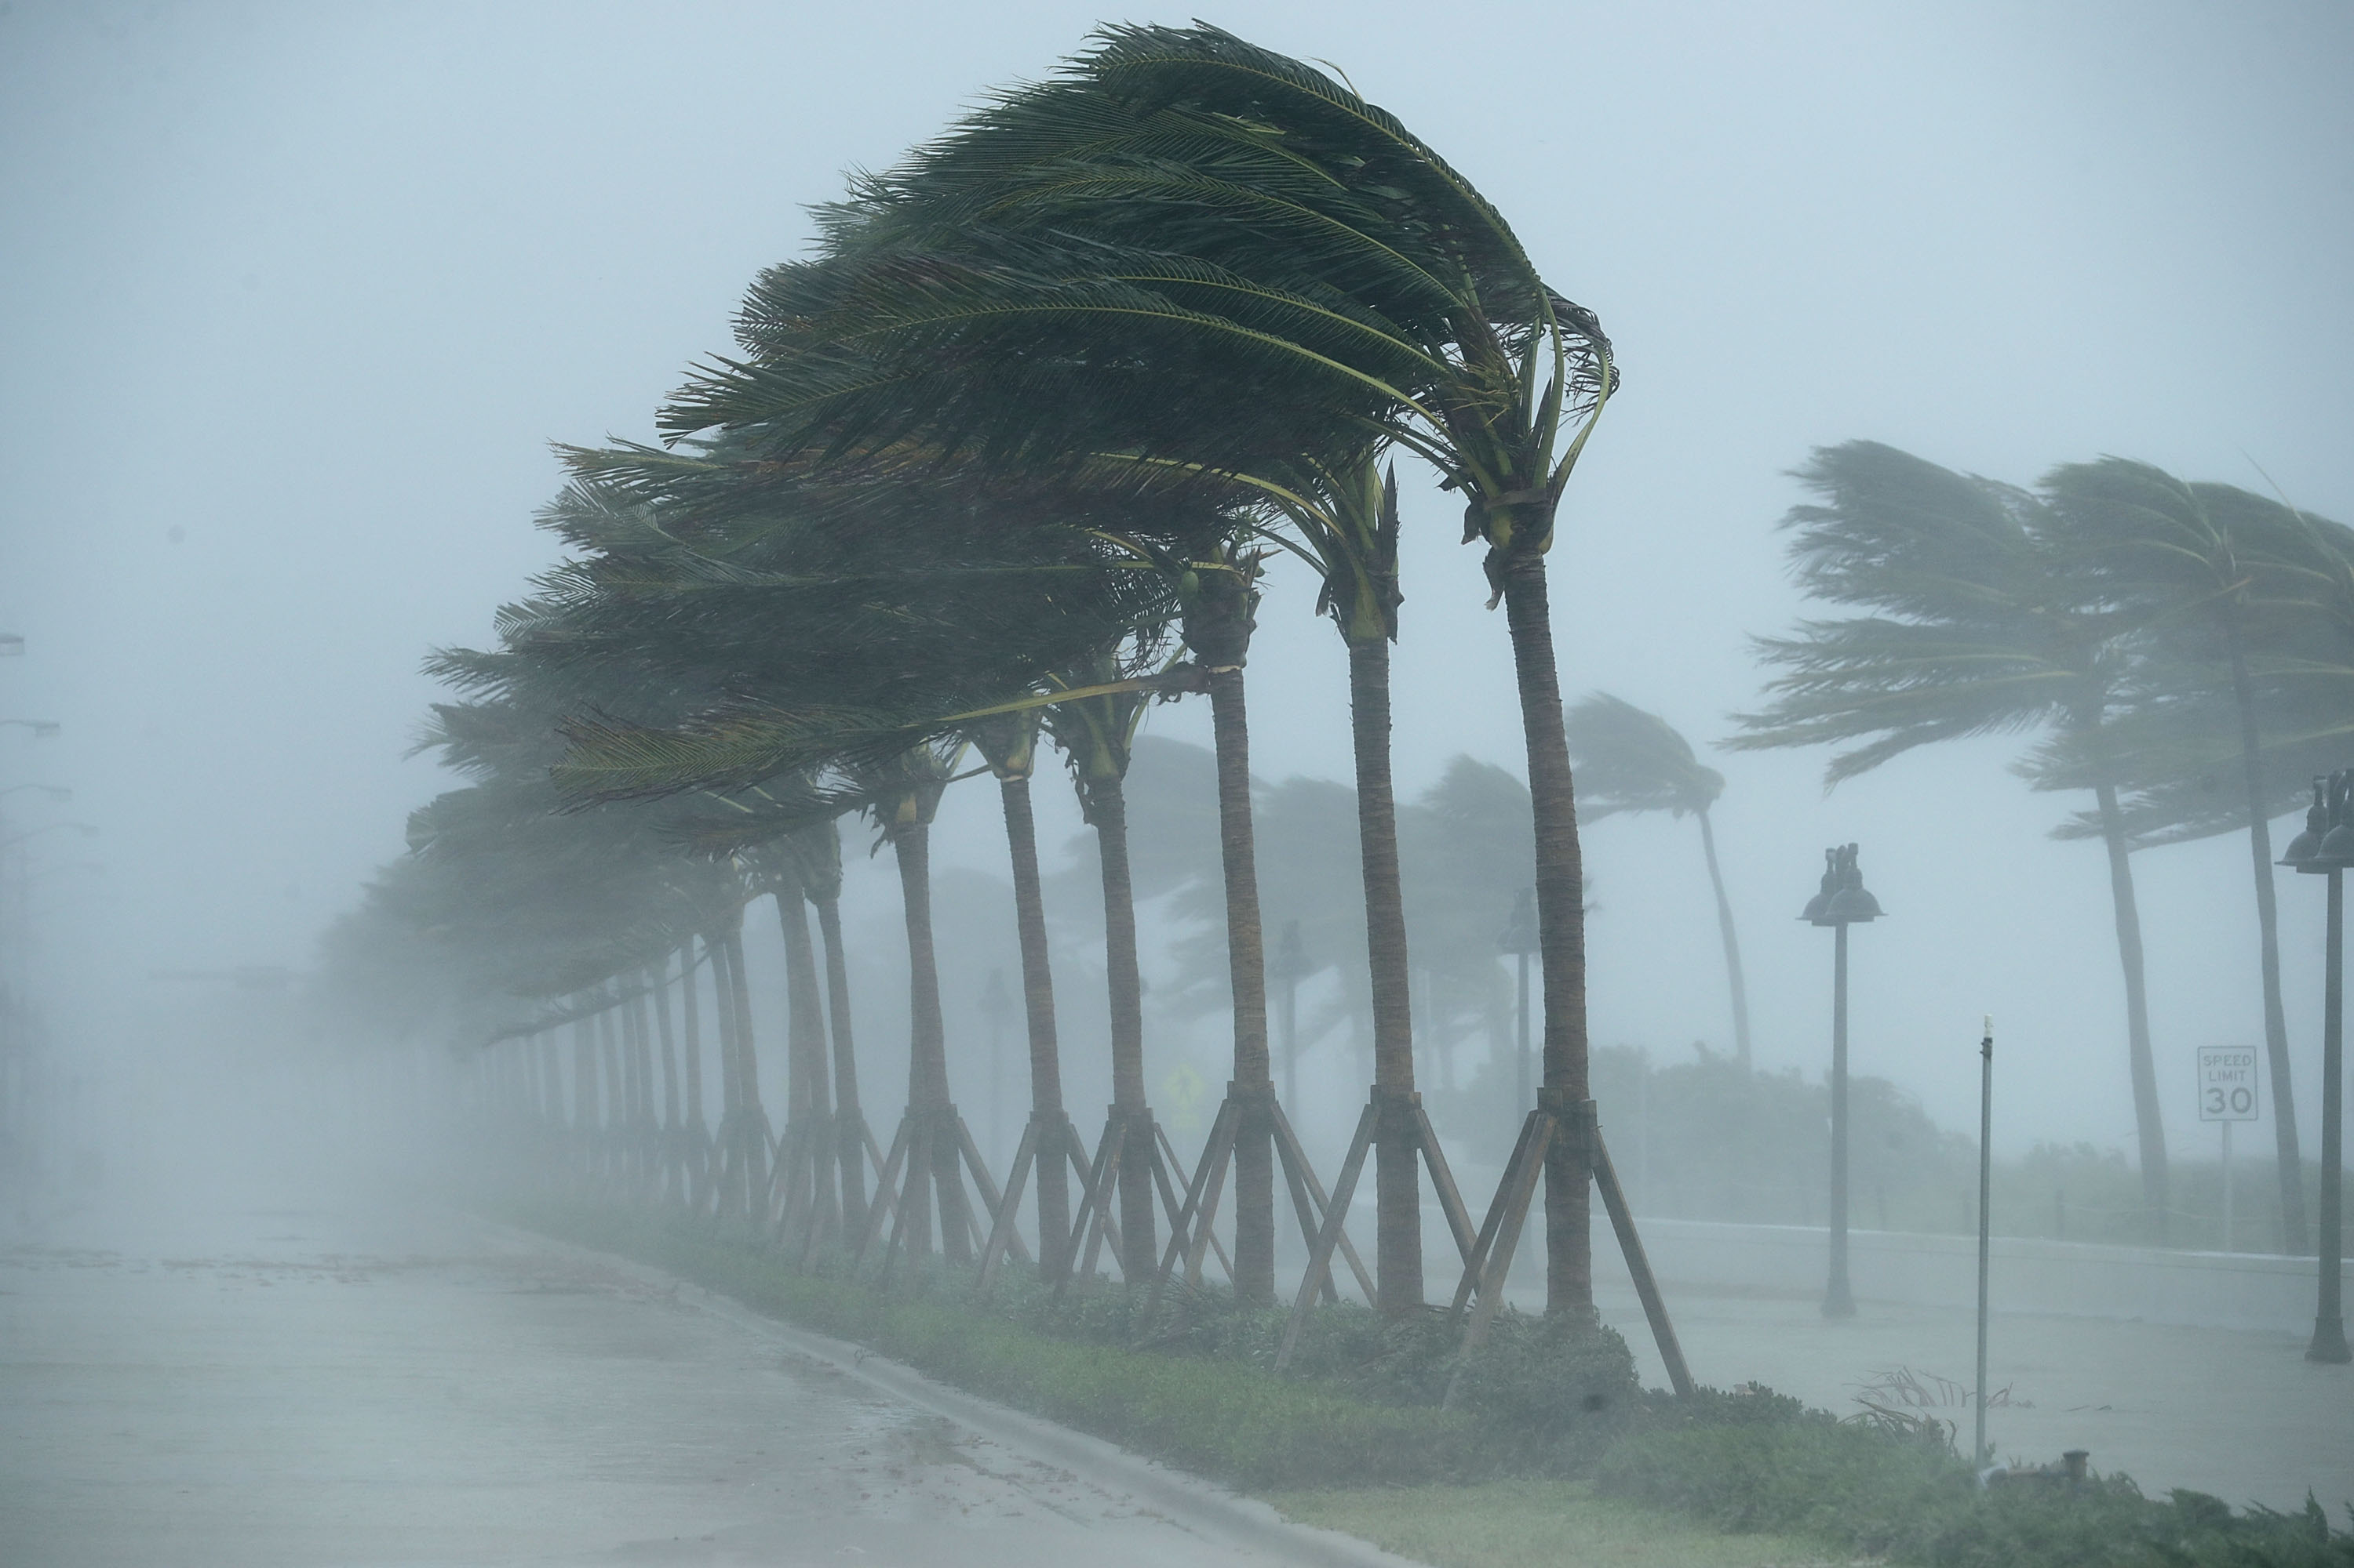
Hurricanes: Past, Present and Future
Kerry Emanuel
Lorenz Center
Massachusetts Institute of Technology

Slide 2

Program
What is a hurricane?
Historical and economic significance of hurricanes
How hurricanes work
Hurricanes in our future

Slide 3

What is a Hurricane?
Formal definition: A tropical cyclone with 1-min average winds at 10 m altitude in excess of 32 m/s (64 knots or 74 MPH) occurring over the North Atlantic or eastern North Pacific

Slide 4


The word Hurricane is derived from the Mayan word Huracan and the Taino and Carib word Hunraken, a terrible God of Evil, and brought to the West by Spanish explorers
Blow, winds, and crack your cheeks! rage! blow! You cataracts and hurricanoes, spout Till you have drench’d our steeples, drown’d the cocks! -- King Lear

Slide 5
Hurricanes in History

Slide 6
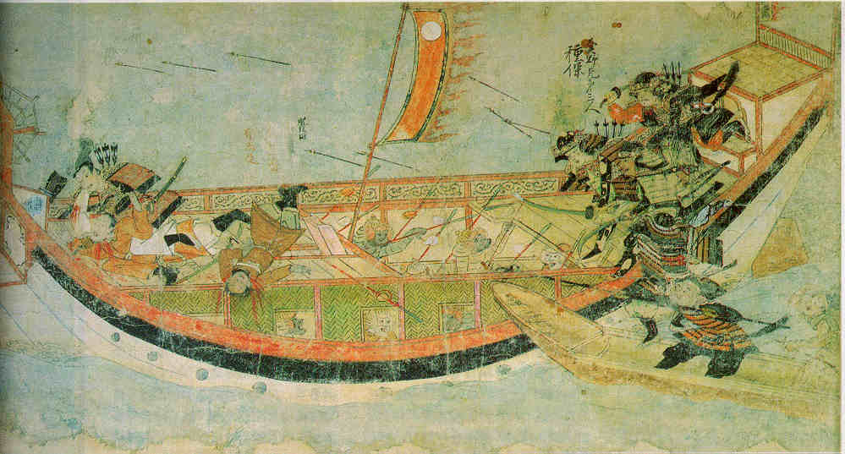
Early historical encounters: The Mongol invasions of Japan in 1274 and 1281
Scene from the 13th century Mongol invasion scrolls, based on a narrative written by the Japanese warrior Takezaki Suenaga.

Slide 7
Christopher Columbus’s Hurricane

Slide 8
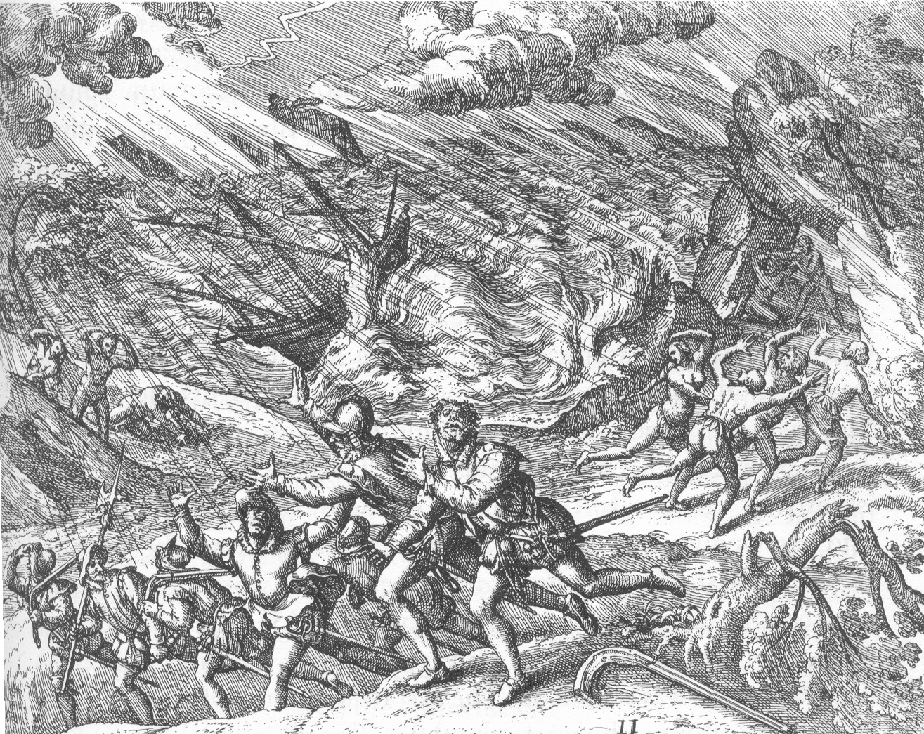
Warmest climes but nurse the cruelest fangs
– Herman Melville, Moby Dick
Illustration from Travels in the West Indies, Theodor DeBry
Notes:
Columbus’s 4th voyage, 1502. Don Nicholas de Orvando, the governor of Hispaniola refused entry to Santo Domingo. See notes (2)

Slide 9
Galveston, 1900
The opinion held by some who are unacquainted with the actual conditions of things, that Galveston will at some time be seriously damaged by some such disturbance, is simply an absurd delusion
- Isaac Cline, Local Forecast Official and Section Director, U.S Weather Bureau, Galveston, Texas, in The Galveston News, 1891

Slide 10
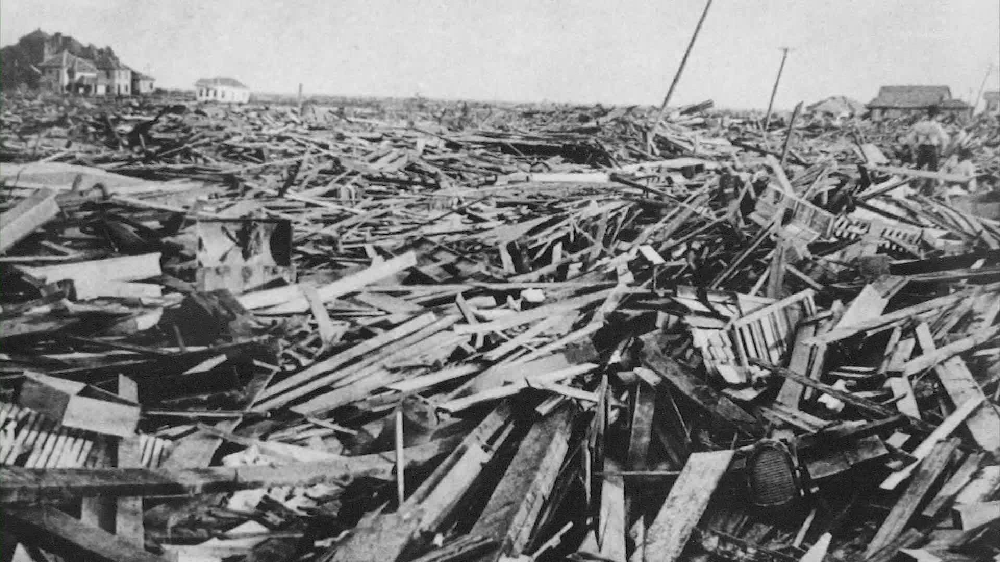
Sunday, September 9, 1900, revealed one of the most horrible sights that ever a civilized people looked upon. - Isaac Cline

Slide 11
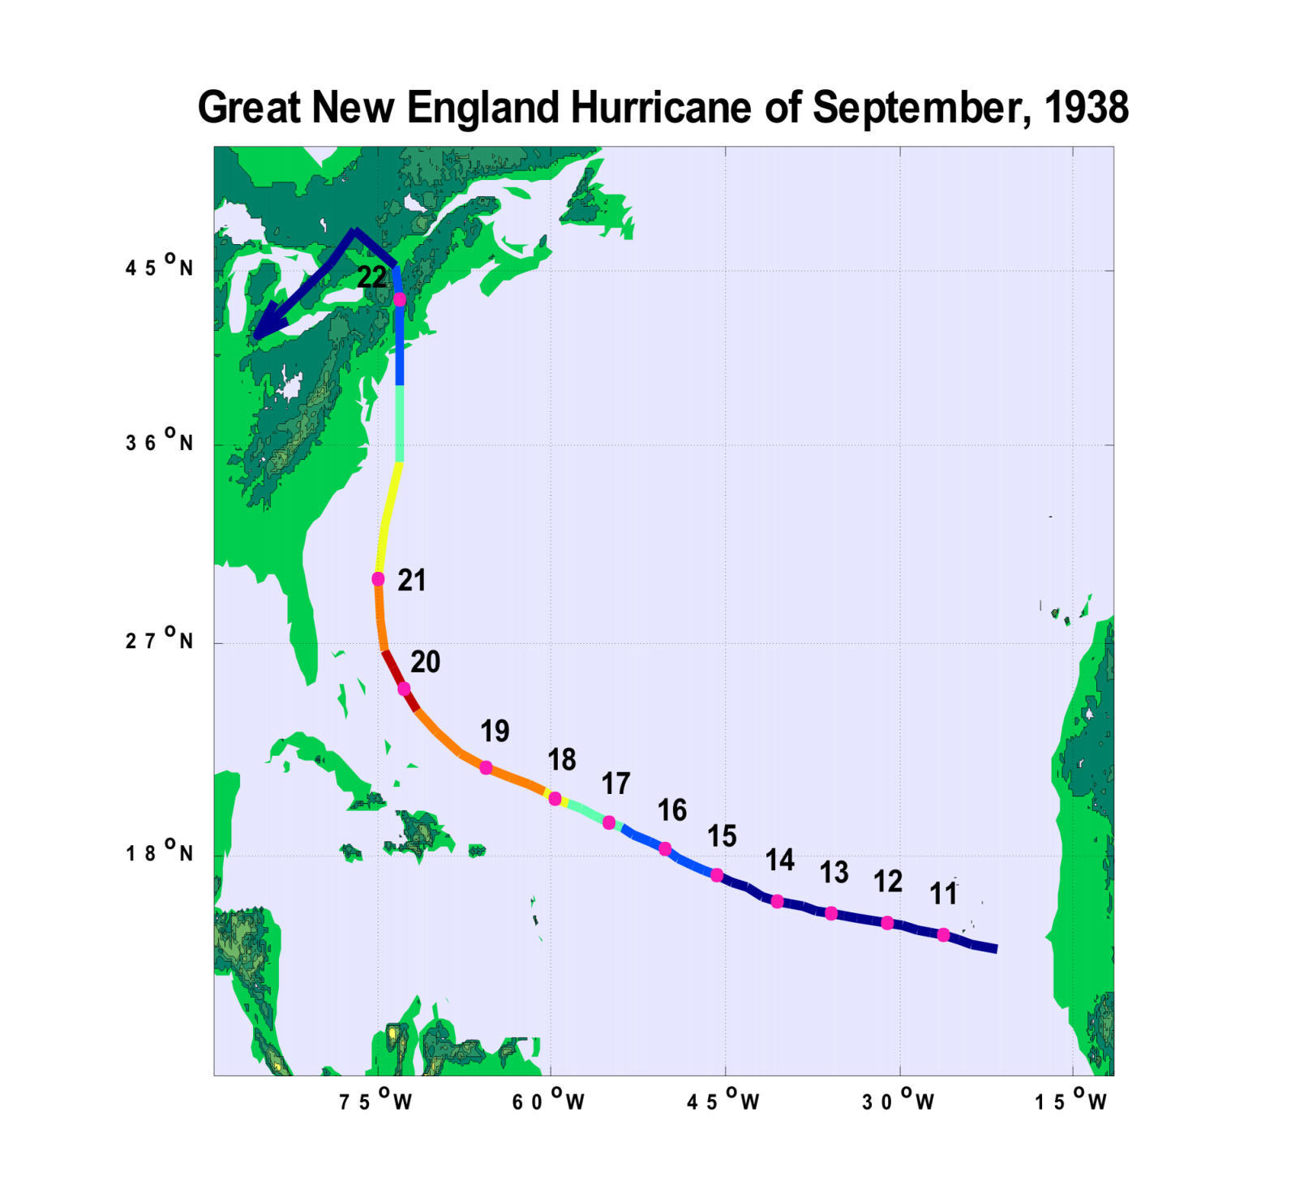

Slide 12
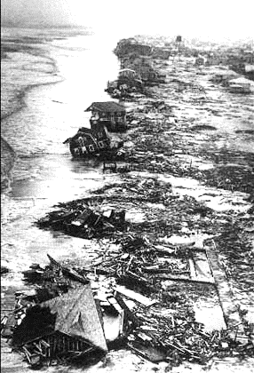
Long Island Shore after the 1938 Hurricane

Slide 13
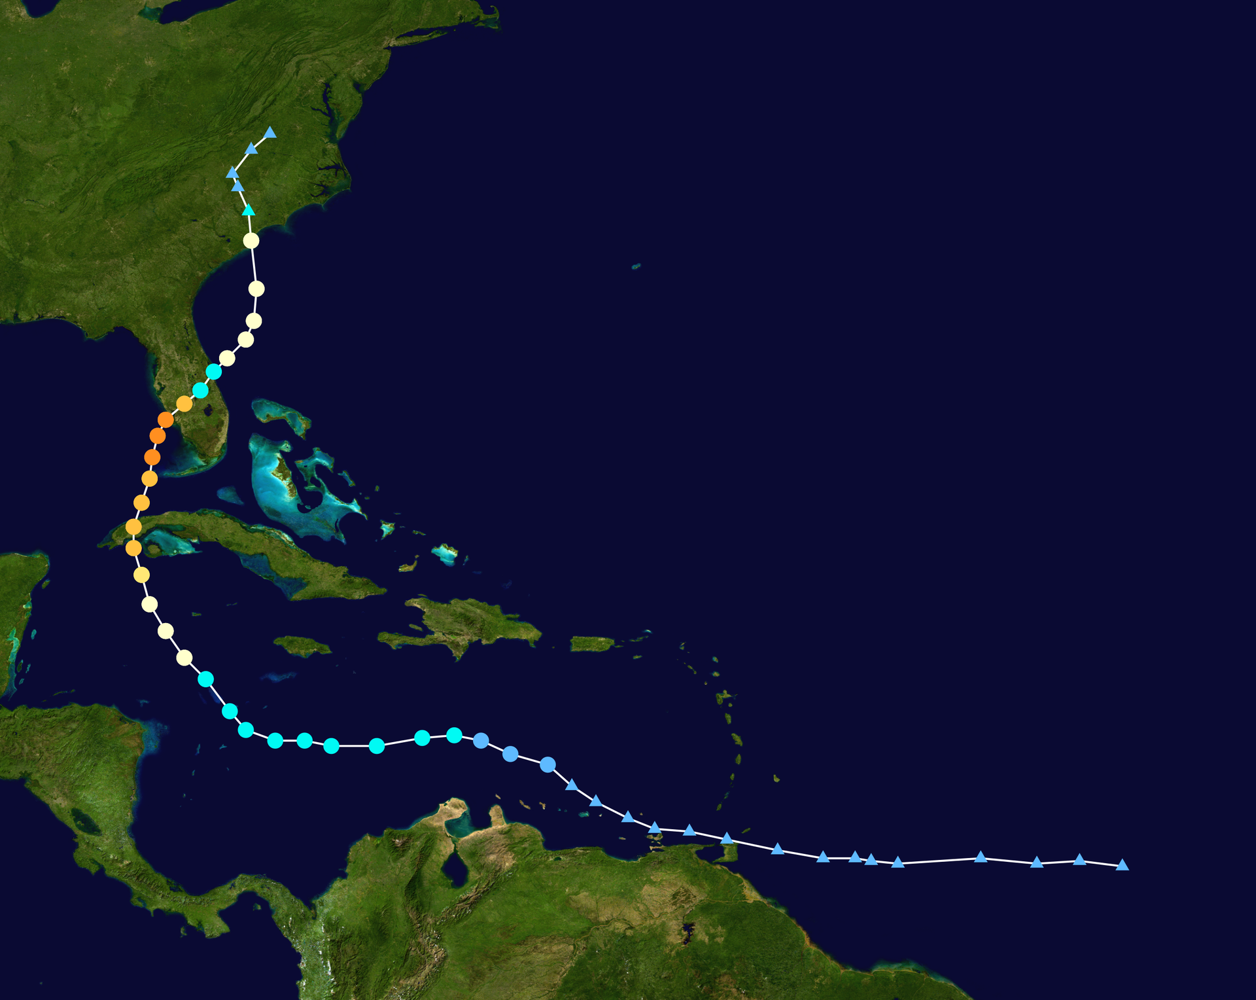
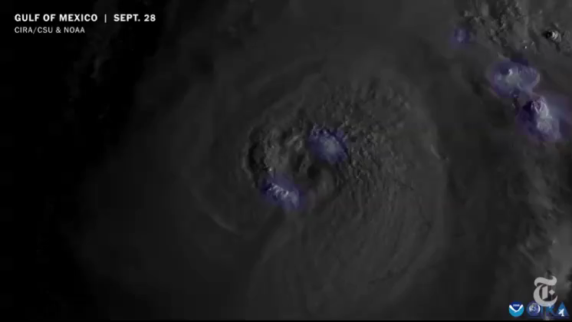
Hurricane Ian
September 23-October 2, 2022

Slide 14
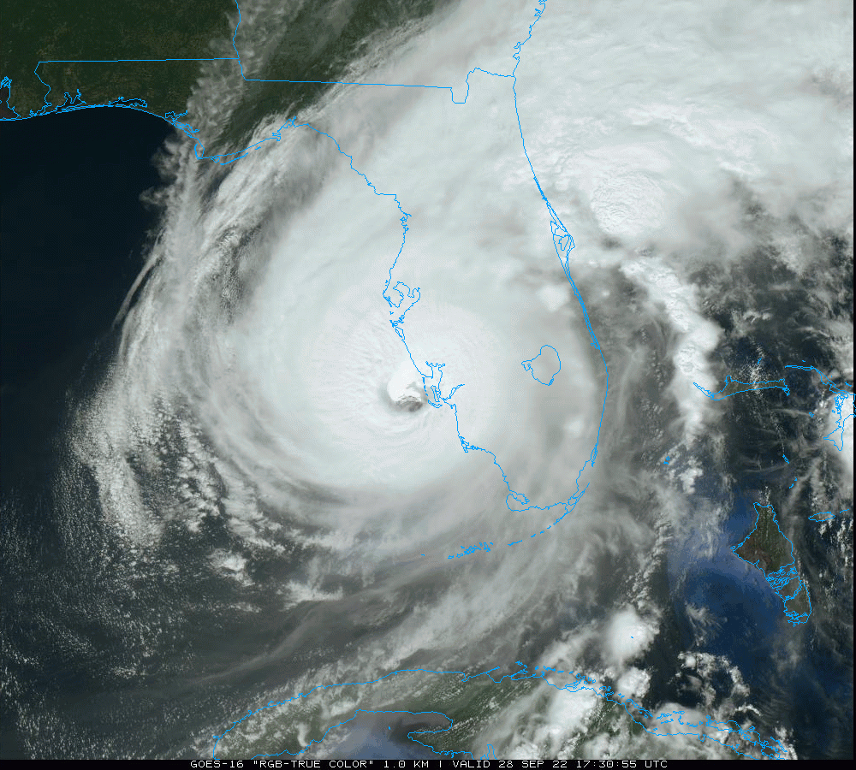

Slide 15
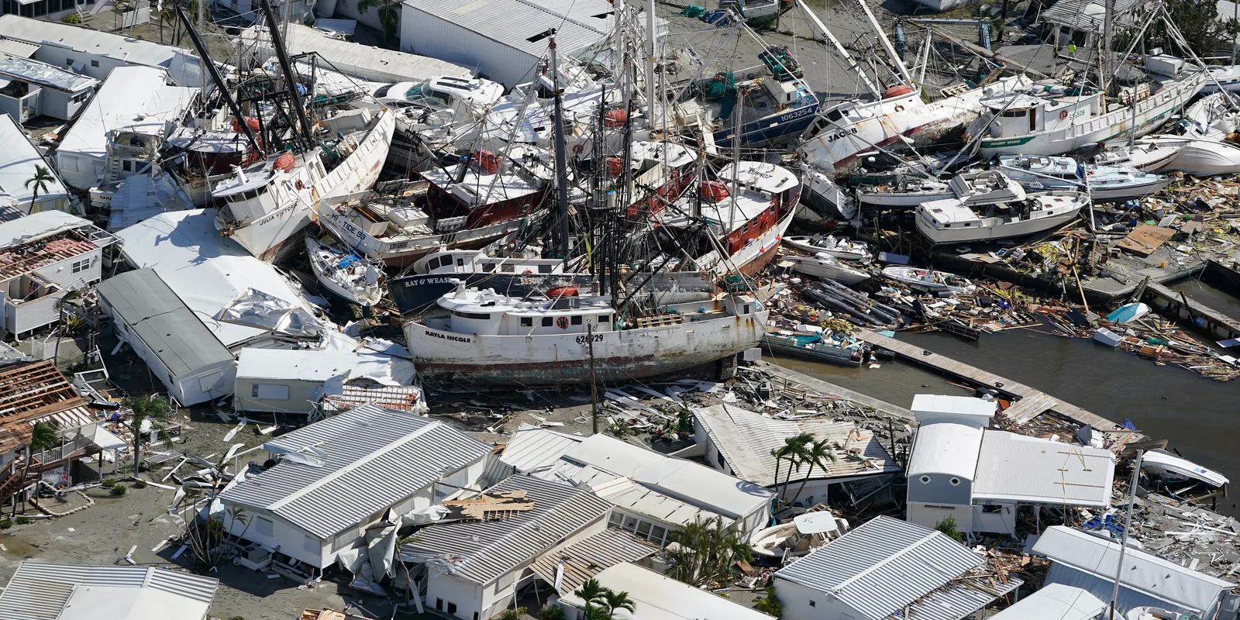

Slide 16
Paleotempestology
barrier beach
upland
overwash fan
backbarrier marsh
a)
lagoon
barrier beach
upland
overwash fan
b)
backbarrier marsh
lagoon
terminal lobes
flood tidal delta
Source: Jeff Donnelly, WHOI
Notes:
16

Slide 17
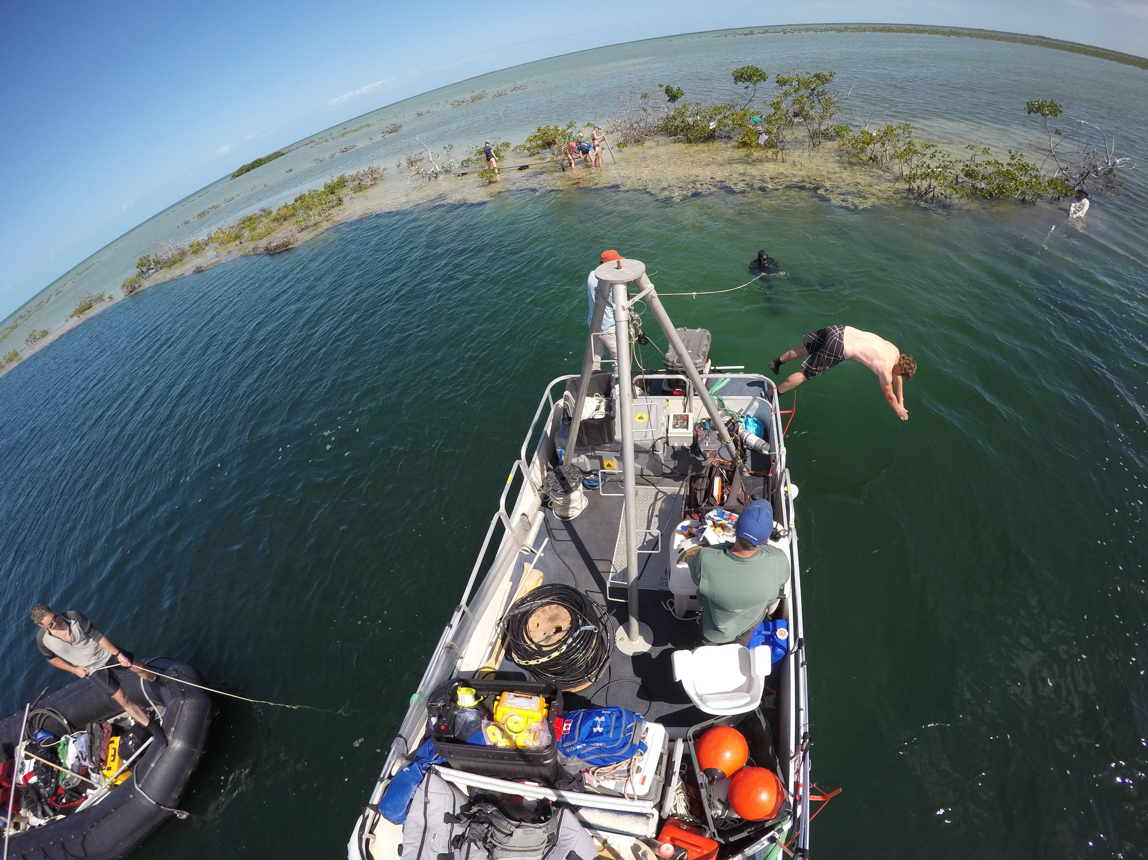
Notes:
C. Maio and R. Sullivan retrieved a core containing a record of ancient hurricane activity in Lane’s Delight Blue Hole in the Bahamas. The 12 m core spanned from the upper right of the photo with Maio holding the bottom of the core barrel to the bottom left of the photo with Sullivan’s line going into the water.

Slide 18
Sr time-series for cores NKI5 (black) and KI2 (gray), compared to b) El Niño reconstructions from Laguna Pallcocha, Ecuador (Moy et al., 2002), and c) proxy records of hurricane-induced sedimentation from Laguna Playa Grande, Vieques, Puerto Rico (Donnelly and Woodruff, 2007).
Woodruff et al., Quatern. Sci. Rev., 2009

Slide 19
Hurricane Structure and Climatology

Slide 20

The View from Space

Slide 21
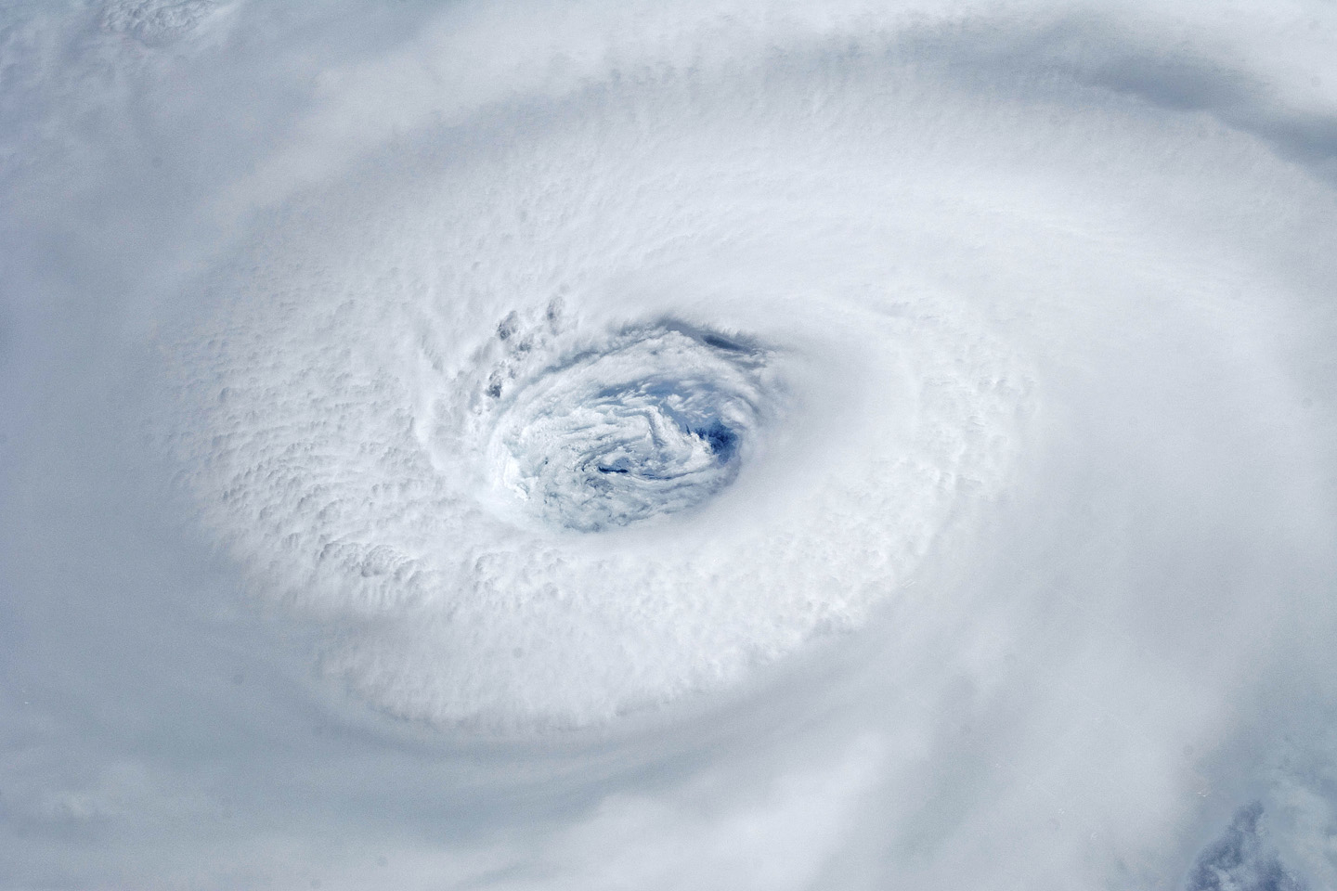
Igor, 2010
Notes:
Astronauts aboard the International Space Station took this digital photograph of the eye of Hurricane Igor at 10:56 Atlantic Daylight Time (13:56 UTC) on September 14, 2010. The storm was a category four hurricane on the Saffir-Simpson scale of intensity. At the time of the image, Igor was centered in the Atlantic Ocean near 18°N 52°W and slowly moving west-northwest at 11 kilometers (7 miles) per hour, according to the U.S. National Hurricane Center. Maximum sustained winds of 213 km (132 mi.) per hour, with gusts to 259 km (161 mi.) per hour. Credit: NASA

Slide 22


27 July 1943: Army Air Corps Colonel Joseph Duckworth took an Air Force AT-6 trainer from an airfield in Texas and became the first aviator to penetrate the eye of a hurricane.
Shortly thereafter, routine hurricane reconnaissance began in the North Atlantic and western North Pacific
AT-6

Slide 23
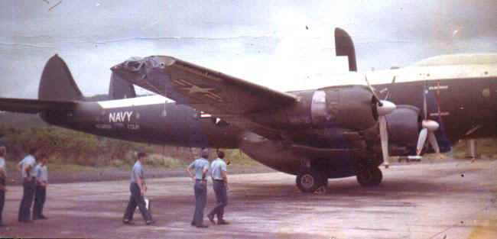
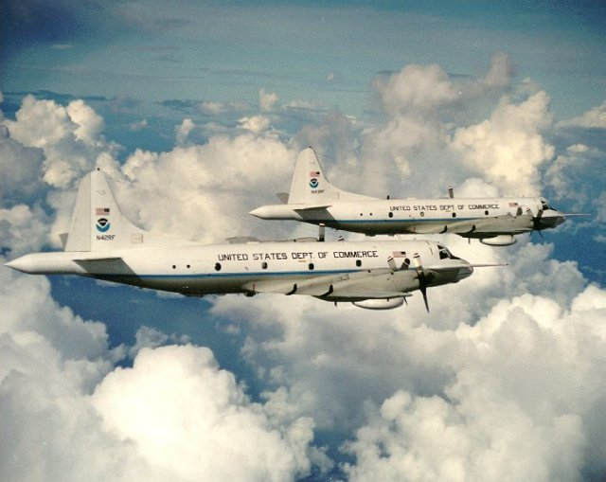
Airborne Reconnaissance
WV-2, 1964
NOAA WP-3Ds
Mid 1970s

Slide 24
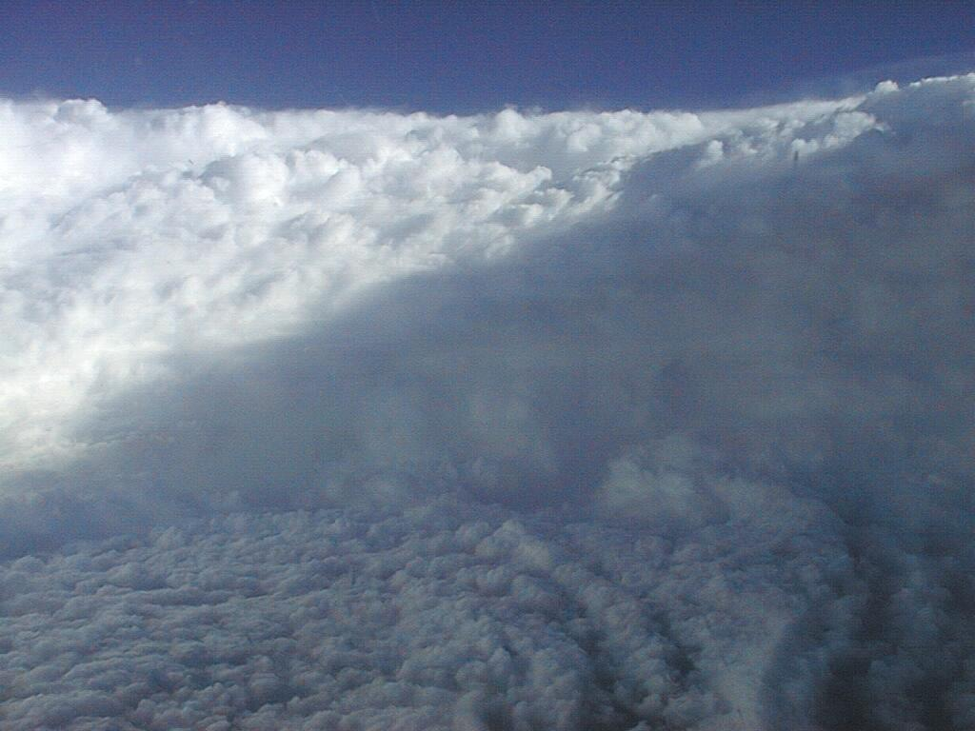

Slide 25

Eye of Hurricane Ivan

Slide 26
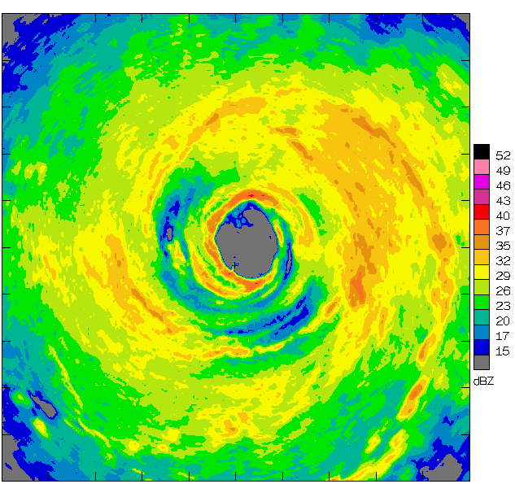
Airborne Radar: Horizontal Map
360 km
(220 mi)

Slide 27
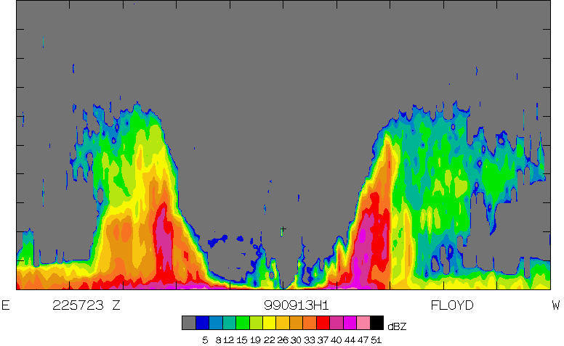
Airborne Radar: Vertical Slice
20 km
(12 mi)
120 km
(75 mi)

Slide 28
Tropical Cyclone Climatology

Slide 29
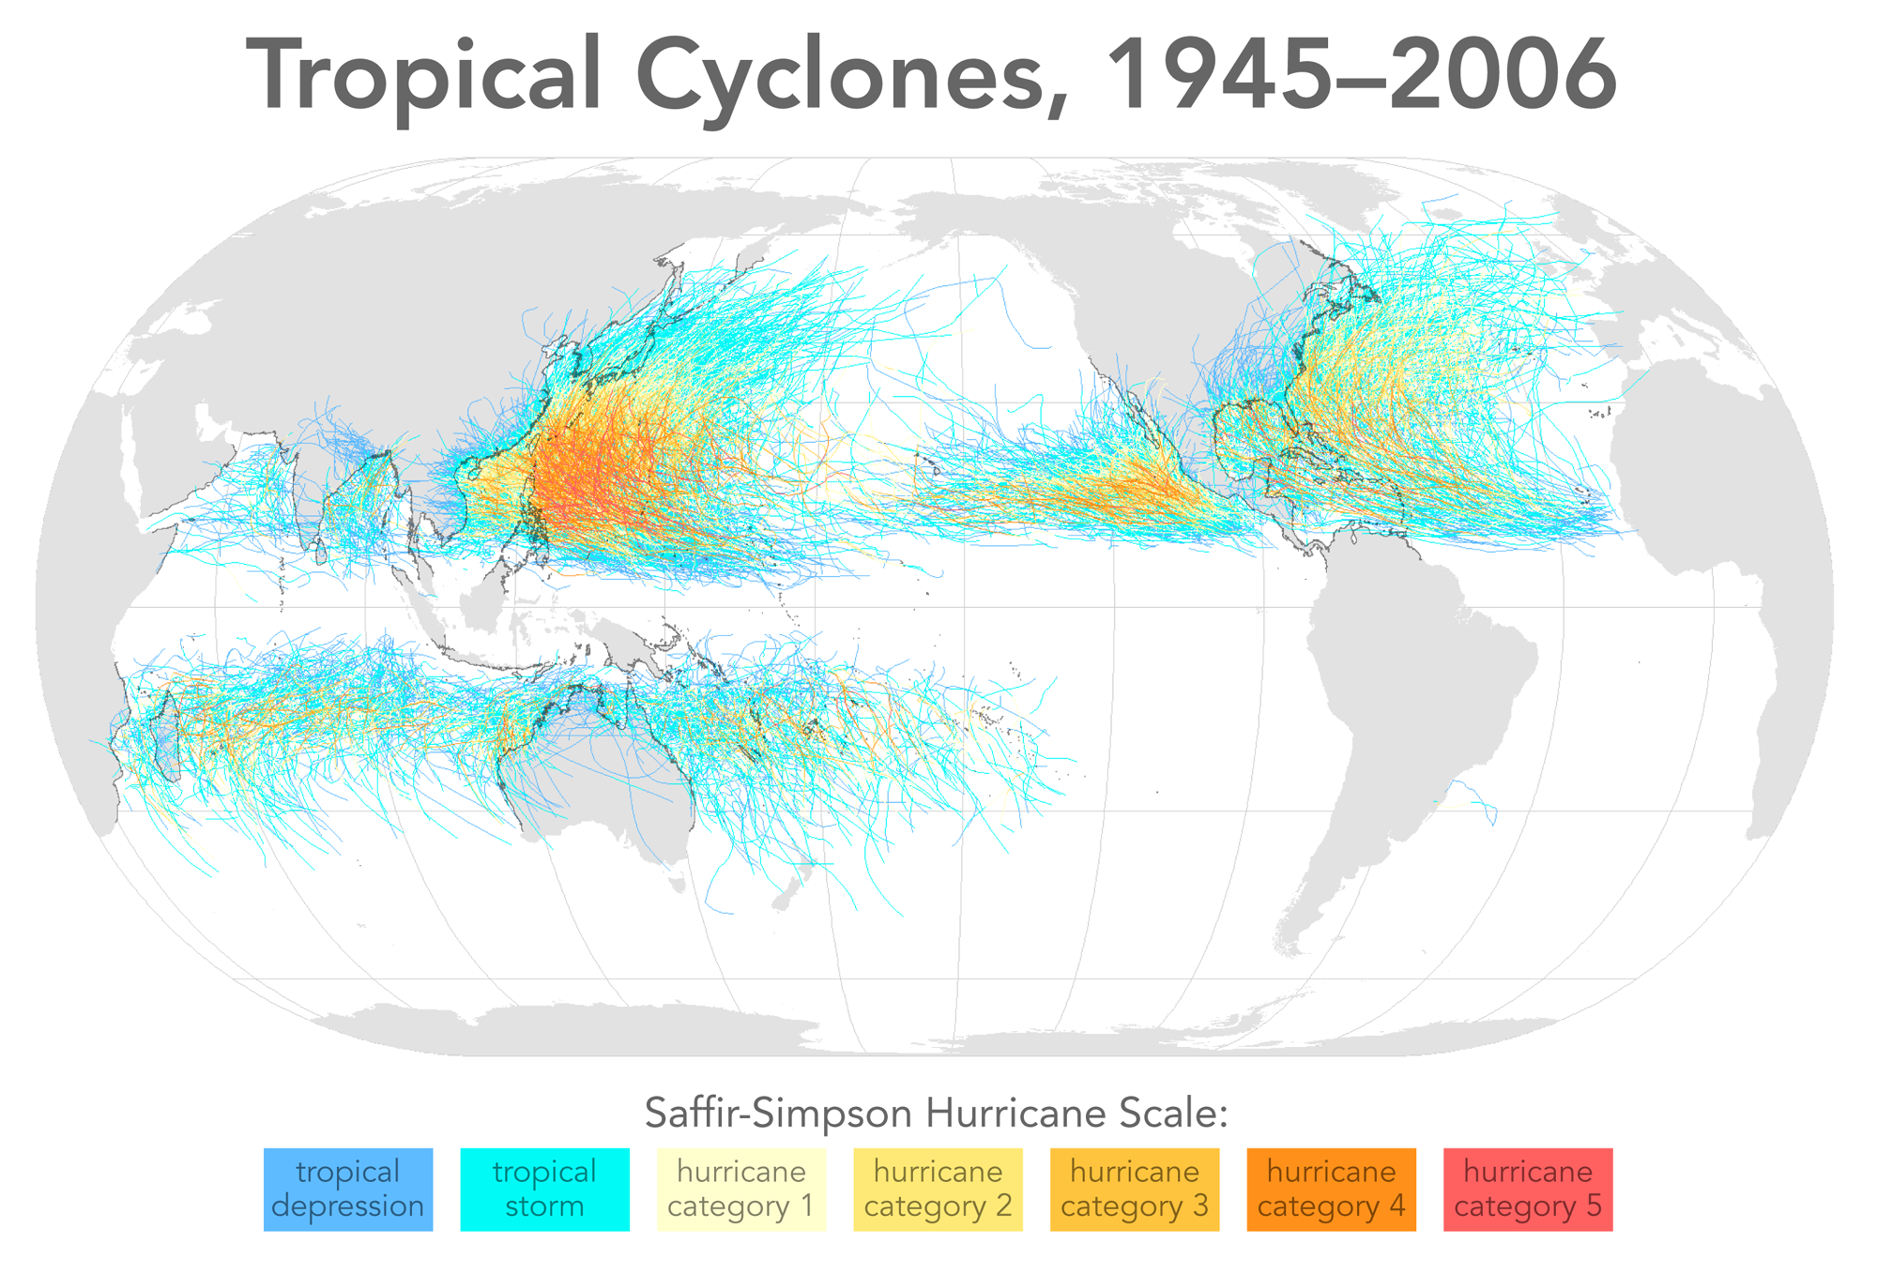

Slide 30
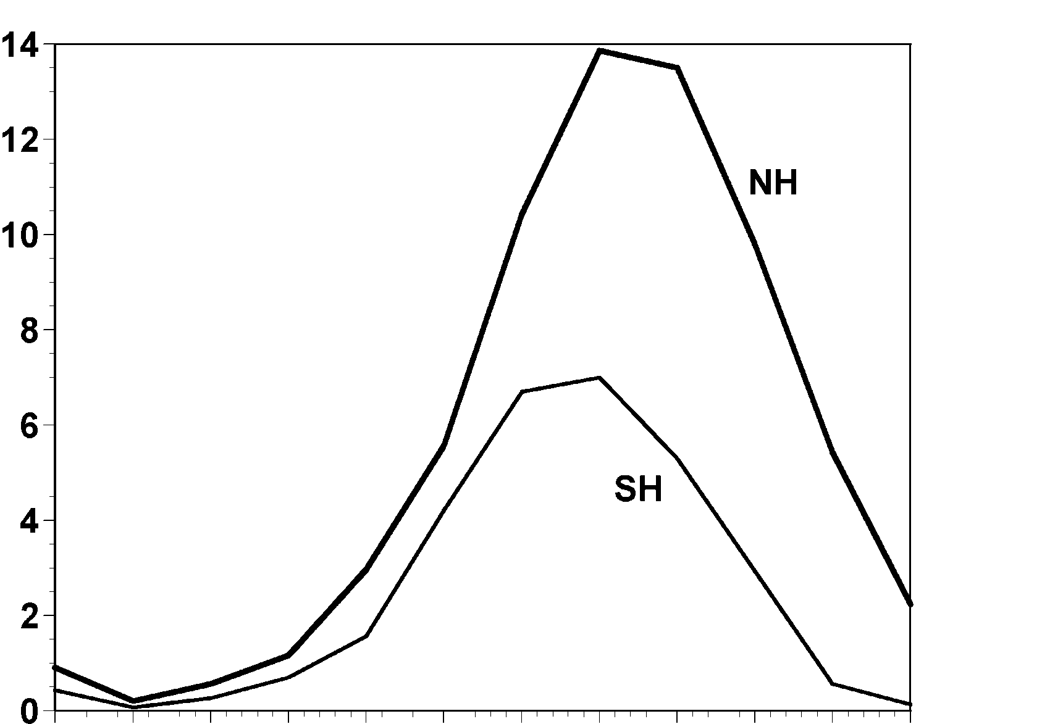
Annual Cycle of Tropical Cyclones
Number of Events per Month
a
Northern
Hemisphere
(NH)
a
Southern
Hemisphere
(SH)
Jan Feb Mar Apr May Jun Jul Aug Sep Oct Nov Dec NH
Jul Aug Sep Oct Nov Dec Jan Feb Mar Apr May Jun SH
Notes:
This graph shows the average number of tropical cyclones per month in the northern and southern hemispheres. Hurricanes tend to follow the sun, peaking in the summer and autumn and all but vanishing during the early spring. Typhoons can develop over the western North Pacific during any month of the year, but they are rare in the winter.
Image is copyrighted 2005 by Oxford University Press.
Image and description from “Divine Wind: The History and Science of Hurricanes”, Kerry Emanuel, 2005, Oxford University Press, 296 p.

Slide 31
Global records prior to ~1980 are unreliable

Slide 32
Some Tropical Cyclone Physics

Slide 33
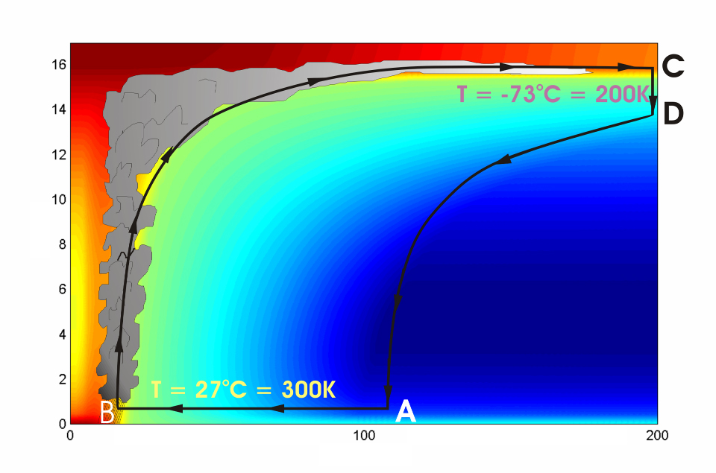




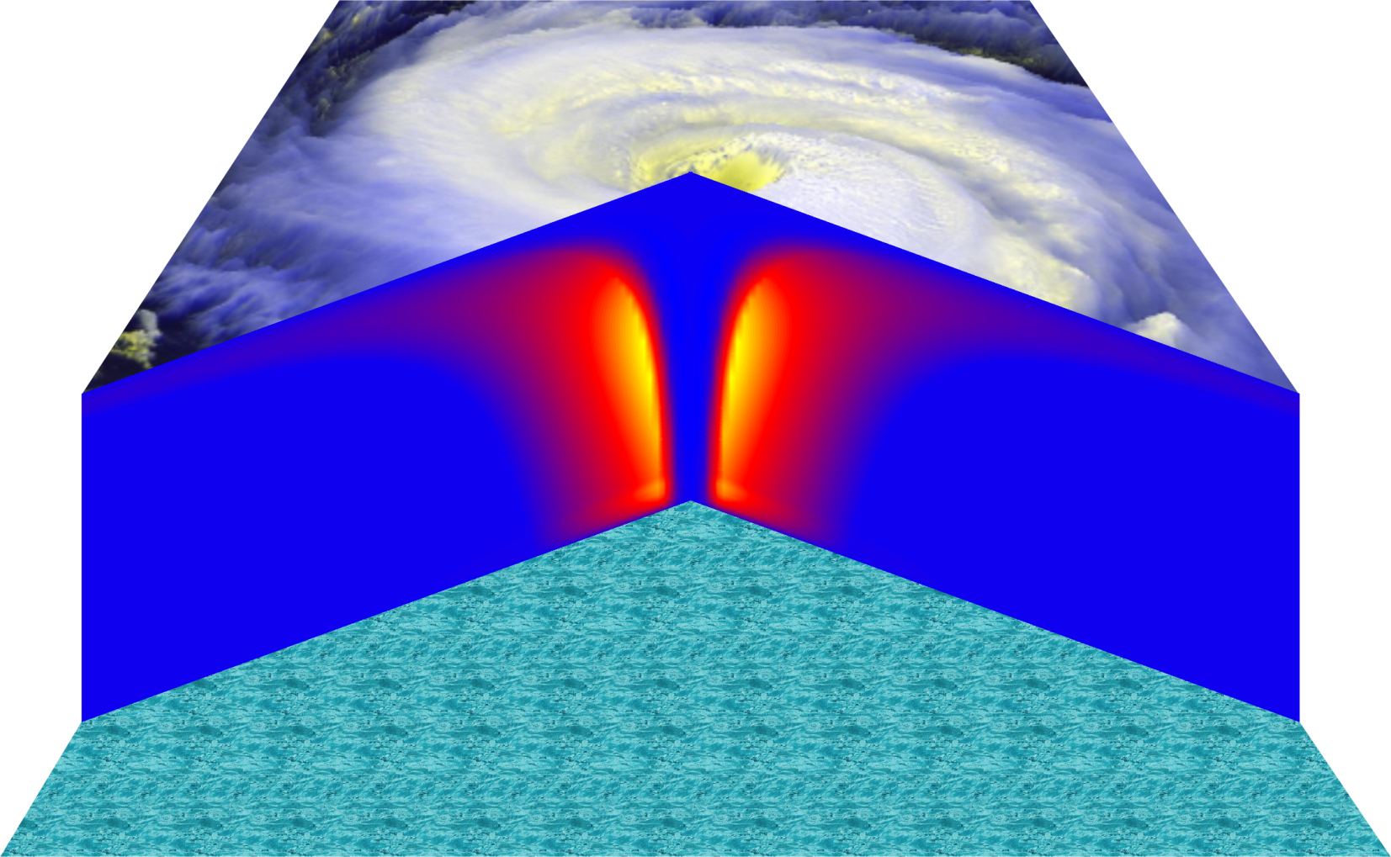
Cross-section through a Hurricane & Energy Production
eye
edge
Air loses energy
Hot air rises
Height above ocean (km)
Cooled air sinks
Low entropy (temperature)
Air spirals inward and gains energy from the ocean
Ocean surface
Radius (km)
Notes:
The energy cycle of a mature hurricane - the hurricane as a Carnot heat engine. This two-dimensional plot of the thermodynamic cycle shows a vertical cross section of the hurricane, whose storm center lies along the left edge. The colors depict the entropy distribution; cooler colors indicate lower entropy. Loosely, this means the total heat content of the air. Note that as air approaches the eyewall, its entropy increases rapidly, reflecting the large input of heat from the ocean.
Let’s follow a sample of air that begins at point A near the sea surface, a hundred kilometers or so from the storm center. The process mainly responsible for driving the storm is the evaporation of seawater, which transfers energy from sea to air. As a result of that transfer, air spirals inward close to the sea surface, between Points A and B. The storm center is an area of relatively low pressure, so the pressure on air decreases as it travels from A to B. But it is always in contact with the sea surface, which acts as an almost unlimited heat reservoir, so its temperature is approximately constant (acquiring entropy at a constant temperature). It is during this leg that enormous quantities of heat are added to the air from evaporation of seawater. Evaporation of water is a very efficient way to transfer heat from one body to another. That is why you feel cold when you are wet, especially if it is windy and/or dry: evaporation is taking heat from your body. Thus the addition of heat in leg A-B shows up mostly as an increase in humidity in the air. This form of heat is called latent heat. Evaporation of sea water into the inflowing air is by far the most important source of heat driving the hurricane, which makes leg A-B the firebox of the hurricane. When hurricanes reach land, they quickly die because they are cut off from their oceanic energy source. At point B, the air turns and flows upward through the towering cumulonimbus clouds that make up the hurricane’s eyewall. It is here that the latent heat is converted to sensible heat as water vapor condenses. But it is important to note that although there is enormous conversion between these two forms of heat, the total heat content (entropy, actually) remains approximately constant along this leg (note that the colors do not change along leg B-C). As the air flows upward, the pressure on it decreases very rapidly. What we have here is an example of adiabatic expansion. By the time the air reaches point C in the high troposphere or lower stratosphere, some 12 to 18 kilometers above the sea surface, the adiabatic expansion has lowered its temperature to a value close to that of the undisturbed upper tropical atmosphere, around -70°C or about 200 Kelvin. The air remains at approximately this temperature as it sinks down toward the tropopause (point D). Although the air is undergoing compression, it is losing heat by electromagnetic radiation to space. The depicted compression is very nearly isothermal. Finally, between D and A, the air returns to its starting point while undergoing an adiabatic compression. Voilà, the four legs of a Carnot cycle.
In a real hurricane, the energy cycle is open because hurricanes continuously exchange air with their environment.
Image is copyrighted 2005 by Oxford University Press.
Description from “Divine Wind: The History and Science of Hurricanes”, Kerry Emanuel, 2005, Oxford University Press, 296 p.
Definitions
The Carnot heat engine uses a particular thermodynamic cycle studied by Nicolas Léonard Sadi Carnot in the 1820s and expanded upon by Thomas Benoit in the 1840s and 50s. A heat engine is an engine that uses heat to produce mechanical work by carrying a working substance through a cyclic process from and for more information see http://en.wikipedia.org/wiki/Carnot_heat_engine).
Entropy is the measure of disorganization or degradation in the universe that reduces available energy, or tendency of available energy to dwindle. Chaos, opposite of order (from www.himalayasaltcrystal.com/glossary.htm).
Latent heat is the energy released or absorbed during a change of state (from www.indiaweather.in/gloss_j.asp).
Sensible heat is the heat that can be felt or sensed. The energy input which causes an increase or decrease in temperature (from www.aaronprocess.com/glossary.asp).
Adiabatic refers to changes in temperature caused by the expansion (cooling) or compression (warming) of a body of air as it rises or descends in the atmosphere, with no exchange of heat with the surrounding air (www.bbc.co.uk/weather/weatherwise/glossary/).
The troposphere is the lowest layer of the atmosphere and contains about 95 percent of the mass of air in the Earth's atmosphere. The troposphere extends from the Earth's surface up to about 10 to 15 kilometers. All weather processes take place in the troposphere. Ozone that is formed in the troposphere plays a significant role in both the greenhouse gas effect and urban smog (from ilrdss.sws.uiuc.edu/glossary/glossary_allresults.asp?glosID=T&page=5).
The Stratosphere is the layer of atmosphere that lies about 15 to 50 kilometres above the Earth's surface. In the stratosphere, the temperature rises with increasing height, which is the opposite of the situation in the lower atmosphere. Ozone occurs in minute quantities throughout the full depth of the atmosphere, but its concentration peaks within the stratosphere at an altitude of about 35 kilometres. This is referred to as the ozone layer. There is little up-and-down air movement in the stratosphere, so the ozone layer stays in position (from www.science.org.au/nova/004/004glo.htm)/
The tropopause is a boundary region in the atmosphere between the troposphere and the stratosphere (from en.wikipedia.org/wiki/Tropopause).
Electromagnetic radiation refers to energy transfer in the form of electric and magnetic waves that travel at the speed of light. Examples: light, radio waves, gamma rays, x-rays (from ie.lbl.gov/education/glossary/Glossary.htm).
Isothermal means to have equal or constant temperature with respect to either space or time (from www.4wx.com/glossary/i.php).

Slide 34
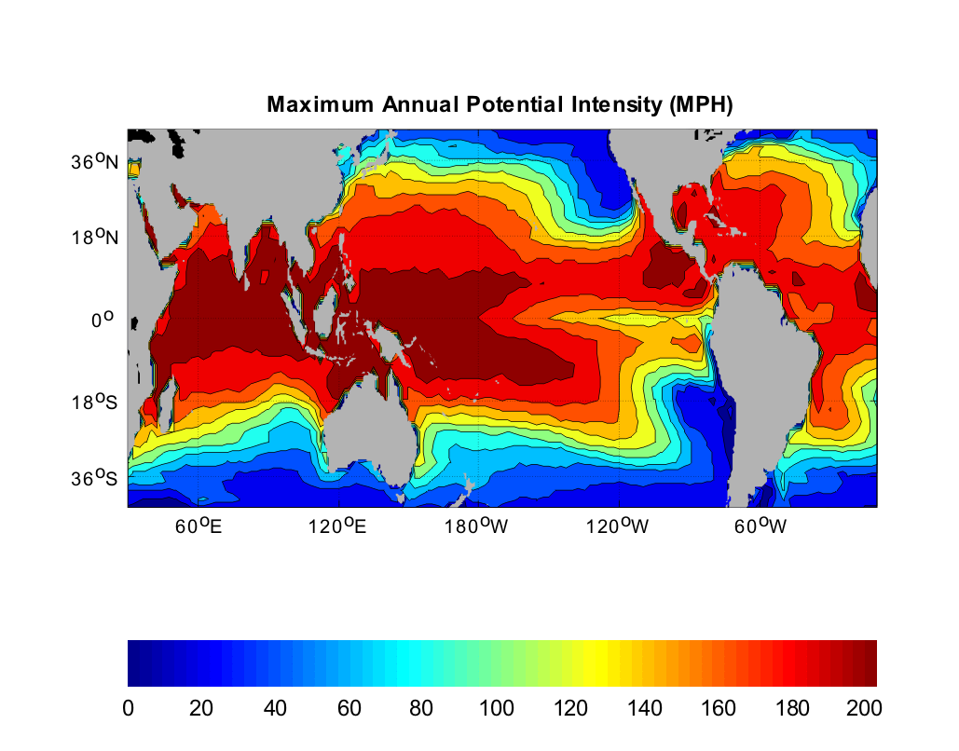
Heat Engine Theory Predicts Maximum Hurricane Winds
MPH
Notes:
34

Slide 35
The Global Hurricane Hazard
About 15,000 deaths per year since 1971
$ 1.1 trillion 2015 U.S. dollars in damages ($21 billion/yr) since 1971
Global population exposed to hurricane hazards has tripled since 1970
EM-DAT, 2020: The OFDA/CRED International Disaster Database
http://www.emdat.be/.

Slide 36
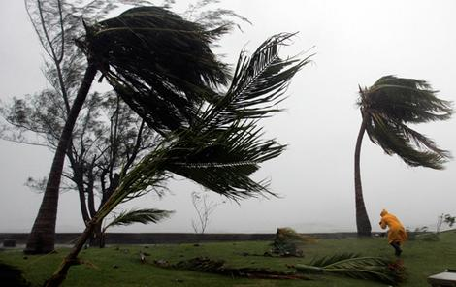
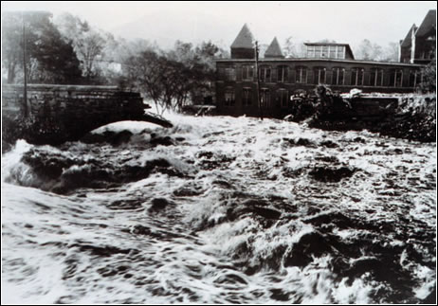
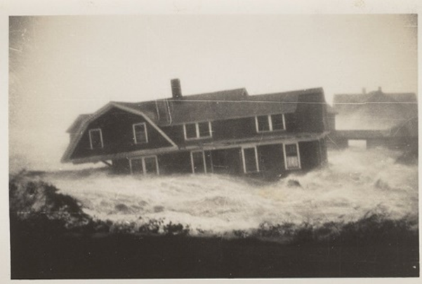

Hurricane Risks:
Wind
Rain
Storm Surge

Slide 37
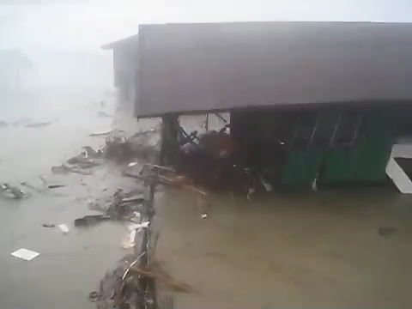

Slide 38


Slide 39
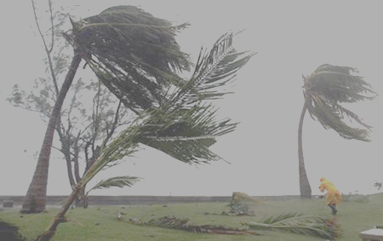
Is Hurricane Risk Changing?

Slide 40
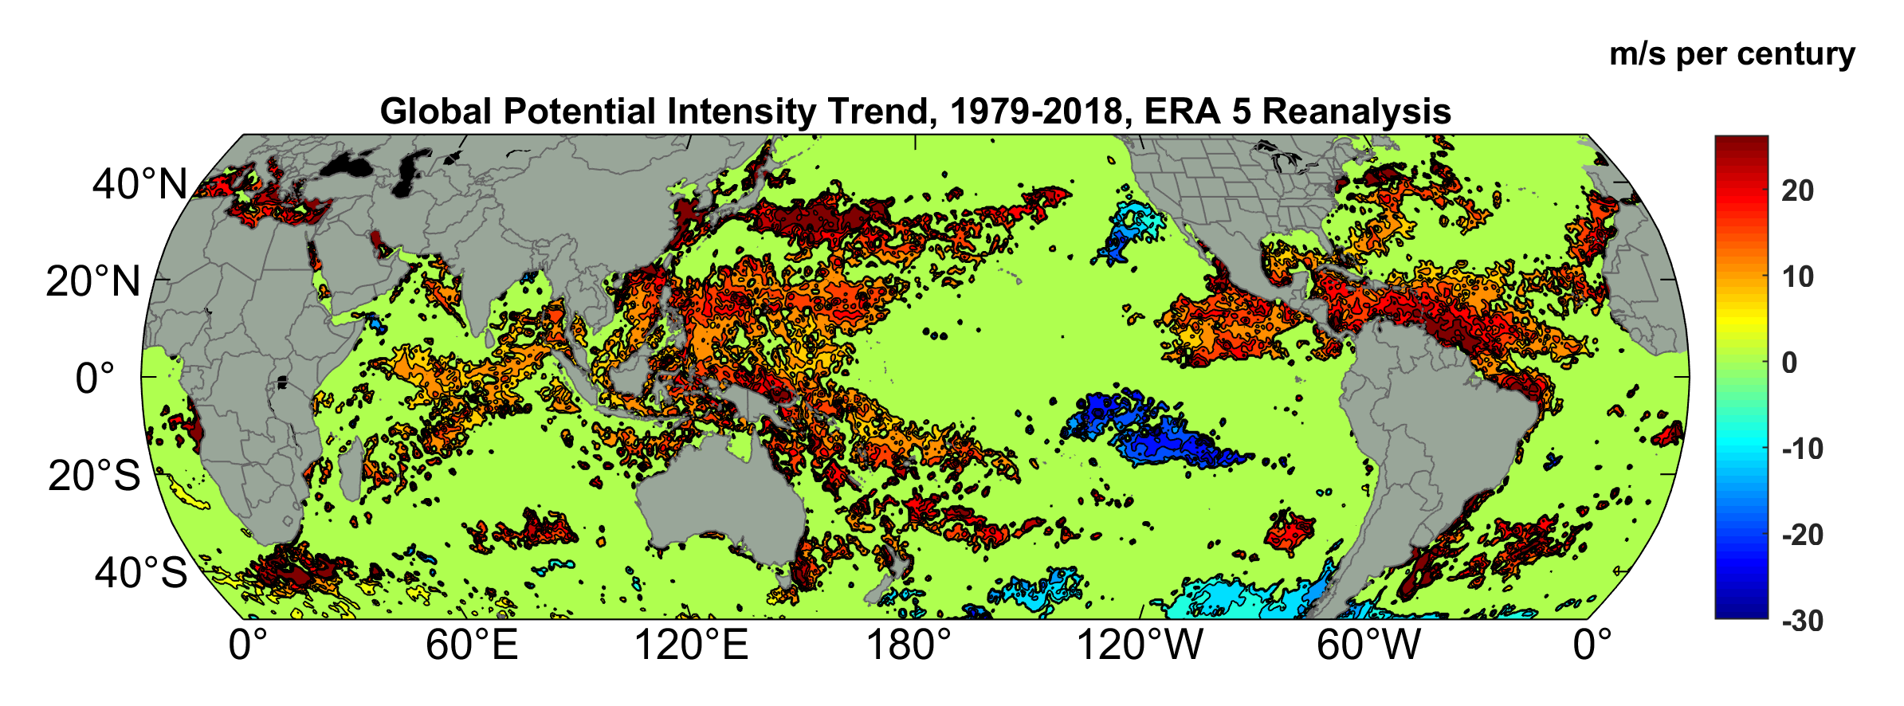
Potential Intensity Trend, 1979-2018, ERA 5 Reanalysis
(Trend shown only where p value < 0.05)

Slide 41
Satellite-derived proportion of major hurricane fixes
Time series of fractional proportion of global major hurricane estimates to all hurricane estimates for the period 1979–2017. Each point, except the earliest, represents the data in a sequence of 3-y periods. The first data point is based on only 2 y (1979 and 1981) to avoid the years with no eastern hemisphere coverage. The linear Theil−Sen trend (black line) is significant at the 98% confidence level (Mann−Kendall P value = 0.02). The proportion increases by 25% in the 39-y period (about 6% per decade).
Kossin et al., PNAS, 2020

Slide 42
Using Physical Models to Estimate Hurricane Flood Risk

Slide 43
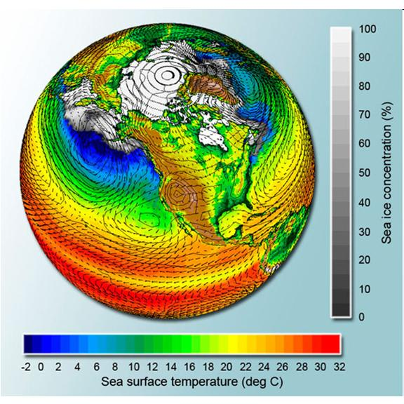
Why Not use Climate Models to Simulate Future Hurricanes?

Slide 44

Problem: Most of today’s models are too coarse to simulate destructive hurricanes
Histograms of Tropical Cyclone Intensity as Simulated by a Global Model with 30 mile grid point spacing. (Courtesy Isaac Held, GFDL)
Category 3
Modeled
Observed
Global models do not simulate the storms that cause destruction
Wind Speed (meters per second)

Slide 45
Using Physics to Assess Hurricane Risk
Reliable, global records of coarse-scale climate are robust and widely available
Cull from these datasets the key statistics known to control tropical cyclone generation, movement, and intensity evolution
Bootstrap these key statistic to create unlimited synthetic time series of the hurricane-relevant environmental variables
Use these to drive specialized, very high resolution physical hurricane models (CHIPS)
Extensively validate the results against historical hurricane data
Exact same method can be applied to output of climate models

Slide 46
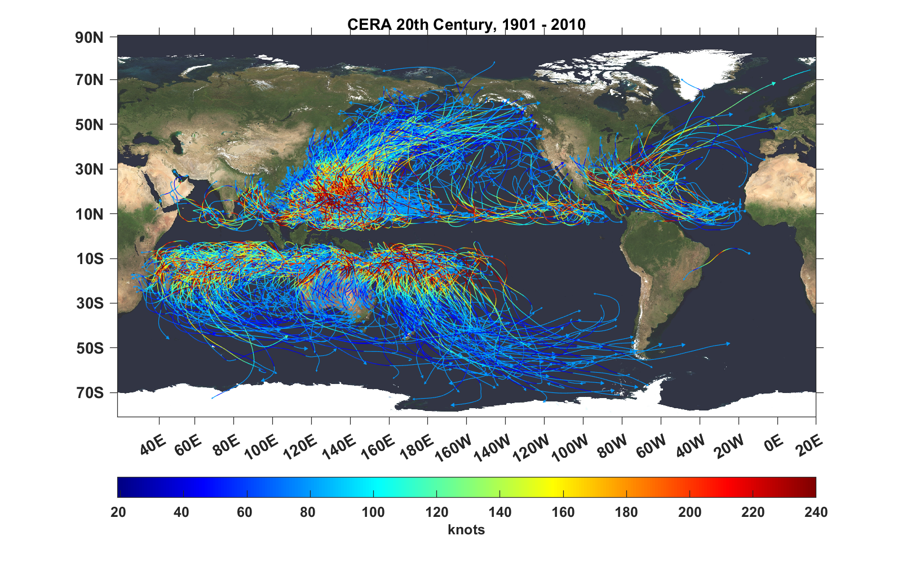
Top 1,000 storms Downscaled from CERA 29th Century Reanalysis

Slide 47
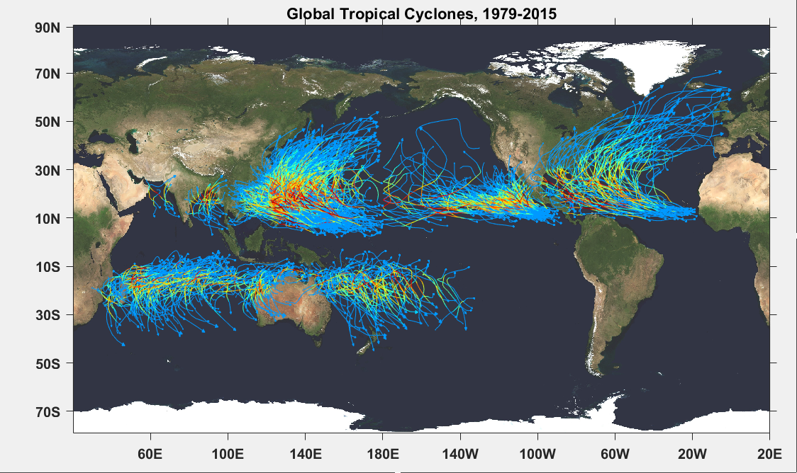

Slide 48
Atlantic Annual Cycle
Blue dots: Actual
Red line: Predicted

Slide 49
Major Atlantic Hurricanes
7-year running averages

Slide 50
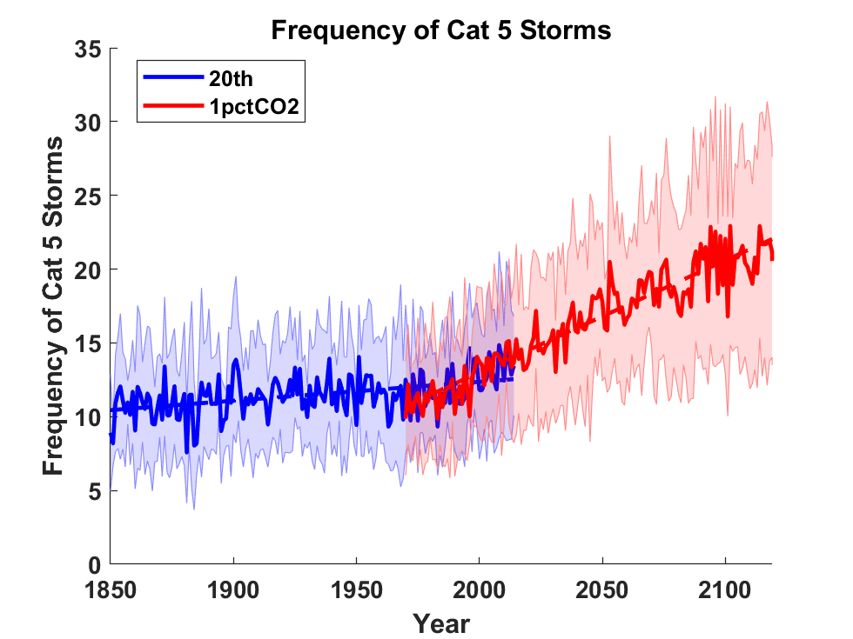
Global Tropical Cyclone Frequency from 9 Current Generation (CMIP6) Climate Models

Slide 51
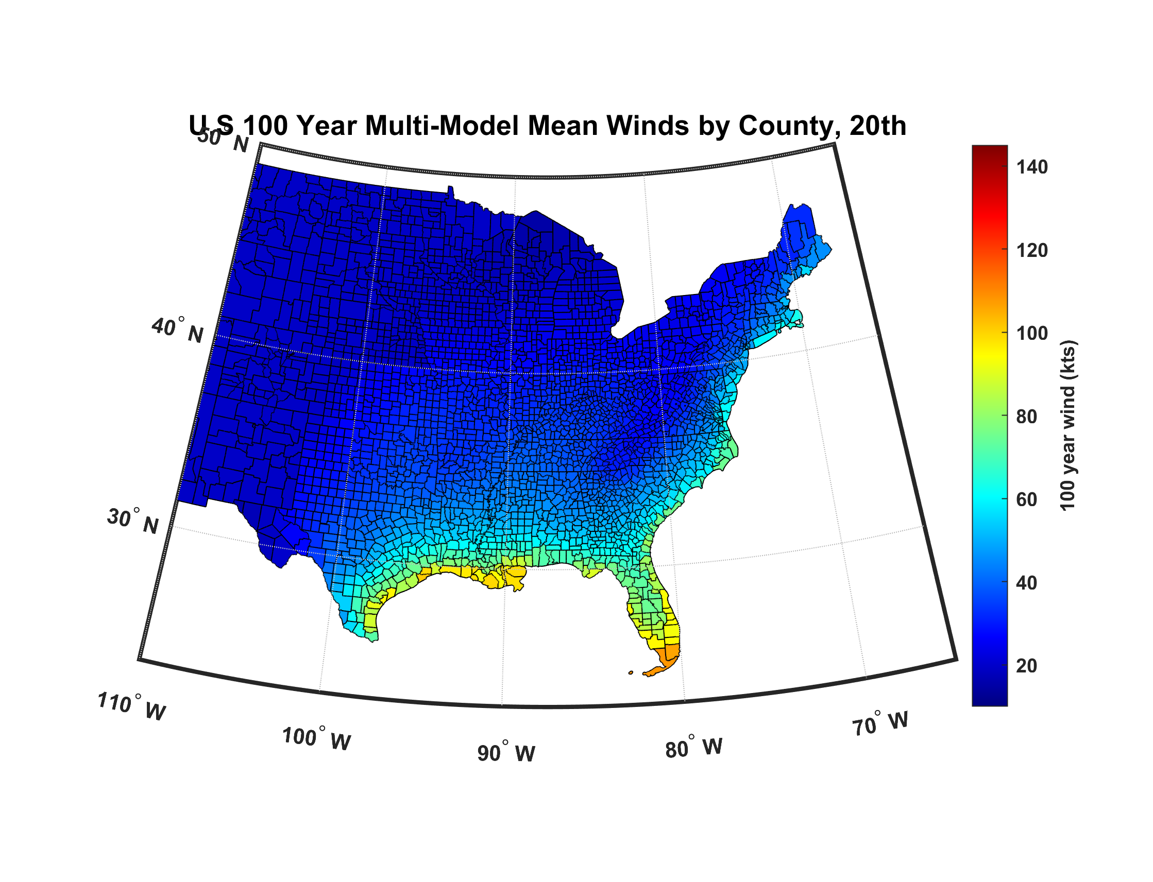

Slide 52
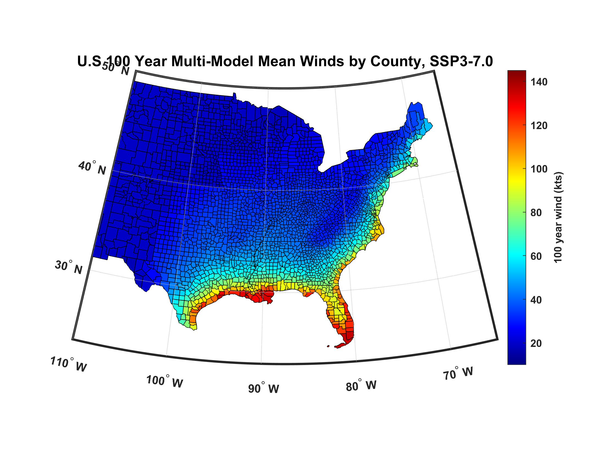

Slide 53
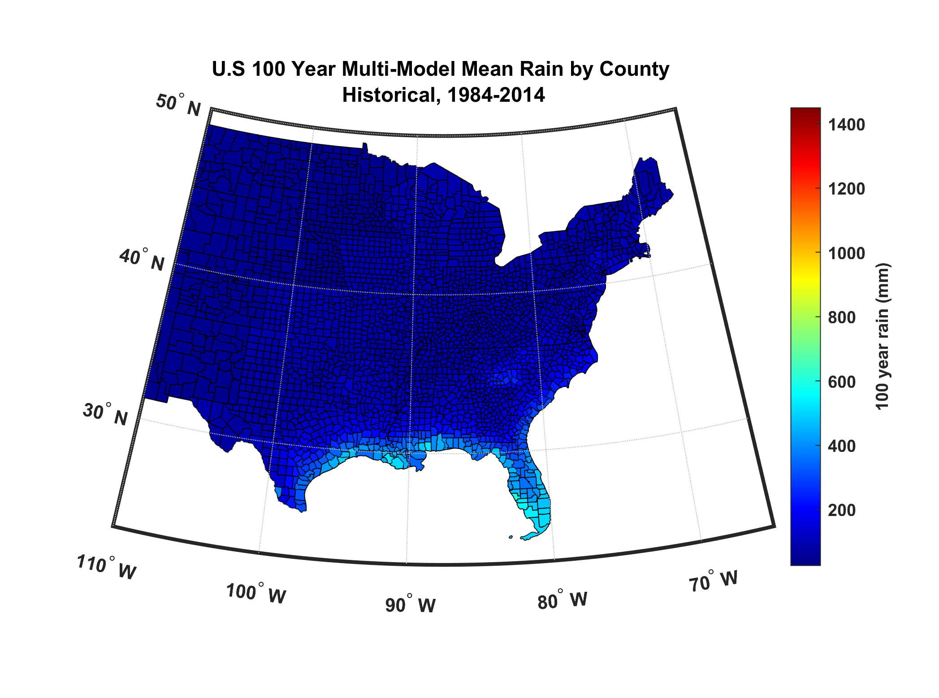

Slide 54
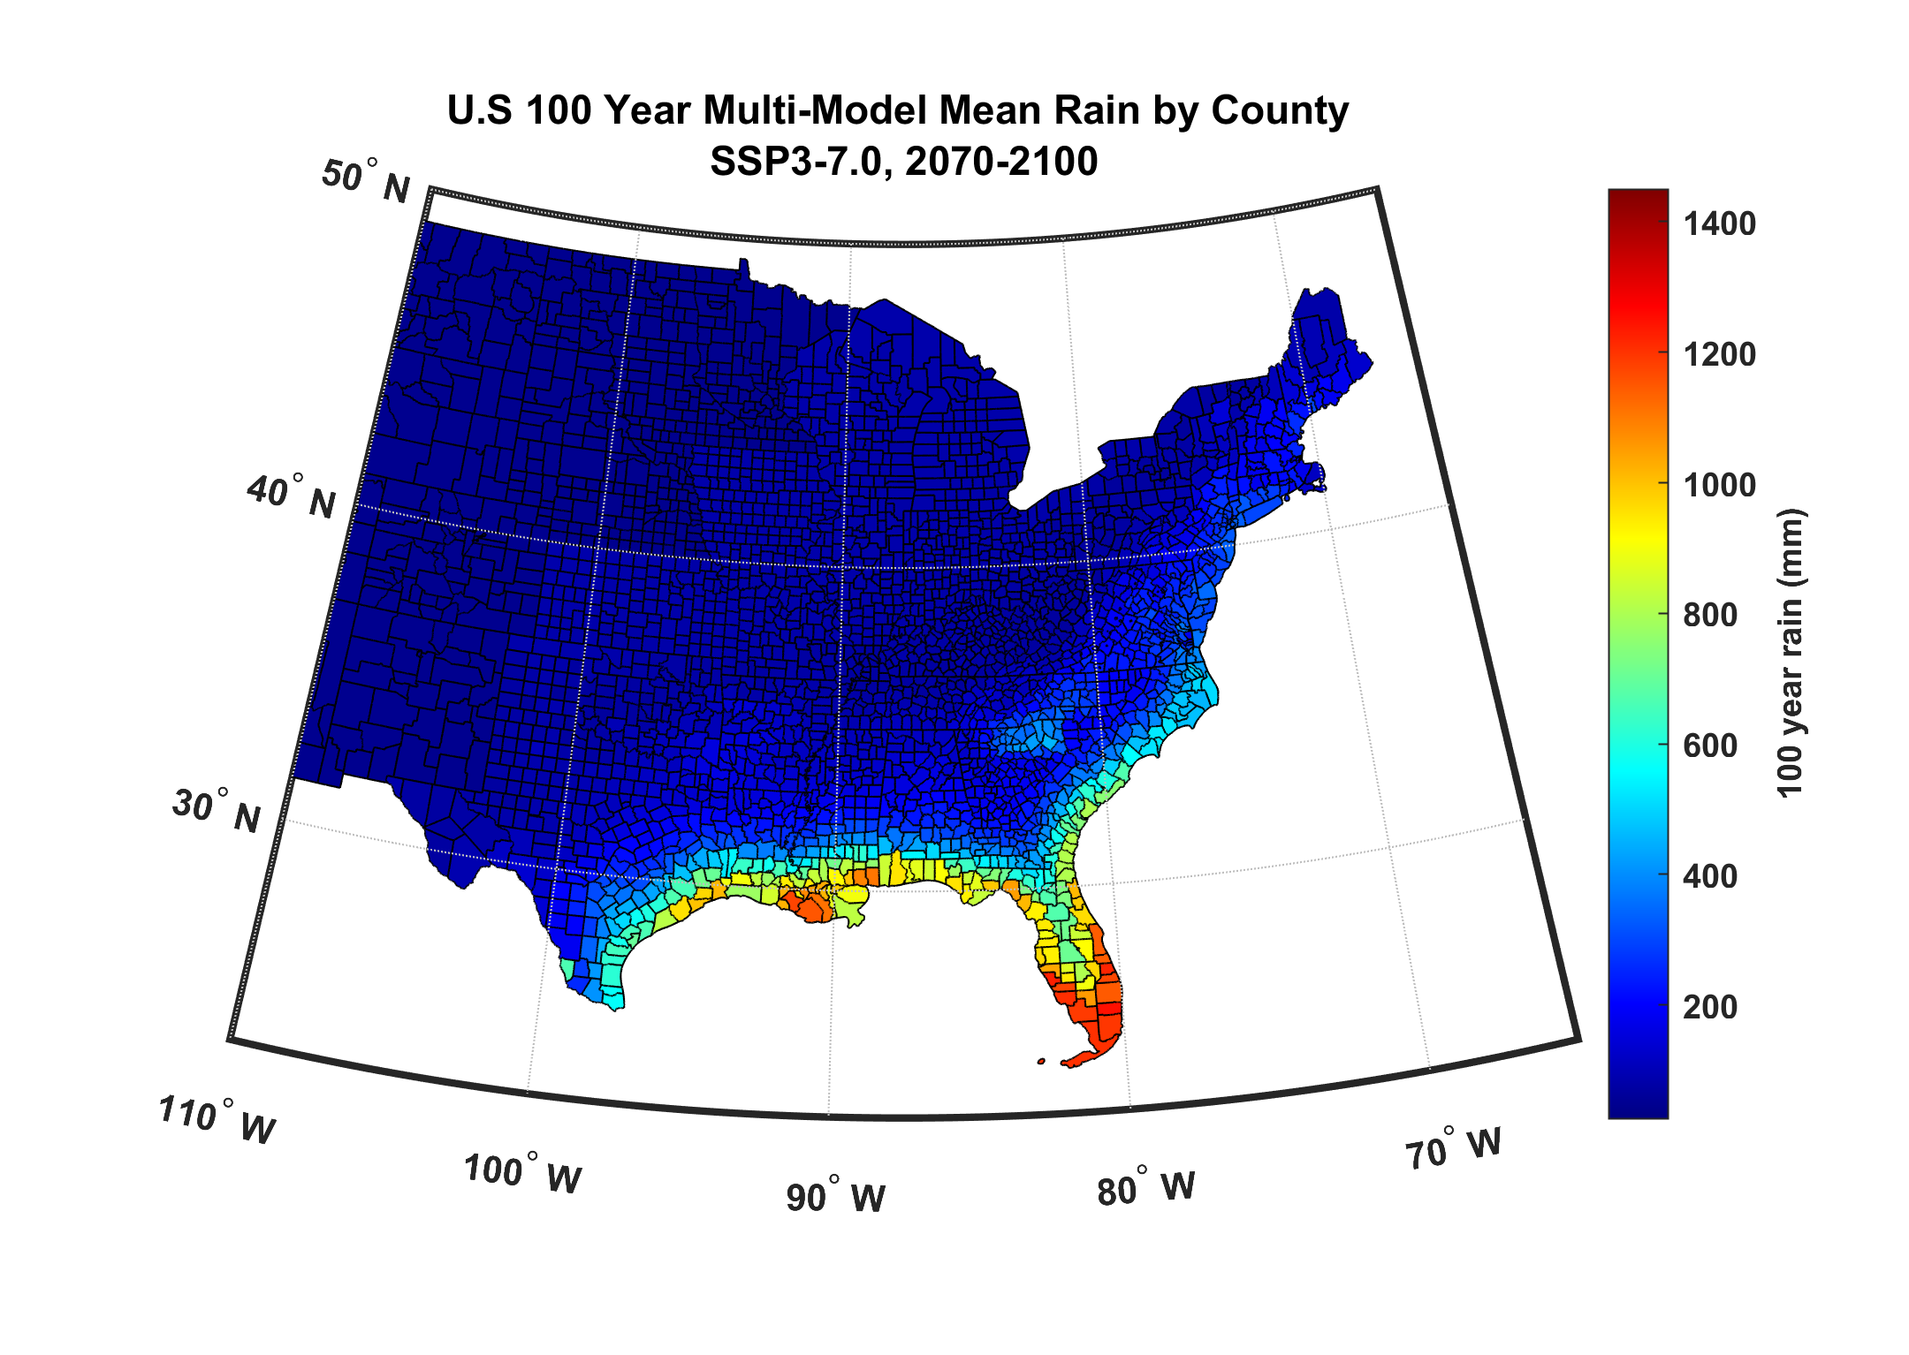

Slide 55
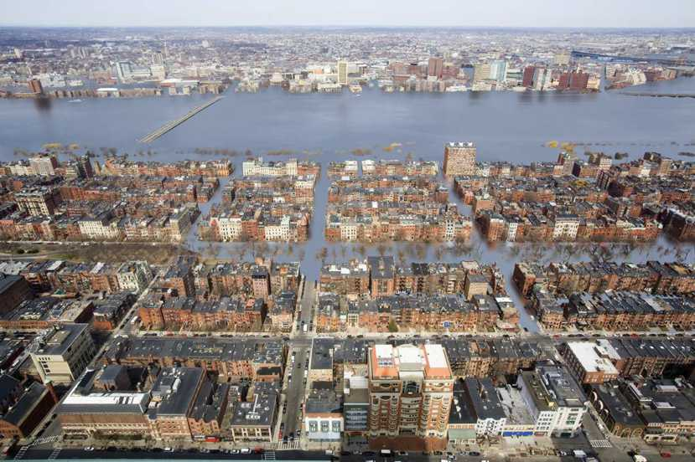
Is This in Our Future?
Combination of Hurricane Storm Surge and Freshwater Flooding

Slide 56
Summary
Hurricanes are fascinating examples of coherent storms in a turbulent atmosphere and are powered by heat flow from the oceans to the atmosphere
They have had profound effects on the course of history
While death tolls are falling because of greatly improved warning and evacuations, damages are rising sharply as more people move to the coast
Far more fatalities and damage result from water than from wind
Wind risk, and particularly flood risk are rising because of global warming

Slide 57
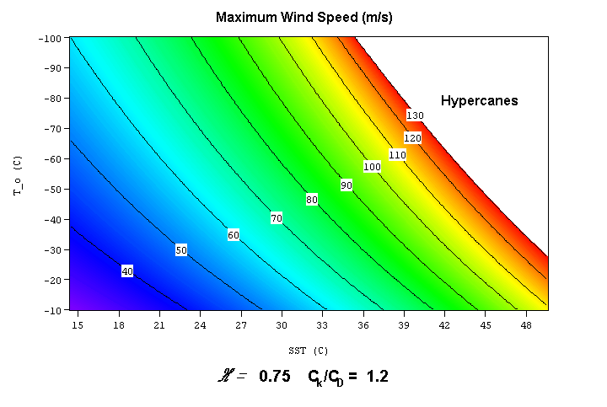

Slide 58

Eye of Hurricane Ian

