Slide 1

Statistically Robust Estimation of Climate Risks
Why we need to bring physics to bear on estimating natural hazard risk
Kerry Emanuel
Lorenz Center
Massachusetts Institute of Technology

Slide 2
Flawed Basis of Current Risk Modeling
Almost all current risk assessments are based on historical statistics
Historical records are flawed and too short (stay tuned)
Moreover, the past 50-150 years is a poor guide to the present owing to climate change that has already occurred
We need to bring physics to bear on weather hazard risk
Risk modelers have been slow to migrate to a physics-based approach
Risk modeling industry is being challenged by non-profits and start-ups
Government and the insurance industry should accelerate this transition
Climate researchers are getting more involved in physical modeling of risk

Slide 3
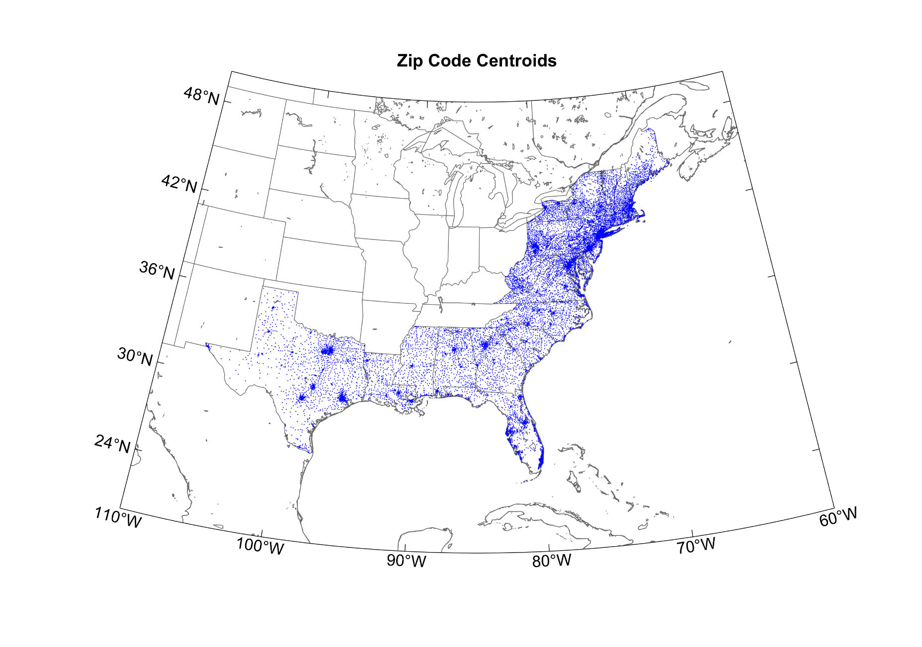
The Nature of the Beast
Start with total insured values (TIVs) of one commercial and two residential property insurance firms aggregated over zip codes
Net TIV: ~$ 2 trillion
12,968 zip codes

Slide 4
Procedure
Apply a set of 49,600 synthetic tropical cyclones making landfall in the continental U.S.
These have been generated using a physical model applied to the present climate (technique to be described shortly)
At each centroid, calculate the peak wind generated by each event and apply a damage function that estimates the fraction of property value destroyed
Using insured value, calculate loss at each zip code and sum over all zip codes
From the set of 49,600 storms create many 1,000 year time series of loss by randomly drawing from a Poisson distribution based on the annual frequency of landfalling tropical cyclones each year
This illustration is for a stationary climate but the same idea can be applied to evolving climate states

Slide 5
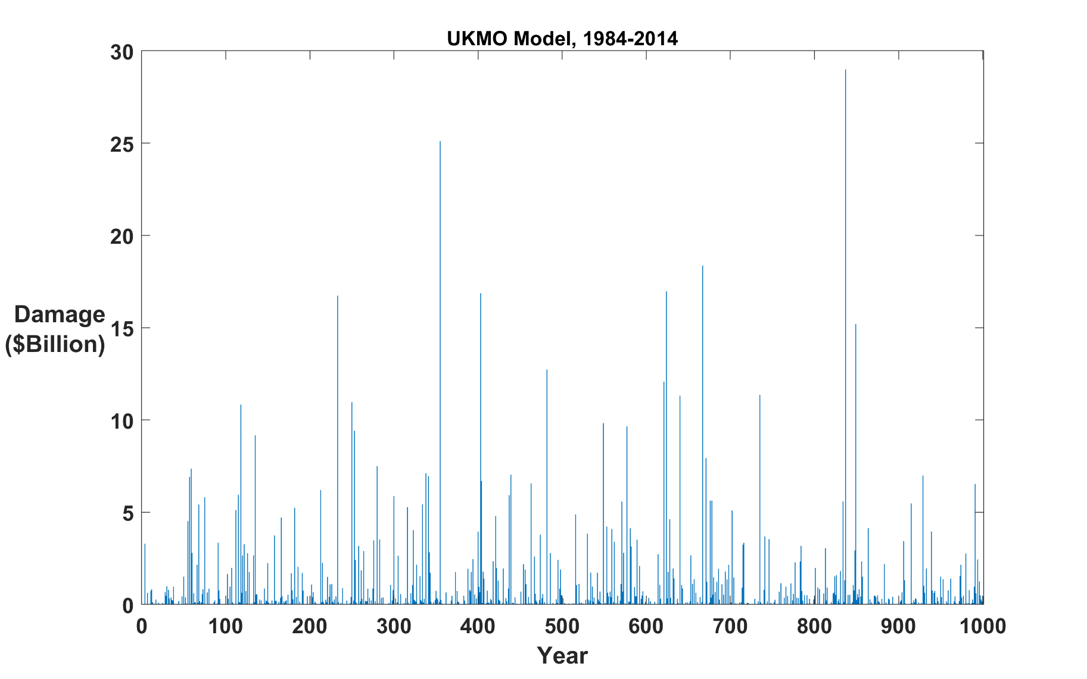
Example:
Question: Can we estimate average annual loss (AAL) from 50-100 years of record?
Answer: Good luck with that!

Slide 6
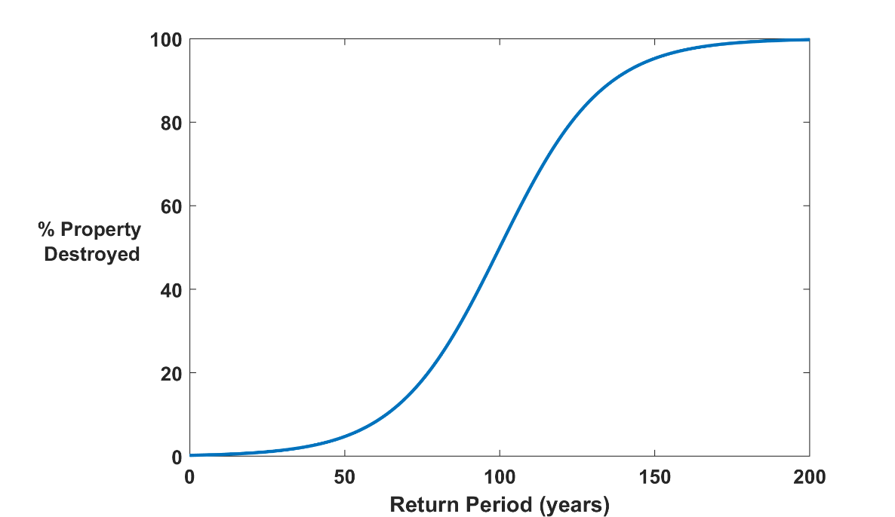

Why Climate Risk is Dominated by Extreme Events:
Societies are usually well adapted to frequent events (> 1/100 yr)
Societies are often poorly adapted to rare events (< 1/100 yr)
Large cost increases result when > 100-yr events become < 100-yr events
Largest slope

Slide 7
Historical Records
Most extreme weather events: ~< 100 years of good records (U.S.)
Even if we had 1000 years of great records, the past is no longer a good guide to the present
We need to turn to physical models to get better estimates of current (and future) weather risks

Slide 8
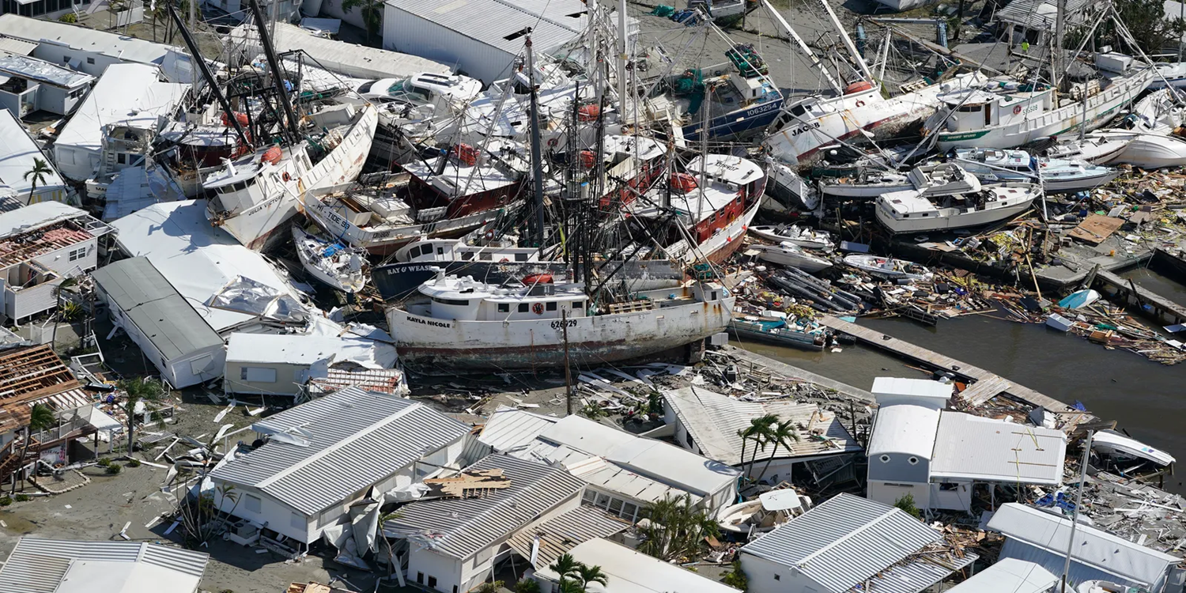
How can we bring physical modeling to bear on weather risk assessment?

Slide 9
Doing it right:
Bring Physical Models to Bear on Risk Estimation.
Example: Numerical Weather Prediction
Satellite Image
Global Model

Slide 10
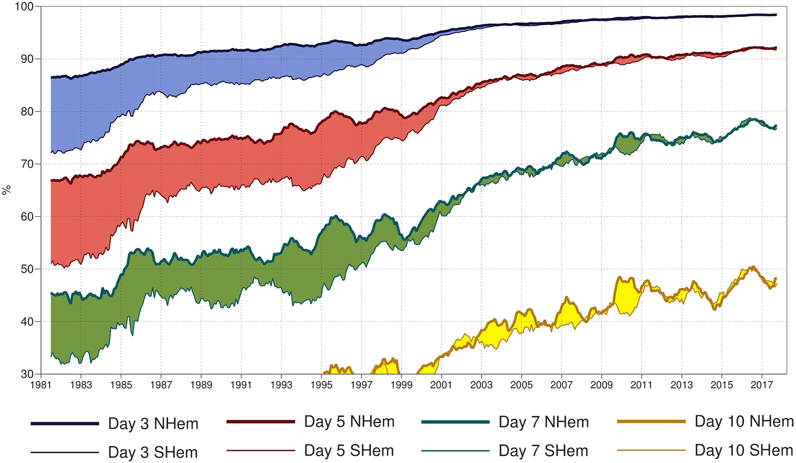
7-day forecast today about as accurate as 3-day forecast in 1980
A measure of the skill of numerical weather prediction models

Slide 11
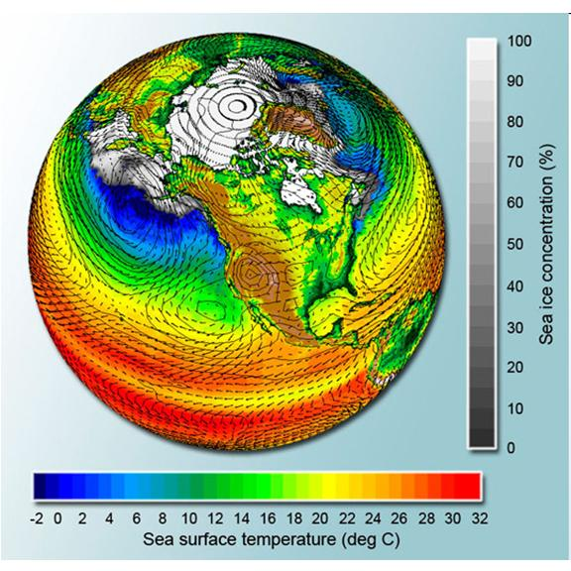
Global climate models have been developed to simulate global and regional climate

Slide 12

Problem: Today’s models are far too coarse to simulate destructive hurricanes
Histograms of Tropical Cyclone Intensity as Simulated by a Global Model with 50 km grid point spacing. (Courtesy Isaac Held, GFDL)
Category 3
Modeled
Observed
Global models do not simulate the storms that cause destruction
Wind Speed (meters per second)
Detailed, high-resolution modeling suggests grid spacing of no more than 3 km required
HighResMip: Grid spacings of 20-200 km (NICAM has short run at 14 km)
We need high resolution and O(1000 yr) simulations

Slide 13
Using Physics to Assess Hurricane Risk
(Downscaling)
Reliable, global records of coarse-scale climate are robust and widely available
Cull from these datasets the key statistics known to control tropical cyclone generation, movement, and intensity evolution
Bootstrap these key statistic to create unlimited synthetic time series of the hurricane-relevant environmental variables
Use these to drive specialized, very high resolution physical hurricane models (algorithms for solving governing equations)
Extensively evaluate the results against historical hurricane data
Exact same method can be applied to output of climate models

Slide 14

Hazard Risk Model Details:
Step 1: Seed each ocean basin with a very large number of weak, randomly located cyclones
Step 2: Cyclones are assumed to move with the large- scale atmospheric flow in which they are embedded, plus a correction for the earth’s rotation and sphericity (beta-drift)
Step 3: Run the detailed hurricane intensity model for each cyclone, and note how many achieve at least tropical storm strength (Model is phrased in angular momentum coordinates. Flow-dependent resolution)
Step 4: Using the small fraction of surviving events, determine storm statistics. Can easily generate 100,000 events
Details: Emanuel et al., Bull. Amer. Meteor. Soc, 2008
Notes:
14

Slide 15
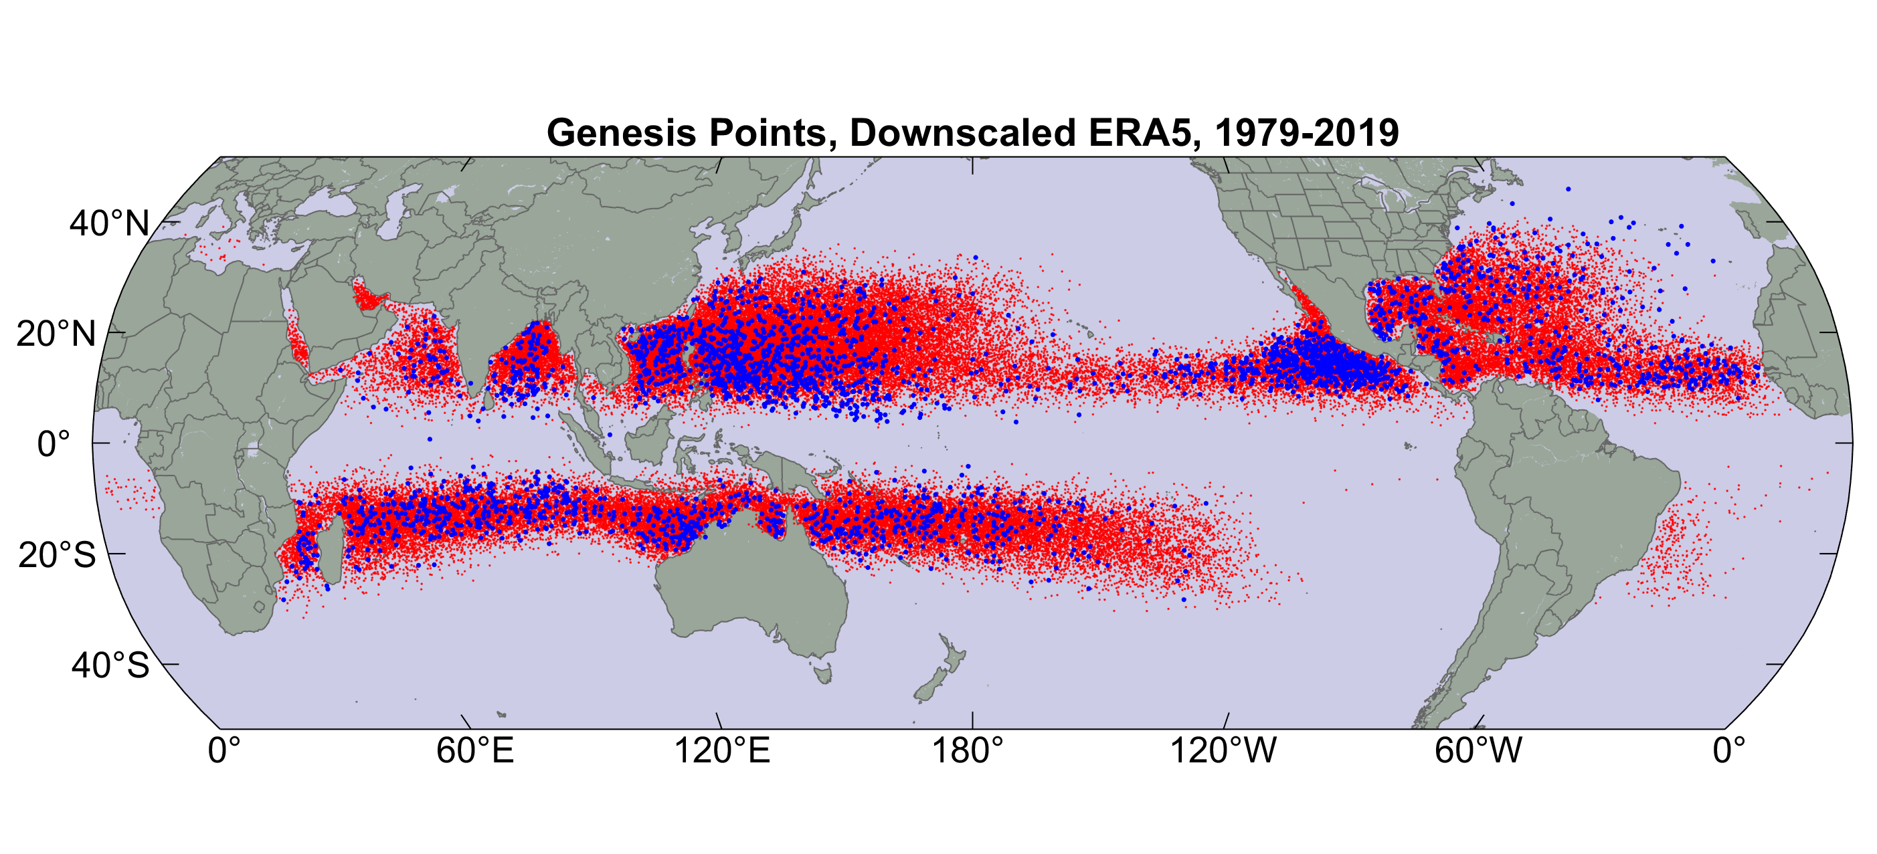
Origin points of successful seeds (red); observed genesis locations (blue)

Slide 16
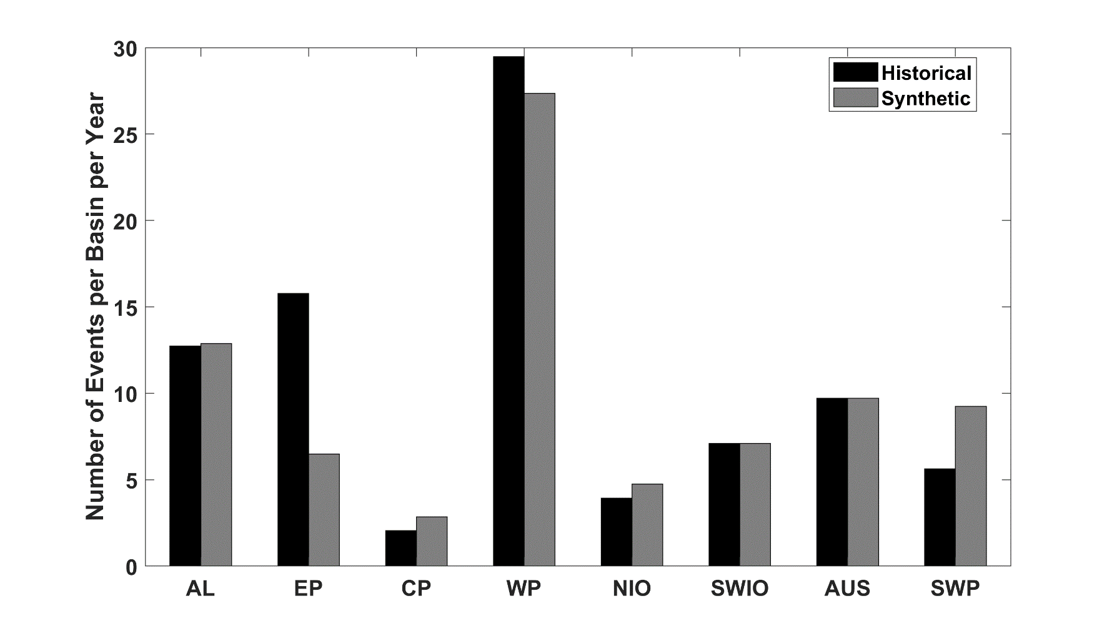
Average annual number of tropical cyclones over the period 1980-2020 in observations (IBTrACS; Knapp et al. 2010; black bars) and from random seeding of ERA-5 (gray bars)

Slide 17
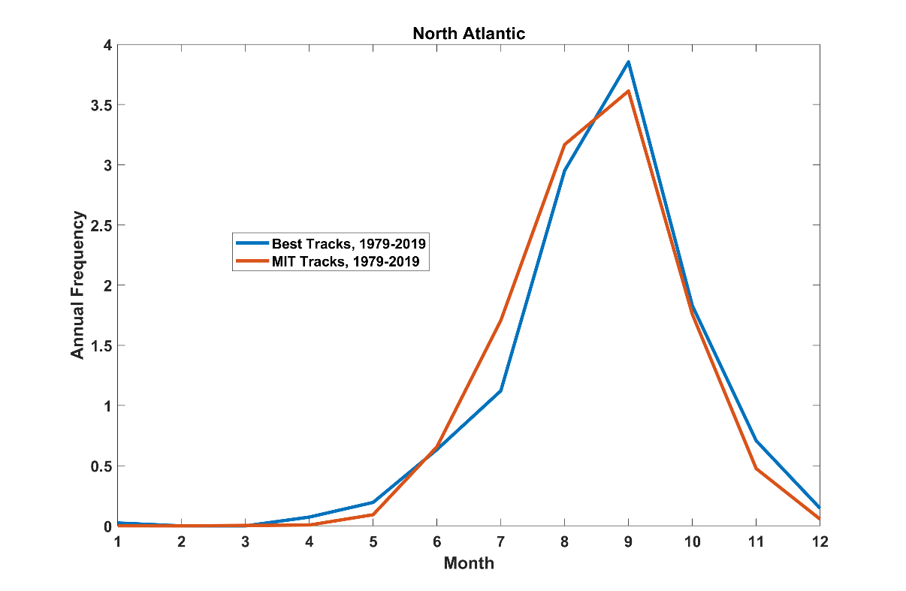
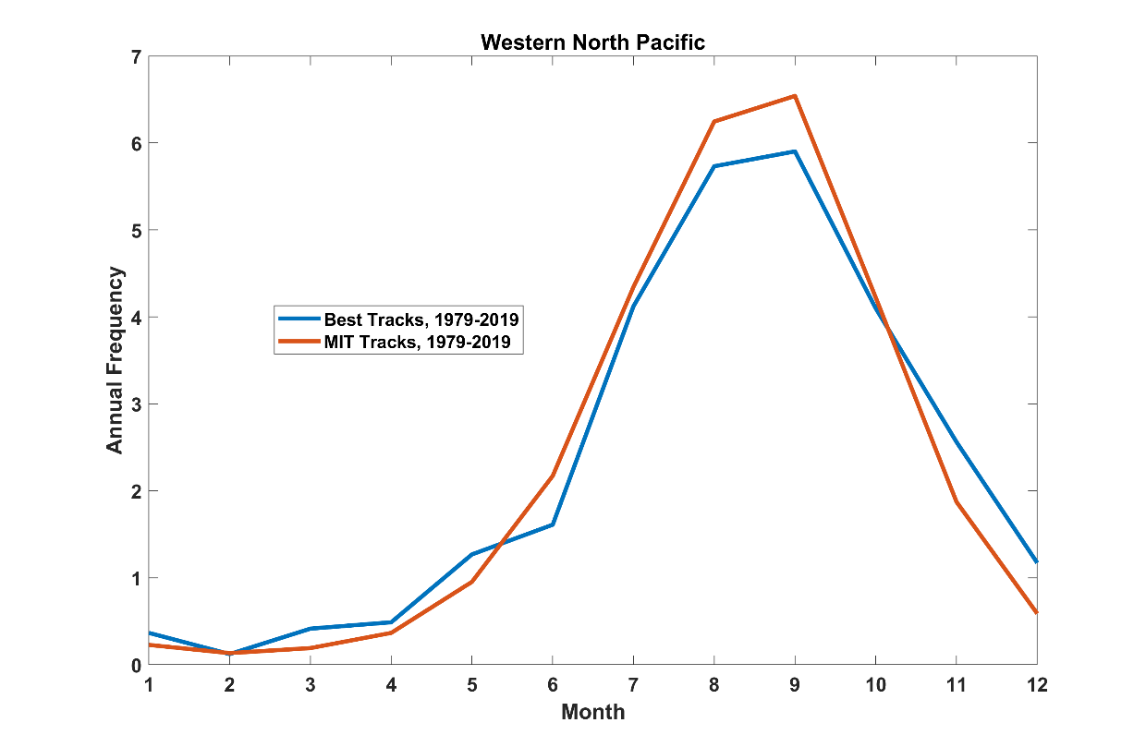
Seasonal Cycle
North Atlantic
Seasonal Cycle
Northwest Pacific

Slide 18

Cumulative Distribution of Storm Lifetime Peak Wind Speed, with Sample of 1755 Synthetic Tracks
Blue bars: Actual
Red bars: Predicted
90% confidence bounds

Slide 19
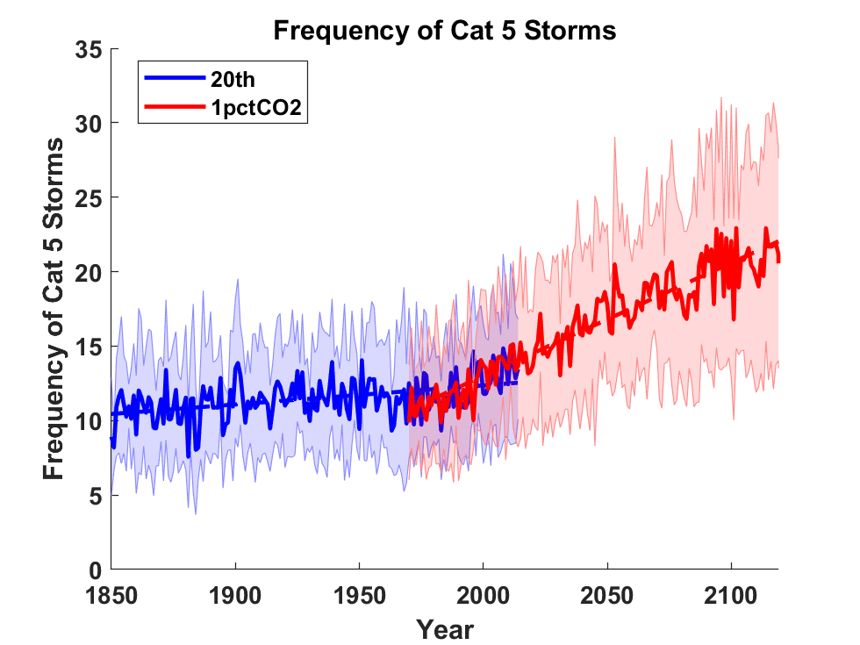
Application to Global Climate Change Simulations:
Global CAT 5 Tropical Cyclone Frequency from 8 Current Generation (CMIP6) Climate Models

Slide 20

Damage to an Insurance Portfolio
Start with total insured values (TIVs) of one commercial and two residential property insurance firms aggregated over zip codes
Net TIV: ~$ 2 trillion
12,968 zip codes

Slide 21
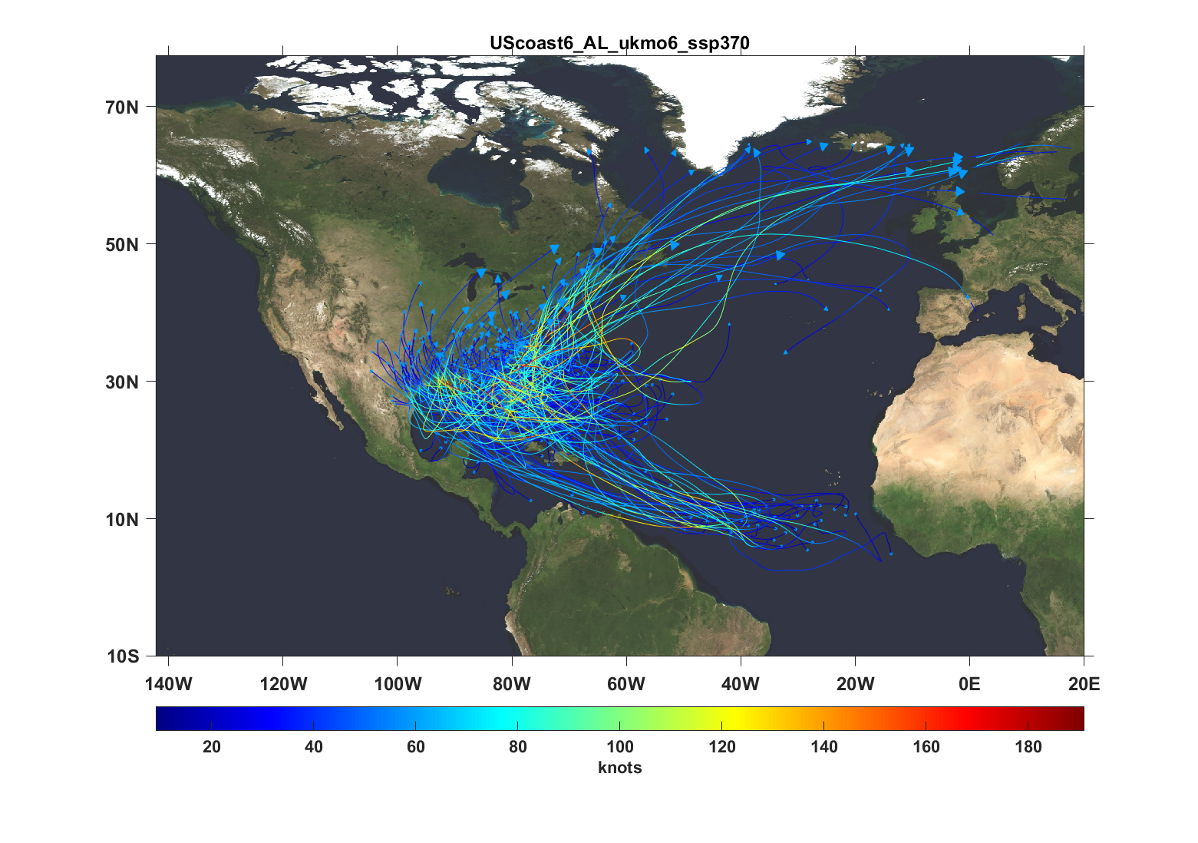
200 of 6,200 synthetic tropical cyclones affecting the eastern U.S., UKMO model

Slide 22
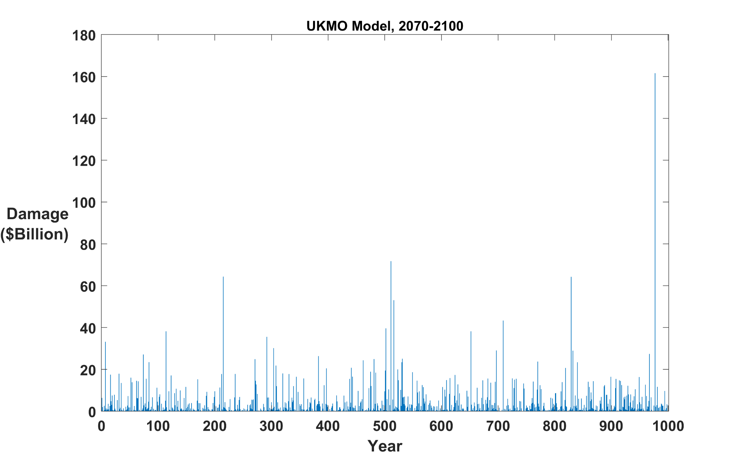
1,000-year synthetic time series of damage, climate of 2070-2100
Bad year:
$161 billion

Slide 23
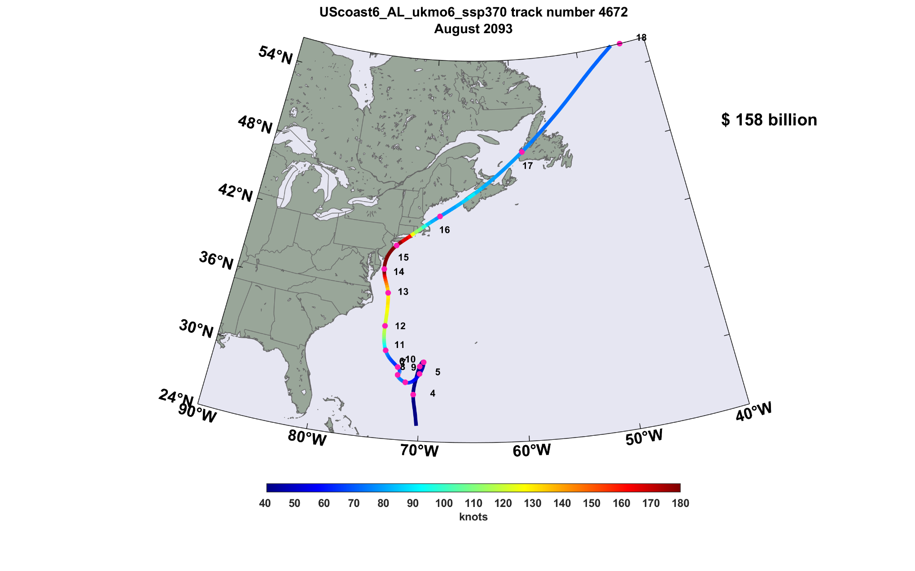
Track of $158 billion hurricane

Slide 24
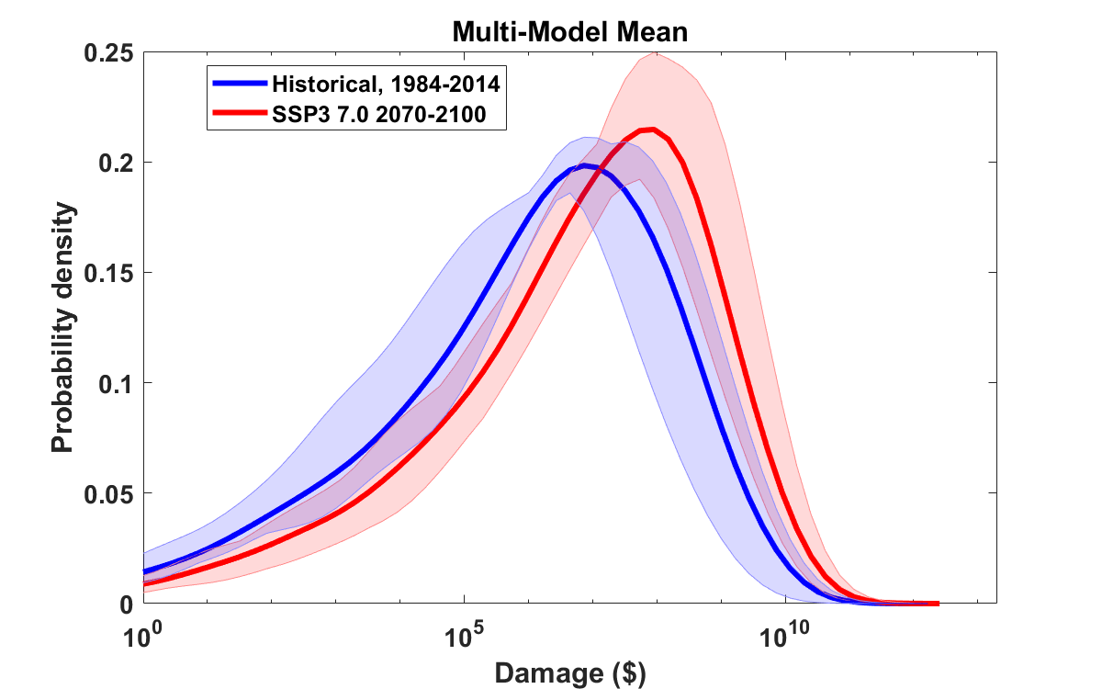
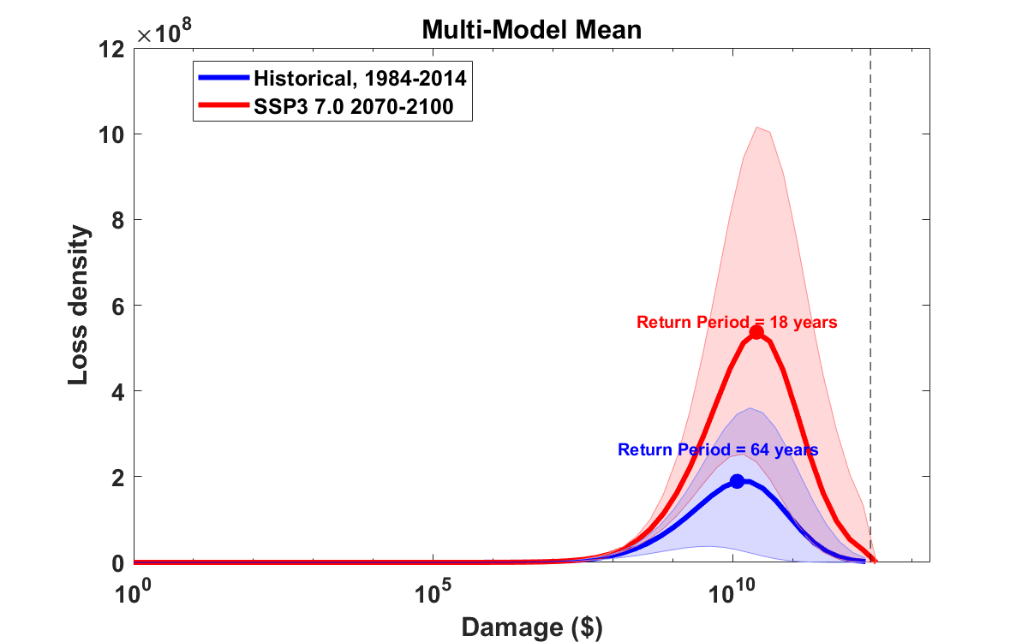
Probability density of log₁₀(Loss) for 1984-2014 (blue) and 2070-2100 (red)
Curves: 8-model mean
Shading: 5th to 95th quantile
among the 8 global models
TIV
Loss density (PDF multiplied by loss) corresponding to above
Expected annual loss proportional to area under these curves

Slide 25
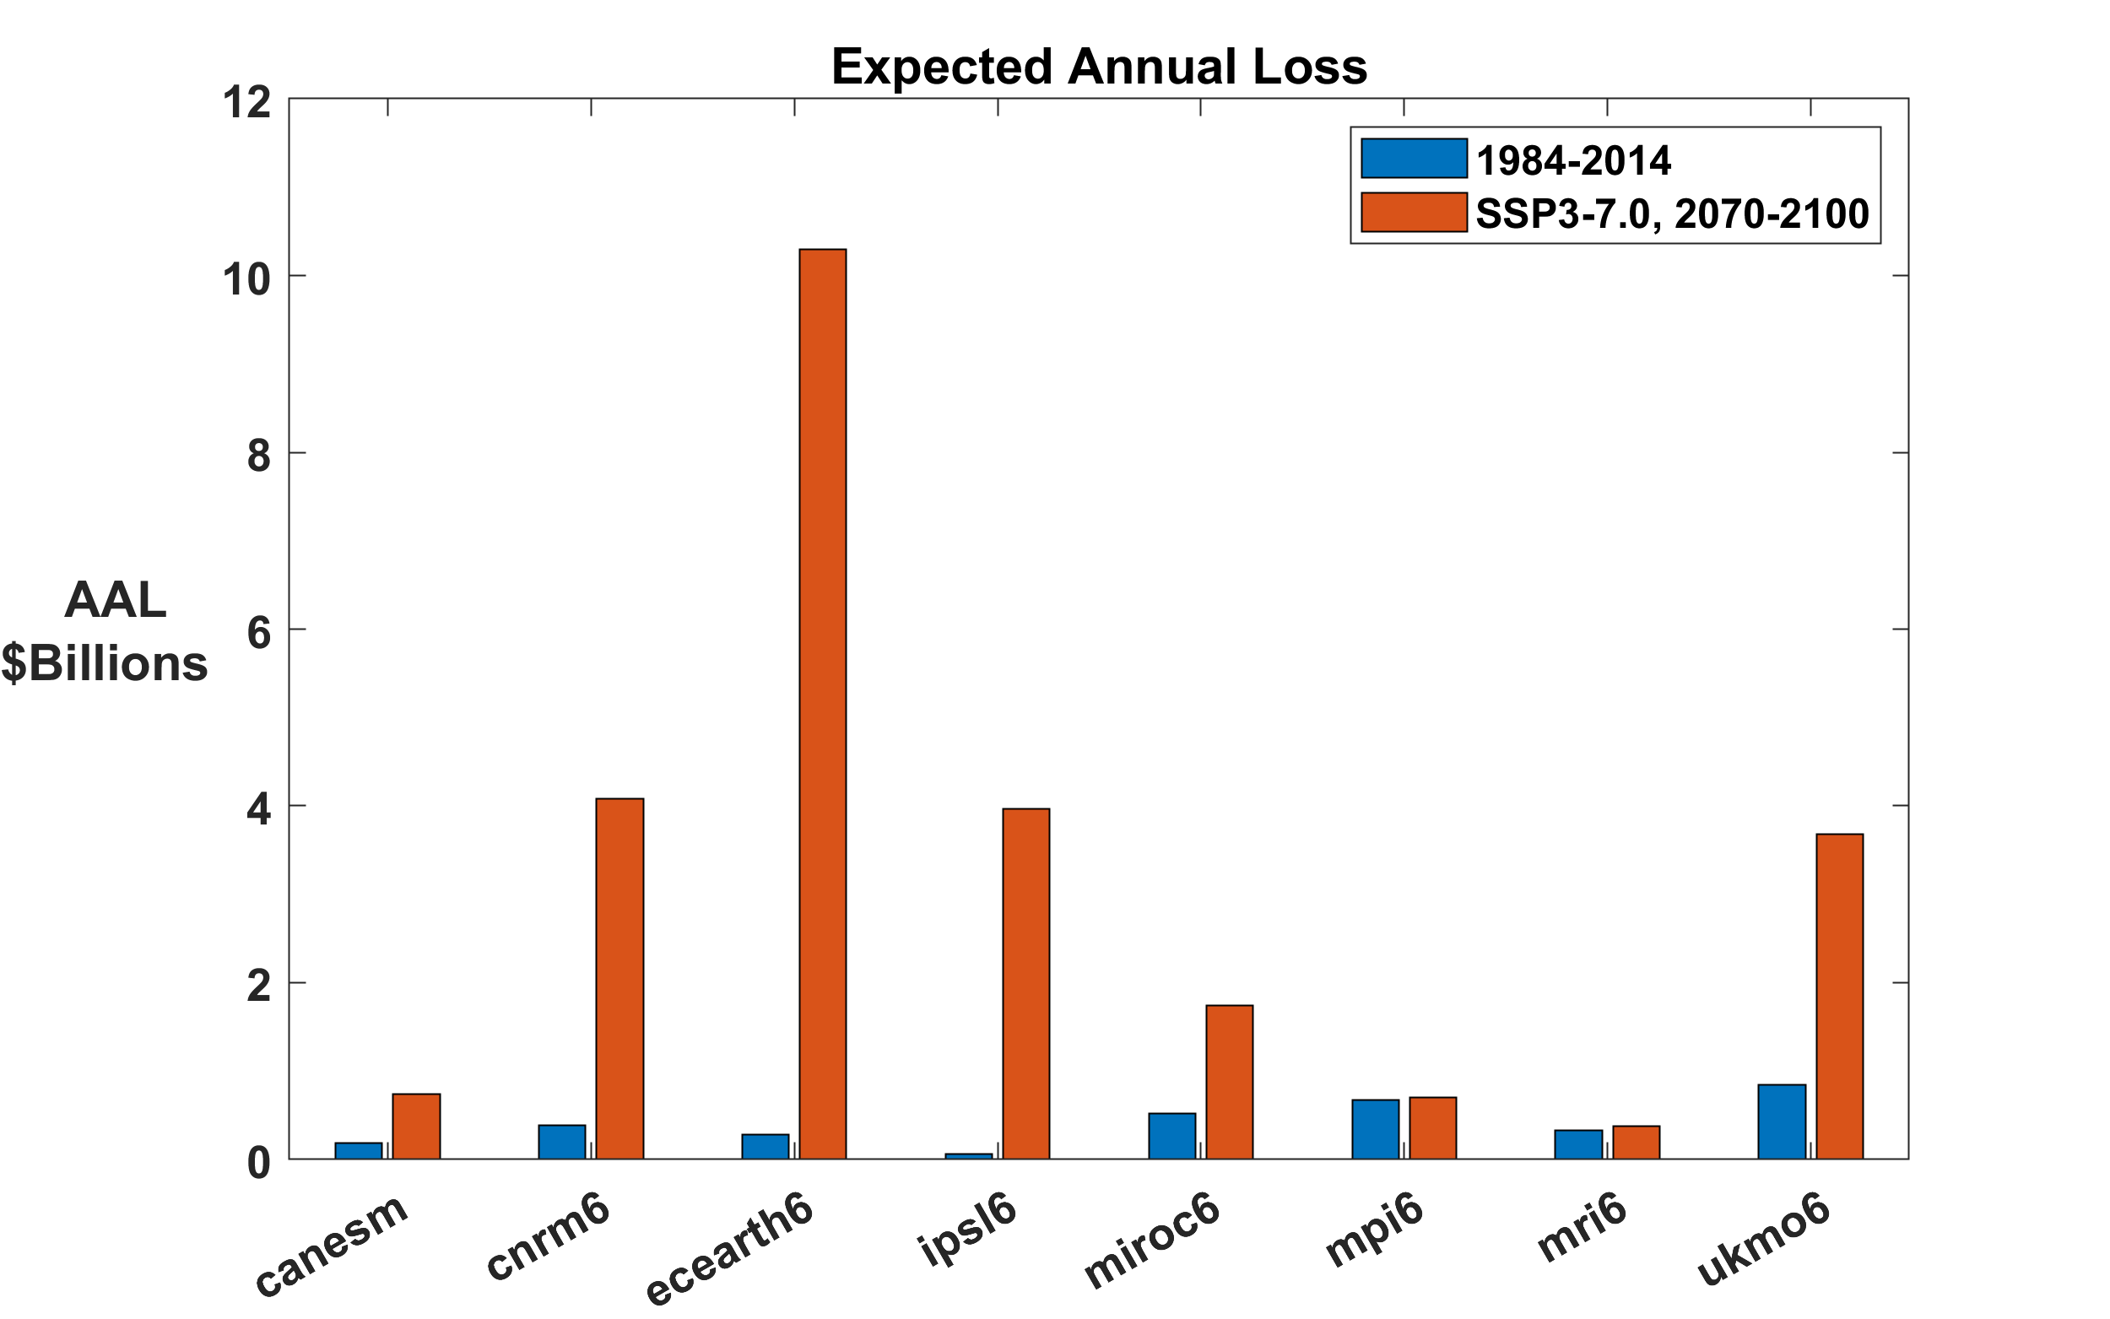
Average Annual Loss

Slide 26
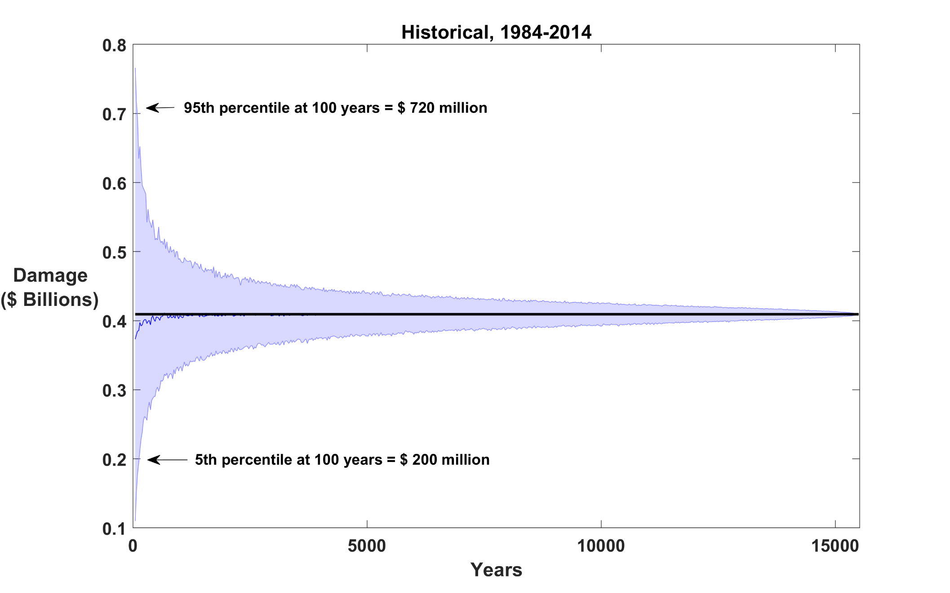
Sampling errors in average annual loss by subsetting combined dataset of 8 models

Slide 27
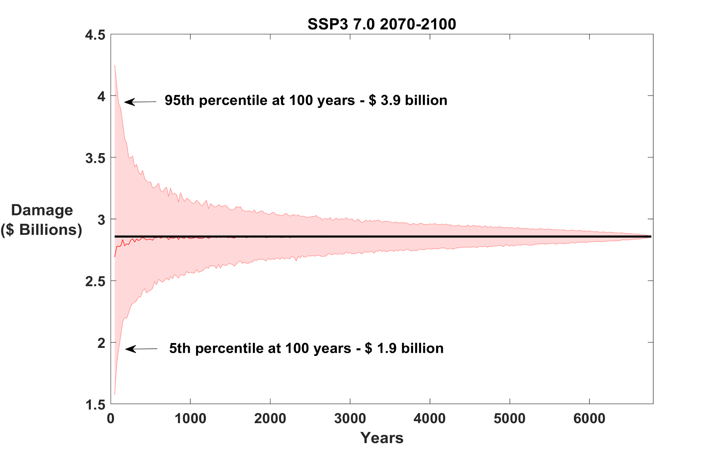
Sampling errors in average annual loss by subsetting combined dataset of 8 models, future climate

Slide 28
Summary
Extreme events make substantial contributions to climate risk
Large contributions from events with return periods of several human generations and larger
Historical records of insufficient length (and often quality) to make robust estimates of long-term risk, even with stable underlying climate (aleatory uncertainty)
We need to migrate toward physical modeling of weather hazards, to create more statistically robust risk estimates and to account for climate change
Far better and more robust estimates of current risk can be made by physically modeling the hazard (hurricanes in this case)
Risk estimation in future climate depends on global climate models, which are plagued by large epistemic uncertainty

