Slide 1
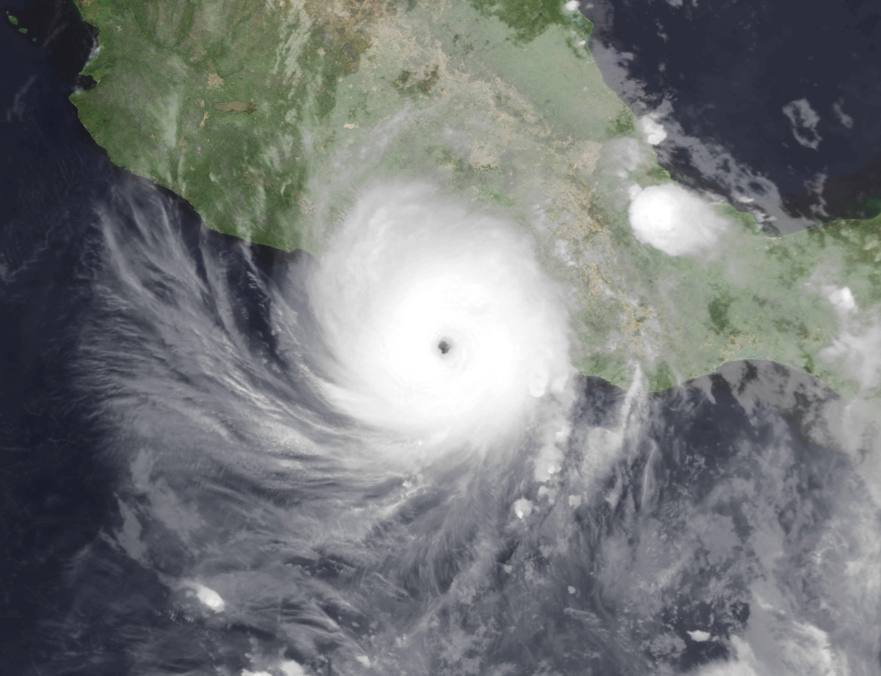
Hurricane Otis: A case for a rapid migration toward probabilistic tropical cyclone forecasting
Kerry Emanuel
Lorenz Center, MIT
Jonathan Lin, Columbia

Slide 2
Hurricane Otis
Strongest landfalling hurricane in eastern North Pacific region since NHC assumed operational responsibility in 1988
> 52 fatalities
$12–16 billion (USD) of total damage in Mexico; costliest tropical cyclone on record for Mexico and one of the most expensive natural disasters in Mexico’s history
Intensified 90 kt in just 21 h
Forecasting nightmare
Reinhart and Reinhart, 2024: National Hurricane Center
Tropical cyclone report: Hurricane Otis (EP182023)

Slide 3
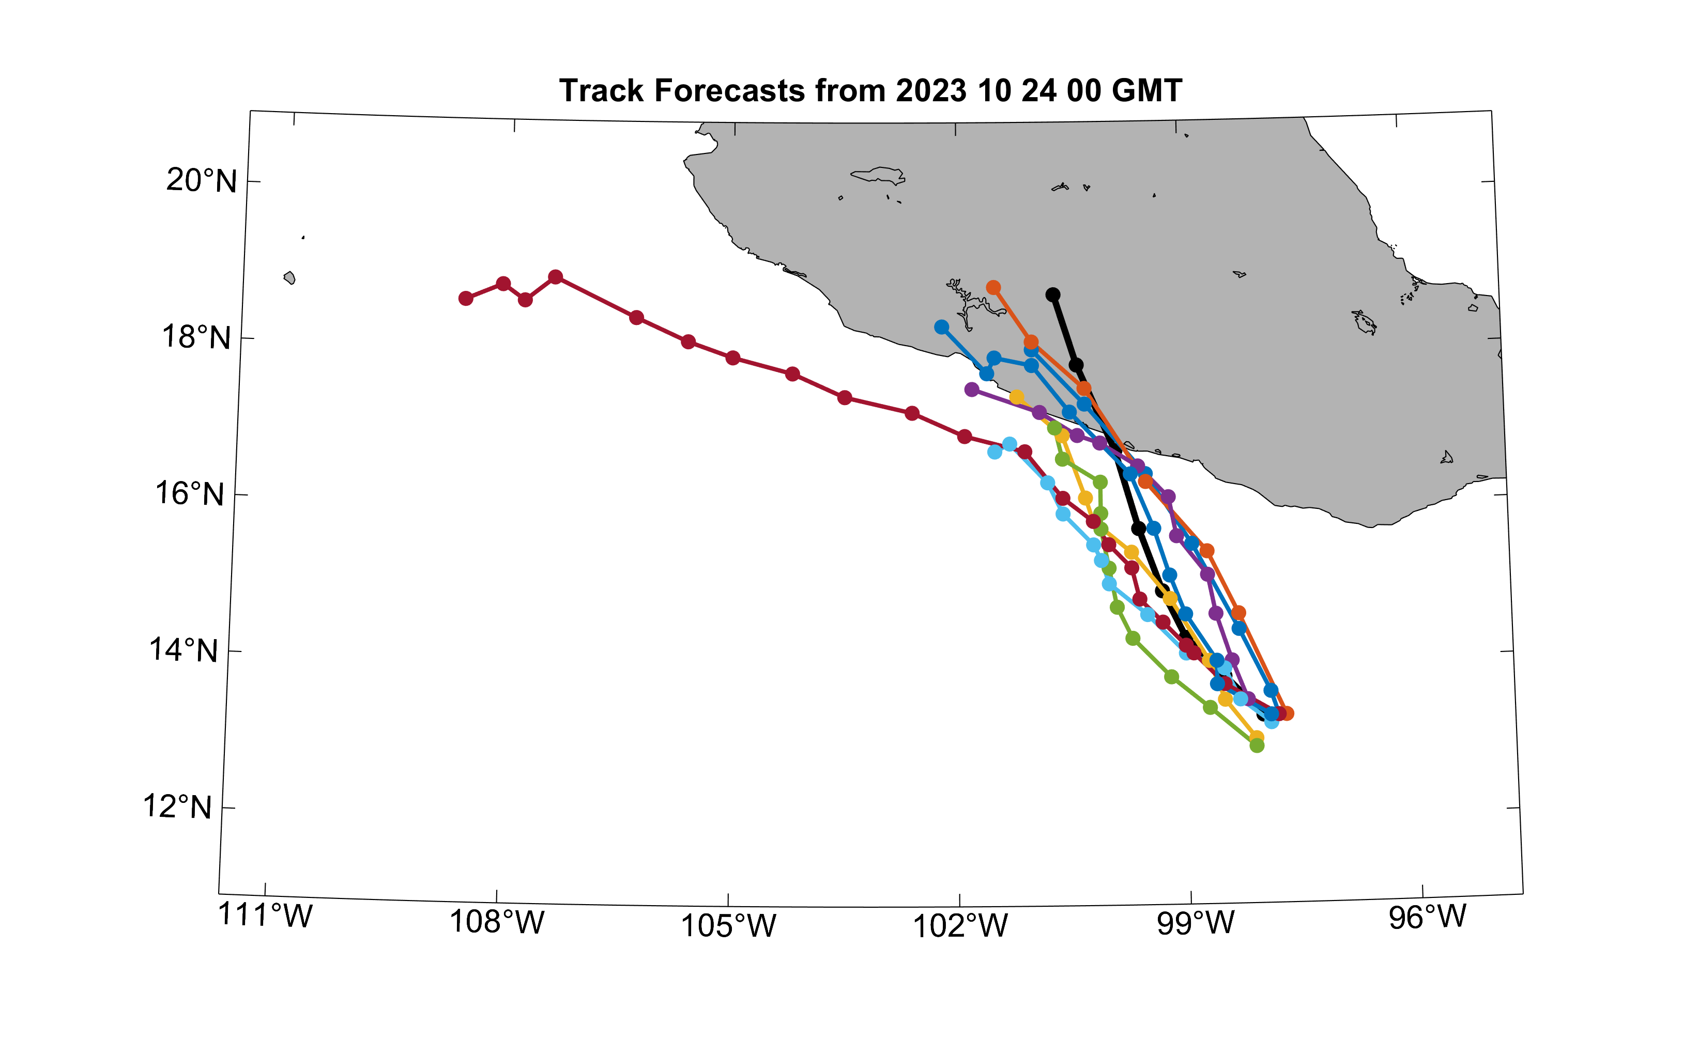
Operational track guidance, 30 hours before landfall
Best track

Slide 4
Operational intensity guidance, 30 hours before landfall

Slide 5
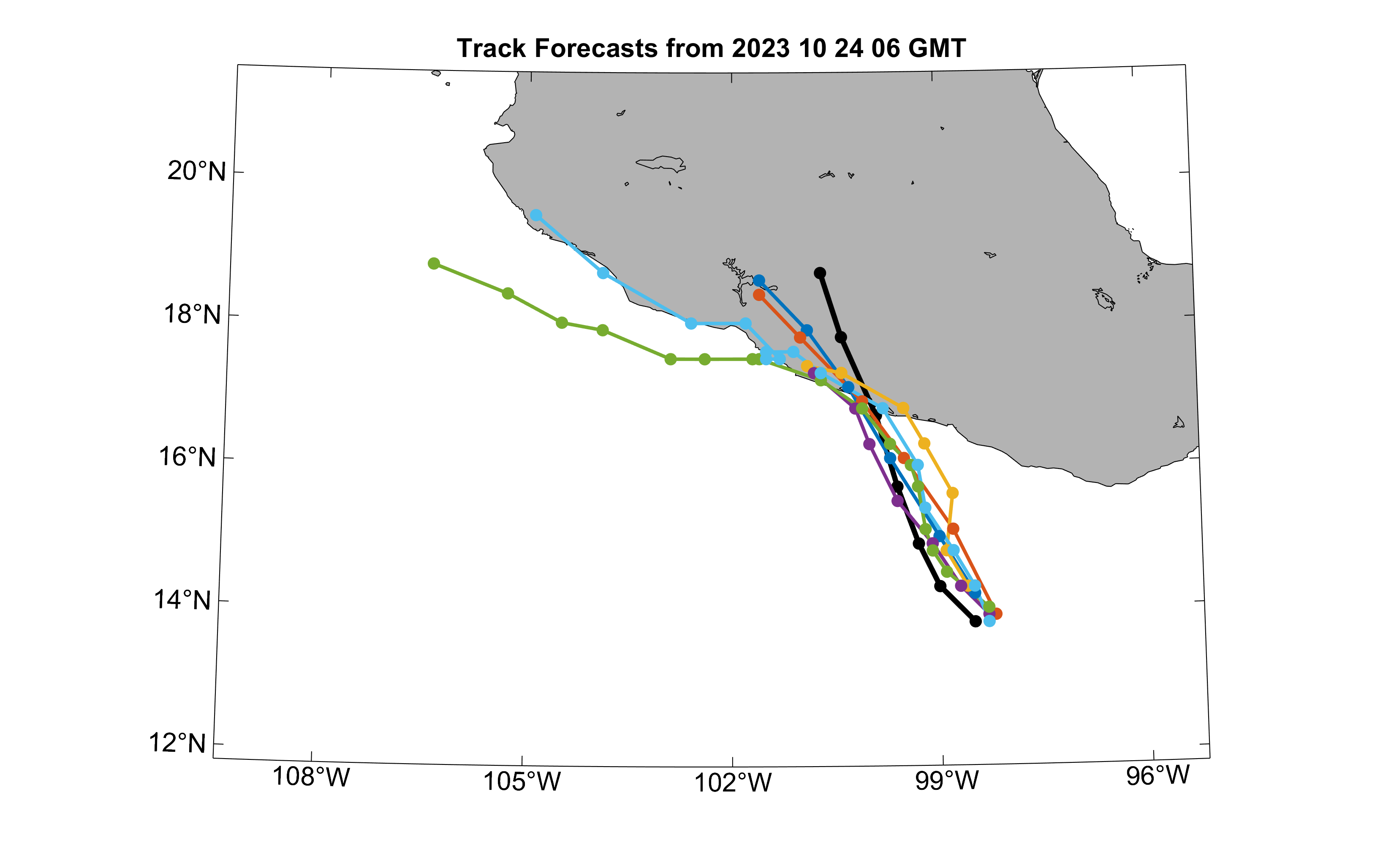
Operational track guidance, 24 hours before landfall
Best track

Slide 6
Operational intensity guidance, 24 hours before landfall

Slide 7
Forecasting Hurricanes using Large-Ensemble Output (FHLO)
Philosophy: Consider a cyclone embedded into a large-scale environmental field. How does the vortex evolve in time?
Forecast Ensemble Members (i.e. EPS)
Synthetic Tracks
Synthetic Tracks
Environmental Quantities
Downscaled Intensity Model
Surface Wind Model
Real-time, 1,000 member ensemble TC forecasts available at https://tcs.mit.edu/
Notes:
Flow chart of ProPHET model

Slide 8
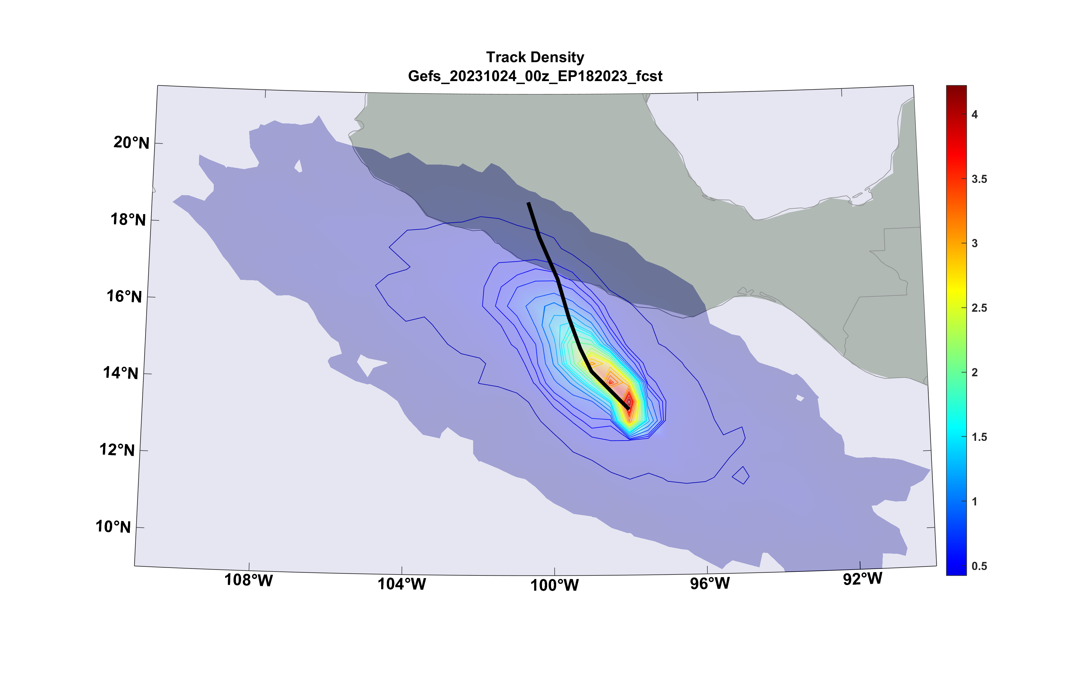
FHLO Forecast Track Density, 30 hours before landfall
Best track

Slide 9
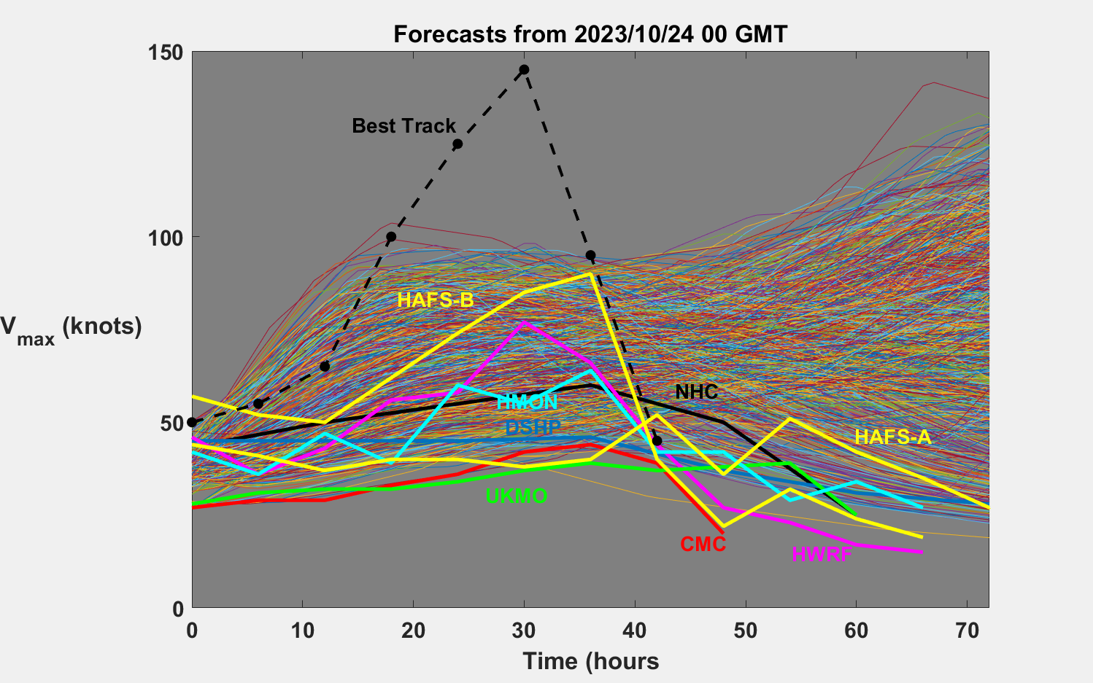

Slide 10
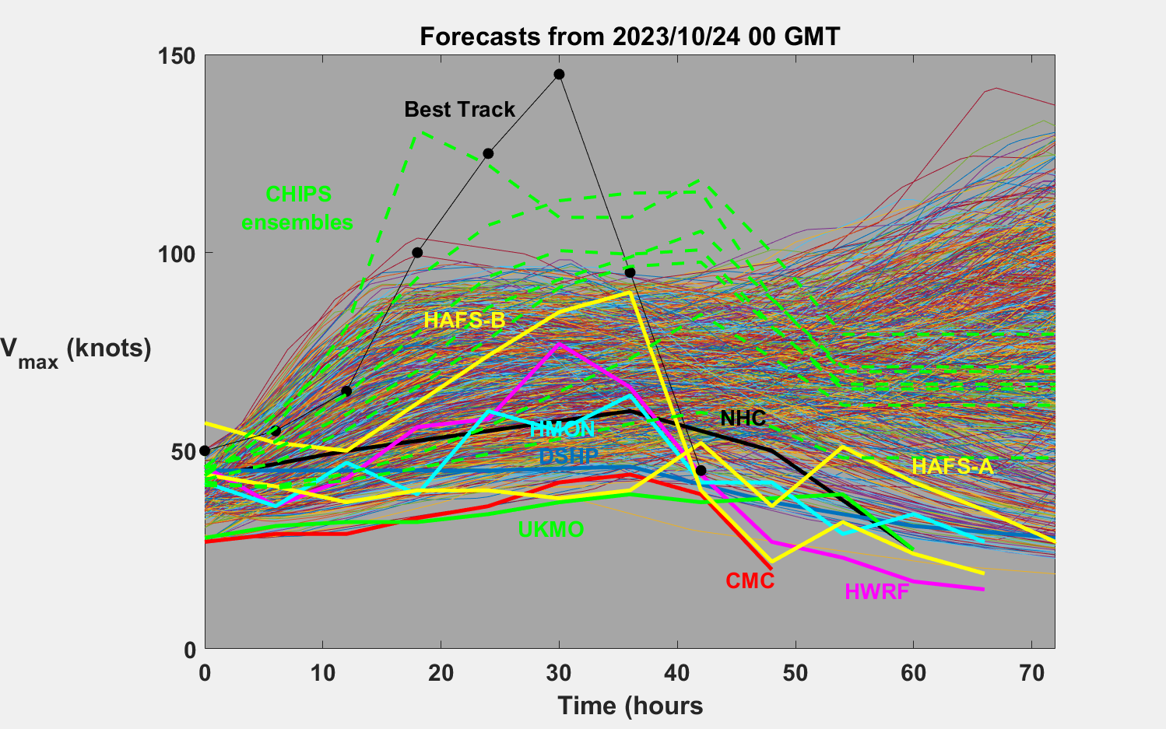

Slide 11
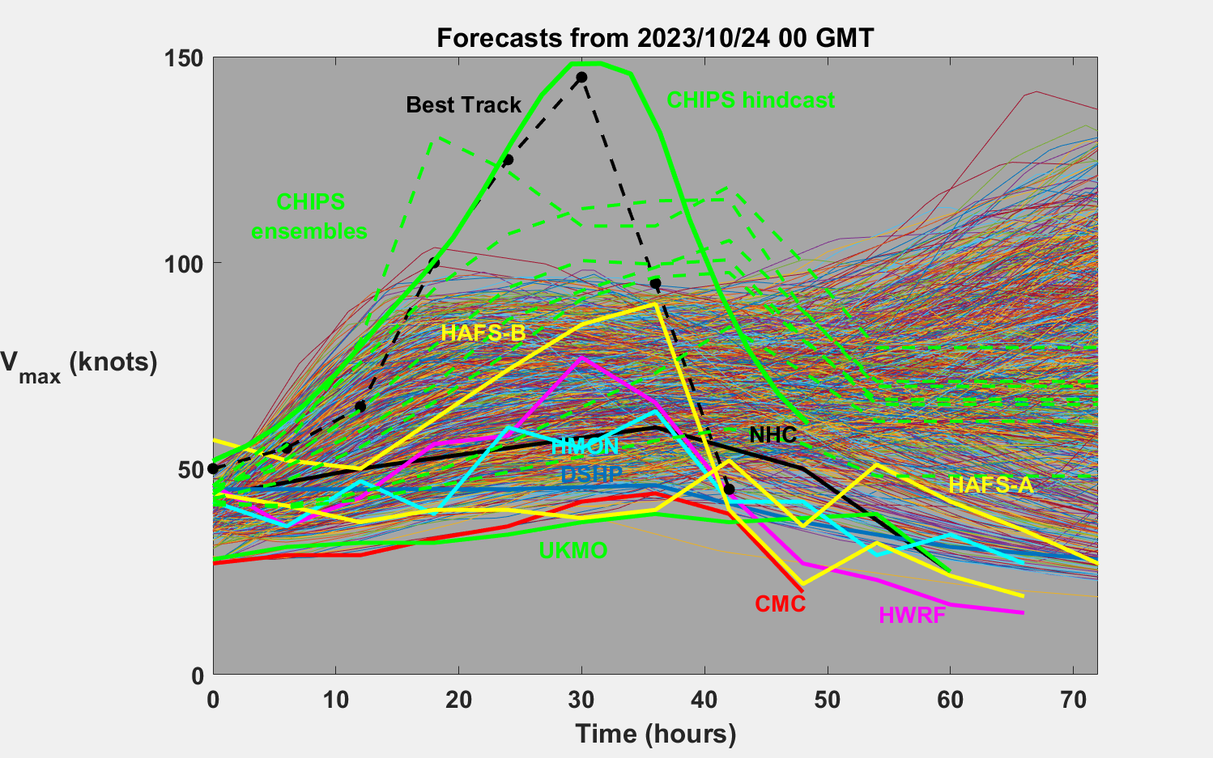

Slide 12
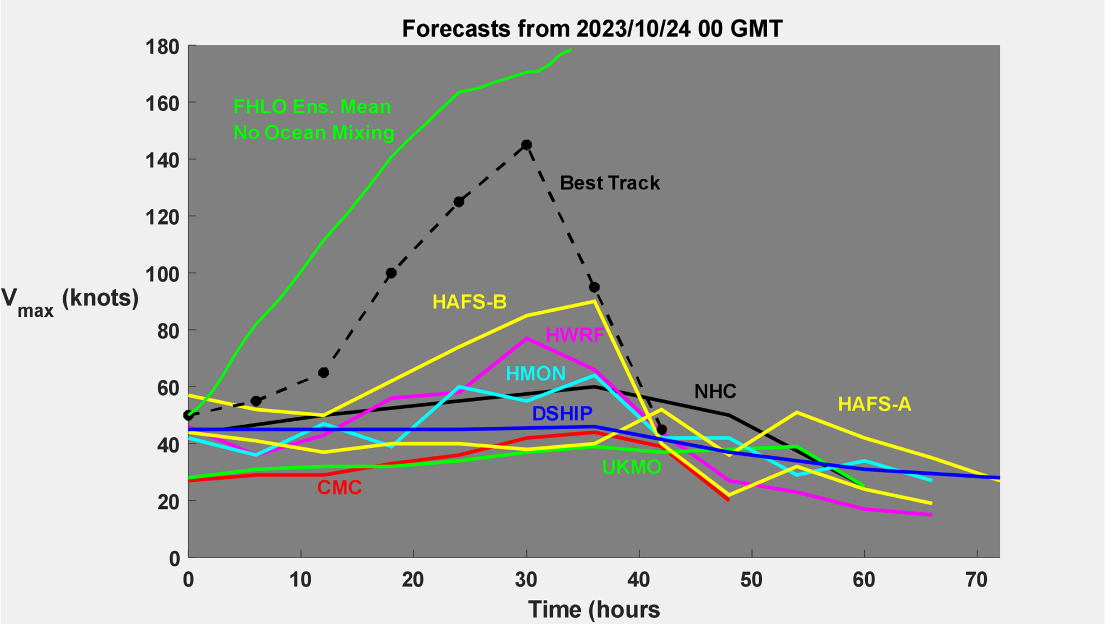

Slide 13
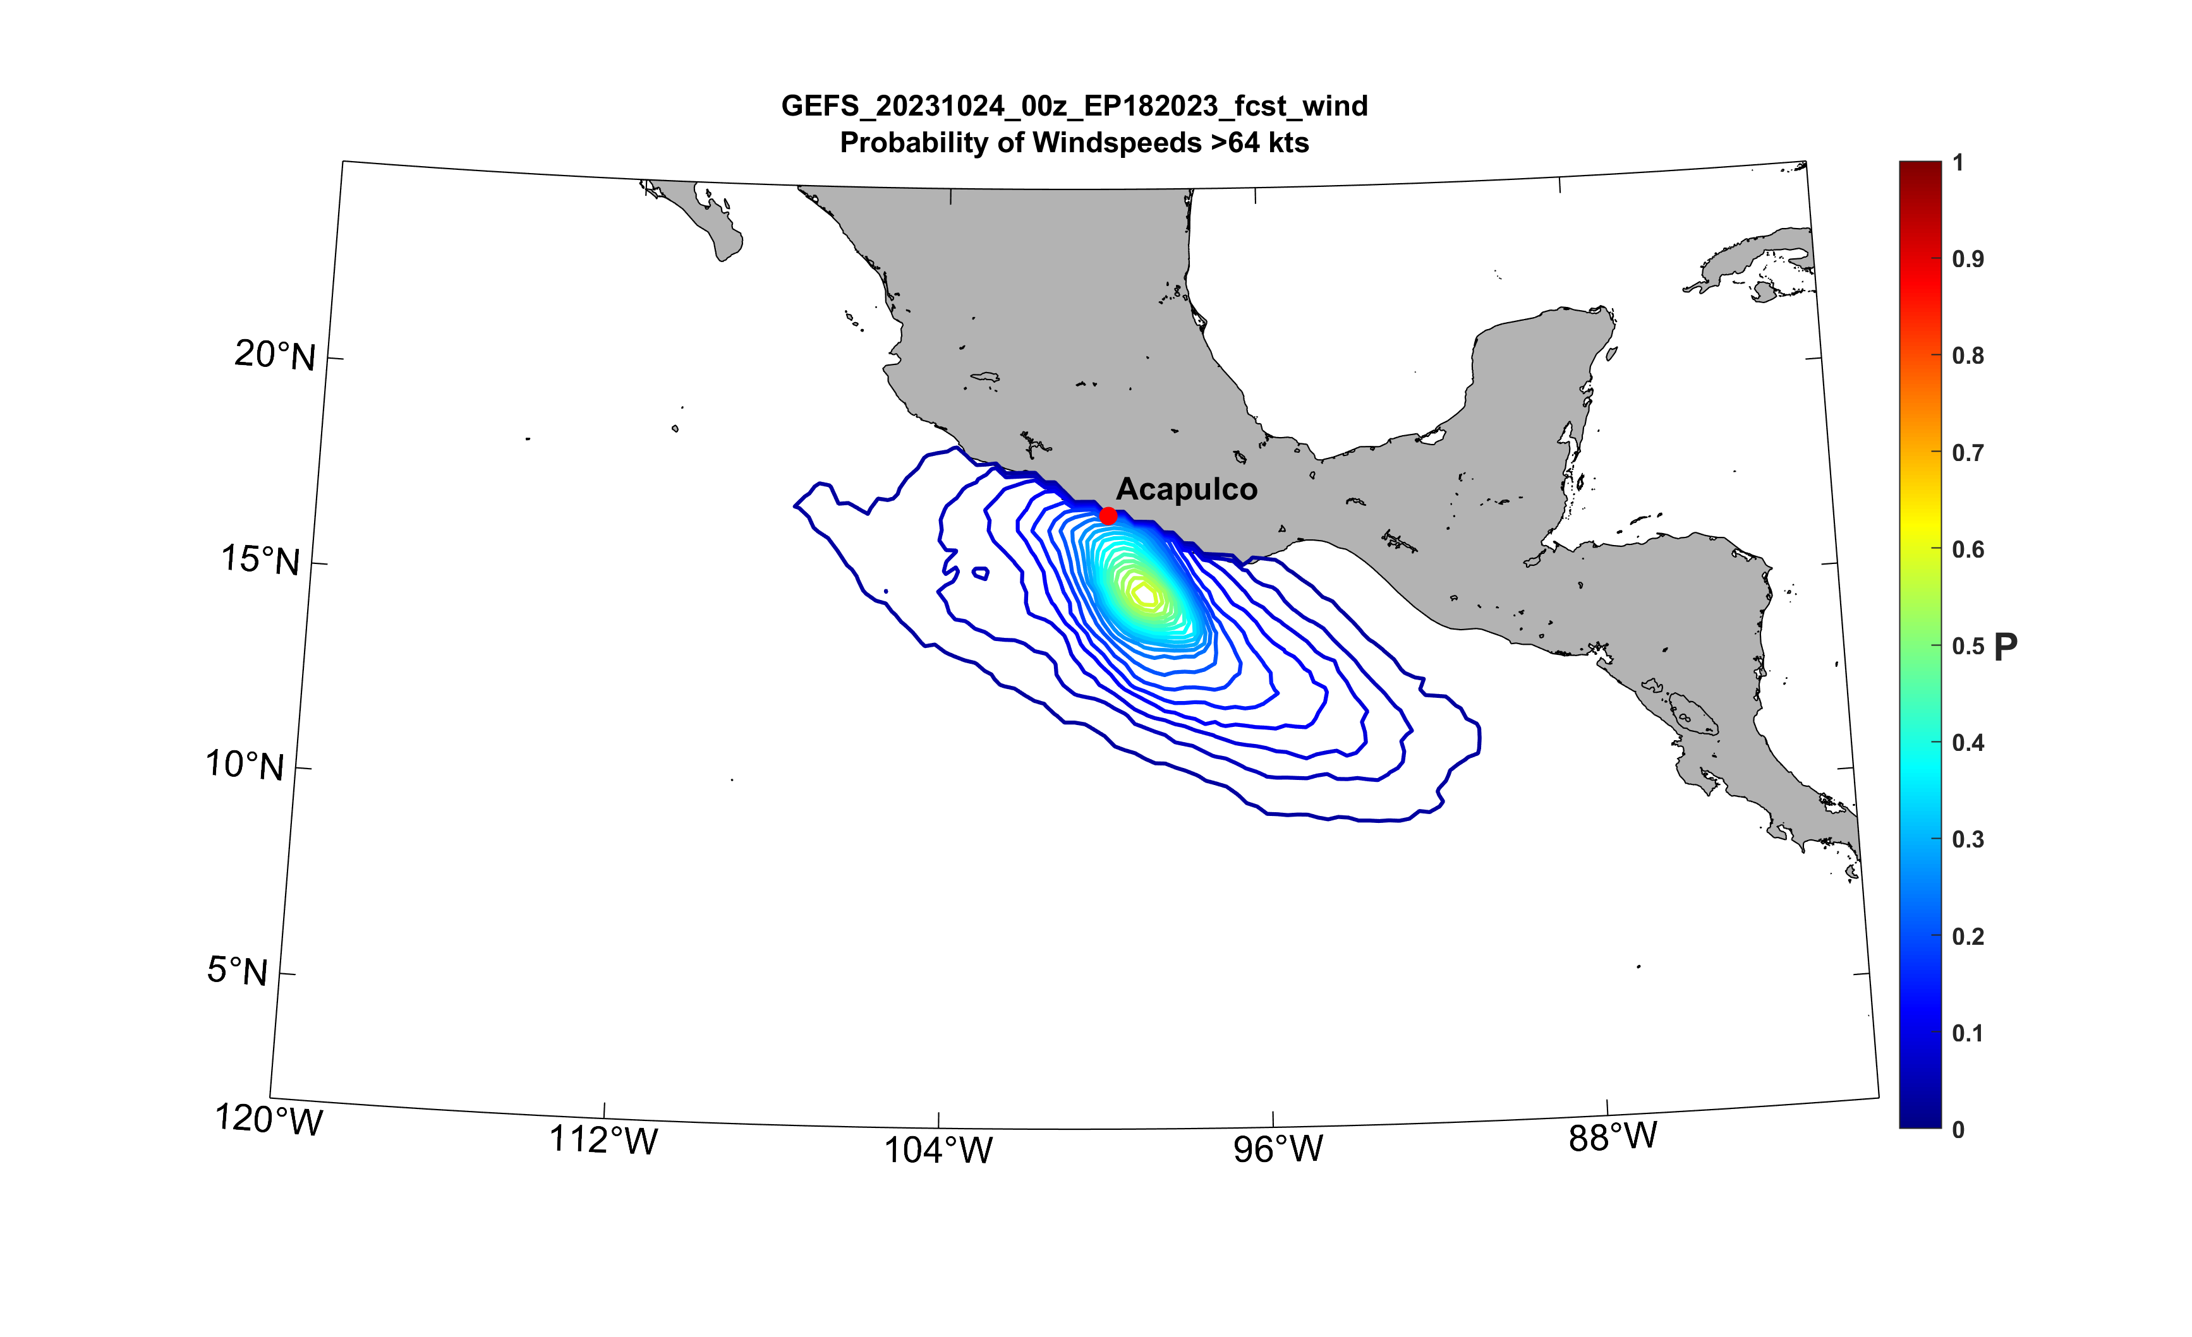
FHLO Forecast probability of wind speed > 64 kts, 30 hours before landfall

Slide 14
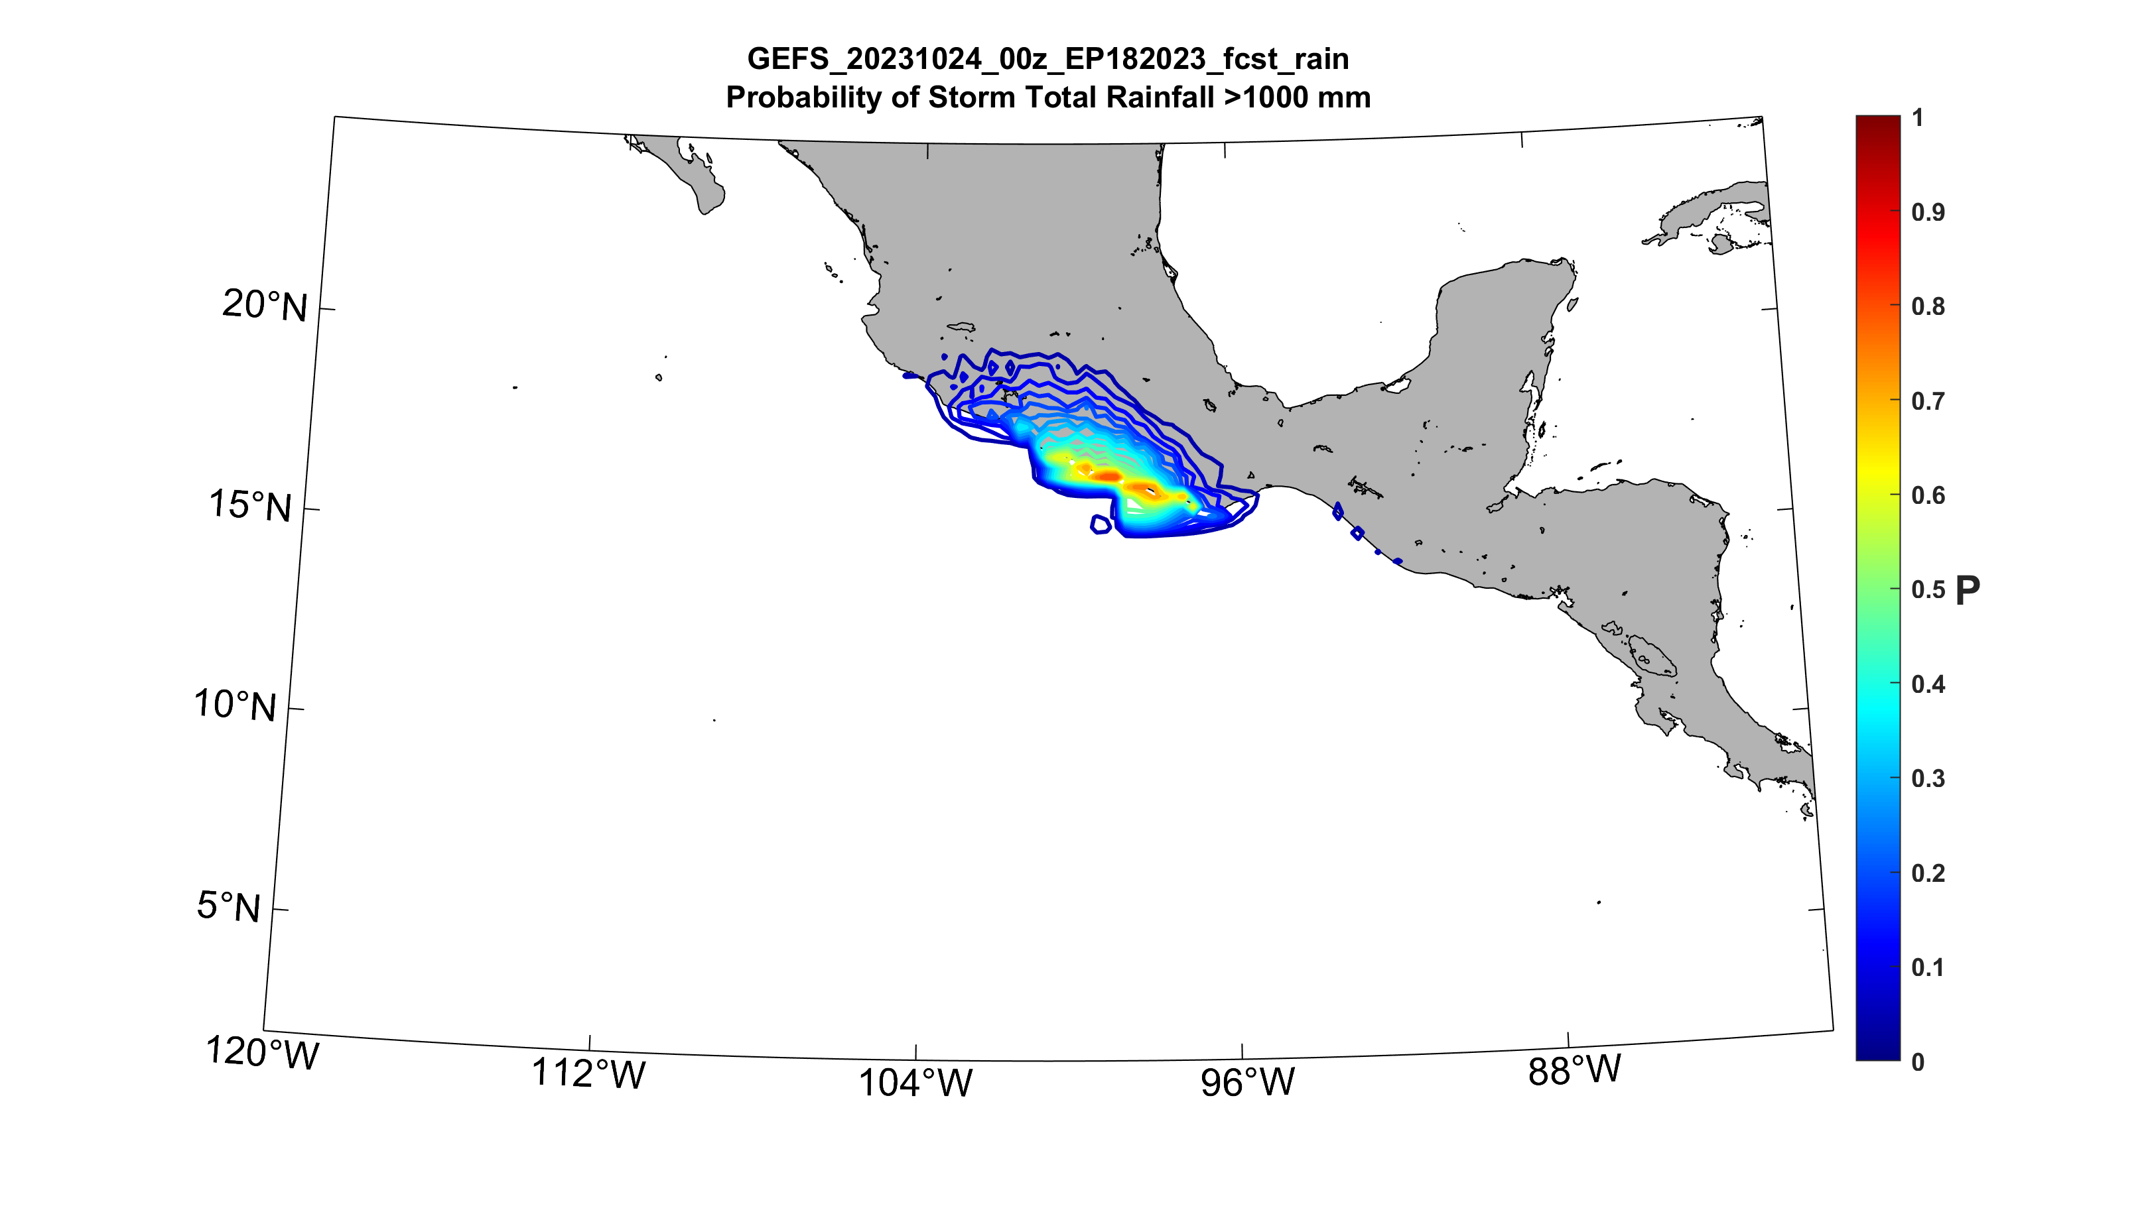
FHLO Forecast probability of storm total rain > 1m, 30 hours before landfall

Slide 15
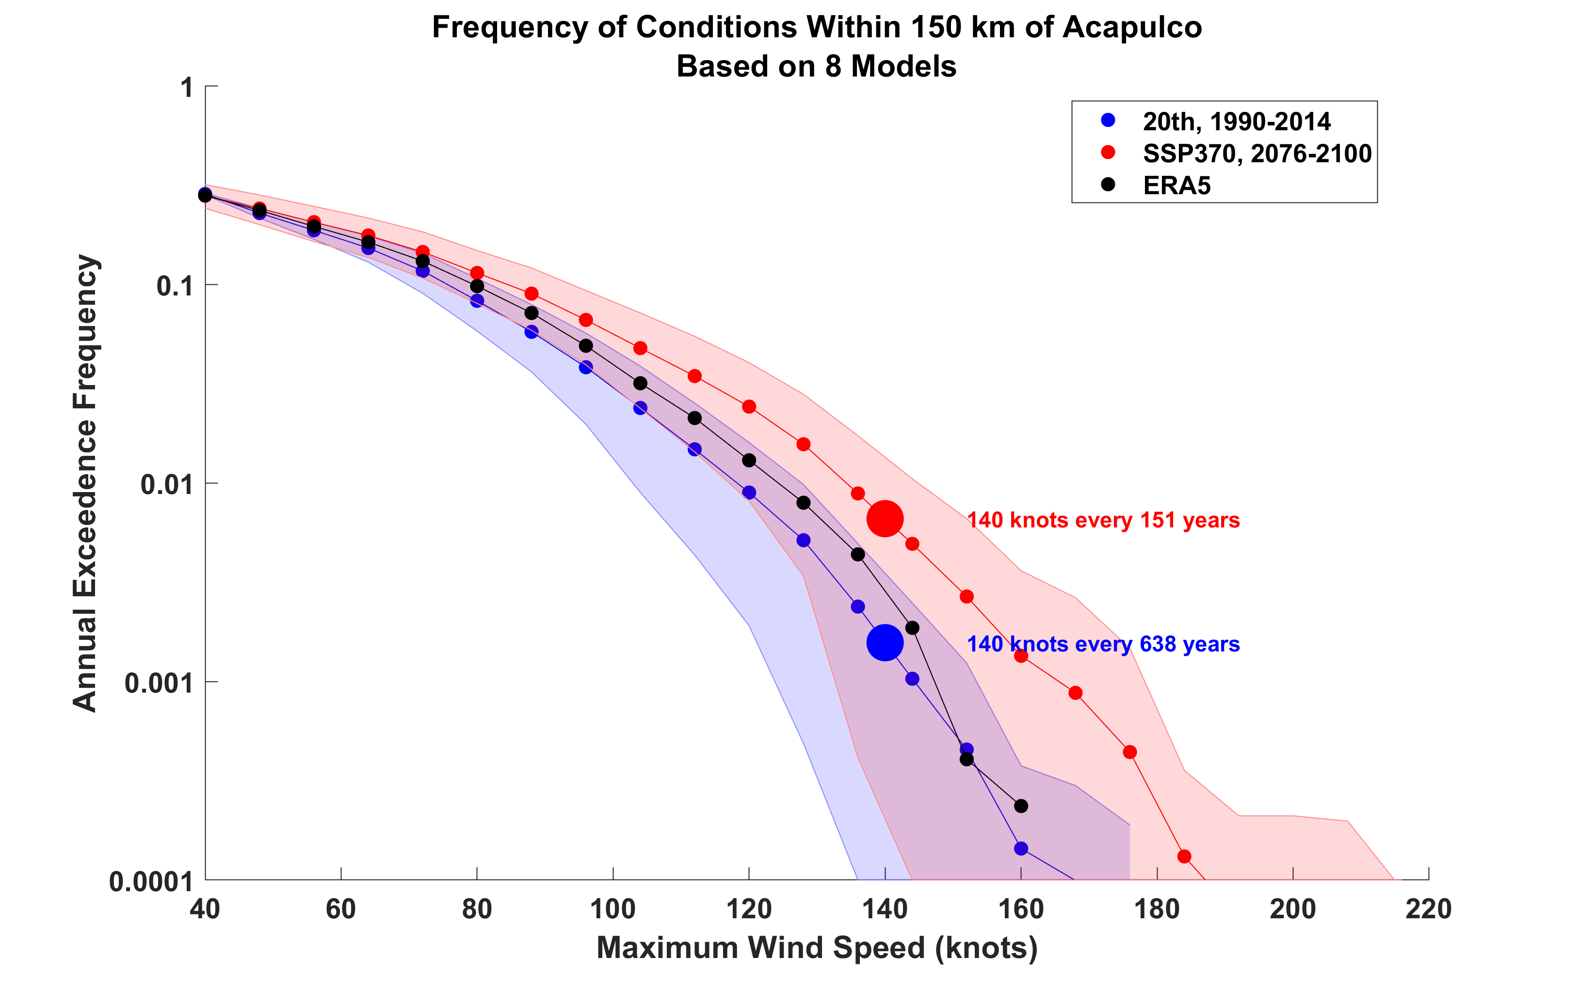
Frequency of exceeding threshold maximum wind speed with 150 km of Acapulco, based on downscaling ERA5 and 8 CMIP6 models

Slide 16
Summary
Otis was a highly unusual landfalling hurricane
Forecasts generally poor, mostly because of underestimation of initial intensity and translation speed
Real-time CHIPS and FHLO ensembles showed modest probabilities of hurricane-force winds in Acapulco, 30 hrs ahead of landfall
Earlier recon of even weak storms expected to make landfall seems warranted
Communicated forecasts should be more people- centric (probability of hazardous conditions where they live) and less storm-centric (where is the storm, how bad is it, and where’s it going to go)

