Slide 1
Lorenz, Gödel and Penrose: From chaos to fundamental physics
Tim Palmer
Oxford

Slide 2
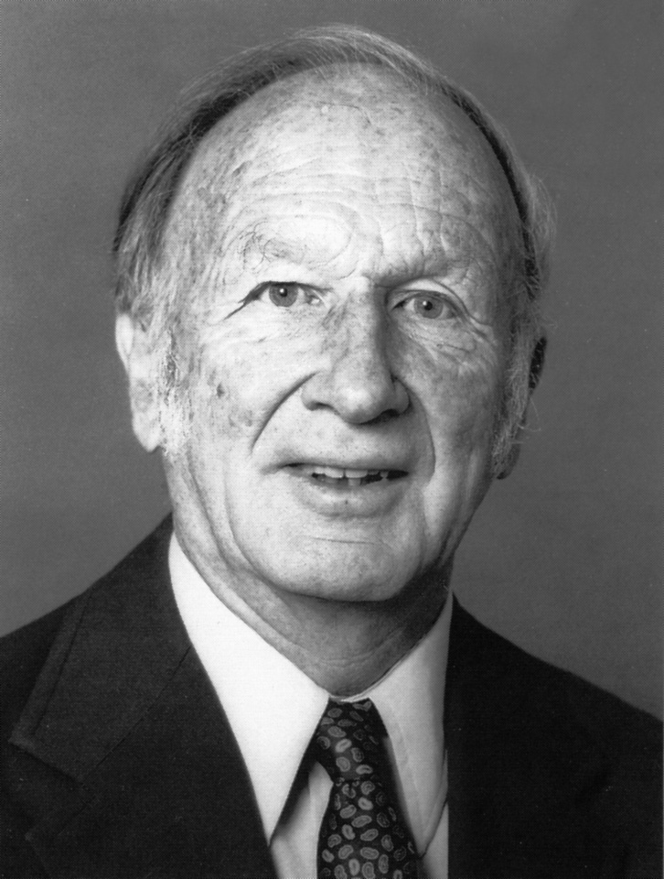
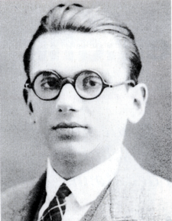
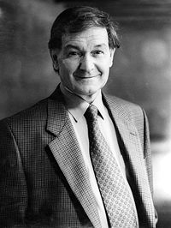
Ed Lorenz
Kurt Gödel
Roger Penrose

Slide 3
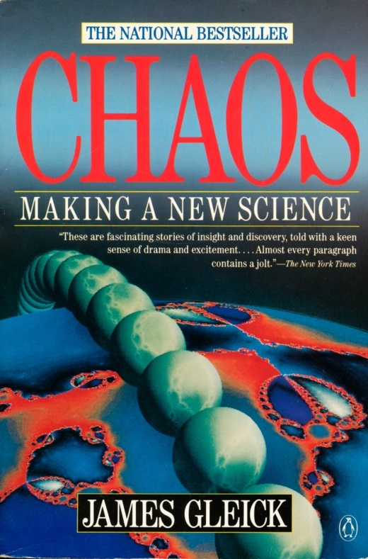
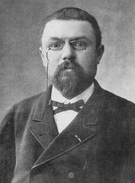
The Butterfly Effect.
But what about…
?

Slide 4
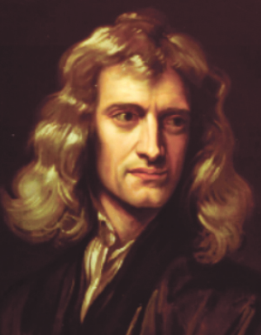
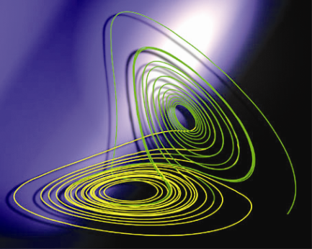
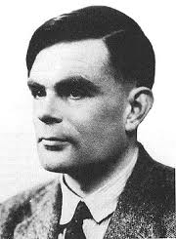
I
•
Alan Turing

Slide 5
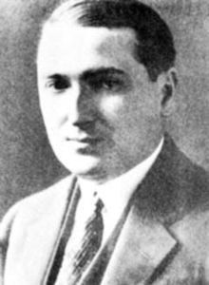
Post Correspondence Problem
Given a collection of dominos, eg
Emil Post
can we make a list of dominos (repetitions allowed) so that the string on the top matches the string on the bottom? In this case yes, ie
The PCP is to determine whether any given collection of dominos has a match. The problem is unsolvable by algorithms (non-computable).

Slide 6
PCP equivalent to “Is there an algorithm for determining whether a line in state space intersects the fractal attractor of an iterated function system (type of dynamical system)” Dube 1992

Slide 7
Differential Equations
Geometry
Number Theory
.02202002200002..

Slide 8
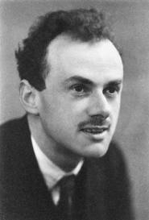
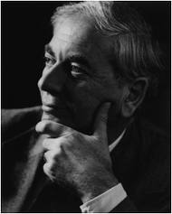
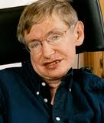
Paul Dirac
Dennis Sciama
…
Stephen Hawking

Slide 9
“It seems to me to be quite plausible that the correct theory of quantum gravity might be a deterministic but non-computable theory.” (Penrose 1989: The Emperor’s New Mind: Concerning Computers, Minds and the Laws of Physics)

Slide 10
Non-computability of chaotic attractors and the quantum theory of gravity. Is there a link?

Slide 11
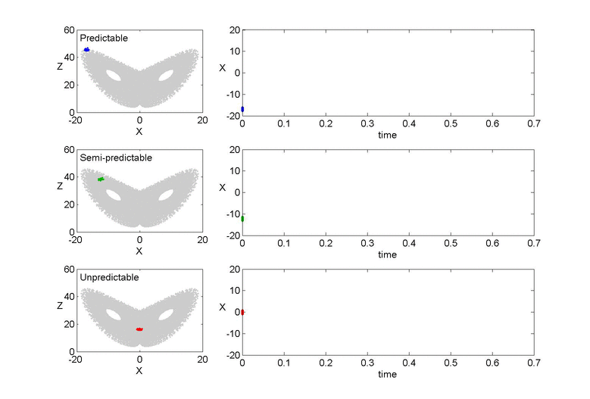
Thanks to Hannah Arnold

Slide 12
Liouville Equation for a Hamiltonian System
Schrödinger Equation

Slide 13
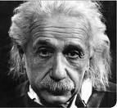
Could quantum theory “merely” be a statistical description of some deeper deterministic level of reality?
God does not play dice!
“One can always hope that there will be future developments which will lead to a drastically different theory from the present quantum mechanical theory and for which there may be a partial return of determinism.”
Einstein believed passionately that the answer was yes!

Slide 14
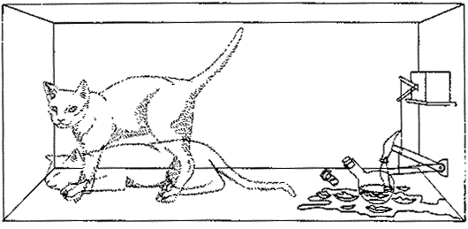
However, today almost all physicists believe the answer is - No!! (Von Neumann Theorem, Gleason Theorem, Kochen-Specker Theorem, Bell Theorem, Pusey et al Theorem…..)
And so for example ….

Slide 15
However, it is possible to nullify all of these theorems, and reinstate the possibility of the Einsteinian notion of reality – with a “loophole” that owes its existence to Ed Lorenz’s work….
THE INVARIANT SET POSTULATE A New Geometric Framework for the Foundations of Quantum Theory and the Role Played by Gravity
TNP
Proc.Roy.Soc. A 465:3165-3185 (2009)

Slide 16
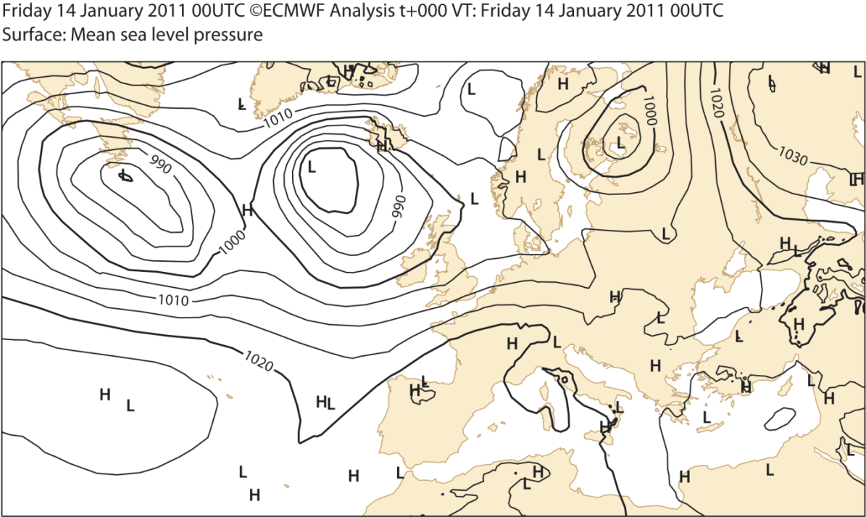
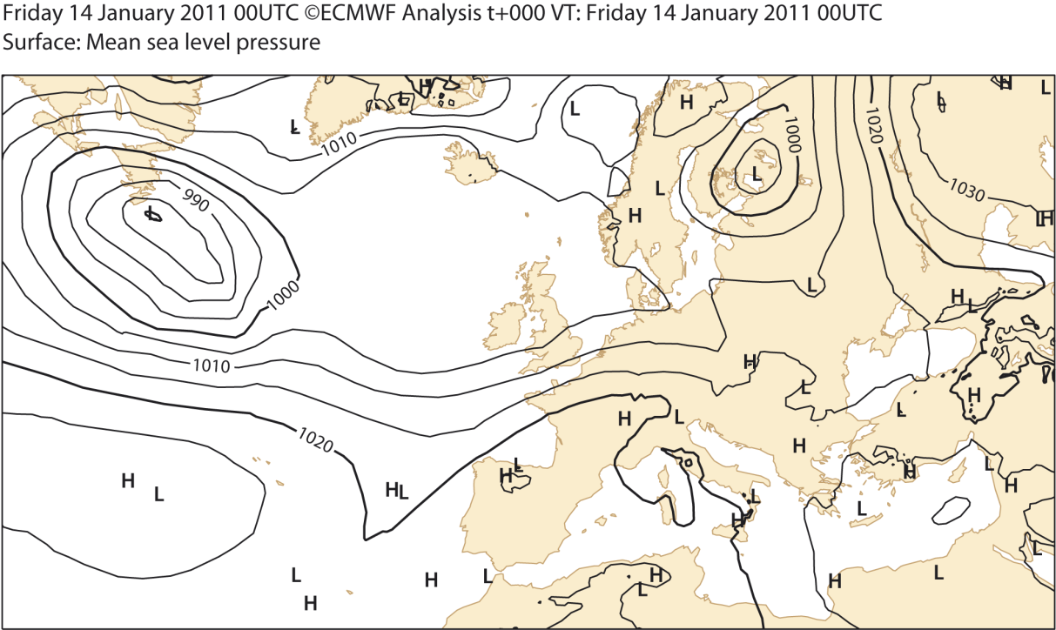
Actual Weather
Counterfactual Weather
?

Slide 17
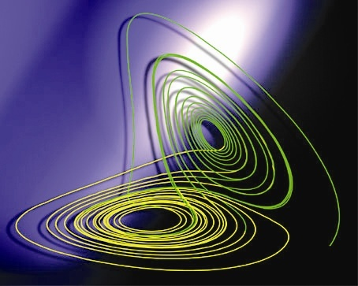
The validity of counterfactual reasoning is central to proving all quantum no-go theorems
.
.

Slide 18
WMAP
•
If the universe U could be considered as a nonlinear dynamical system evolving on a similar type of zero-volume invariant set in state space, then counterfactual worlds U’ of the type needed to prove the quantum no-go theorems would not in general lie on the invariant set. This would nullify these theorems.
•
•

Slide 19
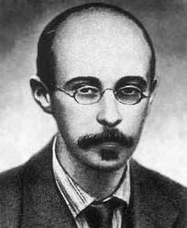
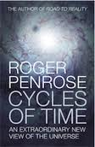
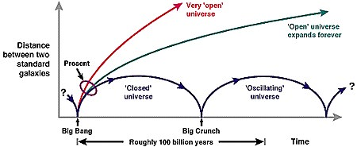
Alexander Friedmann (worked under Wilhelm Bjerknes in Leipzig 1914)

Slide 20
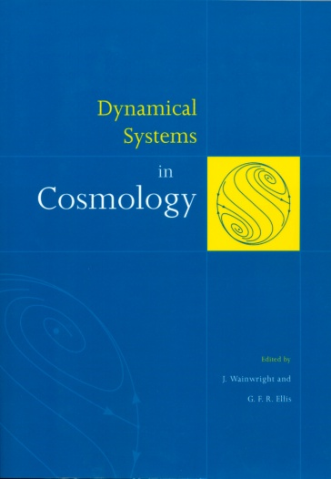
Like climate, these Friedmann universes can be treated as nonlinear dynamical systems
Chaotic solutions
But such solutions do not have Lorenzian-like fractal attractors. There is no process in fundamental physics which would cause phase space volumes to shrink to zero.
Or is there?

Slide 21
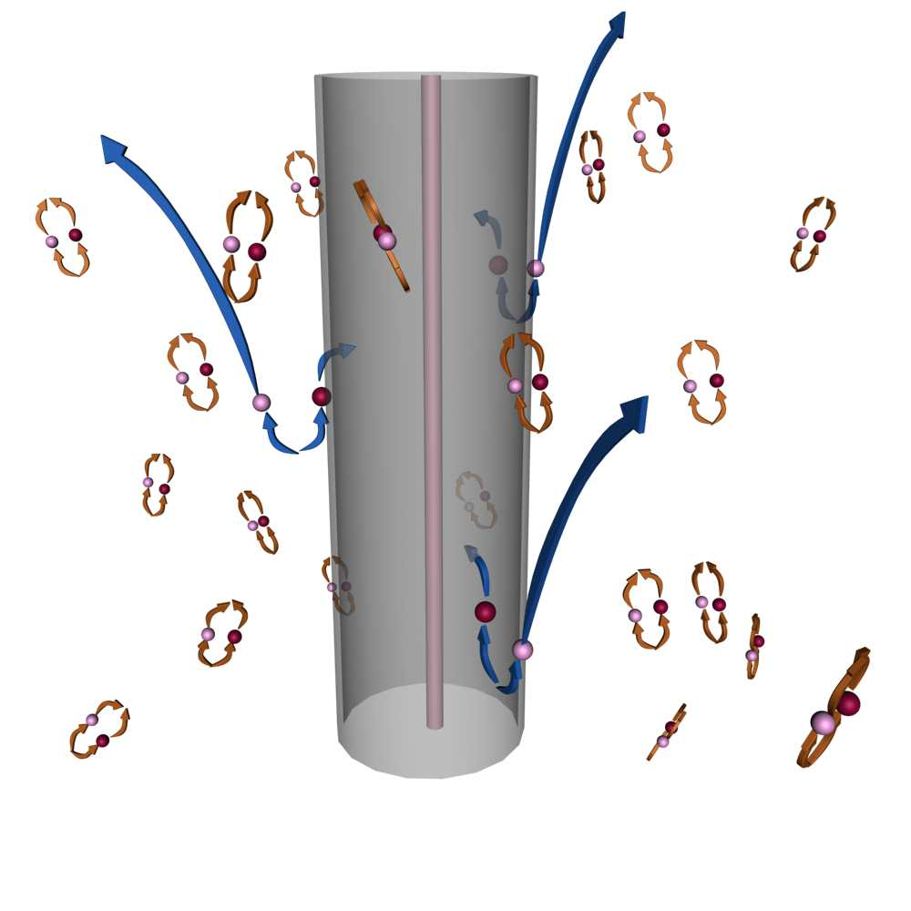
Hawking Radiation
“..information…directed into such a space time singularity is …destroyed. …A better way of describing this is as a loss of degrees of freedom, so that … the phase space [of the universe] has actually become smaller than it was before.” (Penrose 2010: Cycles of Time)
Black Body Radiation
Black Hole

Slide 22
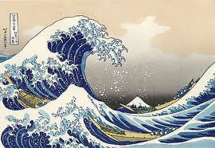
Fluid Turbulence (well defined fractal invariant set at least in 2D)
Large-Scale Forcing balancing Small-Scale Dissipation

Slide 23
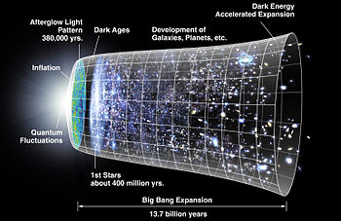
The Universe. With large-scale “forcing” (dark energy – positive cosmological constant?) balancing small scale “dissipation” (state-space convergence at space-time singularities, more generally on the Planck scale?) the universe could indeed have a measure-zero invariant set (à la Lorenz) of the type needed to nullify all quantum no-go theorems.

Slide 24
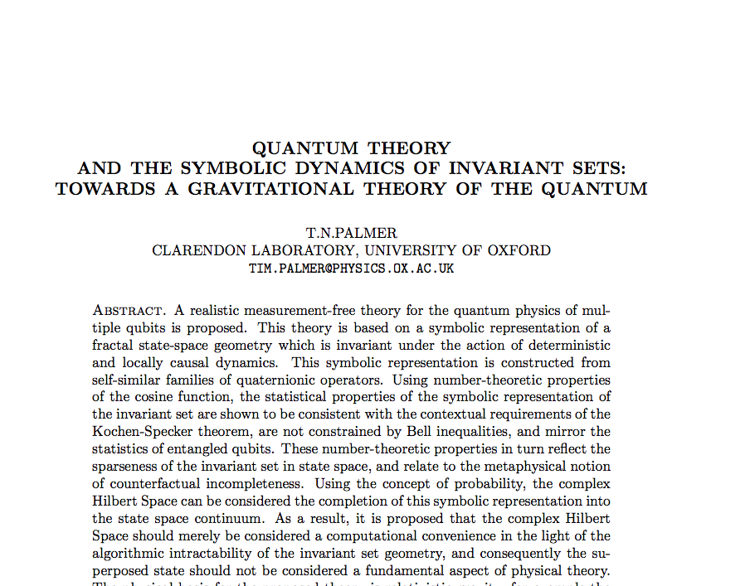
http://arxiv.org/abs/1210.3940

Slide 25
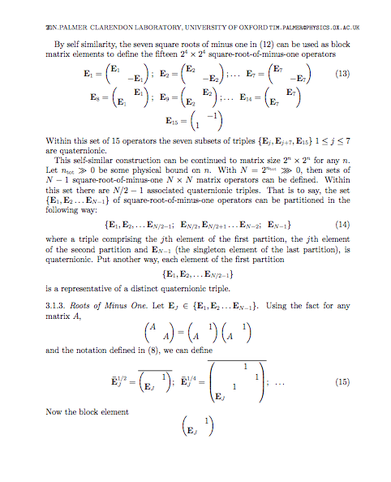
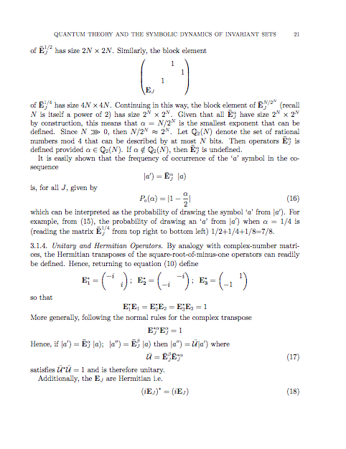

Slide 26
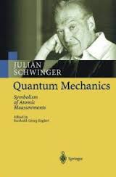
Describe invariant set by symbolic labellings

Slide 27
B
Trajectories on I
t₀
t₁
t₂
t₁
t₂
t₀
t₁
t₀
t₂

Slide 28
Measurement and the Geometry of I
Treat measurement outcomes as gravitationally stable regions of I (cf Penrose, Diósi, Gisin, Percival etc). Label points in I according to which “basin of attraction” that point belongs (cf symbolic dynamics).
Gravitational instability
Cantor Set generated by 2³ intervals with reduction factor 1/2⁴. D=3/4
Coloured red, blue according to a specific rule…..
“riddled” basins of attraction

Slide 29
Operators which describe labelling of I. Have quaternionic structure.

Slide 30
The Quantum Wave Function as a Logarithmic Oscillation in State Space?

Slide 31
z₊
x₊
z₊
S-G
z axis
S-G
x axis
S-G
z axis
Source
z₋
x₋
z₋
1
2
3
Often used to introduce the mystery of quantum theory – and, by analogy with polarisation in classical electromagnetism, to introduce the quantum spin state as a linear superposition of basis vectors (eg Sakurai, 1994).

Slide 32
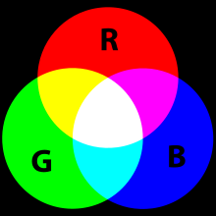
z₊
x₊
z₊
S-G
z axis
S-G
x axis
S-G
z axis
Source
z₋
x₋
z₋
1
2
3

Slide 33
So What?
The holy grail of Theoretical Physics is the grand unification of the forces of physics (electromagnetism, nuclear, gravity). Most Theoretical Physics Departments have some research activity in this area. As a result, thousands of professional physicists around the world work on the problem. However, after over 50 years of intense research, there is still no accepted “grand unified” theory of physics.
Almost without exception, this research assumes as fundamental the axioms of quantum theory. The work then proceeds by trying to find clever (eg string-based) Lagrangians on which standard “quantisation” methods are applied.
An alternative hypothesis – based on ideas that were utterly unknown to the founding fathers of quantum mechanics - is that quantum theory is a statistical description of an extended deterministic but non-computable theory of gravity which is geometric both in space-time (à la Einstein) and in state space (à la Lorenz). Prediction: No such thing as a “graviton”. Not a popular view in contemporary physics.
If the alternative hypothesis was right, then all the standard approaches to grand unification (including string theory) would be profoundly misguided. Perhaps these thousands of (very bright!) scientists could then be redeployed to research things more useful for society - like weather and climate!

Slide 34
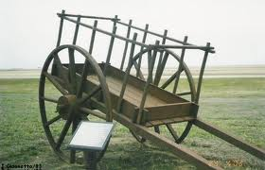
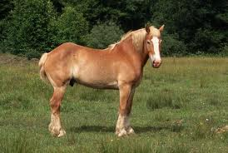
The very expression “quantum theory of gravity” may be a misguided one – putting the quantum “cart” before the gravitational “horse”

Slide 35
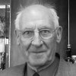
“We may be able to understand Hawking Radiation using ideas in non-equilibrium thermodynamics, in particular the Principle of Maximum Entropy Production.”
“We may be able to understand Earth’s climate using ideas in non-equilibrium thermodynamics, in particular the Principle of Maximum Entropy Production.”

