Slide 1
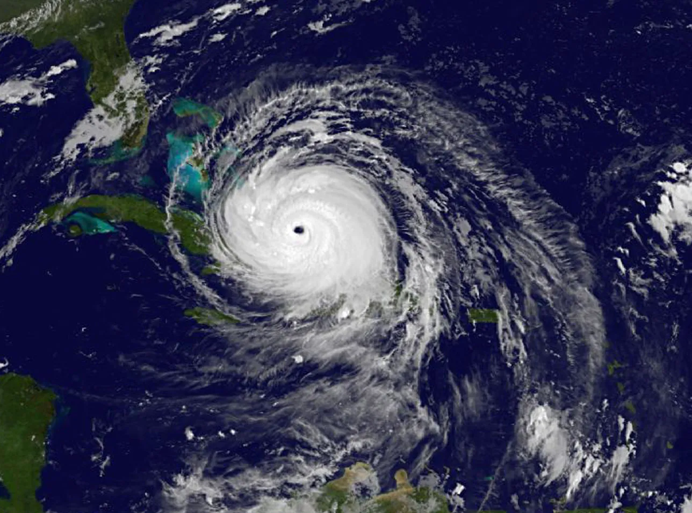
LORENZ UNDERWRITERS

Slide 2
VALUE PROPOSITION
Lorenz aims to be the first to underwrite insurance using physics driven hazard modeling
TODAY’S AGENDA
Why replace the industry’s statistical models, both established and emerging, with physical models?
  Historical context
  The Challenges for Statistics (small training set, non-stationarity, leptokurtosis)
What is physical modeling and how accurate is it?
  Weather forecasting and global circulation models
  Why it is necessary to “downscale” global models
  The Physical Cyclone Downscaling Models that we employ
How do we use the physical cyclone models to underwrite insurance better?
Does it make money?

Slide 3
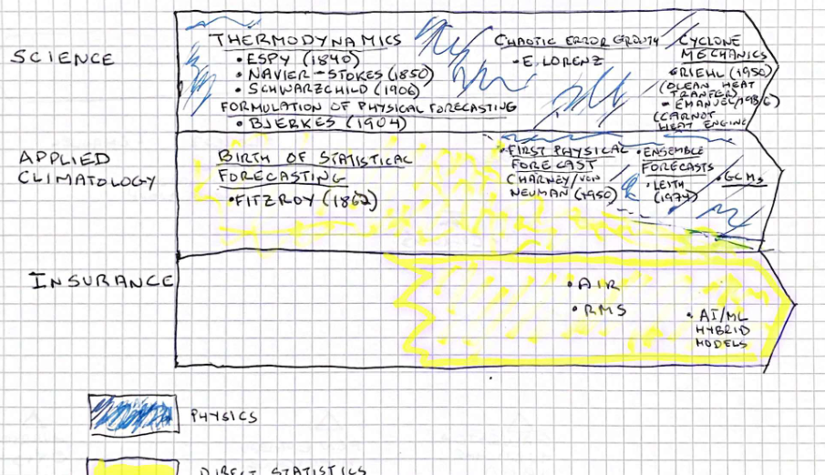
EVOLUTION OF WEATHER MODELING

Slide 4
THE CHALLENGE FOR STATISTICAL MODELLING
The small data set of severe storms over a century of observations imposes great uncertainty to risk estimates
Damage ($Billions)
Average Annual Loss ($Billions)
We use Global Circulation Models (GCMs) and Physical Downscaling (zooming in) techniques to generate 10,000 sets of 1,000-year “histories” of tropical cyclones that make landfall each year using a stationary climate* of today more relevant to assessing the risk over the next 5 years)
We simulated loss distribution of one commercial and two residential property insurance firms with $~2 Trillion of Total Insured Value (TIV) over ~13K zip codes above using one set of a thousand years
A single 1,000-year realization exhibits realistic annual losses. AAL uncertainty (95% confidence) is large for records shorter than about 1,000 years.
Modelers and insurers who don’t have access to a large and accurate synthetic storm set may get false comfort from (erroneously tight) confidence intervals derived from the small ~100 yr. observed storm set.

Slide 5
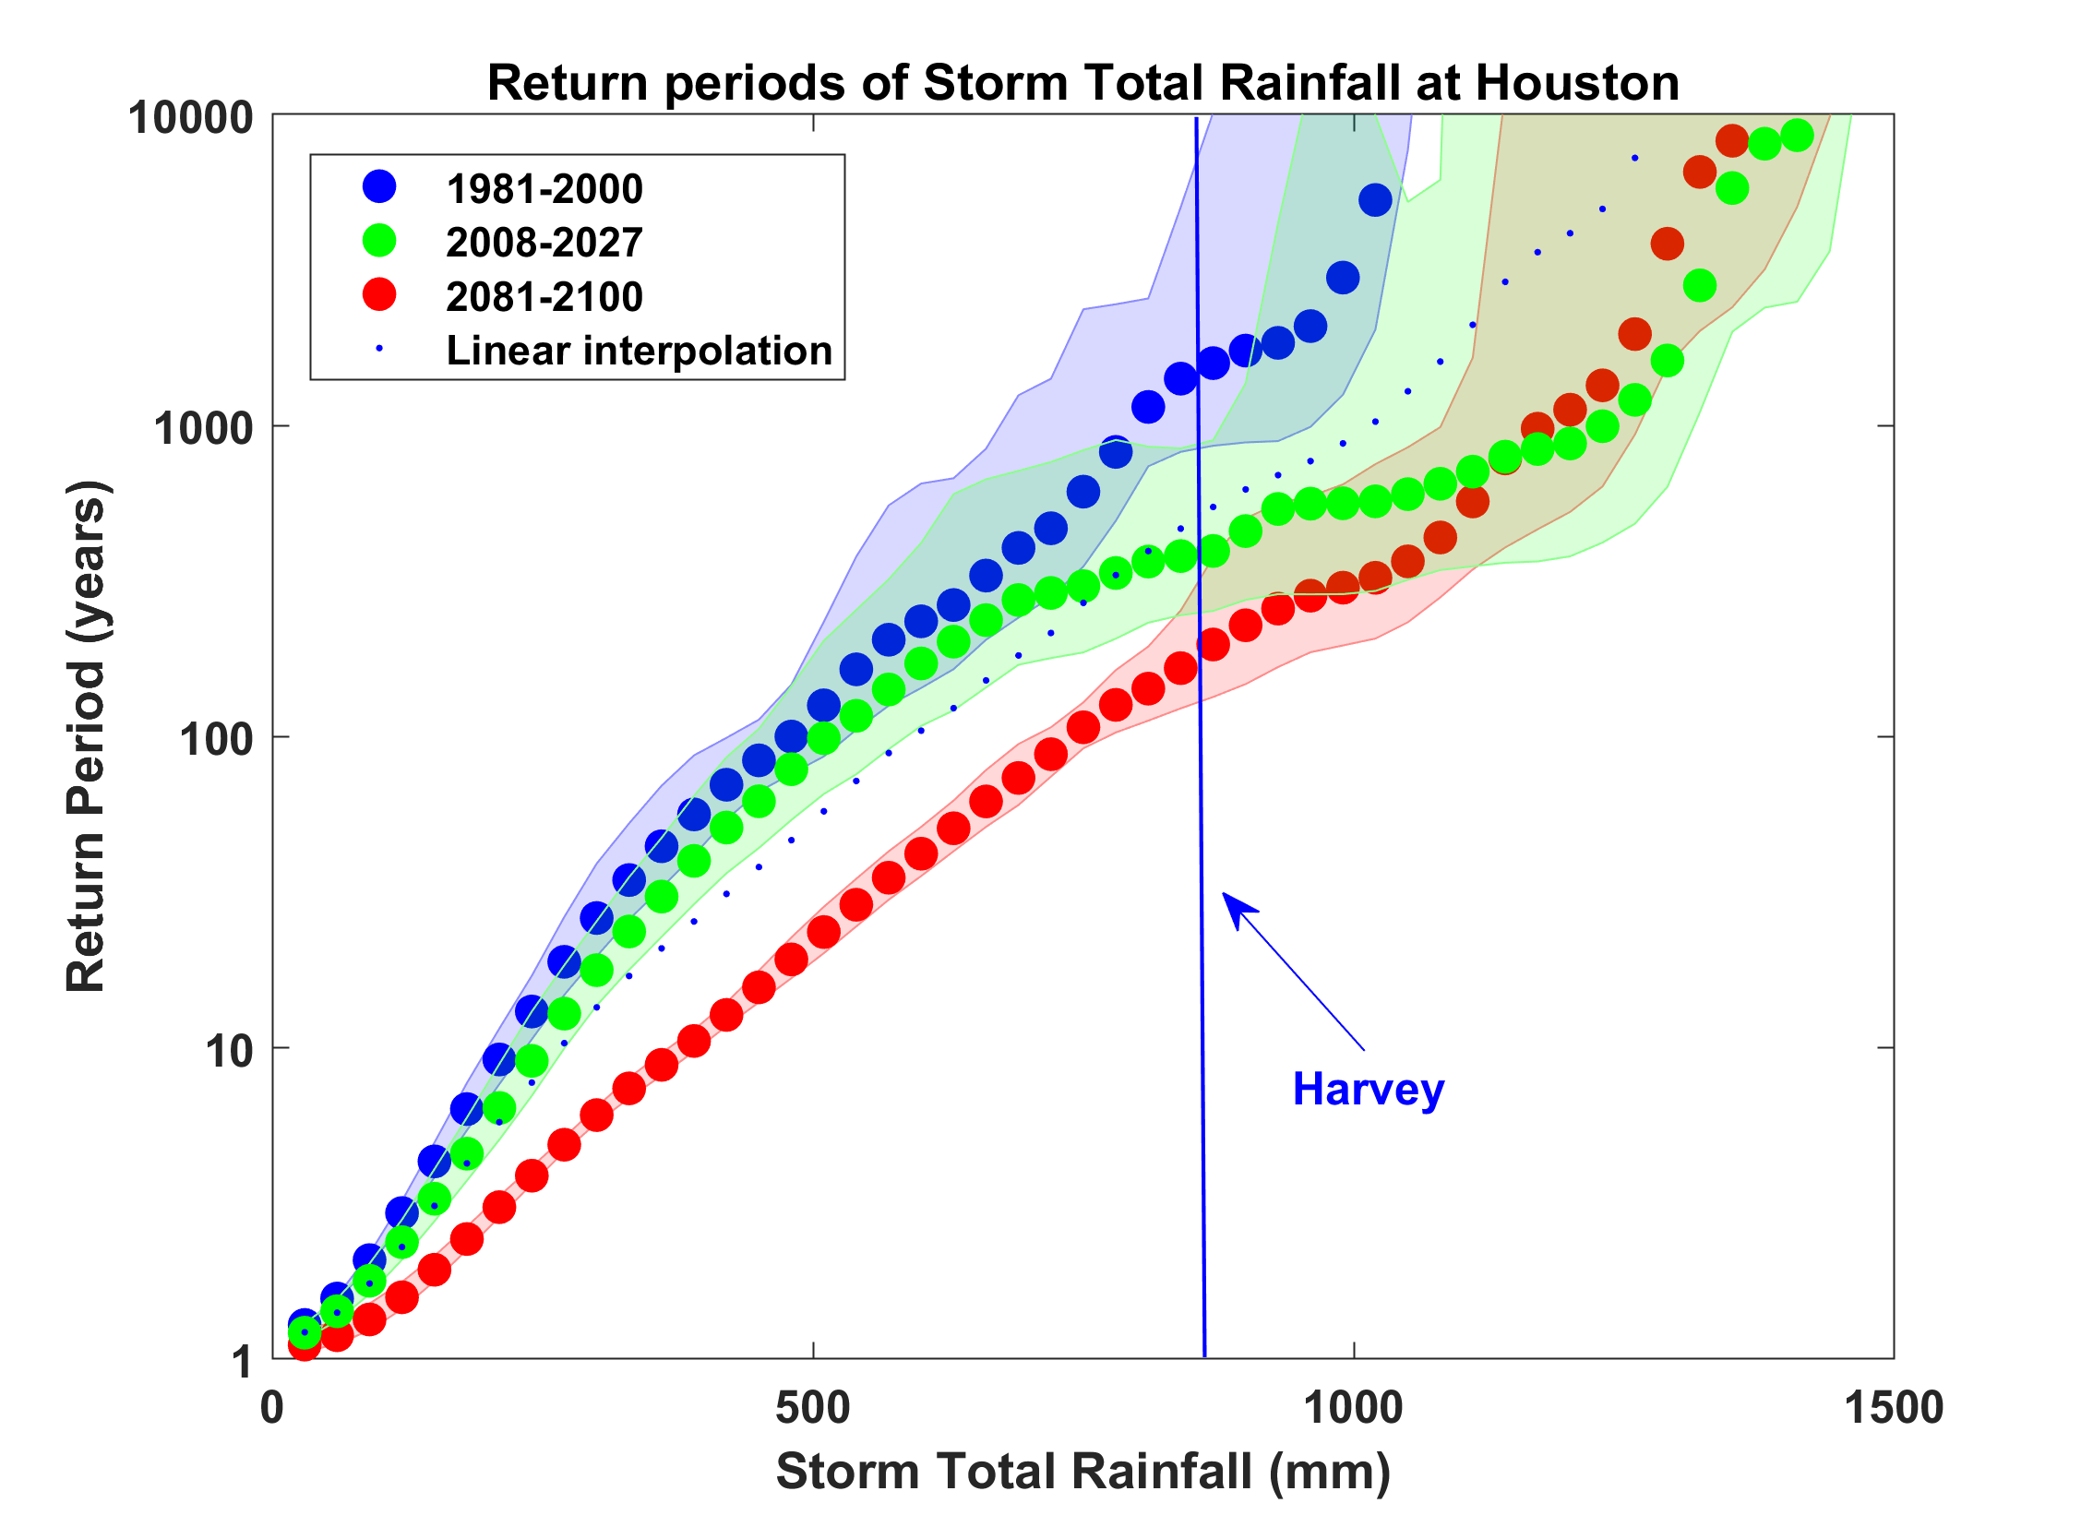
THE CHALLENGE FOR STATISTICAL MODELLING
Climate change has materially altered the true probability of loss. Most of the data set available for statical analysis is stale (aka non-stationarity)
Physical modelling reveals the rainfall probabilities for Houston using 1981-2000 data (blue) and 2008 – 2027 (green) on the left. Climate change shifted Harvey from a 1000-year event (as seen by insurance a statistical model) to what is now a 200-year
Stale statistical risk estimates are particularly damaging (dangerous?) for insurers as 100-year events become 50-year events (right chart). The steepest part of the s curve is shifting leftward and statistical models can’t accurately gauge this migration to greater loss likelihood

Slide 6
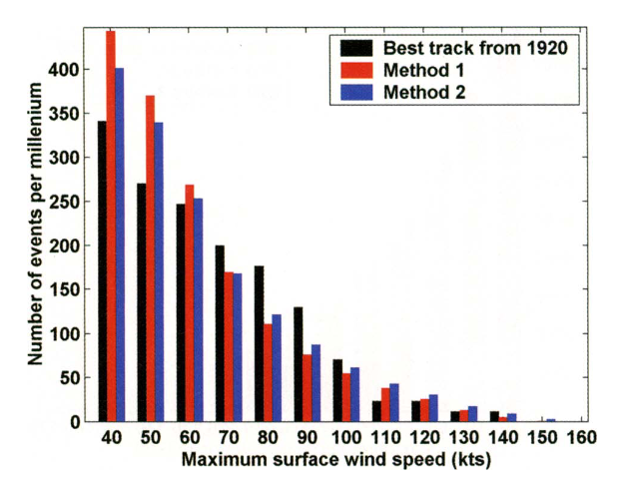
THE CHALLENGE FOR STATISTICAL MODELLING
The non-linear physics of hurricanes generate leptokurtic intensity distributions. Statistical models generally overestimate probabilities near the mean and underweight the true tail
The chart depicts modeled and observed maximum wind speeds within 100 km of downtown Miami
  29 actual observations (lack), 3000 simulations hybrid statistical model (red), 3000 simulations physical model (blue)
  Both the hybrid and physical model are from Emanuel 2006. Emanuel has since dropped the hybrid model and improved the physical model
The hybrid statistical model overestimates weaker storms (70 knots or less) and underestimates the destructive tail.
The same “meanward” bias has been observed in ML short term weather forecasts (where they exhibit skill).
Statistical models, including ML, lack the chaotic error growth that contributes to cyclone’s fat intensity tails

Slide 7
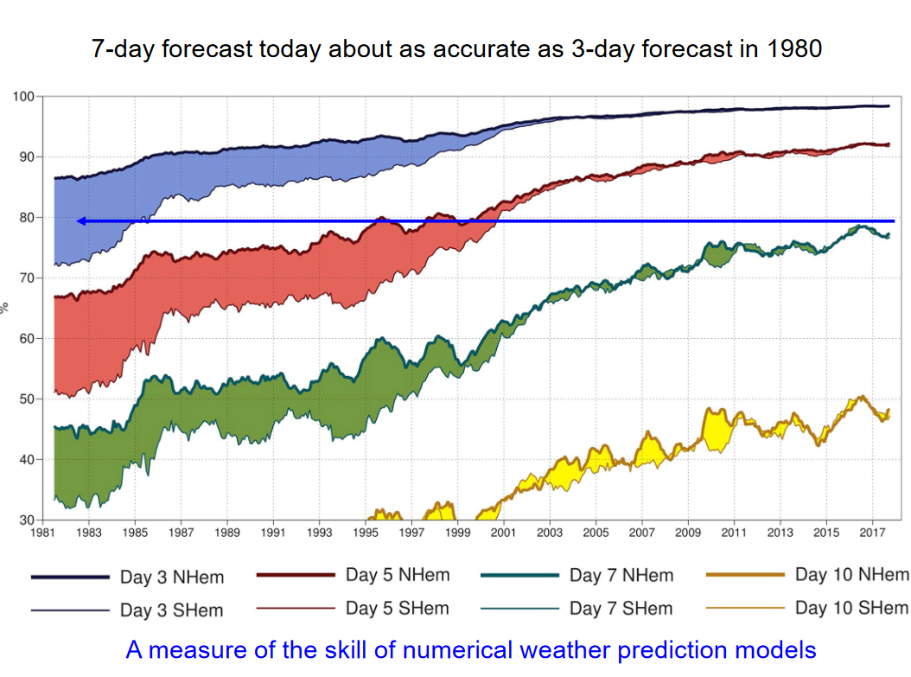
THE ADVANTAGES OF PHYSICAL MODELING
Since its inception in 1950s physical weather forecasting has improved greatly and has all but displaced prior statistical methods.
Chart on the right shows the growing accuracy of physical forecasts (3,5,7, and 10 days forward) for both the northern and southern hemispheres.
Physical forecasting models incorporate the known laws of physics which drives their accuracy.
The same non-linear physical formulae makes them too computationally intensive for hazard modeling.

Slide 8
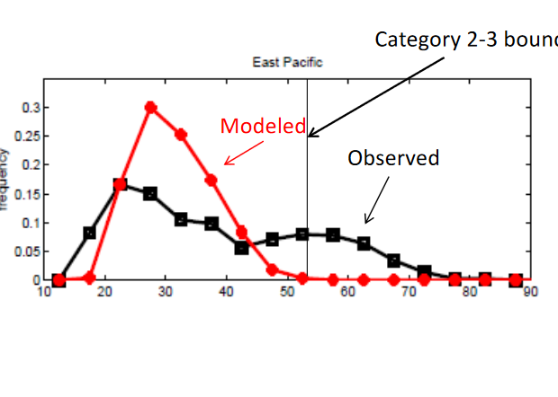
GLOBAL PHYSICAL MODELS
Modern physical forecasting models have a 5-10 km grid resolution with consequent computational intensity that restricts there use for boundary condition problems including statistical hazard quantification.
Physical Global Circulation Models (GCM) have a 50-100 km grid resolution allowing them to run the thousands of simulations needed for statistical analysis. Their resolution is inadequate to model cyclone intensity properly as the chart (right) showing output from a 50 km grid GCM makes clear.
Emanuel at MIT solved this by embedding a very detailed but fast cyclone within large scale global models.

Slide 9

PHYSICAL CYCLONE MODELING
The Emanuel/MIT technique, which Lorenz Underwriters employs, follows four steps.
Step 1 Genesis: Seed each ocean basin with a very many weak randomly located cyclones with randomized origin points. Most die (e.g., from vertical wind shear)
Step 2 Track Generation: Surviving cyclones are allowed to move with the large-scale atmospheric flow in which they are embedded, plus a correction for the earth’s rotation and sphericity (beta-drift). The large-scale flows emanate from the GCM. Tracks that don’t impact model target locations are edited out.
Step 3 Intensity Modelling: A detailed hurricane intensity model (CHIPS) is run for each cyclone. (CHIPS is phrased in angular momentum coordinates. Flow-dependent resolution provides great accuracy at and near the eye wall). Cyclones that fail to develop threshold wind speed are edited out.
Step 4: Using the small fraction of surviving events, determine storm statistics. Can easily generate 100,000 events
Notes:
9
In this downscaling technique, one starts with large scale airflow and thermodynamic conditions supplied from a climate reanalysis or a climate model. This time-evolving global state is randomly seeded with very weak proto-vortices. They move according to the air currents supplied from the climate analysis or climate model. Their intensity is calculated using a deterministic numerical model that was first developed to forecast real hurricane intensity in real time, and is still being used that way. This intensity model predicts that the vast majority of seeds die; the survivors are considered to represent the true hurricane climatology associated with that climate analysis or climate model.

Slide 10
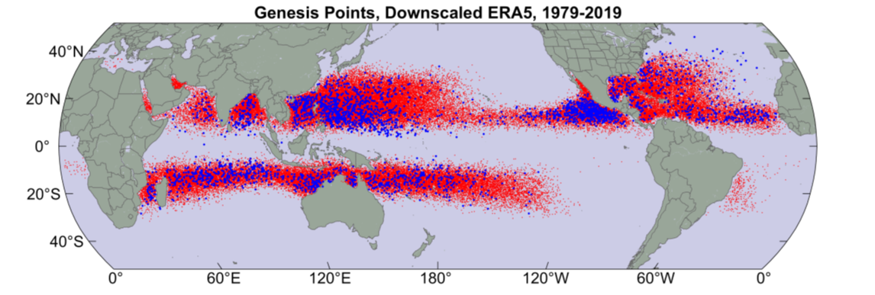
CYCLONE GENESIS
- Gensis points from our model (red dots) provide a dense sampling that includes regions with no cyclones on record (such as the Persian Gulf). The blue dots represent historical observations of actual genesis points.
Some of the historical observations in the northern reaches of the North Atlantic represent other types of storms that were probably mis-characterized as hurricanes.

Slide 11
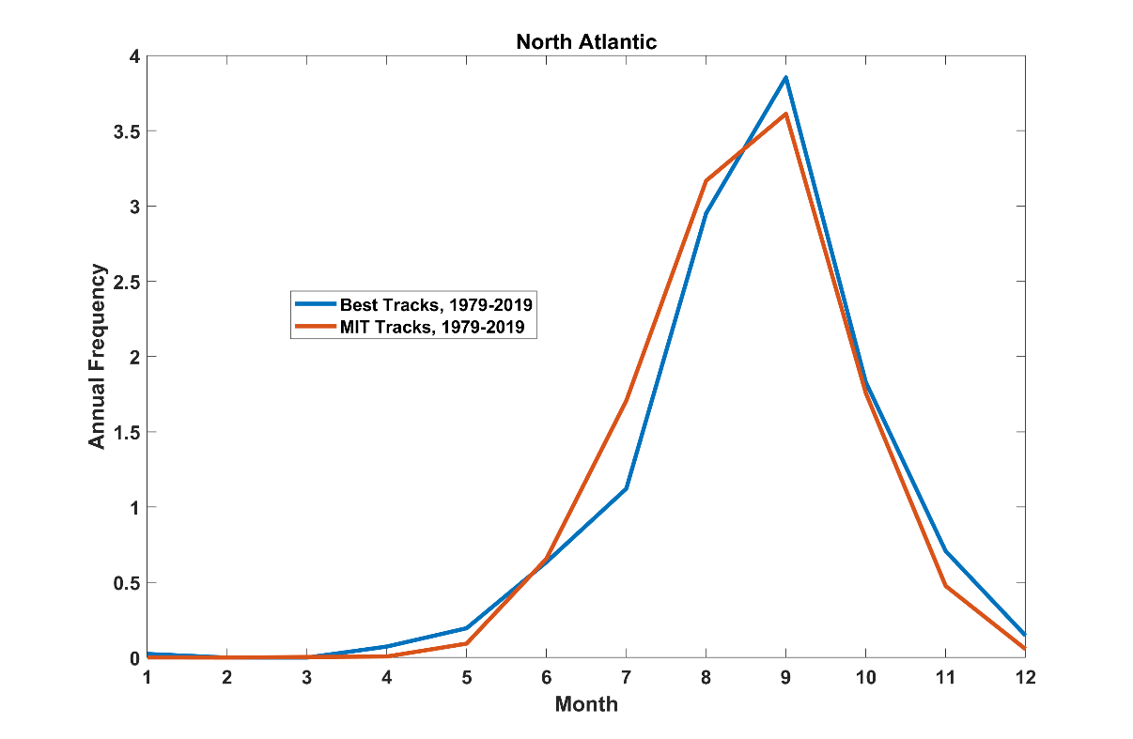
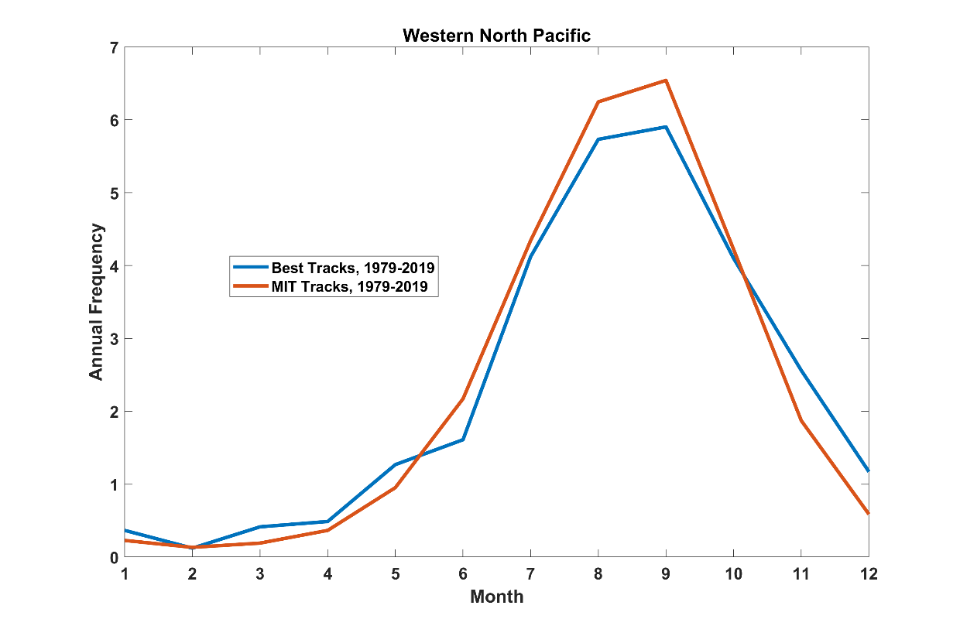
CYCLONE GENESIS: Validation
The modeled genesis frequency and seasonal distribution (red) conforms with the historical record.

Slide 12
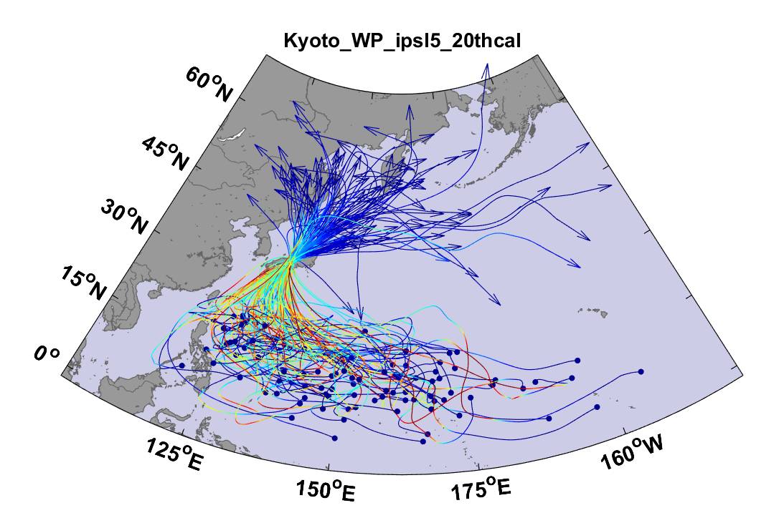
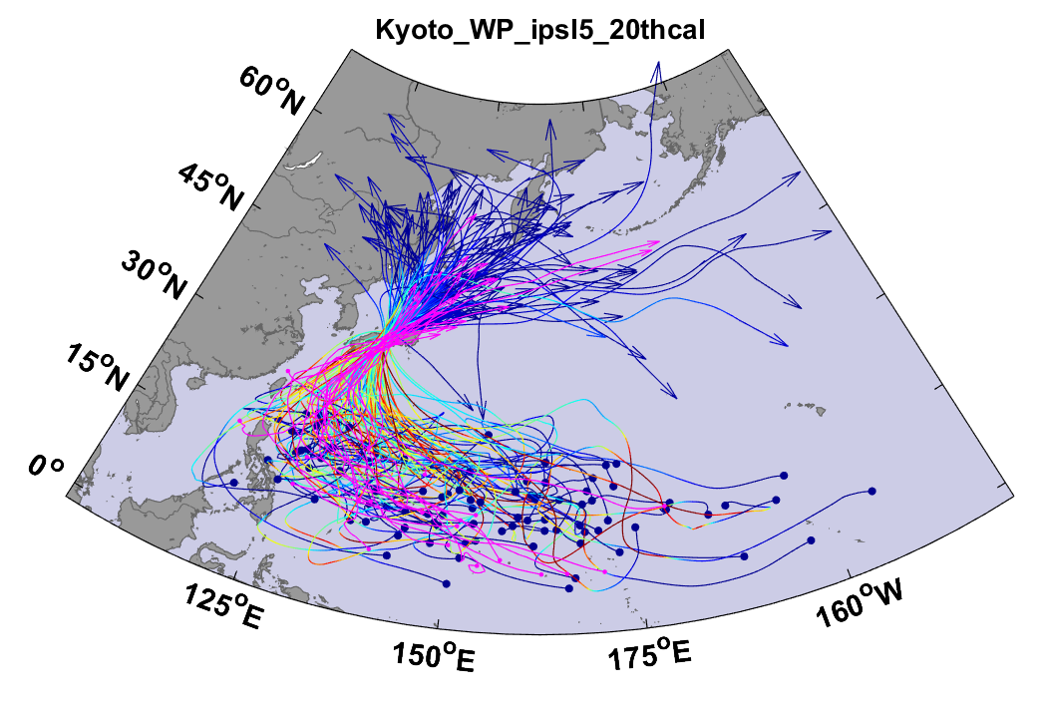
TRACK GENERATION (and validation)
The 100 strongest modeled cyclones affecting Kyoto are shown at left. Warmer colors indicate higher wind speeds. Historically observed storms are added in magenta at right providing track model validation.

Slide 13
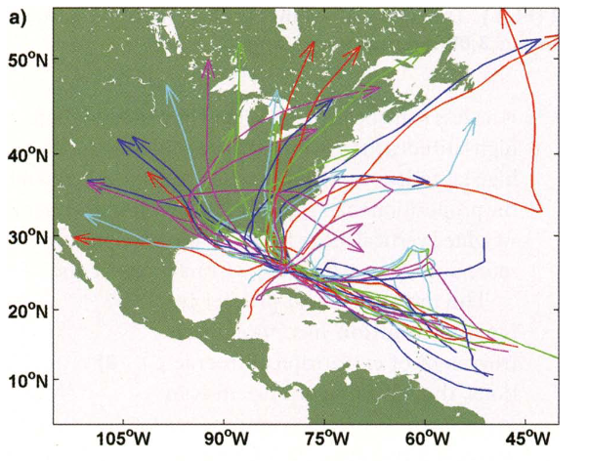
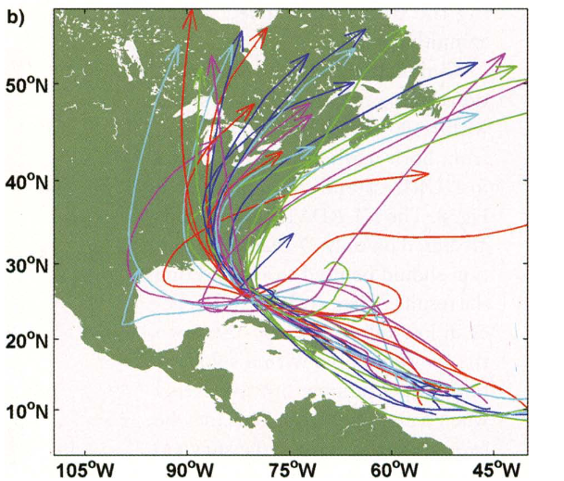
TRACK GENERATION
Two additional maps from Emanuel 2006 show the 30 most intense modeled tracks that affect Miami using the Hybrid Model (left) and the physical model (right)
None of the ones from the Physical model arrive from west of south. Lacking a means of integrating wind shear with specific track, the Hybrid Model erroneously retains west to east tracks that would lose power from the shear
Statistically downscaled (Hybrid Model)
Physically downscaled

Slide 14
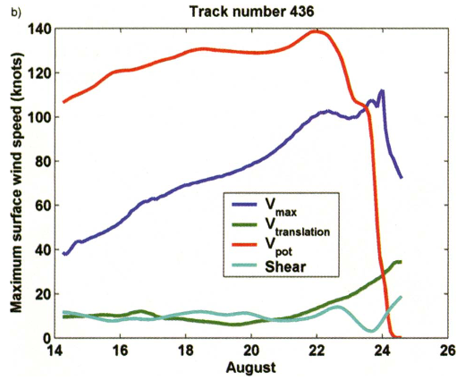
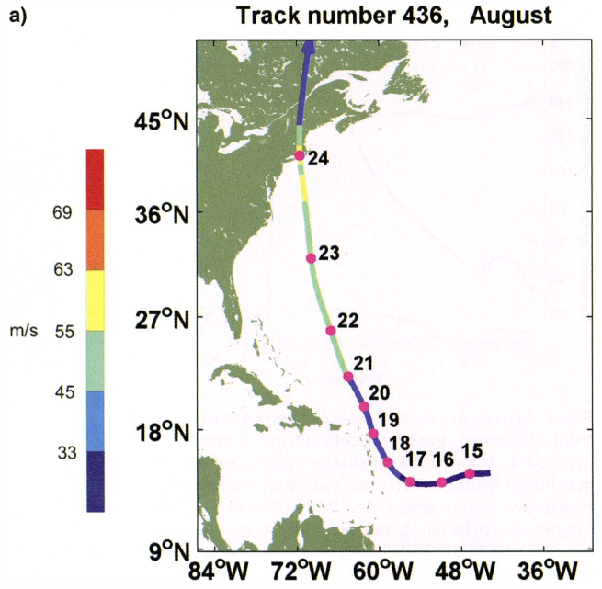
INTENSITY MODELLING (single synthetic storm example)
Selected output from the MIT Emanuel model here depicts the most intense synthetic storm to affect Boston from a set of 3000.
Our physical downscaling model is very good at producing this signature profile for intense Northeast coast storms

Slide 15
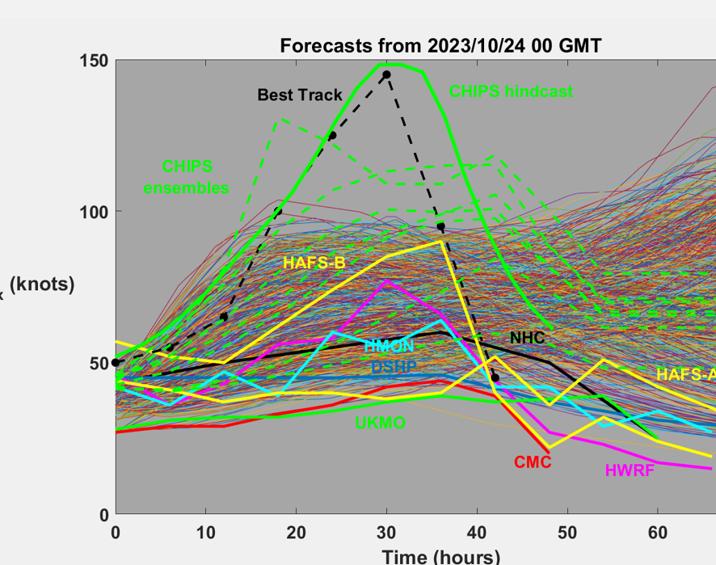
INTENSITY VALIDATION (single storm example)
The dashed black line in chart shows the actual intensity observations over time for Hurricane Otis in the dashed black line. The solid green line shows a hindcast of Otis employing the CHIPS intensity model from MIT Emanuel. The replication of both intensity and rate of intensification for such an extreme storm provides model validation.
CHIPS was also run as a forecaster (ensembles in dashed green lines) where it outperformed the NHC’s statistical model ( )and physical model( ). Their failure led to The NHC’s catastrophically flawed forecast (solid black line)

Slide 16
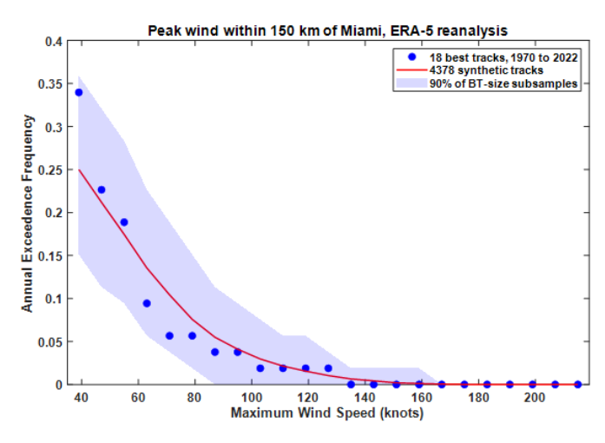
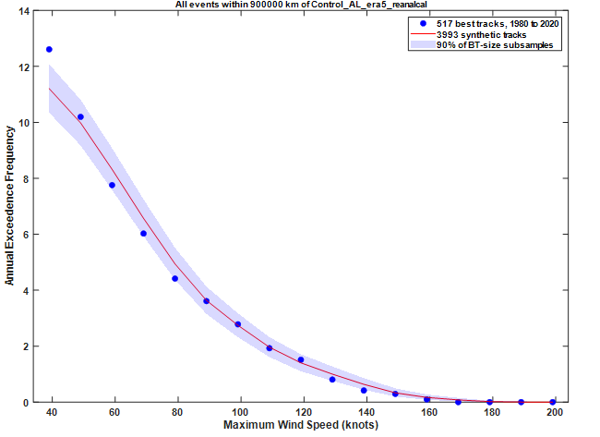
INTENSITY MODELING STATISTICS (and validation)
Statistics can be are derived from synthetic tracks (as shown in the prior two slides). Peak wind annual exceedance frequencies are shown for a global set and a set edited for Miami. The MIT Emanuel model generated roughly 4000 tracks for each. Predictions at both global and local level fit within the 90% confidence interval of observed storms.
Is this also showing peak winds? Need to edit label

Slide 17
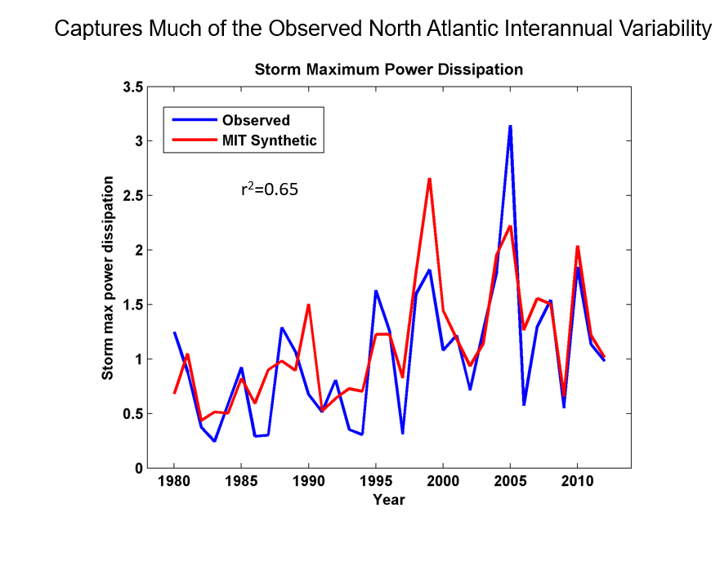
ADDITIONAL MODEL VALIDATION
Storm power dissipation oscillates markedly in the North Atlantic
The MIT Emanuel model captures the underlying drivers of this interannual variability and provides a good replication of the phenomenon.

Slide 18
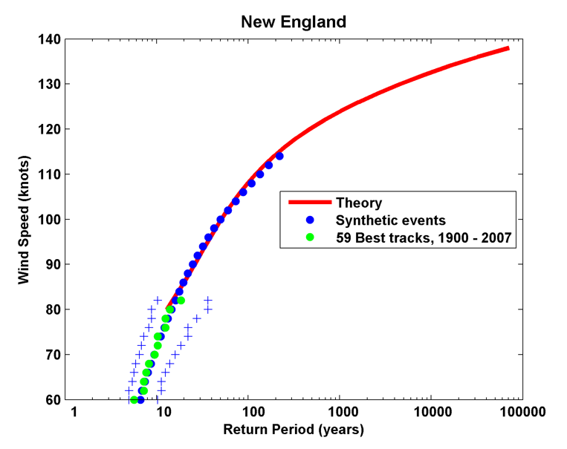
MODEL APPLICATION (extending the out of sample data set)
The same physics that drives weaker cyclones applies to the strongest and the MIT Emanuel model leverages this to fill out the data set used for our hazard statistics beyond the observed range.
The chart shows the extended synthetic event set for New England, where severe storms are rare but destructive.
This is becoming crucial as climate change generates out of sample intensity drivers (such as ocean temperature)
What are the blue plusses? Also, I am not really reading the punchline. I think you want to say two things. (1) We did a good job prlicating observed storm intensities. (2) We can do a good job going forward as the climate changes. (3) we can estimate damages for not yet observed 1 :100 year events

Slide 19
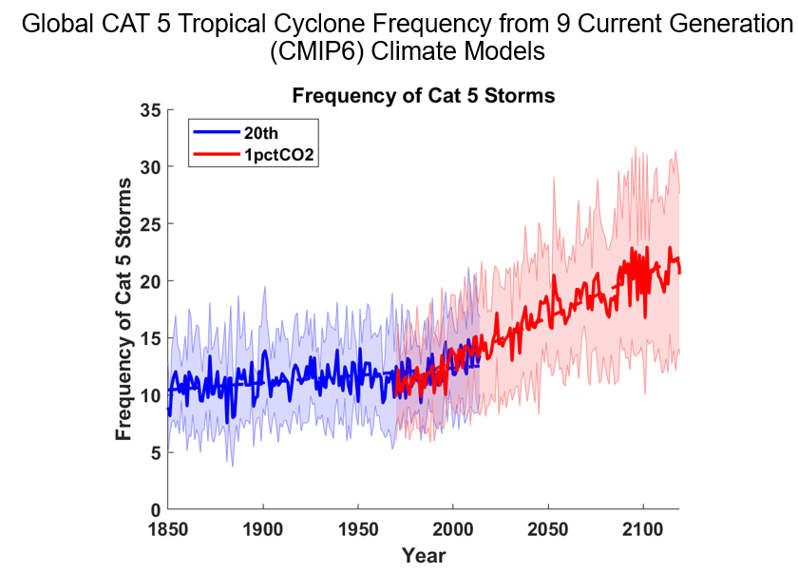
MODEL APPLICATION (climate change)

Slide 20
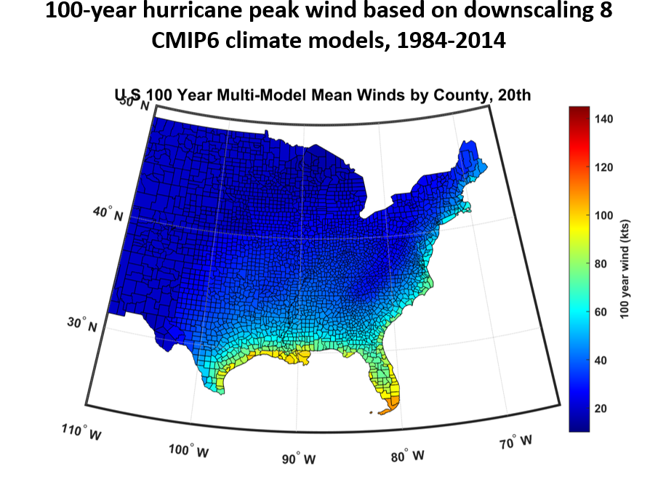
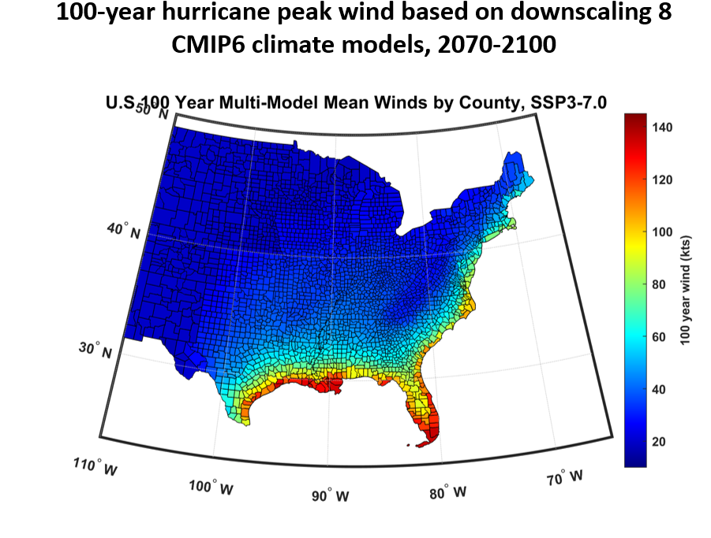
MODEL APPLICATION (climate change)

Slide 21
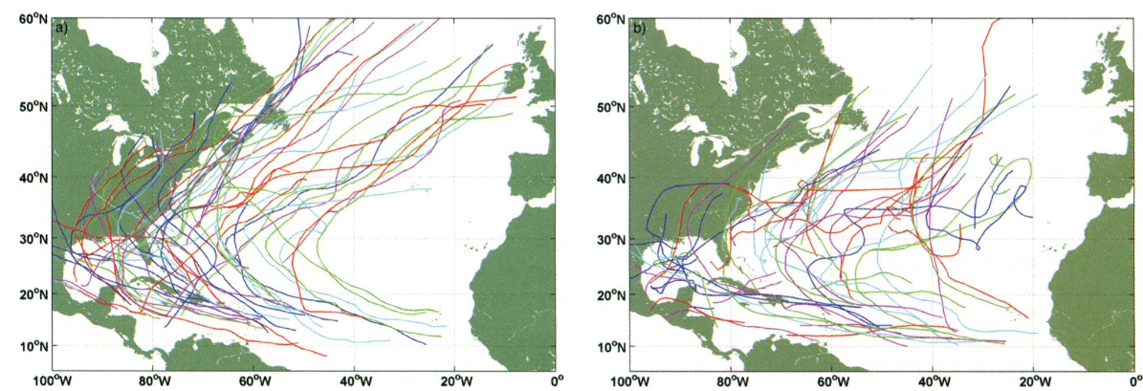
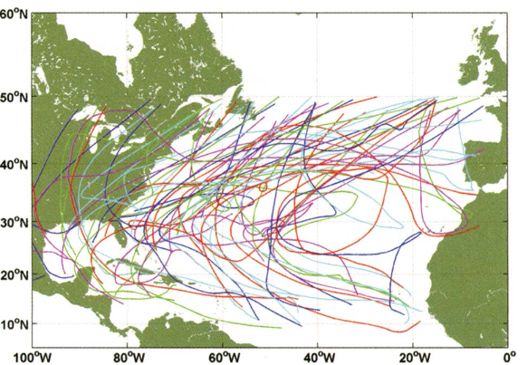
TRACK GENERATION
Cyclone tracks below map a random sample of simulated tracks from a hybrid statistical/physical model (left) and a physical model right. The central map shows actual tracks from HURDAT
Both models are from Emanuel 2006 and were state of the art at the time. Emanuel has since abandoned the hybrid model and improved the physical model.
Both the actual and physical tracks display curvature and loops missing in the hybrid tracks.

