Slide 1

12.815
Atmospheric Radiation and Convection

Slide 2
Course Details
Stellar site: http://stellar.mit.edu/S/course/12/fa15/12.815/
Instructors:
  Sara Seager seager@mit.edu
  Kerry Emanuel: emanuel@mit.edu
TAs:
  Tom Beucler: tbeucler@mit.edu
  Maria Anna Zawadowicz: mariaz@mit.edu (after October 19th)
Grading: 9 problem sets + final paper and presentation
Required Textbooks:
  K.-N. Liou, An Introduction to Atmospheric Radiation, 2nd edition
  D Hartmann, Global Physical Climatology
  Note: We will provided extensive readings from K. A. Emanuel, Atmospheric Convection, Oxford Univ. Press
Recommended Textbook:
  G. W. Petty, A First Course in Atmospheric Radiation, 2nd edition (Sundog Publishing)

Slide 3
Main Objective
Provide a comprehensive treatment of radiative and convective transfer through planetary atmospheres, including moist convection, culminating in an basic understanding of radiative-convective equilibrium.

Slide 4
Topics
Radiation:
  Modeling emission and transmission
  Molecular absorption/emission lines
  Scattering and clouds
  Remote sensing
Convection:
  Convection from maintained and instantaneous sources
  Convection from distributed sources
  Moist thermodynamics
  Stability
  Shallow and deep moist convection
Radiative-Convective Equilibrium
  Random states
  Aggregated states

Slide 5
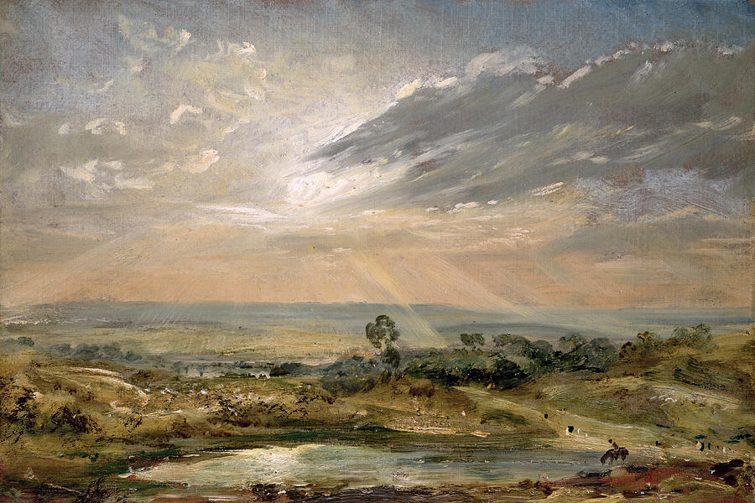
Elements of Radiation and Convection
John Constable: Branch Hill Pond, Hampstead

Slide 6
Composition of Earth’s Atmosphere
Notes:
The mainisotopes of argon found on Earth are ⁴⁰Ar (99.6%), ³⁶Ar (0.34%), and ³⁸Ar (0.06%). Naturally occurring ⁴⁰K with a half-life of 1.25 × 10⁹ years, decays to stable ⁴⁰Ar (11.2%) by electron capture and positron emission, and also to stable ⁴⁰Ca (88.8%) via beta decay. These properties and ratios are used to determine the age of rocks.[13]

Slide 7
Elements of Radiative Transfer
Earth’s Mean Energy Budget

Slide 8
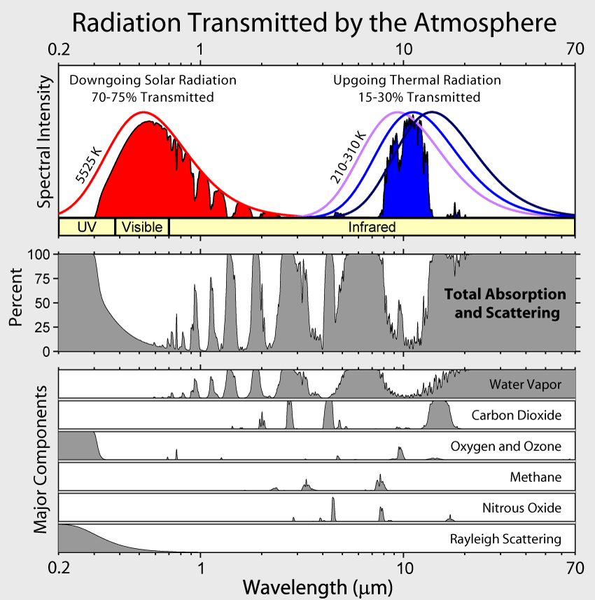

Slide 9
Radiative Equilibrium
Equilibrium state of atmosphere and surface in the absence of non-radiative enthalpy fluxes

Slide 11
Disposition of Solar Radiation:
=~ 240 W m⁻²
Absorption by clouds, atmosphere, and surface

Slide 12
Terrestrial Radiation:
Effective emission temperature:

Slide 13
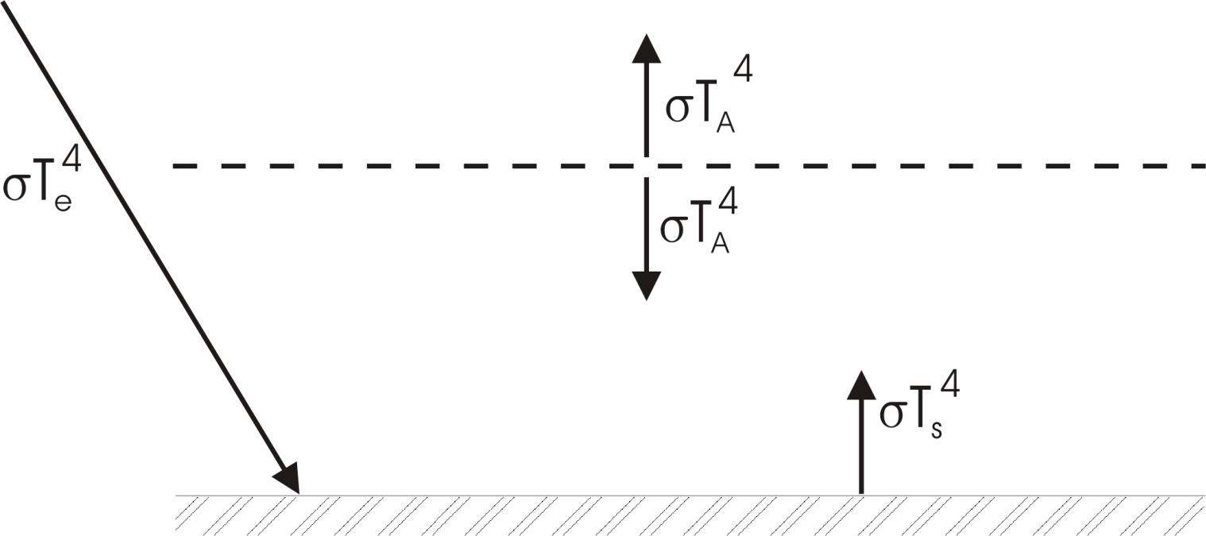
Highly Reduced Model
Transparent to solar radiation
Opaque to infrared radiation
Blackbody emission from surface and each layer

Slide 14
Radiative Equilibrium:
Top of Atmosphere:
Surface:

Slide 15
Surface temperature too large because:
Real atmosphere is not opaque
Heat transported by convection as well as by radiation

Slide 16
Greenhouse Gases

Slide 17
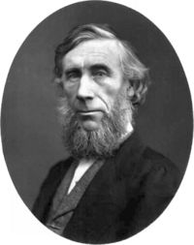
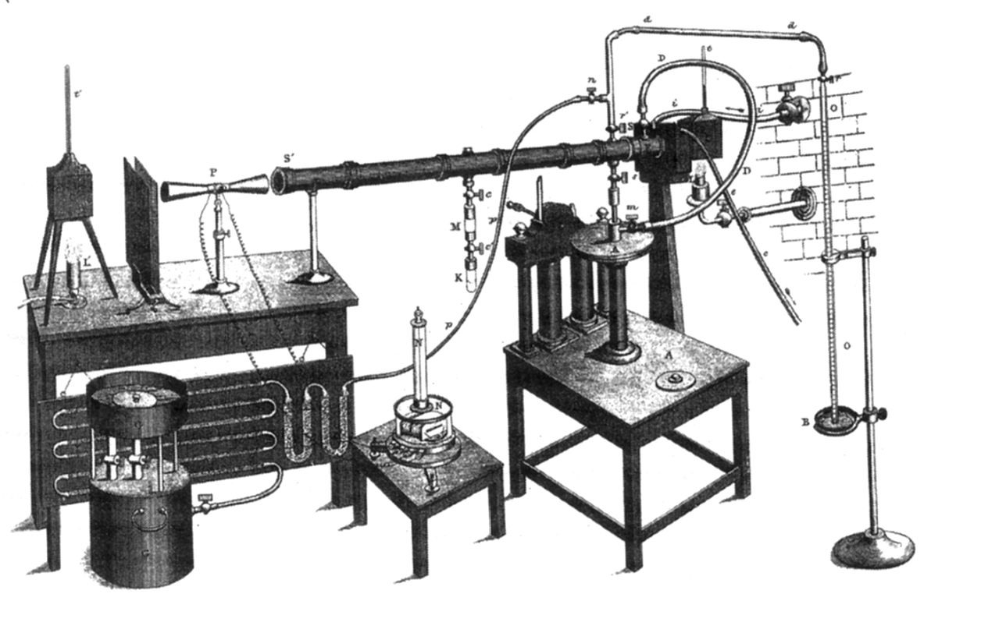
Atmospheric Absorption
John Tyndall (1820-1893)

Slide 18
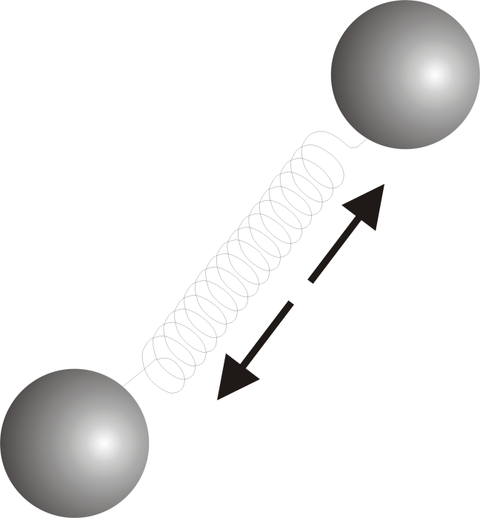
Tyndall’s Discovery:
Oxygen (O₂) and Nitrogen (N₂), which together comprise about 97% of the atmosphere, are transparent to solar and infrared radiation
If that’s all there were:
= Stefan-Boltzmann constant
a = Planetary albedo
= Solar constant

Slide 19
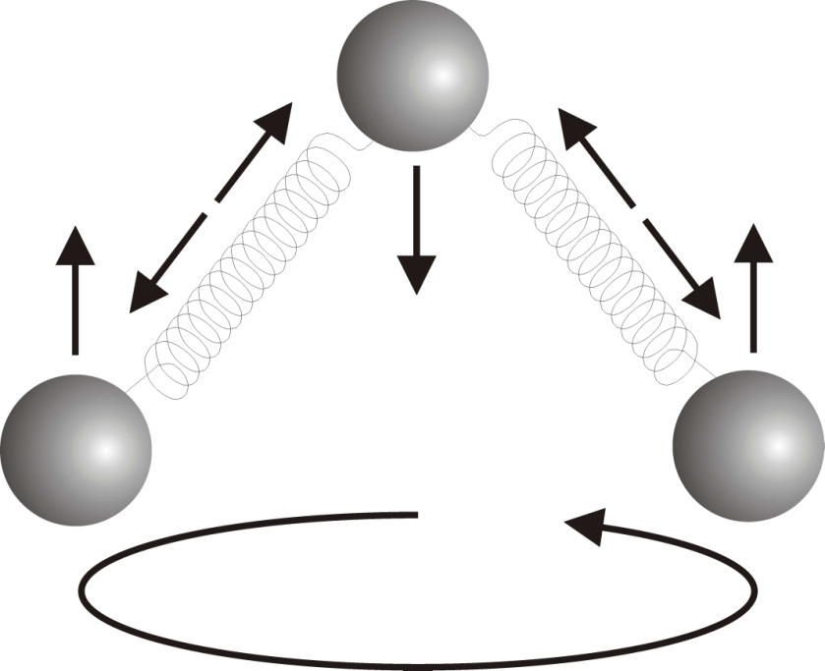
But certain trace gases interact strongly with radiation:
H₂0 (water vapor)
CO₂ (carbon dioxide)
CH₄ (methane)
Clouds also interact strongly with radiation. Together, they yield:

Slide 20
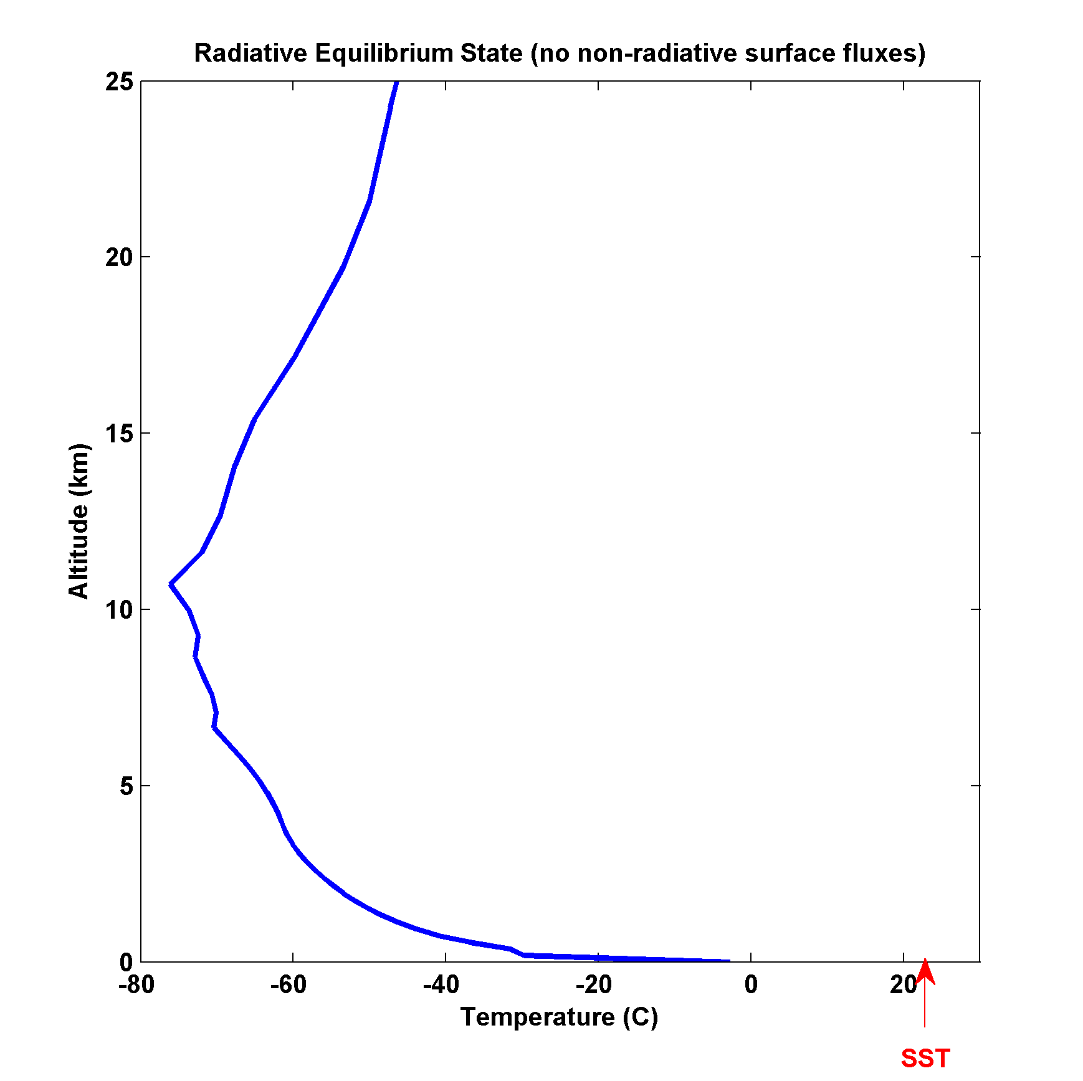
Full calculation of radiative equilibrium:
(no non-radiative fluxes, fixed relative humidity)

Slide 21
Surface temperature too large because:
Real atmosphere is not opaque
Heat transported by convection as well as by radiation

Slide 22
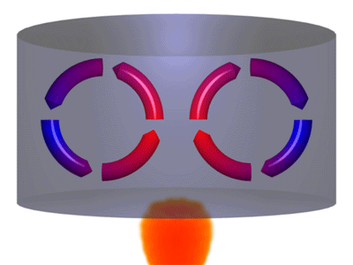

Slide 23
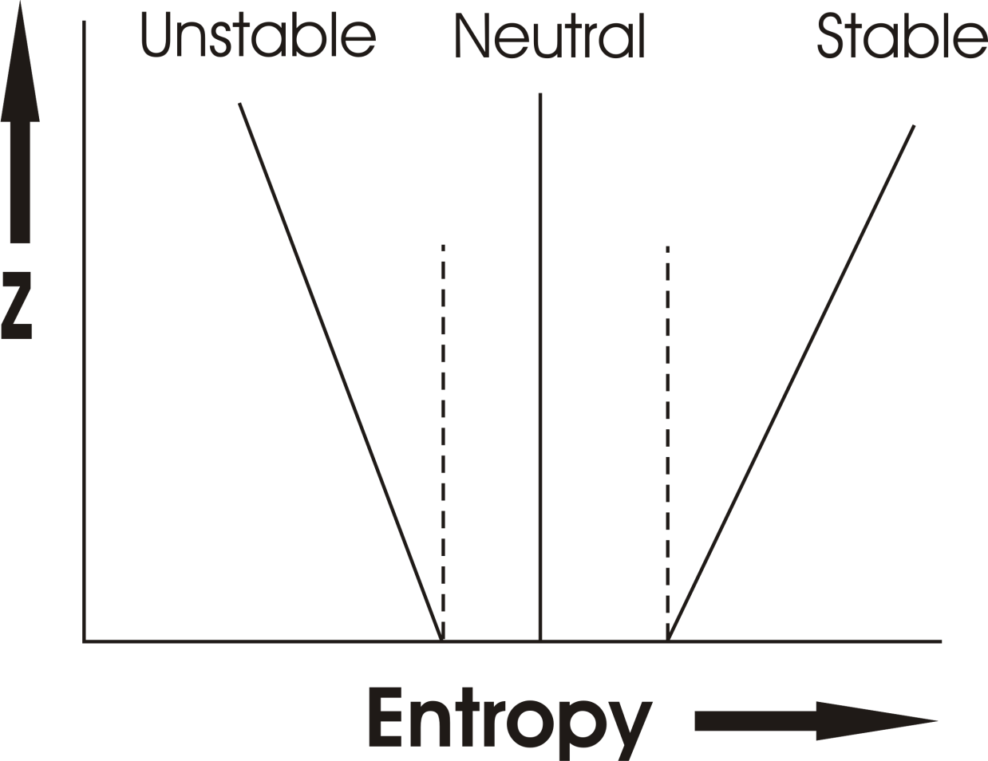
Earth’s atmosphere:

Slide 24
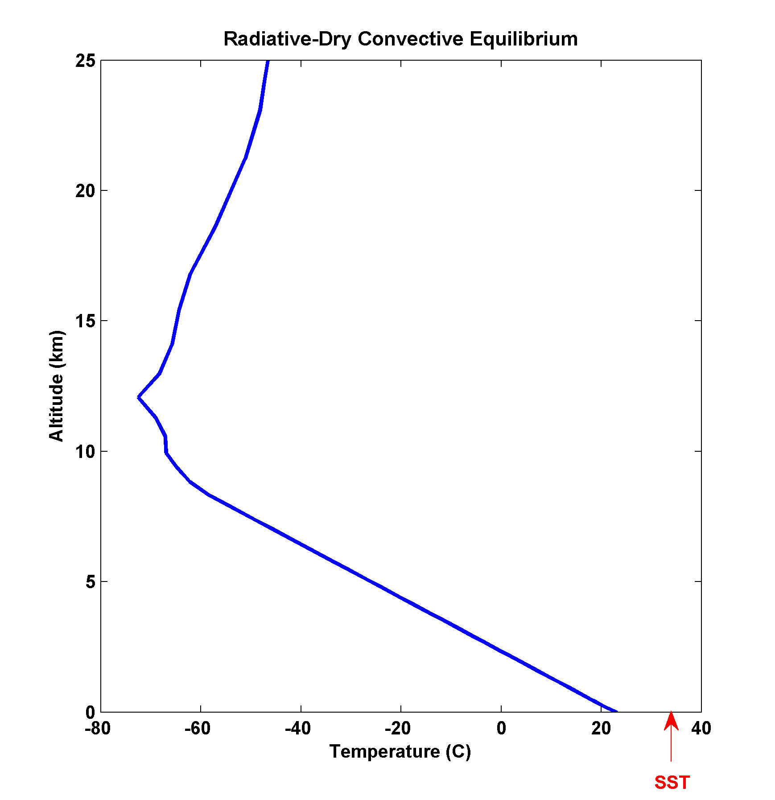
Full calculation of radiative-dry convective equilibrium
(Surface dry turbulent enthalpy flux, fixed relative humidity)

Slide 25
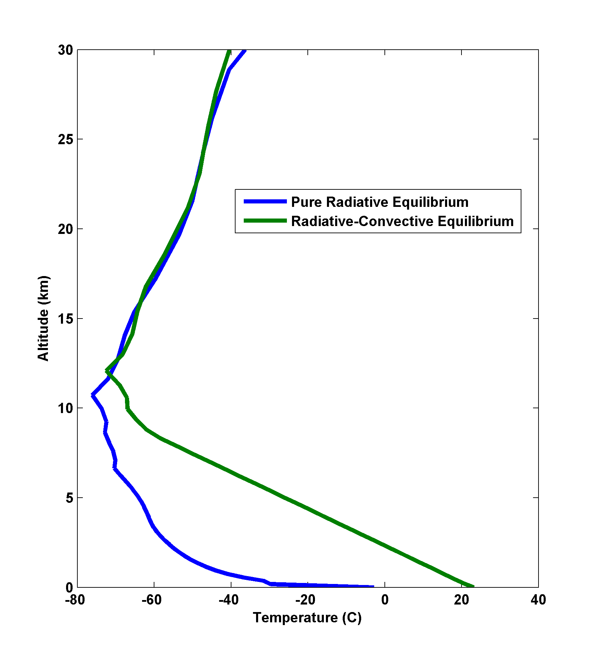

Slide 26
Moist Convection

Slide 27


Slide 28
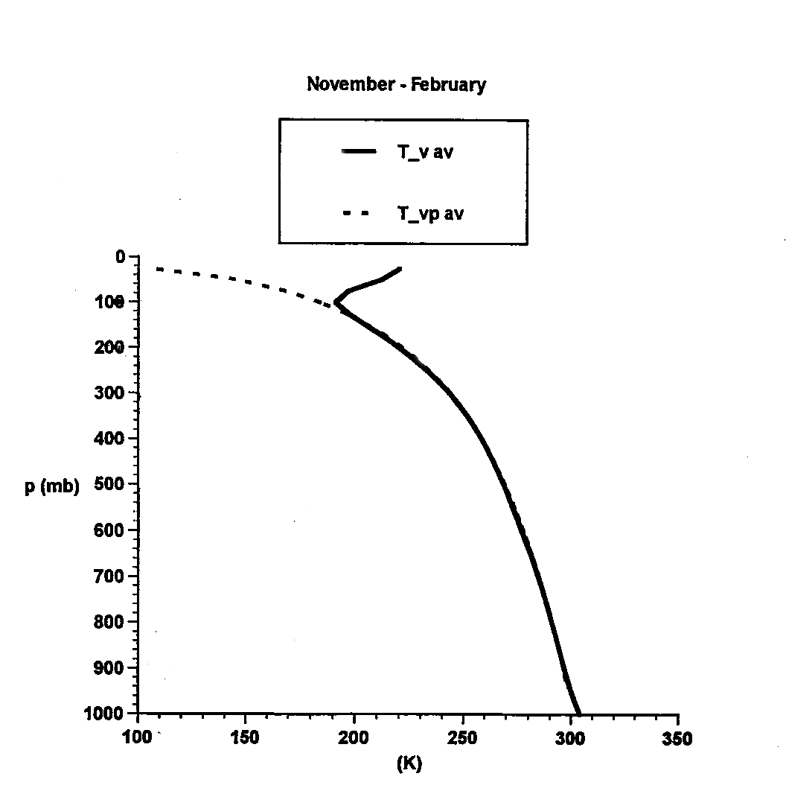
Tropical Soundings Tend to Lie Along
“Moist Adiabats”

Slide 29
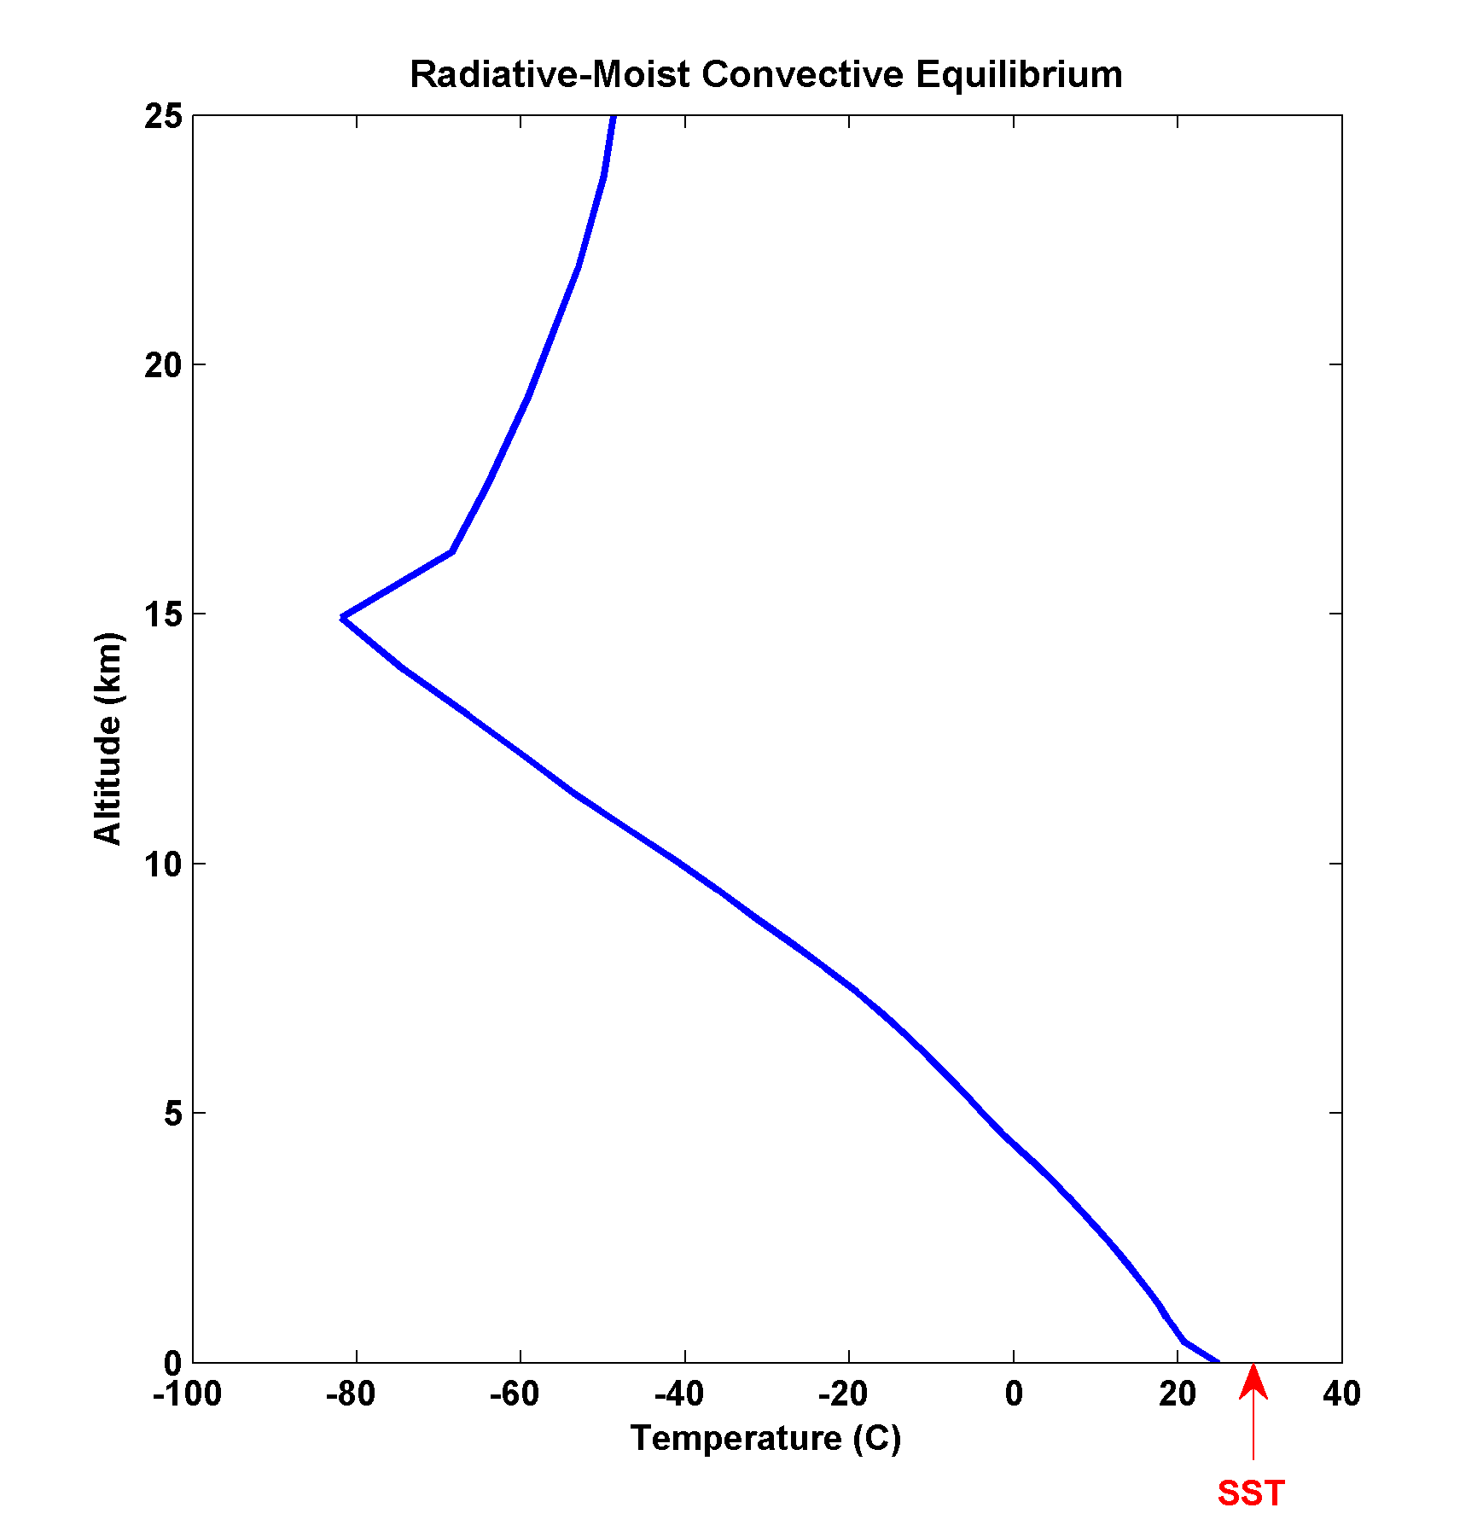

Slide 30
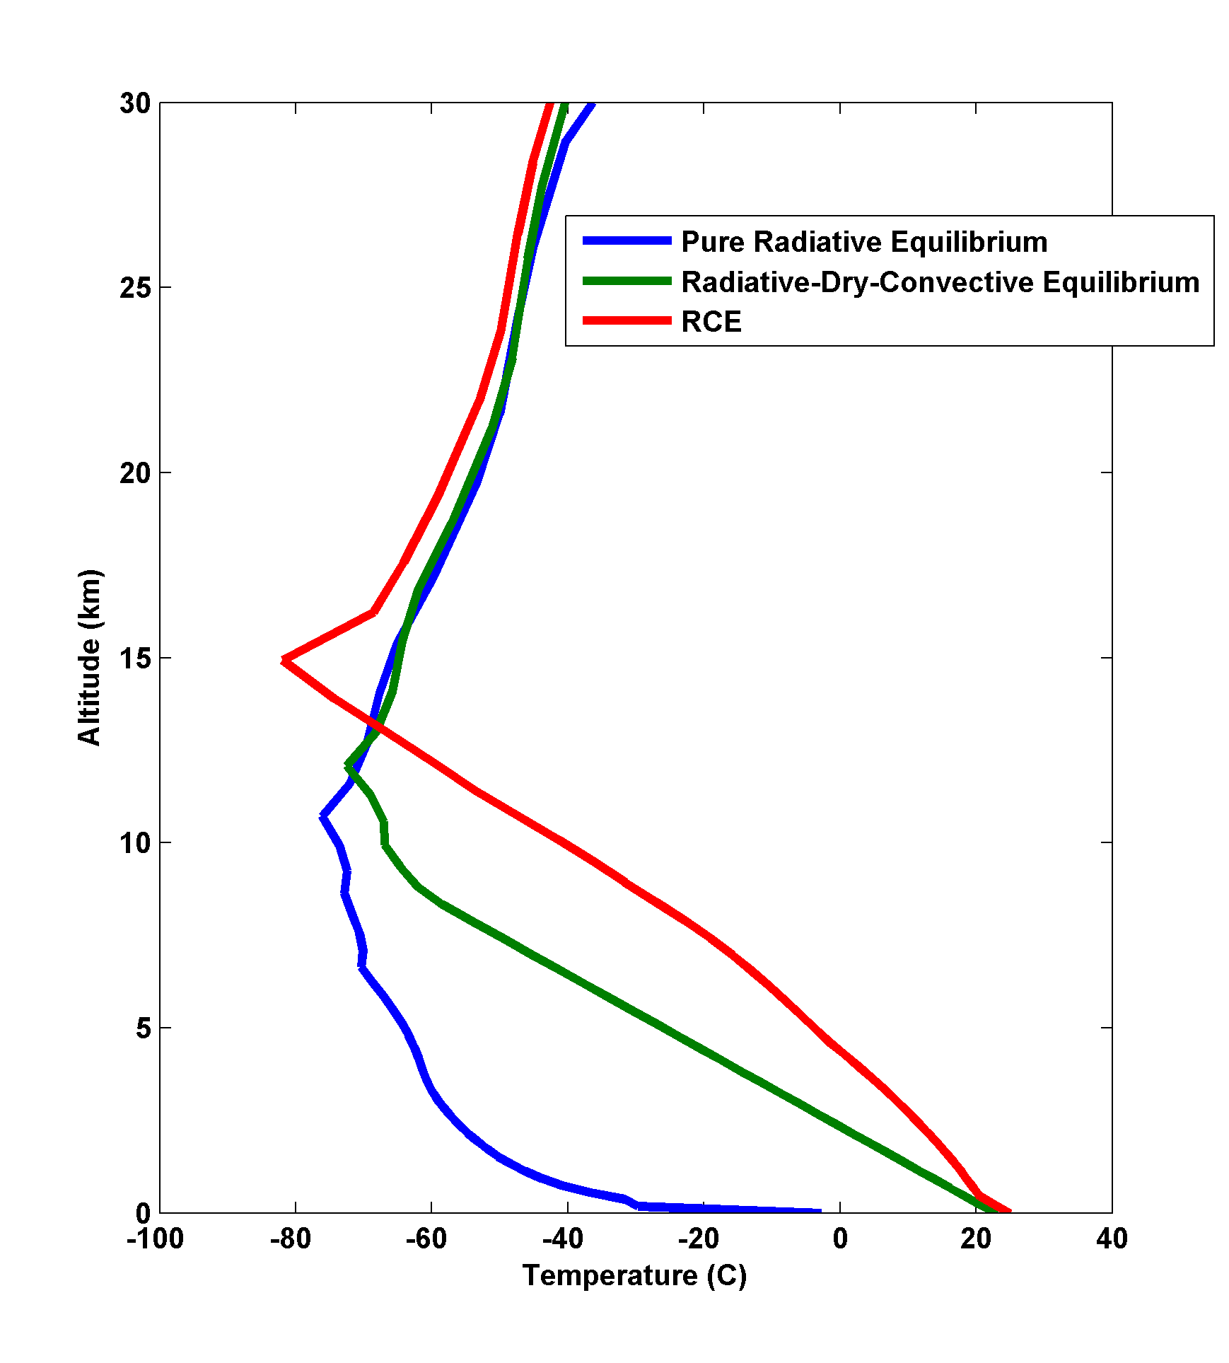

Slide 31
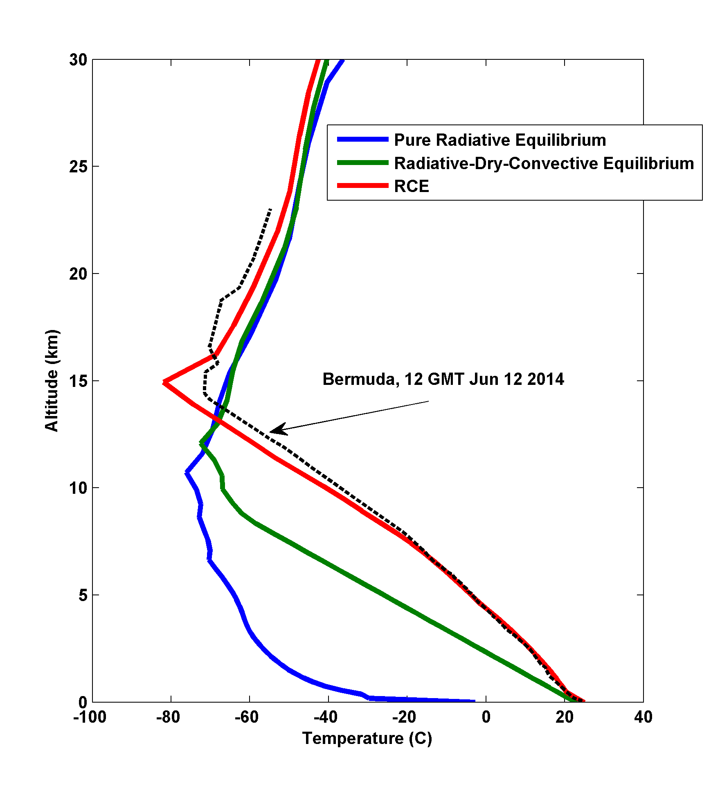

Slide 32
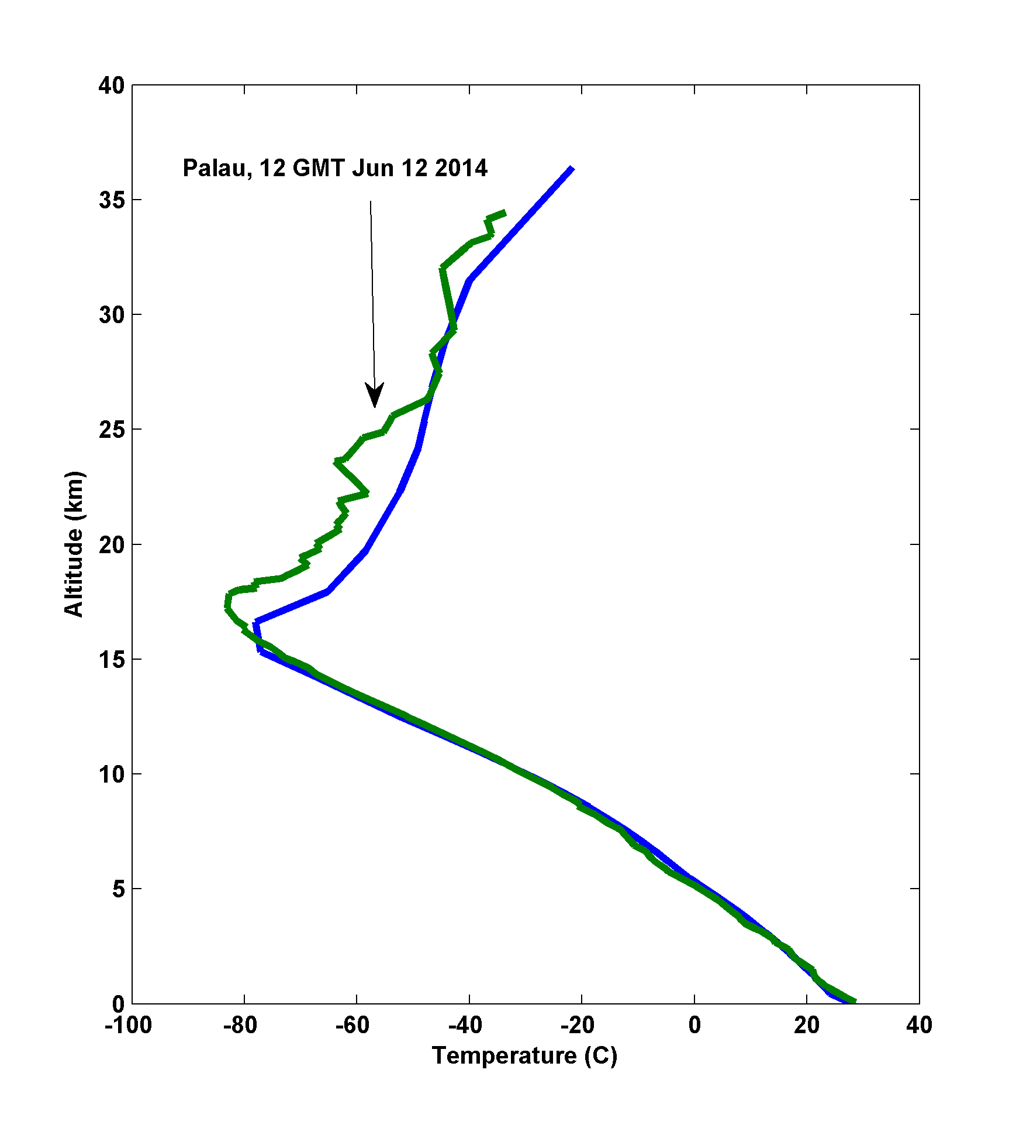

Slide 33
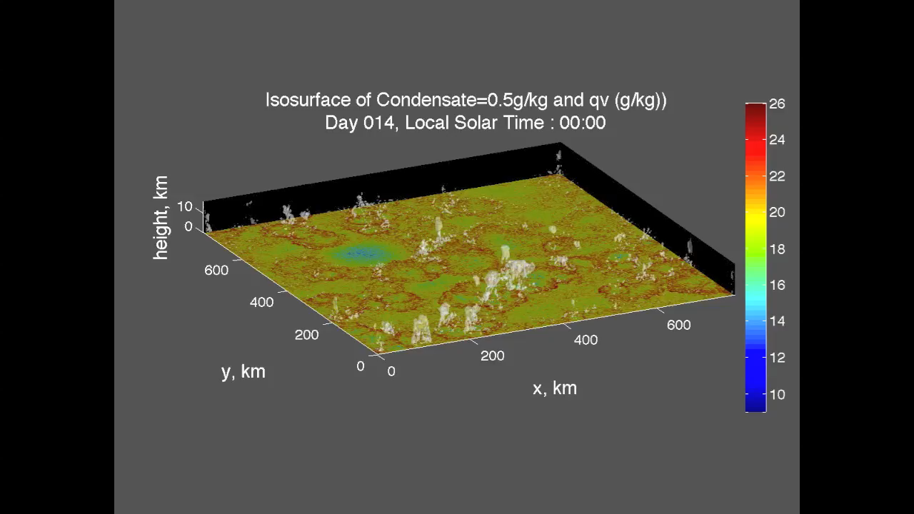
Explicit numerical simulations of radiative-moist convective equilibrium

Slide 34
Next Up:
Overview of Radiation
Please Read Chapters 1 & 2 of Atmospheric Convection (available on Stellar site…note; only select figures are available; see end of chapters)

