Slide 1
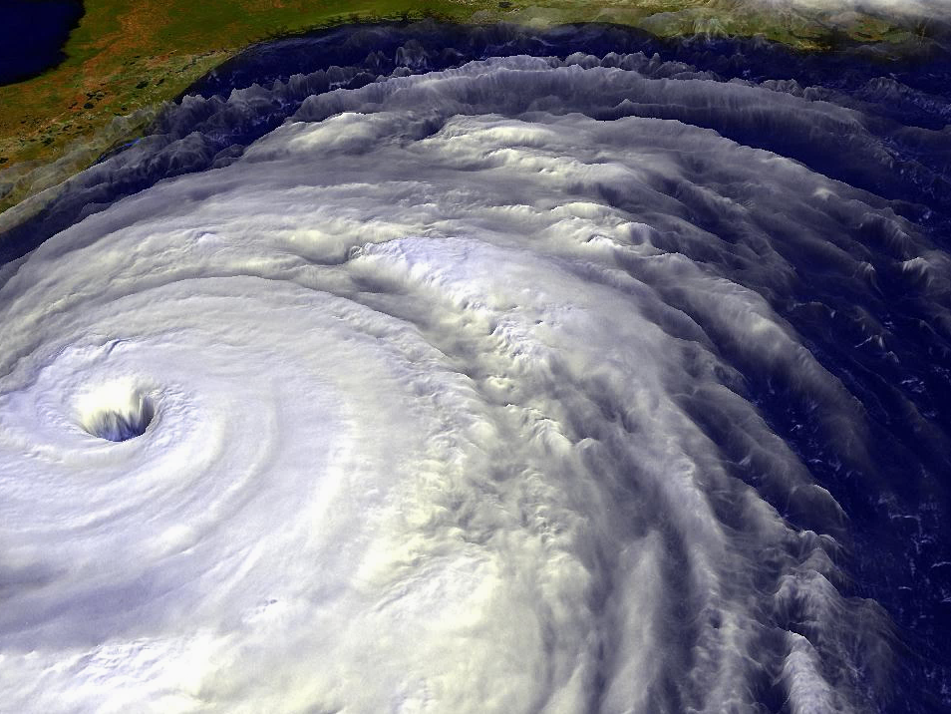
Tropical Cyclone Axisymmetric Physics
Kerry Emanuel
Lorenz Center, MIT
Notes:
1

Slide 2

Program
Brief Overview
Steady-state energetics and physics
Structure
Intensification physics

Slide 3

Overview: What is a Tropical Cyclone?
A tropical cyclone is a nearly symmetric, warm-core cyclone powered by wind-induced enthalpy fluxes from the sea surface

Slide 4
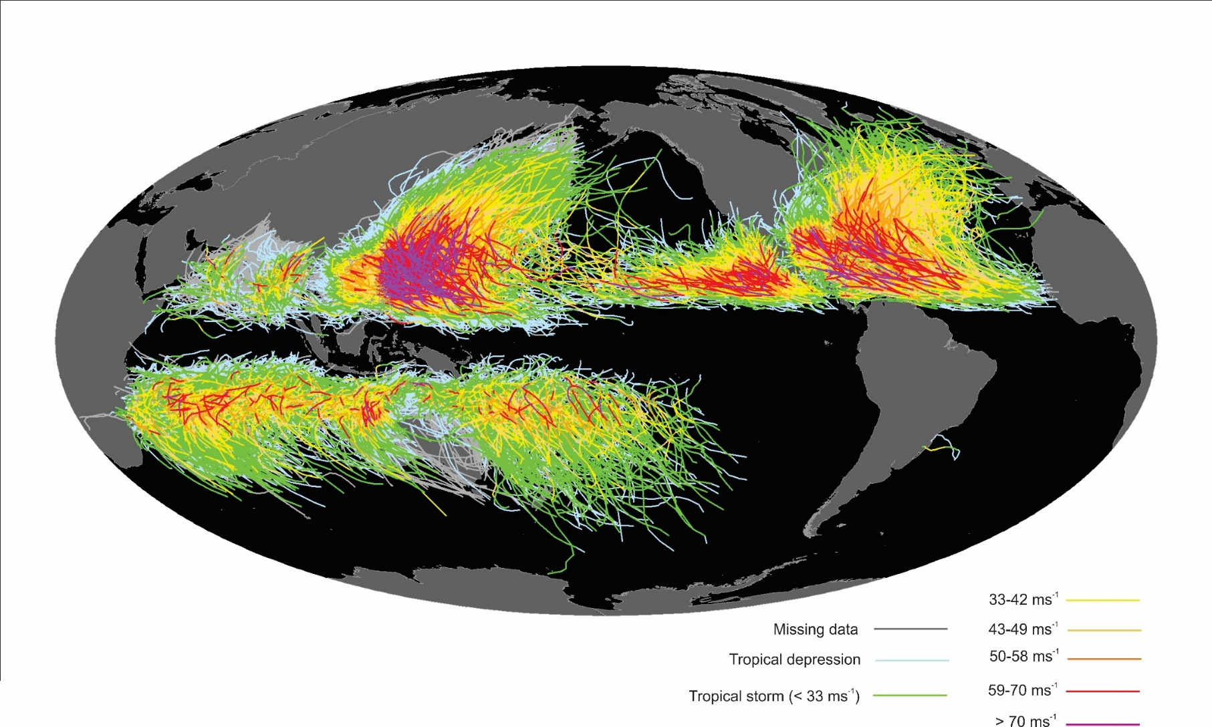
Global Climatology
Tracks of all tropical cyclones in the historical record from 1851 to 2010. The tracks are colored according to the maximum wind at 10 m altitude, on the scale at lower right.

Slide 5

The View from Space

Slide 6
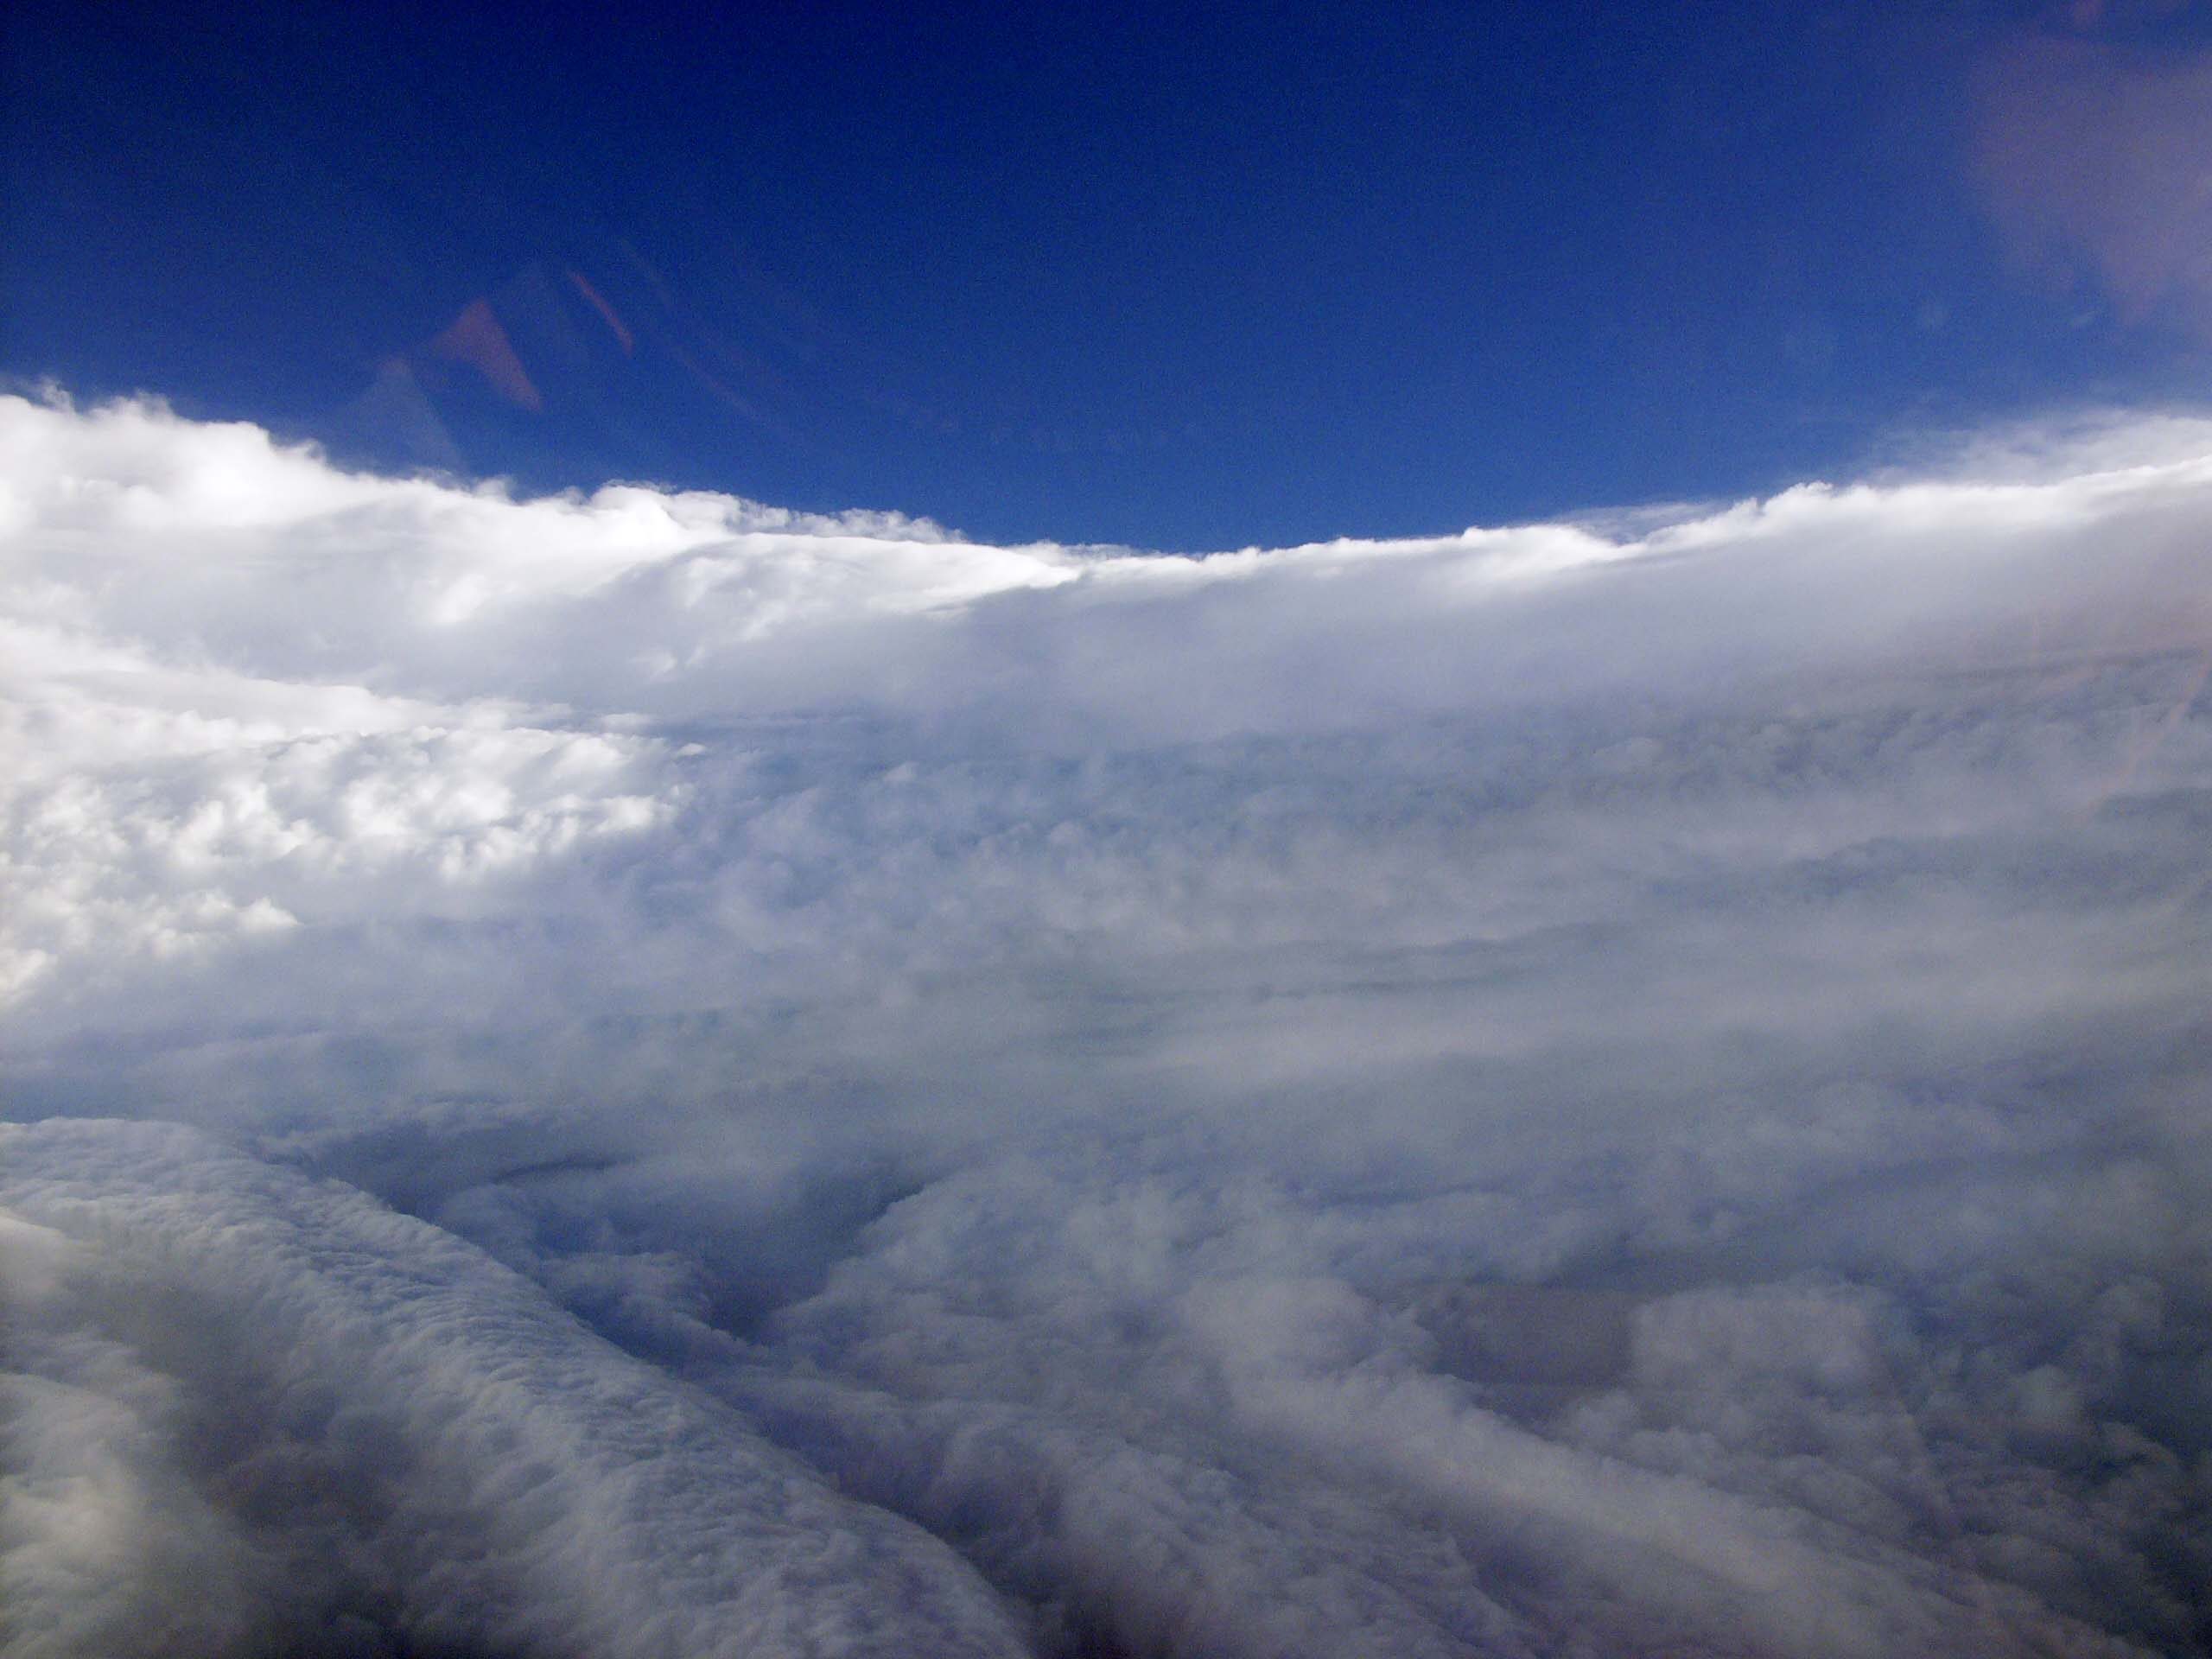
View of the eye of Hurricane Katrina on August 28th, 2005, as seen from a NOAA WP-3D hurricane reconnaissance aircraft.

Slide 7
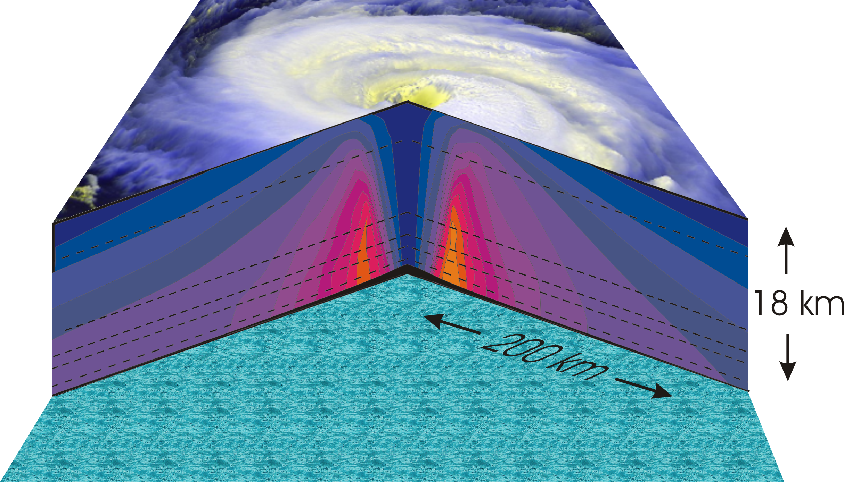
Hurricane Structure: Wind Speed
Azimuthal component of wind
< 11 5 ms⁻¹ - > 60 ms⁻¹
Notes:
A composite view of the distribution of wind speed in a typical hurricane based on measurements made from research aircraft. In this image and the two that follow, the center of the hurricane is in the center of the panel and the cutaway extends outward about 200 km (125 miles) and upward to about 18 km (11 miles). A satellite image of the top of a storm has been superimposed.
This image shows the speed of the wind going counterclockwise around the center of the storm; the black dashed lines show the altitudes at which the aircraft were flying. The darkest shade of blue indicates the lightest winds, less than 5 meters/second (11 mph). Each successive color represents an increment of 5 meters/second (11 mph), with bright orange showing winds in excess of 65 meters/second (145 mph). The strongest winds occur just above the ocean in a ring around the center, slightly outside the eyewall of the storm. Winds decrease rapidly inward toward the center, which is practically calm. They also decrease outward from the ring of maximum wind , but much more slowly, so that strong winds can still be found 100 kilometers (60 miles) from the center of the storm. As we go up from the surface, the counterclockwise winds get lighter and lighter. If the highest aircraft had flown even higher, it would have actually encountered “negative” wind speed, which here means winds going the other way (clockwise) around the center.
Image is copyrighted 2005 by Oxford University Press.
Image and description from “Divine Wind: The History and Science of Hurricanes”, Kerry Emanuel, 2005, Oxford University Press, 296 p.

Slide 8
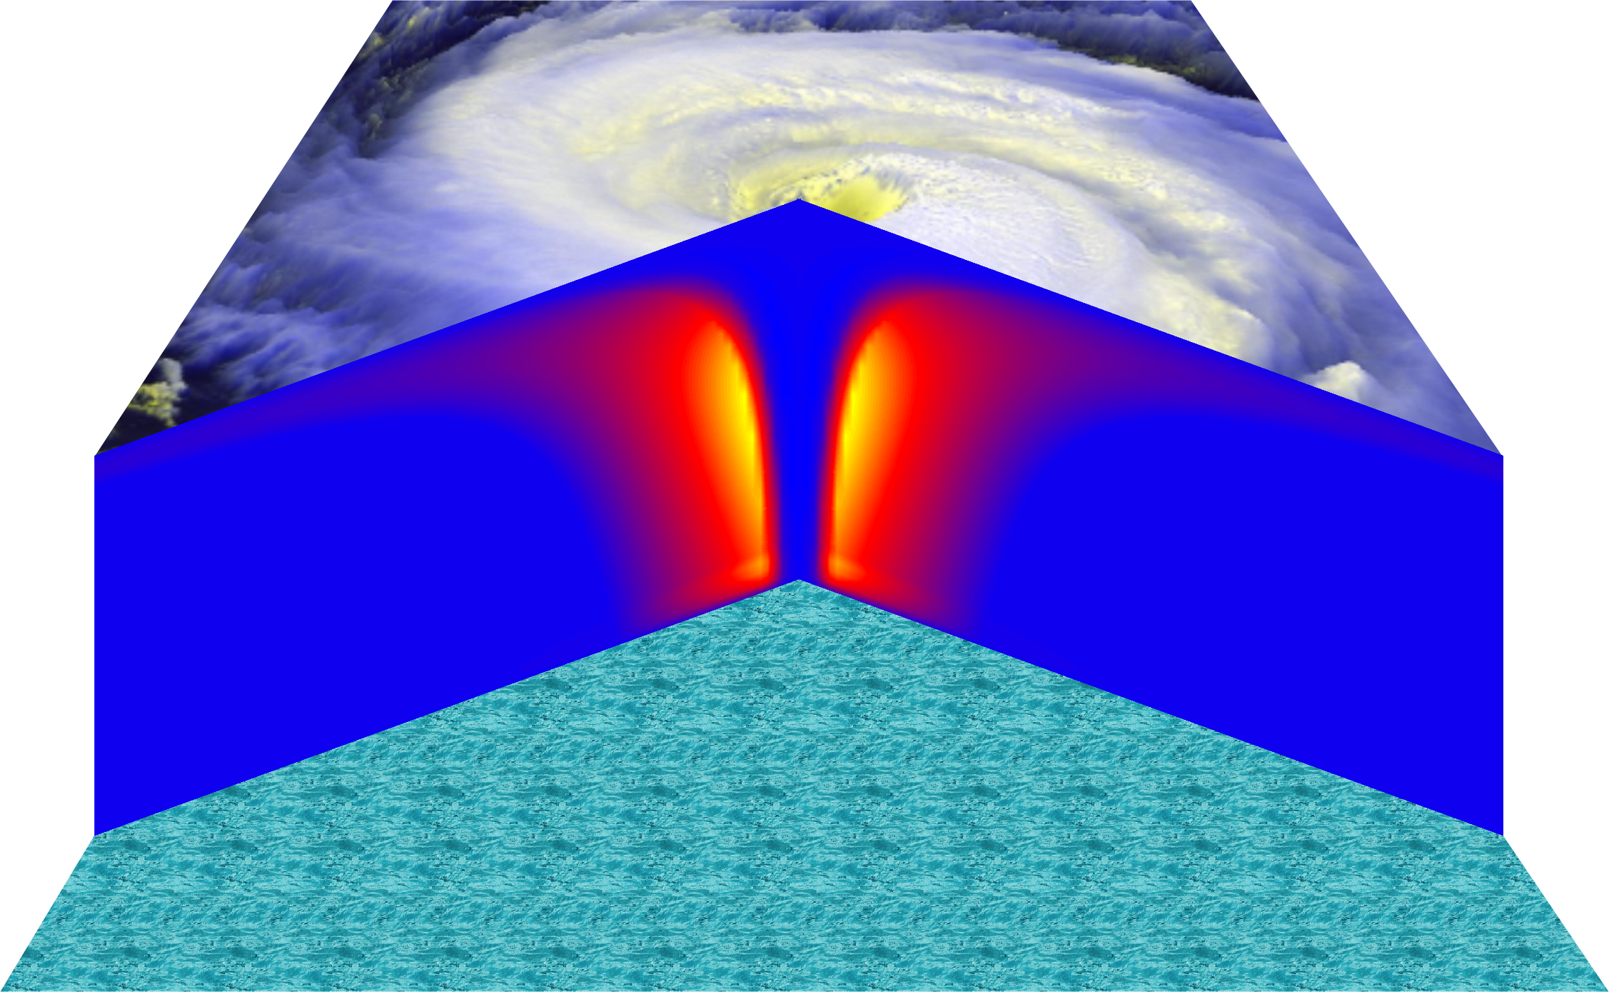
Vertical Air Motion
Updraft Speed
Strong upward motion in the eyewall
Notes:
This image shows a composite view of the distribution of updraft (vertical air motion) in a typical hurricane based on computer model calculations. The yellow and orange represent a strong upward motion in the eyewall. Although it is too weak to be seen in this figure, there is downward motion in the eye itself, strongest right next to the eyewall, and also in a broad region outside the eyewall. But since this figure is made by averaging the air motion along circles centered at the storm center, the strong updrafts associated with the spiral rain bands are missed.
Image is copyrighted 2005 by Oxford University Press.
Description from “Divine Wind: The History and Science of Hurricanes”, Kerry Emanuel, 2005, Oxford University Press, 296 p.

Slide 9
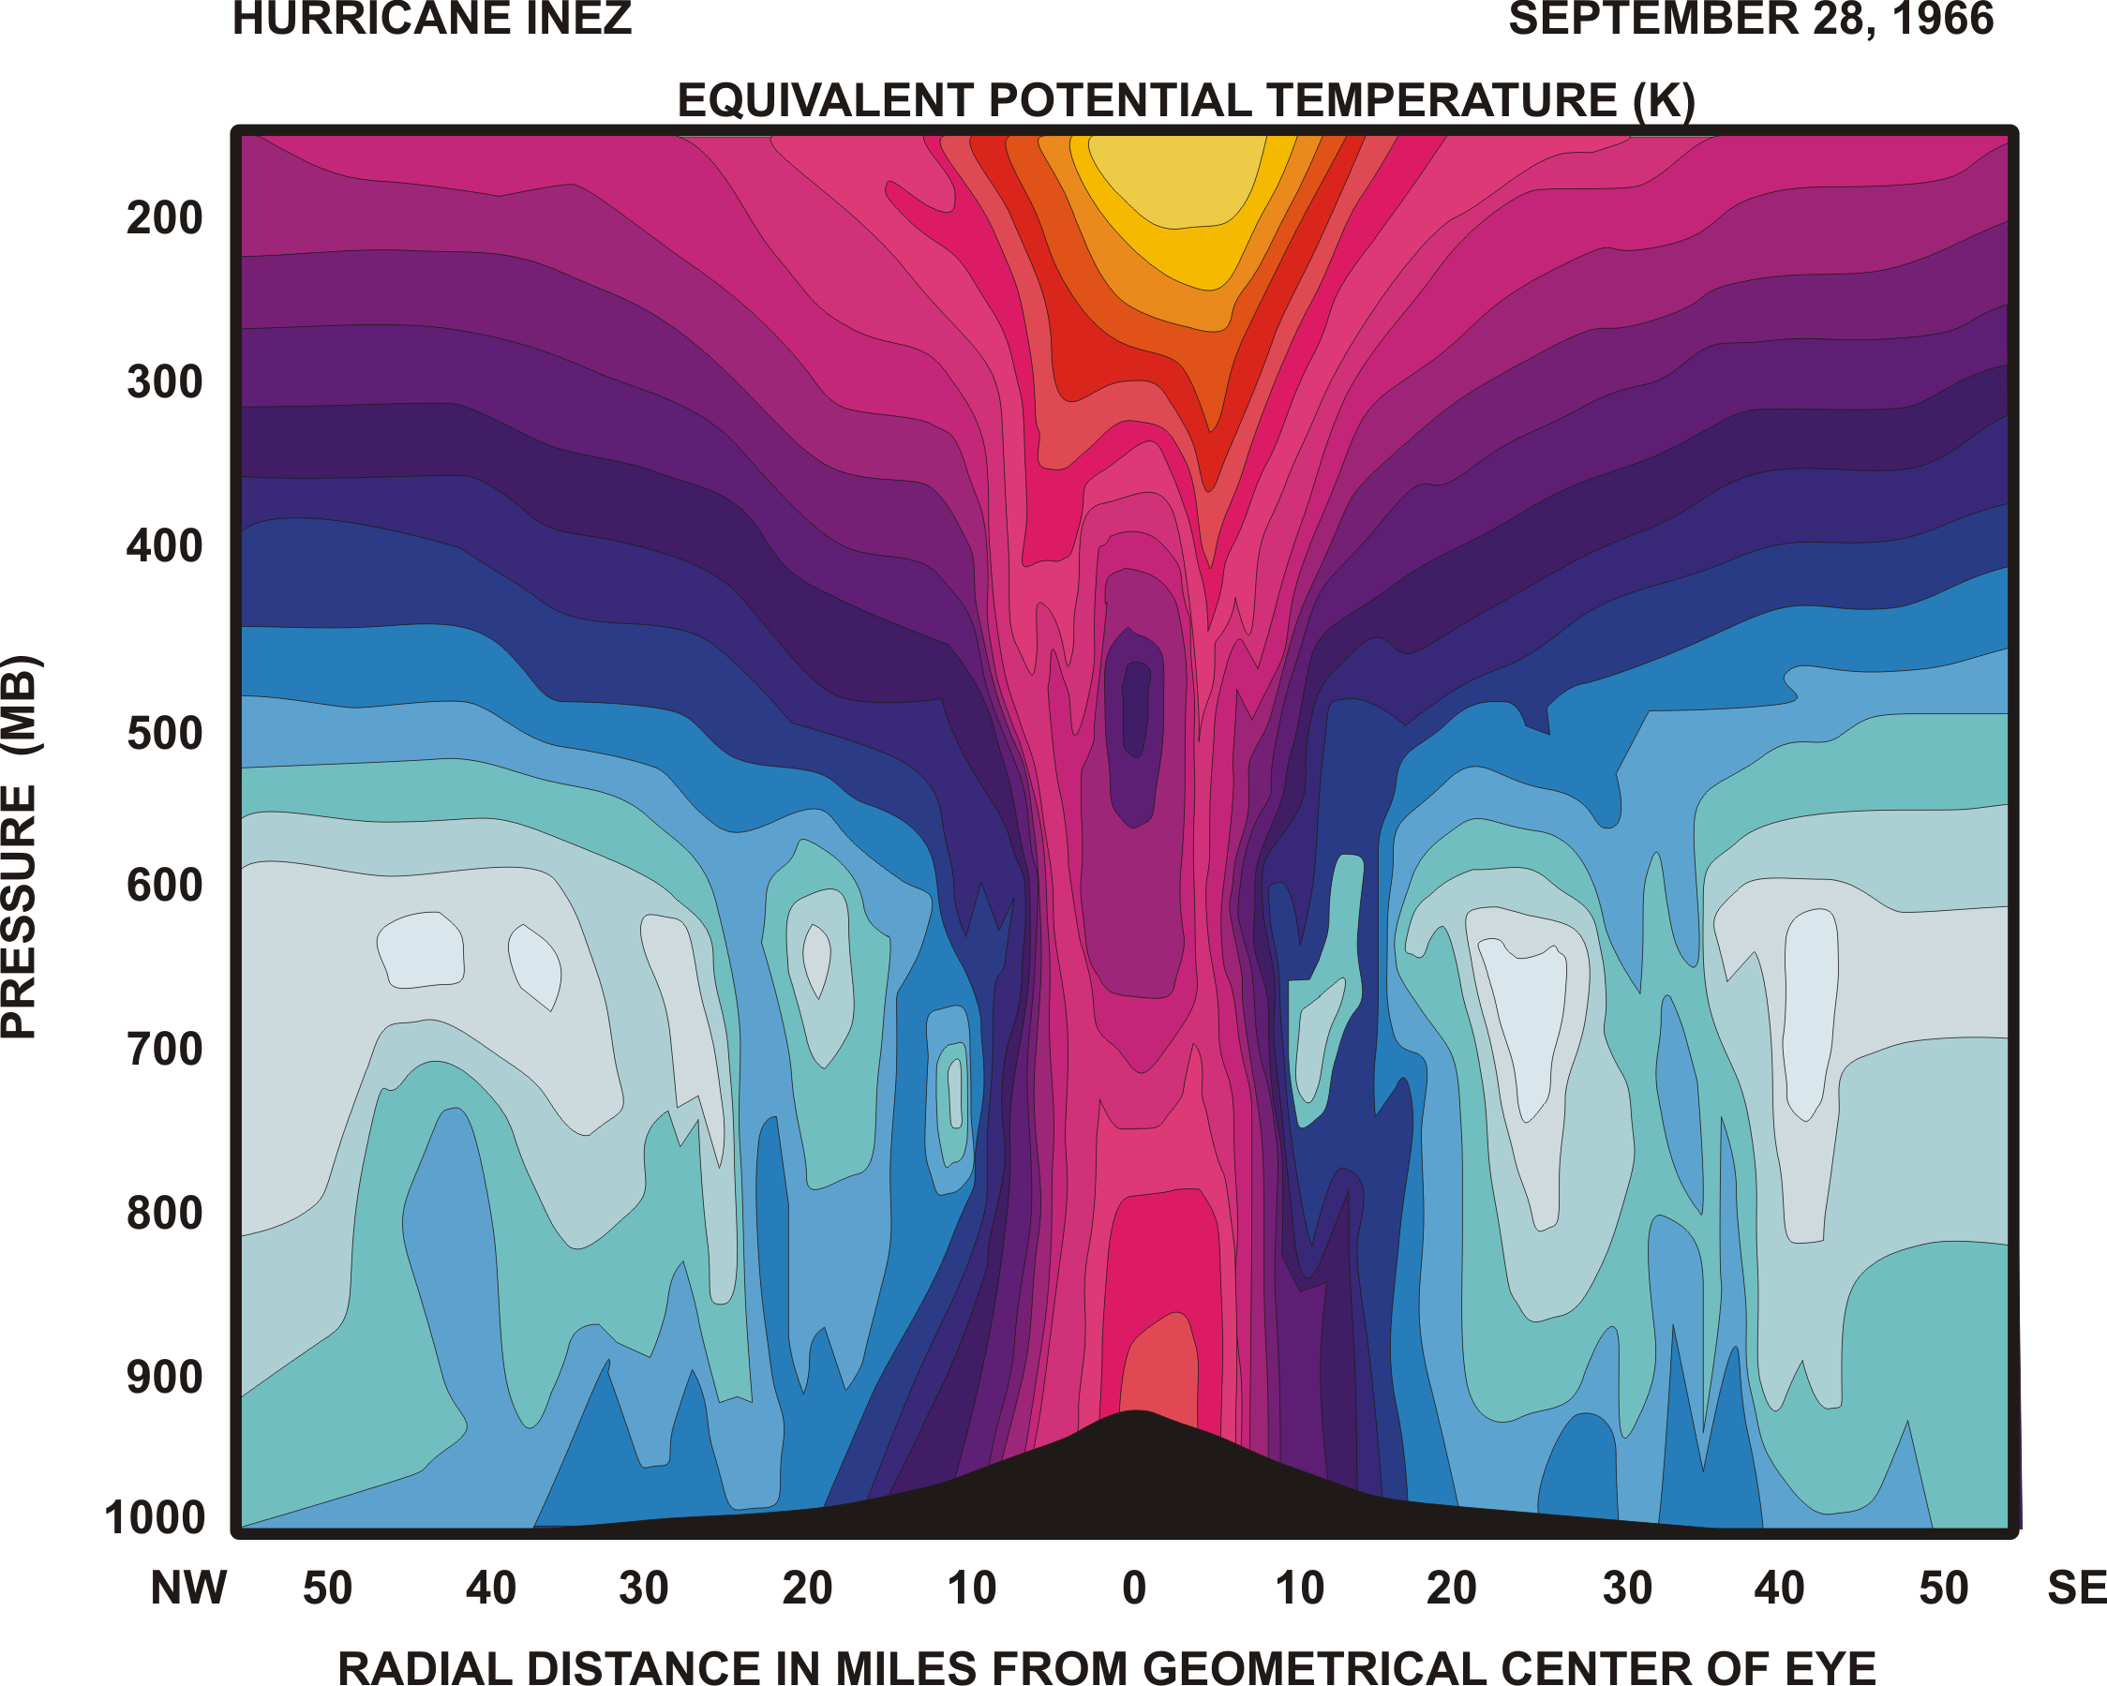
Specific entropy

Slide 10
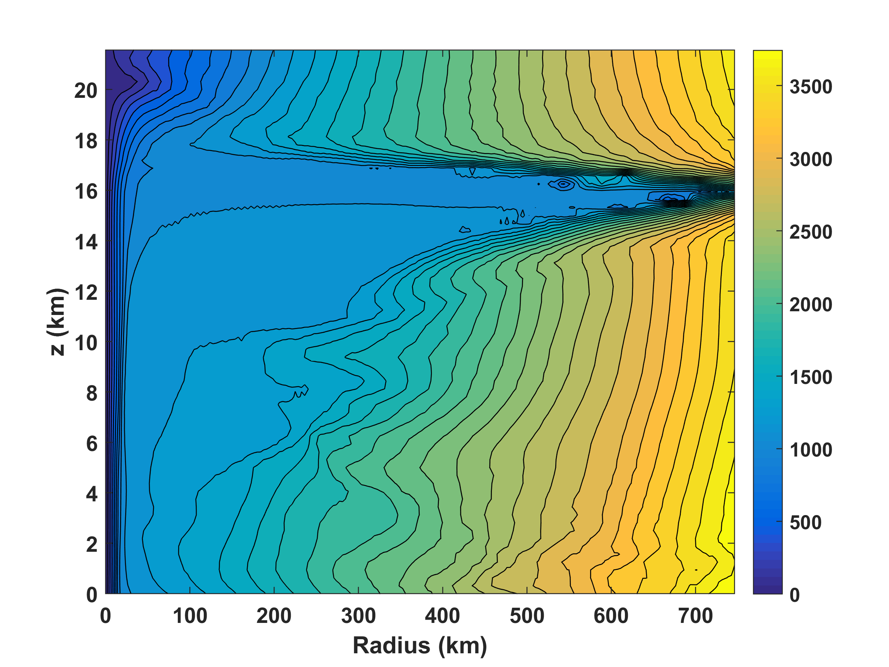
Absolute angular momentum per unit mass

Slide 11
Physics of Mature Hurricanes
References:
Emanuel, J. Atmos. Sci., 1986
Rousseau-Rizzi & Emanuel, J. Atmos. Sci., 2019 (in early online release)

Slide 12
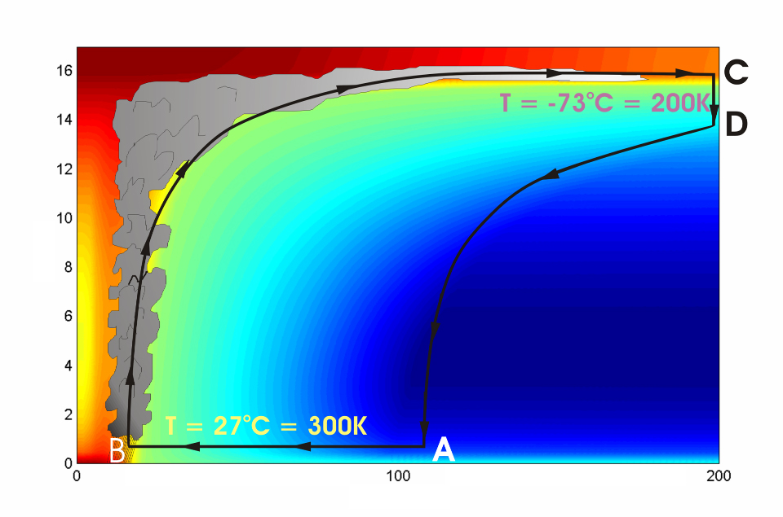





Cross-section through a Hurricane & Energy Production
eye
edge
Isothermal compression
Adiabatic expansion
Adiabatic compression
Height above ocean
Nearly isothermal expansion
Low entropy
Ocean surface
Radius (km)
Notes:
NOTE: We have animated the path of air for this slide and included labels to help our audience understand what you will be describing. Many of them will have never even heard of a Carnot heat engine and do not have a strong understanding of entropy. We would like to do whatever we can in to make this information accessible to our audience. Please let us know if you approve of these changes, and feel free to replace the labels as needed. The simpler you can keep your description of this, the better. You do an excellent job of describing the process in your book.
***
The energy cycle of a mature hurricane - the hurricane as a Carnot heat engine. This two-dimensional plot of the thermodynamic cycle shows a vertical cross section of the hurricane, whose storm center lies along the left edge. The colors depict the entropy distribution; cooler colors indicate lower entropy. Loosely, this means the total heat content of the air. Note that as air approaches the eyewall, its entropy increases rapidly, reflecting the large input of heat from the ocean.
Let’s follow a sample of air that begins at point A near the sea surface, a hundred kilometers or so from the storm center. The process mainly responsible for driving the storm is the evaporation of seawater, which transfers energy from sea to air. As a result of that transfer, air spirals inward close to the sea surface, between Points A and B. The storm center is an area of relatively low pressure, so the pressure on air decreases as it travels from A to B. But it is always in contact with the sea surface, which acts as an almost unlimited heat reservoir, so its temperature is approximately constant (acquiring entropy at a constant temperature). It is during this leg that enormous quantities of heat are added to the air from evaporation of seawater. Evaporation of water is a very efficient way to transfer heat from one body to another. That is why you feel cold when you are wet, especially if it is windy and/or dry: evaporation is taking heat from your body. Thus the addition of heat in leg A-B shows up mostly as an increase in humidity in the air. This form of heat is called latent heat. Evaporation of sea water into the inflowing air is by far the most important source of heat driving the hurricane, which makes leg A-B the firebox of the hurricane. When hurricanes reach land, they quickly die because they are cut off from their oceanic energy source. At point B, the air turns and flows upward through the towering cumulonimbus clouds that make up the hurricane’s eyewall. It is here that the latent heat is converted to sensible heat as water vapor condenses. But it is important to note that although there is enormous conversion between these two forms of heat, the total heat content (entropy, actually) remains approximately constant along this leg (note that the colors do not change along leg B-C). As the air flows upward, the pressure on it decreases very rapidly. What we have here is an example of adiabatic expansion. By the time the air reaches point C in the high troposphere or lower stratosphere, some 12 to 18 kilometers above the sea surface, the adiabatic expansion has lowered its temperature to a value close to that of the undisturbed upper tropical atmosphere, around -70°C or about 200 Kelvin. The air remains at approximately this temperature as it sinks down toward the tropopause (point D). Although the air is undergoing compression, it is losing heat by electromagnetic radiation to space. The depicted compression is very nearly isothermal. Finally, between D and A, the air returns to its starting point while undergoing an adiabatic compression. Voilà, the four legs of a Carnot cycle.
In a real hurricane, the energy cycle is open because hurricanes continuously exchange air with their environment.
Image is copyrighted 2005 by Oxford University Press.
Description from “Divine Wind: The History and Science of Hurricanes”, Kerry Emanuel, 2005, Oxford University Press, 296 p.

Slide 13
Carnot Theorem: Maximum efficiency results from a particular energy cycle:
Isothermal expansion
Adiabatic expansion
Isothermal compression
Adiabatic compression
Note: Last leg is not adiabatic in hurricanes: Air cools radiatively. But since the environmental temperature profile is moist adiabatic, the amount of radiative cooling is the same as if air were saturated and descending moist adiabatically.
Maximum rate of energy production:

Slide 14
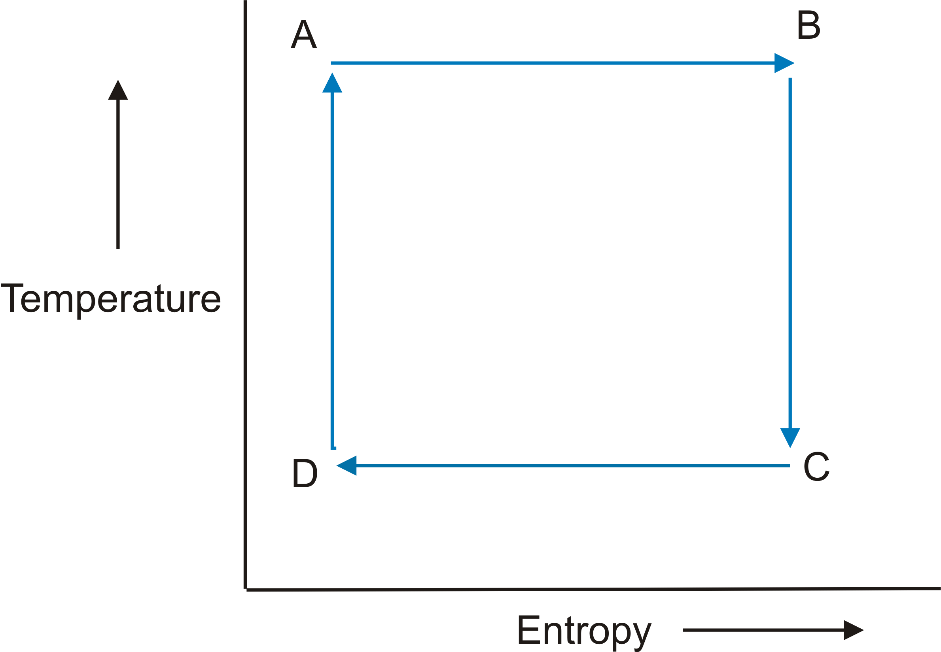

Slide 15
Total rate of heat input to hurricane:
Dissipative heating
Surface enthalpy flux
In steady state, energy production is used to balance frictional dissipation:

Slide 16
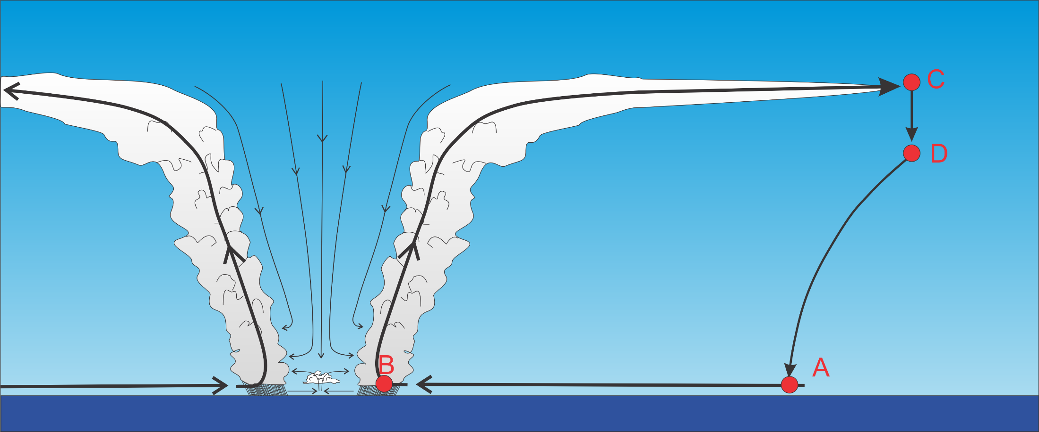
Differential Carnot Cycle

Slide 17
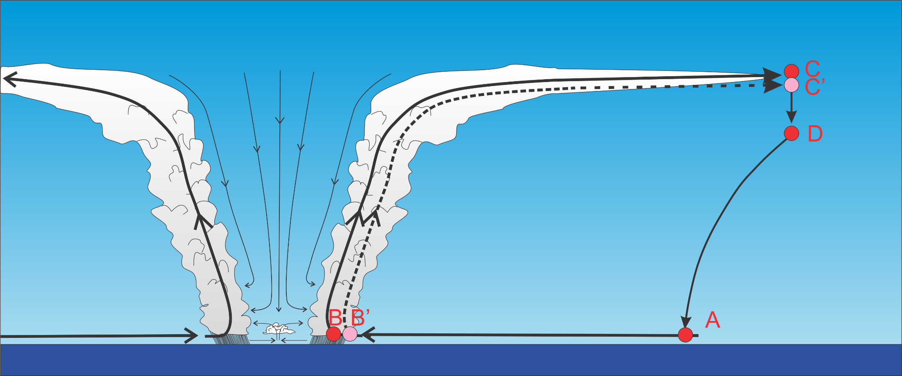

Slide 18
Internally determined
Note that this is valid between ANY two streamlines in the region of ascent

Slide 19
Simulations with cloud-permitting axisymmetric model for different horizontal mixing lengths
Rousseau-Rizzi and Emanuel, J. Atmos. Sci., 2019

Slide 20
Derivation of gradient wind potential intensity from thermal wind balance
Gradient balance
Hydrostatic balance
Thermal wind

Slide 21
Integrate in pressure:
(1)

Slide 22
Define outflow to be where
Convective criticality:
(1)

Slide 23
ds_{b} /dM_{g} determined by boundary layer processes

Slide 24
Put (1) in differential form:
(2)
Integrate entropy equation through depth of boundary layer:
(3)
Integrate angular momentum equation through depth of boundary layer:
(4)

Slide 25
Substitute (3) and (4) into (2) and equate
(5)
Same answer as from Carnot cycle. This is still not a closed expression, since we have not determined the boundary layer enthalpy, k or the outflow temperature, T_{o}

Slide 26
What Determines Outflow Temperature?
Reference: Emanuel and Rotunno, J. Atmos. Sci., 2011

Slide 27
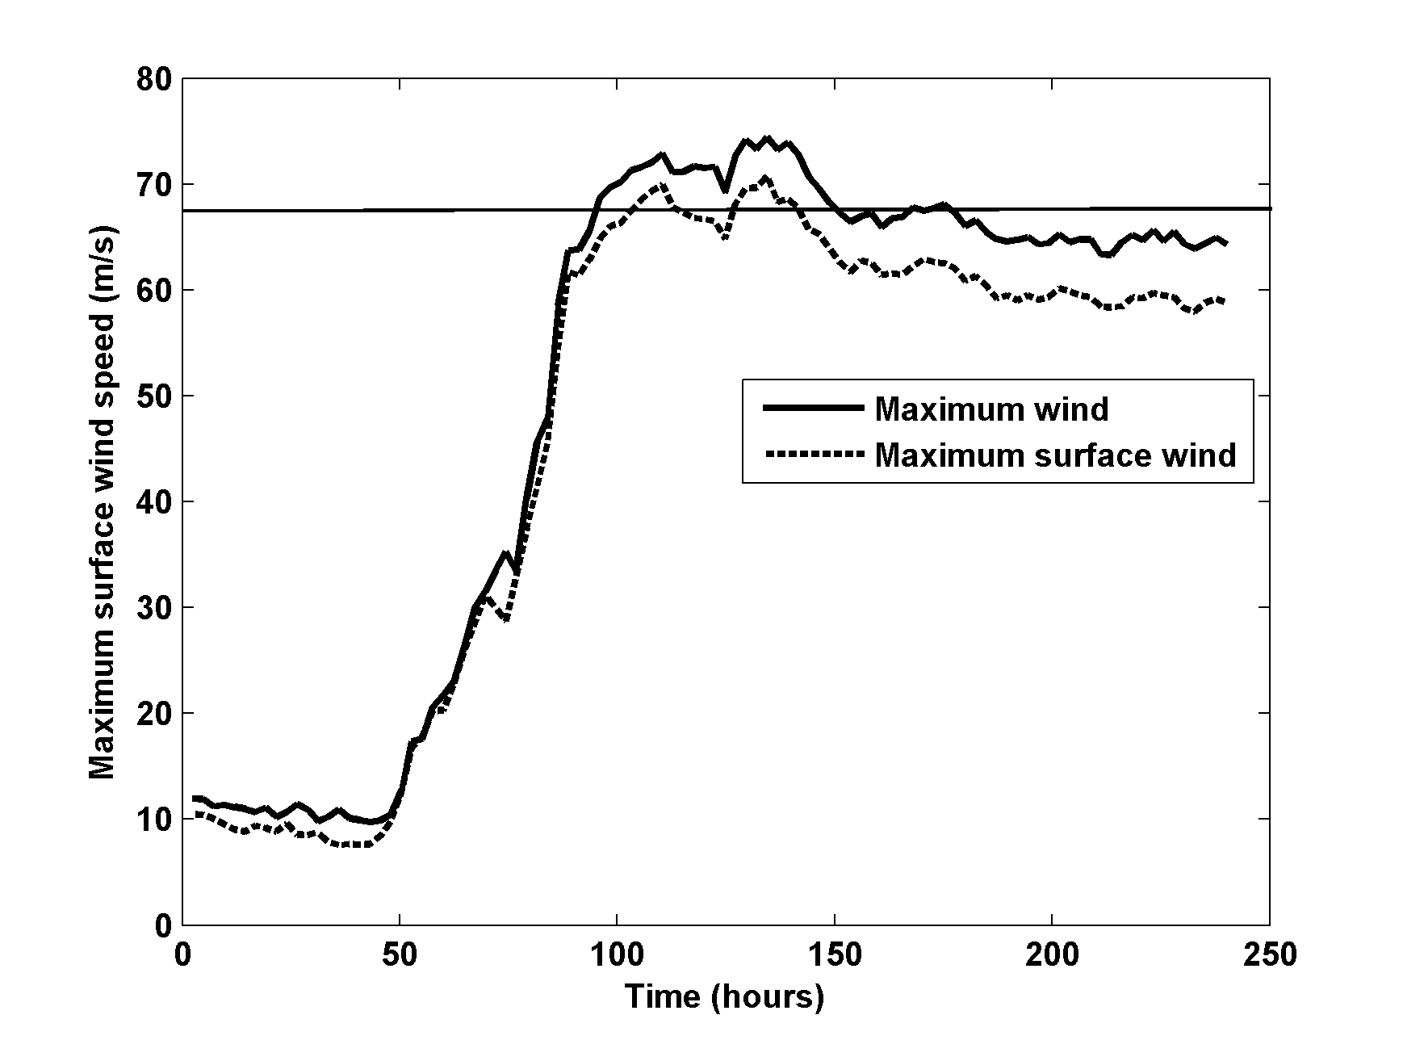
Simulations with Cloud-Permitting, Axisymmetric Model

Slide 28
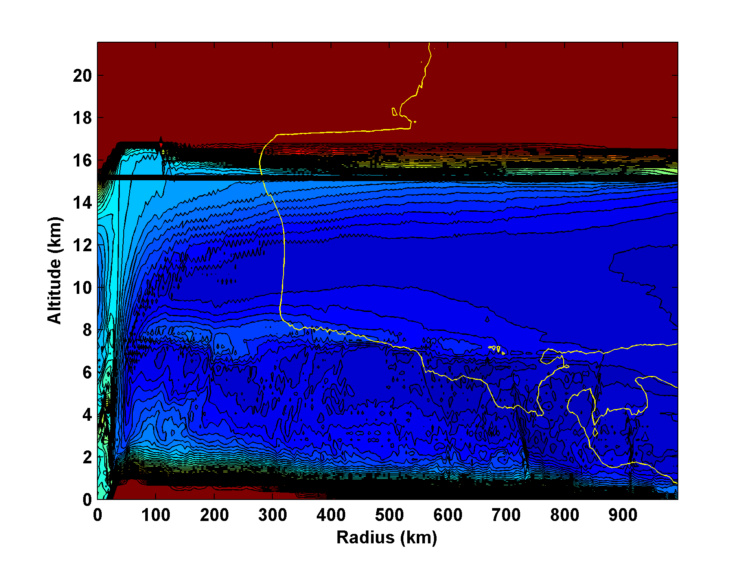
Saturation entropy (contoured) and V=0 line (yellow)

Slide 29
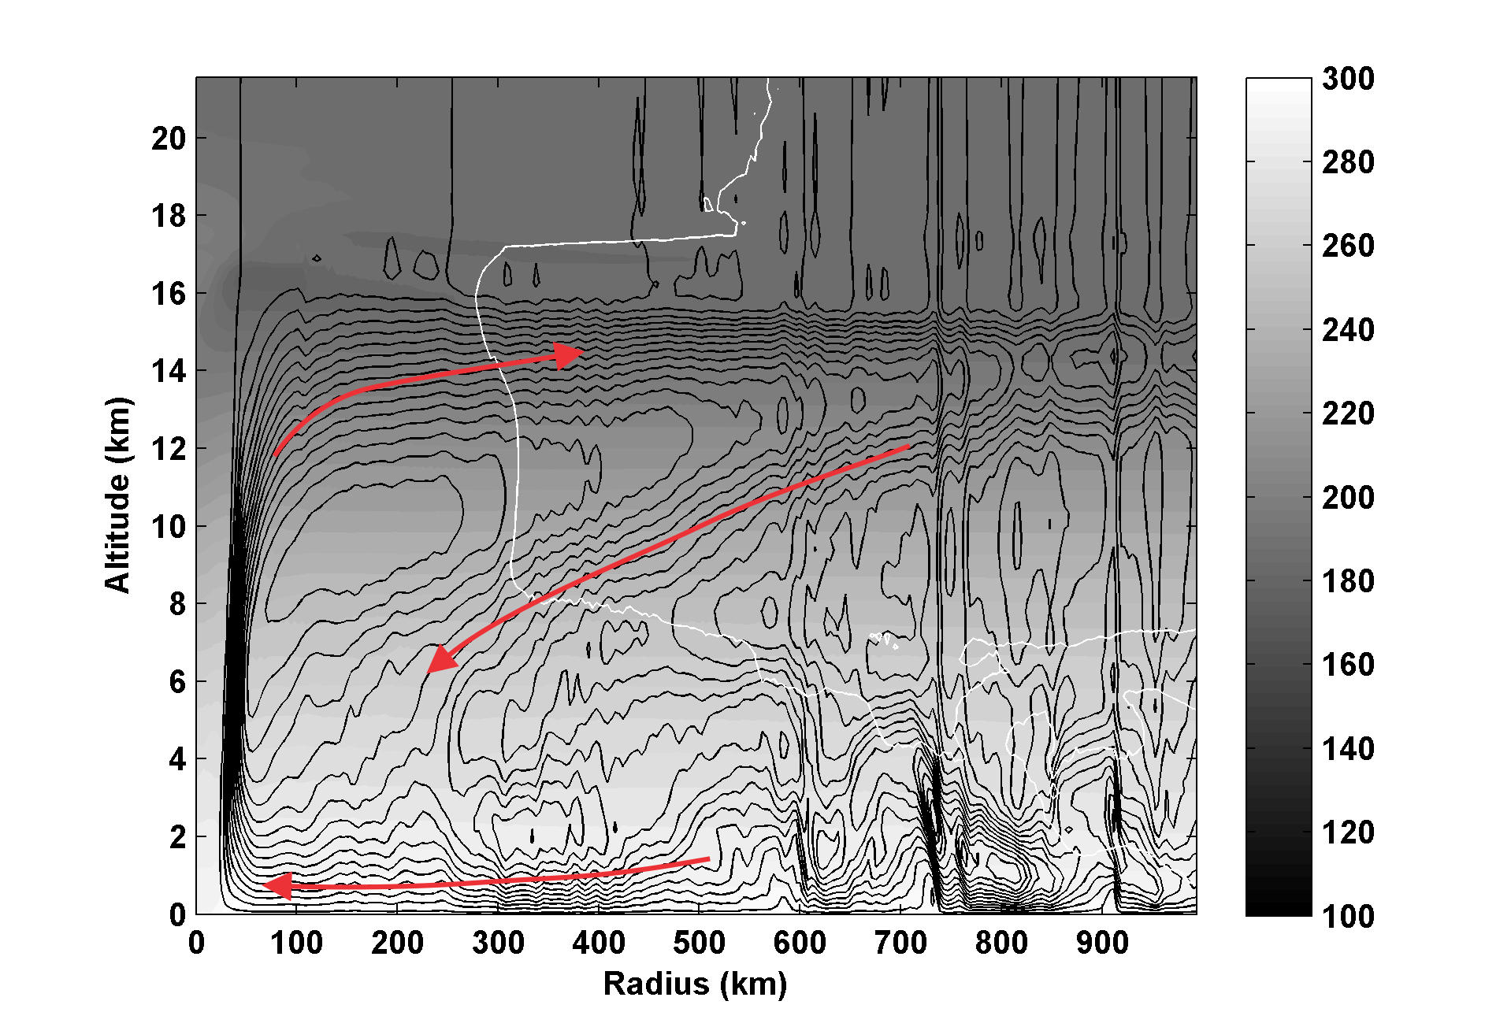
Streamfunction (black contours), absolute temperature (shading) and V=0 contour(white)

Slide 30
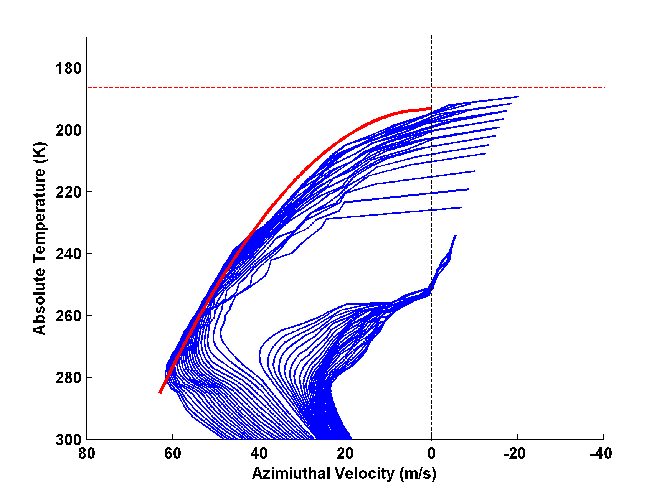
Angular momentum surfaces plotted in the V-T plane. Red curve shows shape of balanced M surface originating at radius of maximum winds. Dashed red line is ambient tropopause temperature.

Slide 31
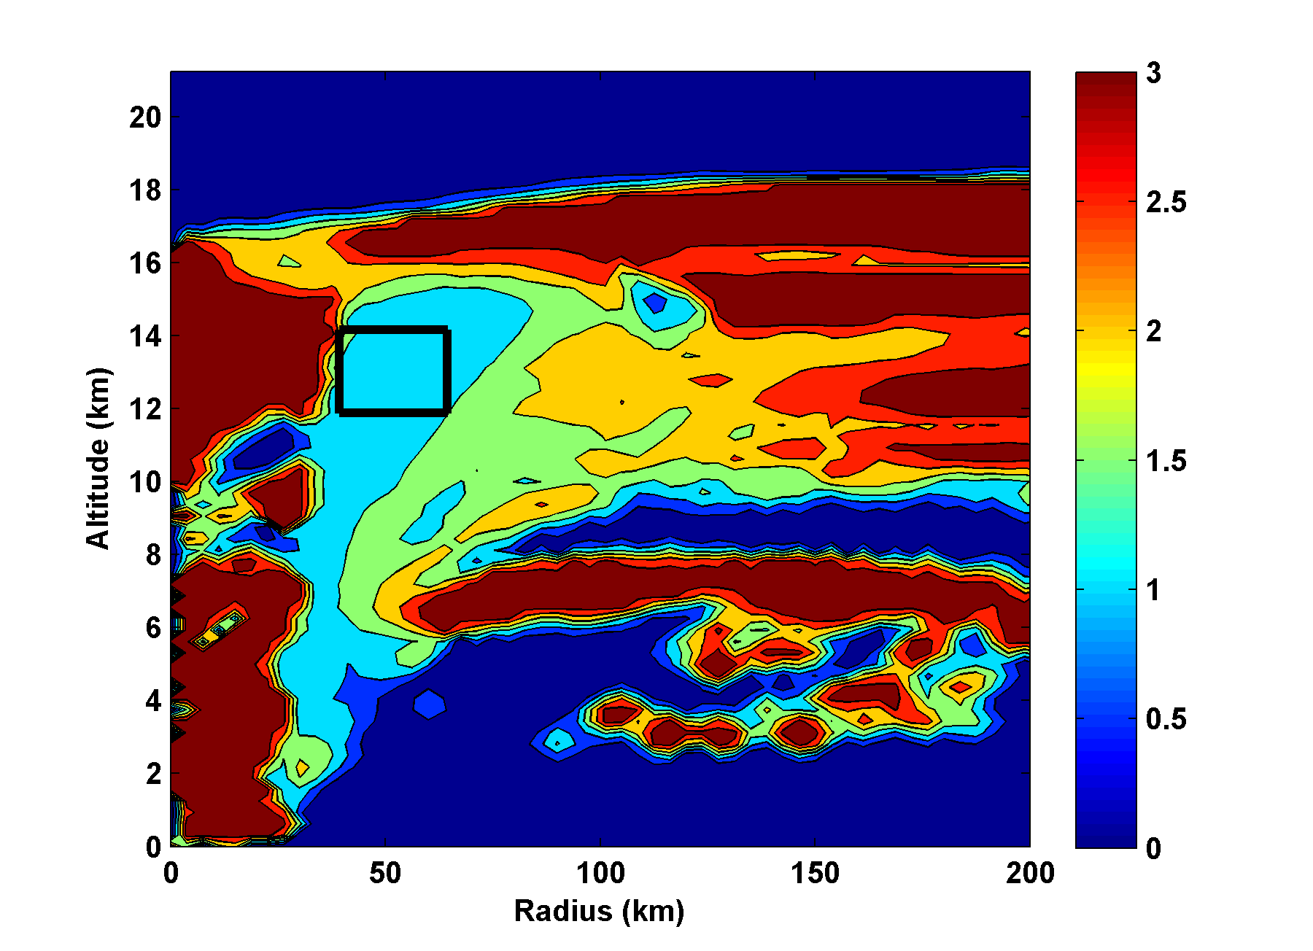
Richardson Number (capped at 3). Box shows area used for scatter plot.

Slide 32
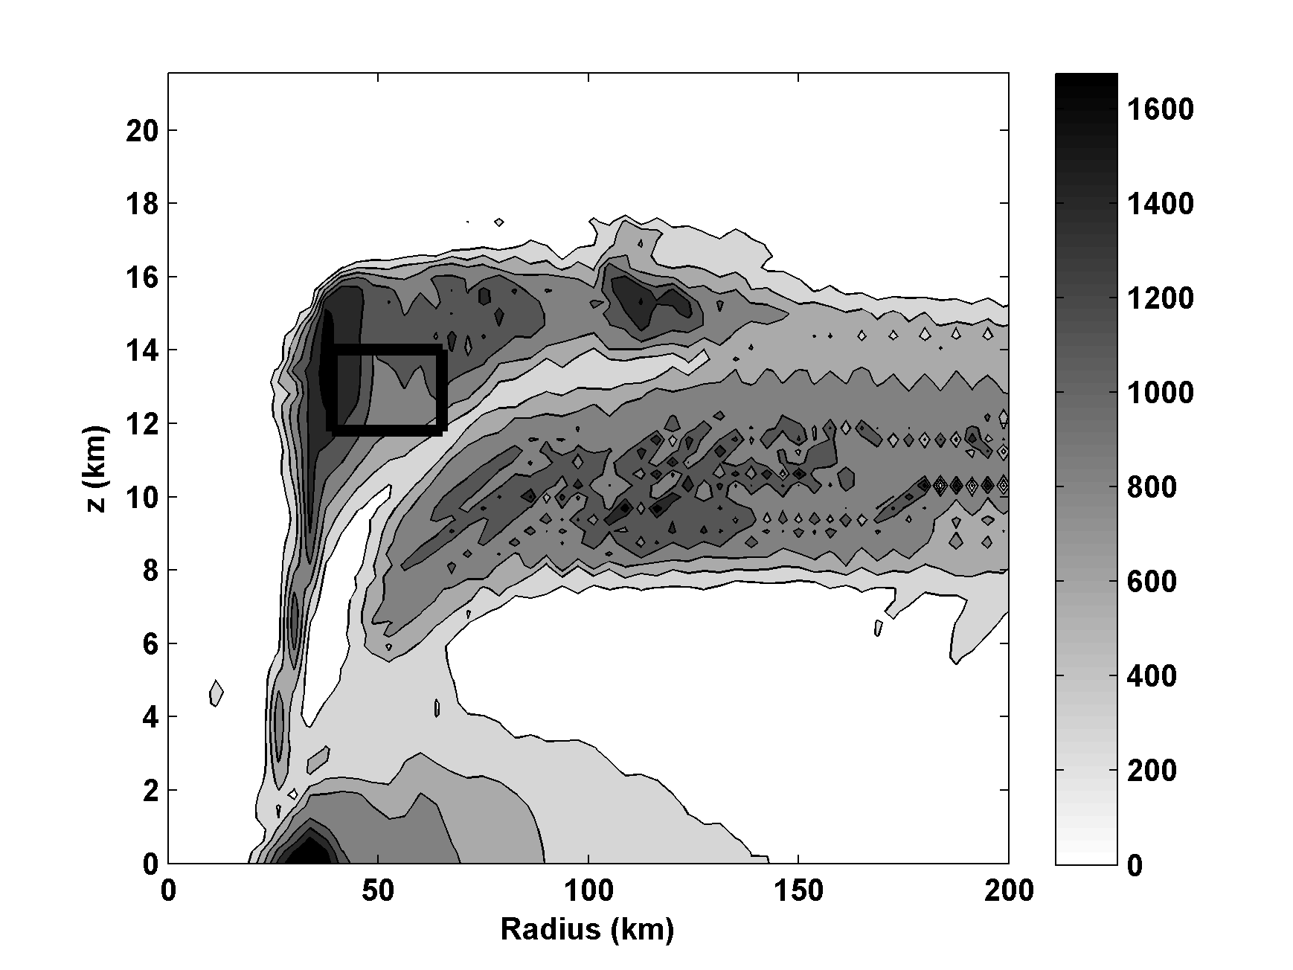
Vertical Diffusivity (m²s⁻¹)

Slide 33
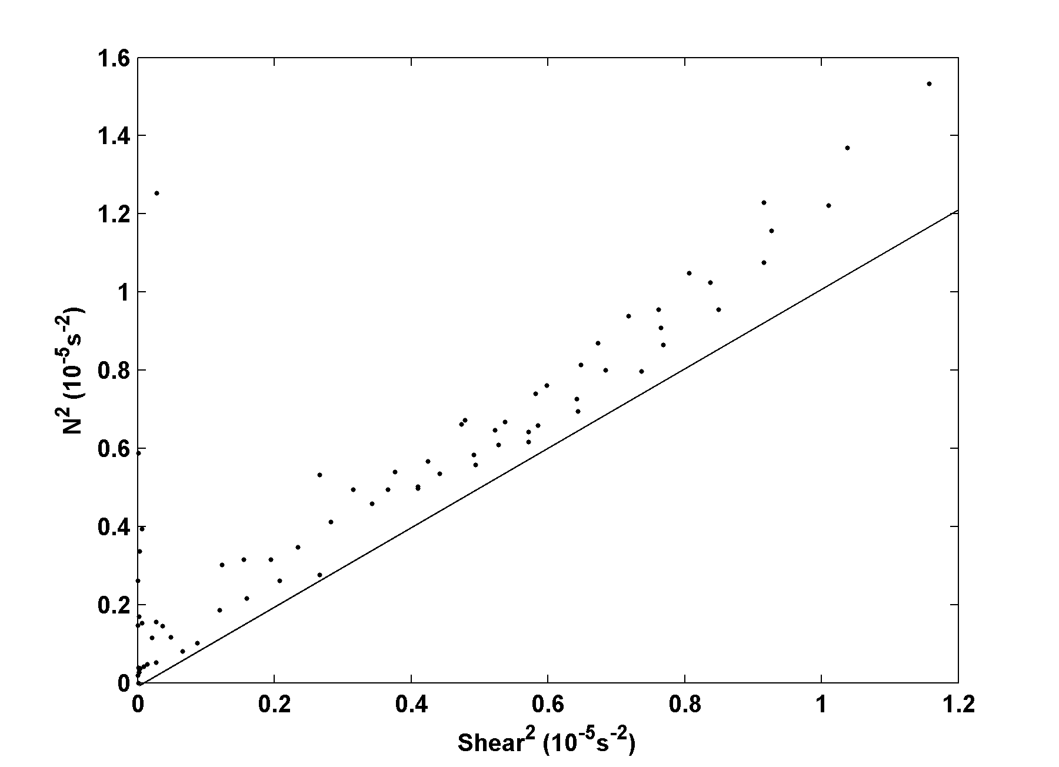
Ri=1

Slide 34
Implications for Outflow Temperature

Slide 35
(5)
But the vertical gradient of saturation entropy is related to the vertical gradient of temperature:
(6)
Use definition of s* and C.-C.:
(7)

Slide 36
Substitute (16) into (15) and use hydrostatic equation:
(8)
we can neglect first term on left of (8)
If
Substitute (5) into (8):
(9)
Gives dependence of Outflow T on s*

Slide 37
Using
We can re-write (9) as
(10)
We can also re-write (1) as
(11)
Boundary layer entropy:
(12)
Boundary layer angular momentum:
(13)

Slide 38
Combine (12) and (13):
Let
(14)
Balance condition (1):
(15)

Slide 39
Eliminate V_{b} between (14) and (15):
(16)
Eliminate r_{b}² between (11) and (16):
(17)
where
Remember that
(10)

Slide 40
inward from some outer radius r_{o}, defined such that
In general, integrating this system will not yield T_{o}=T_{t} at
r=r_{max}. Iterate value of r_{t} until this condition is met.
If V >> fr, we ignore dissipative heating, and we neglect pressure dependence of s₀*, then we can derive an approximate closed-form solution.

Slide 41
Assuming that Ri is critical in the outflow leads to an equation for T_{o} that, coupled to the interior balance equation and the slab boundary layer lead (surprisingly!) to a closed form analytic solution for the gradient wind (as represented by angular momentum, M, at the top of the boundary layer:
(18)

Slide 42
Evaluate at r_{o}:
(19)
(20)
The maximum wind speed, , found from maximizing the radial dependence of wind speed in the solution (18) on previous slide is given by
(21)

Slide 43
Substituting (20) into (21) gives
(22)
Can be calculated directly from SST and soundings

Slide 44
Also,

Slide 45
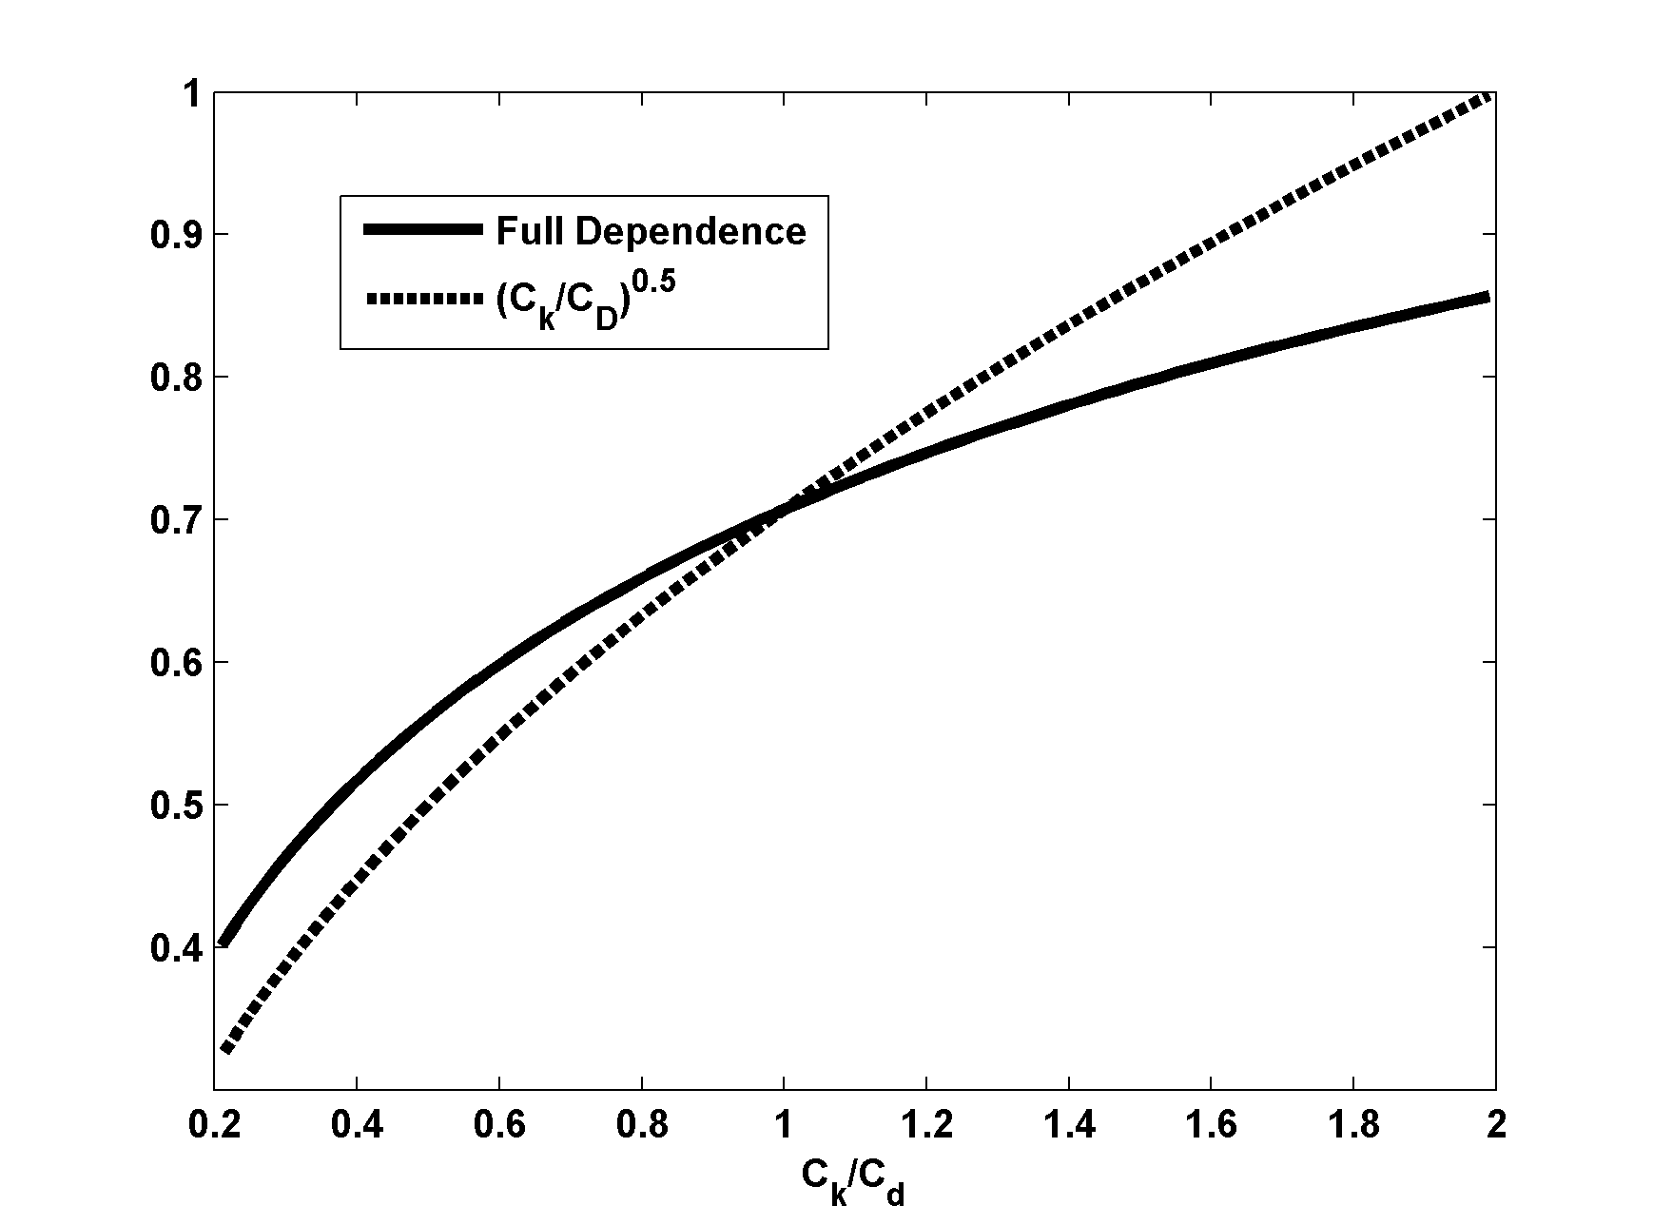

Slide 46
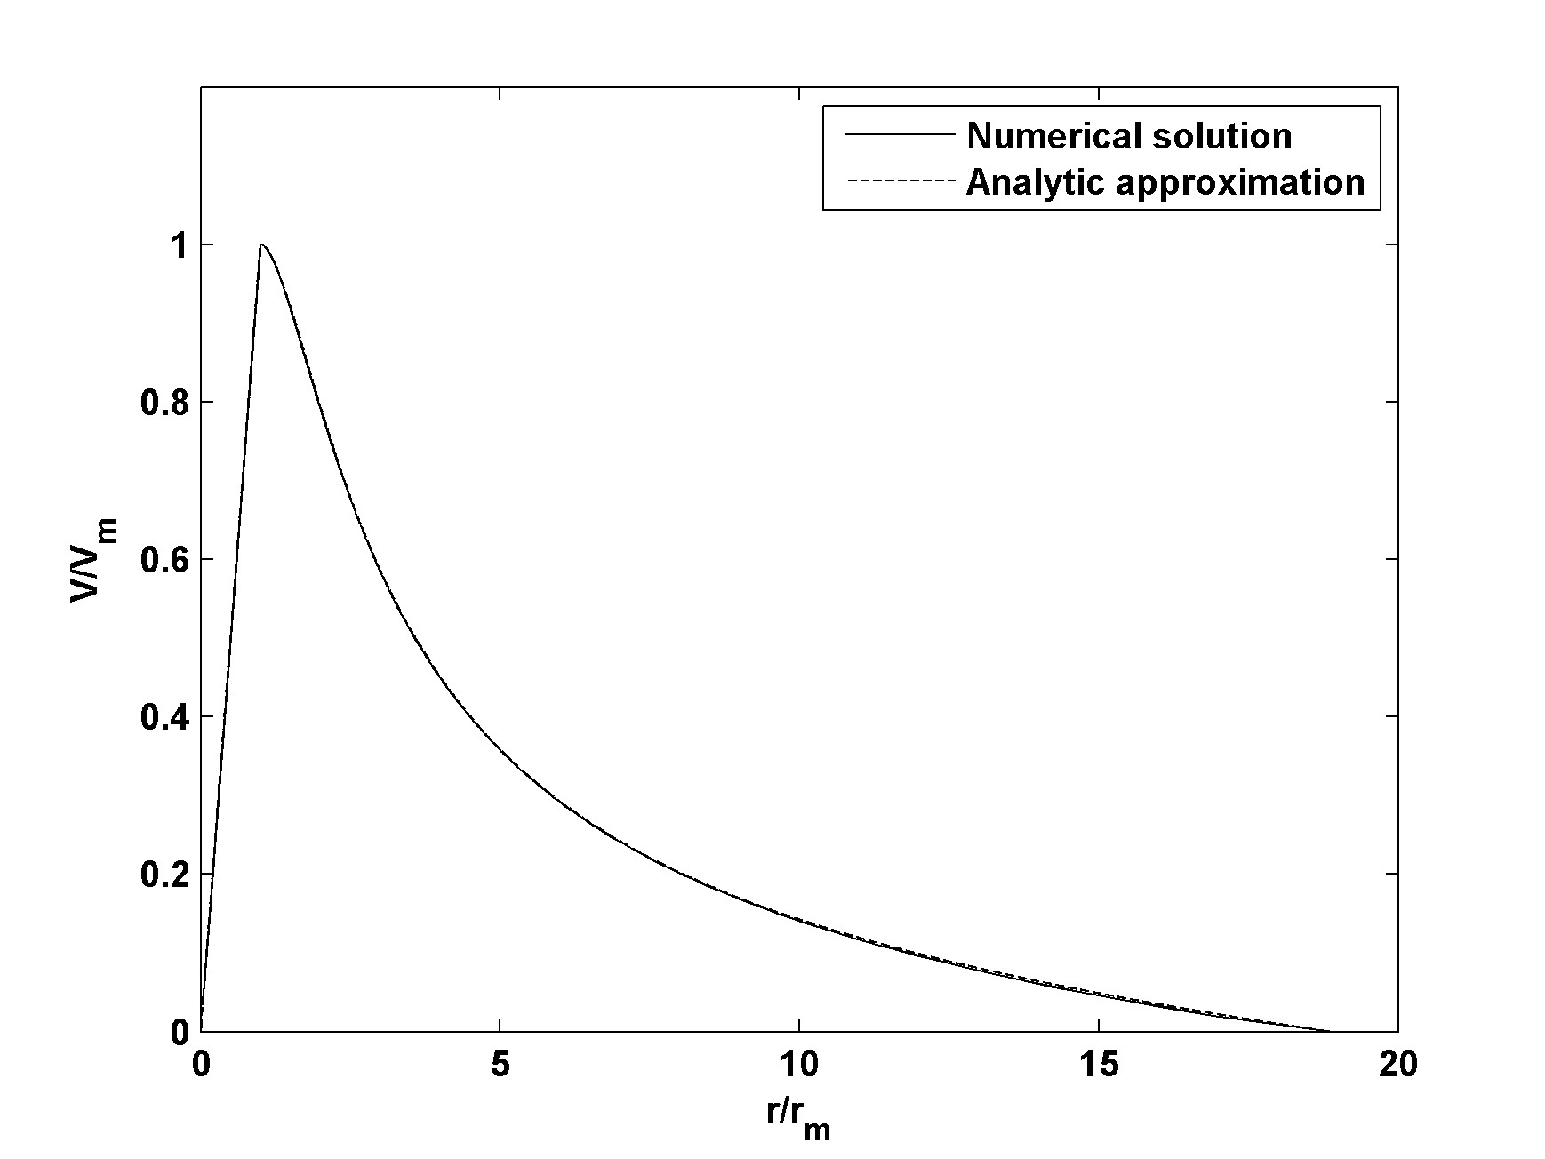

Slide 48
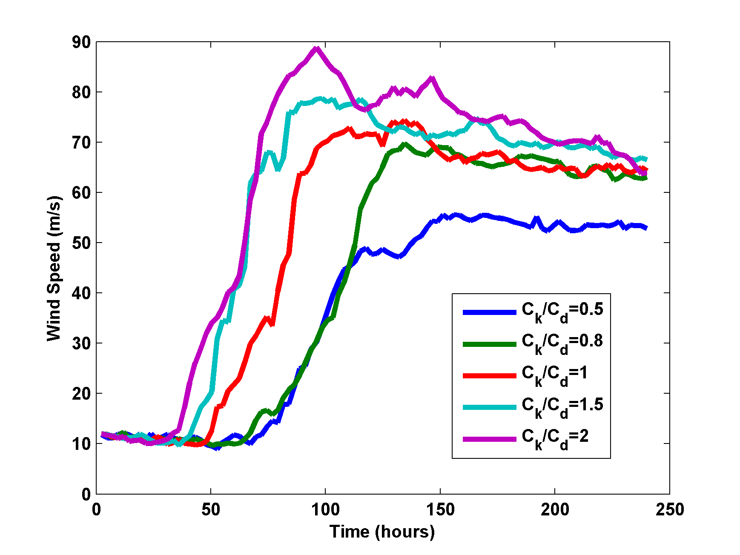
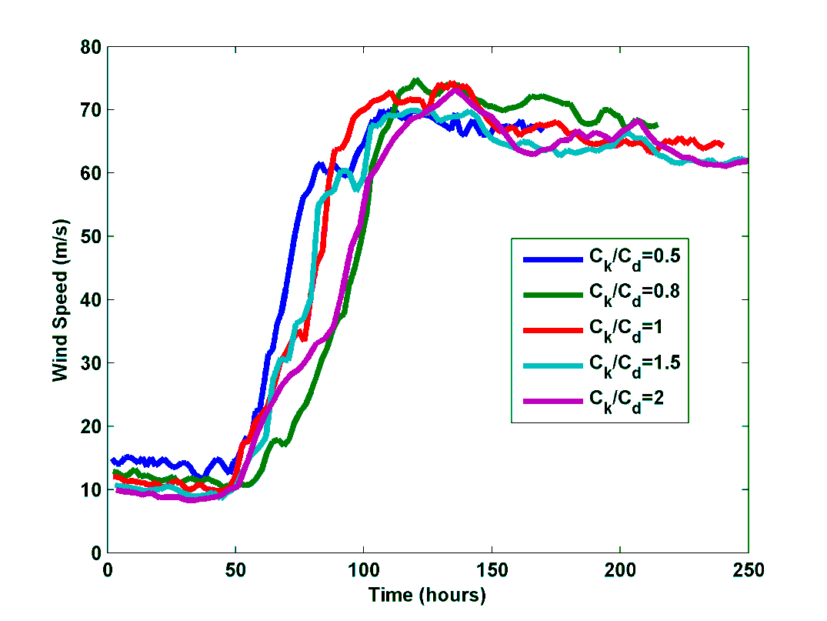
Numerical integrations with RE87 model (no dissipative heating, no pressure dependence of k₀*) : Left, regular variables; Right: Velocity scaled by (31) and time scaled by the inverse square-root of the enthalpy exchange coefficient.

Slide 49
Effects of Pressure-Dependence of Surface Saturation Enthalpy

Slide 50
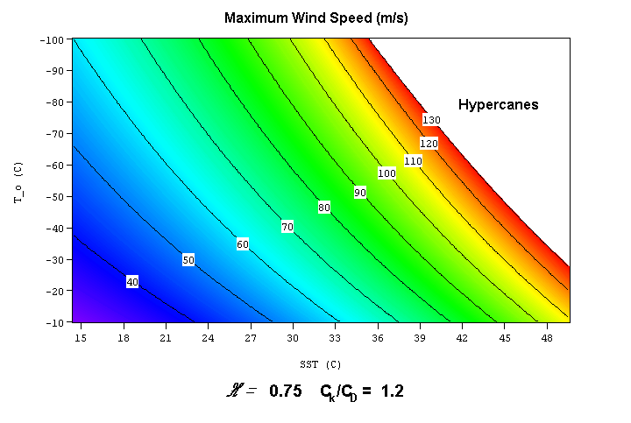

Slide 51
Annual Maximum Potential Intensity (m/s)

Slide 52
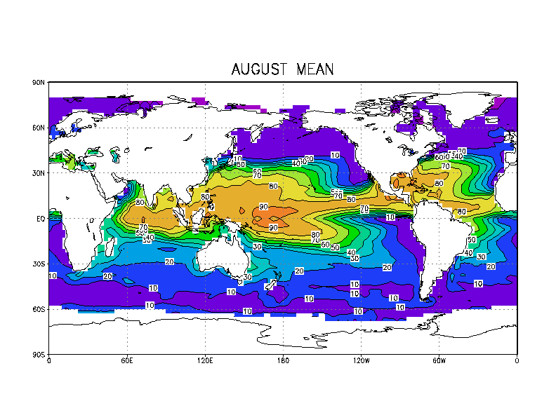

Slide 53
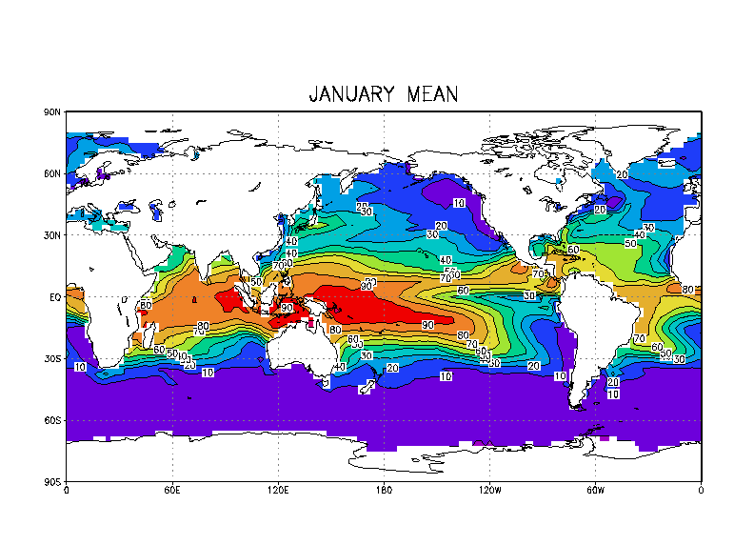

Slide 55
Thermodynamic disequilibrium is necessary to maintain ocean heat balance:
Ocean mixed layer Energy Balance (neglecting lateral heat transport):
Ocean mixed layer entrainment
Greenhouse effect decreases this
Weak explicit dependence on T_{s}
Mean surface wind speed

Slide 56
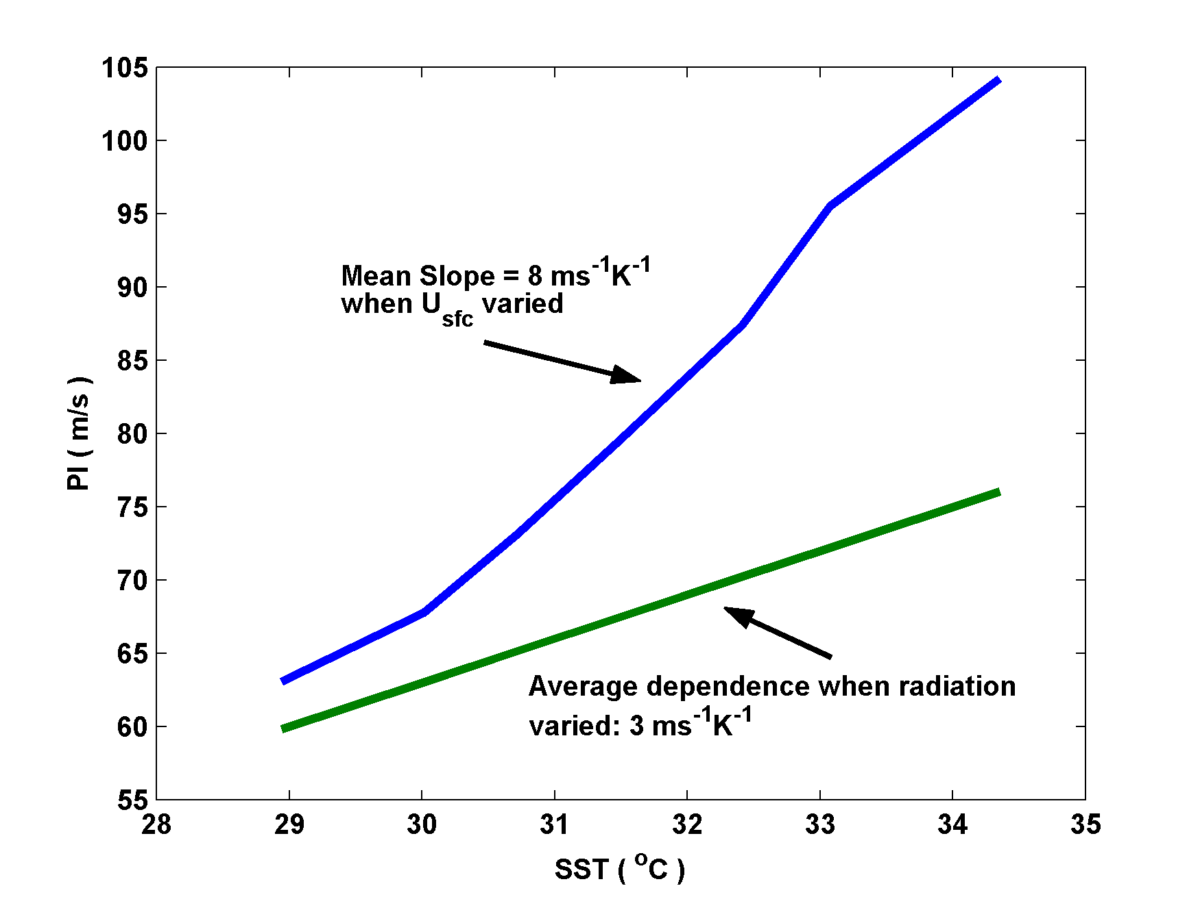
Dependence on Sea Surface Temperature (SST):

Slide 57
Relationship between potential intensity (PI) and intensity of real tropical cyclones
(Following slides from Emanuel, K.A., 2000: A statistical analysis of hurricane intensity. Mon. Wea. Rev., 128, 1139-1152.)

Slide 58
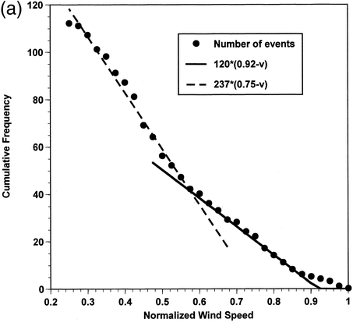

Slide 59
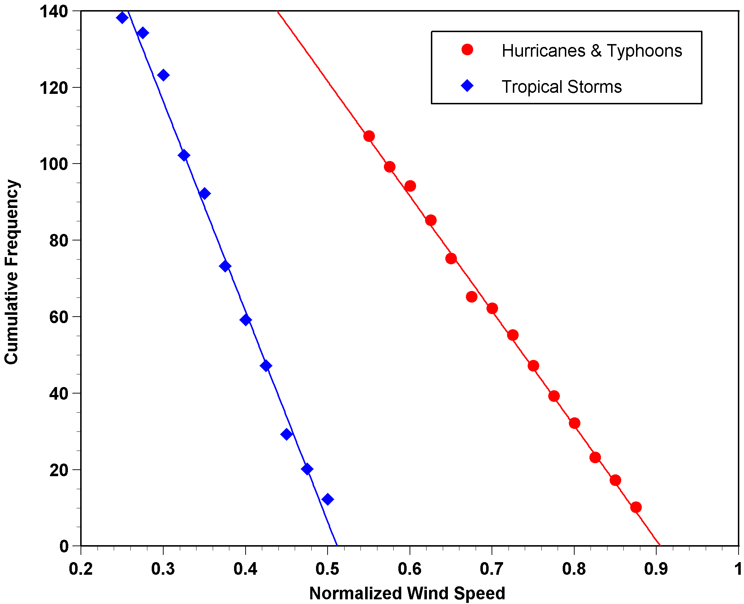

Slide 60
Tropical Cyclone Structure

Slide 61
Three Regions
Eye (w < 0)
Inner Core (w > 0)
Outer region (w < 0)

Slide 62
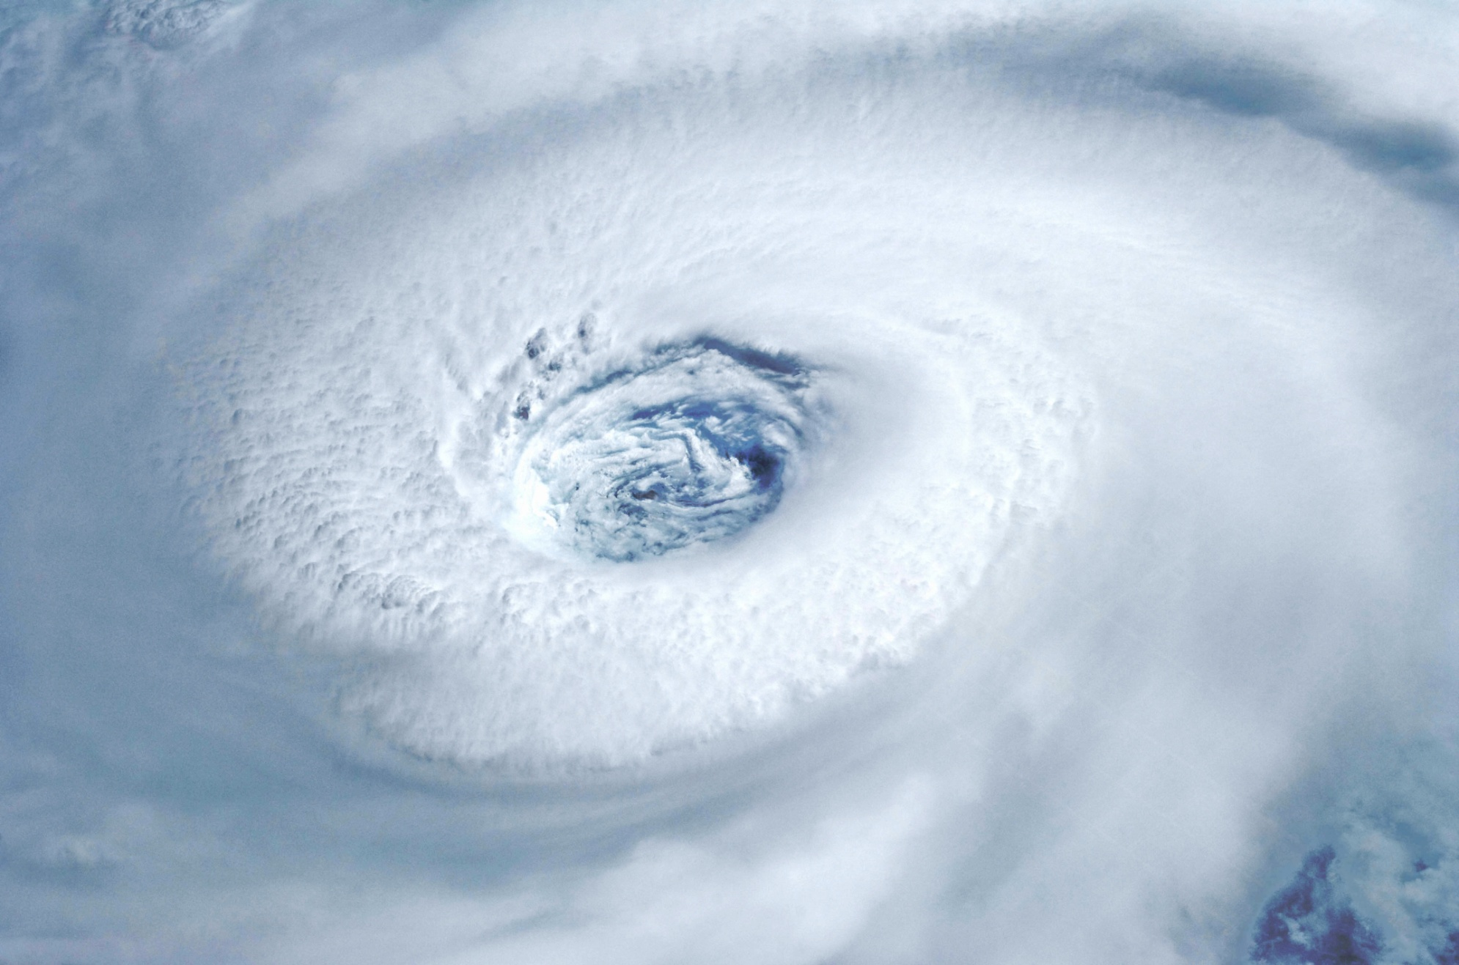
The Eye

Slide 63
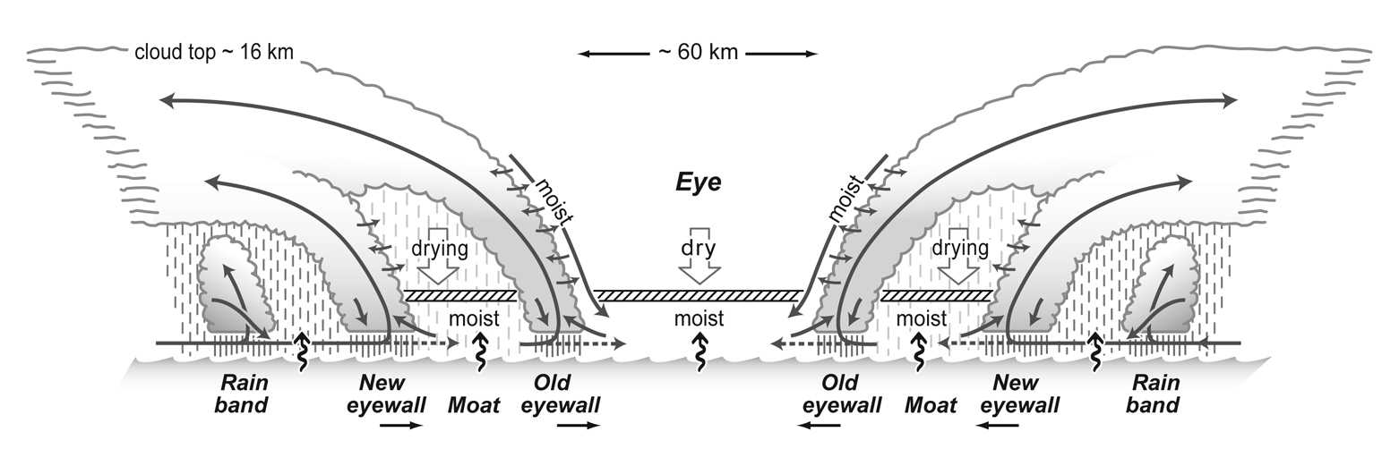
Angular Momentum Budget in Eye Boundary Layer

Slide 64
Steady state eye subsidence owing to radiative cooling
Blue arrows show turbulent angular momentum fluxes. In eye PBL, radial M flux from eyewall must balance oceanic M sink.

Slide 65
Eye Angular Momentum Budget
horizontal advection
torque from surface drag
convergence of radial eddy flux of angular momentum
In steady state, azimuthal velocity profile must be concave

Slide 66
Inner core:

Slide 67
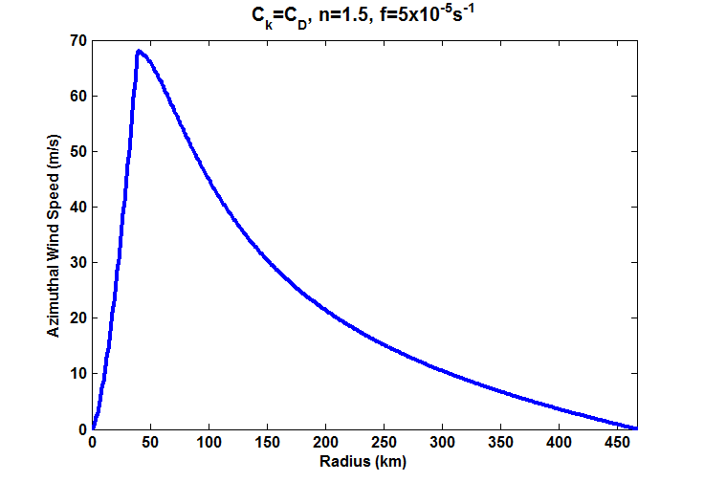

Slide 68
Approximate PBL Radial Wind:
Vertical Velocity:

Slide 69
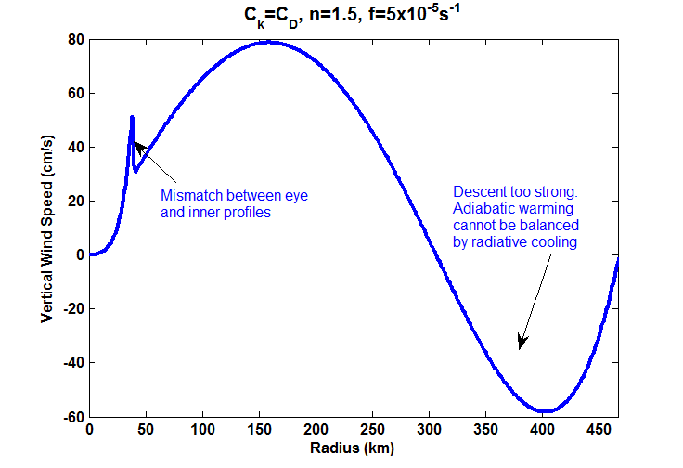
Vertical Velocity

Slide 70
Outer Region
Assume zero moist convection, so subsidence warming balances radiative cooling:
Assume w_{cool} constant:
Integrate

Slide 71
Now using
and taking
results in
Integrate inward from r = r_{o}. No exact analytic solution.

Slide 72
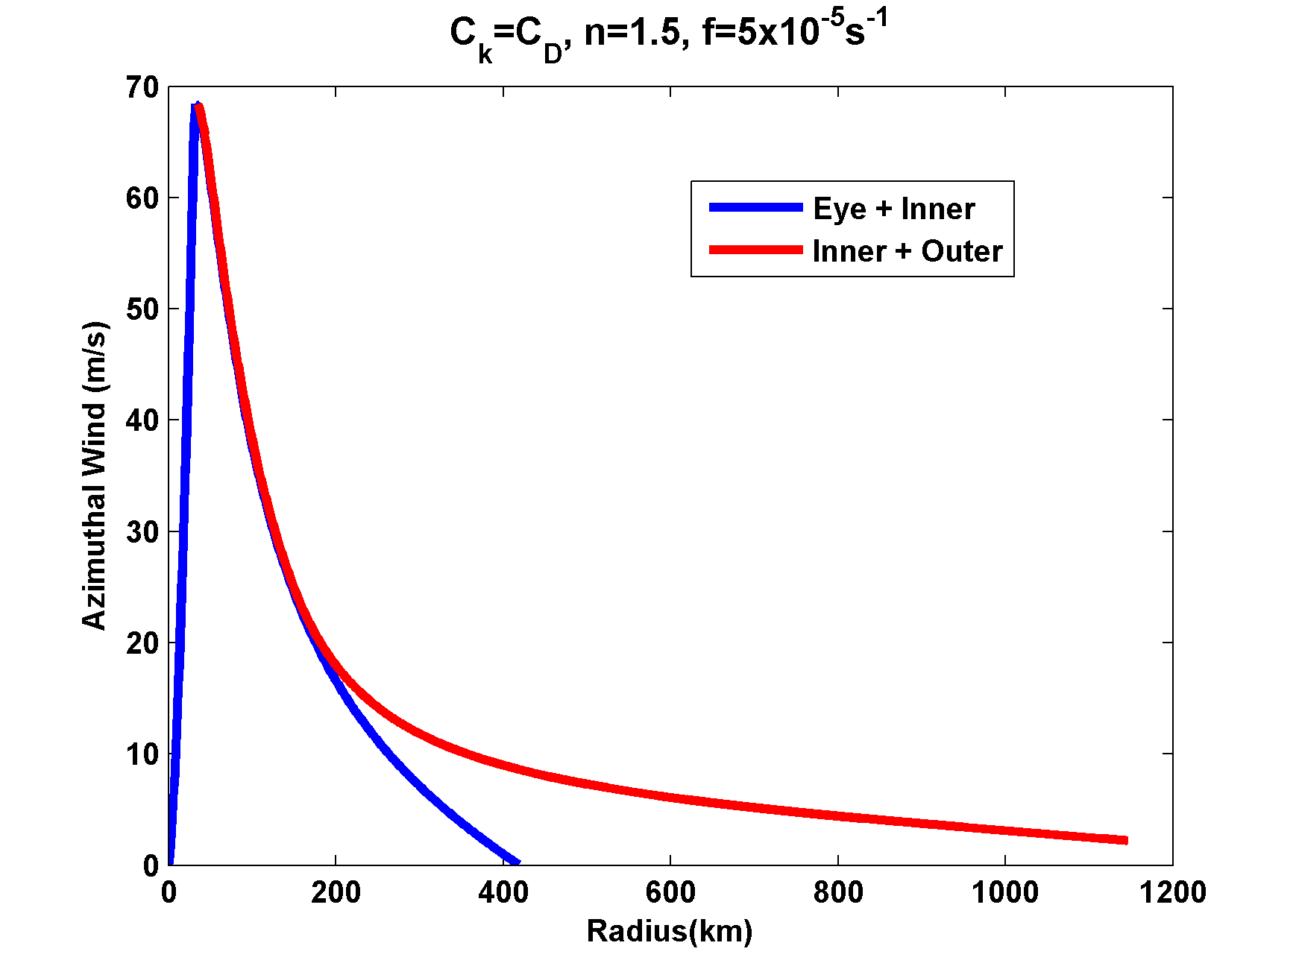

Slide 73
Chavas et al., J. Atmos., 2015

Slide 74
Tropical Cyclone Inner Core Dynamics

Slide 75
Main Assumptions
Axisymmetric flow
Gradient and hydrostatic balance above PBL
Troposphere neutral to slantwise moist convection outside eye

Slide 76
Assume that interior flow is always close to gradient and hydrostatic balance:
(1)
where r_{o} is the radius of the angular momentum surface where its absolute temperature is T_{o}. Define that point as the point along the angular momentum surface at which the azimuthal velocity changes sign. At that point, by definition,
so (1) becomes:
(2)

Slide 77
Also assume Richardson Number criticality of outflow:
(3)
Conservation of entropy in PBL (in M coordinates):
(4)
where is the total time derivative of angular momentum, F is the vertical turbulent flux of entropy, and D represents the irreversible entropy sources of owing to kinetic energy dissipation, non-equilibrium evaporation of liquid water, and diffusion of water vapor.

Slide 78
Substitute into (4) and integrate over depth of PBL:
(5)
(Dissipative heating)

Slide 79
(5) becomes
(6)

Slide 80
Dealing with Eye Dynamics
Begin with equation for thermal wind balance:
Assume solid body rotation inside r=r_{max}:
Solve for temperature of eye:
(7)
Note: Continue to solve (6) for s_{b} in eye, but this is less than (and decoupled from) s*

Slide 81
Complete System
(8)
(9)
(10)
(11)

Slide 82
MATLAB code of model
(very fast!)
ftp://texmex.mit.edu/pub/emanuel/scripts/smodel_public.m

Slide 83
Approximate System
Neglect pressure dependence of s₀*
V~M/r (inner core)
Neglect dissipative heating
|V| ~ V
h=constant

Slide 84
(12)
(13)
(14)

Slide 85
Differentiate (14) with respect to M, and substitute from (12) and (13):
(15)
Suppose that maximum winds always occur on the same M surface. Then, using
(16)

Slide 86
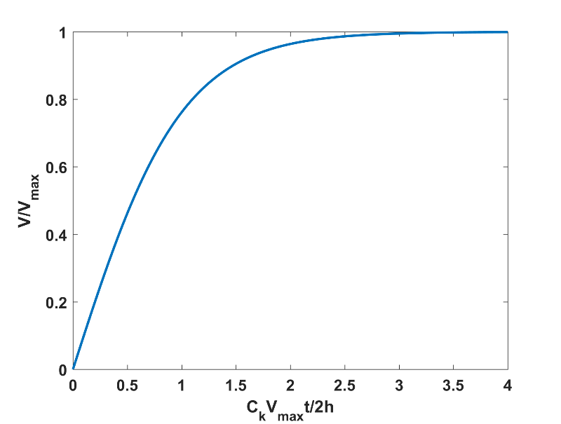
From previous lecture,
(17)
If V = 0 at t = 0, the integration of (16) gives
(18)

Slide 87
Note that first on right of (15) term steepens V gradient when
V gradient cannot steepen indefinitely:

Slide 88
Eyewall undergoes frontal collapse!
This can only be prevented by 3-D eddies. In the present model, we prevent frontal collapse by insisting on solid body rotation everywhere inside r_{max}.

Slide 89
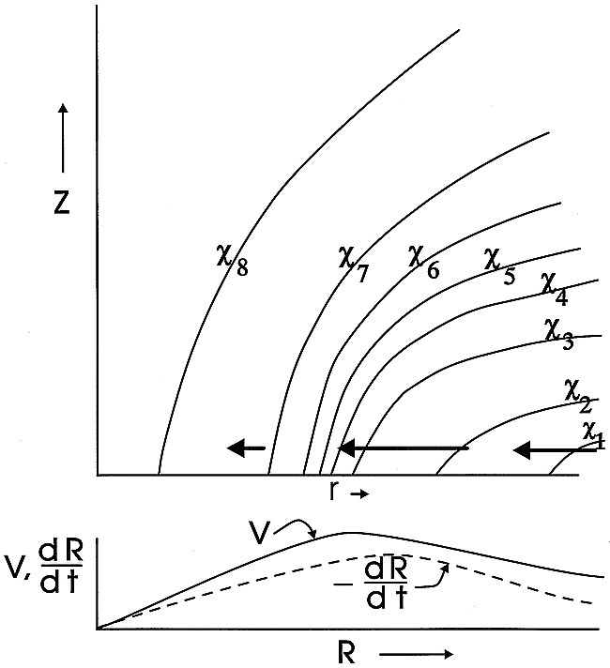

Slide 90
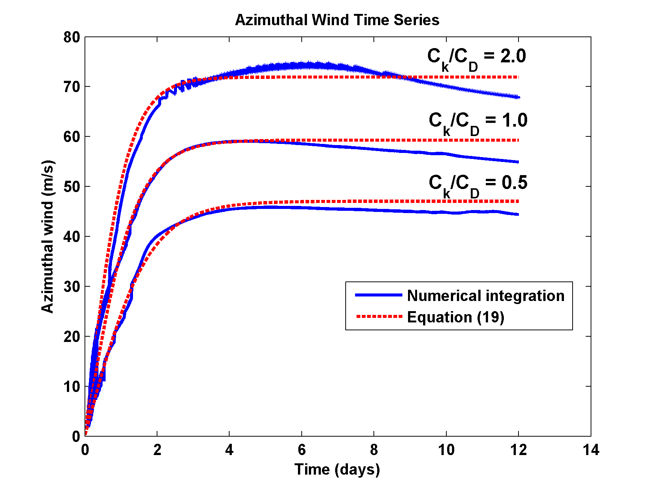
Comparison with numerical solution of (7) – (11)
(18)

Slide 91
Varying C_{k}
Varying C_{D}

Slide 92
