Slide 1

The Changing Risk Landscape
Kerry Emanuel
Lorenz Center
Massachusetts Institute of Technology

Slide 2
The Changing Landscape of Weather and Climate Perils
Tropical Cyclones
Severe Convective Storms
Winter Storms
Flooding
Wildfires
Droughts
Heatwaves

Slide 3
Data from the Insurance Information Institute

Slide 4
Data from the Insurance Information Institute

Slide 5
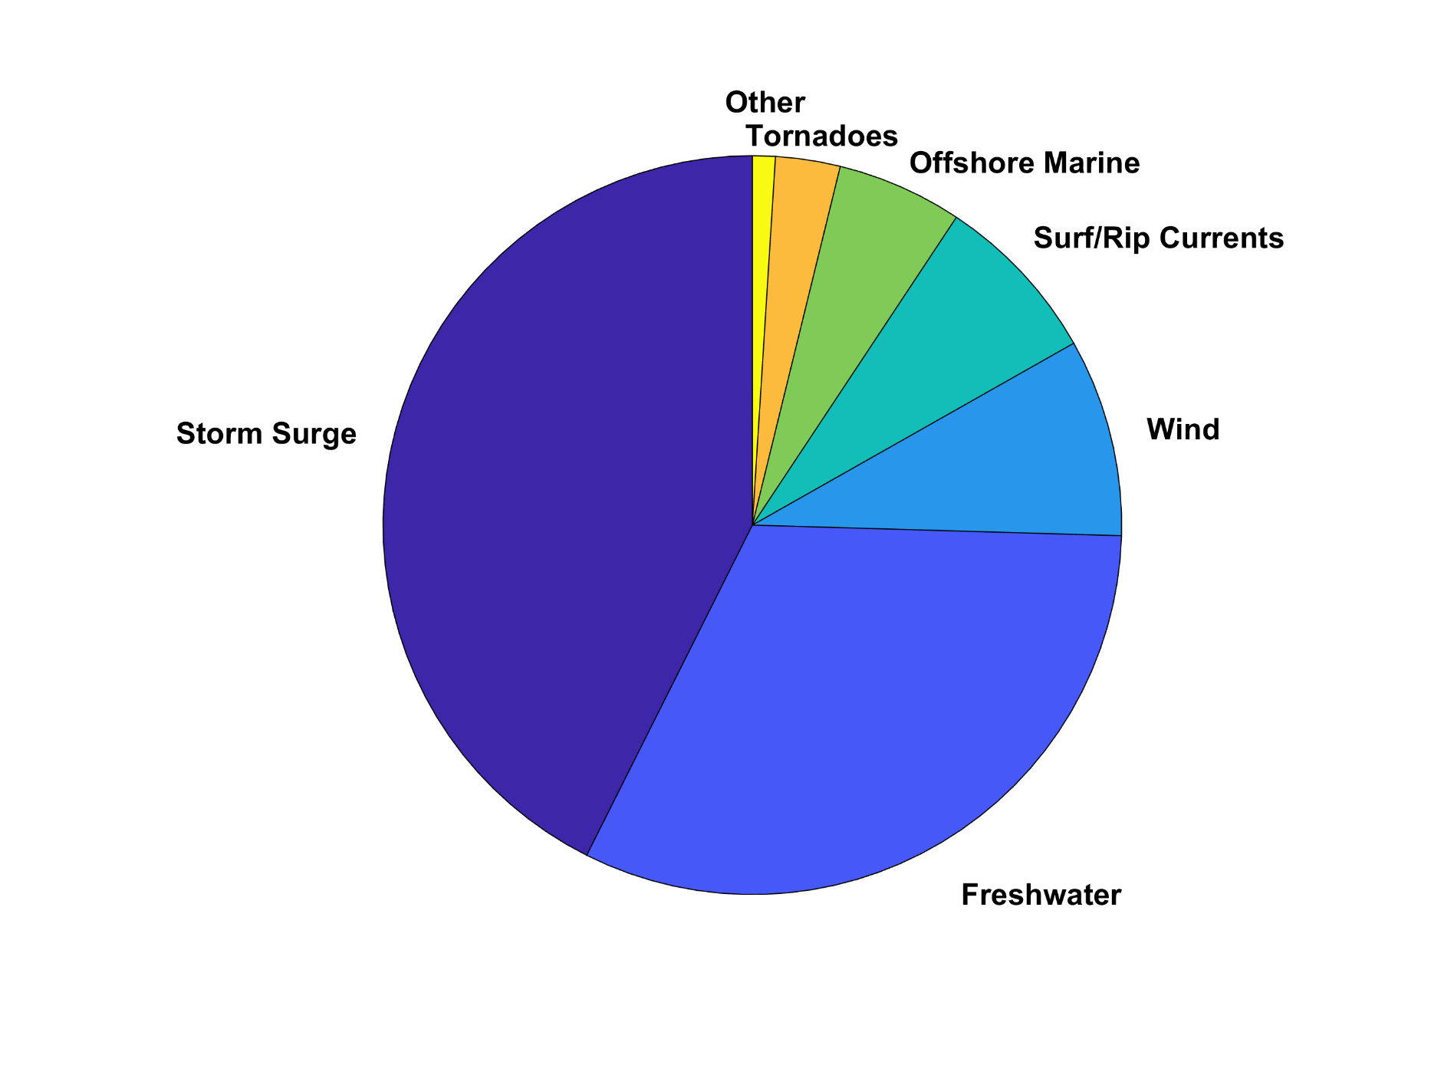
U.S. Hurricane Fatalities, 1963-2022
Sources: Rappaport (BAMS, 2014) updated by Brennan (August 8, 2023, AMA blog)

Slide 6
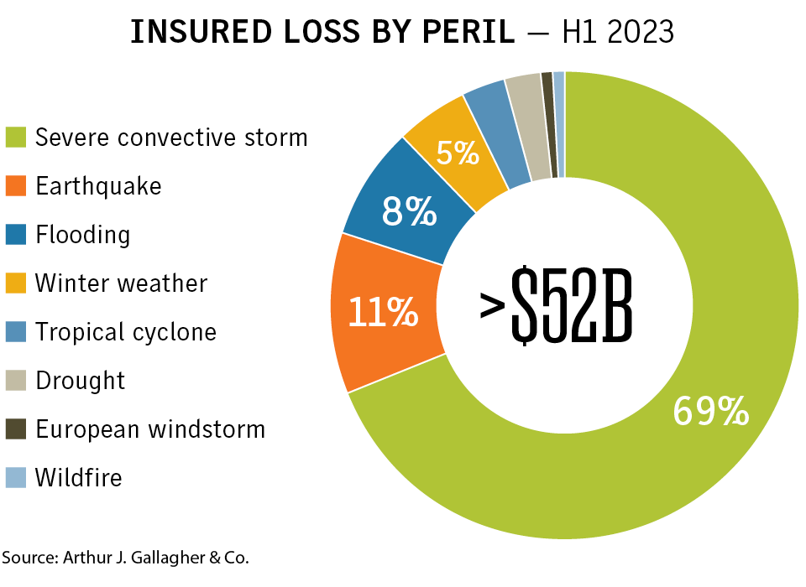
GLOBAL

Slide 7
Two trends to contend with:
Demographic
Climate Change

Slide 8
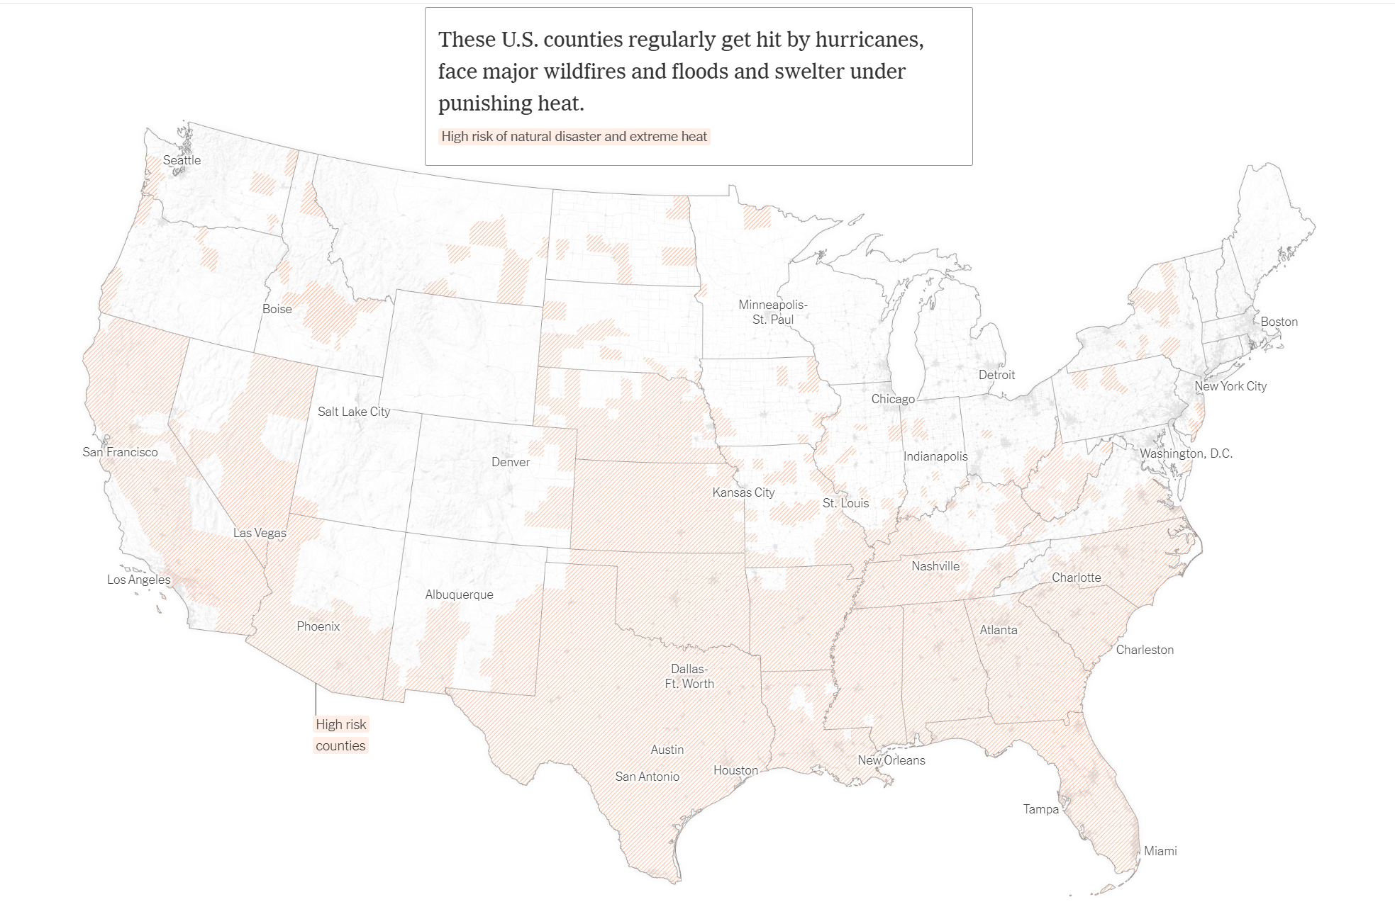
Source: New York Times

Slide 9
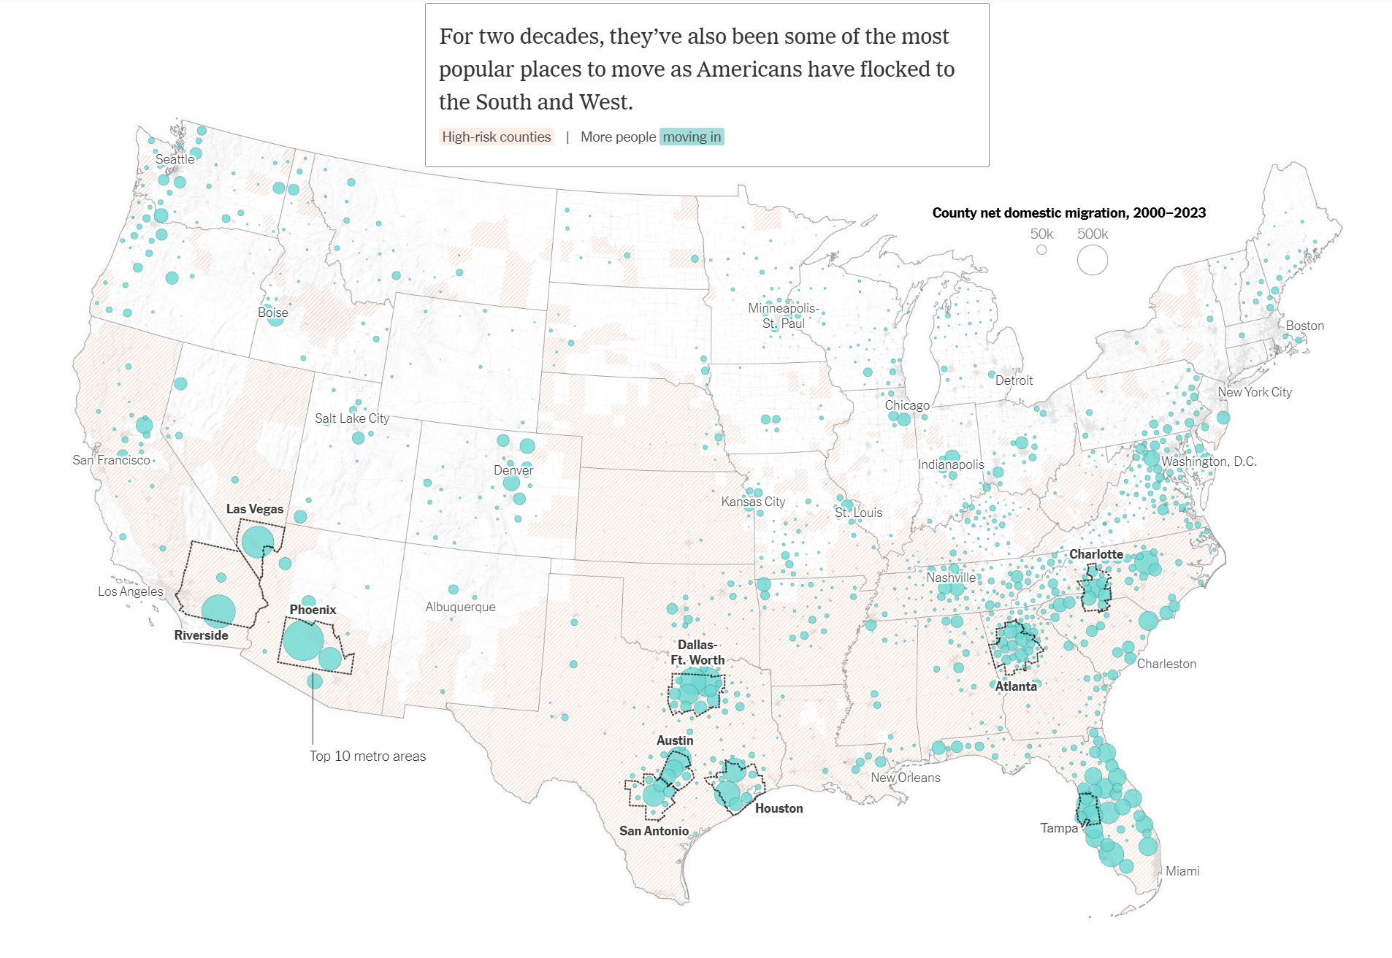
Source: New York Times

Slide 10
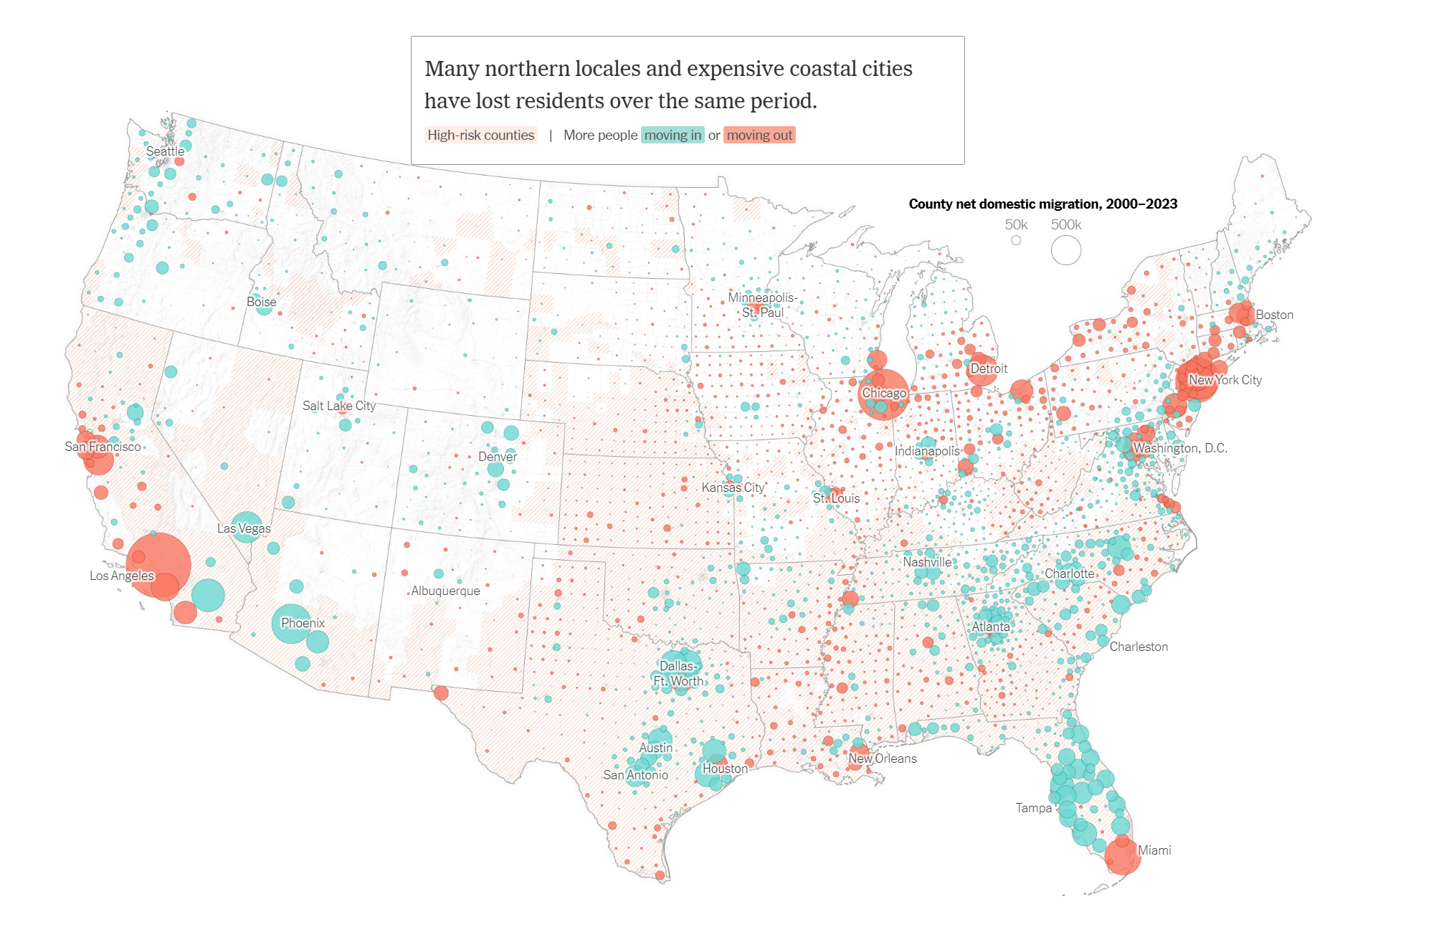
Source: New York Times

Slide 11
SFHA=special flood hazard area
Whose paying for this?
Kansas!
Courtesy First Street Foundation

Slide 12
Global Damage Normalized by Gross World Product
Storms, droughts, floods, wildfires
270% increase since 1970
Population of TC-prone regions increased by ~200%
Suggests that climate change may have contributed to increasing damage
EM-DAT, 2024: The OFDA/CRED International Disaster Database
http://www.emdat.be/.

Slide 13
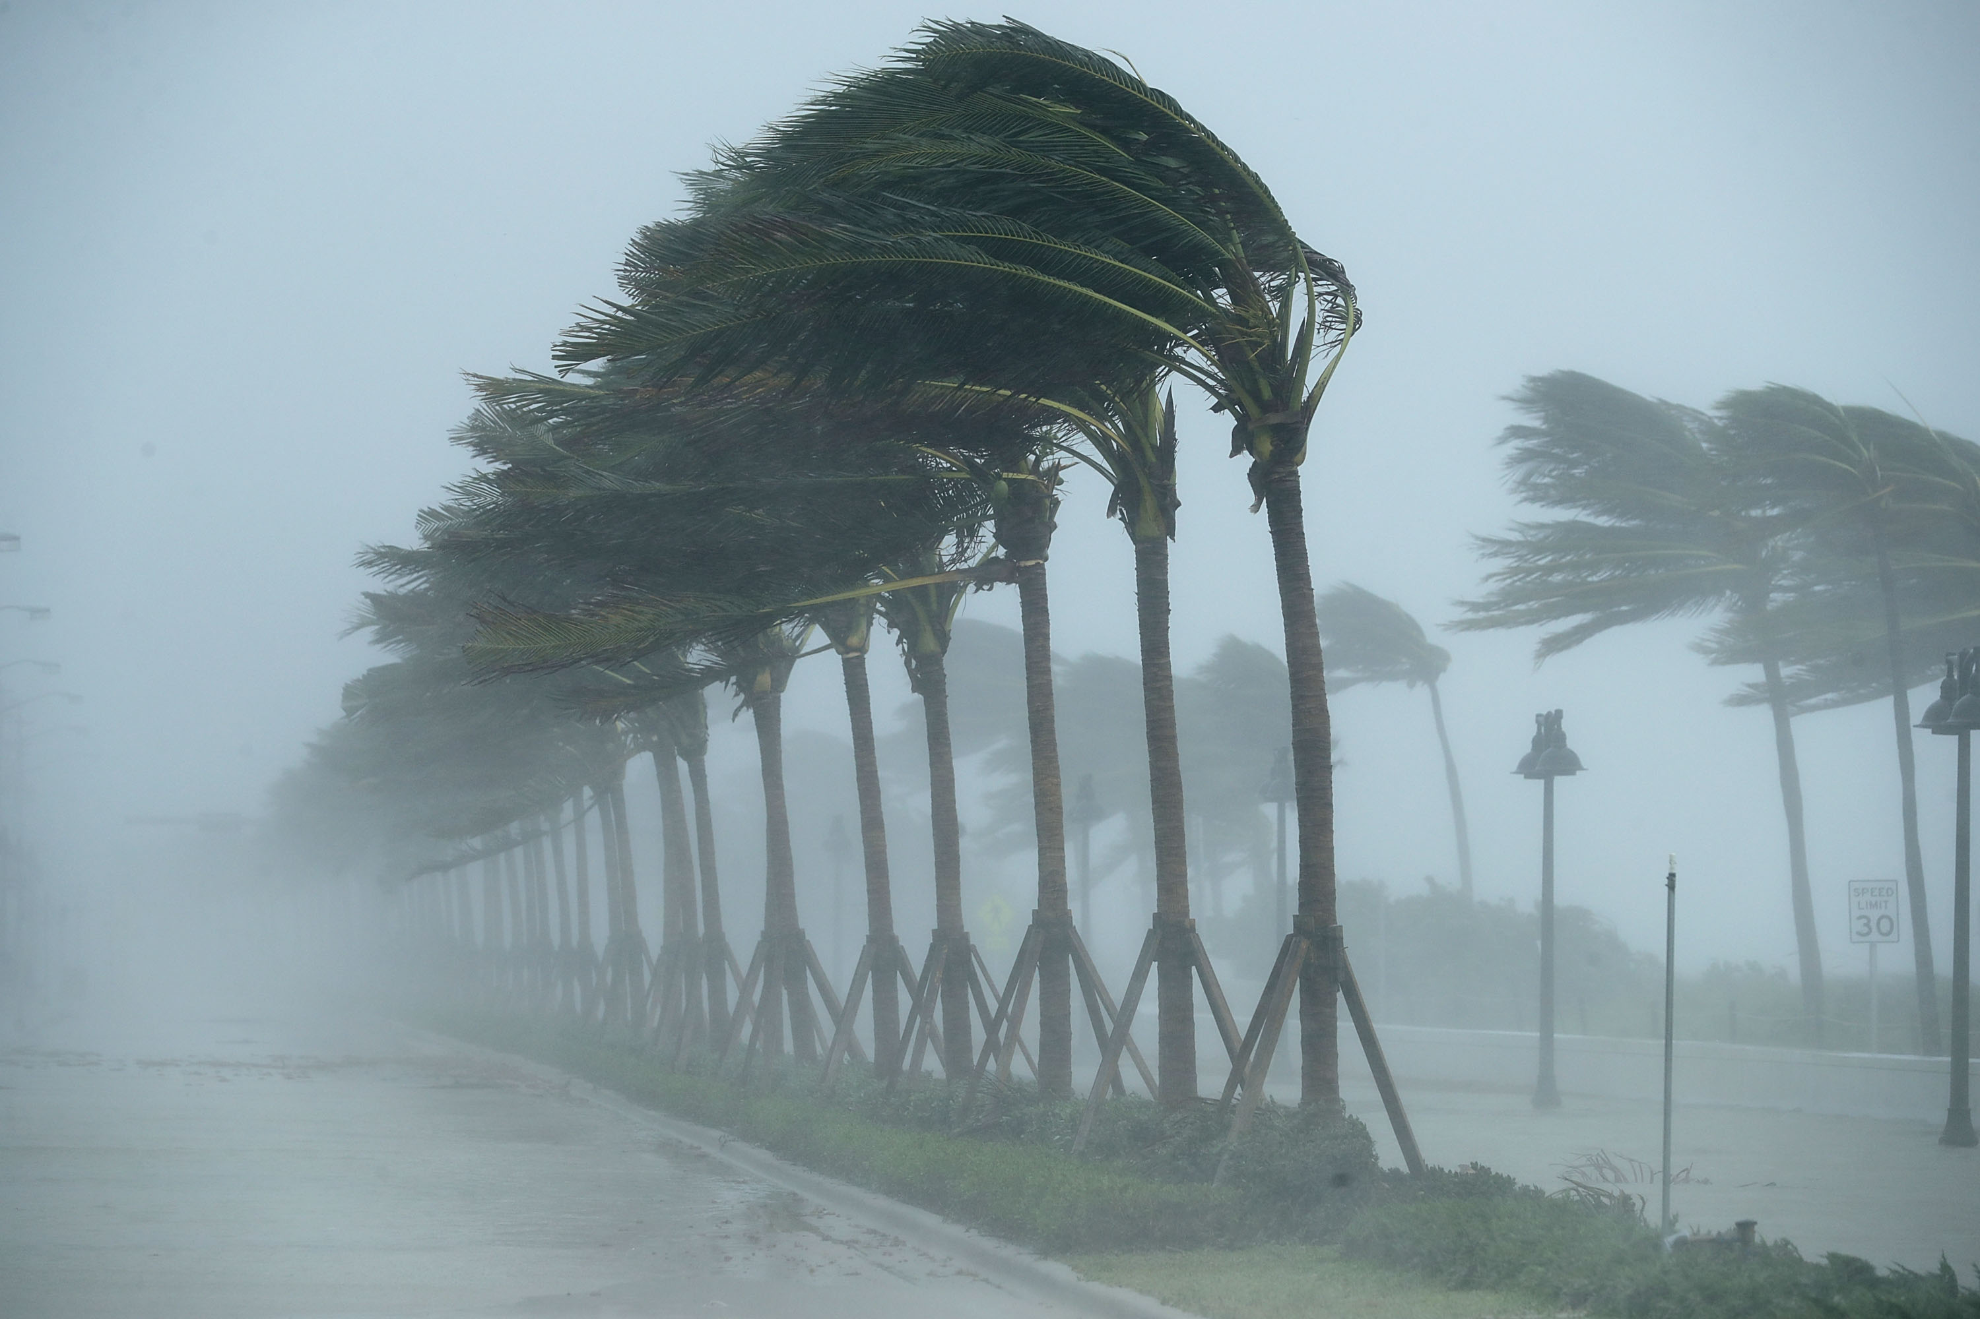
Trends in Perils

Slide 14
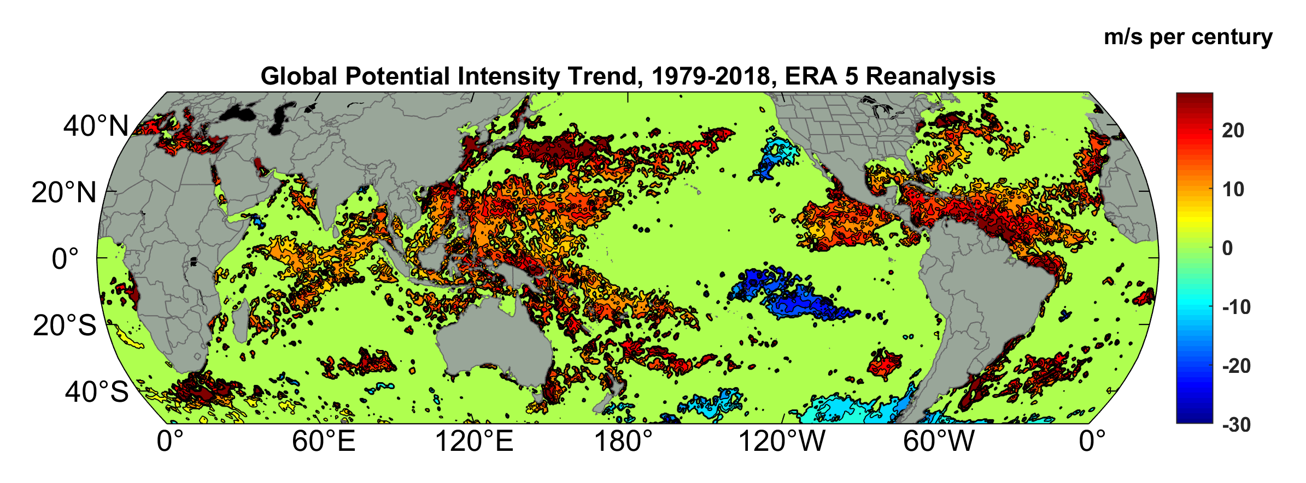
Potential Intensity Trend, 1979-2018, ERA 5 Reanalysis
Potential intensity is a thermodynamic upper bound on TC wind speeds
(Trend shown only where p value < 0.05)

Slide 15
Satellite-derived proportion of major hurricane fixes
Time series of fractional proportion of global major hurricane estimates to all hurricane estimates for the period 1979–2017. Each point, except the earliest, represents the data in a sequence of 3-y periods. The first data point is based on only 2 y (1979 and 1981) to avoid the years with no eastern hemisphere coverage. The linear Theil−Sen trend (black line) is significant at the 98% confidence level (Mann−Kendall P value = 0.02). The proportion increases by 25% in the 39-y period (about 6% per decade).
Kossin et al., PNAS, 2020

Slide 16
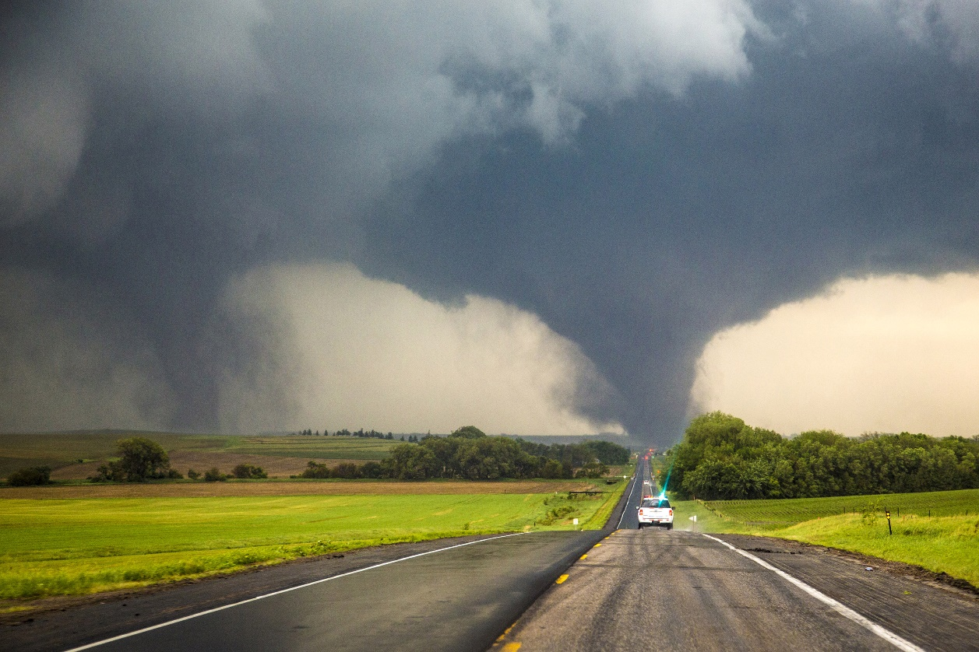
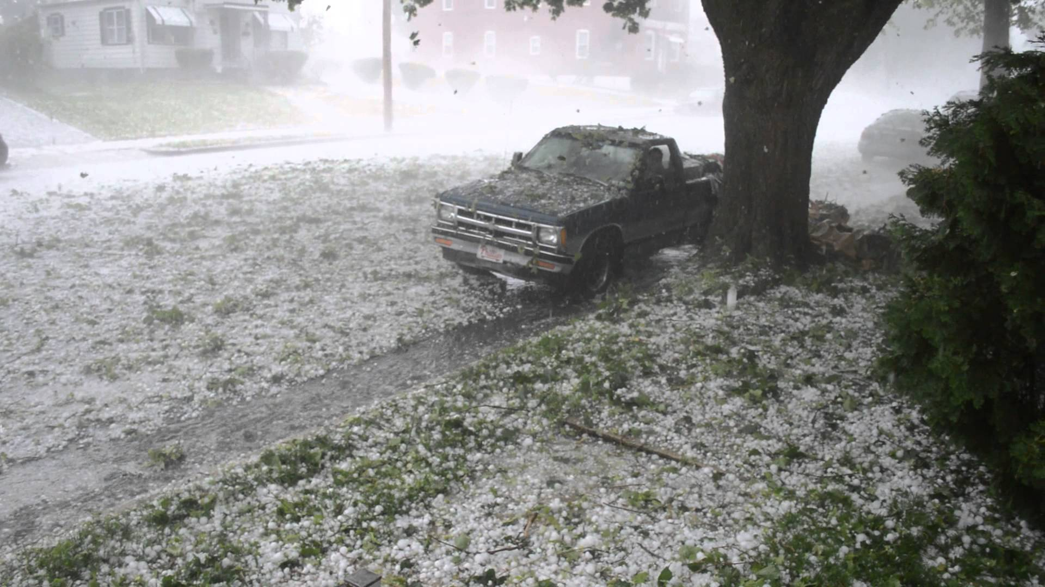
Each year in the U.S., 1,200 tornadoes on average kill 60 people, injure 1,500, and cause roughly $400 million in damages
Hail causes about $1 billion dollars in damage to crops and property each year, according to the National Oceanic Atmospheric Administration (NOAA)

Slide 17
Trends in a Measure of Favorable Environments for Hailstorms (shaded) and annual mean number of hail days (contoured)
Tang, B.H., Gensini, V.A. & Homeyer, C.R. Trends in United States large hail environments and observations. npj Clim Atmos Sci 2, 45 (2019). https://doi.org/10.1038/s41612-019-0103-7

Slide 18
Flawed Basis of Current Risk Modeling
Most current risk assessments are based on historical statistics
Historical records are flawed and too short
Moreover, the past 50-150 years is a poor guide to the present owing to climate change that has already occurred
We need to bring physics to bear on weather hazard risk
Climate and weather researchers are getting more involved in physical modeling of risk
Government and the insurance/reinsurance industries should encourage this development

Slide 19
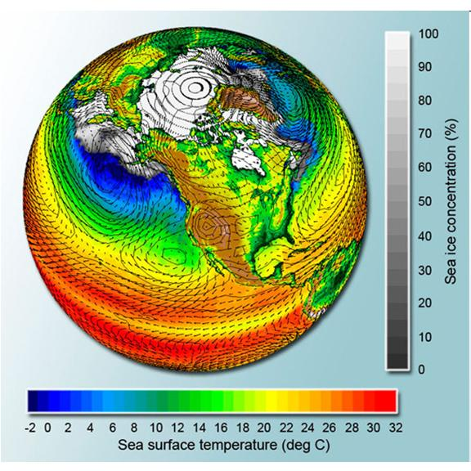
Applying Physics to Risk
Global climate models can potentially simulate droughts and heatwaves…..

Slide 20
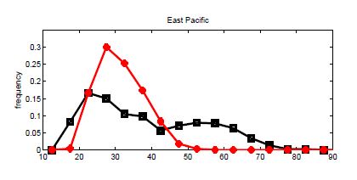
…. but are far too coarse to simulate, e.g., destructive hurricanes
Histograms of Tropical Cyclone Intensity as Simulated by a Global Model with 50 km grid point spacing. (Courtesy Isaac Held, GFDL)
Category 3
Modeled
Observed
Global models do not simulate the storms that cause destruction
Wind Speed (meters per second)
Detailed, high-resolution modeling suggests grid spacing of no more than 3 km required
HighResMip: Grid spacings of 20-200 km (NICAM has short run at 14 km)
We need high resolution and O(1000 yr) simulations

Slide 21
This problem led to the development of several methods of “downscaling” tropical cyclones from global analyses/models
Genesis Module: Generate seed disturbances physically commensurate with global climate state
Track Module: TCs move with some weighted vertical average of flow in global climate state
Intensity Module: Use physically based hurricane model or statistical algorithm driven by physically based inputs
Rainfall Module: Use physics to calculate rain associated with each TC

Slide 22
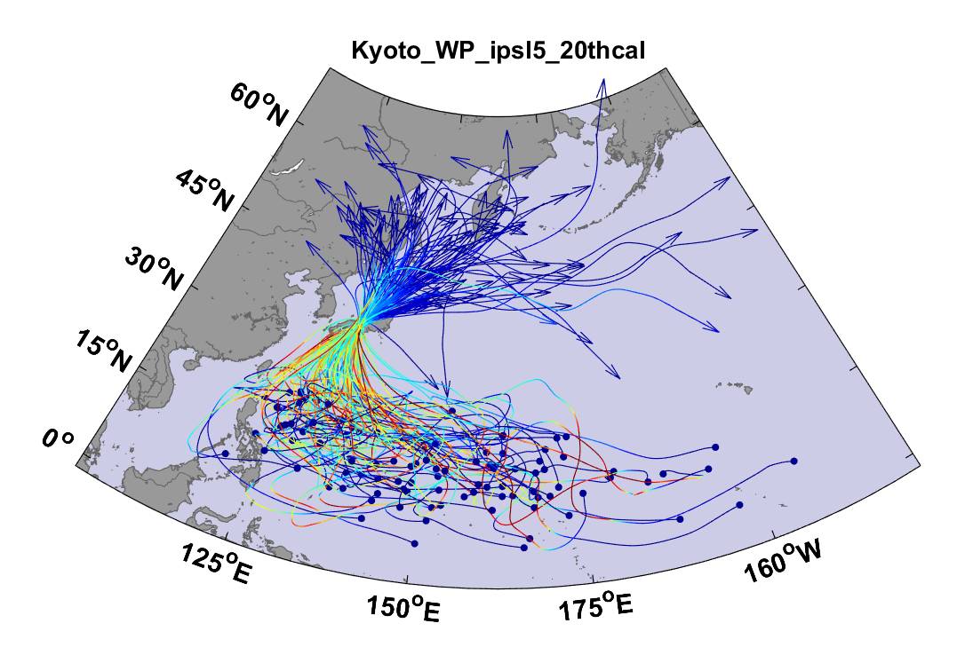
Example:
Top 100 out of 2000 TCs Affecting Kyoto, 1981-2000

Slide 23
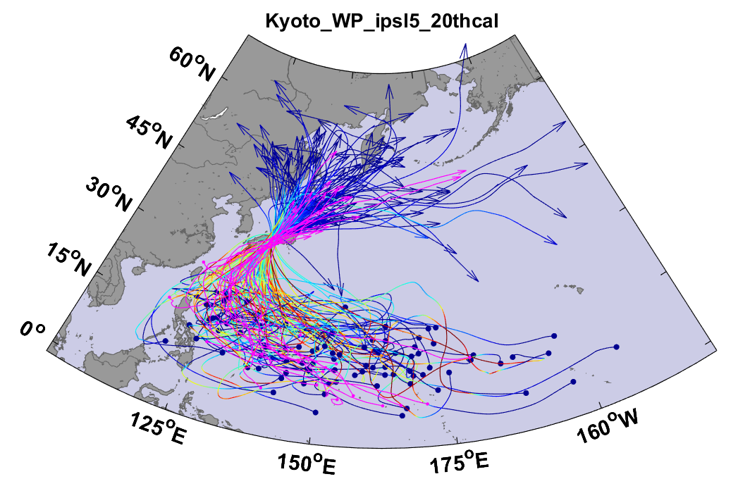
Same, but with top 20 historical tracks

Slide 24
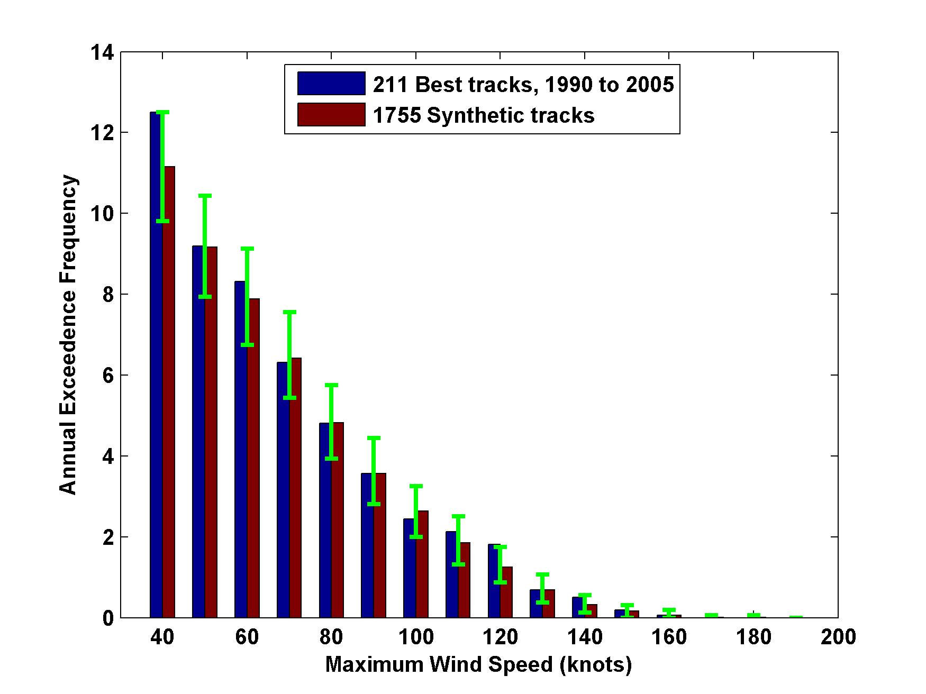
Cumulative Distribution of Storm Lifetime Peak Wind Speed, with Sample of 1755 Synthetic Tracks
Blue bars: Actual
Red bars: Predicted
90% confidence bounds

Slide 25
Major Hurricanes
7-year running averages

Slide 26
Modeling Business Performance
(Very Simple Case)
Company insures all property in 22 U.S. coastal cities
Specify a starting capital
Specify steady annual income (premiums + investment income – expenses)
No reinsurance
Use 10,000 100-year times series of loss from synthetic TC data
Calculate net capital over 100 years, 10,000 times

Slide 27
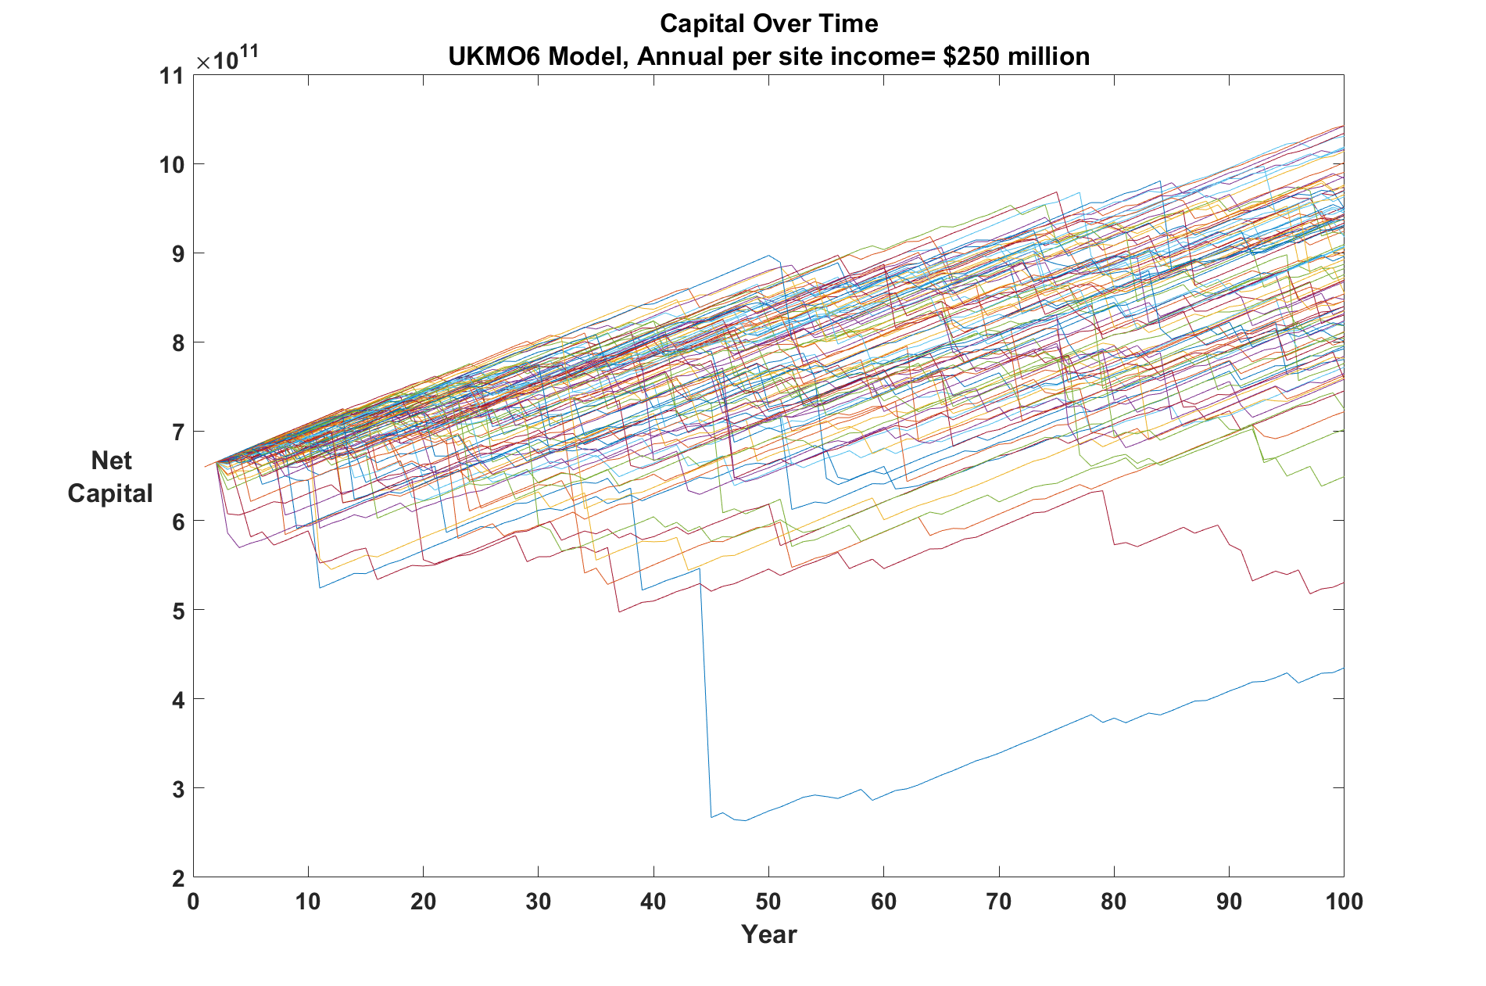
Here is 100 of 10,000 time series of the company’s capital over 100 years:
Notes:
Note that the net income of 0.018 unit is per policy.

Slide 28
Same but with TC power doubling over 100 years

Slide 29
While we are making progress bringing physics to bear on estimating current and future TC risk, we are not as advanced on other perils such as:
Non-tropical cyclones (winter storms)
Hybrid cyclones (like Sandy)
Severe convective storms

Slide 30
Summary
Climate change has already rendered suspect historically based hazard models
Atmospheric and climate modelers are starting to apply physics-based models to natural hazard risk
The insurance/reinsurance industry can help accelerate the transition to physics-based CAT modeling

Slide 31
Spare Slides

Slide 32
Data from the Insurance Information Institute

