Slide 1

What We Know About Climate Change
Kerry Emanuel
Lorenz Center
Department of Earth, Atmospheric, and Planetary Sciences, MIT
Web: emanuel.mit.edu

Slide 2

Program:
Brief history of earth’s climate and climate science
Anthropogenic effects on climate
Climate risks

Slide 3
Earth’s Natural Climate Variations

Slide 4
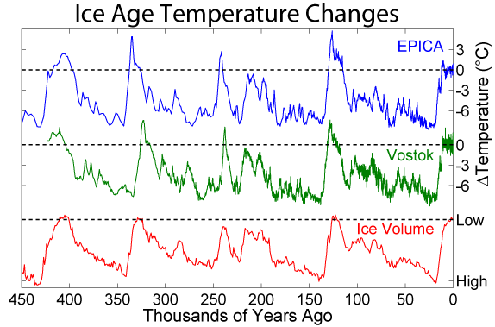
Last 450 Thousand Years
Antarctica

Slide 5
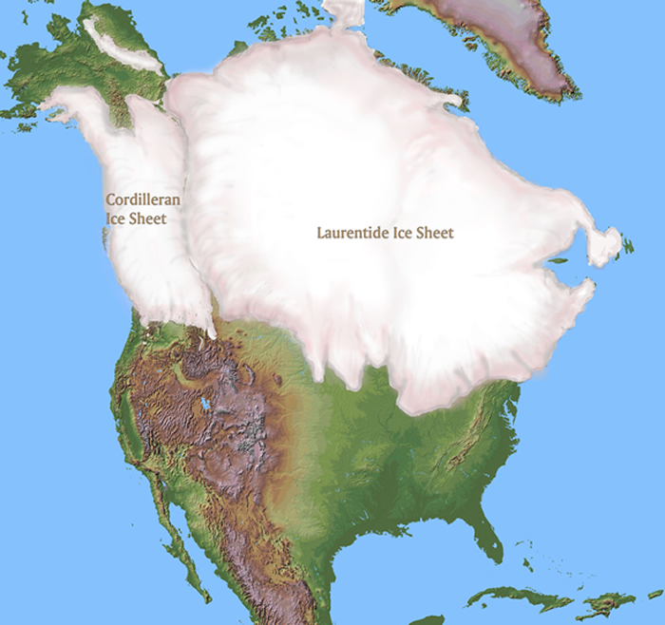
~ 20,000 years before present

Slide 6
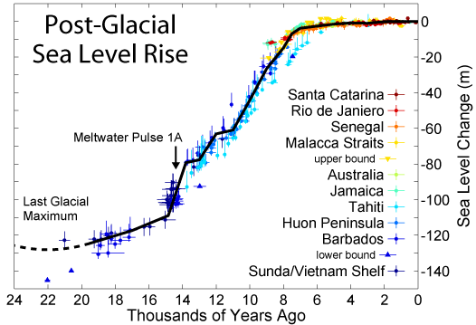

Slide 7
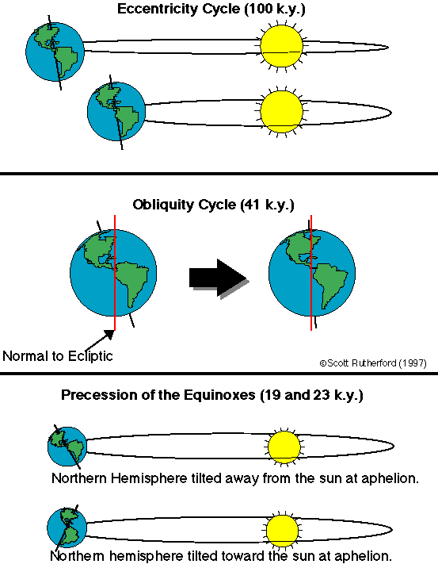
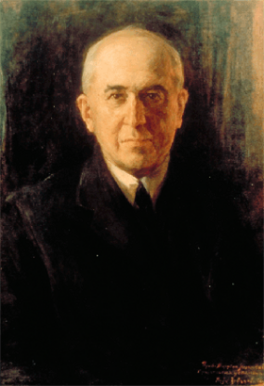
Climate Forcing by Orbital Variations (1912)
Milutin Milanković, 1879-1958

Slide 8
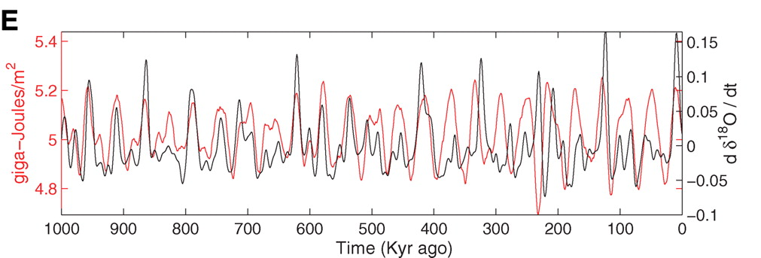
Strong Correlation between High Latitude Summer Insolation and Ice Volume
Black: Time rate of change of ice volume
Red: Summer high latitude sunlight
P. Huybers, Science, 2006

Slide 9
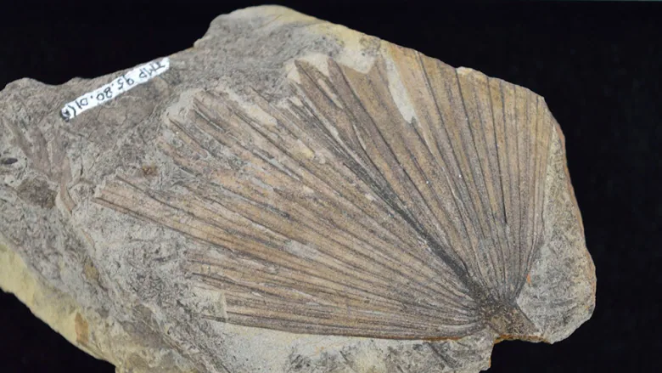
Fossil of palm leaf from ~65 million years ago, found near Edmonton, Alberta, Canada

Slide 10
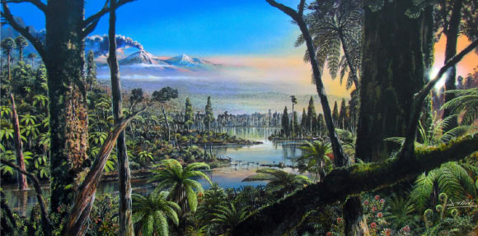
Reconstruction of the West Antarctic mid-Cretaceous (~100 million years ago) temperate rainforest.
Image credit: J. McKay / Alfred-Wegener-Institut

Slide 11
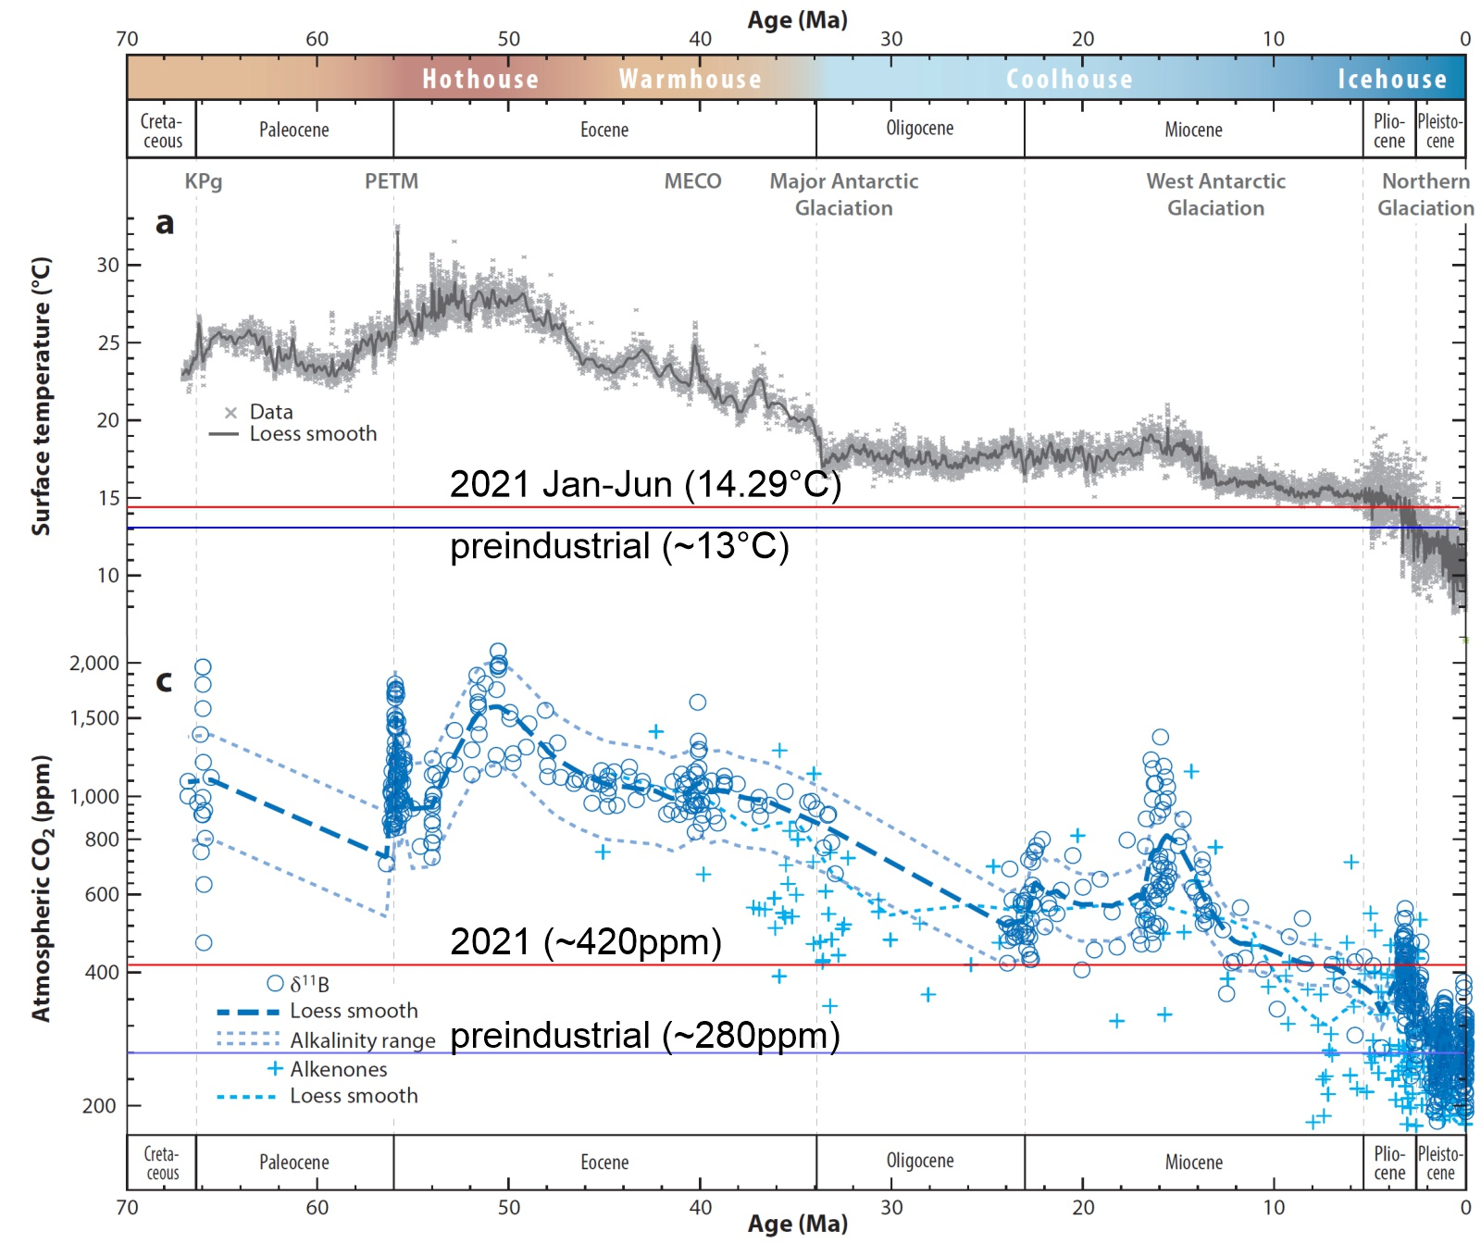

Slide 12
The Greenhouse Effect

Slide 13
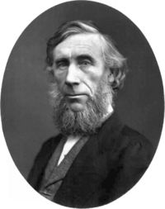
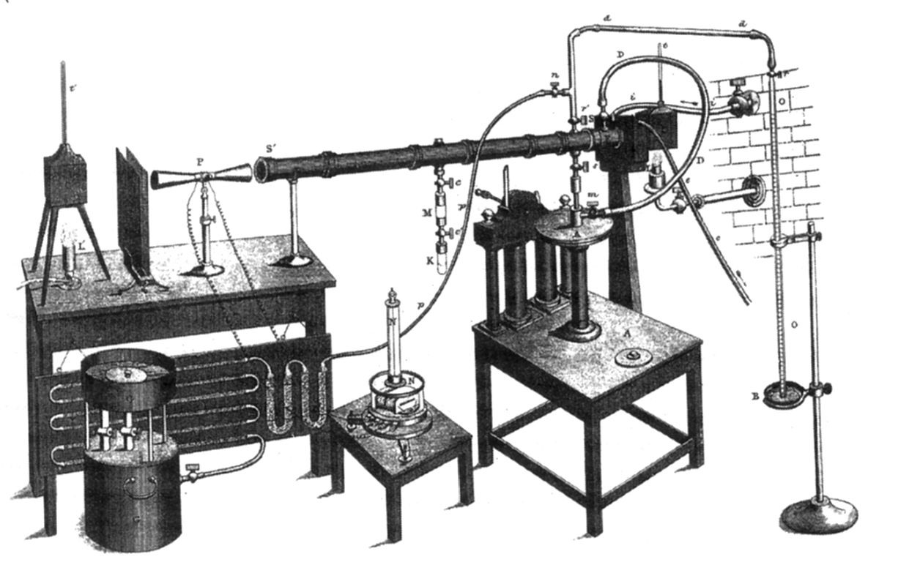
John Tyndall (1820-1893)

Slide 14
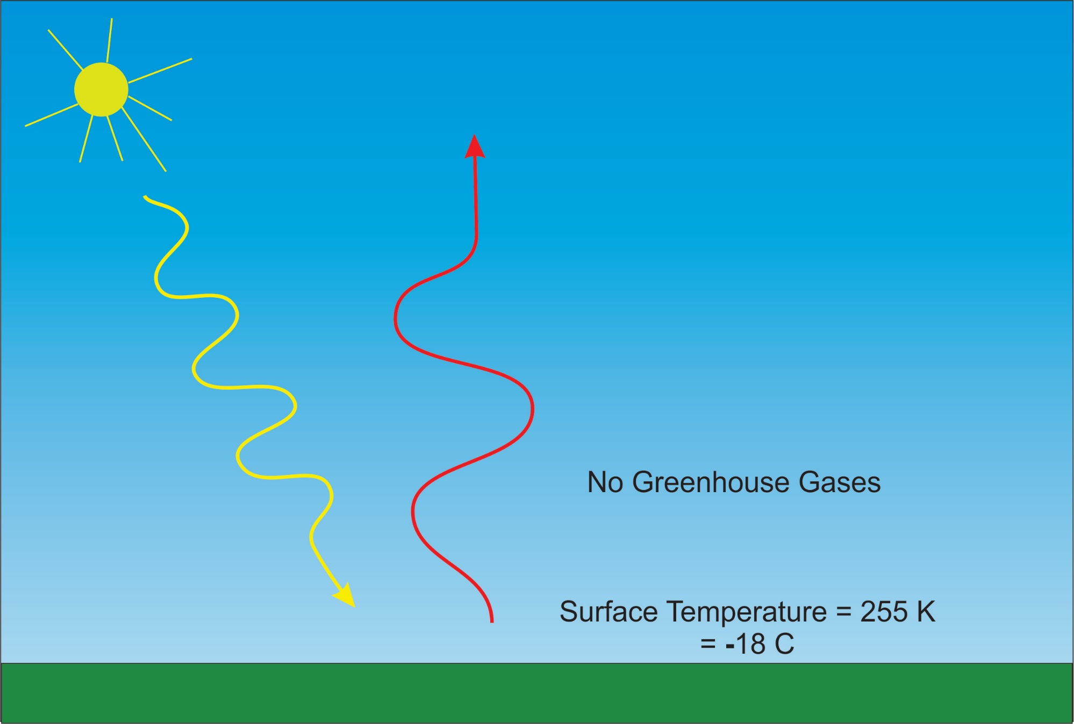
solar
infrared

Slide 15
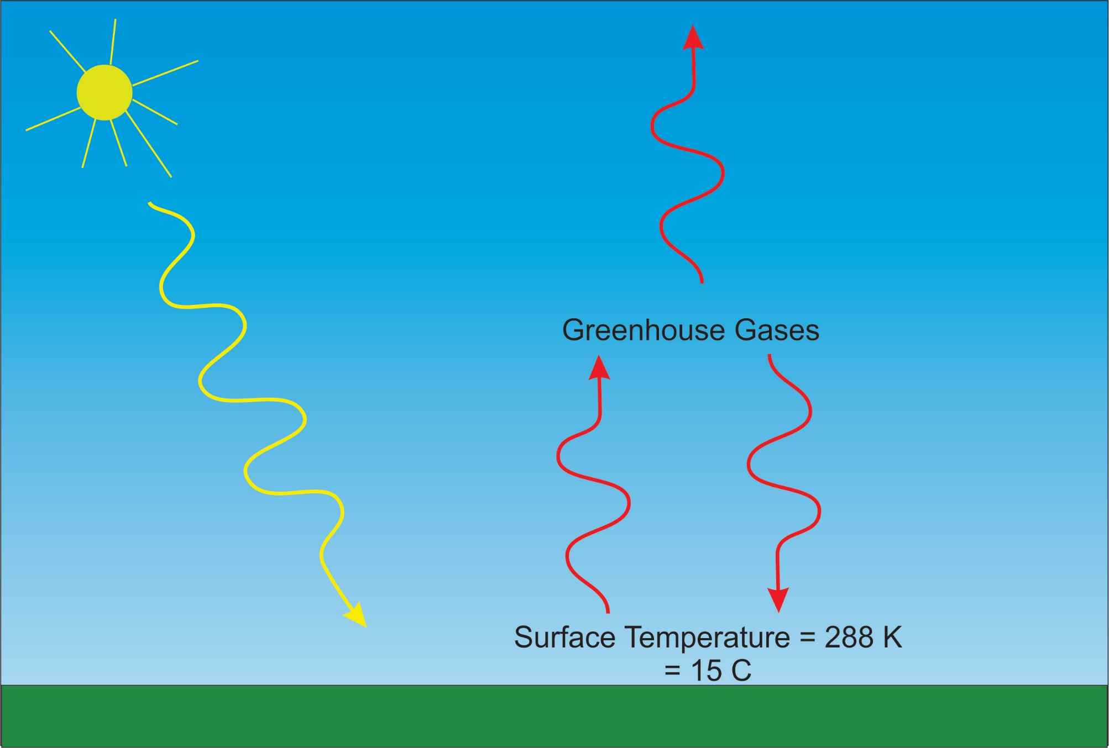
infrared
solar

Slide 16
Tyndall’s Essential Results:
Oxygen (O₂ ), nitrogen (N₂), and argon (Ar), though they make up ~99% of the atmosphere, are almost entirely transparent to solar and terrestrial radiation
Water vapor (H₂O), carbon dioxide (CO₂), nitrous oxide (N₂O), and a handful of other trace gases make the lower atmosphere nearly opaque to infrared radiation, though still largely transparent to solar radiation (but clouds have strong effects on radiation at all wavelengths). Together they increase the Earth’s surface temperature from about 0ºF to around 60ºF.

Slide 17
Atmospheric Composition
The orange sliver makes the difference between a mean surface temperature of 0ºF and of 60ºF.

Slide 18
Water Vapor (H₂O), about 0.25% of the mass of the atmosphere, is the most important greenhouse gas, but responds to atmospheric temperature change on a time scale of about 2 weeks
Climate is therefore strongly influenced by long-lived greenhouse gases (e.g. CO₂, CH₄, N₂O) that together comprise about 0.04% of the mass of the atmosphere. Concentration of CO₂ has increased by 46% since the dawn of the industrial revolution

Slide 19
Our Influence on Greenhouse Gases

Slide 20
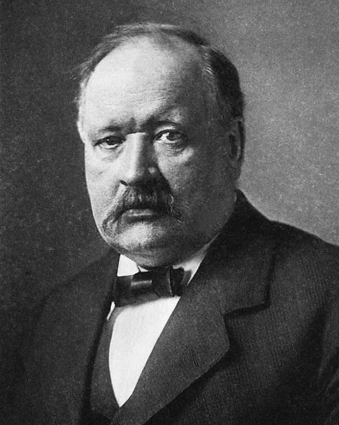
Svante Arrhenius, 1859-1927
“Any doubling of the percentage of carbon dioxide in the air would raise the temperature of the earth's surface by 4°; and if the carbon dioxide were increased fourfold, the temperature would rise by 8°.” – Världarnas utveckling (Worlds in the Making), 1906

Slide 21
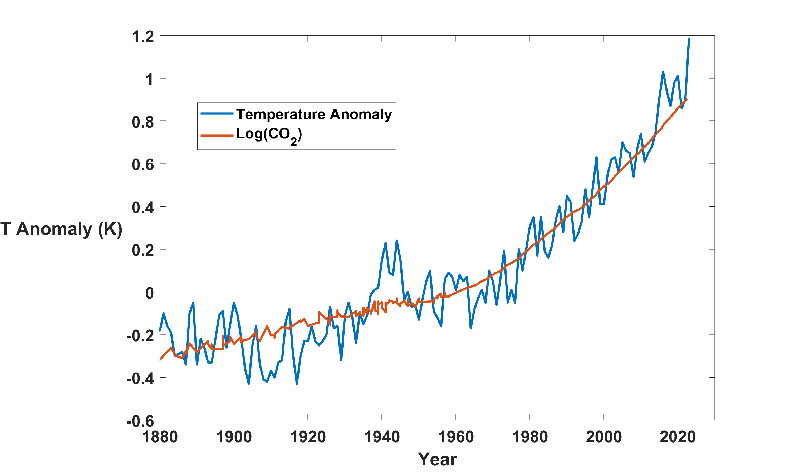
Global Mean Temperature and CO₂
2023

Slide 22
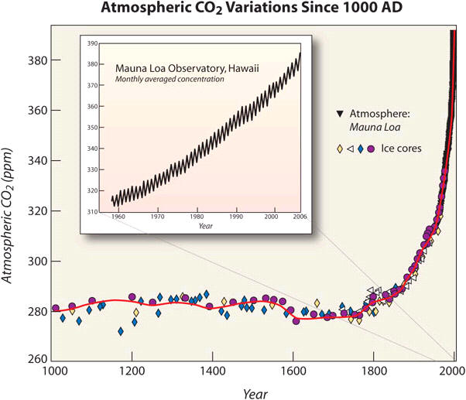
Today

Slide 23
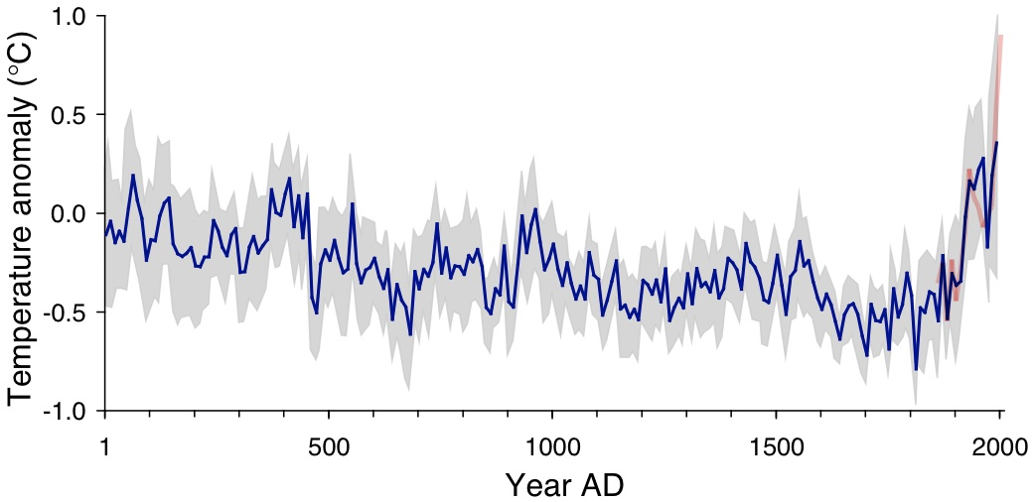
Arctic air temperature change reconstructed (blue), observed (red)
The long-term cooling trend in the Arctic was reversed during recent decades. The blue line shows the estimated Arctic average summer temperature over the last 2000 years, based on proxy records from lake sediments, ice cores, and tree rings. The shaded area represents variability among the 23 sites use for the reconstruction. The red line shows the recent warming based on instrumental temperatures. From Kaufman et al. (2009).

Slide 24
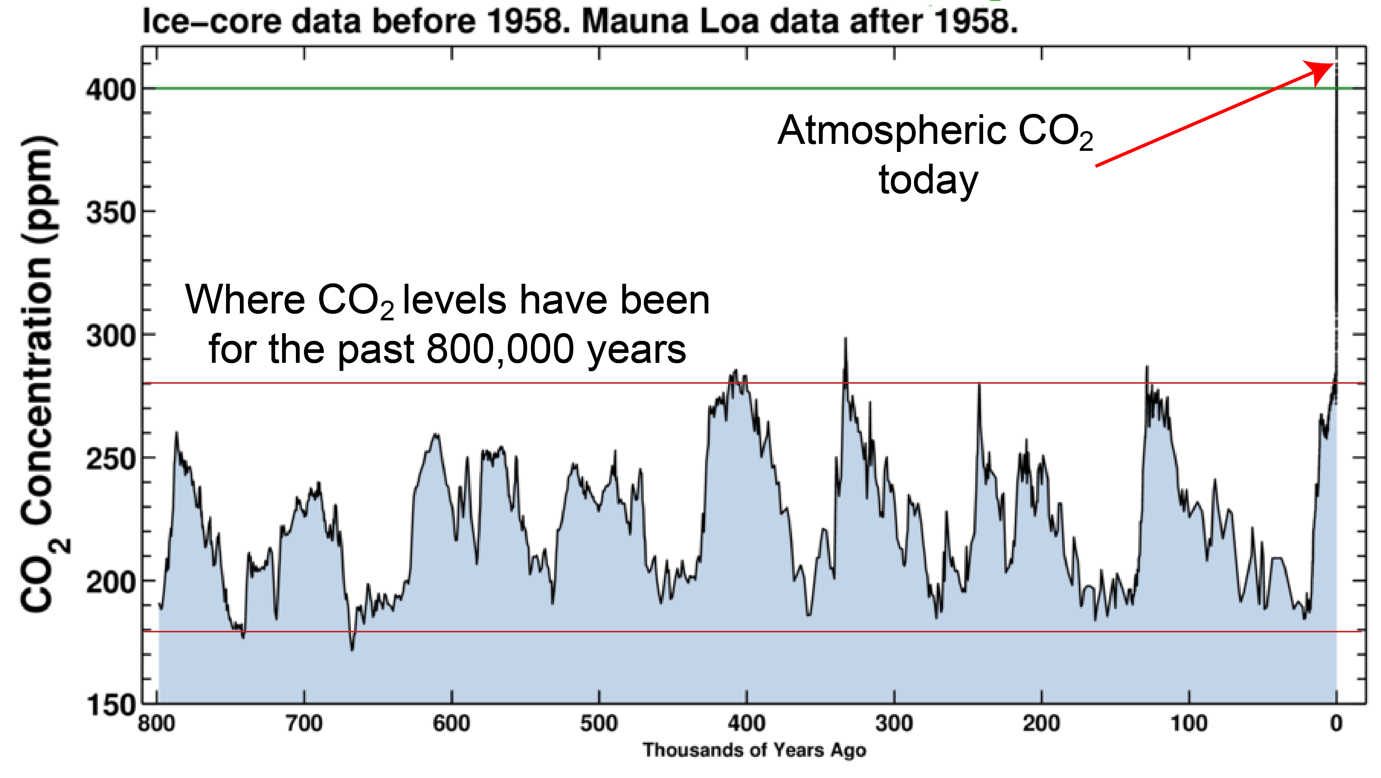

Slide 25
Other Trends

Slide 26
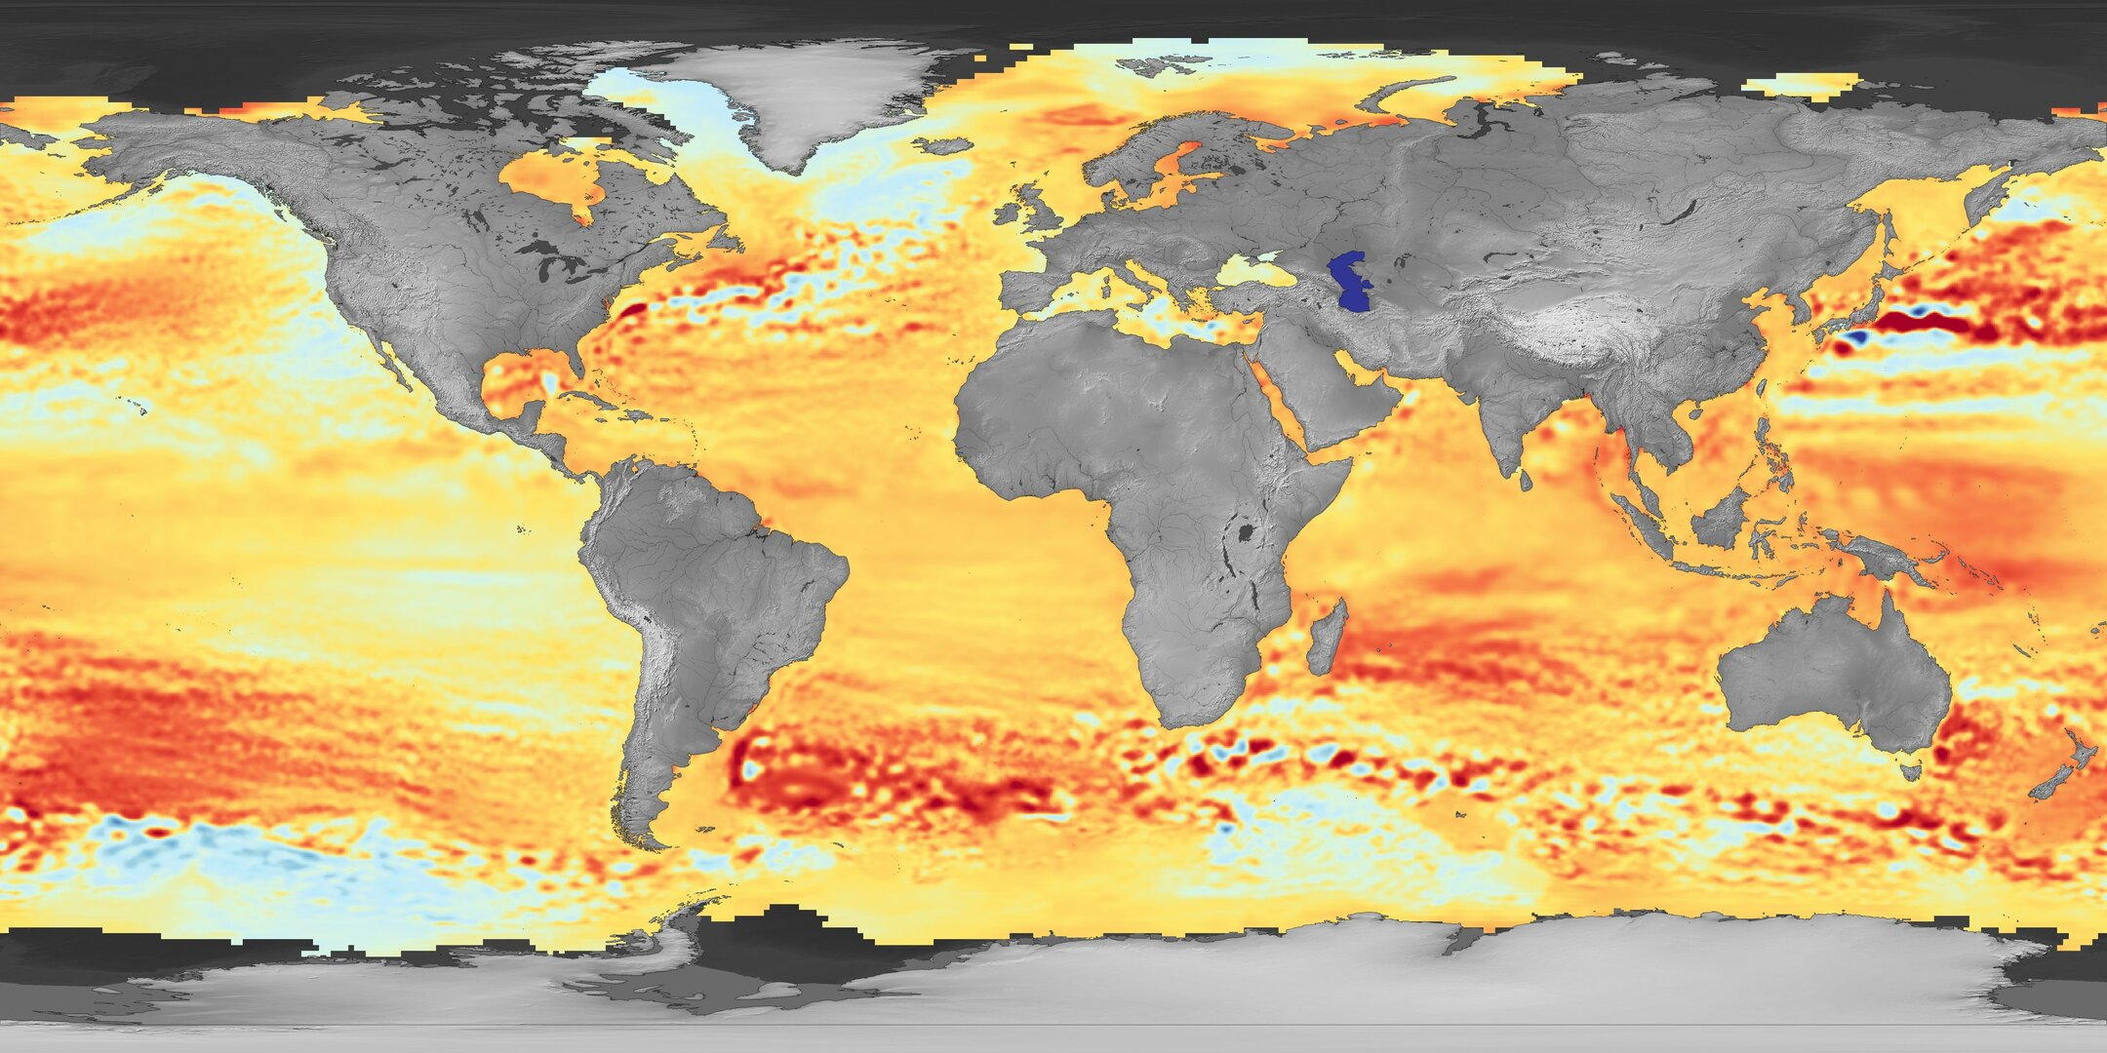

Regional mean sea-level trends between January 1993 and October 2019
Melting ice caps
Changing winds over the sea
Changing ocean temperature
Changing gravitational attraction by land ice

Slide 27
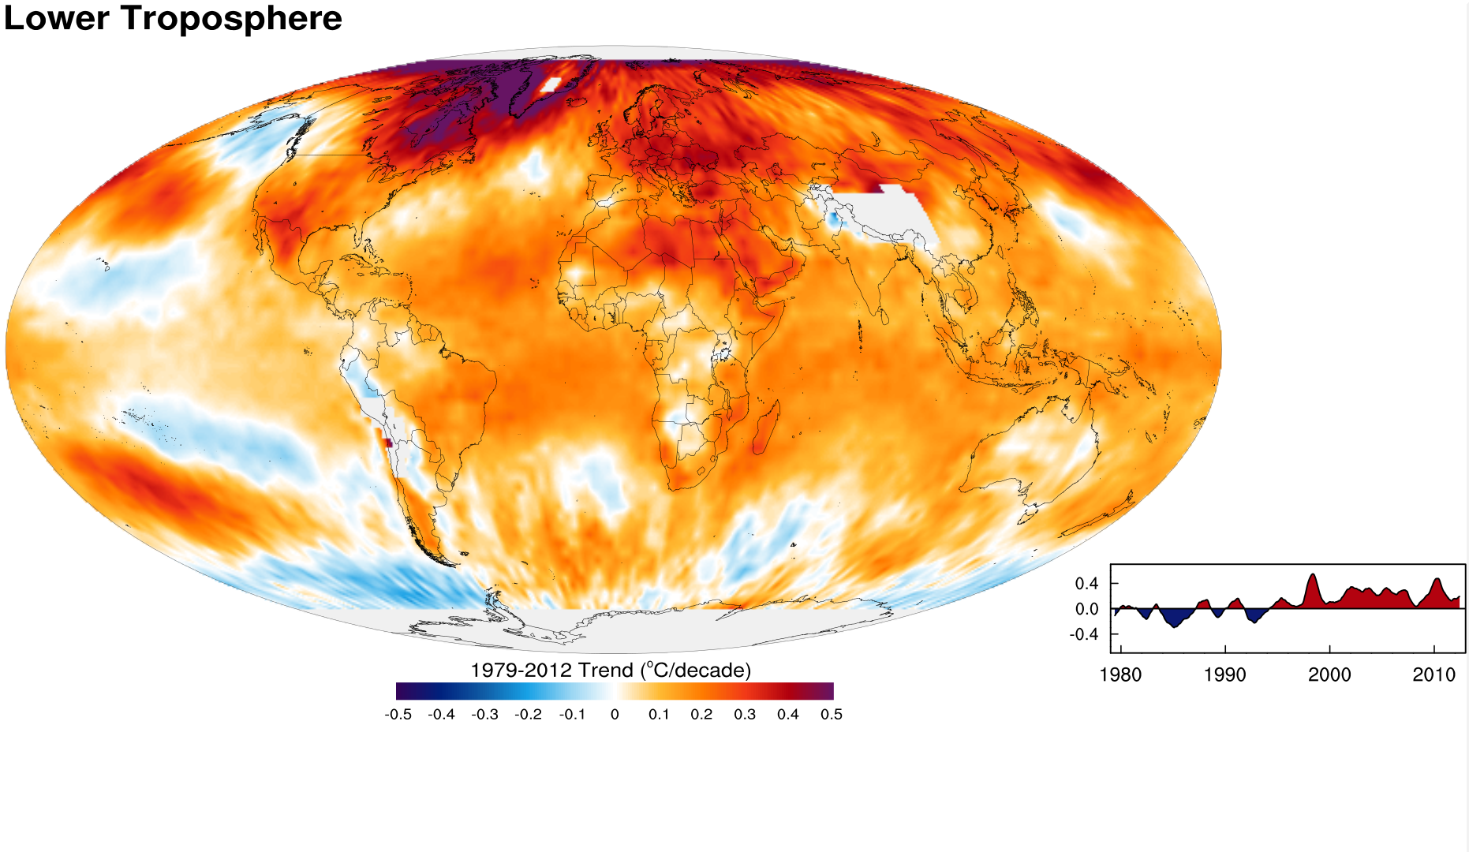
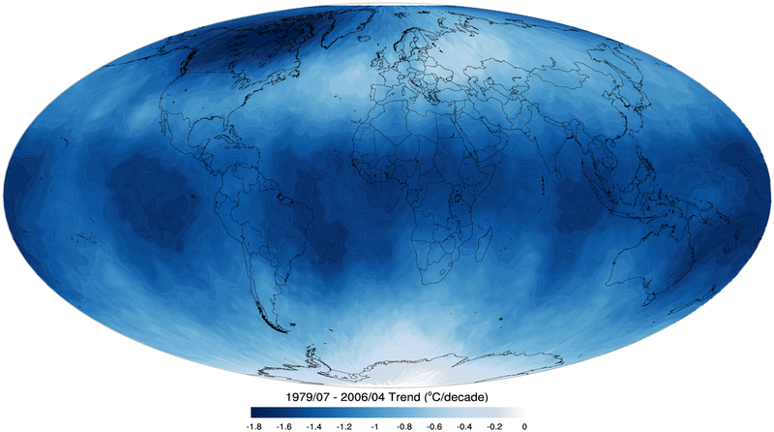
Tropospheric temperature trend from 1979-2012 based on satellite measurements (RSS)
Top of the stratosphere (TTS) 1979-2006 temperature trend.

Slide 28

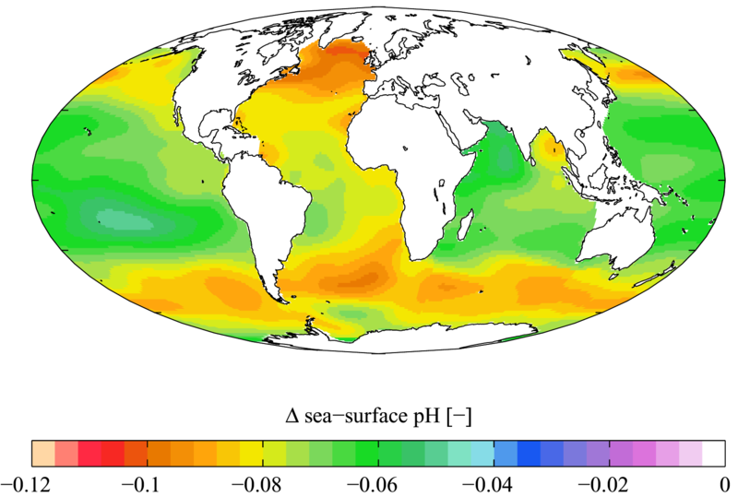

Slide 29
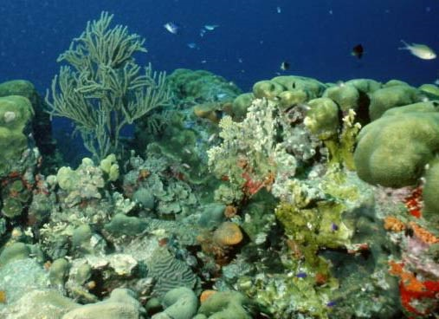
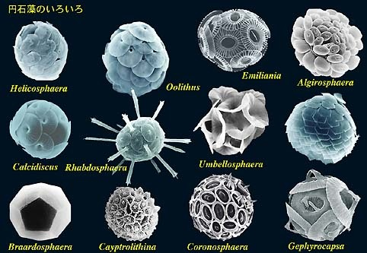
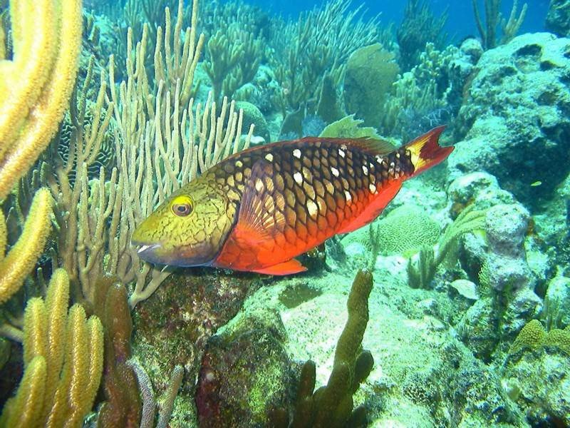
Acidification through CO₂ threatens marine life
Plankton
Coral Reefs
Notes:
Abbildung 4.3-1
Aragonitsättigung und
gegenwärtige Riffstandorte
von Warmwasserkorallen
(blaue Punkte). (a)
vorindustrielle Werte
(ca. 1870, atmosphärische
CO2-Konzentration
280 ppm), (b) Gegenwart
(ca. 2005, 375 ppm CO2), (c)
Zukunft (ca. 2065, 517 ppm
CO2). Der Grad der
Aragonitsättigung (Ù)
bezeichnet das relative
Verhältnis zwischen dem
Produkt der Konzentrationen
von Kalzium- und
Karbonationen und dem
Löslichkeitsprodukt für
Aragonit. Standorte mit
einer Aragonitsättigung
unterhalb von 3,5 sind nur
noch bedingt für riffbildende
Warmwasserkorallen
geeignet (marginal),
unterhalb von 3 sind sie
ungeeignet.
Quelle: Steffen et al., 2004

Slide 30
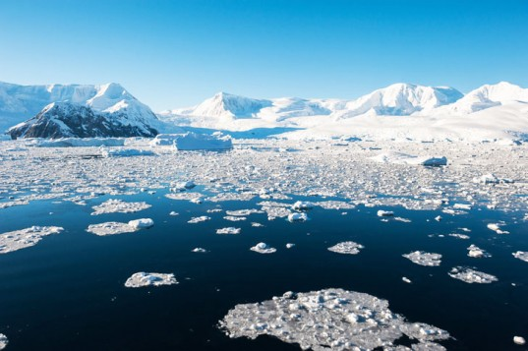
Global Climate Models

Slide 31
20th Century With and Without Human Influences
Based on 4-member PCM ensembles, Meehl et al., J. Climate, 2004

Slide 32
The Future

Slide 33
Sources of Uncertainty
Cloud Feedback
Water Vapor Feedback
Ocean Response
Aerosols

Slide 34

Clouds

Slide 35


Estimate of how much global climate will warm as a result of doubling CO₂: a probability distribution
Source: 100000 PAGE09 runs
Chris Hope, U. Cambridge
courtesy Tim Palmer
Notes:
Describe pdf. Reflects post-IPCC knowledge as well as IPCC AR4.

Slide 36
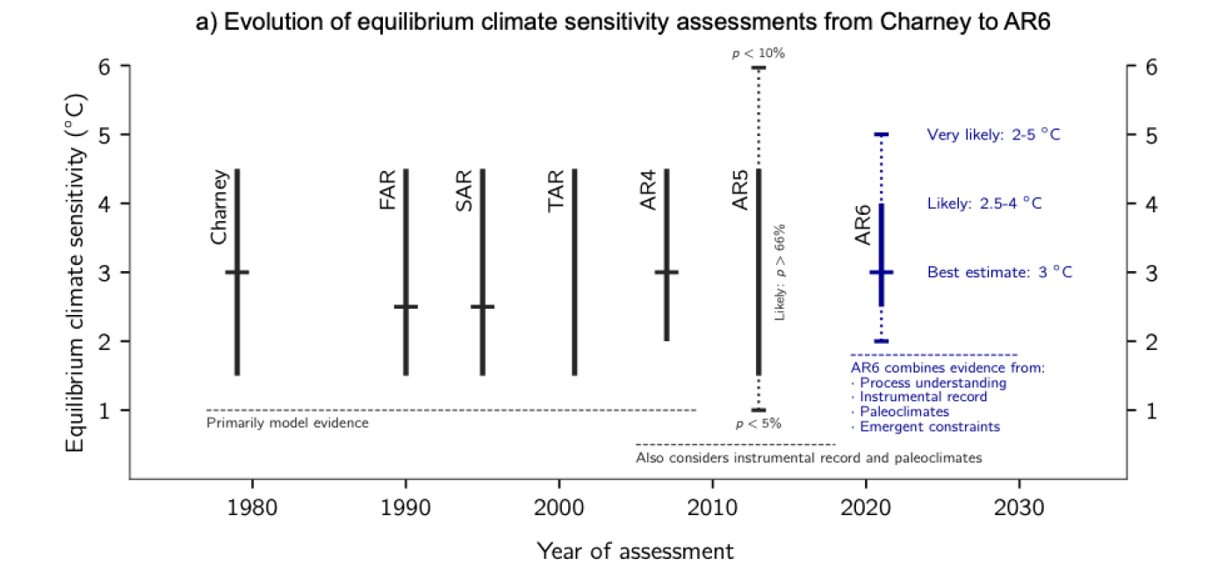
Equilibrium climate sensitivity is the equilibrium response of annual mean global mean surface temperature to doubling CO₂
Arrhenius, 1906

Slide 37
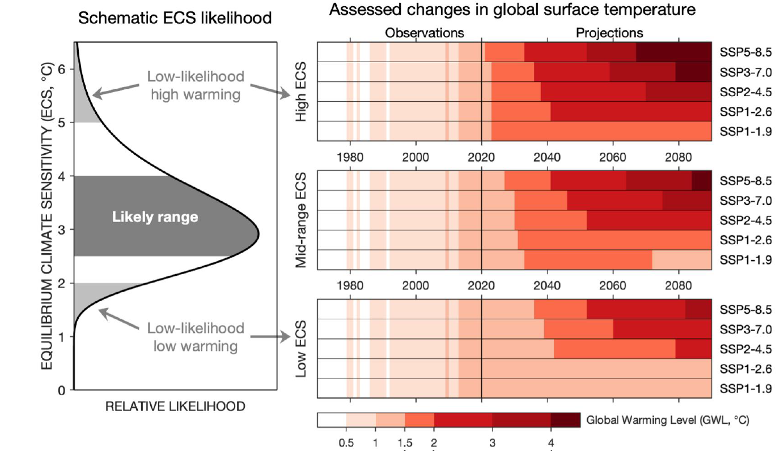
Projection uncertainty arises from uncertainty in future emissions and climate model uncertainty
From IPCC AR6

Slide 38
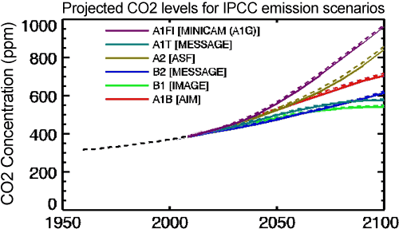
CO₂ Will Go Well Beyond Doubling
Double Pre-Industrial

Slide 39
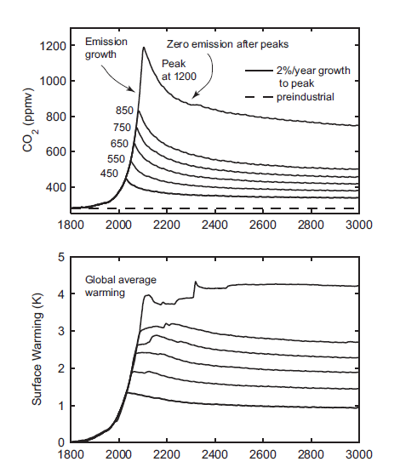
IPCC 2007: Doubling CO₂ will lead to an increase in mean global surface temperature of 2 to 4.5 ºC.
Atmospheric CO₂ assuming that emissions stop altogether after peak concentrations
Global mean surface temperature corresponding to atmospheric CO₂ above
Courtesy Susan Solomon

Slide 40
Known Risks
Increasing sea level
Increasing hydrological events… droughts and floods
Increasing incidence of high category hurricanes and associated storm surges and freshwater flooding
More heat stress and other health risks
Armed conflict
Some increase in plant productivity
Reduction in health problems related to cold weather
Benefits

Slide 41
“Taken as a whole, the range of published evidence indicates that the net damage costs of climate change are likely to be significant and to increase over time.”
- Intergovernmental Panel on Climate Change

Slide 42
Formal Definition of Risk:
Risk is the SUM over COST X PROBABILTY

Slide 43
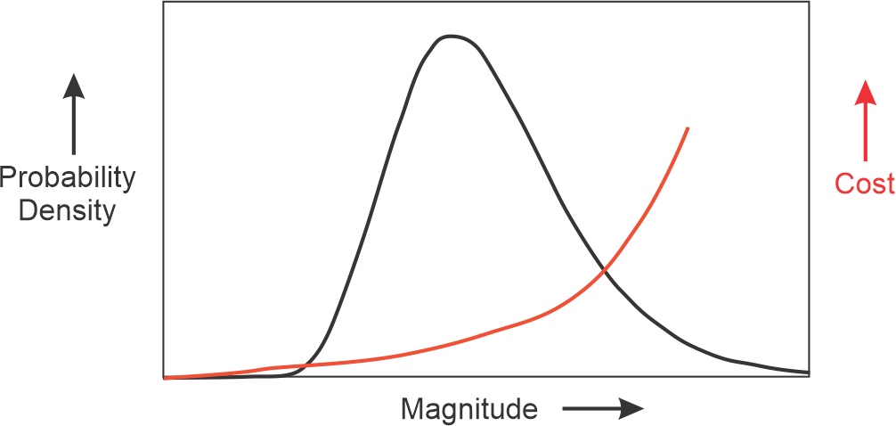
Uncertainty increases risk

Slide 44
Climate Risks
No one really directly cares whether the world will warm up by 3-5 C (nor should they)
We care about real risks: Heat waves, wild fires, hurricanes, droughts, floods, etc.
We need to quantify these risks, including uncertainty, to position ourselves to make intelligent choices
Insurance is one instrument for quantifying risk, but it is not currently even accounting for climate change that has already occurred
Science is positioned to make rapid progress in quantifying climate risk

Slide 45
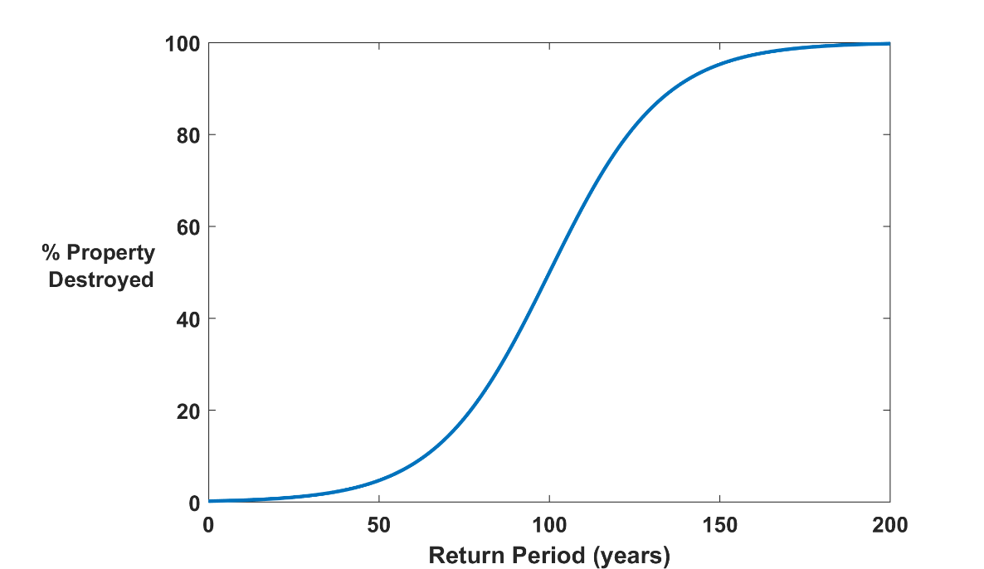
Why Climate Risk is Dominated by Extreme Events:
Societies are usually well adapted to frequent events (> 1/100 yr)
Societies are often poorly adapted to rare events (< 1/100 yr)
Large cost increases result when > 100-yr events become < 100-yr events
Largest slope

Slide 46
Summary of Main Points
Several aspects of climate science are well established
Earth’s climate is strongly bounded but shows strong sensitivity within the bounds
Climate science dates back well into the 19th century and is well established

Slide 47
Summary of Main Points
Earth’s greenhouse effect triples the amount of radiation absorbed by the surface though it is regulated by trace gases comprising no more than 0.04% of the mass of the atmosphere. The concentration of CO₂ has increased by ~45% since the dawn of the industrial revolution
Beginning with the calculations of Arrhenius more than 100 years ago, simple models predict an increase in global mean surface temperature of around 3 ºC for each doubling of CO₂. These are consistent with the results of global climate models
Long atmospheric lifetime (~1000 years) of CO₂ limits window of time in which serious risks could be curtailed

Slide 48
Summary of Main Points
We are altering the composition of our atmosphere at considerable risk to ourselves and to future generations
Climate change is felt mostly through extreme events, like heat waves, hurricanes, floods, and wildfires

