Slide 1

What We Know About Climate Change
Kerry Emanuel
Lorenz Center
Department of Earth, Atmospheric, and Planetary Sciences, MIT

Slide 2

Important Points about Climate and Climate Science
Earth’s climate is stable within certain limits, but sensitive to change in forcing within those limits.
Climate science has a long and illustrious history
The idea that we are altering climate is based on simple physics, simple models, and complex models
Human activities can and do have a strong effect on climate
There is a definite risk of catastrophic climate change
Where there is risk there is also opportunity

Slide 3
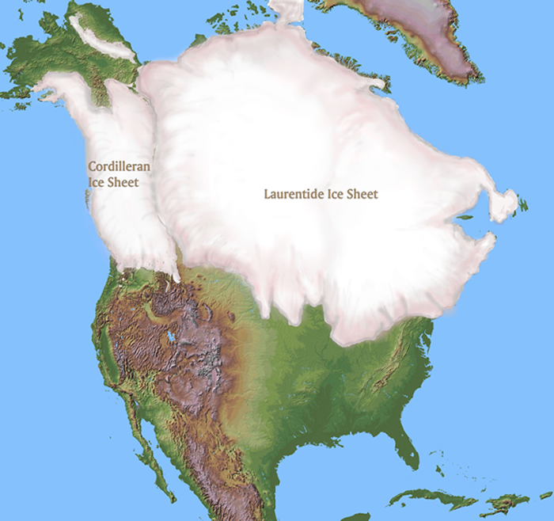
~ 20,000 years before present

Slide 4

Polar radiative forcing: 10 W/m² (4 W/m² for 2 x CO₂)
Global mean temperature fluctuation: ~5 C

Slide 5

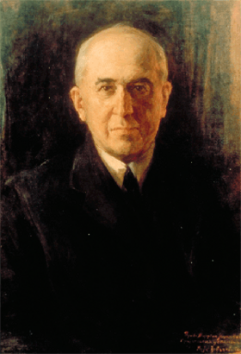
Climate Forcing by Orbital Variations (1912)
Milutin Milanković, 1879-1958

Slide 6


John Tyndall (1820-1893)

Slide 7
Tyndall’s Essential Results:
Oxygen (O₂ ), nitrogen (N₂), and argon (Ar), though they make up ~99% of the atmosphere, are almost entirely transparent to solar and terrestrial radiation
Water vapor (H₂O), carbon dioxide (CO₂), nitrous oxide (N₂O), and a handful of other trace gases make the lower atmosphere nearly opaque to infrared radiation, though still largely transparent to solar radiation (but clouds have strong effects on radiation at all wavelengths). Together they increase the Earth’s surface temperature from about 0ºF to around 60ºF.

Slide 8
Atmospheric Composition
The orange sliver (can you see it?) makes the difference between a mean surface temperature of 0ºF and of 60ºF.

Slide 9
Water Vapor (H₂O), about 0.25% of the mass of the atmosphere, is the most important greenhouse gas, but responds to atmospheric temperature change on a time scale of about 2 weeks
Climate is therefore strongly influenced by long-lived greenhouse gases (e.g. CO₂, CH₄, N₂O) that together comprise about 0.04% of the mass of the atmosphere. Concentration of CO₂ has increased by 43% since the dawn of the industrial revolution

Slide 10

Svante Arrhenius, 1859-1927
“Any doubling of the percentage of carbon dioxide in the air would raise the temperature of the earth's surface by 4°; and if the carbon dioxide were increased fourfold, the temperature would rise by 8°.” – Världarnas utveckling (Worlds in the Making), 1906

Slide 11
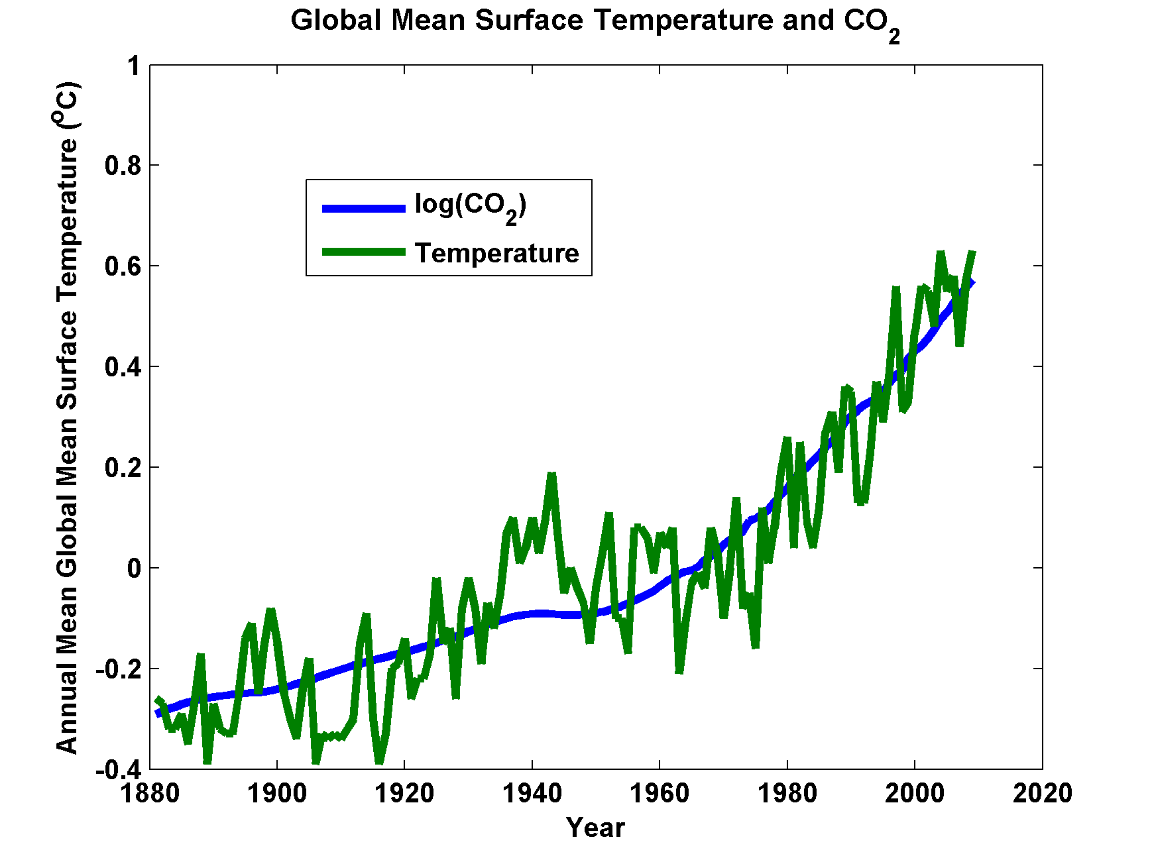

Slide 12
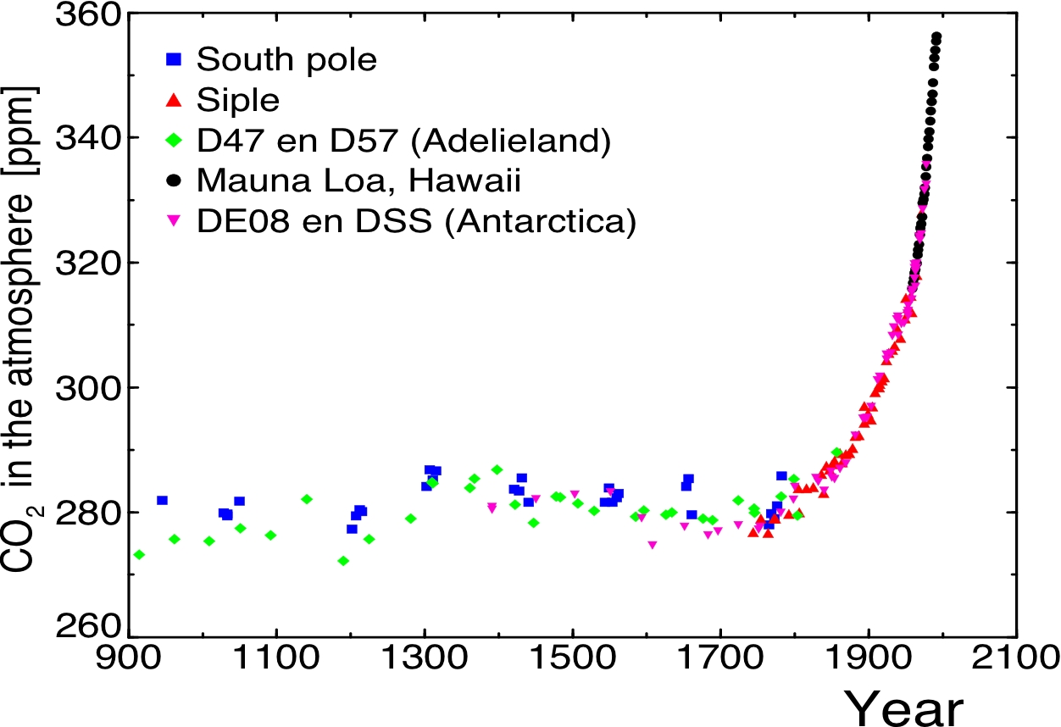
Today

Slide 13
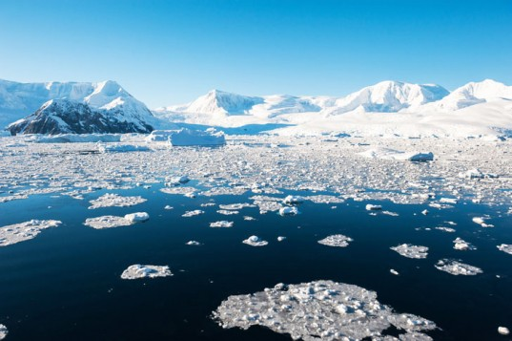
The Instrumental Record

Slide 14
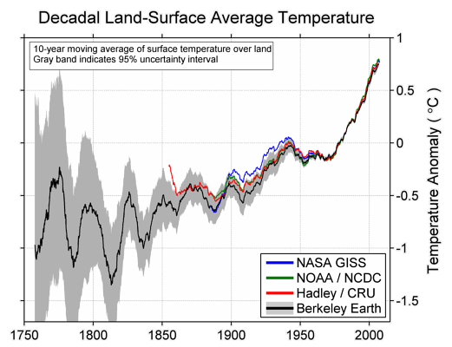

Slide 15
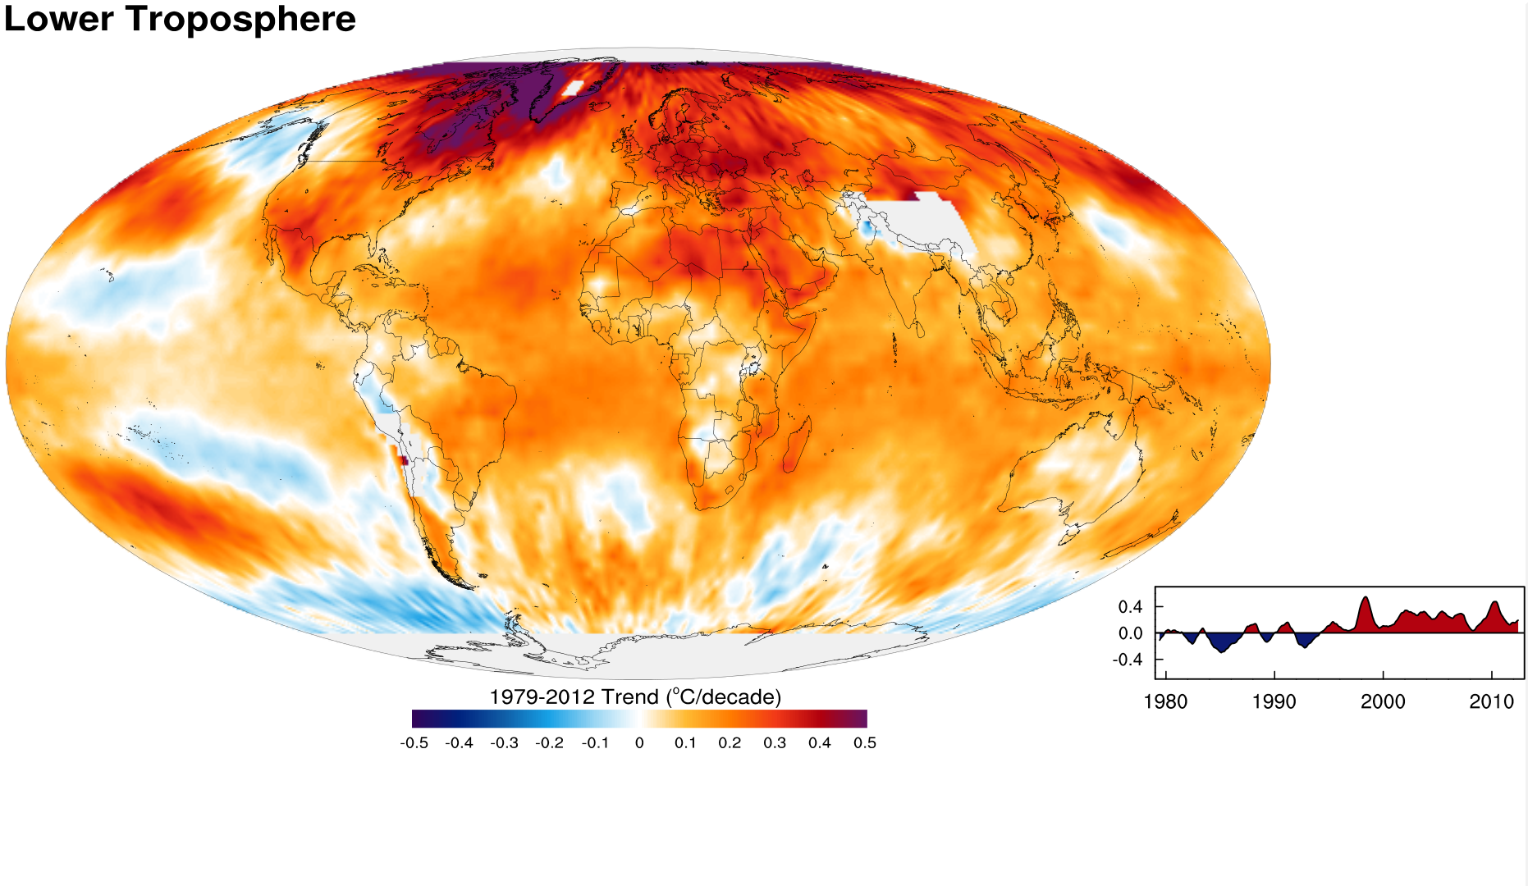
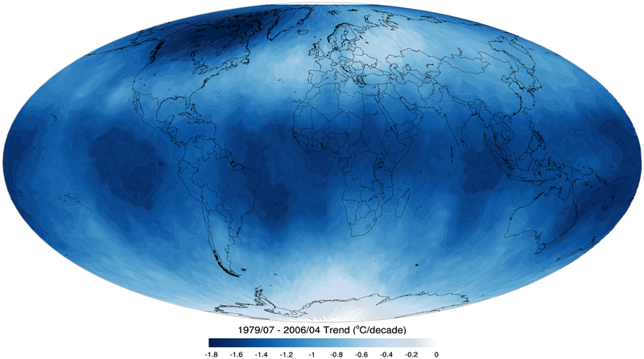
Tropospheric temperature trend from 1979-2012 based on satellite measurements (RSS)
Top of the stratosphere (TTS) 1979-2006 temperature trend.

Slide 16
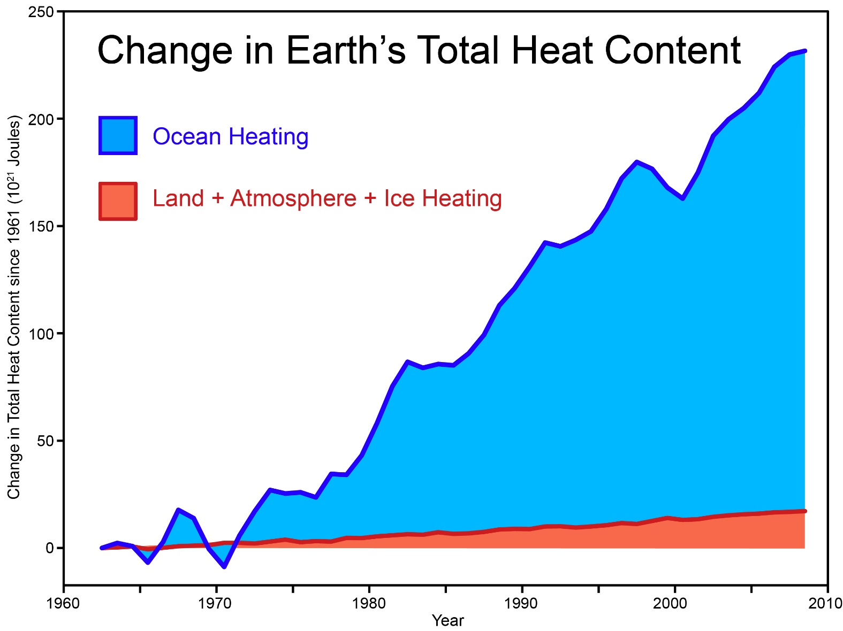
Total amount of heat from global warming that has accumulated in Earth's climate system since 1961, from Church et al. (2011) (many thanks to Neil White from the CSIRO for sharing their data).
Notes:
http://www.skepticalscience.com/graphics.php?g=46

Slide 17
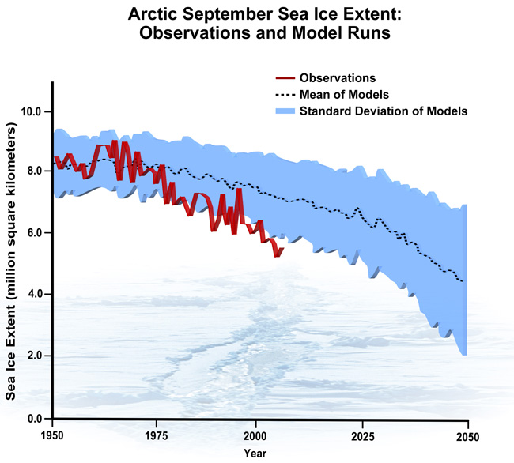
September Arctic Sea Ice Extent

Slide 18
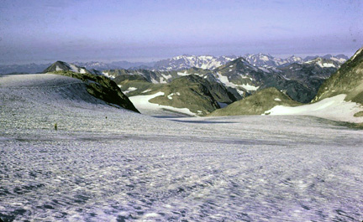
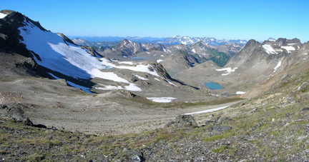
White Chuck Glacier,
Washington state, in 1973
White Chuck Glacier in 2006 from same vantage point. The glacier retreated 1.2 miles in 30 years.

Slide 19
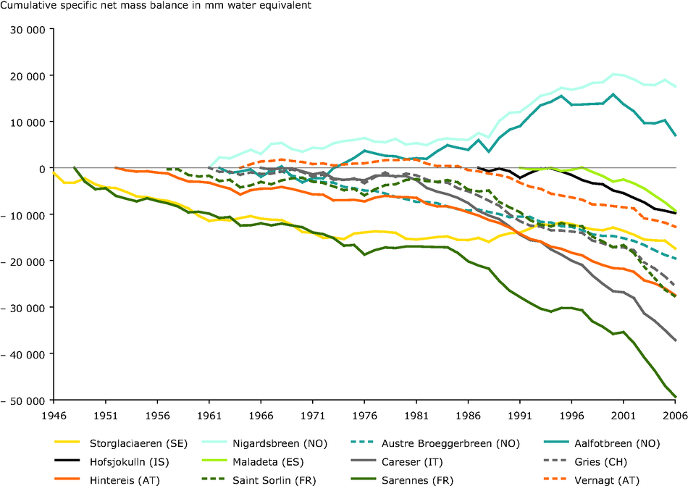
European Alpine Glaciers

Slide 20
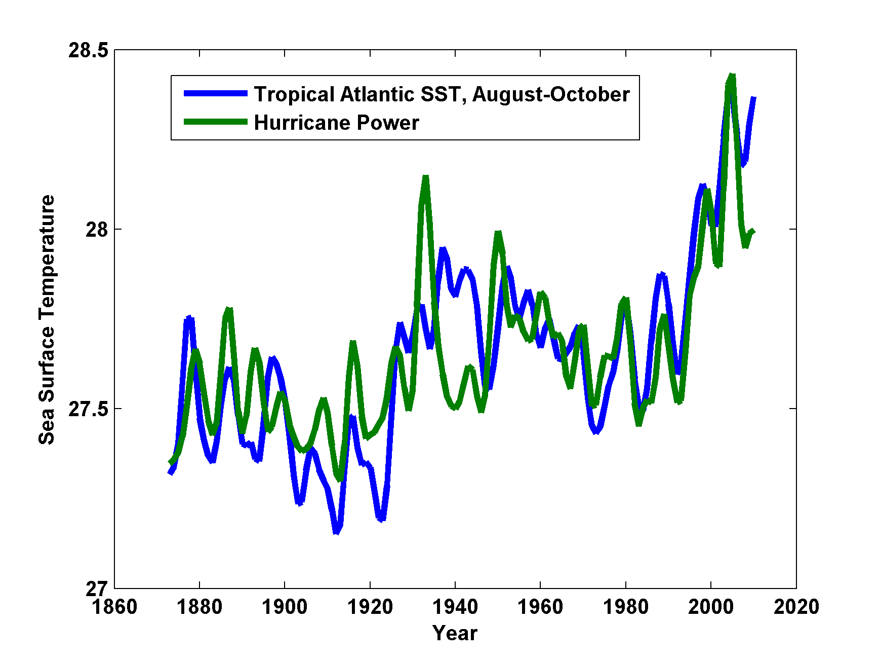
Atlantic Hurricane Power (Green) and Sea Surface Temperature (Blue)

Slide 21

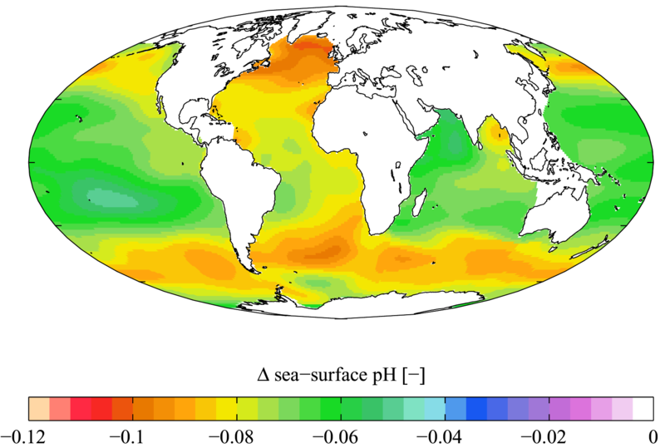

Slide 22

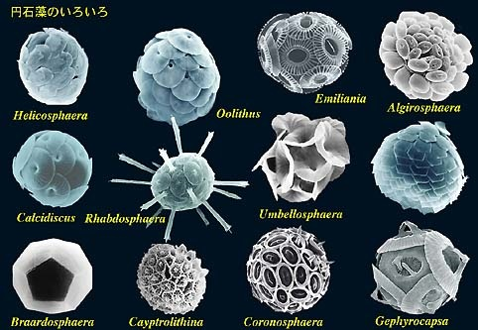

Acidification through CO₂ threatens marine life
Plankton
Coral Reefs
Notes:
Abbildung 4.3-1
Aragonitsättigung und
gegenwärtige Riffstandorte
von Warmwasserkorallen
(blaue Punkte). (a)
vorindustrielle Werte
(ca. 1870, atmosphärische
CO2-Konzentration
280 ppm), (b) Gegenwart
(ca. 2005, 375 ppm CO2), (c)
Zukunft (ca. 2065, 517 ppm
CO2). Der Grad der
Aragonitsättigung (Ù)
bezeichnet das relative
Verhältnis zwischen dem
Produkt der Konzentrationen
von Kalzium- und
Karbonationen und dem
Löslichkeitsprodukt für
Aragonit. Standorte mit
einer Aragonitsättigung
unterhalb von 3,5 sind nur
noch bedingt für riffbildende
Warmwasserkorallen
geeignet (marginal),
unterhalb von 3 sind sie
ungeeignet.
Quelle: Steffen et al., 2004

Slide 23
Simple Models

Slide 24
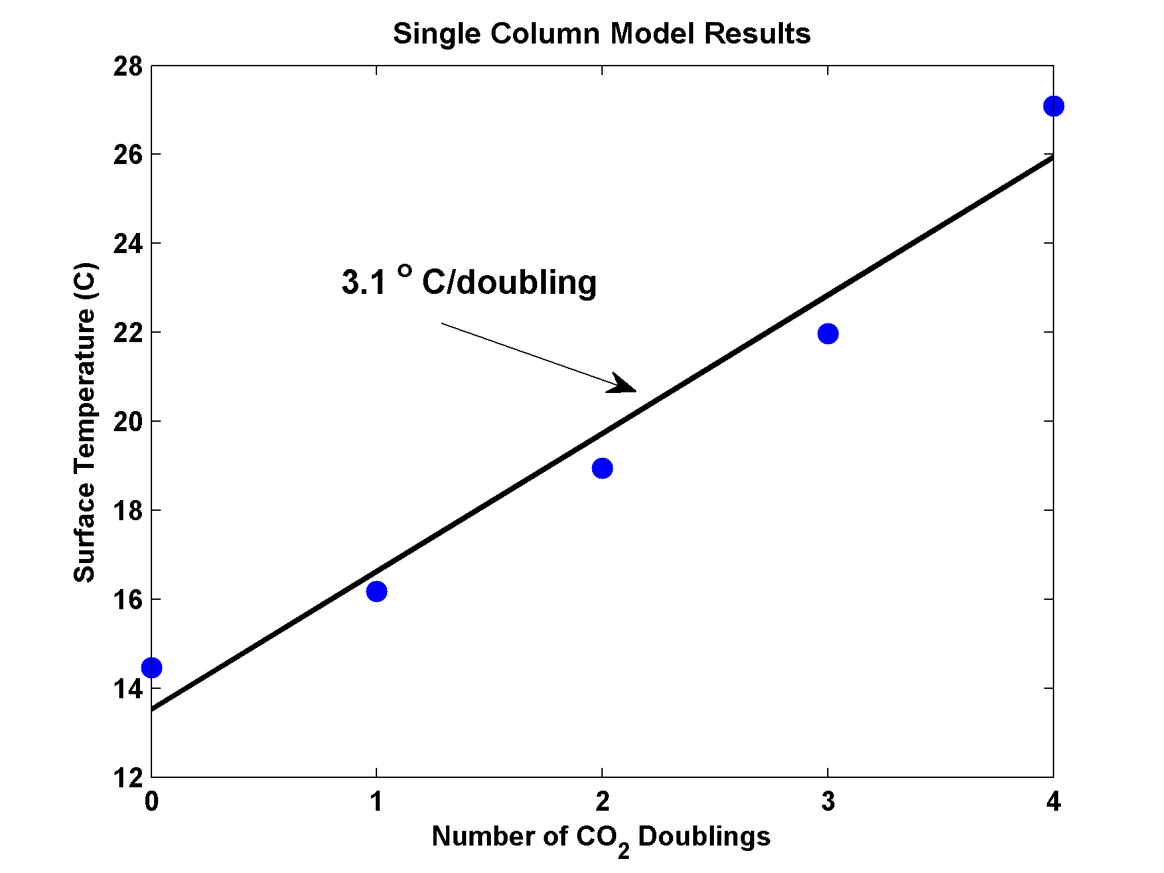
MIT Single Column Model
IPCC Estimate:
2-4.5 ºC

Slide 25
Global Climate Models

Slide 26
20th Century With and Without Human Influences
Based on 4-member PCM ensembles, Meehl et al., J. Climate, 2004

Slide 27
Known Risks
Increasing sea level
Increasing hydrological events… droughts and floods
Increasing incidence of high category hurricanes and associated storm surges and freshwater flooding
More heat stress

Slide 28
“Climate change could have significant geopolitical impacts around the world, contributing to poverty, environmental degradation, and the further weakening of fragile governments. Climate change will contribute to food and water scarcity, will increase the spread of disease, and may spur or exacerbate mass migration.”
    -- Quadrennial Defense Review, U.S. Department of Defense, February, 2010

Slide 29
The Future

Slide 30
Sources of Uncertainty
Cloud Feedback
Water Vapor Feedback
Ocean Response
Aerosols

Slide 31


Estimate of how much global climate will warm as a result of doubling CO₂: a probability distribution
Source: 100000 PAGE09 runs
Chris Hope, U. Cambridge
courtesy Tim Palmer
Notes:
Describe pdf. Reflects post-IPCC knowledge as well as IPCC AR4.

Slide 32

CO₂ Will Go Well Beyond Doubling
Triple Pre-Industrial
Double Pre-Industrial

Slide 33
Solutions and Opportunities
Renewables (solar and wind)
  Might provide up to 30% of current power needs
Carbon Capture and Sequestration
  Currently would add ~$200/ton to energy costs
  Reasonable prospects for reducing this to ~$100/ton
  Currently little incentive to develop this
Next Generation Fission Reactors

Slide 34
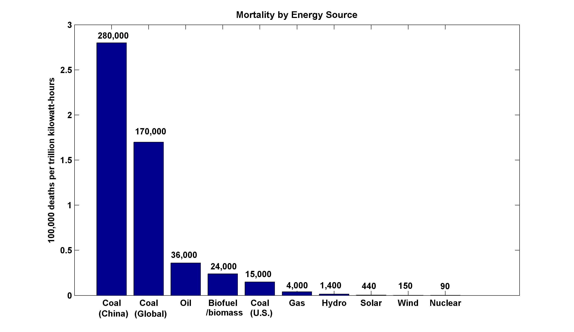
~13,000 premature deaths annually in the U.S. from coal production and combustion
Nuclear power, by replacing fossil fuels, has prevented an estimated 1.84 million air-pollution related deaths worldwide
(includes Chernobyl, Fukushima)

Slide 35
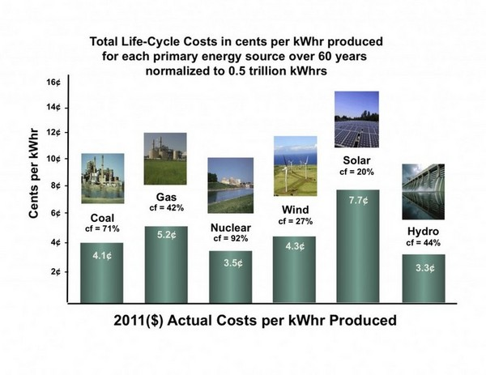
However, up-front capital costs of Gen I nuclear are large

Slide 36
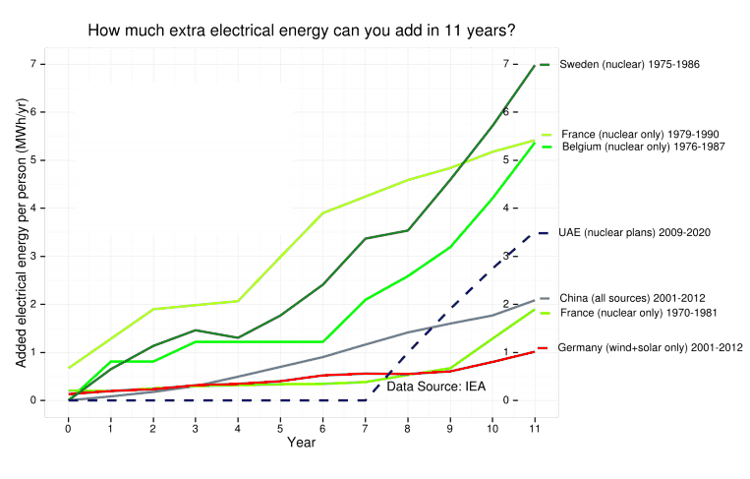

Slide 37
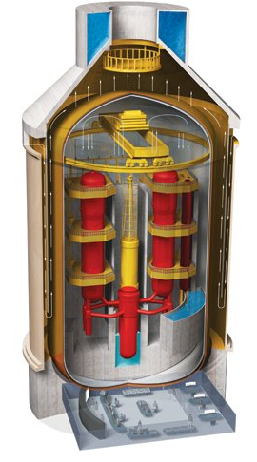
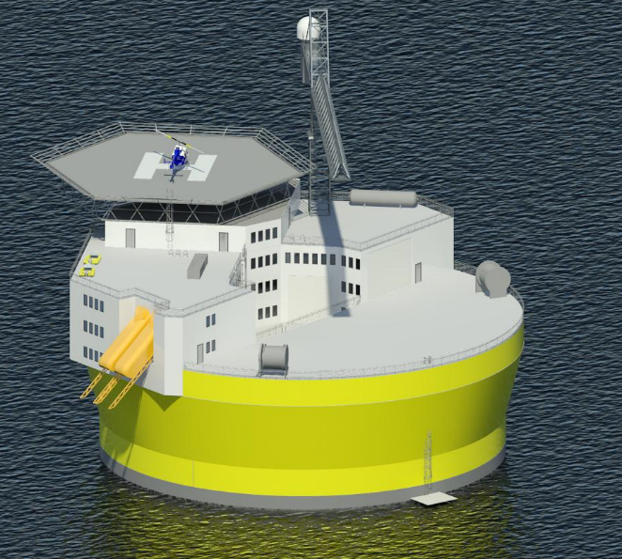
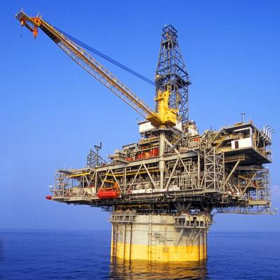
Offshore floating nuclear power plant
+
=
Floating rig
Nuclear reactor
OFNP
Reduced capital cost (>90% cut in reinforced concrete)
Reduced construction/decommissioning schedule
Flexible siting + minimal local infrastructure (‘plug and play’)
Reliable passive cooling; no land/ocean contamination
Profs. J. Buongiorno, M. Golay, N. Todreas

Slide 38
We Can Do Even Better:
Next Generation (Gen IV) Fission Reactors
One Example: Molten Salt Reactors
  Passively safe
  Can run on nuclear waste from Light Water Reactors
  Operate at ambient pressure
  Can run on thorium; unsuitable for weapons
  Estimated plant lifetime > 80 years

Slide 39
Turning Electricity into Liquid Fuels
E-CEM (Electrolytic Cation Exchange Module)
  Developed by U.S. Navy
  Uses electricity to synthesize liquid fuel from CO₂ in seawater and electrolysis to get H₂, then combined into hydrocarbons
  Carbon-neutral
  Can be done for $3-6 per gallon.

Slide 40
Summary of Main Points
Several aspects of climate science are well established
Earth’s climate is strongly bounded but shows strong sensitivity within the bounds
Climate science dates back well into the 19th century and is well established

Slide 41
Summary of Main Points
Earth’s greenhouse effect triples the amount of radiation absorbed by the surface though it is regulated by trace gases comprising no more than 0.04% of the mass of the atmosphere. The concentration of CO₂ has increased by ~45% since the dawn of the industrial revolution
Beginning with the calculations of Arrhenius more than 100 years ago, simple models predict an increase in global mean surface temperature of around 3 ºC for each doubling of CO₂. These are consistent with the results of global climate models
Long atmospheric lifetime (~1000 years) of CO₂ limits window of time in which serious risks could be curtailed

Slide 42
Summary of Main Points
Solar, wind, and especially next-gen fission can replace existing power generation infrastructure in 10-20 years
We will eventually need to do this anyway. Why not start now?
Real economics: 20 years from now, will we be selling clean energy technology to China and India, or buying it from them?

Slide 43
Spare Slides

Slide 44
Energy Source Mortality Rate (deaths/trillionkWhr)
Coal – global average 170,000 (50% global electricity)
Coal – China 280,000 (75% China’s electricity)
Coal – U.S. 15,000 (44% U.S. electricity)
Oil (electricity) 36,000 (36% of energy, 8% of Natural Gas 4,000 (20% global electricity)
Biofuel/Biomass 24,000 (21% global energy)
Solar (rooftop) 440 (< 1% global electricity)
Wind 150 (~ 1% global electricity)
Hydro – global average 1,400 (15% global electricity)
Nuclear – global average 90 (17% global electricity w/Chern&Fukush)

Slide 45
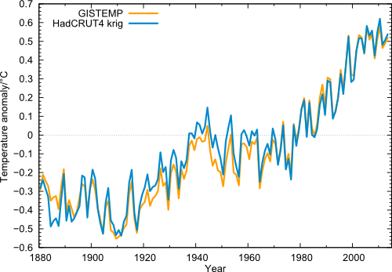
Global temperature (annual values) in the data from NASA GISS (orange) and from Cowtan & Way (blue), i.e. HadCRUT4 with interpolated data gaps.

Slide 46
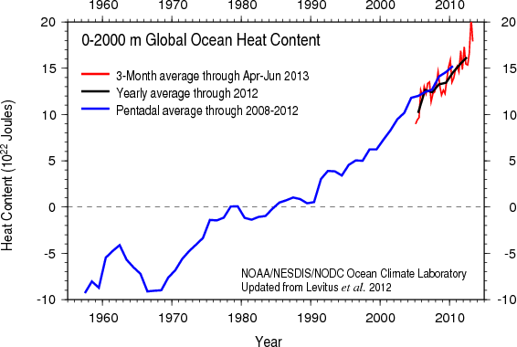
Based on bathythermograph and ARGO (post-2004) data
Image credit: NOAA

Slide 47
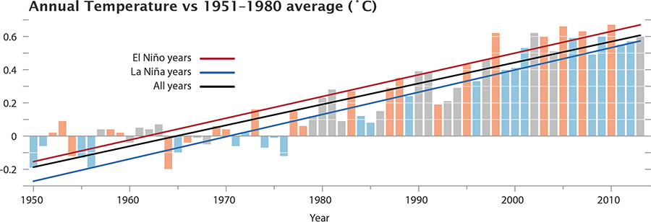
The GISS data, with El Niño and La Niña conditions highlighted. Neutral years like 2013 are gray.

Slide 48
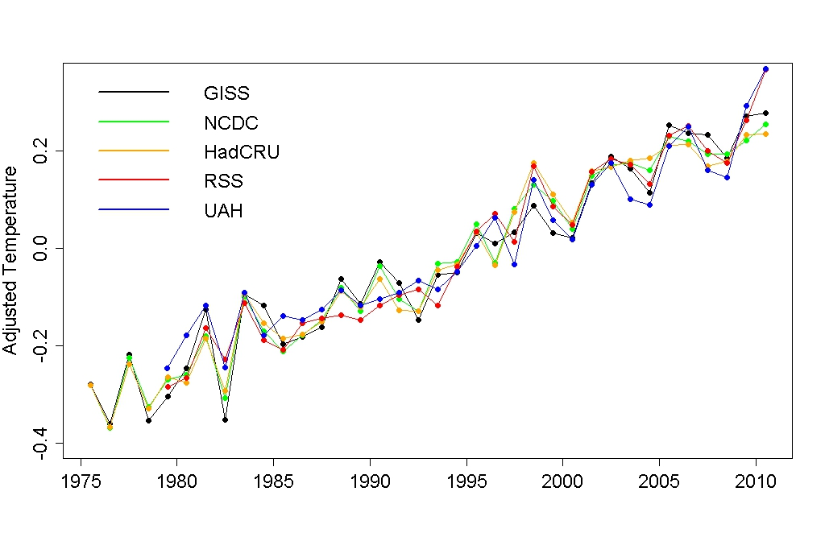
Adjusted annual average temperature data with the estimated impact of El Niño, volcanic eruptions, solar variation, and the residual annual cycle removed.
Notes:
http://tamino.wordpress.com/2011/01/20/how-fast-is-earth-warming/

Slide 49
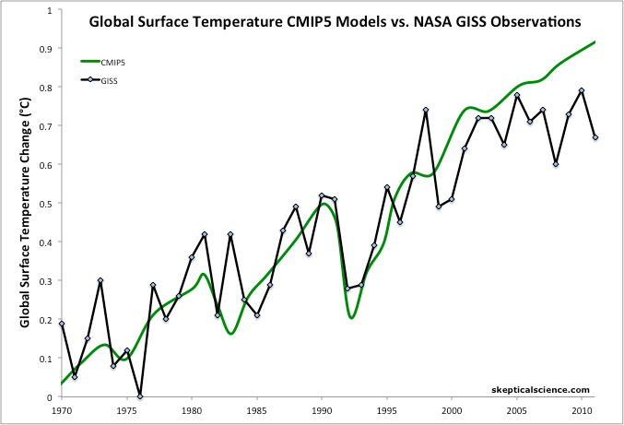
Figure 1: Average global temperature surface anomaly multi-model mean from CMIP5 (green) and as measured by the NASA Goddard Institute for Space Studies (GISS black). Most of this figure is a hindcast of models fitting past temperature data.
Notes:
http://www.skepticalscience.com/christy-exaggerates-model-data-discrepancy.html

Slide 50
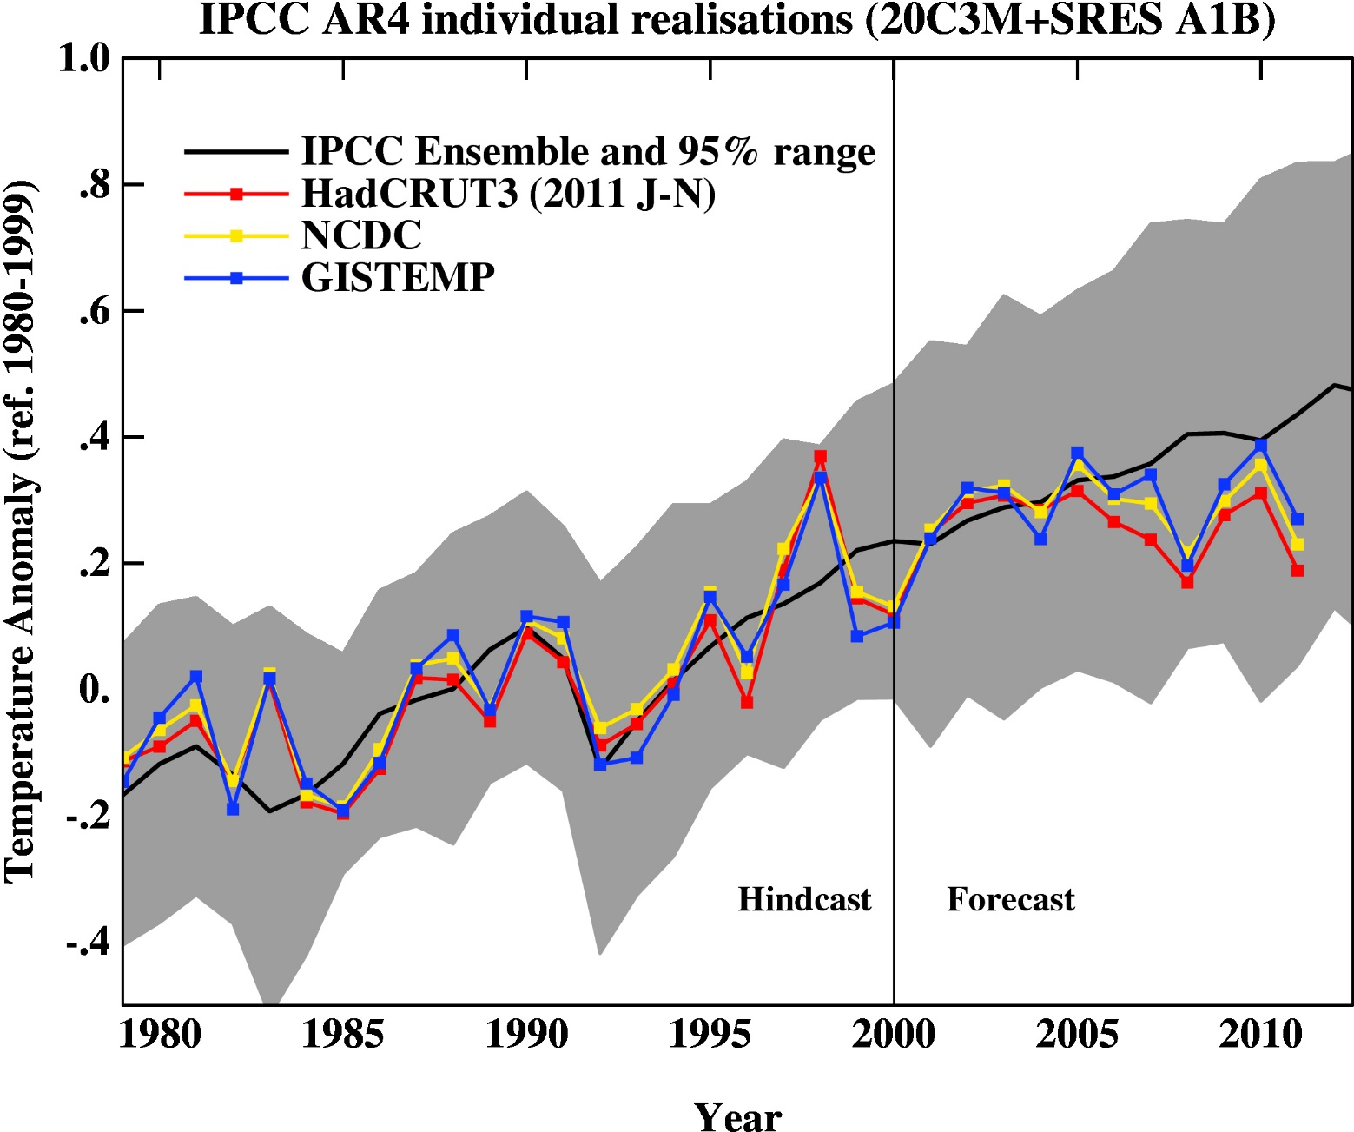
Figure 2: 2007 IPCC report model ensemble mean (black) and 95% individual model run envelope (grey) vs. surface temperature anomaly from GISS (blue), NOAA (yellow), and HadCRUT3 (red).
Notes:
http://www.skepticalscience.com/christy-exaggerates-model-data-discrepancy.html

Slide 51
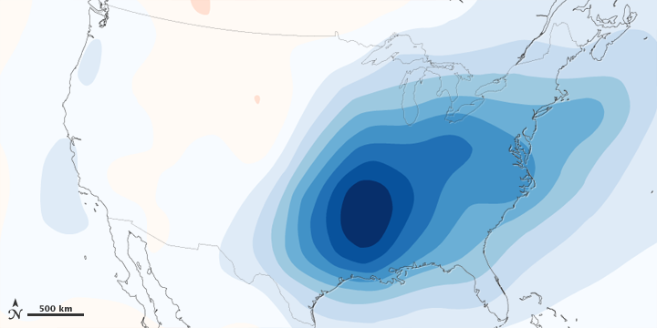
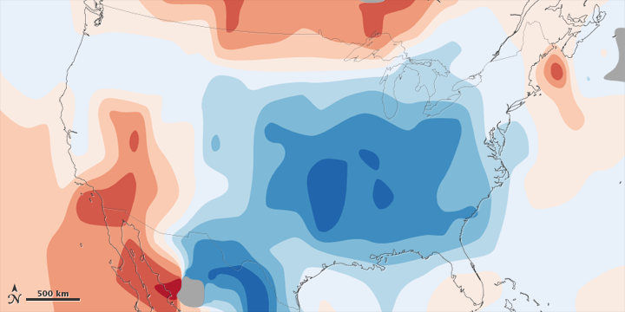
Figure 5: 1970-1990 aerosol loading of the atmosphere over the lower 48 United States and estimated associated surface air temperature change.
Figure 6: Observed total surface temperature change over the lower 48 United States from 1930 to 1990.
Notes:
http://www.skepticalscience.com/christy-exaggerates-model-data-discrepancy.html

Slide 52
Past and Projected Sea Level vs. Temperature
(Source: WBGU after David Archer 2006)
Notes:
This graph shows how temperature and sea level were closely related in Earth’s history. During the last Ice Age, temperatures were about 6 ºC colder than now, while sea level was 120 meters lower. During the Pliocene, when it was last significantly warmer than now (by about 2 ºC), sea level was 20-30 meters higher. During the Eocene there was almost no ice on the planet, and sea level was about 70 meters higher.
The history of climate thus sends a strong warning: past climate changes by just a few degrees in global temperature have come with very large sea level changes, by tens of meters. In the long run, this is likely to happen again. The sea level rise by the year 2100 (likely below one meter) is only the small beginning of a much larger rise that will unfold over coming centuries and perhaps millennia, caused by our carbon emissions in this century.

Slide 53

Paleo reconstructions of temperature change over the last 2000 years
“Hockey Stick”
Instrumental Record
Year
Notes:
53

Slide 54
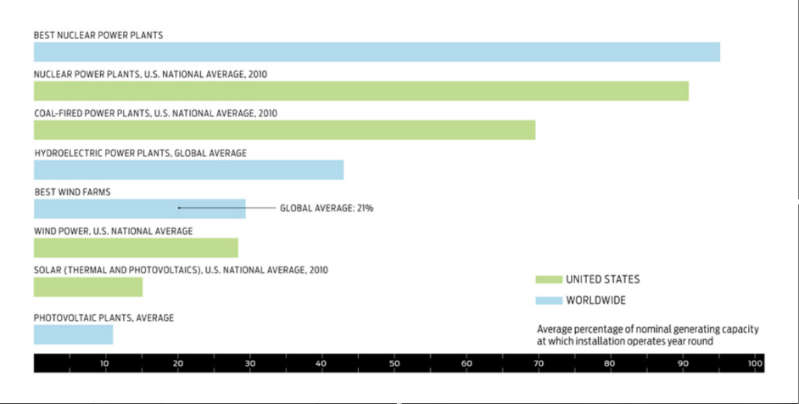
Renewables Require Baseload

Slide 55
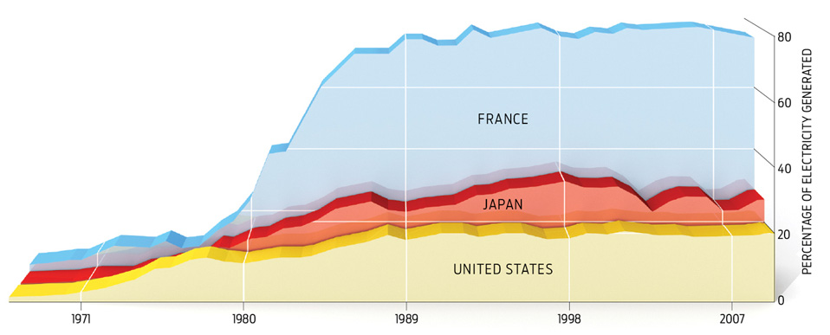
Can be deployed on 15-25 year time scale

Slide 56
Carbon Dioxide and Climate:
A Scientific Assessment
Report to the National Academy of Sciences
Jule G. Charney and co-authors
1979
When it is assumed that the CO2 content of the atmosphere is doubled and statistical thermal equilibrium is achieved, the more realistic of the modeling efforts predict a global surface warming of between 2°C and 3.5 °C, with greater increases at high latitudes.

