Slide 1

Severe Thunderstorms and Climate
Vince Agard and Kerry Emanuel
Program in Atmospheres, Oceans, and Climate
MIT

Slide 2
Two Broad Categories of Convection:
Quasi-equilibrium convection
  Convection consumes available energy at about the rate that large- scale processes generate it
  Most tropical convection and middle-latitude summer convection is of this type
  Generally benign
  Responsible for significant fraction of global mean, annual mean rainfall
Stored-energy convection
  Convective available energy builds up over time and is then suddenly released
  Comparatively rare
  Responsible for most convection-related problems: tornadoes, hailstorms, flash-floods, and straight-line wind storms

Slide 3

Quasi-Equilibrium Convection

Slide 4
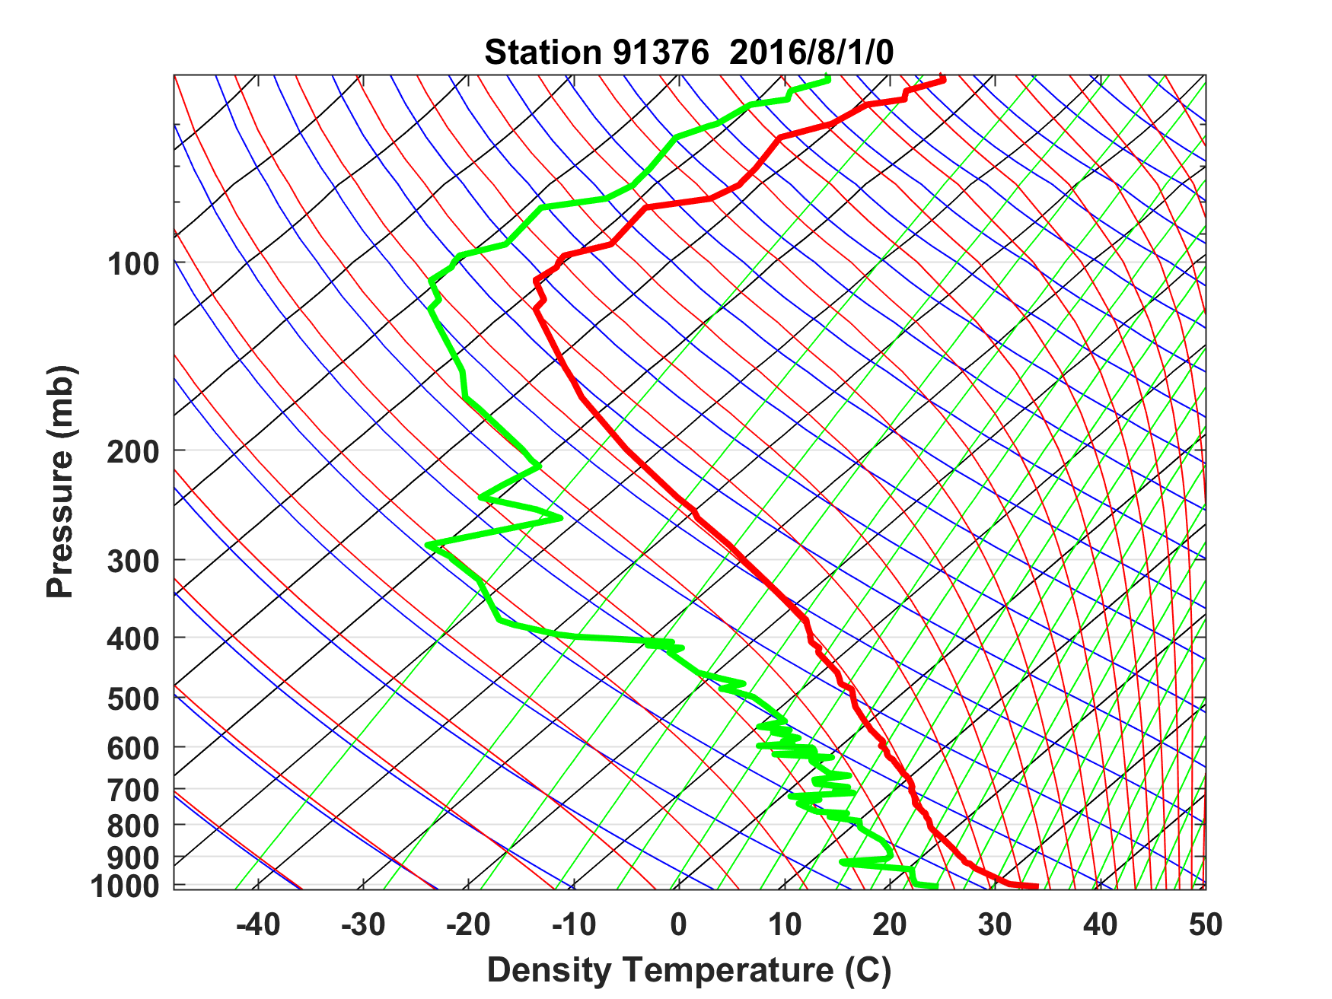
Sounding at Majuro, August 1 2016 0 GMT

Slide 5
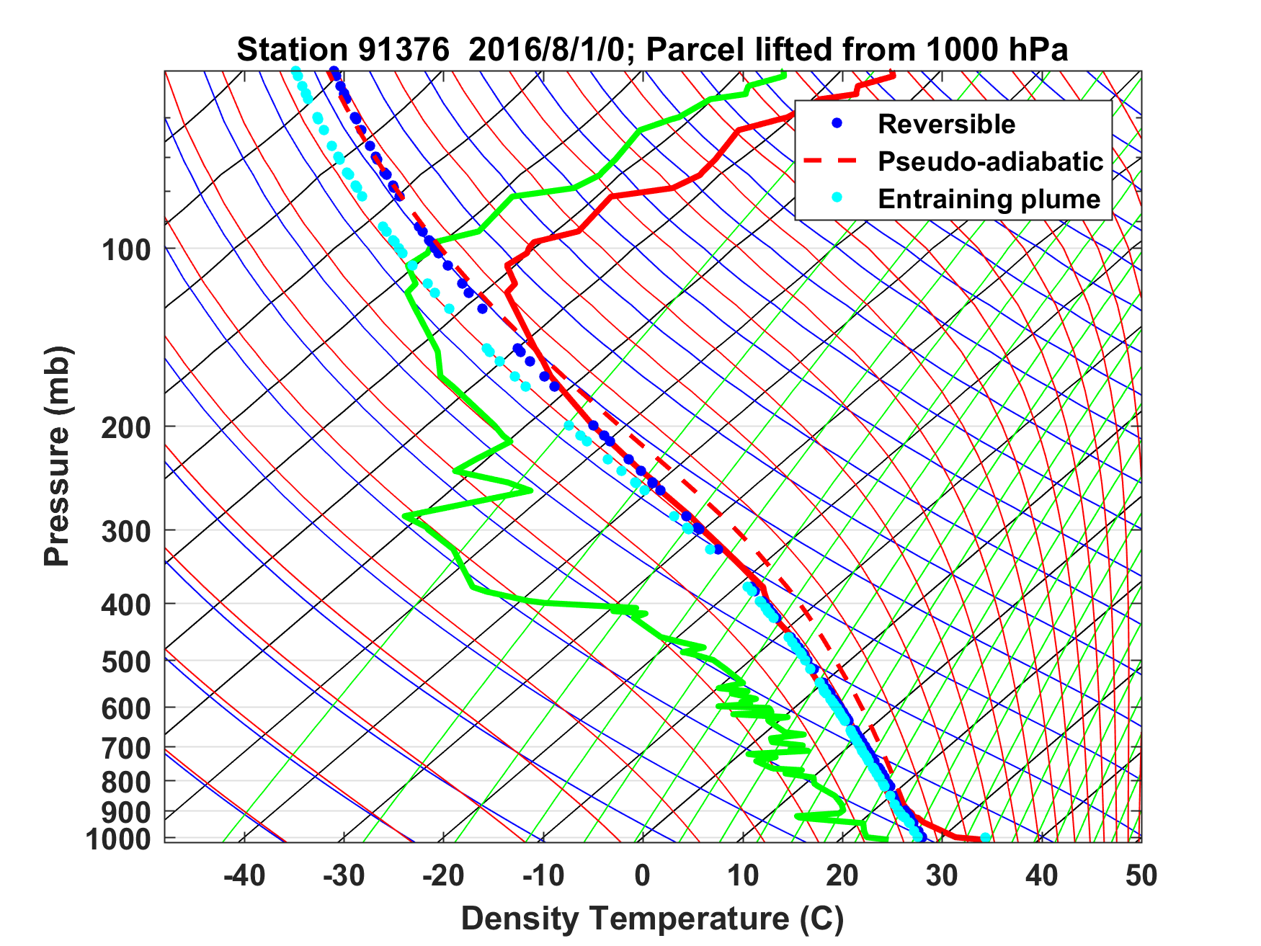
Sounding at Majuro, August 1 2016 0 GMT

Slide 6

Stored-Energy Convection

Slide 7
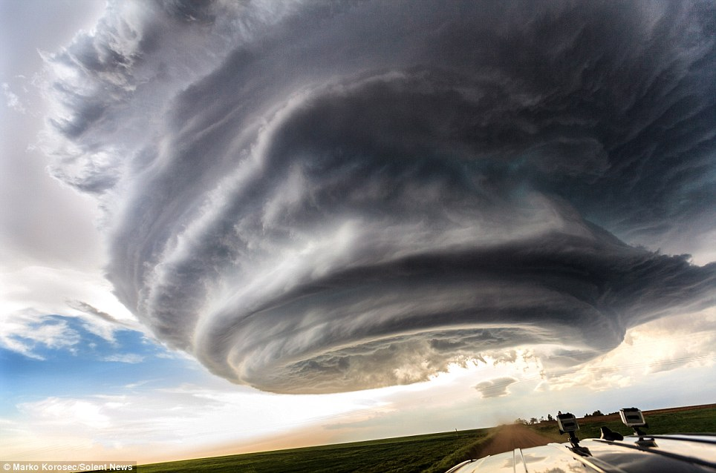

Slide 8
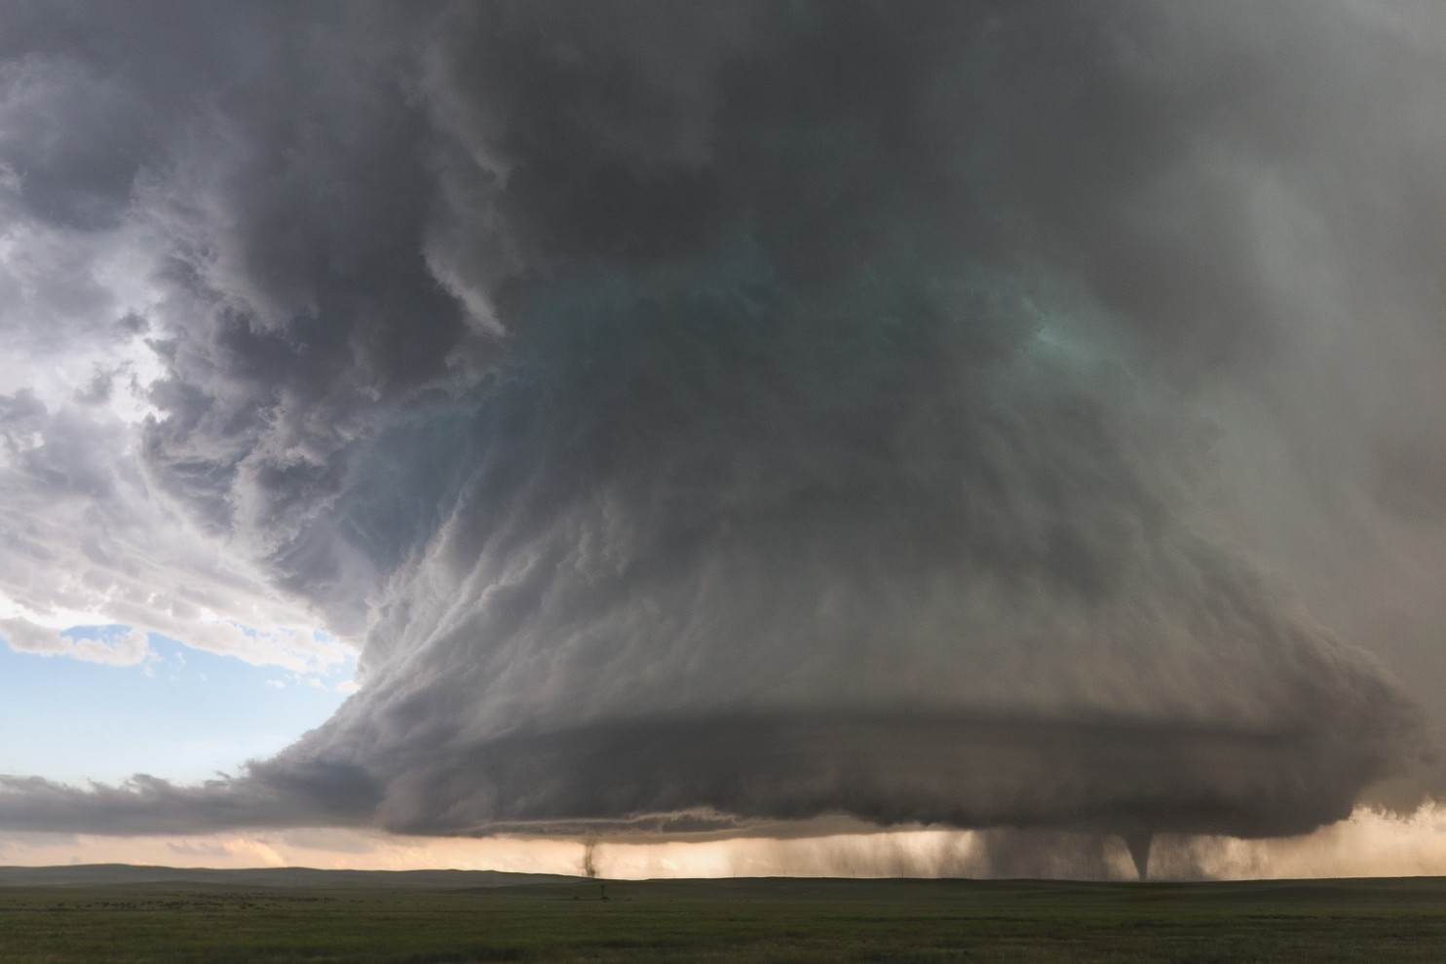

Slide 9
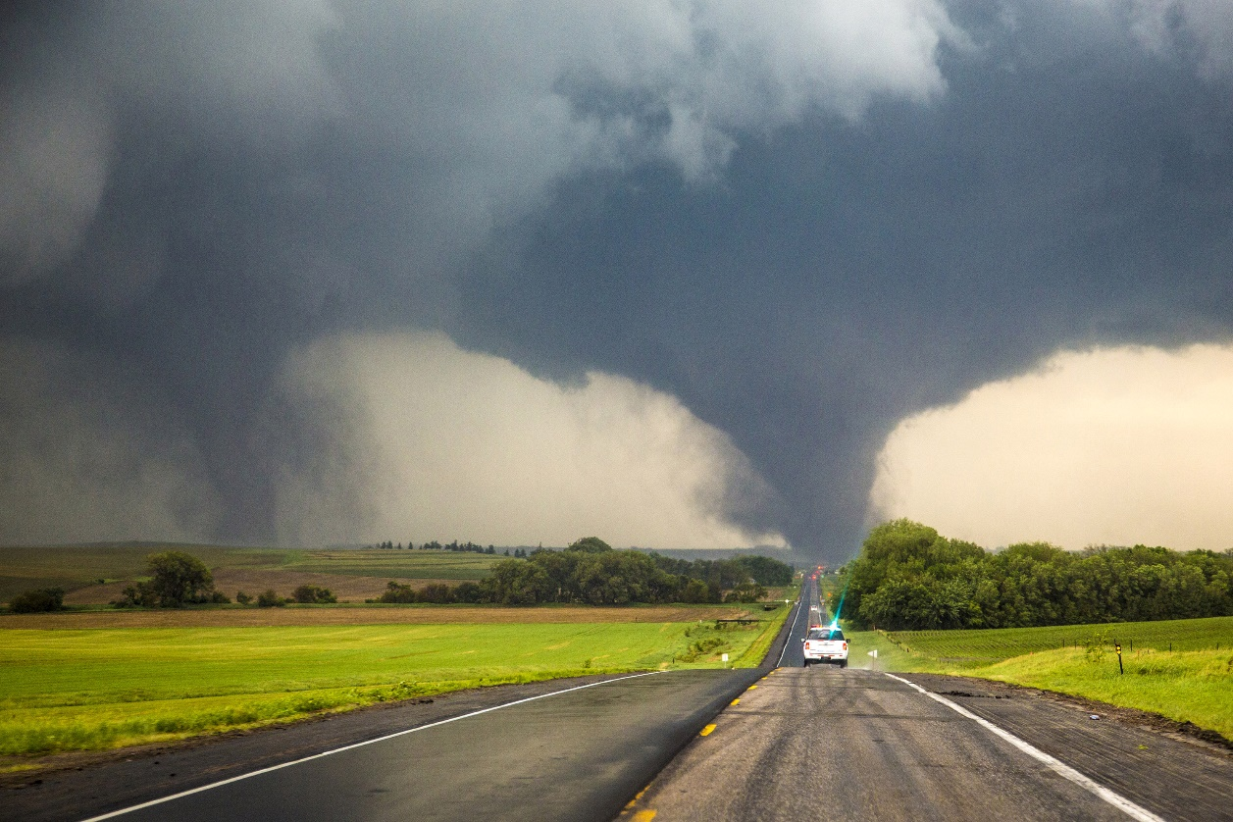
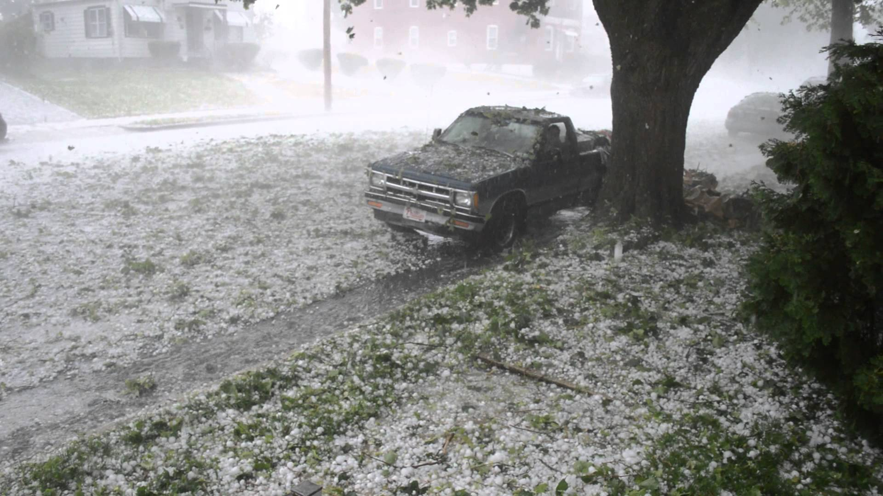
Each year in the U.S., 1,200 tornadoes on average kill 60 people, injure 1,500, and cause roughly $400 million in damages
Hail causes about $1 billion dollars in damage to crops and property each year, according to the National Oceanic Atmospheric Administration (NOAA)

Slide 10

Even worse…..

Slide 11
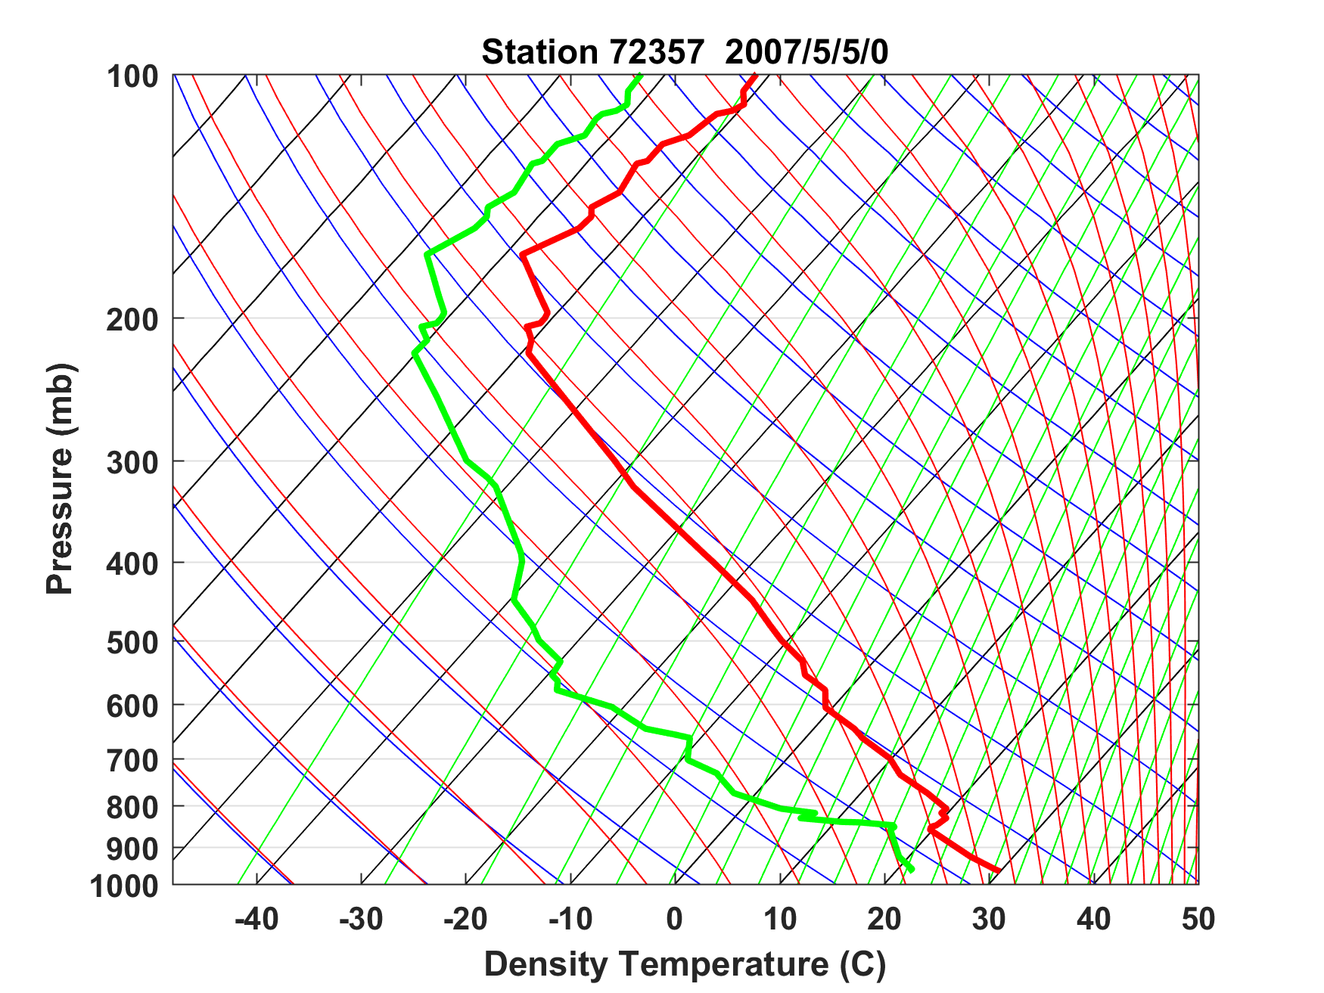
Sounding at Norman, Oklahoma, May 5th 2007

Slide 12
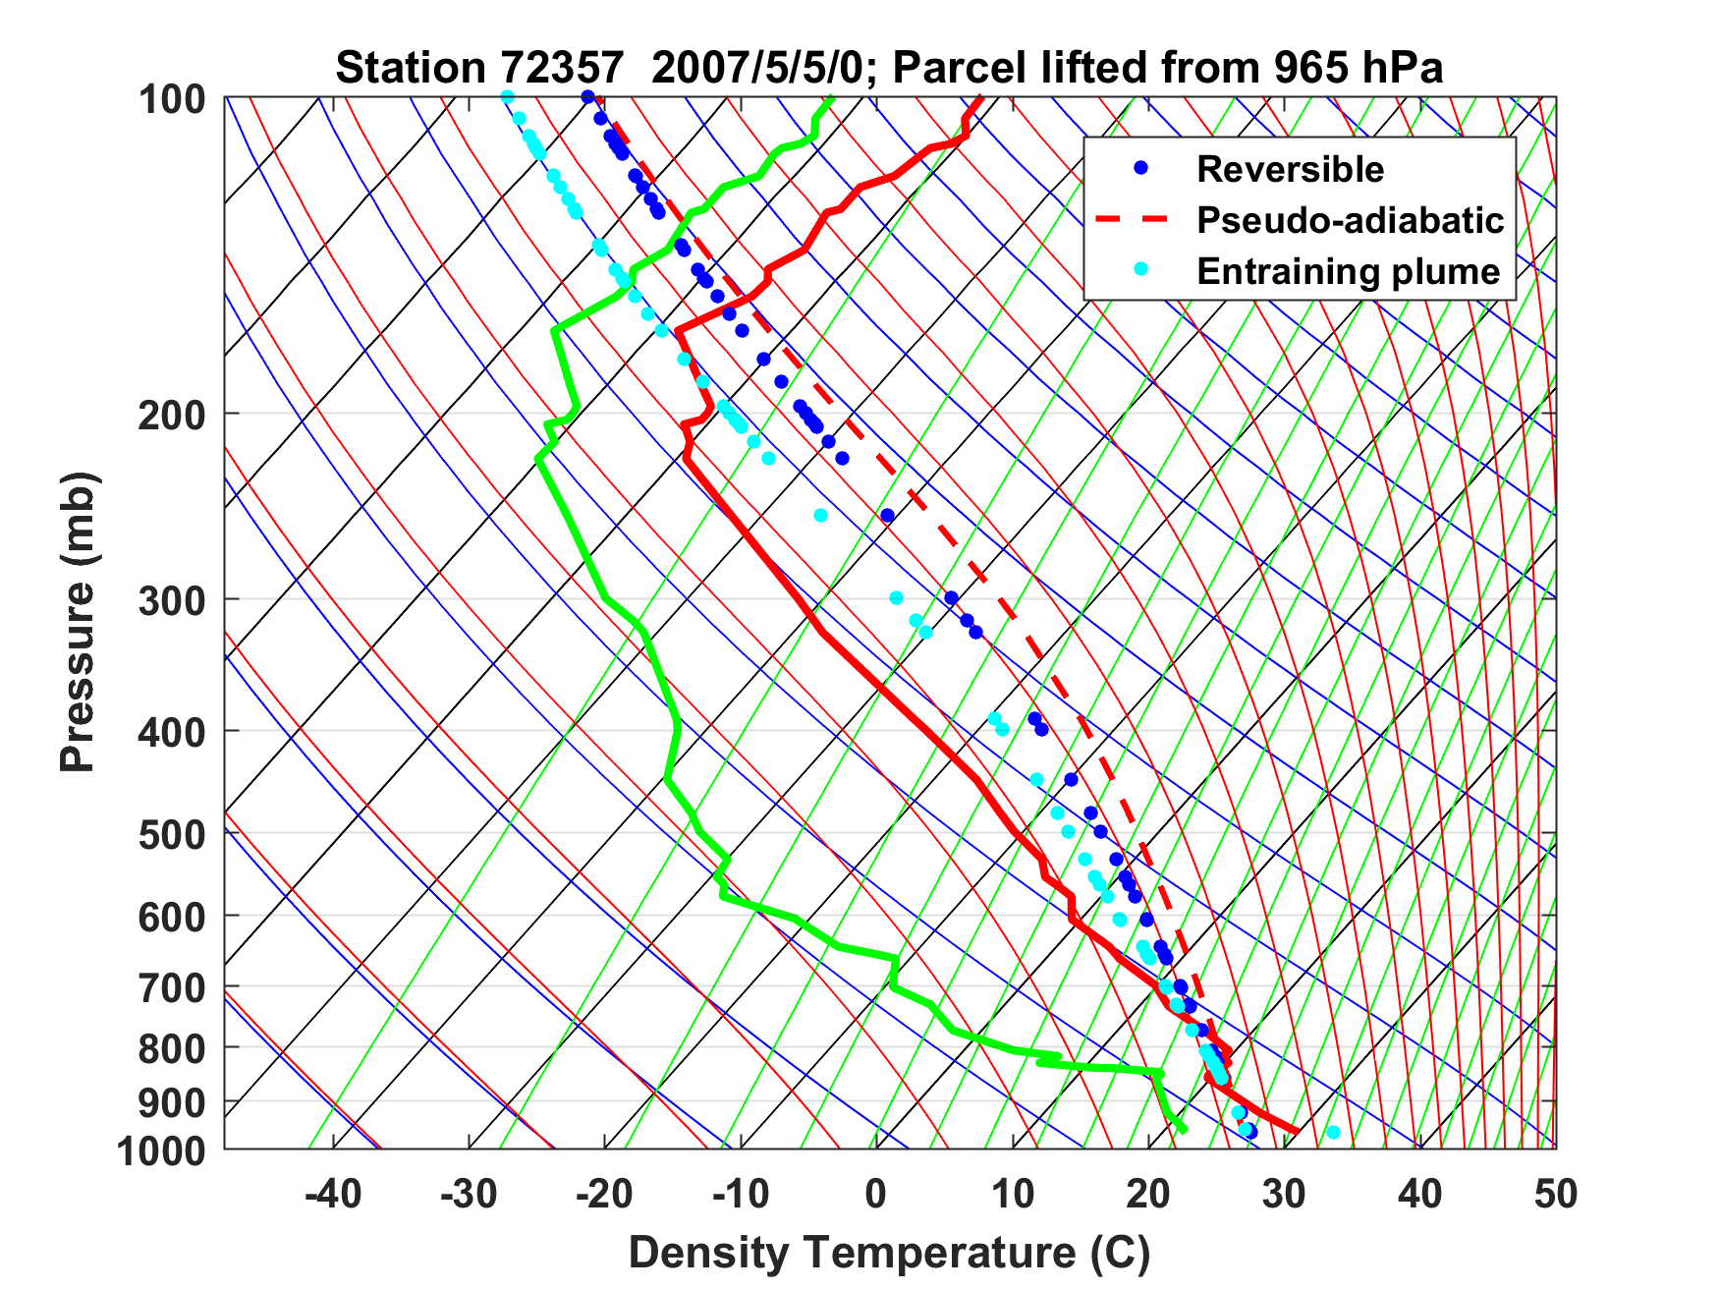
Sounding at Norman, Oklahoma, May 5th 2007

Slide 13
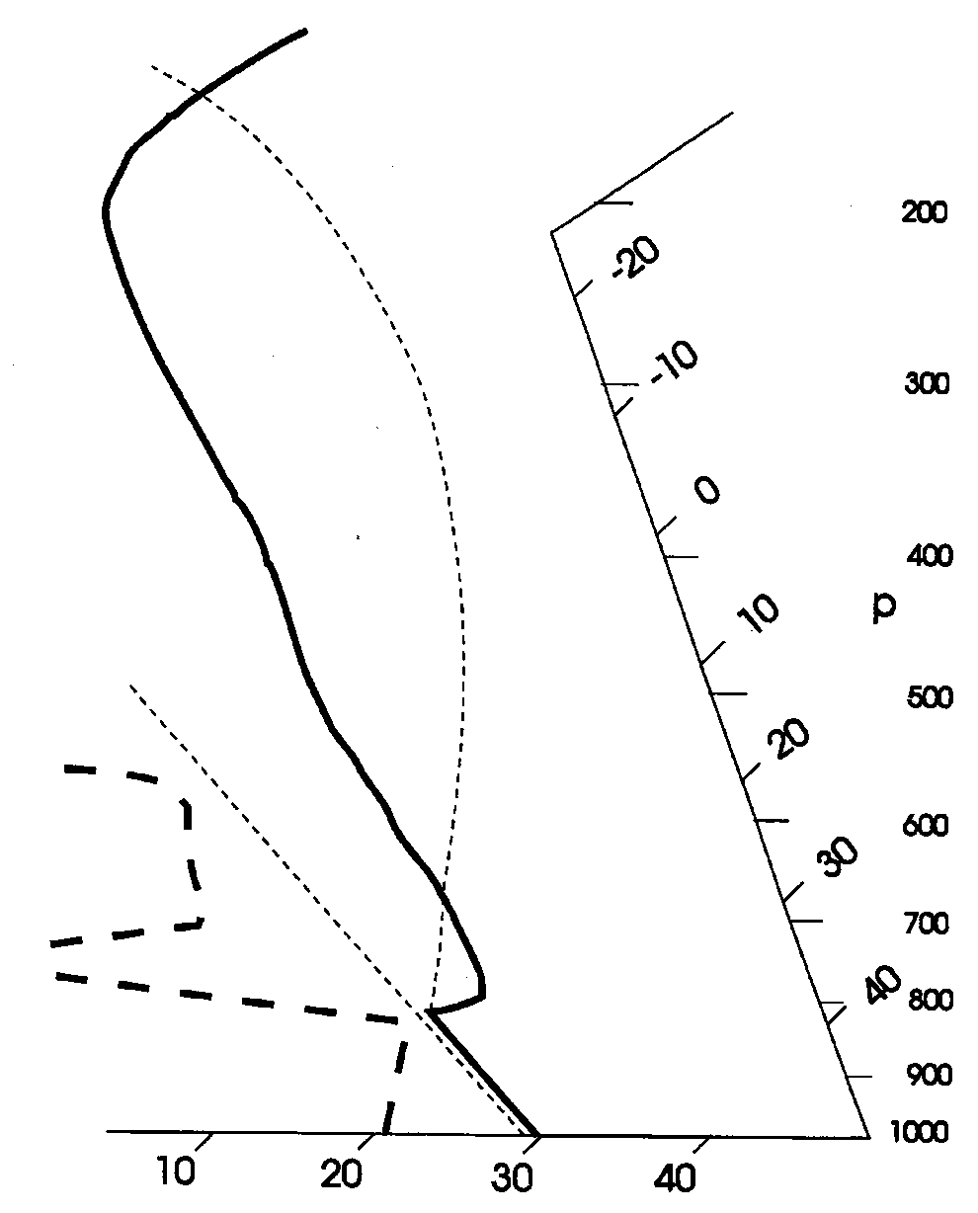
Stability Assessment using Tephigrams:
Convective Available Potential Energy
(CAPE):

Slide 14
Sounding at Norman, Oklahoma, May 5th 2007
CAPE = 6900 J/Kg → w = 110 m/s

Slide 15
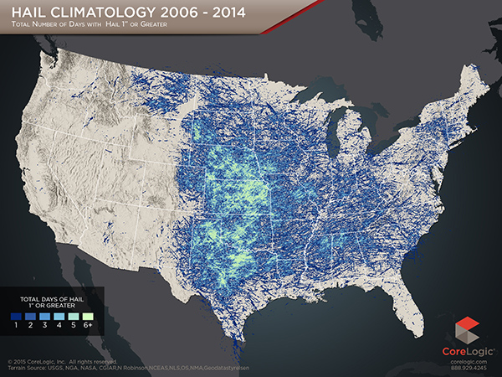

Slide 16
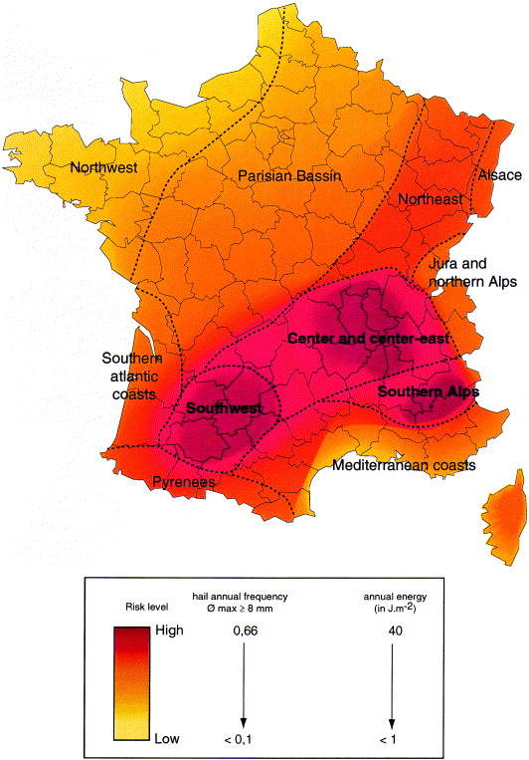
Hail climatology of France

Slide 17
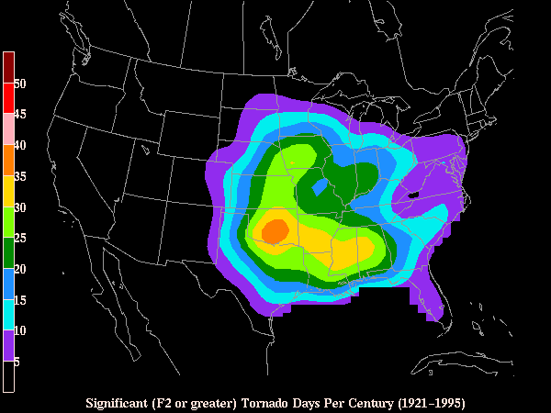
Number of Significant (>= F2) Tornadoes per Century

Slide 18

Necessary Conditions for Severe Thunderstorms:
High values of CAPE
Large vertical shear of horizontal wind, particularly at low levels

Slide 19
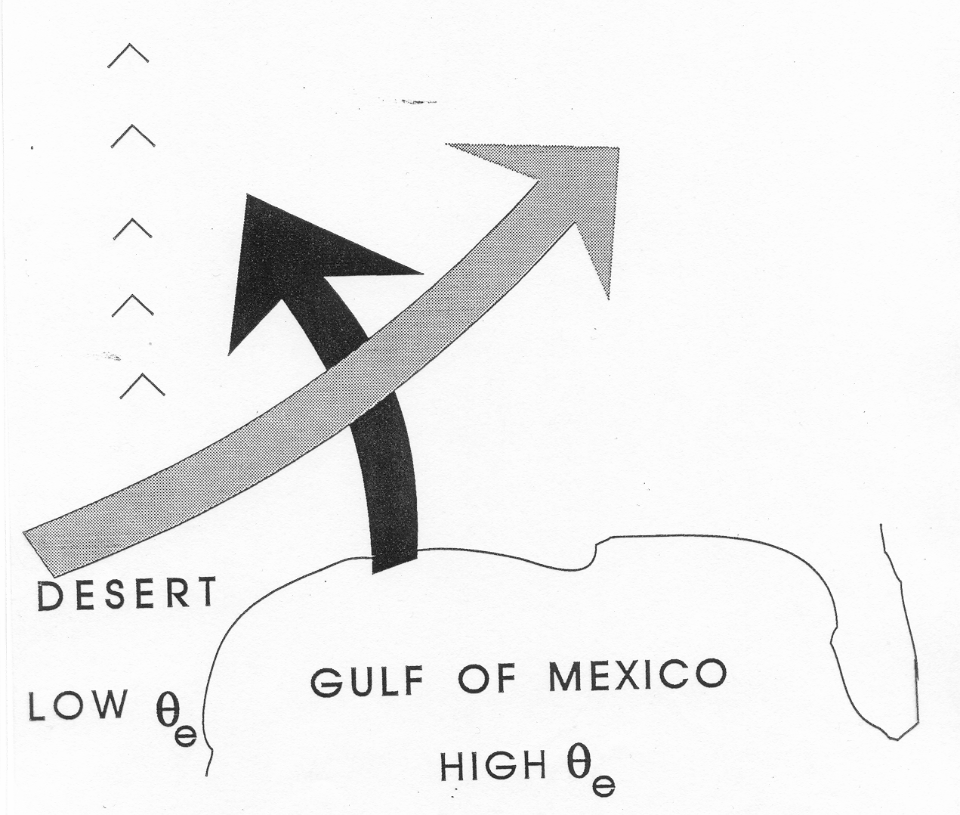
Conventional View:
Differential Advection
Emanuel, Atmospheric Convection, 1994

Slide 20
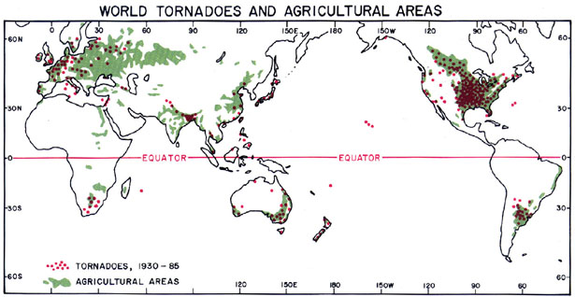
Global Distribution of Tornadoes

Slide 21
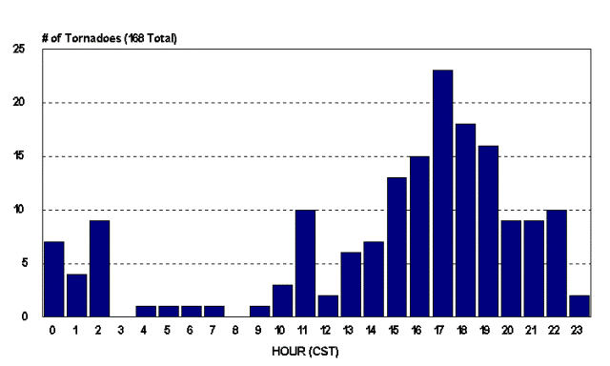
Diurnal Variation of Tornadoes

Slide 22
Key Questions:
What determines geographical distribution of stored- energy storms?
Why do tornadoes and hailstorms peak in late- afternoon to early evening?
Why are peak CAPE values around 3000-6000 J/Kg?
How might these values change with climate?

Slide 23
Hypothesis:
Large CAPE is produced when a deep, dry- adiabatic layer is advected over moist soil which is then subjected to solar heating.

Slide 24
We can model these circumstances with an idealized initial value problem
z=H
Dry Static Energy:
D = c_{p}T + gz
Moist Static Energy:
M = c_{p}T + L_{v}q + gz
Dry adiabatic
free troposphere
Start with a dry-adiabatic column over a heated, dry surface
D = D₀
M = D₀
q = 0
Q_{rad}
Q_{S}
T=T₀
T = T_{sfc0}; q = 0
dry surface
Notes:
So now we can think about this problem in terms of the dry and moist static energies in the different parts of the column. Initially, before the BL forms, the entire column is just a solid block with constant dry static energy (dry adiabatic), and since there’s no moisture anywhere, its moist static energy is just equal to its dry static energy. That all remains true in the free troposphere even after the BL forms. However, in the BL, we make that requirement that moist static energy be conserved upon contact with the moist surface. That means that the dry static energy must decrease when this happens, so D<D0 in the BL, and we have a deficit of DSE between the BL and the FT. On the other hand, we start off with M in the BL equal to D0, and it’s going to increase as heat and moisture get fluxed in. Therefore, we have a *surplus* of MSE in the BL wrt the FT. Since CAPE can be expressed as the vertical integral of the MSE difference between a lifted parcel and its environment, we can interpret the MSE surplus as an indicator of CAPE, and likewise, the DSE deficit is an indicator of CIN (convective inhibition).

Slide 25
Replace lower boundary by a moist soil surface and create an initially thin, moist boundary layer. Then heat surface with solar radiation and allow new boundary layer to develop.
z=H
D = c_{p}T + gz
M = c_{p}T + L_{v}q + gz
Dry adiabatic
free troposphere
D = D₀
M = D₀
q = 0
z=h
Q_{e}
D < D₀
M > D₀
q > 0
Q_{rad}
Moist
boundary layer
Q_{S}
T=T_{BL}
Q_{L}
T = T_{sfc}; q = q*(T_{sfc})
moist surface
Notes:
So now we can think about this problem in terms of the dry and moist static energies in the different parts of the column. Initially, before the BL forms, the entire column is just a solid block with constant dry static energy (dry adiabatic), and since there’s no moisture anywhere, its moist static energy is just equal to its dry static energy. That all remains true in the free troposphere even after the BL forms. However, in the BL, we make that requirement that moist static energy be conserved upon contact with the moist surface. That means that the dry static energy must decrease when this happens, so D<D0 in the BL, and we have a deficit of DSE between the BL and the FT. On the other hand, we start off with M in the BL equal to D0, and it’s going to increase as heat and moisture get fluxed in. Therefore, we have a *surplus* of MSE in the BL wrt the FT. Since CAPE can be expressed as the vertical integral of the MSE difference between a lifted parcel and its environment, we can interpret the MSE surplus as an indicator of CAPE, and likewise, the DSE deficit is an indicator of CIN (convective inhibition).

Slide 26
Boundary Layer Equations
Dry static energy
Moist static energy
Lilly’s entrainment formulation
Surface sensible heat flux
Surface latent heat flux
Net surface flux
Boundary layer mass

Slide 27
Note: M_{s} is related to D_{s} by Clausius-Clapeyron Equation
Initial conditions:
M (t=0) = D₀
D (t=0) determined so that air is just saturated at boundary layer top
h=h₀

Slide 28
Nondimensionalize:

Slide 29
Equations are normalized and recombined to arrive at
Determined so that air is initially just saturated at boundary layer top

Slide 30
Long-time Asymptotic Behavior
CAPE reaches a maximum at a particular time and then falls to zero at a later time, while the boundary layer depth goes to infinity at the later time and D, D_{s}, and M approach unity. T_{s} is the surface air temperature of the initial dry state.
CAPE still reaches a peak at a particular time and then falls off to or asymptotes to a positive long-time asymptotic value. The asymptotic limits are given by
Note: When a = 1, these criteria are equivalent to T_{s} > T₀ and T_{s} < T₀, respectively

Slide 31
Convective Available Potential Energy
(CAPE)
T_{top} determined by fixed anvil temperature hypothesis

Slide 32
Asymptotic Cape Scaling in ‘Warm’ Regime, Applicable at Time when PBL Growth Becomes Linear

Slide 33
Results

Slide 34
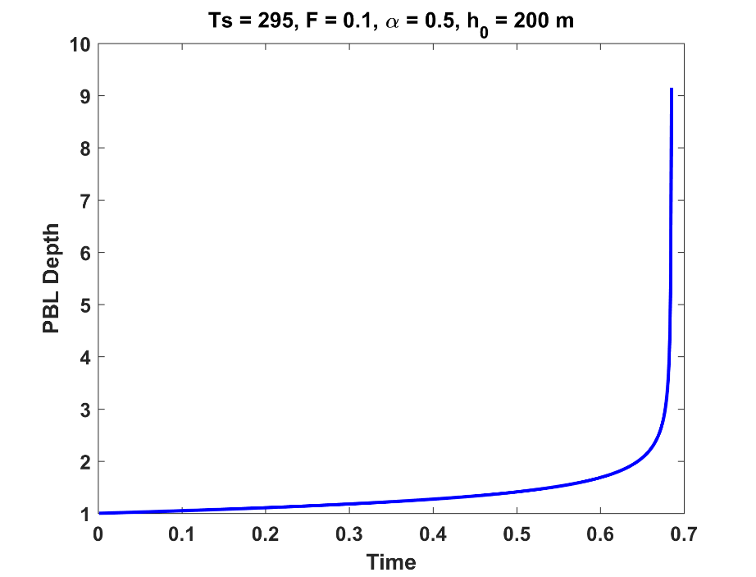
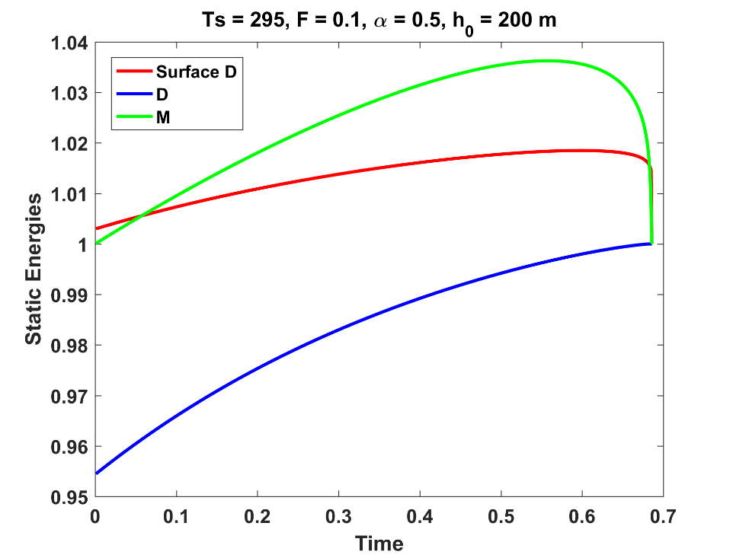
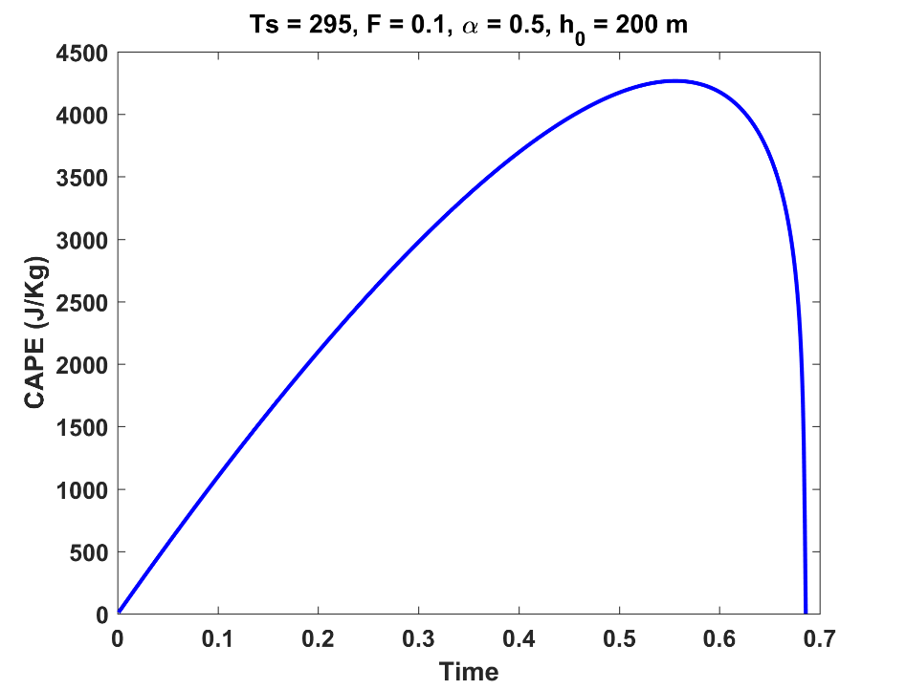
Cold Regime

Slide 35
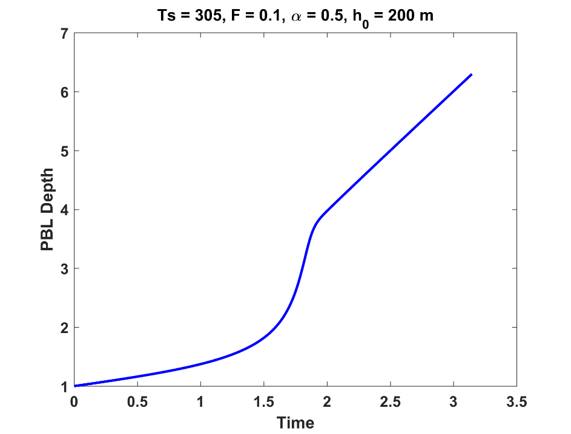
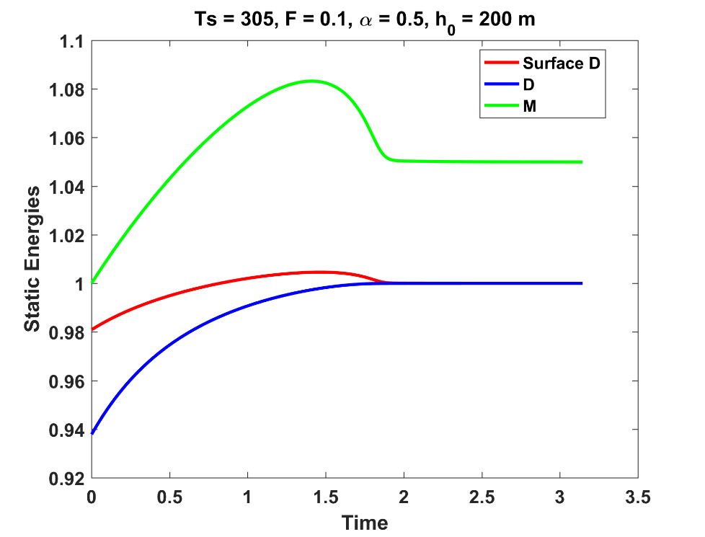
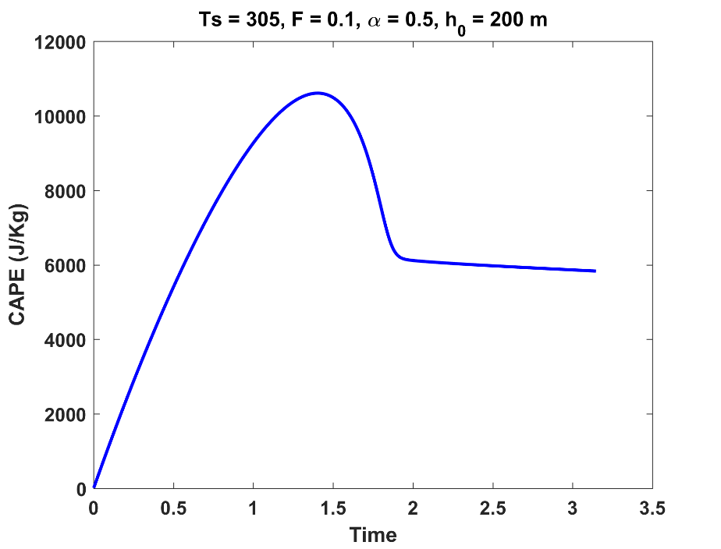
Warm Regime

Slide 36
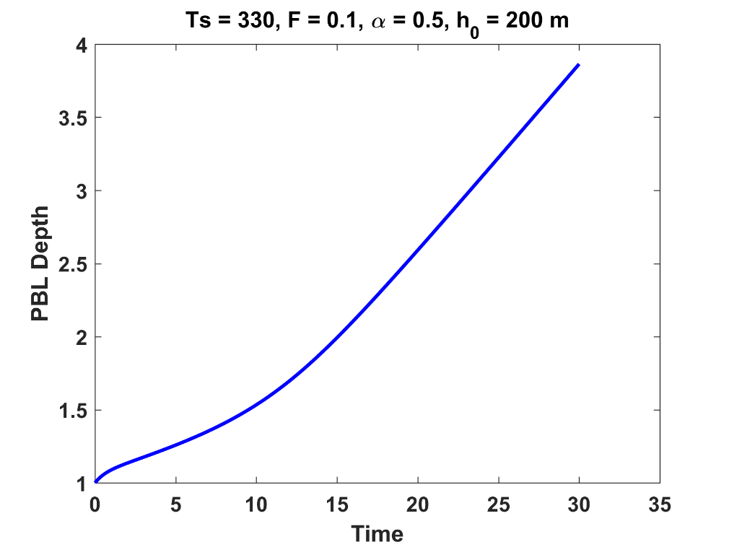
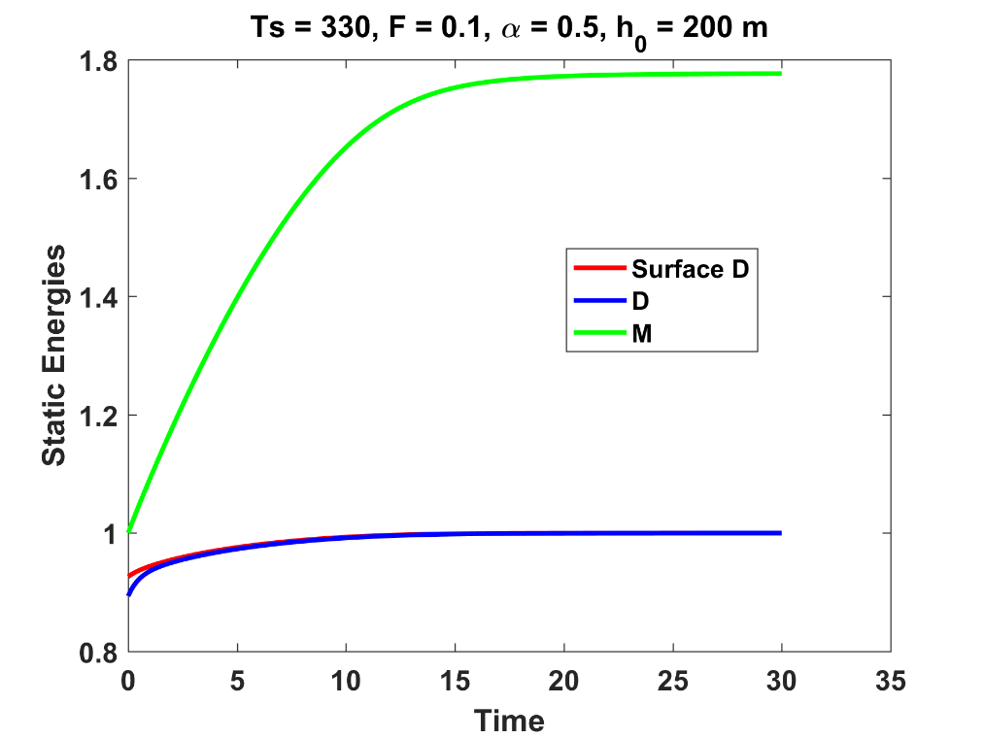
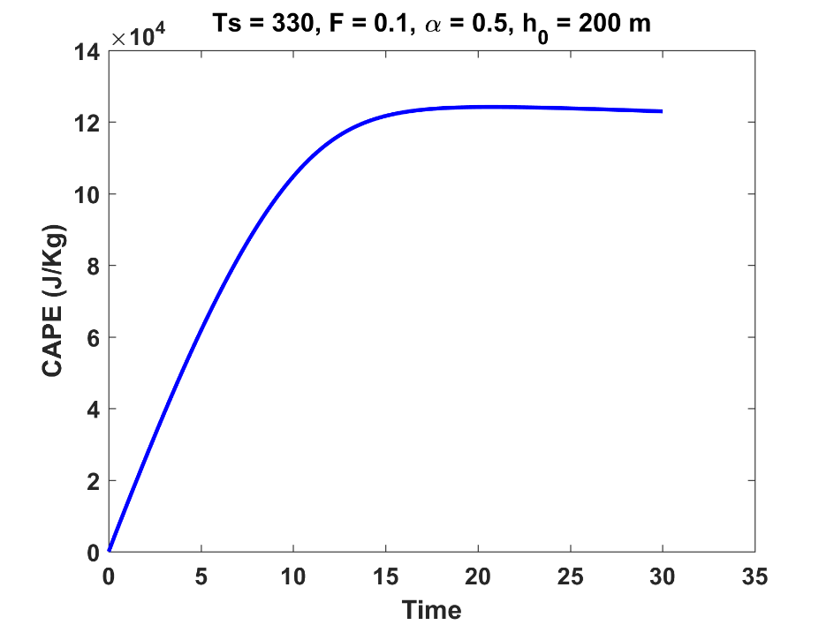
Very Warm Regime

Slide 37
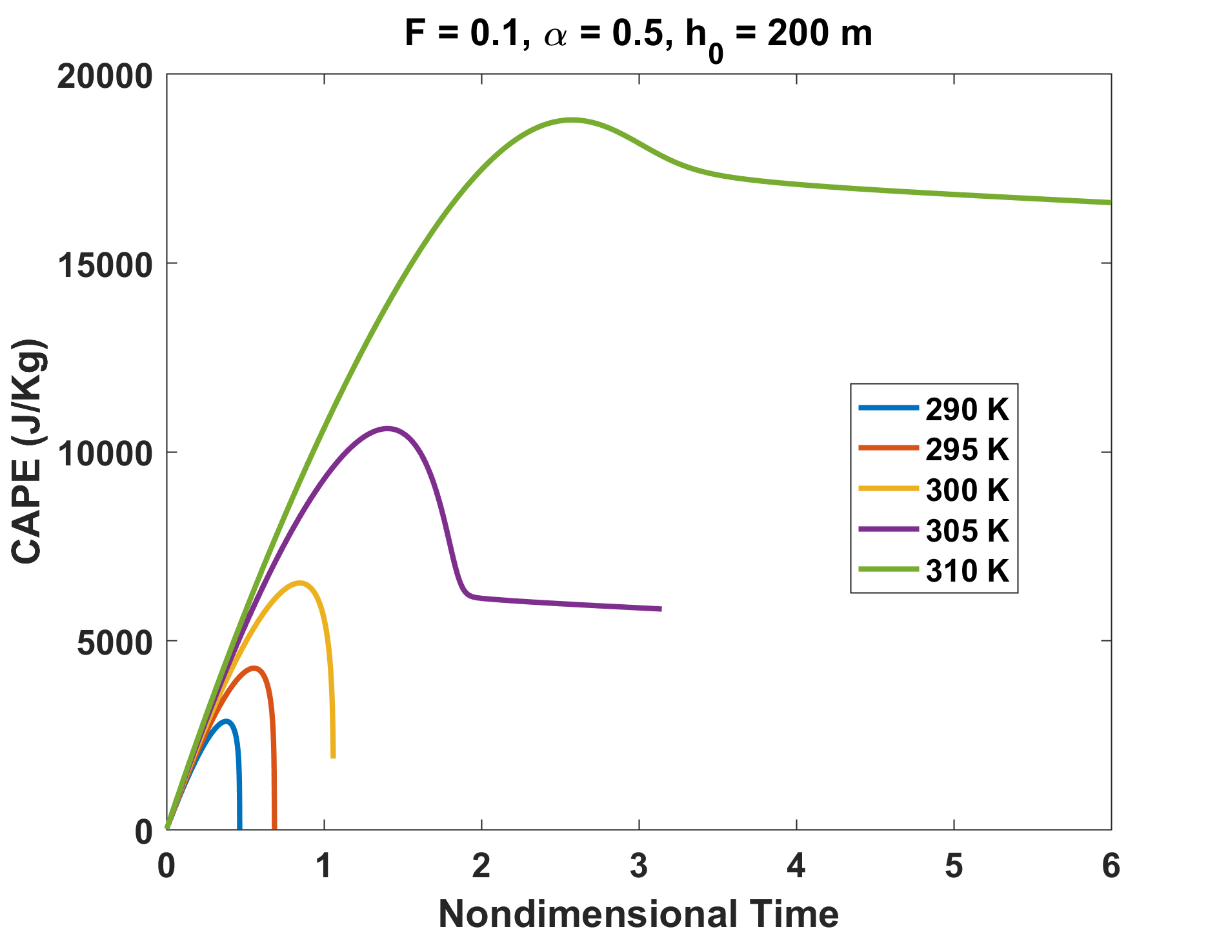
Peak CAPE increases with increasing temperature

Slide 38
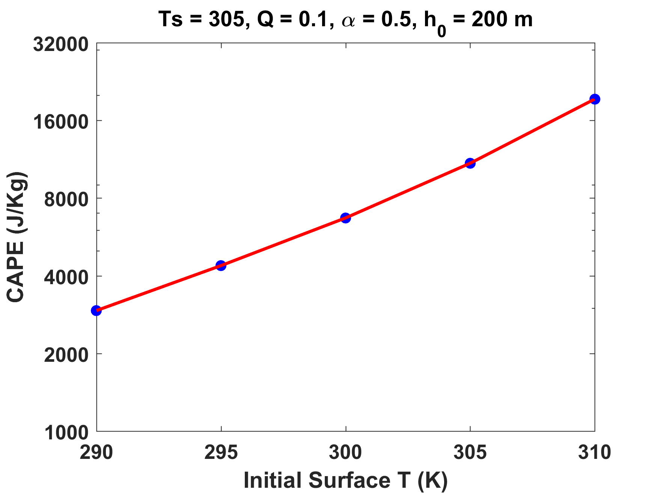
The relation between initial surface temperature and peak CAPE is slightly faster than exponential
Log scale
Notes:
And indeed it does. Here’s the big takeaway: In this idealized analytical model, transient peak CAPE scales with the difference between dry bulb and wet bulb temperatures, and thereby increases with increasing temperature according to the Clausius-Clapeyron relation.
I’ve written this up into a paper (which I’ve rewritten a couple of times) and I hope to be able to submit it soon (journal undecided).

Slide 39
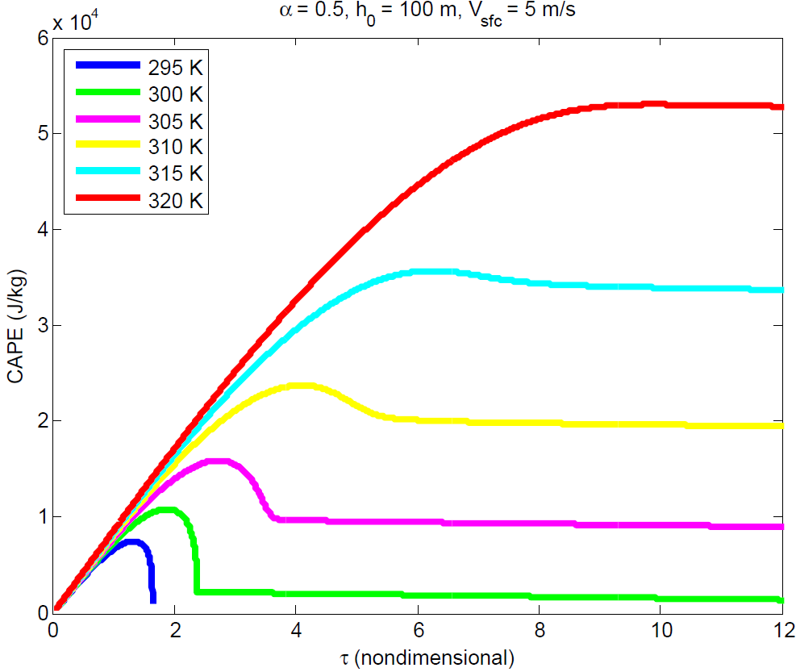
What happens when we impose a limiting time scale?
Notes:
While the peak CAPE increases with increasing temperature, the *time* to peak CAPE increases also.

Slide 40
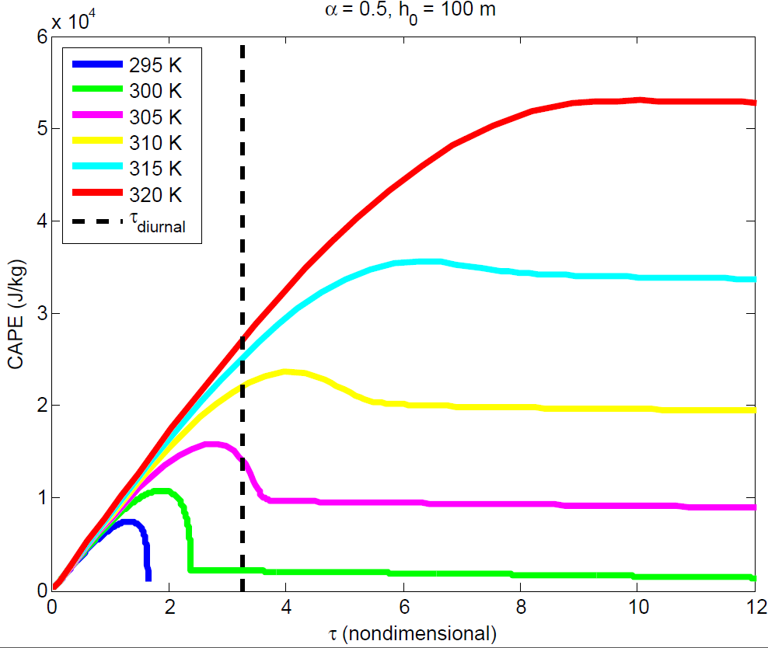

What happens when we impose a limiting time scale?
Notes:
While the peak CAPE increases with increasing temperature, the *time* to peak CAPE increases also.

Slide 41
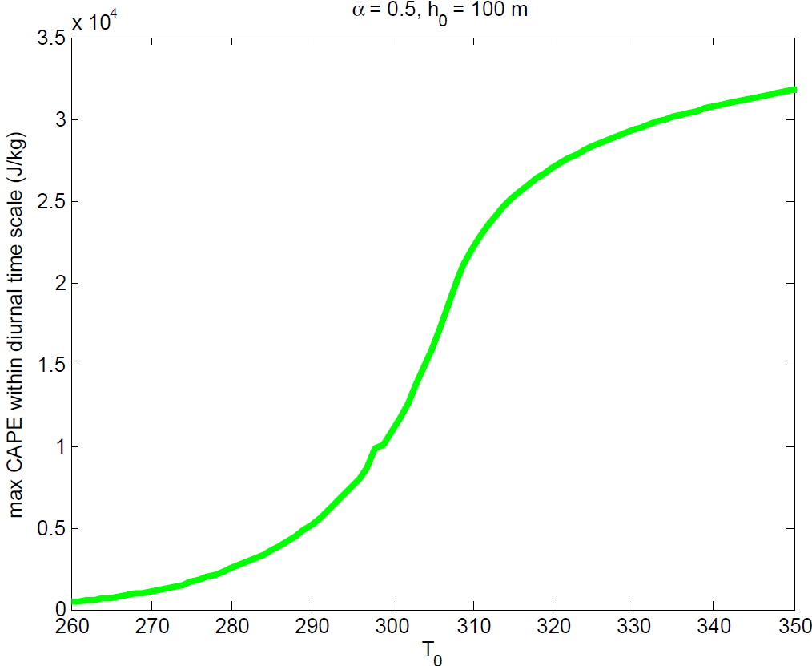
What happens when we impose a limiting time scale?
Notes:
While the peak CAPE increases with increasing temperature, the *time* to peak CAPE increases also.

Slide 42
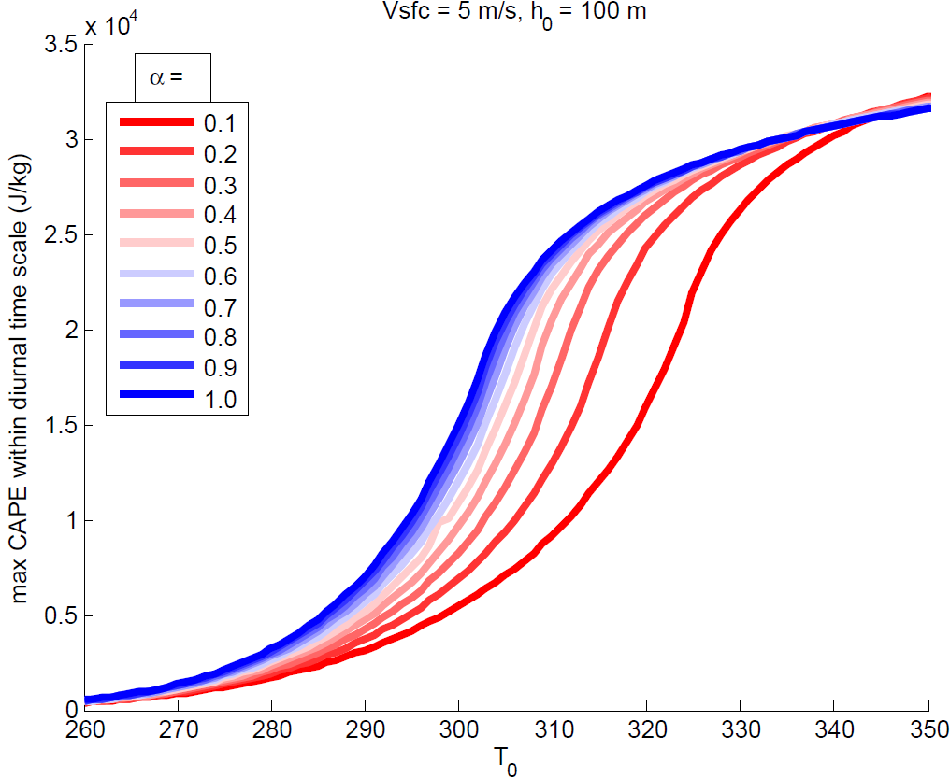
A moister land surface means higher CAPE at lower temperatures
Notes:
While the peak CAPE increases with increasing temperature, the *time* to peak CAPE increases also.

Slide 43
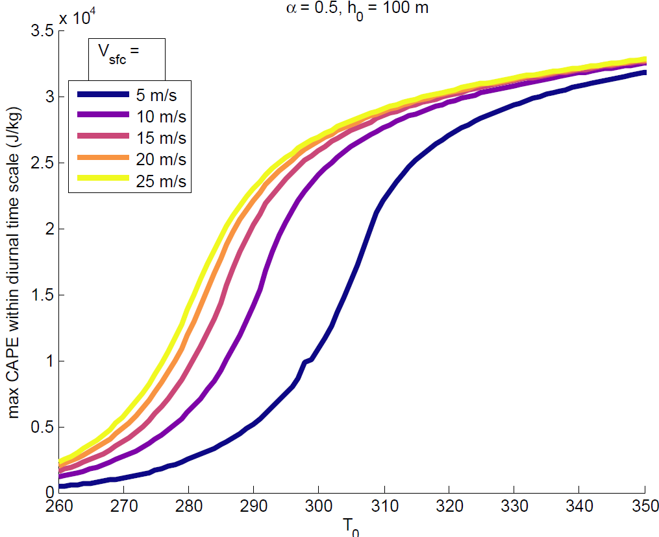
Higher surface wind speed also translates to higher CAPE
Notes:
While the peak CAPE increases with increasing temperature, the *time* to peak CAPE increases also.

Slide 44
CAPE
Notes:
Left: SPC storm reports for the dates of each case study. Right: CAPE (J/Kg) at the reanalysis time step immediately preceding the onset convection in each case.
The hatched areas indicate the locations of the 99.9th percentile of CAPE values. Oceanic grid cells are masked.

Slide 45
Notes:
Right: Paths of boundary layer parcels of interest (blue) tracked backward in time for the 2 days before the composite time. Red lines indicate the paths of parcels that end up superimposed on the parcels of interest at the 700 hPa level at the composite time. Circles indicate the initial positions of each parcel at 00Z the day prior to the day of the composite. Left: CAPE of boundary layer air along trajectories, April 28 2012 case.

Slide 46
Mean total accumulated CAPE (white), and contributions to CAPE accumulation from diabatic heating (blue), relative advection (red), and radiative cooling (green) in columns of interest for each case.

Slide 47
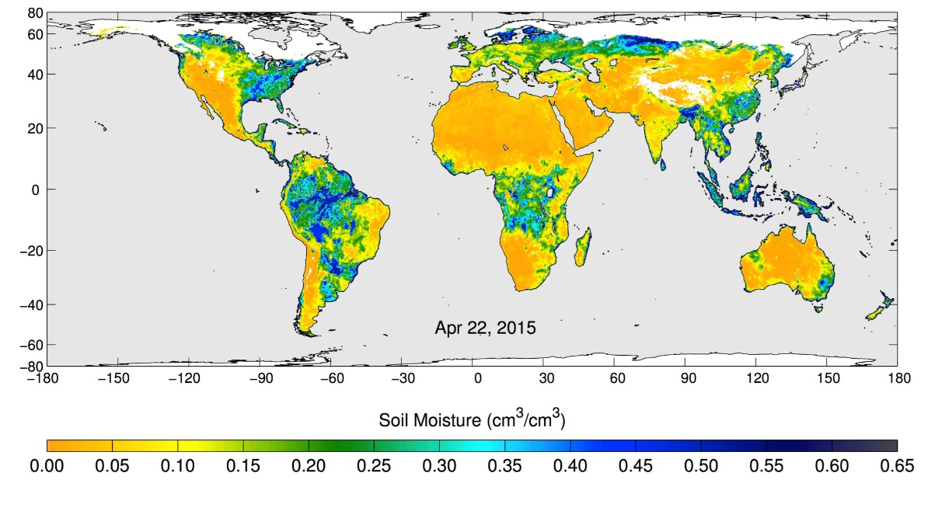
Volumetric water content in the top 5 centimeters of soil, from NASA's Soil Moisture Active Passive (SMAP) observatory, 22 April 2015
Notes:
These maps of global soil moisture were created using data from the radiometer instrument on NASA's Soil Moisture Active Passive (SMAP) observatory. Each image is a composite of three days of SMAP radiometer data, centered on April 15, 18 and 22, 2015. The images show the volumetric water content in the top 2 inches (5 centimeters) of soil. Wetter areas are blue and drier areas are yellow. White areas indicate snow, ice or frozen ground.

Slide 48
Global Distribution of Tornadoes

Slide 49
Summary
Large CAPE occurs when deep dry-adiabatic layers are advected over moist soils (connection to agriculture?)
Peak values of CAPE scale approximately with the difference between wet- and dry-bulb temperature, which increases exponentially with surface temperature
Imposing a diurnal cycle limits the growth of peak CAPE with surface temperature
Peak CAPE increases with surface wind speed and soil moisture
Dependence on soil moisture may offer a degree of seasonal predictability of CAPE
Dependence on soil moisture may also yield multiple equilibria

