Slide 1

Aggregation of Moist Convection: What We Have Learned from Cloud-Permitting Models and Theory
Kerry Emanuel
Lorenz Center
MIT

Slide 2

Starting Point: Radiative-Moist Convective Equilibrium
Vertical profile nearly neutral to moist convection
Strongly-two way interaction: Radiation drives profile toward instability, convection lofts water that strongly affects radiative transfer

Slide 4


Slide 5
An Interesting Surprise: Self-Aggregation of Convection
Held, Hemler, and Ramaswamy (1993)
Tompkins, (2001)
Bretherton, Blossey, and Khairoutdinov (2005)
Khairoutdinov and Emanuel (2010, 2012)
Muller and Held (2012)
Wing and Emanuel (2014)
Muller and Bony (2015)

Slide 6
Approach: Idealized modeling of convective organization in radiative-convective equilibrium using a cloud resolving model
System for Atmospheric Modeling (SAM) of Khairoutdinov and Randall (2003)
Constant solar insolation: 413.98 W/m²
Horizontal Resolution: 3km
Vertical Resolution: 64 levels
Periodic lateral boundaries
Initial sounding from domain average of smaller domain run in RCE
Fully interactive RRTM radiation and surface fluxes.
Rigid Lid
28 km
Fixed SST
297-312 K
768 km
768 km
Allison Wing, PhD thesis, 2014
Notes:
Three-dimensional cloud resolving model Anelastic equations of motion RRTM radiation scheme SAM 1-moment microphysics scheme
Prognostic thermodynamic variables:
Liquid water/ice moist static energy: h_{L} = c_{p}T + gz – L_{c}(q_{c}+q_{r})-L_{s}(q_{i}+q_{s}+q_{g})
Total nonprecipitating water
Total precipitating water

Slide 7
Convection in Radiative-Convective Equilibrium
Allison Wing, PhD thesis, 2014
Notes:
Day 1 is pretty homogeneous. By day 10 small area has become drier.

Slide 8
Self-Aggregation
Allison Wing, PhD thesis, 2014
Notes:
Day 1 is pretty homogeneous. By day 10 small area has become drier.

Slide 9
Evolution of Vertically Integrated Water Vapor
Allison Wing, PhD thesis, 2014
Notes:
Day 1 is pretty homogeneous. By day 10 small area has become drier.

Slide 10
Evolution of Vertically Integrated Water Vapor
Notes:
Over next 20 days, small dry patch amplfies and expands. By day 30 covers nearly a quarter of the domain.

Slide 11
Evolution of Vertically Integrated Water Vapor
Allison Wing, PhD thesis, 2014
Notes:
Process continues and by day 50 areas of the domain not in dry patch have become moister than they were initially.

Slide 12
Evolution of Vertically Integrated Water Vapor
Allison Wing, PhD thesis, 2014
Notes:
Now the expanding dry region has confined all the moist area (which is now moister than anywhere earlier in the simulation) to one band. This band evolves

Slide 13
Evolution of Vertically Integrated Water Vapor
Allison Wing, PhD thesis, 2014
Notes:
Evolves into a single circular cluster in which high tpw values are concentrated. Outside the moist cluster, the rest of the domain has very low values of tpw.

Slide 14
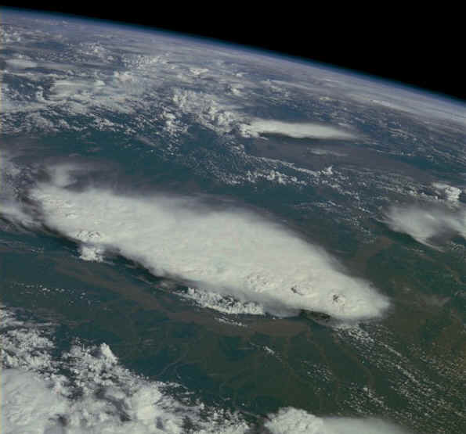
Monsoonal Thunderstorms, Bangladesh and India, July 1985

Slide 15
Vertical-time sections in dry patch
Wing and Emanuel, JAMES, 2014
Relative humidity
All quantities are perturbations from RCE state
Longwave heating
Shortwave heating
Net radiative heating

Slide 16
Aggregation Depends on Surface Temperature
Larger domain needed for high SSTs to aggregate
Allison Wing, PhD thesis, 2014
Notes:
Speculated that high SST simulations required a larger domain size, perhaps because of the large values of dry static stability that occur at high temperature.

Slide 17
Stability of RCE Using a Single-Column Model

Slide 18
MIT Single-Column Model
Broadband shortwave and longwave radiation
Parameterized Moist Convection
First un into RCE state with fixed SST
Then re-initialize with temperature fixed above 1.5 km; calculate vertical velocity needed for temperature equilibrium (“Weak-Temperature Gradient” mode). Vertical velocity advects water vapor
Introduce small perturbations and observe growth or decay.

Slide 19
Results
No drift from RCE state when SST <~ 32 C
Migration toward states with ascent or descent at higher SSTs
These states correspond to multiple equilibria in two-column models by Raymond and Zeng (2000) and by several others since (e.g. Sobel et al., 2007; Sessions et al. 2010)

Slide 20
Migration toward Descent

Slide 21
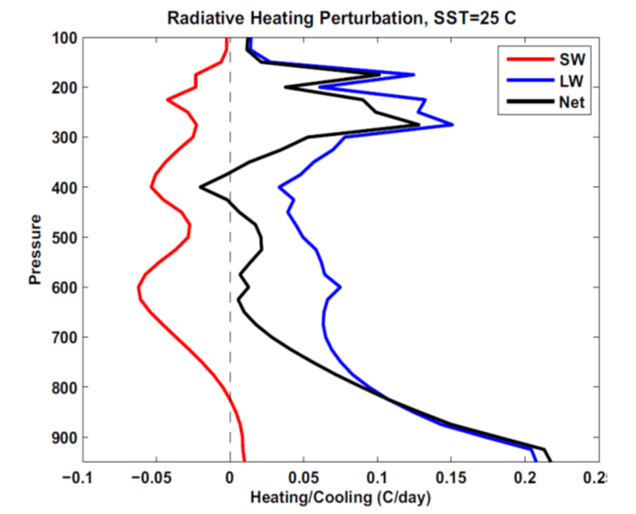
Now go back to RCE State and just introduce a 20% reduction in water vapor concentration; observe instantaneous response of radiative heating rates
25ºC
40ºC
Perturbation shortwave (red), longwave (blue), and net (black) radiative heating rates in response to an instantaneous reduction of specific humidity of 20% from the RCE states for (left) SST525C and (right) 40C. Note the different scales on the abscissas.

Slide 22
Perturbation net radiative heating rates in response to an instantaneous reduction of specific humidity of 20% from the RCE states for SSTs ranging from 25 to 45C.

Slide 23
Results of Linear Stability Analysis of Two-Layer Model:
Criterion for instability:
Dry static stabilities
emissivities
Mean state radiative cooling rates. These are negative!
Precipitation efficiency
<0
<0
>0
Radiative-convective equilibrium becomes linearly unstable when the infrared opacity of the lower troposphere becomes sufficiently large, and when precipitation efficiency is large

Slide 24

Essential Physics:
RCE linearly unstable when longwave emissivity of the lower troposphere is sufficiently large, the mean state radiative cooling rates small, and the precipitation efficiencies large. Drying of upper troposphere leads to cooling of lower troposphere, reduction of convection, further drying, etc.
Once cluster forms, it is strongly maintained by intense negative OLR anomaly associated with central dense overcast. This leads to strong hysteresis in the radiative-convective system

Slide 25
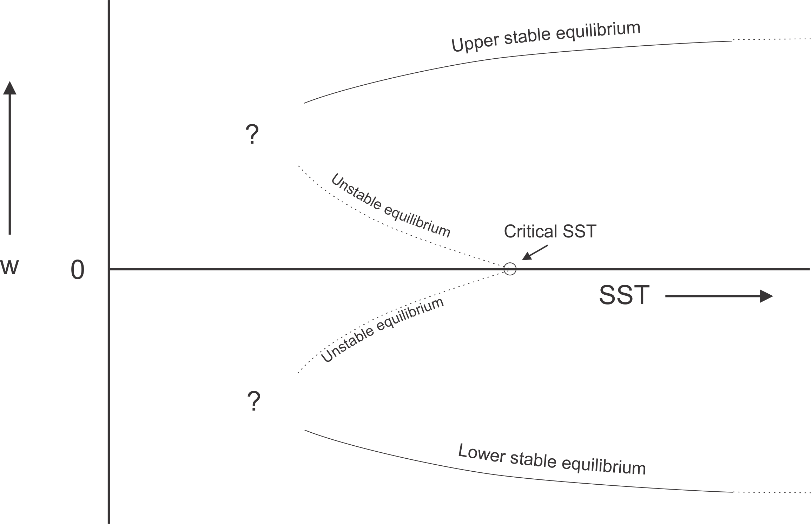
Hypothesized Subcritical Bifurcation
Clustering metric

Slide 26
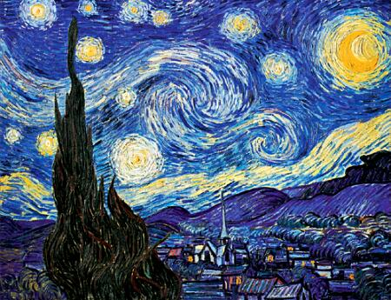
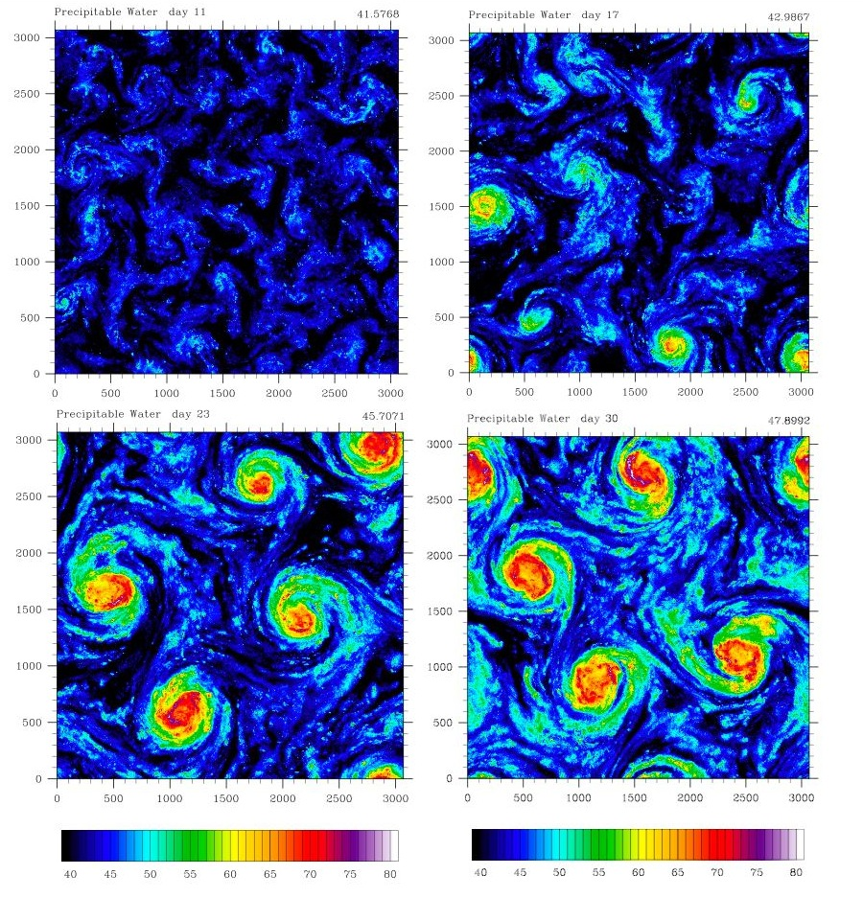
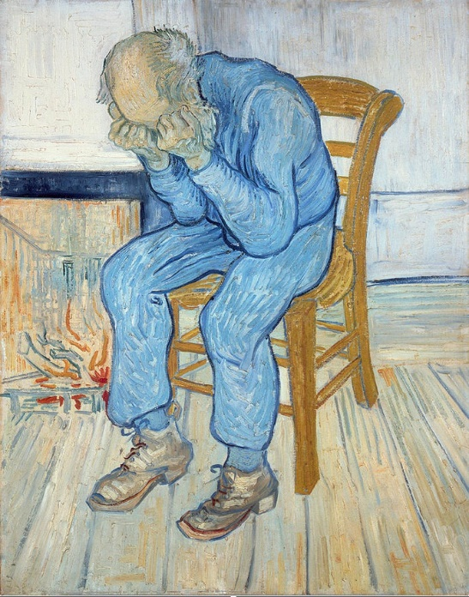
Self-Aggregation on an f-plane
Vincent Van Gogh: Starry Night
First known portrait of a climate scientist (same artist)

Slide 27
Hurricane-World Scaling
Radius of maximum winds:
Distance between storm centers:
Number density:

Slide 28
Hurricane-World Scaling
Modified thermodynamic efficiency:
Angular velocity of earth’s rotation:
Saturation water concentration of sea surface:
Net top-of-atmosphere upward radiative flux:
Net upward surface radiative flux:
Potential intensity:

Slide 29
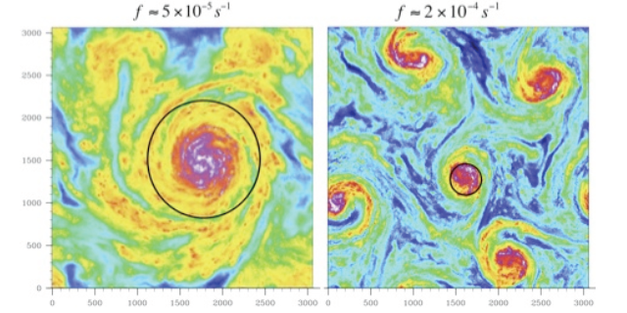

Slide 30
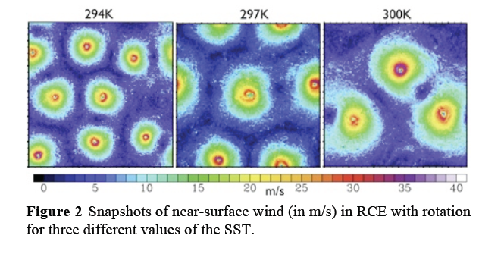

Slide 31
Two Major Unsolved Problems in Atmospheric Science
The Madden-Julian Oscillation (MJO)
  Discovered in early 1970s by Roland Madden and Paul Julian
  A tropospheric, equatorially focused wave in winds and pressure travelling eastward with a period of ~40 days
Tropical Cyclogenesis

Slide 32
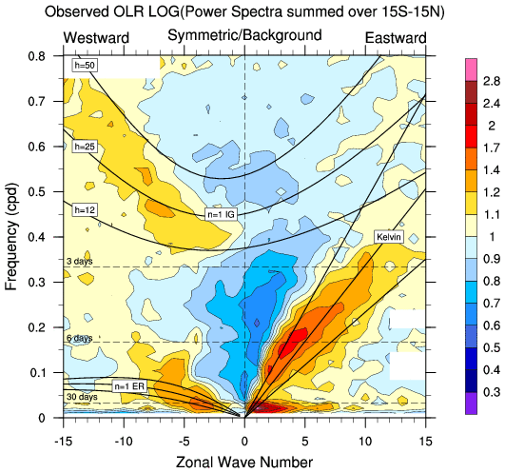
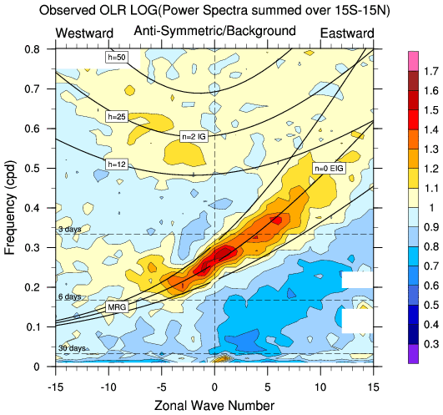
Equatorial Intraseasonal Variability
Symmetric OLR
Anti-symmetric OLR

Slide 33
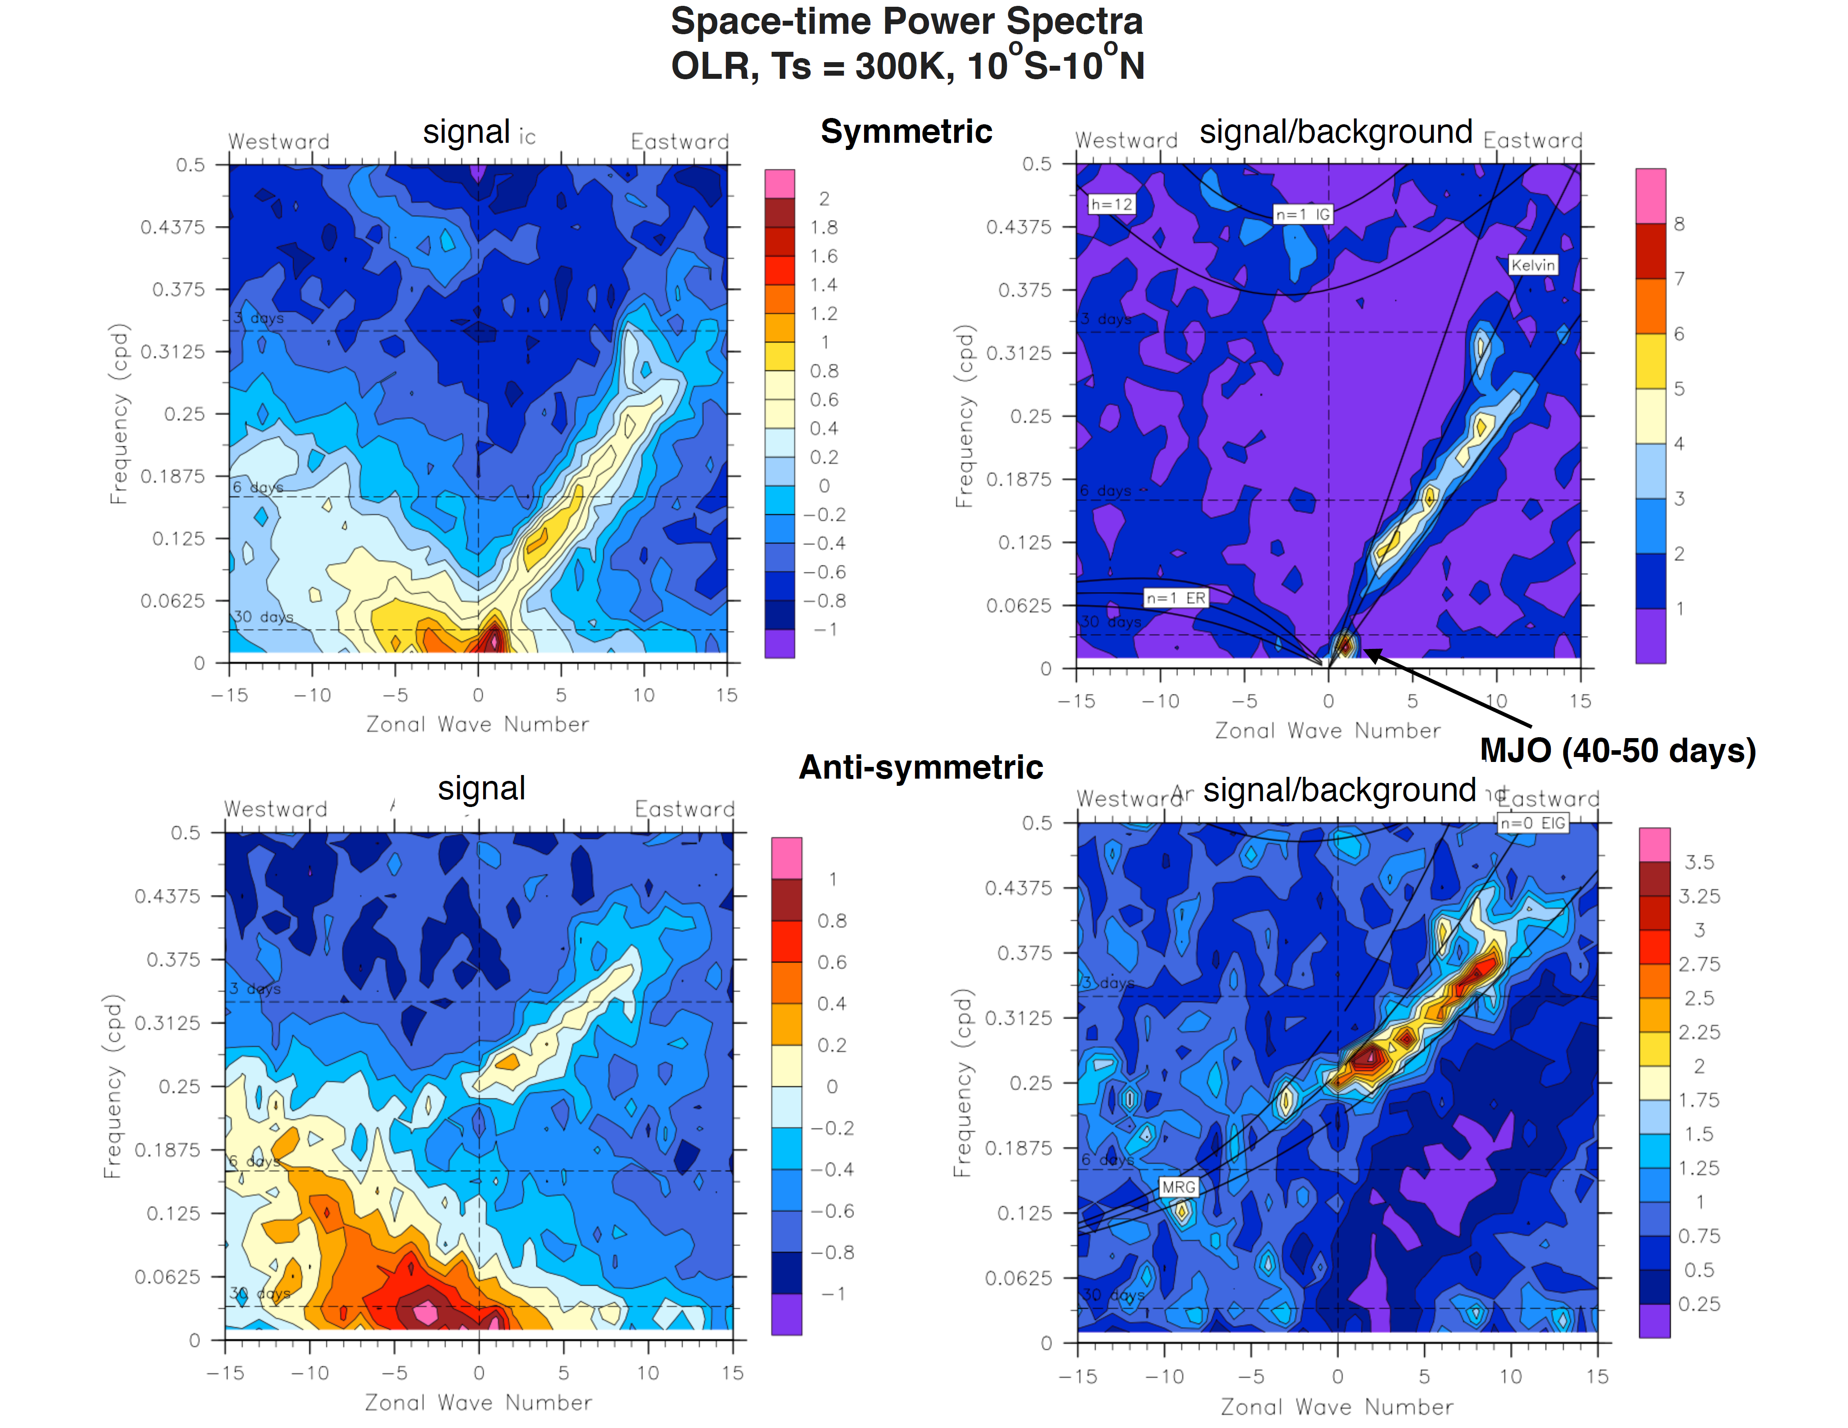
Cloud-permitting model run on aqua-planet with constant SST (bounded at +/-46º latitude)
(Marat Khairoutdinov)
Symmetric OLR
Anti-symmetric OLR
Courtesy Marat Khairoutdinov

Slide 34
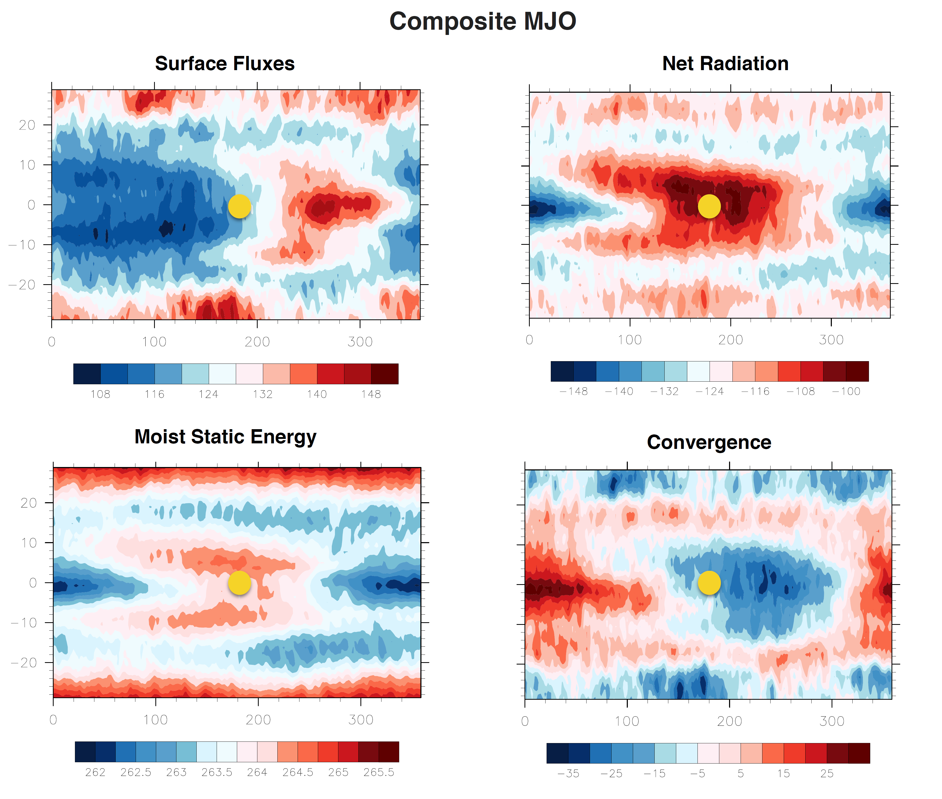


Slide 35
Consequences for Earth’s Climate

Slide 36
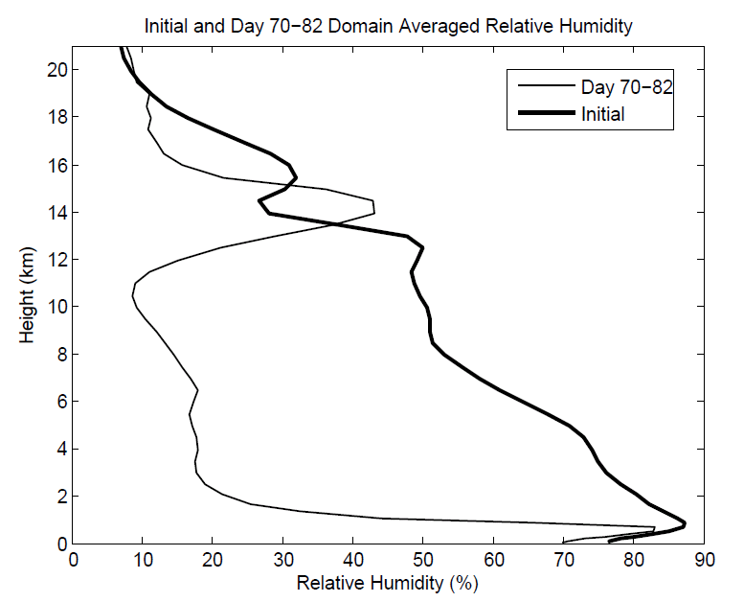
Aggregation Dramatically Dries Atmosphere!

Slide 37
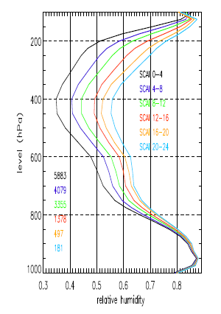
Variation of tropical relative humidity profiles with a Simple Convective Aggregation Index (SCAI).
Courtesy Isabelle Tobin, Sandrine Bony, and Remy Roca
Tobin, Bony, and Roca, J. Climate, 2012

Slide 38
Hypothesis
(Kharoutdinov and Emanuel, 2010)
At high temperature, convection self-aggregates
→Horizontally averaged humidity drops dramatically
→Reduced greenhouse effect cools system
→Convection disaggregates
→Humidity increases, system warms
→System wants to be near phase transition to aggregated state

Slide 39
Recipe for Self-Organized Criticality
System should reside near critical threshold for self-aggregation: Regulation of tropical sea surface temperature!

Slide 40
From Hohenegger and Stevens, JAMES, 2016
Notes:
Time evolution of (a–c) components of the surface energy budget (W/m^2) and (d) SST (K) in U50D (black) and U50D_noagg (orange). All quantities from daily averages.

Slide 41
Summary
Complex but comprehendible interactions between radiation, clouds, and water vapor may be key to cracking some outstanding problems in atmospheric science and climate, such as the MJO and tropical cyclogenesis
Under some conditions, RCE is unstable, owing to the particular dependencies of convection and radiation on atmospheric water vapor and clouds
Aggregation of convection may have profound effects on climate
Physics of aggregation may not operate well, if at all, in today’s climate models
We need to do a better job educating students in radiative transfer and thermodynamics

