Slide 1
Motivations
Several problems have remained virtually immune to solution by standard GFD:
  Tropical Cyclogenesis
  The Madden-Julian Oscillation
  Relative stability of the climate of the tropics
Indications that these may depend on the nature of radiative transfer and its interaction with clouds and water vapor, whose distribution depends in part on dynamics

Slide 2
Elements of Thermal Balance:
Solar Radiation
Luminosity: 3.9 x 10²⁶ J s⁻¹ = 6.4 x 10⁷ Wm⁻²
at top of photosphere
Mean distance from earth: 1.5 x 10¹¹ m
Flux density at mean radius of earth

Slide 4
Disposition of Solar Radiation:
Absorption by clouds, atmosphere, and surface

Slide 5
Terrestrial Radiation:
Effective emission temperature:

Slide 6
Radiative Transfer
Shortwave Absorption:
  Clouds, H₂O, O₃, some CO₂
Shortwave Reflection:
  Clouds, surface, atmosphere
Longwave Absorption:
  Clouds, H₂O, CO₂, CH₄, N₂O

Slide 7
Planck’s Law
Based on assumption of local thermodynamic equilibrium
  (Not valid at very high altitudes in atmosphere)

Slide 8
Stefan-Boltzmann Law is the integral of the Planck function over all frequencies and all angles in a hemisphere:

Slide 9
Absorption and Emission in a Gas:
An isolated atom can absorb only those photons whose energy is equal to the difference between two atomic energy levels
Molecules have additional energy levels:

Slide 10
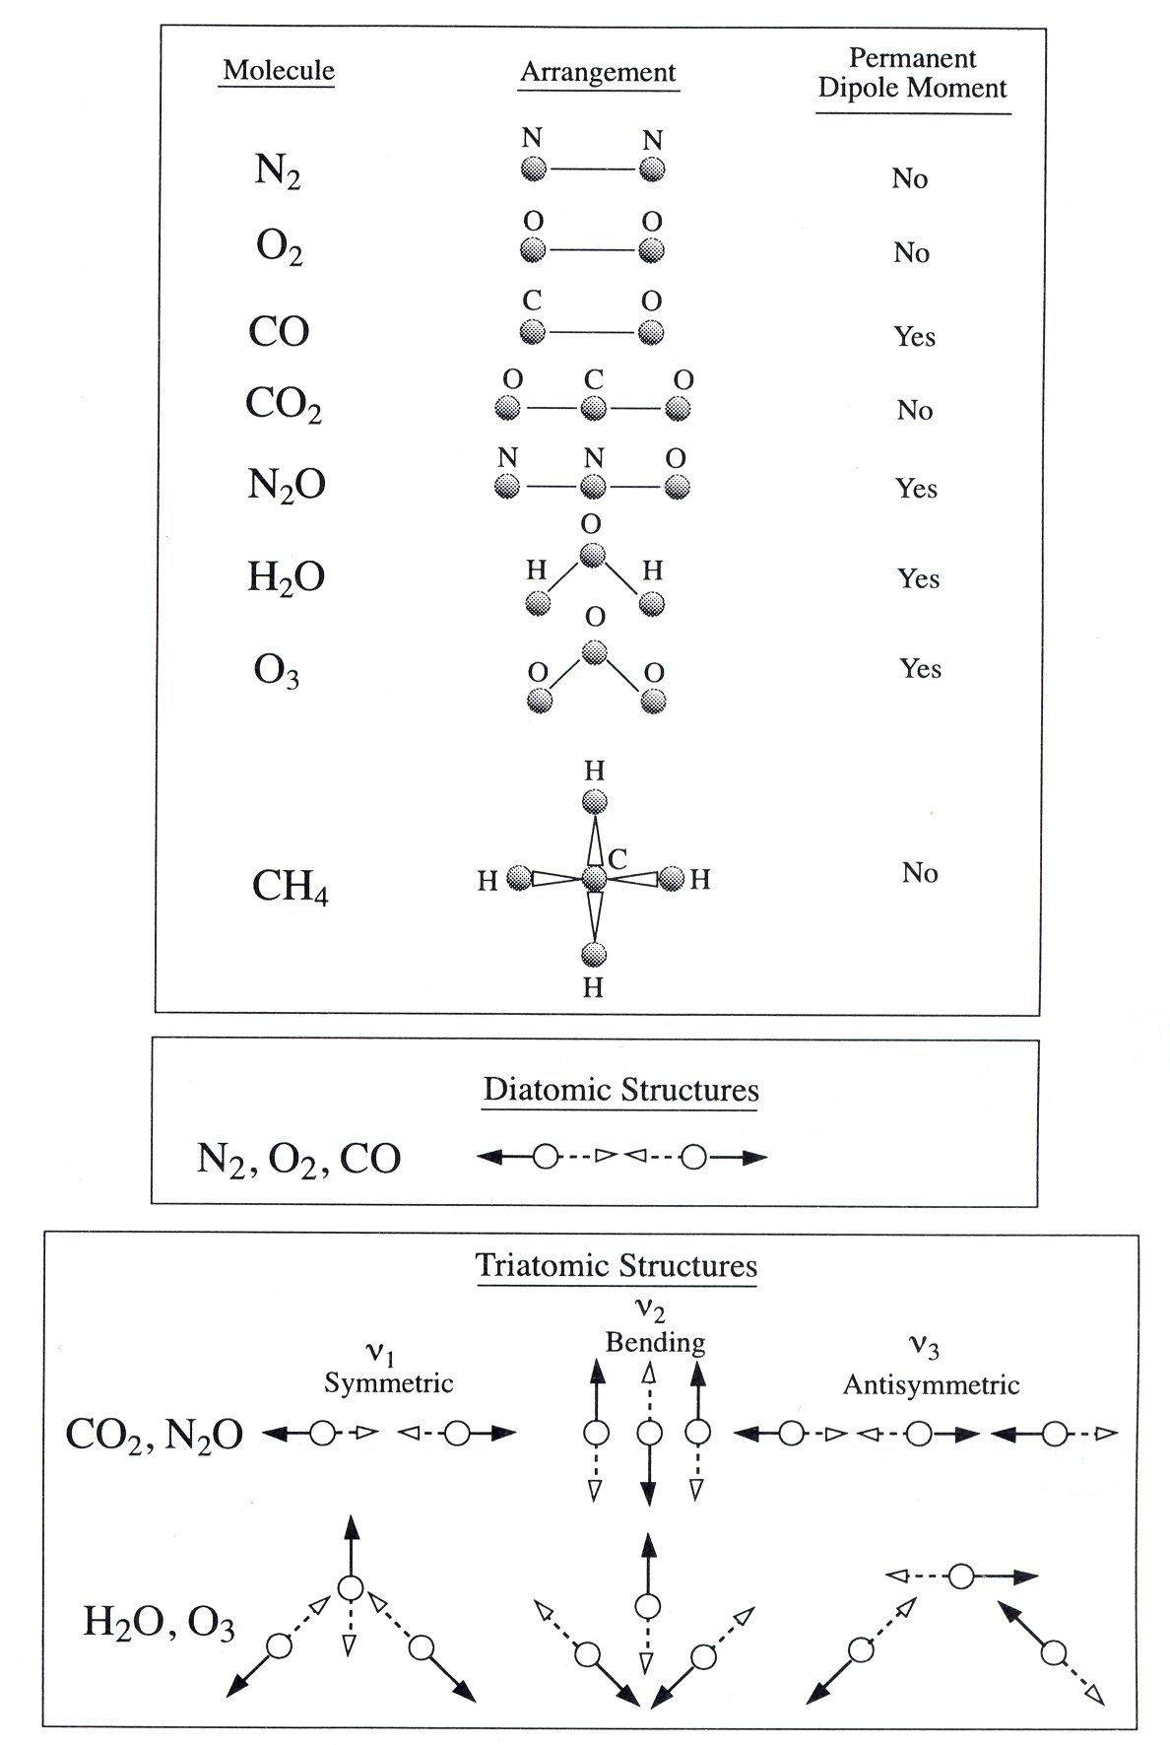

Slide 11
For molecules in a gas:
Translational energy is the kinetic energy of molecular motions in a gas, proportional to the gas temperature. Not quantized.
Molecules in a gas can absorb more frequencies than isolated atoms.
Collisions between molecules can carry away energy or supply energy to interactions between matter and photons.
Natural, pressure and Doppler broadening

Slide 12
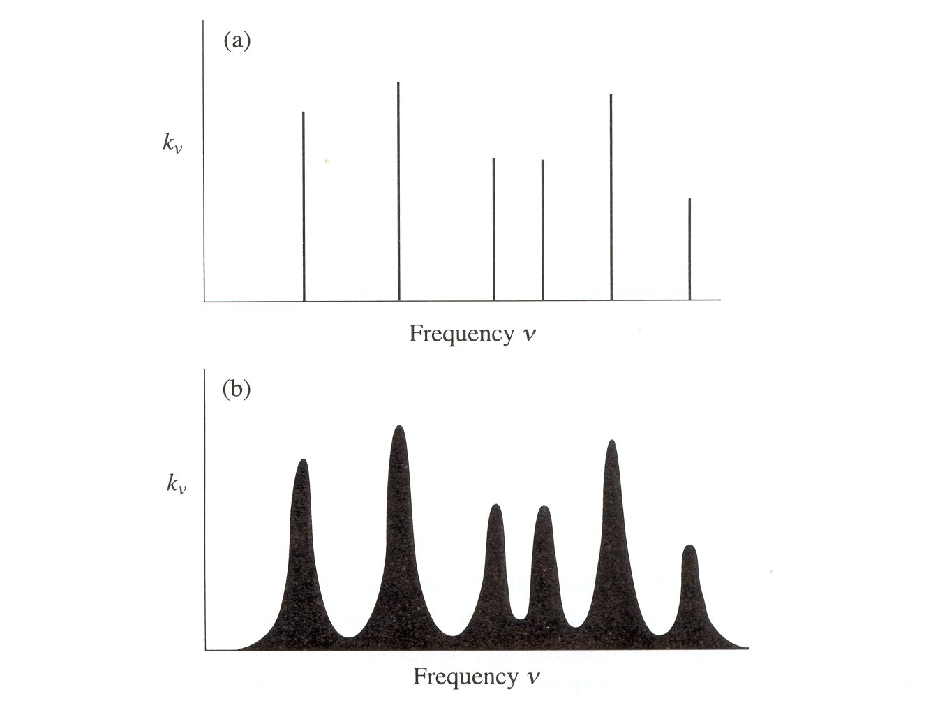

Slide 13
Principal Atmospheric Absorbers
H₂O: Bent triatomic, with permanent dipole moment and pure rotational bands as well as rotation-vibration transitions
O₃: Like water, but also involved in photodissociation
CO₂: No permanent dipole moment, so no pure rotational transitions, but temporary dipole during vibrational transitions
Other gases: N₂O, CH₄

Slide 14
Atmospheric Composition

Slide 15
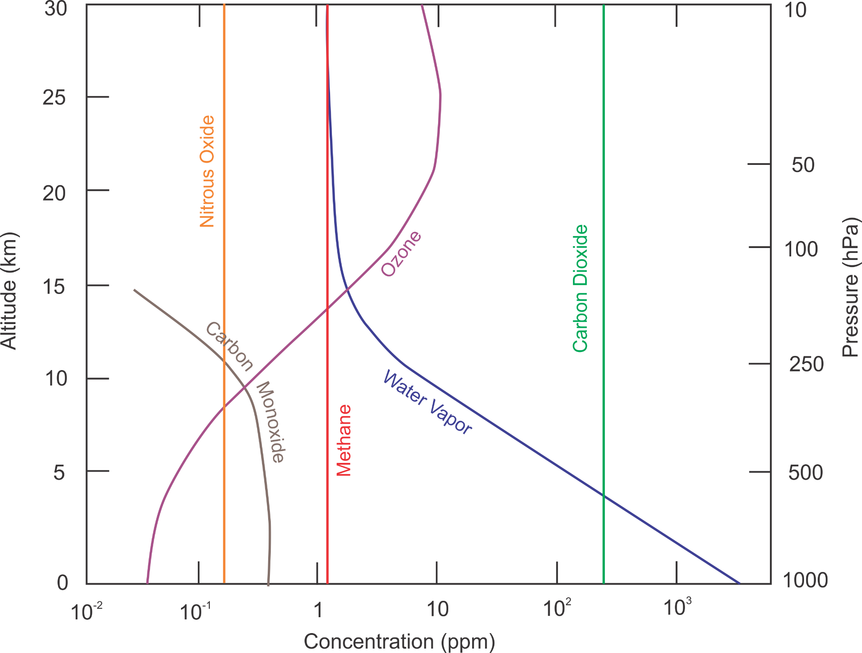
Image credit: Kerry Emanuel

Slide 16
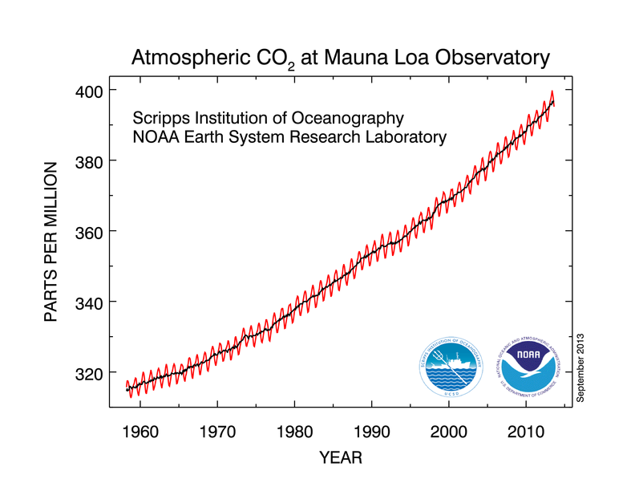

Slide 17
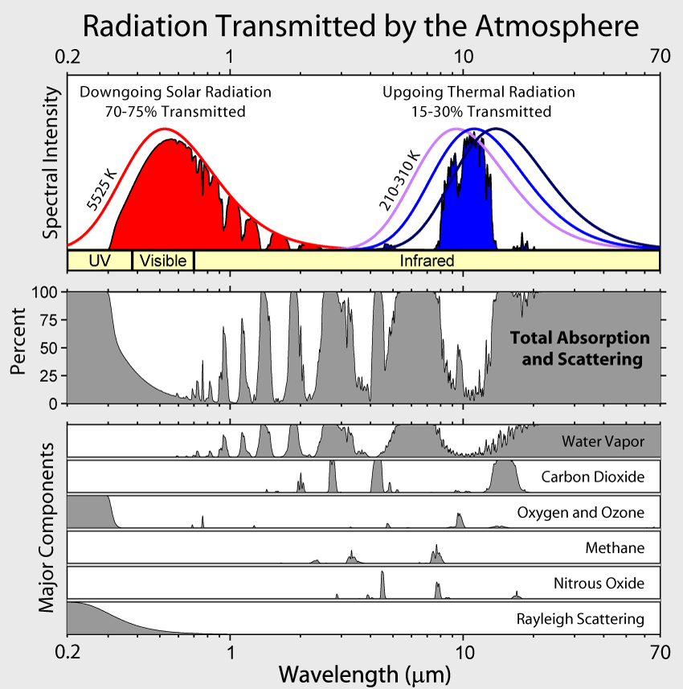

Slide 18
Radiative Equilibrium
Equilibrium state of atmosphere and surface in the absence of non-radiative enthalpy fluxes
Radiative heating drives actual state toward state of radiative equilibrium

Slide 19
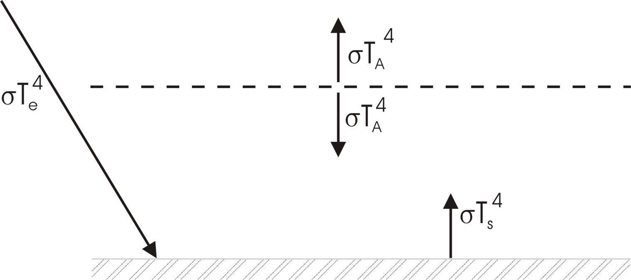
Highly Reduced Model
Transparent to solar radiation
Opaque to infrared radiation
Blackbody emission from surface and each layer

Slide 20
Radiative Equilibrium:
Top of Atmosphere:
Surface:

Slide 21
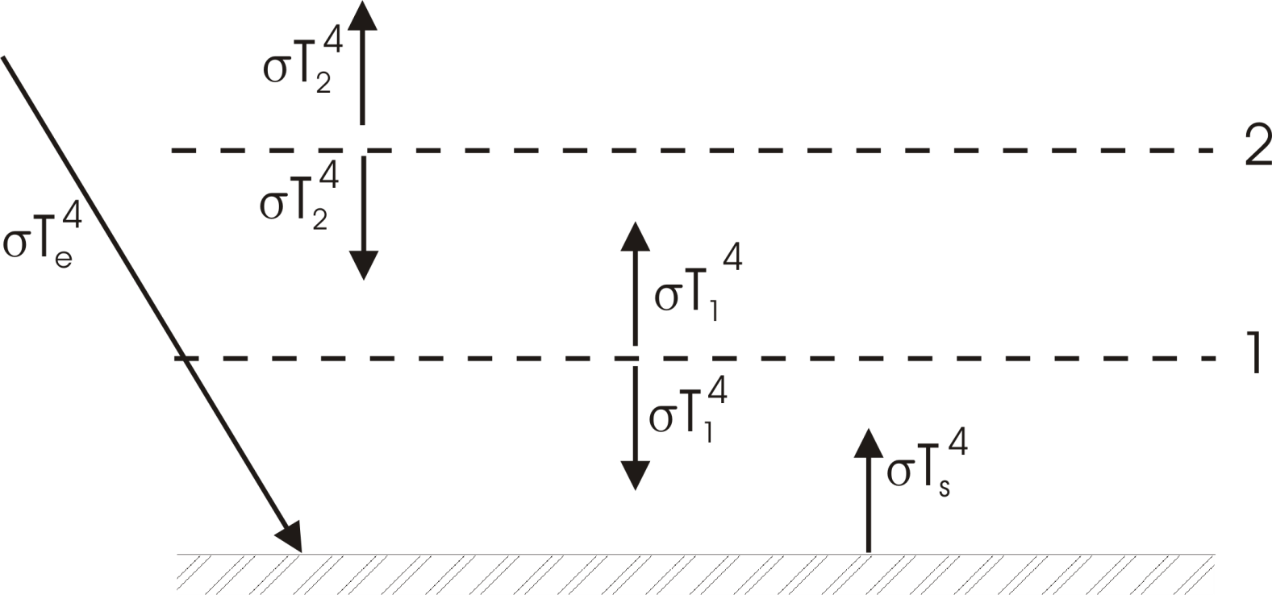
Extended Layer Models

Slide 22
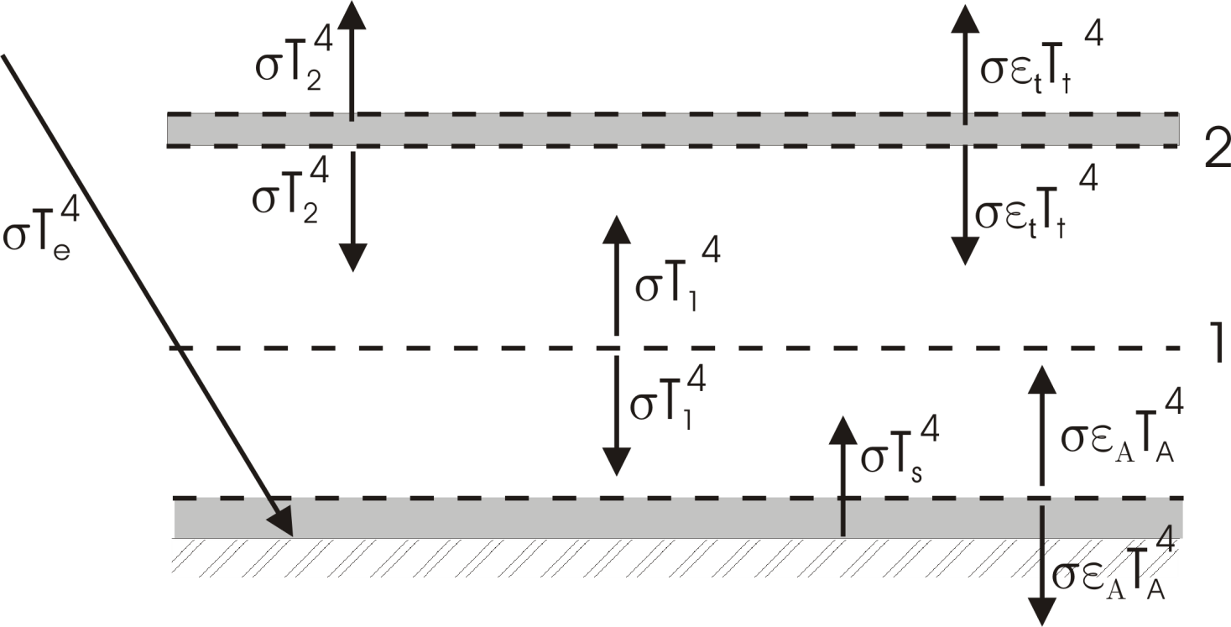
Effects of emissivity<1

Slide 23
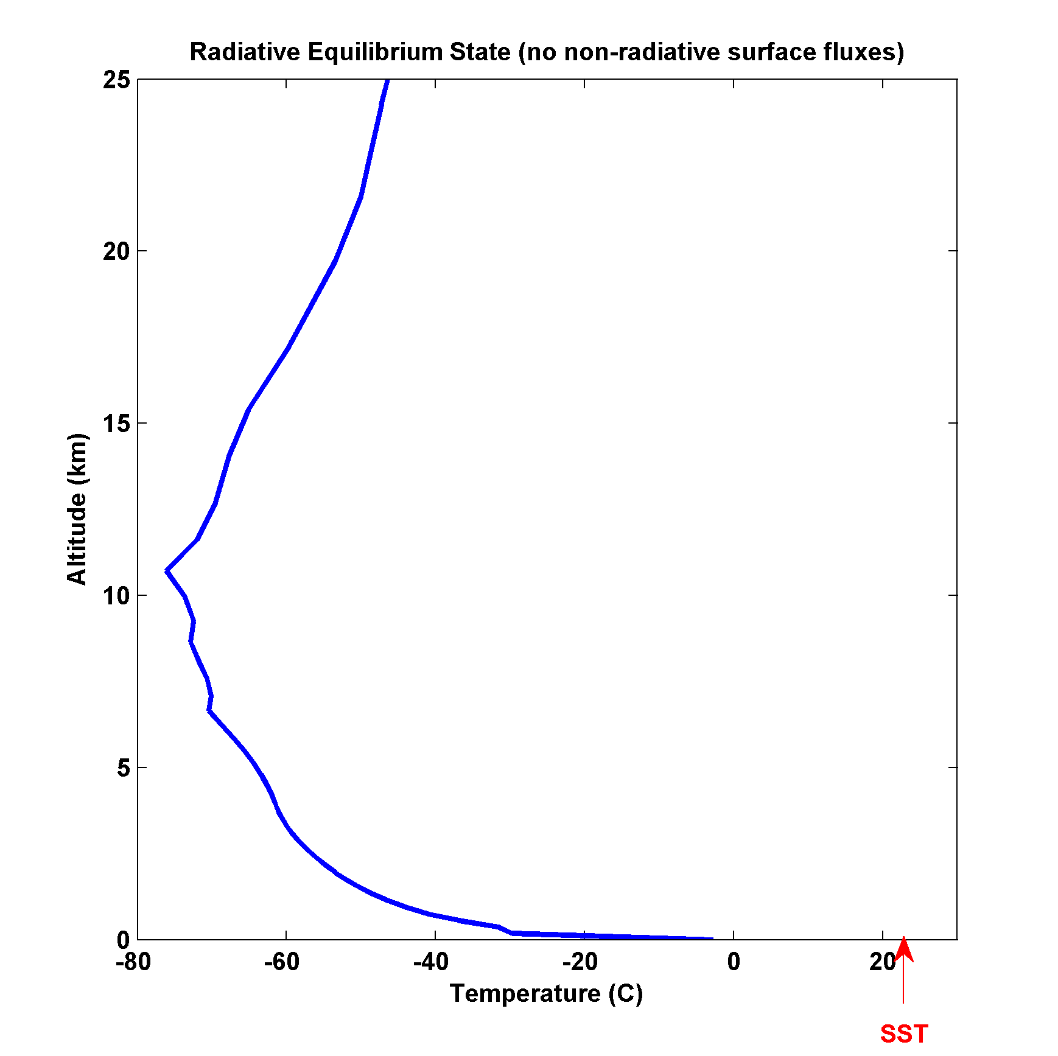
Full calculation of radiative equilibrium:
(no non-radiative fluxes, fixed relative humidity)

Slide 24
Missing ingredient: Convection
As important as radiation in transporting enthalpy in the vertical
Also controls distribution of water vapor and clouds, the two most important constituents in radiative transfer

Slide 25
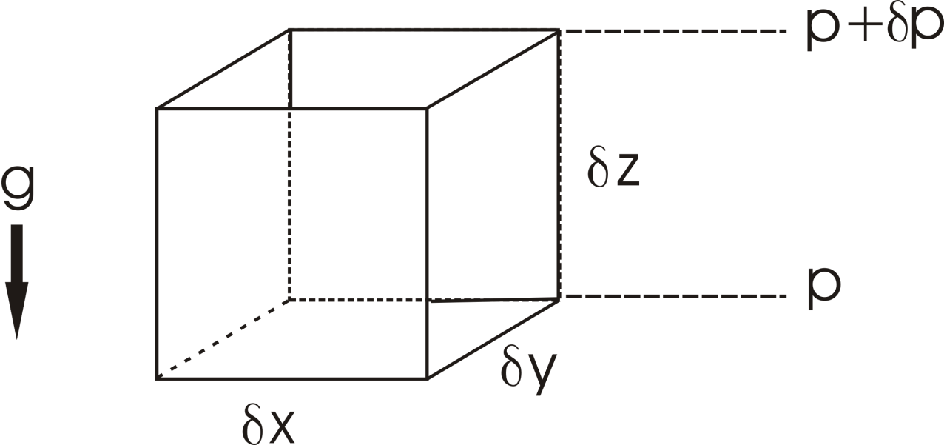
Hydrostatic equilibrium:

Slide 26
Pressure distribution in atmosphere at rest:
Earth: H~ 8 Km

Slide 27
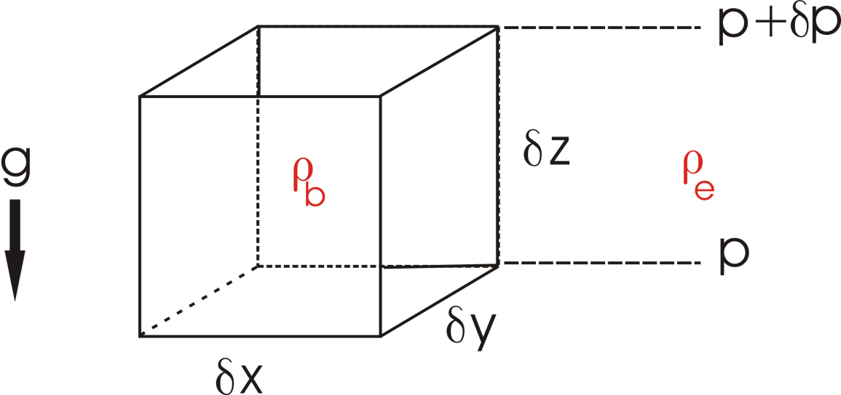
Buoyancy:

Slide 28
Buoyancy and Entropy
Specific Volume:
Specific Entropy: s

Slide 29
The adiabatic lapse rate:

Slide 30
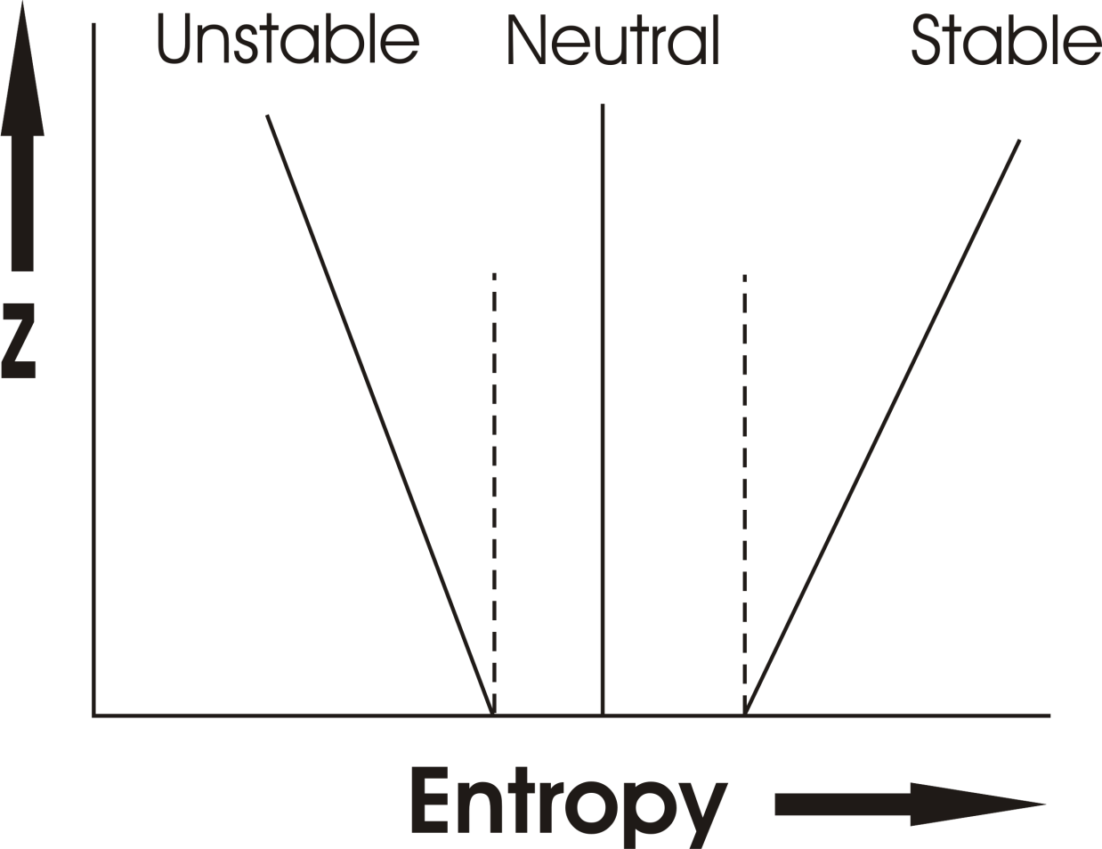
Earth’s atmosphere:

Slide 31
The Prandtl Problem
Prandtl L 1925 Z. Angew. Math. Mech. 5 136

Slide 33
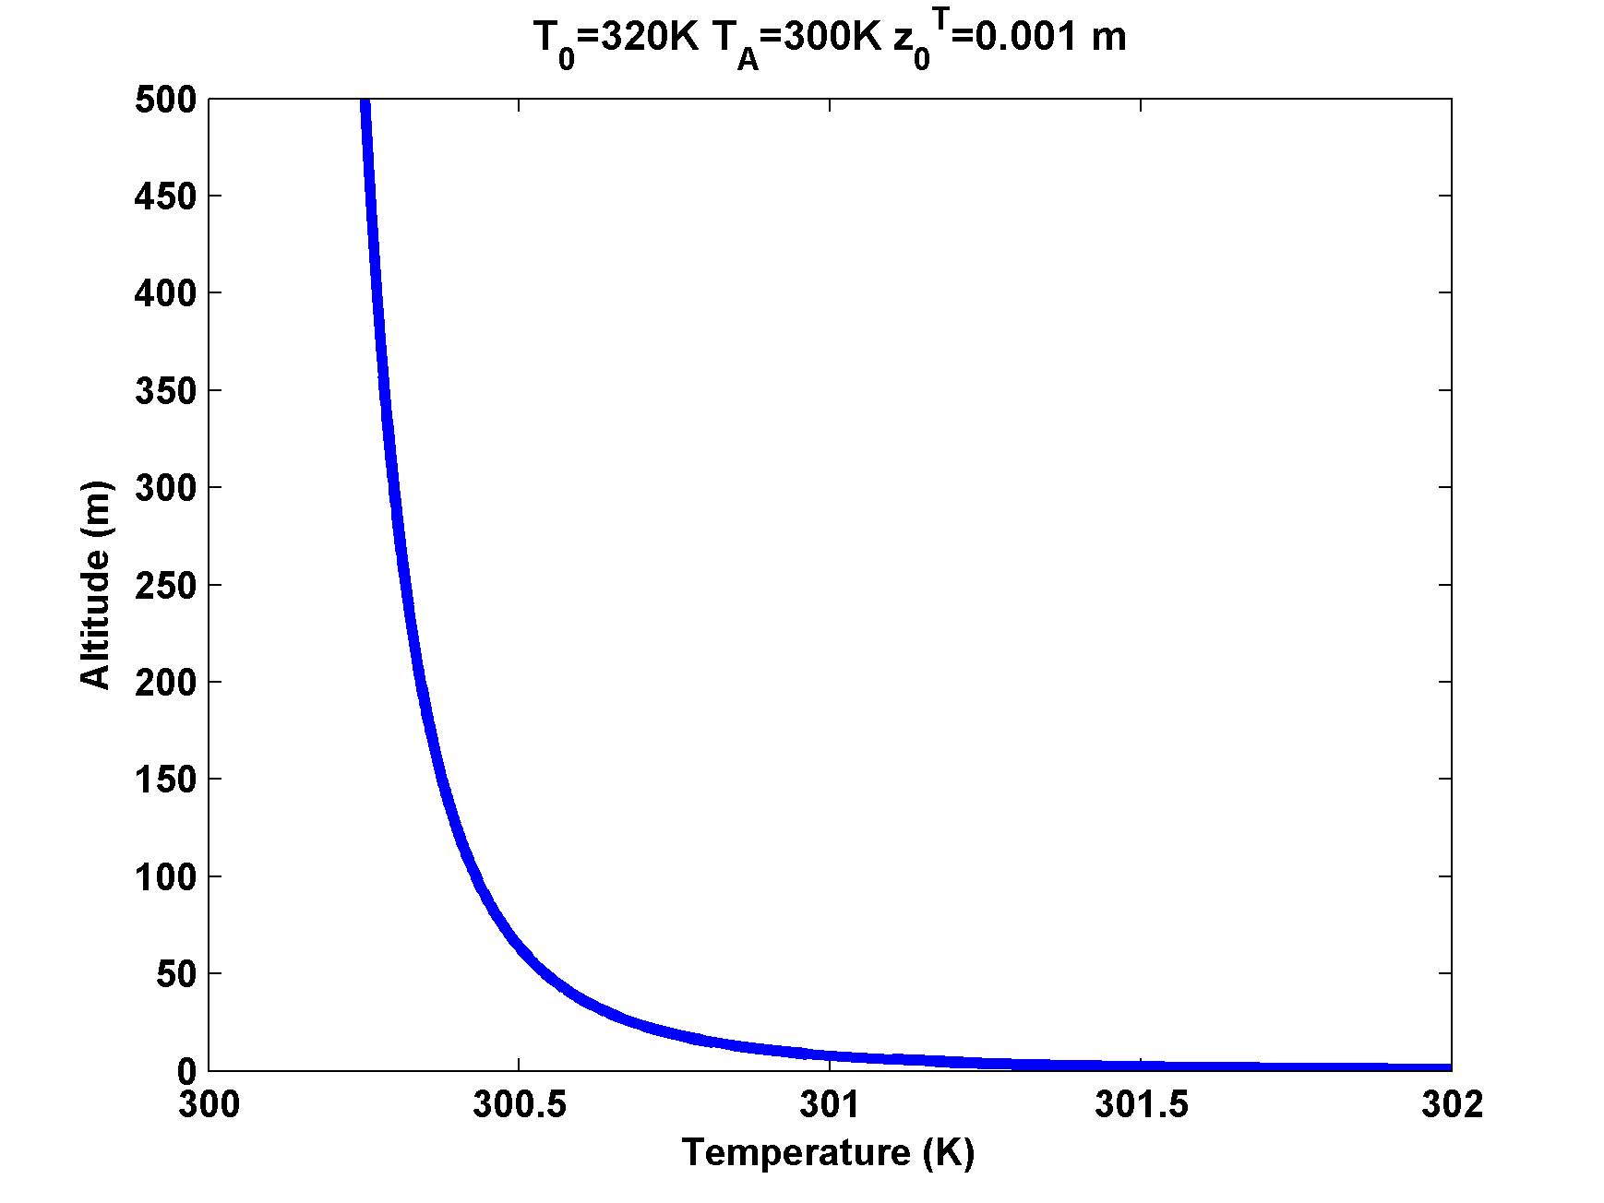

Slide 34
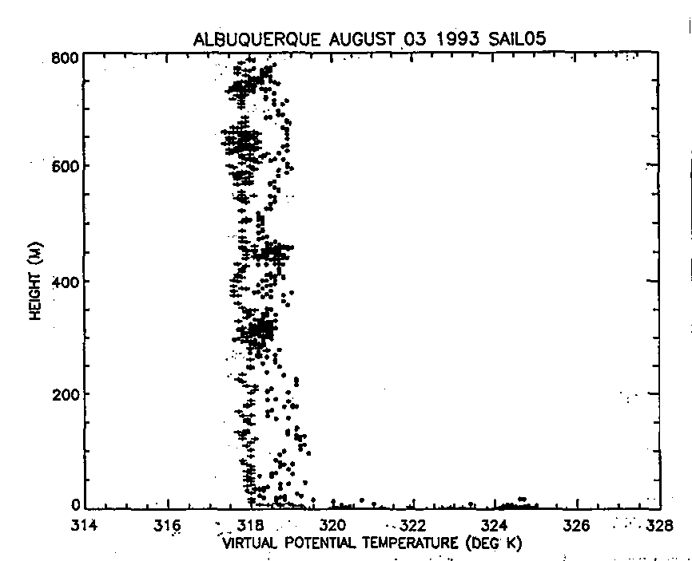
Model Aircraft Measurements
(Renno and Williams, 1995)

Slide 35
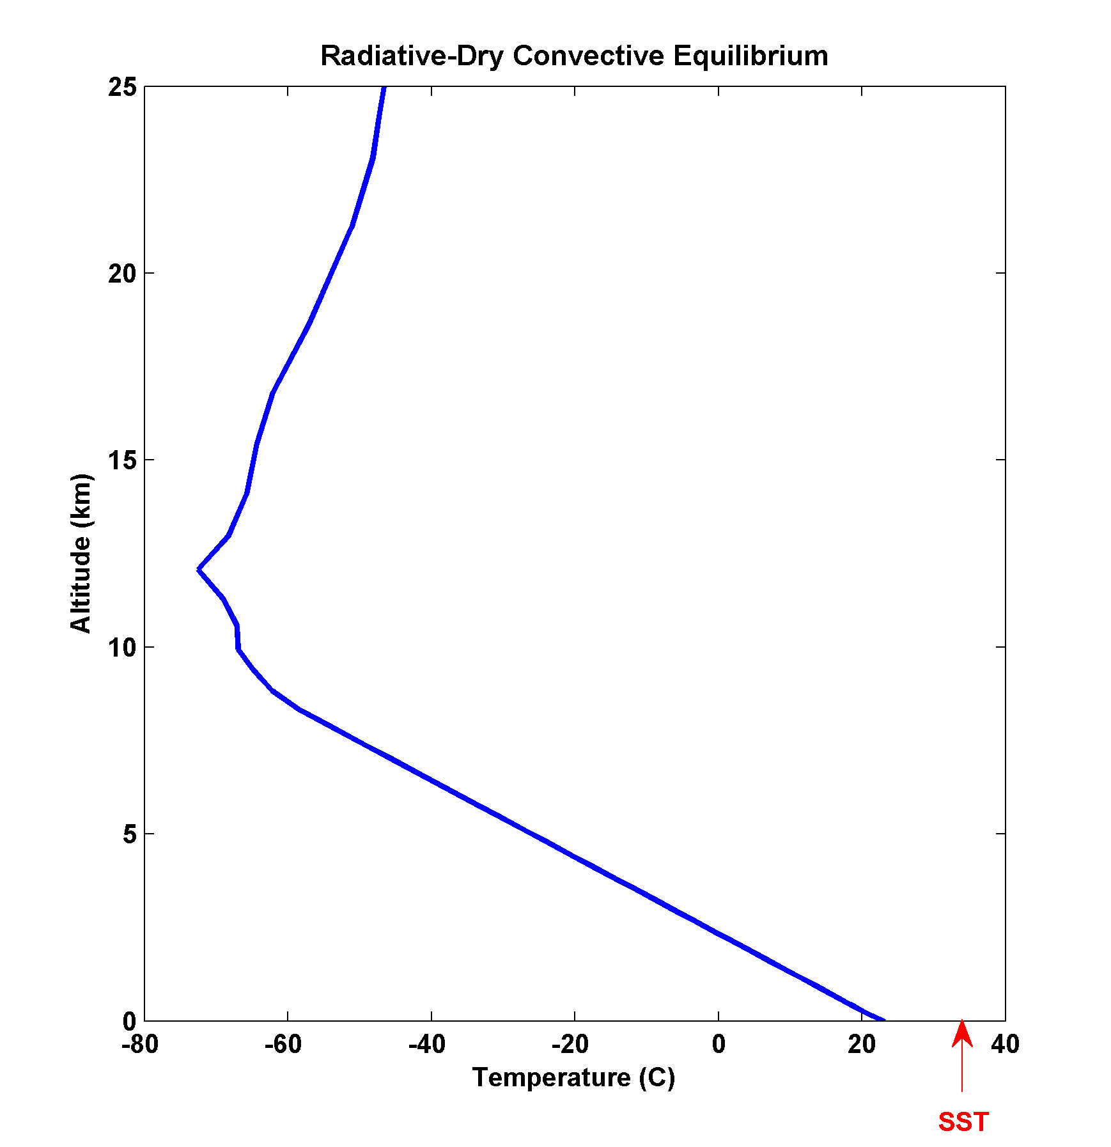
Full calculation of radiative-dry convective equilibrium
(Surface dry turbulent enthalpy flux, fixed relative humidity)

Slide 36
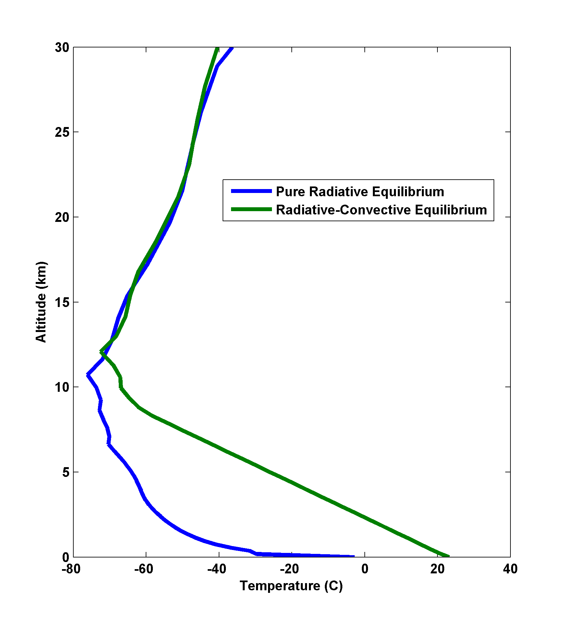

Slide 37
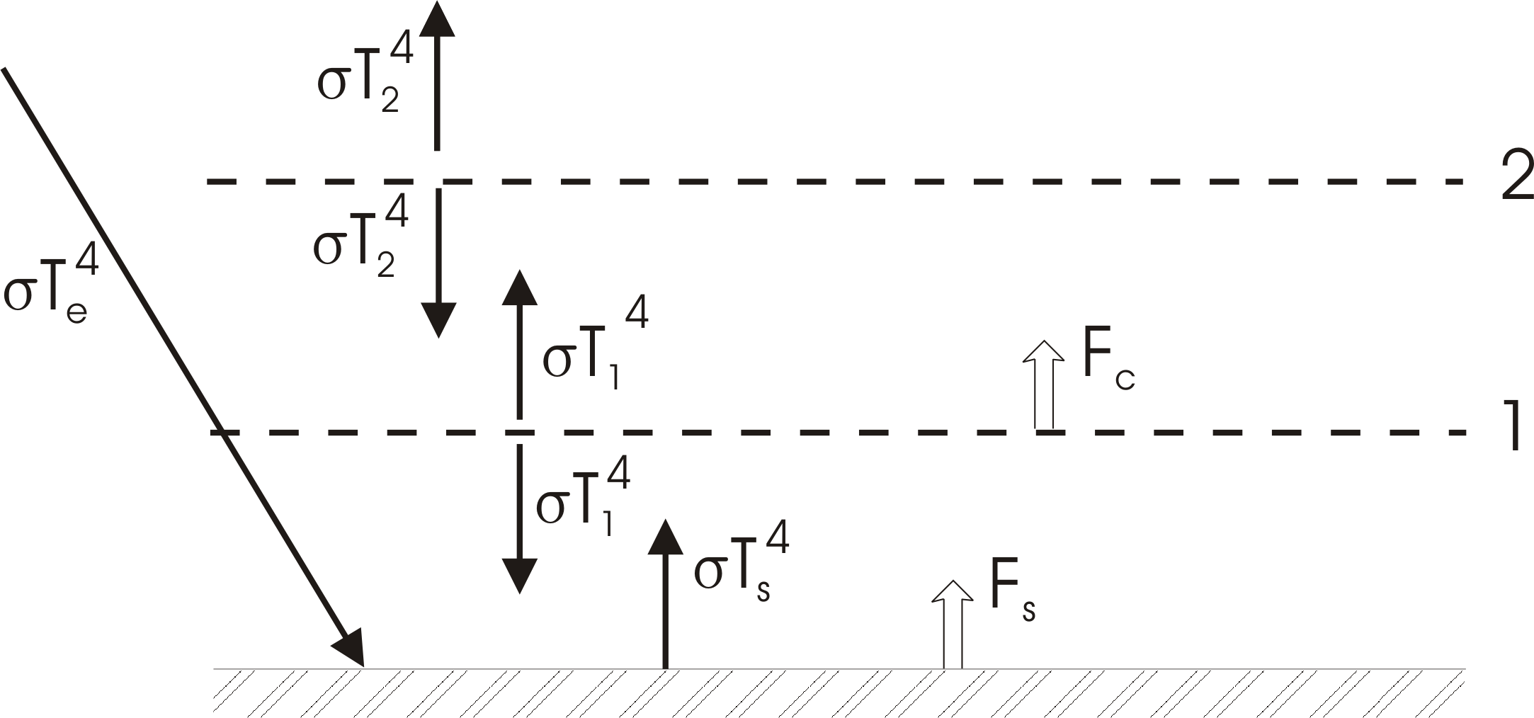
Simple Radiative-Convective Model
Enforce convective neutrality:

Slide 38
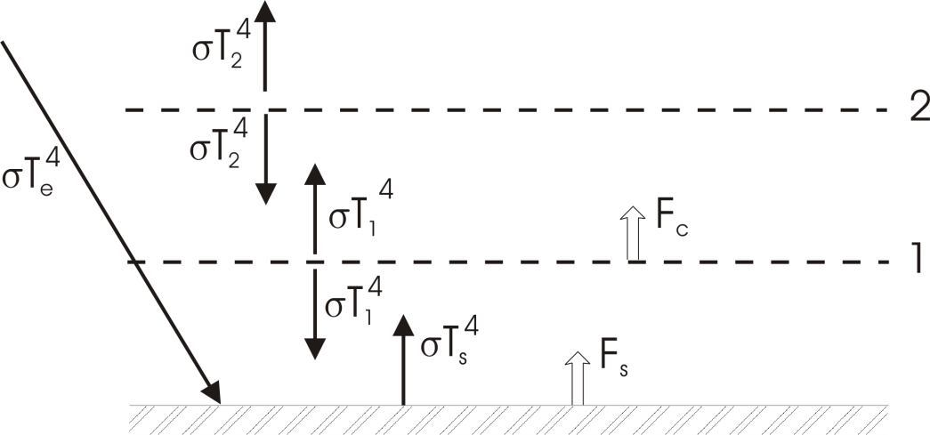

Slide 39
Moist Convection
Significant heating owing to phase changes of water
Redistribution of water vapor – most important greenhouse gas
Significant contributor to stratiform cloudiness – albedo and longwave trapping

Slide 40
Water Variables
Mass concentration of water vapor (specific humidity):
Vapor pressure (partial pressure of water vapor): e
Saturation vapor pressure: e*
C-C:
Relative Humidity:

Slide 41
The Saturation Specific Humidity
Ideal Gas Law:

Slide 42
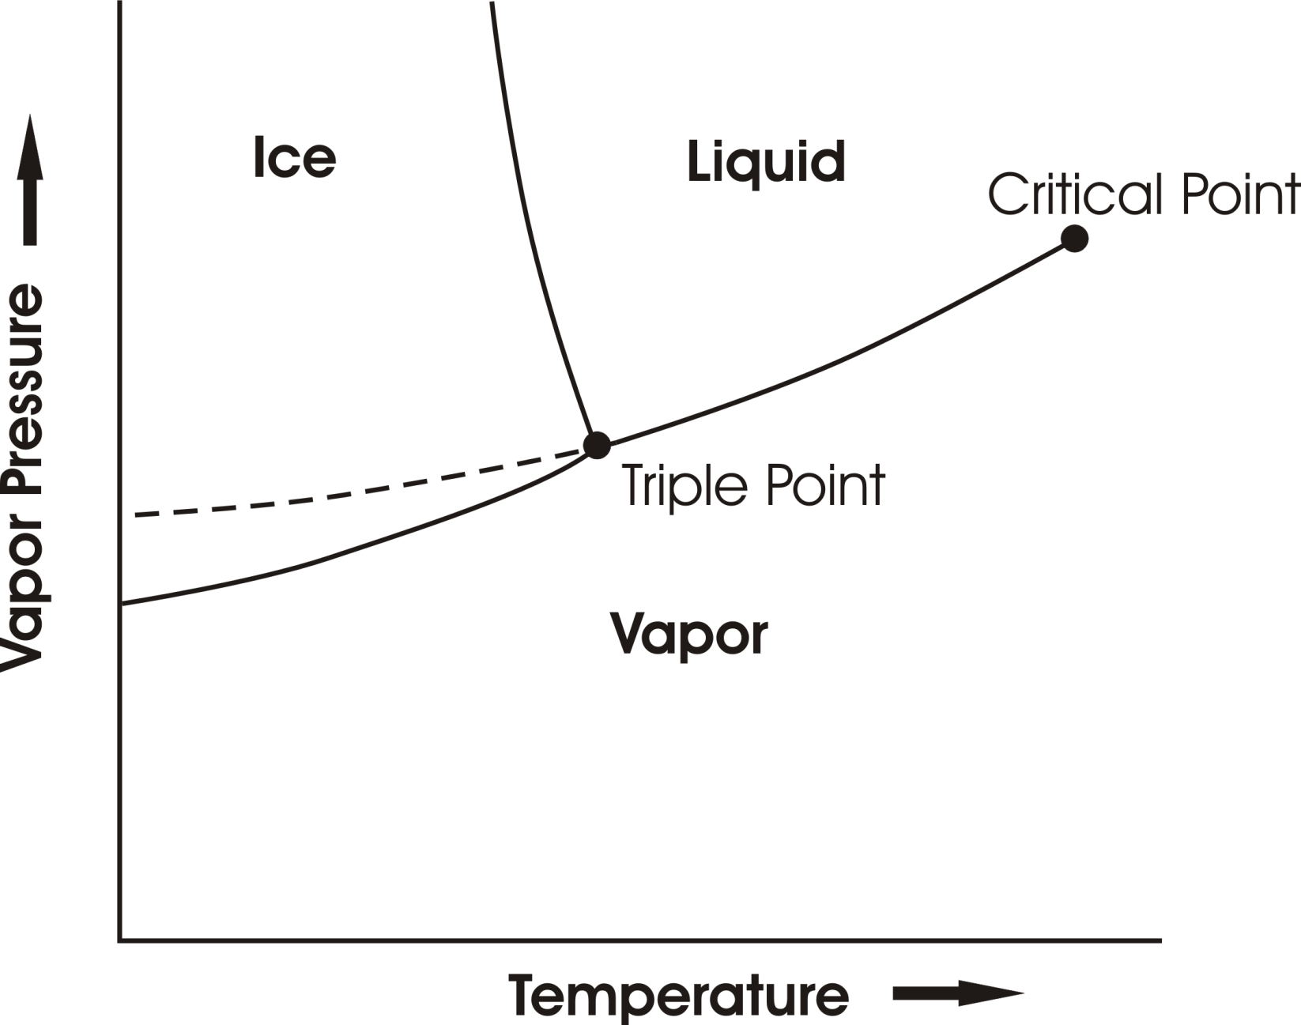
Phase Equilibria

Slide 43
Bringing Air to Saturation
Increase q (or p)
2. Decrease e* (T)

Slide 44
When Saturation Occurs…
Heterogeneous Nucleation
Supersaturations very small in atmosphere
Drop size distribution sensitive to size distribution of cloud condensation nuclei

Slide 45
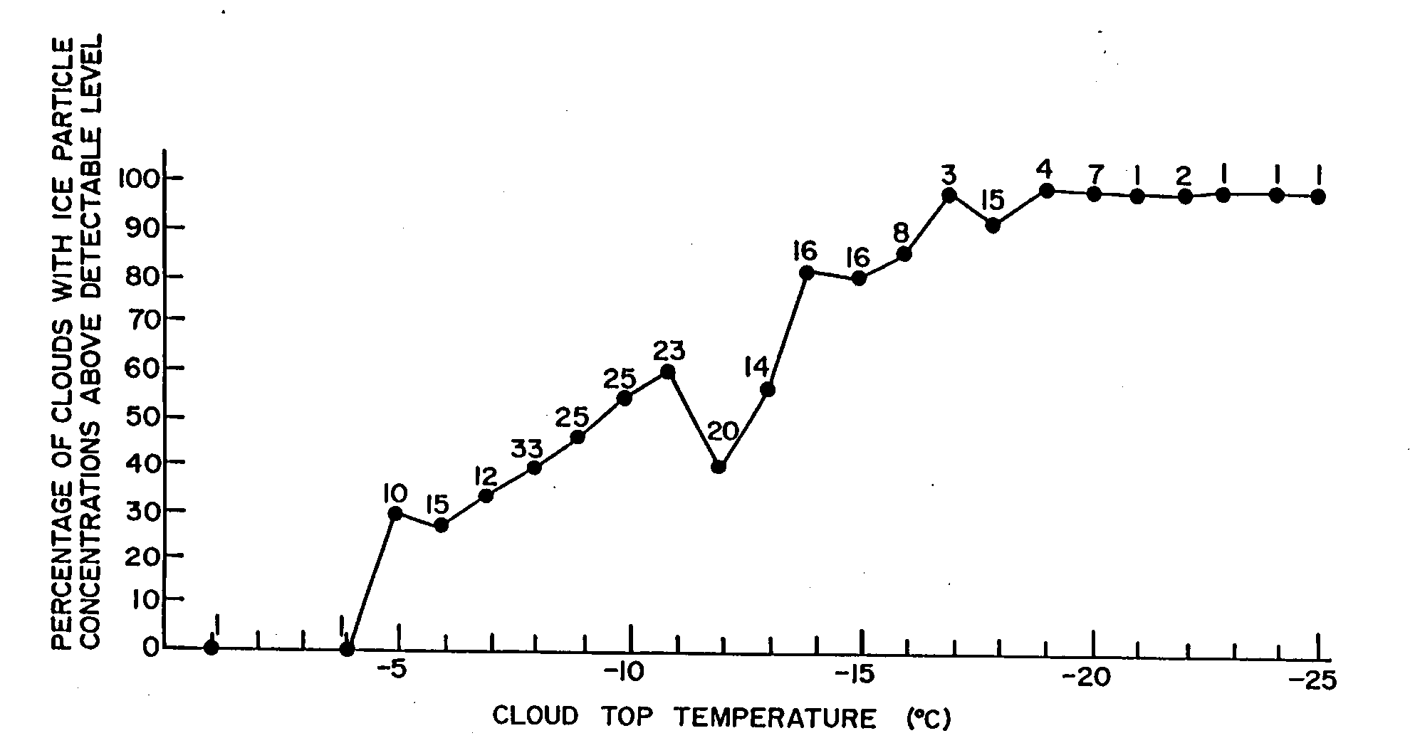
Ice Nucleation Problematic

Slide 46
Precipitation Formation:
Stochastic coalescence (sensitive to drop size distributions)
Bergeron-Findeisen Process
Strongly nonlinear function of cloud water concentration
Time scale of precipitation formation ~10-30 minutes

Slide 47
Stability
No simple criterion based on entropy:

Slide 48
Trick:
Define a saturation entropy, s* :
We can add an arbitrary function of q_{t} to s* such that

Slide 49
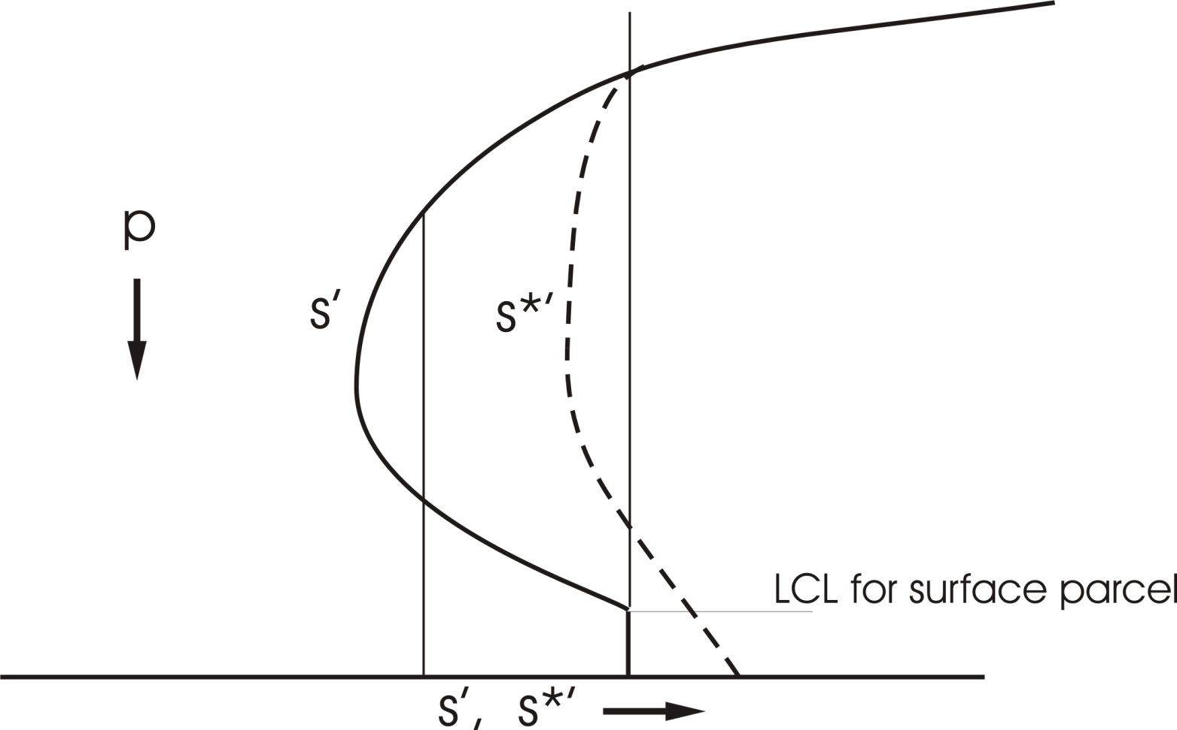
Conserved, but not a state variable
State variable, but not conserved

Slide 50
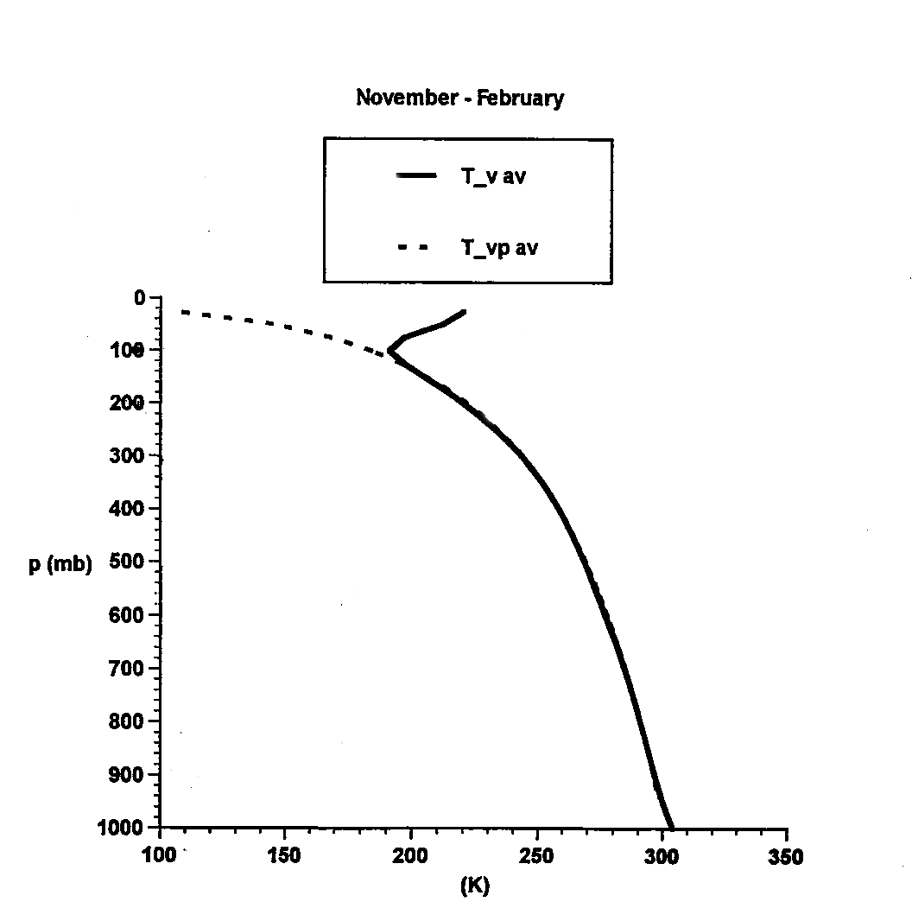
Tropical Soundings

Slide 51
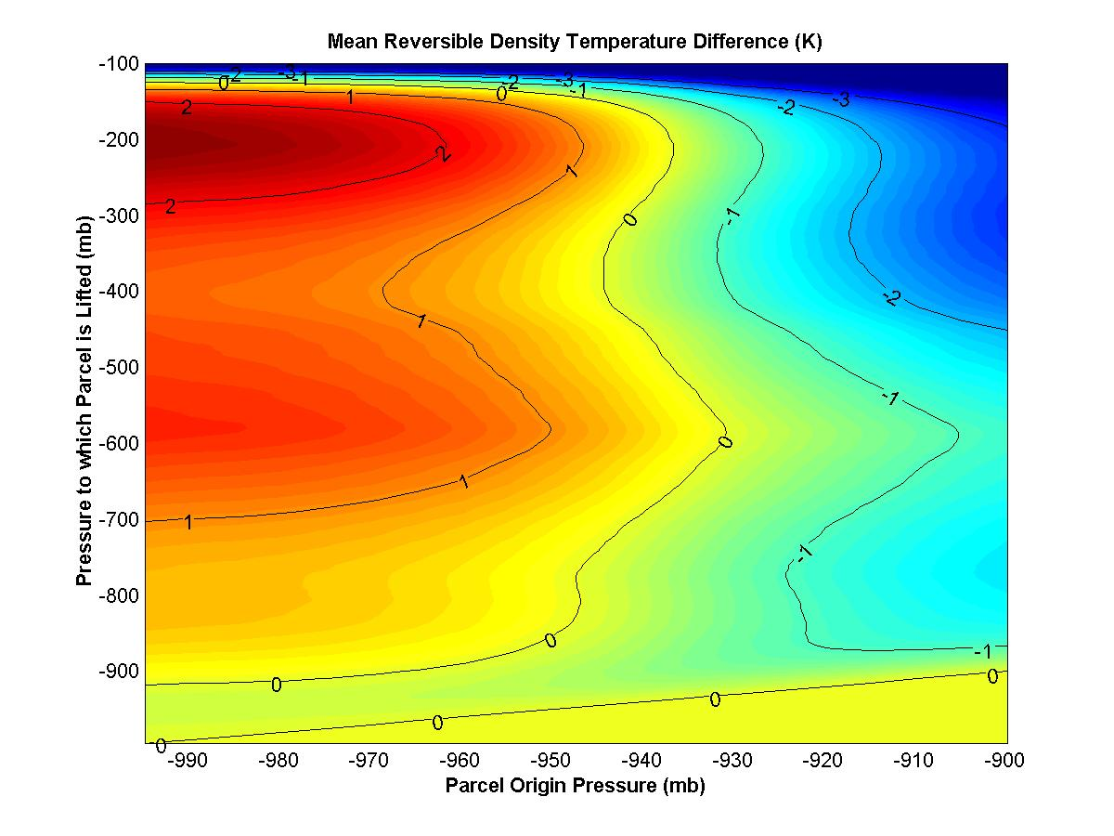
Other Stability Diagrams:

Slide 52
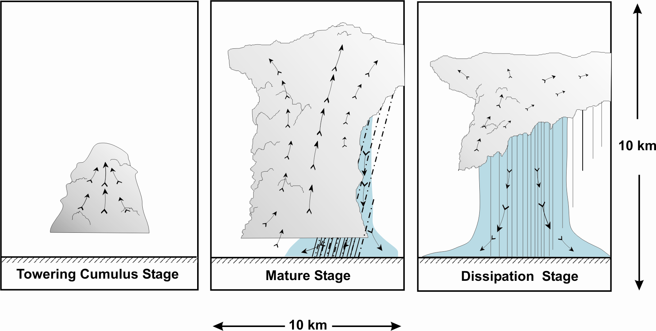
“Air-Mass” Showers:

Slide 53
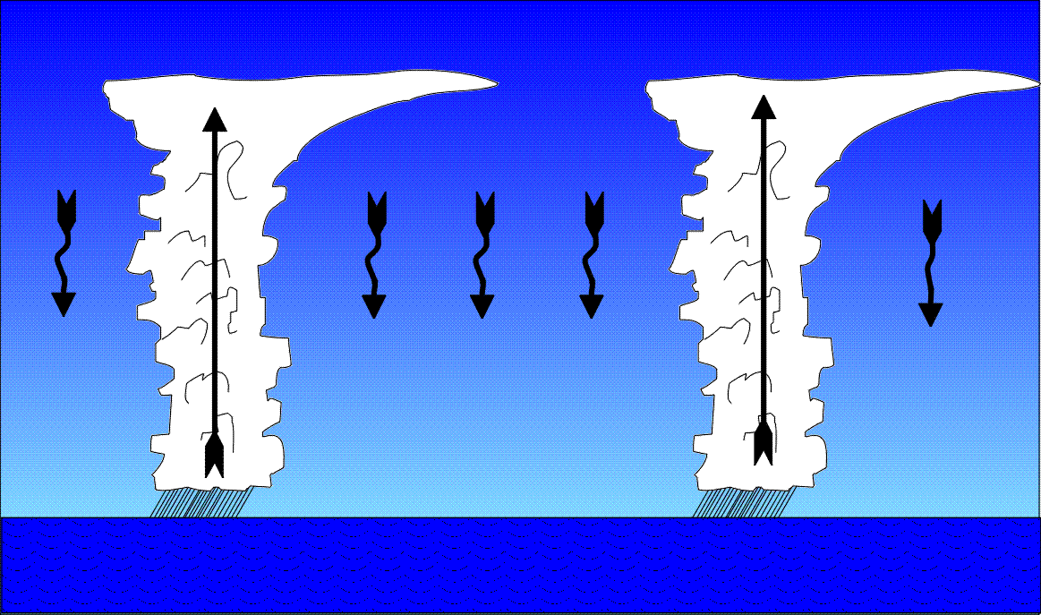
Precipitating Convection favors Widely Spaced Clouds (Bjerknes,1938)

Slide 54
Properties:
Convective updrafts widely spaced
Surface enthalpy flux equal to vertically integrated radiative cooling
Precipitation = Evaporation = Radiative Cooling
Radiation and convection highly interactive

Slide 55
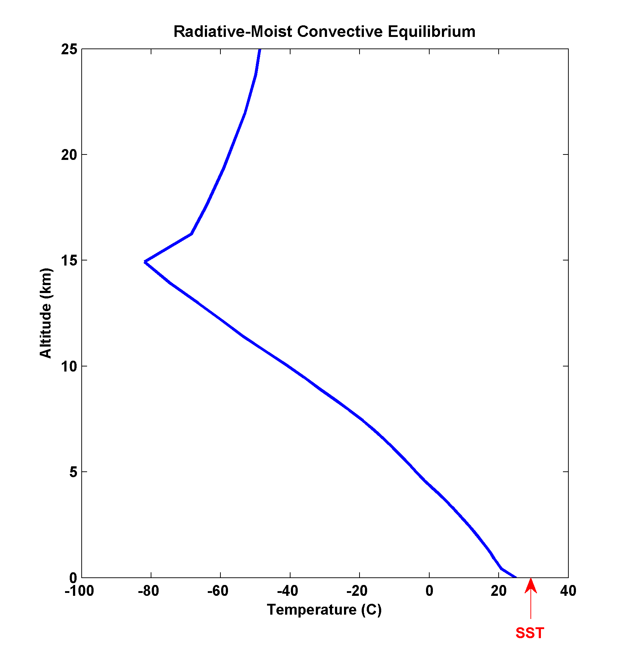

Slide 56
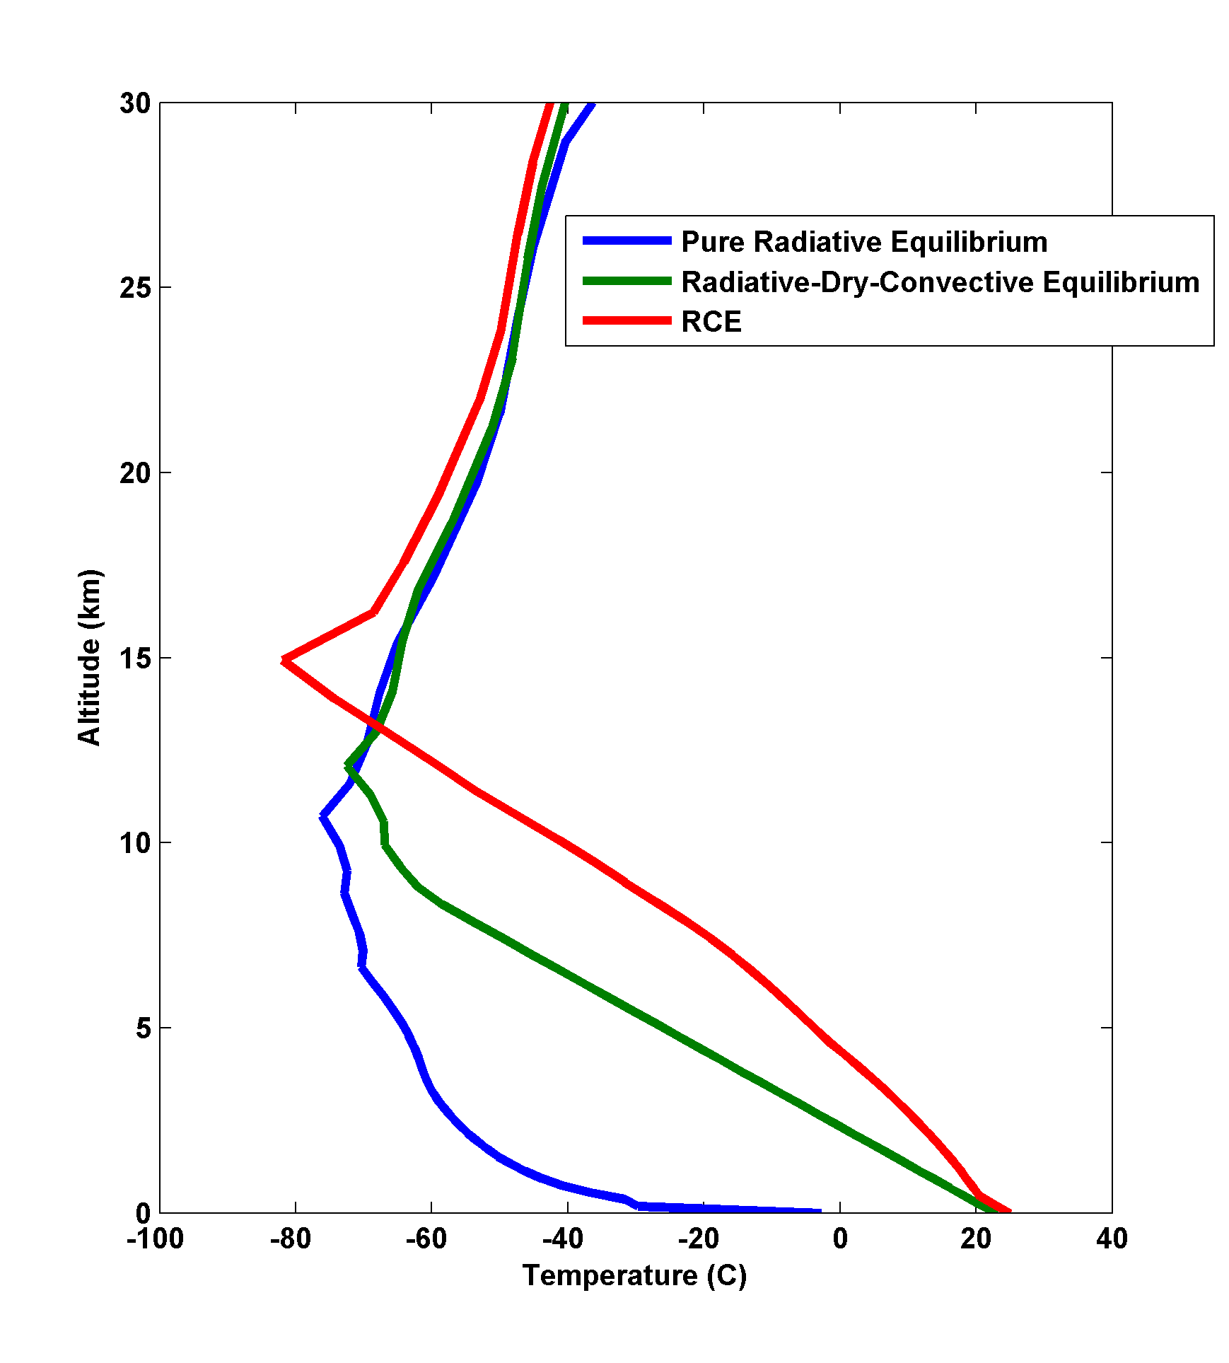

Slide 57
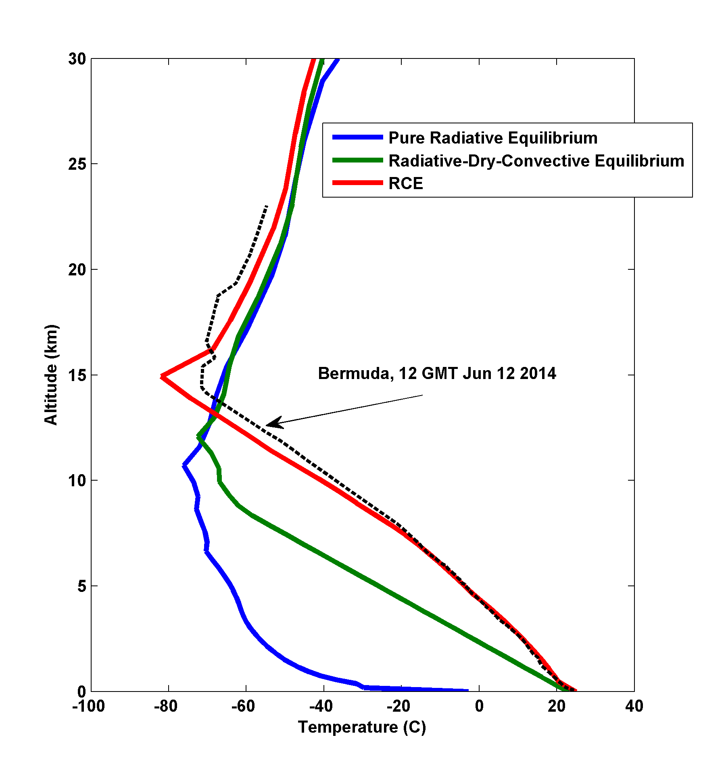

Slide 58
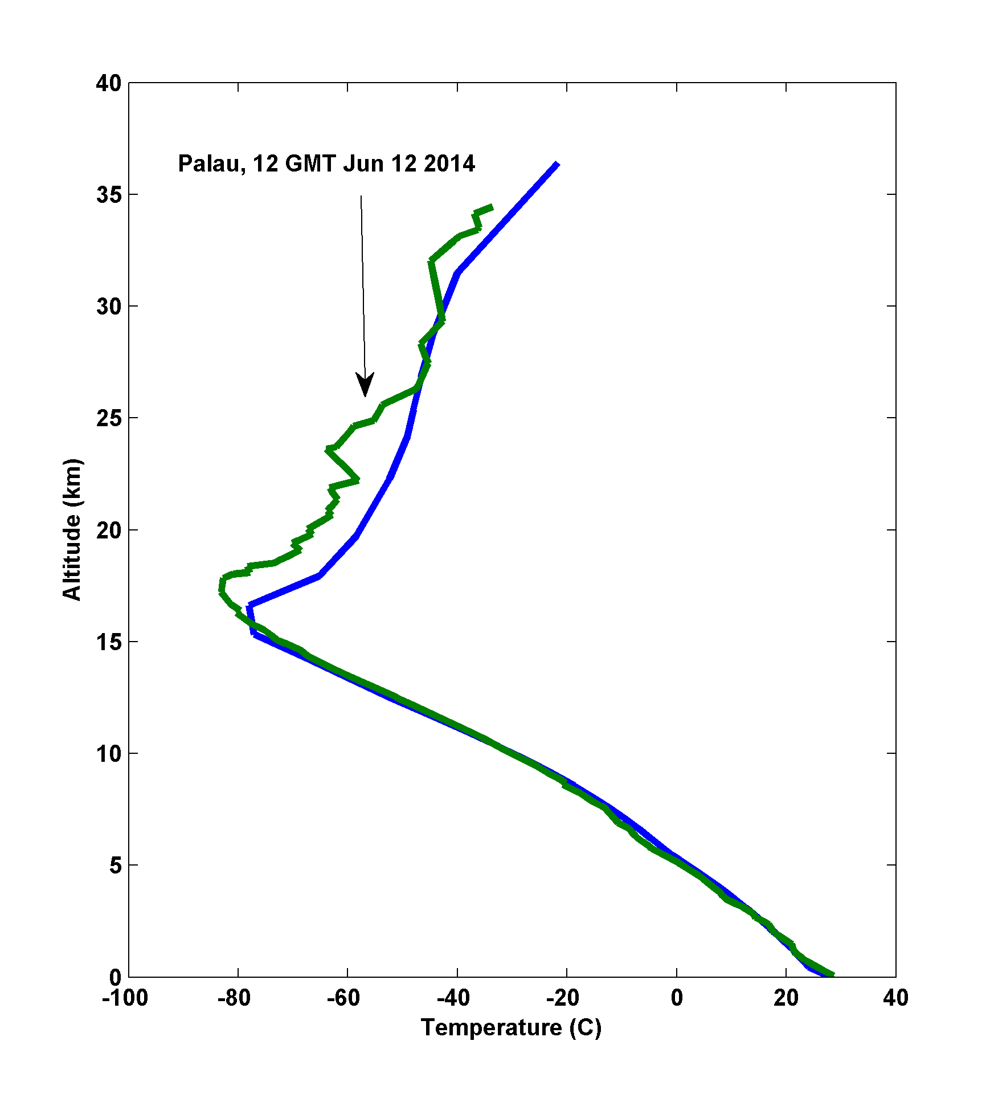

Slide 59
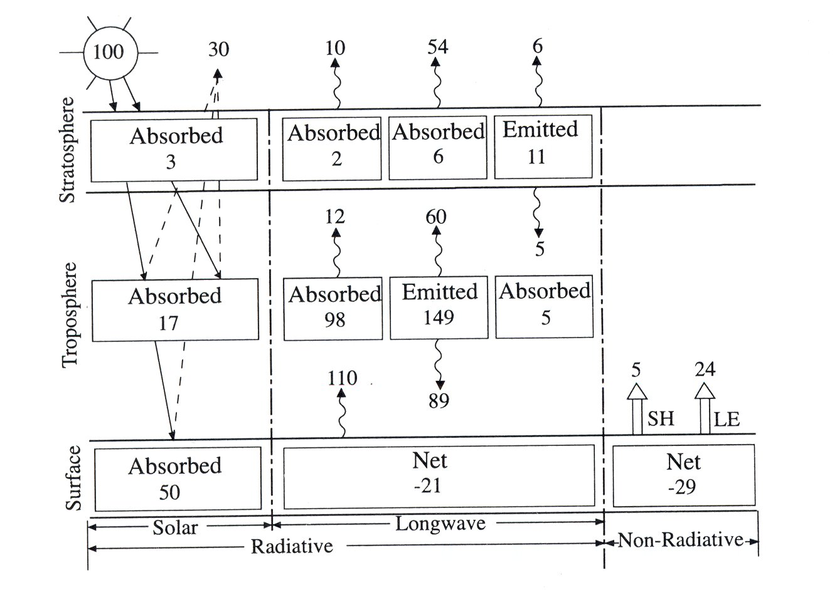
Energy Balance

Slide 60
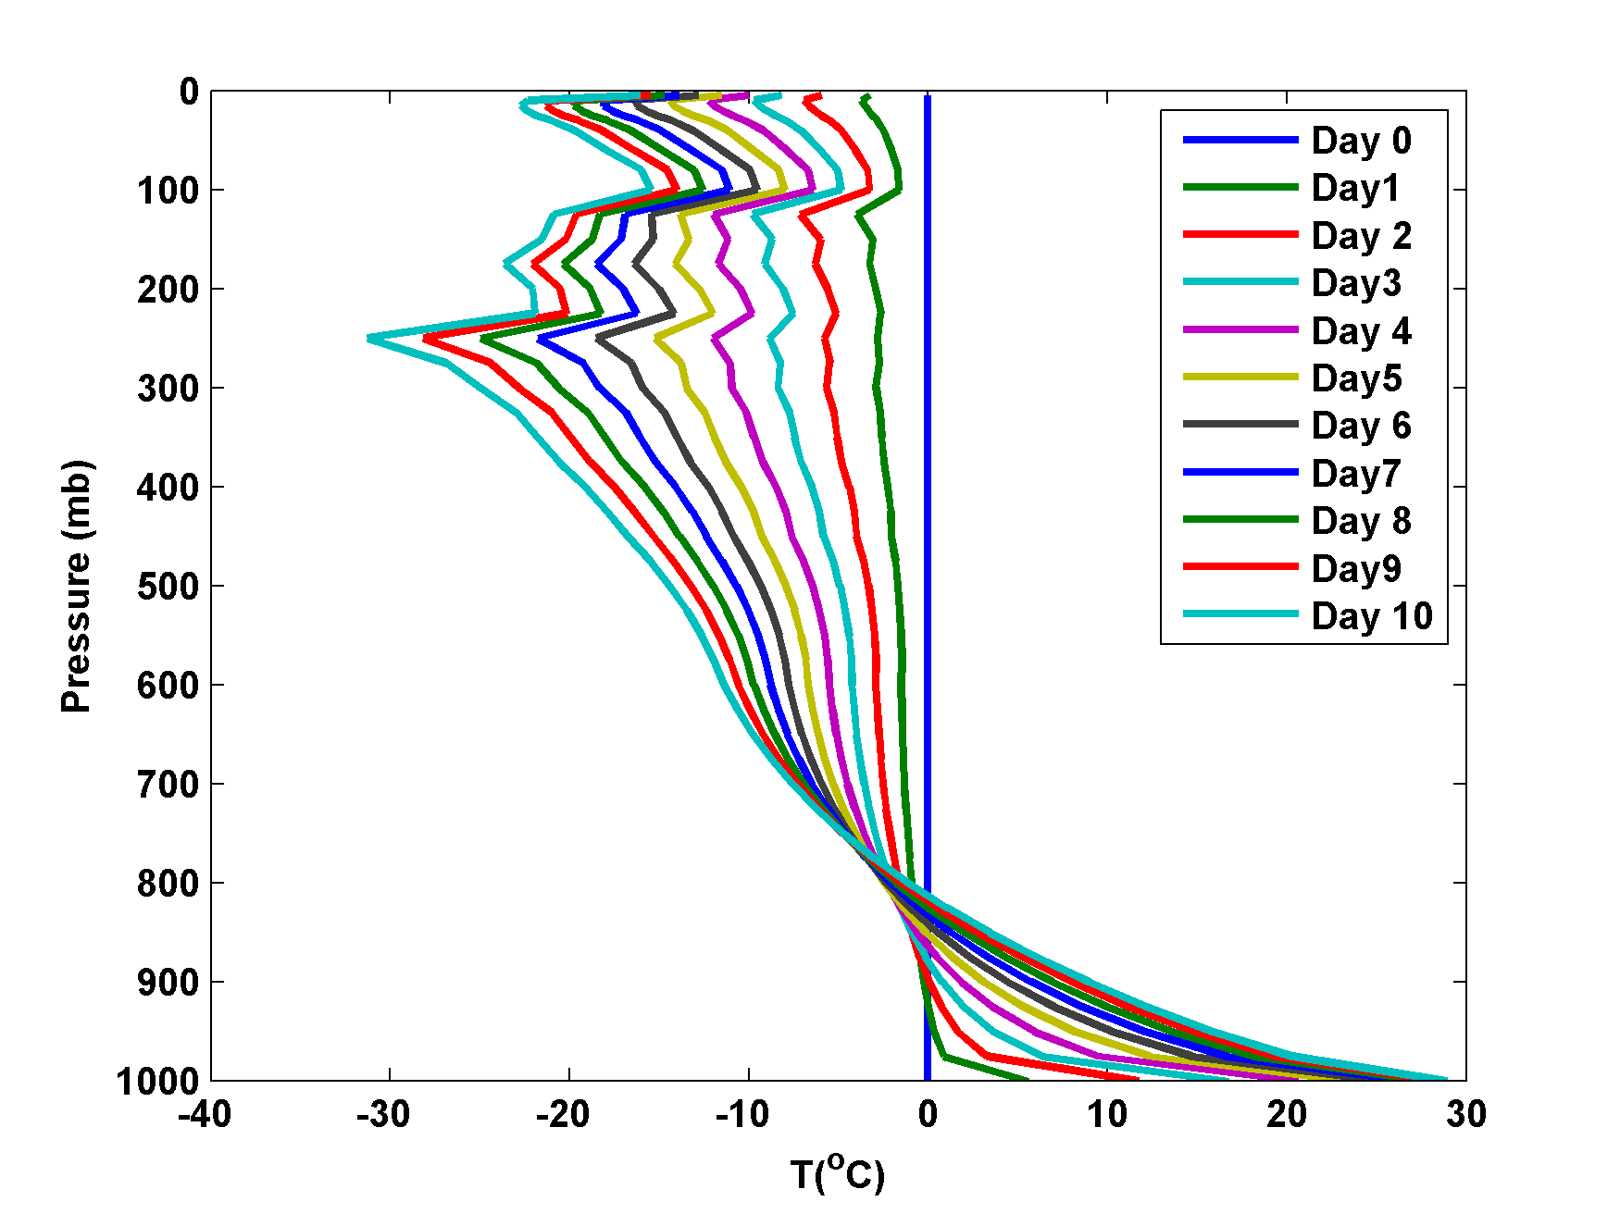
Time scale of approach to equilibrium

Slide 61
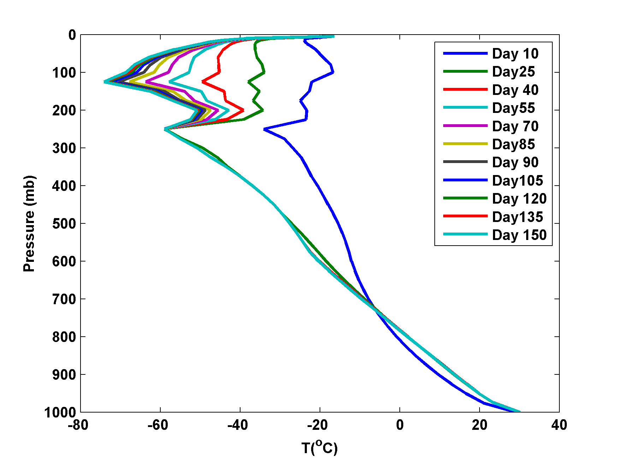

Slide 62
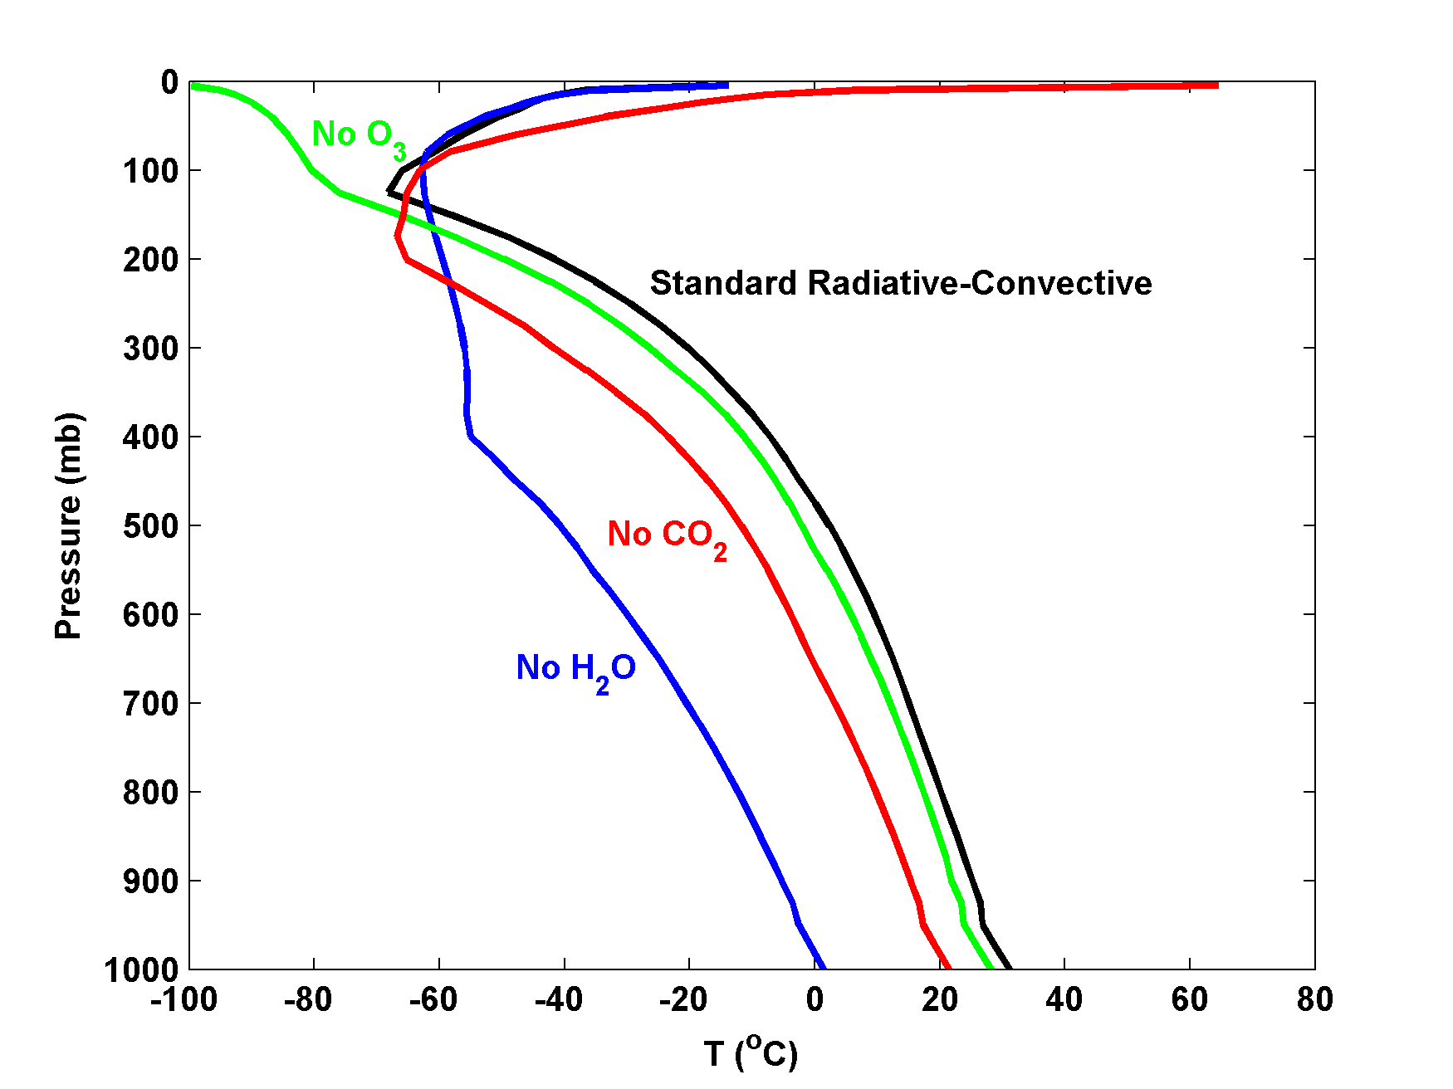
Contributions of various absorbers
Note: All simulations have variable clouds interacting with radiation

Slide 63
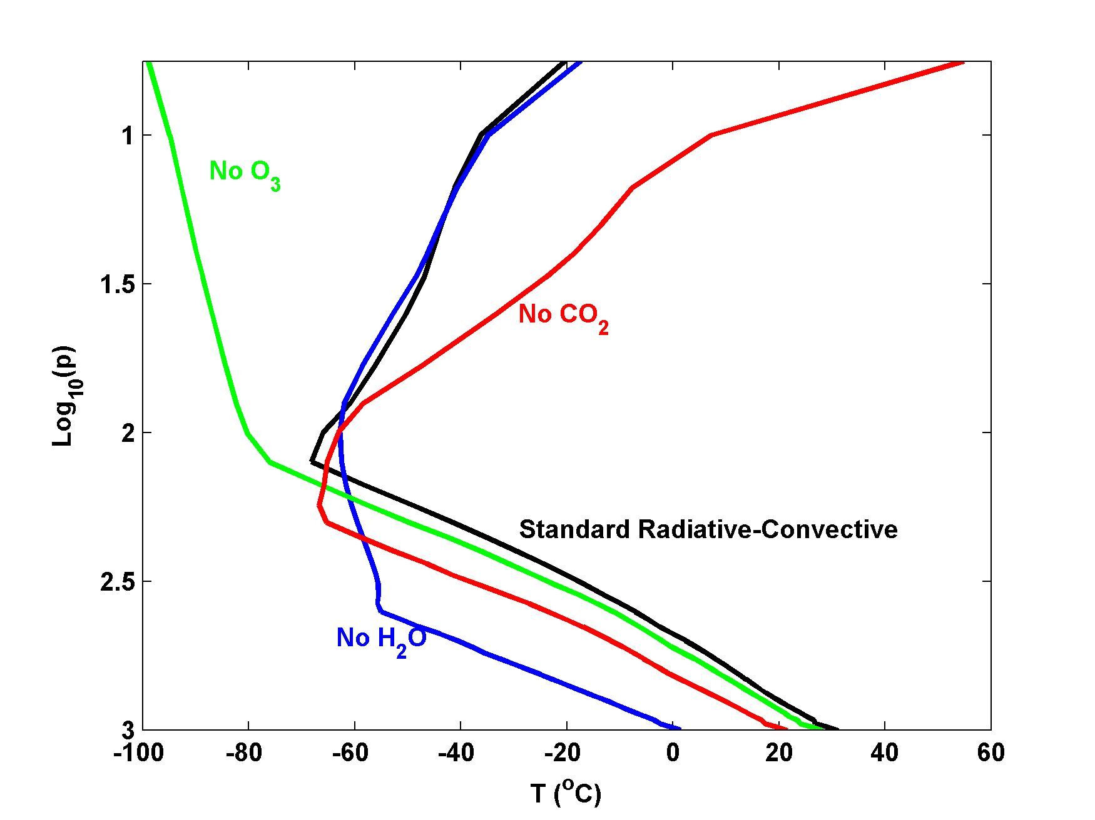

Slide 64
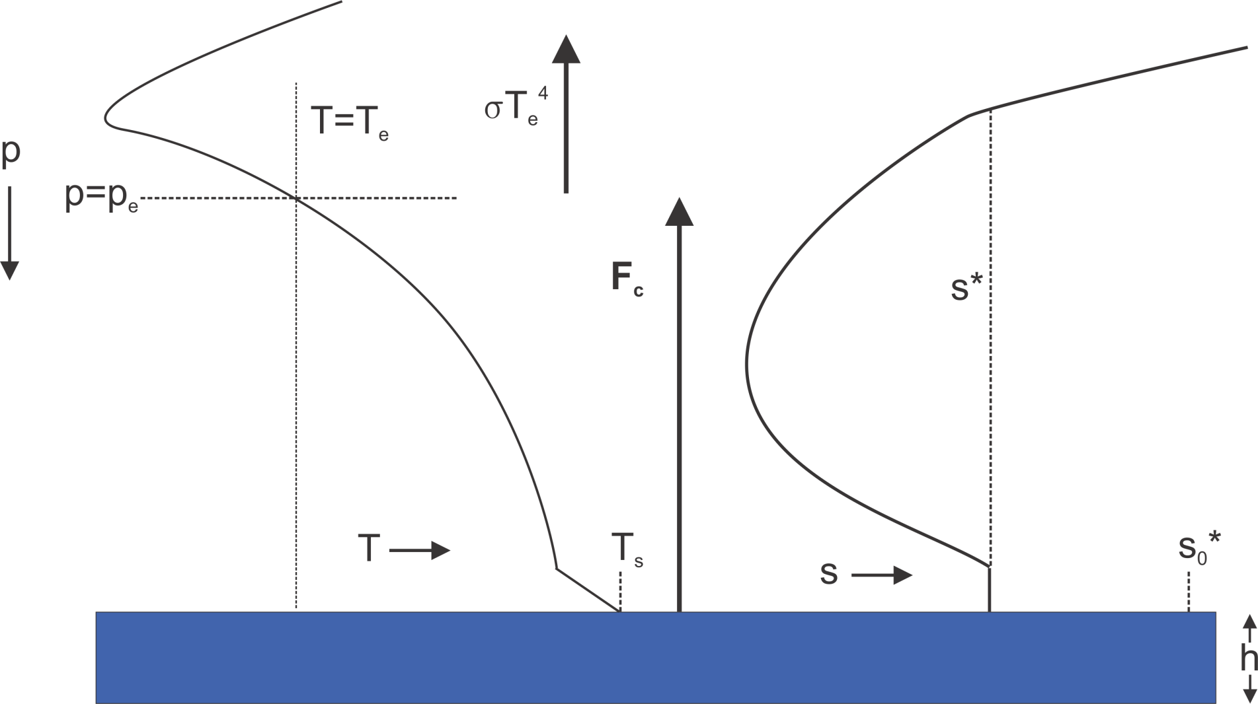
Simple Radiative-Convective Model
Effective emissions from level p_{e}; no net IR flux at surface
p_{e} affected by T_{e}, greenhouse gases, clouds

Slide 65
Steady State Balance
Control variables: T_{e}, p_{e}, |V_{s}|

Slide 66
Relaxation Time Scales
Perturb temperatures holding T_{e}, p_{e} and |V_{s}| constant
B is defined as the climate sensitivity,

Slide 67
Non-dimensional Form
Then
Notes:
Note to myself: I get better fit if I include radiative relaxation of ocean and atmosphere toward each other (i.e. perturbation radiative fluxes at the bottom of the atmosphere). See spare slide at end of this file.

Slide 68
Special Cases
Fixed Ocean: T_{s}’=0:
Fixed Atmosphere: T_{A}’=0:

Slide 69
General Solution
Longer than either fixed ocean or fixed atmosphere time scales!

Slide 70
Estimate B as a function of T_{s} from Single-Column Model
Theory
Single-column Model
Relaxation time (days)
Notes:
Note to myself: Solution at left using the full form as given in last slide in this file.

Slide 71
Weak Temperature Gradient Approximation
Sobel, A. H., and C. S. Bretherton, 2000: Modeling tropical precipitation in a single column. J. Climate, 13, 4378–4392.
Assume that (virtual) temperature above PBL is invariant
Calculate vertical motion to maintain constant (virtual) temperature
Use that vertical motion to advect water vapor

Slide 72
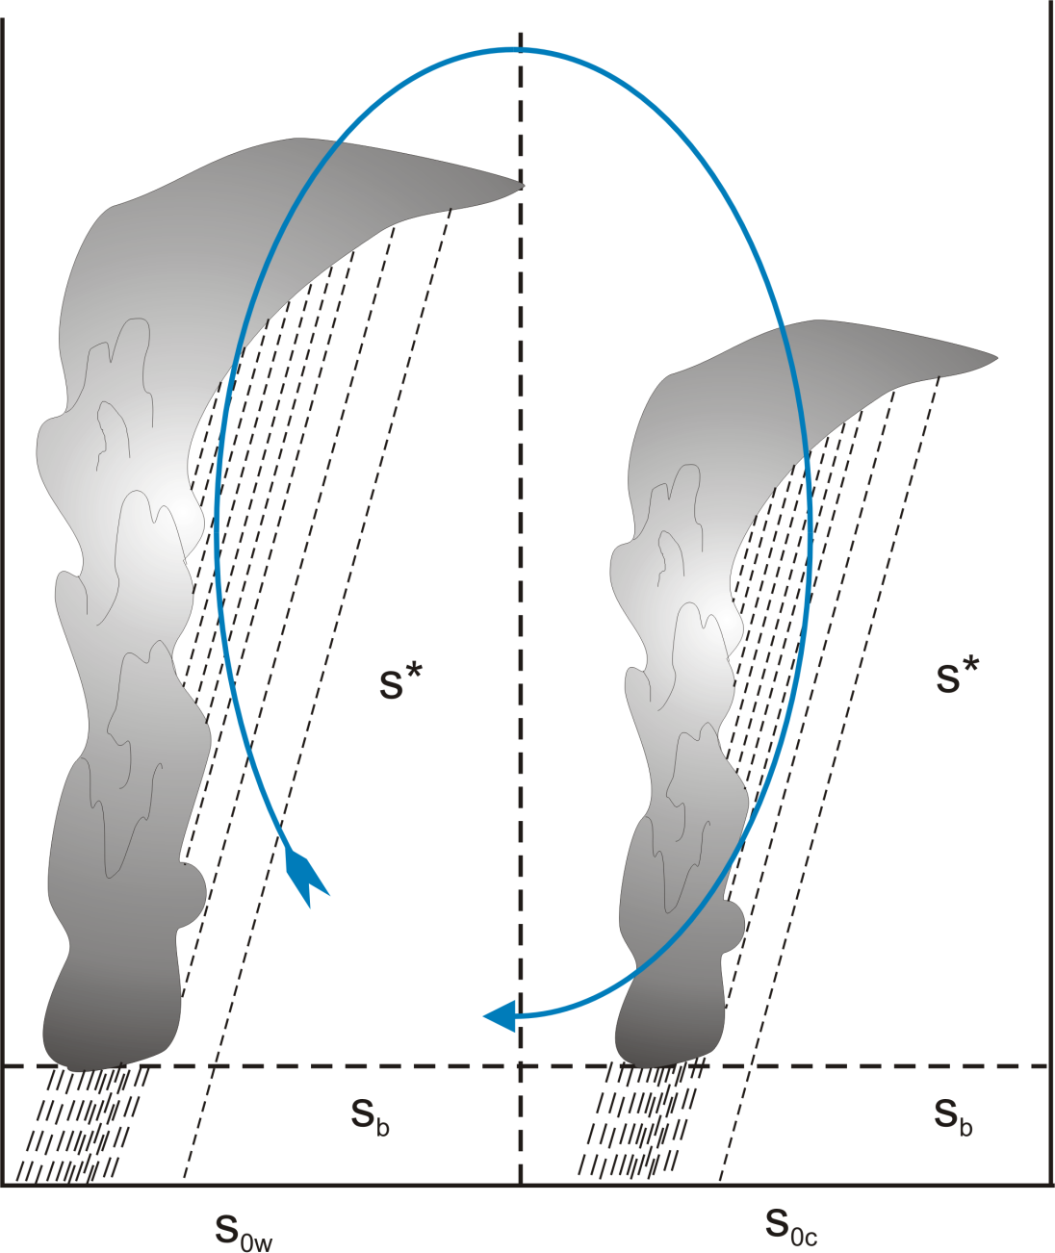
Two-Box Model:
Weak circulation: Deep convection in both boxes

Slide 73
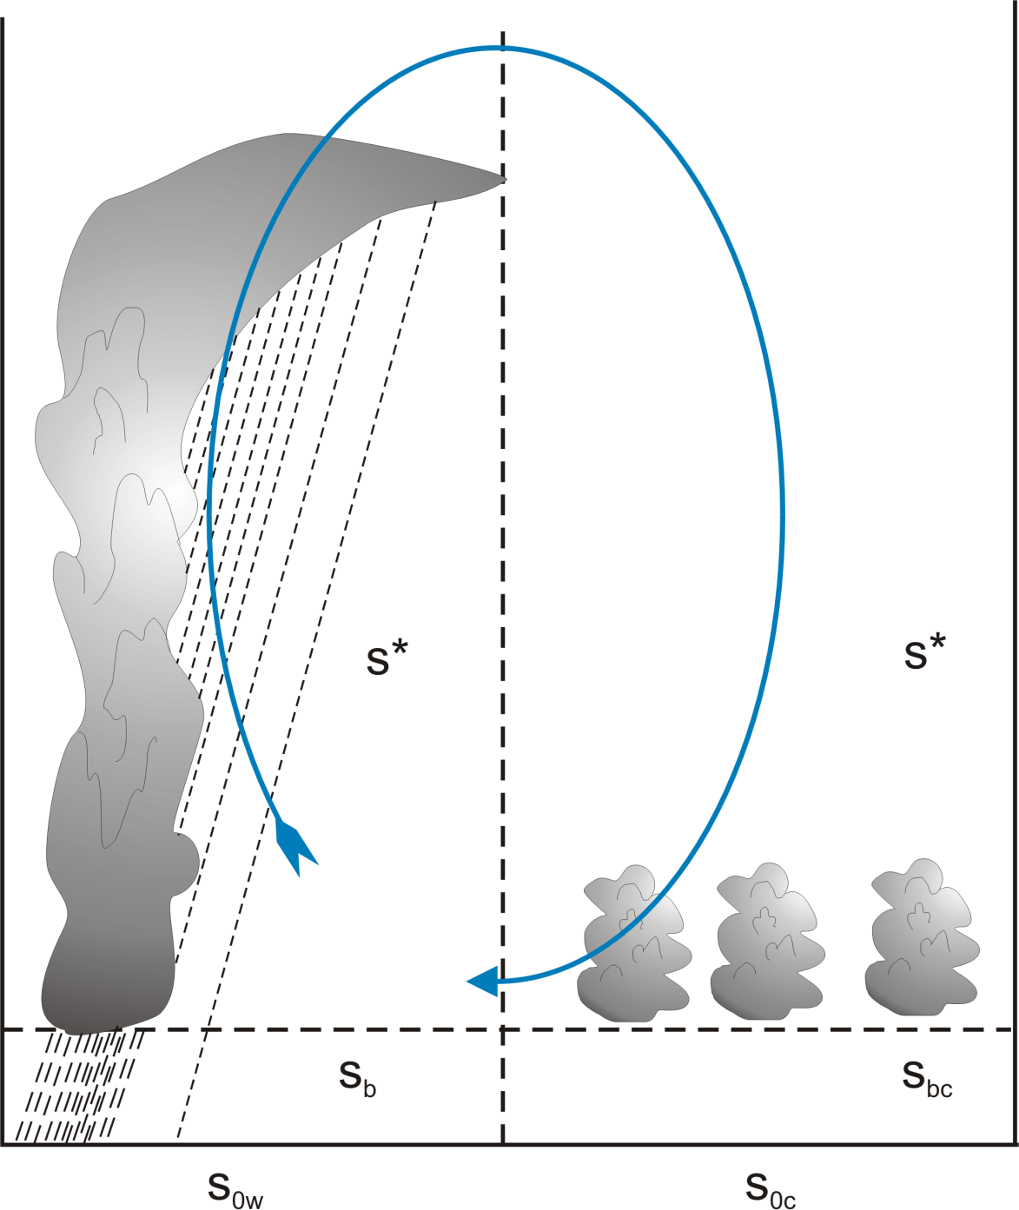
Strong circulation: Deep convection only in warm box

Slide 74
Explicit Simulation of Radiative-Convective Equilibrium
(Work of Allison Wing, and with much help from Marat Khairoutdinov)

Slide 75
Approach: Idealized modeling of convective organization in radiative-convective equilibrium using a cloud resolving model
System for Atmospheric Modeling (SAM) of Khairoutdinov and Randall (2003)
Constant solar insolation: 413.98 W/m²
Horizontal Resolution: 3km
Vertical Resolution: 64 levels
Periodic lateral boundaries
Initial sounding from domain average of smaller domain run in RCE
Fully interactive RRTM radiation and surface fluxes.
Rigid Lid
28 km
Fixed SST
297-312 K
768 km
768 km
Notes:
Three-dimensional cloud resolving model Anelastic equations of motion RRTM radiation scheme SAM 1-moment microphysics scheme
Prognostic thermodynamic variables:
Liquid water/ice moist static energy: h_{L} = c_{p}T + gz – L_{c}(q_{c}+q_{r})-L_{s}(q_{i}+q_{s}+q_{g})
Total nonprecipitating water
Total precipitating water

Slide 76
Evolution of Vertically Integrated Water Vapor
Notes:
Day 1 is pretty homogeneous. By day 10 small area has become drier.

Slide 77
Evolution of Vertically Integrated Water Vapor
Notes:
Over next 20 days, small dry patch amplfies and expands. By day 30 covers nearly a quarter of the domain.

Slide 78
Evolution of Vertically Integrated Water Vapor
Notes:
Process continues and by day 50 areas of the domain not in dry patch have become moister than they were initially.

Slide 79
Evolution of Vertically Integrated Water Vapor
Notes:
Now the expanding dry region has confined all the moist area (which is now moister than anywhere earlier in the simulation) to one band. This band evolves

Slide 80
Evolution of Vertically Integrated Water Vapor
Notes:
Evolves into a single circular cluster in which high tpw values are concentrated. Outside the moist cluster, the rest of the domain has very low values of tpw.

Slide 81
Surface Temperature Dependence
Larger domain needed for high SSTs to aggregate
Notes:
Speculated that high SST simulations required a larger domain size, perhaps because of the large values of dry static stability that occur at high temperature.

Slide 82

Analysis of Feedback Terms
Framework: Budget for spatial variance of column integrated frozen moist static energy
Consider anomalies from the horizontal mean (primes)
Feedback term: FMSE anom * Diabatic term anom
Positive Feedback: Process increases FMSE of already moist region
Negative Feedback: Process decreases FMSE of moist region
Notes:
Surface fluxes. Column shortwave heating, column longwave cooling. FMSE conserved, convection can’t change column integral.
Advantages: not just det by removing processes, actually can compare magnitudes within given simulation, calc a number that is relevant.

Slide 83
Total Diabatic Feedback Term
All terms normalized by
Black line:
DRY
MOIST
DRY
MOIST
Notes:
Explain axes, black line. When does cluster form? Point out pos fb (red) in dry region, beginning, shifting to moister regions as progresses. Strong pos fv developing in moist regions ~day 60. Point out blue (neg fb) in dry days 30-60, but h’ still increasing in magnitude there. Colors -> magnitude UNITS J/m^2 W/m^2

Slide 84
Column Shortwave Flux Convergence
DRY
MOIST
DRY
MOIST
Notes:
SW: mostly a positive feedback. Magnitude indicates not trivial, important.

Slide 85
Column Longwave Flux Convergence
DRY
MOIST
DRY
MOIST
Notes:
LW is sometimes pos fb, sometimes neg. magnitude comparable to sw. point out super strong in moistest regions – LW cloud fb maintaining cluster.

Slide 86
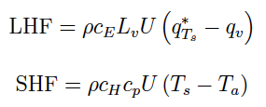
Surface Enthalpy Flux Partitioning
Partition surface enthalpy flux anomalies into
  part due to U’
  part due to Δq’ or ΔT’
  part due to U’Δq’ or U’ΔT’

Slide 87
Surface Flux – Wind Feedback Term
DRY
MOIST
DRY
MOIST
Notes:
This is WISHE term. Conflicting results. Here it is primarly a positive fb--- and a strong wrong. But main role is to counteract….

Slide 88
Surface Flux –Air-Sea Disequilibrium Feedback Term
DRY
MOIST
DRY
MOIST
Notes:
…strong neg disequilibrium fb.

Slide 89
Total Surface Flux Feedback Term
DRY
MOIST
DRY
MOIST
Notes:
Sfc flux: mostly negative fb.

Slide 90
Convergence Term
DRY
MOIST
DRY
MOIST

Slide 91

Single-Column Model
MIT Single-Column Model
Fouquart and Bonnel shortwave radiation, Morcrette longwave
Emanuel-Zivkovic-Rothman convection
Bony-Emanuel cloud scheme
25 hPa level spacing in troposphere; higher resolution in stratosphere
Run into RCE state with fixed SST, then re-initialized in WTG mode with T fixed at 850 hPa and above; small perturbations to w in initial condition

Slide 92
Results
No drift from RCE state when SST <~ 32 C
Migration toward states with ascent or descent at higher SSTs
These states correspond to multiple equilibria in two-column models by Raymond and Zeng (2000) and by several others since (e.g. Sobel et al., 2007; Sessions et al. 2010)

Slide 93
Descending Branch

Slide 94
25 ºC
40 ºC
Perturbation shortwave (red), longwave (blue), and net (black) radiative heating rates in response to an instantaneous reduction of specific humidity of 20% from the RCE states for (left) SST = 25C and (right) 40C. Note the different scales on the abscissas.

Slide 95
Perturbation net radiative heating rates in response to an instantaneous reduction of specific humidity of 20% from the RCE states for SSTs ranging from 25 to 45C.

Slide 96
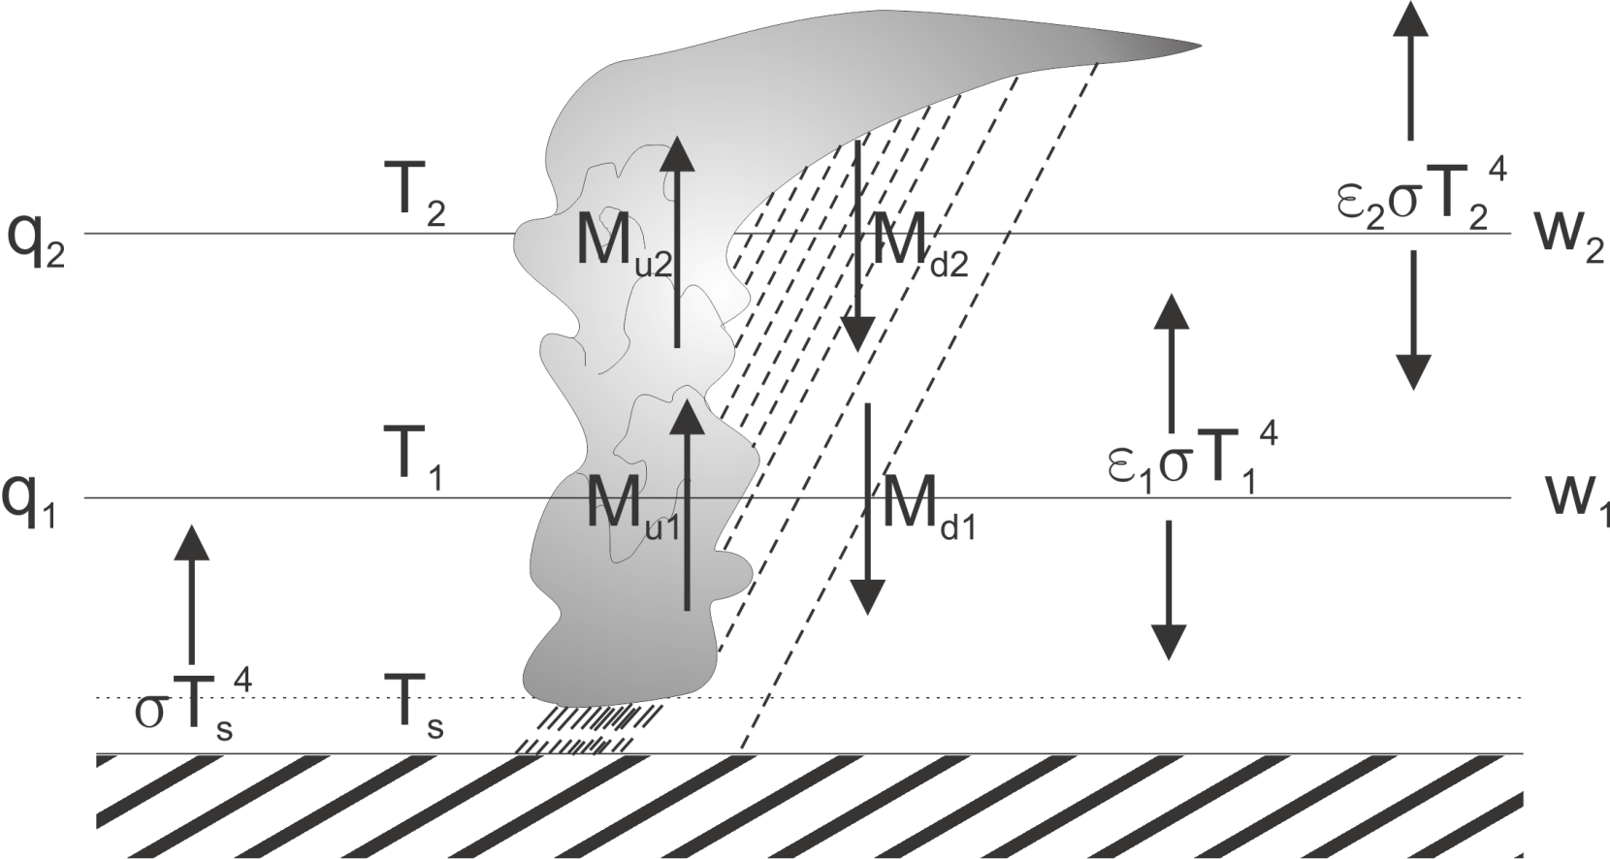
Two-Layer Model
Temperatures held constant, IR emissivities depend on q, convective mass fluxes calculated from boundary layer QE, w’s calculated from WTG

Slide 97
Results of Linear Stability Analysis of Two-Layer Model:
Criterion for instability:
Dry static stabilities
emissivities
Precipitation efficiency
< 0
< 0
> 0
Radiative-convective equilibrium becomes linearly unstable when the infrared opacity of the lower troposphere becomes sufficiently large, and when precipitation efficiency is large

Slide 98
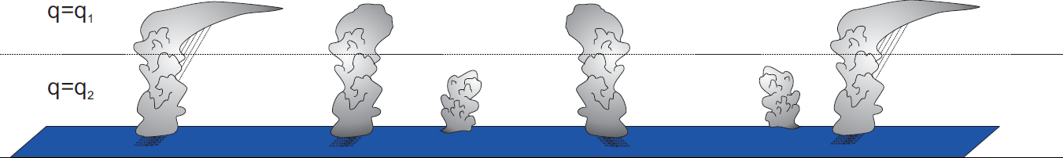
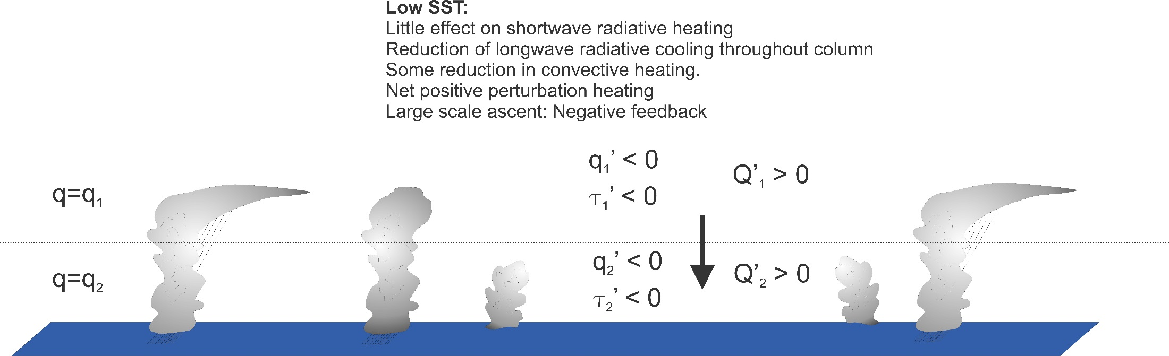
Interpretation
Ordinary Radiative-Convective Equilibrium
Introduce local downward vertical velocity

Slide 99
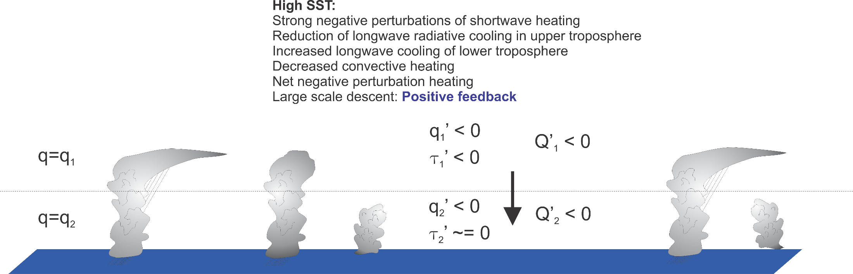

Slide 100
Note:
Once cluster forms, it is strongly maintained by intense negative OLR anomaly associated with central dense overcast. But cloud feedbacks are NOT important in instigating the instability. This leads to strong hysteresis in the radiative-convective system

Slide 101
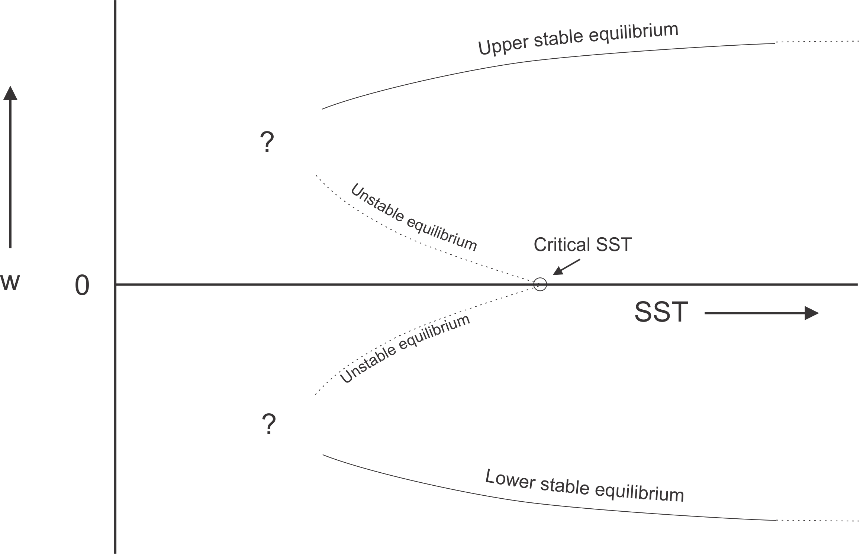
Hypothesized Subcritical Bifurcation
Clustering metric

Slide 102
Consequences

Slide 103
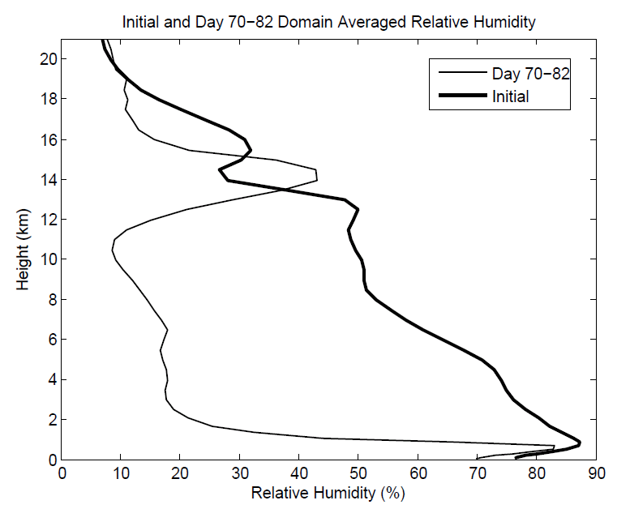
Aggregation Dramatically Dries Atmosphere!

Slide 104
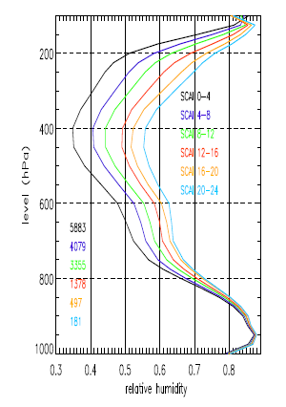
Variation of tropical relative humidity profiles with a Simple Convective Aggregation Index (SCAI).
Courtesy Isabelle Tobin, Sandrine Bony, and Remy Roca
Tobin, Bony, and Roca, J. Climate, 2012

Slide 105
Hypothesis
At high temperature, convection self-aggregates
→Horizontally averaged humidity drops dramatically
→Reduced greenhouse effect cools system
→Convection disaggregates
→Humidity increases, system warms
→System wants to be near phase transition to aggregated state

Slide 106
Recipe for Self-Organized Criticality
(First proposed by David Neelin, but by different mechanism)
System should reside near critical threshold for self-aggregation: Regulation of tropical sea surface temperature!
Convective cluster size should follow power law distribution

Slide 107
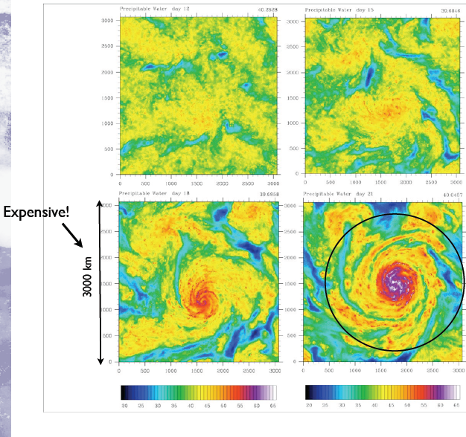
Self-Aggregation on an f-plane

Slide 108
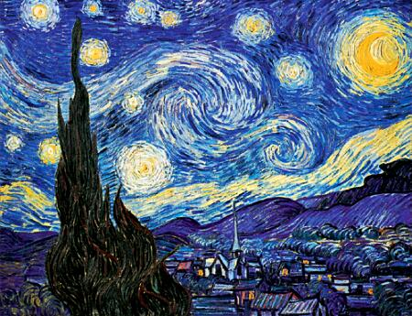
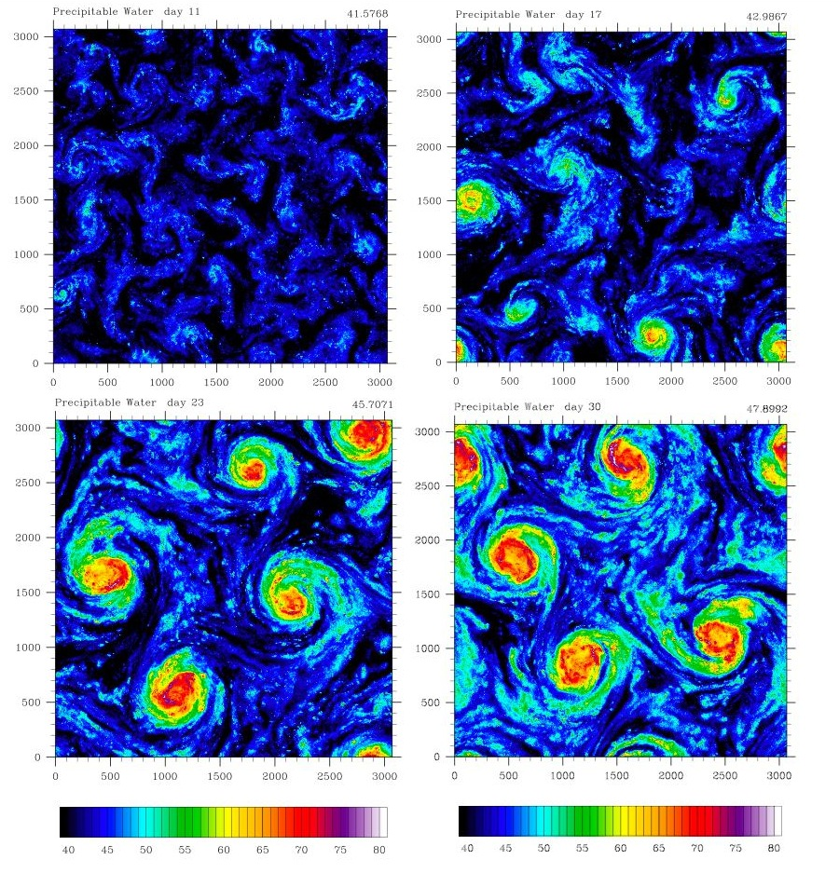
Self-Aggregation on an f-plane
Vincent Van Gogh: Starry Night

Slide 109
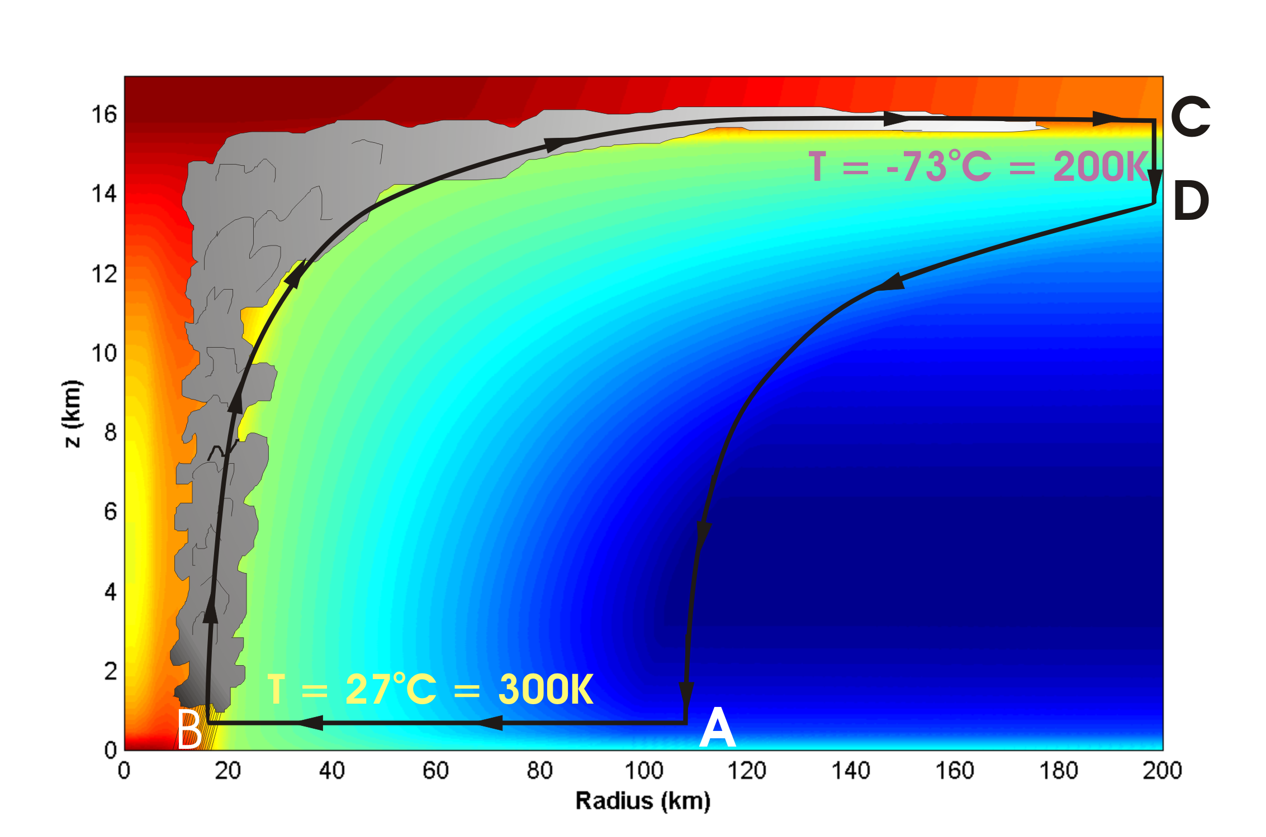
Energy Production

Slide 110
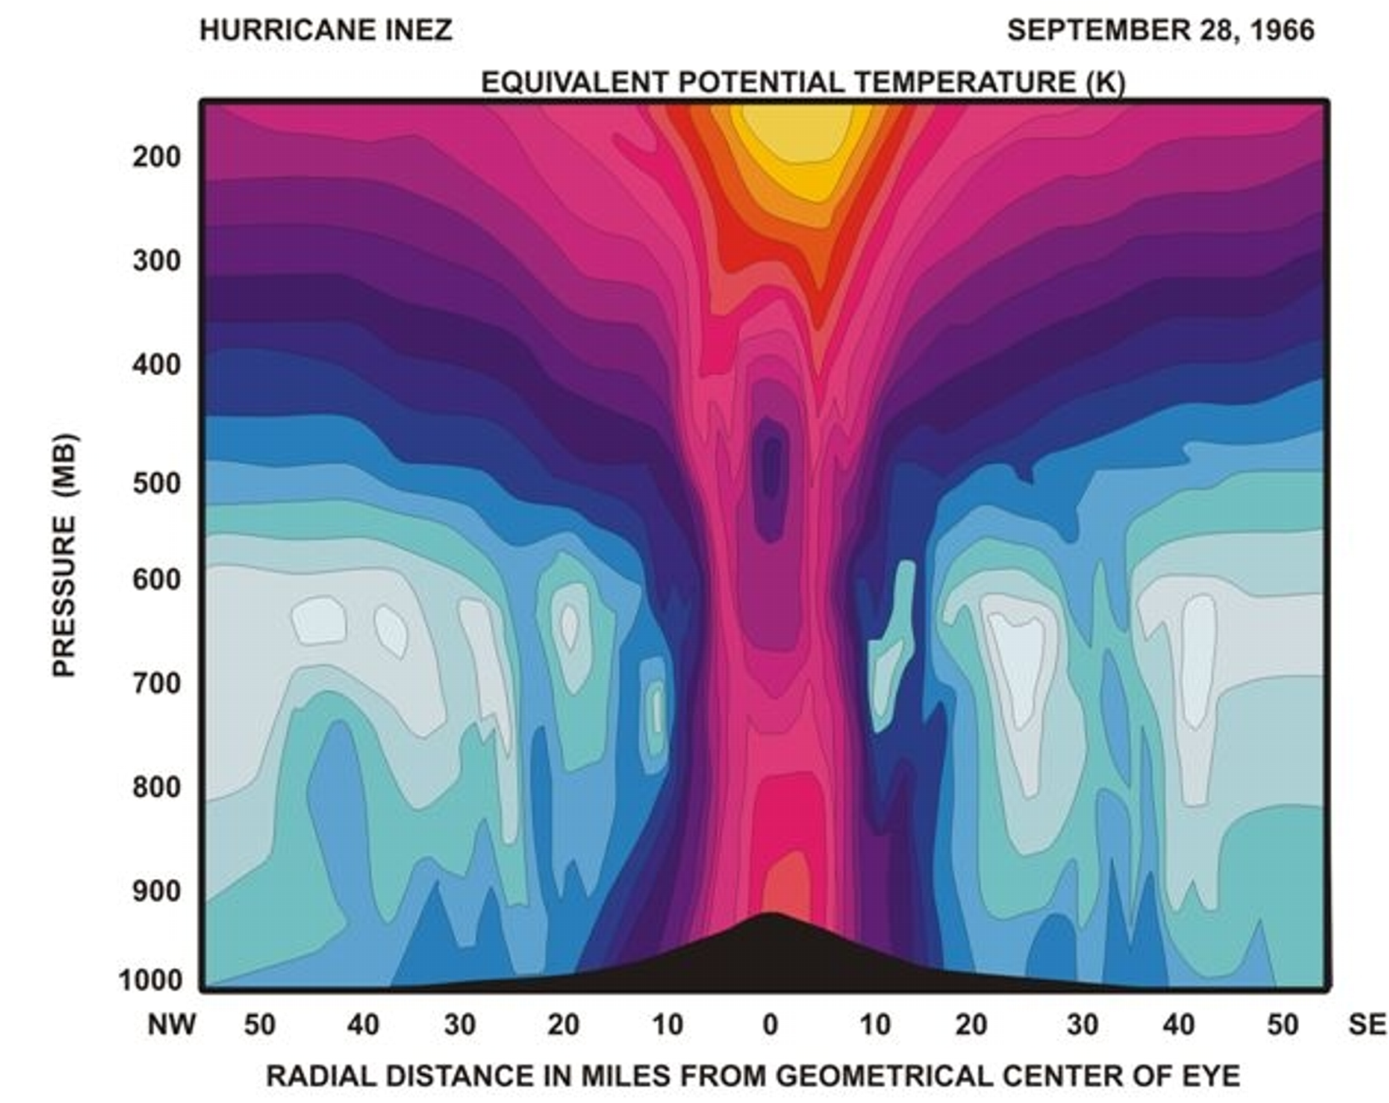
Distribution of Entropy in Hurricane Inez, 1966
Source: Hawkins and Imbembo, 1976

Slide 111
Carnot Theorem: Maximum efficiency results from a particular energy cycle:
Isothermal expansion
Adiabatic expansion
Isothermal compression
Adiabatic compression
Note: Last leg is not adiabatic in hurricane: Air cools radiatively. But since environmental temperature profile is moist adiabatic, the amount of radiative cooling is the same as if air were saturated and descending moist adiabatically.
Maximum rate of energy production:

Slide 112
Theoretical Upper Bound on Hurricane Maximum Wind Speed:
Surface temperature
Ratio of exchange coefficients of enthalpy and momentum
Outflow temperature
Air-sea enthalpy disequilibrium

Slide 113

Hurricane-World Scaling
Modified thermodynamic efficiency:
Angular velocity of earth’s rotation:
Saturation water concentration of sea surface:
Net top-of-atmosphere upward radiative flux:
Net upward surface radiative flux:
Potential intensity:

Slide 114
Hurricane-World Scaling
Radius of maximum winds:
Distance between storm centers:
Number density:

Slide 115


Slide 116


Slide 117
Quasi-equilibrium Theory of Small Perturbations to Radiative-Convective Equilibrium States
See Quasi-Equilibrium Dynamics of the Tropical Atmosphere paper on course web site
Free troposphere assumed to have moist adiabatic lapse rate (s* does not vary with height
Boundary layer quasi-equilibrium applies

Slide 118
Basis of statistical equilibrium physics
Dates to Arakawa and Schubert (1974)
Analogy to continuum hypothesis: Perturbations must have space scales >> intercloud spacing
TKE consumption by convection ~ CAPE generation by large scale
Numerical models on the verge of simulating clouds + large-scale waves
We further assume convective criticality

Slide 119
Implications of the moist adiabatic lapse rate for the structure of tropical disturbances
Approximate moist adiabatic condition as that of constant saturation entropy:
Assume hydrostatic perturbations:

Slide 120
Maxwell’s relation:
Integrate:
Only barotropic and first baroclinic mode survive

Slide 121
This implies, through the linearized momentum equations, e.g.
that the horizontal velocities may be partitioned similarly:

Slide 122


Slide 123
Implications for vertical structure of vertical velocity
Integrate:

Slide 124
At tropopause:
This implies that if a rigid lid is imposed at the tropopause, the divergence of the barotropic velocities must vanish and the barotropic components therefore satisfy the barotropic vorticity equation:

Slide 125


Slide 126
Feedback of Air Motion on (virtual) Temperature
Convection cannot change vertically integrated enthalpy,
Then neglecting surface fluxes, radiation, and horizontal advection,
Neelin and Held (1987): This function is negative for upward motion

Slide 127
Upward motion is associated with column moistening:
Yano and Emanuel, 1991:
Ascent leads to cooling

Slide 128
Prediction: Inviscid, small amplitude perturbations under rigid lid: Shallow water solutions with reduced equivalent depth

Slide 129


Slide 130

WISHE and Radiative Feedbacks

Slide 131



Slide 132

OLR power spectrum, 1979–2001 (Symmetric)
Kelvin wave dispersion curves for equivalent depths of 25 and 50 m
Kelvin wave Phase Speed: 15 m s⁻¹
from
Wheeler and Kiladis, 1999

Slide 133
Consider a hypothetical planet like Earth, but with no continents and no seasons and for which the only friction acting on the atmosphere is at the surface.
This planet has an exact nonlinear equilibrium solution for the flow of the atmosphere, characterized by:
Every column is in radiative-convective equilibrium
Wind vanishes at planet’s surface
Horizontal pressure gradients balanced by Coriolis accelerations

Slide 134

Thermal Wind Balance
Image credit: Kerry Emanuel

Slide 135
Exact Solution!
Every individual column of the atmosphere and the surface beneath it are in radiative-convective equilibrium
Surface pressure is constant
Pressure above the surface decreases poleward, more rapidly at higher altitudes
Pressure gradient in geostrophic balance with a west wind

Slide 136
Two potential problems with this solution:
Not enough angular momentum available for required west-east wind
Equilibrium solution may be unstable

