Slide 1

Climate Change: An Update and Some Thoughts About the Future
Kerry Emanuel
Lorenz Center
Massachusetts Institute of Technology

Slide 2
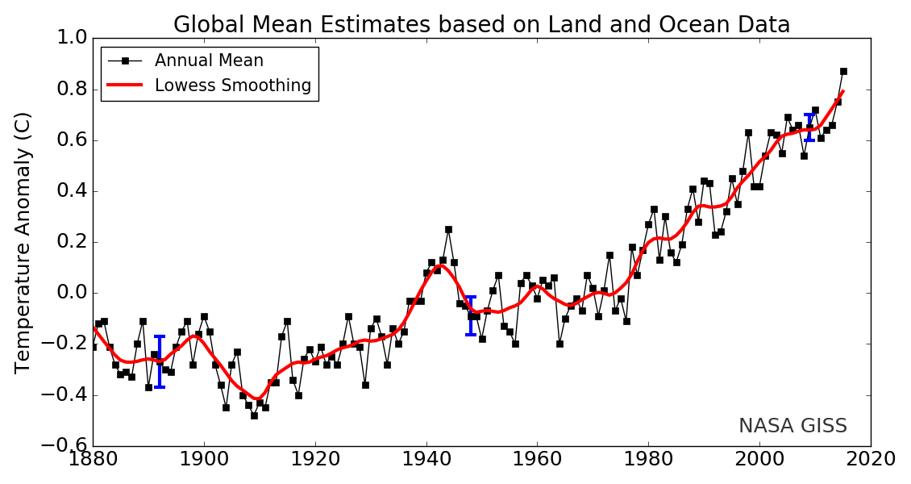
Our Planet Continues to Heat Up

Slide 3
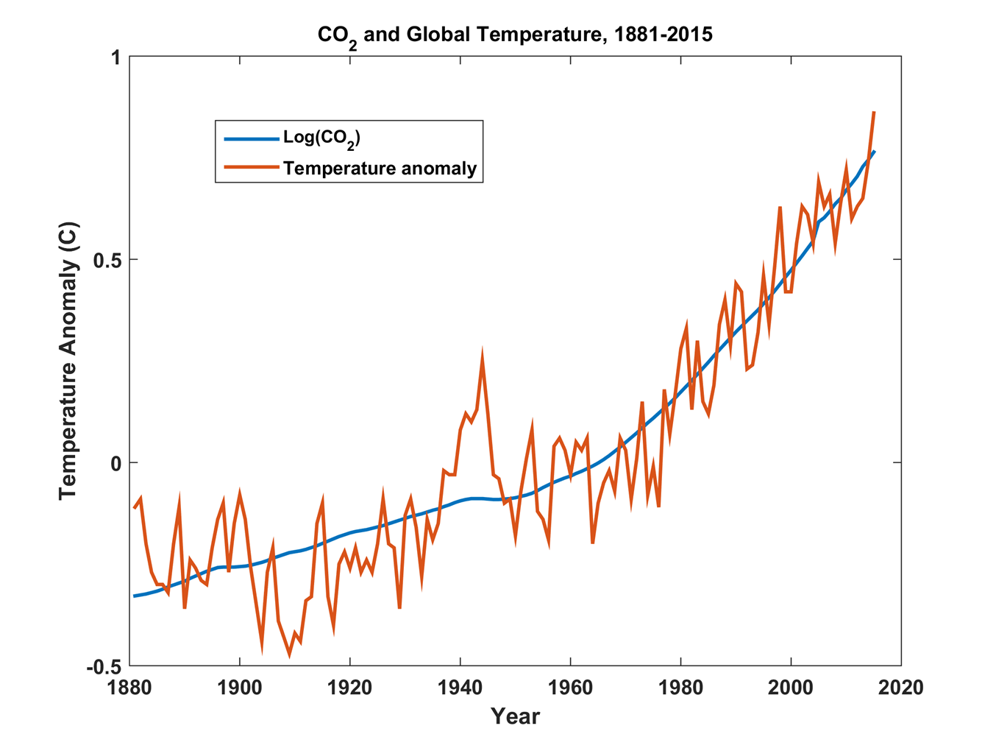
The Warming Continues to Track Atmospheric CO₂ …..

Slide 4

… as predicted by Svante Arrhenius, more than a century ago
“Any doubling of the percentage of carbon dioxide in the air would raise the temperature of the earth's surface by 4°; and if the carbon dioxide were increased fourfold, the temperature would rise by 8°.” – Världarnas utveckling (Worlds in the Making), 1906

Slide 5
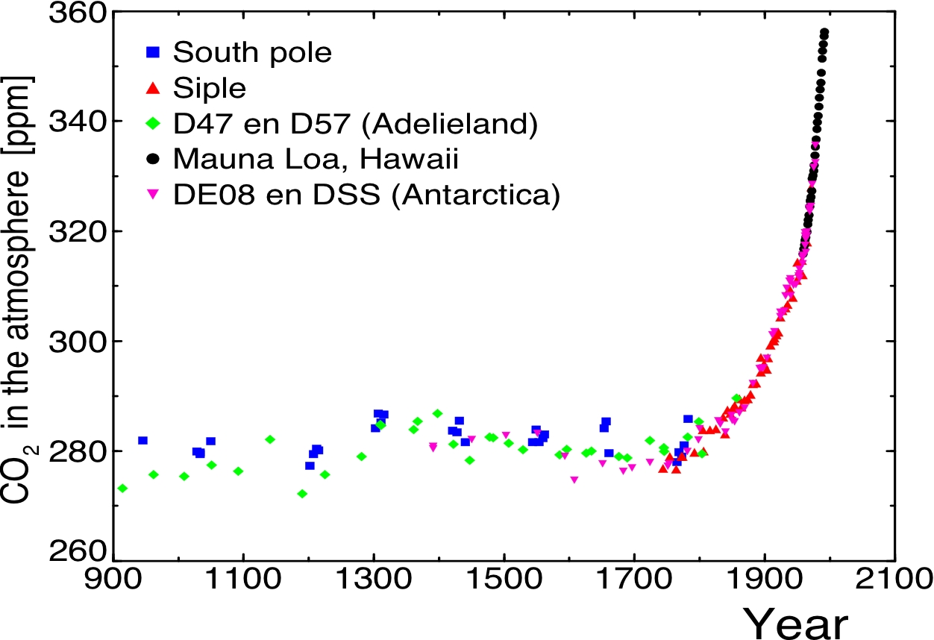
Today

Slide 6
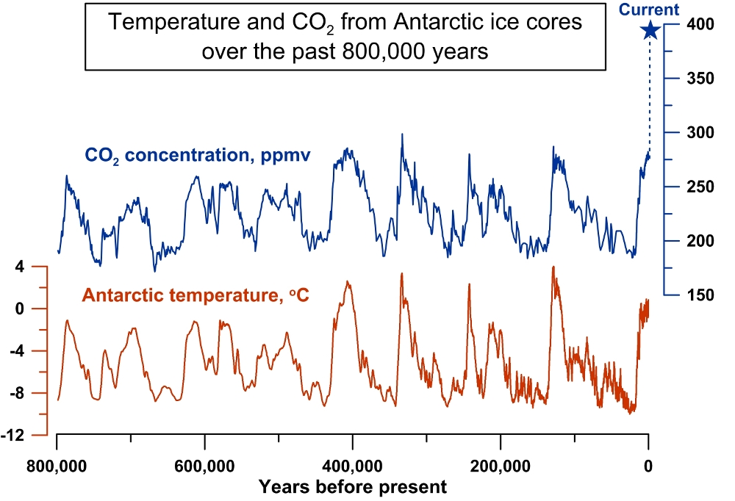
CO₂ concentration has not been this high for at least 15 million years

Slide 7
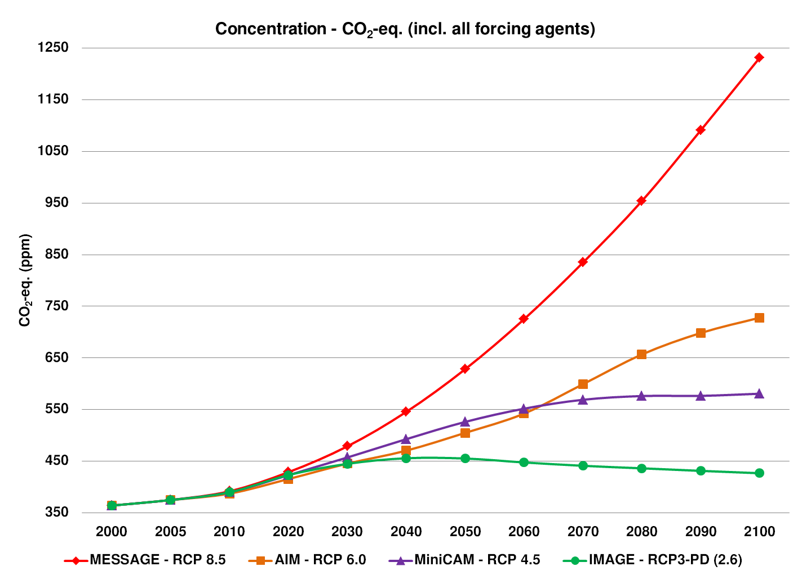
CO₂ Will Go Well Beyond Doubling
Double Pre-Industrial

Slide 8

IPCC 2007: Doubling CO₂ will lead to an increase in mean global surface temperature of 2 to 4.5 ºC.
Atmospheric CO₂ assuming that emissions stop altogether after peak concentrations
Global mean surface temperature corresponding to atmospheric CO₂ above
Courtesy Susan Solomon

Slide 9
Known Risks
Increasing sea level
Increasing hydrological events… droughts and floods
Increasing incidence of high category hurricanes and associated storm surges and freshwater flooding
More heat stress
Significant threat to marine ecology

Slide 11
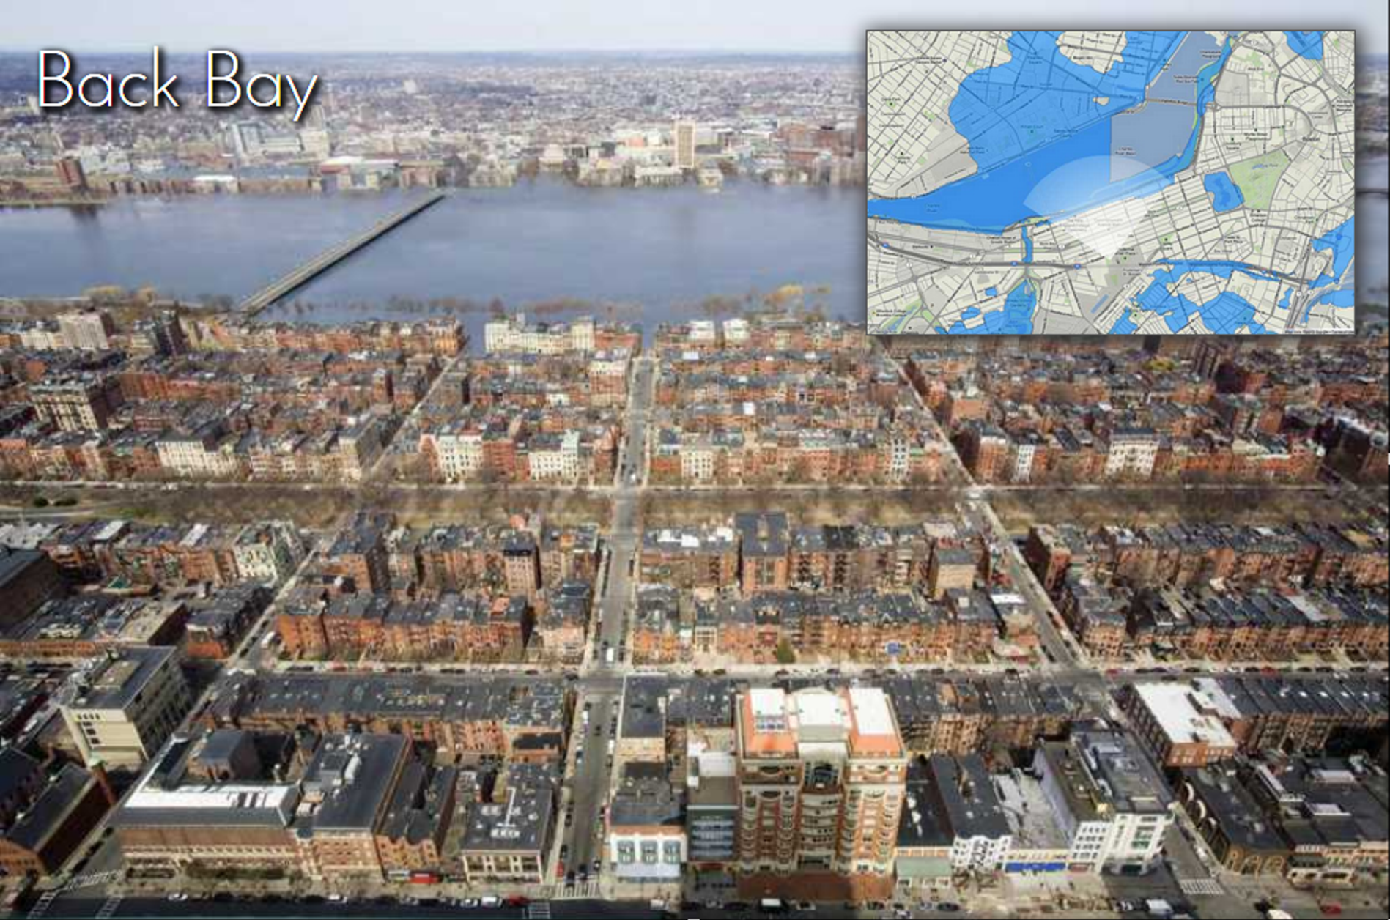
Boston with 1.5 m storm surge

Slide 12
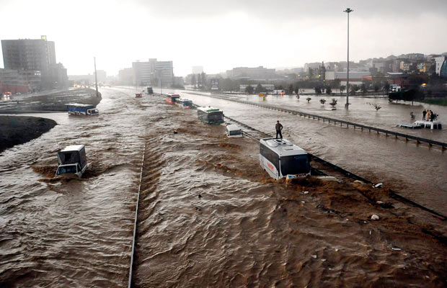
Hydrological Extremes Increase with Temperature
Floods

Slide 13
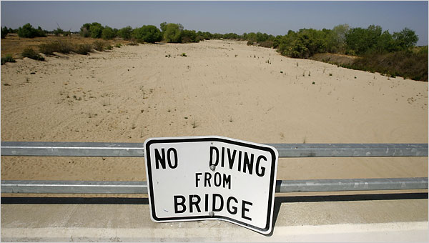
Drought

Slide 14
Wet Bulb Temperature: Upper Survivable Limit of 35ºC
Current
2071-2100, RCP 4.5
2071-2100, RCP 8.5
Pal and Eltahir, Nature Climate Change, 26 October 2015

Slide 15

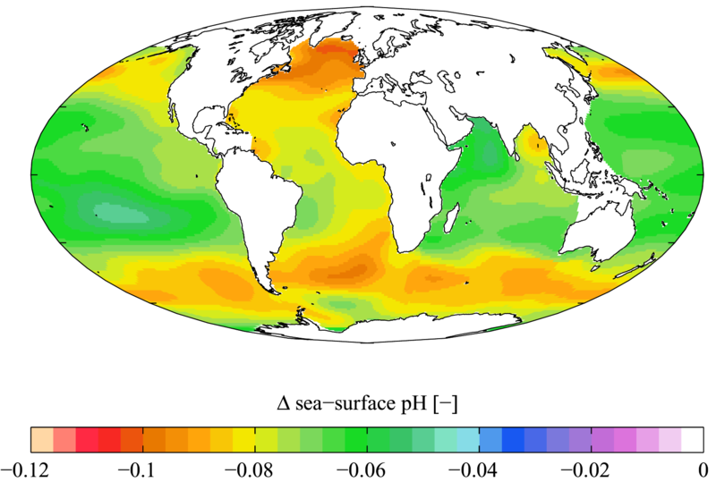

Slide 16

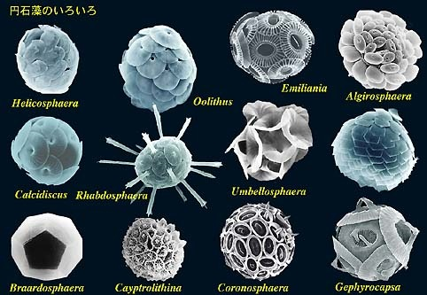
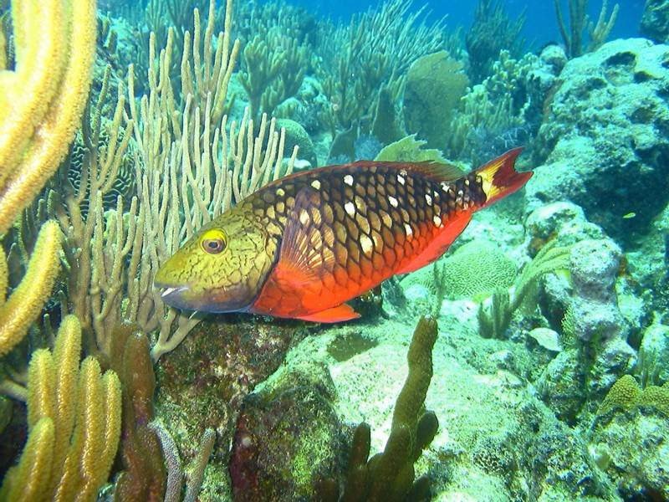
Acidification through CO₂ threatens marine life
Plankton
Coral Reefs
Notes:
Abbildung 4.3-1
Aragonitsättigung und
gegenwärtige Riffstandorte
von Warmwasserkorallen
(blaue Punkte). (a)
vorindustrielle Werte
(ca. 1870, atmosphärische
CO2-Konzentration
280 ppm), (b) Gegenwart
(ca. 2005, 375 ppm CO2), (c)
Zukunft (ca. 2065, 517 ppm
CO2). Der Grad der
Aragonitsättigung (Ù)
bezeichnet das relative
Verhältnis zwischen dem
Produkt der Konzentrationen
von Kalzium- und
Karbonationen und dem
Löslichkeitsprodukt für
Aragonit. Standorte mit
einer Aragonitsättigung
unterhalb von 3,5 sind nur
noch bedingt für riffbildende
Warmwasserkorallen
geeignet (marginal),
unterhalb von 3 sind sie
ungeeignet.
Quelle: Steffen et al., 2004

Slide 17
U.S. Department of Defense
“DoD recognizes the reality of climate change and the significant risk it poses to U.S. interests globally. The National Security Strategy, issued in February 2015, is clear that climate change is an urgent and growing threat to our national security, contributing to increased natural disasters, refugee flows, and conflicts over basic resources such as food and water. These impacts are already occurring, and the scope, scale, and intensity of these impacts are projected to increase over time.”
“We are already observing the impacts of climate change in shocks and stressors to vulnerable nations and communities, including in the United States, and in the Arctic, Middle East, Africa, Asia, and South America.”

Slide 18
What Keeps us Awake at Night
Climate change begets political instability and increases incidence of armed conflict
China and Russia are building many lightwater nuclear reactors (60’s technology) and leasing them to developing nations (like Pakistan), creating significant vulnerabilities of enriched uranium and nuclear waste
Increasing risk of nuclear terrorism

Slide 19
What’s To Be Done?

Slide 20
De-Carbonize!

Slide 21
How?
Even conservative economists recognize that in a free market, industries must be made to absorb the costs of their “externalities”…those hidden costs they impose on the rest of us by, e.g., dumping pollutants into the atmosphere
If the fossil fuel industries were made to pay for their costs to human health and for the costs of climate change, they could not compete with carbon-free energy
Price carbon!

Slide 22
Solutions and Opportunities
Renewables (solar and wind)
  Might provide up to 30% of current power needs
Carbon Capture and Sequestration
  Currently would add ~$200/ton to energy costs
  Reasonable prospects for reducing this to ~$100/ton
  Currently little incentive to develop this
Next Generation Fission Reactors

Slide 23
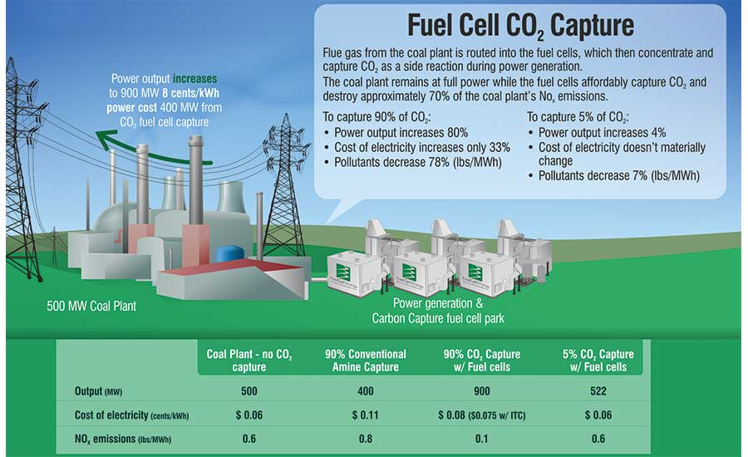
Carbon Capture using Fuel Cells

Slide 24
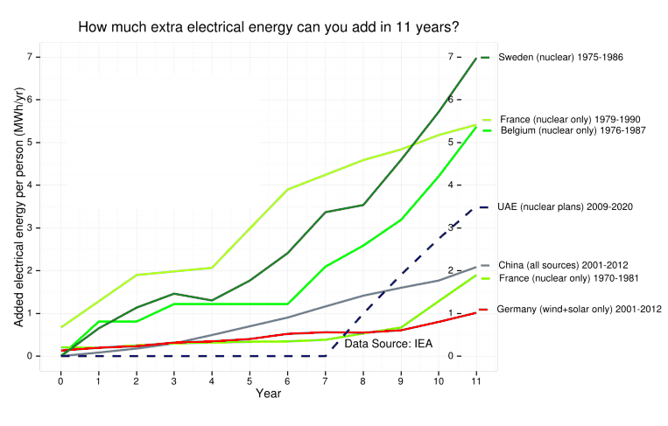

Slide 25
Next Generation (Gen IV) Fission Reactors
One Example: Molten Salt Reactors
  Passively safe
  Can run on nuclear waste from Light Water Reactors
  Operate at ambient pressure
  Can run on thorium; unsuitable for weapons
  Estimated plant lifetime > 80 years

Slide 26
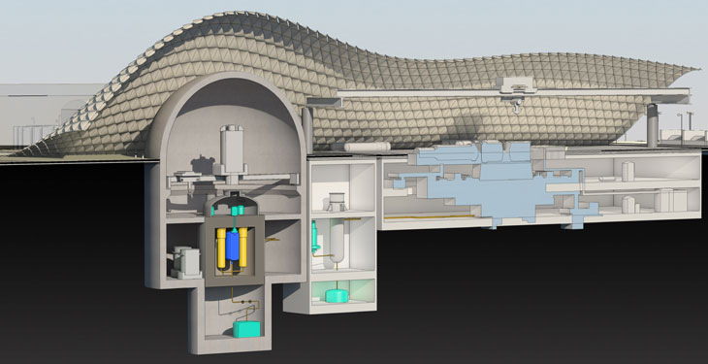
Molten Salt Thorium Reactor
Transatomic, Inc., Cambridge, MA

Slide 27
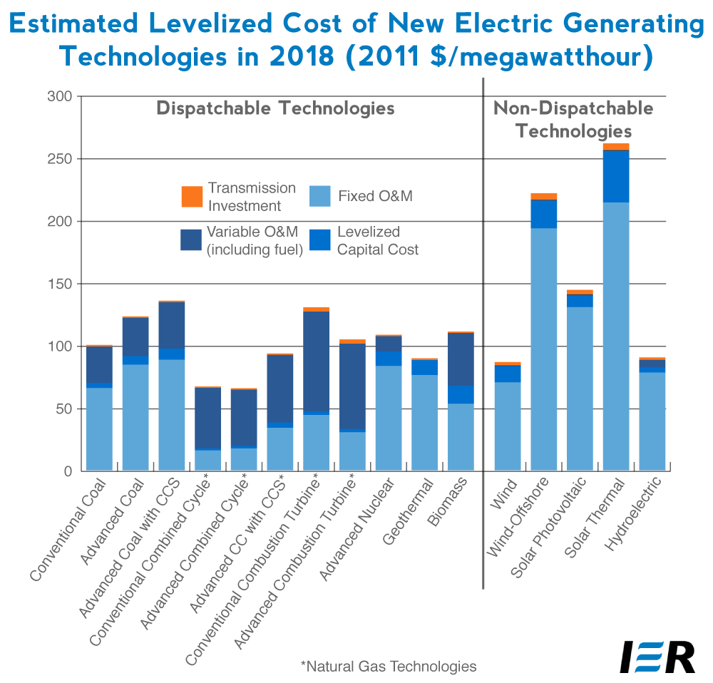
U.S. Levelized Cost of Electricity
U.S. Energy Information Administration, Annual Energy Outlook 2013

Slide 28
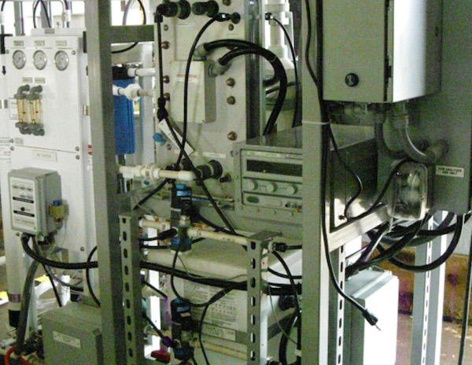
U.S. Navy makes Gasoline from Seawater by extracting dissolved CO2 and fracking water molecules to generate hydrogen…carbon + Hydrogen = hydrocarbon fuels

Slide 29
Summary
Unmitigated emissions of greenhouse gases presents an unacceptably high level of risk to our descendants
Largest risk may arise from armed conflict in a nuclear world, brought about by increasing shortages of food and water
Many new technologies are making it possible to decarbonize modern civilization at low or even negative cost
Those nations that lead the development of carbon-free energy technology will gain the edge in the 6-trillion dollar annual global energy market

Slide 30
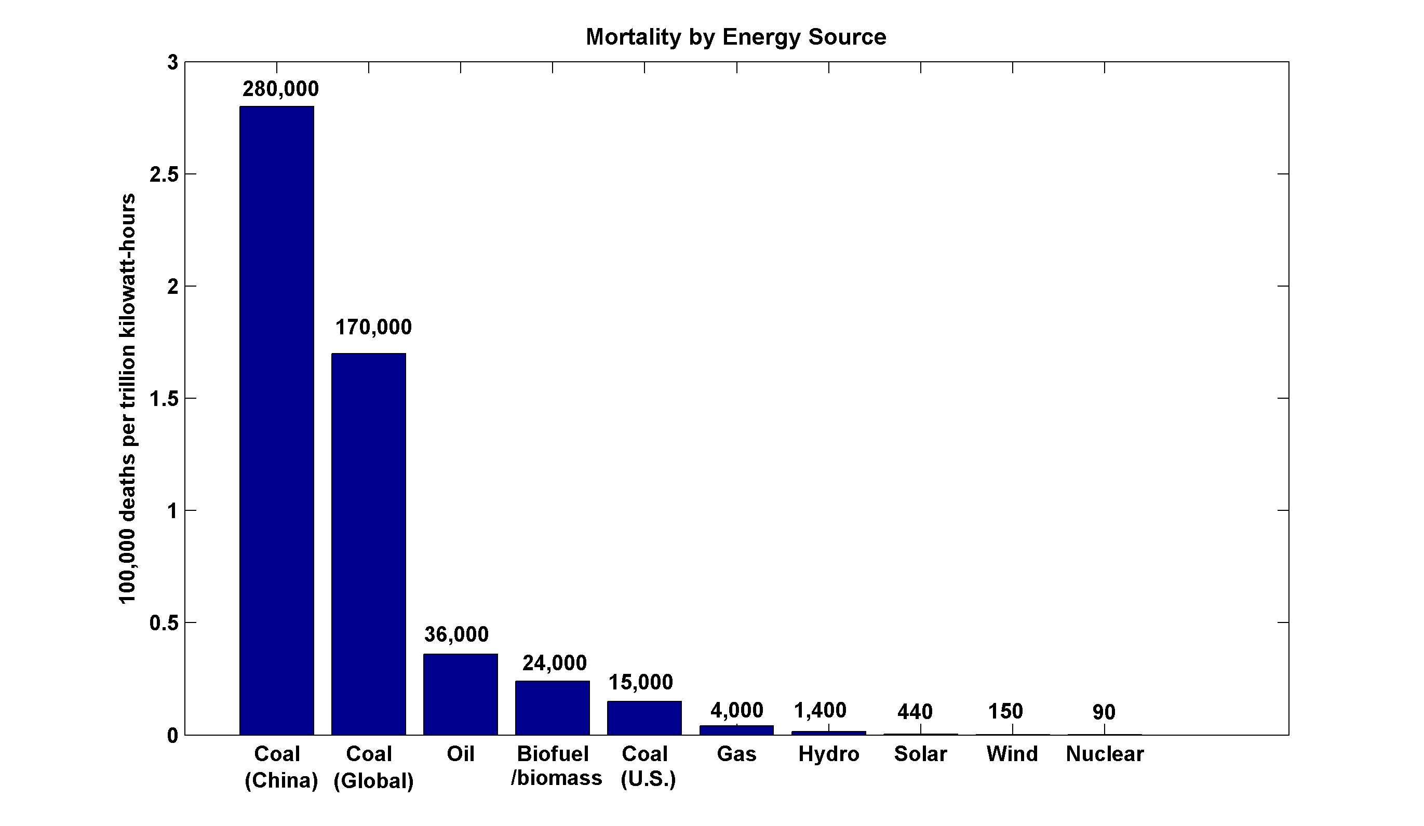
~13,000 premature deaths annually in the U.S. from coal production and combustion
Nuclear power, by replacing fossil fuels, has prevented an estimated 1.84 million air-pollution related deaths worldwide
(includes Chernobyl, Fukushima)

Slide 31
