Slide 1
Tropical Cyclone Risk to DoD Installations Using Advanced Physical Downscaling CR24-A3-8124
Presented by: Lead Principal Investigator: James Neumann, Principal, Industrial Economics, Incorporated (Iec) with co-Principal Investigator Kerry Emanuel, Chief Science Officer, WindRiskTech
SEPTEMBER 13, 2023

Slide 2
Project Team
[PLAN]: 1 slide - Jim develop and present, simple enough but a key strength is we have worked together before. I can also introduce you folks on the call – I think I’d want at least Kerry and Sai on, for presentation and for Q&A, and I think it would be helpful if Chas can listen in as well and there might be a question he is helpful with, too.
Text
Text
Text
Text
Text

Slide 3
Cost Estimate
[PLAN]: 1 slide - Jim develop and present – super simple, I will also take 30 seconds to explain tracks component and discount structure.
Text
Text
Text
Text
Text

Slide 4
Problem Statement
Climate risk is dominated by extreme events.
Societies are usually well adapted to frequent events (> 1/100 yr)
Societies are often poorly adapted to rare events (< 1/100 yr)
Large cost increases result when > 100-yr events become < 100-yr events
Almost all current risk assessments are based on historical statistics
Historical records are flawed and too short
Moreover, the past 50-150 years is a poor guide to the present owing to climate change that has already occurred
We need to bring physical modeling to bear on the problem of climate risk
We also need to quantify uncertainties in climate risk assessment

Slide 5
Technical Objectives
Provide quantitative estimates of tropical cyclone-related risks from wind and flooding for any list of DoD installation locations for the current and for future projected climates and sea levels. Also provide uncertainty measures.
Risk estimates for return periods long enough for DoD installation engineers to make robust estimates of average annual loss (AAL)
Will include the effects of climate change, sea-level rise, and natural climate oscillations such as El Niño/La Niña
Our risk data would be transferred to “installation planners and engineers assessing coastal risks to existing facilities or making future infrastructure investment decisions”

Slide 6
Technology/Methodology Description
Reliable, global records of coarse-scale climate are robust and widely available, though their representation of hurricanes is poor
Use such global records to generate potentially unlimited time series of hurricane-relevant coarse-scale climate variables
Use these time series to drive specialized, very high resolution physical hurricane track, intensity, and rainfall models
Drive inland flood and coastal surge models with these synthetic hurricanes
Extensively evaluate the results against historical hurricane data
Exact same method can be applied to output of climate models

Slide 7
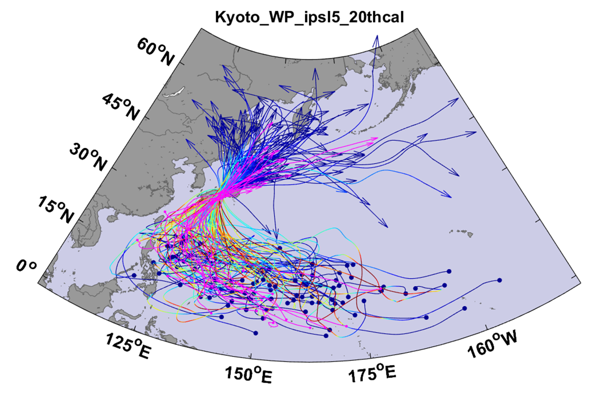
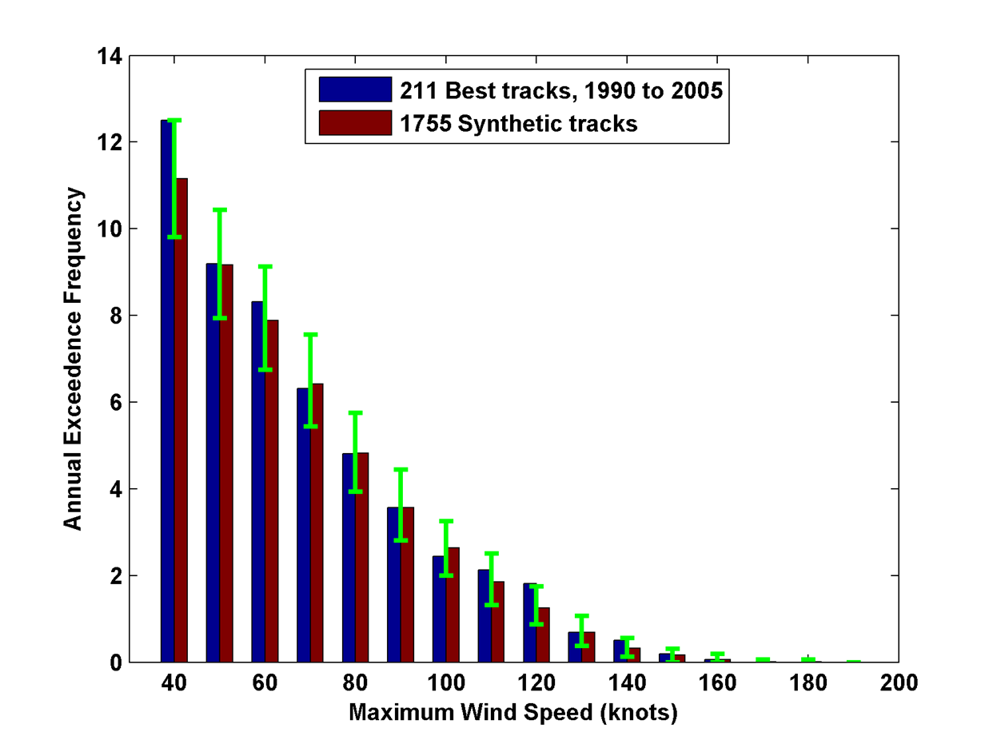
Technology/Methodology Description (continued)
Example:
Top 100 out of 2000 synthetic TCs Affecting Kyoto, 1981-2000. Historical tracks overlaid in magenta
Captures full range of observed hurricane intensities
Blue: Historical
Red: Synthetic
Green: Sampling error

Slide 8
Technology/Methodology Maturity
Technique was developed 18 years ago and refined since then
Used in more than 70 peer-reviewed publications
Basis of First Street Foundation’s hurricane-related risks
We have more than 25 clients, including :
The World Bank
Environmental Protection Agency
British Petroleum
AIG
Korea Electric Power Company (KEPCO)
Massachusetts State Attorney General’s Office

Slide 9
Technical Approach: Overview
Produce detailed, quantitative estimates of present and future tropical cyclone risks to a specified set of DoD bases
[PLAN]: 1 slide - (I have just listed the 5 tasks below…Jim you can put these in flow chart form)
Establish two sites/bases for initial technology deployment – one site for wind, storm surge, and riverine flooding demonstration, and a second for wind and storm surge.
Downscale hurricanes from re-analyses for an historical period (e.g 1985- 2014, for a comparison to climate models). Wind speeds and surge levels will then be calibrated against historical data
Downscale eight global climate models from the CMIP6 archive for an historical period, for calibration, and a future period, in accord with ESTCP guidance. Apply surge and inland flood models
Present results and software to ESTCP and to the base engineers and planners at the two sites
Develop results for 12 additional sites – ten for wind only, two for wind and surge, and of those two, one with compound freshwater riverine flooding.

Slide 10
Technical Approach: Site Description
[PLAN]: 1 slide – Jim do this we have not chosen sites, but we should talk about the process of choosing them, criteria, fact of global scope but some sites likely more vulnerable than others, etc.
Text
Text
Text
Text
Text

Slide 11
Technical Approach: Performance Objectives
[PLAN]: 2 slides I think – Jim/Kerry to develop: I think we should include all three for the full proposal
Performance Objective | Metric | Data Requirements | Success Criteria
Quantitative Performance Objectives
Calibration of system to historical hurricane winds | Agreement between wind speed and surge level profiles for all sites | Historical data from the IBTrACS archive and reanalysis data from ECMWF (ERA5), NCEP and NASA (Merra2) | Modeled hurricane return periods as a function of wind speed will be calibrated using return periods based on IBTrACS data over the thirty-year historical period1985-2014, and we will compare to other metrics of variability including seasonal, interannual, and spatial variations.

Slide 12
Technical Approach: Performance Objectives (continued)
[PLAN]: 2 slides
Performance Objective | Metric | Data Requirements | Success Criteria
Quantitative Performance Objectives
Calibration of surge model to historical tide gauge data | Agreement between predicted and observed storm tide depths Agreement between climate model inundation return period and reanalysis return period | Historical data from IBTrACS and tide gauge Reanalysis data from ECMWF (ERA5), NCEP and NASA (Merra2), Climate model for 20th century | Predicted water depths within 20% of observed tidal gauge data Calibrated inundation water depth 20th century return periods for each climate model within 10% of reanalysis return periods.

Slide 13
Technical Approach: Task Descriptions
[PLAN]: they say 5-7 slides. Kerry (with Jim) If we take 7, total for this section would be 11, but that’s fine. This is pretty straightforward, our tasks are pretty clear and intuitive I think – but here’s where we can get creative in using your slide decks, perhaps use images or even video(s) that we didn’t put in proposal, so we can get more images in front of them. Most strategic section I think, and most open ended.
My proposed slides start with the next one
Text
Text
Text
Text

Slide 14
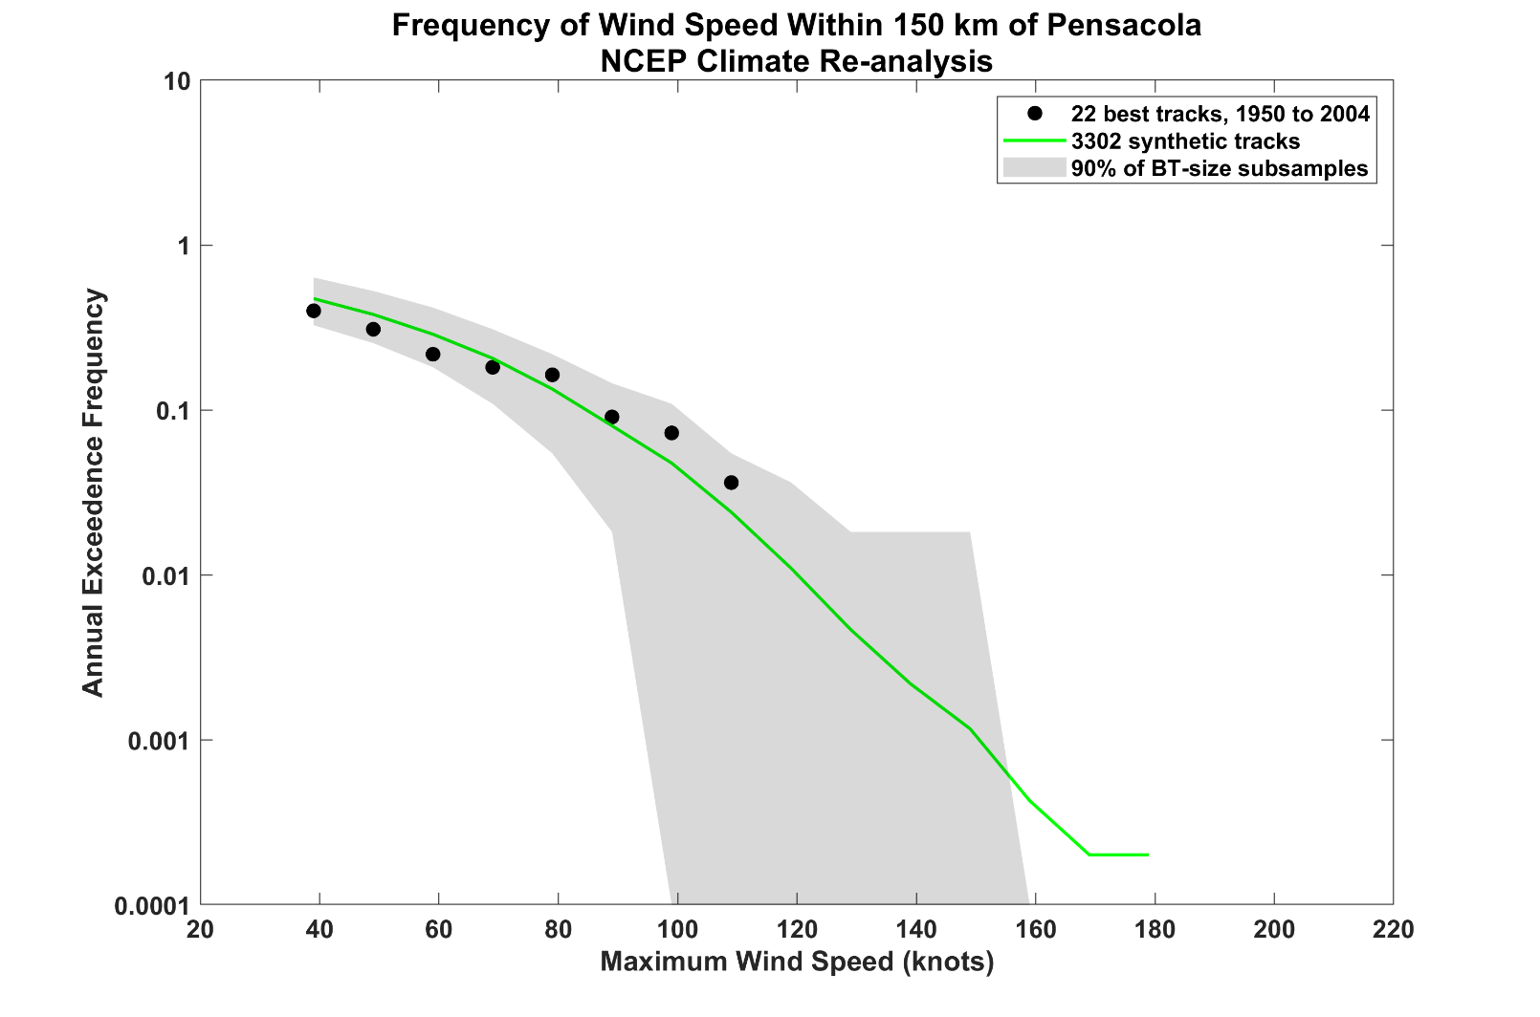
Technical Approach: Task Descriptions (continued)
Example 1: Wind Risk at Pensacola, Florida
Downscaled reanalysis vs observations

Slide 15
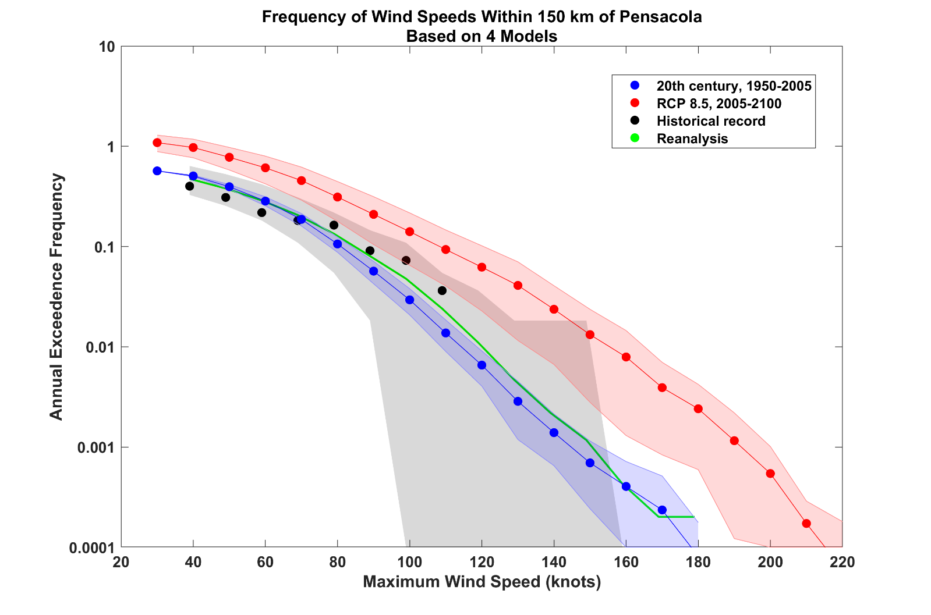
Technical Approach: Task Descriptions (continued)
Now add downscaling of 4 climate models

Slide 16
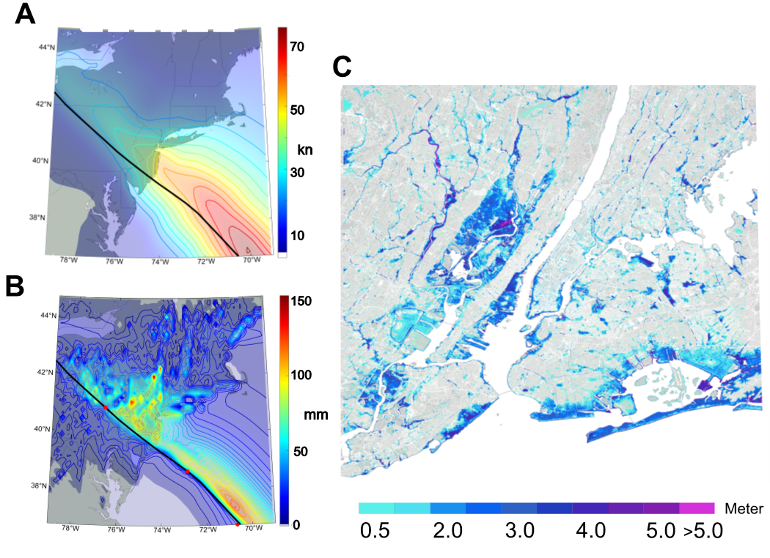
Technical Approach: Task Descriptions (continued)
Flood levels from a single Sandy-like storm affecting New York City
Wind
+Surge
= Flood Levels
+Rain
Notes:
Maximum flood levels (C) in and around New York City from compound surge and freshwater inputs from a single tropical cyclone event that resembles (but is not identical to) Hurricane Sandy of 2012. The event was downscaled from ERA-5 reanalyses. The track of the center of the synthetic storm is shown by the black curves in panels (A) and (B). The maximum wind speed experienced by all points during the event is contoured and panel (A) while the storm total rainfall is shown in (B).

Slide 17
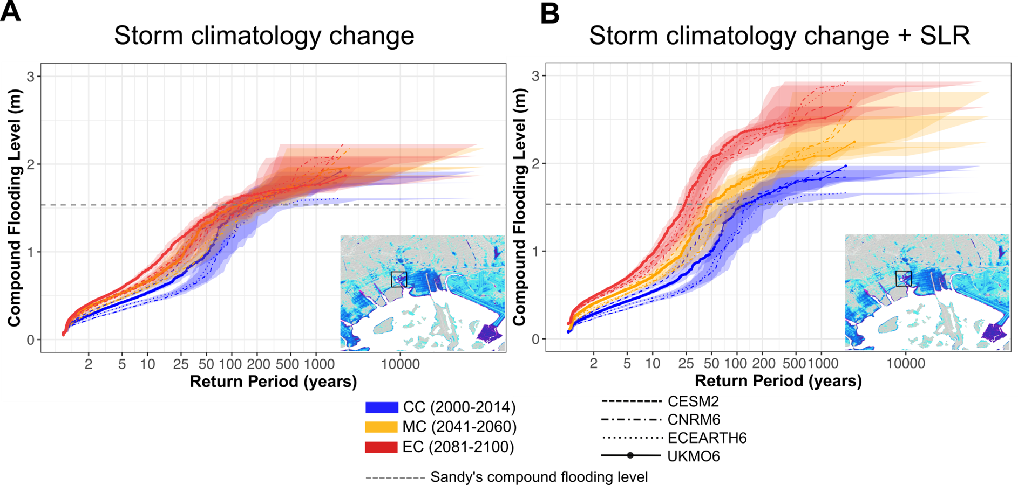
Technical Approach: Task Descriptions (continued)
Climate change effects on flood levels in New York
Notes:
Impact of future TC climatology change and SLR on the risk of compound flooding in NYC. (A) Contribution of TC climatology change alone, and (B) contribution of both TC climatology change and SLR to the future risk of compound flooding. The results are based on the mean of compound flooding level (calculated for the depicted coastal area) in the current and future climates. Each line shows the results from synthetic TCs downscaled from each climate model in the current and future climates. The blue color represents the results for the current climate, orange color represents the middle of the century, and red color represents the end of the century. The gray dashed line shows the magnitude of compound flooding from Sandy (calculated from the Sandy-like event (\#1299) for the depicted area.

Slide 18
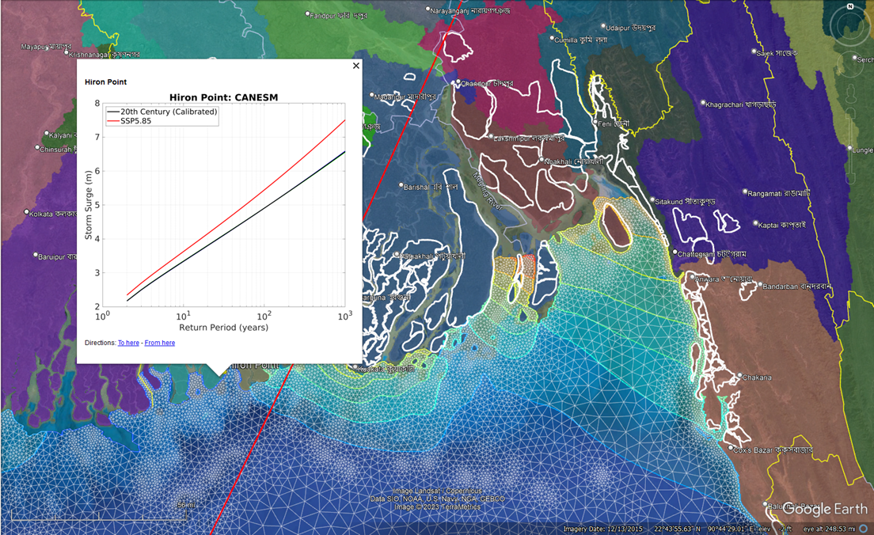
Technical Approach: Task Descriptions (continued)
Illustrating advanced user interface – surge levels in Bangladesh
Hiron Point CANESM Surge return period comparison 20th Century & SSP-5 8.5 -- model calibrated to reanalyses

Slide 19
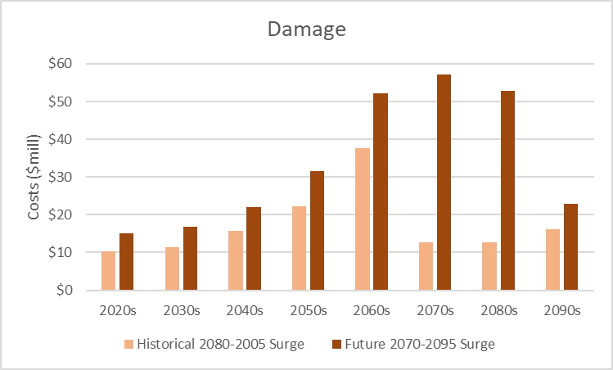
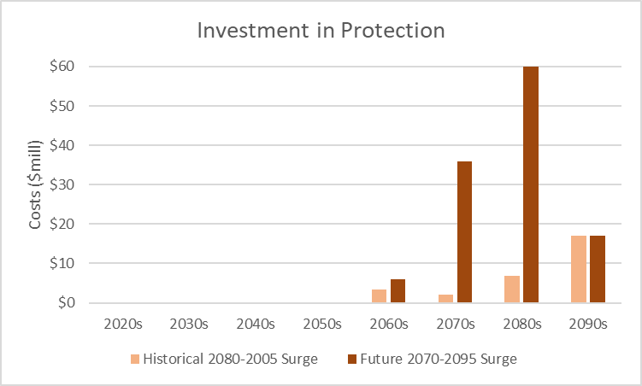
Technical Approach: Task Descriptions (continued)
Illustration of Benefit to DoD of Our Product
Top panel: difference between estimated storm surge damage to Norfolk County, VA private (non-military) infrastructure using historical tide gauge data with projected SLR (beige bar); and projected surge data using WindRiskTech tools and data. Damage is net of potential adaptation investment in sea walls, beach nourishment, and structure elevation.
Bottom panel: estimated optimal investment in adaptation/protection over time using historical tide gauge data and projected surge data using WindRiskTech tools and data.
See Technical Proposal Section 6 for additional detail
Note: For illustration of potential Benefit to DoD only – we do not propose to estimate property or other economic damages under the proposed work.

Slide 20
Technology Transition
[PLAN]: Sai to draft – webinar and documentation focus, they say 1-2 slides, I say use 2, one for data products, one for describing our vision of the webinars. Need to be quite clear on our target audience, key to ID them in Task 1
Text
Text
Text
Text
Text

Slide 21
Technology Transition (continued)
[PLAN]: 1-2 slides, I say use 2
Text
Text
Text
Text
Text

Slide 22
Schedule of Milestones
[PLAN]: I say at least 2 slides – Jim to do - one for Tasks 1-4, one for Task 5, I already have Gantt charts for these in proposal, which directly respond to the questions they have on second slide, but I can hammer that home.
Text
Text
Text
Text
Text

Slide 23
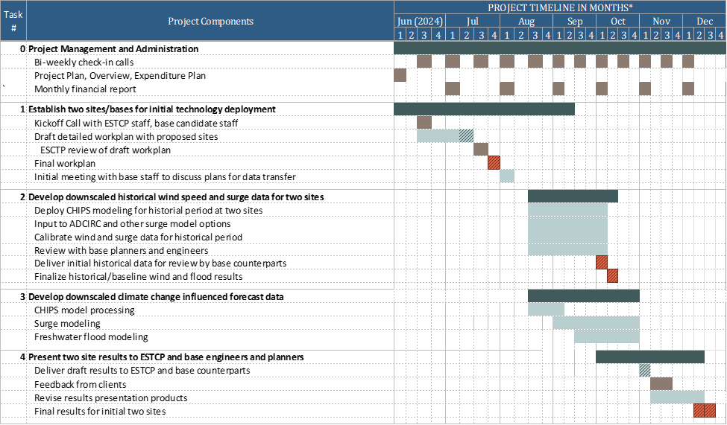
Schedule of Milestones (continued)

Slide 24
Schedule of Milestones (continued)
Text
Text
Text
Text
Text
Text

Slide 25
Backup Slides

Slide 26
ESTCP Review Comments
[PLAN]: these not presented in the 30 minutes, but they might refer to in Q&A
a. ESTCP Review Comments – 1 slide, Jim can develop and I can present if called out during Q&A
Text
Text
Text
Text
Text
Text

Slide 27
Expected DoD Benefit
[PLAN]: only one slide, our stuff directly addresses their questions I think – but benefit has not yet been established at DoD sites because infrastructure location and value we expect is classified, and only engineers and planners could assess. Jim can draft, we all could comment if asked. Chas help on this
Text
Text
Text
Text
Text

Slide 28
Related Efforts
Drs. Emanuel and Ravela participate in two of five flagships of MIT’s Grand Challenges program that funds research on quantifying weather hazards. This will help us expand into other hazards, including extratropical cyclones and severe convection, including tornadoes and hail. The quantification of extratropical cyclone hazards, of relevance to DoD installations outside the tropics, is particularly challenging because at present there is no straightforward approach to downscaling these storms, other than by embedding finger grids in global models. We hope to develop more computationally efficient, physically based methods over the next five years.

Slide 29
Technical Risks
While the wind and surge components of our methods have been extensively optimized and test against observations, the compound flooding component has not been tested as robustly as we would have wished, owing to the relative rarity of this kind of event and the consequent paucity of observations.
Forward projections of hurricane-related risks can only be as good as the climate models that drive our downscaling. The best we can do, besides waiting for improved models, is to rigorously quantify model-based uncertainty in future hurricane risks

Slide 30
Name Here, IEc
JNeumann@Indecon.com
617-354-0074
Name Here, WindRisk Tech
Namehere@indecon.com
XXX-XXX-XXXX

