Slide 1
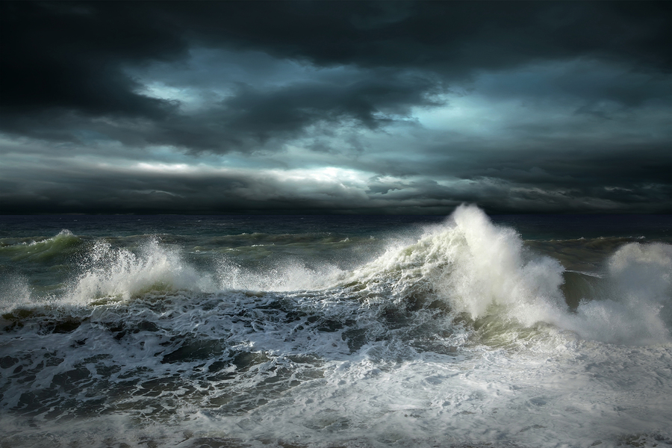
How to Instigate Action on Climate Change
Kerry Emanuel
Lorenz Center
Massachusetts Institute of Technology

Slide 2
Program
What climate science tells us
Human consequences of climate change
Why we should stop subsidizing risk

Slide 3

Reconstruction of the West Antarctic mid-Cretaceous (~100 million years ago) temperate rainforest.
Image credit: J. McKay / Alfred-Wegener-Institut

Slide 4
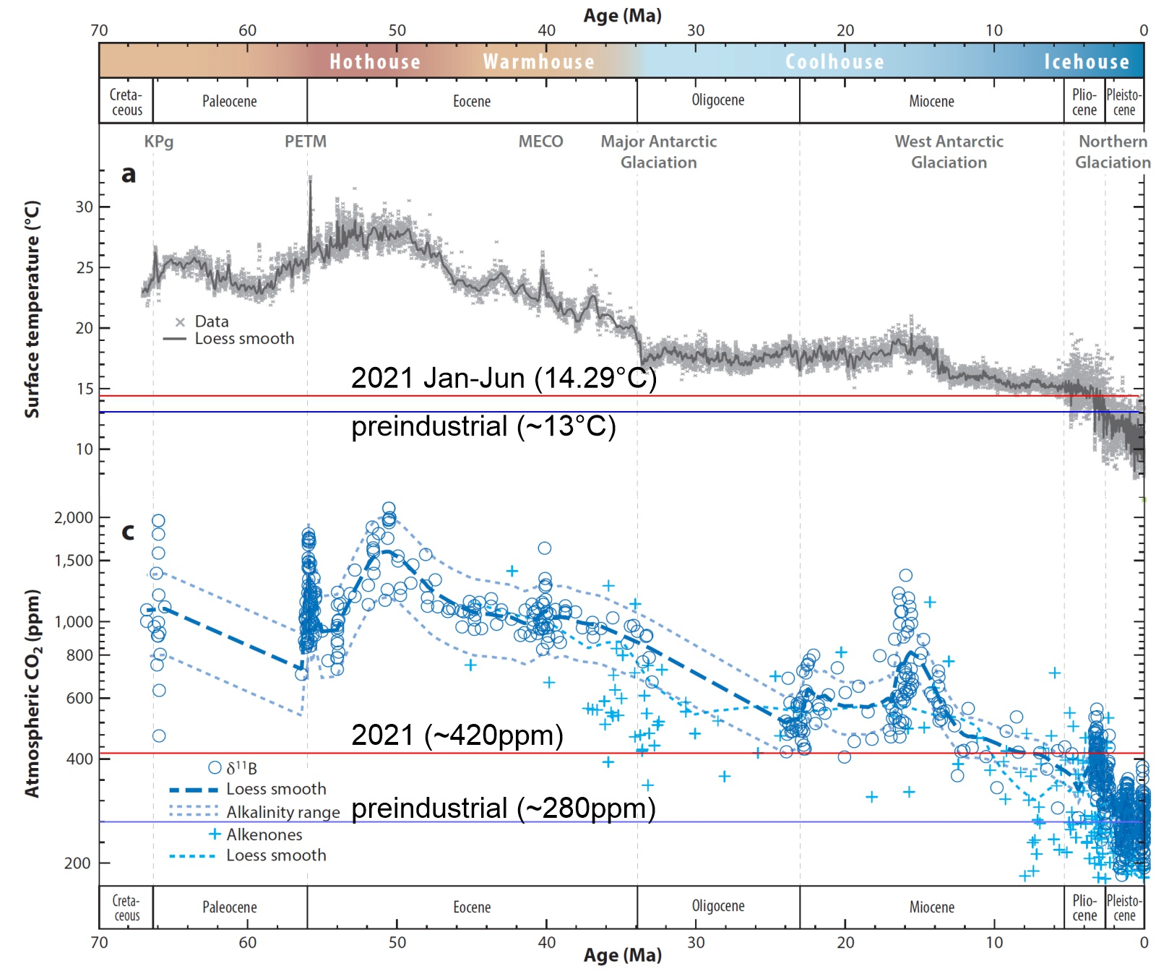

Slide 5
The Greenhouse Effect

Slide 6
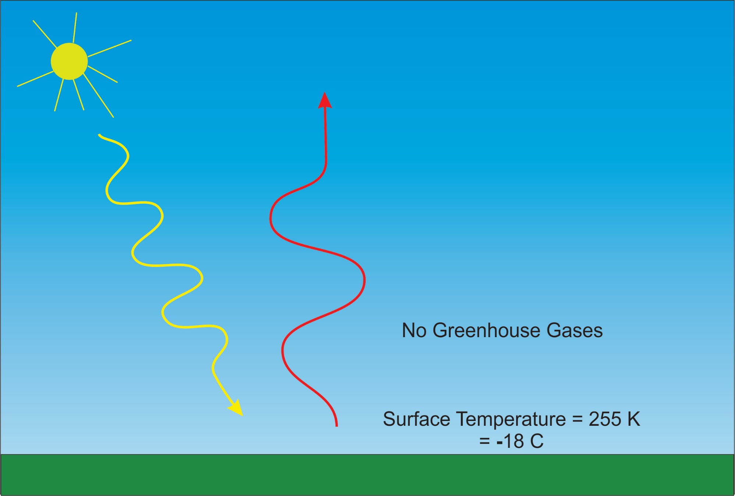

Slide 7
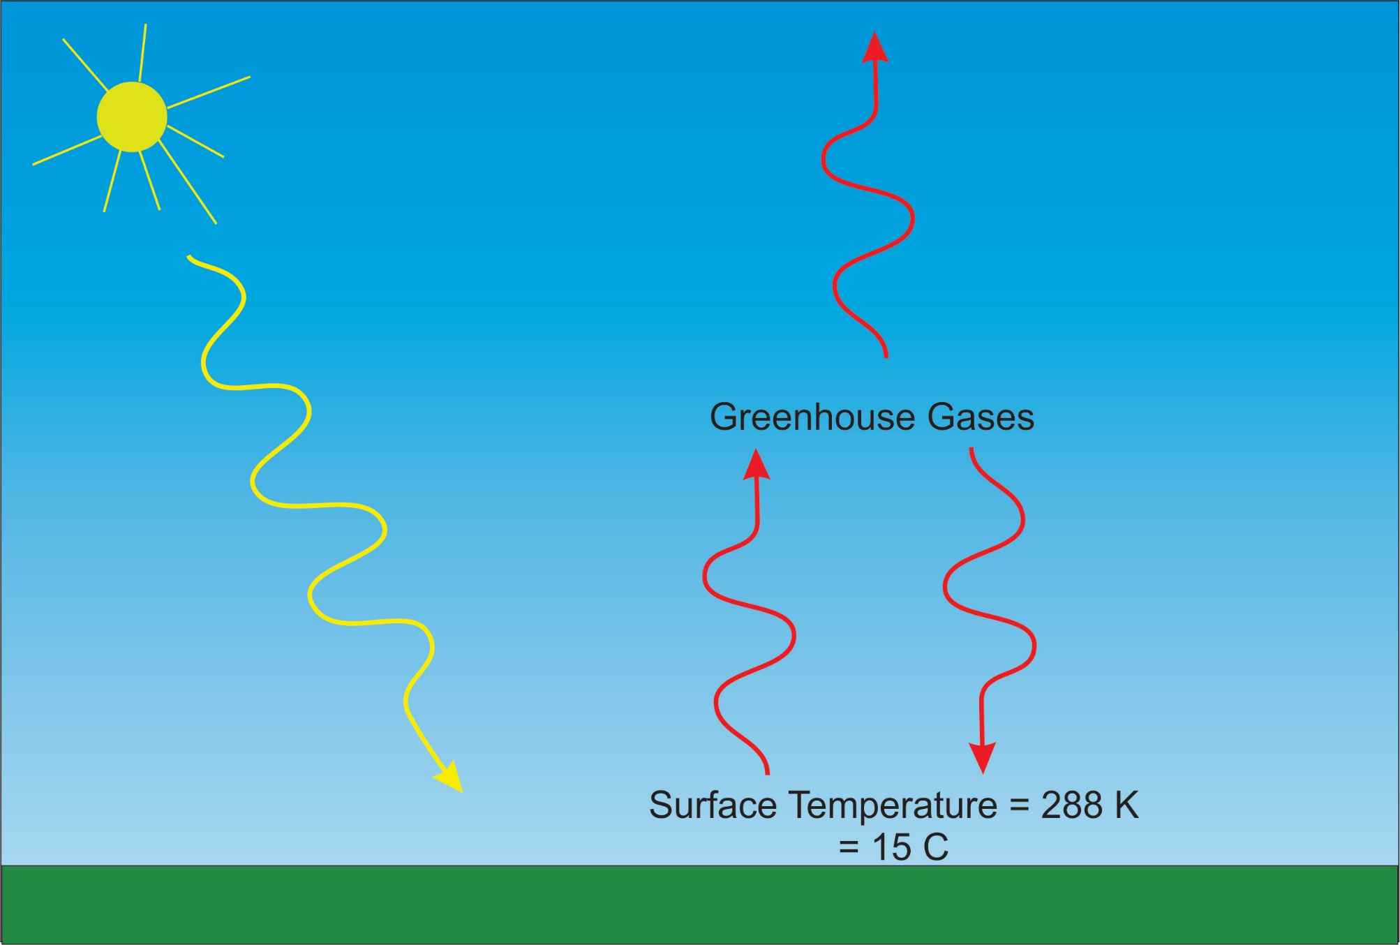

Slide 8
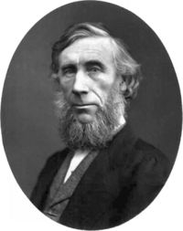
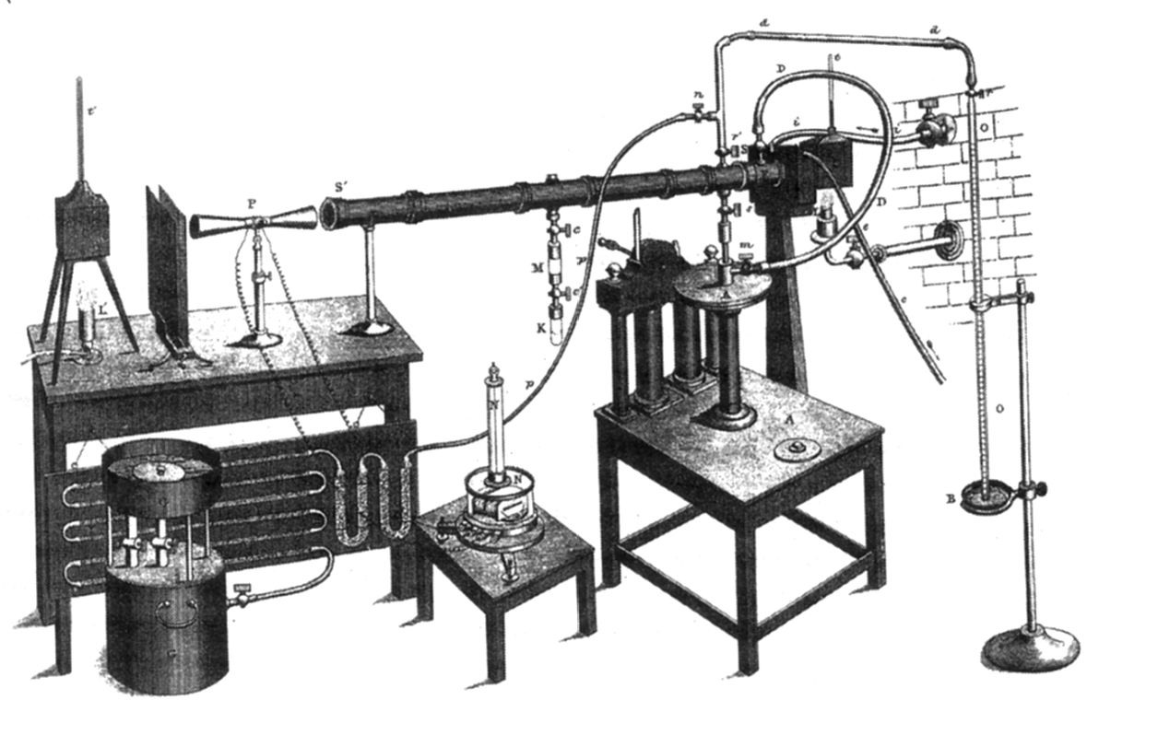
John Tyndall (1820-1893)

Slide 9
Atmospheric Composition
No effect on radiation
The orange sliver makes the difference between a mean surface temperature of 0ºF and of 60ºF.

Slide 10
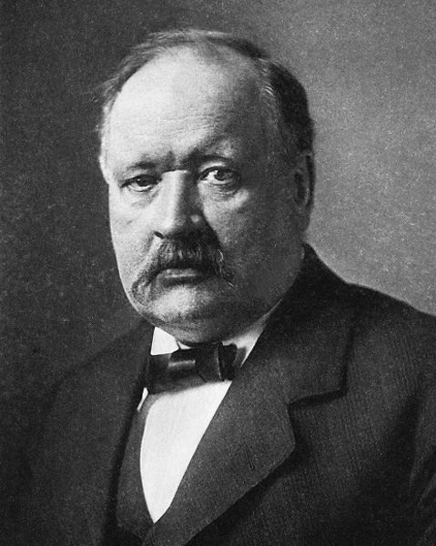
Svante Arrhenius, 1859-1927
“Any doubling of the percentage of carbon dioxide in the air would raise the temperature of the earth's surface by 4°; and if the carbon dioxide were increased fourfold, the temperature would rise by 8°.” – Världarnas utveckling (Worlds in the Making), 1906

Slide 11
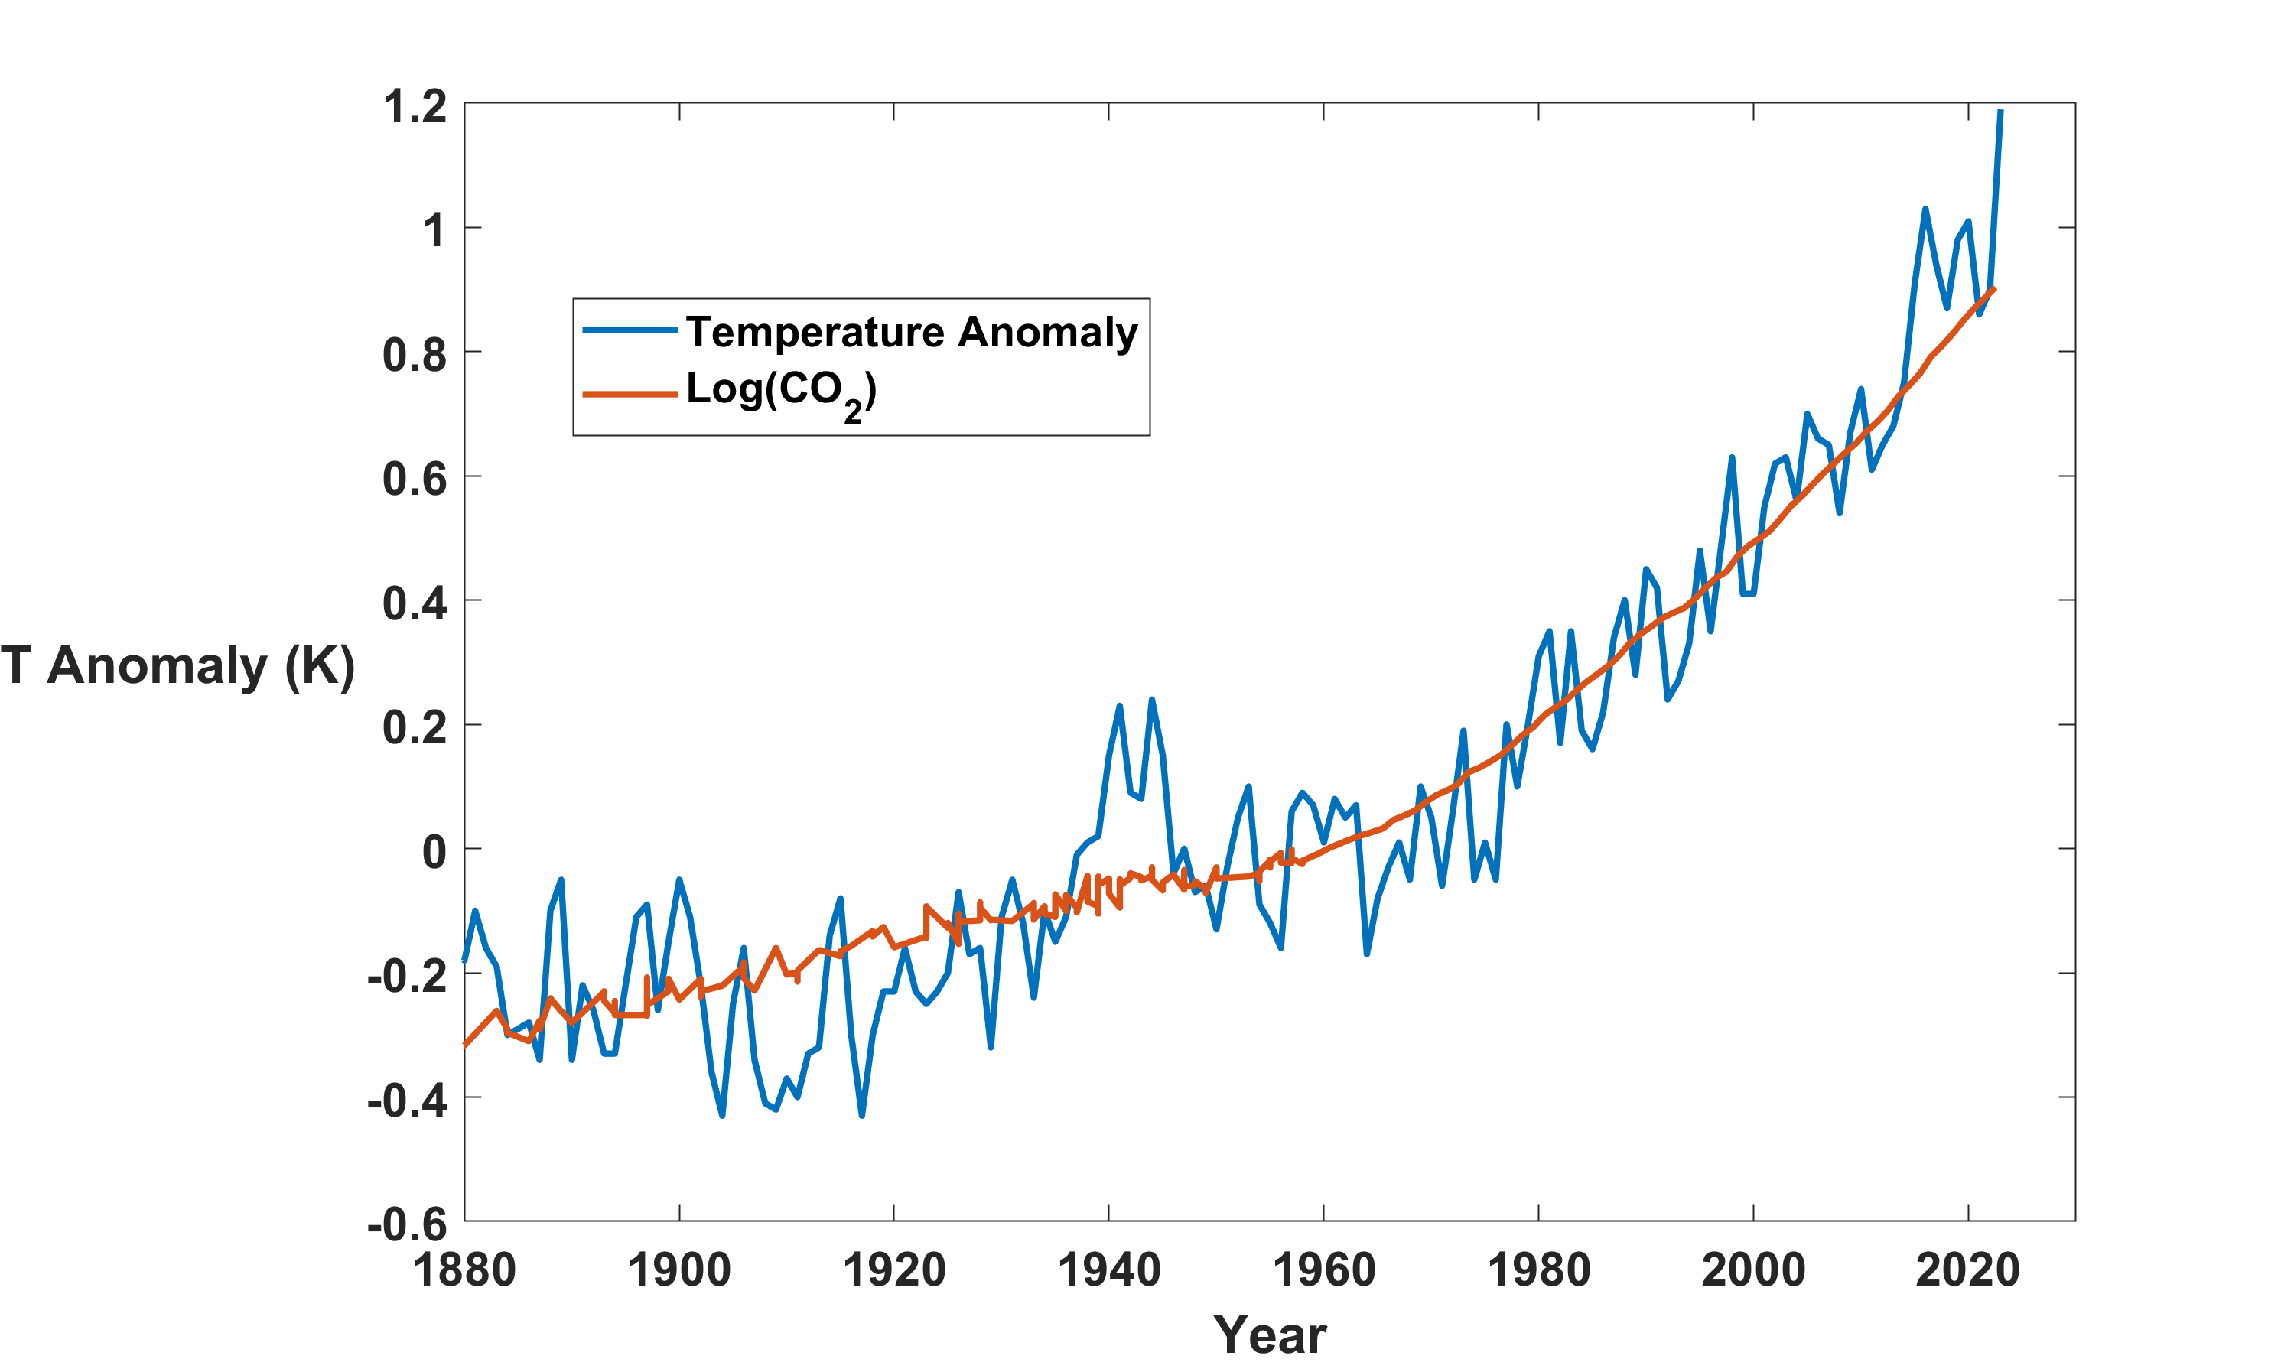
Global Mean Temperature and CO₂
2023

Slide 12
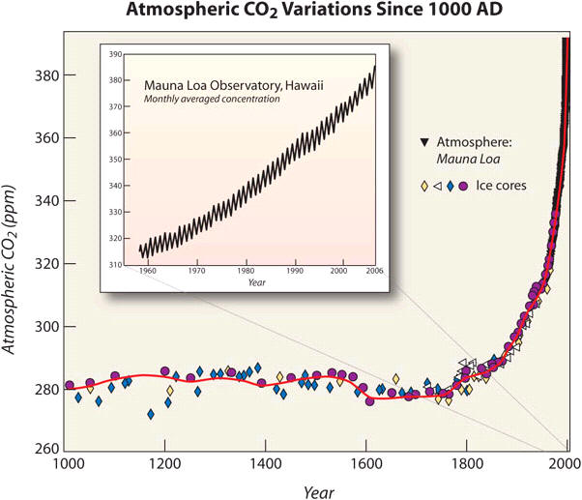
Today

Slide 13
Why Should We Care?

Slide 14
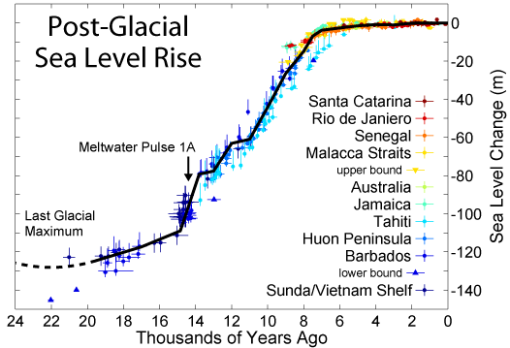
Human civilization began around 7,000 years ago
We are highly adapted to the very stable climate of the last 7,000 years

Slide 15
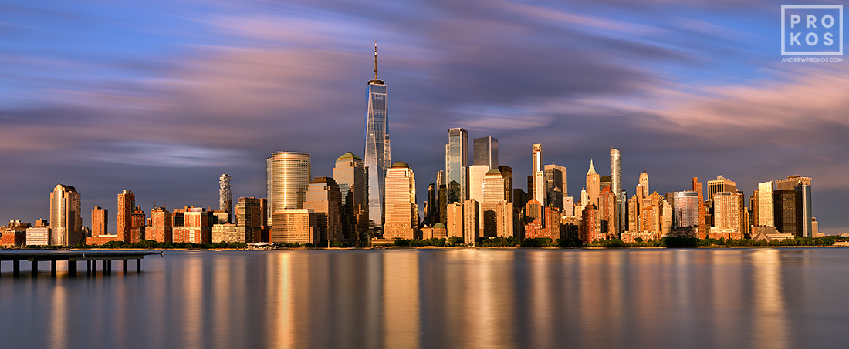
New York City
Sea level, if Greenland and Antarctic ice sheets melt

Slide 16
Known Risks
Increasing sea level
Increasing hydrological events… droughts and floods
Increasing incidence of high category hurricanes and associated storm surges and freshwater flooding
More heat stress and other health risks
Armed conflict
Some increase in plant productivity
Reduction in health problems related to cold weather
Benefits

Slide 17
“Climate change could have significant geopolitical impacts around the world, contributing to poverty, environmental degradation, and the further weakening of fragile governments. Climate change will contribute to food and water scarcity, will increase the spread of disease, and may spur or exacerbate mass migration.”
    -- Quadrennial Defense Review, U.S. Department of Defense, February, 2010

Slide 18
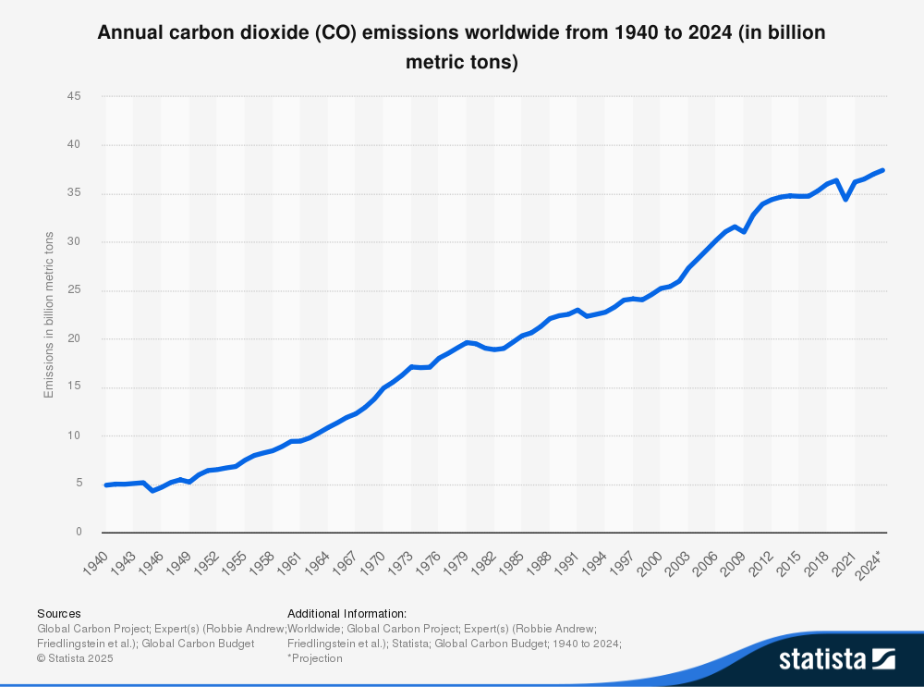
Despite wide publicity of climate risk and large subsidies for renewables, carbon emissions continue to climb

Slide 19
Why are we failing to curb emissions?
Short answer: We are insulating people from the growing climate risk and even paying them to move from safer to risker places

Slide 20
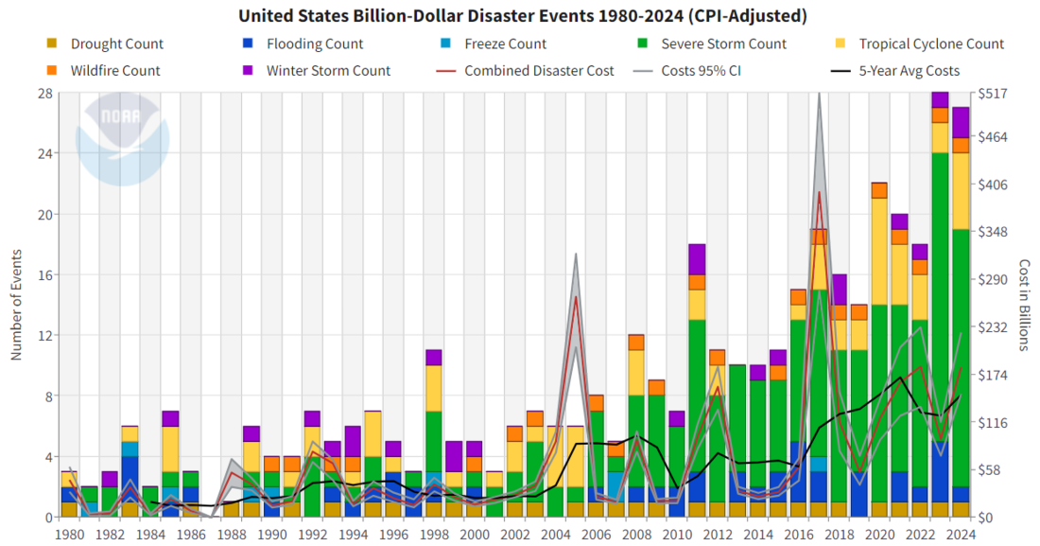
Damages from Natural Disasters are Increasing
Source: National Oceanic and Atmospheric Administration (NOAA)

Slide 21
Global Damage Normalized by Gross World Product
Storms, droughts, floods, wildfires
270% increase since 1970
Population of TC-prone regions increased by ~200%
Climate change may have contributed to increasing damage
EM-DAT, 2024: The OFDA/CRED International Disaster Database
http://www.emdat.be/.

Slide 23
People are migrating from relatively safe places to dangerous ones.
WHY?

Slide 24
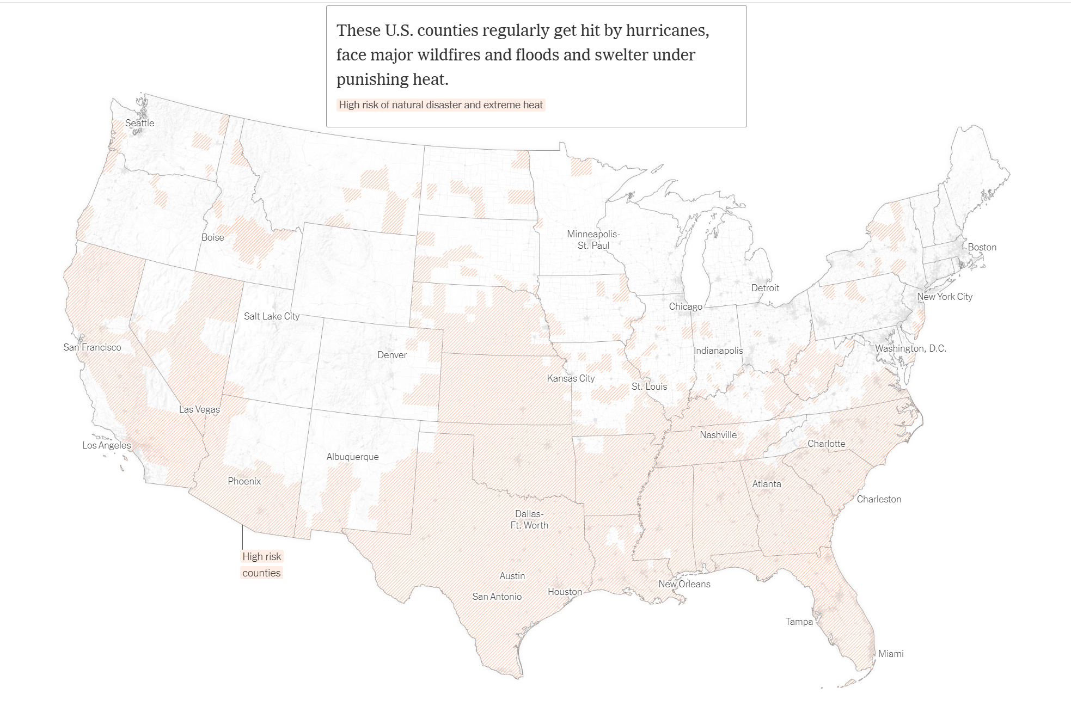
Source: New York Times

Slide 26
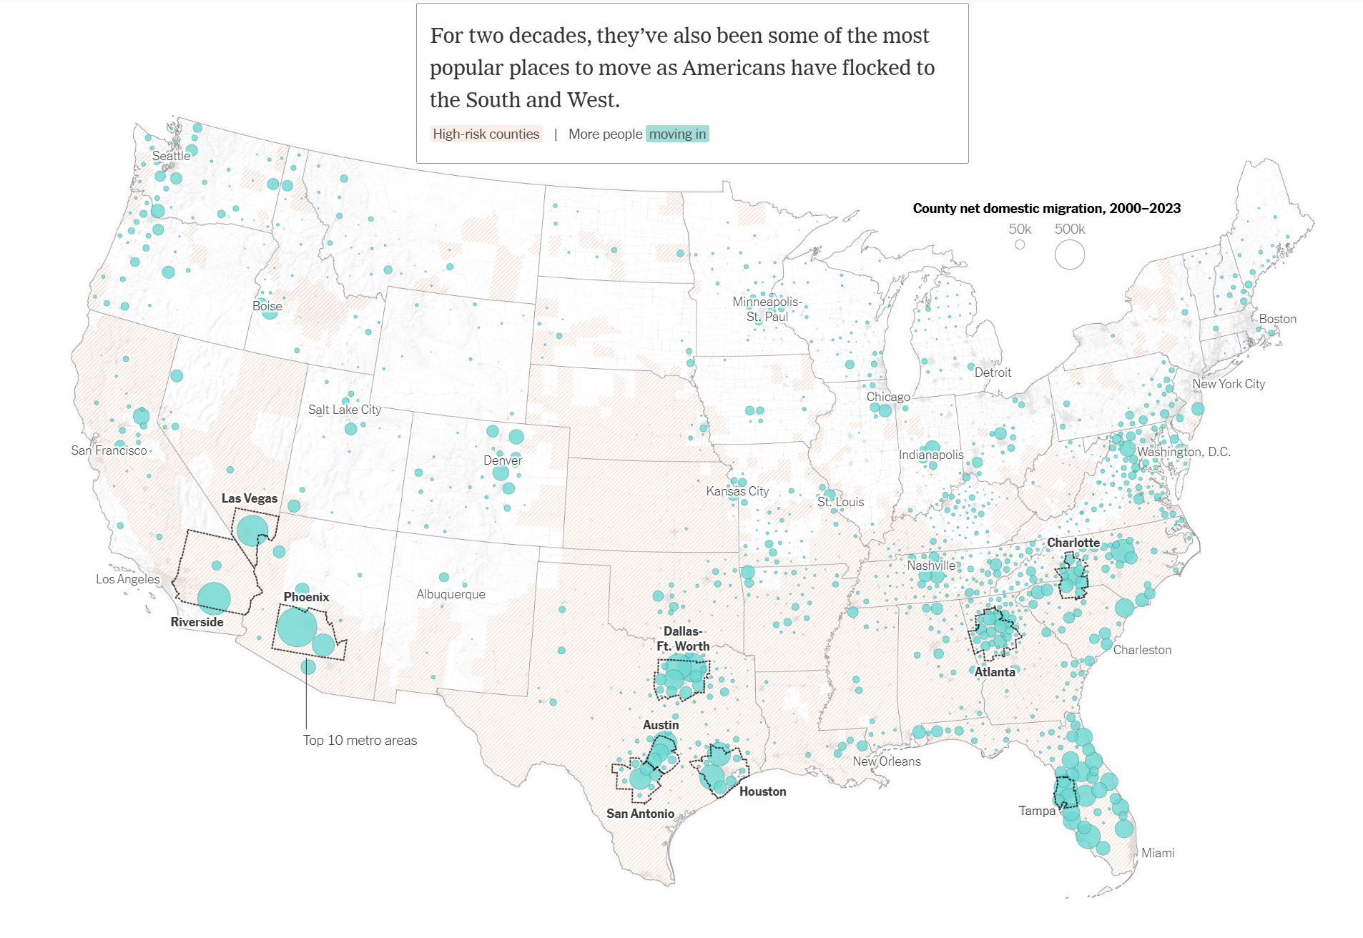
Source: New York Times

Slide 27
Here is why we move to more dangerous places:
All water damage is insured by the federal government through the National Flood Insurance Program (NFIP)
Political pressure forces rates to be artificially low in risky places and too high in safe places
Insurance is regulated by individual states through insurance commissioners
Regulation was supposed to ensure solvency but long ago became captive to special interests
State insurance commissioners routinely cap insurance premiums in risky areas, such as coastal regions

Slide 30
Franklin county
First Street Foundation

Slide 31
First Street Foundation

Slide 32
SFHA=special flood hazard area
Whose paying for this?
Kansas!
Courtesy First Street Foundation

Slide 36
FEMA’s flood maps are being challenged
FEMA flood maps are based strictly on historical data, going back ~100 years
Climate change has already rendered obsolete risk estimates centered on the climate of about 50 years ago
First Street Foundation and others have used physics- based models to estimate current risk
These suggest that in many places the risk is much worse than FEMA estimates

Slide 37
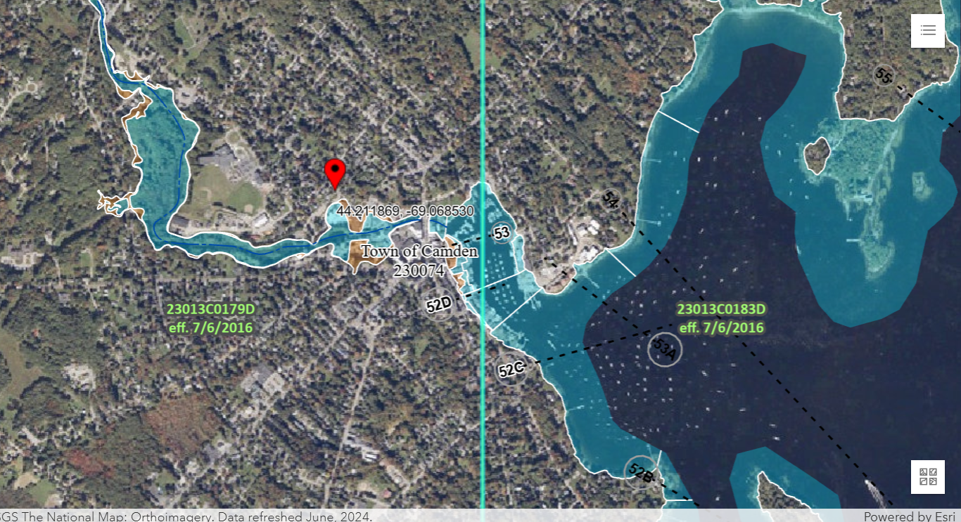
FEMA’s flood map for Camden

Slide 38
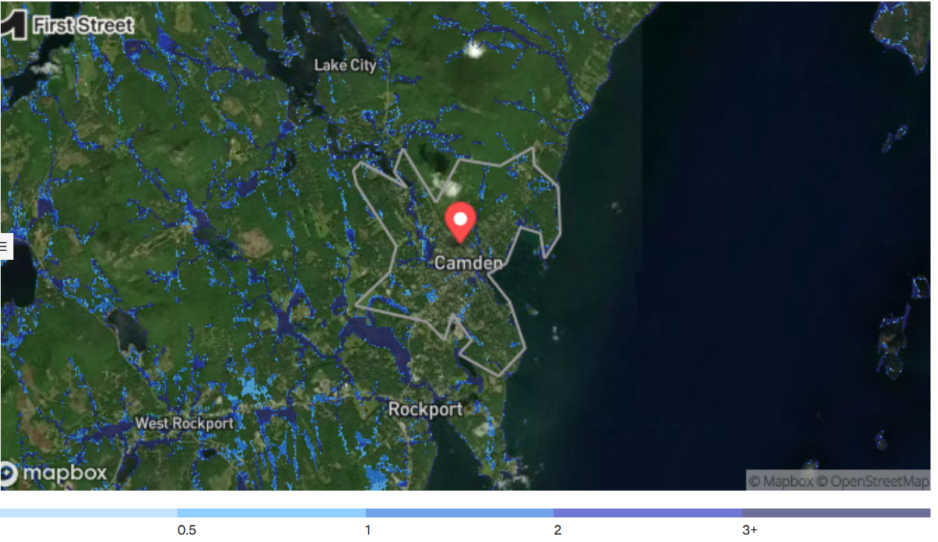
First Street Flood Regions

Slide 39
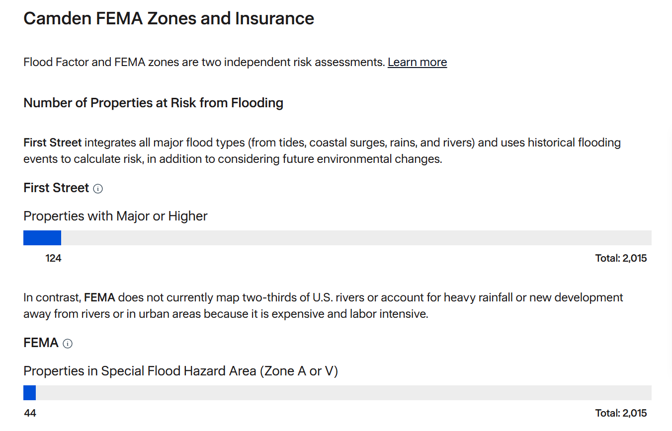

Slide 40
Case Study: The Camden National Bank
First Street Foundation, 2024

Slide 41
Camden National Bank
Number one on the top 10 list of U.S. banks with the highest ratio of uninsured damage relative to total property value of their portfolio of branches
Just over $3.7 billion in outstanding real estate loans
In a 1% annual likelihood weather event, the bank branches would incur over $18 million in gross damages, with $17.8 million of that being uninsured
Data from First Street Foundation, September, 2024

Slide 43
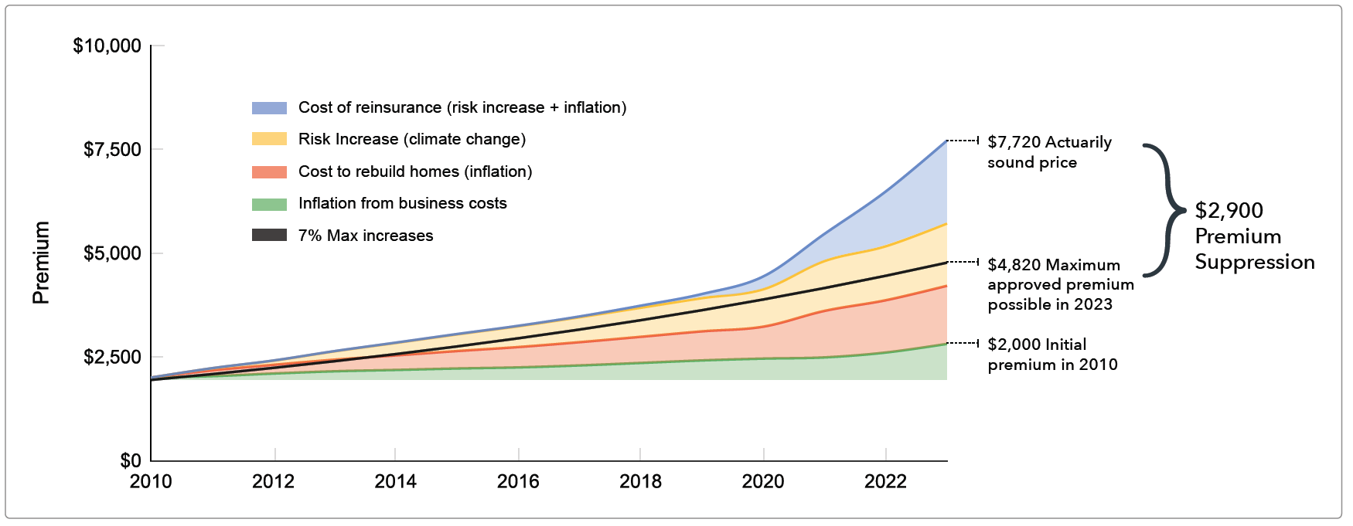
Under political pressure, state insurance commissioners (some of whom are elected) place caps on private insurance premiums, forcing the firms to lose money
Insurance premiums in California
The result: Massive exodus of insurance companies from California, including State Farm, Allstate, Farmers, American National, Chubb and Tokio Marine

Slide 44
Private insurance has become large unprofitable
U.S. Homeowners insurance annual combined ratio

Slide 45
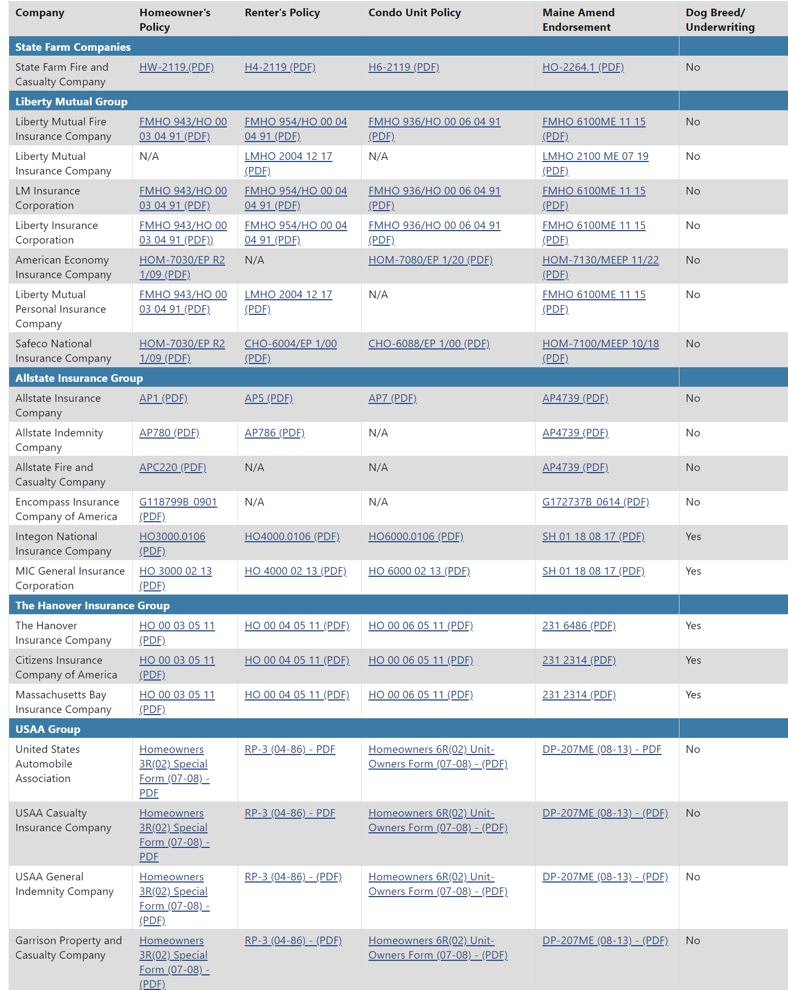
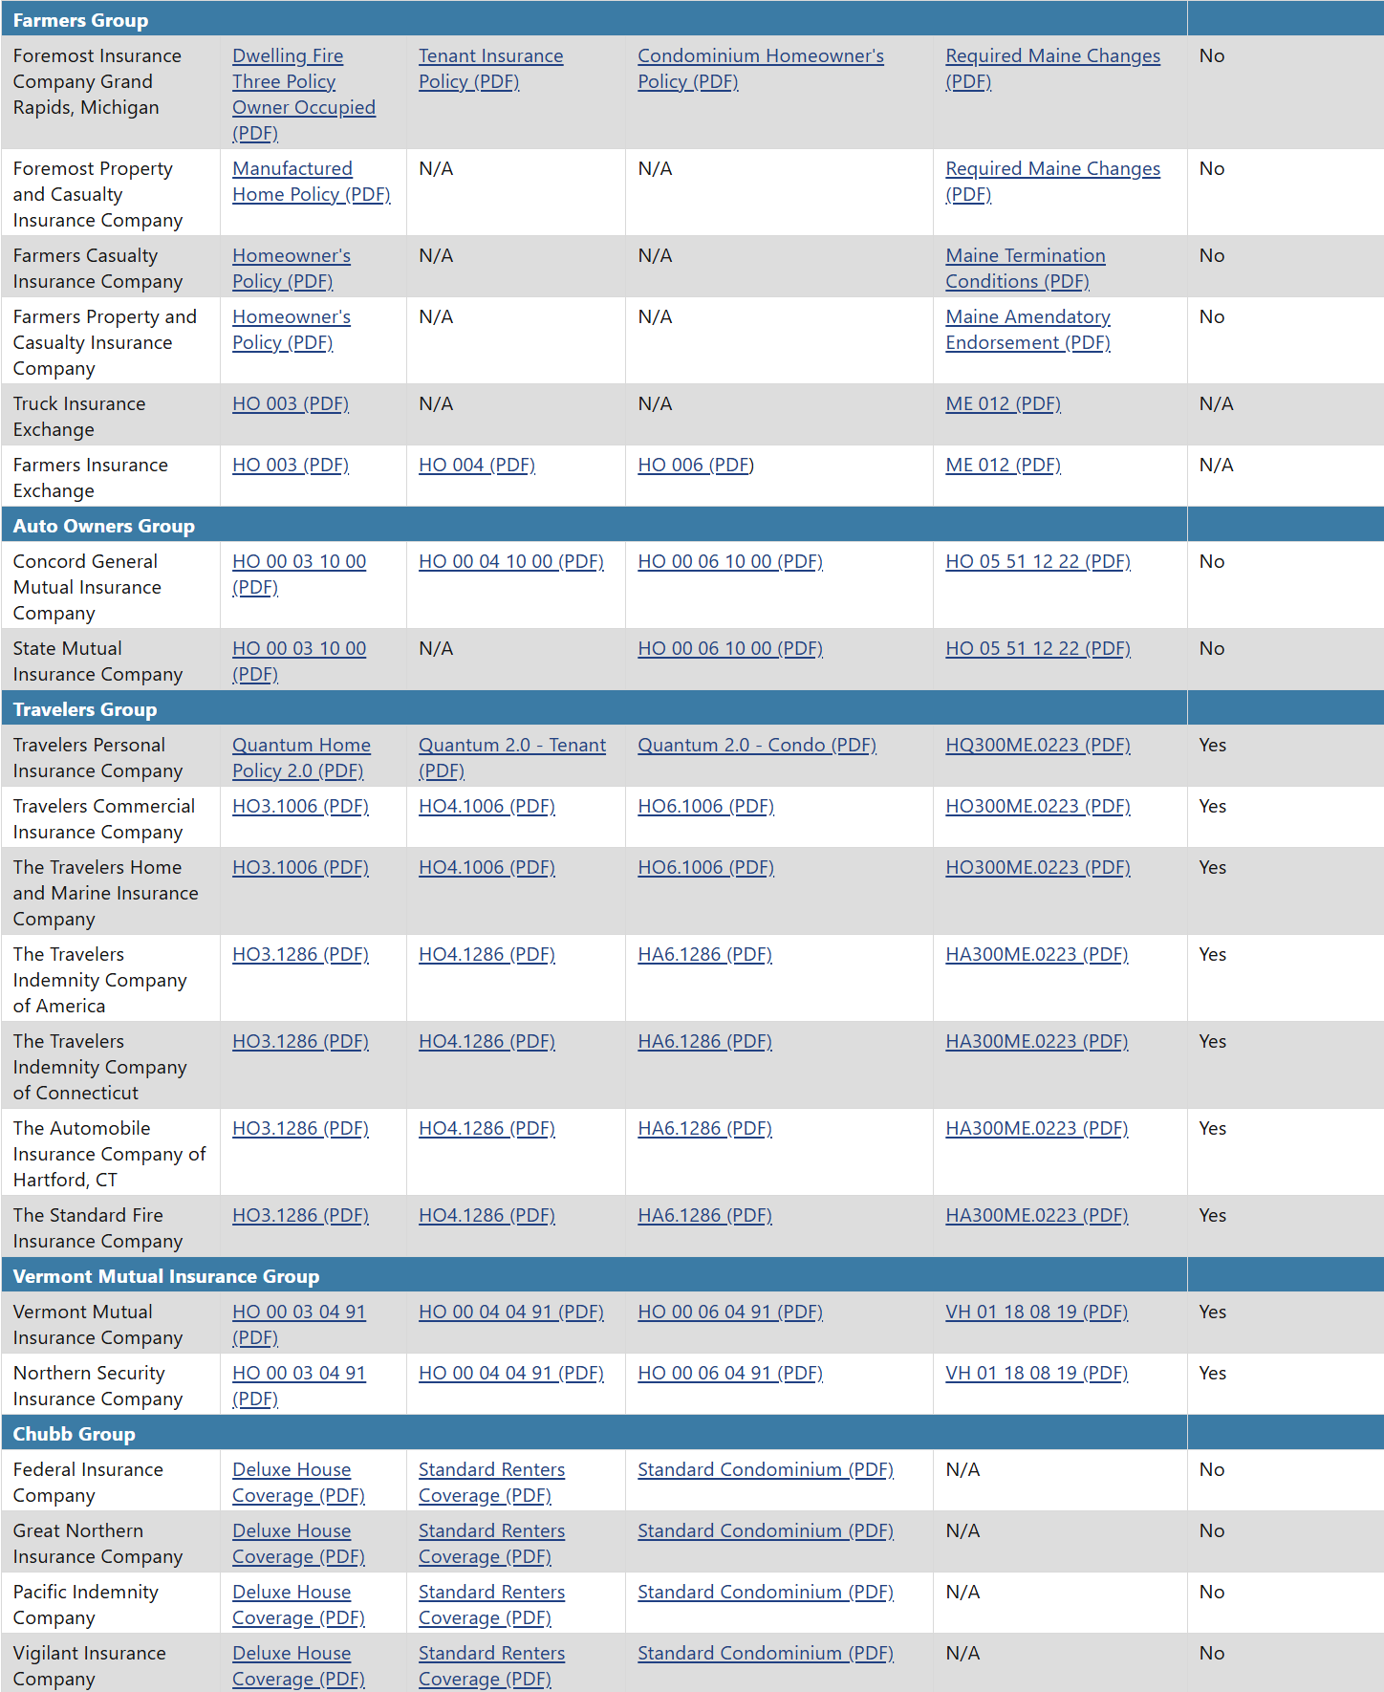
But private insurance is highly competitive; its premiums do not need to be regulated
Homeowner’s Insurance Companies Doing Business in Maine (2025)
Source: State of Maine Bureau of Insurance

Slide 46
What A Mess
National Flood Insurance has been captured by special interests in risky places, holding down premiums there, with premiums too high in less risky areas
State regulation of private insurance has capped premiums in risky places, causing insolvency in direct contradiction to its mandate
We are paying folks to move to and develop risk-prone regions
This is driving up damages, with climate change acting as a large threat multiplier

Slide 47
Consequences
We have inadvertently encouraged a massive migration from safer to riskier places by preventing insurance from communicating risk
Relatively poor people are paying the insurance bills of relatively wealthy people
Damages are soaring, amplified by climate change
We are insulating wealthier and more politically influential people from climate change and reducing their incentive to do something about it

Slide 48
Options
Stop subsidizing risk
  State regulators should stop capping premiums
  It is time to privatize flood insurance
Doing the above instantaneously would cause immense suffering – in some places premiums would rise more than a factor of ten
Government could ease the pain through buy- back programs and by temporarily subsidizing premiums for the less well off
The most dangerous places could undertake managed retreat, encouraging individuals and, where appropriate, whole communities to move

