Slide 1

Climate, Energy, and Security:
Risks and Opportunities
Kerry Emanuel
Lorenz Center
Department of Earth, Atmospheric, and Planetary Sciences, MIT

Slide 2
Climate

Slide 3

Svante Arrhenius, 1859-1927
“Any doubling of the percentage of carbon dioxide in the air would raise the temperature of the earth's surface by 4°; and if the carbon dioxide were increased fourfold, the temperature would rise by 8°.” – Världarnas utveckling (Worlds in the Making), 1906

Slide 4
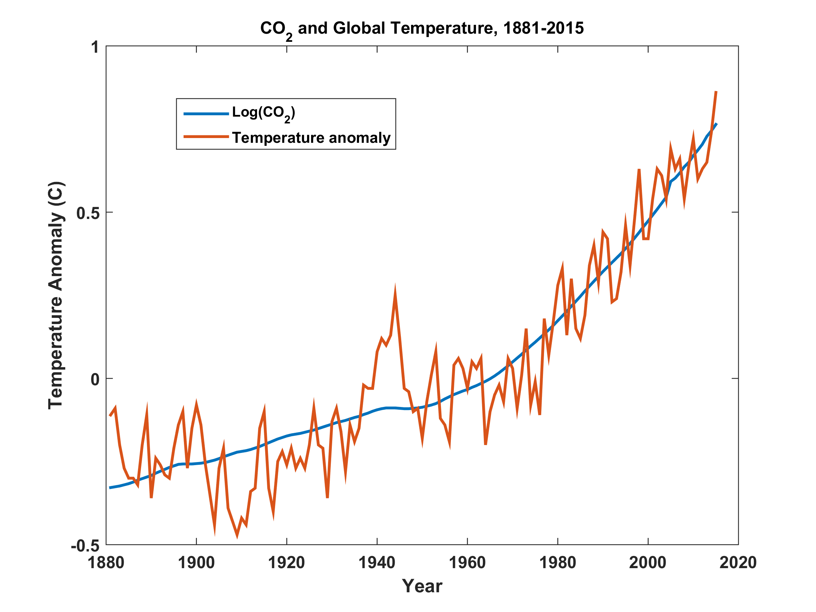

Slide 5
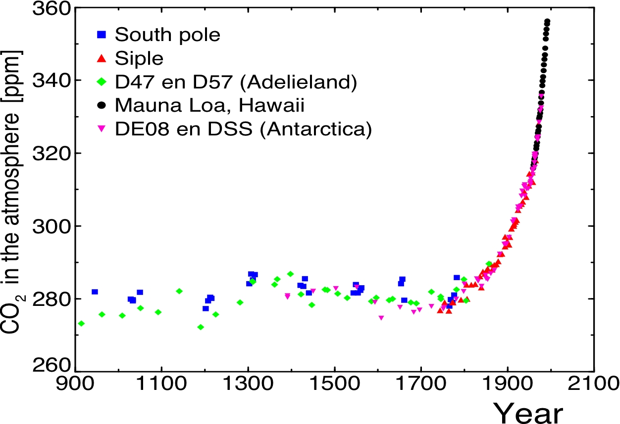
Today

Slide 6
20th Century With and Without Human Influences
Based on 4-member PCM ensembles, Meehl et al., J. Climate, 2004

Slide 7
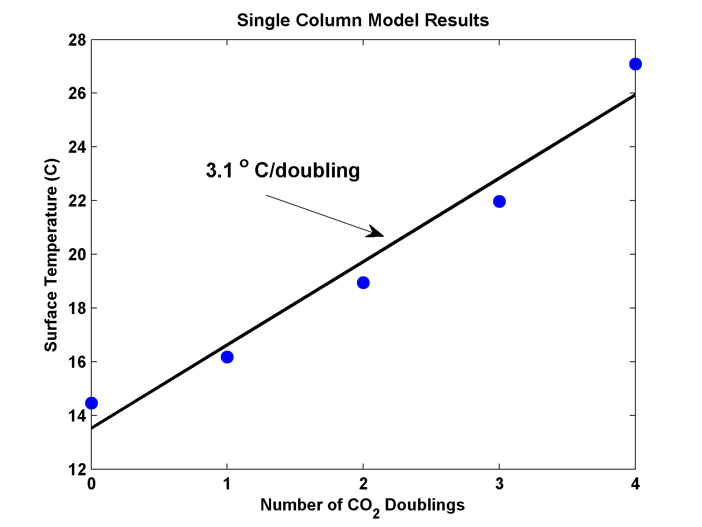
MIT Single Column Model
IPCC Estimate:
2-4.5 ºC

Slide 8
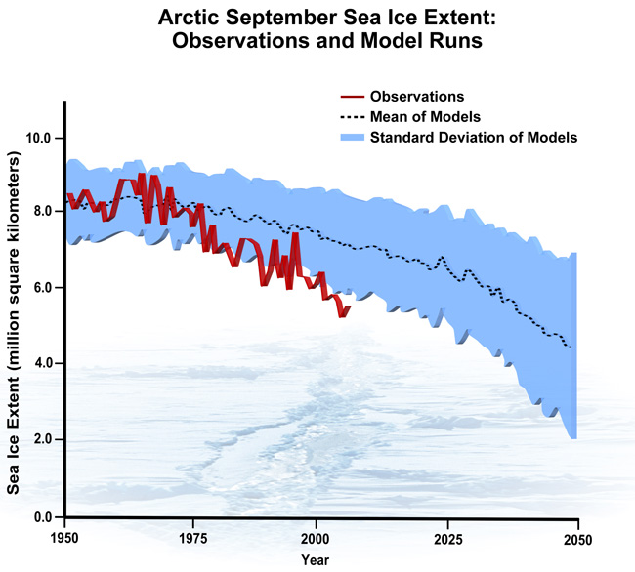
September Arctic Sea Ice Extent

Slide 9
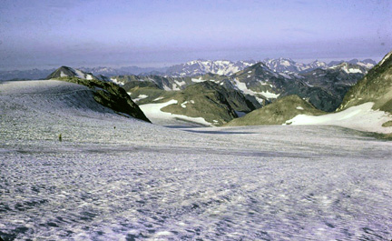
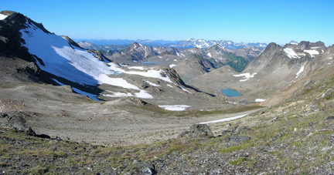
White Chuck Glacier,
Washington state, in 1973
White Chuck Glacier in 2006 from same vantage point. The glacier retreated 1.2 miles in 30 years.

Slide 10
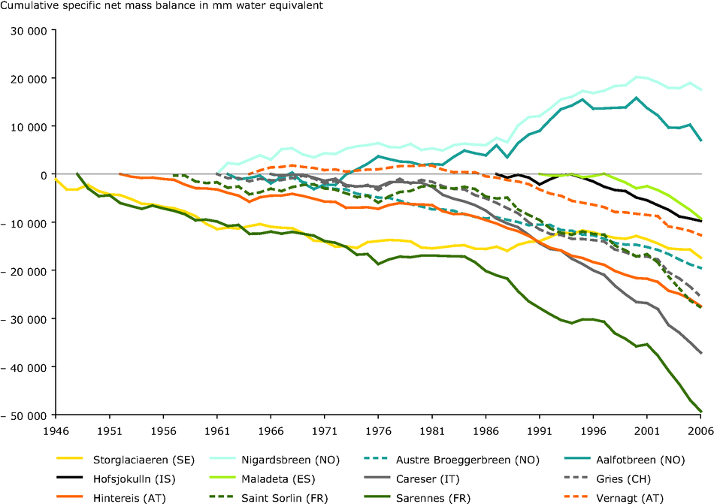
European Alpine Glaciers

Slide 11
Time series of the latitudes at which tropical cyclones reach maximum intensity.
From Kossin et al. (2014)

Slide 12

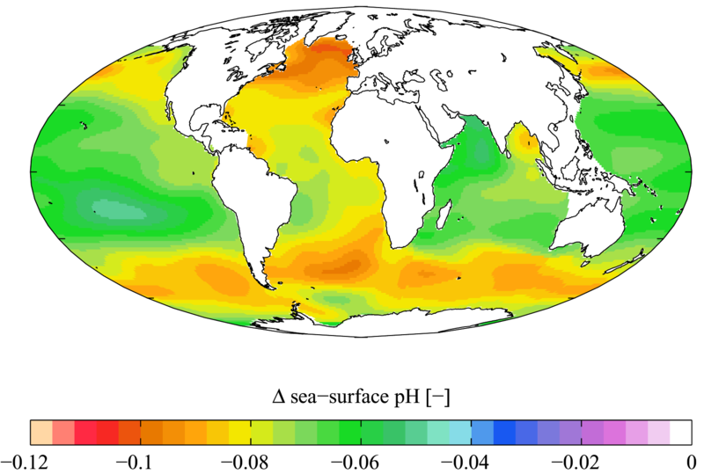

Slide 13

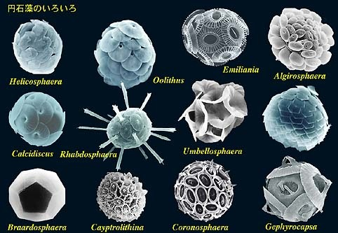
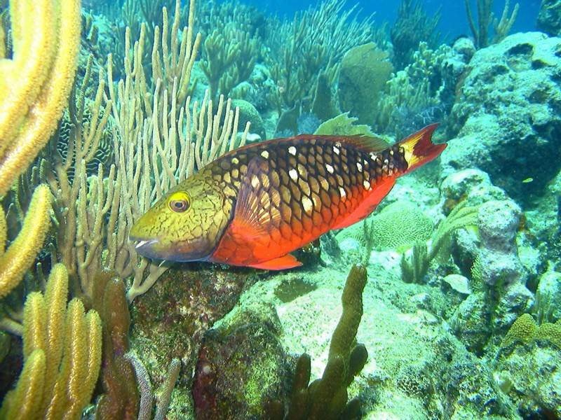
Acidification through CO₂ threatens marine life
Plankton
Coral Reefs
Notes:
Abbildung 4.3-1
Aragonitsättigung und
gegenwärtige Riffstandorte
von Warmwasserkorallen
(blaue Punkte). (a)
vorindustrielle Werte
(ca. 1870, atmosphärische
CO2-Konzentration
280 ppm), (b) Gegenwart
(ca. 2005, 375 ppm CO2), (c)
Zukunft (ca. 2065, 517 ppm
CO2). Der Grad der
Aragonitsättigung (Ù)
bezeichnet das relative
Verhältnis zwischen dem
Produkt der Konzentrationen
von Kalzium- und
Karbonationen und dem
Löslichkeitsprodukt für
Aragonit. Standorte mit
einer Aragonitsättigung
unterhalb von 3,5 sind nur
noch bedingt für riffbildende
Warmwasserkorallen
geeignet (marginal),
unterhalb von 3 sind sie
ungeeignet.
Quelle: Steffen et al., 2004

Slide 14

Sources of Uncertainty
Cloud Feedback
Water Vapor Feedback
Ocean Response
Aerosols

Slide 15


Estimate of how much global climate will warm as a result of doubling CO₂: a probability distribution
Source: 100000 PAGE09 runs
Chris Hope, U. Cambridge
courtesy Tim Palmer
Notes:
Describe pdf. Reflects post-IPCC knowledge as well as IPCC AR4.

Slide 16

CO₂ Will Go Well Beyond Doubling
Double Pre-Industrial

Slide 17

IPCC 2007: Doubling CO₂ will lead to an increase in mean global surface temperature of 2 to 4.5 ºC.
Atmospheric CO₂ assuming that emissions stop altogether after peak concentrations
Global mean surface temperature corresponding to atmospheric CO₂ above
Courtesy Susan Solomon

Slide 18
Known Risks
Increasing sea level
Increasing hydrological events… droughts and floods
Increasing incidence of high category hurricanes and associated storm surges and freshwater flooding
More heat stress

Slide 19
“Climate change could have significant geopolitical impacts around the world, contributing to poverty, environmental degradation, and the further weakening of fragile governments. Climate change will contribute to food and water scarcity, will increase the spread of disease, and may spur or exacerbate mass migration.”
    -- Quadrennial Defense Review, U.S. Department of Defense, February, 2010

Slide 20
Energy

Slide 21
Solutions and Opportunities
Renewables (solar and wind)
  Might provide up to 30% of current power needs
Carbon Capture and Sequestration
  Currently would add ~$200/ton to energy costs
  Reasonable prospects for reducing this to ~$100/ton
  Currently little incentive to develop this
Next Generation Fission Reactors

Slide 22
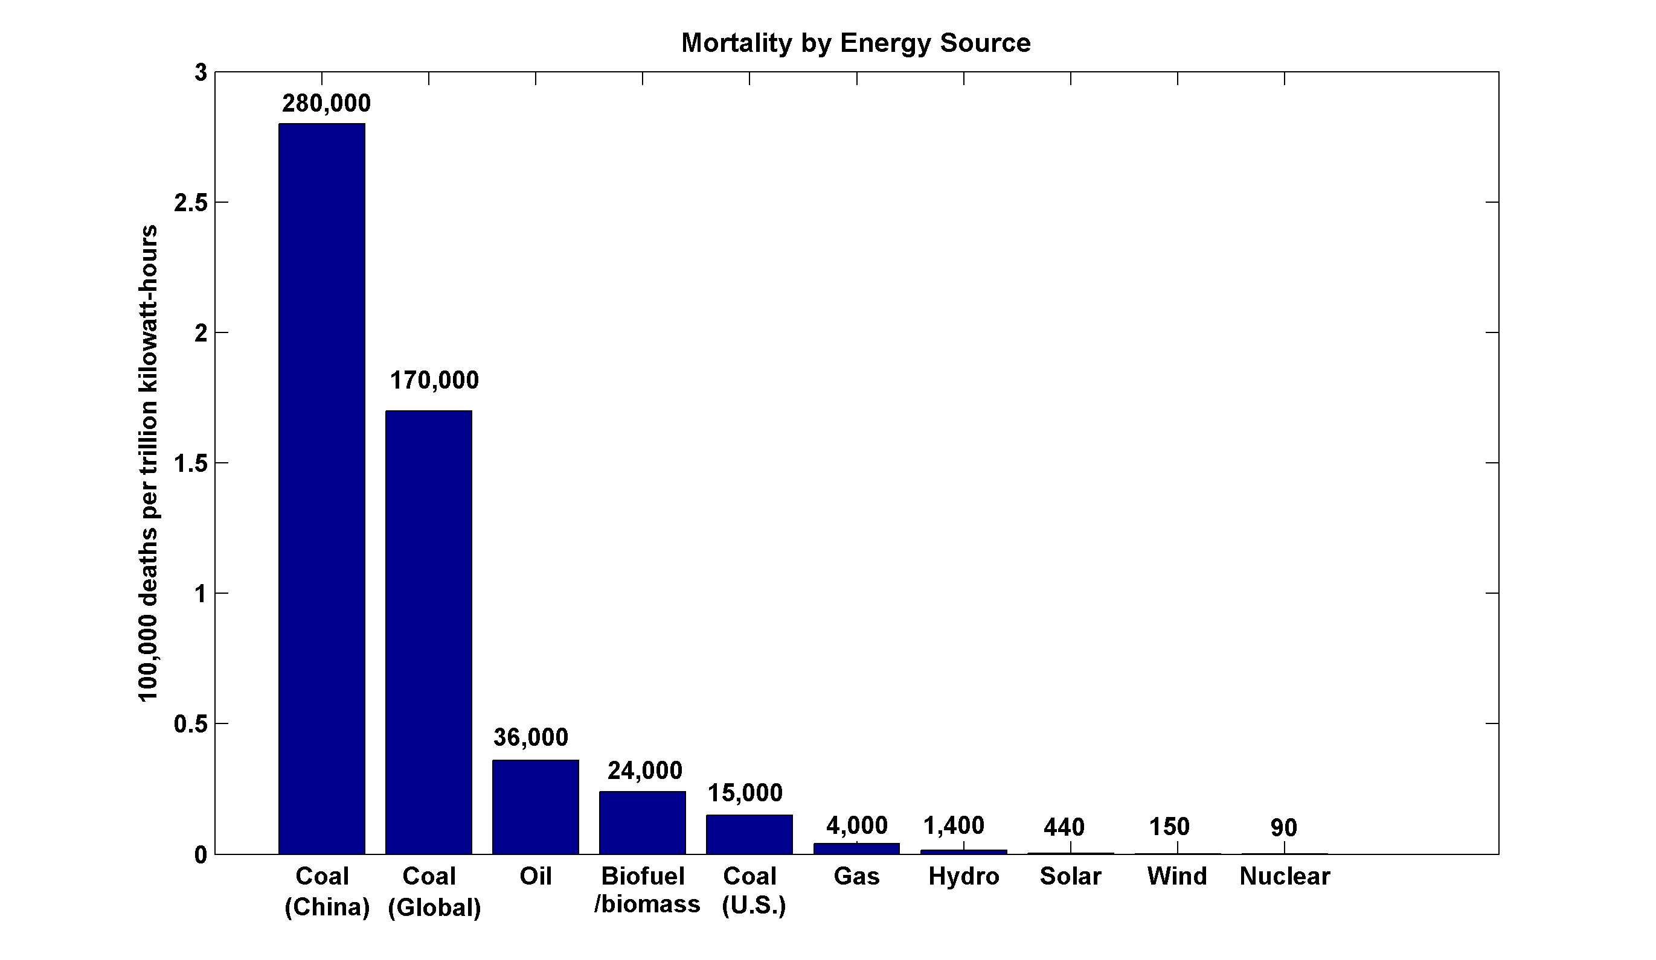
~13,000 premature deaths annually in the U.S. from coal production and combustion
Nuclear power, by replacing fossil fuels, has prevented an estimated 1.84 million air-pollution related deaths worldwide
(includes Chernobyl, Fukushima)

Slide 23
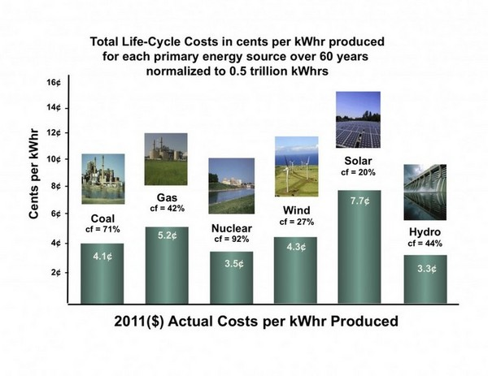
However, up-front capital costs of Gen I nuclear are large

Slide 24
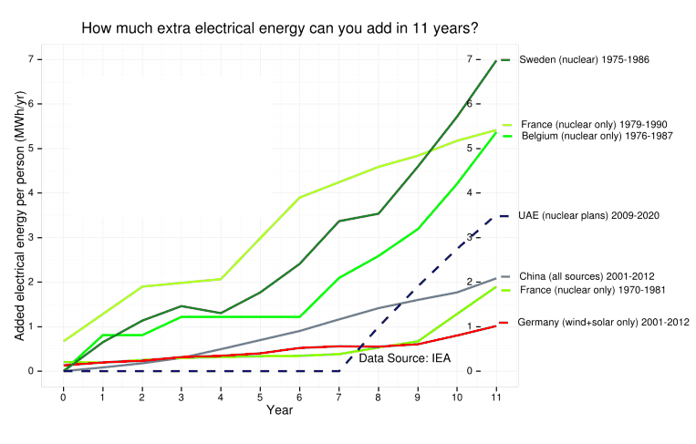

Slide 25
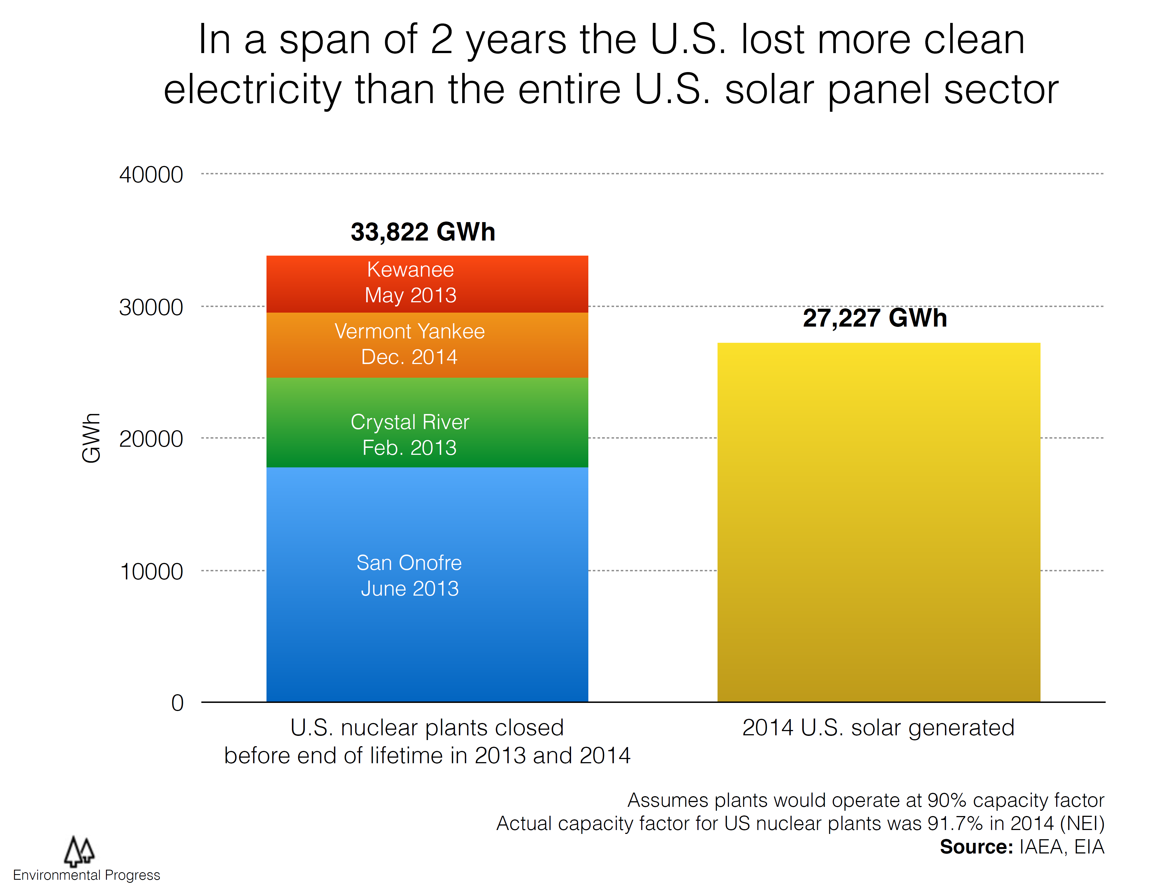

Slide 26
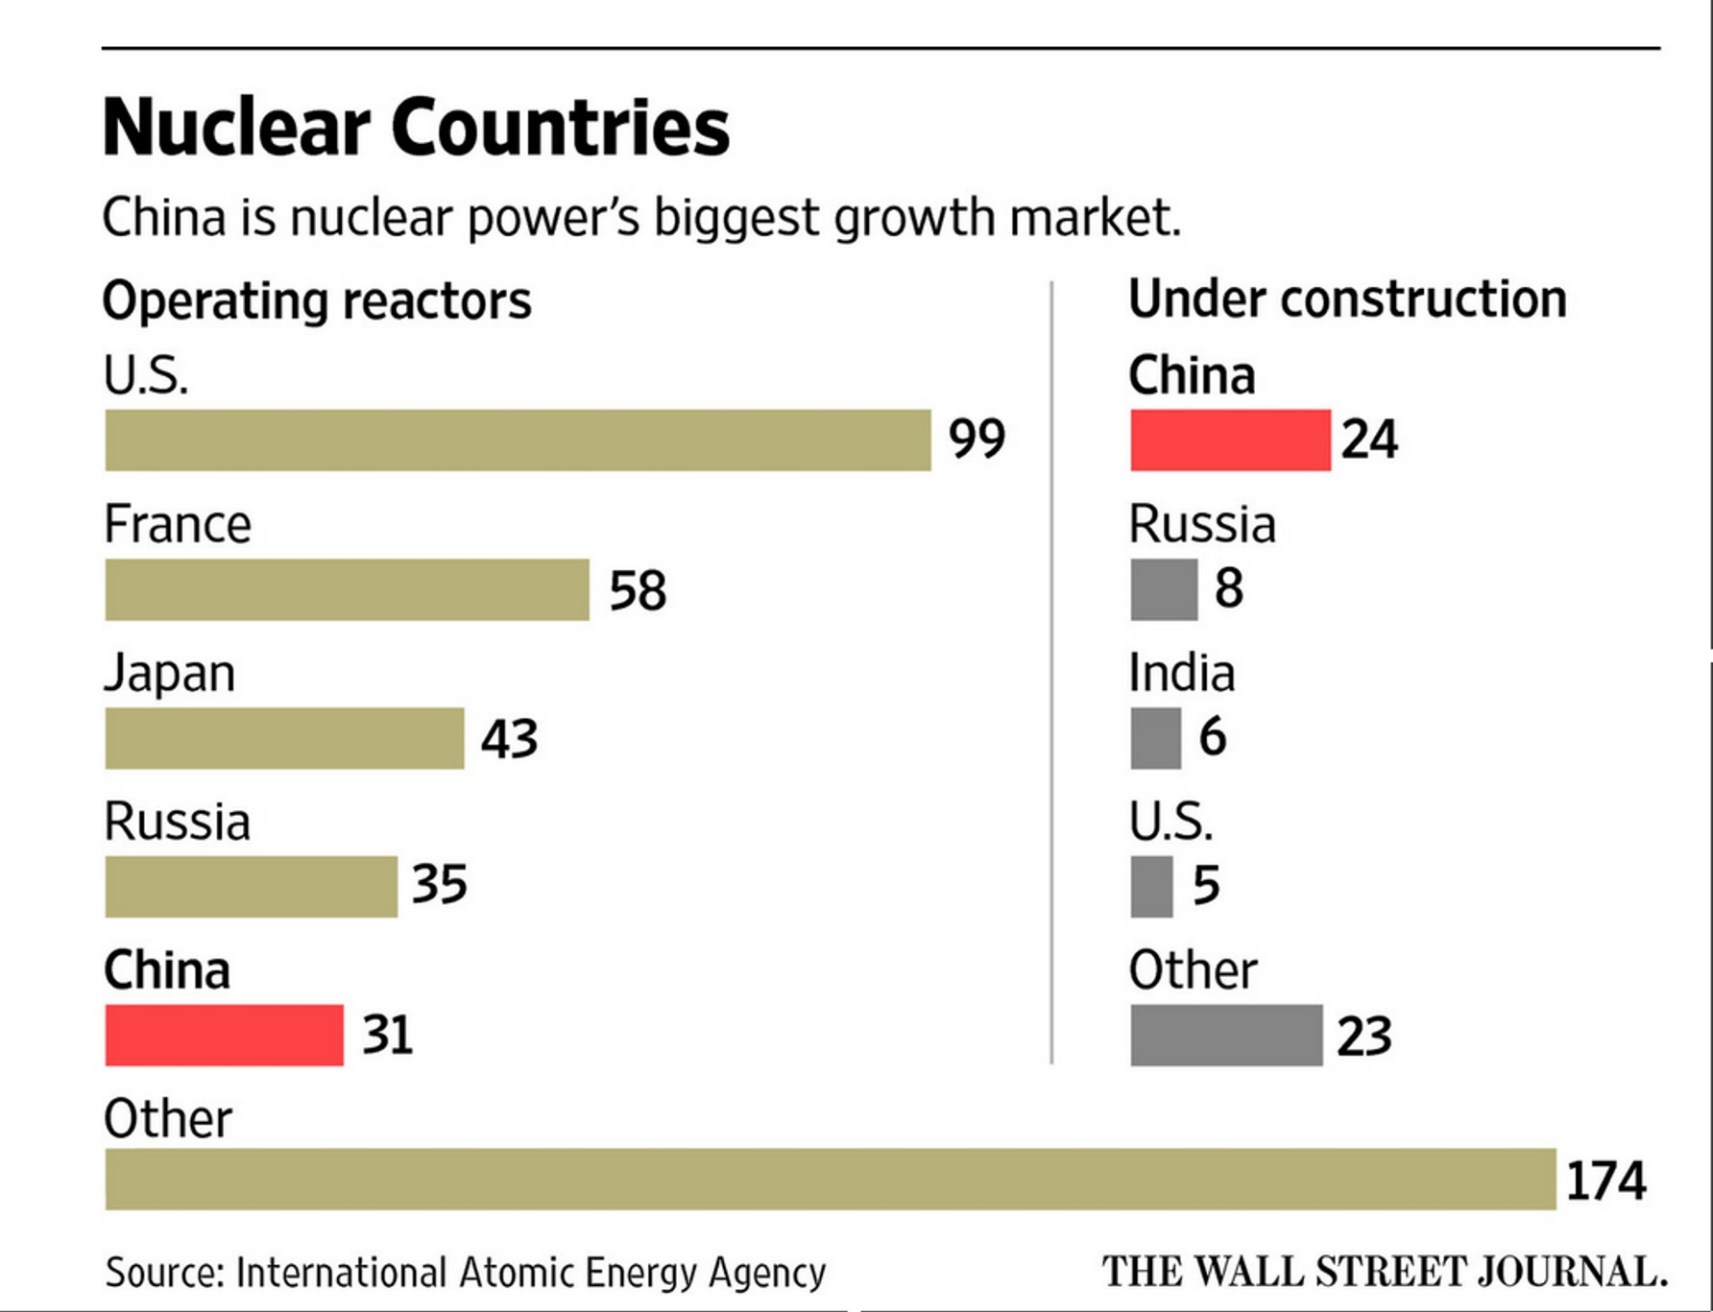

Slide 27
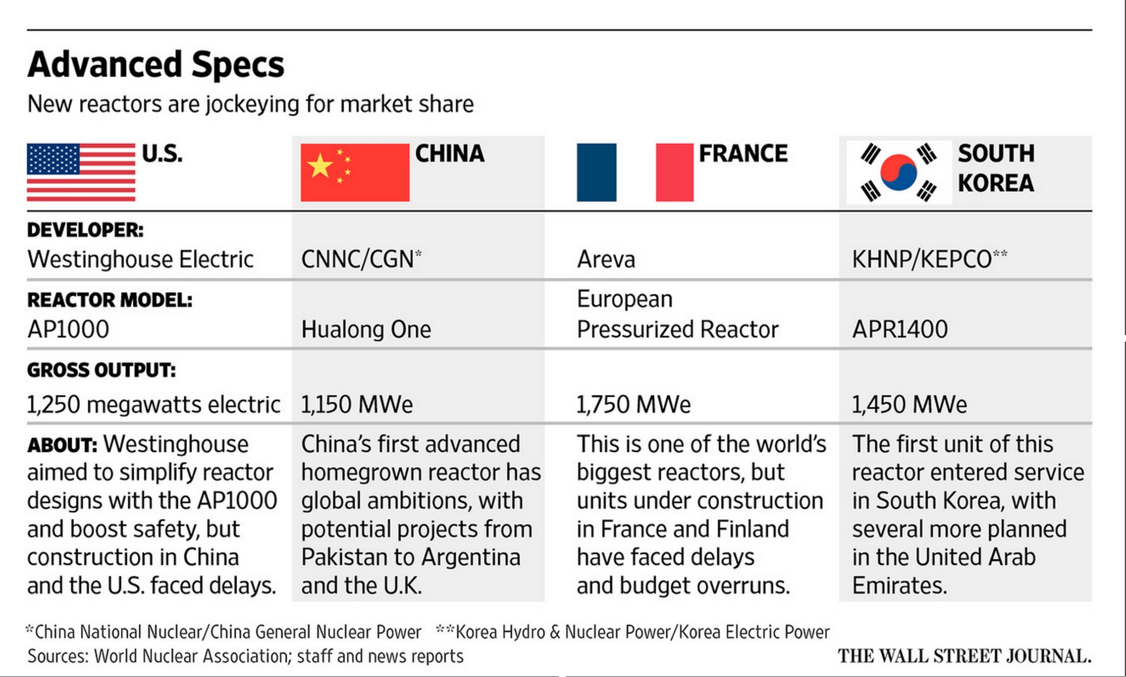

Slide 28
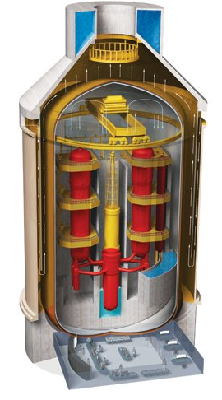
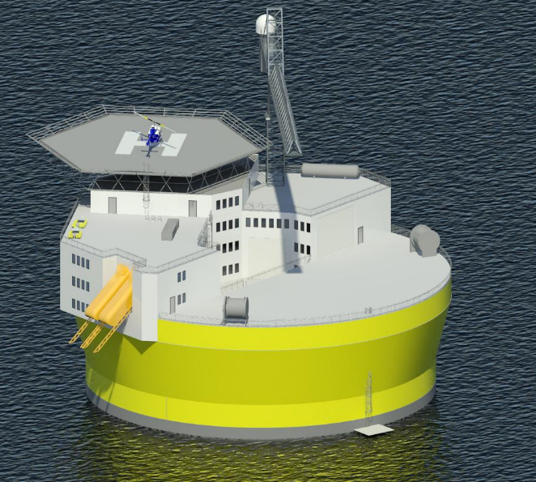
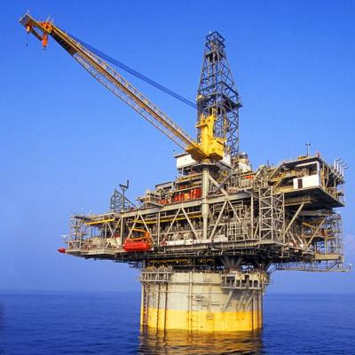
Offshore floating nuclear power plant
+
=
Floating rig
Nuclear reactor
OFNP
Reduced capital cost (>90% cut in reinforced concrete)
Reduced construction/decommissioning schedule
Flexible siting + minimal local infrastructure (‘plug and play’)
Reliable passive cooling; no land/ocean contamination
Profs. J. Buongiorno, M. Golay, N. Todreas

Slide 29
We Can Do Even Better:
Next Generation (Gen IV) Fission Reactors
One Example: Molten Salt Reactors
  Passively safe
  Can run on nuclear waste from Light Water Reactors
  Operate at ambient pressure
  Can run on thorium; unsuitable for weapons
  Estimated plant lifetime > 80 years

Slide 30
Turning Electricity into Liquid Fuels
E-CEM (Electrolytic Cation Exchange Module)
  Developed by U.S. Navy
  Uses electricity to synthesize liquid fuel from CO₂ in seawater and electrolysis to get H₂, then combined into hydrocarbons
  Carbon-neutral
  Can be done for $3-6 per gallon.

Slide 31
Summary of Main Points
The world is warming because of greenhouse gas emissions
Continued warming presents serious risks
Nuclear, carbon capture, and renewables enable us to decarbonize without serious economic disruption
Measures to give the U.S. a competitive advantage in nuclear energy will be economically advantageous and reduce proliferation risk

Slide 32
Spare Slides

Slide 33
Energy Source Mortality Rate (deaths/trillionkWhr)
Coal – global average 170,000 (50% global electricity)
Coal – China 280,000 (75% China’s electricity)
Coal – U.S. 15,000 (44% U.S. electricity)
Oil (electricity) 36,000 (36% of energy, 8% of Natural Gas 4,000 (20% global electricity)
Biofuel/Biomass 24,000 (21% global energy)
Solar (rooftop) 440 (< 1% global electricity)
Wind 150 (~ 1% global electricity)
Hydro – global average 1,400 (15% global electricity)
Nuclear – global average 90 (17% global electricity w/Chern&Fukush)

Slide 34
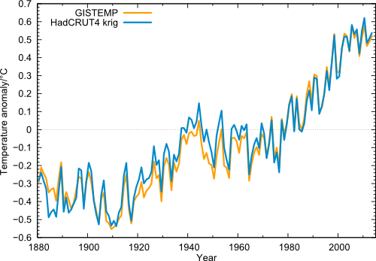
Global temperature (annual values) in the data from NASA GISS (orange) and from Cowtan & Way (blue), i.e. HadCRUT4 with interpolated data gaps.

Slide 35
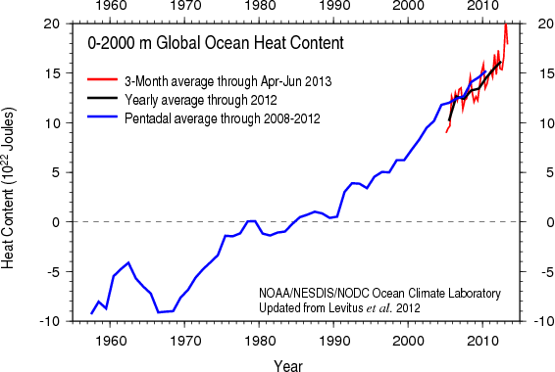
Based on bathythermograph and ARGO (post-2004) data
Image credit: NOAA

Slide 36
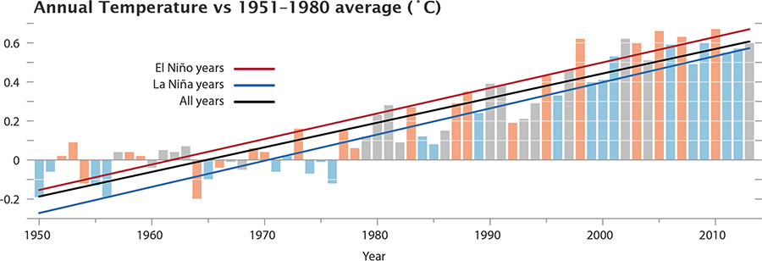
The GISS data, with El Niño and La Niña conditions highlighted. Neutral years like 2013 are gray.

Slide 37
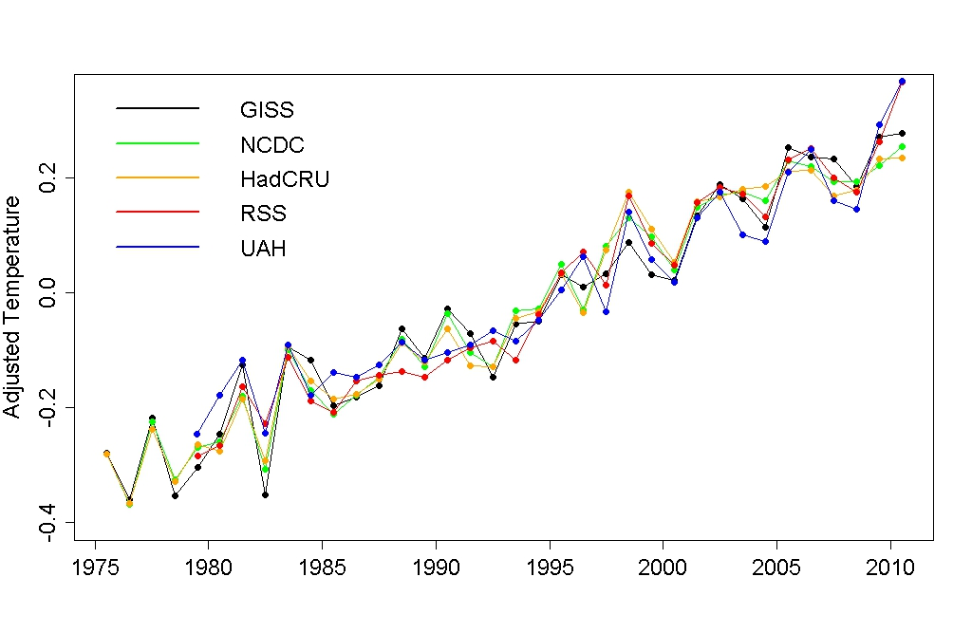
Adjusted annual average temperature data with the estimated impact of El Niño, volcanic eruptions, solar variation, and the residual annual cycle removed.
Notes:
http://tamino.wordpress.com/2011/01/20/how-fast-is-earth-warming/

Slide 38
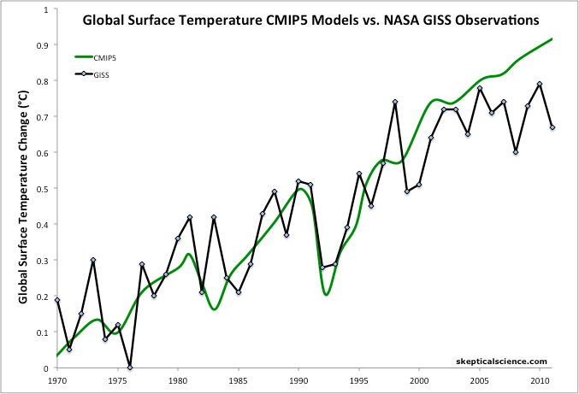
Figure 1: Average global temperature surface anomaly multi-model mean from CMIP5 (green) and as measured by the NASA Goddard Institute for Space Studies (GISS black). Most of this figure is a hindcast of models fitting past temperature data.
Notes:
http://www.skepticalscience.com/christy-exaggerates-model-data-discrepancy.html

Slide 39
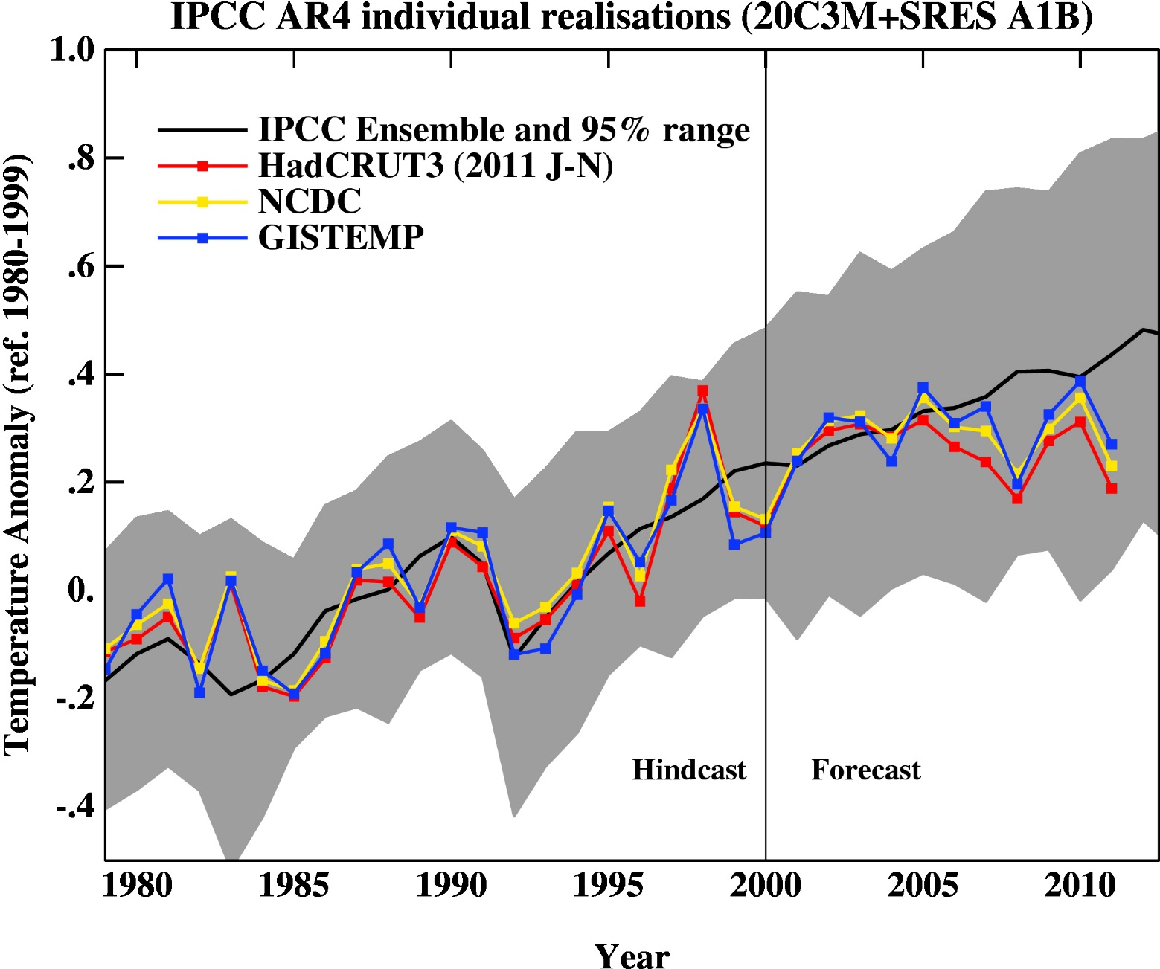
Figure 2: 2007 IPCC report model ensemble mean (black) and 95% individual model run envelope (grey) vs. surface temperature anomaly from GISS (blue), NOAA (yellow), and HadCRUT3 (red).
Notes:
http://www.skepticalscience.com/christy-exaggerates-model-data-discrepancy.html

Slide 40
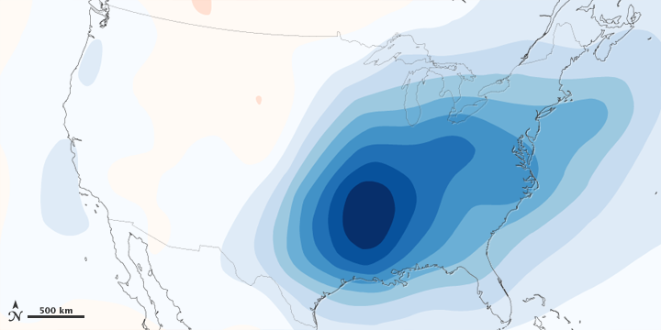
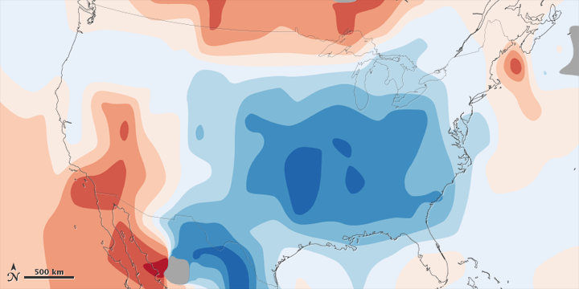
Figure 5: 1970-1990 aerosol loading of the atmosphere over the lower 48 United States and estimated associated surface air temperature change.
Figure 6: Observed total surface temperature change over the lower 48 United States from 1930 to 1990.
Notes:
http://www.skepticalscience.com/christy-exaggerates-model-data-discrepancy.html

Slide 41
Past and Projected Sea Level vs. Temperature
(Source: WBGU after David Archer 2006)
Notes:
This graph shows how temperature and sea level were closely related in Earth’s history. During the last Ice Age, temperatures were about 6 ºC colder than now, while sea level was 120 meters lower. During the Pliocene, when it was last significantly warmer than now (by about 2 ºC), sea level was 20-30 meters higher. During the Eocene there was almost no ice on the planet, and sea level was about 70 meters higher.
The history of climate thus sends a strong warning: past climate changes by just a few degrees in global temperature have come with very large sea level changes, by tens of meters. In the long run, this is likely to happen again. The sea level rise by the year 2100 (likely below one meter) is only the small beginning of a much larger rise that will unfold over coming centuries and perhaps millennia, caused by our carbon emissions in this century.

Slide 42

Paleo reconstructions of temperature change over the last 2000 years
“Hockey Stick”
Instrumental Record
Year
Notes:
42

Slide 43
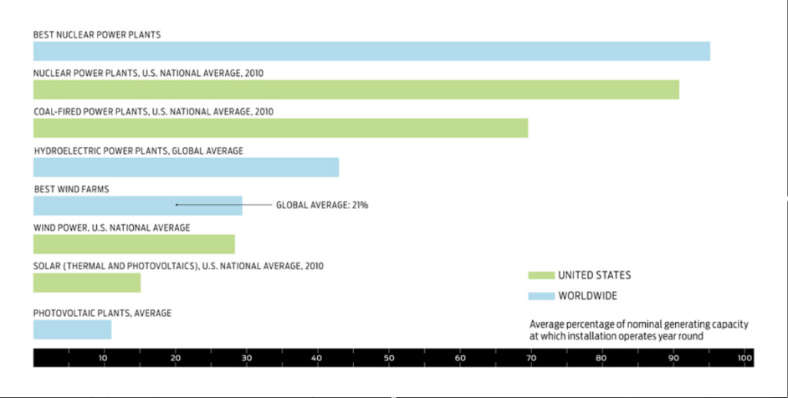
Renewables Require Baseload

Slide 44
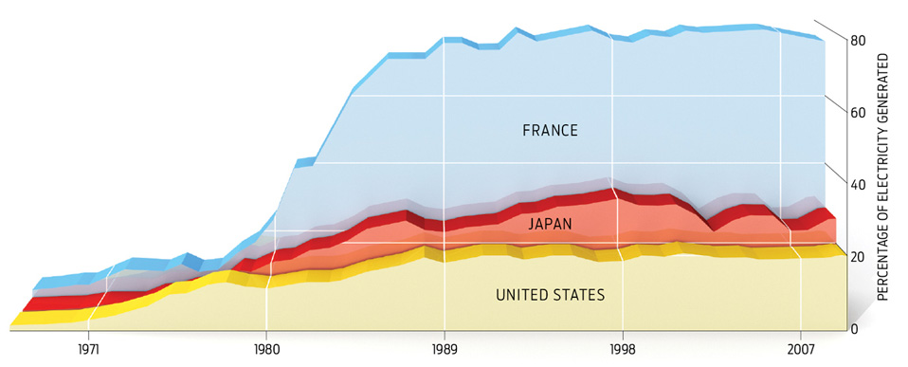
Can be deployed on 15-25 year time scale

Slide 45
Carbon Dioxide and Climate:
A Scientific Assessment
Report to the National Academy of Sciences
Jule G. Charney and co-authors
1979
When it is assumed that the CO2 content of the atmosphere is doubled and statistical thermal equilibrium is achieved, the more realistic of the modeling efforts predict a global surface warming of between 2°C and 3.5 °C, with greater increases at high latitudes.

