Slide 1

The Hurricanes of 2017 from a Climate Perspective
Kerry Emanuel
EAPS and Lorenz Center, MIT
Notes:
1

Slide 2
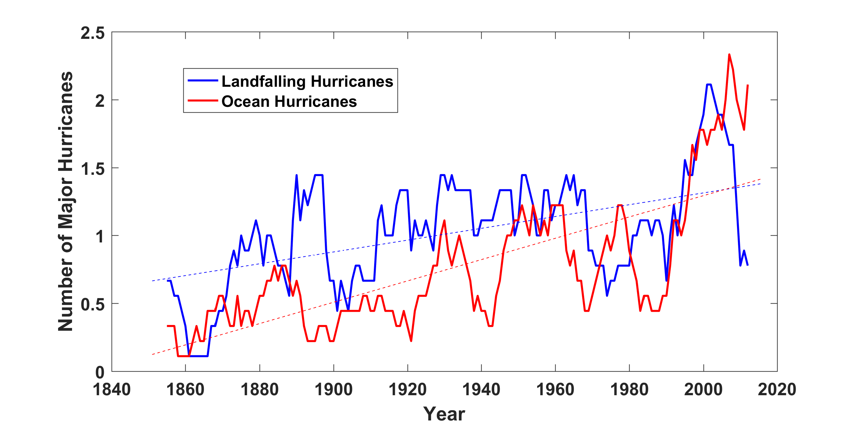
Historical Records:
Prior to 1970, Many Storms Were Missed
Major hurricanes in the North Atlantic, 1851-2016, smoothed using a 10-year running average. Shown in blue are storms that either passed through the chain of Lesser Antilles or made landfall in the continental U.S.; all other major hurricanes are shown in red. The dashed lines show the best fit trend lines for each data set.

Slide 3
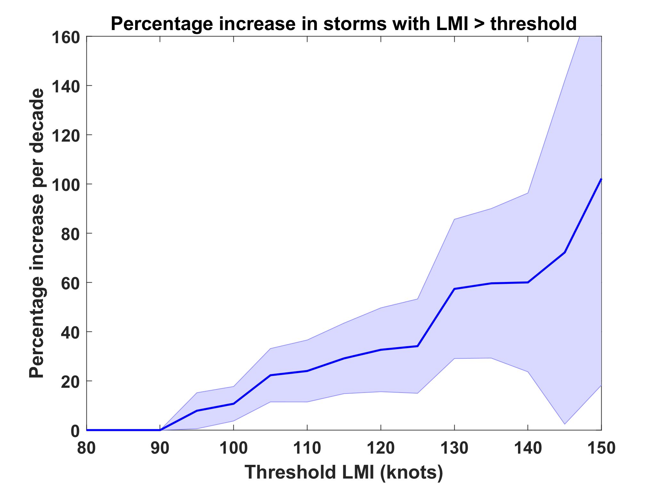
Trends in Global TC Frequency Over Threshold Intensities, from Historical TC Data, 1980-2016. Trends Shown Only When p < 0.05.

Slide 4
Hurricanes are reaching peak intensity at higher latitudes
Time series of the latitudes at which tropical cyclones reach maximum intensity.
From Kossin et al. (2014)

Slide 5
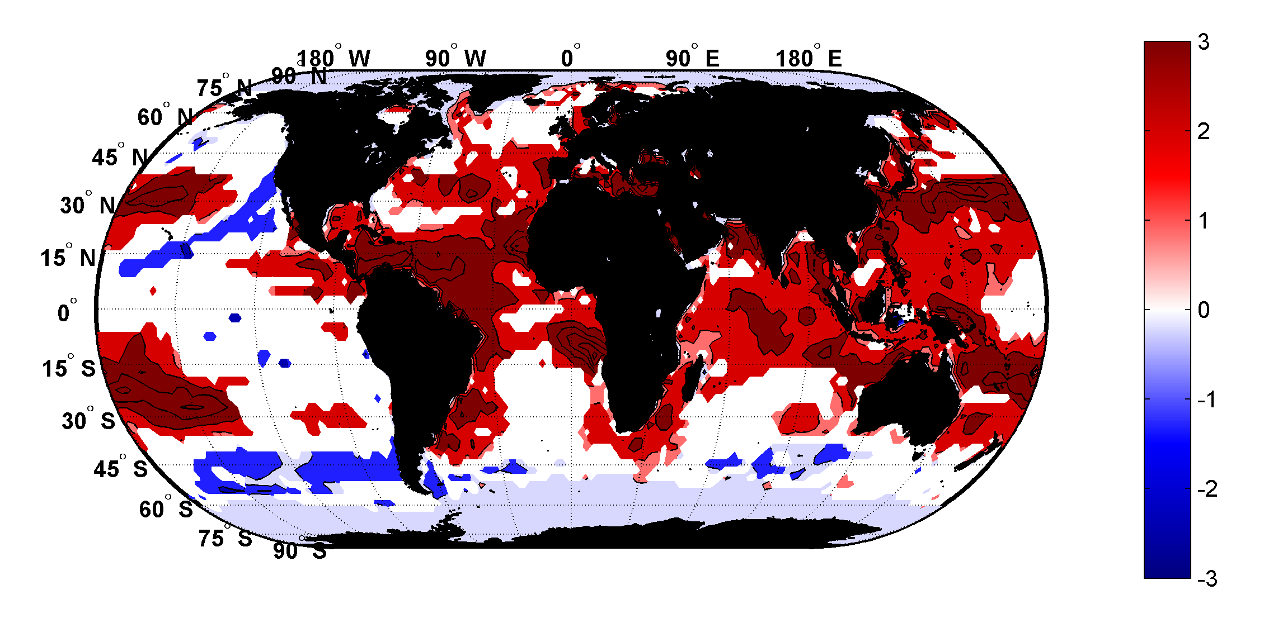
Trends in Thermodynamic Potential for Hurricanes, 1980-2010
(NCAR/NCEP Reanalysis)
ms⁻¹decade⁻¹

Slide 6
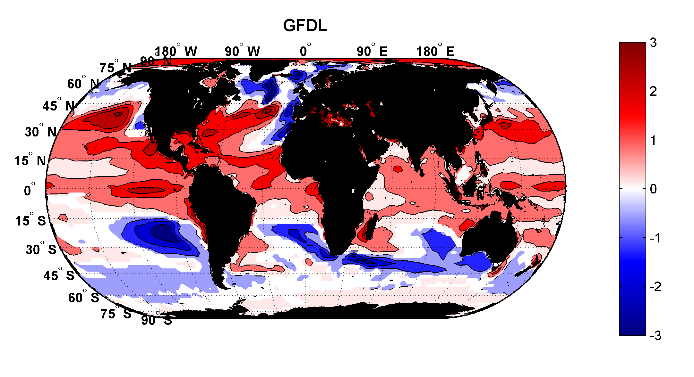
Projected Trend Over 21st Century: GFDL model under RCP 8.5
ms⁻¹decade⁻¹

Slide 7
Using Physics to Estimate Hurricane Risk:
Generates Many Thousands of Hurricanes Downscaled from Reanalyses and Climate Models
Details: Emanuel et al., Bull. Amer. Meteor. Soc, 2008

Slide 8
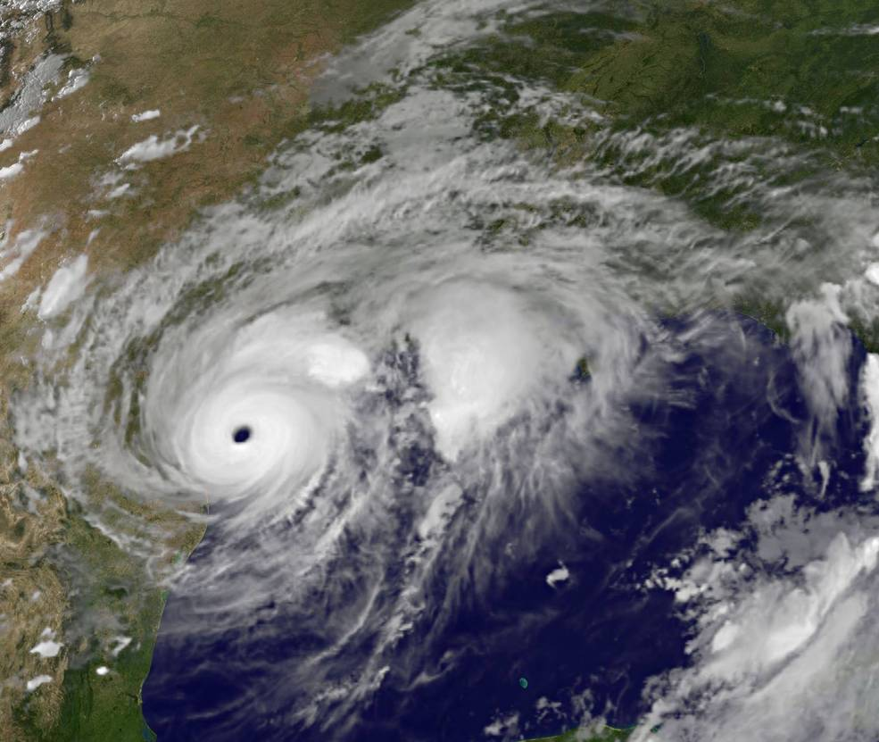
Application to Hurricane Harvey

Slide 9
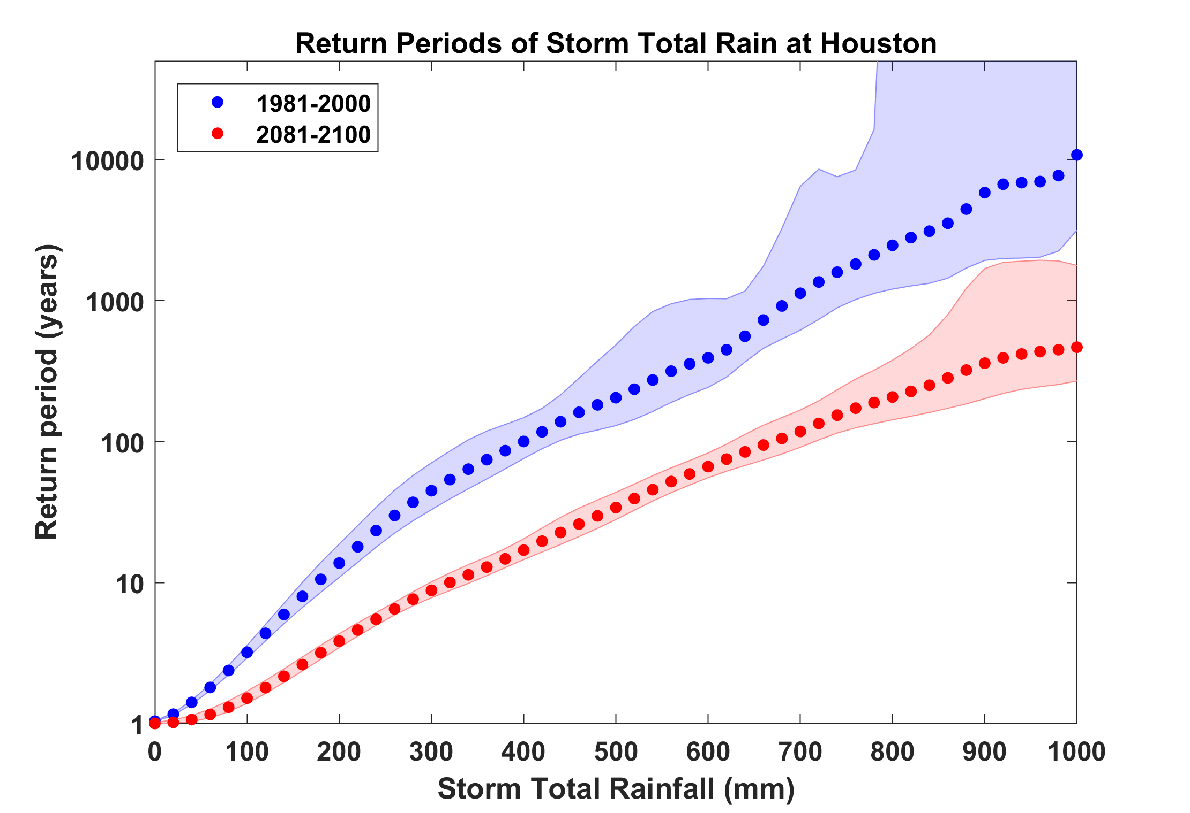
Probability of Storm Accumulated Rainfall at Houston, from 6 Climate models, 1981-2000 and 2081-2100, Based on 2000 Events Each. Shading shows spread among the models.
Harvey

Slide 10
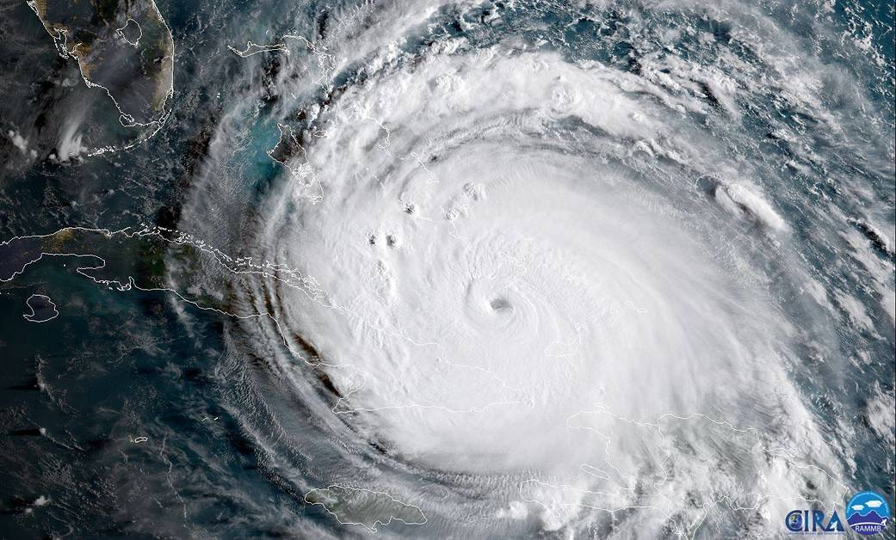
Hurricane Irma

Slide 11
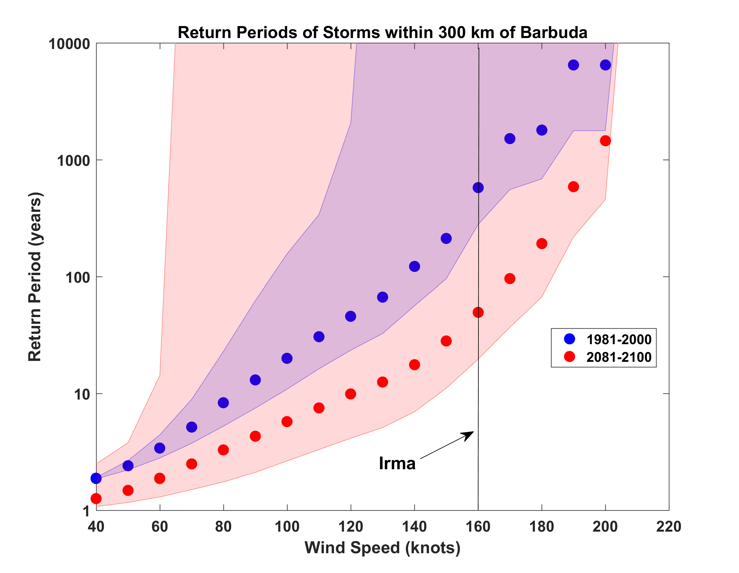
Probabilities of Storms of Irma’s Intensity within 300 km of Barbuda, from 6 Climate models, 1981-2000 and 2081-2100, Based on 2000 Events Each. Shading shows spread among the models.

Slide 12
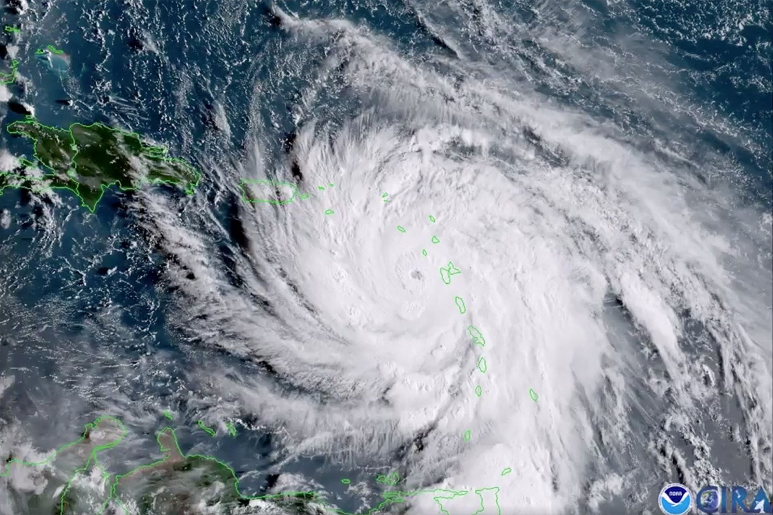
Hurricane Maria

Slide 13
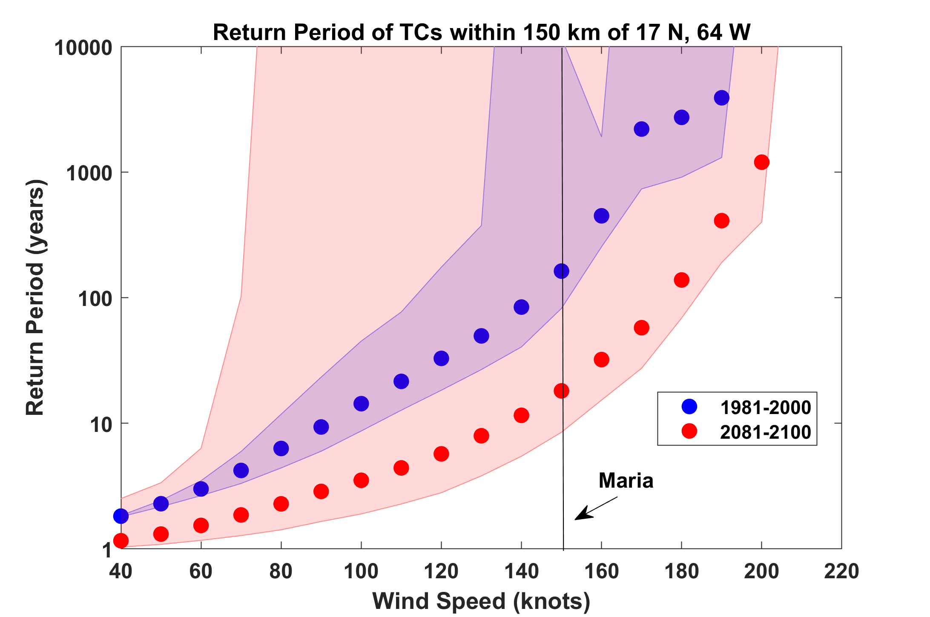

Slide 14

Summary
The observational record of hurricanes is too short and noisy, and of a quality too low to make robust inferences of climate signals
Satellite data do show a migration of peak intensity toward higher latitudes and some indication of a greater fraction of intense storms

Slide 15
Summary (continued)
Potential intensity theory demonstrates that the thermodynamic limit on hurricane intensity rises with temperature
Observations show that this limit is indeed increasing
Physics can be used to model hurricane risk in current and future climates

Slide 16
Summary (continued)
Rain of Harvey’s magnitude in Texas was a ~ 1% annual probability event in 1990 and is projected to increase to 15% by 2090. A linear increase in frequency yields a 5% probability in 2017.
Irma’s peak winds of 185 MPH within 300 km of Barbuda are estimated to have had an annual probability of 0.13% in 1990, increasing to 1.3% in 2090
Likewise, the probability of a storm of Maria’s magnitude is expect to increase ten-fold by 2090

