Slide 1
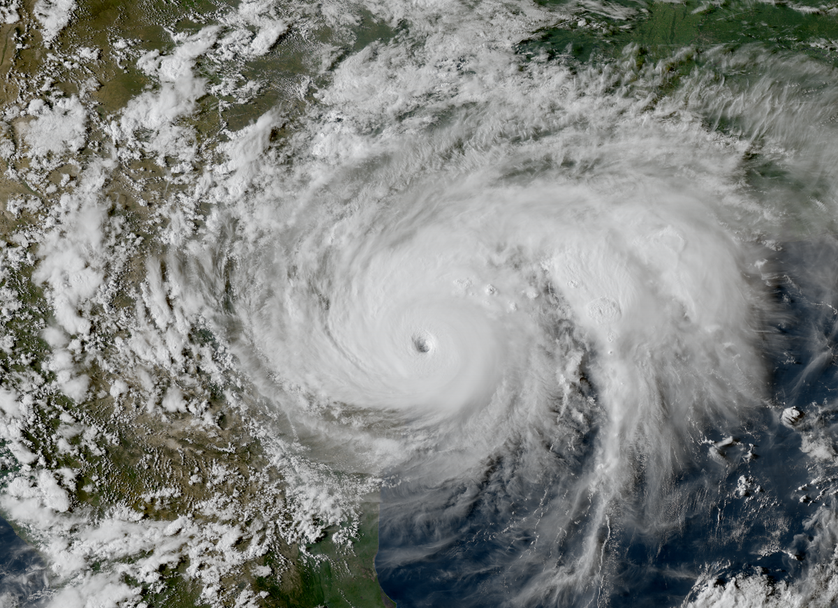
Hurricane Harvey Approaching Houston, August 25th 2017

Slide 2
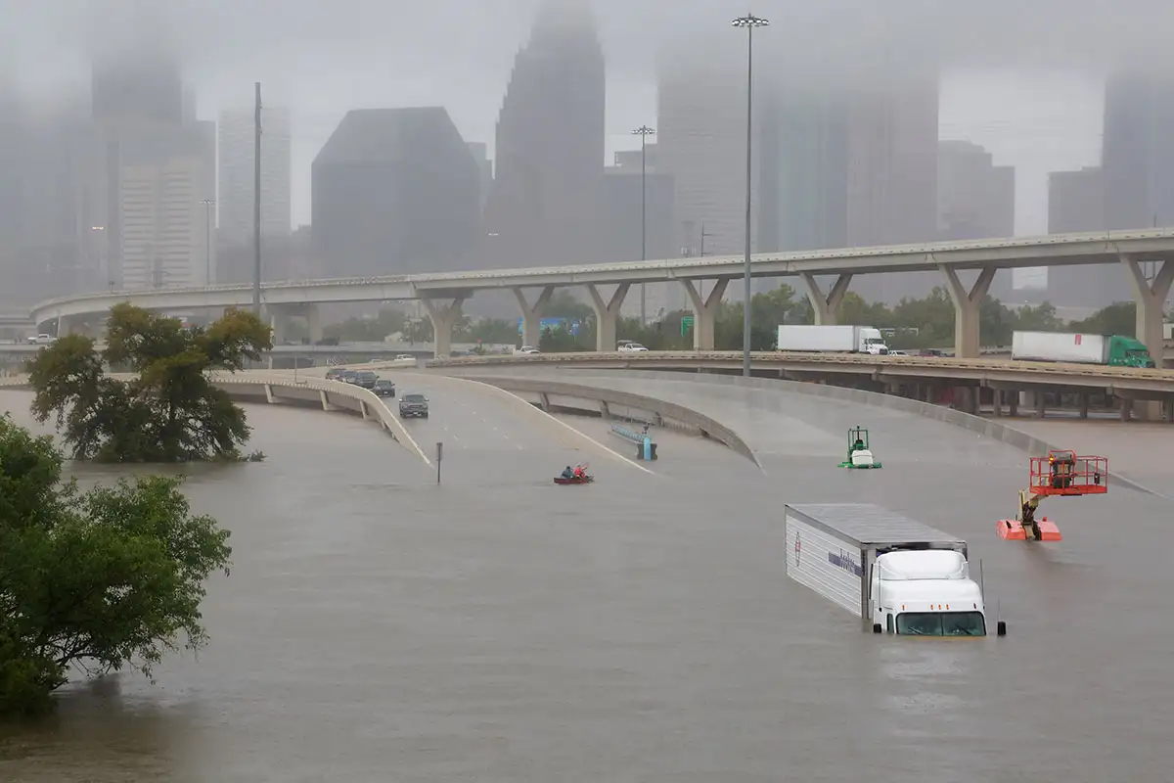
More than 1 meter of rain fell on large sections of Houston
107 deaths, > $125 billion in damages

Slide 3
Notes:
The actual track of Hurricane Harvey. Red dots are 00 GMT positions, and the black numbers are dates in August and September, 2017. The color along the track denotes the maximum surface winds at the time, according to the color scale at bottom.

Slide 4
Notes:
Among the heaviest rain producers in Texas, out of 4,000 events downscaled from ERA-5 reanalyses, 1979-2018. Close to Houston, the track is not unlike that of Hurricane Harvey of 2017 in that it stalled and turned around. Dots, numbers and colors are as in the previous slide.

Slide 5
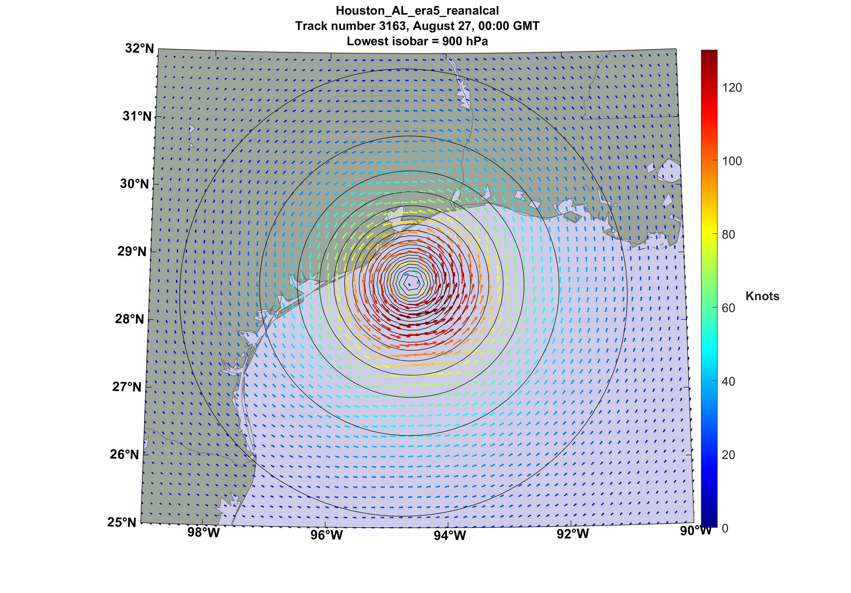
Notes:
Arrows show surface wind vectors (colored according to scale at right) associated with this same event, at 00 GMT on August 27th , 2010

Slide 6
Notes:
For this same event, the colors show the peak wind speed experienced at every point on the map during the storm. The black curve shows the track of the storm center.

Slide 7
Notes:
The rate of rainfall (millimeters per hour) around this same event as it approached the Texas coast, on 00 GMT August 27th 2010. Note the double maximum…one over Galveston Bay and the other offshore.

Slide 8
Notes:
Storm total rainfall (in millimeters) associated with this same event.

Slide 9
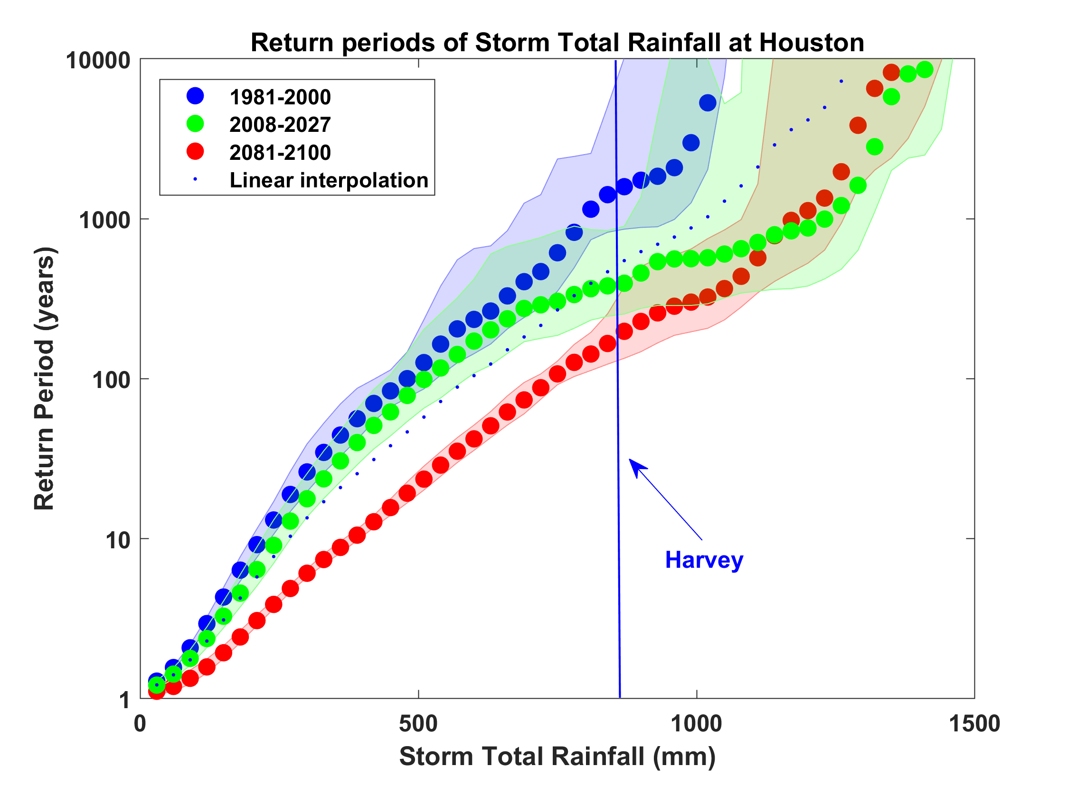
Probability of Storm Accumulated Rainfall in Harris County, from 6 Climate models, 1981-2000, 2008-2027, and 2081-2100, Based on 2000 Events Each, and Using RCP 8.5. Shading Shows Spread Among the Models.
Notes:
This shows the return periods (literally, the inverse of the annual probability) of storm total rain in Harris County, Texas, from downscaling 6 climate models during the periods 1981-2000 (blue), 2008-2027 (green; centered on the year 2017 when Harvey occurred), and 2081-2100 (red). The vertical blue line shows an estimate of the average rainfall in Harris county from Harvey. In round numbers, Harvey would have been a 1,000-year rain event in 1990, a 200-year rain event in 2017, and a 100-year rain event by the end of this century. The shading shows the scatter among the 6 climate models.

Slide 10
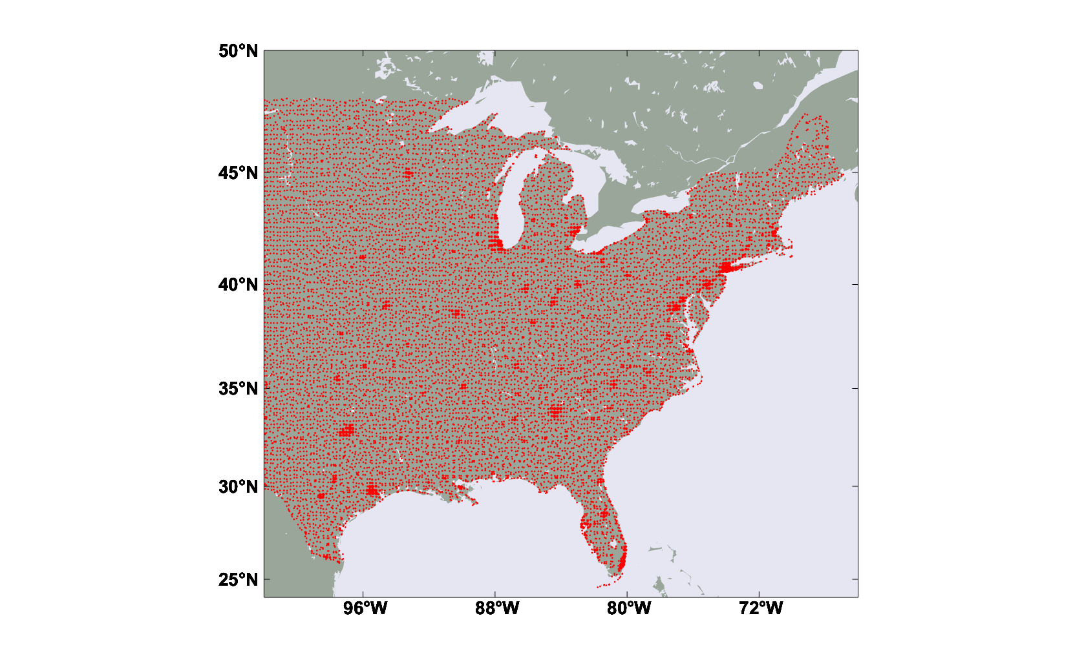
Property-value weighted centroids of values within 21 km X 21 km blocks over the eastern and central U.S., from a publicly available total property value database with a net worth of $41 trillion. The area covered by the dots is proportion to the value in the blocks. We ran 6,200 U.S. landfalling hurricanes downscaled from each of 8 climate models for each of two periods of time: 1984:2014 and 2070-2100. This amounts to almost 50,000 tracks for each period. We then use a wind-to-damage function to calculate the total damage from each storm. Only wind damage is considered here.
Notes:
The property values in this database are based on light intensity measure from satellites at night. See LitPop: Global Exposure Data for Disaster Risk Assessment - Research Collection (ethz.ch)

Slide 11
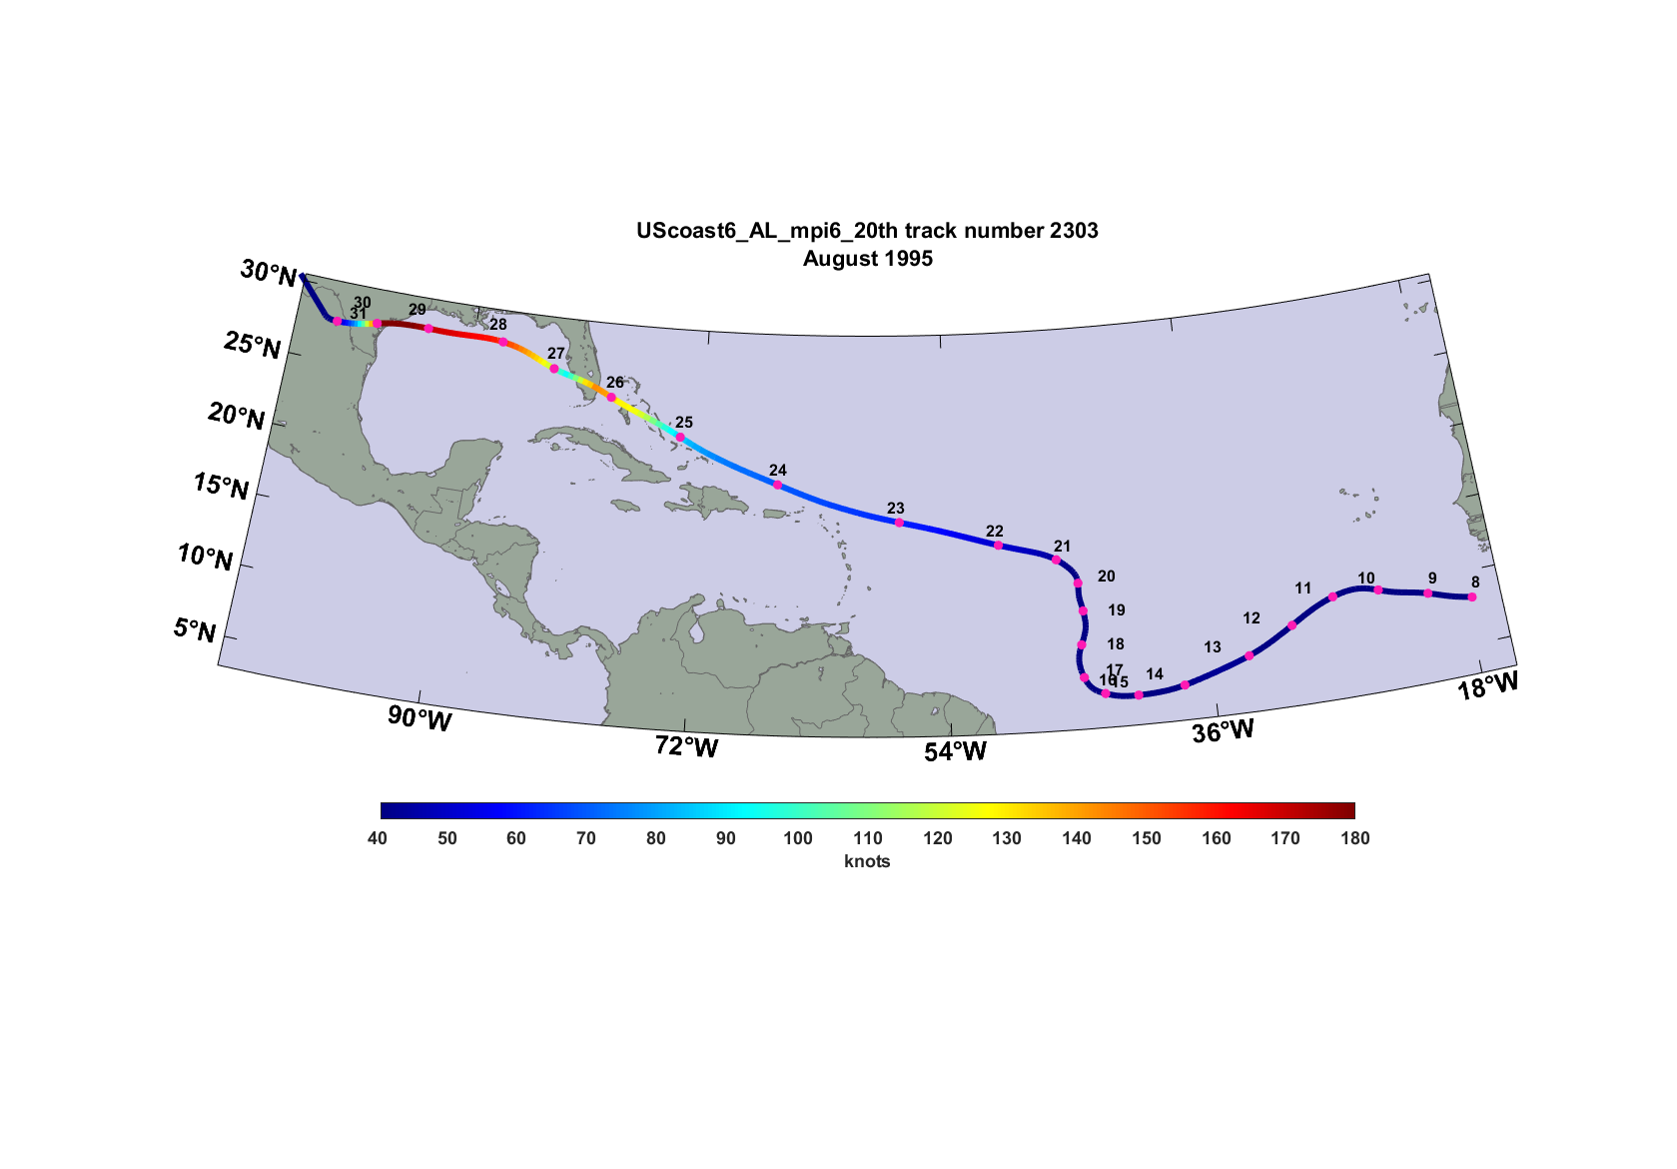
A $1.3 trillion loss event in 1995
Notes:
Dots are 00 GMT storm center positions, numerals are dates in August, 1995 when this happened. Colors correspond to the maximum surface wind speeds along the track, with color code indicated at bottom. The storm pretty much takes out Miami, Galveston and Houston. This is a highly unlikely, but possible event.

Slide 12
Notes:
Wind swath for first U.S. landfall. Peak winds experienced during event at each point on this map.

Slide 13
Notes:
Showing storm total rainfall (millimeters) for this event, first U.S. landfall.

Slide 14
Notes:
Wind swath for second U.S. landfall. Peak winds experienced during event at each point on this map.

Slide 15
Notes:
Showing storm total rainfall (millimeters) for this event, second U.S. landfall.

Slide 16
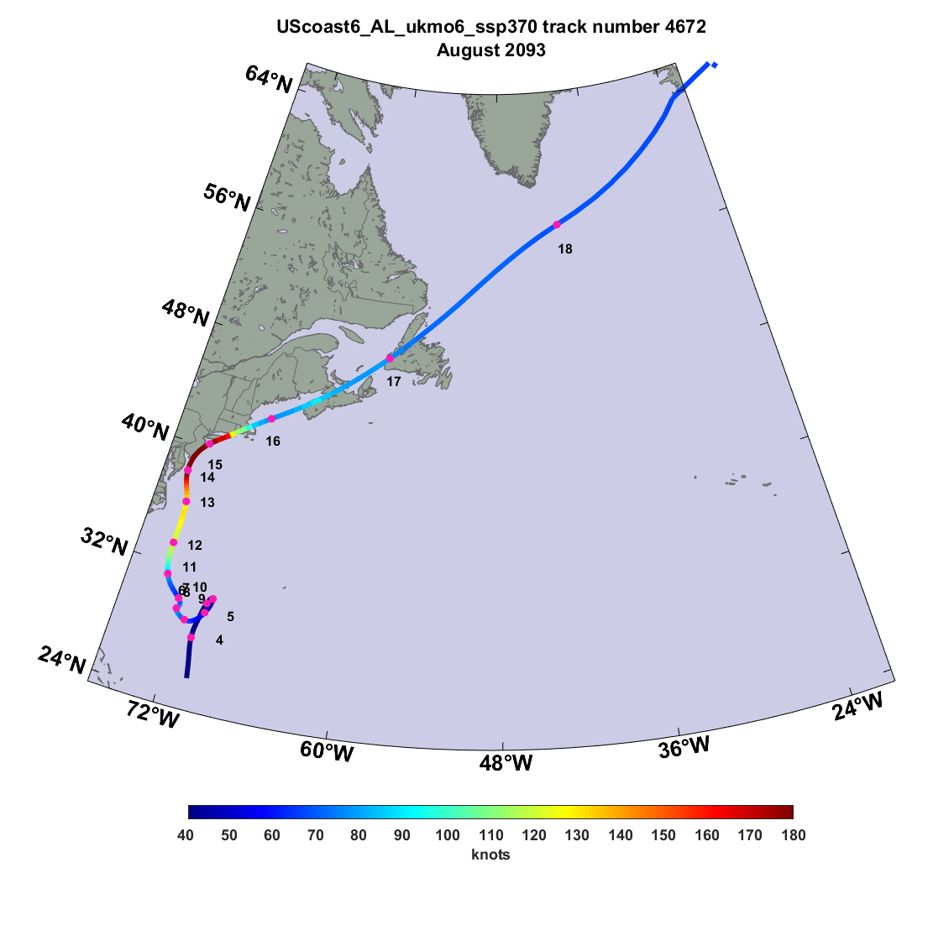
A $2.2 trillion loss event in 2093
> 5% of all U.S. property value

Slide 17
Notes:
Wind swath for most expensive future event. Peak winds experienced during event at each point on this map. Major loses in Maryland near Annapolis, whole Jersey shore, New York, Connecticut shore, Rhode Island and SE Massachusetts.

