Slide 1
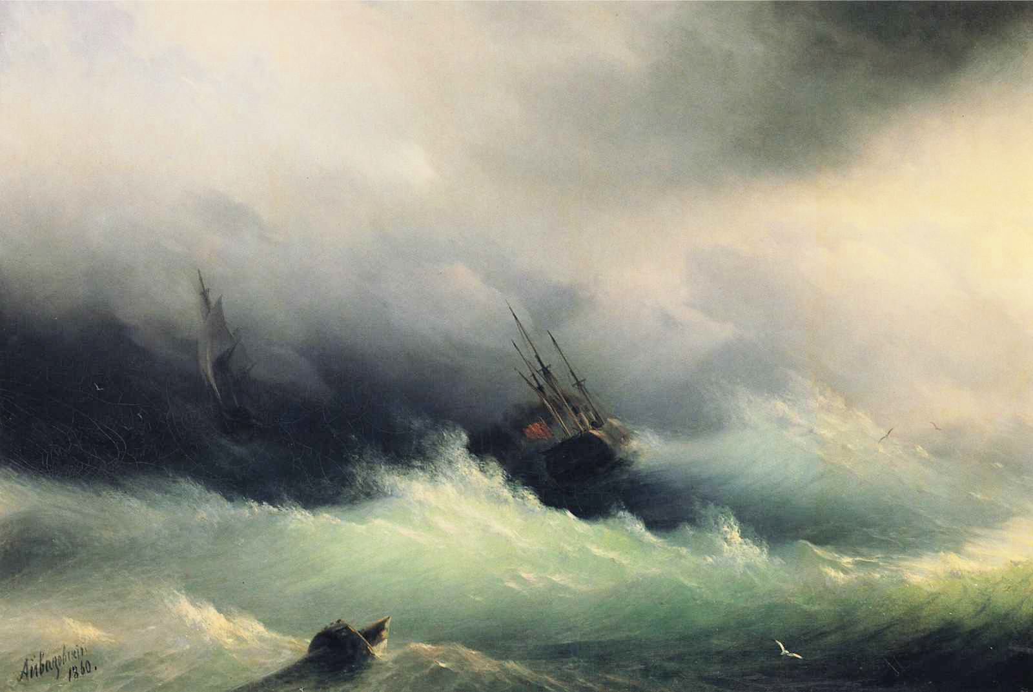
The Importance of Bringing Tropical Cyclone Science to Bear on Long-Term Hazard Risk
Kerry Emanuel
Lorenz Center
Massachusetts Institute of Technology

Slide 2
Flawed Basis of Current Risk Modeling
Almost all current risk assessments are based on historical statistics
Historical records are flawed and too short (stay tuned) to assess key statistics, like average annual loss
Moreover, the past 50-150 years is a poor guide to the present owing to climate change that has already occurred
We need to bring physics to bear on weather hazard risk
CAT modeling industry has been slow to migrate to a physics- based approach
Weather researchers should consider getting more involved in physical modeling of weather risk

Slide 3
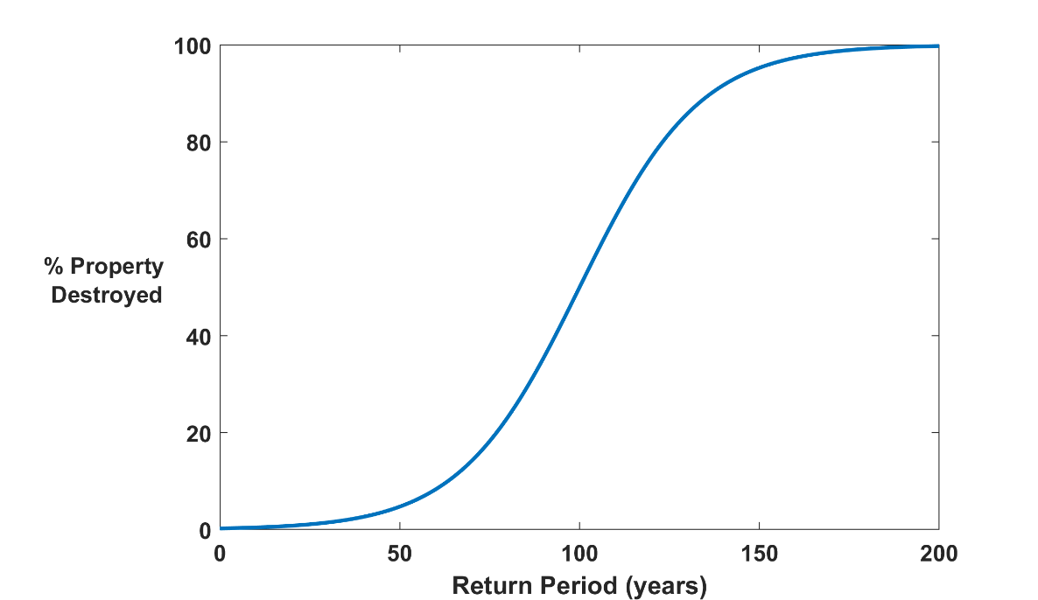
Why Climate Risk is Dominated by Extreme Events:
Societies are usually well adapted to frequent events (> 1/100 yr)
Societies are often poorly adapted to rare events (< 1/100 yr)
Large cost increases result when > 100-yr events become < 100-yr events
Largest slope
Notes:
This is a cartoon version of a damage curve from natural hazards. Usually one plots the (fractional) damage versus the magnitude of the hazard but here it is plotted versus the return period associated with that magnitude. The result is a curve that is nearly universal across different hazards.

Slide 4
Modeling risk: Today’s global climate models are far too coarse to simulate destructive hurricanes
Histograms of Tropical Cyclone Intensity as Simulated by a Global Model with 50 km grid point spacing. (Courtesy Isaac Held, GFDL)
Category 3
Modeled
Observed
Global models do not simulate the storms that cause destruction
Wind Speed (meters per second)
Detailed, high-resolution modeling suggests grid spacing of no more than 3 km required
HighResMip: Grid spacings of 20-200 km (NICAM has short run at 14 km)
We need high resolution and O(1000 yr) simulations

Slide 5
MIT TC Downscaling:
Step 1: Seed each ocean basin with a very large number of weak, randomly located cyclones
Step 2: Cyclones are assumed to move with the large- scale atmospheric flow in which they are embedded, plus a correction for the earth’s rotation and sphericity (beta-drift)
Step 3: Run the detailed hurricane intensity model (CHIPS) for each cyclone, and note how many achieve at least tropical storm strength (Model is phrased in angular momentum coordinates. Flow- dependent resolution)
Step 4: Using the small fraction of surviving events, determine storm statistics. Can easily generate 100,000 events
Details: Emanuel et al., Bull. Amer. Meteor. Soc, 2008
Notes:
5
In this downscaling technique, one starts with large scale airflow and thermodynamic conditions supplied from a climate reanalysis or a climate model. This time-evolving global state is randomly seeded with very weak proto-vortices. They move according to the air currents supplied from the climate analysis or climate model. Their intensity is calculated using a deterministic numerical model that was first developed to forecast real hurricane intensity in real time, and is still being used that way. This intensity model predicts that the vast majority of seeds die; the survivors are considered to represent the true hurricanre climatology associated with that climate analysis or climate model.

Slide 6
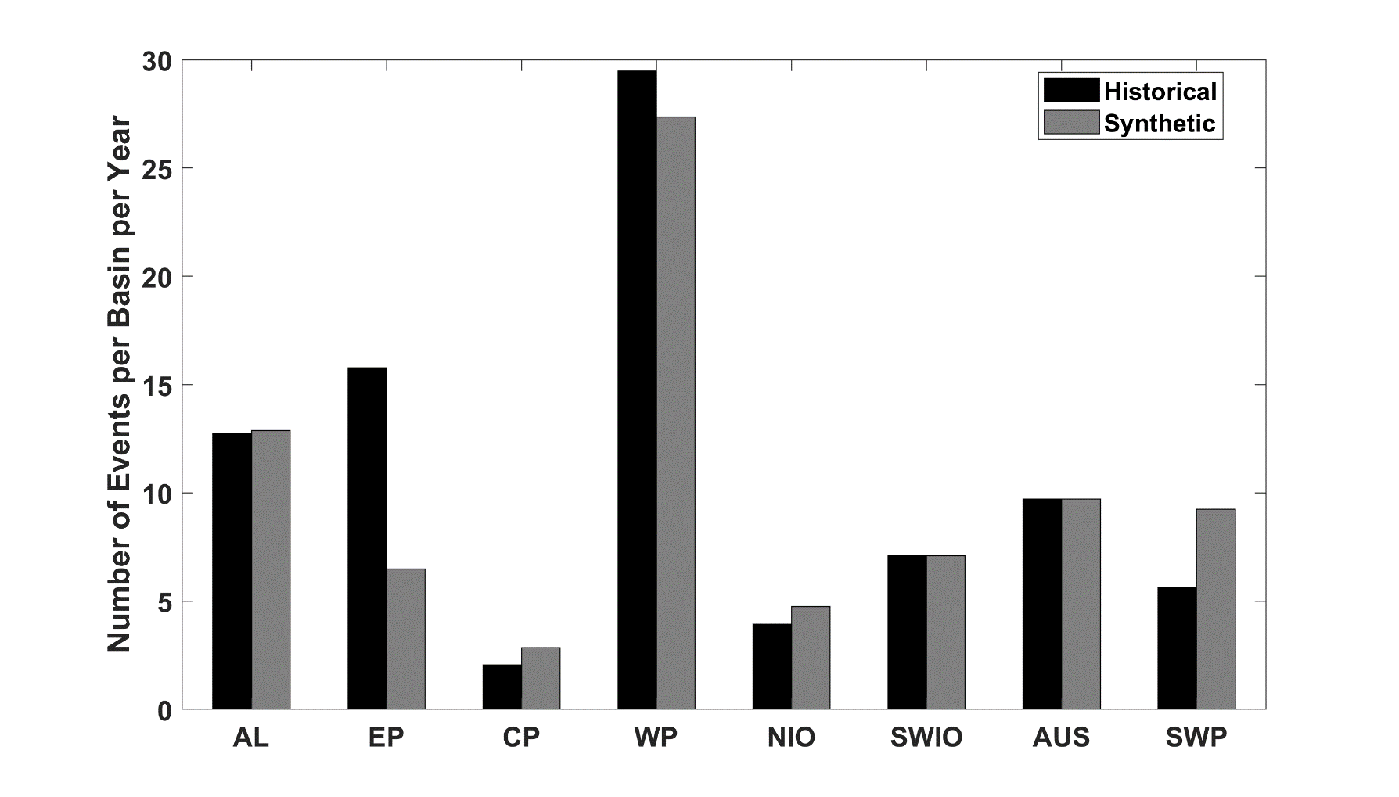
Average annual number of tropical cyclones over the period 1980-2020 in observations (IBTrACS; Knapp et al. 2010; black bars) and from random seeding of ERA-5 (gray bars)
Notes:
These are cyclone counts, synthetic and historical, in ocean basins: AL=North Atlantic; EP=Eastern North Pacific; CP =Central North Pacific; WP=Western North Pacific; NIO=North Indian Ocean; SWIO=Southwest Indian Ocean, AUS=Australian region; SWP= Southwest Pacific Ocean.

Slide 7
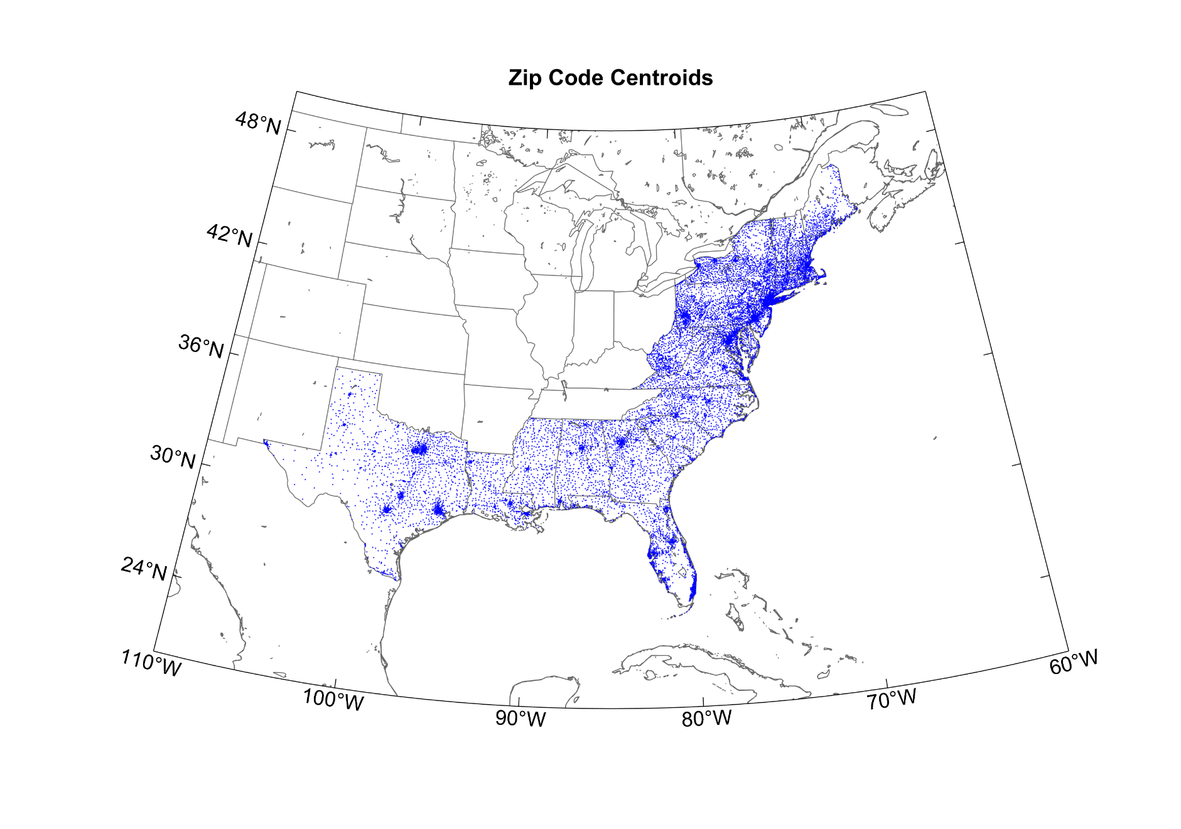
Damage to an Insurance Portfolio
Start with total insured values (TIVs) of one commercial and two residential property insurance firms aggregated over zip codes
Net TIV: ~$ 2 trillion
12,968 zip codes
Notes:
This data set is more than 15 years old.

Slide 8
Procedure
Apply a set of 49,600 synthetic tropical cyclones making landfall in the continental U.S.
These have been generated using a physical model applied to the present climate
At zip code each centroid, calculate the peak wind generated by each event and apply a damage function that estimates the fraction of property value destroyed
Using insured value, calculate loss at each zip code and sum over all zip codes
From the set of 49,600 storms create many (10,000) 1,000- year time series of loss by randomly drawing from a Poisson distribution based on the annual frequency of landfalling tropical cyclones each year
This illustration is for a stationary climate but the same idea can be applied to evolving climate states

Slide 9
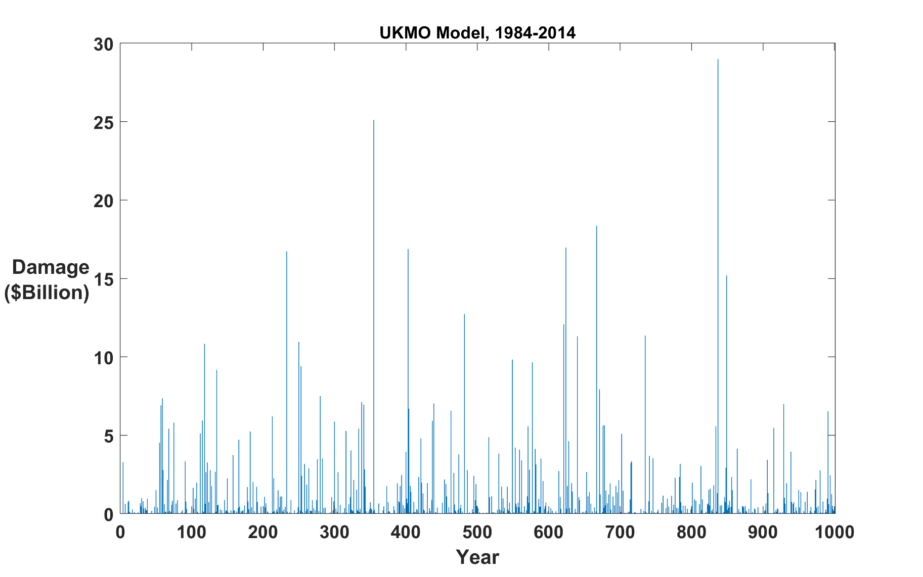
Example Damage Time Series (one of 10,000):
Annual
Question: Can we estimate average annual loss (AAL) from 50-100 years of record?
Answer: Good luck with that!

Slide 10
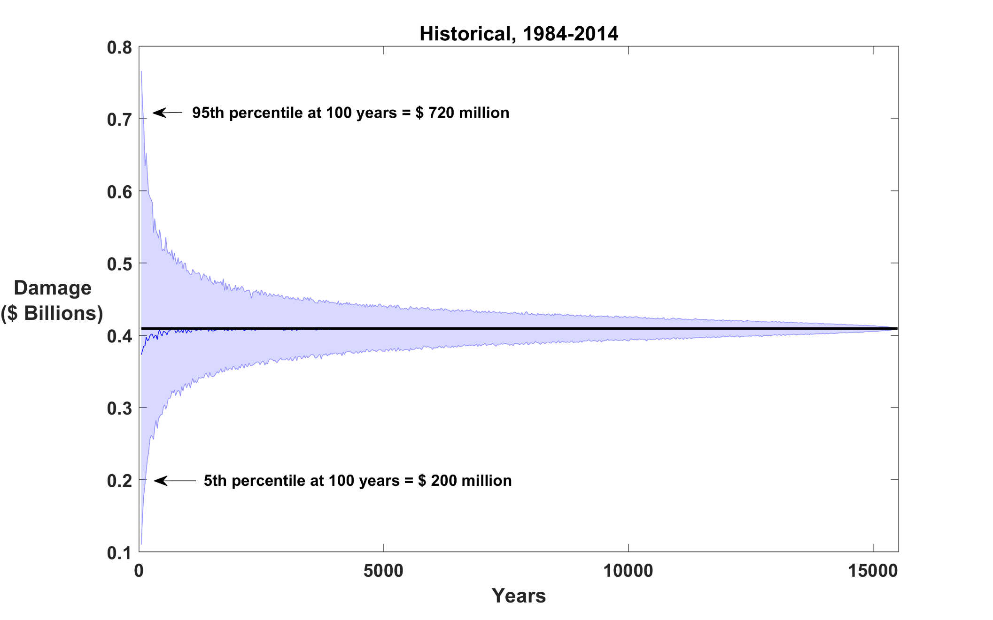
Sampling errors in average annual loss by subsetting combined dataset of 8 models
Average Annual Loss
Record Length (years)
Notes:
This is based on calculations of 10,000 time series of lengths ranging from 10 to 15,000 years, downscaled from 8 climate models run for the current climate. The black line is the true AAL and the blue shading ranges from the 5th to the 95th percentiles of the estimates based on the individual time series. One can make very large errors if one has only 100 years of record!

Slide 11
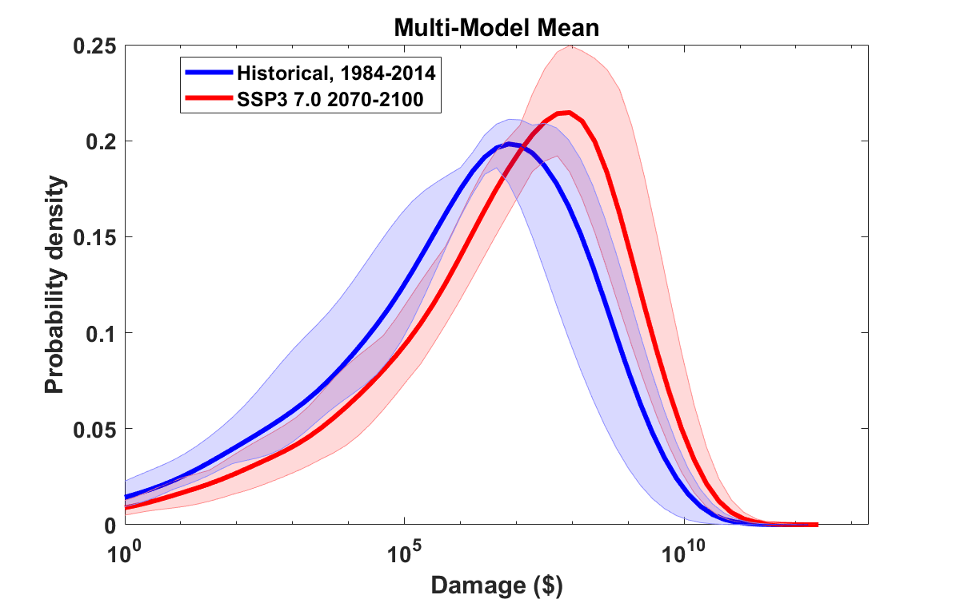
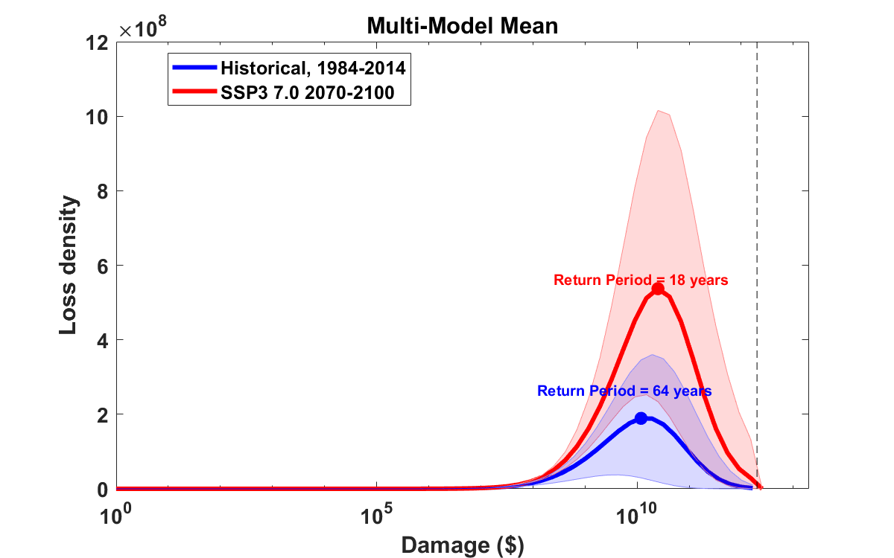
Probability density of log₁₀(Loss) for 1984-2014 (blue) and 2070-2100 (red)
Curves: 8-model mean
Shading: 5th to 95th quantile
among the 8 global models
TIV
Loss density (PDF multiplied by loss) corresponding to above
Expected annual loss proportional to area under these curves
Notes:
This shows the effect of climate change, based on downscaling 8 GCMs for two periods of time: 1984-2014 from the historical period, and 2070-2100 of a warmer climate represented by SSP3-7.0, a middle-of-the-road emissions scenario.. The upper plot shows the probability density of annual damage to the aforementioned portfolio for the historical climate (blue) and the future climate (red). The solid curves represent the multi-model means and the shading shows the range from the 5th to the 95th percentile among the 8 models.
The bottom panel is the same data, but the probability density has been multiplied by the damage itself. The total damage is proportional to the area enclosed by the curves.

Slide 12
Summary
Extreme events make substantial contribution to climate risk
Large contributions from events with return periods of several human generations and larger
Historical records are of insufficient length (and often quality) to make robust estimates of long-term risk, even with stable underlying climate (aleatory uncertainty)
We need to migrate toward physical modeling of weather hazards, to create more statistically robust risk estimates and to account for climate change
Far better and more robust estimates of current risk can be made by physically modeling the hazard (hurricanes in this case)
Risk estimation in future climate depends on global climate models, which are plagued by large epistemic uncertainty

